Slide 1
ML Security:
Adversarial Examples
Suman Jana

Slide 2
Motivation & Roadmap
AI is now part of critical systems: code, finance, medicine, infrastructure
Security assumptions from traditional software do not carry over
Today’s plan:
  Why AI security is different
  Threat models for learning systems
  Deep dive: adversarial examples
  Goal: move from intuitions → concrete attack surfaces

Slide 3
Traditional Software Security (Baseline)
Explicit control flow
Human-written logic
Discrete state transitions
Security analysis tools:
  Static analysis
  Symbolic execution
  Taint tracking
  Model checking
Vulnerabilities live in code paths

Slide 4
ML Systems: A Different Computational Object
Program = learned parameters, not written logic
  No explicit control flow
  No readable invariants
Decision boundary is:
  High-dimensional
  Continuous
  Implicit
Behavior emerges from data, not design
If a model has 99% test accuracy, what does that actually say about its security?

Slide 5
Why Program Analysis Breaks for ML
No loops, branches, or CFG
Gradients ≠ semantics
State space is ℝⁿ, not discrete
Small perturbations → large semantic changes
Traditional notions of:
  Reachability
  Coverage
  Safety invariants
  do not apply directly

Slide 6
New Attack Surfaces in ML
Training data
Model architecture
Loss function
Inference inputs
Deployment context (distribution shift)
Security becomes end-to-end, not code-local

Slide 7
Taxonomy of AI Security Threats
Training-time attacks
  Data poisoning
  Backdoors
Inference-time attacks
  Adversarial examples
  Evasion
Model-level attacks
  Extraction
  Inversion
System-level attacks
  Tool misuse
  Prompt injection (for LLMs)

Slide 8
Why Adversarial Examples Matter
Exist even for simple models
Do not require access to training data
Often transfer across models
Violate the “small change → small effect” assumption
Reveal geometric fragility of learned models

Slide 9
What Is an Adversarial Example?
Input x classified correctly
Perturbation δ is small under some norm
x + δ is misclassified
Key tension:
  Perceptually identical
  Algorithmically catastrophic

Slide 10
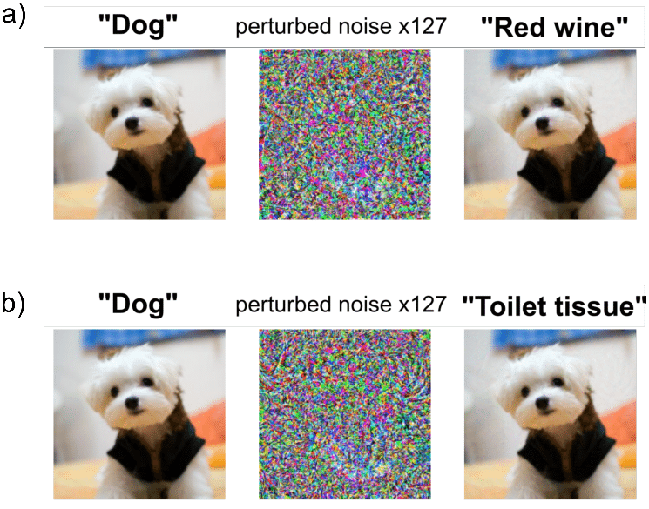
What Is an Adversarial Example?

Slide 11
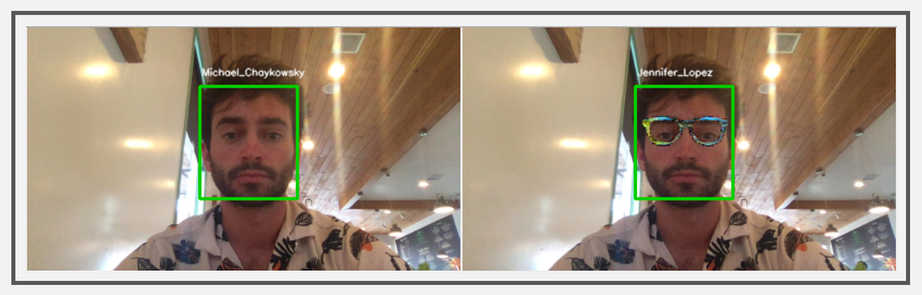
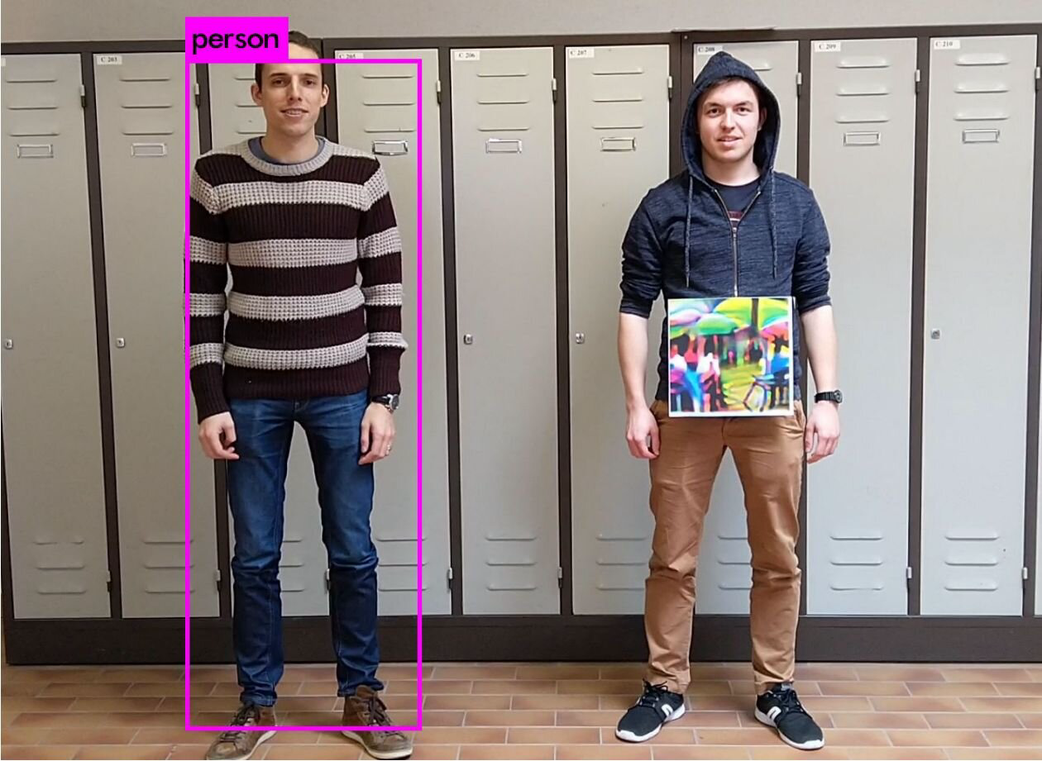
What Is an Adversarial Example?

Slide 12
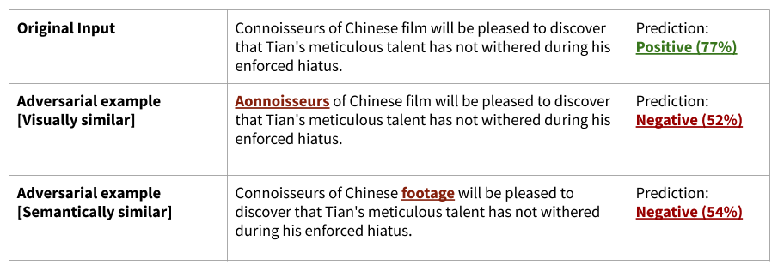
What Is an Adversarial Example?

Slide 13
Why This Is Surprising
Humans: robustness under noise
ML: extreme sensitivity
Indicates mismatch between:
  Data manifold
  Decision boundary
Raises question: what is the model really learning?
Is an adversarial example a bug, a feature, or a specification failure?

Slide 14
Threat Model Assumptions
White-box vs black-box
Access to:
  Model parameters?
  Gradients?
  Queries?
Goal:
  Targeted vs untargeted
Constraint:
  ℓ∞, ℓ₂, ℓ₀ bounds
(Important to emphasize security always depends on threat model)

Slide 15
Geometry of the Problem
High-dimensional input spaces
Concentration of measure
Most points lie near the boundary
Linear regions dominate behavior
Robustness ≠ accuracy

Slide 16
From Optimization to Attack
Model trained by minimizing loss L(x, y; θ) wrt wights/parameters
Attacker maximizes loss wrt input
Security inversion:
  Defender minimizes
  Attacker maximizes
  Attack = constrained optimization problem (under perturbation budget)

Slide 17
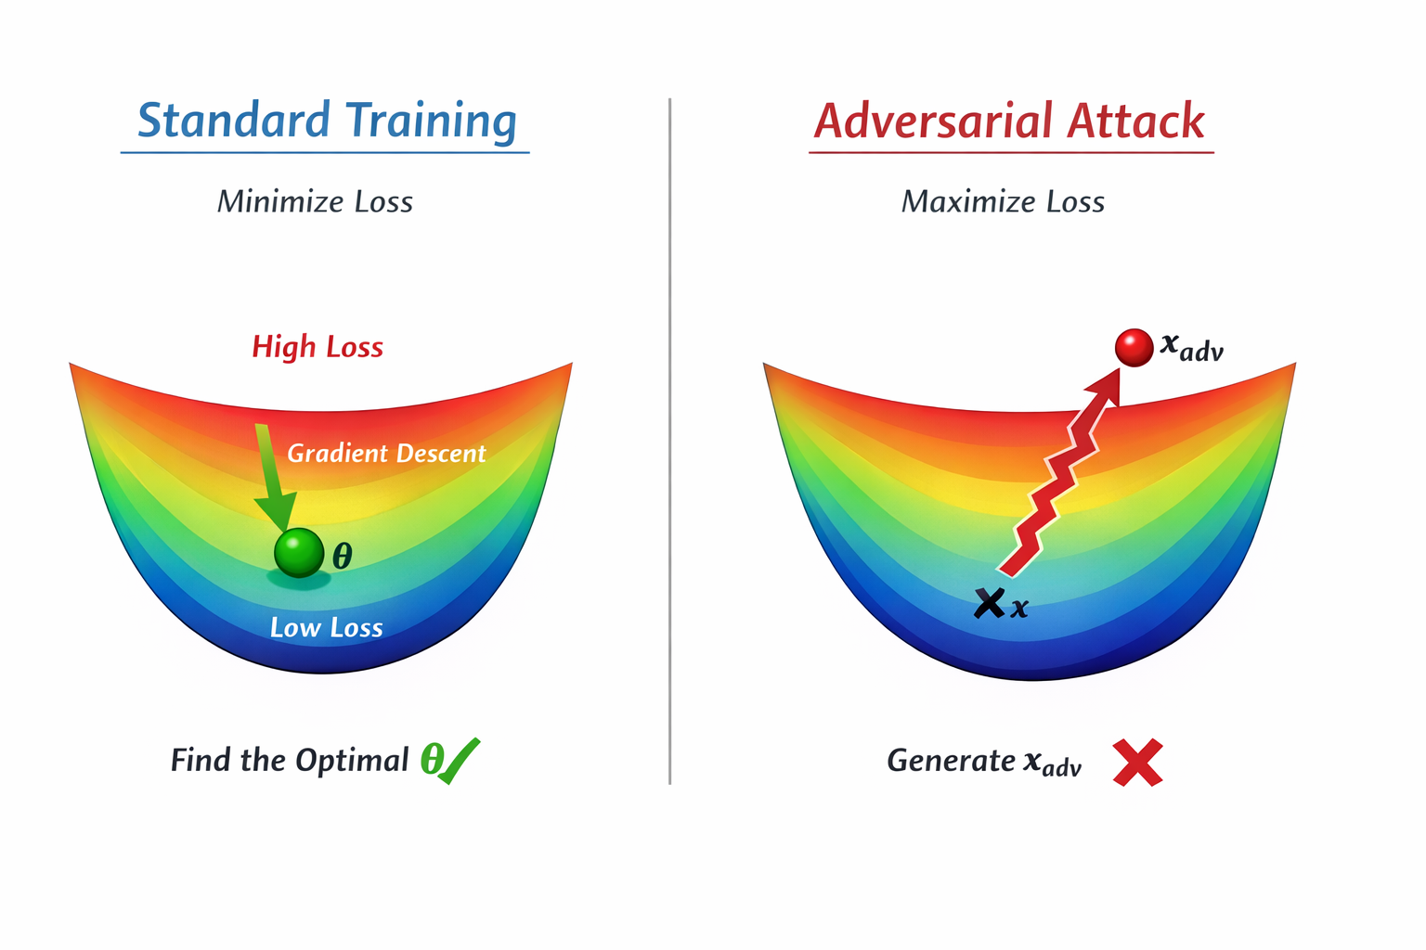
First-Order Approximation
Linearize loss around input x
Use gradient ∇ₓL
Local worst-case direction
High-dimensional linearity dominates

Slide 18
Fast Gradient Sign Method (FGSM)
Perturbation:
  δ = ε · sign(∇ₓL)
Why sign?
Maximizes loss under ℓ∞ constraint
One-step
Cheap
Surprisingly effective

Slide 19
Why FGSM works?
Models behave locally linearly
High dimensionality amplifies small ε
Robustness not optimized during training
Decision boundary is close everywhere
FGSM is a linear attack. Why does it work so well on highly nonlinear networks?

Slide 20
Iterative attacks (PGD intuition)
FGSM as one step of gradient ascent
Iterative refinement
Projection keeps perturbation bounded
Strongest known first-order adversary

Slide 21
Transferability Phenomenon
Adversarial examples transfer across models
Suggests shared vulnerabilities
Points to data distribution, not architecture
Breaks “security through obscurity”

Slide 22
Why This Is a Security Problem?
No memory corruption
No undefined behavior
Yet:
  Predictable exploitation
  Attacker-controlled failure
Forces rethinking of “correctness”

Slide 23
Defenses
Adversarial training
Input preprocessing
Randomization
Certified robustness
Tradeoff: robustness vs accuracy
If we know adversarial examples exist, why not just detect and reject them?

Slide 24
Adversarial Training:
Train on adversarial examples
  Min-Max game: defender chooses θ, Attacker chooses δ with ||δ|| ≤ ε
  Goal:
  Defender minimizes E[ Loss(x + δ, y; θ) ]
  Attacker maximizes Loss(x + δ, y; θ)
Converts worst-case into training objective

Slide 25
Limitations of Adversarial Training
Computationally expensive (PGD in loop)
Trades off clean accuracy
Robustness is norm-specific
Does not generalize well to unseen threat models
Breaks under distribution shift

Slide 26
Fundamental Limitations
Robustness is computationally expensive
Certified guarantees scale poorly
Distribution shift breaks assumptions
Security ≠ generalization

Slide 27
Connections to Broader ML Security
Poisoning ≈ training-time adversarial examples
Backdoors = targeted robustness failure
LLM jailbreaks = semantic adversarial examples
Same root cause: learned decision surfaces

Slide 28
Takeaways
ML systems are geometric objects, not programs
Security failures arise from continuity + dimension
Adversarial examples are:
  Simple
  Fundamental
Still not fully solved
Sets the stage for:
  Robust learning
  Formal guarantees
  System-level defenses

