Slide 1
Spoken Dialogue Systems Introduction
Svetlana Stoyanchev
Columbia University
01/26/2014

Slide 2
Instructor: Svetlana Stoyanchev
Contact Info:
sstoyanchev@columbia.edu
Skype: svetastenchikova
Office Hours: Mondays: 2-4, Speech Lab (CEPSR 7LW3)
Currently: Interactions Corporation (acquired from AT&T Research), research on dialogue systems, natural language processing, semantic parsing
Previously: Columbia University
The Open University, UK;
Stony Brook University

Slide 3
Introductions
Name?
Are you graduate/undergraduate?
Do you have any experience with NLP/speech/ dialogue?
What year are you?
What are your goals and plans?

Slide 4
Outline
Overview of Dialogue Research
Dialogue System Genres
Dialogue System Examples
What is involved in dialogue?
SDS components and special topics
Course Structure
Break-out Exercise

Slide 5
What is Natural Language Dialogue?
Communication involving
Multiple contributions
Coherent interaction
More than one participant
Interaction modalities
Input: Speech, typing, writing, gesture
Output: Speech, text, graphical display, animated face/body (embodied virtual agent)

Slide 6
When is automatic dialogue system useful?
When hands-free interaction is needed
In-car interface
In-field assistant system
Command-and-control interface
Language tutoring
Immersive training
When speaking is easier than typing
Voice search interface
Virtual assistant (Siri, Google Now)
Replacing human agents (cutting cost for companies)
Call routing
Menu-based customer help
Voice interface for customer assistance

Slide 7
Visions of dialogue from science fiction
Hal “2001: A Space Odyssey” (1968)
Naturally conversing computer
Star Treck (original 1966)
Natural language command and control
Her (2013)
A virtual partner with natural dialogue capabilities

Slide 8
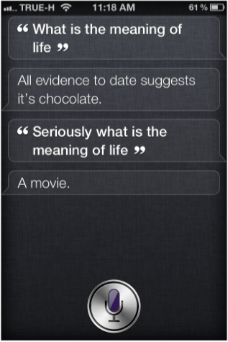
Examples of modern Virtual Assistant dialogue systems
Apple Siri (2010)
Supports questions in a set of domains
Answers open-end questions
Cute “Easter egg” responses

Slide 9
Examples of modern Virtual Assistant dialogue systems
Android Google Now (2013)
Predictive search assistant
Windows Cortana (2014)
Works across different Windows devices
Aims to be able to “talk about anything”

Slide 10
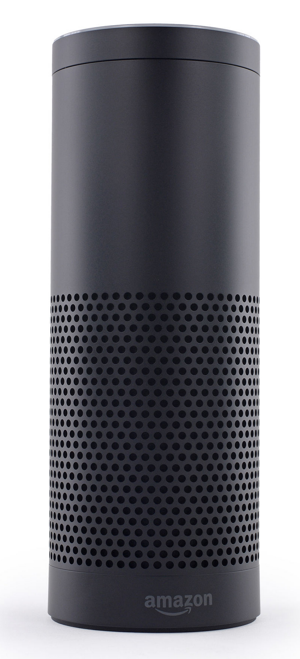
Embedded devices with dialogue capabilities
Amazon Echo (2014) – home assistant device
Plays music
With voice commands
Question answering
Get weather, news
More complex questions, like
“how many spoons are in a cup?”
Setting timer
Manages TODO lists

Slide 11
Embedded devices with dialogue capabilities
Answers questions
Sets time
Device control and queries:
Thermostat
Etc.
Uses Wolfram Alfa engine on the back-end to answer questions

Slide 12
When do you use dialogue systems?

Slide 13
Research Dialogue Systems
Research systems explore novel research questions in speech recognition/language understanding/generation/dialogue management
Research systems
Based on more novel theoretical frameworks (reinforcement learning)
Open-domain speech recognition
Focus on theory development
Transition from research to commercial
Siri came out of a DARPA-funded research project

Slide 14
The First Dialogue System: Eliza
Eliza (text only) (Joseph Weizenbaum, MIT, 1966)
A “psychologist” system
Example conversation: http://www.masswerk.at/elizabot/
ELIZA: Is something troubling you ?
YOU: I am worried about teaching
ELIZA: How long have you been worried about teaching ?
YOU: For couple weeks
ELIZA: Do you feel strongly about discussing such things ?
YOU: yes
ELIZA: You seem to be quite positive.
YOU: I am concerned about choosing course content
ELIZA: Do you believe it is normal to be concerned about choosing course content ?

Slide 15
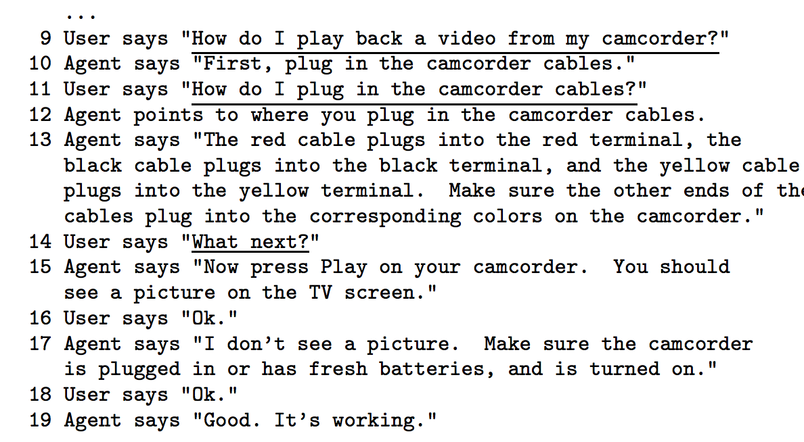
Collaborative Systems
Collagen (Rich, Sidner & Lesh 2001) MITSUBISHI ELECTRIC RESEARCH LABORATORIES
Application-independent theory based on making a computer an collaborative agent
Based on Shared Plan AI theory

Slide 16
Tutoring (Litman & Silliman,2004), U. Pittsburgh

Slide 17
Clarissa – spoken system
Clarissa (Rayner et al. 2005) NASA
First spoken dialogue system in space
Deployed in International Space Station
Procedure browser that assists in space missions

Slide 18
CMU Bus Information
Bohus et al. (deployed in 2005) CMU
Telephone-based bus information system
Deployed by Pittsburgh Port Authority
Receives calls from real users
Noisy conditions
Speech recognition word error rate ~ 50%
Use collected data for research
Provide a platform to allow other researchers to test SDS components

Slide 19
CMU LetsGo Dialogue Example

Slide 20
Commercial vs. Research dialogue systems
Goal
System Flexibility
Ability to accept varied input
Support multiple wide range
of queries
Multiple domains
User initiative
Research
Commercial
System Reliability

Slide 21
What is involved in NL dialogue
Understanding
What does a person say?
Identify words from speech signal
“Please close the window”
What does the speech mean?
Identify semantic content
Request ( subject: close ( object: window))
What were the speaker’s intentions?
Speaker requests an action in a physical world

Slide 22
What is involved in NL dialogue
Managing interaction
Internal representation of the domain
Identify new information
Identifying which action to perform given new information
“close the window”, “set a thermostat” -> physical action
“what is the weather like outside?” -> call the weather API
Determining a response
“OK”, “I can’t do it”
Provide an answer
Ask a clarification question

Slide 23
What is involved in NL dialogue
Access to information
To process a request “Please close the window” you (or the system) needs to know:
There is a window
Window is currently opened
Window can/can not be closed

Slide 24
What is involved in NL dialogue
Producing language
Deciding when to speak
Deciding what to say
Choosing the appropriate meaning
Deciding how to present information
So partner understands it
So expression seems natural

Slide 25
Types of dialogue systems
Command and control
Actions in the world
Robot – situated interaction
Information access
Database access
Bus/train/airline information
Librarian
Voice manipulation of a personal calendar
API access
IVRs – customer service
Simple call routing
Menu-based interaction
Allows flexible response “How may I help you?”
Smart virtual assistant (vision)
Helps you perform tasks, such as buying movie tickets, trouble shooting
Reminds you about important events without explicit reminder settings

Slide 26
Aspects of Dialogue Systems
Which modalities does the system use
Voice only (telephone/microphone & speaker)
Voice and graphics (smartphones)
Virtual human
Can show emotions
Physical device
Can perform actions
Back-end
which resources (database/API/ontology) it accesses
How much world knowledge does the system have
Hand-built ontologies
Automatically learned from the web
How much personal knowledge does it have and use
Your calendar (google)
Where you live/work (google)
Who are your friends/relatives (facebook)

Slide 27
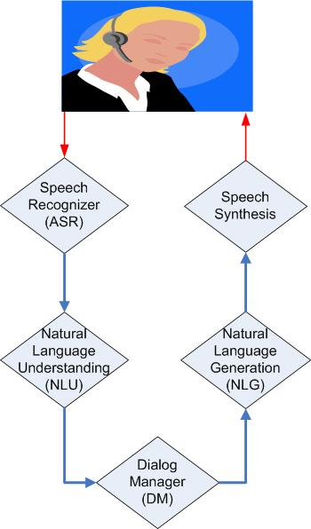
Dialog system components
Voice input
Speech
Language Model/Grammar
Acoustic model
Hypothesis (automatic
transcription)
Text
Generation templates/
rules
Grammar/Models
Logical form
of user’s input
Logical form
of system’s output

Slide 28
Dialog system components
Voice input
Speech
Language Model/Grammar
Acoustic model
Hypothesis (automatic
transcription)
Text
Generation templates/
rules
Grammar/Models
Logical form
of user’s input
Logical form
of system’s output

Slide 29
Speech recognition
Convert speech signal into text
Most SDS use off-the-shelf speech recognizers
Research systems are highly configurable:
Kaldi – most used research recognizer
Sphinx/pocket sphinx (java API)
Industry (free cloud version), not configurable
Google
Nuance
AT&T Watson

Slide 30
Speech recognition
Statistical process
Use acoustic models that maps signal to phonemes
Use language models (LM)/grammars that describe the expected language
Open-domain speech recognition use LM built on large corpora

Slide 31
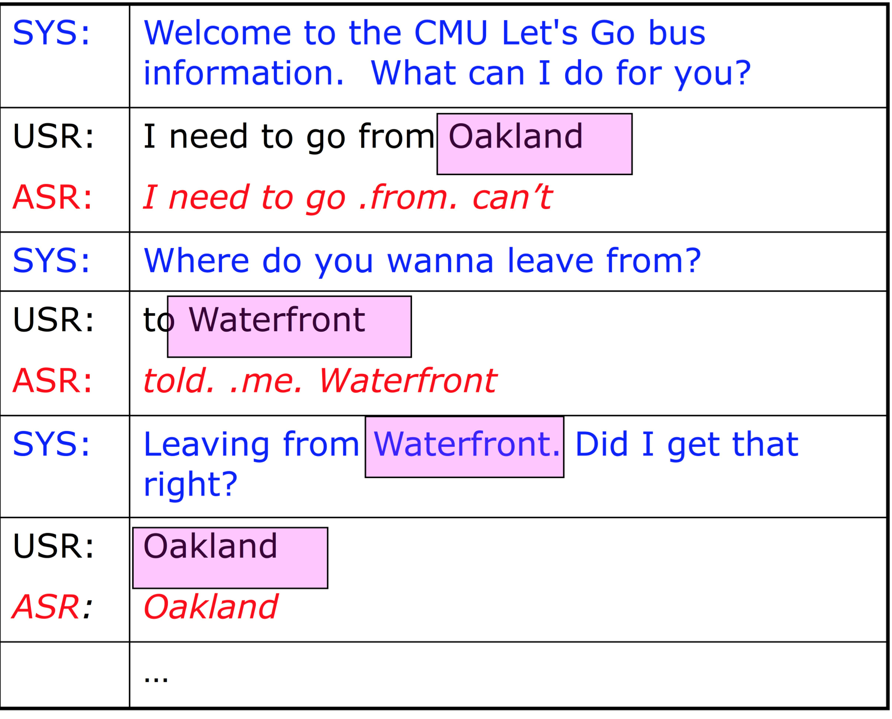
Speech recognition
Challenges: recognition errors due to
Noisy environment
Speaker accent
Speaker interruption, self correction, etc.

Slide 32
Speech recognition
Speaker-dependent/independent
Domain dependent/independent

Slide 33
Speech recognition
Grammar-based
Allows dialogue designer to write grammars
For example, if your system expects digits a rule:
S -> zero | one | two | three | …
Advantages: better performance on in-domain speech
Disadvantages: does not recognize out-of-domain
Open Domain – large vocabulary
Use language models built on large diverse dataset
Advantages: can potentially recognize any word sequence
Disadvantages: lower performance on in-domain utterances (digits may be misrecognized)

Slide 34
Dialog system components
Voice input
Speech
Language Model/Grammar
Acoustic model
Hypothesis (automatic
transcription)
Text
Generation templates/
rules
Grammar/Models
Logical form
of user’s input
Logical form
of system’s output

Slide 35
Natural Language Understanding
Convert input text into internal representation. Example internal representation in wit.ai:
{
"msg_body": "what is playing at Lincoln Center",
"outcome": {
"intent": "get_shows",
"entities": {
"Venue": {
"value": "Lincoln Center",
}
},
"confidence": 0.545
},
"msg_id": "c942ad0f-0b63-415f-b1ef-84fbfa6268f2"
}

Slide 36
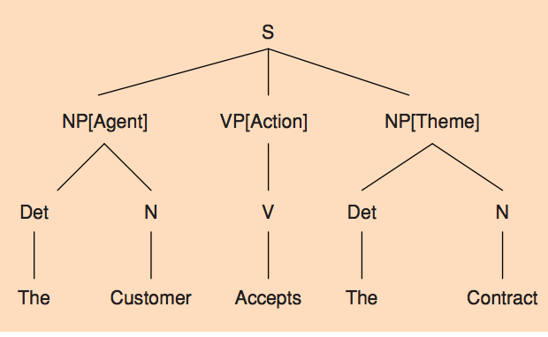
NLU approaches
Can be based on simple phrase matching
“leaving from PLACE”
“arriving at TIME”
Can use deep or shallow syntactic parsing

Slide 37
NLU approaches
Can be rule-based
Rules define how to extract semantics from a string/syntactic tree
Or Statistical
Train statistical models on annotated data
Classify intent
Tag named entities

Slide 38
Dialog system components
Voice input
Speech
Language Model/Grammar
Acoustic model
Hypothesis (automatic
transcription)
Text
Generation templates/
rules
Grammar/Models
Logical form
of user’s input
Logical form
of system’s output

Slide 39
Dialogue Manager (DM)
Is a “brain” of an SDS
Decides on the next system action/dialogue contribution
SDS module concerned with dialogue modeling
Dialogue modeling: formal characterization of dialogue, evolving context, and possible/likely continuations

Slide 40
DM approaches
Rule-based
Key phrase reactive
Finite state/Tree based
model the dialogue as a path through a tree or finite state graph structure
Information-state Update
Statistical (learn state transition rules from data or on-line)
Hybrid (a combination of rules and statistical method)

Slide 41
Dialog system components
Voice input
Speech
Language Model/Grammar
Acoustic model
Hypothesis (automatic
transcription)
Text
Generation templates/
rules
Grammar/Models
Logical form
of user’s input
Logical form
of system’s output

Slide 42
NLG approaches
Presenting semantic content to the user
Template-based
In a airline reservation system:
User: “Find me a ticket from New York to London”
System: “What date do you want to travel?”
User: “March 10”
System: “There is a United flight from Newark airport to London Heathrow on March 10 leaving at 9:15 AM”
Template: There is a AIRLINE flight from AIRPORT to AIRPORT on DATE leaving at TIME

Slide 43
Natural language generation (NLG)
Content selection
User asks “Find me restaurants in Chelsea”
System finds 100 restaurants
NLG decides how to present a response and which information to present
“I found 100 restaurants, the restaurant with highest rating is …”
“I found 100 restaurants, the closest to you is …”
“I found 100 restaurants, I think you would like …”

Slide 44
Dialog system components
Voice input
Speech
Language Model/Grammar
Acoustic model
Hypothesis (automatic
transcription)
Text
Generation templates/
rules
Grammar/Models
Logical form
of user’s input
Logical form
of system’s output

Slide 45
Dialogue System Architecture
Ravenclaw/Olympus
Asynchronous architecture:
Each component runs in a separate process
Communication managed by the “Hub” with messaging

Slide 46
New Tools
OpenDial – DM framework; Pier Lison (2014)
Wit.ai – A tool for building ASR/NLU for a system

Slide 47
OpenDial
Pier Lison’s PhD thesis 2014
DM components can run either synchronously or asynchronously
ASR/TTS: OpenDial comes with support for commercial off-the shelve ASR (Nuance & AT&T Watson)
NLU: based on probabilistic rules
XML NLU rules
DM: rule-based. Dialogue states triggered with rules
XML DM rules
NLG: template-based
XML NLG rules

Slide 48
Wit.AI
1.5 year start up recently bought by Facebook
Web-based GUI to build a hand-annotated training corpus of utterances
Developer types utterances corresponding to expected user requests
Builds a model to tag utterances with intents
Developer can use API using python, javascript, ruby, and more
Given speech input, output intent and entity tags in the output

Slide 49
Specialty Topics for Dialogue Systems
turn-taking
mixed-initiative
referring in dialogue
grounding and repair
dialogue act modeling
dialogue act recognition
error recovery in dialogue
prosody and information structure
Argumentation & persuasion
incremental speech processing
multi‐modal dialogue
multi-party dialogue (3 or more
participants)
tutorial dialogue
multi‐task dialogue
embodied conversational agents
human-­‐robot dialogue interaction
dialogue tracking in other language-­‐processing systems (machine translation, summarization/extrac.on)
non-­‐cooperative dialogue systems (negotiation, deception)
affective dialogue systems
dialogue with different user populations (children, elderly, differently abled)
dialogue “in the wild”
long‐term Dialogue Companions
user behavior, including entrainment in dialogue

Slide 50
Course Structure

Slide 51
Course Structure
Class part 1: main topics of dialogue systems
Speech Recognition/Language Understanding
Dialogue modeling
Dialogue management
Information presentation/language generation
Evaluation of dialogue
Class part 2: special topics
Error recovery
Entrainment/adaptation in dialogue
User behavior in dialogue
Dialogue systems for education
Multimodal/situated dialogue systems

Slide 52
Class organization
Discussion of 2-4 papers
30 minute panel discussion with all presenters of the day
Introduction of the next topic (by the instructor) or a guest lecture

Slide 53
Course Materials
Papers available on-line
Discussion papers
Background papers
Additional papers
The schedule is tentative and can change
See resources and links
Open source or free versions of commercial software
Course slides will be posted (see Dropbox link for in-progress version)

Slide 54
Class presentation
A student will be assigned to present 1 - 2 papers during the class
Prepares 15-30 minute presentation
Slides
Critical review (using a review form)
Everyone else prepares questions for the discussion papers
Please email your questions to the TA/instructor before the class

Slide 55
How to read a research paper
1st pass
Get a bird’s-eye view of the paper
Abstract, intro, section titles, conclusions
2nd pass
Read the paper with greater care
Pay attention to graphs and figures
Mark important references (other papers you might want to read)
3rd pass
Read the paper paying attention to all details (proofs, algorithms)
Identify strengths and weaknesses

Slide 56
Presentation Slides
describe the task addressed by the paper
approach proposed by the authors
data or system used
summarize the related work
describe the experiments and results (if present)

Slide 57
Critical review
Clarity
Originality
Implementation and soundness
Substance
Evaluation
Meaningful Comparison
Impact
Recommendation

Slide 58
Guest Lectures
Entrainment in dialogue. Rivka Levitan (CUNY, Brooklyn College)
Voice search (David Elson, Google)
Multimodal Interaction (Michael Johnston, Interactions Corporation)
Situated dialogues with robots
Belief tracking

Slide 59
Course Project
Build a dialogue system
Propose a research question (optional)
Evaluate your system/research question
Final report: in a format of a research paper
Demonstration: each group demonstrates the project
Students can vote for the best project/demo
Suggestion: form groups of 2 – 3 students

Slide 60
Building a dialogue system
A dialogue system with a dialogue manager
Allow multi-turn interaction (beyond request – response)
Application type
Information retrieval
Can use a real back-end API (calendar, events, movies, etc.)
Navigation (maps API)
Information gathering (survey system)
Chatbot
Interface:
Can have GUI on smartphone (not required)
Run in a browser
Stand-alone appliation

Slide 61
Domain examples
A voice interface for an existing API:
A calendar system that interfaces a google calendar and allows a user add/remove/query events in the calendar
A system that queries weather information
A system that holds a dialogue questions about current events in NYC: find concerts/plays/movies at NYC venues
Voice Interface for a travel api, e.g tripadvisor that allows to query hotels
A chatbot system that uses a database on a back-end e.g.
a chat interface for a toy that talks with children
a chat interface that may be used in a museum to provide information for visitors

Slide 62
Example Dialog System
API: NY times allows to filter by
category/subcategory of event
Location: borrow, neighborhood
Boolean flags: kid-friendly
Example dialogue:
U: Find me concerts in Brooklyn tonight
S: Looking for music concerts, what genre?
U: jazz
S: Which neighborhood
U: Brooklyn heights
Another example dialogue:
U: find me all jazz concerts in Brooklyn heights Saturday morning
S: there are 2 matching concerts: lists
U: Do you want to find out more?

Slide 63
Exploring a research question
Compare system performance with different speech recognizers (e.g. Kaldi, Pocket Sphinx, Google, Nuance)
Compare system performance with different TTS engines (Festival)
Build a statistical NLU for the OpenDial system. ** (this has a practical application), or try connecting WitAI NLU as a module for OpenDial
Build a multimodal graphical display for your system (e.g. as a module in OpenDial) and compare voice-only and multimodal condition
Experiment with dialogue flow in your system
Experiment with clarification strategies in your system
Experiment with different methods of information presentation or natural language generation

Slide 64
System Evaluation
Choose your evaluation metrics:
User subjective rating
Task success rate
Performance of individual components
Recruit other students from the class to be your experimental subjects or find external subjects
Evaluate your system or hypothesis
Analyze the data and summarize the results

Slide 65
Project Deliverables
Make an appointment/send email get feedback on your ideas
2/16 Project Ideas – 5 minute “elevator speech” in class (describe domain and research question) 1- 2 page summary
3/9 Related Work and Method write-up
Make an appointment to show the demo and discuss your progress
Send us a draft of your paper for feedback
5/4 (last class) Project demonstrations in class
5/15 Final Project Write-up

Slide 66
Submitting assignments
Submit papers in PDF format using CourseWorks
Use Github for code collaboration and submission

Slide 67
Next Class
Please email your preferences for presentation
Need 3 volunteers for the next week’s presentations
Create an account on wit.ai
Go through the tutorial
Set up a sample spoken interface

Slide 68
Break-out session

Slide 69
Divide in teams
Google Now
Siri
Microsoft Cortana

Slide 70
Task
Call your phone provider (AT&T, Verison, etc.)
Find out when your next bill is due
Balance
Imaginary problem: try to find out the plan options

Slide 71
What seemed to work well and what not so well?
How easy was it to accomplish the task?
Was the experience fun or frustrating?
Would you use this system again (if you had a choice)?
How good was the understanding?
Did it understand what you said?
What happened when things went wrong?
What kinds of techniques did the system use (if any) to try to prevent errors?
Did they seem successful?
Were you able to express what you wanted to the system?
What is one way you might improve this system?

Slide 72
References
David Traum’s course on SDS
http://projects.ict.usc.edu/nld/cs599s13/schedule.php

