Slide 1
Evaluation of SDS
Svetlana Stoyanchev
3/2/2015

Slide 2
Goal of dialogue evaluation
Assess system performance
Challenges of evaluation of SDS systems
  SDS developer designs rules but dialogues are not predictable
  System action depends on user input
  User input is unrestricted

Slide 3
Stakeholders
Developers
Business Operator
End-user

Slide 4
Criteria for evaluation
Key Criteria
  Performance of SDS components
    ASR (WER)
    NLU (concept Error rate)
    DM/NLG (is the response appropriate)
  Interaction time
  User engagement
Criteria may vary based on an application
  Information access/query
    Minimize interaction time
  Browsing museum guide
    Maximize user engagement

Slide 5
Evaluation measures/methods
Evaluation measures
  Turn correction ratio
  Concept accuracy
  Transaction success
Evaluation methods
  Recruit and pay humans to perform task in a lab
Disadvantages of human evaluation:
  High cost
  * Unrealistic subject behavior

Slide 6
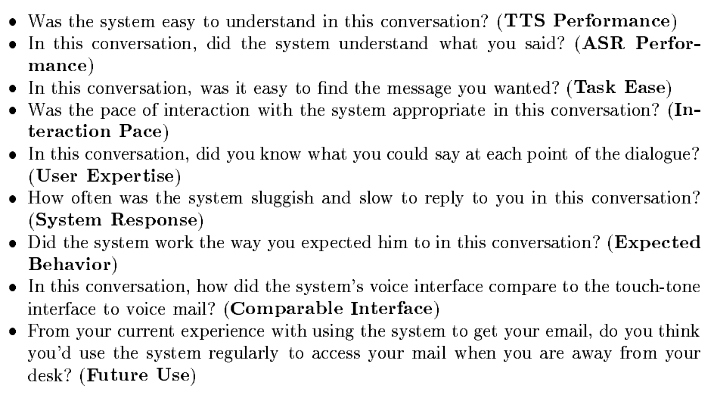
A typical questionnaire

Slide 7
PARADISE framework
PARAdigm for Dialogue System Evaluation
Framework goal: predict user performance using system features
Performance measures:
  User Satisfaction
  Task Success
  Dialogue Cost

Slide 8
Applying PARADISE Framework
Walker, Kamm, Litman 2000
Collect data from users via controlled experiment (subjective rating of satisfaction)
  Mark or automatically log system measures
Apply multivariate linear regression
  User SAT is a dependent variable
  Independent variables – logged
Predict user SAT using simpler metrics that can be automatically collected in a live system

Slide 9
Data collection for PARADISE framework
Systems
  ANNIE : voice dialing, employee directory look-up and voice and email access
    Novice/expert
  ELVIS: accessing email
    Novice/expert
  TOOT: finding a train with specified constraints

Slide 10
Automatically logged variables
Efficiency
  System turns
  User turns
Dialogue quality
  Timeouts (when a user did not respond)
  Rejects (when the system confidence is low leading to “I am sorry I did not understand”)
  Help – number of times the system believes that a user said ‘help’
  Cancel - number of times the system believes that a user said ‘cancel’
  Barge-in

Slide 11
Method
Train models using multivariate regression
Test across different systems measuring
  How much variance does the model predict
    R^2

Slide 12
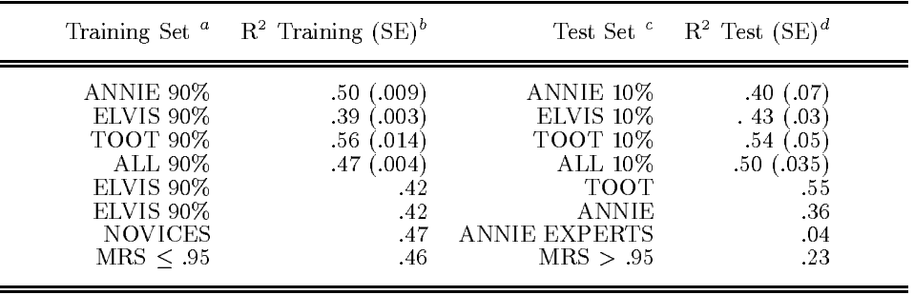
Results: train and test on the same system

Slide 13
Results: train and test on all

Slide 14
Results: cross-system train/test

Slide 15
Results: cross-dialogue type

Slide 16
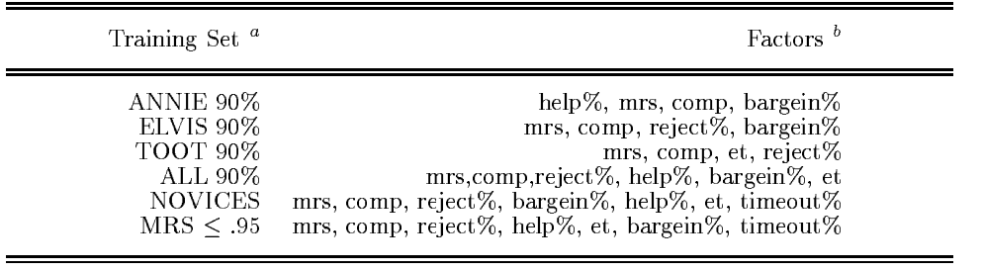
Which features were useful?
Comp: task success/ dialogue completion
Mrs: mean recognition score
Et: elapsed time
Reject%: % of utterances in a dialogue rejected by the system

Slide 17
Applying PARADISE Framework
2000 – 2001 DARPA communicator
  9 participating sites
  Develop air reservation system
“SDS in the wild”
Over 6 months recruited users call to make airline reservation
  Recruit frequent travellers

Slide 18
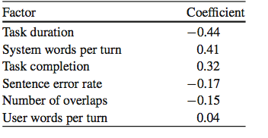
Communicator Result

Slide 19
Discussion
Consistent contributors to User SAT
  Negative effect of task duration
  Negative effect of sentence errors
Task Success vs. User Satisfaction
  Not always the same
Commercial systems vs. Research systems
  Different goals
Difficult to generalize across different system types

Slide 20
Next: other methods of evaluation
F. Jurčíček and S. Keizer and F. Mairesse and B. Thomson and K. Yu and S. Young Real user evaluation of spoken dialogue systems using Amazon Mechanical Turk. in Proceedings of Interstpeech, 2011 [ presenter: Mandi Wang ]
K. Georgila, J. Henderson, and O. Lemon. 2005. Learning User Simulations for Information State Update Dialogue Systems. In Proceedings of Interspeech.[ presenter: Xiaoqian Ma ]

