Slide 1
Spoken Language Understanding in Dialogue Systems
Svetlana Stoyanchev
02/02/2015

Slide 2
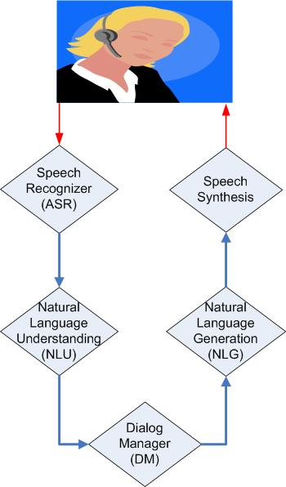
Dialog system components
Voice input
Speech
Language Model/Grammar
Acoustic model
Hypothesis (automatic
transcription)
Text
Generation templates/
rules
Grammar/Models
Logical form
of user’s input
Logical form
of system’s output

Slide 3
Speech recognition (ASR)
Automatically transcribe audio sample into text
Input: an audio sample
Output: sequence of words

Slide 4
Speech recognition in SDS
Most SDS use off-the-shelf speech recognizers
Research ASR are highly configurable:
Kaldi – most used research recognizer
Sphinx/pocket sphinx (java API)
Industry (free cloud version), not easily configurable
Google
Nuance
AT&T Watson

Slide 5
Speech recognition (ASR)
Possible configuration
Acoustic model
Grammar / Language model
Phones lattice:
JH EH N ER EY T ER
JH EH N ER EY AH L
JH EH N ER EY IH K
generator
Acoustic model
N-best hypothesis list:
Generator
General
Generic
…
Language Model

Slide 6
Acoustic model
Computes the probability of the observed acoustic features in an audio given a word (phone) sequence
May be trained on 5-10 hours of speech (or much more)
AM is particular for
a recording environment
microphone and broadcast speech
telephone speech
Accent
American English
British English
Accented English
Default acoustic models may work less well for different recording environments or accented English (UK English, Indian English)
Speaker-dependent acoustic model is trained on a particular speaker

Slide 7
Grammar-based Speech Recognition
Dialogue designer writes grammars
Digits grammar:
S -> zero | one | two | three | …
Greeting grammar:
S -> (hello | good morning | greetings) (Lana | Rita | Paul | Dan)
See http://www.w3.org/TR/jsgf/
Advantages: better performance on in-domain speech
Disadvantages: does not recognize out-of-domain

Slide 8
Statistical Language Models (SLM)
Assign probabilities to word sequences
SLM trained using a collection of sample utterances
Use language models built on large diverse dataset
Advantages: can potentially recognize any word sequence
Disadvantages: lower performance on in-domain utterances (digits may be misrecognized)

Slide 9
Output from ASR
1-best hypothesis (most SDS)
N-best hypothesis

Slide 10
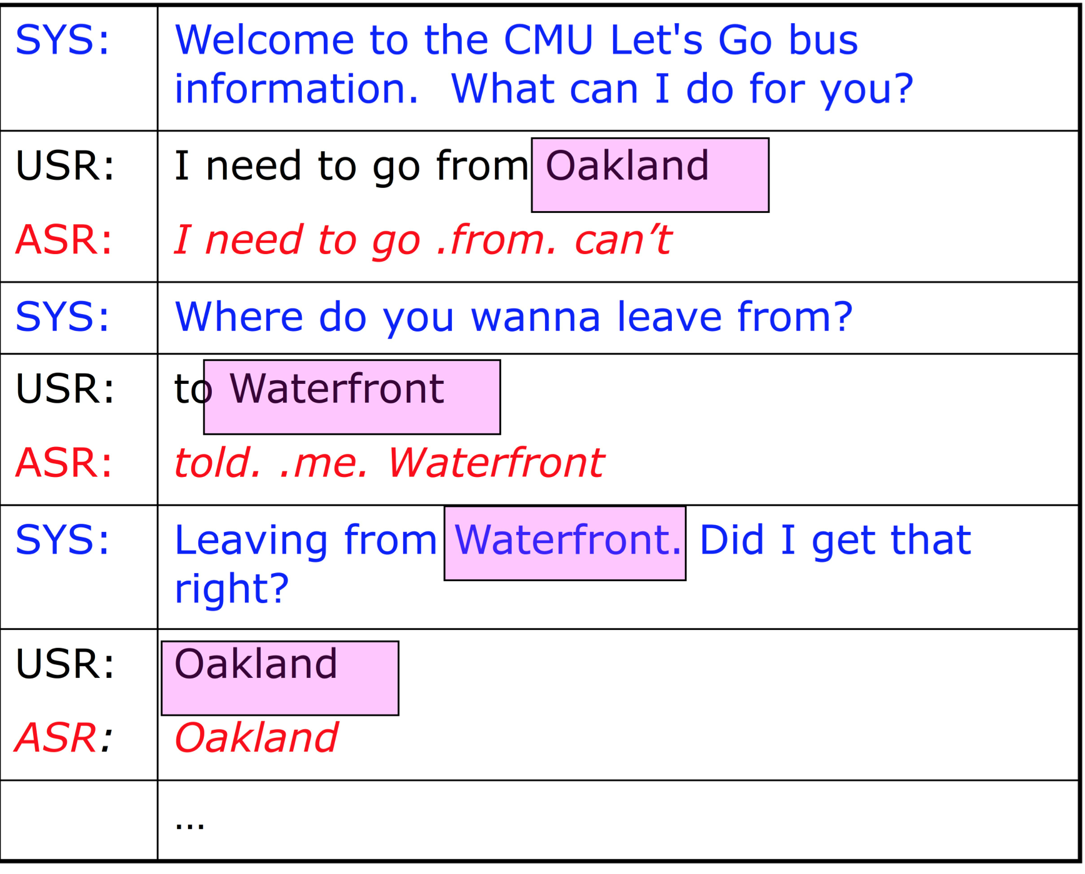
Speech recognition challenges
Challenges: recognition errors due to
Noisy environment
Speaker accent
Speaker interruption, self correction, disfluencies (hmm., uh, etc ).
ASR Word Error Rates (WER) in systems …

Slide 11
Speech recognition
Challenges: recognition errors due to
Noisy environment
Speaker accent
Speaker interruption, self correction, etc.
ASR Word Error Rates (WER) in systems vary between 5 – 70%

Slide 12
Dialog system components
Voice input
Speech
Language Model/Grammar
Acoustic model
Hypothesis (automatic
transcription)
Text
Generation templates/
rules
Grammar/Models
Logical form
of user’s input
Logical form
of system’s output

Slide 13
Natural Language Understanding (NLU)
Convert input text into internal representation
Why is NLU challenging?
ASR errors
30 % Word Error Rate means that every 3rd word is misrecognized
Ambiguity of NL
Synonymy in NL

Slide 14
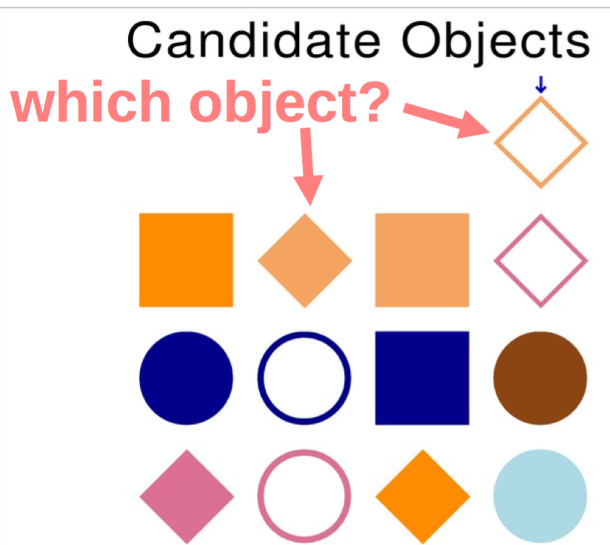
Why is NLU challenging?
Ambiguity: the same text can often mean several different things
syntactic ambiguity I saw the man with the binoculars
referential ambiguity The object is the beige diamond
word sense ambiguity I need to go to the bank
ambiguity in implication It's cold outside
An NLU module often needs
to resolve ambiguity and identify the user's specific meaning

Slide 15
Why is NLU challenging?
Synonymy
Multiple ways to say the same thing:
“Find me inexpensive restaurants with nice ambiance”
“I am looking for an inexpensive restaurant that has relaxed atmosphere”
“Locate cheap restaurants good for informal dinner”
An NLU module often needs to map many different surface texts onto the same meaning

Slide 16
NLU approaches
NLU Approaches
Rule-based
Statistical
NLU Internal representation may be:
Frames (collection of slot-values)
speech act labels
speech act label + semantic content

Slide 17
NLU approaches
Rule-based
Internal representation frames
Rules define how to extract semantics from a string/syntactic tree
Statistical
Internal representation: intent and/or semantic tags
Train statistical models on annotated data
Classify intent
Tag domain-specific concepts

Slide 18
Rule-based NLU: Frames
Frame: Air
Origin.City Denver
Destination.City
Airline.Name
…
A Frame is a collection of slot-values
NLU uses CFG grammar
Represented by a network:

Slide 19
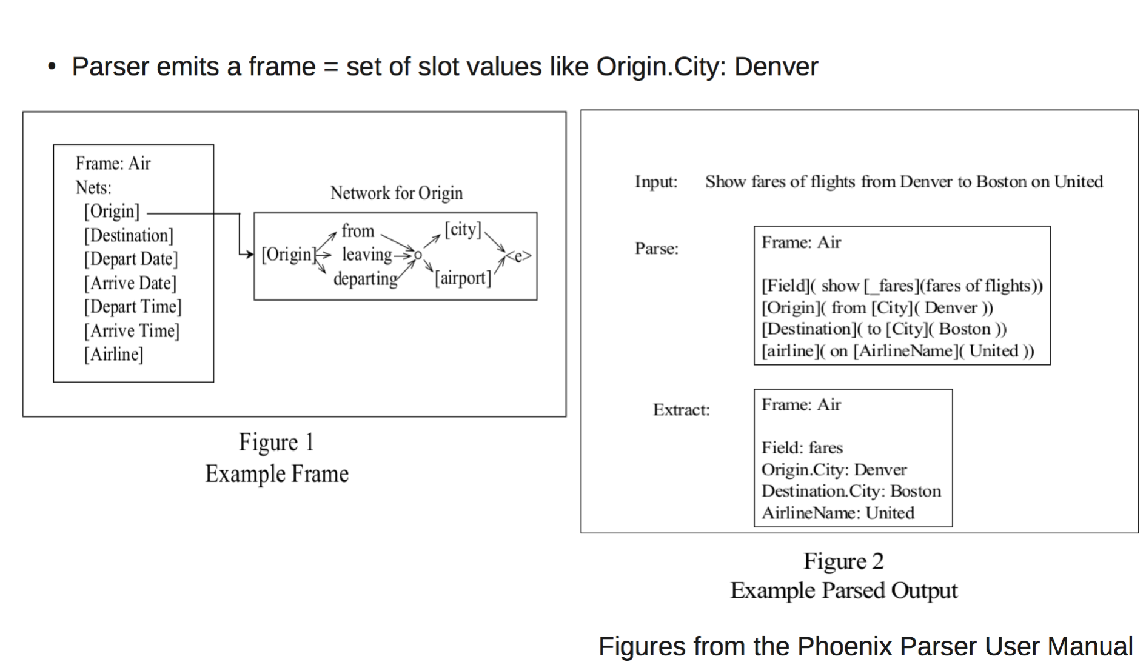
Rule-Based NLU Frames Example

Slide 20
Rule-based NLU: Frames
Very flexible representation
Can decompose the meaning of an utterance into the components that are meaningful to a dialogue system
Can have hierarchical structure
Values can be shared across slots
Place
City
State
Country
Origin
Destination
City

Slide 21
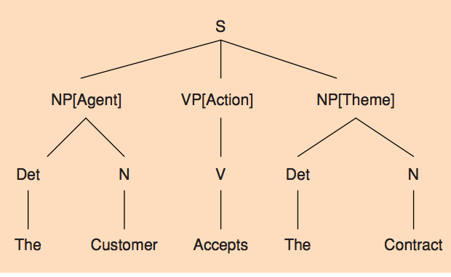
Rule-based NLU
Frames can be parsed using slot-value parsing
Phoenix (Ward & Issar 1996)
Let’s Go bus information
Syntactic parsing + semantic rules

Slide 22
Statistical NLU terminology
Identify Intent and Concept Labels in a user utterance
Intent is also known as:
speech act
dialogue act
dialogue move
conversational act
Concept labels
Semantic labels/tags

Slide 23
Statistical NLU
Intent: represent what type of action a user utterance is making
Taxonomy of speech act example:
greeting, acknowledging, requesting, asserting, offering, etc
Labels: concept labels are domain-specific concepts
city, airline, time, product name, etc.
Approach: train classifiers on tagged utterances

Slide 24
Intent Classification
Intent: get_shows
What is playing in Lincoln Center
What movies are showing at Angelica Film center tonight
List movies at Film Forum after 7pm tomorrow
…
Intent: get_restaurants
Find inexpensive restaurants in Chelsea
Sushi restaurants in the Village
Brunch in Brooklyn Heights
…
Approach: supervised classification (SVM, CRF, Decision Tree, etc.)

Slide 25
Concept Labels
Intent: get_shows
What is playing in Lincoln Center/VENUE
What movies are showing at Angelica Film Center/VENUE tonight/TIME
List movies at Film Forum/VENUE after 7pm tomorrow/TIME
…
Intent: get_restaurants
Find inexpensive/PRICERANGE restaurants in Chelsea/NEIGHBORHOOD
Sushi/CUSINE restaurants in the Village/NEIGHBORHOOD
Brunch/CUSINE in Brooklyn Heights/NEIGHBORHOOD
…
Approach: sequence tagging
For each word/concept: identify probability that the word is part of the concept
Use Viterbi decoding to get the most likely tags

Slide 26
How much data is needed for training?
The more the better
Depends on variability of domain
Generally >1K examples

Slide 27
Natural Language Understanding
Example NLU output in wit.ai:
{
"msg_body": "what is playing at Lincoln Center",
"outcome": {
"intent": "get_shows",
"entities": {
"Venue": {
"value": "Lincoln Center",
}
},
"confidence": 0.545
},
"msg_id": "c942ad0f-0b63-415f-b1ef-84fbfa6268f2"
}

Slide 28
Rule-based vs. statistical NLU
Rule-based
+ robust
+ flexible representation
Requires manually created rules
- Requires large number of rules for domains with high variation of possible sentences
Statistical
+ Robust for synonymy
- Requires data to train on

Slide 29
Statistical NLU in SDS
Training NLU for SDS:
Chicken-and-egg problem:
To train NLU we need data
To get data we need a SDS system
NLU for SDS research: how to overcome this issue?

Slide 30
Approaches to statistical NLU
WOZ system
Rule-based system
Generate Synthetic data
Deploy initial system
Collect data
Train new NLU models
Deploy the system with the new NLU

Slide 31
Next week’s papers
Mandy Korpusik, Nicole Schmidt, Jennifer Drexler, Scott Cyphers, and James Glass DATA COLLECTION AND LANGUAGE UNDERSTANDING OF FOOD DESCRIPTIONS In IEEE SLT Workshop, 2014
Fabrizio Morbini and Eric Forbell and Kenji Sagae Improving Classification-Based Natural Language Understanding with Non-Expert Annotation in Proceedings of SigDial 2014
Ali El-Kahky, Derek Liu, Ruhi Sarikaya, Gokhan Tur, Dilek Hakkani-Tur, and Larry Heck Extending Domain Coverage of Language Understanding Systems via Intent Transfer Between Domains Using Knowledge Graphs and Search Query Click Logs IEEE International Conference on Acoustics, Speech, and Signal Processing (ICASSP) 2014

Slide 32
Next Class
Please email your preferences for presentation (if you have not yet)
Need 3 volunteers for the next week’s presentations!!
Create an account on wit.ai
Go through the tutorial
Set up a sample spoken interface
Download OpenDial
Look at the xml for NLU specification

