Slide 1
Seminar on Spoken Dialogue Systems
Columbia University
Svetlana Stoyanchev
2/23/15

Slide 2
Today’s agenda
Discussion of the POMDP paper (Edward Li)
Project presentations by the teams
Information Presentation in SDS, paper presentations:
Taghi Paksima, Kallirroi Georgila, and Johanna D. Moore. Evaluating the Effectiveness of Information Presentation in a Full End-to-End Dialogue System. In Proceedings of the 10th Annual SIGdial Meeting on Discourse and Dialogue, pp. 1-10, London, UK, 2009. [Presenter: Samara Trilling ]
Margaret Mitchell, Dan Bohus, Ece Kamar Crowdsourcing Language Generation Templates for Dialogue Systems. INLG, 2014 [presenter:Sarah Ita Levitan]
Discussion of frameworks

Slide 3
Frameworks
Wit.AI
Vs.
OpenDial

Slide 4
Wit.AI
NLU/ASR interface
Provides interface to create and annotate utterance examples for your domain
Interface with different platforms:
iOS, Android, Ruby, Python, Web (javascript), etc.
NO Dialogue Management framework
You would need to implement DM yourself.

Slide 5
ExampleSystem Architecture using Wit.AI
Wit AI interface
Open-source/freeware TTS
(Festival, Nuance, AT&T)
json
text
Intent + concepts
Python DM
While (get input):
perform action given intent&concepts:
Ask for cuisine
Ask for price range
Ask for neighborhood
Look up restaurant
Present result
State/Frame, e.g Restaurant domain
Cuisine : ?
Price range : ?
Neighborhood: ?

Slide 6
OpenDial
DM Framework implemented by Pier Lison for his PhD thesis, 2014
Blackboard architecture
Multiple modules “cooperate” to
Interpret system input
Maintain SDS state
Decide on the action to perform
DM components can run either synchronously or asynchronously

Slide 7
OpenDial
ASR/TTS: OpenDial comes with support for commercial off-the shelve ASR (Nuance & AT&T Watson)
Components:
Rule-structured (Rules are defined in XML): collection of probabilistic rules with trigger variables
NLU, DM, NLG
External components: operate by monitoring dialogue state
ASR, TTS, domain specific (visualization, back-end, robot input sensors)

Slide 8
OpenDial
Aims to combine flexibility of Information State architecture (Traum & Larsson) with robustness and flexibility of statistically optimized SDS
Use of N-best list of hypotheses allows to take advantage of the uncertainty of ASR
Declarative specification of the dialogue in terms of rule-structured models facilitated SDS development

Slide 9
Open Dial Examples
See opendial->domains->examples->
Pizzas
Simulator-step-by-step.xml (not probabilistic)
Instructions to a robot to move around a grid
Example with probabilistic DM (util values are set in the rules)
Simulator (probabilistic)
Flight booking
Flight-booking-nlu.xml
Flight-booking-nlg.xml
Flignt-booking-dm.xml

Slide 10
Open Dial
Defines dialogue in terms of utterances and dialogue acts
U_u - Utterance user
U_m – Utterance machine
A_u – dialogue Act user
A_m – dialogue Act machine
Define dialogue rules using ‘triggers’ and ‘effects’ (if-then-else) using XML representation
Allows probabilistic rules

Slide 11
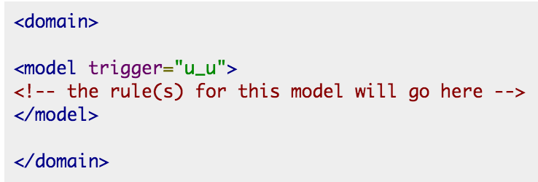
NL Understanding
Define rules that trigger conditionally on content of a user utterance

Slide 12
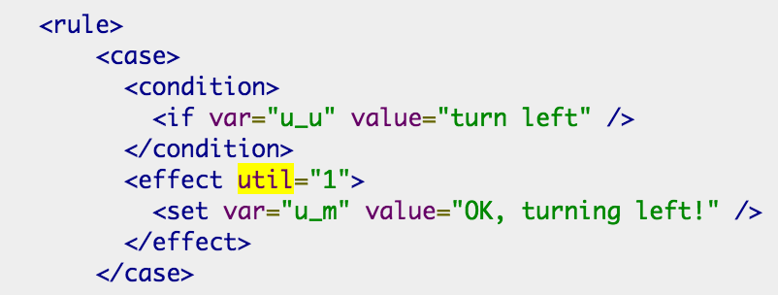
Rules for user utterances (trigger=“u_u”)
Simple NLU rule testing equality of a user utterance and setting a response utterance u_ms

Slide 13
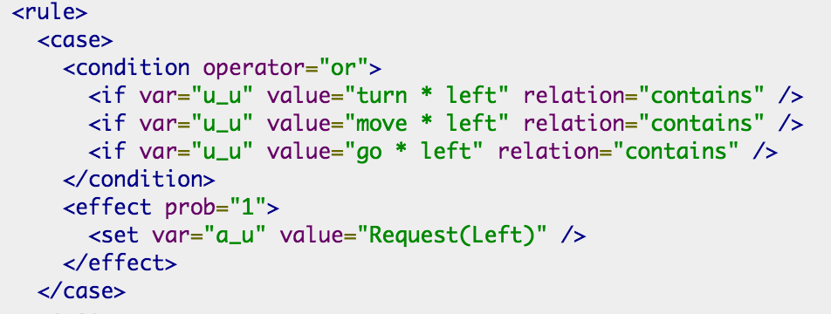
NLU for simulator-step-by-step
Conditional NLU rule testing for a user utterance and setting response dialog act

Slide 14
DM (action selection) for simulator-step-by-step

Slide 15
NLG for simulator-step-by-step

Slide 16
Overall picture
NLU
Trigger: u_u (user utterance)
Effect: set a_u (user act)
DM
Trigger: a_u (act user)
Effect: a_m (act machine)
NLG
Trigger: a_m (act machine)
Effect: u_m (utterance machine)

Slide 17
Probabilistic rules
The DM applies probability/utility rules (see Lison’s thesis chapter 4)
Probability rules
Form: If … then … else …
condition
effect
probability (of the effect)
cumulative effect of a condition sum to 1
Utility
most utility rules only include one single decision variable
the possibility to integrate multiple decision variables is helpful in domains where the system can execute multiple actions in parallel (for instance to communicate through both verbal and non-verbal channels)

Slide 18
Example of a utility rule
Read chapter 4 of P.Lison’s thesis for more info on probability and utility rules

Slide 19
Suggestions
If using OpenDial, read chapter 7 of P. Lison’s thesis
Develop DM functionality using text interface
Start by understanding example dialogs
Start with non-probabilistic DM
Explore probabilistic rules to handle ASR errors
Plug in speech
Post questions on:
the class discussion board
OpenDial discussion forum

Slide 20
Next Class (3/2)
Feedback on your ideas
1 paper on NLG
Brian McMahan and Matthew Stone Training an integrated sentence planner on user dialogue SigDial, 2014 [ presenter: Ananya Aniruddh Poddar]
2 papers on Evaluation
F. Jurčíček and S. Keizer and F. Mairesse and B. Thomson and K. Yu and S. Young Real user evaluation of spoken dialogue systems using Amazon Mechanical Turk. in Proceedings of Interstpeech, 2011
K. Georgila, J. Henderson, and O. Lemon. 2005. Learning User Simulations for Information State Update Dialogue Systems. In Proceedings of Interspeech.

