Slide 1
Dialogue Modeling and Dialogue Management Frameworks
Svetlana Stoyanchev
Seminar on SDS, Columbia
2/16/2015

Slide 2
Dialogue modeling:
formal characterization of dialogue, evolving context, and possible/likely continuations
Theoretical approach
Dialogue management
SDS module concerned with dialogue modeling
Practical implementation

Slide 3
Outline
Plan-based dialogue
Speech Act theory
Dialogue Annotations
Information State Approach
DM Frameworks

Slide 4
Plan-based Models of Dialogue
Theory originators: Cohen, Allen, Perrault
This theory was developed 1979 - 1996
Dialogues are treated as a special case of rational (non-communicative) behavior
Dialogue is part of the behavior, not just a communicative interface
Participants are rational agents

Slide 5
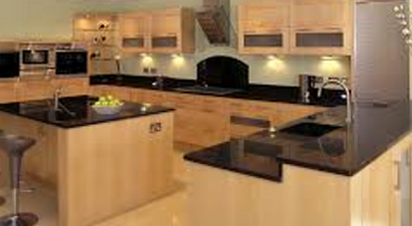
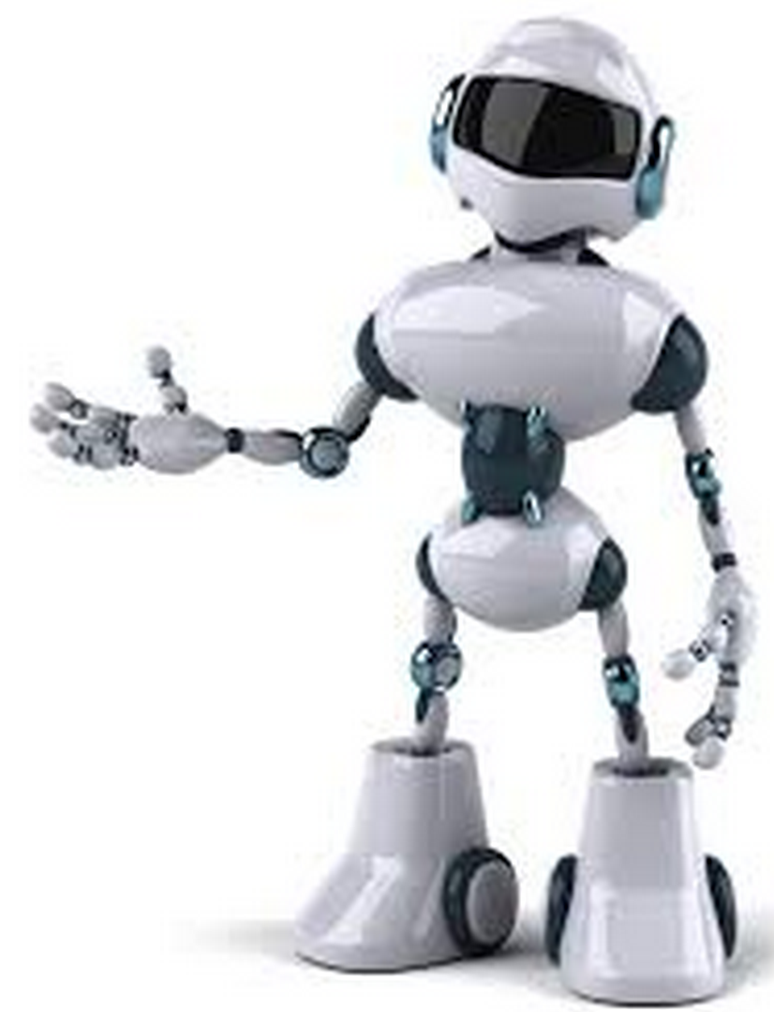
Plan-based Dialogue Theory
Agent’s actions are based on BDI: Belief, Desire & Intention
Dialogue participants are rational agents
Environment: kitchen
Participants: A and B
A is a robot that can move but is not familiar with the kitchen environment
B can not move but knows where everything is

Slide 6
Knowledge and wants
Knowledge – KNOW (B, P) B knows that P is true
Wants:
Participant: A
Participant: B
P1: teacup is in a cupboard
P2: teapot is on a countertop
P3: water is in the sink
etc
Make Tea

Slide 7
Plan construction & knowledge share
Participant: A
Participant: B
Goals
Goals
Plans
Plans:
Make tea
Boil water
find cattle
pour water
turn cattle on
Get a tea cup
locate cup
retrieve cup
Get a tea bag
locate
retrieve
Combine
Personal goals
Where is a tea cup?
Infer A’s goal/plan
(making tea)
Its in on the lower shelf in a
cupboard above the sink
Respond to A
Provide additional info
And the sugar is above it

Slide 8
Speech Acts
Utterances are actions that update dialogue context
A link between the mental states of agents and purposeful communication
Roots in Philosophy
Austin (1962), Searle (1975)
Effects of an utterance
Locutionary
Words that constitute an utterance
Illocutionary
Request (semantics and intent of an utterance)
Perlocutionary
Underlying intention, effect, pragmatics

Slide 9
Speech Acts
“Are there any Flights from Boston”
Effects of an utterance
Locutionary
Words that constitute an utterance
Illocutionary
Request information about Flights from Boston
Perlocutory
Effect: requesting a clerk to provide information

Slide 10
Speech Acts
Are used for planning in dialogue
A dialogue plan is dynamically constructed using
Agent goals
Agent knowledge
Speech act preconditions
Speech act effects

Slide 11
Common Speech Acts
Inform
Request
Response
Yes/No question

Slide 12
Common Speech Acts
Inform
Speaker (S), Hearer (H), Preposition (P)
Preconditions:
KNOW(S,P) and
WISH (S, P, H)
Effect:
KNOW(H,P)
Speaker informs the hearer of something by causing hearer to believe that the speaker wants them to know something

Slide 13
Why aren’t logic and plan‐based approaches used more today?
Most systems are simpler, single domain, limited task, don’t need complex reasoning
Focus on robustness/speed
Need to deal with uncertainty in input processing
Speech act theory is adapted for more structured (and limited) dialogue

Slide 14
Dialogue Annotation Schemes
Schemes for annotating dialogues
Used for :
building statistical models of dialogue
prediction of next dialogue act in a live system with a combination of features
from the current utterance
Previous utterances (dialogue history)
Observer system that analyses human dialogue
Can you think of examples?

Slide 15
Dialogue Annotation Schemes
Schemes for annotating dialogues
Used for :
building statistical models of dialogue
prediction of next dialogue act in a live system with a combination of features
from the current utterance
Previous utterances (dialogue history)
Observer system that analyses human dialogue
Meeting assistant
Dialogue summarization

Slide 16
DAMSL generic annotation schema
Dialogue Markup in Several Layers Core & Allen 1997
Addresses the problem with single label of speech acts
Because of multi-purpose nature of utterances
DAMSL uses 3 layers
Each utterance can have multiple labels
Speech Act
Inform-accept
Inform

Slide 17
DAMSL generic annotation schema
3-layer scheme
Forward communicative functions
Traditional speech act theory
Backward communicative function
How current utterance relates to the previous dialog
Accept/reject a proposal
Confirm understanding
Answer a question
Utterance Features
Communicative process vs subject

Slide 18
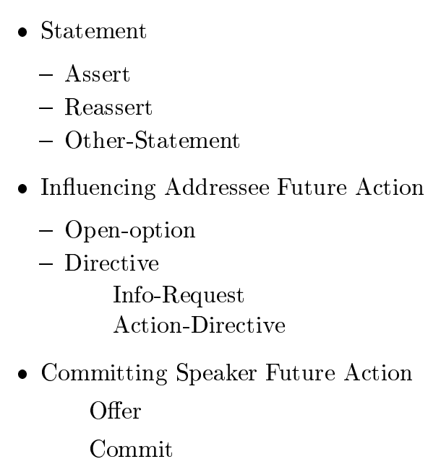
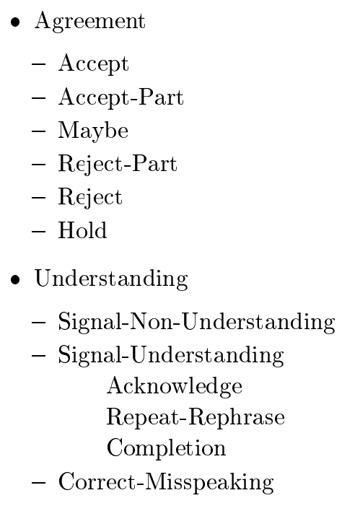
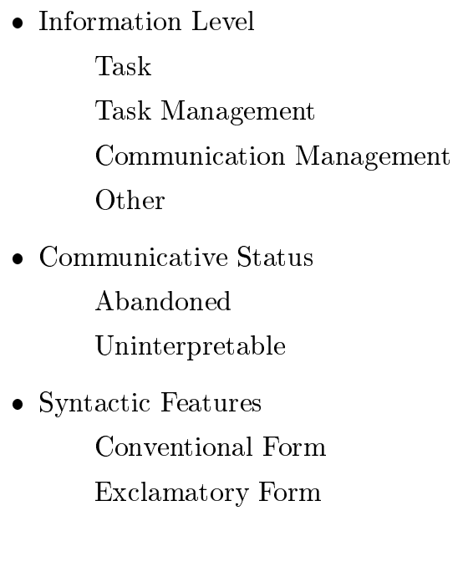
DAMSL scheme
Forward Functions
Backward Functions
Utterance Features

Slide 19
DAMSL scheme
Forward Functions
Backward Functions
Utterance Features

Slide 20
DAMSL example

Slide 21
Evaluation of Annotation Scheme
Do annotators agree on the tags?
Multiple annotators annotate the same dialogue and compare the agreement
Kappa Statistic to measure inter-annotator agreement (IAG)
PA = % agreement
PE = % expected agreement (depends on the number of possible tags)
.67 is considered reliably good

Slide 22
DAMSL scheme Kappa IAG
Forward Functions
Backward Functions
Utterance Features
.57
.60
.66
.70
.42
.15

Slide 23
Other generic annotation schemes
Carletta (1997)
H. Bunt (2013) – ISO standard
Motivated by all previous annotation schemes
Multifunctional (as DAMSL)
A: Henry, can you take us through these slides?
H: Oh Okay, just ordering my notes
A assigns the next turn to H
A formulates indirect request
Not limited to 3 dimensions:
Each utterance is labeled with
1 general purpose function
up to 9 dimension-specific functions

Slide 24
General function of DIT annotation scheme

Slide 25
General function of DIT annotation scheme
U: Who answered the door?

Slide 26
General function of DIT annotation scheme
U: Did Tom or Mary answer the door?

Slide 27
Dimensions of DIT scheme
Task
Feedback
Turn management
Time management
Discourse structuring
Social obligation management

Slide 28
Examples of dimension-specific annotations

Slide 29
How are annotation frameworks used?
Analysis of human dialogues (meetings, customer service dialogues with live agents, non-task-oriented dialogues)
Analyzing dialogue structure & building predictive models
Manual annotation of DA
Build automatic models to classify DA
Building models for SDS applications
Annotate user responses
Build predictive models for DA

Slide 30
Comments on generic annotation schemes
Generic schemes are designed to handle general (human) conversation
SDS scheme are simplified for application purposes
Application-specific DA schemes

Slide 31
Dialogue Management

Slide 32
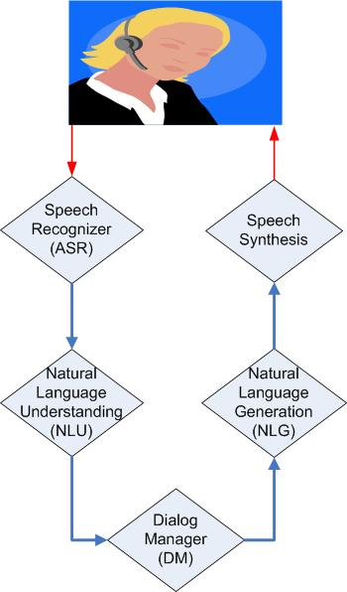
Dialog system components
Voice input
Speech
Language Model/Grammar
Acoustic model
Hypothesis (automatic
transcription)
Text
Generation templates/
rules
Grammar/Models
Logical form
of user’s input
Logical form
of system’s output

Slide 33
Dialogue Manager (DM)
Is a “brain” of an SDS
Decides on the next system action/dialogue contribution
SDS module concerned with dialogue modeling

Slide 34
Dialogue Management
Address how SDS is implemented
Reusability of components
Approaches:
Frame-based approach (structural)
Information State approach (Traum & Larsson 2003)

Slide 35
Information State Approach
Formalizes theories of dialogue
Speech act
Combines different theoretical approaches to SDS
Planning (more flexible and complex)
Structural (simple scripted dialogues)
Leads to better engineering of SDS components
Separate development of modules
Facilitates reuse of components

Slide 36
ISU Architecture

Slide 37
Information State DM
Formalize DM function as Information State Update
Identify relevant aspects of information
How are they updated
What controls this updates
Dialogue context
Current state of the system including
Known information
Role of DM
Update dialogue context
Provide context-dependent expectations
Interface with task/domain processing
Decide what context to express next

Slide 38
Information state
Private:
Belief set
Agenda: stack of actions
Shared:
Belief set
QUD: stack of questions
LM: move

Slide 39
Declarative representation of system behavior
SDS designer writes update rules

Slide 40
Discussion questions for Traum& Larsson paper
Do the dialogue moves and update rules have to be tailored for each specific?
The authors mention that information state-based theory of dialogue includes informational components, such as common ground, beliefs, intentions, etc. How are these concepts extracted, and then represented in this approach?

Slide 41
SDS Trends
1966 Eliza – string pattern match DM
1970 – 2000: Plan-based systems, Speech act theories
2000 – 2010: Information State Update, Frame-based SDS (Communicator DARPA project)
2010 – 2014: Using web as data source, template-based DM, virtual assistants on phones (Siri, Cortana, Google Now), in-car SDS
2015 using inference engines on the back-end (
What’s next?

Slide 42
Presentations
**David Traum and Staffan Larsson, The Information State Approach to Dialogue Management. in Current and New Directions in Discourse and Dialogue, Ed. Jan van Kuppevelt and Ronnie Smith, Kluwer, pages 325--353, 2003.
Discussion papers:
Ben Hixon, Rebecca Passonneau Open Dialogue Management for Relational Databases NAACL 2013
Presenter: Jee Hyun Wang
Pierre Lison. Model-based Bayesian Reinforcement Learning for Dialogue Management. In Proceedings of the 14th International Conference of the Speech Communication Association (Interspeech 2013), Lyon, France, 2013. Presenter: Edward Li

Slide 43
Find Project Partner
2/16 Find a project partner
2/23 Project descriptions due
Considerations when finding partners:
What is your focus (system vs. research question)
Which topics
Goals to submit a paper

