Slide 1
GOBLAN A Graphical Object Language
Yunsung Kim, Sean Garvey, Sameer Lal, Jee Hyun Wang

Slide 2
Table of Contents
Graph Programming in Conventional Languages
Graph Programming in GOBLAN
What is “Message Passing?”
Strength of GOBLAN
Structure of GOBLAN
Demo

Slide 3
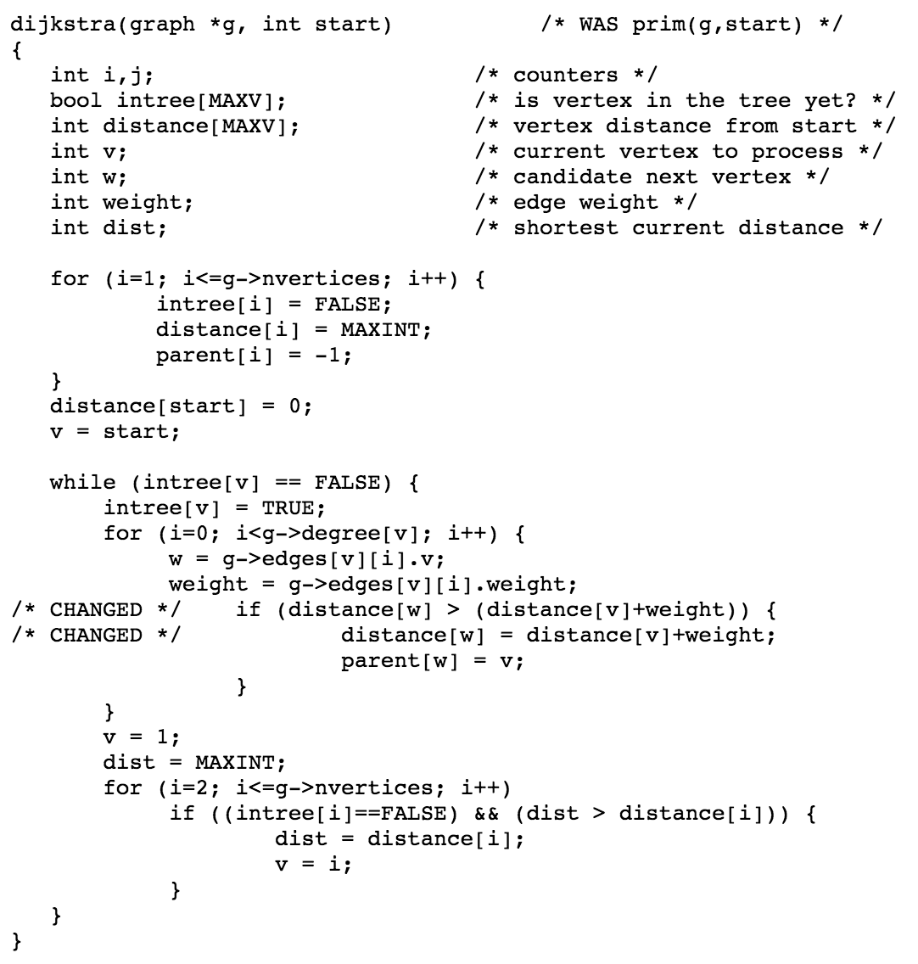
Graph Programming in Conventional Languages
Conventional Languages implementation of graph programming
Can be tedious, time consuming
Usually try to manipulate the graph as a whole, by using lists and arrays, and many loops.

Slide 4
Graph Programming in GOBLAN
Domain specific language for constructing and manipulating complex structured graphs
Introduces a new paradigm of graph programming
Message Passing
Enables the communication between individual nodes

Slide 5
Message Passing
Algorithms consists of two parts
1) Communicating data between nodes through messages
2) Processing messages to update current node data
Many graph algorithms fall into the paradigm of message passing
node_1
msg
node_2

Slide 6
Message Passing
1
Tree search
Q: Where is ?
2
3
4
5
6
8
7
9

Slide 7
Message Passing
Tree search
1
Query
Q: Where is ?
Query
Query
2
3
1. Receive message
4
5
6
8
7
9

Slide 8
Message Passing
Tree search
1
Q: Where is ?
2
Query
“Do I have ?”
3
2. Process message
4
5
6
8
7
9

Slide 9
Message Passing
Tree search
1
Q: Where is ?
“I'm 3 and
I have !”
2
Query
3
3. Pass message
4
5
6
8
7
9

Slide 10
Message Passing
1. 1→3
Tree search
1
Q: Where is ?
2
3
3. Pass message
Query
Query
Query
Query
Query
4
5
6
8
Query
7
9

Slide 11
Message Passing
1. 1→3
Tree search
1
Q: Where is ?
2
3
1. Receive message
“I'm 3 and
I have !”
4
5
6
8
Query
7
9

Slide 12
Message Passing
1. 1→3
Tree search
1
Q: Where is ?
2
1. 3→7
3
2. Process message
4
5
6
8
Query
7
9

Slide 13
Message Passing
1. 1→3
2. 1→3→7
Tree search
1
Q: Where is ?
“3→7”
2
1. 3→7
3
3. Pass message
4
5
6
8
Query
7
9

Slide 14
Strength of GOBLAN
Intuitive node declaration
Object function:
run { node } ( arg1, arg2, …. )
Message passing:
pass pkt -> chld
Graph construction:
new graph(node:A)[|…|]

Slide 15
Strength of GOBLAN
Intuitive node declaration
node:NodeType {
data {
/* data specification */
}
edge {
/* edge attribute specification */
}
pack {
/* message attribute specification */
}
type do (type arg1, type arg2, ...) {
/* asynchronous function definition
(Can be called anywhere in the program) */
}
catch {
/* synchronous function definition
(Invoked upon receiving a message) */
}
}

Slide 16
Strength of GOBLAN
Object function: run { node } ( arg1, arg2, …. )
Asynchronous object function
Allows simple invocation of graph algorithms
Invoked anywhere in the program

Slide 17
Strength of GOBLAN
Message passing: pass pkt -> chld
Simple keyword : chld | prnt |prnt_chld | chld_prnt
High level encapsulation of intricate recursion

Slide 18
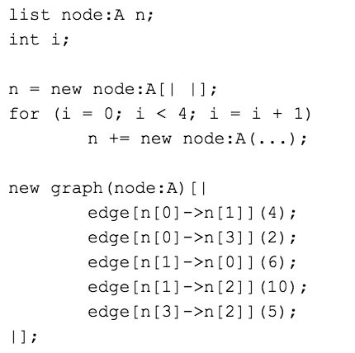
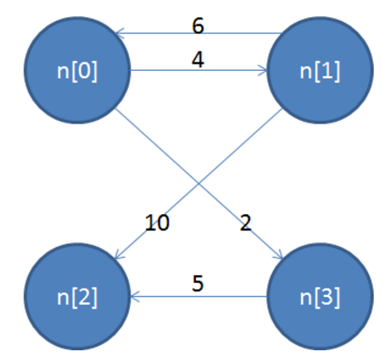
Strength of GOBLAN
Graph construction: new graph(node:A)[|…|]
Interconnecting nodes through
statements that are easy to understand

Slide 19
Structure of GOBLAN
How graphs are represented
N₁
…
chld
prnt
…
ID
edge
N2
N1
edge
N₂
edge
ID
chld
…
prnt
…

Slide 20
Structure of GOBLAN (compiling)
Lexer
Parser
AST
Semantics
List.bc
List.c
Code Generation
SAST
executable
clang
LLVM-LINK

Slide 21
DEMO
Dijkstra's algorithm
Tree Search

Slide 22
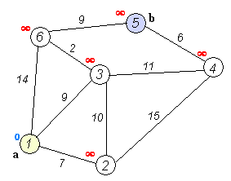
DEMO
Dijkstra's algorithm

Slide 23
DEMO
Tree Search
0
Id: 0
Data: 0
1
Id: 1
Data: 1
2
Id: 2
Data: 2
3
Id: 3
Data: 3
4
5
6
7
8
9
10
Id: 4
Data: 0
Id: 5
Data: 1
Id: 6
Data: 2
Id: 7
Data: 3
Id: 8
Data: 0
Id: 9
Data: 1
Id: 10
Data: 1

