Slide 1
What Change History Tells Us about Thread Synchronization
Rui Gu, Guoliang Jin, Linhai Song, Linjie Zhu, Shan Lu
University of Wisconsin – Madison, USA
Notes:
Okay, let’s get started. My name is Ray Gu. I’d like to present our work about “What change history tells us about thread synchronization”. This is a joint work with my previous phd colleges and Prof. Shan Lu when we were all at University of Wisconsin – Madison, USA .

Slide 2
Proper Thread Synchronization is Hard
Very easy to get things wrong
Hard-to-find concurrency bugs(Data race, Atomicity Violation, Dead Lock)
Hard to debug
Enforce complex thread scheduling between threads(GDB, LLDB)
Unexpected performance degradation
Lock Contention
Notes:
Threading is a powerful tool, which allows us to do things that were extremely difficult without it. However, sometimes, threads are just too difficult for normal, real-world developers. They introduce too many opportunities for developers to have obscure bugs which are hard to reproduce, to find, and to fix. For example, concurrency bugs like Data race, Atomicity Violation and deadlock are notoriously difficult to diagnose. Manually enforcing the buggy thread scheduling in general debuggers are also tedious. Moreover, threading could also cause unexpected performance degradation, for instance, lock contention.

Slide 3
Information Beyond Bug Reports
Unreported bugs, optimizations
Small but non-trivial concurrency bugs
Synchronization related performance optimizations(premature, mature?)
Scattered information throughout revision history
How is a concurrency bug introduced? Are those locks needed when the synchronization body is created?
Hidden trending information
Is synchronization problems(correctness, performance) getting worse when software evolves?
Do critical sections more likely to be modified when it ages?
Notes:
When people try to understand real-world synchronization related issues, they always seek the help of bug reports from bug databases. However, a lot of information is buried within the repositories and thus never get reported. For instance, in mysql, many small but non-trivial concurrency bugs are fixed without creating an official bug report. There are also many synchronization related performance optimizations done without report. Those changes could be either premature or mature. Some important information is scattered through revision history. For example, how a concurrency bug is introduced? Is the lock necessary when the synchronization body is first created? Furthermore, many trending information is also hidden within the code repository. For example, answers to questions like Is synchronization problems getting worse when software ages? Do critical sections more likely to be modified when software gets old?

Slide 4
Key Questions
How often synchronization is an afterthought for developers?
How many critical section related changes throughout software history? Why did developers make these changes?
Is synchronization related problem(correctness, performance) getting worse when software evolves?
Is over-synchronization a real problem?
How software changes lead to synchronization-related correctness problems(Concurrency Bugs)?
Notes:
The following is some key questions that motivates our study. Including, Blablabla. All of these questions can’t be answered by purely looking at bug databases.

Slide 5
Impact
Previous studies have looked at bug databases only. But not all the information can be obtained from bug databases.
Better understanding of synchronization issues faced by real-world developers is highly needed.
New Language Features – Place Holder
Analysis Tools – Efficient Race Detection
Run-time System – Place Holder
Code Development Tools – Synchronization Adjustment
Notes:
So, in order to understand what synchronization issues do we face, previous studies have looked at bug databases only. However, as we mentioned in the previous slides, not all the information can be obtained from bug database. A better understanding of synchronization issues can guide both research and software development in many aspects including new language features, analysis tools, run-time system and code development tools.

Slide 6
Overview
An empirical study on:
Critical Section Evolution
Over Synchronizations
Concurrency Bug Origins
Notes:
In this paper, we study the code repositories of open-source multi-threaded projects to obtain a broad and in-depth view of how developers handle synchronizations. We particularly focused on 3 parts, which are how critical sections evolve during the code history, over synchronization issues and how concurrency bugs are introduced.

Slide 7
Difficulties Encountered
Large revision numbers(8 - 19 years)
Apache - 26,000, Mozilla Firefox - 180,000, ...
Different kinds of synchronization primitives
Different kinds of Mutex Locks, Condition Variables
Different kinds of synchronization primitive changes
Critical Section Getting Larger, Smaller, Synchronization Type Change, Synchronization Variable Change etc.
Notes:
We’ve faced many difficulties during our study. The first one is the large number of revision history. Apache contains 26,000 revisions and Mozilla contains more than 180,000 revisions. Since we need to analyze every single change that is related to critical section, it could take days if the tools are designed badly. The second challenge is that there are many types of synchronization primitives. Even though they are C/C++ programs, we cannot only look at pthread synchronization primitives. Almost every application we analyzed more or less uses their own synchronization implementation. For example, apache use their apr library, firefox uses autolocks and mysql use their own synchronization library too. The third challenge we faced is there are many types of modifications to synchronization primitives. A critical section can grow larger, smaller or even get splitted. The synchronization primitive type could change. The synchronization variable change.

Slide 8
Contribution
Comprehensive empirical study on how lock-protected critical sections are changed when software evolves.
Detailed case study on over-synchronization issues.
Detailed case study on how concurrency bugs are introduced.
Notes:
After tackling with those difficulties. We made the following contribution. The first one is a comprehensive empirical study on how lock-protected critical sections are changed when software evolves. The second one is a detailed case study on over-synchronization issues. Over synchronization issues are caused by unnecessary synchronization that will degrades execution performance. The third one is a detailed case study on how concurrency bugs are introduced.

Slide 9
Methodology for Critical Section Study
4 representative C/C++ open source projects
Hierarchical taxonomy for all critical section changes
Regular-expression based Python scripts for structural patterns
Manual study on 500+ cases found by the scripts for purpose patterns
Notes:
Okay, we’re now going to talk about our first part, the evolution of critical sections. We’ve studied 4 representative C/C++ open source projects that have sufficient repository history. During our study, we have designed a hierarchical taxonomy for critical section changes with two dimensions. The first one is critical section change structural patterns. The second dimension is critical section change purpose patterns. Accurate structural change pattern categorization requires inter-procedural, control-flow and pointer-alias analysis, which unfortunately cannot scale to large code repositories. We use regular expression based python scripts to find how critical sections changed between revisions. Because it offers the best balance between complexity and accuracy. After we find the changes, we do manual studies on more than 500 cases to understand the change purpose behind them.

Slide 10
Software
4 representative C/C++ open-source software projects including data base, web server, web browser, media player
Applications | Period | # of Revisions | Latest Version Size(LoC)
Apache Web Server | 1996 - 2014 | 25897 | 258K
Mozilla Browser | 2007 - 2014 | 188000 | 8.17M
MPlayer Media Player | 2001 - 2014 | 37000 | 448K
MySQL Database | 2000 - 2014 | 6800 | 3.91M
Notes:
These are the 4 C/C++ applications we’ve studied. Apache httpd, Mozilla firefox, Mplayer and MySQL-server. They are all large and mature open-source software projects under active development. Their types cover database, web server, web browser and media player. Their repository period ranges from 8 years to 14 years. For the size of code base, in their version at the end of 2014, the range is from 258 thousand lines of code to 3.91 million lines of code.

Slide 11
Critical Section Change Structural Patterns
Adding critical sections:
Add Synchronization
/* Empty the accept queue of completion contexts */ + apr_lock_acquire(qlock); while (qhead) { CloseHandle(qhead->Overlapped.hEvent); closesocket(qhead->accept_socket); qhead = qhead->next; } + apr_lock_release(qlock);
Add All
+ pthread_mutex_lock(&rli->log_space_lock);
+ rli->log_space_total -= rli->relay_log_pos;
+ pthread_mutex_unlock(&rli->log_space_lock);
Notes:
We’ve summarized the following critical section change structural patterns. The first one is add synchronization. By saying add, we mean all or part of the synchronization body is not protected by any locks. After the change, a lock had been put around them. The second type is add all. It means both the synchronization body and the synchronization primitive is added in this revision.

Slide 12
Critical Section Change Structural Patterns
Removing critical sections:
Remove Synchronization
- pthread_mutex_lock(&THR_LOCK_keycache);
+ /* pthread_mutex_lock(&THR_LOCK_keycache); */
pthread_mutex_lock(&LOCK_status);
for (i=0; variables[i].name; i++) {
…
pthread_mutex_unlock(&LOCK_status);
- pthread_mutex_unlock(&THR_LOCK_keycache);
+ /* pthread_mutex_unlock(&THR_LOCK_keycache); */
Remove All
wait_for_refresh(thd);
}
- pthread_mutex_lock(&thd->mysys_var->mutex);
- thd->mysys_var->current_mutex=0;
- thd->mysys_var->current_cond=0;
- pthread_mutex_unlock(&thd->mysys_var->mutex);
return result;
}
Notes:
The third type is Remove synchronization. It means in the revision, the synchronization primitive, lock, is removed, but part or all the synchronization body still remains. The fourth type is remove all. It means during the revision, both the synchronization body and the synchronization primitive are being removed.

Slide 13
Critical Section Change Structural Patterns
Modifying existing critical sections
Modify Body
Modify Synchronization(Variable, Primitive, Boundary, Split, Unlock)
- VOID(pthread_mutex_lock(&hostname_cache->lock));
+ VOID(pthread_mutex_lock(&LOCK_hostname));
if (!(hp=gethostbyaddr((char*) in,sizeof(*in), AF_INET))) {
- VOID(pthread_mutex_unlock(&hostname_cache->lock));
+ VOID(pthread_mutex_unlock(&LOCK_hostname));
DBUG_PRINT("error",("gethostbyaddr returned %d",errno)); goto err; }
Notes:
The fifth one is modify body. It means the synchronization primitives around the synchronization body doesn’t change at all. Only the code within has been changed. The last type of change is modify synchronization. It contains modifying the synchronization primitive type, synchronization variable, synchronization boundary and so on. This is an example shows how real-world developers change the lock variable of a critical section.

Slide 14
Observations
 | Apache | Mozilla | MPlayer | MySQL
Add | 138 | 227 | 65 | 1548
Rem | 199 | 272 | 59 | 1411
Mod | 467 | 204 | 33 | 4301
Total # | 804 | 703 | 157 | 7260
 | Add | Rem | Mod
Percentage | 22% | 21% | 56%
Notes:
We had many interesting observations during our study. The first finding is a summarization of all the changes. The total number of changes ranges from 157 in Mplayer to 7260 in MySQL. The number of the three major patterns, Add, remove and modification is showed in this table.
Use a normalized pie chart to replace. Emphasize the trend.

Slide 15
Observations
Notes:
This picture shows a detailed break down of the changes. The ratio between Add-All and Add-Sync is 3:1 to 4:1 across all the applications. Meaning that roughly 25% percent of the locks are added after the body is created. We’ve randomly sampled 30 cases of add sync. Among these cases
24 / 30 : Developers forget to add the locks
6 / 30 : The locks are not needed when the body is first introduced
We only want add-all, add-sync.

Slide 16
Observations
How many changes for each critical section?
 | Apache | Mozilla | MPlayer | MySQL
Mod-Body | 196 | 139 | 23 | 932
Mod-Sync | 93 | 15 | 9 | 640
Total | 261 | 149 | 23 | 1173
 | Mod-Body | Mod-Sync
Percentage | 80% | 50%
Notes:
We’ve talked about the result representing synchronization changes. What about for each critical section, how many changes and what kind of changes did they go through? This table shows the number of critical sections with specific modifications. The data shows that 80% of the critical sections have gone through body modifications at least once. Half of the critical sections have gone through synchronization primitive change at least once.
Use pie chart.
Do mention the percentage and put it on the slides.

Slide 17
Observations
Notes:
This picture shows a detailed break down of the Mod sync category of previous picture. Modification to the body code still counts the most. Changing synchronization primitives and variables affects 25% of all the critical sections. Adjusting lock and unlock locations (Mod Sync Split, Mod Sync Boundary, Mod Sync Unlock) accounts for 40% of all CS modifications and affects ¼ of all CSes.

Slide 18
Observations
Critical section change number
Line of code change number
MySQL
Notes:
Now let’s focus on two trending questions. When did those critical section changes happen? Are Synchronization Problems Getting Harder or Easier with Software Evolving?
To answer these two questions, we made the following graphs. The x-axis shows the month started from the creation of the repository. The left y-axis shows the number of critical section changes. The right y-axis shows the line of code changes. The black dotted line shows how many line of code changes along with time and the red solid line shows how many critical section changes along with the time. The statistical data shows that these two lines are highly correlated. And there is no indication shows that people are less likely to make critical section related changes when software gets old. Thus, no sign of getting worse of easier

Slide 19
Critical Section Change Purpose Patterns
Purpose | Patterns
Correctness | Fixing functional bugs
Functionality | Adding or changing code functionality
Maintainability | Code refactoring
Performance | Improving performance
Robustness | Adding sanity checks, logs.
Notes:
Now, let’s move on to our second dimension, critical section change purpose patterns. We’ve summarized 5 purpose behind the critical section modifications. The first one is correctness. It means that developers made those changes aiming at fixing bugs. The second purpose is functionality. It covers all the changes of adding or changing code functionality. The 3rd one is maintainability, basically code refactoring change. The 4th one is performance. Those changes are purely aiming at improving performance. The last one is robustness. Changes like adding sanity checks, logs.

Slide 20
Observations
Notes:
In order to understand why developers made this critical section changes, we randomly sampled 200 cases, 50 per each application to find the reasons behind this. This picture shows the break down.
As we can see, correctness fixes, functionality changes and code refactoring are almost equally common, each leading to about 25% of all changes. Performance purpose contributes to roughly 10% of the cases.
Remove the 60 x-axis.

Slide 21
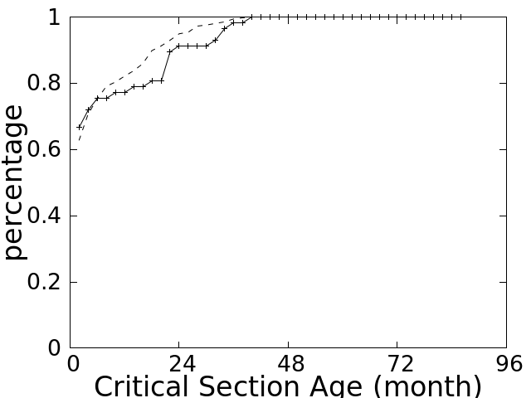
Observations
Mozilla

Slide 22
Over Synchronization Study
What is over synchronization?
Unnecessary synchronizations that will cause performance degradation
Why do we care about it?
Performance considerations
Code maintenance considerations
Notes:
Now, we’ll move on to over synchronization issues. By saying over synchronization, we mean those facts that some code snippet may not quite need to be protected by locks or can be protected by some finer granularity locks. Developers care about this because it might be the root cause of lock contention and sometimes, it’s hard to maintain.

Slide 23
Methodology and Threats to Validity
Randomly picked up 20 cases from Mod Sync Variable, Mod Sync Split, Mod Sync Boundary that fix/relieve over synchronization issues.
They do not cover all over-synchronization issues fixed by these three types of changes nor other over-synchronization issues fixed by other changes.
Notes:
In order to take a look into these issues, we randomly pick 20 cases from Mod…, that fix/relieve over synchronization issues. Note that they do not cover all over-synchronization issues fixed by these three types of changes nor other over-synchronization issues fixed by other changes. The most common two ways of doing it are changing synchronization variables and changing synchronization primitive types. For example, changing mutex lock to read-write locks.

Slide 24
Observations
+static pthread_mutex_t LOCK_hostname;
...
DBUG_RETURN(0); // out of memory
#else
- VOID(pthread_mutex_lock(&hostname_cache->lock));
+ VOID(pthread_mutex_lock(&LOCK_hostname));
if (!(hp=gethostbyaddr((char*) in,sizeof(*in), AF_INET)))
{
- VOID(pthread_mutex_unlock(&hostname_cache->lock));
+ VOID(pthread_mutex_unlock(&LOCK_hostname));
DBUG_PRINT("error",("gethostbyaddr returned %d",errno));
goto err;
}
Notes:
This is one case of showing how developers change the lock variable. In this case, developers use the newly decleared LOCK_hostname to replace the original locks. For all the critical sections protected by hostname_cache->lock, only part of them are replaced by the new lock.

Slide 25
Observations
Where to Apply the Changes?
Critical sections with highly contended locks
How to Conduct Mod Sync Variable?
Select a new lock
Replace locks with existing ones
Among 11 cases under study, original locks are replaced by new ones
Notes:
Based on our observation, we find out that these changes usually applied to those critical sections with highly contented locks. The commit log shows that developers believe the fix will have a positive effect on the performance. Changing lock variable mainly involve two challenges, selecting a new lock and finding all critical sections that need lock-variable replacement. 11 out of 20 cases fall into this category. All these cases are replaced by a brand-new lock which is newly declared and introduced into the software in the corresponding revision. Finding all critical sections that need lock-variable replacement is error prone. There is a case that apache-httpd took 4 revisions to finally finish all the needed replacement.

Slide 26
Concurrency Bug Origins

Slide 27
Methodology and Threats to Validity
Manual studies on 40 bugs from two bug sources:
Bug Source One:
28 real-world concurrency bugs coming from more than 10widely used C/C++ software projects, repeated and evaluated in 12 recent concurrency-bug related papers.
Bug Source Two:
12 randomly sampled concurrency bugs from our critical-section change study.
Notes:
Now, we’ll talk about our last part, the manual study on how concurrency bugs are introduced. We’ve studied 28 real-world concurrency bugs from more than 10 widely used C/C++ projects. They’re all relatedly evaluated in 4 recent concurrency bug papers. We believe using these thoroughly studied bugs will make our understanding more solid.
In order to add some diversity, the second bug source is 12 randomly sampled concurrency bugs from our critical section change study.

Slide 28
Taxonomy
Our categorization is based on three key ingredients:
Shared variables
Instructions that accessing these shared variables
Synchronization contexts(surrounding locks, preceding barriers)
Notes:
We first summarized 4 categories of how concurrency bugs are introduced. Our categorization based on 3 key ingredients. Shared variables, instruction that accesses these shared variables and synchronization contexts. By saying synchronization contexts, we mean the surrounding locks or preceding barriers. Among the 40 bugs that we studied, 15 have unknown origins, as they exist in the first publicly available version of their respective projects.

Slide 29
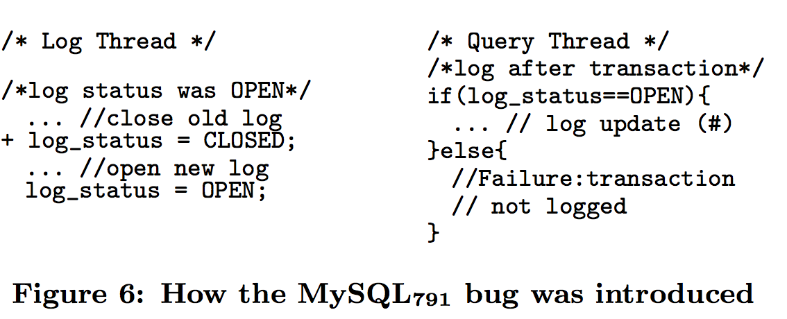
Observations
Categorization of how concurrency bugs are introduced:
Type 1: One Thread, New Instructions in Old Context
Type 2: One Thread, New Instructions in New Context
Notes:
The first type is introduced by changes in a single thread, where some new memory instructions are inserted in old synchronization contexts. In this example, there is a new instruction inserted in the log thread. Thus, query thread will read a temporary value of log_status that will cause the transaction not being logged.
The second type is the buggy revision introduces a new code region with a new synchronization context, which is not well synchronized with some old code in another thread. This type is very straightforward, for example, the new thread accesses shared variables without using the proper lock used by old threads.

Slide 30
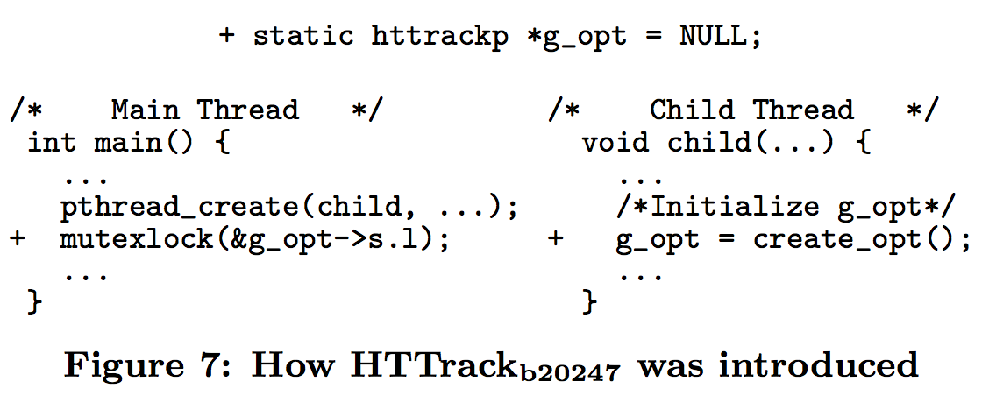
Observations
Categorization of how concurrency bugs are introduced:
Type 3: Multiple Threads, New Variables Accessed in Old Contexts
Type 4: Multiple Threads, New Instructions in New Contexts
Notes:
The third type is that there exist two code regions r1 and r2 that can execute concurrently in old version. The buggy revision introduces a new variable accessed by both regions. The lack of synchronization between these two regions leads to concurrency bugs. In the above example, concurrent accesses to variable g_opt cause a new shared variable to be read before initialization.
The fourth type is basically happens when revision introduces new multi-threaded components into software or significant re-implementation for many threads. Thus, both the contexts and shared variables are newly created. The lack of proper synchronization between them will introduce concurrency bugs.

Slide 31
Discussion
Understanding how concurrency bugs are introduced can helps us in:
Improving the performance and accuracy of existing concurrency-bug analysis techniques
Synchronization analysis
Memory-access analysis
Concurrency Bug Prevention
Notes:
Over half of these bugs are introduced under old-synchronization contexts that are completely unchanged by bug-introducing revisions. This indicates that synchronization analysis can be greatly simplified in concurrency-bug detection and testing when code history information is available. Also half of these bugs only involve shared variables and memory access instructions that are newly introduced by the bug introducing revision. This indicates that memory-access analysis can also be greatly simplified when the code history is available. Our understanding of how concurrency bugs are introduced have the following impacts, 1.

Slide 32
Conclusions
Notes:
To conclude, our paper studies code repositories to understand synchronization challenges encountered by real-world developers. We first check 250,000 code revisions of 4 representative software projects to figure out how many critical section related changes are there and the reason behind them. We then conduct thorough case studies to better understand how concurrency bugs are introduced by code changes and how developers handle over-synchronization problems. Our finding provides insights and and motivation for future research on tackling synchronization problems. Now the time is left for questions.

