Slide 1
Coding, Language and Society
Girls Who Code
Noura Farra

Slide 2
Introducing Myself
I am a PhD student in computer science
I grew up in Lebanon, where I studied computer engineering
I was more interested in the human and social applications of technology
Notes:
I enjoyed computer engineering, although my real interest was in the human applications. When you talk about human-related and society related work, people think of doctors or lawyers or teachers, they don’t think of engineers, they don’t think of computers. But computers, and coding can have a really important role in applications to society, and today I just want to talk about some of them, those that are related to language. Using computers to process language written by people.
Can anyone think of ways we use computers to process language?

Slide 3
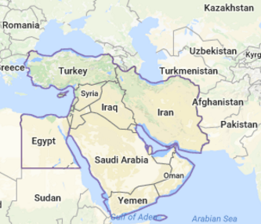
Introducing Myself
I am a PhD student in computer science
I grew up in Lebanon, where I studied computer engineering
I was more interested in the human and social applications of technology
Notes:
I enjoyed computer engineering, although my real interest was in the human applications. When you talk about human-related and society related work, people think of doctors or lawyers or teachers, they don’t think of engineers, they don’t think of computers. But computers, and coding can have a really important role in applications to society, and today I just want to talk about some of them, those that are related to language. Using computers to process language written by people.
Can anyone think of ways we use computers to process language?

Slide 4
Code that Processes Language…

Slide 5
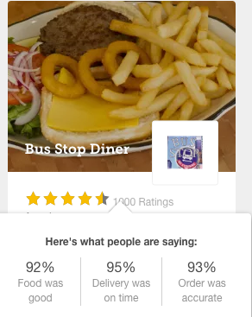
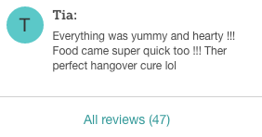
Code that Processes Language…
Notes:
How do they do that? They don’t have people go through all the reviews and find out exactly what they like and don’t like do they? They have a code that automatically reads the reviews and finds out what people like and don’t like.

Slide 6
Code that Processes Language…
Predicting the next word!
Notes:
Have you tried this in Google?
How do you think Google predicts the search phrase?

Slide 7
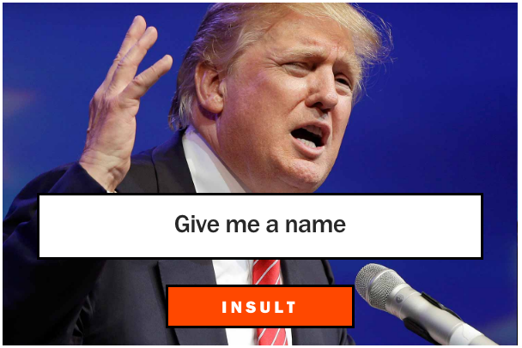
Code that Processes Language…
Notes:
And a lot more! Siri, Facebook, Twitter trending topics, Amazon, Watsapp, Robots… !

Slide 8
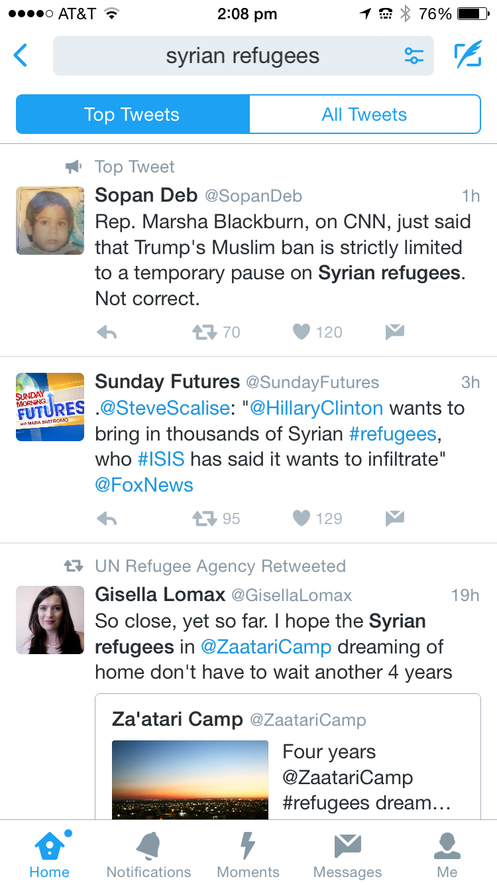
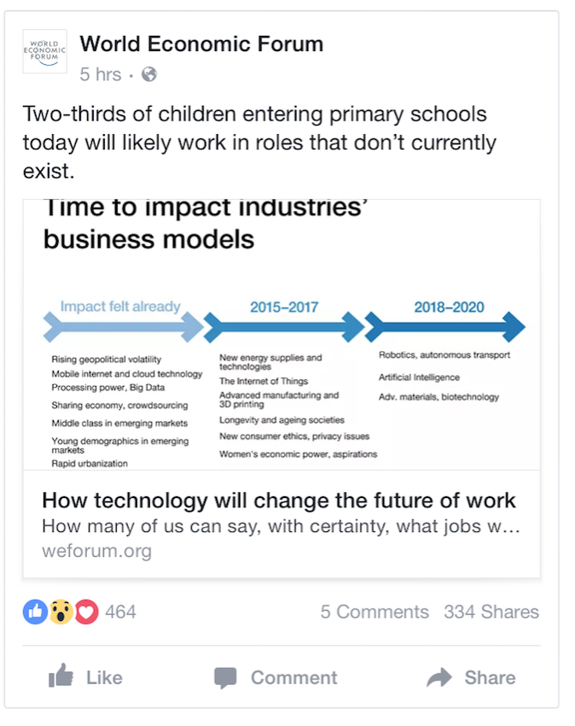
Language and our society
Notes:
A lot of our interactions in society today are online, because of social media. And we can learn a lot by studying people’s interactions online, their opinions, their feelings, understand what’s going on with people around the world, what’s bothering them, what are the issues they’re talking about.
People’s opinions are everywhere, and we can learn a lot by studying them.
There is a lot going on that can be captured and processed by studying language (e.g Facebook, Twitter), and as you can see each person has a different opinion

Slide 9
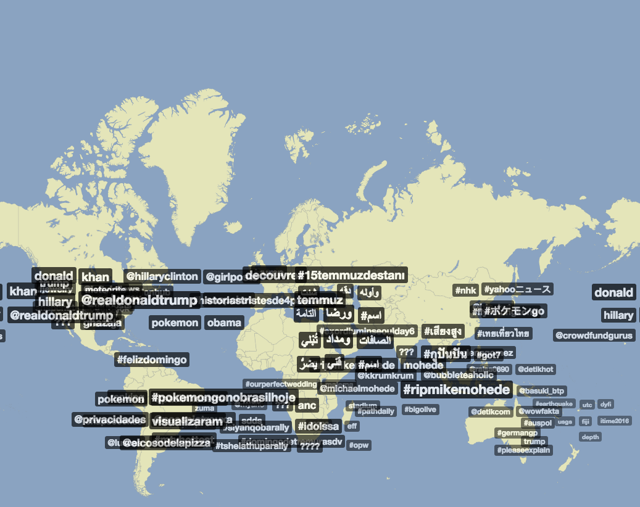
Language and our society
What languages do you see?
Notes:
This is a map of Twitter topics trending around the word. This map was also generated by analyzing language.
Do you see any familiar topics?

Slide 10
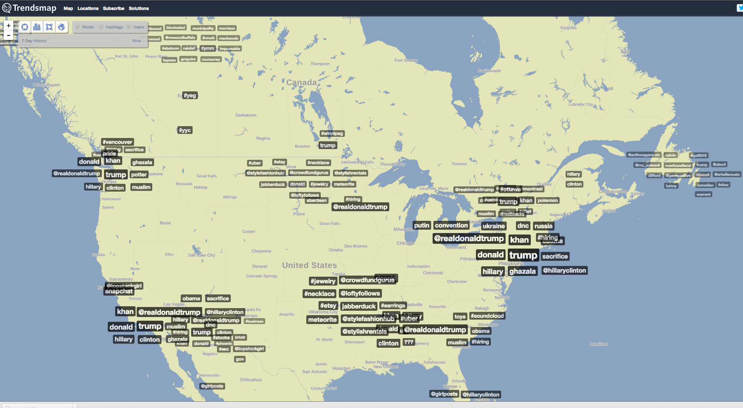
Language and our society
Notes:
This is a map of Twitter topics trending around the word, it is a screenshot taken yesterday. This map was also generated by analyzing language.
Do you see any familiar topics?

Slide 11
Learning people’s opinions around the world
Imagine we can collect people’s online posts and their frustrations from around the world and use it try to understand how to make their lives better…
Syrian people: positive
Dictator regime: negative
Our nation: positive
Notes:
Let me tell you a little bit about what I’m working on now.
So here is what I do, I write code that takes a text, it can be a blog, Facebook comment, post, and such, and it has to be opinionated (people are expressing their feelings) and the code identifies automatically what are the topics, or targets, that this person is talking about, and the sentiment towards each. Because people can write and be positive about one thing and negative about another.
So this person is writing about how the country is losing a lot of its people especially doctors, engineers, philosophers, because they are leaving the country due to the dictator regime
I wrote this code that reads a text in Arabic and finds what are the topics that the writer is positive or negative about.
http://worldsayswhat.com/wp-content/uploads/2015/07/world-1.jpg
Maybe a better pic with countries

Slide 12
Learning people’s opinions around the world
Hungarian
Ma Jeruzsálemben az izraeli biztonsági erők megtiltották a 45 éven aluli palesztinok számára, hogy az al-Aqsa mecsetben imádkozzanak
Thai
Amharic
ขณะที่ทีมเยือนได้จาก โยฮัน มิกูด์ นาที 32 กับ วาเลเรียง อิสมาเอล จุดโทษนาที 58 ทำให้ ลี ยง เข้ารอบด้วยประตูรวม
ባለፈው ረቡዕ ኢትዮጵያ ባቀረበችው አቤቱታ ኤርትራ በሠሜን ኢትዮጵያ በሚገኙ የኢንዱስትሪና የታሪካዊ ሥፍራዎች ላይ ጥቃት ለማድረስ እቅድ እንዳለት አመልክታለች ሲል የአፍሪካ ዜና አገልግሎት ጅ5 ገለጠ።
Notes:
We are working on understanding what people are saying around the world during natural disasters and political crisis, so we can respond to them. This is part of the low resource language project.
Hungarian translation:
Today in Jerusalem, the Israeli security forces forbade the Palestinians under the age of 45 to the al-Aqsa mosque to pray
Thai translation:
K̄hṇa thī̀ thīm yeụ̄xn dị̂ cāk yo ḥạn mi kūd̒ nāthī 32 kạb wā le reīyng xis̄ mā xel cud thos̄ʹ nāthī 58 thảh̄ı̂ lī yng k̄hêārxb d̂wy pratū rwm
The team from Johannes Miguel at 32 minutes with Wales by Ismael 58th minute penalty gave Lyon a finalist door.
Amharic translation:
Last Wednesday, saying Africa, Ethiopia, Eritrea āmelikitelechi her own complaint with the plan to attack the northern industrial and historical sites in Ethiopia News Agency G5 revealed.
… and many more

Slide 13
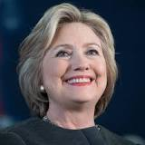
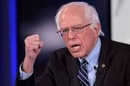
My Google internship!
Voter guide for presidential candidates
Which one of them shares my views about healthcare? About women’s rights ?
Notes:
I was *involved* in the voter guide. I worked on the issue quotes part.
This is what I worked on during Google. Let’s say I want to find out more information about a candidate so that I can know who to vote for. So we can search for the political issue we are interested in and see what the candidate thinks about the issue?

Slide 14
Grading essays!
Do you agree or disagree with the following statement? It is important to know about events happening in the world, even if it is unlikely that they will affect your daily life. Use specific reasons and examples to support your answer.
Opinion
Predict Essay Scores
Human-Score Correlation?
Topics
Opinion-Targets
Notes:
Have you had such essay questions before?
So we basically developed an automatic system that processes the language in the essay and predicts a score for the essay based on : what topics are the essay talking about? Does the essay contain strong opinions? And are the opinions about the topic? Then we compare with the human scores and see how well we do.

Slide 15
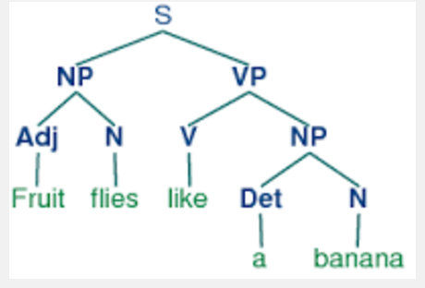
Code that Understands Language…
Processing text
Reading and storing words, looking at which words appear most frequently
Online dictionaries
e.g positive words, negative words, emotion words
Predicting parts of speech
Parsing sentences
Machine Learning
Teach computers to recognize patterns by examples
Word
happy
upsetting
fruit
Sentiment
positive
negative
neutral
Notes:
All of these are computer science tasks and programs that can help in many of the applications we use in language processing.

Slide 16
It’s not easy…
A PhD is (very) long!
Dealing with advisor switch
Not everyone will see things the way you do
Many people focus on the details of the mathematical models…
I am more interested in creating new and groundbreaking applications
I had multiple projects rejected, because I chose simpler methods
Don’t be afraid to lead the way forward
If you’ve managed to convince your audience that your idea is simple
.... then you have succeeded!
Notes:
Maybe somewhere later for the technical parts?
Take from ETS slides the TOEFL problem

Slide 17
Thank you for listening
Girls Who Code

