Slide 1
Networking in Xen and KVM
Kangkook Jee (kj2181)
May 6 2010

Slide 2
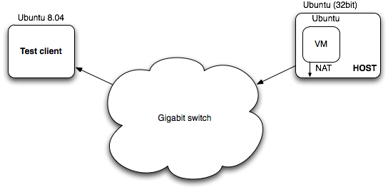
Test set-up & environments
Network
1 Gbps network
NAT connection for guest-host connection (CS network doesn’t allow bridged network)
KVM setting
KVM version 84 (latest 88)
Host (Ubuntu 9.10), Guest (Ubuntu 9.10)
Network device: KVM native device, Virtio device
Xen
Xen hypervisor version 3.2 (latest 4.0)
Host (Ubuntu 8.04), Guest (8.04)
Network device: Xen’s Native PV device

Slide 3
Bandwidth measurement
Measurement with iperf network benchmark tool
Measured Tx thruput varying message size (32 ~ 32K bytes)
Test for native, xen, kvm-native, kvm-virtio
Xen network device shows BAD performance – need more investigation
 | 32KB Msg
Native | 942 Kbps
Xen | 0.131 Kbps
KVM | 121 Kbps
VirtIO | 933 Kbps
Bandwidth (Kbps)
Message (Bytes)

Slide 4
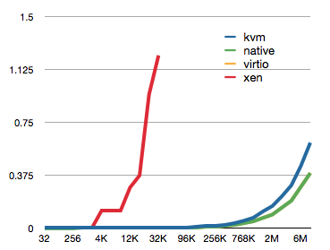
Latency measurement
Using NetPipe benchmark tool
Measured latency varying message sizes (32 ~ 8 M)
VirtIO’s latency is comparable to native’s latency
Xen’s PV device also shows BAD latency results

Slide 5
Resource profiling
Profiling “KVM + VirtIO” using Oprofile
samples % image name app name symbol name
129570 16.3352 kvm_intel kvm_intel /kvm_intel
108678 13.7013 qemu-system-x86_64 qemu-system-x86_64 /usr/bin/qemu-system-x86_64
31394 3.9579 kvm kvm /kvm
29704 3.7448 libc-2.10.1.so libc-2.10.1.so /lib/tls/i686/cmov/libc-2.10.1.so
28089 3.5412 vmlinux vmlinux copy_from_user
23601 2.9754 nf_conntrack nf_conntrack /nf_conntrack
21621 2.7258 vmlinux vmlinux __ticket_spin_lock
21592 2.7221 bridge bridge /bridge
16870 2.1268 vmlinux vmlinux __ticket_spin_unlock
16677 2.1025 tg3 tg3 /tg3
11016 1.3888 tun tun /tun
8162 1.0290 vmlinux vmlinux nf_iterate
* Names in reds are modules/libraries with no symbol information
Measured during tcp transfer test with iperf -- copy_from_user ()
Many modules/libraries to be recompiled (- fno-omit-frame-pointers)
Xenoprofile for Xen but still has the same issues
CPU (%)

Slide 6
Issues: Measuring resource utilization
Not easy to find generic/proper measurement model to measure guest overhead on the host side
Candidate profilers
Oprofile, Xenoprofile
Support for linux and Xenified linux
Requires symbol information for both linux kernel and hypervisor kernel (and for libraries and modules)
Perf
Relatively new thing (included from kernel 2.6.32) and seems promising
Not sure it would work with Xen hybervisor
Others
Gprof, valgrind …

Slide 7
Issues: Xen network performance
For Xen test, followed the standardized installation procedures
DOM0 and Hybervisor kernel from Ubuntu 8.04
xen_create_image script to create a guest
But it showed awkwardly BAD network performance
May be due to some errors regarding configuration
Or NAT can be the culprit (Bridged network is the default configuration for Xen)

Slide 8
Issues: other thoughts
Xen is very hard to configure/deploy
Ubuntu 8.04 is the last distribution comes with DOM0 kernel
Install and tested with this version, but no package for symbol information
For the latest distributions, users need to build their own Xenified kernels – unreliable and error-prune
KVM + VirtIO relatively easy and straightforward
Lack in documentation
Outdated and hard to find standard ways of doing things

Slide 9
Todos
Configure test environment with the latest versions with symbol information
Complete measurement on resource usage
Fix Xen’s network performance issues
Configure bridged-network and compare its bandwidth/latency with NAT-network’s
Any other recommendations?

