Slide 1
Breaking An Image Based Captcha
Michele Merler
Jacquilene Jacob

Slide 2

Objective
Applications online are inherently insecure
Growing rate of hackers
Confidentiality of online systems should be guaranteed by Captchas
Image based Captchas propose to overcome issues of text based ones (user friendlyness, robustness to attacks)
BUT…
Are they really secure?
Verify effective security offered by image based Captchas

Slide 3
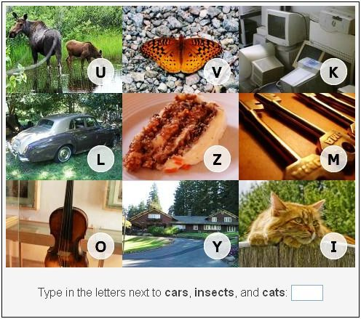
Target System
Verification Solution
Challenge is combination of images from various categories
User asked to report letters corresponding to requested categories
VidoopCaptcha.com

Slide 4
Process Flow
Image Category Recognizer
Training Data
Feature Extraction
Train Classifier
Test Data
Preprocessing
Feature Extraction
Results
Training data
Feature extraction
Train using kNN
Character Recognizer
Notes:
4

Slide 5
Process Flow
Image Category Recognizer
Training Data
Feature Extraction
Train Classifier
Test Data
Preprocessing
Feature Extraction
Results
Training data
Feature extraction
Train using kNN
Character Recognizer
Notes:
5

Slide 6
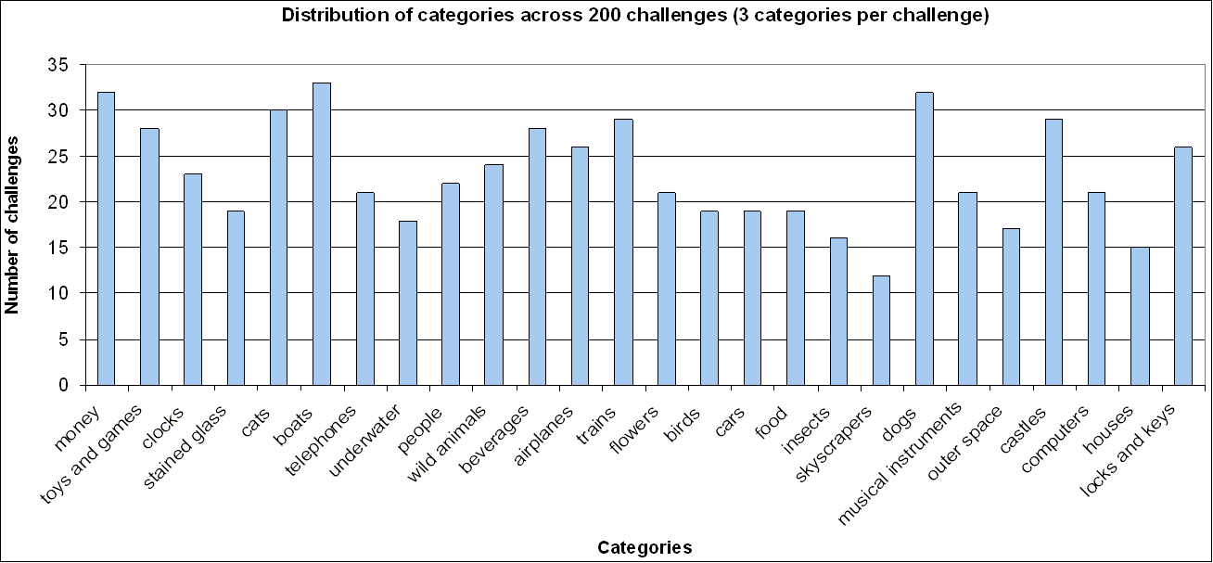
Data Acquisition
TRAINING DATA
Images downloaded from Flickr with a Perl script
~500 images per category
TEST DATA
200 challenges downloaded from VidoopCaptcha with a Perl script
26 categories
Manual ground truth annotation

Slide 7
Process Flow
Image Category Recognizer
Training Data
Feature Extraction
Train Classifier
Test Data
Preprocessing
Feature Extraction
Results
Image Splitting
Character region extraction
Character Recognition
Training data
Feature extraction
Train using kNN
Character Recognizer

Slide 8
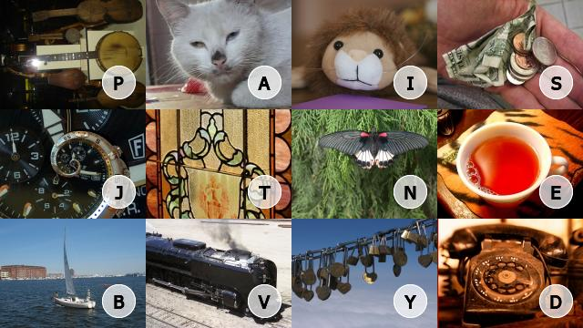

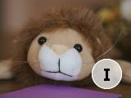

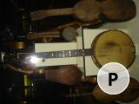
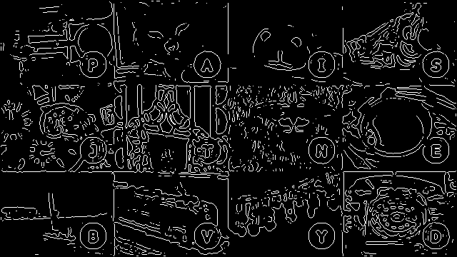
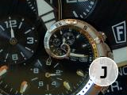
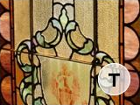
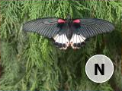


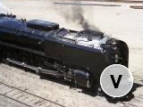


Test Data-Preprocessing
Image Splitting
Character region extraction
Character Recognition
LoG based edge extraction
Horizontal and vertical dominant lines
Generalized Hough transform
Evaluate consistency among subimages
Square (side = sqrt(2)*radius) character regions rescaled to 27x27 pixels
Conversion to grayscale and binarization
1-NN classifier trained on 20 popular fonts images generated with GD library

Slide 9
Process Flow
Image Category Recognizer
Training Data
Feature Extraction
Train Classifier
Test Data
Preprocessing
Feature Extraction
Results
Training data
Feature extraction
Train using kNN
Character Recognizer
Notes:
9

Slide 10
Character Classification
Training data
Feature extraction
Train using 1-NN
Character Recognizer
Character Training Data
Character Feature Extraction
Train using kNN classifier
64 images generated with GD library for each upper case character, using 20 common fonts
Simple binary vector with all pixels in image
1-NN classifier

Slide 11
Process Flow
Image Category Recognizer
Training Data
Feature Extraction
Train Classifier
Test Data
Preprocessing
Feature Extraction
Results
Training data
Feature extraction
Train using kNN
Character Recognizer
Notes:
11

Slide 12
Feature Extraction
Features from all 26 categories
Edge Histograms (6x8 regions)
Color Moments (RGB, 3x3 regions)
Color Histograms (32+32 bins in CbCr)
GIST features (314 dims. vectors)
For each category, SVM classifier trained on all positive data, negative data randomly taken from other categories
#positive data = #negative data

Slide 13
Results
200 test challenges
Image split and character regions detection accuracy: 100%
Character recognition accuracy: 96%

Slide 14
Results
200 test challenges
Average processing time per challenge: 12 sec.
Best breaking rate: 3%
We can break 9 image Captchas per hour (216/day)
# recognized images
Single image
Pair images
Triplet images

Slide 15
Results
200 test challenges
Average processing time per challenge: 12 sec.
Best breaking rate: 3%
We can break 9 image Captchas per hour (216/day)
# passed challenges

Slide 16
Conclusions
Breaking Image based Captchas is possible
VidoopCaptcha is not 100% secure
Future directions:
- Try other features (SIFT + codebook)
- Obtain cleaner training data (performances suggest poor training data)
- Improve speed and efficiency using more powerful programming languages
- Test online version of Captcha breaker

Slide 17
Questions?

