Slide 1
Software Defined Networking
COMS 6998-8, Fall 2013
Instructor: Li Erran Li (lierranli@cs.columbia.edu)
http://www.cs.columbia.edu/~lierranli/coms6998-8SDNFall2013/
10/22/2013: SDN Virtualization

Slide 2
Outline
Announcements
  Prof. Jen Rexford’s Talk on August 28, 11:00 am, Davis Auditorium, CEPSR
  Juniper/Comcast SDN Competition: participate as a 3rd team if interested
  Reminder: midterm next Tuesday!
Review of Previous Lecture: Forwarding Abstraction
SDN Virtualization
  OpenvSwitch
  Network Function Virtualization (NFV)
  FlowVisor

Slide 3
Review of Previous Lecture
What are the different platforms for forwarding?
  Dedicated hardware
  Network processors
  NetFPGA
  General purpose software on commodity servers

Slide 4
Review of Previous Lecture (Cont’d)
What are performance and programmability tradeoffs?
  Software:
    Flexible and easy to program
    Slow forwarding speed
  Programmable hardware:
    Flexible and fast
    Hard to program, costly and power hungry
  Custom hardware:
    Fast, cheap and power efficient
    Long development cycle and not flexible

Slide 5
Review of Previous Lecture (Cont’d)
What are the forwarding abstractions?
  Fixed match action table (today’s switch chipset)
  Reconfigurable match table (OpenFlow++)
    Flexible header fields, flexible actions, flexible memory allocation in multi-stages of match and actions
  Programmable pipeline with modular hardware building blocks on NetFPGA (SwitchBlade)
  Modular router (Click)

Slide 6
Fixed function switch
Review of Previous Lecture (Cont’d)
L2: 128k x 48
Exact match
L3: 16k x 32
Longest prefix
match
ACL: 4k
Ternary match
X
X
X
X
X
PBB Stage
?????????
L2 Stage
L3 Stage
ACL Stage
Queues
In
L2 Table
L3 Table
ACL Table
Out
Action: set L2D
Action: set L2D, dec TTL
Action: permit/deny
Parser
Deparser
Stage 1
Stage 2
Stage 3
Data
Source: P. Bosshart, TI

Slide 7
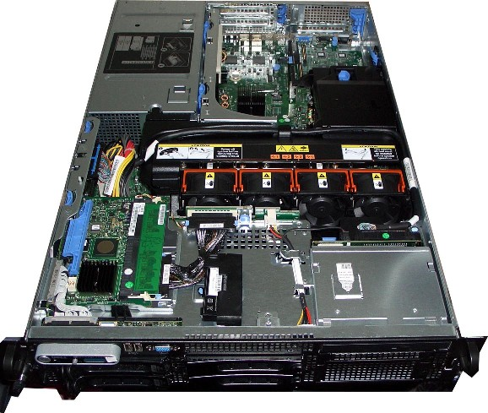
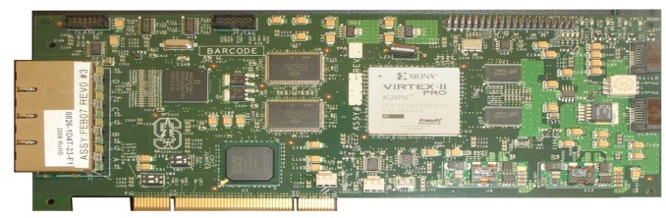
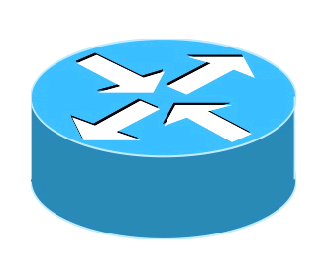
Review of Previous Lecture (Cont’d)
NetFPGA
Software
VE2
VE3
VE3
VE1
VE2
VE3
VE4
VE1
Click
Click
Click
Click
CPU
Memory
Hard Disk
PCI
NetFPGA
VDP1
VDP2
VDP3
VDP4
SwitchBlade
Software
VDP = Virtual Data Plane
Click = Click Software Router
VE = Virtual Environment
Hardware
Virtual Env.
Source: B. Anwer, Gatech
Notes:
Switchblade is simply a server with an FPGA card installed in it, in this case its NetFPGA.
[Click] As you can see this is a simple server with software running on CPU utilizing memory and harddsik. There is a NetFPGA card that is connected through the PCI slot.
[Click]
So what SwitchBlade does is that it extends the software virtual environments to hardware and each virtual environment has a corresponding virtualized data plane in hardware.
So what happens in switchblade is that the pipeline changes according the virtualized data plane. So for each incoming packet the pipeline changes according to individual dataplane user selection. For an OpenFlow VDP pipeline is different than IPv4 VDP etc.
Switchblade is a forwarding device that can be used as a switch or router or at any layer which user wants.

Slide 8
Review of Previous Lecture (Cont’d)
SwitchBlade
Virtual Data
Plane Selection
Shaping
Preprocessing
Forwarding
Postprocessing
Parallel custom data planes
  Ability to demultiplex into existing data planes and maintain isolation on common hardware platform
Rapid development and deployment
  Pluggable preprocessor (e.g. packet parser) modules enable a range of customizable functions at hardware rates
Customizability and programmability
  Dynamic selection of modules, and ability to operate in several different forwarding modes (IPv4, IPv6, OpenFlow).
Source: B. Anwer, Gatech

Slide 9
Review of Previous Lecture (Cont’d)
Click modular router
  Elements
    Small building blocks, performing simple operations
    Instances of C++ classes
  Packets traverse a directed graph of elements
FromDevice(eth0)->CheckIPHeader(14)
->IPPrint->Discard;
Control plane
User-level
routing daemons
Linux kernel
Click
Forwarding plane

Slide 10
Review of Previous Lecture (Cont’d)
Push connection
  Source pushes packets downstream
  Triggered by event, such as packet arrival
  Denoted by filled square or triangle
Pull connection
  Destination pulls packets from upstream
  Packet transmission or scheduling
  Denoted by empty square or triangle
Agnostic connection
  Becomes push or pull depending on peer
  Denoted by double outline
10/22/13
PATS Research Group
10
Notes:
10

Slide 11
Review of Previous Lecture (Cont’d)
RMT
Ethernet
ETHERTYPE
VLAN
VLAN
IPV4
IPV6
L2S
IPV4-DA
IPV6-DA
RCP
L2D
RCP
TCP
UDP
ACL
Done
MY-TABLE
Parse Graph
Table Graph
Source: P. Bosshart, TI

Slide 12
Review of Previous Lecture (Cont’d)
RMT logical to physical mapping
Physical
Stage 1
Physical
Stage 2
Physical
Stage n
3
IPV4
9 ACL
ETH
VLAN
TCAM
2
VLAN
5
IPV6
Match Table
Match Table
Match Table
L2S
IPV4
IPV6
640b
Action
Action
Action
4
L2S
7 TCP
L2D
TCP
UDP
SRAM
HASH
8 UDP
ACL
Logical Table 6
L2D
Logical Table 1
Ethertype
640b
Table Graph
Notes:
To make it possible to efficiently use multiple stages of match tables, it is assumed that the RMT Model can be configured to map Logical Tables to the Physical Tables.
To create bigger tables, one table may traverse multiple stages.
To create many smaller tables, several tables can be packed into one stage.
To make the allocation even more flexible, the Action instructions and the Statistic could share the same table space.
This slide gives a crude representation of how the the Logical Tables could be mapped to the Physical Tables.
In practice, the control plane would need to create a Table Flow Graph (to accompany the Parse Graph) to decide how the Logical Tables are mapped.
The control plane is assumed to know the number and size of the physical stages available.
There could be as few as 1 stage. A given switch might only allow Logical Tables to directly correspond to Physical Tables.

Slide 13
Outline
Announcements
Review of Previous Lecture: Forwarding Abstraction
SDN Virtualization
  OpenvSwitch
  Network Function Virtualization (NFV)
  FlowVisor

Slide 14
Networking in Virtual Environments
is Important
One cloud is planning to run 128 VMs per host.
That's 2+ full racks in one machine.

Slide 15

Networking in Virtual Environments
is Different
Challenges
● Scalability (105 VMs)
● Isolation
● Mobility
● ...
Conveniences
● Hypervisor info
● Introspection
● Leaf nodes
● ...
Source: B. Pfaff, Nicira

Slide 16
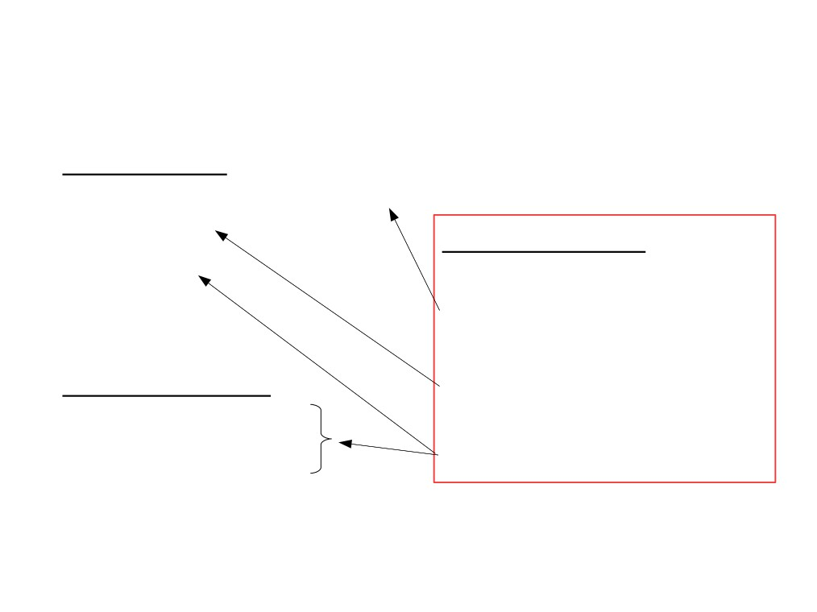
Networking in Virtual Environments
is Different
Challenges
● Scalability (105 VMs)
● Isolation
● Mobility
Open vSwitch
Distribute the Switch
Centralized Control
Take Advantage
● ...
Conveniences
● Hypervisor info
● Introspection
● Leaf nodes
● ...
Source: B. Pfaff, Nicira

Slide 17
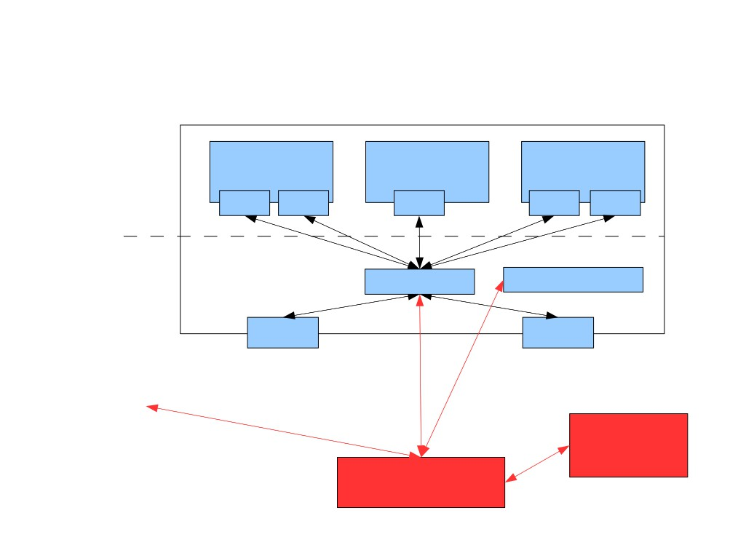
Basic Design (Xen)
Xen host (physical machine)
Virtual machines
(DomUs)
VM 1 VM 2
VM 3
VNIC VNIC VNIC
VNIC VNIC
Control domain
(Dom0)
ovs-vswitchd
XAPI
NIC
NIC
...other Xen hosts...
Adminstrative
CLI/GUI
Controller
Source: B. Pfaff, Nicira

Slide 18
Open vSwitch
Controller
  Configuration: read/write config. states, setup triggers for asynchronous events
  OpenFlow
Features
  VLAN
  Port mirroring
  ACLs
  NetFlow logging for VMs
  QoS
Source: B. Pfaff, Nicira

Slide 19
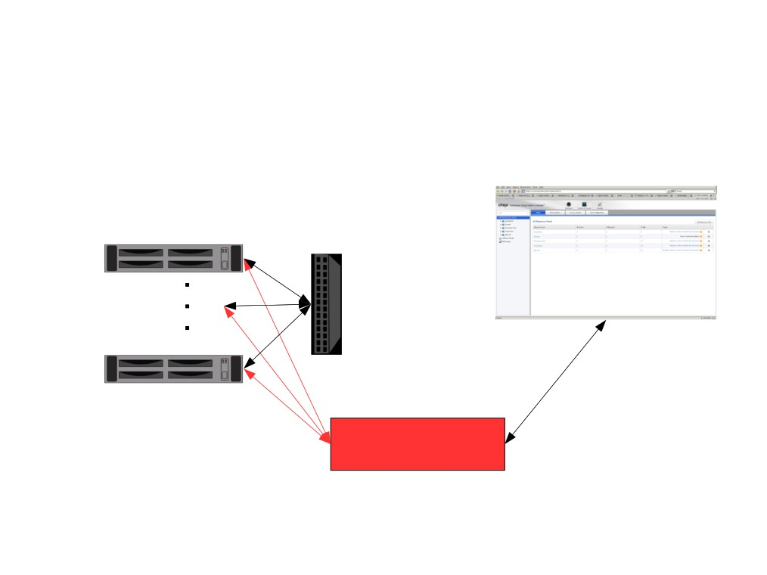
Open vSwitch Application:
Single Distributed Switch
VM host 1
VM host n
Web UI
Controller
Source: B. Pfaff, Nicira

Slide 20
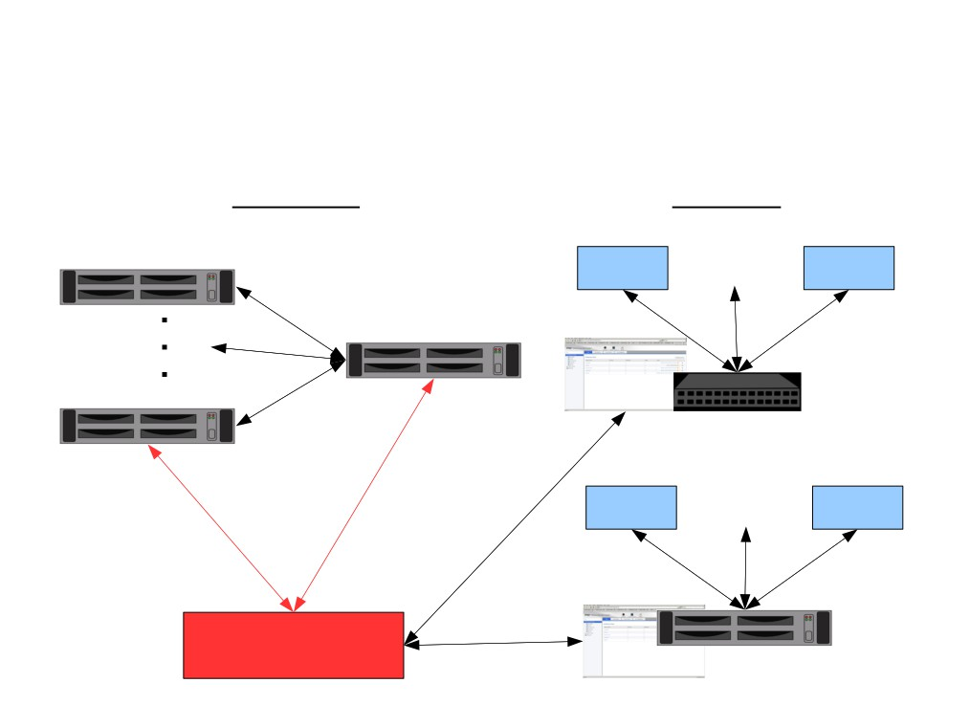
Open vSwitch Application:
Multiple Distributed Switches
Physical
Logical
VM host 1
VM 1 VM n
GRE
Physical vSwitch
VM host n
Tenant #1 (switched)
VM 1
VM n
Web UI
Controller
Web UI
Tenant #2 (routed)
Source: B. Pfaff, Nicira

Slide 21
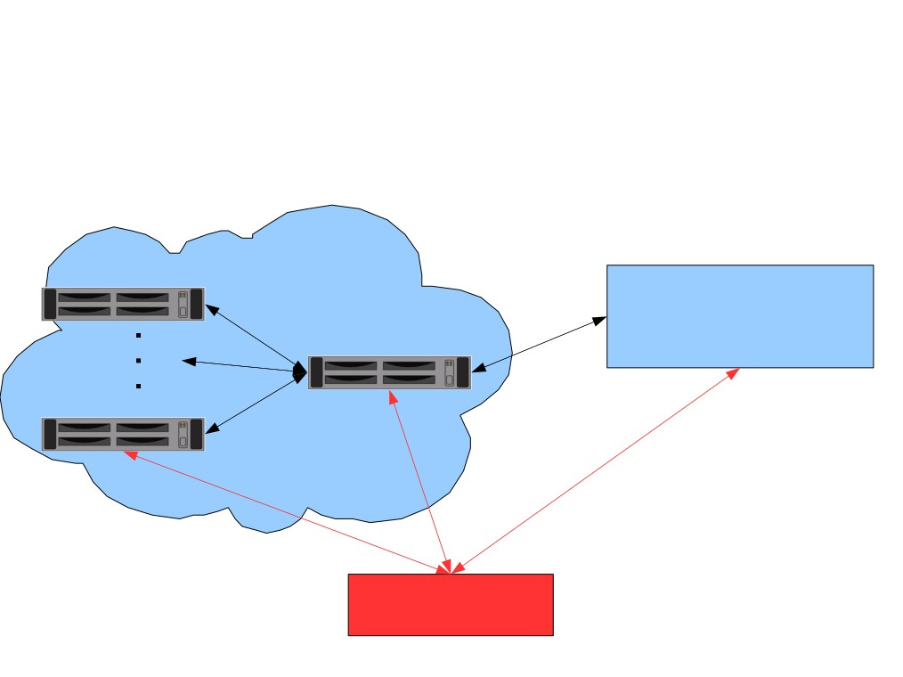
Open vSwitch Application:
Extending Data Center into Cloud
Managed Cloud
VM host 1
GRE/
IPSEC/
SSL
Customer Data Center
GRE
“Cloud access server”
VM host n
Controller
Source: B. Pfaff, Nicira

Slide 22
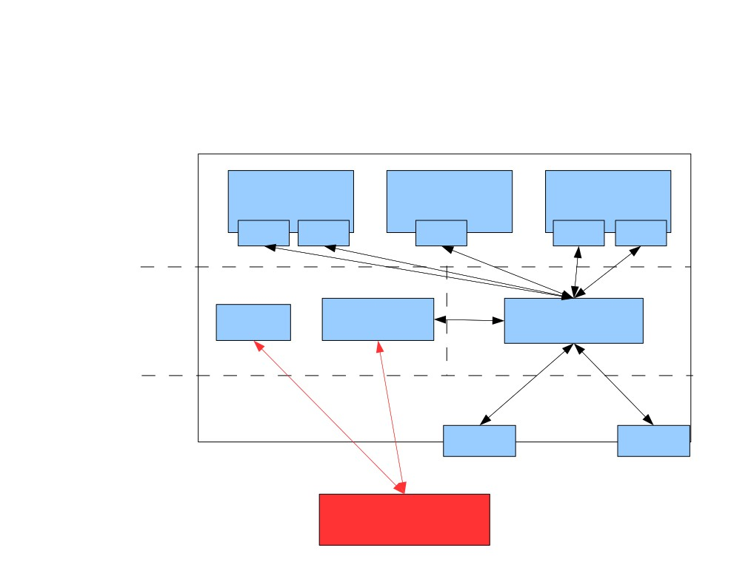
Implementation (Xen)
Physical machine
Virtual machines
(DomUs)
VM 1 VM 2
VM 3
VNIC VNIC VNIC
VNIC VNIC
Control domain
(Dom0)
Fast Path
XAPI ovs-vswitchd
user
kernel
Xen hypervisor
NIC
NIC
Controller
Source: B. Pfaff, Nicira

Slide 23

Open vSwitch is Fast
As fast as Linux bridge
with same CPU usage
Bandwidth
Latency
Fast Path: > 1 Gbps
Fast Path: < 1 µs
ovs-vswitchd: 100 Mbps
ovs-vswitchd: < 1 ms
Controller: 10 Mbps
Controller: ms
Source: B. Pfaff, Nicira

Slide 24
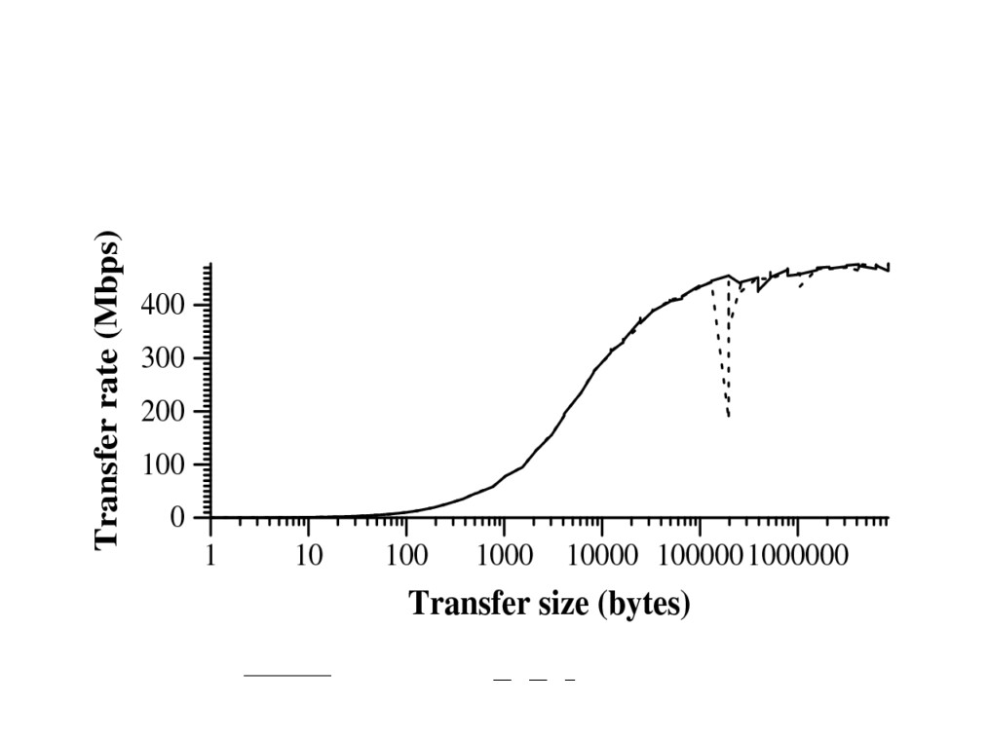
Open vSwitch is Fast
vswitch
Linux bridge
Source: B. Pfaff, Nicira

Slide 25
Open vSwitch Source Code and Commands
Install in OpenFlow VirtualBox VM
  git clone git://git.openvswitch.org/openvswitch
  make install
Run
  /etc/init.d/openvswitch-switch start
ovs-vsctl: Configures ovs-vswitchd, a high-level interface for database
  Create a bridge:
    ovs-vsctl -- --may-exist add-br br0
  Add port to a bridge:
    ovs-vsctl -- --may-exist add-port br0 eth0

Slide 26
Open vSwitch Source Code and Commands (Cont’d)
  List all bridges:
    ovs-vsctl list-br
  List all ports:
    ovs-vsctl list-ports br0
  Find uuid of port s1-eth1:
    Ovs-vsctl list port s1-eth1
ovsdb-tool: Command-line tool for managing database file
  ovsdb-tool show-log [-mmm] <file>

Slide 27
Open vSwitch Source Code and Commands (Cont’d)
ovs-ofctl speaks to OpenFlow module
  ovs-ofctl dump-flows <bridge>
  ovs-ofctl snoop <bridge>
ovs-dpctl speaks to kernel module
  See datapaths and their ahached interfaces:
    ovs-dpctl show <bridge>
  Exact match flows cached in datapath:
    ovs-dpctl dump-flows <bridge>

Slide 28
Outline
Announcements
Review of Previous Lecture: Forwarding Abstraction
SDN Virtualization
  OpenvSwitch
  Network Function Virtualization (NFV)
  FlowVisor

Slide 29
Network Functions Virtualization
Many network equipment: switches, routers, NATs, firewalls, can be replaced by software running on VM
Advantage
  use standard COTS hardware (e.g., high volume servers, storage)
    reduces CAPEX and OPEX
  fully implement functionality in software
    reducing development and deployment cycle times, opening up the R&D market
  consolidate equipment types
    reducing power consumption
  optionally concentrate network functions in datacenters
    obtaining further economies of scale and enabling rapid scale-up and scale-down

Slide 30
Is NFV a new idea?
VLAN and VRF: virtualized L2/L3 infrastructure
Linux router (e.g. Click): virtualized router on Linux platform
Open vSwitch
  Open Source (Apache 2.0 license) production quality virtual switch
  extensively deployed in datacenters, cloud applications, …
  switching can be performed in SW or HW
  now part of Linux kernel (from version 3.3)
  runs in many VMs
  broad functionality (traffic queuing/shaping, VLAN isolation, filtering, …)
  supports many standard protocols (STP, IP, GRE, NetFlow, LACP, 802.1ag)

Slide 31
Potential VNFs
Potential Virtualized Network Functions (from NFV ISG whitepaper)
switching elements: Ethernet switch, Broadband Network Gateway, CG-NAT, router
mobile network nodes: HLR/HSS, MME, SGSN, GGSN/PDN-GW, RNC, NodeB, eNodeB
residential nodes: home router and set-top box functions
tunnelling gateway elements: IPSec/SSL VPN gateways
traffic analysis: DPI, QoE measurement
QoS: service assurance, SLA monitoring, test and diagnostics
NGN signalling: SBCs, IMS
converged and network-wide functions: AAA servers, policy control, charging platforms
application-level optimization: CDN, cache server, load balancer, application accelerator
security functions: firewall, virus scanner, IDS/IPS, spam protection

Slide 32
NFV Industry Specifications Group
An Industry Specifications Group (ISG) has been formed under ETSI to study NFV
  ETSI is the European Telecommunications Standards Institute with >700 members
NFV Members
  Acme Packet, Allot, Amdocs, AT&T, ALU, Benu Networks, Broadcom, BT, Cablelabs, Ceragon, Cisco, Citrix, DT, DOCOMO, ETRI, FT, Fraunhofer FOKUS, Freescale, Fujitsu Labs, HP, Hitachi, Huawei, IBM, Intel, Iskratel, Italtel, JDSU, Juniper, KT, MetraTech, NEC, NSN, NTT, Oracle, PT, RadiSys, Samsung, Seven Principles, Spirent, Sprint, Swisscom, Tektronix, TI, Telefon Ericsson, Telefonica, TA, Telenor, Tellabs, UPRC, Verizon UK, Virtela, Virtual Open Systems, Vodafone Group, ZTE
Working and expert groups
  Architecture of the Virtualisation Infrastructure (INF)
  Management & Orchestration (MANO)
  Performance & Portability Expert Group (PER)
  Reliability & Availability (REL)
  Security Expert Group (SEC)
  Software Architecture (SWA)

Slide 33
NFV architecture
VNF
VNF
VNF
NFV infrastructure
NFV Orchestrator
NFV OS
VM
VM
VM
VNP
VNP
VNP
VM
image
hypervisor
net partitioner
NFV hardware
compute
storage
networking
special purpose
The NFV architecture is still being debated

Slide 34
Outline
Announcements
Review of Previous Lecture: Forwarding Abstraction
SDN Virtualization
  OpenvSwitch
  Network Function Virtualization (NFV)
  FlowVisor

Slide 35
Flowvisor Overview
App
App
App
App
App
App
Controller 1
Controller
2
Windows
(OS)
Linux
Mac
OS
Controller 1
Controller
2
Windows
(OS)
Linux
Mac
OS
Controller 1
Controller
2
Windows
(OS)
Linux
Mac
OS
Virtualization
Virtualization (FlowVisor)
x86
(Computer)
OpenFlow
Simple, common, stable, hardware substrate below
+ Programmability
+ Strong isolation model
+ Competition above
→ Faster innovation

Slide 36

Flowvisor Overview (Cont’d)
• Divide the production network into logical slices
o each slice/service controls its own packet forwarding
o users pick which slice controls their traffic: opt-in
o existing production services run in their own slice
▪e.g., Spanning tree, OSPF/BGP
• Enforce strong isolation between slices
o actions in one slice do not affect another
• Allows the (logical) slice to mirror the production network
o real hardware, performance, topologies, scale, users
Source: R. Sherwood

Slide 37
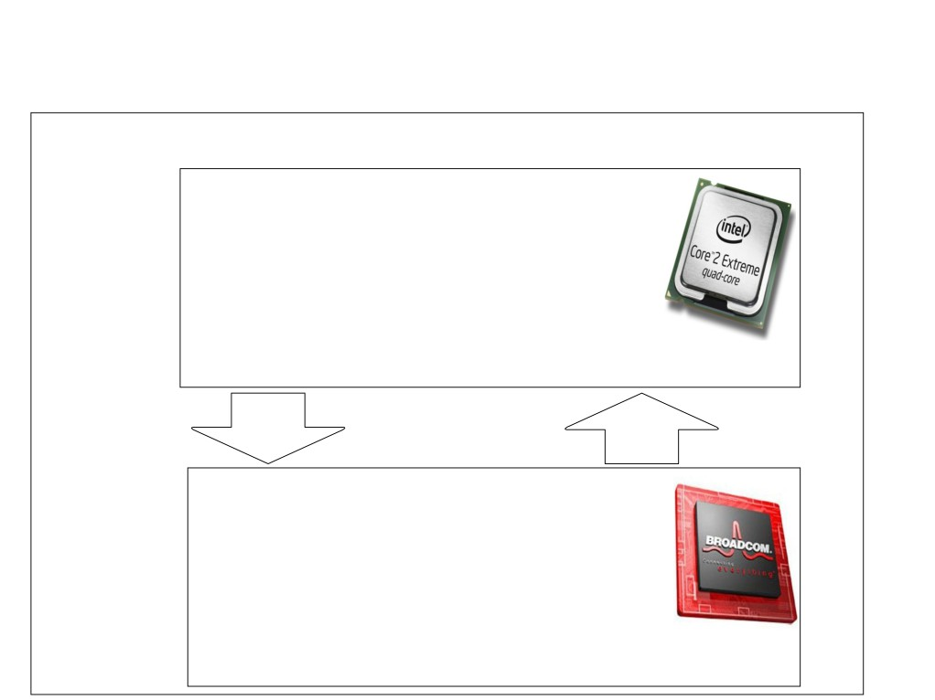
Current Network Devices
Switch/Router
• Computes forwarding rules
Control
• “128.8.128/16 --> port 6”
Plane
• Pushes rules down to data
plane
General-purpose
CPU
Rules
Control/Data
Protocol
Excepts
• Enforces forwarding rules
Data
• Exceptions pushed back to
control plane
Plane
• e.g., unmatched packets
Custom
ASIC

Slide 38
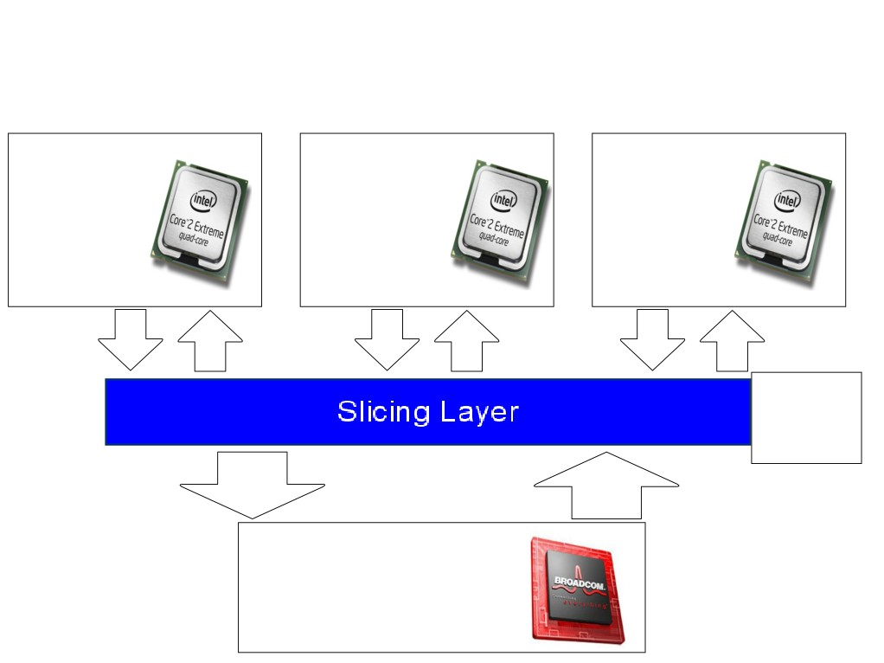
Add a Slicing Layer Between Planes
Slice 2
Slice 1
Slice 3
Control
Control
Control
Plane
Plane
Plane
Slice
Policies
Control/Data
Protocol
Rules
Excepts
Data
Plane
Source: R. Sherwood

Slide 39
Network Slicing Architecture
A network slice is a collection of sliced switches/routers
• Data plane is unmodified
- Packets forwarded with no performance penalty
- Slicing with existing ASIC
• Transparent slicing layer
- each slice believes it owns the data path
- enforces isolation between slices
• i.e., rewrites, drops rules to adhere to slice police
- forwards exceptions to correct slice(s)
Source: R. Sherwood

Slide 40
Slicing Policies
The policy specifies resource limits for each slice:
- Link bandwidth
- Maximum number of forwarding rules
- Topology
- Fraction of switch/router CPU
- FlowSpace: which packets does the slice
control?
Source: R. Sherwood

Slide 41
Substrate: “Flowspace”
Ethernet
DA, SA, etc
IP
DA, SA, etc
TCP
DP, SP, etc
Payload
Collection of bits to plumb flows
(of different granularities)
between end points
Header
User-defined flowspace
Payload
“OpenFlow++”
Source: N. Mckeown

Slide 42
Flowspace: Simple example
Single flow
All flows from A
All flows between two subnets
IP DA
A
IP SA
Source: N. Mckeown

Slide 43
Flowspace: Generalization
Single flow
Set of flows
Field 1
Field 2
Field n
Source: N. Mckeown

Slide 44
Properties of Flowspace
Backwards compatible
  Current layers are a special case
  No end points need to change
Easily implemented in hardware
  e.g. TCAM flow-table in each switch
Strong isolation of flows
  Simple geometric construction
  Can prove which flows can/cannot communicate
Source: N. Mckeown

Slide 45
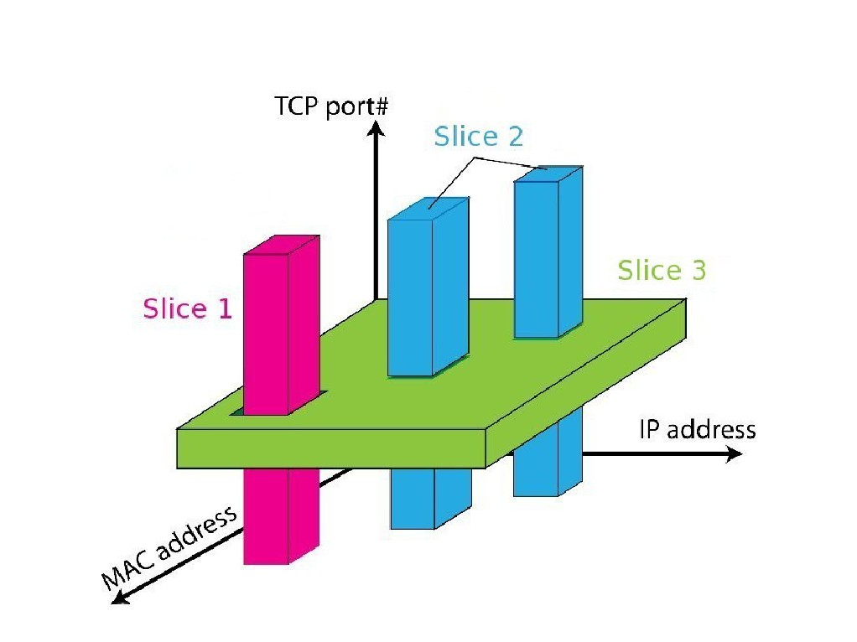
FlowSpace: Maps Packets to Slices
Source: R. Sherwood

Slide 46
Real User Traffic: Opt-In
• Allow users to Opt-In to services in real-time
o Users can delegate control of individual flows to
Slices
o Add new FlowSpace to each slice's policy
• Example:
o "Slice 1 will handle my HTTP traffic"
o "Slice 2 will handle my VoIP traffic"
o "Slice 3 will handle everything else"
• Creates incentives for building high-quality services
Source: R. Sherwood

Slide 47



FlowVisor Slicing Example
Bob’s
Controller
Alice’s
Controller
OpenFlow
Protocol
OpenFlow
Switch
FlowVisor
OpenFlow
Protocol
OpenFlow
Switch
OpenFlow
Switch
Source: N. Mckeown

Slide 48



FlowVisor Slicing Example (Cont’d)
http
Load-balancer
Broadcast
Multicast
OpenFlow
Protocol
OpenFlow
Switch
FlowVisor
OpenFlow
Protocol
OpenFlow
Switch
OpenFlow
Switch
Source: N. Mckeown

Slide 49
FlowVisor Slicing Example (Cont’d)
LTE-WiFi
Handover
Tricast Lossless
Handover
Learning
switch
Mobile VMs
New BGP
Bob’s
FlowVisor
Alices’s
FlowVisor
GENI’s
FlowVisor
Production
Network
Controller
OpenFlow Protocol
Network Administrator’s
FlowVisor
OpenFlow Protocol
OpenFlow
Switch
OpenFlow
Switch
OpenFlow
Switch
Source: N. Mckeown

Slide 50
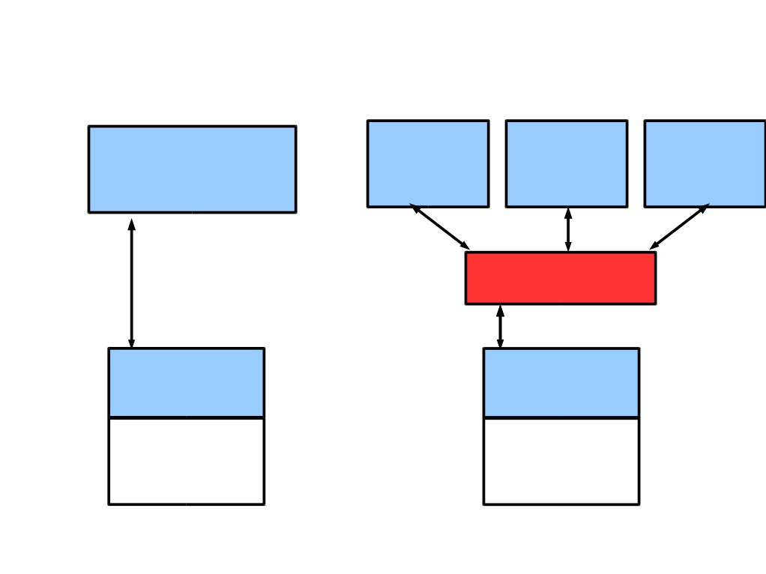
FlowVisor Implemented on OpenFlow
Server
Servers
Custom
OpenFlow
Controller
OpenFlow OpenFlow OpenFlow
Control
Controller Controller Controller
Plane
OpenFlow
Network
OpenFlow
FlowVisor
Protocol
OpenFlow
Stub
Control
OpenFlow
OpenFlow
Plane
Firmware
Firmware
Data
Plane
Data Path
Data Path
Switch/
Switch/
Router
Router

Slide 51
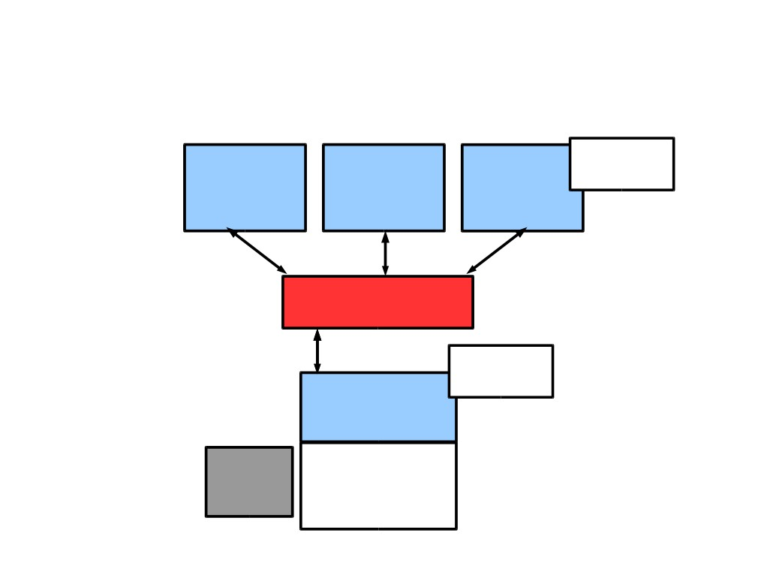
FlowVisor Message Handling
Alice Bob
Rule
Cathy
Controller Controller
Controller
OpenFlow
Policy Check:
Policy Check:
Is this rule
allowed?
FlowVisor
Who controls
this packet?
OpenFlow
Full Line Rate
Forwarding
Exception
OpenFlow
Firmware
Packet
Data Path
Source: R. Sherwood

Slide 52
FlowVisor Implementation
●Custom handlers for each of OpenFlow's 20
message types
● Transparent OpenFlow proxy
● 8261 LOC in C
● New version with extra API for GENI
●Code: git clone git://openflow.org/flowvisor.git`
Source: R. Sherwood

Slide 53
Isolation Techniques
Isolation is critical for slicing
Link bandwidth: per-slice queue on each port of a switch
Forwarding rules: pre-set limit of number of flow entries of a given slice
Topology: limit to per-slice view
Flow space: rewrite flow definition and actions to prevent violation of slice definition
Device CPU

Slide 54
Device CPU Isolation
• Ensure that no slice monopolizes device CPU
• CPU exhaustion
• prevent rule updates
• drop LLDPs ---> Causes link flapping
• Techniques
• Limiting rule insertion rate from controller
• Use periodic drop-rules to throttle exceptions
Source: R. Sherwood

Slide 55
Flowvisor Commands
fvconfig generate config.xml
Run: flowvisor config.xml
fvctl is the cli used to control a running instance of flowvisor (over XMLRPC)
fvctl --passwd-file=/etc/flowvisor/fvpasswd command [args…]
fvctl command [args…]

Slide 56
Conclusion and Future Work
• Network slicing can help perform more realistic
evaluations and support multiple tenants
• FlowVisor allows experiments to run concurrently
but safely on the production network
• Currently limited to subsets of actual topology
  - Add virtual links, nodes support

Slide 57
Questions?

