Slide 1
Software Defined Networking
COMS 6998-8, Fall 2013
Instructor: Li Erran Li (lierranli@cs.columbia.edu)
http://www.cs.columbia.edu/~lierranli/coms6998-8SDNFall2013/
10/15/2013: SDN Forwarding Abstraction

Slide 2
Outline
Announcement: Guest Lecture on SDN middleboxes on Nov 12 by Seyed Kaveh Fayazbakhsh from Stony Brook University
Review of Previous Lecture: SDN Updates
SDN Forwarding Abstractions
  Click software router
  SwitchBlade NetFPGA programmable router
  OpenFlow++

Slide 3
Review of Previous Lecture
What update abstractions did we learn?
  Per-packet consistent update: each packet is processed either by the old configuration or the new one
  Per-flow consistent update: all packets of a flow is processed by the same configuration (either old or new)
  Congestion free update: updates are congestion free under asynchronous switch and traffic matrix changes
Source: Andreas Voellmy, Yale

Slide 4
Review of Previous Lecture (Cont’d)
How to achieve consistent update?
  Install new rules on internal switches, leave old configuration in place
  Install edge rules that stamp with the new version number
Source: Andreas Voellmy, Yale

Slide 5
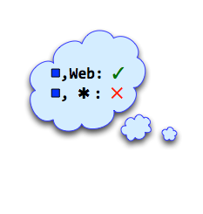
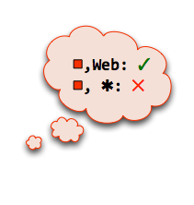
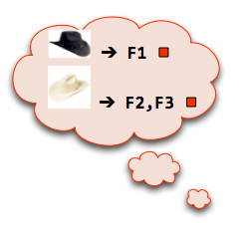
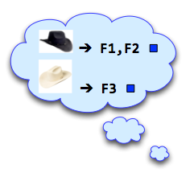
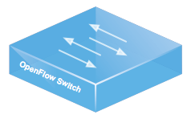
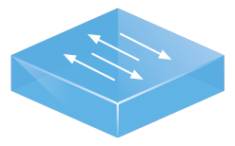
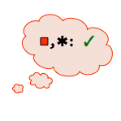


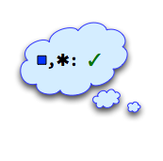

2-Phase Update in Action
Review of Previous Lecture (Cont’d)
F1
I
F2
F3
Traffic
Source: M. Reitblatt, Cornell

Slide 6

Review of Previous Lecture (Cont’d)
How to perform congestion
free update?
Update
Scenario
Update requirements
Operator
zUpdate
Current Traffic Distribution
Intermediate
Traffic Distribution
Intermediate
Traffic Distribution
Target Traffic Distribution
Data Center Network
Source: J. Liu, Yale
Routing Weights
Reconfigurations
Notes:
zUpdate stands in the middle between operators and data center network. It keeps monitoring the current traffic distribution in the network. When operator has an update scenario to perform, zUpdate translate the update requirement into the constraint to the target traffic distribution. Then, zUpdate will automatically find a target traffic distribution, and a chain of intermediate traffic distributions which bridges the current and the target traffic distributions and makes sure that the whole transition process is congestion-free.
After that, zUpdate configures the network according to the plan.

Slide 7
A clos network with ECMP
Review of Previous Lecture (Cont’d)
All switches: Equal-Cost Multi-Path (ECMP)
Link capacity: 1000
150
150
620
+ 150
150
= 920
150
+ 150
300
300
300
300
600
600
Source: J. Liu, Yale
Notes:
Now let us take a look at an example to see why a congestion-free update is difficult.
We have a small FatTree network. The capacity of each link is 1000.
There are two flows with size 620 from two CORE switches to ToR3. We highlight the two bottleneck links on the network. The two flows put 620 load on the two links.
At the same time, there is a flow from ToR1 to ToR2. This flow has multiple paths to reach ToR2 and each switch is using ECMP which equally splits the traffic loads among the out-going links.
We can find that this flow’s load on the two bottleneck links are 150.
Similarly, another flow from ToR5 to ToR4 with size 600 also has 150 load on the two links.
The total load of the bottleneck links is 920 which is less than the capacity. Therefore, now the network has no congestions.

Slide 8
Asynchronous changes can cause transient congestion
Review of Previous Lecture (Cont’d)
Link capacity: 1000
620 + 300 + 150 = 1070
Drain AGG1
300
300
600
When ToR1 is changed but ToR5 is not yet:
Not Yet
Source: J. Liu, Yale
Notes:
Let us see what happens if ToR1 is changed first. During the period that ToR1 is updated but ToR5 has not yet. The bottleneck link on the right will be congested.

Slide 9

Solution: introducing an intermediate step
Review of Previous Lecture (Cont’d)
Initial
Final
Transition
300
300
300
300
0
600
500
100
Congestion-free regardless the asynchronizations
Congestion-free regardless the asynchronizations
Intermediate
?
200
400
450
150
Source: J. Liu, Yale
Notes:
So overall, we see that despite we have no congestion on both the initial and the final traffic distributions, it is impossible the make the direct transition congestion-free. Then what shall we do? A method we can try is to introduce some intermediate step which has the property that the transitions from the initial to it and from it to the final are congestion-free regardless the update orders.
So does this intermediate step exist? Yes, and this is an example. I will talk about how we can find it later. But now from this example we can see that even playing with two flows on such a small network it has already been hard enough to make a congestion-free update. In real production network, when we have thousands of switches and millions of flows, it is impossible to plan and execute a congestion-free update by operators.

Slide 10
Review of Previous Lecture (Cont’d)
What happens when control plane network partitions?
Assumptions:
  Out-of-band control network
  Routing and forwarding based on addresses
  Policy specification using end-host names
  Controller only aware of local name-address bindings
Source: Andreas Voellmy, Yale

Slide 11
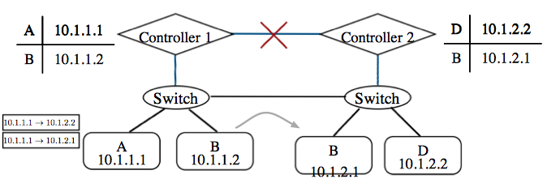
Review of Previous Lecture (Cont’d)
Consider policy isolating A from B. A control network partition occurs. Only possible choices
  Let all packets through (including from A to B) (Correctness)
  Drop all packets (including from A to D) (Availability)

Slide 12
Review of Previous Lecture (Cont’d)
Solutions:
  Network can label packets with sender’s identity
    Route based on identity instead of address
  Inband control

Slide 13
Outline
Review of Previous Lecture: SDN Updates
SDN Forwarding Abstractions
  Click software router
  SwitchBlade NetFPGA programmable router
  OpenFlow++

Slide 14
Modular software forwarding plane:
Click modular router
Control plane
Elements
  Small building blocks, performing simple operations
  Instances of C++ classes
Packets traverse a directed graph of elements
FromDevice(eth0)->CheckIPHeader(14)
->IPPrint->Discard;
User-level
routing daemons
Linux kernel
Click
Forwarding plane

Slide 15
Elements
10/15/13
PATS Research Group
15

Slide 16
Push and pull
Push connection
  Source pushes packets downstream
  Triggered by event, such as packet arrival
  Denoted by filled square or triangle
Pull connection
  Destination pulls packets from upstream
  Packet transmission or scheduling
  Denoted by empty square or triangle
Agnostic connection
  Becomes push or pull depending on peer
  Denoted by double outline
10/15/13
PATS Research Group
16
Notes:
16

Slide 17
Push and pull violations
10/15/13
PATS Research Group
17

Slide 18
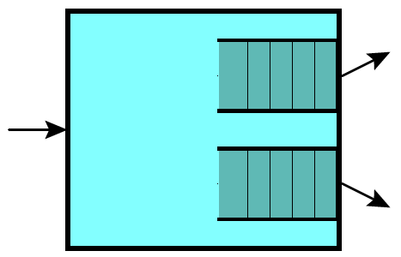
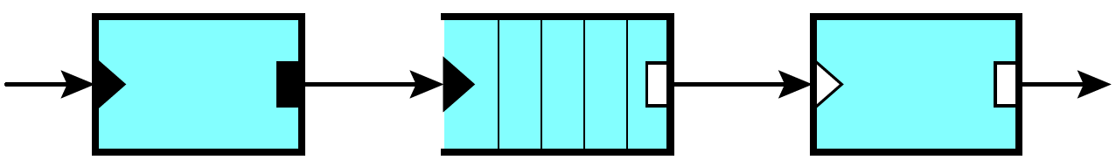
Implicit queue v. explicit queue
Implicit queue
Used by STREAM, Scout, etc.
Hard to control
Explicit queue
Led to push and pull, Click’s main idea
Contributes to high performance

Slide 19
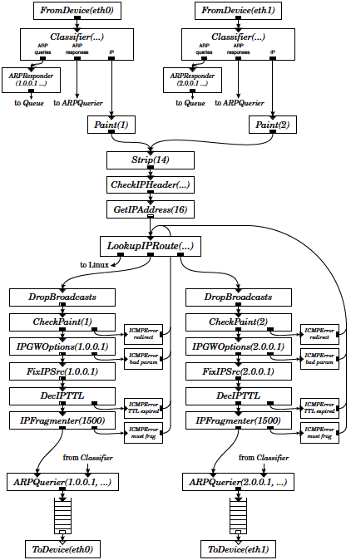
IP router configuration
10/15/13
PATS Research Group
19

Slide 20
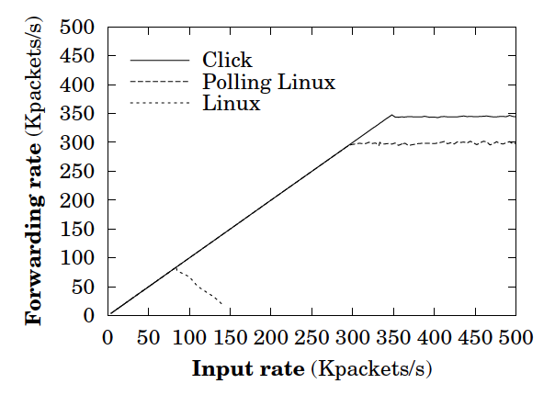
Click performance, circa 2000
Maximum loss-free forwarding rate with 64-byte packet:
333k, 284k, 84k for
Click, Linux w/ polling driver, Plain Linux

Slide 21
Improving software router performance: exploiting parallelism
Can you build a Tbps router out of PCs running Click?
  Not quite, but you can get close
RouteBricks: high-end software router
  Parallelism across servers and cores
  High-end servers: NUMA, multi-queue NICs
  RB4 prototype
    4 servers in full mesh acting as 4-port (10Gbps/port) router
    4  8.75 = 35Gbps
  Linearly scalable by adding servers (in theory)

Slide 22
Outline
Review of Previous Lecture: SDN Updates
SDN Forwarding Abstractions
  Click software router
  SwitchBlade NetFPGA programmable router
  OpenFlow++

Slide 23
Motivation
Many new protocols require data-plane changes.
  Examples: OpenFlow, Path Splicing, AIP, …
These protocols must forward packets at acceptable speeds
May need to run in parallel with existing or alternative protocols
Goal: Platform for rapidly developing new network protocols that
  Forwards packets at high speed
  Runs multiple data-plane protocols in parallel
Source: B. Anwer, Gatech
Notes:
1- Recently there have been many new protocols in networking community that require data plane changes. Some of these changes are small and some are significant.
2- but all of these protocols must be run on acceptable speed to better understand their behavior and see their feasibility.
3- But we cannot simply retire old hardware and start deploying these new protocols, they need to be tested while we are using existing data plane protocols. This means sharing of hardware to run these protocols in parallel to amortize cost.
4-

Slide 24
Existing Approaches
Develop custom software
  Advantage: Flexible, easy to program
  Disadvantage: Slow forwarding speeds
Develop modules in custom hardware
  Advantage: Excellent performance
  Disadvantage: Long development cycles, rigid
Develop in programmable hardware
  Advantage: Flexible and fast
  Disadvantage: Programming is difficult
Source: B. Anwer, Gatech

Slide 25
SwitchBlade: Main Idea
Identify modular hardware building blocks that implement a variety of data-plane functions
Allow a developer to enable and connect various building blocks in a hardware pipeline from software
Allow multiple custom data planes to operate in parallel on the same hardware
Flexible, fast, and easy to program.
Advantages of hardware and software with minimal overhead.
Source: B. Anwer, Gatech

Slide 26
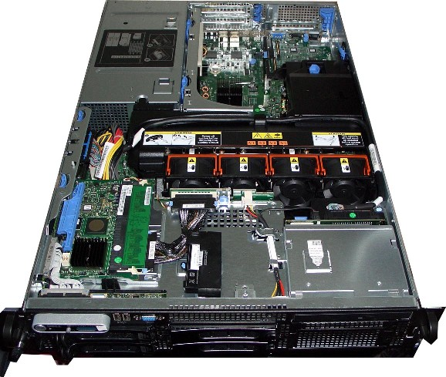
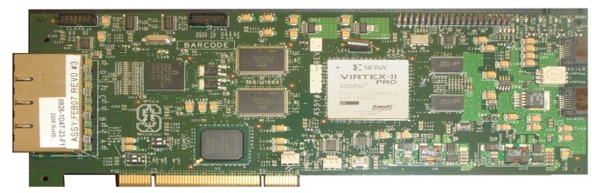
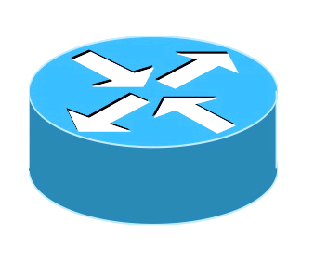
SwitchBlade: Push Custom Forwarding Planes into Hardware
Software
VE2
VE3
VE3
VE1
VE2
VE3
VE4
VE1
Click
Click
Click
Click
CPU
Memory
Hard Disk
PCI
NetFPGA
VDP1
VDP2
VDP3
VDP4
SwitchBlade
Software
VDP = Virtual Data Plane
Click = Click Software Router
VE = Virtual Environment
Hardware
Virtual Env.
Source: B. Anwer, Gatech
Notes:
Switchblade is simply a server with an FPGA card installed in it, in this case its NetFPGA.
[Click] As you can see this is a simple server with software running on CPU utilizing memory and harddsik. There is a NetFPGA card that is connected through the PCI slot.
[Click]
So what SwitchBlade does is that it extends the software virtual environments to hardware and each virtual environment has a corresponding virtualized data plane in hardware.
So what happens in switchblade is that the pipeline changes according the virtualized data plane. So for each incoming packet the pipeline changes according to individual dataplane user selection. For an OpenFlow VDP pipeline is different than IPv4 VDP etc.
Switchblade is a forwarding device that can be used as a switch or router or at any layer which user wants.

Slide 27
SwitchBlade Features
Parallel custom data planes
  Ability to demultiplex into existing data planes and maintain isolation on common hardware platform
Rapid development and deployment
  Pluggable preprocessor modules enable a range of customizable functions at hardware rates
Customizability and programmability
  Dynamic selection of modules, and ability to operate in several different forwarding modes.
Source: B. Anwer, Gatech

Slide 28
Virtual Data Planes (VDPs)
Virtual Data
Plane Selection
Shaping
Preprocessing
Forwarding
Separate packet processing pipeline, lookup tables, and forwarding modules per VDP
Stored table maps MAC address to VDP identifier
VDP Selection step
  Identifies VDP based on MAC address
  Attaches 64-bit platform header that controls functions in later stages
  Register interface controls this header per VDP
Source: B. Anwer, Gatech

Slide 29
Platform Header
Hash Value
Module Bitmap
Mode
Hash Value
Module bitmap
Mode
VDP ID
Hash value computed based on custom bits in header (allows for custom forwarding, if desired)
Bitmap indicates which preprocessor modules should execute on this packet
Mode indicates the forwarding mode (LPM or otherwise)
VDP-ID indicates the VDP of the packet
Source: B. Anwer, Gatech

Slide 30
Virtual Data Plane Isolation
Each Virtual Data Plane (VDP) has preprocessing, lookup, and post processing stages
  Fixed set of forwarding tables
  Lookup, ARP, and exception tables
One rate limiter per virtual-data plane
Forwarding tables, rate limiters operate in isolation
Source: B. Anwer, Gatech

Slide 31
SwitchBlade Features
Parallel custom data planes
  Ability to demultiplex into existing data planes and maintain isolation on common hardware platfor.
Rapid development and deployment
  Pluggable preprocessor modules to enable a range of customizable functions at hardware rates
Customizability and programmability
  Dynamic selection of modules, and ability to operate in several different forwarding modes
Source: B. Anwer, Gatech

Slide 32
Preprocessing
Virtual Data
Plane Selection
Shaping
Preprocessing
Forwarding
Per-VDP Module Selection
Bit field Register
Preprocessing
Selector
Per-VDP module field Selection
Custom
Preprocessor
Hasher
Select processing functions from library of reusable modules
  Selection function through bitmap
  Enables fast customization without resynthesis
  Example implementations: Path Splicing, IPv6, OpenFlow
Hash custom bits in packet header and insert value in hash field in platform header
  Enables custom forwarding
Source: B. Anwer, Gatech

Slide 33
Hashing
16-bit
Ethernet
8-bit
32-bit
IP Packet
Data
32-bit
16-bit
Data
Data
32-bit hash
32-bit hash
Hash custom bits in packet header
  Insert hash value in field in platform header
Module accepts up to 256-bits from the preprocessor according to user selection
Notes:
64 to 95
And
Skip 16 bitsand use 112 to 127.
128 to 135

Slide 34
Example: OpenFlow
Limited implementation (no VLANs or wildcards)
Preprocessing Steps
  Parse packet and extracts relevant tuples
  240-bit OpenFlow “bitstream” passed to hasher module in the preprocessor
  Hasher outputs 32-bit hash value on which custom forwarding could take place
  Mode field set to perform exact match
Most post-processing functions disabled (e.g., TTL decrement)
Source: B. Anwer, Gatech

Slide 35
Adding New Modules
Adding a new module at any stage requires Verilog programming
User writes preprocessing (and postprocessing) modules to extract the bits used for lookup
Resynthesize hardware
Enable module from register interface in software
Source: B. Anwer, Gatech
Notes:
Hardest part for adding new modules: taking care of timing issues
Adding new function boils down to adding a new module in the pipeline

Slide 36
SwitchBlade Features
Parallel custom data planes
  Ability to demultiplex into existing data planes and maintain isolation on common hardware platform.
Rapid development and deployment
  Pluggable preprocessor modules to enable a range of customizable functions at hardware rates.
Customizability and programmability
  Dynamic selection of modules, and ability to operate in several different forwarding modes.
Source: B. Anwer, Gatech

Slide 37
Forwarding
Virtual Data
Plane Selection
Shaping
Preprocessing
Forwarding
Per-VDP Lookup, Software Exception and ARP Tables
Output Port Lookup
Per-VDP counters and stats
Postprocessor
Wrappers
Custom Postprocessor
Output port lookup performs custom forwarding depending on the mode bits in the platform header
Wrapper modules allow matching on custom bit offsets
Custom post processors allow other functions to be enabled/disabled on the fly (e.g., checksum)

Slide 38
Software Exceptions
Ability to redirect some packets to CPU
Packets are passed with VDP (and platform header), to allow for VDP-based software exceptions
One possible application: Virtual routers in software
Source: B. Anwer, Gatech

Slide 39
Custom Postprocessing Paths
Logic
Forwarding
Output Queues
IPv6
Forwarding
Logic
TTL
Dest.
MAC
Open
Flow
Checksum
Source
MAC
Path Splicing
User Defined
User Defined
Source: B. Anwer, Gatech

Slide 40
Implementation
NetFPGA-based implementation
  Based on NetFPGA reference router implementation
  Xilinx Virtex 2 Pro 50
SRAM for packet forwarding
BRAM for storing forwarding information
PCI for communication with CPU
Source: B. Anwer, Gatech

Slide 41
Evaluation
Resource utilization: How much hardware resources does running SwitchBlade require?
  Answer: Minimal additional overhead, compared to running any custom protocol directly
Packet forwarding overhead: How fast can Switchblade forward packets?
  Answer: No additional overhead with respect to base NetFPGA implementation
Source: B. Anwer, Gatech

Slide 42
Evaluation Setup
Source
Sink
CPU
Memory
Hard Disk
PCI
VDP1
VDP2
VDP3
VDP4
NetFPGA
Packet
Generator
NetFPGA
Packet
Receiver
SwitchBlade
Three-node topology
  NetFPGA traffic generator and sink
Multiple parallel data planes running on SwitchBlade
Source: B. Anwer, Gatech

Slide 43
Little Additional Resource Overhead
Implementation | Avail. Data-planes | Gate Count
IPv4 | One | 8 M
Splicing | One | 12 M
OpenFlow | One | 12 M
SwitchBlade | Four | 13M
Four virtualized data planes in parallel at one time
Larger FPGAs will ultimately support more data planes
Source: B. Anwer, Gatech
Notes:
New preprocessing and extra post processing modules needed.

Slide 44
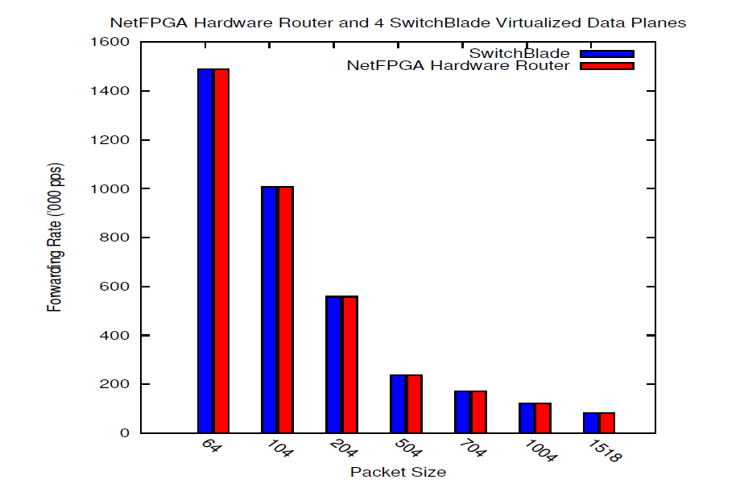
SwitchBlade Incurs No Additional Forwarding Overhead
Forwarding Rate (kpps)
Source: B. Anwer, Gatech
Notes:
Explain why bars are same for reference router + SwitchBlade.
-Path Splicing: each entry can represent one table(for experimentation) which provides great flexibility and less storage, and hopefully in Path Deflection also
-Variable Extractor: Used first 64-bits of the Ethernet frame are used for hashing.
- Postprocessing is used for Ipv4 router.

Slide 45
Conclusion
SwitchBlade: A programmable hardware platform with customizable parallel data planes
  Rapid deployment using library of hardware modules
  Provides isolation using rate limiters and fixed forwarding tables
Rapid prototyping in programmable hardware and software
Multiple data planes in parallel
  Resource sharing minimizes hardware cost
http://gtnoise.net/switchblade
Source: B. Anwer, Gatech

Slide 46
Outline
Review of Previous Lecture: SDN Updates
SDN Forwarding Abstractions
  Click software router
  SwitchBlade NetFPGA programmable router
  OpenFlow++

Slide 47
OpenFlow++: RMT Outline
Conventional switch chips are inflexible
SDN demands flexibility…sounds expensive…
How do we do it: The Reconfigurable Match Table (RMT) switch model
Flexibility costs less than 15%

Slide 48
Fixed function switch
L2: 128k x 48
Exact match
L3: 16k x 32
Longest prefix
match
ACL: 4k
Ternary match
X
X
X
X
X
PBB Stage
?????????
L2 Stage
L3 Stage
ACL Stage
Queues
In
L2 Table
L3 Table
ACL Table
Out
Action: set L2D
Action: set L2D, dec TTL
Action: permit/deny
Parser
Deparser
Stage 1
Stage 2
Stage 3
Data
Source: P. Bosshart, TI

Slide 49
What if you need flexibility?
Flexibility to:
  Trade one memory size for another
  Add a new table
  Add a new header field
  Add a different action
SDN accentuates the need for flexibility
  Gives programmatic control to control plane, expects to be able to use flexibility
Source: P. Bosshart, TI

Slide 50
What does SDN want?
Multiple stages of match-action
  Flexible allocation
Flexible actions
Flexible header fields
No coincidence OpenFlow built this way…
Source: P. Bosshart, TI

Slide 51
What about Alternatives?
Aren’t there other ways to get flexibility?
Software? 100x too slow, expensive
NPUs? 10x too slow, expensive
FPGAs? 10x too slow, expensive
Source: P. Bosshart, TI

Slide 52
What We Set Out To Learn
How do I design a flexible switch chip?
What does the flexibility cost?
Source: P. Bosshart, TI

Slide 53
What’s Hard about a
Flexible Switch Chip?
Big chip
High frequency
Wiring intensive
Many crossbars
Lots of TCAM
Interaction between physical design and architecture
Good news? No need to read 7000 IETF RFC’s!
Source: P. Bosshart, TI

Slide 54
OpenFlow++: RMT Outline
Conventional switch chip are inflexible
SDN demands flexibility…sounds expensive…
How do we do it: The RMT switch model
Flexibility costs less than 15%
Source: P. Bosshart, TI

Slide 55
The RMT Abstract Model
Parse graph
Table graph
Source: P. Bosshart, TI

Slide 56
Arbitrary Fields: The Parse Graph
Packet:
Ethernet IPV4 TCP
Ethernet
IPV4
IPV6
TCP
UDP
Source: P. Bosshart, TI

Slide 57
Arbitrary Fields: The Parse Graph
Packet:
Ethernet IPV4 TCP
Ethernet
IPV4
TCP
UDP
Source: P. Bosshart, TI

Slide 58
Arbitrary Fields: The Parse Graph
Packet:
Ethernet IPV4 RCP TCP
Ethernet
IPV4
RCP
TCP
UDP
Source: P. Bosshart, TI

Slide 59
Reconfigurable Match Tables:
The Table Graph
VLAN
ETHERTYPE
MAC
FORWARD
IPV4-DA
IPV6-DA
ACL
RCP
Source: P. Bosshart, TI

Slide 60
Changes to Parse Graph and Table Graph
Ethernet
ETHERTYPE
VLAN
VLAN
IPV4
IPV6
L2S
IPV4-DA
IPV6-DA
RCP
L2D
RCP
TCP
UDP
ACL
Done
MY-TABLE
Parse Graph
Table Graph
Source: P. Bosshart, TI

Slide 61
But the Parse Graph and Table Graph don’t show you how to build a switch
Source: P. Bosshart, TI

Slide 62
Match/Action Forwarding Model
Match
Action Stage
Match
Action Stage
Match
Action Stage
Queues
Match Table
Match Table
Match Table
Action
Action
Action
In
Out
Programmable Parser
Deparser
Stage 1
Stage 2
…
Stage N
Data
Source: P. Bosshart, TI

Slide 63
Performance vs Flexibility
Multiprocessor: memory bottleneck
Change to pipeline
Fixed function chips specialize processors
Flexible switch needs general purpose CPUs
Memory
L2
L3
CPU
ACL
Memory
CPU
Memory
CPU
Source: P. Bosshart, TI

Slide 64
How We Did It
Memory to CPU bottleneck
Replicate CPUs
More stages for finer granularity
Higher CPU cost ok
CPU
CPU
CPU
C
P
U
CPU
CPU
Memory
C
P
U
CPU
CPU
C
P
U
CPU
CPU
Source: P. Bosshart, TI

Slide 65
RMT Logical to Physical Table Mapping
Physical
Stage 1
Physical
Stage 2
Physical
Stage n
ETH
3
IPV4
9 ACL
VLAN
TCAM
L2S
IPV4
IPV6
2
VLAN
5
IPV6
Match Table
Match Table
Match Table
640b
Action
Action
Action
L2D
TCP
UDP
4
L2S
7 TCP
SRAM
HASH
ACL
8 UDP
Logical Table 6
L2D
Table Graph
Logical Table 1
Ethertype
640b
Notes:
To make it possible to efficiently use multiple stages of match tables, it is assumed that the RMT Model can be configured to map Logical Tables to the Physical Tables.
To create bigger tables, one table may traverse multiple stages.
To create many smaller tables, several tables can be packed into one stage.
To make the allocation even more flexible, the Action instructions and the Statistic could share the same table space.
This slide gives a crude representation of how the the Logical Tables could be mapped to the Physical Tables.
In practice, the control plane would need to create a Table Flow Graph (to accompany the Parse Graph) to decide how the Logical Tables are mapped.
The control plane is assumed to know the number and size of the physical stages available.
There could be as few as 1 stage. A given switch might only allow Logical Tables to directly correspond to Physical Tables.

Slide 66
Action Processing Model
Field
Header In
Header Out
ALU
Field
Data
Match result
Instruction
Source: P. Bosshart, TI
Notes:
Action processing is assumed to be available in each physical stage of the pipeline.
The headers are available along with the match result and metadata. Optional state could be available to the Action Processors.
There are assumed to be some number of processors (could be 1, could be hundreds) to perform Actions on headers.
The Action instruction set is assumed to be protocol independent (e.g. “insert these 8 bits starting at bit 19 of the 3rd header”).

Slide 67
Modeled as Multiple VLIW CPUs per Stage
ALU
ALU
ALU
ALU
ALU
ALU
ALU
ALU
ALU
Match result
VLIW Instructions
Source: P. Bosshart, TI

Slide 68
RMT Switch Design
64 x 10Gb ports
  960M packets/second
  1GHz pipeline
Programmable parser
32 Match/action stages
Huge TCAM: 10x current chips
  64K TCAM words x 640b
SRAM hash tables for exact matches
  128K words x 640b
224 action processors per stage
All OpenFlow statistics counters
Source: P. Bosshart, TI

Slide 69
OpenFlow++: RMT Outline
Conventional switch chip are inflexible
SDN demands flexibility…sounds expensive…
How do I do it: The RMT switch model
Flexibility costs less than 15%
Source: P. Bosshart, TI

Slide 70
Cost of Configurability:
Comparison with Conventional Switch
Many functions identical: I/O, data buffer, queueing…
Make extra functions optional: statistics
Memory dominates area
  Compare memory area/bit and bit count
RMT must use memory bits efficiently to compete on cost
Techniques for flexibility
  Match stage unit RAM configurability
  Ingress/egress resource sharing
  Table predication allows multiple tables per stage
  Match memory overhead reduction
  Match memory multi-word packing
Source: P. Bosshart, TI

Slide 71
Chip Comparison with Fixed Function Switches
Area
Section | Area % of chip | Extra Cost
IO, buffer, queue, CPU, etc | 37% | 0.0%
Match memory & logic | 54.3% | 8.0%
VLIW action engine | 7.4% | 5.5%
Parser + deparser | 1.3% | 0.7%
Total extra area cost |  | 14.2%
Power
Section | Power % of chip | Extra Cost
I/O | 26.0% | 0.0%
Memory leakage | 43.7% | 4.0%
Logic leakage | 7.3% | 2.5%
RAM active | 2.7% | 0.4%
TCAM active | 3.5% | 0.0%
Logic active | 16.8% | 5.5%
Total extra power cost |  | 12.4%

Slide 72
Conclusion
How do we design a flexible chip?
  The RMT switch model
  Bring processing close to the memories:
    pipeline of many stages
  Bring the processing to the wires:
    224 action CPUs per stage
How much does it cost?
  15%
Lots of the details how we designed this in 28nm CMOS are in the paper
Source: P. Bosshart, TI

Slide 73
Questions?

