Slide 1
Software Defined Networking
COMS 6998-8, Fall 2013
Instructor: Li Erran Li (lierranli@cs.columbia.edu)
http://www.cs.columbia.edu/~lierranli/coms6998-8SDNFall2013/
10/8/2013: SDN Update

Slide 2
Outline
Review of Previous Lecture
  SDN Programming Language
  SDN Verification
SDN Update
  Consistent Update
  Congestion-Free Update
  Network Partition

Slide 3
Review of Previous Lecture
SDN programming language
Maple is imperative, supports:
  Function in a general purpose language that describes how a packet should be routed, not how flow tables are configured.
  Conceptually invoked on every packet entering the network; may also access network environment state.
NetKAT/NetCore/Pyretic domain specific languages are declarative:
  Formal semantics expresses packet forwarding
  Support parallel and sequential composition
Source: Andreas Voellmy, Yale

Slide 4
Review of Previous Lecture (Cont’d)
Composition
To compose monitoring and routing, what composition operator to use?
To compose load balancing and routing, what composition operator to use?
Source: Andreas Voellmy, Yale

Slide 5
Review of Previous Lecture (Cont’d)
Pattern | Actions
dstip=3.4.5.6 | Fwd 1
dstip=6.7.8.9 | Fwd 2
Pattern | Actions
srcip=1.2.3.4 | Count
Monitor
+
Route
Controller Platform
Pattern | Actions
srcip=1.2.3.4, dstip=3.4.5.6 | Fwd 1, Count
srcip=1.2.3.4, dstip=6.7.8.9 | Fwd 2, Count
srcip=1.2.3.4 | Count
dstip=3.4.5.6 | Fwd 1
dstip=6.7.8.9 | Fwd 2
Source: Nate Foster, Cornell

Slide 6
Review of Previous Lecture (Cont’d)
Pattern | Actions
srcip=*0 | dstip:=10.0.0.1
srcip=*1 | dstip:=10.0.0.2
Pattern | Actions
dstip=10.0.0.1 | Fwd 1
dstip=10.0.0.2 | Fwd 2
Load Balance
;
Route
Controller Platform
Pattern | Actions
srcip=*0 | dstip:=10.0.0.1, Fwd 1
srcip=*1 | dstip:=10.0.0.2, Fwd 2
Source: Nate Foster, Cornell

Slide 7


Review of Previous Lecture (Cont’d)
SDN verification
NetPlumber: the System for real time verification of data plane properties
App
App
App
App
Controller
Logically centralized location
to observe the state changes
State updates
NetPlumber
SNMP Trap
Source: P. Kazemian, Stanford
Notes:
The system that we build for this purpose is called NetPlumber. It runs on a single or clusters of machines on the side and checks the stream of state updates against network policy. NetPlumber is more suitable for Software Defined networks, because IN SDNs, the interface between the controller and switches is a logically centralized location to observe all the state changes such as installation or removal of rules or link up/down events. So NetPlumber can tap into this communication and get a stream of network update. However NP can be used in conventional networks

Slide 8
Review of Previous Lecture (Cont’d)
NetPlumber graph:
  Creates a dependency graph of all forwarding rules in the network and uses it to verify policy
  Nodes: forwarding rules in the network
  Directed Edges: next hop dependency of rules
Switch 1
Switch 2
R1
R2
Notes:
Internally, NetPlumber creates a dependency graph of al rules in the network and uses it to verify network policy. The nodes of this graph are forwarding rules of networks and directed edges show the next hop relationship between edges, meaning that there is an edge from Rule R1 to R2, if there is a physical link from switch 1 to switch 2 in the network and also the input header space of R1, has some intersection with the input header space of R2. In another word, all this next hop dependency is saying is that there is at least one packet header processed by R1, can be processed next by R2.

Slide 9
Review of Previous Lecture (Cont’d)
0
1
X
X
1 0 0 1
1 0 X X
S
S
Where is the missing edge?
Example NetPlumber graph
Source: P. Kazemian, Stanford
Notes:
To understand how NetPlumber works, Let’s look at one simple example, consisting of these 4 switches. NP look at the forwarding rules of each of these switch and for each rule, create one rule node in the net plumber graph. We use a completely visual representation of the rules in this example. We assume that headers are only 4 bits long. The match pattern of each rule that specify which packets should be processed by the rule is represented by these 8 squares. The upper square corresponds to value 0, and the lower squares corresponds to value 0. For example this rule matches on 1001 headers and forward them to the green box. This one matches on 01xx headres, rewrite them to 001x and forward ot the green box. NP puts one node for every rule in the switches. Then it creates directed edges between the rules. For example we have this directed edge because the output headers of this this rule has some intersection with input headers of this rule

Slide 10
Review of Previous Lecture (Cont’d)
0
1
X
X
1 0 0 1
1 0 X X
S
S
Example NetPlumber graph
Source: P. Kazemian, Stanford
Notes:
To understand how NetPlumber works, Let’s look at one simple example, consisting of these 4 switches. NP look at the forwarding rules of each of these switch and for each rule, create one rule node in the net plumber graph. We use a completely visual representation of the rules in this example. We assume that headers are only 4 bits long. The match pattern of each rule that specify which packets should be processed by the rule is represented by these 8 squares. The upper square corresponds to value 0, and the lower squares corresponds to value 0. For example this rule matches on 1001 headers and forward them to the green box. This one matches on 01xx headres, rewrite them to 001x and forward ot the green box. NP puts one node for every rule in the switches. Then it creates directed edges between the rules. For example we have this directed edge because the output headers of this this rule has some intersection with input headers of this rule

Slide 11
Outline
Review of Previous Lecture
  SDN Programming Language
  SDN Verification
SDN Update
  Consistent Update
  Congestion-Free Update
  Network Partition

Slide 12

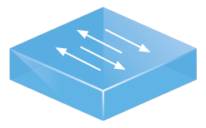
Updates Happen
Network Updates
Maintenance
Failures
ACL Updates
Desired Invariants
No black-holes
No loops
No security violations
Notes:
Updates are a fact of life for network administrators. Configuration changes happen whenever an administrator brings device down for maintenance, performs traffic engineering, or does essentially anything on the network.

Slide 13






Update one Switch
Distributed Programming:
non-atomic table updates
Priority | Predicate | Action
Priority | Predicate | Action
10 | SSH | Drop
⊆
⊆
Priority | Predicate | Action
5 | dst_ip = H1 | Fwd 1
Priority | Predicate | Action
10 | SSH | Drop
5 | dst_ip = H1 | Fwd 1
update re-ordering
⊆
Priority | Predicate | Action
5 | dst_ip = H1 | Fwd 1
5 | dst_ip = H2 | Fwd 2
Priority | Predicate | Action
10 | SSH | Drop
5 | dst_ip = H1 | Fwd 1
5 | dst_ip = H2 | Fwd 2
Source: Nate Foster, Cornell

Slide 14
Update one Switch (Cont’d)
Solution: insert barrier messages to enforce partial ordering of rule updates

Slide 15
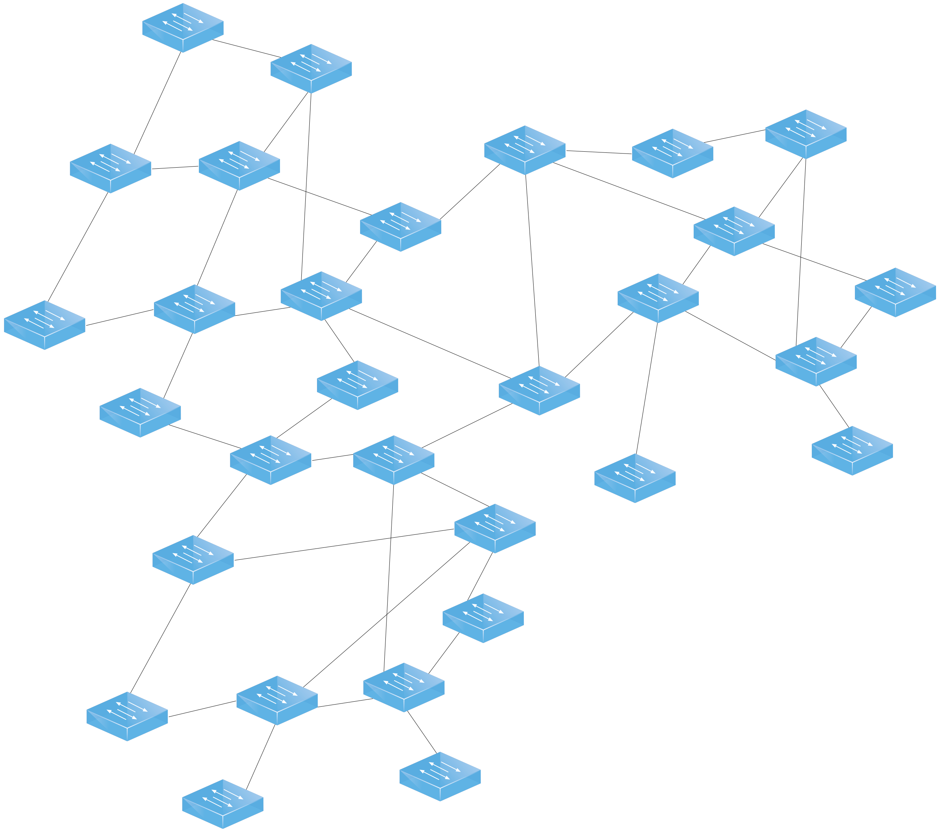
Network Updates Are Hard
Source: M. Reitblatt, Cornell
Notes:
Unfortunately, performing updates is quite tricky. Networks are large distributed systems and completing an update can take some time. Changes on one part of the network can begin affecting traffic before the full update has been rolled out, introducing forwarding loops, blackholes or worse.

Slide 16

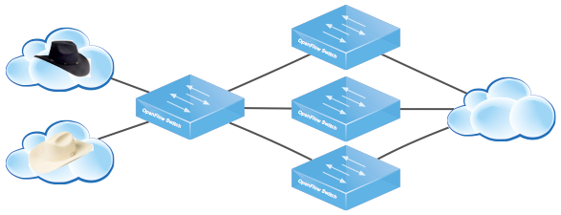
Network Update Abstractions
Goal
Tools for whole network update
Approach
Develop update abstractions
Endow them with strong semantics
Engineer efficient implementations
Source: M. Reitblatt, Cornell
Notes:
Instead of having network administrators sit down and work out how to perform an update rule by rule, switch by switch, we instead propose they should use a simple abstraction that updates the entire network in one fell swoop. The abstraction will provide powerful, reasonable semantics that allow administrators to understand how the network will behave during update, and leave the exact implementation details to a runtime that figures out the most efficient way to perform the actual update.

Slide 17
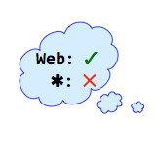
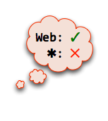
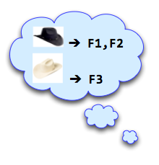
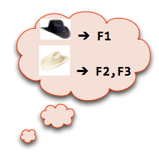
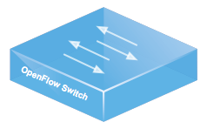
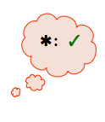

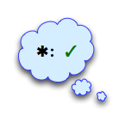

Example: Distributed Access Control
Security Policy
Src | Traffic | Action
 | Web | Allow
 | Non-web | Drop
 | Any | Allow
F1
I
F2
F3
Traffic
Source: M. Reitblatt, Cornell

Slide 18


Naive Update
Security Policy
Src | Traffic | Action
 | Web | Allow
 | Non-web | Drop
 | Any | Allow
F1
I
F2
Order
F1
F2
F3
I
F3
Traffic
Source: M. Reitblatt, Cornell

Slide 19

Use an Abstraction!
Security Policy
✓
UPDATE
✓
✓
Source: M. Reitblatt, Cornell

Slide 20
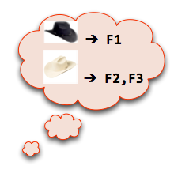
Atomic Update?
Security Policy
Src | Traffic | Action
 | Web | Allow
 | Non-web | Drop
 | Any | Allow
F1
I
F2
F3
Traffic
Source: M. Reitblatt, Cornell
Notes:
“As-if all the switches moved to the new configuration at the same time” Atomic Updates lead to Nuclear explosions

Slide 21
Per-Packet Consistent Updates
Per-Packet Consistent Update
Each packet processed with old or new configuration, but not a mixture of the two.
Security Policy
Obeys policy:
Src | Traffic | Action
 | Web | Allow
 | Non-web | Drop
 | Any | Allow
Obeys policy:
Source: M. Reitblatt, Cornell

Slide 22
Universal Property Preservation
Theorem: Per-packet consistent updates preserve all trace properties.
Trace Property
Any property of a single packet’s path through the network.
Examples of Trace Properties:
Loop freedom, access control, waypointing ...
Trace Property Verification Tools:
NetPlumber, ConfigChecker ...
Source: M. Reitblatt, Cornell
Notes:
Emphasize universal guarantee: programmers don’t need to write down specific properties or specifications. ANY path property is preserved, without having to tell us what property you want “As it turns out”

Slide 23
Formal Verification
Corollary: To check an invariant, verify the old and new configurations.
Security Policy
Analyzer
✓
Security Policy
Analyzer
✓
Verification Tools
Anteater [SIGCOMM ’11]
NetPlumber [SIGCOMM ’13]
ConfigChecker [ICNP ’09]
Source: M. Reitblatt, Cornell

Slide 24
Mechanisms

Slide 25
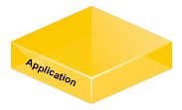

2-Phase Update
Overview
Runtime instruments configurations
Edge rules stamp packets with version
Forwarding rules match on version
Algorithm (2-Phase Update)
Install new rules on internal switches, leave old configuration in place
Install edge rules that stamp with the new version number
update(config,topo)
Calculate rules,
generate messsages
Source: M. Reitblatt, Cornell
Notes:
The natural question is: when can we perform a per-packet update? Is it always possible?
It turns out the answer is yes: we can always perform a per-packet update between configurations. There is a general mechanism, the 2-phase update mechanism, that always works, regardless of the configuration or topology.
The mechanism works by instrumenting the entire network configuration with version numbers. The rules are then predicated upon a packet having a specific version number.
To perform the update, first install the new configuration rules on the internal switches. Then, install rules on the edge switches that stamp incoming packets with the new version. Then, when all the old version packets are gone, delete the old configuration.

Slide 26
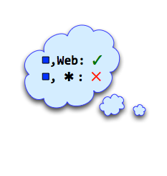
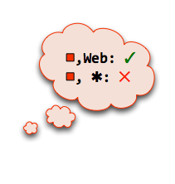
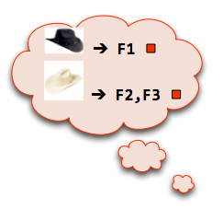
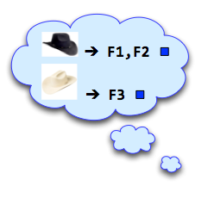
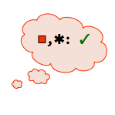
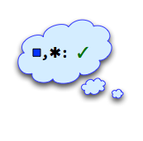
2-Phase Update in Action
F1
I
F2
F3
Traffic
Source: M. Reitblatt, Cornell

Slide 27

Optimized Mechanisms
Optimizations
Extension: strictly adds paths
Retraction: strictly removes paths
Subset: affects small # of paths
Topological: affects small # of switches
Runtime
Automatically optimizes
Power of using abstraction
update(config,topo)
Calculate rules,
generate messsages
Source: M. Reitblatt, Cornell
Notes:
Pronounce optimizations and explain that they reduce overhead in common situations

Slide 28
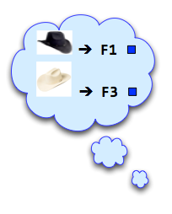
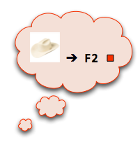
Subset Optimization
F1
I
F2
F3
Traffic
Source: M. Reitblatt, Cornell
Notes:
To make all of this concrete, lets consider the simple network here. It has 4 switches: an ingress switch on the left and 3 switches in the middle that perform filtering. Traffic flows from left to right and it’s connected to two external networks: a trusted white-hat network and an untrusted black-hat network. The network has a security policy that allows trusted white-hat traffic unrestricted access to the internal network on the right, and restricts the untrusted black-hat network to only send web traffic.
Note: Make example completely graphical (add ingress routing), remove text configurations

Slide 29
Correctness
Question: How do we convince ourselves these mechanisms are correct?
Solution: built an operational semantics, formalized our mechanisms and proved them correct
Example: 2-Phase Update
Install new rules on internal switches, leave old configuration in place
Install edge rules that stamp with the new version number
}
Unobservable
}
One-touch
Theorem: Unobservable + one-touch = per-packet.
Source: M. Reitblatt, Cornell
Notes:
To answer this question, we used a common technique from the PL community and built a formal model...
Maybe Q, Solution, Insight

Slide 30
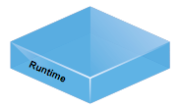

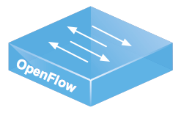
Implementation
Runtime
  NOX Library
  OpenFlow 1.0
  2.5k lines of Python
  update(config, topology)
  Uses VLAN tags for versions
  Automatically applies optimizations
Verification Tool
  Checks OpenFlow configurations
  CTL specification language
  Uses NuSMV model checker
update(config,topo)
Source: M. Reitblatt, Cornell
Notes:
Make other boxes more transparent/gray out

Slide 31
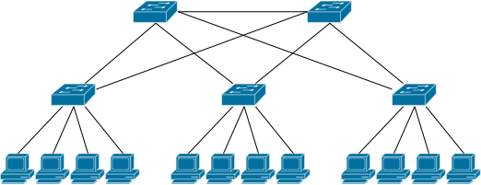
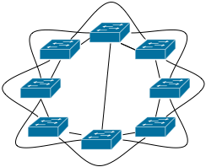
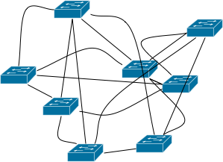
Evaluation
Question: How much extra rule space is required?
Setup
  Mininet VM
Applications
  Routing and Multicast
Scenarios
  Adding/removing hosts
  Adding/removing links
  Both at the same time
Topologies
Fattree
Small-world
Waxman
Source: M. Reitblatt, Cornell
Notes:
Thought: are these useful opts in practice? Ran simulations to test. Make set-up graphical, illustrate topos + set-up structure etc

Slide 32
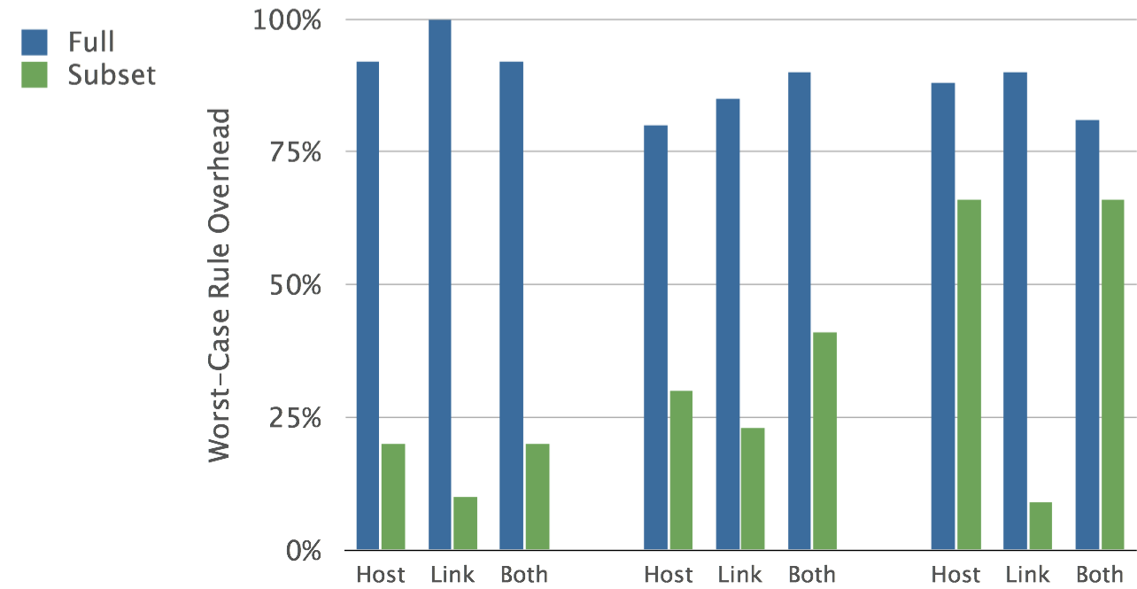
Results: Routing Application
Fattree
Small-world
Waxman
Source: M. Reitblatt, Cornell

Slide 33
Conclusion
Update abstractions
  Per-packet
  Per-flow
Mechanisms
  2-Phase Update
  Optimizations
Formal model
  Network operational semantics
  Universal property preservation
Source: M. Reitblatt, Cornell
Notes:
Without an update abstraction, you have two choices: either work very hard to figure out how to implement your update to preserve the properties you care about, or just throw your update at the network and hope it will work. With an update abstraction, you can just throw your update at the runtime and know it will work.

Slide 34
Outline
Review of Previous Lecture
  SDN Programming Language
  SDN Verification
SDN Update
  Consistent Update
  Congestion-Free Update (zUpdate)
  Network Partition

Slide 35

DCN is constantly in flux
Upgrade → Reboot
New Switch
Traffic Flows
Source: J. Liu, Yale
Notes:
In data centers, applications generate traffic flows and rely on network to deliver them.
The traffic distribution of these flows can change with the updates in network.
For example, before shutting down a switch, we typically move flows on the switch out to other switches.
After the switch goes online again, we move the flows back.
For another example, when a new switch is connected into the network, we often conduct some existing flows to go through it to test it or make a use of it.

Slide 36
DCN is constantly in flux
Traffic Flows
Virtual Machines
Source: J. Liu, Yale
Notes:
While the network is in flux, applications’ behaviors are also changing the traffic distribution simultaneously.
For instance, an application owns some virtual machines and these virtual machines have some traffic flows with each other.
When the application decides migrate some virtual machines to other locations, the VM migration can reshape the traffic flows.
In production data center networks, updates like our examples are happening everyday.

Slide 37


Network updates are painful for operators
Two weeks before update, Bob has to:
Coordinate with application owners
Prepare a detailed update plan
Review and revise the plan with colleagues
Complex Planning
Switch Upgrade
Unexpected Performance Degradation
At the night of update, Bob executes plan by hands, but
Application alerts are triggered unexpectedly
Switch failures force him to backpedal several times.
Eight hours later, Bob is still stuck with update:
No sleep over night
Numerous application complaints
No quick fix in sight
Laborious Process
Bob: An operator
Source: J. Liu, Yale
Notes:
One day, to fix an operating system level bug in the switches, Bob needs to upgrade all switches in the network as soon as possible. He knows the applications hosted in the data center can have serious concerns about their performance during the update, so he firstly spends two weeks to coordination the applications owners to learn their requirements. Based on what he learns, he made a detailed update plan including which part of the network he will touch, what are the steps of the upgrade, and even configuration scripts he will uses.
He also asked his colleagues to review and revise the plan to make sure it is good to go.
To make the update even safer, he decides to do it in off-peak hours at night.
However, his cautious attitude does not give him a smooth process. He triggered some application alerts unexpectedly.
What makes it worse is that some switch failures prevent him from following his original plan, and force him to backpedal several times.
Eight hours later, Bob is still struggling without any sleep. He makes little progress, but receives many complaints from applications. He has to suspend the update now, because he sees no quick fix currently. And he gets upset.

Slide 38
Congestion-free DCN update is the key
Applications want network updates to be seamless
  Reachability
  Low network latency (propagation, queuing)
  No packet drops
Congestion-free updates are hard
  Many switches are involved
  Multi-step plan
  Different scenarios have distinct requirements
  Interactions between network and traffic demand changes
Congestion
Source: J. Liu, Yale
Notes:
The problems in network update make application nervous, because from network they always want reachability, low network latency and no packet drop. For reachability, data center networks offer multiple paths for flows so typically we do not loss reachability during an update. For network delay, the propagation delay is within 1ms so we do not worry about that. But the queuing delay and packet drop, they both depend on whether there are congestions in the network. So essentially, what applications want is a congestion-free update.
However for operators, performing a congestion-free update is hard. It is because an update typically involves many switches, and to avoid the congestion a plan with multiple steps is needed. There are various scenarios and each of them has a distinct requirement for the network update. So one update plan made for one scenario cannot be re-used in others.
And moreover, sometimes network updates should interact with the traffic demand changes from applications, which make the situation even more complex.
To better understand the preceding challenges, let us do a case study.

Slide 39
A clos network with ECMP
All switches: Equal-Cost Multi-Path (ECMP)
Link capacity: 1000
150
150
620
+ 150
150
= 920
150
+ 150
300
300
300
300
600
600
Source: J. Liu, Yale
Notes:
Now let us take a look at an example to see why a congestion-free update is difficult.
We have a small FatTree network. The capacity of each link is 1000.
There are two flows with size 620 from two CORE switches to ToR3. We highlight the two bottleneck links on the network. The two flows put 620 load on the two links.
At the same time, there is a flow from ToR1 to ToR2. This flow has multiple paths to reach ToR2 and each switch is using ECMP which equally splits the traffic loads among the out-going links.
We can find that this flow’s load on the two bottleneck links are 150.
Similarly, another flow from ToR5 to ToR4 with size 600 also has 150 load on the two links.
The total load of the bottleneck links is 920 which is less than the capacity. Therefore, now the network has no congestions.

Slide 40
Switch upgrade: a naïve solution triggers congestion
Link capacity: 1000
= 1070
620
+ 300
+ 150
= 920
+ 150
Drain AGG1
600
Source: J. Liu, Yale
Notes:
Now we want to shutdown AGG1. Before doing that, we want to move out all the traffic on AGG1. We try to simply reconfigure ToR1 and make it never forwards the flow green to AGG1 anymore. However, this naïve solution causes congestions. Because the reconfiguration on the green flow will change its traffic distribution over the network which congests one of the bottleneck link.

Slide 41
Switch upgrade: a smarter solution seems to be working
Link capacity: 1000
= 1070
+ 50
= 970
620
+ 300
+ 150
Drain AGG1
500
100
Weighted ECMP
Source: J. Liu, Yale
Notes:
To avoid the congestion, we can change ToR5 to make it split the flow blue as 500, 100. This change will redistribute the loads of the blue flow over the network. As a result, we get a good traffic distribution over the network: it has no congestions, and it has no traffic on AGG1. It looks perfect.

Slide 42
Traffic distribution transition
Initial Traffic Distribution
Congestion-free
Final Traffic Distribution
Congestion-free
Transition
?
300
300
300
300
0
600
500
100
Simple?
NO!
Asynchronous Switch Updates
Source: J. Liu, Yale
Notes:
Let us make a summary. Initially we have a traffic distribution, and for draining a switch we want the network gets a new traffic distribution. Both of the traffic distributions have no congestion. And now the only problem is whether the transition process is congestion-free or not. To realize the transition, we need to reconfigure two switches. Is it so simple in the end? Of course not!. At least we should know which switch is to update first.

Slide 43
Asynchronous changes can cause transient congestion
When ToR1 is changed but ToR5 is not yet:
Link capacity: 1000
620 + 300 + 150 = 1070
Drain AGG1
300
300
600
Not Yet
Source: J. Liu, Yale
Notes:
Let us see what happens if ToR1 is changed first. During the period that ToR1 is updated but ToR5 has not yet. The bottleneck link on the right will be congested.

Slide 44

Solution: introducing an intermediate step
Initial
Final
Transition
300
300
300
300
0
600
500
100
Congestion-free regardless the asynchronizations
Congestion-free regardless the asynchronizations
Intermediate
?
200
400
450
150
Source: J. Liu, Yale
Notes:
So overall, we see that despite we have no congestion on both the initial and the final traffic distributions, it is impossible the make the direct transition congestion-free. Then what shall we do? A method we can try is to introduce some intermediate step which has the property that the transitions from the initial to it and from it to the final are congestion-free regardless the update orders.
So does this intermediate step exist? Yes, and this is an example. I will talk about how we can find it later. But now from this example we can see that even playing with two flows on such a small network it has already been hard enough to make a congestion-free update. In real production network, when we have thousands of switches and millions of flows, it is impossible to plan and execute a congestion-free update by operators.

Slide 45

How zUpdate performs congestion-free update
Update
Scenario
Update requirements
Operator
zUpdate
Current Traffic Distribution
Intermediate
Traffic Distribution
Intermediate
Traffic Distribution
Target Traffic Distribution
Data Center Network
Source: J. Liu, Yale
Routing Weights
Reconfigurations
Notes:
zUpdate stands in the middle between operators and data center network. It keeps monitoring the current traffic distribution in the network. When operator has an update scenario to perform, zUpdate translate the update requirement into the constraint to the target traffic distribution. Then, zUpdate will automatically find a target traffic distribution, and a chain of intermediate traffic distributions which bridges the current and the target traffic distributions and makes sure that the whole transition process is congestion-free.
After that, zUpdate configures the network according to the plan.

Slide 46
Key technical issues
Describing traffic distribution
Representing update requirements
Defining conditions for congestion-free transition
Computing an update plan
Implementing an update plan
Source: J. Liu, Yale
Notes:
To achieve the goal of zUpdate, we should address some key technical issues.
In the following of this talk, we will first formulate traffic distribution, and use this formulation to express the update requirements in different scenarios. Then we will find the condition for a congestion-free transition, and compute and implement an update plan based on the preceding formulations and conditions.

Slide 47
Describing traffic distribution
: flow f’s load on link v, u
=150
150
=300
300
600
Source: J. Liu, Yale
Notes:
To formulate a traffic distribution we first define lv, u f which means the flow f’s load on link from switch v to u.
For example, on this network, a flow with flow size 600 comes in. If s1 equally split the traffic load, f’s load on the link from s1 to s2 is 300. Its load on link from s2 to s4 is 150.
Traffic distribution is a set of lv, u f when we enumerate all flows and links.

Slide 48
Representing update requirements
When s2 recovers
Drain s2
Constraint: no flow to s2
Constraint: ECMP equal split
Source: J. Liu, Yale
Notes:
With the formulations, we can easily represent the requirements on target traffic distributions.
For example, when we want to drain s2, we can simply require that ls1s2f should be 0. Generally, we require that each flow’s loads on the incoming links of s2 should be 0.
For another example, when s2 recovers, we want all the switch to get back to equally splitting the traffic, we require that ls1s2f is equal to ls1s2f. Generally, we require that for each flow, the flows load on each out-going link of a switch should be equal.
Here we only offer two examples. We have formulated all the requirements for the scenarios we mentioned.
Please look into the paper for more details.

Slide 49
Switch asynchronization exponentially inflates the possible load values
Transition from old traffic distribution to new traffic distribution
f
ingress
1
2
4
6
egress
8
f
3
5
7
Asynchronous updates can result in 2^5 possible load values on link (7,8) during transition.
In large networks, it is impossible to check if the load value exceeds link capacity.
Source: J. Liu, Yale
Notes:
Now we consider a traffic distribution transition.
We start from a single flow case.
To realize a transition, we insert new rules of flow f into all the switches.
Therefore, in large network, switch asynchronization causes too many potential loads on each link, which prevents us from judging whether a link will be overloaded during the transition.

Slide 50
Two-phase commit reduces the possible load values to two
Transition from old traffic distribution to new traffic distribution
ingress
f
1
2
4
6
egress
version flip
f
8
3
5
7
With two-phase commit, f’s load on link (7,8) only has two possible values throughout a transition
Source: J. Liu, Yale
Notes:
To solve this problem, we leverage two-phase commit for a transition.
The process is as following:
At the beginning of a transition, we push out the new rules. The flow keeps using the old rules until all the new rules are installed in each switch. Finally, we indicate the ingress switch to make a version flip, so that the flowing switches all use the new rules to process the flow.
Eventually, it comes to the new traffic distribution.
We proof that with two-phase commit, a flow’s load on a link throughout the transition only have two possible values, the load in the old traffic distribution or the one in the new traffic distribution.

Slide 51
Flow asynchronization exponentially inflates the possible load values
f1
1
2
4
6
f1 + f2
8
f2
0
3
5
7
Asynchronous updates to N independent flows can result in 2^N possible load values on link (7,8)
Source: J. Liu, Yale
Notes:
In last example, we only consider a single flow in the network. However, in practice, a link can carry multiple flows simultaneously.
For example, if this network has two flows f1 and f2 and either of the flows is using two-phase commit, the total load on the link from switch 7 to 8 will have four potential values. We can see the asynchronization among flows still exponentially inflates the possible link load values.

Slide 52
Handling flow asynchronization
f1
1
2
4
6
8
f2
0
5
3
7
The load on link switch 7 to 8 has four potential values, but it is no more than the sum of f1’s maximum potential value and f2’s maximum potential value.
Source: J. Liu, Yale
Notes:
To handle the flow asynchronizaiton, we first make an observation. The load on link switch 7 to 8 has four potential values, but it is no more than the sum of f1’s maximum potential value and f2’s maximum potential value.
When we generalize this observation, we get the constraint of a congestion-free transition. On each link, we sum up each flow’s potential maximum load. If this worst case does not congestion the link, the link is congestion-free during the transition.

Slide 53
Computing congestion-free transition plan
Linear Programming
Constraint:
Congestion-free
Constraint:
Update Requirements
Constant:
Current Traffic Distribution
Variable:
Intermediate
Traffic Distribution
Variable:
Intermediate
Traffic Distribution
Variable:
Target Traffic
Distribution
Constraint:
Deliver all traffic
Flow conservation
Source: J. Liu, Yale
Notes:
Given all the previous analysis, computing a transition plan becomes straightforward.
The current traffic distribution is a constant for us, and our variables are the target and the intermediate traffic distributions. We have some constraints on our variables. The first one is the update requirements to the target traffic distribution. Then to avoid congestion, we require that all the adjacent traffic distributions satisfy the congestion-free transition constraint. Additionally, each traffic distribution should also satisfy some other constraints, such that they should deliver all the traffic demands and they respect the flow conservation.
Fortunately, all the constraints are linear. We can compute the variable traffic distributions with LP.

Slide 54
Implementing an update plan
Computation time
Switch table size limit
Update overhead
Failure during transition
Traffic demand variation
Weighted-ECMP
ECMP
Other Flows
Critical
Flows
Flows traversing bottleneck links
Source: J. Liu, Yale
Notes:
For implementing a plan, we still need to solve some practical issues.
In large scale data centers, we could have millions of flows. It is infeasible if we manipulate all the flows over the network. Because if so the computation time of an update plan could be too long, and the limited flow table in switches cannot accommodate so many flow rules. Moreover, the more rules we update, the more overhead on the switch we create. Therefore, we only want to manipulate a small number of critical flows and leave other flows as pure ECMP. We define the flows traversing the bottleneck links as critical flows. Because in practice, a DCN typically only has several bottleneck links, the critical flows are only a small fraction in the total.
Additionally, we also consider how to re-compute a plan or rollback when failure happens during a transition.
Finally, when traffic demands are changing simultaneously during the transition, we simply use the maximum flow size of each flow as the flow size in the plan computation, which can guarantee the transition is still congestion-free.

Slide 55
Evaluations
Testbed experiments
Large-scale trace-driven simulations
Notes:
Next we will show the evaluation results from both testbed experiments and large-scale trace-driven simulations.

Slide 56
Testbed setup
ToR6,7: 6.2Gbps
ToR6,7: 6.2Gbps
ToR6,7: 6.2Gbps
ToR6,7: 6.2Gbps
Drain AGG1
ToR5: 6Gbps
ToR8: 6Gbps
Source: J. Liu, Yale
Notes:
We build a testbed with 22 switches forming a FatTree. Each switch is enabled with OpenFlow 1.0 and the capacity of the links is 10Gbps. We leverage a traffic generator to insert flows into the network. The update scenario is to drain AGG1 and then upgrade its firmware. It is indeed a replay of the example we saw in the beginning of this talk.

Slide 57
zUpdate achieves congestion-free switch upgrade
Initial
Intermediate
3Gbps
3Gbps
3Gbps
3Gbps
2Gbps
4Gbps
4.5Gbps
1.5Gbps
Final
0
6Gbps
5Gbps
1Gbps
Source: J. Liu, Yale
Notes:
We show the real-time link utilization of the two bottleneck links: the blue link the orange link. Initially, the loads on both of the links are stable. During the transition from the initial to the intermediate, the link loads are shifted twice without any congestion. In the transition from the intermediate to the final, we did not see any congestion either.

Slide 58
One-step update causes transient congestion
Initial
3Gbps
3Gbps
3Gbps
3Gbps
Final
0
6Gbps
5Gbps
1Gbps
Source: J. Liu, Yale
Notes:
However, if we make the transition from the initial directly to the final, a transient congestion will happen during the transition.

Slide 59
Large-scale trace-driven simulations
A production DCN topology
Flows
Test flows (1%)
Source: J. Liu, Yale
Notes:
For the large scale simulation, we used a production network topology with real traces of traffic flows.
The scenario is that the onboarding of a new CORE switch. After connecting the new CORE with each container in the network, we conduct 1% existing ToR pair flows onto the new switch.

Slide 60
zUpdate beats alternative solutions
Post-transition Loss Rate
Transition Loss Rate
15
10
Loss Rate (%)
5
0
zUpdate
zUpdate-OneStep
ECMP-OneStep
ECMP-Planned
#step
2
1
1
300+
Source: J. Liu, Yale
Notes:
This figure shows the link loss rate when we use four different approaches to perform the transition. The four approaches are zUpdate, zUpdate-OneStep which has the same target traffic distribution but omit all intermediate steps, ECMP-OneStep which has an ECMP-based target traffic distribution and jump to the target in one step, and ECMP-Planned which has an ECMP-based target traffic distribution and a switch update order is carefully selected to create less congestions during the transition.
The first metric is the post-transition loss rate which shows the link loss in the target traffic distribution. We can see that zUpdate and zupdate-Onestep which uses Weighed-ECMP has no such loss. However, an ECMP-based target traffic distribution can have congestions.
The second metric we compare is the transition loss rate which measures the link loss during the transition process. We can see that zUpdate has no such loss, while the other three have large loss rates. ECMP-planned has a smaller link loss rate because its switch update order is selected to reduce the chance of transient congestions. Nevertheless, its loss rate is still around 3%.
The #step measures how long does a transition take. We can see that zUpdate has 2 steps which means it has one intermediate traffic distribution. ECMP-planned has much more steps, because it needs to force an update order on the switches.

Slide 61
Conclusion
Switch and flow asynchronization can cause severe congestion during DCN updates
zUpdate provides congestion-free DCN updates
  Novel algorithms to compute update plan
  Practical implementation on commodity switches
  Evaluations in real DCN topology and update scenarios
Source: J. Liu, Yale
Notes:
Here we come to the conclusion.
In this paper, we learn that asynchronous changes in network updates can arouse severe congestions.
We introduce zUpdate to perform congestion-free network updates. We formulate the problem, design a novel algorithm to compute the update plan automatically, build a prototype on OpenFlow 1.0 and showing it works well in different real scenarios.

Slide 62
Outline
Review of Previous Lecture
  SDN Programming Language
  SDN Verification
SDN Update
  Consistent Update
  Congestion-Free Update (zUpdate)
  Network Partition

Slide 63
Network Partition
Out-of-band control network
Routing and forwarding based on addresses
Policy specification using end-host names
Controller only aware of local name-address bindings

Slide 64
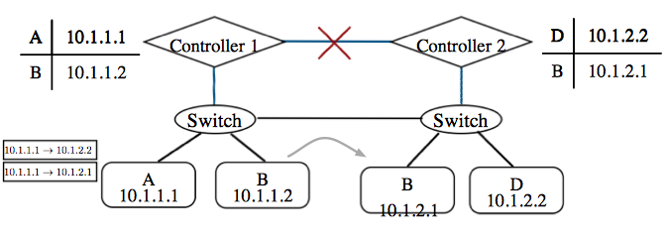
Network Partition
Consider policy isolating A from B. A control network partition occurs. Only possible choices
  Let all packets through (including from A to B) (Correctness)
  Drop all packets (including from A to D) (Availability)

Slide 65
Solution to Network Partition
Network can label packets with sender’s identity
  Route based on identity instead of address
Inband control

Slide 66
Questions?

