Slide 1
Software Defined Networking COMS 6998-8, Fall 2013
Instructor: Li Erran Li (lierranli@cs.columbia.edu)
http://www.cs.columbia.edu/~lierranli/coms6998-8SDNFall2013/
9/24/2013: SDN Programming Language

Slide 2
Outline
Announcements
Homework 2 posted due in 18 days
Next lecture: first half by Josh Reich from Princeton on Pyretic
Review of previous lecture
SDN programming language
Maple: generic programming language syntax such as Java, Python
Frenetic

Slide 3
Review of Previous Lecture
How do we design scalable software defined networks?
Design scalable controllers
Offload control plane processing to switches
How do we design scalable controllers?
Flat structure multiple controllers
Recursive controller design
Hierarchical controller design

Slide 4
Review of Previous Lecture (Cont’d)
How to offload control plane processing to switches?
Offload to switch control plane
Controller proactively generates the rules and distributes them to authority switches
Authority switches keep packets always in the data plane and ingress switches reactively cache rules
Offload to switch data plane
Try to stay in data-plane, by default
Provide enough visibility: for significant flows & sec-sensitive flows; Otherwise, aggregate or approximate statistics

Slide 5
Review of Previous Lecture (Cont’d)
How do we divide work among controller instances?
Partition
Controller instances with different computations tasks
Controller instances have only subsets of the NIB
Switches connect to a subset of controller instances
Aggregation
Reduce fidelity of information

Slide 6
Review of Previous Lecture (Cont’d)
How to maintain network information base (NIB)?
Replicated transactions (SQL) storage for strong consistency (more static information)
One-hop memory-based DHT for weak consistency (more dynamic information)

Slide 7
Review of Previous Lecture (Cont’d)
Authority Switch
Feedback:
Cache rules
Ingress Switch
Forward
Egress Switch
Redirect
First packet
Following packets
Hit cached rules and forward
Offload to switch control plane
Source: Minlan Yu

Slide 8
Outline
Announcements
Homework 2 posted due in 18 days
Next lecture: first half by Josh Reich from Princeton on Pyretic
Review of previous lecture
SDN programming language
Maple: generic programming language syntax such as Java, Python
Frenetic: domain specific programming language

Slide 9
A Key Source of Complexity in Openflow Controllers
onPacketIn(p):
Step 1
examine p and decide what to do with p.
construct and install OF rules so that similar packets are processed at switches with same action.
Step 2
Source: Andreas Voellmy, Yale
Notes:
Programming directly with Openflow requires that the programmer explicitly manage the flow tables of all switches in the network. While this provides substantial flexibility, it is also a key source of complexity in Openflow controllers.
To appreciate the complexities that managing flow tables introduces, look at the packet-in handler of an Openflow controller. The packet-in handler defines what should be done when a packet fails to match in a switch’s flow table. This program consists of roughly two steps. In the first step, the program examines the given packet - for example reading the source and destination addresses to perform access control checks or route computations - and decides what to do with the packet. This first step expresses the user’s desired outcome. Ideally, it would be the only thing that the user has to write.
Of course, if we process every packet at the controller, we will have a non-scalable network. Hence, the packet-in handler must also include a second step which constructs and install OF rules to add to their switches, so that similar packets arriving at switches in the near future are processed using the outcome just decided in step 1.

Slide 10
Simple, generic solution using exact matches
Every flow incurs flow setup delay.
onPacketIn(p):
Step 1
examine p and decide what to do with p.
insert rule with “exact match” for p, i.e. match on ALL attributes, with action determined above.
Step 2
Source: Andreas Voellmy, Yale
Notes:
A simple, generic strategy for the second step is to use exact match rules. An exact match rule uses a match condition that specifies the value of all the fields in the packet header. It is simple to see that the resulting flow tables generated will correctly classify packets, because if a packet matches a rule in the flow table, then the packet-in handler installed the matching rule in response to a previous packet that is indistinguishable from the given packet and hence would cause the controller to make the same decision.
Unfortunately, using exact match rules will cause the first packet of every flow to be diverted to the controller adding substantial delay to many network applications.

Slide 11
Step 1
Step 2
drop
match:{TcpDst=22} action:drop
yes
priority:HIGH
p.TcpDst=22?
tcpDst!=22
send to next hop for p.EthDst
match:{EthDst=p.EthDst} action:nextHop(p)
no
priority:LOW
Source: Andreas Voellmy, Yale
Notes:
Fortunately, many controllers can avoid this performance penalty by taking advantage of Openflow’s wildcard rules. A wildcard rule matches only on a specified subset of the packet headers.
Consider the followimg example that illustrates the use of wildcard rules. This controller drops packets to TCP destination 22, and forwards other packets to the next hop for their destination. For the port 22 packets, the handler generates a rule that matches only on port 22 and uses the “drop” action.
For the other packets, it generates a rule that matches on the Ethernet destination and forwards the packet to the next hop. This rule really should also include a condition specifying that it only handles non-TCP destination 22 packets, but unfortunately, negated conditions are not supported by Openflow. So instead, the controller uses priorities to ensure that rules for port 22 traffic are matched first; it places the port 22 rule at a high priority and the other rules at a low priority.

Slide 12
Switch
EthDst:A,
TcpDst:80
Low | EthDst:A | Port 1
EthDst:A,
TcpDst:22
Controller
If p.TcpDst=22:
insert rule
{prio:HIGH, match:{TcpDst=22}, action:drop }
Else:
insert rule
{prio:LOW, match:{EthDst=p.EthDst},action:nextHop(p.EthDst)
Notes:
Unfortunately, this program has a bug. To see where the program goes wrong, watch what happens when we connect this controller to a single switch and let two packets arrive. Both packets have destination A. The red packet is to TCP port 80, while the green packet is to port 22.
When the red packet arrives, the switch has an empty flow table and sends the packet to the controller. The controller determines that the packet should be forwarded to the next hop, and installs the appropriate rule. The red packet returns to the switch and moves onward.
Now, the port 22 packet arrives at the switch, and instead of being dropped or sent to the controller, it matches the low priority rule for destination A and is therefore forwarded onward. This violates the user’s intentions and may represent a security violation.

Slide 13
Step 1. Make Decisions
User Level
Step 2. Generate Rules
OF Controller Library
Under the hood
OF Switches
Source: Andreas Voellmy, Yale
Notes:
Today, OF programmers are responsible for deciding both how to forward packets and how to configure flow tables.
Programmers will be motivated by performance goals to use wildcard rules and that reasoning about wildcard rules is complex and introduces a substantial risk of misconfiguration.
Is it possible to eliminate the second step from the programmer’s task?

Slide 14
Algorithmic Policy
User Level
Step 1. Make Decisions
Step 2. Generate Rules
OF Controller Library
Under the hood
OF Switches
Source: Andreas Voellmy, Yale
Notes:
In particular, we would like to automate the generation of high quality flow tables, thereby simplifying the user’s programs and eliminating this source of errors.
The remaining part of the user’s program, an “algorithmic policy”.

Slide 15
Algorithmic Policies
Function in a general purpose language that describes how a packet should be routed, not how flow tables are configured.
Conceptually invoked on every packet entering the network; may also access network environment state; hence it has the form:
Written in a familiar language such as Java, Python, or Haskell
Source: Andreas Voellmy, Yale

Slide 16
Example Algorithmic Policy in Java
Does not specify flow table configutation
Route f(Packet p, Env e) {
if (p.tcpDstIs(22))
return null();
else {
Location sloc = e.location(p.ethSrc());
Location dloc = e.location(p.ethDst());
Path path = shortestPath(e.links(), sloc,dloc);
return unicast(sloc,dloc,path);
}
}
Source: Andreas Voellmy, Yale
Notes:
The programming model makes the programmer’s life easy: just take a packet and say what to do with it.

Slide 17
How to implement algorithmic policies?
Naive solutions -- process every packet at controller or use only exact match rules -- perform poorly
Static analysis to determine layout of flow tables is possible, but has drawbacks:
Static analysis of program in general-purpose language is hard and is typically conservative
System becomes source-language dependent
Source: Andreas Voellmy, Yale
Notes:
How can we implement algorithmic policies while still generating good flow tables?
Naive solutions -- process every packet at controller or use only exact match rules -- perform poorly.
Static analysis to determine layout of flow tables is possible, but has drawbacks; in particular static analysis of general purpose language programs is typically conservative. Furthermore, relying on static analysis will cause the system to become substantially dependent on the source language in which we write algorithmic policies.

Slide 18
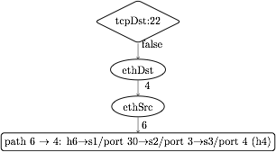
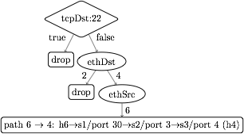
Maple’s approach: runtime tracing
1. Maple observes the dependency of f on packet data.
2. Build a trace tree (TT), a partial decision tree for f.
Prio | Match | Action
1 | tcpDst:22 | ToController
0 | ethDst:2 | discard
0 | ethDst:4, ethSrc:6 | port 30
3. Compile flow tables (FTs) from a trace tree.
Prio | Match | Action
1 | tcpDst:22 | ToController
0 | ethDst:2 | discard
0 | ethDst:4, ethSrc:6 | port 30
Prio | Match | Action
1 | tcpDst:22 | ToController
0 | ethDst:2 | discard
0 | ethDst:4, ethSrc:6 | port 30
Source: Andreas Voellmy, Yale
Notes:
Maple introduces a new technique which consists of runtime tracing.
The key idea of Maple is to observe the dependency of f on packet data. In particular, Maple provides a library which f uses to access packet data. Maple then observes the library function calls during each execution of f to obtain reusability information. Each sequence of function calls is called a trace.
Using this library approach, Maple avoids dependency on the source language.
Maple then accumulates collected traces into a trace tree, which is a partial decision tree of the input algorithmic policy, f.
Finally, Maple compiles flow tables (FTs) for all the switches in the network from the trace tree. The compilation is done so that packets that Maple has not yet successfully inferred a forwarding decision for are sent back to the controller to ensure that Maple continues to execute f and refine its trace tree.

Slide 19
Policy
EthDest:1,
TcpDst:80
Route f(Packet p, Env e) {
if (p.tcpDstIs(22))
return null();
else {
Location sloc =
e.location(p.ethSrc());
Location dloc =
e.location(p.ethDst());
Path path =
shortestPath(
e.links(),sloc,dloc);
return
unicast(sloc,dloc,path);
}
}
Assert(TcpDst,22)
false
Read(EthSrc)
1
Read(EthDst)
2
path1
Source: Andreas Voellmy, Yale
Notes:
Here is how the tracing method works for the example Java algorithmic policy.
Suppose Maple executes the algorithmic policy on a packet with Ethernet source 1, Ethernet dest 2 and tcp destination 80. As the packet moves through the policy, Maple collects a trace of the execution.
When this packet arrives at the check on tcp destination, Maple records the assertion, and its outcome. In this case, the outcome is false. The program proceeds to the else branch, where it reads the source and destination addresses, both of which Maple logs. Finally, the program returns the computed path.

Slide 20
Policy
Trace Tree
EthDst:1,
TcpDst:22
Assert(TcpDst,22)
Route f(Packet p, Env e) {
if (p.tcpDstIs(22))
return null();
else {
Location sloc =
e.location(p.ethSrc());
Location dloc =
e.location(p.ethDst());
Path path =
shortestPath(
e.links(),sloc,dloc);
return
unicast(sloc,dloc,path);
}
}
Assert(TcpDst,22)
true
null
true
false
Read(EthSrc)
?
1
Read(EthDst)
2
path1
Source: Andreas Voellmy, Yale
Notes:
Maple then uses this trace to begin generating the Trace Tree. In this case, Maple still doesn’t know what will happen if the assertion is true, and it therefore adds a placeholder under the true branch.
Now, if we execute f on a packet to tcp destination 22, the assertion is true, and the packet is dropped. Maple logs this new trace and uses it to refine its Trace Tree, filling in the true branch of the assertion.

Slide 21
Compile recorded executions into flow table
tcpDst==22
3
1
True
False
2
ethDst
drop
2
4
drop
ethSrc
6
port 30
barrier rule:
match:{ethDst:4,ethSrc:6}
action:[port 30]
match:{tcpDst==22}
action:ToController
Priority
Source: Andreas Voellmy, Yale
Notes:
The basic compilation algorithm is actually very simple, and we explain it here in the context of an example trace tree. For simplicity the leaves are labelled with switch-specific actions, such as forward on some ports or drop.
The basic algorithm generates one rule for each execution of f, and each execution of f is stored as a path from the root of the trace tree to a leaf. For example, the right-most path in this tree resulted from an execution that observed that tcpDst!=22 and ethDst==4 and ethSrc==6.
The leaf stores the action and the match condition can be obtained from the path from the root to the leaf. In this case, we would want to match on tcpDst!=22, ethDst==4 and ethSrc==6. Of course, as we described earlier, we cannot match on tcpDst!=22, and so instead we will generate a rule at a higher priority that matches on the condition which we wish to negate. This rule, which we call a “barrier rule” ensures that the rule for the execution which we are considering only fires when the condition is false.
We observe that all the rules that require tcpDst!=22 are under the False branch of the assertion node and all the rules that require tcpDst==22 are under the True branch of the assertion node. Therefore, we can determine the priority level of the barrier rule by first generating rules and assigning priorities to the False branch of the node, and then assigning the priority of the barrier rule to have the next higher priority. Then we can assign priorities to the True branch. Hence, by generating rules with a classical in-order traversal from False to True branches, we can correctly assign priorities to rules.
Finally, since the subtree under the True branch may not completely describe how to handle all tcpDst==22 packets, some packets with tcpDst==22 may fall through to the reach the barrier rule. Therefore, the action for the barrier rule must be ToController, so that we can continue to trace f correctly.

Slide 22
Basic compilation: in-order traversal & barrier rules
tcpDst==22
Priority := 0
Priority := 1
Priority := 2
accumulated
match: {}
Priority := 3
True
False
ethDst
{tcpDst:22}
null
{}
2
4
{ethDst:2}
null
ethSrc
(prio:3,{tcpDst:22},action:drop)
{ethDst:4}
6
{ethDst:4,
ethSrc:6}
barrier rule:
(prio:2,{tcpDst:22},action:ToController)
port 30
(prio:1,{ethDst:2},action:drop)
(prio:0,{ethDst:4, ethSrc:6},action:[port 30])
Source: Andreas Voellmy, Yale
Notes:
We step through the execution of the algorithm on the example tree. We initialize a priority variable to 0. We then recursively process the tree in-order processing False branches before True branches.
As we descend in the tree, we keep track of the positively occurring match conditions along the path to the root.
At the root, the set of accumulated match conditions is empty. We then process the ethDst node in the False subtree, which also has an empty set of accumulated match conditions. We then proceed down to the leaf labelled port 30, which has accumulated positive matches on ethDst and ethSrc. We output the rule at the current value of the priority variable and increment the priority variable.
We then backtrack to the ethDst node and process its other child, outputting a rule at priority 1 and increment the priority variable.
We backtrack to the root, where we output the barrier at the current priority 2, increment the priority and finally process the True branch of the assertion.

Slide 23
Basic compilation example result
(prio:3,{tcpDst:22},action:drop)
(prio:2,{tcpDst:22},action:ToController)
No effect
Can use priority 0
(prio:1,{ethDst:2},action:drop)
(prio:0,{ethDst:4, ethSrc:6},action:[port 30])
Trace tree method converts arbitrary algorithmic policies into correct forwarding tables that effectively use wildcard rules.
Deficiencies:
More priorities levels than necessary
More rules than necessary
Annotate TT nodes with extra information to improve compilation
Source: Andreas Voellmy, Yale
Notes:
The compilation results in these 4 flow rules and we see that with this method, we can convert arbitrary algorithmic policies into correct forwarding tables that effectively use wildcard rules.
We also notice some deficiencies in the basic algorithm. The result uses more rules than absolutely necessary. For example, the rule with priority 2 above has no effect, since the rule at priority 3 matches all tcpDst:22 packets at a higher priority. And reducing the number of rules is important, since rule capacity is a scarce resource in switches.
Additionally, the result uses one priority level per rule, often using more priorities than necessary. For example, the rule at priority 1 could actually use priority level 0, since it is disjoint from the other priority 0 rule. Reducing priority levels is important because the time to install a new rule in a table can be proportional to the number of priority levels in that table.
We therefore implement improved compilation methods by annotating the trace tree nodes with extra information and use these annotations during compilation.

Slide 24
Optimization 1: Annotate TT nodes with completeness
tcpDst==22
{}
True
False
no barrier
drop
ethDst
{tcpDst:22}
complete
{}
2
4
complete
drop
ethSrc
{ethDst:2}
{ethDst:4}
(prio:2,{tcpDst:22},action:drop)
6
port 30
complete
(prio:1,{ethDst:2},action:drop)
{ethDst:4,
ethSrc:6}
(prio:0,{ethDst:4, ethSrc:6},action:[port 30])
Source: Andreas Voellmy, Yale
Notes:
To eliminate unnecessary barrier rules, we annotate each node with a flag indicating whether it completely describes how packets reaching that node should be handled.
In this example trace tree, we mark each leaf node as being “complete”.
Then, when processing an assertion node, we do not generate a barrier rule if the tree under the True branch is complete, and so in this example we do not need a barrier at the root node.

Slide 25
Optimization 2: Annotate nodes with priority dependencies
tcpDst==22
{}
True
False
1
drop
ethDst
{tcpDst:22}
{}
2
4
drop
ethSrc
{ethDst:2}
{ethDst:4}
(prio:1,{tcpDst:22},action:drop)
6
port 30
(prio:0,{ethDst:2},action:drop)
{ethDst:4,
ethSrc:6}
(prio:0,{ethDst:4, ethSrc:6},action:[port 30])
Source: Andreas Voellmy, Yale
Notes:
To reduce the number of priority levels used, we annotate each rule-generating node of the trace tree with references to assertions whose barriers must occur above the given node.
In this example, we annotate both leaves under the False branch with references to the root, because the root assertion occurs negatively for those leaves and their match conditions intersect with the match condition of the barrier rule of the root.
Using these dependencies, we would assign the two rightmost leaves priority 0, the assertion node priority 1. Since no barrier rule is needed in this case, we do not increment the priority for the leftmost leaf and therefore assign it priority 1.

Slide 26
Improved compilation result
(prio:1,{tcpDst:22},action:drop)
(prio:0,{ethDst:2},action:drop)
(prio:0,{ethDst:4, ethSrc:6},action:[port 30])
Source: Andreas Voellmy, Yale
Notes:
With these two improvements, the compilation results in just 3 rules and two priority levels, which is the minimal number of priority levels for this rule set.

Slide 27
Maple Status
Maple has been implemented in Haskell using the McNettle Openflow controller, which implements Openflow 1.0.
The implementation includes several other features:
Incremental TT compilation, to avoid full recompilation on every update.
Trace reduction, to ensure traces and trace trees do not contain redundant nodes.
Automatic and user-specified invalidation, to support removing and updating TT and FT when network state changes.
Source: Andreas Voellmy, Yale

Slide 28
Summary: Contributions
Algorithmic policies provide a simple, expressive programming model for SDN, eliminating a key source of errors and performance problems.
Maple provides a scalable implementation of algorithmic policies through several novel techniques, including:
runtime tracing of algorithmic policies,
maintaining a trace tree and compiling TT to flow tables to distribute processing to switches;
using TT annotations to implement compiler optimizations such as rule and priority reductions.
Source: Andreas Voellmy, Yale

Slide 29
Outline
Announcements
Homework 2 posted due in 18 days
Next lecture: first half by Josh Reich from Princeton on Pyretic
Review of previous lecture
SDN programming language
Maple: generic programming language syntax such as Java, Python
Frenetic: domain specific programming language

Slide 30
Key questions:
What are the right abstractions for programming software-defined networks?
How can we engineer trustworthy implementations that provide assurance?
Source: Nate Foster, Cornell

Slide 31
Modular Abstractions
Source: Nate Foster, Cornell

Slide 32
Combining Functionality
One monolithic
application
Monitor + Route + Load Balance + Firewall
Controller Platform
Challenges:
Writing, testing, and debugging programs
Reusing code across applications
Porting applications to new platforms
Source: Nate Foster, Cornell

Slide 33
Pattern | Actions
dstip=10.0.0.1 | Fwd 1
dstip=10.0.0.2 | Fwd 2
Route
Monitor
Pattern | Actions
srcip=1.2.3.4 | Count
+
Pattern | Actions
srcip=1.2.3.4, dstip=10.0.0.1 | Fwd 1, Count
srcip=1.2.3.4, dstip=10.0.0.2 | Fwd 2, Count
srcip=1.2.3.4 | Count
dstip=10.0.0.1 | Fwd 1
dstip=10.0.0.1 | Fwd 2
Route
+ Monitor
Source: Nate Foster, Cornell

Slide 34
Pattern | Actions
srcip=1.2.3.4, dstip=10.0.0.1 | Fwd 1, Count
srcip=1.2.3.4, dstip=10.0.0.2 | Fwd 2, Count
srcip=1.2.3.4 | Count
dstip=10.0.0.1 | Fwd 1
dstip=10.0.0.2 | Fwd 2
Route
+ Monitor
Pattern | Actions
tcpdst = 22 | Drop
* | Fwd ?
+
Firewall
Pattern | Actions
srcip=1.2.3.4, tcpdst = 22 | Count, Drop
srcip=1.2.3.4, dstip=10.0.0.1 | Fwd 1, Count
srcip=1.2.3.4, dstip=10.0.0.2 | Fwd 2, Count
srcip=1.2.3.4 | Count
tcpdst = 22 | Drop
dstip=10.0.0.1 | Fwd 1
dstip=10.0.0.2 | Fwd 2
Route
Monitor
Firewall
+
+
Source: Nate Foster, Cornell

Slide 35
Modular Applications
One module
for each task
Monitor
Route
Load Balance
Firewall
Controller Platform
Benefits:
Easier to write, test, and debug programs
Can reuse modules across applications
Possible to port applications to new platforms
Source: Nate Foster, Cornell

Slide 36
Beyond Multi-Tenancy
Each module controls a
different portion of the traffic
Slice 1
Slice 2
Slice 3
...
Slice N
Controller Platform
Relatively straightforward to split rule, bandwidth, and network events across these modules
Source: Nate Foster, Cornell

Slide 37
Modules Affect the Same Traffic
Each module partially specifies
handling of all traffic
Monitor
Route
Load Balance
Firewall
Controller Platform
How should we combine a collection of such modules into a single application?
Source: Nate Foster, Cornell

Slide 38
Language-Based Approach
Monitor
Route
Load Balance
Firewall
Compiler + Run-Time System
Controller Platform
Design languages based on modular programming abstractions, and engineer efficient implementations using a compiler and run-time system
Source: Nate Foster, Cornell

Slide 39
Language Constructs [POPL ’12, NSDI ’13]
Source: Nate Foster, Cornell

Slide 40
Parallel Composition
Pattern | Actions
dstip=3.4.5.6 | Fwd 1
dstip=6.7.8.9 | Fwd 2
Pattern | Actions
srcip=1.2.3.4 | Count
Monitor
+
Route
Controller Platform
Pattern | Actions
srcip=1.2.3.4, dstip=3.4.5.6 | Fwd 1, Count
srcip=1.2.3.4, dstip=6.7.8.9 | Fwd 2, Count
srcip=1.2.3.4 | Count
dstip=3.4.5.6 | Fwd 1
dstip=6.7.8.9 | Fwd 2
Source: Nate Foster, Cornell

Slide 41
Sequential Composition
Pattern | Actions
srcip=*0 | dstip:=10.0.0.1
srcip=*1 | dstip:=10.0.0.2
Pattern | Actions
dstip=10.0.0.1 | Fwd 1
dstip=10.0.0.2 | Fwd 2
Load Balance
;
Route
Controller Platform
Pattern | Actions
srcip=*0 | dstip:=10.0.0.1, Fwd 1
srcip=*1 | dstip:=10.0.0.2, Fwd 2
Source: Nate Foster, Cornell

Slide 42
Dividing Traffic Over Modules
Predicates specify which packets traverse which modules, using ingress port and packet-header fields
dstport=80
if then
Load Balance
;
Route
dstport=22
else if then
Monitor
+
Route
else
Drop
Source: Nate Foster, Cornell

Slide 43
The NetKAT Language
field ::= switch | inport | srcmac | dstmac | ...
val ::= 0 | 1 | 2 | 3 | ...
a,b,c ::= true (* true constant *)
| false (* false constant *)
| field = val (* test value *)
| a1 | a2 (* disjunction *)
| a1 & a2 (* conjunction *)
| ! a (* negation *)
p,q,r ::= filter a (* filter by predicate *)
| field := val (* modify value *)
| p1 + p2 (* parallel composition *)
| p1 ; p2 (* sequential composition *)
| p* (* iteration *)
Syntactic sugar: if a then p1 else p2 = filter a; p1 + filter !a; p2
Source: Nate Foster, Cornell

Slide 44
Example: Topology Abstraction
It is often useful to write programs in terms of a simplified abstract network topology
Example: load balancer
Abstract topology
Physical topology
Benefits:
Information hiding: limit what each module sees
Protection: limit what each module does
Reuse: write code for appropriate interface
Source: Nate Foster, Cornell

Slide 45
Example: “One Big Switch”
Abstract Network
Physical Network
Simplest example of topology abstraction
Can be used in many applications, including access control, load balancing, distributed middleboxes, etc.
Implementation:
(ingress; raise; application; lower; fabric; egress)
Source: Nate Foster, Cornell
Notes:
Now I can show you how Pyretic supports topology abstraction
In the context of a simple “one-big-switch” transform in which we create one abstract switch out of our underlying network,
the big switch’s ports – here V1 and V2 - are the boundary ports of the underlying network – here ports S1 and T2 respectively
This is a useful abstraction as it enables the programmer to
build distributed software middlebox using centralized programming model (i.e., run a single-switch SDN middlebox on the one-big-switch), and it all just works!

Slide 46
Formal Reasoning
Source: Nate Foster, Cornell

Slide 47
Program Equivalence
Given a program and a topology:
A
B
Want to be able to answer questions like:
“Will my network behave the same if I put the firewall rules on A, or on switch B (or both)?”
Formally, does the following equivalence hold?
(filter switch = A ; firewall; routing + filter switch = B; routing)
~
(filter switch = A ; routing + filter switch = B; firewall; routing)
Source: Nate Foster, Cornell

Slide 48
NetKAT Equational Theory
Packet Algebra
f := n; f’ := n’ ~ f’ := n’ ; f := n if f ≠ f’
f := n; f’ = n’ ~ f’ = n’; f := n if f ≠ f’
f := n; f = n ~ f := n
f = n; f := n ~ f = n
f := n; f’ = n’ ~ f := n’
f = n; f = n’ ~ filter drop if n ≠ n’
Boolean Algebra
a | (b & c) ~ (a | b) & (a | c)
a | true ~ true
a | ! a ~ true
a & b ~ b & a
a & !a ~ false
a & a ~ a
Kleene Algebra p + (q + r) ~ (p + q) + r p + q ~ q + p p + filter false ~ p p + p ~ p p ; (q ; r) ~ (p ; q) ; r p; (q + r) ~ p ; q + p ; r (p + q) ; r ~ p ; r + q ; r | filter true ; p ~ p ~ p ; filter true filter false ; p ~ filter false p ; filter false ~ filter false filter true + p ; p* ~ p* filter true + p* ; p ~ p* p + q ; r + r ~ r ⟹ p* ; q + r ~ r p + q ; r + q ~ q ⟹ p ; r* + q ~q
Source: Nate Foster, Cornell

Slide 49
NetKAT and Kleene Algebras
The design of NetKAT is not an accident!
Its foundations rest upon canonical mathematical structure:
Regular operators (+, ;, and *) encode paths through topology
Boolean operators (&, |, and !) encode switch tables
This is called a Kleene Algebra with Tests [Kozen ’96]
Theorems
Soundness: programs related by the axioms are equivalent
Completeness: equivalent programs are related by the axioms
Decidabilty: program equivalence is decidable (PSPACE)
Source: Nate Foster, Cornell

Slide 50
NetKAT Verification
Model programs and topologies in the Z3 SMT solver
Encode network-wide function as the transitive closure of the sequential composition of the program and topology
Verify reachability properties automatically
Source: Nate Foster, Cornell

Slide 51
Machine-Verified Controllers
Source: Nate Foster, Cornell

Slide 52
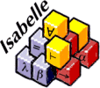
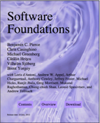
Certified Software Systems
Recent Successes
seL4 [SOSP ’09]
CompCert [CACM ’09]
F* [ICFP ’11, POPL ’12, ’13]
Inductive pred : Type :=
| OnSwitch : Switch -> pred
| InPort : Port -> pred
| DlSrc : EthernetAddress -> pred
| DlDst : EthernetAddress -> pred
| DlVlan : option VLAN -> pred
| ...
| And : pred -> pred -> pred
| Or : pred -> pred -> pred
| Not : pred -> pred
| All : pred
| None : pred
Inductive act : Type :=
| ForwardMod : Mod -> PseudoPort -> act
| ...
Inductive pol : Type :=
| Policy : pred -> list act -> pol
| Union : pol -> pol -> pol
| Restrict : pol -> pred -> pol
| ...
Write code
Lemma inter_wildcard_other : forall x,
Wildcard_inter WildcardAll x = x.
Proof.
intros; destruct x; auto.
Qed.
Lemma inter_wildcard_other1 : forall x,
Wildcard_inter x WildcardAll = x.
Proof.
intros; destruct x; auto.
Qed.
Lemma inter_exact_same : forall x,
Wildcard_inter (WildcardExact x) (WildcardExact x) = WildcardExact x.
Proof.
intros.
unfold Wildcard_inter.
destruct (eqdec x x); intuition.
Qed.
(** val handle_event :
event -> unit Monad.m **)
let handle_event = function | SwitchConnected swId ->
handle_switch_connected swId | SwitchDisconnected swId ->
handle_switch_disconnected swId | SwitchMessage (swId, xid0, msg) -> (match msg with | PacketInMsg pktIn ->
handle_packet_in swId pktIn | _ ->
Monad.ret ()) (** val main : unit Monad.m **) let main = Monad.forever
(Monad.bind Monad.recv (fun evt ->
handle_event evt))
Prove correct
Extract code
Tools
Textbooks
Certified Programming with Dependent Types
Certified
binary
Source: Nate Foster, Cornell
Notes:
what does correctness mean--discuss offline

Slide 53
Certified NetKAT Controller
Each level of abstraction formalized in Coq
Machine-checked proofs that the transformations between levels preserve semantics
Code extracted to OCaml and deployed with real switch hardware
NetKAT
Compiler
Flow tables
Optimizer
Run-time system
OpenFlow messages
Source: Nate Foster, Cornell

Slide 54
NetKAT Compiler
Overview
Compiler: maps NetKAT programs to flow tables
Optimizer: eliminates “empty” and “shadowed” rules
Correctness Theorem
Theorem compile_correct :
forall opt pol sw pt pk bufId, SemanticsPreserving opt ->
netcore_eval pol sw pt pk bufId = flowtable_eval (compile pol sw) sw pt pk bufId.
Formalization Highlights
Library of algebraic properties of flow tables
New tactic for proving equalities on bags
Key invariant: all packet patterns “natural”
Source: Nate Foster, Cornell

Slide 55
OpenFlow 1.0 Specification
42 pages...
...of informal prose
...diagrams and flow charts
...and C struct definitions
Source: Nate Foster, Cornell

Slide 56
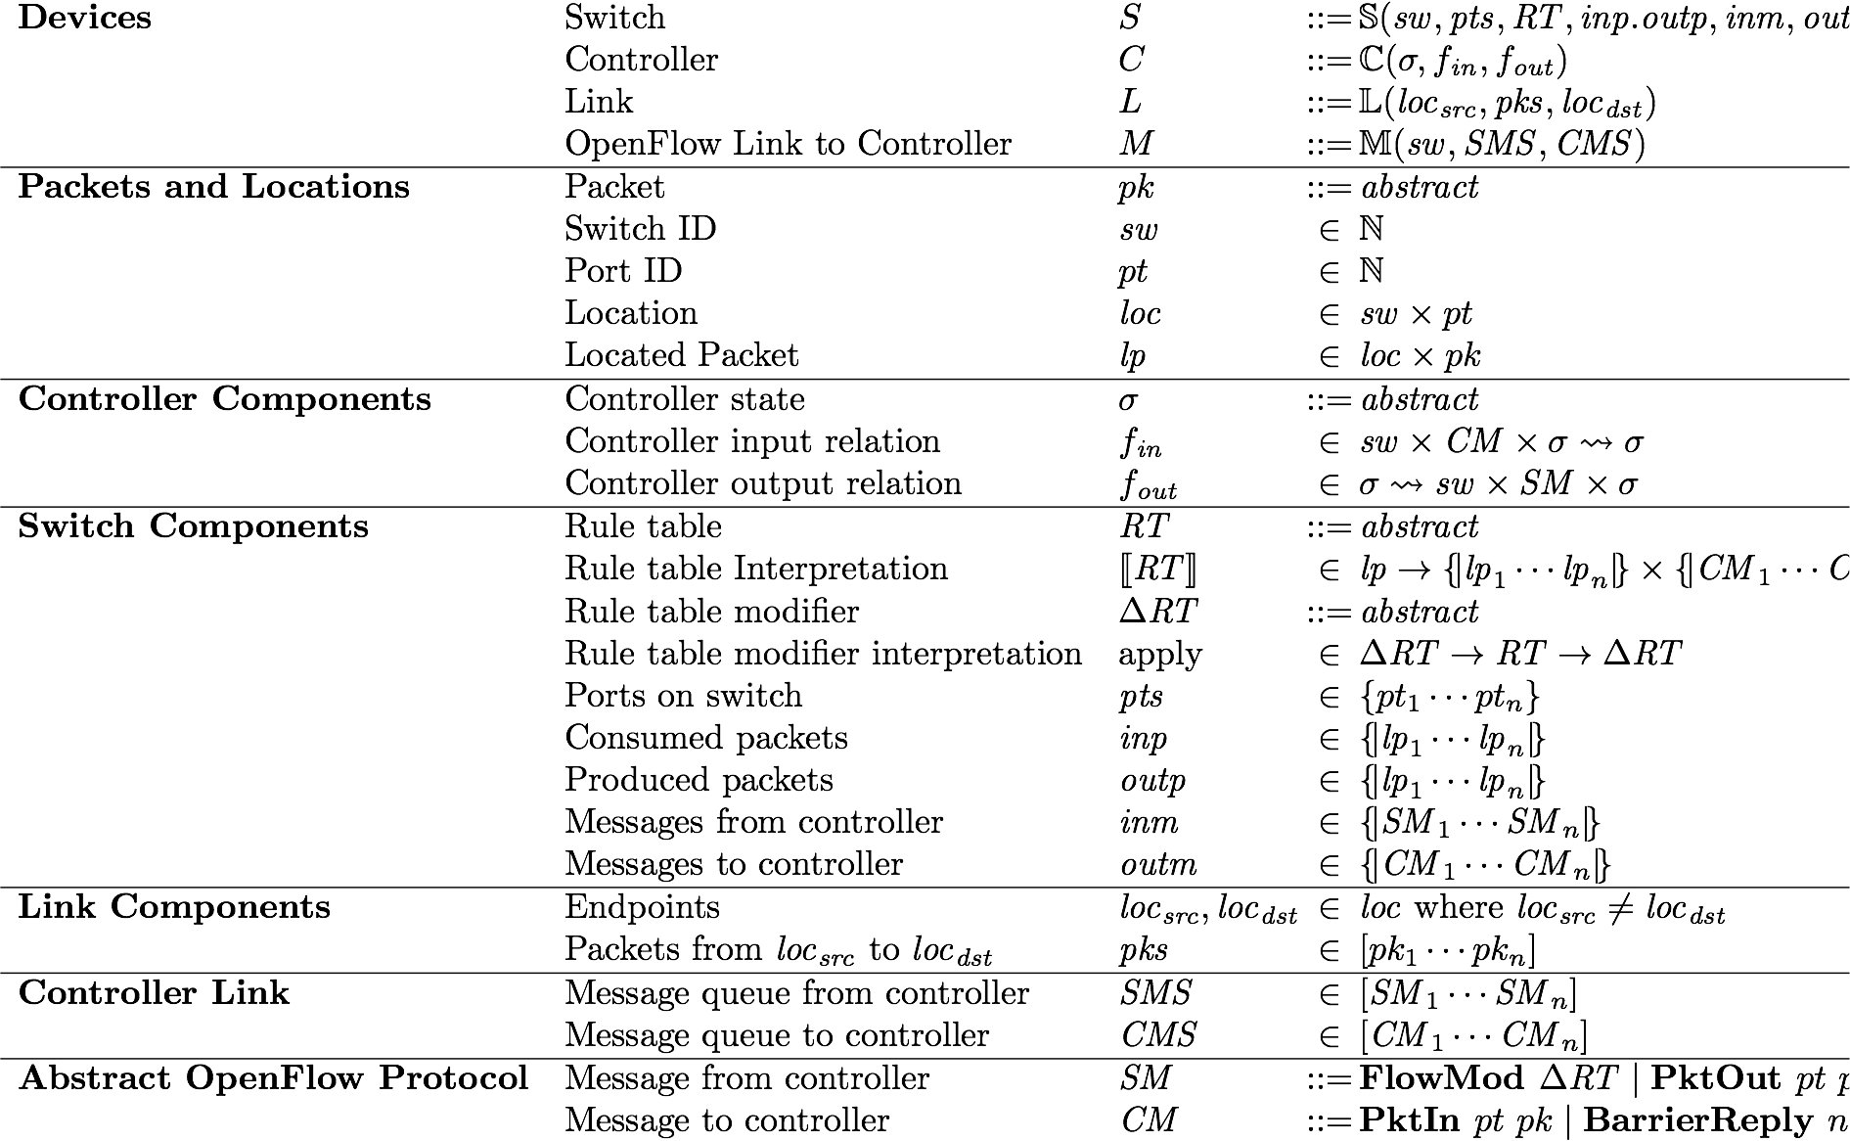
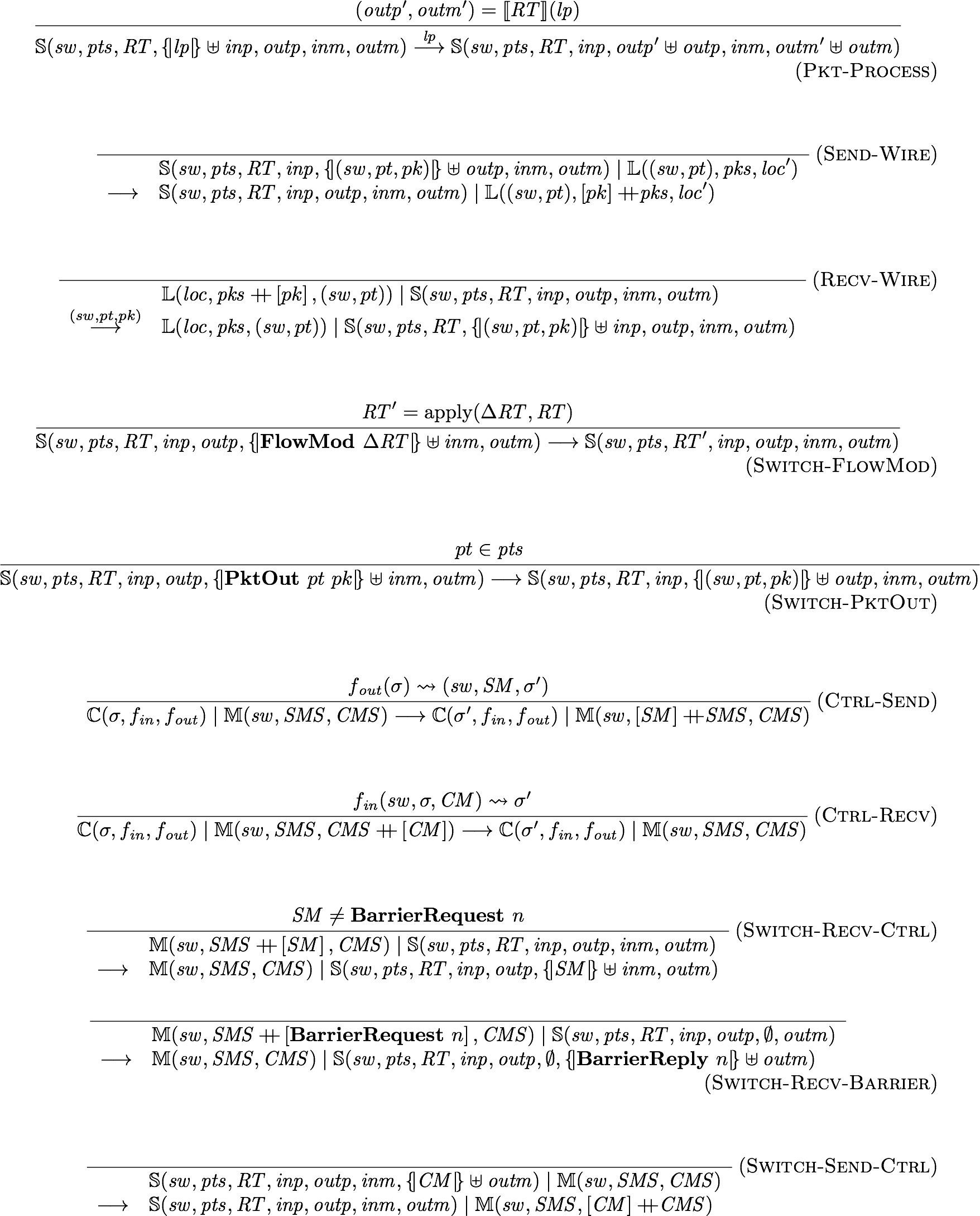
Featherweight OpenFlow
Syntax
Semantics
Key Features:
Models all features related to packet forwarding and all essential asynchrony
Supports arbitrary controllers
Source: Nate Foster, Cornell

Slide 57
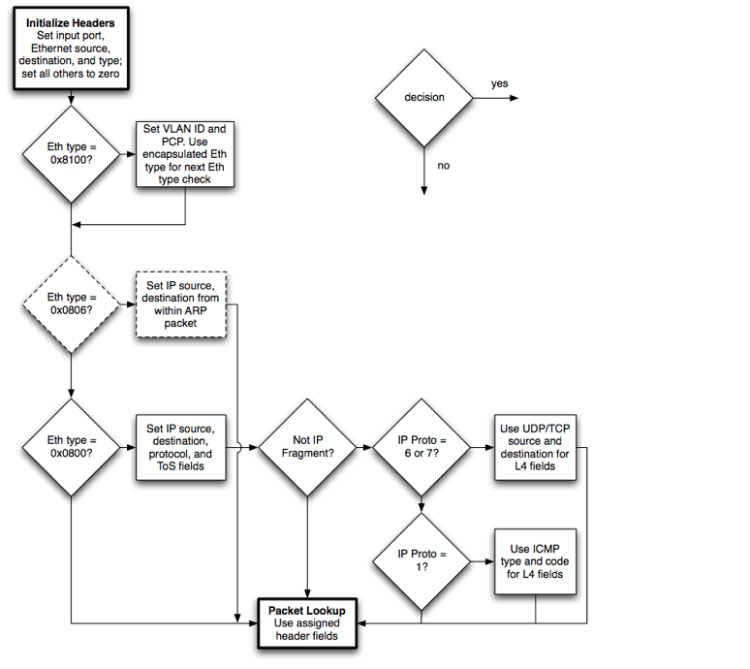
Forwarding
/* Fields to match against flows */
struct ofp_match {
uint32_t wildcards; /* Wildcard fields. */
uint16_t in_port; /* Input switch port. */
uint8_t dl_src[OFP_ETH_ALEN]; /* Ethernet source address. */
uint8_t dl_dst[OFP_ETH_ALEN]; /* Ethernet destination address. */
uint16_t dl_vlan; /* Input VLAN. */
uint8_t dl_vlan_pcp; /* Input VLAN priority. */
uint8_t pad1[1]; /* Align to 64-bits. */
uint16_5 dl_type; /* Ethernet frame type. */
uint8_t nw_tos; /* IP ToS (DSCP field, 6 bits). */
uint8_t nw_proto; /* IP protocol or lower 8 bits of
ARP opcode. */
uint8_t pad2[2]; /* Align to 64-bits. */
uint32_t nw_src; /* IP source address. */
uint32_t nw_dst; /* IP destination address. */
uint16_t tp_src; /* TCP/UDP source port. */
uint16_t tp_dst; /* TCP/UDP destination port. */
};
OFP_ASSERT(sizeof(struct ofp_match) == 40);
Record Pattern : Type := MkPattern {
dlSrc : Wildcard EthernetAddress;
dlDst : Wildcard EthernetAddress;
dlType : Wildcard EthernetType;
dlVlan : Wildcard VLAN;
dlVlanPcp : Wildcard VLANPriority;
nwSrc : Wildcard IPAddress;
nwDst : Wildcard IPAddress;
nwProto : Wildcard IPProtocol;
nwTos : Wildcard IPTypeOfService;
tpSrc : Wildcard TransportPort;
tpDst : Wildcard TransportPort;
inPort : Wildcard Port
}.
Detailed model of matching, forwarding, and flow table update
Definition Pattern_inter (p p':Pattern) :=
let dlSrc := Wildcard_inter EthernetAddress.eqdec (ptrnDlSrc p) (ptrnDlSrc p') in
let dlDst := Wildcard_inter EthernetAddress.eqdec (ptrnDlDst p) (ptrnDlDst p') in
let dlType := Wildcard_inter Word16.eqdec (ptrnDlType p) (ptrnDlType p') in
let dlVlan := Wildcard_inter Word16.eqdec (ptrnDlVlan p) (ptrnDlVlan p') in
let dlVlanPcp := Wildcard_inter Word8.eqdec (ptrnDlVlanPcp p) (ptrnDlVlanPcp p') in
let nwSrc := Wildcard_inter Word32.eqdec (ptrnNwSrc p) (ptrnNwSrc p') in
let nwDst := Wildcard_inter Word32.eqdec (ptrnNwDst p) (ptrnNwDst p') in
let nwProto := Wildcard_inter Word8.eqdec (ptrnNwProto p) (ptrnNwProto p') in
let nwTos := Wildcard_inter Word8.eqdec (ptrnNwTos p) (ptrnNwTos p') in
let tpSrc := Wildcard_inter Word16.eqdec (ptrnTpSrc p) (ptrnTpSrc p') in
let tpDst := Wildcard_inter Word16.eqdec (ptrnTpDst p) (ptrnTpDst p') in
let inPort := Wildcard_inter Word16.eqdec (ptrnInPort p) (ptrnInPort p') in
MkPattern dlSrc dlDst dlType dlVlan dlVlanPcp
nwSrc nwDst nwProto nwTos
tpSrc tpDst
inPort.
Definition exact_pattern (pk : Packet) (pt : Word16.T) : Pattern :=
MkPattern
(WildcardExact (pktDlSrc pk)) (WildcardExact (pktDlDst pk))
(WildcardExact (pktDlTyp pk))
(WildcardExact (pktDlVlan pk)) (WildcardExact (pktDlVlanPcp pk))
(WildcardExact (pktNwSrc pk)) (WildcardExact (pktNwDst pk))
(WildcardExact (pktNwProto pk)) (WildcardExact (pktNwTos pk))
(Wildcard_of_option (pktTpSrc pk)) (Wildcard_of_option (pktTpDst pk))
(WildcardExact pt).
Definition match_packet (pt : Word16.T) (pk : Packet) (pat : Pattern) : bool :=
negb (Pattern_is_empty (Pattern_inter (exact_pattern pk pt) pat)).
Source: Nate Foster, Cornell

Slide 58
Asynchrony
“In the absence of barrier messages, switches may arbitrarily reorder messages to maximize performance.”
“There is no packet output ordering guaranteed within a port.”
Essential asynchrony: packet buffers, message reordering, and barriers
Definition InBuf := Bag Packet.
Definition OutBuf := Bag Packet.
Definition OFInBuf := Bag SwitchMsg.
Definition OFOutBuf := Bag CtrlMsg.
Source: Nate Foster, Cornell

Slide 59
Asynchrony (Cont’d)
Distributed Programming: non-atomic table updates
Priority | Predicate | Action
Priority | Predicate | Action
10 | SSH | Drop
⊆
⊆
Priority | Predicate | Action
5 | dst_ip = H1 | Fwd 1
Priority | Predicate | Action
10 | SSH | Drop
5 | dst_ip = H1 | Fwd 1
update re-ordering
⊆
Priority | Predicate | Action
5 | dst_ip = H1 | Fwd 1
5 | dst_ip = H2 | Fwd 2
Priority | Predicate | Action
10 | SSH | Drop
5 | dst_ip = H1 | Fwd 1
5 | dst_ip = H2 | Fwd 2
Source: Nate Foster, Cornell

Slide 60
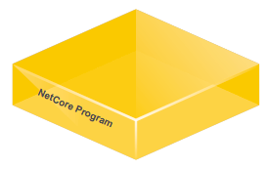
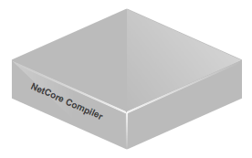
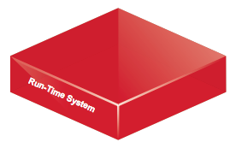
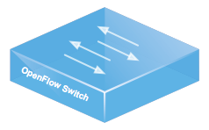
Controllers
Ultimately we want to prove theorems about controllers that implement the NetKAT run-time system...
...but we didn’t want to bake specific controllers into Featherweight OpenFlow!
Controller model: fully abstract
Controller Parameters
: abstract type of controller state
fin :
fout :
Source: Nate Foster, Cornell

Slide 61
Weak Bisimulation
(H1,
)
(S1,pt1,
)
(S2,pt1,
)
(H2,
)
≈
≈
≈
≈
≈
≈
≈
≈
add rules
add rules
Theorem fwof_abst_weak_bisim :
weak_bisimulation concreteStep abstractStep
bisim_relation.
Source: Nate Foster, Cornell

Slide 62
The System
predicates
policies
queries
stream of snapshots over time
predicates
policies
queries
predicates
policies
queries
Frenetic
Frenetic
OCaml embedding
predicates and policies
queries
implemented using
OX
Ox
OCaml OpenFlow Platform
similar to Nox, Pox, Floodlight, etc.
Source: Nate Foster, Cornell

Slide 63
The System
Domain-specific language
predicates and policies
monitoring
mac learning
network address translation
Frenetic DSL
implemented using
Frenetic
Frenetic
OCaml embedding
predicates and policies
queries
implemented using
OX
Ox
OCaml OpenFlow Platform
similar to Nox, Pox, Floodlight, etc.
Source: Nate Foster, Cornell

Slide 64
Conclusion
Modularity is a key concern in the design of any language
NetKAT provides rich abstractions for building modular network programs, including parallel and sequential composition operators
By leveraging recent advances in formal methods, can build trustworthy compilers, run-time systems, and verification tools
Implementation status:
Stand-alone controller platform implemented in OCaml
Sophisticated, proactive compiler for OpenFlow rules
Large parts of the system formally verified in Coq
Experimental support for OpenFlow 1.3
Source: Nate Foster, Cornell

Slide 65
Questions?

