Slide 1
Software Defined Networking
COMS 6998-8, Fall 2013
Instructor: Li Erran Li (lierranli@cs.columbia.edu)
http://www.cs.columbia.edu/~lierranli/coms6998-8SDNFall2013/
9/10/2013: SDN Basics

Slide 2
Outline
Review of previous lecture
SDN Basics
  Concepts
  OpenFlow
  Controller: Floodlight
  OF-Config
  Mininet

Slide 3
Review of Previous Lecture
What is the control plane of a network?
  The functions in the network that control the behavior of the network, e.g., network paths, forwarding behavior
What is the data plane of a network?
  The functions in the network that are responsible for forwarding (or not forwarding) traffic. Typically, the data plane is instantiated as forwarding tables in routers, switches, firewalls, and middleboxes

Slide 4
Review of Previous Lecture (Cont’d)
Which network first had the separation of control plane and data plane?
  The telephone network, specifically AT&T introduced then Network Control Point in 1981 to support a wide range of network applications such as 800 Service and Calling Card Service.
Why separate control?
  More rapid innovation: control logic is not tied to hardware
  Network wide view: easier to infer and reason about network behavior
  More flexibility: can introduce services more rapidly

Slide 5
Review of Previous Lecture (Cont’d)
What is the object of Routing Control Platform (RCP 2004)?
  Compute BGP routes on behalf of routers
How does RCP server communicate with routers?
  Uses existing routing protocol (BGP) to communicate routes to routers
How does RCP obtain the network view?
  Uses IGP routing such as OSPF or ISIS

Slide 6
Review of Previous Lecture (Cont’d)
Source: Matthew Caesar, UIUC
Routing Control Platform (RCP)
Route Control
Server (RCS)
Available BGP routes
Selected BGP routes
Path cost matrix
BGP Engine
IGP Viewer
(NSDI ’04)
BGP updates
BGP updates
IGP link-state advertisements
…
…
…
Divide design into components
  Replication improves availability
Distributed operation, but global state per component

Slide 7
Review of Previous Lecture (Cont’d)
Source: Matthew Caesar, UIUC
RCP
Review of Previous Lecture (Cont’d)
iBGP
Better scalability: reduces load on routers
Easier management: configuration from a single point
Easier evolvability: freedom from router software
Notes:
Then bring up 3 points after describe slide (Animate)
On this slide – say what it is that y’uouve impelemntede, this is an imprlmentation that emultates full mesh, empasisze per router decision making ←- very important piont to bring up!!! Say why is not just a route reflector.
Put text on slide to say why arrows going in both directions, available routes up and assigned routes down.
Reduce number of routers, just show some on maybe just internal ones send up igp. Maybe just say gets igp, and take out lines to internal routers.

Slide 8
Review of Previous Lecture (Cont’d)
What are the 4 planes of 4D (2005)?
  Decision plane
  Dissemination plane
  Discovery plane
  Data plane

Slide 9
Review of Previous Lecture (Cont’d)
Network-level objectives
Decision
Network-wide views
Dissemination
Direct control
Discovery
Data
Decision Plane:
All management logic implemented on centralized servers making all decisions
Decision Elements use views to compute data plane state that meets objectives, then directly writes this state to routers

Slide 10
Review of Previous Lecture (Cont’d)
Network-level objectives
Decision
Network-wide views
Dissemination
Direct control
Discovery
Data
Dissemination Plane:
Provides a robust communication channel to each router – and robustness is the only goal!
May run over same links as user data, but logically separate and independently controlled

Slide 11
Review of Previous Lecture (Cont’d)
Network-level objectives
Decision
Network-wide views
Dissemination
Direct control
Discovery
Data
Discovery Plane:
Each router discovers its own resources and its local environment
E.g., the identity of its immediate neighbors

Slide 12
Review of Previous Lecture (Cont’d)
Network-level objectives
Decision
Network-wide views
Dissemination
Direct control
Discovery
Data
Data Plane:
Spatially distributed routers/switches
Can deploy with today’s technology
Looking at ways to unify forwarding paradigms across technologies

Slide 13
Outline
Review of previous lecture
SDN Basics
  Concepts
  OpenFlow
  Controller: Floodlight
  OF-Config
  Mininet

Slide 14
SDN Concepts
What is software defined networking?
Why SDN?

Slide 15

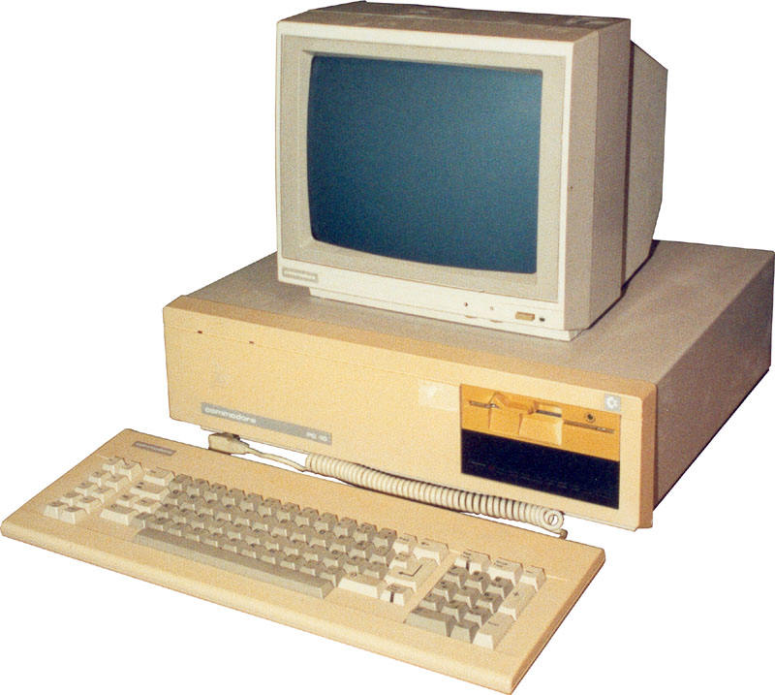
Source: Nick Mckeown, Stanford
App
App
App
App
App
App
App
App
App
App
App
Specialized
Applications
Open Interface
Windows
(OS)
Linux
Mac
OS
Specialized
Operating
System
or
or
Open Interface
Specialized
Hardware
Microprocessor
Vertically integrated
Closed, proprietary
Slow innovation
Small industry
Horizontal
Open interfaces
Rapid innovation
Huge industry
Notes:
The mainframe industry in the 1980s was vertical and closed: it consisted of specialized hardware, operating system and applications --- all from the same company.
A revolution happened when open interfaces started to appear. The industry became horizontal. Innovation exploded.

Slide 16
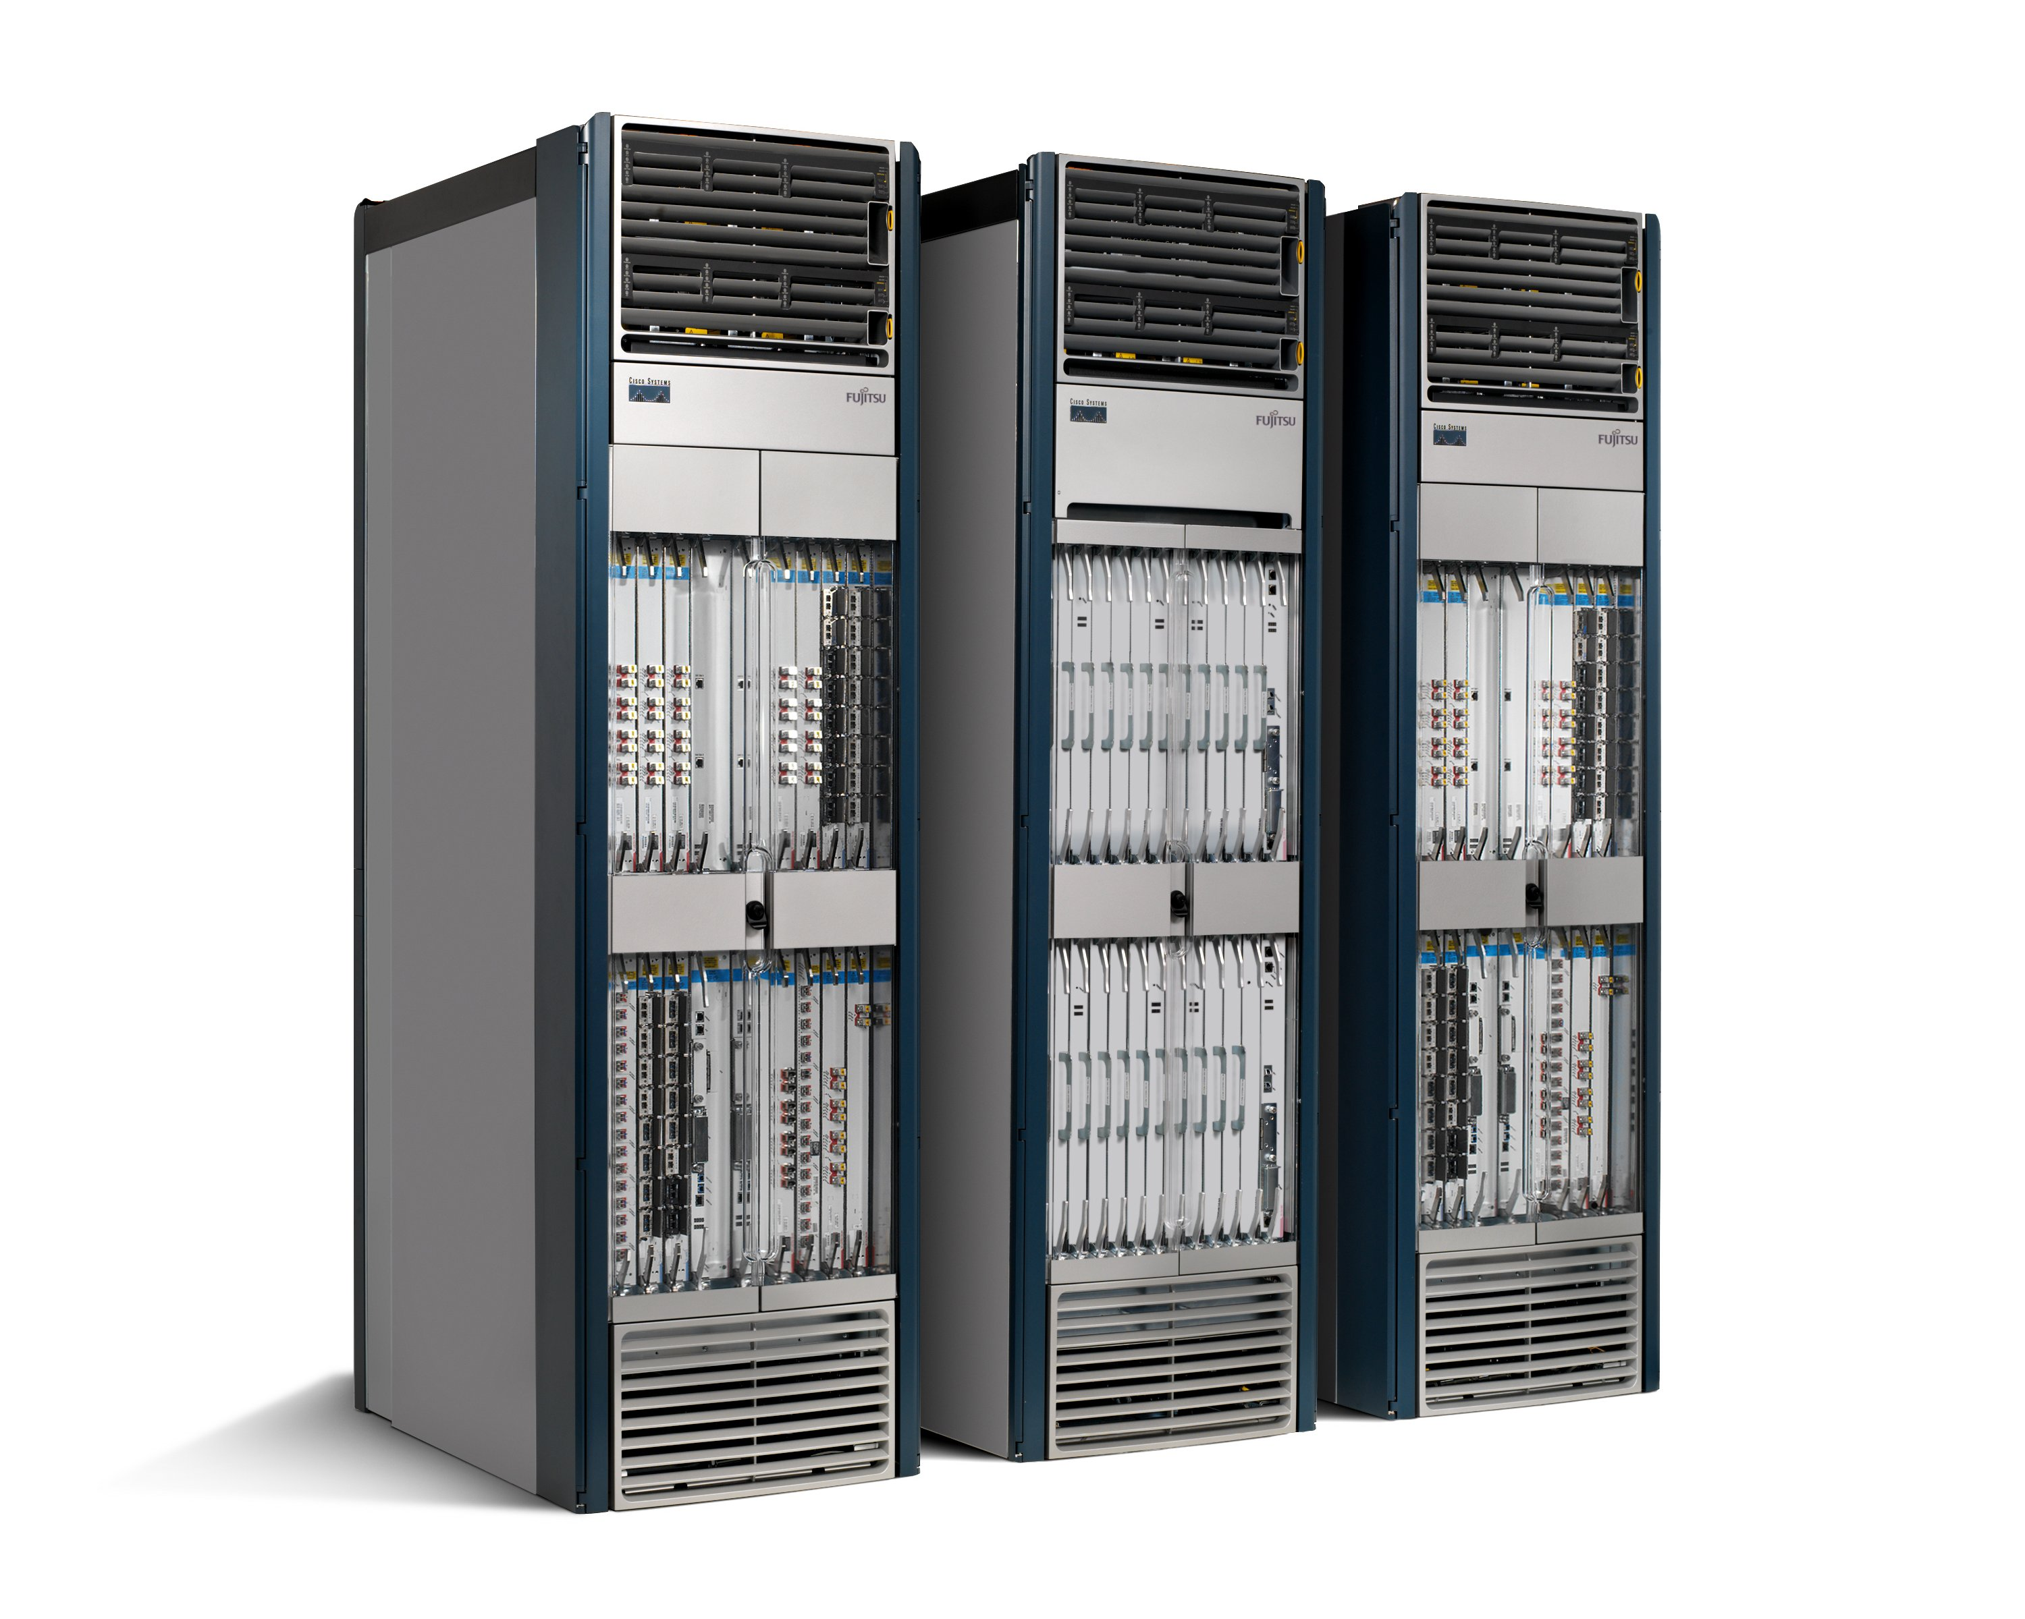
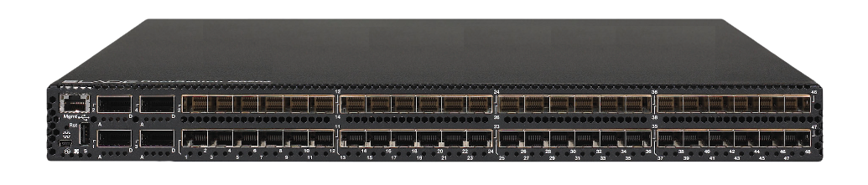
Source: Nick Mckeown, Stanford
App
App
App
App
App
App
App
App
App
App
App
Specialized
Features
Open Interface
Control
Plane
Control
Plane
Control
Plane
or
or
Specialized
Control
Plane
Open Interface
Specialized
Hardware
Merchant
Switching Chips
Vertically integrated
Closed, proprietary
Slow innovation
Horizontal
Open interfaces
Rapid innovation

Slide 17
Source: Nick Mckeown, Stanford
Routing, management, mobility management,
access control, VPNs, …
Feature
Feature
Million of lines
of source code
6,000 RFCs
OS
Custom Hardware
Billions of gates
Bloated
Power Hungry
Vertically integrated, complex, closed, proprietary
Networking industry with “mainframe” mind-set

Slide 18
The network is changing
Source: Nick Mckeown, Stanford
Feature
Feature
Network OS
Feature
Feature
OS
Custom Hardware
Feature
Feature
OS
Feature
Feature
Custom Hardware
OS
Feature
Feature
Custom Hardware
OS
Custom Hardware
Feature
Feature
OS
Custom Hardware

Slide 19

Software Defined Network (SDN)
Source: Nick Mckeown, Stanford
3. Consistent, up-to-date global network view
2. At least one Network OS
probably many.
Open- and closed-source
Feature
Feature
Network OS
1. Open interface to packet forwarding
Packet
Forwarding
Packet
Forwarding
Packet
Forwarding
Packet
Forwarding
Packet
Forwarding

Slide 20
Network OS
Source: Nick Mckeown, Stanford
Network OS: distributed system that creates a consistent, up-to-date network view
  Runs on servers (controllers) in the network
  Floodlight, POX, Pyretic, Nettle ONIX, Beacon, … + more
Uses forwarding abstraction to:
  Get state information from forwarding elements
  Give control directives to forwarding elements

Slide 21
Software Defined Network (SDN)
Source: Nick Mckeown, Stanford
Control Program A
Control Program B
Network OS
Packet
Forwarding
Packet
Forwarding
Packet
Forwarding
Packet
Forwarding
Packet
Forwarding

Slide 22
Control Program
Source: Nick Mckeown, Stanford
Control program operates on view of network
  Input: global network view (graph/database)
  Output: configuration of each network device
Control program is not a distributed system
  Abstraction hides details of distributed state

Slide 23
Forwarding Abstraction
Source: Nick Mckeown, Stanford
Purpose: Abstract away forwarding hardware
Flexible
  Behavior specified by control plane
  Built from basic set of forwarding primitives
Minimal
  Streamlined for speed and low-power
  Control program not vendor-specific
OpenFlow is an example of such an abstraction

Slide 24
Why SDN?
Great talk by Scott Shenker http://www.youtube.com/watch?v=WVs7Pc99S7w
(Story summarized here)

Slide 25
Networking
Source: Nick Mckeown, Stanford
Networking is “Intellectually Weak”
Networking is behind other fields
Networking is about the mastery of complexity
Good abstractions tame complexity
Interfaces are instances of those abstractions
No abstraction => increasing complexity
We are now at the complexity limit

Slide 26
By comparison: Programming
Source: Nick Mckeown, Stanford
Machine languages: no abstractions
  Had to deal with low-level details
Higher-level languages: OS and other abstractions
  File system, virtual memory, abstract data types, ...
Modern languages: even more abstractions
  Object orientation, garbage collection,…

Slide 27
Programming Analogy
Source: Nick Mckeown, Stanford
What if programmers had to:
  Specify where each bit was stored
  Explicitly deal with internal communication errors
  Within a programming language with limited expressability
Programmers would redefine problem by:
  Defining higher level abstractions for memory
  Building on reliable communication primitives
  Using a more general language

Slide 28
Specification Abstraction
Source: Nick Mckeown, Stanford
Network OS eases implementation
Next step is to ease specification
Provide abstract view of network map
Control program operates on abstract view
Develop means to simplify specification

Slide 29
Software Defined Network (SDN)
Source: Nick Mckeown, Stanford
Abstract Network View
Virtualization
Control Program A
Control Program B
Global Network View
Network OS
Packet
Forwarding
Packet
Forwarding
Packet
Forwarding
Packet
Forwarding
Packet
Forwarding

Slide 30
Outline
Review of previous lecture
SDN Basics
  Concepts
  OpenFlow
  Switches and Controllers
  OF-Config
  Mininet

Slide 31
OpenFlow
Why OpenFlow?
How does OpenFlow work?

Slide 32

Why OpenFlow?

Slide 33

The Ossified Network
Routing, management, mobility management,
access control, VPNs, …
Feature
Feature
Million of lines
of source code
5400 RFCs
Barrier to entry
Operating
System
Specialized Packet Forwarding Hardware
Billions of gates
Bloated
Power Hungry
Many complex functions baked into the infrastructure
    OSPF, BGP, multicast, differentiated services,
    Traffic Engineering, NAT, firewalls, MPLS, redundant layers, …
An industry with a “mainframe-mentality”, reluctant to change
33
Notes:
33

Slide 34
Research Stagnation
Lots of deployed innovation in other areas
  OS: filesystems, schedulers, virtualization
  DS: DHTs, CDNs, MapReduce
  Compilers: JITs, vectorization
Networks are largely the same as years ago
  Ethernet, IP, WiFi
Rate of change of the network seems slower in comparison
  Need better tools and abstractions to demonstrate and deploy
Notes:
In these other areas, you can real systems on top of high-quality, open platforms, and you don’t need to reinvent the wheel

Slide 35
Closed Systems (Vendor Hardware)
Stuck with interfaces (CLI, SNMP, etc)
Hard to meaningfully collaborate
Vendors starting to open up, but not usefully
Need a fully open system – a Linux equivalent

Slide 36
Open Systems
Source: Big Switch Networks
 | Performance Fidelity | Scale | Real User Traffic? | Complexity | Open
Simulation | medium | medium | no | medium | yes
Emulation | medium | low | no | medium | yes
Software Switches | poor | low | yes | medium | yes
NetFPGA | high | low | yes | high | yes
Network Processors | high | medium | yes | high | yes
Vendor Switches | high | high | yes | low | no
gap in the tool space
none have all the desired attributes!

Slide 37




Ethane, a precursor to OpenFlow
Centralized, reactive, per-flow control
Controller
Flow Switch
Flow Switch
Flow Switch
Host B
Host A
Flow Switch
See Ethane SIGCOMM 2007 paper for details

Slide 38
OpenFlow: a pragmatic compromise
+ Speed, scale, fidelity of vendor hardware
+ Flexibility and control of software and simulation
Vendors don’t need to expose implementation
Leverages hardware inside most switches today (ACL tables)

Slide 39
How does OpenFlow work?
39

Slide 40
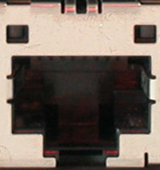
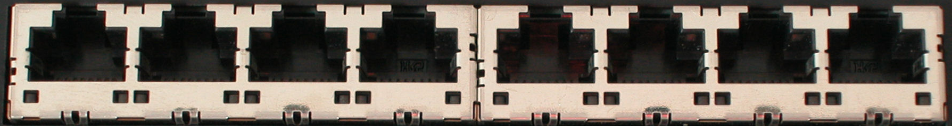
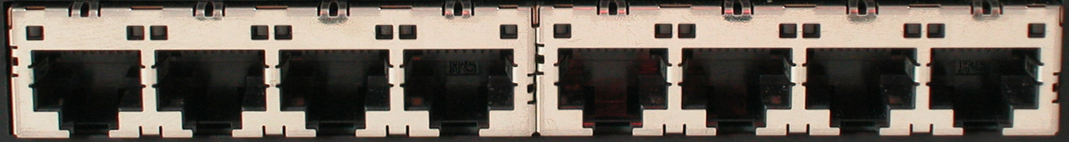
Ethernet Switch

Slide 41
Control Path
Control Path (Software)
Data Path (Hardware)

Slide 42
OpenFlow Controller
OpenFlow Protocol (SSL/TCP)
Control Path
OpenFlow
Data Path (Hardware)

Slide 43
OpenFlow Example
Controller
OpenFlow Client
PC
Software
Layer
Flow Table
MAC
src
MAC
dst
IP
Src
IP
Dst
TCP
sport
TCP
dport
Action
Hardware
Layer
*
*
*
5.6.7.8
*
*
port 1
port 1
port 2
port 3
port 4
5.6.7.8
1.2.3.4

Slide 44
OpenFlow Basics
Flow Table Entries
Rule
Action
Stats
Packet + byte counters
Forward packet to zero or more ports
Encapsulate and forward to controller
Send to normal processing pipeline
Modify Fields
Any extensions you add!
Switch
Port
VLAN
ID
VLAN
pcp
MAC
src
MAC
dst
Eth
type
IP
Src
IP
Dst
IP
ToS
IP
Prot
L4
sport
L4
dport
+ mask what fields to match
Notes:
Now I’ll describe the API that tries to meet these goals.

Slide 45
Examples
Switching
Switch
Port
MAC
src
MAC
dst
Eth
type
VLAN
ID
IP
Src
IP
Dst
IP
Prot
TCP
sport
TCP
dport
Action
*
*
00:1f:..
*
*
*
*
*
*
*
port6
Flow Switching
Switch
Port
MAC
src
MAC
dst
Eth
type
VLAN
ID
IP
Src
IP
Dst
IP
Prot
TCP
sport
TCP
dport
Action
port3
00:20..
00:1f..
0800
vlan1
1.2.3.4
5.6.7.8
4
17264
80
port6
Firewall
Switch
Port
MAC
src
MAC
dst
Eth
type
VLAN
ID
IP
Src
IP
Dst
IP
Prot
TCP
sport
TCP
dport
Action
*
*
*
*
*
*
*
*
*
22
drop

Slide 46
Examples
Routing
Switch
Port
MAC
src
MAC
dst
Eth
type
VLAN
ID
IP
Src
IP
Dst
IP
Prot
TCP
sport
TCP
dport
Action
*
*
*
*
*
*
5.6.7.8
*
*
*
port6
VLAN Switching
Switch
Port
MAC
src
MAC
dst
Eth
type
VLAN
ID
IP
Src
IP
Dst
IP
Prot
TCP
sport
TCP
dport
Action
port6,
port7,
port9
*
*
00:1f..
*
vlan1
*
*
*
*
*

Slide 47

Centralized vs Distributed Control
Both models are possible with OpenFlow
Centralized Control
Distributed Control
Controller
Controller
OpenFlow
Switch
OpenFlow
Switch
Controller
OpenFlow
Switch
OpenFlow
Switch
Controller
OpenFlow
Switch
OpenFlow
Switch

Slide 48
Flow Routing vs. Aggregation
Both models are possible with OpenFlow
Flow-Based
Every flow is individually set up by controller
Exact-match flow entries
Flow table contains one entry per flow
Good for fine grain control, e.g. campus networks
Aggregated
One flow entry covers large groups of flows
Wildcard flow entries
Flow table contains one entry per category of flows
Good for large number of flows, e.g. backbone

Slide 49
Reactive vs. Proactive (pre-populated)
Both models are possible with OpenFlow
Reactive
First packet of flow triggers controller to insert flow entries
Efficient use of flow table
Every flow incurs small additional flow setup time
If control connection lost, switch has limited utility
Proactive
Controller pre-populates flow table in switch
Zero additional flow setup time
Loss of control connection does not disrupt traffic
Essentially requires aggregated (wildcard) rules

Slide 50
Usage examples
Alice’s code:
  Simple learning switch
  Per Flow switching
  Network access control/firewall
  Static “VLANs”
  Her own new routing protocol:
  unicast, multicast, multipath
  Home network manager
  Packet processor (in controller)
  IPvAlice
  VM migration
  Server Load balancing
  Mobility manager
  Power management
  Network monitoring and visualization
  Network debugging
  Network slicing
  … and much more you can create!
Notes:
50
50
What is possible in the controller? Anything that needs intelligent routing of a flow
At Stanford, we have even shown how OpenFlow may be used for:
VM migration
Power management
Load balancing
Network monitoring and debugging
Easier network visualization

Slide 51
What can you not do with OpenFlow ver1.0
Non-flow-based (per-packet) networking
  ex. Per-packet next-hop selection (in wireless mesh)
  yes, this is a fundamental limitation
  BUT OpenFlow can provide the plumbing to connect these systems
Use all tables on switch chips
  yes, a major limitation (cross-product issue)
  BUT OpenFlow 1.3 version will expose these

Slide 52
What can you not do with OpenFlow ver1.0
New forwarding primitives
  BUT provides a nice way to integrate them through extensions
New packet formats/field definitions
  BUT a generalized OpenFlow (2.0) is on the horizon
Optical Circuits
  BUT efforts underway to apply OpenFlow model to circuits
Low-setup-time individual flows
  BUT can push down flows proactively to avoid delays

Slide 53
Where it’s going
OF v1.3: Spring 2013
  multiple tables: leverage additional tables
  tags and tunnels
  multipath forwarding
  per flow meters
OF v2+
  generalized matching and actions: protocol independent forwarding

Slide 54
Outline
Review of previous lecture
SDN Basics
  Concepts
  OpenFlow
  Switches and Controllers
  OF-Config
  Mininet

Slide 55
Switches and Controllers
OpenFlow switches and vendors
Controllers
  Floodlight

Slide 56
OpenFlow building blocks
oftrace
oflops
openseer
Monitoring/
debugging tools
Stanford Provided
ENVI (GUI)
LAVI
n-Casting
Expedient
Applications
NOX
Beacon
Helios
Maestro
SNAC
Controller
Slicing
Software
FlowVisor
Console
FlowVisor
Commercial Switches
Stanford Provided
Software
Ref. Switch
NetFPGA
Broadcom
Ref. Switch
HP, NEC, Pronto, Juniper.. and many more
OpenFlow
Switches
OpenWRT
PCEngine
WiFi AP
OpenVSwitch
56
Notes:
There are components at different levels that work together in making it work
The commercial switch details will follow in next slide
There are a plethora of applications possible. I only list those available at Stanford

Slide 57
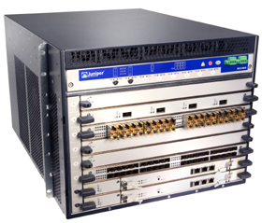
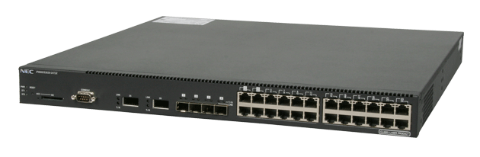
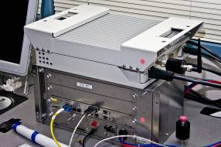
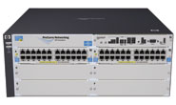
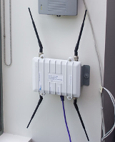

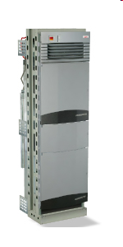

Current SDN hardware
Juniper MX-series
NEC IP8800
WiMax (NEC)
HP Procurve 5400
Netgear 7324
PC Engines
Pronto 3240/3290
Ciena Coredirector
More coming soon...
57

Slide 58
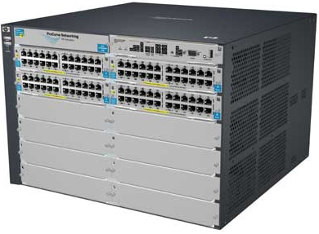

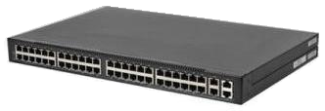
Commercial Switch Vendors
Model | Virtualize | Notes
HP Procurve 5400zl or 6600 | 1 OF instance per VLAN | LACP, VLAN and STP processing before OpenFlow Wildcard rules or non-IP pkts processed in s/w Header rewriting in s/w CPU protects mgmt during loop
NEC IP8800 | 1 OF instance per VLAN | OpenFlow takes precedence Most actions processed in hardware MAC header rewriting in h/w
Pronto 3240 or 3290 with Pica8 or Indigo firmware | 1 OF instance per switch | No legacy protocols (like VLAN and STP) Most actions processed in hardware MAC header rewriting in h/w
58
Notes:
All support ver 1.0
All have approx 1500 flow table entry limit

Slide 59
Controller Vendors
Vendor | Notes
Nicira’s NOX | Open-source GPL C++ and Python Researcher friendly
Nicira’s ONIX | Closed-source Datacenter networks
SNAC | Open-source GPL Code based on NOX0.4 Enterprise network C++, Python and Javascript Currently used by campuses
Vendor | Notes
Stanford’s Beacon | Open-source Researcher friendly Java-based
BigSwitch controller | Ha open source version Based on Beacon Enterprise network
Maestro (from Rice Univ) | Open-source Based on Java
Frenetic or Nettle | Open-source Written in functional programming languages
59

Slide 60
Floodlight Architecture
Source: Big Switch Networks
Overview
FloodlightProvider
(IFloodlightProviderService)
  Floodlight is a collection of modules
  Some modules (not all) export services
  All modules in Java
  Rich, extensible REST API
TopologyManager
(ITopologyManagerService)
LinkDiscovery
(ILinkDiscoveryService)
Forwarding
DeviceManager
(IDeviceService)
StorageSource
(IStorageSourceService)
RestServer
(IRestApiService)
StaticFlowPusher
(IStaticFlowPusherService)
VirtualNetworkFilter
(IVirtualNetworkFilterService)
Notes:
Our topology, device manager know about host attachment points and make it possible to deal with integrating openflow and non openflow networks.

Slide 61
Floodlight Architecture
Source: Big Switch Networks
Module descriptions
FloodlightProvider
(IFloodlightProviderService)
Translates OF messages to Floodlight events
Managing connections to switches via Netty
TopologyManager
(ITopologyManagerService)
Computes shortest path using Dijsktra
Keeps switch to cluster mappings
LinkDiscovery
(ILinkDiscoveryService)
Maintains state of links in network
Sends out LLDPs
Forwarding
Installs flow mods for end-to-end routing
Handles island routing
DeviceManager
(IDeviceService)
Tracks hosts on the network
MAC -> switch,port, MAC->IP, IP->MAC
StorageSource
(IStorageSourceService)
DB style storage (queries, etc)
Modules can access all data and subscribe to changes
RestServer
(IRestApiService)
Implements via Restlets (restlet.org)
Modules export RestletRoutable
StaticFlowPusher
(IStaticFlowPusherService)
Supports the insertion and removal of static flows
REST-based API
VirtualNetworkFilter
(IVirtualNetworkFilterService)
Create layer 2 domain defined by MAC address
Used for OpenStack / Quantum
61
Notes:
Our topology, device manager know about host attachment points and make it possible to deal with integrating openflow and non openflow networks.

Slide 62

Floodlight Programming Model
Northbound APIs
IFloodlightModule
Java module that runs as part of Floodlight
Consumes services and events exported by other modules
  OpenFlow (ie. Packet-in)
  Switch add / remove
  Device add /remove / move
  Link discovery
External Application
IFloodlight-Module
REST
Floodlight Controller
External Application
Communicates with Floodlight via REST
  Quantum / Virtual networks
  Normalized network state
  Static flows
Switch
Switch
vSwitch
Switch

Slide 63
REST API Reference
Source: Big Switch Networks
A moving target…but…
Network State
List Hosts
List Links
List Switches
GetStats (DPID)
GetCounters (OFType…)
Static Flows
Add Flow
Delete Flow
List Flows
RemoveAll Flows
Virtual Network
Create Network
Delete Network
Add Host
Remove Host
User Extensions
…
Floodlight Controller
Switch
Switch
Switch
vSwitch

Slide 64
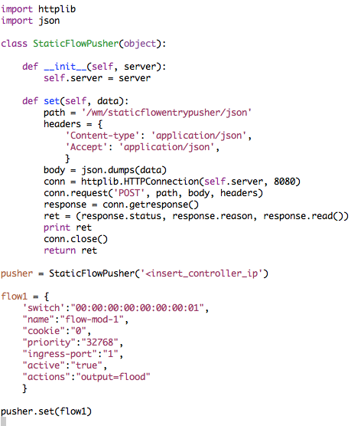
Programming Floodlight
Using the REST API
Fine-grained ability to push flows over REST
Access to normalized topology and device state
Extensible access to add new APIs

Slide 65
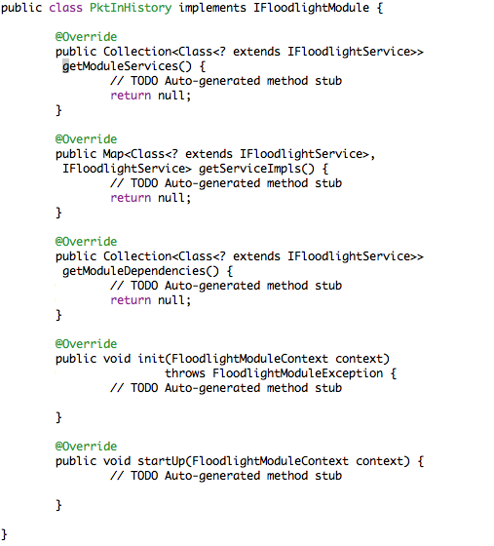
Programming Floodlight
Source: Big Switch Networks
Creating a module
Handle OpenFlow messages directly (ie. PacketIn)
Expose services to other modules
Add new REST APIs

Slide 66
Outline
Review of previous lecture
SDN Basics
  Concepts
  OpenFlow
  Switches and Controllers
  OF-Config
  Mininet

Slide 67
OpenFlow configuration and Management Protocol
Bootstrap OpenFlow network
  Switch connects to controller
  Controller(s) to connect to must be
  configured at switches
Allocate resources within switches
  Ports
  Queues
  . . .
controller
controller
switch
switch
switch
switch

Slide 68
OpenFlow configuration and Management Protocol: Reference Model
Configuration Point
  Source of switch configuration
OpenFlow Capable Switch
  Hosts one or more logical switches
OpenFlow Controller
OpenFlow Logical Switch
  instance of an OpenFlow Switch
Configuration Point
Configuration Point
Configuration Point
Configuration Point
OpenFlow
Controller
OpenFlow
Controller
OF-CONFIG
using IETF Netconf & XML data models
OpenFlow
OpenFlow
OpenFlow
Capable Switch
resources
(ports, queues)
OF Logical Switch
OF Logical Switch

Slide 69
OF-CONFIG Scope and Releases
WG established
in Sep 2011
OF-CONFIG 1.0 (Jan 2012) based on OpenFlow 1.2
  assigning controllers to logical switches
  retrieving assignment of resources to logical switches
  configuring some properties of ports and queues
OF-CONFIG 1.1 (Apr 2012) based on OpenFlow 1.3
  added controller certificates and resource type "table"
  retrieving logical switch capabilities signaled to controller
  configuring of tunnel endpoints
OF-CONFIG 1.1.1 (Aug 2012) based on OpenFlow 1.3.1
  consolidation of version 1.1, fixing small inconsistencies
OF-CONFIG 1.2 (early 2013) based on OpenFlow 1.3.1
  features still under discussion, candidates include
    retrieving capable switch capabilities, configuring logical switch capab.
    assigning resources to logical switches
    simple topology detection
    event notification

Slide 70
Use of Netconf and Yang
Netconf was chosen as management protocol
  not necessarily accepted as ideal solution
  still discussing alternatives
XML schema was chosen as modeling language
  Yang is also used, but XML is normative
  normative XML schema generated from Yang code
So far, the focus has been on configuration
  bootstrap of an OpenFlow network is the obvious first thing to do
New work items will be more on OAM
  incl. event notifications

Slide 71
Outline
Review of previous lecture
SDN Basics
  Concepts
  OpenFlow
  Switches and Controllers
  OF-Config
  Mininet

Slide 72
Mininet
Machine-local virtual network
  great dev/testing tool
Uses linux virtual network features
  Cheaper than VMs
Arbitrary topologies, nodes

Slide 73
Mininet (Cont’d)
Rapidly prototype, develop and test
  Interestingly-sized networks (16-100 nodes) start up in seconds
  No lengthy lab reconfiguration or rebooting required
  Always-accessible network resources, in any topology, at essentially no cost
  Designs that work on Mininet transfer seamlessly to hardware for full speed operation

Slide 74
Mininet (Cont’d)
Repeatably test, analyze, and predict network behavior
  Easy replication of experimental and test results
  Examine effects of code or network changes before testing/deploying on hardware
  Allows automated system-level tests and experiments
  Recreate real-world network and test cases for a variety of topologies and configurations

Slide 75
Mininet (Cont’d)
Quickly get up and running
  Free and permissively licensed (BSD)
  Minimal hardware requirements
  Accessible to novices thanks to simple CLI
  Smooth learning curve thanks to walkthrough, tutorial, examples and API documentation
  Strong users and support community

Slide 76
Questions?

