Slide 1
Software Defined Networking
COMS 6998-8, Fall 2013
Instructor: Li Erran Li (lierranli@cs.columbia.edu)
http://www.cs.columbia.edu/~lierranli/coms6998-8SDNFall2013/
12/3/2013: SDN Security, End Host Networking Stack and Storage

Slide 2
Outline
Reminder: Course Evaluation Due on Dec 9
Review on SDN Debugging
  Data Plane Approach (Breakpoints + Packet Trace): NDB
  Control Plane Approach (Model Checking + Symbolic Execution): NICE
SDN Security
  Defense again Control Plane Attacks (Review)
  Security as a Service
SDN End Host Networking Stack
SDN Storage

Slide 3
Review of Previous Lecture: ndb
  Network Debugger (ndb) Goal
  Capture and reconstruct the sequence of events leading to the errant behavior
Allow users to define a Network Breakpoint
  A (header, switch) filter to identify the errant behavior
Produce a Packet Backtrace
  Path taken by the packet
  State of the flow table at each switch

Slide 4



Review of Previous Lecture: ndb (Cont’d)
Control Plane
Match
ACT
Flow Table State Recorder
Match
ACT
B
S
A
Breakpoint
Switch = S
IP src = A, IP dst = B
TCP Port = 22
Postcard
Collector

Slide 5
Review of Previous Lecture: ndb (Cont’d)
Control Plane
<Match, Action>
<Match, Action>
<Match, Action>
<Match, Action>
<Match, Action>
…
…
Flow Table State Recorder
<Match, Action>
<Match, Action>
<Match, Action>
<Match, Action>
<Match, Action>
…
…
B
<Match, Action>
<Match, Action>
<Match, Action>
<Match, Action>
<Match, Action>
…
…
<Match, Action>
<Match, Action>
<Match, Action>
<Match, Action>
<Match, Action>
…
…
A
Postcard
Collector

Slide 6
Review of Previous Lecture: ndb (Cont’d)
Control Plane
Flow Table State Recorder
<Datapath ID, Packet ID, Version>
Postcard
Collector
<Flow Table State, Version>

Slide 7
Review of Previous Lecture: NICE
Input
NICE
Output
No bugs
In
Controller
Execution
Unmodified
OpenFlow
program
Traces of property violations
State-space
search
Network
topology
Correctness
properties (e.g., no loops)

Slide 8
Review of Previous Lecture: NICE (Cont’d)
Controller (global variables)
Environment:
Switches (flow table, OpenFlow agent)
Simplified switch model
State
End-hosts (network stack)
Simple clients/servers
Communication channels (in-flight pkts)

Slide 9
Combining Symbolic Execution with Model Checking
Review of Previous Lecture: NICE (Cont’d)
host
send(pkt A)
host
discover_packets
host
send(pkt B)
State
0
State
1
State
2
State
3
host
send(pkt C)
Controller state changes
State
4
discover_packets transition:
Controller state 1
Symbolic
execution
of packet_in
handler
New packets
Enable new transitions:
host / send(pkt B)
host / send(pkt C)

Slide 10
Review of Previous Lecture:
Avant-Guard
Security extension to the OpenFlow data plane
  Connection migration
    To address scalability
    issue
  Actuating trigger
    To address responsiveness
    issue
Control Plane
Control Plane Interface
Connection Migration
Actuating Trigger
Flow Table Lookup
Packet Processing
Avant-Guard
Flow Table (TCAM and SRAM)
Data Plane

Slide 11
Review of Previous Lecture:
Connection Migration
Control Plane
(4)
(5)
Report stage
(9)
(10)
Report stage
Classification stage
Migration stage
A
(1) TCP SYN
(6) TCP SYN
B
(2) TCP SYN/ACK
A-1: A --> B: Migrate
(7) TCP SYN/ACK
(3) TCP ACK
(8) TCP ACK
Relay stage
A-2: A --> B: Relay
Relay stage
(11) TCP ACK
TCP Data
(12) TCP ACK
TCP Data
Data Plane

Slide 12
Review of Previous Lecture:
Delayed Connection Migration
Concept
  Delay Connection Migration until the data plane receives (a) data
  packet(s)
Why?
  Good for reducing the effects of some advanced attacks
    E.g., fake TCP connection setup
Control Plane
(5)
(6)
Report stage
(10)
(11)
Report stage
Classification stage
Migration stage
A
(1) TCP SYN
(7) TCP SYN
B
(2) TCP SYN/ACK
A-1: A --> B: Migrate
(8) TCP SYN/ACK
(3) TCP ACK
(9) TCP ACK
(4) TCP ACK
TCP Data
A-2: A --> B: Relay
Relay stage
(12) TCP ACK
TCP Data
Data Plane

Slide 13
Outline
Reminder: Course Evaluation Due on Dec 9
Review on SDN Debugging
  Data Plane Approach (Breakpoints + Packet Trace): NDB
  Control Plane Approach (Model Checking + Symbolic Execution): NICE
SDN Security
  Defense again Control Plane Attacks (Review)
  Security as a Service
SDN Storage

Slide 14
Roadmap
Security in the paradigm of SDN/OpenFlow
Security as an App (SaaA)
  New app development framework: FRESCO
  New security enforcement kernel: FortNOX
Security as a Service (SaaS)
  New security monitoring service for cloud tenants: CloudWatcher
Summary

Slide 15
Problems of Legacy Network Devices
Too complicated
  Control plane is implemented with complicated S/W and ASIC
Closed platform
  Vendor specific
Hard to modify (nearly impossible)
  Hard to add new functionalities
Source: G. Gu, et al, Texas A&M &SRI

Slide 16
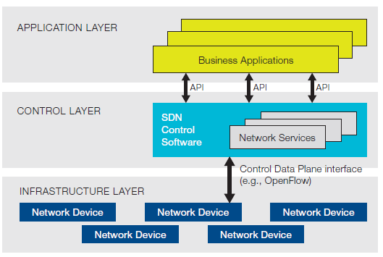
Software Defined Networking (SDN)
Three layer
  Application layer
    Application part of control layer
    Implement logic for flow control
  Control layer
    Kernel part of control layer
    Run applications to control network flows
  Infrastructure layer
    Data plane
    Network switch or router
SDN architecture from ONF

Slide 17


OpenFlow Architecture
OpenFlow Switch specification
application
OpenFlow Switch
OpenFlow
Protocol
PC
SSL
Secure
Channel
controller
sw
A controller application
can enforce any flow rules
to network switches
hw
Flow
Table
From openflow tutorial

Slide 18
Killer Applications of SDN?
Reducing Energy in Data Center Networks (load balancing)
WAN VM Migration
…
How about security?
  We are going to talk about this, more specifically:
  Security as an App (SaaA)
  Security as a Service (SaaS)
Source: G. Gu, et al, Texas A&M &SRI

Slide 19




Software App Store Today

Slide 20
Security as an App
SDN naturally has an application layer
Security functions can be apps on top of SDN/ networking OS
  Firewall
  Scan detection
  DDoS detection
  Intrusion detection/prevention
  …
Why SaaA?
  Cost efficiency
  Easy deployment/maintenance
  Rich, flexible network control
Source: G. Gu, et al, Texas A&M &SRI

Slide 21
Security as a Service
Clouds are large, complicated, and dynamic
How do tenants deploy security devices/functions?
    Tenant can use some pre-installed fixed-location security devices
      Not able to keep up with the high dynamisms in network configurations
    Tenant can Install security devices for themselves
      Difficult
Need a new Security Monitoring as a Service mechanism for a cloud network
Source: G. Gu, et al, Texas A&M &SRI

Slide 22
Challenges and New Contributions
It is not easy to develop security apps
  FRESCO: a new app development framework for modular, composable security services
It is not secure when running buggy/vulnerable/multiple security apps (e.g., policy conflict/bypass)
  FortNOX: a new security enforcement kernel
It is not convenient to install/use security devices for cloud tenants
  CloudWatcher: a new security monitoring service model based on SDN
Source: G. Gu, et al, Texas A&M &SRI

Slide 23
FRESCO:
Framework for Enabling Security
Controls in OpenFlow networks

Slide 24
What is FRESCO?
A new framework
  Enables to compose diverse network security functions easily (with combining multiple modules)
  Enables to create own network security functions easily (without requiring additional H/Ws)
  Enables to deploy network security functions easily and dynamically (without modifying the underlying network architecture)
  Enable to add more intelligence to current network security functions
Source: G. Gu, et al, Texas A&M &SRI

Slide 25
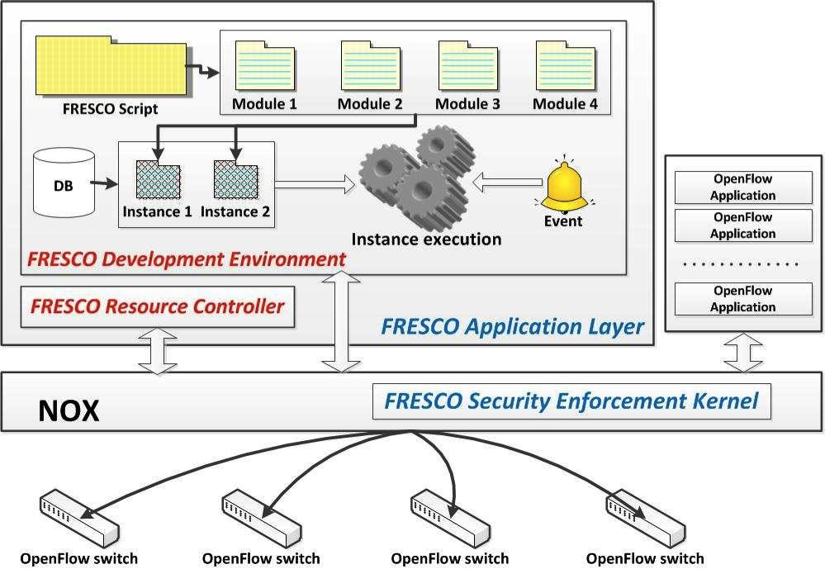
Source: G. Gu, et al, Texas A&M &SRI

Slide 26
FRESCO – Overall Operation
Create
Modules
Load Modules
Run
Modules
Monitor OpenFlow switches
Answer from NOX
Notify NOX of loading FRESCO modules
Source: G. Gu, et al, Texas A&M &SRI

Slide 27
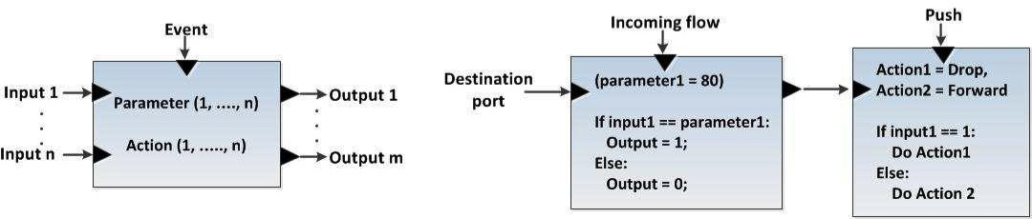
FRESCO Modular Design
event
parameter
action
input
output
Module
key
values
F-DB instance
Source: G. Gu, et al, Texas A&M &SRI

Slide 28
FRESCO – Script Language
Goal
  Define interfaces, actions, and parameters
  Connect multiple modules
  Similar to C/C++ function, start with { and end with }
Format
  Instance name (# of input) (# of output)
    denotes the module name and the number of input and output variables
  INPUT: a₁,a₂,
    denotes input items for a module a_{n} may be set of flows, packets or integer values
  OUTPUT: b₁,b₂,
    denotes output items for a module b_{n} may be set of flows, packets or integer values
  PARAMETER: c₁,c₂,
    denotes configuration values of a module c_{n} may be real numbers or strings
  EVENT: d₁,d₂,
    denotes events that will be delivered to a module d_{n} may be any predefined string
  ACTION : condition ; action,
    denotes actions that will be performed based on condition
Source: G. Gu, et al, Texas A&M &SRI

Slide 29
Simple Working Example: Reflector Net
do_redirect (2) (0) {
TYPE: ActionHandler
EVENT:PUSH
INPUT:SRC_IP, scan_result
OUTPUT: -
PARAMETER: -
ACTION: scan_result == 1? REDIRECT: FORWARD
/* if scan_result equals 1, redirect; otherwise, forward */
}
find_scan (1) (2) {
TYPE: ScanDetector
EVENT:TCP_CONNECTION_FAIL
INPUT: SRC_IP
OUTPUT: SRC_IP, scan_result
PARAMETER: 5
ACTION: -
/* no actions are defined */
}
Module 1
Module 2
Source: G. Gu, et al, Texas A&M &SRI

Slide 30
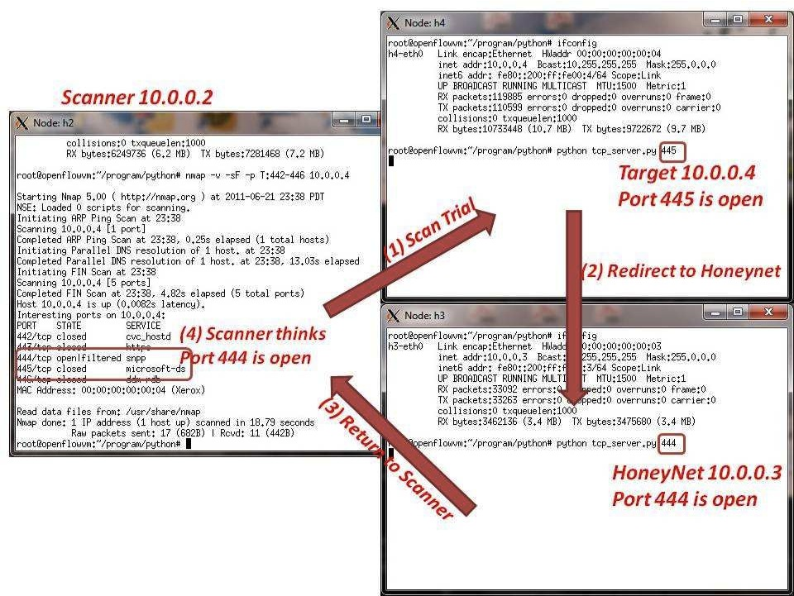
Reflector Net
Source: G. Gu, et al, Texas A&M &SRI

Slide 31
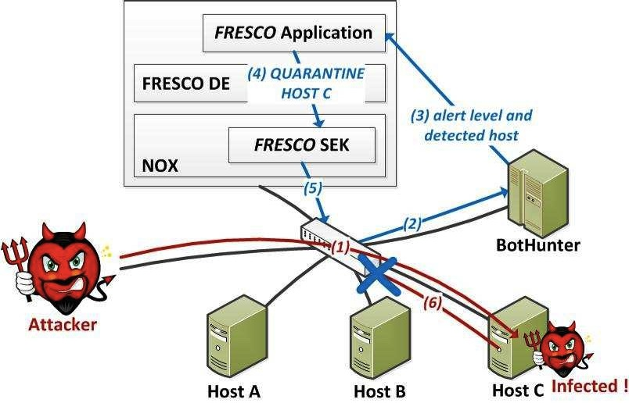
Cooperating with Legacy Security Applications
Source: G. Gu, et al, Texas A&M &SRI

Slide 32
BotMiner - Overview
How to detect botnet C&C channels
  Find C-plane
    Who is talking to whom?
      Flow: SRC IP, DST IP, DST Port, Protocol
      Features
        BPS (bytes per second), FPH (flows per hour)
        BPP (bytes per packet), PPF (packets per flow)
      Clustering based on features
  Find A-plane
    Who is doing what?
      Clients perform malicious activities
        E.g., scanning, spam activity and etc
      Clustering based on malicious actions
        E.g., scan cluster
  Co-Clustering
    Combine results of two clusters to find botnet C&C channels
    Channels showing similar C-plane patterns and performing malicious actions
Source: G. Gu, et al, Texas A&M &SRI

Slide 33
BotMiner in FRESCO (Diagram)

Slide 34
BotMiner in FRESCO (Script)
BM1 (1) (2) {
EVENT:TCP_CONNECTION_FAIL,
TCP_CONNECTION_SUCCESS
INPUT: Source IP
OUTPUT: Result, Input1
PARAMETER: -
ACTION: -
}
BM2 (2) (1) {
EVENT:PUSH
INPUT:BM1-0, BM1-1
OUTPUT: Result
PARAMETER:10
ACTION: -
}
BM3 (0) (1) {
EVENT:TCP_CONNECTION_FAIL,
TCP_CONNECTION_SUCCESS
INPUT: -
OUTPUT: Result
PARAMETER: -
ACTION: -
}
A-Plane Clustering
C-Plane Clustering
BM4 (2) (2) {
EVENT:PUSH
INPUT:BM2-0, BM3-0
OUTPUT: Result1, Result2
PARAMETER:-
ACTION: -
}
BM5 (2) (0) {
EVENT:PUSH
INPUT:BM4-0, BM4-1
OUTPUT: -
PARAMETER:-
ACTION: BM4-0 == 1 ?Drop
}
Co-Clustering
Action
Source: G. Gu, et al, Texas A&M &SRI

Slide 35
More …
Tarpits
White Holes
Scan detector
P2P detector (P2P Plotter)
Botnet detector (BotMiner)
…
Over 90% reduction in lines of code compared with their standard implementations
Already include more than 16 commonly reusable modules (expending over time)
Source: G. Gu, et al, Texas A&M &SRI

Slide 36
FortNOX:
A Security Enforcement Kernel for OpenFlow
Source: G. Gu, et al, Texas A&M &SRI

Slide 37
New Threat
SDN apps can compete, contradict, override one another, incorporate vulnerabilities
Worst case: an adversary can use a vulnerable and deterministic SDN app to control the state of all SDN switches in the network
Source: G. Gu, et al, Texas A&M &SRI

Slide 38
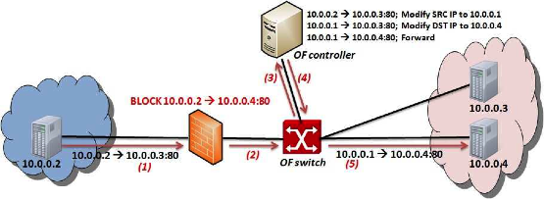
SDN/OpenFlow Evasion Scenario
  .
Dynamic Flow Tunneling
Source: G. Gu, et al, Texas A&M &SRI

Slide 39
Prerequisites for a Secure OpenFlow Platform
Must be resilient to
  Vulnerabilities in OF applications
  Malicious code in 3rd party OF apps
  Complex interaction that arise between OF app interactions
  State inconsistencies due to switch garbage collection or policy coordination across distributed switches
  Sophisticated OF applications that employ packet modification actions
  Adversaries who might directly target our security services to harm the network
Source: G. Gu, et al, Texas A&M &SRI

Slide 40
New Contributions
Development of a security enforcement kernel for the NOX OpenFlow controller
Role-based authorization
Rule conflict detection
Security directive translation
Source: G. Gu, et al, Texas A&M &SRI

Slide 41

Classic NOX Architecture
PY OF
Apps
Python SWIG
Native C
OF Apps
Send_OpenFlow_Command()
NOX
Source: G. Gu, et al, Texas A&M &SRI

Slide 42
FortNOX Architecture
Native C
OF Apps
Separate
Process
Security Apps
PY OF
Apps
OF IPC Proxy
Actuator
Python SWIG
Directive Translator
IPC Interface
Aggregate Flow Table
FT_Send_OpenFlow_Command
Operator Rules
Role-based Source Auth
State Table Manager
OF Mod Commands
Add (conflict enforced)
Modify (conflict enforced)
Delete (priority enforced)
SECURITY Rules
Conflict Analyzer
OF App Rules
Switch Callback Tracking
FortNOX
Switch Callback tracking
Source: G. Gu, et al, Texas A&M &SRI

Slide 43
Summary of FortNOX
FortNOX – A new security enforcement kernel for OF networks
  Role-based Authorization
  Rule-Authentication
  Conflict Detection and Resolution
  Security Directive Translation
Ongoing Efforts and Future Work
  Prototype implementations for newer controllers (Floodlight, POX)
  Security enforcement in multicontroller environments
  Improving error feedback to OF applications
  Optimizing rule conflict detection
“A Security Enforcement Kernel for OpenFlow Networks”. HotSDN’12
Source: G. Gu, et al, Texas A&M &SRI

Slide 44
Some Demonstrations
www.openflowsec.org
  Some technical reports and publications
  DEMO videos
  Demo 1: Constraints Enforcement [high res .mov or Youtube! ]
  Demo 2: Reflector Nets [high res .mov or Youtube! ]
  Demo 3: Automated Quarantine [high res .mov or Youtube! ]
  FRESCO/FortNOX beta to be released soon
Source: G. Gu, et al, Texas A&M &SRI

Slide 45
CloudWatcher:
Network Security Monitoring Using
OpenFlow in Dynamic Cloud Networks or: How to Provide
Security Monitoring as a Service in Clouds?
Source: G. Gu, et al, Texas A&M &SRI

Slide 46
Goal
Provide Security Monitoring as a Service for a cloud network
How to Provide
  Routing algorithms
    The algorithms guarantee that specified (static) network security devices can monitor (dynamic) specific network flows
  A script language
    Register security devices easily
    Create security policies easily
Source: G. Gu, et al, Texas A&M &SRI

Slide 47
CloudWatcher
A new framework
  Provide security monitoring services for large and dynamic cloud networks
  Detour network packets to be inspected by pre-installed network security devices automatically
    OpenFlow
  Provide a script to operate this framework
Source: G. Gu, et al, Texas A&M &SRI

Slide 48



Operating Scenario
Register Security Devices
{ID, TYPE, LOCATION, MODE, Func}
{1, NIDS, 8, PASSIVE, Detect HTTP}
Administrator
Create Security Policies
{FLOW CONDITON, DEVICE SET}
{10.0.0.* → *:80, {1}}
Parse Security Policies
Create Routing Rules
NIDS (ID = 1)
Translate Routing Rules into OpenFow Rules
Router (Device ID = 8)
Enforce Flow Rules into Routers
Source: G. Gu, et al, Texas A&M &SRI

Slide 49
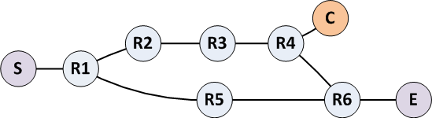
How to Control Flows
4 approaches
  Multipath naïve
  Shortest through
  Multipath shortest
  Shortest inline
- Sample network -
S: start node, E: end node
R: router, C: security device

Slide 50
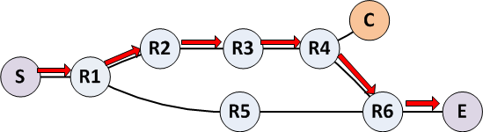
Shortest Through (algorithm 2)
Find the shortest path passing through R4
  Shortest path between S and R4
  Shortest path between R4 and E
  Path: S → R1 → R2 → R4 → R4 → R6 → E
It considers the security device without producing redundant paths
However, it may take more time to deliver packets
Source: G. Gu, et al, Texas A&M &SRI

Slide 51
Summary of CloudWatcher
CloudWatcher provides a new framework to monitor cloud networks
  With the help of the SDN technology
A cloud administrator can select algorithms based on network status
A cloud administrator can monitor his network by writing simple scripts
Work in progress; a position paper in NPSec’12
Source: G. Gu, et al, Texas A&M &SRI

Slide 52
Summary
SDN is a new technology, and security can be a new killer app
  SDN is impactful to drive a variety of innovations in network security
We investigate the possibilities of security as an app and security as a service
We propose key technologies to enable SaaA and SaaS
  FRESCO
  FortNOX
  CloudWatcher
Let’s contribute together to SDN and Security!
Source: G. Gu, et al, Texas A&M &SRI

Slide 53
Outline
Reminder: Course Evaluation Due on Dec 9
Review on SDN Debugging
  Data Plane Approach (Breakpoints + Packet Trace): NDB
  Control Plane Approach (Model Checking + Symbolic Execution): NICE
SDN Security
  Defense again Control Plane Attacks (Review)
  Security as a Service
SDN End Host Networking Stack
SDN Storage

Slide 54
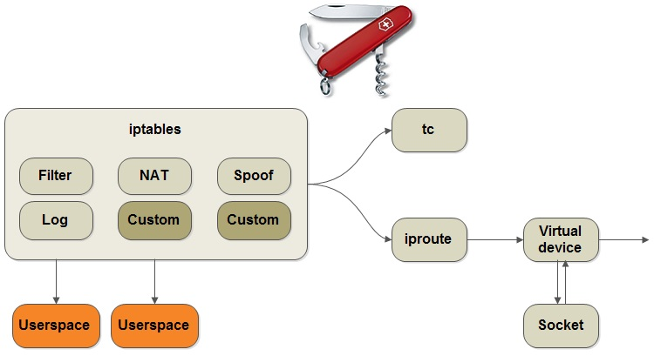
15 Years Ago
Linux networking stack

Slide 55
15 Years of Research
New network architectures (e.g. x-kernel)
Domain specific languages (e.g. Click)
Path abstraction (e.g. Scout)
(Now) Software-Defined Networking
Source: Sapan, et al, Princeton

Slide 56
15 Years Later
Linux networking stack

Slide 57
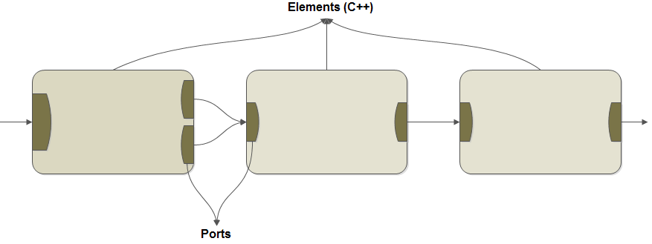
Click
Source: Sapan, et al, Princeton

Slide 58
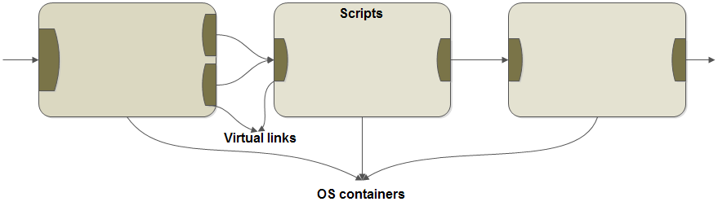
NativeClick
Key mechanisms: OS container and VPP
Source: Sapan, et al, Princeton

Slide 59
Comparison with Openvswitch
Openvswitch is in linux kernel
  Controls L2 and L3
NativeClick: a holistic view of Linux networking stack
  Much more than L2 and L3, e.g. tc (traffic control)

Slide 60
Summary
Standard networking tools are here to stay
NativeClick combines benefits of Click (clean modularity) and Linux stack
NativeClick abstractions: NativeClick elements and NativeClick ports
Source: Sapan, et al, Princeton

Slide 61
Outline
Reminder: Course Evaluation Due on Dec 9
Review on SDN Debugging
  Data Plane Approach (Breakpoints + Packet Trace): NDB
  Control Plane Approach (Model Checking + Symbolic Execution): NICE
SDN Security
  Defense again Control Plane Attacks (Review)
  Security as a Service
SDN End Host Networking Stack
SDN Storage
Source: Thereska, et al, MSR

Slide 62
Background: Enterprise data centers
General purpose applications
Application runs on several VMs
Separate network for VM-to-VM
traffic and VM-to-Storage traffic
Storage is virtualized
Resources are shared
VM
VM
VM
VM
VM
VM
Virtual
Machine
Virtual
Machine
Hypervisor
vDisk
vDisk
S-NIC
NIC
S-NIC
NIC
Switch
Switch
Switch
S-NIC
S-NIC
Storage server
Storage server
Source: Thereska, et al, MSR
Software Defined Networking (COMS 6998-8)
2
Notes:
-Such DCs comprise compute and storage servers. We can think of each app as a tenant -The storage servers act as front ends for back end storage. Storage is virtualized and VMs are presented with virtual hard disks that are simply large files on storage servers.

Slide 63
Motivation
Want: predictable application behaviour and performance
Need system to provide end-to-end SLAs, e.g.,
Guaranteed storage bandwidth B
Guaranteed high IOPS and priority
Per-application control over decisions along IOs’ path
It is hard to provide such SLAs today
Source: Thereska, et al, MSR
Notes:
-Tenant want predictable behaviour and performance in these shared resource environments, as if they had their own dedicated resources. They want performance guarantees and control over the services processing their data along the IO stack.
- The problem is that data centers today cannot provide those guarantees and control. Let’s understand why through an example.

Slide 64
Example: guarantee aggregate bandwidth B for Red tenant
App
App
OS
OS
VM
VM
Virtual
Machine
Virtual
Machine
Malware scan
Compression
Hypervisor
vDisk
…
…
vDisk
File system
File system
Storage server
S-NIC
NIC
S-NIC
NIC
Caching
Caching
Scheduling
Scheduling
File system
Switch
Switch
Switch
Hypervisor
Deduplication
IO Manager
S-NIC
S-NIC
…
Storage server
Storage server
Drivers
Caching
Deep IO path with 18+ different layers that are configured and operate independently and do not understand SLAs
Scheduling
Drivers
Notes:
No understanding of application performance requirements. Applications today do not have any way of expressing their SLAs, e.g., you do not open a file specifying how fast you want to read from it. It’s all best effort.
Sharing resources today means living with interference from neighbouring tenants, e.g., blue application can be aggressive and consume most of the storage bandwidth. This interference causes unpredictable performance.
Now, you might be thinking: there are other resources, e.g., network resources are also part of the end-to-end SLA, and we have ways to handle this complexity like software-defined networking. Why is storage different?

Slide 65
Challenges in enforcing end-to-end SLAs
No storage control plane
No enforcing mechanism along storage data plane
Aggregate performance SLAs
  - Across VMs, files and storage operations
Want non-performance SLAs: control over IOs’ path
Want to support unmodified applications and VMs
Source: Thereska, et al, MSR
Notes:
-No storage control plane that can coordinate the layers configuration to enforce an SLA
-Each layer has own configuration and makes own decisions.
- We have set a high bar for the SLAS: Want detailed SLAs. Aggregate is challenging because it adds a further distributed dimension to the config problem: configuration of layers across machines

Slide 66
IOFlow architecture
Decouples the data plane (enforcement) from the
control plane (policy logic)
App
App
High-level SLA
Storage server
OS
OS
File system
Malware scan
Compression
File system
File system
Controller
Deduplication
Scheduling
Scheduling
Hypervisor
…
Caching
IO Manager
Scheduling
Drivers
Drivers
Client-side IO stack
IOFlow API
Server-side IO stack
Source: Thereska, et al, MSR
Notes:
Controller is logically centralized and has global visibility

Slide 67
Contributions
Defined and built storage control plane
Controllable queues in data plane
Interface between control and data plane (IOFlow API)
Built centralized control applications that demonstrate power of architecture
Source: Thereska, et al, MSR

Slide 68
Storage flows
Storage “Flow” refers to all IO requests to which an SLA applies
  <{VMs}, {File Operations}, {Files}, {Shares}> ---> SLA
Aggregate, per-operation and per-file SLAs, e.g.,
<{VM 1-100}, write, *, \\share\db-log}>---> high priority
<{VM 1-100}, *, *, \\share\db-data}> ---> min 100,000 IOPS
Non-performance SLAs, e.g., path routing
<VM 1, *, *, \\share\dataset>---> bypass malware scanner
source set
destination sets
Source: Thereska, et al, MSR
Notes:
- IOFlow supports a flow abstraction described using four parameters
- Min: system can do more if underutilized
-We make the observation that this high level flow description maps in a straightforward way to low level queues and their functions that we’ve built as we’ll see next.

Slide 69
IOFlow API: programming data plane queues
  1. Classification [IO Header -> Queue]
  2. Queue servicing [Queue -> <token rate, priority, queue size>]
  3. Routing [Queue -> Next-hop]
IO
Header
Malware
scanner
…
…
…
Source: Thereska, et al, MSR
Notes:
3 key functions that IOFlow provides. -If a queue reaches the queue size threshold, the queue notifies the controller and blocks any further inserts to that queue. There is no support in the IO stack for dropping IO requests like in networking, but there is support for blocking requests and applying
- There are two storage-specific technical challenges: there is no end-to-end classification of storage traffic in the storage stack. Also, rate limiting storage requests is challenging.

Slide 70
Lack of common IO Header for storage traffic
SLA: <VM 4, *, *, \\share\dataset> --> Bandwidth B
Block device
Z: (/device/scsi1)
Stage configuration: “All IOs from VM4_sid to //serverX/AB79.vhd should be rate limited to B”
Volume and file
H:\AB79.vhd
Server and VHD
\\serverX\AB79.vhd
Block device
/device/ssd5
Source: Thereska, et al, MSR
Notes:
-For concreteness, we move to a concrete storage stack inside Windows.
- Mismatch: SLAs specified using high-level names, but layers observe different low-level identifiers/IO Headers
-VM name is also lost. By the time a request arrives at the storage server its source VM is lost.
-This is not just a problem in Windows. Other OSes have similar stacks.
- Root cause: layers with diverse functionalities. Virtualization made problem worse. Networks do not have this problem <ip, port, protocol>

Slide 71
Flow name resolution through controller
SLA: {VM 4, *, *, //share/dataset} --> Bandwidth B
Controller
SMBc exposes IO Header it understands:
<VM_SID, //server/file.vhd>
Queuing rule (per-file handle):
<VM4_SID, //serverX/AB79.vhd> --> Q1
Q1.token rate --> B
Source: Thereska, et al, MSR
Notes:
-Layers expose IO headers to controller. Controller maps the SLA to layer-specific IO headers
-SMB is file server protocol inside hypervisor. It understands VM Security descriptors, remote servers and file names. – When do you install this rule? When the file is opened. Queuing rule is maintained as part of the file handle and any subsequent IOs on that handle obey the rule. The controller is not on the IO data path
-Main takeaway is that controller is exposed to previously-private metadata that each layer had.
Controller is not on critical path

Slide 72
Rate limiting for congestion control
  Queue servicing [Queue -> <token rate, priority, queue size>]
Important for performance SLAs
Today: no storage congestion control
Challenging for storage: e.g., how to rate limit two VMs, one reading, one writing to get equal storage bandwidth?
tokens
IOs
Source: Thereska, et al, MSR
Notes:
- If an aggressive tenant sends too many IO requests to the storage node it might prevent it from meeting another tenant’s SLA
-Token buckets are a standard algorithm for rate limiting network packets. The token bucket algorithm outputs incoming packets as long as enough tokens are available. By providing a queue with more or less tokens, one can control the rate at which its requests drain.

Slide 73
Rate limiting on payload bytes does not work
VM
VM
8KB Reads
8KB Writes
Storage server
Source: Thereska, et al, MSR
Notes:
- Note that requests cannot be dropped on the storage stack, unlike in networks. So a key congestion signal is unavailable for storage. Once they enter the storage server, the server is committed to completing them.

Slide 74
Rate limiting on bytes does not work
VM
VM
8KB Reads
8KB Writes
Storage server
Source: Thereska, et al, MSR
Notes:
- Step in the right direction since the hypervisor knows the read io size from the IO header
- For SSDs, writes could be more expensive than reads, by an order of magnitude
- So let’s rate limit on number of requests or IOPS

Slide 75
Rate limiting on IOPS does not work
VM
VM
64KB Reads
8KB Writes
Storage server
Need to rate limit based on cost
Software Defined Networking (COMS 6998-8)
Source: Thereska, et al, MSR
Notes:
Read limiting based on IOPS cannot handle bandwidth changes. Reads would get more bandwidth. Furthermore, storage requests can have arbitrary long sizes (e.g., 1GB)
Clear that need to rate limit based on cost.

Slide 76
Rate limiting based on cost
Controller constructs empirical cost models based on device type and workload characteristics
    RAM, SSDs, disks: read/write ratio, request size
Cost models assigned to each queue
    ConfigureTokenBucket [Queue -> cost model]
Large request sizes split for pre-emption
Source: Thereska, et al, MSR
Notes:
Controller knows when new devices are added and through the discovery component it constructs models for them.
Cost models: E.g., consume 2 tokens for 64KB requests and 1 token for 4K requests.

Slide 77
Recap: Programmable queues on data plane
  Classification [IO Header -> Queue]
    Per-layer metadata exposed to controller
    Controller out of critical path
  Queue servicing [Queue -> <token rate, priority, queue size>]
    Congestion control based on operation cost
  Routing [Queue -> Next-hop]
How does controller enforce SLA?
Source: Thereska, et al, MSR
Notes:
Changes on data plane: Not all layers are expected to implement all 3 calls, they can implement 0 or a subset

Slide 78
Distributed, dynamic enforcement
<{Red VMs 1-4}, *, * //share/dataset> --> Bandwidth 40 Gbps
VM
VM
SLA needs per-VM enforcement
Need to control the aggregate rate of VMs 1-4 that reside on different physical machines
Static partitioning of bandwidth is sub-optimal
VM
VM
VM
VM
VM
VM
Hypervisor
Hypervisor
40Gbps
Storage server
Source: Thereska, et al, MSR
Notes:
In practice they read from multiple servers, but for simplicity here we focus on VM aggregation

Slide 79
Work-conserving solution
VMs with traffic demand should be able to send it as long as the aggregate rate does not exceed 40 Gbps
Solution: Max-min fair sharing
VM
VM
VM
VM
VM
VM
VM
VM
Hypervisor
Hypervisor
Storage server
Source: Thereska, et al, MSR

Slide 80
Max-min fair sharing
Well studied problem in networks
  Existing solutions are distributed
    Each VM varies its rate based on congestion
    Converge to max-min sharing
  Drawbacks: complex and requires congestion signal
But we have a centralized controller
  Converts to simple algorithm at controller
Source: Thereska, et al, MSR

Slide 81
Controller-based max-min fair sharing
t = control interval
s = stats sampling interval
What does controller do?
Infers VM demands
Uses centralized max-min within a tenant and across tenants
Sets VM token rates
Chooses best place to enforce
INPUT:
per-VM demands
Controller
s
t
OUTPUT:
per-VM allocated token rate
Source: Thereska, et al, MSR

Slide 82
Controller decides where to enforce
Minimize # times IO is queued and distribute rate limiting load
VM
VM
SLA constraints
  Queues where resources shared
  Bandwidth enforced close to source
  Priority enforced end-to-end
Efficiency considerations
  Overhead in data plane ~ # queues
  Important at 40+ Gbps
VM
VM
VM
VM
VM
VM
Hypervisor
Hypervisor
Storage server
Source: Thereska, et al, MSR
Notes:
-Based on SLA constraints and efficiency considerations. Can be thought of as an optimization problem. -The enforcement bottleneck tends to be queue locks. In this case this means enforcing at the hypervisors, but there are cases for high IOPS rates (>400000) when both hypervisors and storage servers do enforcement.
- Controller sets up queues and their service rates

Slide 83
Centralized vs. decentralized control
Centralized controller in SDS allows for simple algorithms that focus on SLA enforcement and not on distributed system challenges
Analogous to benefits of centralized control in software-defined networking (SDN)
Source: Thereska, et al, MSR

Slide 84
IOFlow implementation
2 key layers for
VM-to-Storage
performance SLAs
Controller
4 other layers
. Scanner driver (routing)
. User-level (routing)
. Network driver
. Guest OS file system
Implemented as filter drivers on top of layers
Source: Thereska, et al, MSR
Notes:
- Adding the IOFlow API to all layers I mentioned in the design is ongoing work. So far we have added it to:
- 2 key layers. File server protocol in hypervisor and entrance to the storage server.
- Key strength: no need to change apps
We have also added it to several other layers. For routing we have scanner and the ability to route to a user-space layer.
Controller is a separate service

Slide 85
Evaluation map
IOFlow’s ability to enforce end-to-end SLAs
Aggregate bandwidth SLAs
Priority SLAs and routing application in paper
Performance of data and control planes
Source: Thereska, et al, MSR

Slide 86
Evaluation setup
Clients:10 hypervisor servers, 12 VMs each
4 tenants (Red, Green, Yellow, Blue)
30 VMs/tenant, 3 VMs/tenant/server
VM
VM
VM
VM
VM
VM
VM
VM
Hypervisor
Hypervisor
…
Storage network:
Mellanox 40Gbps RDMA RoCE full-duplex
Switch
1 storage server:
16 CPUs, 2.4GHz (Dell R720)
SMB 3.0 file server protocol
3 types of backend: RAM, SSDs, Disks
Storage server
Controller: 1 separate server
1 sec control interval (configurable)
Source: Thereska, et al, MSR
Notes:
RoCE: RDMA over Converged Ethernet.
In this evaluation we show RAM for two reasons: it shows IOFlow can enforce high-perf SLAs and it shows worst-case data plane overheads in doing so.

Slide 87
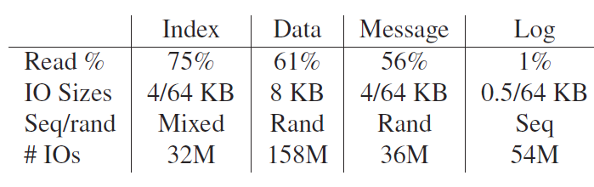
Workloads
4 Hotmail tenants {Index, Data, Message, Log}
Used for trace replay on SSDs (see paper)
IoMeter is parametrized with Hotmail tenant characteristics (read/write ratio, request size)
Source: Thereska, et al, MSR
Notes:
-The “Message” workload stores email content in files; ‘Index” is a background maintenance activity scheduled at night time in the data center; the “Data” and “Log” workloads are database data and transaction logs respectively. Metadata on emails is stored on these databases. So we have a diverse combination of file system, database and log workloads, typical of enterprise data centers.

Slide 88
Enforcing bandwidth SLAs
  4 tenants with different storage bandwidth SLAs
  Tenants have different workloads
    Red tenant is aggressive: generates more requests/second
Tenant | SLA
Red | {VM1 – 30} -> Min 800 MB/s
Green | {VM31 – 60} -> Min 800 MB/s
Yellow | {VM61 – 90} -> Min 2500 MB/s
Blue | {VM91 – 120} -> Min 1500 MB/s
Notes:
Access same storage server

Slide 89
Things to look for
Distributed enforcement across 4 competing tenants
  Aggressive tenant(s) under control
Dynamic inter-tenant work conservation
  Bandwidth released by idle tenant given to active tenants
Dynamic intra-tenant work conservation
  Bandwidth of tenant’s idle VMs given to its active VMs
Source: Thereska, et al, MSR

Slide 90
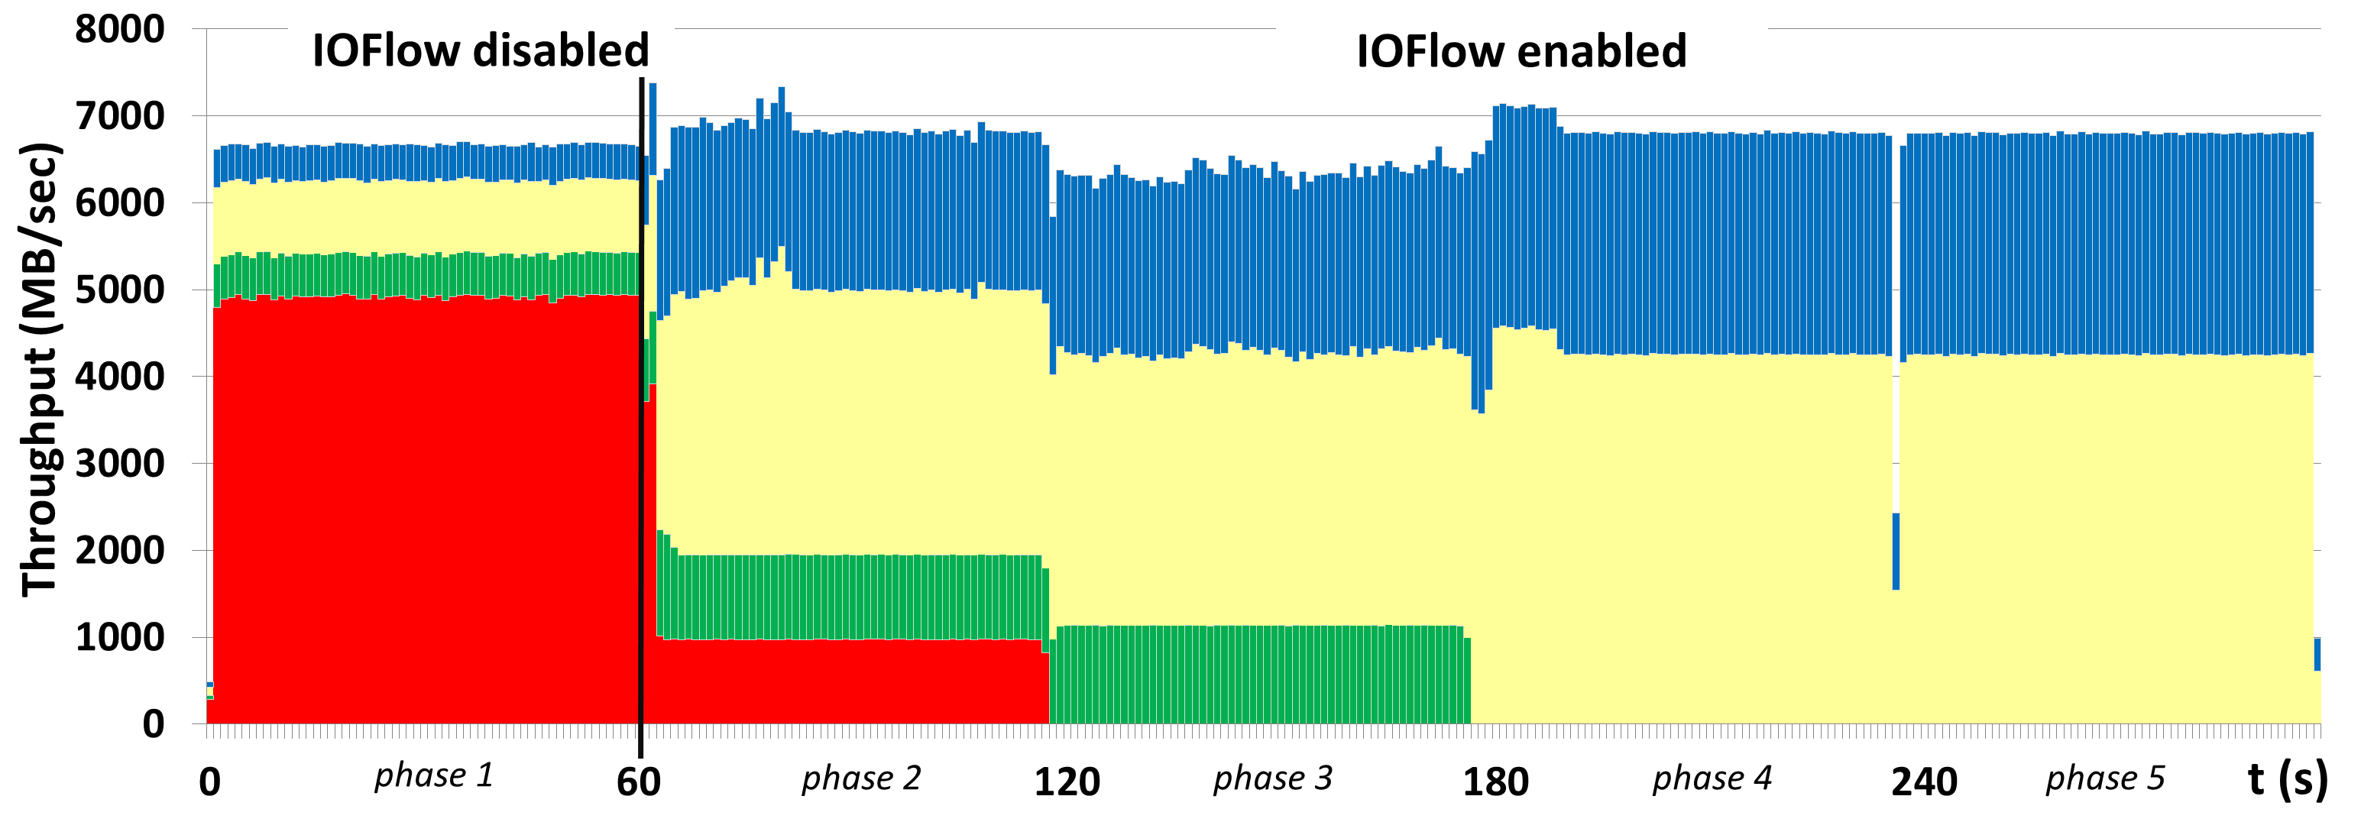
Results
Controller notices red tenant’s performance
Intra-tenant work conservation
Inter-tenant work conservation
Tenants’ SLAs enforced. 120 queues cfg.
Source: Thereska, et al, MSR

Slide 91
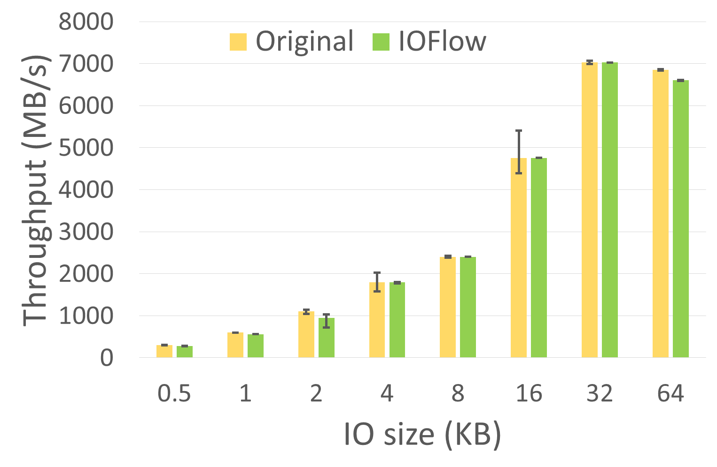
Data plane overheads at 40Gbps RDMA
Negligible in previous experiment. To bring out worst case varied IO sizes from 512Bytes to 64KB
Reasonable overheads for enforcing SLAs
Notes:
Metric: total throughput overhead across 120 tenants
Per-op overheads in general dominate per-byte overheads as expected, but overall the overheads are reasonable. The results for SSDs and disks are qualitatively similar.
At 512B: ~500K IOPS
Details: IoMeter with random-access requests, read:write 1:1
120 tenants with an SLA of 1/120th of storage capacity
Enforcement at hypervisors SMBc layer

Slide 92
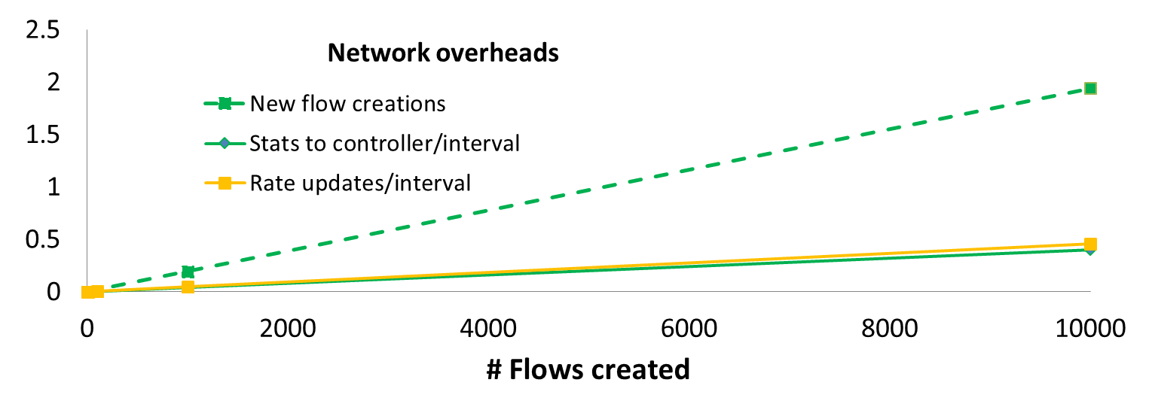
Control plane overheads: network and CPU
Controller configures queue rules, receives statistics and updates token rates every interval
<0.3% CPU overhead at controller
Overheads (MB)
Source: Thereska, et al, MSR

Slide 93
Summary of contributions
Defined and built storage control plane
Controllable queues in data plane
Interface between control and data plane (IOFlow API)
Built centralized control applications that demonstrate power of architecture
Ongoing work: applying to public cloud scenarios
Source: Thereska, et al, MSR

Slide 94
Questions?

