Slide 1
Software Defined Networking
COMS 6998-8, Fall 2013
Instructor: Li Erran Li (lierranli@cs.columbia.edu)
http://www.cs.columbia.edu/~lierranli/coms6998-8SDNFall2013/
11/19/2013: SDN Wireless Networks

Slide 2
Outline
Review
  Midterm
  SDN and Middleboxes
SDN Wireless Networks
  Motivation
  Data Plane Abstraction: OpenRadio
  Control Plane Architecture
    Radio Access Networks: SoftRAN
    Core Networks: SoftCell

Slide 3
Review of Previous Lecture: Middlebox Basics
A middlebox is any traffic processing device except for routers and switches.
Why do we need them?
  Security
  Performance
  Functionality (e.g. echo cancellation, video transcoding)
Deployments of middlebox functionalities:
  Embedded in switches and routers (e.g., packet filtering)
  Specialized devices with hardware support of SSL acceleration, DPI, etc.
  Virtual vs. Physical Appliances
  Local (i.e., in-site) vs. Remote (i.e., in-the-cloud) deployments
They can break end-to-end semantics (e.g., load balancing)

Slide 4
Review of Previous Lecture: Middlebox Consolidation
VPN Web Mail IDS Proxy
Firewall
Protocol Parsers
Session Management
Contribution of reusable modules: 30 – 80 %

Slide 5
Review of Previous Lecture: Middlebox State
Output
Middlebox VM
Caches
Other
processes
...
Internal to a replica (ephemeral)
May be shared among replicas (coherent)
Threshold counters
Non-critical statistics
Application Logic
Flow Table
Key | Value
5-tuple | [Flow State]
Partitionable among replicas
Input
( Flows )

Slide 6
Outline
Review
  Midterm
  SDN and Middleboxes
SDN Wireless Networks
  Motivation
  Data Plane Abstraction: OpenRadio
  Control Plane Architecture
    Radio Access Networks: SoftRAN
    Core Networks: SoftCell

Slide 7
Wireless Data Growth
AT&T
  Wireless data growth
  20,000% in the past
  5 years
Question: How to substantially improve wireless capacity?
Source: CISCO Visual Networking Index (VNI) Global Mobil Data Traffic Forecast 2011 to 2016

Slide 8


OpenRadio: Access Dataplane
OpenRadio APs built with merchant DSP & ARM silicon
  Single platform capable of LTE, 3G, WiMax, WiFi
  OpenFlow for Layer 3
  Inexpensive ($300-500)
Forwarding
Dataplane
Control
CPU
Baseband &
Layer 2 DSP
Exposes a match/action interface to program how a flow is forwarded, scheduled & encoded
RF
RF
RF
Source: Katti, Stanford

Slide 9
Design goals and Challenges
Programmable wireless dataplane using off-the-shelf components
  At least 40MHz OFDM-complexity performance
    More than 200 GLOPS computation
    Strict processing deadlines, eg. 25us ACK in WiFi
  Modularity to provide ease of programmability
    Only modify affected components, reuse the rest
    Hide hardware details and stitching of modules
Source: Katti, Stanford
9
Notes:
The goal in providing flexibility is to enable implementation of a wide set of optimizations and variations, but not arbitrary modifications. The cost in providing arbitrary flexibility is loss in performance (eg. SDRs). We want to cover modifications but retain performance. This will affect the granularity of protocol decomposition and the selection of processing abstractions, as we will discuss next.

Slide 10
Wireless Basebands
OFDM Demod
Demap
(BPSK)
Deinterleave
Viterbi Decode
Descramble
CRC Check
Hdr Parse
OFDM Demod
OFDM Demod
Demap
(BPSK)
Demap
(64QAM)
Demap
(BPSK)
Demap
(64QAM)
Deinterleave
Deinterleave
(WiFi)
Deinterleave (UEP)
Decode
(1/2)
Decode
(3/4)
Decode
(1/2)
Decode
(3/4)
Descramble
CRC Check
Hdr Parse
Descramble
Descramble
CRC Check
Hdr Parse
Hdr Parse
WiFi 6mbps
WiFi 6, 54mbps
WiFi 6, 18mbps and UEP
Source: Katti, Stanford
10
Notes:
Goal: We want to understand the nature of “programmability” in the context of wireless radios.
Outline: Lets consider a PHY protocol, say WiFi and list the operations that are performed. Then, let’s look at different modes of the protocol, like different modulation schemes and different coding rates. Based on the parts that are common and the parts that need modification or need to be turned off/on from mode to mode, we can partition the sequence of operations. This gives us the natural granularity of blocks that make up wireless protocols and the level of abstraction needed for programming.
We formalize this approach by identifying that the nature of “programming” involved here is the decision of whether to use a processing block and the associated parameters. The design of the “programming interface” involves the choice of processing blocks and their granularity. It is also the tradeoff between flexibility and ease of programming. (As we will see, it is also the tradeoff between flexibility and performance).
Give examples of what we DO NOT want to program: The specific algorithm used for Fourier Transform, the specific algorithm used for ML decoding, the specific algorithm used for computing the CRC etc.
Note: The list of blocks here is not exhaustive, only an example. Also, the division is not laid out in stone. A block can always be further subdivided – you may split an OFDM Demod block into “subcarrier demapper”, “CP remove” and “FFT”. We are only using this to drive to the principle of processing and decision plane separation.

Slide 11
Modular declarative interface
Composing ACTIONS
Inserting RULES
E
J
A
A
Deinterleave (UEP)
Hdr Parse
D
I
CRC Check
Deinterleave
(WiFi)
C
H
B
Demap
(64QAM)
Descramble
B
G
B
C
Demap
(BPSK)
Decode
(3/4)
D
A
F
OFDM Demod
Decode
(1/2)
D
  Blocks
F
A
A
A
B
C
C
H
Data
flow
F
G
D
D
E
H
F
G
F
G
I
I
H
H
H
H
J
J
I
I
I
6M, 54M
Control
flow
6M
54M
UEP
6M
J
J
J
J
  Rules: Branching logic
  Actions: DAGs of blocks
Source: Katti, Stanford
Notes:
Convenient abstraction level means that declarative description of protocol is possible with blocks as units; hardware is abstracted in the blocks so that the imperative execution plan need not be specified.
Sufficient expressiveness means that most protocol variants of interest can be realized with this API.

Slide 12
State machines and deadlines
Rules and actions encode the protocol state machine
  Rules define state transitions
  Each state has an associated action
Deadlines are expressed on state sequences
Start
decoding
Finish
decoding
B
F
A
D
H
I
G
J
C
deadline
Source: Katti, Stanford
12

Slide 13
Design principle I
Judiciously scoping flexibility
Provide just enough flexibility
Keep blocks coarse
Higher level of abstraction
High performance through hardware acceleration
  Viterbi co-processor
  FFT co-processor
Off-the-shelf heterogeneous multicore DSPs
  TI, CEVA, Freescale etc.
Algorithm | WiFi | LTE | 3G | DVB-T
FIR / IIR | √ | √ | √ | √
Correlation | √ | √ | √ | √
Spreading |  |  | √
FFT | √ | √ |  | √
Channel Estimation | √ | √ | √ | √
QAM Mapping | √ | √ | √ | √
Interleaving | √ | √ | √ | √
Convolution Coding | √ | √ | √ | √
Turbo Coding |  | √ | √
Randomi-zation | √ | √ | √ | √
CRC | √ | √ | √
Notes:
Balance flexibility and performance.

Slide 14
Design principle II
Processing-Decision separation
A
B
C
D
Logic pulled out to decision plane
Blocks and actions are branch-free
  Deterministic execution times
  Efficient pipelining, algorithmic scheduling
  Hardware is abstracted out
F
G
H
I
J
6M, 54M
A
Regular compilation | OpenRadio scheduling
Instructions | Atomic processing blocks
Heterogeneous functional units | Heterogeneous cores
Known cycle counts | Predictable cycle counts
Argument data dependency | FIFO queue data dependency
B
C
D
60x
E
F

Slide 15
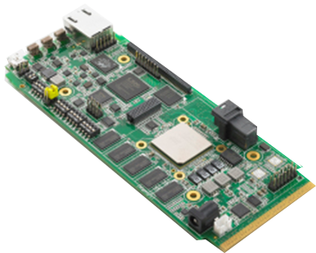
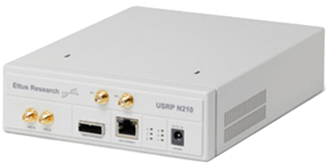

Prototype
I/Q base-
band
samples
RF signal
(Digital)
(Analog)
Baseband-processor unit (BBU)
Radio front end (RFE)
Antenna chain(AX)
Layer 1 & 2
Layer 0 & 1
Layer 0
COTS TI KeyStone multicore DSP platform
(EVM6618, two chips with 4 cores each at 1.2GHz, configurable hardware accelerators for FFT, Viterbi, Turbo)
Prototype can process 40MHz, 108Mbps 802.11g on one chip using 3 of 4 cores
Source: Katti, Stanford
15

Slide 16
OpenRadio: Current Status
OpenRadio APs with full WiFi/LTE software on TI C66x DSP silicon
OpenRadio commodity WiFi APs with a firmware upgrade
Network OS under development
Source: Katti, Stanford

Slide 17
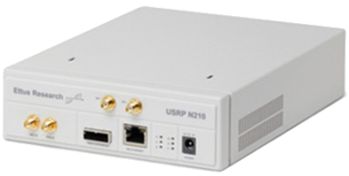
Software architecture
BBU
RFE
AX
(Digital)
(Analog)
monitor & control
OR Wireless Decision Plane
protocol state machine, flowgraph composition, block configurations, knowledge plane, RFE control logic
OR Runtime System
compute resource scheduling, deterministic execution ensuring protocol deadlines are met
OR Wireless Processing Plane
deterministic signal processing blocks, header parsing, channel resource scheduling, multicore fifo queues, sample I/O blocks
data in
data out
Bare-metal with drivers

Slide 18
Summary
Provides programmatic interfaces to monitor and program wireless networks
  High performance substrate using merchant silicon

Slide 19
Outline
Review
  Midterm
  SDN and Middleboxes
SDN Wireless Networks
  Motivation
  Data Plane Abstraction: OpenRadio
  Control Plane Architecture
    Radio Access Networks: SoftRAN
    Core Networks: SoftCell

Slide 20
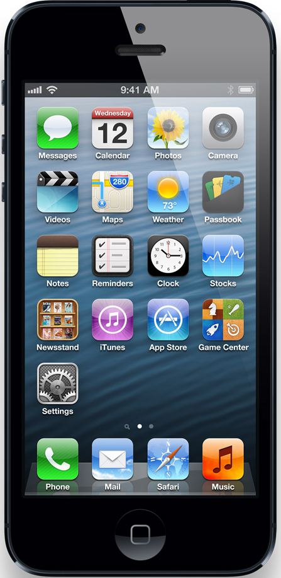
LTE Radio Access Networks
Goal: high capacity wide-area wireless network
Base Station (BS)
Serving Gateway
Packet Data
Network Gateway
User Equipment (UE)
Serving Gateway
Internet
access
core
Notes:
This figure shows the architecture of today’s cellular core networks. User equipment connect to base stations via radio channels.
Base stations connect to the Internet via the cellular core network. There are two main components in the cellular core network, serving gateway and packet data network gateway.

Slide 21
Coping with Increasing Traffic
Increasing demand on wireless resources
  Dense deployments
  Radio resource management (RRM) decisions made at one base stations affect neighboring base stations
  RRM needs to be coordinated

Slide 22


Radio Resource Management: Interference
BS2
BS1
Client1
Client2
(Power used at BS1) affects (interference seen at Client 2)
(Interference seen at Client 2) affects (power required at BS2)

Slide 23
Radio Resource Management : Mobility
BS2
BS1
Client1
Client1
Coordination required to decide handovers
Load at BS1 reduces and load at BS2 increases

Slide 24
LTE-RAN: Current Architecture
  Distributed control plane
    Control signaling grows with density
    Inefficient RRM decision making
    Harder to manage and operate the network
    Clients need to resynchronize state at every handover
  Works fine with sparse deployments, but problems compound in a dense network

Slide 25

SoftRAN: Big Base Station Abstraction
Big Base Station
Radio Element 1
time
controller
frequency
Radio Element 2
Radio Element 3
time
time
time
frequency
radio element
frequency
frequency

Slide 26
Radio Resource Allocation
Flows
3D Resource Grid
time
radio element
frequency

Slide 27
SoftRAN: SDN Approach to RAN
Coordination :
X2 Interface
Control Algo
OS
Control Algo
OS
Packet Tx/Rx
Control Algo
Packet Tx/Rx
OS
BS1
Packet Tx/Rx
BS3
Control Algo
Control Algo
OS
BS5
OS
Packet Tx/Rx
Packet Tx/Rx
BS2
BS4

Slide 28
SoftRAN: SDN Approach to RAN
Control Algo
Operator Inputs
Network OS
Packet Tx/Rx
Packet Tx/Rx
BS1
Packet Tx/Rx
BS3
BS5
Packet Tx/Rx
Packet Tx/Rx
BS2
BS4

Slide 29
SoftRAN Architecture Summary
CONTROLLER
RAN Information Base
Periodic Updates
Controller
API
Bytes
Rate
Queue
Size
Network
Operator
Inputs
RADIO ELEMENTS
Interference
Map
Flow
Records
QoS
Constraints
3D Resource Grid
Radio
Element API
Time
Radio Resource
Management
Algorithm
Radio Element
POWER
FLOW
Frequency

Slide 30
SoftRAN Architecture: Updates
Radio element -> controller (updates)
  Flow information (downlink and uplink)
  Channel states (observed by clients)
Network operator -> controller (inputs)
  QoS requirements
  Flow preferences

Slide 31
SoftRAN Architecture: Controller Design
RAN information base (RIB)
  Update and maintain global network view
    Interference map
    Flow records
Radio resource management
  Given global network view: maximize global utility
  Determine RRM at each radio element

Slide 32
SoftRAN Architecture: Radio Element API
Controller -> radio element
  Handovers to be performed
  RF configuration per resource block
    Power allocation and flow allocation
  Relevant information about neighboring radio elements
    Transmit Power being used

Slide 33
SoftRAN: Backhaul Latency
controller
time
radio element
frequency

Slide 34
Refactoring Control Plane
Controller responsibilities:
  Decisions influencing global network state
    Load balancing
    interference management
Radio element responsibilities:
  Decisions based on frequently varying local network state
    Flow allocation based on channel states

Slide 35
SoftRAN Advantages
  Logically centralized control plane:
  Global view on interference and load
    Easier coordination of radio resource management
    Efficient use of wireless resources
  Plug-and-play control algorithms
    Simplified network management
  Smoother handovers
    Better user-experience

Slide 36
SoftRAN: Evolving the RAN
Switching off radio elements based on load
  Energy savings
Dynamically splitting the network into Big-BSs
  Handover radio elements between Big-BSs

Slide 37
Implementation: Modifications
SoftRAN is incrementally deployable with current infrastructure
  No modification needed on client-side
  API definitions at base station
    Femto API : Standardized interface between scheduler and L1 (http://www.smallcellforum.org/resources-technical-papers)
    Minimal modifications to FemtoAPI required

Slide 38
Implementation (Ongoing): Controller
Floodlight : controller implementation
Radio resource management algorithm
  Load balancing
  Interference management
  QoS constraints
  Network operator preferences

Slide 39
Future Work
Expand SoftRAN to include 3G and Wifi networks
RAN virtualization to support resource sharing among multiple operators

Slide 40
Outline
Review
  Midterm
  SDN and Middleboxes
SDN Wireless Networks
  Motivation
  Data Plane Abstraction: OpenRadio
  Control Plane Architecture
    Radio Access Networks: SoftRAN
    Core Networks: SoftCell

Slide 41
Cellular Core Network Architecture
Base Station (BS)
Serving Gateway
Packet Data
Network Gateway
User Equipment (UE)
Serving Gateway
Internet
access
core
Notes:
This figure shows the architecture of today’s cellular core networks. User equipment connect to base stations via radio channels.
Base stations connect to the Internet via the cellular core network. There are two main components in the cellular core network, serving gateway and packet data network gateway.

Slide 42
Cellular core networks are not flexible
Most functionalities are implemented at
Packet Data Network Gateway
  Content filtering, application identification,
  stateful firewall, lawful intercept, …
This is not flexible
Packet Data
Network Gateway
Combine functionality from different vendors
Easy to add new functionality
Only expand capacity for bottlenecked functionality
Notes:
Most functionalities are implemented at the packet gateway today, including application identification, content filtering, monitoring and billing, and so on.
It is not flexible because carriers cannot combine functionality from different vendors.
It is also not easy to add new functionality because vendors have to integrate the functionality with other functionalities that might have already exist for more than 10 years.
It is also no possible to only expand capacity for bottlenecked functionality. Carriers have to buy a new equipment in order to expand the capacity.

Slide 43
Cellular core networks are not scalable
A lot of processing and state!
Base Station
Serving Gateway
Packet Data
Network Gateway
User Equipment
Serving Gateway
Internet
access
core
Notes:
With so many functionalities centralized at the packet gateway, it has to do a lot of processing at high speed keep state for each flow.
The serving gateway serves as the mobility anchor for hundreds of thousands of devices. It also has to do a lot of processing and state.
Such a centralized data plane design has performance bottlenecks in these few points.

Slide 44

Cellular core networks are not cost-effective
Capex & Opex
Base Station
Serving Gateway
Packet Data
Network Gateway
User Equipment
Serving Gateway
Internet
access
core
Notes:
It is also not cheap to build such a network.
It can cost as much as millions of dollar to buy a single box.
This is only the capital cost, not to mention the operational cost.
As shown in a recent report, the unit revenue decreases much faster than the unit cost.
So the current solution is not sustainable.

Slide 45

Can we make cellular core networks like data center networks?
✔ Flexible
✔ Scalable
✔ Cost-Effective
Notes:
On the other hand, data center networks have solved similar problems.
Can we make cellular core networks like data center networks? Flexible, scalable, and cost effective.

Slide 46
Can we make cellular core networks like data center networks?
Yes! With SoftCell!
✔ Flexible
✔ Scalable
✔ Cost-Effective
Notes:
Yes! With SoftCell.

Slide 47


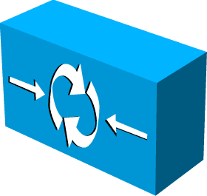
SoftCell Overview
Commodity hardware
No change
No change
+ SoftCell software
Controller
Internet
Notes:
It makes no change no user equipment, the radio access technology, or the Internet.
It only replaces the core network with commodity switches and middleboxes, controlled by a logically centralized controller.
Data Plane:
Switch: connectivity, traffic steering
Middlebox: various network services
~mix-match, combine functionality from different vendors
~easy to add new functionality
~up-/down-scale
~cheap
Control Plane:
Logically centralized controller, centralized control, rather than distributed protocol (hard to reason, debug, trouble shooting)
~Easy to manage
~Easy to change

Slide 48
SoftCell: Taking Control of
Cellular Core Networks
Characteristics of Cellular Core Networks
Scalable Data Plane
  Asymmetric Edge: Packet Classification
  Core: Multi-Dimensional Aggregation
Scalable Control Plane
  Hierarchical Controller

Slide 49
Characteristics of Cellular Core Networks
“North south” traffic pattern: in cellular core networks, most traffic is from/to the Internet
  In data centers, 76% traffic is intra data center traffic. [Cisco Global Cloud Index]
Notes:
First, cellular core networks have fine-grained and sophisticated policies. A cellular core network serves millions of customers with diverse needs.
Second, the dominant traffic in cellular core networks are from or to the Internet, while in data centers, most traffic stays inside the data center.
Third, cellular core networks have asymmetric edge. The access edge has lower bandwidth than the gateway edge.

Slide 50
Characteristics of Cellular Core Networks
“North south” traffic pattern
Asymmetric edge: low-bandwidth access edge vs. high-bandwidth gateway edge
Internet
~1 million UEs
~10 million flows
~400 Gbps – 2 Tbps
Access Edge
~1K UEs
~10K flows
~1 – 10 Gbps
Gateway Edge
Notes:
First, cellular core networks have fine-grained and sophisticated policies. A cellular core network serves millions of customers with diverse needs.
Second, the dominant traffic in cellular core networks are from or to the Internet, while in data centers, most traffic stays inside the data center.
Third, cellular core networks have asymmetric edge. The access edge has lower bandwidth than the gateway edge.

Slide 51
Characteristics of Cellular Core Networks
“North south” traffic pattern
Asymmetric edge
Traffic initiated from low-bandwidth access edge
Internet
~1 million UEs
~10 million flows
~400 Gbps – 2 Tbps
Access Edge
~1K UEs
~10K flows
~1 – 10 Gbps
Gateway Edge
Notes:
First, cellular core networks have fine-grained and sophisticated policies. A cellular core network serves millions of customers with diverse needs.
Second, the dominant traffic in cellular core networks are from or to the Internet, while in data centers, most traffic stays inside the data center.
Third, cellular core networks have asymmetric edge. The access edge has lower bandwidth than the gateway edge.

Slide 52

Characteristics of Cellular Core Networks
“North south” traffic pattern
Asymmetric edge
Traffic initiates from low-bandwidth access edge
Goal: Scalable support of fine-grained policies in such a network
with diverse needs!
Notes:
First, cellular core networks have fine-grained and sophisticated policies. A cellular core network serves millions of customers with diverse needs.
Second, the dominant traffic in cellular core networks are from or to the Internet, while in data centers, most traffic stays inside the data center.
Third, cellular core networks have asymmetric edge. The access edge has lower bandwidth than the gateway edge.

Slide 53
traffic to customer with parental control to go through a firewall then a content filter
Fine-grained and sophisticated policies
“ I want
and
balance the load among
all content filters and firewalls in the network!”
Notes:
Now let’s take a look at an example policy in cellular core networks.
The carrier wants to direct video traffic to gold plan customers to go through a firewall then a video transcoder.
Furthermore, since there can be multiple instances of firewalls or transcoders, the carrier wants to balance the load among multiple middlebox instances.

Slide 54
traffic to customer with parental control to go through a firewall then a content filter
Decouple the problem
“ I want
and
balance the load among
all content filters and firewalls in the network!”
Notes:
To implement the policy, we first decouple the problem into two parts.

Slide 55
traffic to customer with parental control to go through a firewall then a content filter
Decouple the problem
Service Policy: meet customer demand
Traffic Management Policy: meet operational goal
balance the load among
all content filters and firewalls in the network!”

Slide 56





subscriber attributes + application type
➔ an ordered list of middleboxes
Decouple the problem
Service Policy: meet customer demand
Content Filter <-> Firewall
Normal Customer
Parental Control
Normal Customer
Firewall
Government Customer
IPS <-> Firewall
Web Accelerator <-> Customized Firewall
“Gold Plan” Customer
Web Traffic
Notes:
The first part is a service policy, which predicts on application type like whether the traffic is video traffic and subscriber attributes like whether the traffic goes to a gold plan customer.
Traffic that matches the predict will be directed to an ordered sequence of middleboxes.

Slide 57
Decouple the problem
Traffic Management Policy: meet operational goal
Specify how to allocate network resources, e.g. load balance among multiple middlebox instances
Notes:
The second part is traffic management policy, which allocates network resource to traffic, like which middlebox instance to pick, which forwarding path to choose.

Slide 58
Challenge: Scalability
Packet Classification: decide which service policy to be applied to a flow
  How to classify millions of flows?
Traffic Steering: generate switch rules to implement paths given by traffic management policy
  How to implement million of paths?
Notes:
The main challenge to solve the problem is scalability.
First, we have to do packet classification. Given a flow, we have to decide which service policy to be applied to a flow. The challenge is how to classify millions of flows?
Second, we have to generate switch rules to implement paths given by traffic management policy. As switches have limited flow table size, how to implement millions of paths in switches is a big challenge.
Now let’s me tell you how to do packet classification in a scalable way.

Slide 59
“North south” Traffic Pattern
Too expensive to do packet classification at Gateway Edge!
Internet
~1 million UEs
~10 million flows
~400 Gbps – 2 Tbps
Access Edge
~1K UEs
~10K flows
~1 – 10 Gbps
Gateway Edge
Low traffic volume
Small number of active flows
High traffic volume
Huge number of active flows
Notes:
The dominant traffic in cellular core networks is “north south” traffic.
Traffic can enter the network both from the access edge and the gateway edge.
At the access edge, each base station handles around 1 thousand devices.
It operates at relatively low link speed.
However, the gateway edge aggregates traffic for around 1 million devices.
So it operates at a very high link speed and handles a huge number of flows.
Apparently, it is too expensive to do packet classification at the gateway edge.

Slide 60
“North south” Traffic Pattern
Internet
~1 million UEs
~10 million flows
~400 Gbps – 2 Tbps
Access Edge
~1K UEs
~10K flows
~1 – 10 Gbps
Gateway Edge
Opportunity: Traffic initiated from the access edge!
Notes:
The dominant traffic in cellular core networks is “north south” traffic.
Traffic can enter the network both from the access edge and the gateway edge.
At the access edge, each base station handles around 1 thousand devices.
It operates at relatively low link speed.
However, the gateway edge aggregates traffic for around 1 million devices.
So it operates at a very high link speed and handles a huge number of flows.
Apparently, it is too expensive to do packet classification at the gateway edge.

Slide 61


Asymmetric Edge: Packet Classification
Internet
Access Edge
Gateway Edge
Packet Classification
software
Simple Forwarding
hardware
Encode classification results in packet header
Classification results are implicitly piggybacked in header
Notes:
However, there is also opportunities.
In cellular core networks, most traffic is initiated from mobile devices entering the access edge.
So we leverage this characteristic and adopt an asymmetric edge design.
We do packet classification when traffic enter the network at the access edge and encode classification results in packet header.
Then when traffic returns from the Internet, the gateway edge only needs to do forwarding as classification results are implicitly piggybacked in packet header.

Slide 62
Challenge: Scalability
Packet Classification: decide which service policy to be applied to a flow
  How to classify millions of flows?
Traffic Steering: generate switch rules to implement paths given by traffic management policy
  How to implement million of paths?
Notes:
Now, let me tell you how do we implement millions of paths in limited switch flow table size.

Slide 63
Traffic Steering
Steering traffic to go through different sequences of middlebox instances
  Difficult to configure with traditional layer-2 or layer-3 routing
  [PLayer’08] use packet classifiers, large flow table
What about use a tag to encode a path?
  Aggregate traffic of the same path
  Suppose 1000 service policy clauses, 1000 base stations
  May result in 1 million paths, need 1 million tags
Limited switch flow tables: ~1K – 4K TCAM, ~16K – 64K L2/Eth
Solution: multi-dimensional aggregation

Slide 64
Multi-Dimensional Aggregation
Use multi-dimensional tags rather than flat tags
Exploit locality in the network
Selectively match on one or multiple dimensions
  Supported by TCAM in today’s switches
Policy Tag
BS ID
UE ID
Aggregate flows that share a common policy (even across UEs and BSs)
Aggregate flows going to the same (group of) base stations
Aggregate flows going to the same UE
Notes:
The basic idea is to use multi-dimensional tags rather than flat tags.
We aggregate in three dimensions, policy tag, BS ID and UE ID.
Policy tag aggregate flows that share a common policy, even across devices or base stations.
BS ID aggregates flows going to the same base station.
UE ID aggregates flows going to the same device. This is especially useful in UE handoff.
Multi-dimensional tags allow us to exploit locality in the network.
And we can selectively match on one or multiple dimensions in order to further reduce flow table size.

Slide 65
Location-Based Hierarchical IP Address
BS 1
BS 2
BS 3
BS 4

Slide 66
Location-Based Hierarchical IP Address
BS ID: an IP prefix assigned to each base station
BS 1
10.0.0.0/16
BS ID
BS 2
10.1.0.0/16
10.1.0.7
UE ID
BS 3
10.2.0.0/16
192.168.0.5
UE ID: an IP suffix unique under the BS ID
BS 4
10.3.0.0/16

Slide 67
Route to different BSs with BS ID
Forward to base station with prefix matching
Can aggregate nearby BS IDs
BS 1
10.0.0.0/16
SW 1
SW 2
SW 3
BS 2
SW 4
10.1.0.0/16
Match | Action
10.0.0.0/16 | Forward to BS 1
10.1.0.0/16 | Forward to BS 2
Match | Action
10.0.0.0/15 | Forward to Switch 3

Slide 68
MB load balancing with policy tag and BS ID
BS 1
10.0.0.0/16
SW 1
SW 2
BS 2
10.1.0.0/16
SW 3
BS 3
10.2.0.0/16
SW 4
SW 5
Transcoder 1
BS 4
10.3.0.0/16
Transcoder 2
Notes:
Cannot do with VLAN

Slide 69
MB load balancing with policy tag and BS ID
BS 1
Match | Action
tag1, 10.0.0.0/15 | Forward to Transcoder 1
10.2.0.0/15 | Forward to Switch 5
10.0.0.0/16
SW 1
SW 2
BS 2
10.1.0.0/16
SW 3
BS 3
10.2.0.0/16
SW 4
SW 5
Transcoder 1
BS 4
10.3.0.0/16
Match | Action
tag1, 10.2.0.0/15 | Forward to Transcoder 2
Transcoder 2
Notes:
Cannot do with VLAN

Slide 70
Policy Consistency
UE Mobility: frequent, unplanned
Policy consistency:
  Ongoing flows traverse the same sequence of middlebox instances, even in the presence of UE mobility
  Crucial for stateful middleboxes, e.g., stateful firewall

Slide 71
Policy Consistency
An ongoing flow traverses stateful Firewall 1 before handoff
  Use 10.0.0.7 (old IP under BS1), go via the old path
New Flow can go via stateful Firewall 2
  Use 10.1.0.11 (new IP under BS2), go via the new path
Firewall 1
Old Path
BS 1: 10.0.0.0/16
New Path
10.0.0.7
Old flow
Handoff
192.168.0.5
BS 2: 10.1.0.0/16
10.1.0.11
Old Flow
10.0.0.7
New Flow
192.168.0.5
New Flow
10.1.0.11
Firewall 2

Slide 72
Multi-Dimensional Identifier Encoding
Encode multi-dimensional identifiers to source IP and source port
Return traffic from the Internet:
  Identifiers are implicitly piggybacked in destination IP and destination port
Commodity chipsets (e.g., Broadcom) can wildcard on these bits
Policy Tag
BS ID
UE ID
Encode
Src IP
BS ID
UE ID
Src Port
Tag
Flow ID
Notes:
Don’t use flat tags
note that each UE has (say) 10 flows, so there is plenty of space in the TCP/UDP port number for the tag. even if all ten flows go to the same external service, you'd still have a ton of bits left to store the tag.
somewhere you should mention that, although OpenFlow 1.0 only does prefix matching on IP addresses and TCP/UDP port numbers, today's commodity chipsets (e.g., BroadCom Trident chipset) can wildcard on any of those bits, and as such is not limited to prefix matching.

Slide 73
Scalable Data Plane Summary
Packet classification based on service policy
Encoding results to packet headers
Traffic steering based on traffic management policy
Selectively multi-dimensional aggregation
Simple forwarding
based on multi-dimensional tags
Steering Fabric

Slide 74
SoftCell: Taking Control of
Cellular Core Networks
Characteristics of Cellular Core Networks
Scalable Data Plane
  Asymmetric Edge: Packet Classification
  Core: Multi-Dimensional Aggregation
Scalable Control Plane
  Hierarchical Controller

Slide 75
Control Plane Load
Packet classification
Handle every flow
Frequent switch update
Multi-dimensional aggregation
Handle every policy path
Infrequent switch update
Internet
Notes:
Finally, let’s take a look at the control plane load.
The access edge does packet classification.
So it has to handle every flow.
The switches are updated very frequently.
In the core, it only needs to setup up policy paths.
So the switches are updated less frequently.
Handling all these switch update in one controller can overwhelm the controller.

Slide 76
Hierarchical Controller
Local agent (LA) at each base station
Offload packet classification to local agents
Controller
LA
LA
LA
Internet
LA
Notes:
So we adopt a hierarchical controller design.
We introduce a local agent at each base station and offload packet classification to local agents, in order to scale the control plane.

Slide 77
Evaluation
Control Plane: LTE workload characteristics
  Dataset: 1 week traces from a large LTE network
    ~1500 base stations, ~1 million UEs
  Measure:
    Network wide (Controller load): # of UE arrivals/sec, # of handoffs/sec
    Per Base station (Local agent load): # of active UEs, # of bearer arrivals/sec
  Compare with micro benchmark
Data Plane: large-scale simulations

Slide 78
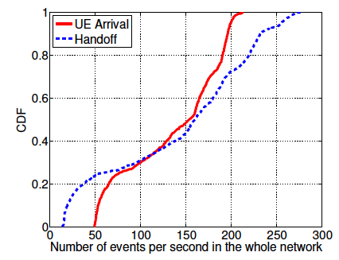
Network Wide (Controller Load)
99.999th percentile
214 UE arrivals/s
280 handoffs/s
Notes:
http://tinyurl.com/cz279q5
http://www.openflow.org/wk/index.php/Controller_Performance_Comparisons

Slide 79
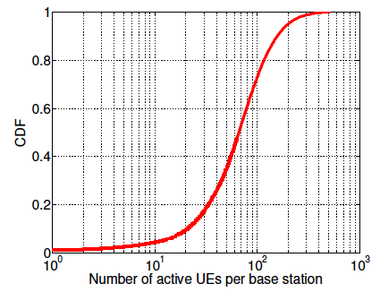
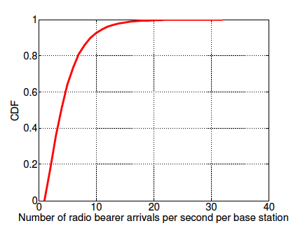
Per Base Station (Local Agent Load)
99.999th percentile
514 active UEs
34 bearer arrivals/s

Slide 80
Micro Benchmark
Service Policy
Packet
Classification
Multi-Dimensional
Aggregation
Subscriber
Attributes
Topology
Floodlight OpenFlow Controller
Packet Classifiers
For topology with ~1 K BSs and ~1 K service policy clauses, ~10 ms to calculate one path. Can pre-compute.
Switch Rules For
Path Implementation
Packet
Classification
LA
LA
LA
Local Agent (Floodlight)
Emulate 1000 local agents: 2.2 million requests/sec
All packet-in go to controller: 1.8 K requests/sec
All packet-in processed locally: 505.8 K requests/sec
Switch Rules For Header Rewriting

Slide 81
Evaluation
Control Plane: LTE workload characteristics
Data Plane: large-scale simulation
  Synthesized topology [Ceragon’10]: 128 switches, 1280 base stations
  8 middlebox types, 10 replicas each type
  1000-8000 service policy clauses, traversing 4-8 MBs
  Measure: switch flow table size (# of rules)

Slide 82
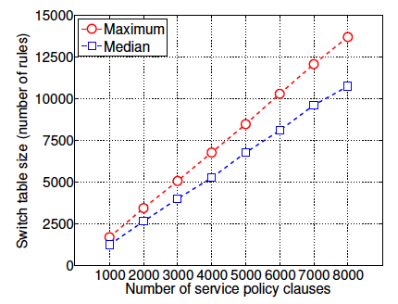
Flow table size vs. # of service policy clauses
13.7 K rules
for 8 K service policy clauses
1.7 K rules
for 1 K service policy clauses

Slide 83
Related Work
Cellular network architecture:
  [OpenRoads’10]: slice the network to enable multiple carriers
  [Ericsson’12]: GTP tunnel support in OpenFlow
Traffic Steering/Service Chaining:
  [PLayer’08]: use off-path MBs to make it more flexible
  NFV (Network Function Virtualization): virtualize network functions/services, supported by many carriers and vendors
No previous works present a scalable architecture that supports fined-grained policies

Slide 84
Conclusion and Future Work
SoftCell uses commodity switches and middelboxes to build flexible and cost-effective cellular core networks
SoftCell cleanly separates fine-grained service policies from traffic management policies
SoftCell achieves scalability with
Asymmetric Edge Design
Data Plane
Multi-dimensional Aggregation
Control Plane
Hierarchical Controller Design
Deploy SoftCell in real test bed
Exploit multi-stage tables in modern switches
  Reduce m×n rules to m+n rules
Notes:
In conclusion, CellSDN uses commodity switches and middleboxes to build flexible and cost-effective cellular core networks.
It supports fine-grained service policies and traffic management policies.
It achieves scalability with asymmetric edge design, multi-dimensional aggregation and hierarchical controller.

Slide 85
Questions?

