Slide 1
Software Defined Networking
COMS 6998-8, Fall 2013
Guest Speaker: Seyed Kaveh Fayazbakhsh Stony Brook University
11/12/2013: SDN and Middleboxes

Slide 2





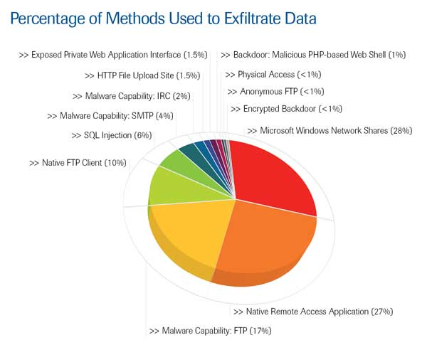




Need for Network Evolution
New applications
Evolving
threats
Policy
constraints
Performance, Security
New devices

Slide 3
Network Evolution today: Middleboxes!
Type of appliance | Number
Firewalls | 166
NIDS | 127
Media gateways | 110
Load balancers | 67
Proxies | 66
VPN gateways | 45
WAN Optimizers | 44
Voice gateways | 11
Total Middleboxes | 636
Total routers | ~900
Data from a large enterprise:
>80K users across tens of sites
Just network security
$10 billion
(Sherry et al, SIGCOMM’ 12)

Slide 4
There are many middleboxes!
Survey across 57 enterprise networks
(Sherry et al, SIGCOMM’ 12)

Slide 5
Things to keep in mind about middleboxes
A middlebox is any traffic processing device except for routers and switches.
Why do we need them?
  Security
  Performance
Deployments of middlebox functionalities:
  Embedded in switches and routers (e.g., packet filtering)
  Specialized devices with hardware support of SSL acceleration, DPI, etc.
  Virtual vs. Physical Appliances
  Local (i.e., in-site) vs. Remote (i.e., in-the-cloud) deployments
They can break end-to-end semantics (e.g., load balancing)

Slide 6
SDN Stack
Where do middleboxes logically fit in?
App
Applications
Controller
Runtime
Control Flow, Data Structures, etc.
Controller Platform
Switch API
Switches

Slide 7
Outline
Recent trends in middlebox design/deployment
  Middlebox Consolidation (CoMb)
  Extensible Software Middlebox Architecture (xOMB)
Middleboxes/SDN Integration
  Elastic Execution (Split/Merge)
  Policy enforcement (SIMPLE)
  Handling dynamic traffic modification (FlowTags)

Slide 8
Outline
Recent trends in middlebox design/deployment
  Middlebox Consolidation (CoMb)
  Extensible Software Middlebox Architecture (xOMB)
Middleboxes/SDN Integration
  Elastic Execution (Split/Merge)
  Policy enforcement (SIMPLE)
  Handling dynamic traffic modification (FlowTags)

Slide 9




Design and Implementation of a
Consolidated Middlebox
Architecture
Vyas Sekar
Sylvia Ratnasamy
Michael Reiter
Norbert Egi Guangyu Shi
Ack: Vyas Sekar

Slide 10
Key “pain points”
Narrow
interfaces
Management
Management
Management
Specialized
boxes
Increases capital expenses & sprawl
Increases operating expenses
Limits extensibility and flexibility
“Point”
solutions!
➔

Slide 11
Key idea: Consolidation
Two levels corresponding to two sources of inefficiency
Network-wide
Controller
2. Consolidate
Management
1. Consolidate
Platform

Slide 12
Consolidation at Platform-Level
Today: Independent, specialized boxes
Proxy
Firewall
IDS/IPS
AppFilter
Decouple
Hardware and
Software

Slide 13
Consolidation reduces CapEx
Multiplexing benefit = Sum_of_MaxUtilizations/
Max_of_TotalUtilization

Slide 14
Consolidation Enables Extensibility
VPN Web Mail IDS Proxy
Firewall
Protocol Parsers
Session Management
Contribution of reusable modules: 30 – 80 %

Slide 15
Management consolidation enables flexible resource allocation
Today: All processing at logical “ingress”
Process (P)
Process (0.4 P)
Process (0.3 P)
Process (0.3 P)
N3
N1
Overload!
P: N1→ N3
N2
Network-wide distribution reduces load imbalance
Notes:
Simplify this slide!

Slide 16
CoMb System Overview
Network-wide
Controller
Logically centralized
e.g., NOX, 4D
General-purpose hardware
Existing work: simple, homogeneous routing-like workload
Middleboxes: complex, heterogeneous, new opportunities

Slide 17
CoMb Management Layer
Goal: Balance load across network.
Leverage multiplexing, reuse, distribution
Policy
Constraints
Resource
Requirements
Routing,
Traffic
Network-wide
Controller
Processing
responsibilities

Slide 18
Capturing Reuse with HyperApps
HTTP:
1+2 unit of CPU
1+3 units of mem
HyperApp: find the union of apps to run
HTTP = IDS & Proxy
HTTP
UDP
HTTP
NFS
3
4
CPU
Memory
IDS
Proxy
2
3
UDP = IDS
1
1
3
1
common
Memory
CPU
CPU
Memory
NFS = Proxy
HTTP
Footprint on
resource
1
4
CPU
Memory
Need per-packet
policy, reuse dependencies!

Slide 19
Modeling Processing Coverage
HTTP: Run IDS -> Proxy
IDS < Proxy
0.4
IDS < Proxy
0.3
IDS < Proxy
0.3
HTTP
N1 → N3
N1
N2
N3
What fraction of traffic of class HTTP from N1→ N3
should each node process?

Slide 20
Network-wide Optimization
Minimize Maximum Load, Subject to
Processing coverage for each class of traffic
→ Fraction of processed traffic adds up to 1
No explicit
Dependency
Policy
Load on each node
→ Sum over HyperApp responsibilities per-path
A simple, tractable linear program
Very close (< 0.1%) to theoretical optimal

Slide 21
CoMb System Overview
Network-wide
Controller
Logically centralized
e.g., NOX, 4D
General-purpose hardware
Existing work: simple, homogeneous routing-like workload
Middleboxes: complex, heterogeneous, new opportunities

Slide 22
CoMb Platform
Applications
IDS
…
Proxy
Challenges:
Performance
Parallelize
Isolation
Core1
…
Core4
Policy Enforcer
Challenges:
Lightweight
Parallelize
Policy Shim (Pshim)
IDS -> Proxy
NIC
Challenges:
No contention
Fast classification
Classification:
HTTP
Traffic

Slide 23
Parallelizing Application Instances
✔
App-per-core
HyperApp-per-core
M1
M2
M3
M1
M2
M2
M3
Core1
Core2
Core3
Core1
Core2
PShim
PShim
PShim
PShim
Inter-core communication
More work for PShim
+ No in-core context switch
+ Keeps structures core-local
+ Better for reuse
- But incurs context-switch
- Need replicas
HyperApp-per-core is better or comparable
Contention does not seem to matter!

Slide 24
CoMb Platform Design
Core-local processing
Workload balancing
Core 1
Core 2
Core 3
M1
M2
M3
M1
M4
M5
M1
M4
Hyper
App1
Hyper
App2
Hyper
App3
Hyper
App4
Hyper
App3
PShim
PShim
PShim
PShim
PShim
Q1
Q2
Q3
Q4
Q5
NIC hardware
Parallel, core-local
Contention-free network I/O

Slide 25
Benefits: Reduction in Maximum Load
MaxLoad_{Today} /MaxLoad_{Consolidated}
Consolidation reduces maximum load by 2.5-25X

Slide 26
Benefits: Reduction in Provisioning Cost
Provisioning_{Today} /Provisioning_{Consolidated}
Consolidation reduces provisioning cost 1.8-2.5X

Slide 27
Outline
Recent trends in middlebox design/deployment
  Middlebox Consolidation (CoMb)
  Extensible Software Middlebox Architecture (xOMB)
Middleboxes/SDN Integration
  Elastic Execution (Split/Merge)
  Policy enforcement (SIMPLE)
  Handling dynamic traffic modification (FlowTags)

Slide 28


xOMB: Extensible Open Middleboxes with Commodity Servers
James Anderson, Ryan Braud, Rishi Kapoor, George Porter and Amin Vahdat
Ack: Rishi Kapoor

Slide 29
xOMB
CoMb focused on consolidated deployment of middleboxes and simplifying network deployment.
xOMB is a framework for programmable middleboxes using commodity servers.
Provides low-level functionality necessary for high performance processing
User defined functionality on top of basic xOMB blocks

Slide 30

xOMB Framework
Controller
Hardware Switch
F(N)
G(N)
LAN
Client Connections
F(N)
G(N)
F(N)
G(N)
Backend Servers
30

Slide 31
xOMB Architecture
xOMB Modules
or
User Defined
Pipeline
Socket I/O
Basic
Functionality
Buffer
Manager
Connection
Manager
Message Reorder Buffer
Control Plane
Client TCP
Backend
TCP
Notes:
Btw, why do we need a message reorder buffer?

Slide 32
Outline
Recent trends in middlebox design/deployment
  Middlebox Consolidation (CoMb)
  Extensible Software Middlebox Architecture (xOMB)
Middleboxes/SDN Integration
  Elastic Execution (Split/Merge)
  Policy enforcement (SIMPLE)
  Handling dynamic traffic modification (FlowTags)

Slide 33

Split / Merge
System Support for Elastic Execution in
Virtual Middleboxes
Shriram RAJAGOPALAN
IBM Research & UBC
Dan WILLIAMS
IBM Research
Hani JAMJOOM
IBM Research
Andrew WARFIELD UBC
Ack: Shriram Rajagopalan

Slide 34
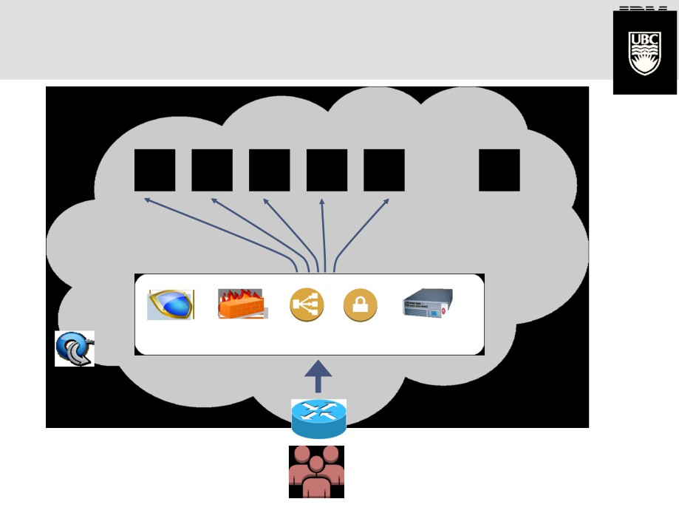
Elastic Apps Need Elastic Middleboxes
Elastic
App
Tier
Flows
SDN
Virtual
Middleboxes
IDS/IPS Firewall
LB VPN Accelerator
Clients

Slide 35
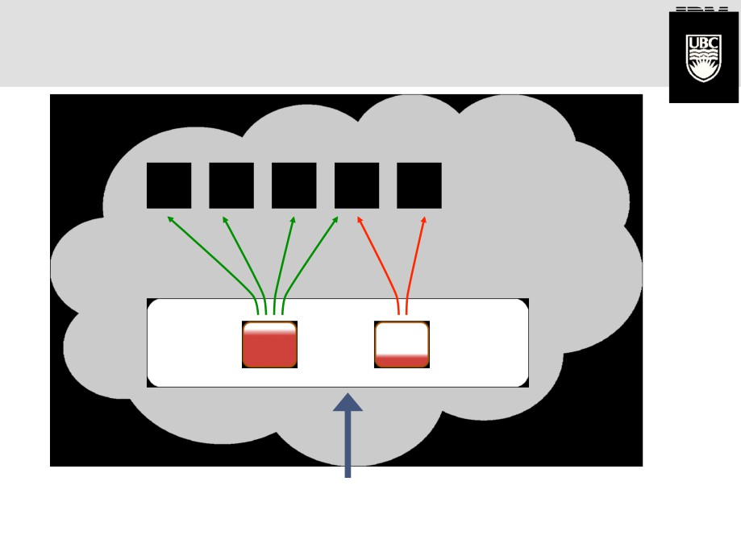
Alleviating Hotspots
Elastic
App
Tier
SDN
Virtual
Middleboxes
M1 M2
Solution: When M1 is overloaded, provision more
middlebox(es) to serve new flows.

Slide 36
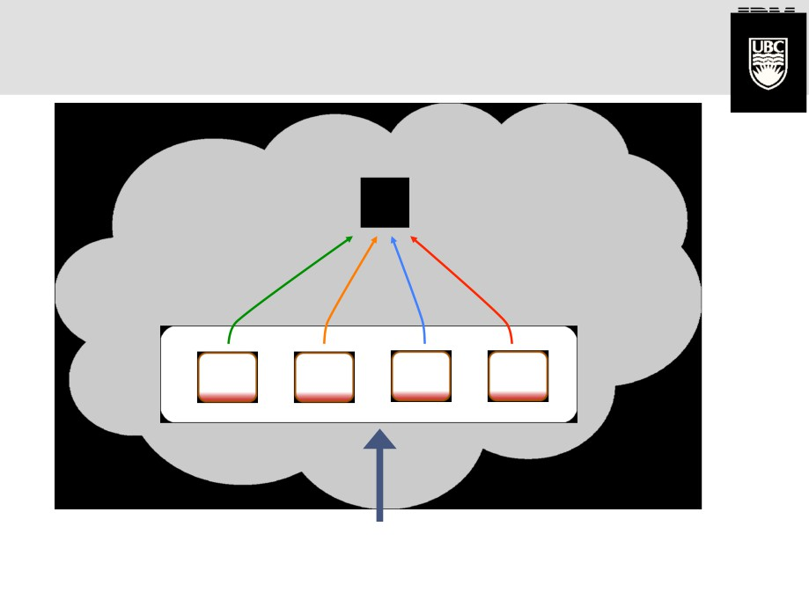
Alleviating Hotspots
Elastic
App
Tier
SDN
Virtual
Middleboxes
M1 M2
M3 M4
Scaling Inefficiencies Lead to Poor Utilization.

Slide 37
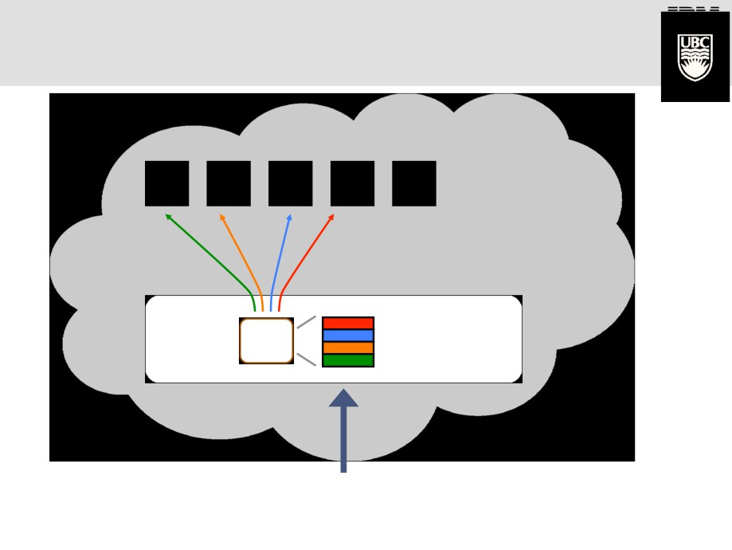
Split/Merge Insight
Elastic
App
Tier
Flow State is Naturally Partitioned
SDN
Flow
Virtual
Middleboxes
M1 Table

Slide 38
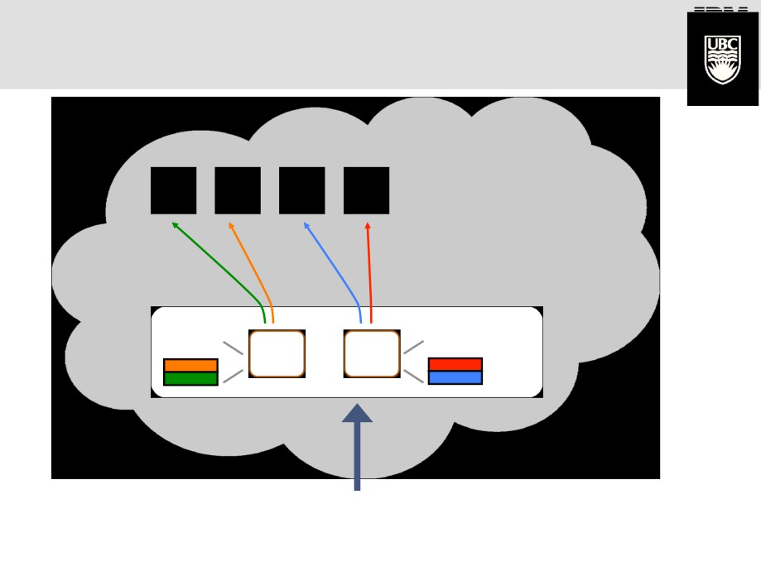
Split/Merge Insight
Elastic
App
Tier
SDN
Flow
Flow
Table
Virtual
Middleboxes
Table
Intuition: Dynamic partitioning of flow states among
replicas enables elastic execution.

Slide 39
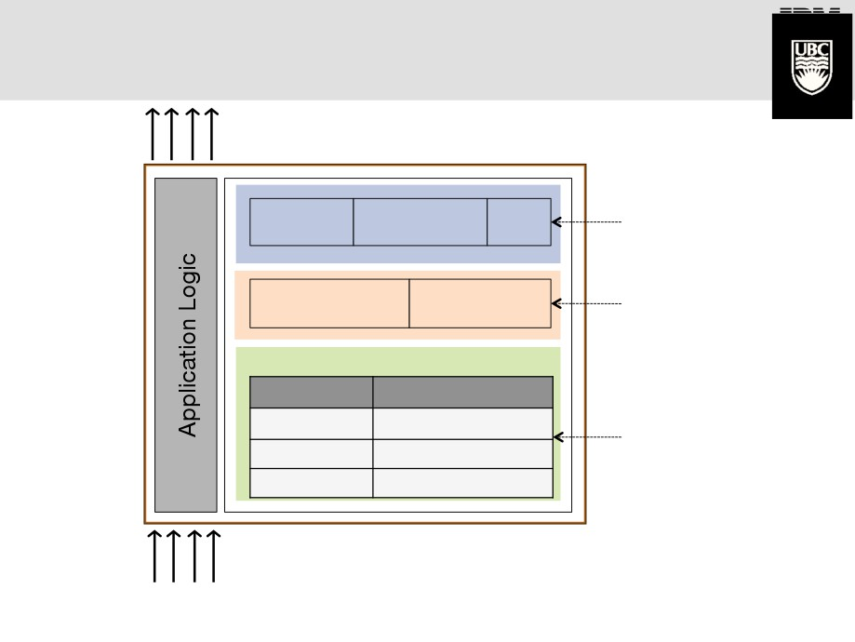
State Inside a Middlebox
Output
Flows
Middlebox VM
Other
processes
Internal to a replica
Caches
…
Threshold Non-critical
May be shared among replicas (coherent)
counters statistics
Flow Table
Key Value
5-tuple [Flow State]
Partitionable among replicas
Input
Flows

Slide 40
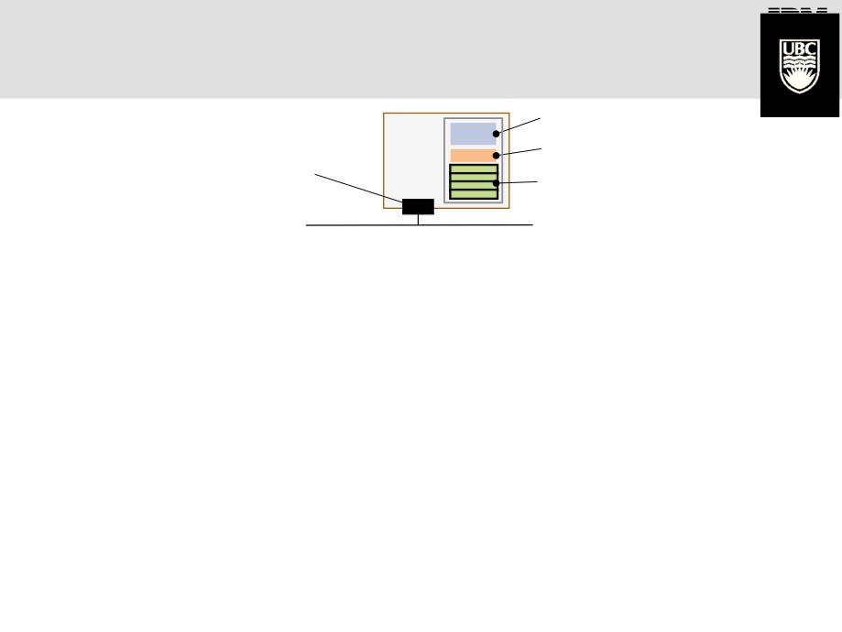
Split/Merge: A State-Centric
Approach to Elasticity
Internal
Coherent
VM
Virtual Network
Interface
Partitionable
(Flow States)

Slide 41
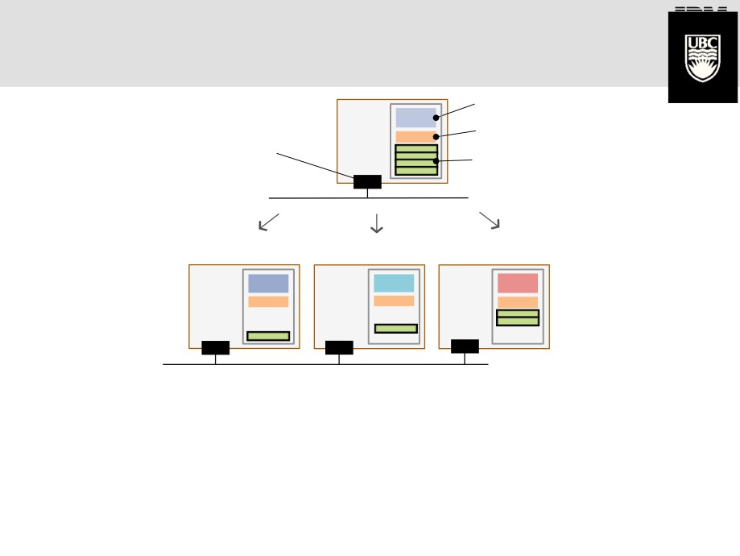
Split/Merge: A State-Centric
Approach to Elasticity
Internal
Coherent
VM
Virtual Network
Interface
Partitionable
(Flow States)
Split
Replica 1 Replica 2
Replica 3
VM
VM VM
2
3
1

Slide 42
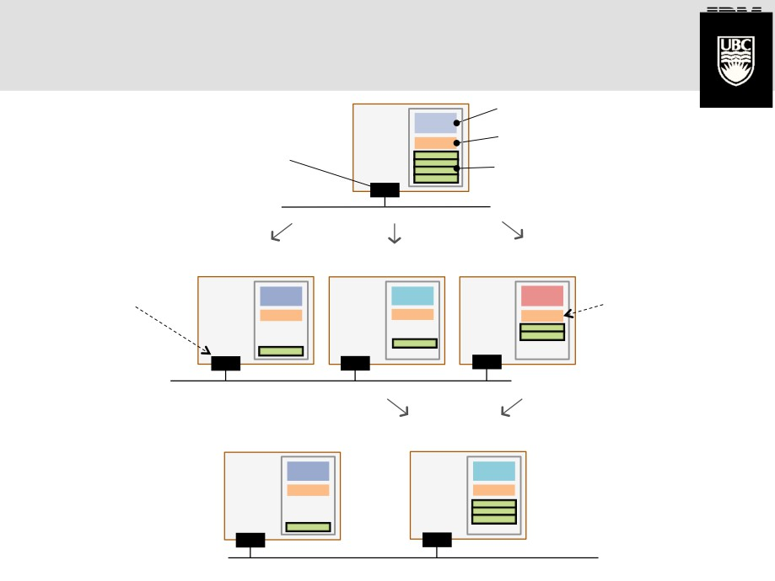
Split/Merge: A State-Centric
Approach to Elasticity
Internal
VM
Virtual Network
Interface!
Coherent
Partitionable
(Flow States)
Split
Replica 1
VM
Replica 2 Replica 3
1
VM VM
Unchanged
2
3
Coherency is
Interfaces!
maintained
Merge
Replica 1
Replica 2+3
VM
1
VM
2

Slide 43

Implementation

Slide 44
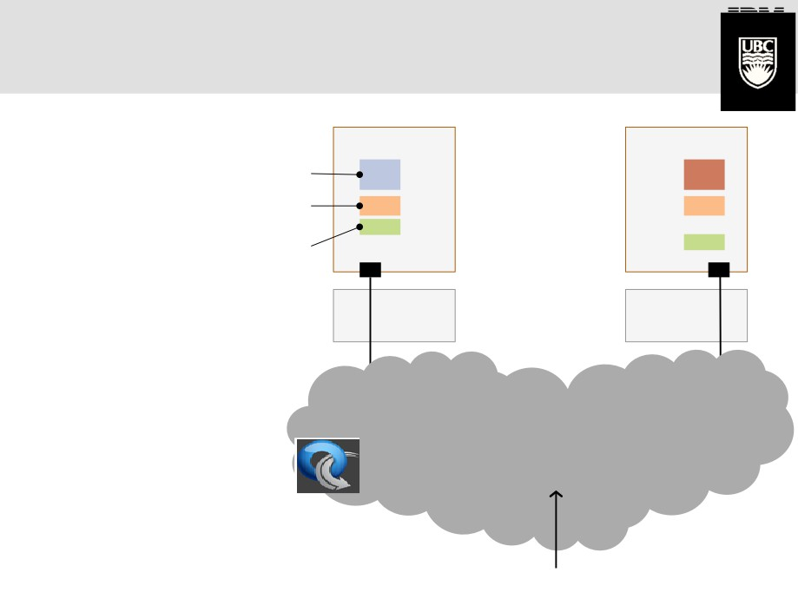
FreeFlow
Replica 1 Replica 2
VM
VM
Internal
Coherent
Partitionable
(Flow States)
1
2
VMM VMM
Traffic to Middlebox
Flow 1
Flow 2

Slide 45
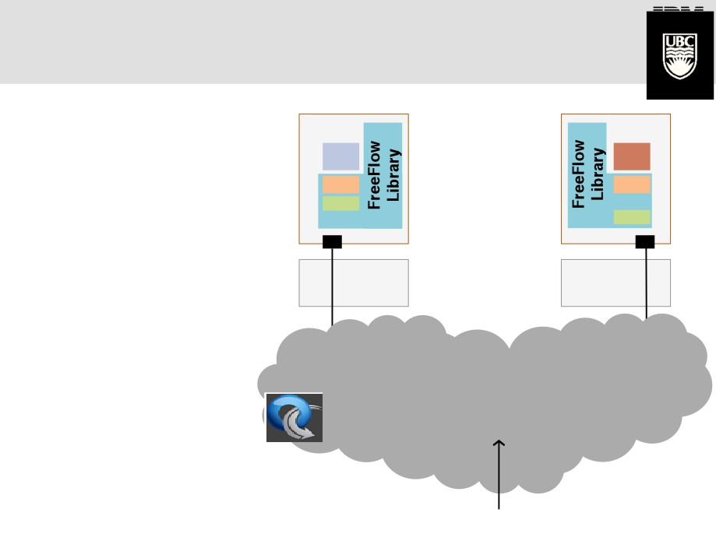
FreeFlow
Replica 1
Replica 2

Need to manage
VM
VM
application state
1
2
VMM
VMM
Traffic to Middlebox
Flow 1
Flow 2

Slide 46
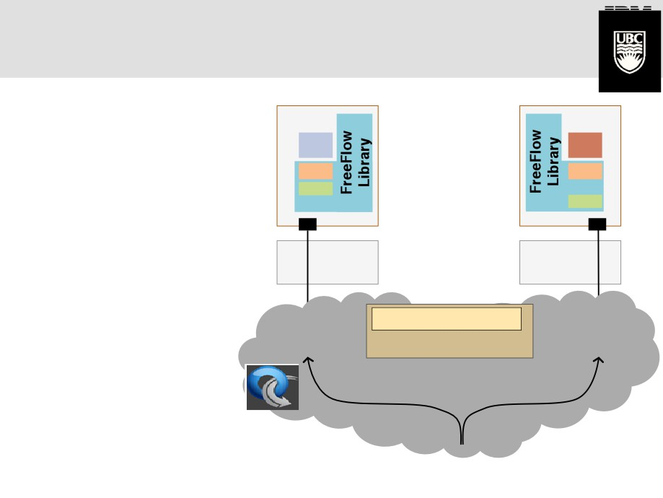
FreeFlow
Replica 1
Replica 2
VM
 Need to manage
VM
application state
1
 Need to ensure
flows are routed to
2
the correct replica
VMM
VMM
FreeFlow Module
Controller
Flow 1
Flow 2
Traffic to Middlebox

Slide 47
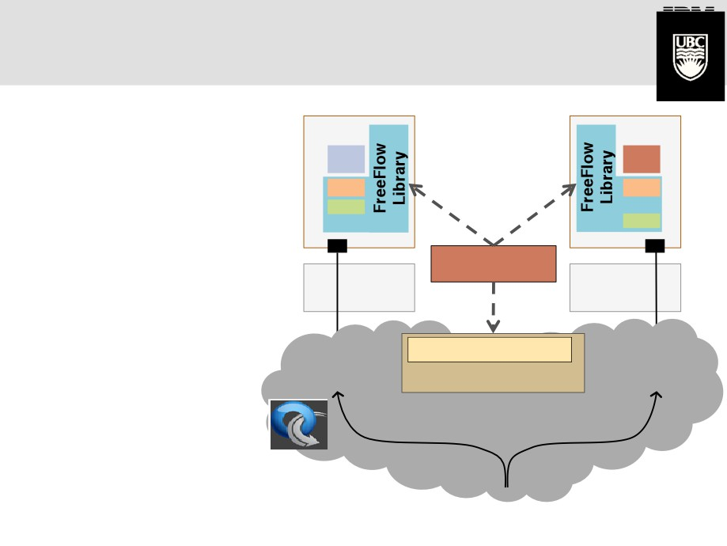
FreeFlow
Replica 1
Replica 2
VM
 Need to manage
VM
application state
1
 Need to ensure
flows are routed to
2
Orchestrator
the correct replica
VMM
VMM
 Need to decide
when to split or
FreeFlow Module
Controller
Flow 1
Flow 2
merge a replica
Traffic to Middlebox

Slide 48
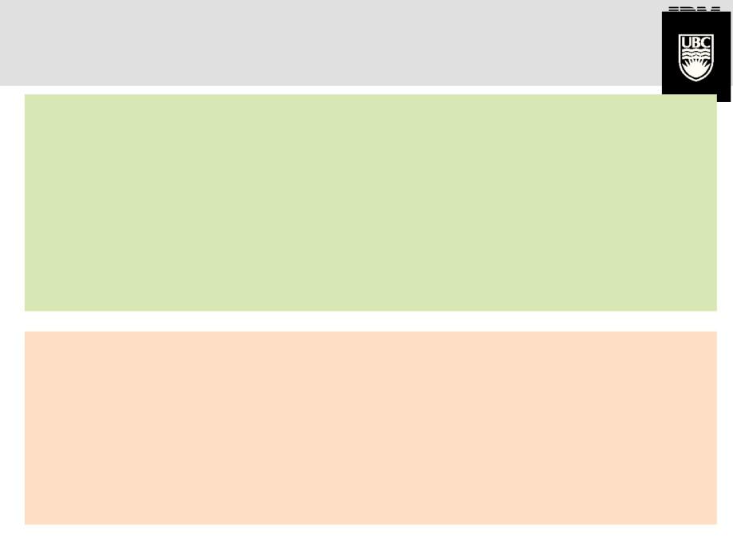
Annotating State using FreeFlow API
create_flow(flow_key, size)
delete_flow(flow_key)
Partitioned State API
flow_state get_flow(flow_key)
put_flow(flow_key)
flow_timer(flow_key, timeout, callback)
create_shared(key, size, cb)
delete_shared(key)
Coherent State API
state get_shared(key, flags) // synch | pull |local
put_shared(key, flags)
// synch | push |local

Slide 49
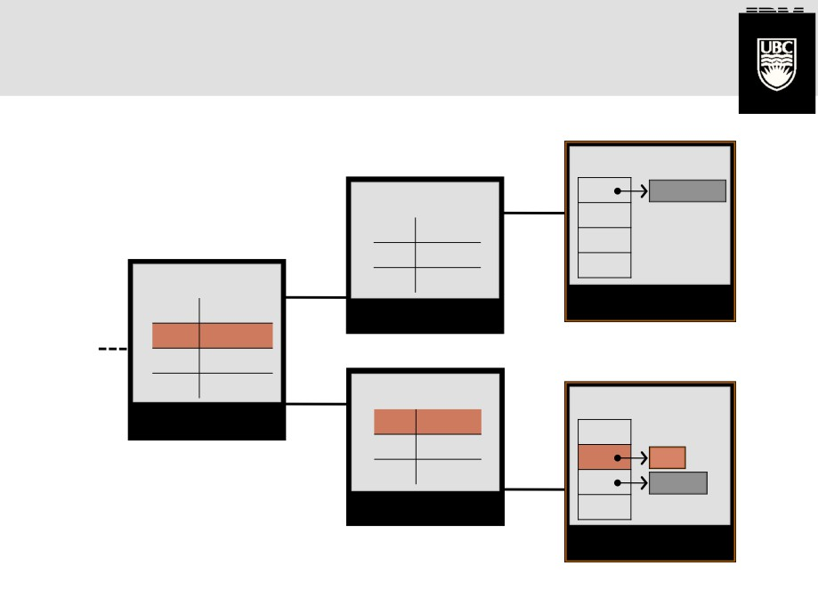
Forwarding Flows Correctly
using OpenFlow
1.1.1.1 (de:ad:be:ef:ca:fe)
Flow Table
OpenFlow Table
<a>
<a> port 1 port 1
…
…
OpenFlow Table
MBox Replica 1
Open Flow SW
Middlebox Replica 1!
<a> port 1
port 1 Virtual Switch!
<b> port 2
<c> port 2
1.1.1.1 (de:ad:be:ef:ca:fe)
…
OpenFlow Table
Open Flow SW
Flow Table
OpenFlow Switch! port 2
<b> port 1
<c> port 1
<b>
…
<c>
<c>
Open Flow SW
Virtual Switch! port 1
…
MBox Replica 2
Middlebox Replica 2!

Slide 50
Flow Migration
1.1.1.1 (de:ad:be:ef:ca:fe)
Migrating <b> from
replica 2 to replica 1
Flow Table
OpenFlow Table
<a>
<a> port 1 port 1
…
…
OpenFlow Table
MBox Replica 1
Open Flow SW
Middlebox Replica 1!
<a> port 1
port 1 Virtual Switch!
<b> port 2
<c> port 2
1.1.1.1 (de:ad:be:ef:ca:fe)
…
OpenFlow Table
Open Flow SW
Flow Table
port 2
<b> port 1
<c> port 1
<b>
…
<c>
Open Flow SW
Virtual Switch! port 1
…
MBox Replica 2
Middlebox Replica 2!

Slide 51
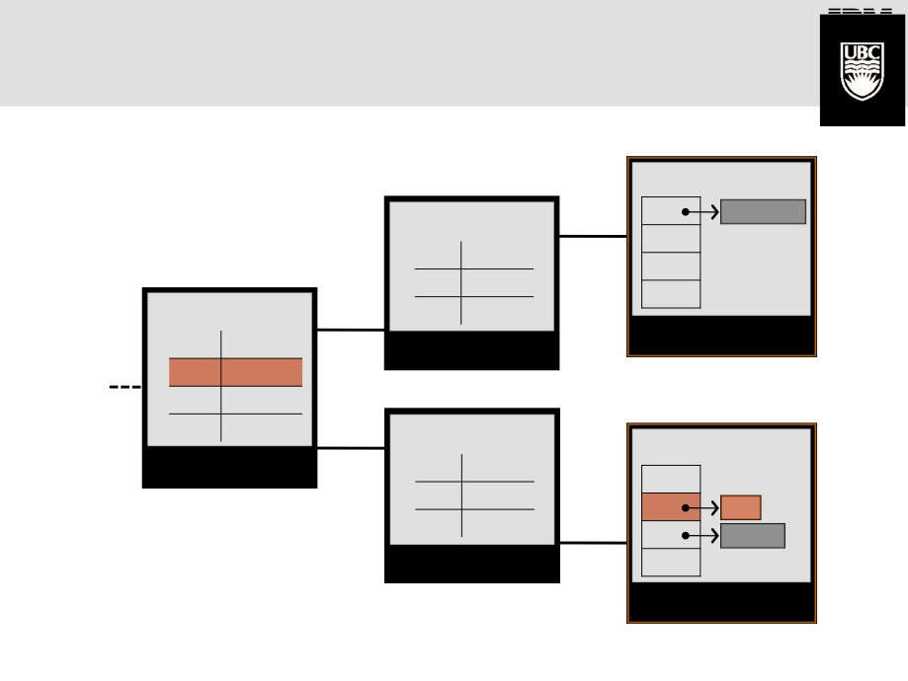
Flow Migration
1.1.1.1 (de:ad:be:ef:ca:fe)
1. Suspend flow and
buffer packets
Flow Table
OpenFlow Table
<a>
<a> port 1 port 1
…
…
OpenFlow Table
MBox Replica 1
Open Flow SW
Middlebox Replica 1!
<a> port 1
port 1 Virtual Switch!
<b> controller
<c> port 2
1.1.1.1 (de:ad:be:ef:ca:fe)
…
OpenFlow Table
Open Flow SW
Flow Table
port 2
<c> port 1
…!
<b>
<c>!
<c>
Open Flow SW
Virtual Switch! port 1
…
MBox Replica 2
Middlebox Replica 2!

Slide 52
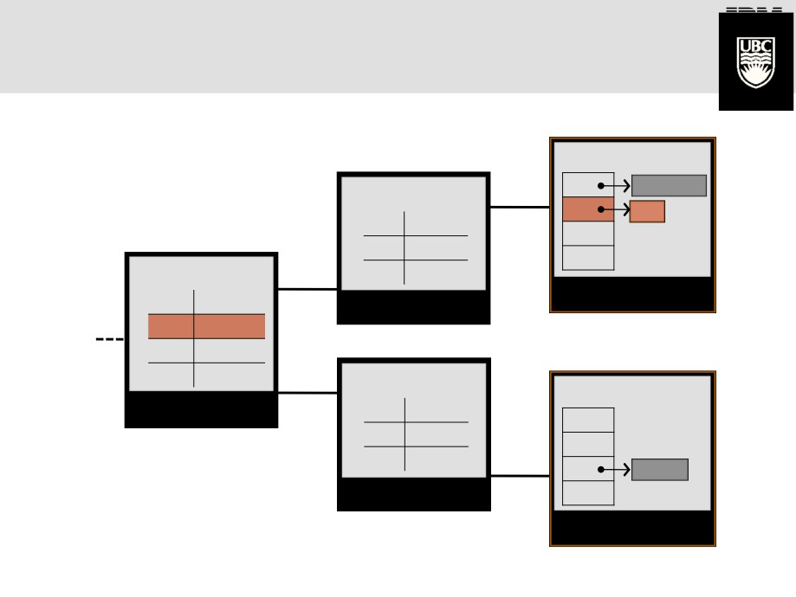
Flow Migration
1.1.1.1 (de:ad:be:ef:ca:fe)
2. Move flow state
to target
Flow Table
OpenFlow Table
<a>
<b>
<a> port 1 port 1
…
…
OpenFlow Table
MBox Replica 1
<a> port 1
Open Flow SW
Middlebox Replica 1!
port 1 Virtual Switch!
<b> controller
<c> port 2
1.1.1.1 (de:ad:be:ef:ca:fe)
…
OpenFlow Table!
Open Flow SW
Flow Table!
port 2
<c>
port 1
…
<c>
<c
Open Flow SW
port 1!
Virtual Switch!
…
MBox Replica 2
Middlebox Replica 2!

Slide 53
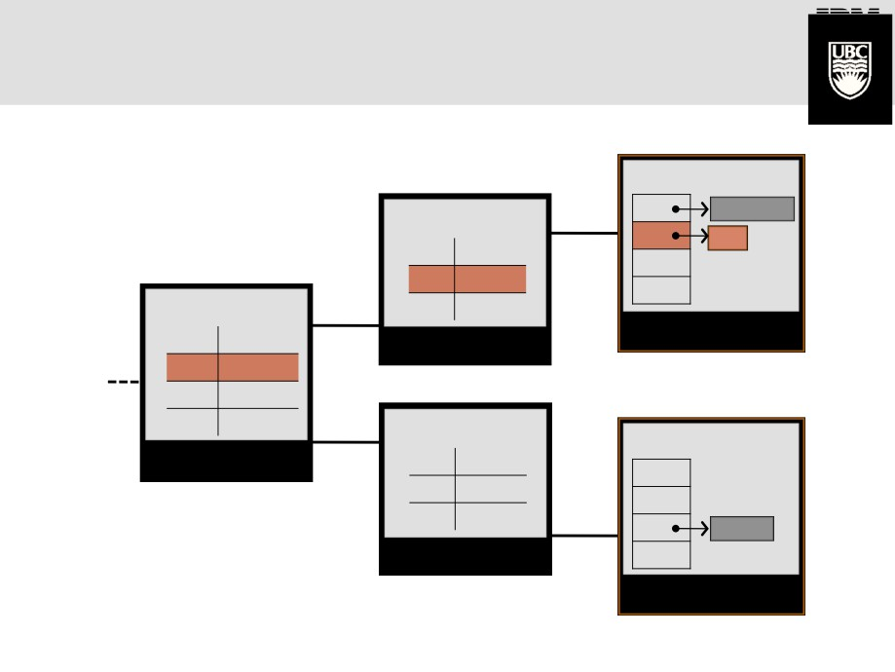
Flow Migration
1.1.1.1 (de:ad:be:ef:ca:fe)
3. Release buffer and
resume flow
Flow Table
OpenFlow Table
<a>
<b>
<a> port 1 port 1
<b> port 1
…
OpenFlow Table
…
MBox Replica 1
<a> port 1
Open Flow SW
Middlebox Replica 1!
port 1 Virtual Switch!
<b> port 1
<c> port 2
1.1.1.1 (de:ad:be:ef:ca:fe)
…
OpenFlow Table
Open Flow SW
Flow Table
OpenFlow Switch! port 2
<c>
port 1
…
<c>
Open Flow SW
port 1
Virtual Switch!
..
MBox Replica 2
Middlebox Replica 2!

Slide 54
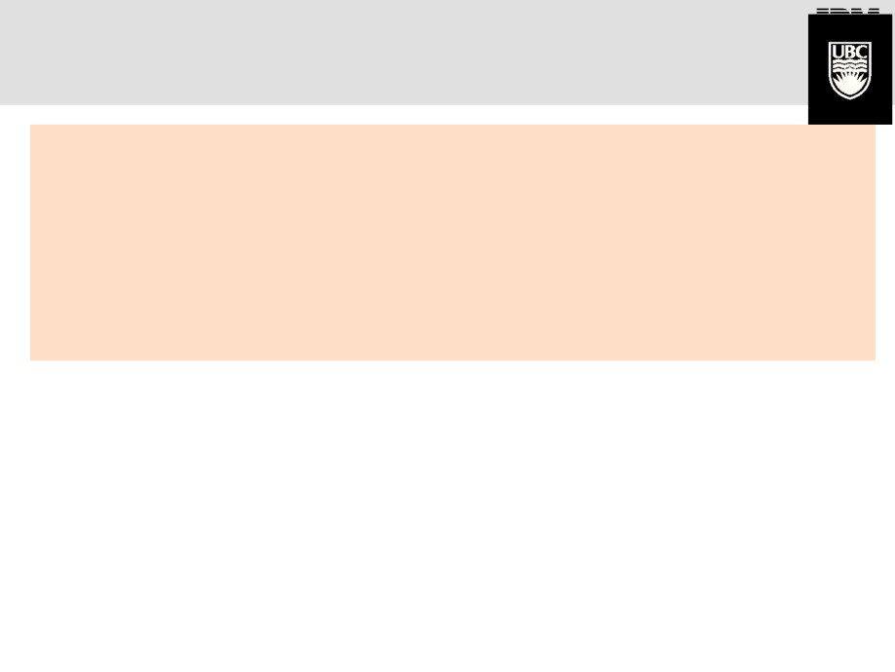
Managing Coherent State
create_shared(key, size, cb)
delete_shared(key)
state get_shared(key, flags) // synch | pull |local
put_shared(key, flags)
// synch | push |local

Slide 55
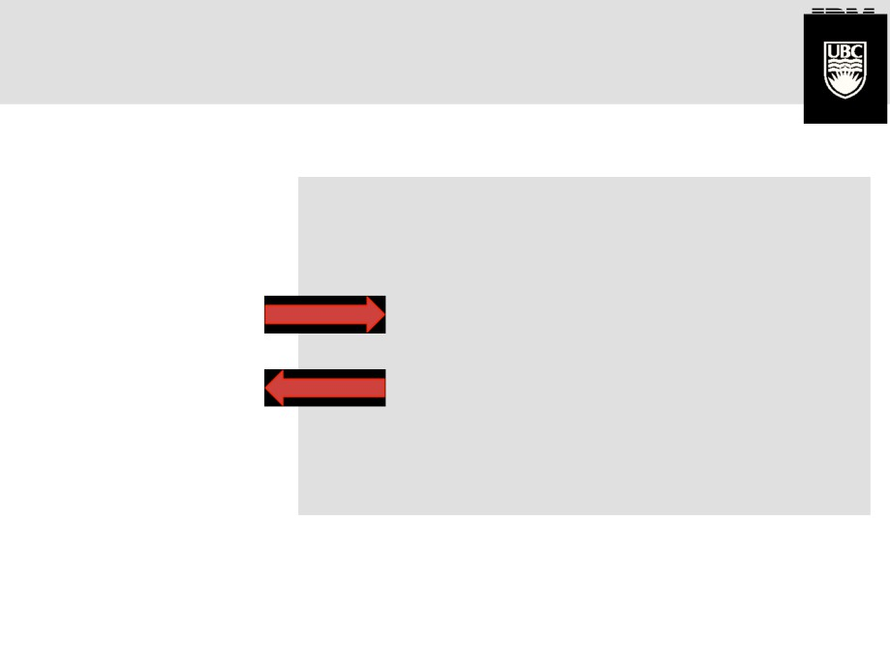
Managing Coherent State
Strong Consistency
create_shared(“foo”, 4, NULL)
while (1)
process_packet()
p_foo = get_shared(“foo”, synch)
Distributed lock
for every update
val = (*p_foo)++
put_shared(“foo”, synch)
if (val > threshold)
bar()
Middlebox applications rarely need strong consistency!
Notes:
Distributed coordinatino (lock) mechanism e.g., zookeeper → a costly solution

Slide 56
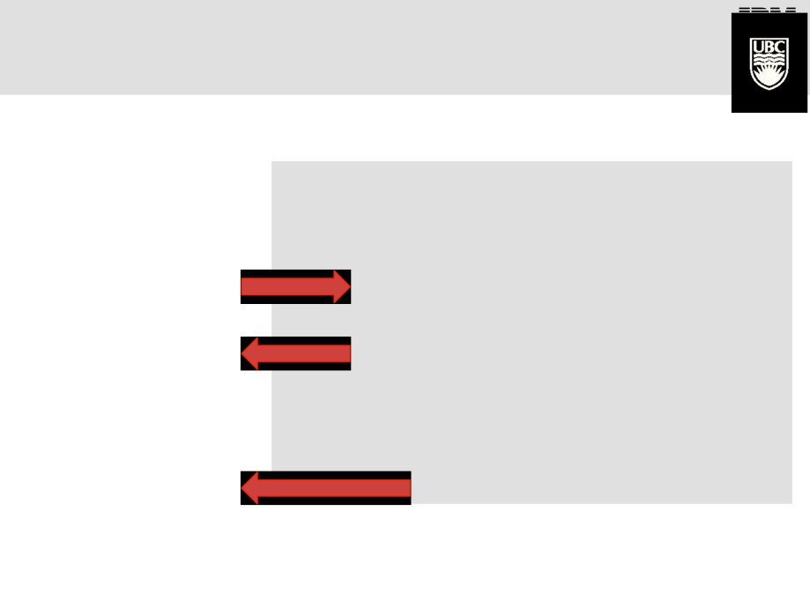
Managing Coherent State
Eventual Consistency
create_shared(“foo”, 4, merge_fn)
while (1)
process_packet()
p_foo = get_shared(“foo”, local)
Hi frequency
local updates
val = (*p_foo)++
put_shared(“foo”, local)
if (val > threshold)
bar()
Periodic global
updates
put_shared(“foo”, push)
Notes:
Eventual consistency: just maintain local consistency and worry about global consistency beyond some threshold, push, pull, or when a replica is about to be destroyed → combiners

Slide 57
Eliminating Hotspots by Shedding Load

Slide 58
Eliminating Hotspots by Shedding Load
Notes:
Why are the still fluctuations even though it is the ave over the past 40 seconds?

Slide 59
Outline
Recent trends in middlebox design/deployment
  Middlebox Consolidation (CoMb)
  Extensible Software Middlebox Architecture (xOMB)
Middleboxes/SDN Integration
  Elastic Execution (Split/Merge)
  Policy enforcement (SIMPLE)
  Handling dynamic traffic modification (FlowTags)

Slide 60


SIMPLE-fying Middlebox Policy Enforcement Using SDN
Zafar Ayyub Qazi
Cheng-Chun Tu
Luis Chiang
Vyas Sekar
Rui Miao
Minlan Yu

Slide 61
Can SDN simplify middlebox management?
Centralized Controller
Web
Firewall
IDS
Proxy
OpenFlow
“Flow” | FwdAction
… | …
“Flow” | FwdAction
… | …
Proxy
IDS
Scope: Enforce middlebox-specific steering policies
Necessity + Opportunity:
Incorporate functions markets views as important

Slide 62
What makes this problem challenging?
Centralized Controller
Web
Firewall
IDS
Proxy
OpenFlow
“Flow” | FwdAction
… | …
“Flow” | FwdAction
… | …
Proxy
IDS
Middleboxes introduce new dimensions beyond L2/L3 tasks.
Achieve this with unmodified middleboxes and existing SDN APIs

Slide 63

Our Work: SIMPLE
Web
Firewall
IDS
Proxy
Policy enforcement layer for
middlebox-specific “traffic steering”
Flow | Action
… | …
Flow | Action
… | …
Legacy
Middleboxes
OpenFlow
capable

Slide 64
Challenge: Policy Composition
*
Firewall
IDS
Proxy
Policy Chain:
Firewall
Proxy
IDS
Oops! Forward Pkt to IDS or Dst?
S1
S2
Dst
“Loops”
Traditional flow rules may not suffice!

Slide 65
Challenge: Resource Constraints
Firewall
Proxy
Space for
traffic split?
S2
S4
S1
S3
IDS1 = 50%
IDS2 = 50%
Can we set up “feasible” forwarding rules?

Slide 66
Challenge: Dynamic Modifications
User1: Proxy → Firewall
User2: Proxy
Proxy may modify flows
User 1
Proxy
S1
S2
User 2
Firewall
Are forwarding rules at S2 correct?

Slide 67
SIMPLE System Overview
Web
Firewall
IDS
Proxy
Resource Manager
Modifications Handler
Rule Generator
Flow | Action
… | …
Flow | Action
… | …
Legacy
Middleboxes
OpenFlow
capable

Slide 68
Composition → Tag Processing State
*
Firewall
IDS
Proxy
Policy Chain:
Firewall
Proxy
IDS
Fwd to Dst
S1
S2
Post-Firewall
Dst
Post-Proxy
ORIGINAL
Post-IDS
Insight: Distinguish different instances of the same packet

Slide 69
SIMPLE System Overview
Web
Firewall
IDS
Proxy
Resource Manager
Modifications Handler
Rule Generator
Flow | Action
… | …
Flow | Action
… | …
Legacy
Middleboxes
OpenFlow
capable

Slide 70
Resource Constraints→ Joint Optimization
Topology & Traffic
Middlebox
Capacity + Footprints
Switch
TCAM
Policy
Spec
Resource Manager
Optimal & Feasible
load balancing
Theoretically hard!
Not obvious if some configuration is feasible!

Slide 71
Offline + Online Decomposition
Policy
Spec
Network
Topology
Switch
TCAM
Mbox Capacity
+ Footprints
Traffic
Matrix
Resource Manager
Offline Stage
Online Step
Deals with Switch constraints
Deals with only load balancing

Slide 72
SIMPLE System Overview
Web
FW
IDS
Proxy
Resource Manager
Modifications Handler
Rule Generator
Flow | Action
… | …
Flow | Action
… | …
Legacy
Middleboxes
OpenFlow
capable

Slide 73
Modifications → Infer flow correlations
Correlate
flows
Install rules
Payload Similarity
User 1
Proxy
S1
S2
User 2
Firewall
User1: Proxy → Firewall
User2: Proxy

Slide 74
SIMPLE Implementation
Web
FW
IDS
Proxy
Resource Manager
(Resource Constraint)
CPLEX
Modifications Handler
(Dynamic modifications)
Rule Generator
(Policy Composition)
POX extensions
OpenFlow 1.0
Flow | Tag/Tunnel | Action
… |  | …
Flow | Tag/Tunnel | Action
… |  | …

Slide 75
Evaluation and Methodology
What benefits SIMPLE offers? load balancing?
How scalable is the SIMPLE optimizer?
How close is the SIMPLE optimizer to the optimal?
How accurate is the dynamic inference?
Methodology
  Small-scale real test bed experiments (Emulab)
  Evaluation over Mininet (with up to 60 nodes)
  Large-scale trace driven simulations (for convergence times)

Slide 76
Benefits: Load balancing
Optimal
4-7X better load balancing and near optimal

Slide 77
Outline
Recent trends in middlebox design/deployment
  Middlebox Consolidation (CoMb)
  Extensible Software Middlebox Architecture (xOMB)
Middleboxes/SDN Integration
  Elastic Execution (Split/Merge)
  Policy enforcement (SIMPLE)
  Handling dynamic traffic modification (FlowTags)

Slide 78


FlowTags:
Enforcing Network-Wide Policies in the Presence of
Dynamic Middlebox Actions
Seyed K. Fayazbakhsh Vyas Sekar
Minlan Yu
Jeff Mogul

Slide 79
Middleboxes complicate policy enforcement in SDN
Policy routing
Access control
Diagnostics
Forensics
Admin
Logical view: Specify policy goals
Control Apps
Physical View
Network OS
Dynamic
traffic-dependent
modifications!
e.g., NATs, proxies
“Flow” | Action
… | …
Data Plane

Slide 80

Example: Policy Routing
H1: NAT → Firewall
H2: NAT → IDS
NAT
IDS
Firewall
H1
Internet
S1
S2
H2
How do we setup correct forwarding rules?

Slide 81
Example: Dynamic Dependence
Web ACL:
Block H2 → xyz
Proxy
H1
Get xyz.com
Cached
response
Response
Internet
Get xyz.com
S1
S2
H2
Cached response
Cached responses may violate policy

Slide 82
Strawman Solutions
Careful placement? (i.e., manual)
  May not always be feasible
Consolidating middleboxes? (e.g., CoMb)
  Just “punting” the problem
Inferring flow mappings? (e.g., SIMPLE)
  Hard to reason about accuracy + high overhead
Key missing piece:
Lack of “visibility” into middlebox context

Slide 83
FlowTags: High-level Idea
Middleboxes “help” with the lack of visibility
Add FlowTags to packets to bridge gaps
  NAT gives IP mappings; Proxy gives cache hit/miss
Middleboxes “produce” + “consume” FlowTags
Switches only “consume” FlowTags

Slide 84
FlowTags Architecture Overview
Control Apps
Existing Interfaces
e.g., OpenFlow
Controller
FlowTags
API
FlowTags
Config
SDN
enabled
Switches
FlowTags
Enhanced
Middleboxes
FlowTable
“decouple”
e.g., NAT exposes mappings
Proxy gives hit/miss state
IDS uses tags to disambiguate

Slide 85


Policy Implementation via FlowTags
Policy: Block H2 → xyz
TagsFlowTable
TagsActionTable
H1, MISS → 1
H1, HIT → 2
H2, MISS → 3
H2, HIT → 4
Tag | Src | Action
4 | H2 | Block
H1
Proxy
ACL
S2
S1
Internet
Input | Tag | Out
Proxy | 2 | H1
Proxy | 1,3,4 | S2
Input | Tag | Out
S1 | 1,3,4 | ACL
ACL | 4 | S1
ACL | 1,3 | Internet
H2

Slide 86
FlowTags Proof-of-Concept
Using Squid (> over 100,000 lines of code)
About 30 lines of code to add FlowTags support
  Manually identify code chokepoints
Validated use-cases with examples

