Slide 1
Software Defined Networking
COMS 6998-8, Fall 2013
Instructor: Li Erran Li (lierranli@cs.columbia.edu)
http://www.cs.columbia.edu/~lierranli/coms6998-8SDNFall2013/
9/3/2013: Class Intro and Pre-SDN

Slide 2
Outline
Part I: Course Introduction and Logistics
Part II: Precursor to SDN

Slide 3
Part I: Course Introduction and Logistics
Introduction
  My research
  SDN
Course syllabus
Course goals and structure
Example projects

Slide 4
Introduction
Researcher at Bell Labs, Alcatel-Lucent
Ph.D. from Dept. of CS, Cornell, 2001
Research interest: software defined networking, mobile computing, cloud computing, and security
Research Goal: improve our mobile user experience through innovation in network architecture, mobile cloud computing systems and security

Slide 5
Experiences
Relevant working experiences
  Software defined networking
    Software defined cellular core networks (SoftCell, Princeton TR’13),
    Software defined radio access networks (SoftRAN, HotSDN’13),
  Mobile computing: mobile cloud computing
  Cloud computing: scaling out enterprise applications, cloud-based video proxy, policy-aware enterprise application cloud extension

Slide 6
Experiences (Cont’d)
Professional Activities
  ACM Workshop on Cellular Networks: Operations, Challenges, and Future Design (CellNet), 2012-2013
  DIMACS Workshop on Software Defined Networking, Dec, 2012
  ACM MobiSys Workshop on Mobile Cloud Computing & Services: Social Networks and Beyond (MCS), June 2010
  DIMACS Workshop on Systems and Networking Advances in Cloud Computing, Dec, 2011
Teaching
  Cellular Networks and Mobile Computing (Spring 2012, Fall 2012, Spring 2013)

Slide 7
Brief Introduction to SDN
What is software defined networking?
Why SDN?
How has SDN been shaping networking research and industry?

Slide 8
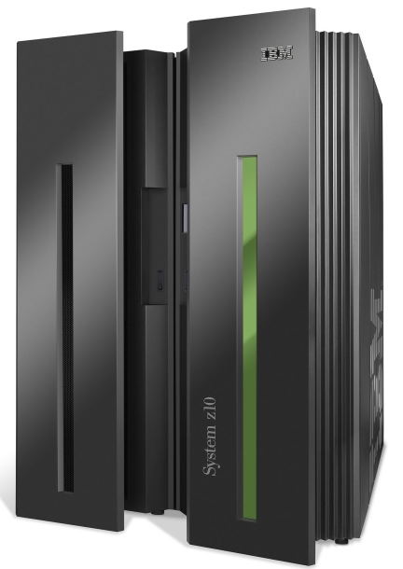
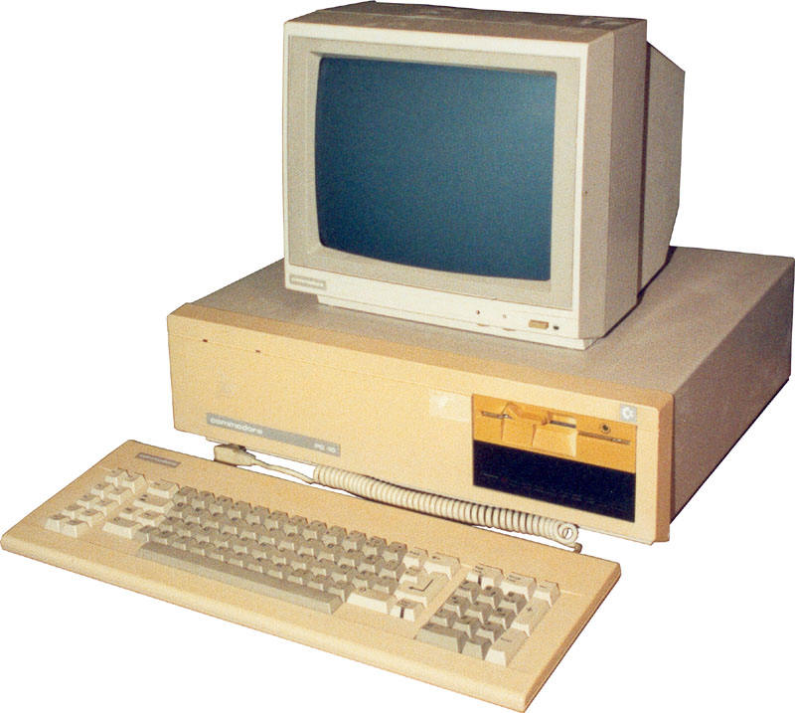
Source: Nick Mckeown, Stanford
App
App
App
App
App
App
App
App
App
App
App
Specialized
Applications
Open Interface
Windows
(OS)
Linux
Mac
OS
Specialized
Operating
System
or
or
Open Interface
Specialized
Hardware
Microprocessor
Vertically integrated
Closed, proprietary
Slow innovation
Small industry
Horizontal
Open interfaces
Rapid innovation
Huge industry
Notes:
The mainframe industry in the 1980s was vertical and closed: it consisted of specialized hardware, operating system and applications --- all from the same company.
A revolution happened when open interfaces started to appear. The industry became horizontal. Innovation exploded.

Slide 9
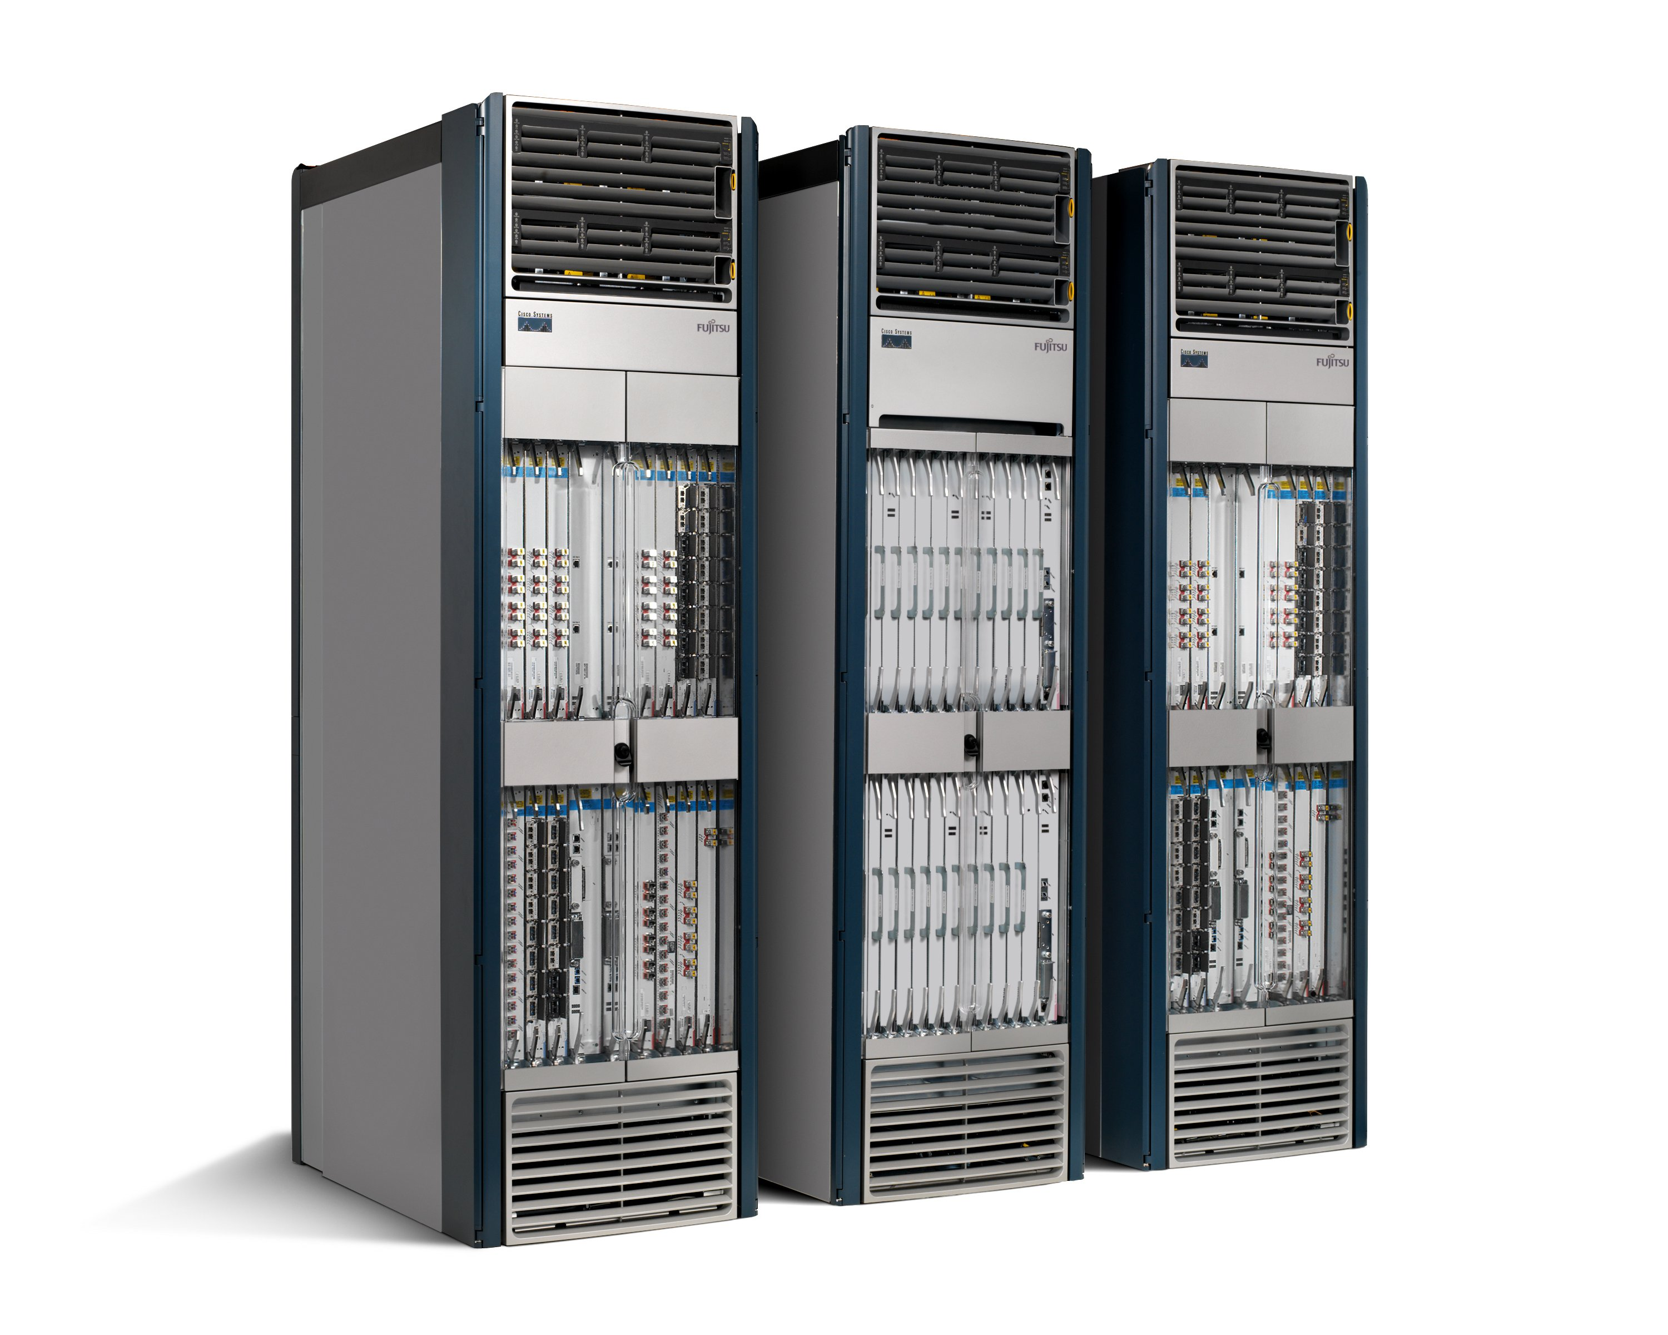
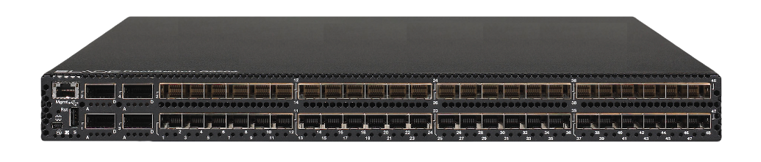
Source: Nick Mckeown, Stanford
App
App
App
App
App
App
App
App
App
App
App
Specialized
Features
Open Interface
Control
Plane
Control
Plane
Control
Plane
or
or
Specialized
Control
Plane
Open Interface
Specialized
Hardware
Merchant
Switching Chips
Vertically integrated
Closed, proprietary
Slow innovation
Horizontal
Open interfaces
Rapid innovation

Slide 10
Source: Nick Mckeown, Stanford
Routing, management, mobility management,
access control, VPNs, …
Feature
Feature
Million of lines
of source code
6,000 RFCs
OS
Custom Hardware
Billions of gates
Bloated
Power Hungry
Vertically integrated, complex, closed, proprietary
Networking industry with “mainframe” mind-set

Slide 11
The network is changing
Source: Nick Mckeown, Stanford
Feature
Feature
Network OS
Feature
Feature
OS
Custom Hardware
Feature
Feature
OS
Feature
Feature
Custom Hardware
OS
Feature
Feature
Custom Hardware
OS
Custom Hardware
Feature
Feature
OS
Custom Hardware

Slide 12
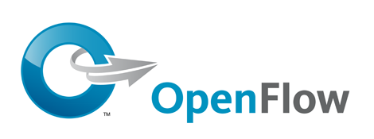
Software Defined Network (SDN)
Source: Nick Mckeown, Stanford
3. Consistent, up-to-date global network view
2. At least one Network OS
probably many.
Open- and closed-source
Feature
Feature
Network OS
1. Open interface to packet forwarding
Packet
Forwarding
Packet
Forwarding
Packet
Forwarding
Packet
Forwarding
Packet
Forwarding

Slide 13
Network OS
Source: Nick Mckeown, Stanford
Network OS: distributed system that creates a consistent, up-to-date network view
  Runs on servers (controllers) in the network
  Floodlight, POX, Pyretic, Nettle ONIX, Beacon, … + more
Uses forwarding abstraction to:
  Get state information from forwarding elements
  Give control directives to forwarding elements

Slide 14
Software Defined Network (SDN)
Source: Nick Mckeown, Stanford
Control Program A
Control Program B
Network OS
Packet
Forwarding
Packet
Forwarding
Packet
Forwarding
Packet
Forwarding
Packet
Forwarding

Slide 15
Control Program
Source: Nick Mckeown, Stanford
Control program operates on view of network
  Input: global network view (graph/database)
  Output: configuration of each network device
Control program is not a distributed system
  Abstraction hides details of distributed state

Slide 16
Forwarding Abstraction
Source: Nick Mckeown, Stanford
Purpose: Abstract away forwarding hardware
Flexible
  Behavior specified by control plane
  Built from basic set of forwarding primitives
Minimal
  Streamlined for speed and low-power
  Control program not vendor-specific
OpenFlow is an example of such an abstraction

Slide 17
OpenFlow Basics
Notes:
17

Slide 18
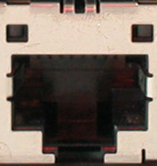
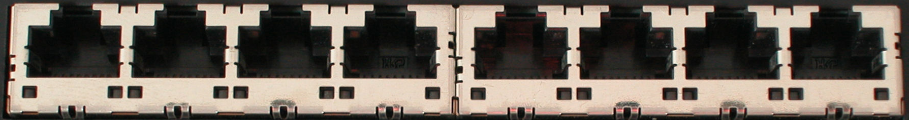
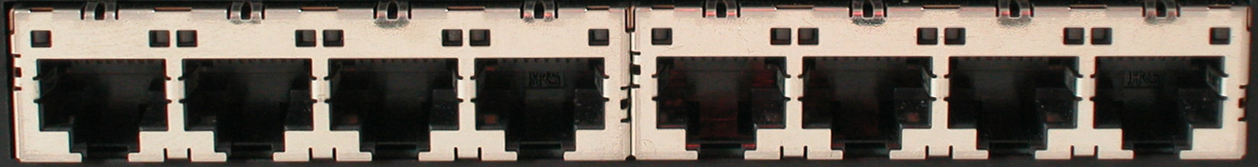
OpenFlow Basics
Source: Nick Mckeown, Stanford
Control Program A
Control Program B
Network OS
OpenFlow Protocol
Ethernet Switch
Control Path
OpenFlow
Data Path (Hardware)

Slide 19
OpenFlow Basics
Source: Nick Mckeown, Stanford
Control Program A
Control Program B
Network OS
“If header = p, send to port 4”
Packet
Forwarding
“If header = q, overwrite header with r,
add header s, and send to ports 5,6”
“If header = ?, send to me”
Flow
Table(s)
Packet
Forwarding
Packet
Forwarding

Slide 20
Plumbing Primitives
<Match, Action>
Source: Nick Mckeown, Stanford
Match arbitrary bits in headers:
  Match on any header, or new header
  Allows any flow granularity
Action
  Forward to port(s), drop, send to controller
  Overwrite header with mask, push or pop
  Forward at specific bit-rate
Header
Data
Match: 1000x01xx0101001x

Slide 21
General Forwarding Abstraction
Source: Nick Mckeown, Stanford
Small set of primitives
“Forwarding instruction set”
Protocol independent
Backward compatible
Switches, routers, WiFi APs, basestations, TDM/WDM

Slide 22
Why SDN?
Great talk by Scott Shenker http://www.youtube.com/watch?v=WVs7Pc99S7w
(Story summarized here)

Slide 23
Networking
Source: Nick Mckeown, Stanford
Networking is “Intellectually Weak”
Networking is behind other fields
Networking is about the mastery of complexity
Good abstractions tame complexity
Interfaces are instances of those abstractions
No abstraction => increasing complexity
We are now at the complexity limit

Slide 24
By comparison: Programming
Source: Nick Mckeown, Stanford
Machine languages: no abstractions
  Had to deal with low-level details
Higher-level languages: OS and other abstractions
  File system, virtual memory, abstract data types, ...
Modern languages: even more abstractions
  Object orientation, garbage collection,…

Slide 25
Programming Analogy
Source: Nick Mckeown, Stanford
What if programmers had to:
  Specify where each bit was stored
  Explicitly deal with internal communication errors
  Within a programming language with limited expressability
Programmers would redefine problem by:
  Defining higher level abstractions for memory
  Building on reliable communication primitives
  Using a more general language

Slide 26
Specification Abstraction
Source: Nick Mckeown, Stanford
Network OS eases implementation
Next step is to ease specification
Provide abstract view of network map
Control program operates on abstract view
Develop means to simplify specification

Slide 27
Software Defined Network (SDN)
Source: Nick Mckeown, Stanford
Abstract Network View
Virtualization
Control Program A
Control Program B
Global Network View
Network OS
Packet
Forwarding
Packet
Forwarding
Packet
Forwarding
Packet
Forwarding
Packet
Forwarding

Slide 28
How SDN shaping Industry?
Open Networking Foundation (ONF)
  New non-profit standards organization (Mar 2011)
  Defining standards for SDN, starting with OpenFlow
  Board of Directors
    Google, Facebook, Microsoft, Yahoo, DT, Verizon
  39 Member Companies
    Cisco, VMware, IBM, Juniper, HP, Broadcom, Citrix, NTT, Intel, Ericsson, Dell, Huawei, …
OpenDaylight
  led by IBM and Cisco
  Mission is to develop open source SDN platform

Slide 29
How SDN shaping Industry (Cont’d)
Cellular industry
Recently made transition to IP
Billions of mobile users
Need to securely extract payments and hold users accountable
IP is bad at both, yet hard to change
SDN enables industry to customize their network

Slide 30

How SDN shaping Industry (Cont’d)
Source: Nick Mckeown, Stanford
Data Center
Cost
200,000 servers
Fanout of 20 ➔ 10,000 switches
$5k vendor switch = $50M
$1k commodity switch = $10M
Savings in 10 data centers = $400M
Control
More flexible control
Tailor network for services
Quickly improve and innovate

Slide 31
How SDN shaping Industry (Cont’d)
Big companies
Google B4: deployed SDN to manage cross data center traffic
Microsoft SWAN: software defined WAN
Facebook: infrastructure team exploring SDN
Vmware: Nicira, overlay approach to SDN
Intel: OpenFlow switch
Cisco: OpenFlow switch
…

Slide 32
How SDN shaping Industry (Cont’d)
Startups
Affirmed Networks: virtualized subscriber and content management tools for mobile operators
Big Switch Networks: OpenFlow-based SDN switches, controllers and monitoring tools
Embrane: layer 3-7 SDN services to enterprises and service providers
Accelera: software defined wireless networks funded by Stanford Professor Andrea Goldsmith
…

Slide 33
How SDN shaping Research?
Ease of trying new ideas
  Existing tools: NOX, Beacon, switches, Mininet
  More rapid technology transfer
  GENI, Ofelia and many more
A stronger foundation to build upon
  Provable properties of forwarding
  New languages and specification tools

Slide 34
How SDN shaping Research (Cont’d)
Research activities
  Open Networking Summit started in 2011
  ACM HotSDN workshop started in 2012
  ACM SIGCOMM, USENIX NSDI sessions

Slide 35
Course Syllabus
SDN Basics and Scalability (Lecture 2, 3)
  OpenFlow, Floodlight, POX, mininet, Cbench
  Scalable control plane: hierarchical controller, logical crossbar
  Scalable data plane
SDN Abstraction (Lecture 4, 5, 6)
  Programming language, verification, network update
Programmable Data Plane (Lecture 7)
  Protocol independent forwarding, Click modular router, SwitchBlade
SDN Application (Lecture 8, 9, 10)
  Virtualization, traffic management, wireless networks
SDN Endhosts, Middleboxes and Storage (Lecture 11)
SDN Debugging, Fault Tolerance and Security (Lecture 12)

Slide 36
Course Goals and Structure
The course equips you to address the following questions:
  What is software defined networking?
  What are the key building blocks?
  How do I use SDN to solve enterprise, carrier, and data center/cloud networking problems?
  What is the future of SDN?
Notes:
Understanding the interplay of cellular networks and mobile computing through measurements
Cellular aware mobile application design

Slide 37
Course Goals and Structure (Cont’d)
The course emphasizes concepts, handson experiences and research
  Midterm will be on concepts (30% of grade)
  Two programming assignments (one on Floodlight and the other on Pyretic) (20% of grade)
  Course projects (50% of grade)
Notes:
Understanding the interplay of cellular networks and mobile computing through measurements
Cellular aware mobile application design

Slide 38
Research Project
Topic
  Choose from a list of topics
  Come up with your own topic
  Must be related to software defined networking, ideally solves a real problem
  Should contain some research elements, e.g. scalable system design, novel algorithms
Teams of 1 to 4 students
Final deliverables
  Project report (research paper format, 10 to 12 pages)
  Project presentation and demo

Slide 39
Research Project (Cont’d)
Precisely define the project
Understand related work
Propose novel techniques or systems
  Creativity will be evaluated
System implementation
  Controller platform: Floodlight, POX, Pyretic, Nettle
  Testing: mininet, Cbench (controller benchmark tool)

Slide 40
Research Project (Cont’d)
Evaluate your solution, e.g. performance, scalability
  Thoroughness will be evaluated
Write up and present your projects
  Evaluated using professional paper review criterions
Project timelines (suggested)
  September 17: Form final project team
  October 8: project description (2-4 pages)
  December 3: final presentation and demo
  December 10: final project report (10-12 pages)
I will meet with you regularly

Slide 41
List of Suggested Projects
Cellular network virtualization
Programming language abstraction for wireless networks
SDN to improve video applications
SDN measurement primitives
SDN testing and debugging
SDN security: mitigate DDoS attacks

Slide 42
Class Resources
Course web page: schedule, project timelines, list of potential projects, etc
Piazza page for discussion
Online resources
  COS-597E, Princeton University, Fall 2013
  CSE690-01, Stony Brook University, Fall 2013
  Coursera Software Defined Networking by Dr. Nick Feamster
  SDN reading list
  Open Networking Summit
For any questions or concerns: email me at lierranli@cs.columbia.edu
TA: YoungHoon Jung, jung@cs.columbia.edu

Slide 43
Part II: Precursor to SDN
AT&T’s Network Control Points: separation of control plane and data plane in circuit switched networks (dates back to 1980s)
Routing control platform (2004)
A Clean Slate 4D Approach to Network Control and Management (2005)

Slide 44
Routing control platform (RCP)

Slide 45
How ISPs route
Source: Matthew Caesar, UIUC
3
2
2
6
4
9
3
1
Border router
Internal router
Provide internal reachability (IGP)
Learn routes to external destinations (eBGP)
Distribute externally learned routes internally (iBGP)
Select closest egress (IGP)
Notes:
Say “There are four parts to internet routing” (don’t say in route selection)

Slide 46
What’s wrong with Internet routing?
Source: Matthew Caesar, UIUC
Full-mesh iBGP doesn’t scale
  # sessions, control traffic, router memory/cpu
  Route-reflectors help by introducing hierarchy
    but introduce configuration complexity, protocol oscillations/loops
Hard to manage
  Many highly configurable mechanisms
  Difficult to model effects of configuration changes
  Hard to diagnose when things go wrong
Hard to evolve
  Hard to provide new services, improve upon protocols

Slide 47
Routing Control Platform
Source: Matthew Caesar, UIUC
What’s causing these problems?
  Each router has limited visibility of IGP and BGP
  No central point of control/observation
  Resource limitations on legacy routers
Solution: compute routes from central point, remove protocols from routers
Inter-AS Protocol
RCP
RCP
RCP
network
network
network
Notes:
Why drawing RCP above network boxes – just say orally, that it’s not part of the forawarind plane

Slide 48
RCP in a single ISP
Source: Matthew Caesar, UIUC
RCP
iBGP
Better scalability: reduces load on routers
Easier management: configuration from a single point
Easier evolvability: freedom from router software
Notes:
Then bring up 3 points after describe slide (Animate)
On this slide – say what it is that y’uouve impelemntede, this is an imprlmentation that emultates full mesh, empasisze per router decision making ←- very important piont to bring up!!! Say why is not just a route reflector.
Put text on slide to say why arrows going in both directions, available routes up and assigned routes down.
Reduce number of routers, just show some on maybe just internal ones send up igp. Maybe just say gets igp, and take out lines to internal routers.

Slide 49
RCP architecture
Source: Matthew Caesar, UIUC
Routing Control Platform (RCP)
Route Control
Server (RCS)
Available BGP routes
Selected BGP routes
Path cost matrix
BGP Engine
IGP Viewer
(NSDI ’04)
BGP updates
BGP updates
IGP link-state advertisements
…
…
…
Divide design into components
  Replication improves availability
Distributed operation, but global state per component

Slide 50
Challenges and contributions
Source: Matthew Caesar, UIUC
Reliability
  Problem: single point of failure
  Contribution: simple replication of RCP components
Consistency
  Problem: inconsistent decisions by replicas
  Contribution: guaranteed consistency without inter-replica protocol
Scalability
  Problem: storing all routes increases cpu/memory usage
  Contribution : can support large ISP in one computer
→ Building this system is feasible
Notes:
“Rest of talk about how build thing”, how to build for one isp, say will focus on last two points!

Slide 51
Potential consistency problem
Source: Matthew Caesar, UIUC
RCP 1
RCP 2
“Use egress D (hence use B as your next-hop)”
“Use egress C (hence use A as your next-hop)”
A
B
C
D
Need to ensure routes are consistently assigned
  Even in presence of failures/partitions

Slide 52
Consistent assignment
Single RCP, single partition
Source: Matthew Caesar, UIUC
RCP 1
“Use egress A”
“Use egress B”
A
B
Solution: Assign all routers along the shortest IGP path the same exit router
  Ensures forwarding loops don’t arise

Slide 53
Consistent assignment
Single RCP, multiple partitions
Source: Matthew Caesar, UIUC
RCP 1
Partition 1
Partition 2
Solution: Only use state from router’s partition in assigning its routes
  Ensures next hop is reachable

Slide 54
Consistent assignment
Multiple RCPs, multiple partitions
Source: Matthew Caesar, UIUC
RCP 1
RCP 2
Partition 1
Partition 2
Partition 3
Solution: RCPs receive same IGP/BGP state from each partition they can reach
  IGP provides complete visibility and connectivity
  RCS only acts on partition if it has complete state for it
→No consistency protocol needed to guarantee consistency in steady state
Notes:
Need to stress ibgp connectivity is ensured thru igp connectivity
Say what a partition is, say explicitly that RCP is not in IGP forwarding plane ←say this earlier. Otherwise not clear what partitoin is and why can’t route through rcs1 eg

Slide 55
Scalability solution
Source: Matthew Caesar, UIUC
Eliminate redundancy
  Store only a single copy of each BGP route
Accelerate lookup
  Quickly find routers whose routes changed
Avoid recomputation
  Compute routes once for groups of routers
  Don’t recompute if relative ranking of egress routers unchanged
Notes:
Talk about next slide in terms of these three points, eg you could say explicitly, “to avoid redundancy” we build redundancy using ZZZ

Slide 56
A Clean Slate 4D Approach to Network Control and Management

Slide 57
Motivation
Data plane
  handles individual packets
Control plane
  implements distributed routing algorithms
Management plane
  monitors the network
  configures the data/control plane
Many dependencies among states
However, most of them maintained manually

Slide 58
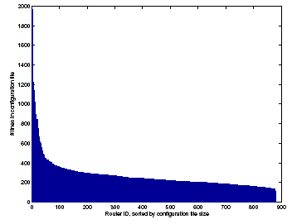
Fundamental Problem
Size of configuration files in a single enterprise network (881 routers)
Lines in
config file
Router ID (sorted by file size)

Slide 59
Reachability Example
R1
Chicago (chi)
R2
Data Center
New York (nyc)
Front Office
R5
R3
R4
Two locations, each with data center & front office
All routers exchange routes over all links

Slide 60
Reachability Example
R1
Chicago (chi)
R2
Data Center
New York (nyc)
Front Office
R5
R3
chi-DC
R4
chi-FO
nyc-DC
nyc-FO
chi-DC
chi-FO
nyc-DC
nyc-FO

Slide 61
Reachability Example
R1
Packet filter:
Drop nyc-FO -> *
Permit *
R2
chi
Data Center
Front Office
Packet filter:
Drop chi-FO -> *
Permit *
R5
nyc
R3
chi-DC
R4
chi-FO
nyc-DC
nyc-FO
chi-DC
chi-FO
nyc-DC
nyc-FO

Slide 62
Reachability Example
R1
Packet filter:
Drop nyc-FO -> *
Permit *
R2
chi
Data Center
Front Office
Packet filter:
Drop chi-FO -> *
Permit *
R5
nyc
R3
R4
A new short-cut link added between data centers
Intended for backup traffic between centers

Slide 63
Reachability Example
R1
Packet filter:
Drop nyc-FO -> *
Permit *
R2
chi
Data Center
Front Office
Packet filter:
Drop chi-FO -> *
Permit *
R5
nyc
R3
R4
Oops – new link lets packets violate security policy!
Routing changed, but
Packet filters don’t update automatically

Slide 64
The 4D Architecture
Propose a clean-slate repartitioning of functionality, rather than exploring incremental extensions
Completely separate decision logic (network issues) from underlying protocols (distributed systems issues)

Slide 65
Three Principles for
Network Control & Management
Network-level Objectives:
Express goals explicitly
  Security policies, QoS, egress point selection
Do not bury goals in box-specific configuration
Reachability matrix
Traffic engineering rules
Management
Logic

Slide 66
Three Principles for
Network Control & Management
Network-wide Views:
Design network to provide timely, accurate info
  Topology, traffic, resource limitations
Give logic the inputs it needs
Reachability matrix
Traffic engineering rules
Management
Logic
Read state info

Slide 67
Three Principles for
Network Control & Management
Direct Control:
Allow logic to directly set forwarding state
  FIB entries, packet filters, queuing parameters
Logic computes desired network state, let it implement it
Reachability matrix
Traffic engineering rules
Write state
Management
Logic
Read state info

Slide 68
Layers of the 4D Architecture
Network-level objectives
Decision
Network-wide views
Dissemination
Direct control
Discovery
Data
Decision Plane:
All management logic implemented on centralized servers making all decisions
Decision Elements use views to compute data plane state that meets objectives, then directly writes this state to routers

Slide 69
Layers of the 4D Architecture
Network-level objectives
Decision
Network-wide views
Dissemination
Direct control
Discovery
Data
Dissemination Plane:
Provides a robust communication channel to each router – and robustness is the only goal!
May run over same links as user data, but logically separate and independently controlled

Slide 70
Layers of the 4D Architecture
Network-level objectives
Decision
Network-wide views
Dissemination
Direct control
Discovery
Data
Discovery Plane:
Each router discovers its own resources and its local environment
E.g., the identity of its immediate neighbors

Slide 71
Layers of the 4D Architecture
Network-level objectives
Decision
Network-wide views
Dissemination
Direct control
Discovery
Data
Data Plane:
Spatially distributed routers/switches
Can deploy with today’s technology
Looking at ways to unify forwarding paradigms across technologies

Slide 72
Advantages of 4D
Separate network logic from distributed systems issues
  enables the use of existing distributed systems techniques and protocols to solve non-networking issues
Higher robustness
  raises level of abstraction for managing the network
  allows operators to focus on specific network-level objectives
Better security
  reduces likelihood of configuration mistakes
Accommodating heterogeneity
Enable Innovations
  only decision plane needs to be changed

Slide 73
Challenges of 4D
Reducing complexity
  Dramatically simplifying overall system? Or is it just moving complexity?
Unavoidable delays to have network-wide view.
  Is it possible to have a network-wide view sufficiently accurate and stable to manage the network?
The logic is centralized in Decision Element (DE)
  Is it possible to respond to network failures and restore data flow within an acceptable time?
  DE can be a single point of failure.
  Attackers can compromise the whole network by controlling DE

Slide 74
Research Agenda: Decision Plane
Algorithms to satisfy Network-level objectives
  Traffic Engineering: beyond intractable problems?
  Reachability Policies
  Planned Maintenance
  Specification of network-level objectives: new language?
Coordination between Decision Elements
  To avoid a single point of failure, multiple DE’s
  1) only elected leader sends instructions to all
  2) independent DE’s without coordination: network elements resolves commands from different DE’s
Hierarchy in Decision Plane

Slide 75
Research Agenda: Dissemination Plane
Separate control from data “logically”
  supervisory channel in SONET, optical links
  no separation channel for control and data in the Internet
How to achieve robust, efficient connection of DE with routers and switches?
  flooding
  spanning-tree protocols
  source routing
When to apply the new logic in data plane
  each router applies update ASAP
  coordinate update at a pre-specified time: need time synch

Slide 76
Research Agenda: Discovery Plane
Today
  consistency between management logic, configuration files, and physical reality is maintained manually!
4D
  Bootstrapping with zero pre-configuration
  Automatically discovering the identities of devices and the logical/physical relationships between them
  Supporting cross-layer auto-discovery

Slide 77
Research Agenda: Data Plane
Data plane handles data packets under direct control of the decision plane
Decision plane algorithms should vary depending on the forwarding paradigms in data plane
Packet-forwarding paradigms
  Longest-prefix matching (IPv4, IPv6)
  Exact-match forwarding (Ethernet)
  Label switching (MPLS, ATM, Frame Relay)
Weighted splitting over multiple outgoing links or single out-going link?

Slide 78
4D Summary
Fundamental questions to re-design control & management functions for data networks
decision logic blended with protocols → abstracts and isolates them
uncoordinated, error-prone low-level mechanisms → consistent manner by network-level objectives
network operators tune parameters → network “designers” directly control
human operators check network-wide views → network itself check the info in real-time

Slide 79
Questions?

Slide 80
RCS data structures
RIB-Out shadow tables
Egress lists
Global route table
(points to currently used route for each router)
(points to routes that use each egress)
(stores copies of routes)
rtr1
rtr2
BGP routes →
rtr1
rtr2
rtr3
eg1
eg1
← Prefixes
← Prefixes
eg2
eg2
eg3
eg3
BGP updates
BGP updates
IGP updates
(from egress routers)
(to routers)

