Slide 1
Cellular Networks and Mobile Computing
COMS 6998-7, Spring 2014
Instructor: Li Erran Li (lierranli@cs.columbia.edu)
http://www.cs.columbia.edu/~lierranli/coms6998-7Spring2014/
3/31/2014: Mobile Cloud Platform Services

Slide 2
Syllabus
Mobile App Development (lecture 1,2,3)
  Mobile operating systems: iOS and Android
  Development environments: Xcode, Eclipse with Android SDK
  Programming: Objective-C and android programming
System Support for Mobile App Optimization (lecture 4,5)
  Mobile device power models, energy profiling and ebug debugging
  Core OS topics: virtualization, storage and OS support for power and context management
Interaction with Cellular Networks (lecture 6,7,8)
  Basics of 3G/LTE cellular networks
  Mobile application cellular radio resource usage profiling
  Measurement-based cellular network and traffic characterization
Interaction with the Cloud (lecture 9,10)
  Mobile cloud computing platform services: push notification, iCloud and Google Cloud Messaging
  Mobile cloud computing architecture and programming models
Mobile Platform Security and Privacy (lecture 11,12,13)
  Mobile platform security: malware detection and characterization, attacks and defenses
  Mobile data and location privacy: attacks, monitoring tools and defenses

Slide 3
Mobile Cloud Platform Services
Social network services
Compute and storage
  Syncing and storage service (iCloud)
  Amazon EC2 infrastructure and platform services
Proxy service (Kindle Split Browser)
Push notification service
Location based service
  Track service (supporting location based services)
Recognition services
  Speech to text/text to speech service
  Natural language processing service (open Siri API for 3rd party applications in the future)

Slide 4
Outline
Social network services
iCloud service
Push notification service
  Apple push notification service
  Google GCM

Slide 5
Social Network Services
iOS social framework in core service layer
Facebook, twitter account needs to be configured
Social Framework includes a controller called SLComposeViewController
  An instance must be created: SLComposeViewController *socialController = [SLComposeViewController composeViewControllerForServiceType:socialNetwork];
Calling the API
  if([SLComposeViewController isAvailableForServiceType:socialNetwork]){
  SLComposeViewControllerCompletionHandler __block completionHandler=^(SLComposeViewControllerResult result){
  [socialController dismissViewControllerAnimated:YES completion:nil];
  switch(result){
  case SLComposeViewControllerResultCancelled:
  default:
  NSLog(@"Cancelled.....");
  break;
  case SLComposeViewControllerResultDone:
  NSLog(@"Posted....");
  break;
  }
  };

Slide 6
Social Network Services (Cont’d)
  [socialController addImage:[UIImage
  imageNamed:@"CollatzFractal.png"]];
  [socialController setInitialText:@"Solve the 3x+1 math puzzle."];
  [socialController addURL:[NSURL
  URLWithString:@"http://en.wikipedia.org/wiki/
  Collatz_conjecture"]];
  [socialController
  setCompletionHandler:completionHandler];
  [self presentModalViewController:socialController animated:YES];
  }

Slide 7
Social Network Services (Cont’d)
Also support http request to social networks
NSDictionary *parameters = @{@"message": @"My first iOS 6 Facebook posting "};
NSURL *feedURL = [NSURL URLWithString:@"http://www.facebook.com/erran"];
SLRequest *feedRequest = [SLRequest
requestForServiceType:SLServiceTypeFacebook
requestMethod:SLRequestMethodGET
// requestMethod:SLRequestMethodPOST
URL:feedURL
parameters:parameters];
feedRequest.account = facebookAccount;
[feedRequest performRequestWithHandler:^(NSData *responseData,
NSHTTPURLResponse *urlResponse, NSError *error)
{
// Handle response
NSString *response = [[NSString alloc] initWithData:responseData
encoding:NSUTF8StringEncoding];
NSLog(@"feedRequest response, status code: %d, data:%@", urlResponse.statusCode,
response);
}];

Slide 8
iCloud
Fundamentally: nothing more than a URL of a shared directory
Two storage models
  iCloud document storage: store user documents and app data in the user’s iCloud account
  iCloud key-value data storage: share small amounts of noncritical configuration data among instances of your app
iCloud-specific entitlements required
  Select your app target in Xcode
  Select the Summary tab
  In the Entitlements section, enable the Enable Entitlements checkbox

Slide 9
iCloud (Cont’d)
Check availability: URLForUbiquityContainerIdentifier:
All files and directories stored in iCloud must be managed by a file presenter object, and all changes you make to those files and directories must occur through a file coordinator object. A file presenter is an object that adopts the NSFilePresenter protocol
Explicitly move files to iCloud
Be prepared to handle version conflicts for a file
Make use of searches to locate files in iCloud
Be prepared to handle cases where files are in iCloud but not fully downloaded to the local device; this might require providing the user with feedback
Use Core Data for storing live databases in iCloud; do not use SQLite

Slide 10
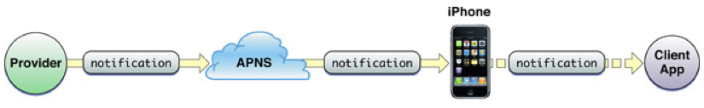
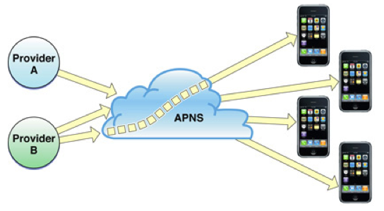
Apple Push Notification Architecture Overview
iOS device maintains a persistent TCP connection to a Apple Push Notification Server(APNS)
A push notification from a provider to a client application
Multi-providers to multiple devices
Notes:
Each push notification carries with it a payload. The payload specifies how users are to be alerted to the data waiting to be downloaded to the client application. The maximum size allowed for a notification payload is 256 bytes; Apple Push Notification Service refuses any notification that exceeds this limit. Remember that delivery of notifications is “best effort” and is not guaranteed.
For each notification, providers must compose a JSON dictionary object that strictly adheres to RFC 4627. This dictionary must contain another dictionary identified by the key aps. The aps dictionary contains one or more properties that specify the following actions:
An alert message to display to the user
A number to badge the application icon with
A sound to play

Slide 11
Apple Push Notification Architecture Overview (Cont’d)
What if devices uninstalled the app?
  Feedback service
    App providers poll to obtain list of device tokens for their applications
    Apple push notification service informs providers in case of repeated failures
What if devices are offline?
  QoS service
    QoS stores the notification
    It retains only the last notification received from a provider
    When the offline device reconnects, QoS service forwards the stored notification to the device
    QoS service retains a notification for a limited period before deleting it
Notes:
Each push notification carries with it a payload. The payload specifies how users are to be alerted to the data waiting to be downloaded to the client application. The maximum size allowed for a notification payload is 256 bytes; Apple Push Notification Service refuses any notification that exceeds this limit. Remember that delivery of notifications is “best effort” and is not guaranteed.
For each notification, providers must compose a JSON dictionary object that strictly adheres to RFC 4627. This dictionary must contain another dictionary identified by the key aps. The aps dictionary contains one or more properties that specify the following actions:
An alert message to display to the user
A number to badge the application icon with
A sound to play

Slide 12
Push Notification
Push notification
  Delivery is best effort and is not guaranteed
  Max size is 256 bytes
  Providers compose a JSON dictionary object
    This dictionary must contain another dictionary identified by the key aps
  Action:
    An alert message to display to the user
    A number to badge the application icon with
    A sound to play
Notes:
Each push notification carries with it a payload. The payload specifies how users are to be alerted to the data waiting to be downloaded to the client application. The maximum size allowed for a notification payload is 256 bytes; Apple Push Notification Service refuses any notification that exceeds this limit. Remember that delivery of notifications is “best effort” and is not guaranteed.
For each notification, providers must compose a JSON dictionary object that strictly adheres to RFC 4627. This dictionary must contain another dictionary identified by the key aps. The aps dictionary contains one or more properties that specify the following actions:
An alert message to display to the user
A number to badge the application icon with
A sound to play

Slide 13
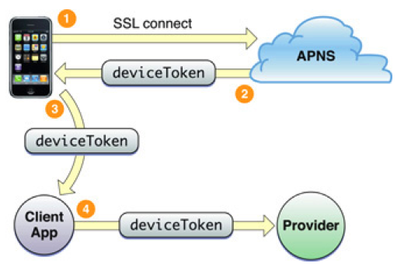
Device Token
Device token is analogous to a phone number
  Contains information that enables APNs to locate the device
  Client app needs to provide the token to its provider
  Device token should be requested and passed to providers every time your application launches
Notes:
By requesting the device token and passing it to the provider every time your application launches, you help to ensure that the provider has the current token for the device. If a user restores a backup to a device or computer other than the one that the backup was created for (for example, the user migrates data to a new device or computer), he or she must launch the application at least once for it to receive notifications again. If the user restores backup data to a new device or computer, or reinstalls the operating system, the device token changes. Moreover, never cache a device token and give that to your provider; always get the token from the system whenever you need it. If your application has previously registered, calling registerForRemoteNotificationTypes: results in the operating system passing the device token to the delegate immediately without incurring additional overhead.

Slide 14
Apple Push Notification Programming Example
Provisioning: https://developer.apple.com/ios/manage/provisioningprofiles/howto.action
  Generate Certification Signing Request (CSR) using Keychain Access
    Save to disk: PushChat.certSigningRequest
    Export the private key as “PushChatKey.p12” and enter a passphrase
  Make an App ID in iOS Provisioning Portal
    Check the Enable for Apple Push Notification service box
    Click on the Configure button for the Development Push SSL Certificate
    Click Download to get the certificate – it is named “aps_development.cer”

Slide 15
Apple Push Notification Programming Example (Cont’d)
Client code
  - (BOOL)application:(UIApplication *)application didFinishLaunchingWithOptions:(NSDictionary *)launchOptions
  {
  // Let the device know we want to receive push notifications
  [[UIApplication sharedApplication] registerForRemoteNotificationTypes:
  (UIRemoteNotificationTypeBadge | UIRemoteNotificationTypeSound | UIRemoteNotificationTypeAlert)];
  return YES;
  }
  - (void)application:(UIApplication*)application didReceiveRemoteNotification:(NSDictionary*)userInfo
  {//userInfo contains the notification
  NSLog(@"Received notification: %@", userInfo);
  }
  - (void)application:(UIApplication*)application didRegisterForRemoteNotificationsWithDeviceToken:(NSData*)deviceToken
  {
  NSLog(@"My token is: %@", deviceToken);
  }
Notes:
A major role of a UIApplication object is to handle the initial routing of incoming user events. It also dispatches action messages forwarded to it by control objects (UIControl) to the appropriate target objects. In addition, the UIApplication object maintains a list of all the windows (UIWindow objects) currently open in the application, so through those it can retrieve any of the application’s UIView objects. The application object is typically assigned a delegate, an object that the application informs of significant runtime events—for example, application launch, low-memory warnings, and application termination—giving it an opportunity to respond appropriately.
Applications can cooperatively handle a resource such as an email or an image file through the openURL: method. For example, an application opening an email URL with this method may cause the mail client to launch and display the message.
The programmatic interfaces of UIApplication and UIApplicationDelegate also allow you to manage behavior that is specific to the device. You can control application response to changes in interface orientation, temporarily suspend incoming touch events, and turn proximity sensing (of the user’s face) off and on again.

Slide 16
Apple Push Notification Programming Example (Cont’d)
Server code
  $devicetoken ='f05571e4be60a4e11524d76e4366862128f430522fb470c46fc6810fffb07af7’;
  // Put your private key's passphrase here:
  $passphrase = 'PushChat';
  // Put your alert message here:
  $message = 'Erran: my first push notification!';
  $ctx = stream_context_create();
  Stream_context_set_option($ctx, 'ssl', 'local_cert', 'ck.pem');
  stream_context_set_option($ctx, 'ssl', 'passphrase', $passphrase);
  // Open a connection to the APNS server
  $fp = stream_socket_client(
  'ssl://gateway.sandbox.push.apple.com:2195', $err,
  $errstr, 60, STREAM_CLIENT_CONNECT|STREAM_CLIENT_PERSISTENT, $ctx);
  if (!$fp)
  exit("Failed to connect: $err $errstr" . PHP_EOL);
  echo 'Connected to APNS' . PHP_EOL;
  // Create the payload body
  $body['aps'] = array(
  'alert' => $message,
  'sound' => 'default'
  );
  // Encode the payload as JSON
  $payload = json_encode($body);
  // Build the binary notification
  $msg = chr(0) . pack('n', 32) . pack('H*', $deviceToken) . pack('n', strlen($payload)) . $payload;
  // Send it to the server
  $result = fwrite($fp, $msg, strlen($msg));
  if (!$result)
  echo 'Message not delivered' . PHP_EOL;
  else
  echo 'Message successfully delivered' . PHP_EOL;
  // Close the connection to the server
  fclose($fp);

Slide 17
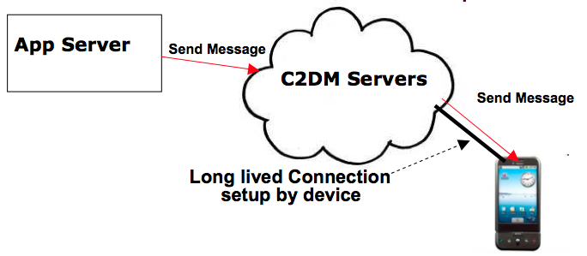
Google Cloud Messaging (Cont’d)
GCM Servers
Push notification problems
  Network firewalls prevent servers from directly sending messages to mobile devices
GCM solution
  Maintain a connection between device and Google GCM server
  Push server updates to apps on the device via this connection
  Optimize this connection to minimize bandwidth and battery consumption (e.g. adjusting the frequency of keep alive messages)
Send-to-sync messages vs. messages with payload
An application can send messages to one or more devices (multicast)

Slide 18
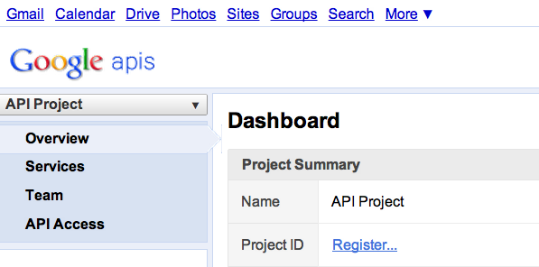
Google Cloud Messaging (Cont’d)
Step 1
Create a Google API project from Google APIs console pagehttps://code.google.com/apis/console/#project:908058729336
  Enable GCM service
  Obtain an API key
  Create new server key
  Install helper libraries

Slide 19
Google Cloud Messaging (Cont’d)
Step 2
Write the Android app
  Copy gcm.jar file into your app classpath
  Configure manifest file for SDK version, permission
  Add broadcast receiver
  Add intent service
  Write my_app_package.GCMIntentService class
  Write main activity
import com.google.android.gcm.GCMRegistrar;
…
GCMRegistrar.checkDevice(this);
GCMRegistrar.checkManifest(this);
final String regId = GCMRegistrar.getRegistrationId(this);
if (regId.equals("")) {
GCMRegistrar.register(this, SENDER_ID);
} else {
Log.v(TAG, "Already registered");
}

Slide 20
Google Cloud Messaging (Cont’d)
Step 3
Write server-side app
  Copy gcm-server.jar file from the SDK’s gcm-server/dist directory to your server class path
  Create a servlet that can be used to receive client’s GCM registration ID
  Create a servlet to unregister registration ID
  Use com.google.android.gcm.server.Sender helper class from GCM library to send a message to client
import com.google.android.gcm.server.*;
Sender sender = new Sender(myApiKey);
Message message = new Message.Builder().build();
MulticastResult result = sender.send(message, devices, 5);

Slide 21
Questions?

