Slide 1
Cellular Networks and Mobile Computing
COMS 6998-7, Spring 2014
Instructor: Li Erran Li (lierranli@cs.columbia.edu)
http://www.cs.columbia.edu/~lierranli/coms6998-7Spring2014/
3/10/2014:Future Directions of Cellular Networks

Slide 2
Outline
Review of Previous Lecture
Future Direction of Cellular Networks
  Introduction to SDN and NFV
  Software Defined Cellular Networks

Slide 3
Review of Previous Lecture
What are the physical layer technologies in LTE?

Slide 4
LTE Physical Layer
The key improvement in LTE radio is the use of OFDM
Orthogonal Frequency Division Multiplexing
  2D grid: frequency and time
  Narrowband channels: equal fading in a channel
    Allows simpler signal processing implementations
  Sub-carriers remain orthogonal under multipath propagation
One resource block
12 subcarriers during one slot
(180 kHz × 0.5 ms)
One resource element
frequency
12 subcarriers
Time domain structure
Frame (10 ms)
One OFDM symbol
One slot
time
Slot (0.5 ms)
Subframe (1 ms)

Slide 5
Review of Previous Lecture (Cont’d)
What are the mobility protocols used in cellular networks?

Slide 6
Mobility Protocol: GTP
SGi
PDN GW
HSS
S5
GTP
Gn
GTP
SGW
S11
MME
SGSN
MSC
IuPS
IuCS
RNC
S1-U
S1-CP
GTP
Iub
eNodeB
NodeB
UE
Courtesy: Zoltán Turányi

Slide 7
Mobility Protocol: Proxy Mobile IP (PMIP)
SGi
PDN GW
HSS
S5
PMIP
S2
SGW
MME
PMIP
S11
Non-3GPP Access
(cdma2000, WiMax, WiFi)
S1-U
S1-CP
GTP
eNodeB
UE
EPC – Evolved Packet Core
Courtesy: Zoltán Turányi

Slide 8
Review of Previous Lecture (Cont’d)
Is carrier sensing multiple access (CSMA) used in cellular networks?

Slide 9
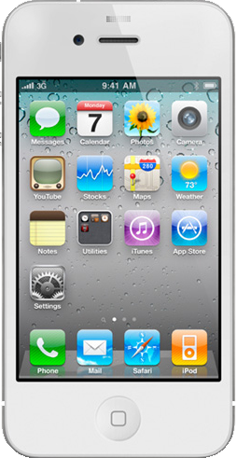
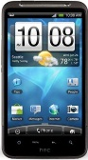
Random Access
Why not carrier sensing like WiFi?
Base station coverage is much larger than WiFi AP
  UEs most likely cannot hear each other
How come base station can hear UEs’ transmissions?
  Base station receivers are much more sensitive and expensive
Base station
UE 2
UE 1
Notes:
Time-frequency resource on which random-access preamble is transmitted on the PRACH channel

Slide 10
Review of Previous Lecture (Cont’d)
What is the current LTE network architecture and its problems?

Slide 11
Current LTE Architecture
No clear separation of control plane and data plane
Hardware centric
Control Plane
Home Subscriber Server (HSS)
Problem with Inter-technology (e.g. 3G to LTE) handoff
Problem of inefficient radio resource allocation
Data Plane
Mobility Management Entity (MME)
Policy Control and Charging Rules Function (PCRF)
Packet Data
Station (eNodeB)
Serving
Network Gateway
(P-GW)
User Equipment (UE)
Base
Gateway (S-GW)

Slide 12
Outline
Review of Previous Lecture
Future Direction of Cellular Networks
  Introduction to SDN and NFV
  Software Defined Cellular Networks

Slide 13
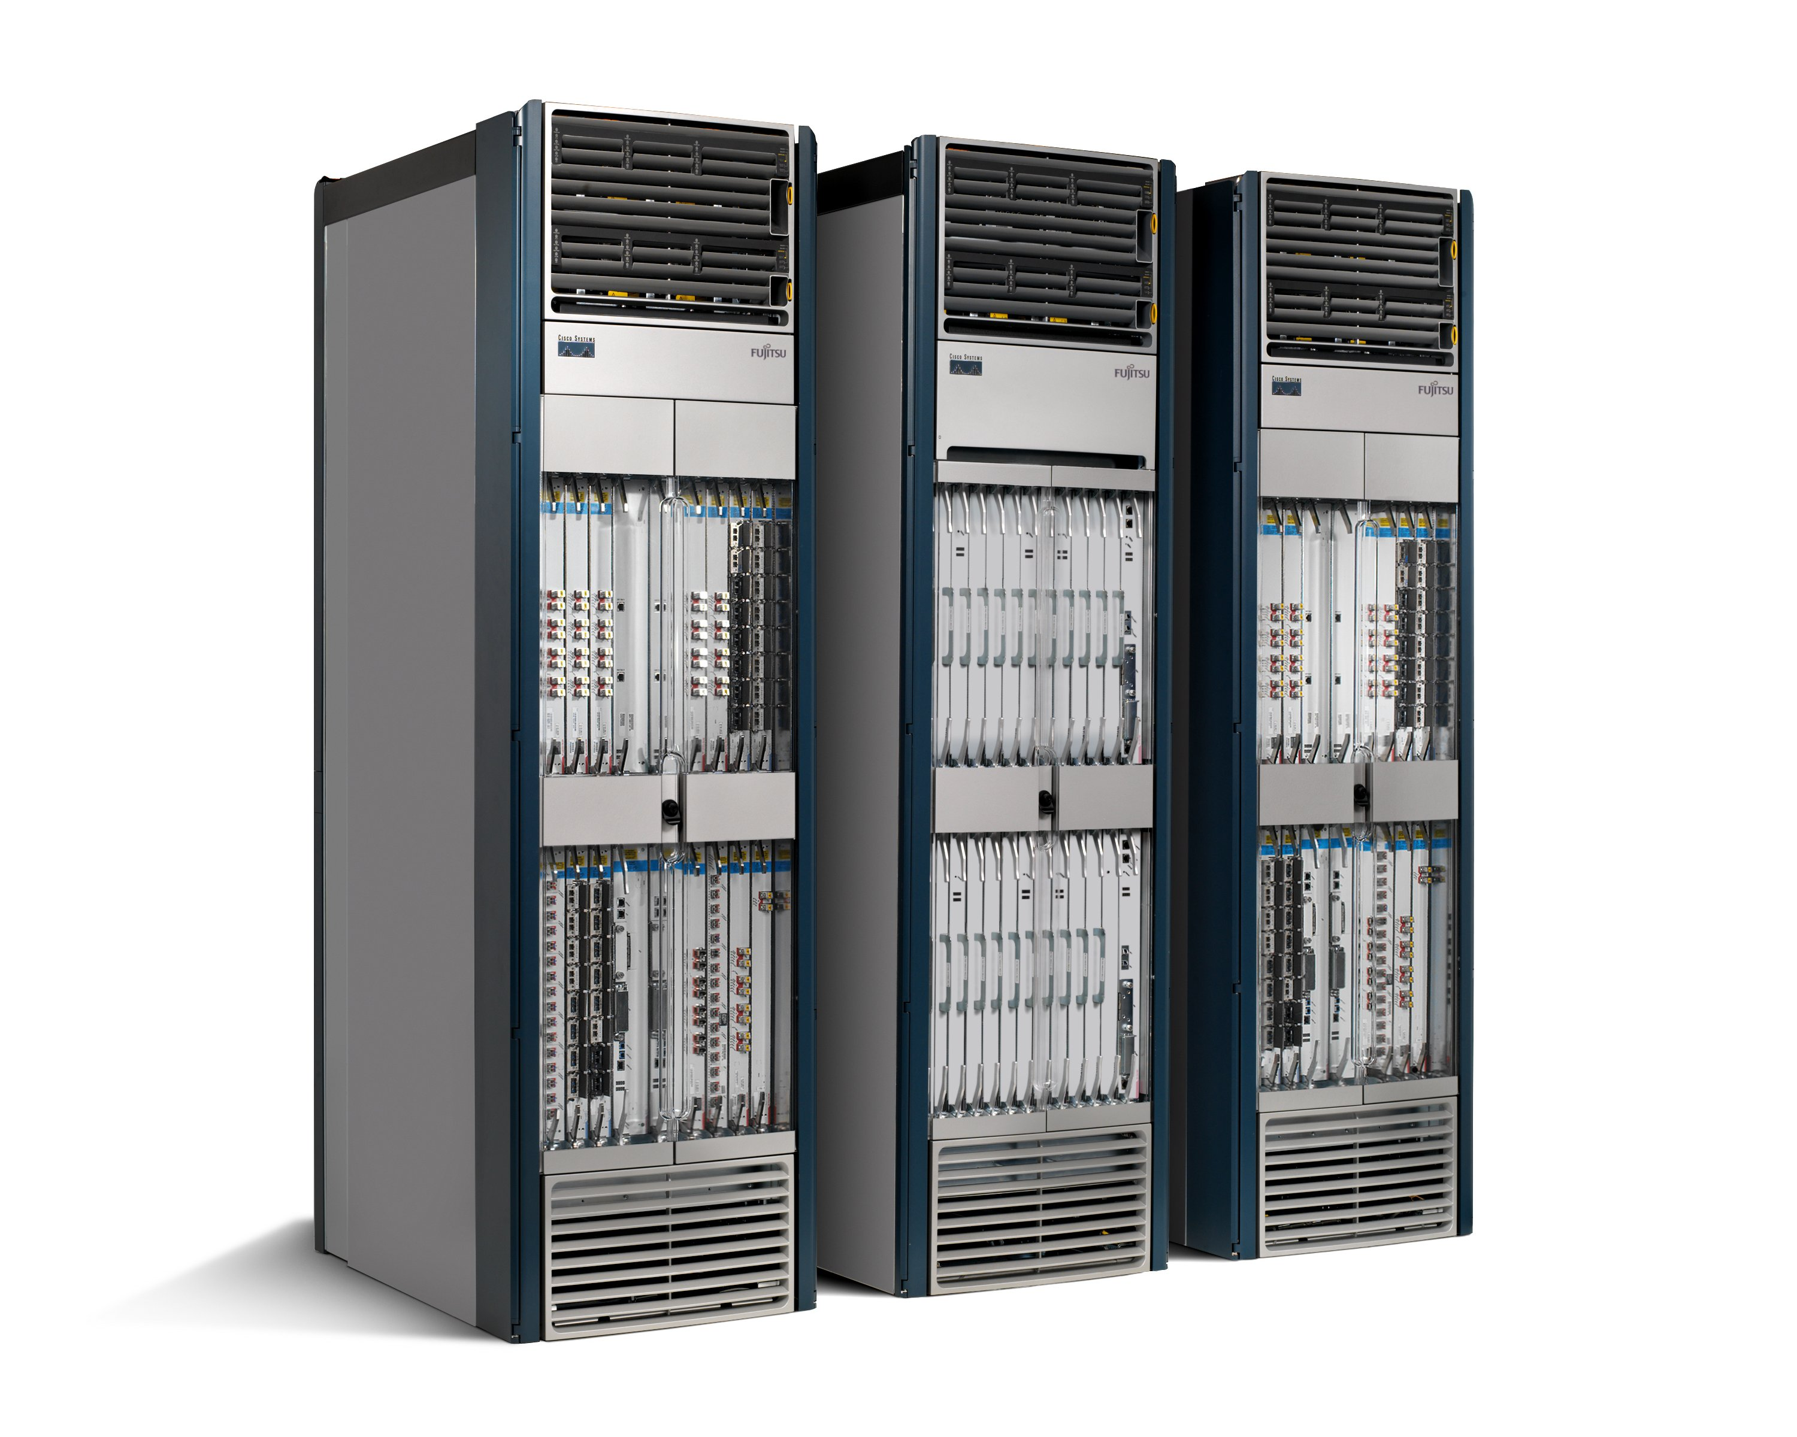
Source: Nick Mckeown, Stanford
Routing, management, mobility management,
access control, VPNs, …
Feature
Feature
Million of lines
of source code
6,000 RFCs
OS
Custom Hardware
Billions of gates
Bloated
Power Hungry
Vertically integrated, complex, closed, proprietary
Networking industry with “mainframe” mind-set

Slide 14
The network Should Change to
Source: Nick Mckeown, Stanford
Feature
Feature
Network OS
Feature
Feature
OS
Custom Hardware
Feature
Feature
OS
Feature
Feature
Custom Hardware
OS
Feature
Feature
Custom Hardware
OS
Custom Hardware
Feature
Feature
OS
Custom Hardware

Slide 15

Software Defined Network (SDN)
Source: Nick Mckeown, Stanford
3. Consistent, up-to-date global network view
2. At least one Network OS
probably many.
Open- and closed-source
Feature
Feature
Network OS
1. Open interface to packet forwarding
Packet
Forwarding
Packet
Forwarding
Packet
Forwarding
Packet
Forwarding
Packet
Forwarding

Slide 16
Network OS
Source: Nick Mckeown, Stanford
Network OS: distributed system that creates a consistent, up-to-date network view
  Runs on servers (controllers) in the network
  Floodlight, POX, Pyretic, Nettle ONIX, Beacon, … + more
Uses forwarding abstraction to:
  Get state information from forwarding elements
  Give control directives to forwarding elements

Slide 17
Software Defined Network (SDN)
Source: Nick Mckeown, Stanford
Control Program A
Control Program B
Network OS
Packet
Forwarding
Packet
Forwarding
Packet
Forwarding
Packet
Forwarding
Packet
Forwarding

Slide 18
Control Program
Source: Nick Mckeown, Stanford
Control program operates on view of network
  Input: global network view (graph/database)
  Output: configuration of each network device
Control program is not a distributed system
  Abstraction hides details of distributed state

Slide 19
Forwarding Abstraction
Source: Nick Mckeown, Stanford
Purpose: Abstract away forwarding hardware
Flexible
  Behavior specified by control plane
  Built from basic set of forwarding primitives
Minimal
  Streamlined for speed and low-power
  Control program not vendor-specific
OpenFlow is an example of such an abstraction

Slide 20

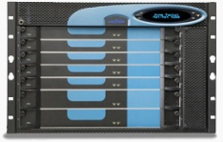
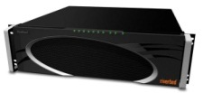

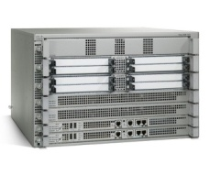







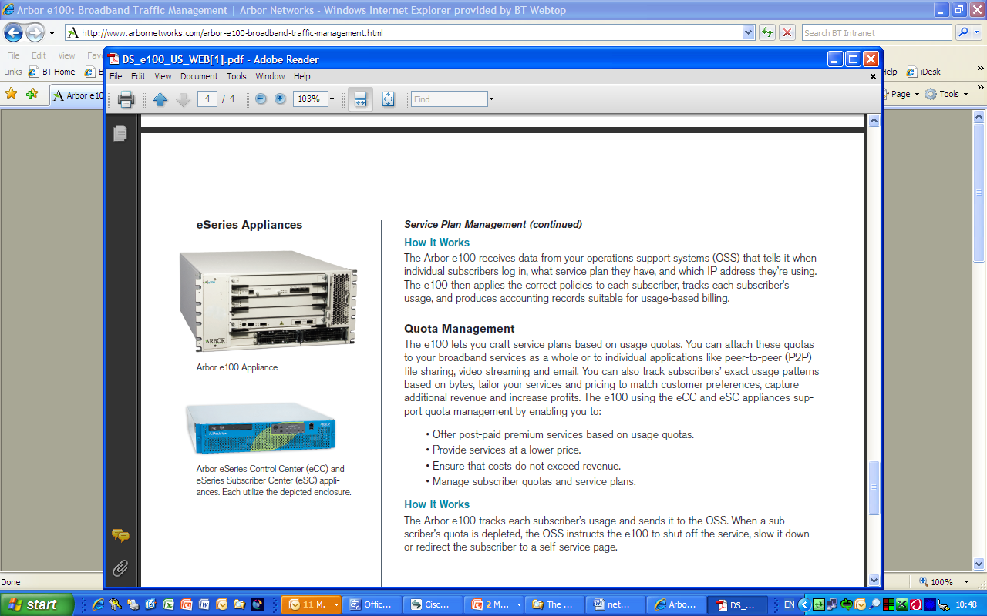
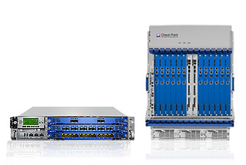
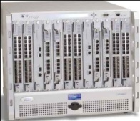

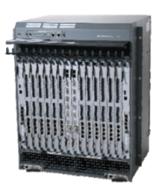
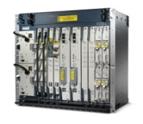
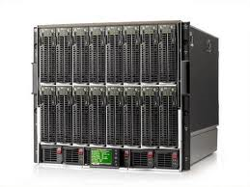
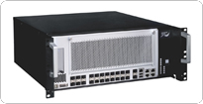
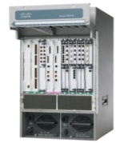

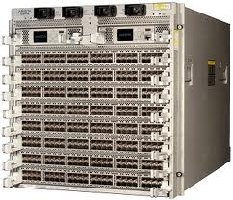
Network Functions
Virtualisation Approach
Session Border
Controller
Independent
Software Vendors
Message
Router
WAN
Acceleration
CDN
DPI
Carrier
Grade NAT
Orchestrated,
automatic
remote install
Firewall
Tester/QoE
monitor
hypervisors
SGSN/GGSN
BRAS
Generic High Volume Servers
Radio Network
Controller
PE Router
Generic High Volume Storage
Classical Network Appliance
Approach
Generic High Volume
Ethernet Switches
Notes:
The Classical network appliance approach uses a proprietary chassis for every new service, some typical examples are shown above left. Although inside the appliances use similar chips they are packaged very differently outside. This creates complexity through the entire life cycle of network services e.g. Design, procurement, test, deployment, configuration, repair, maintenance, replacement, end-of-life, removal. There is no economies of scale (some boxes may only sell in the thousands as opposed to 9 Million IT servers every year). The need for start-ups to develop new hardware, including getting it NEBs and ETSI qualified, is a significant cost and deterrent to enter the telecoms market.
The Network Virtualisation (NV) approach replaces physical network appliances with software virtual appliances running on commodity IT servers. Using open IT techniques allows a competitive and innovative ecosystem to exploit the many x86 and Linux programmers in the world. The Virtual Appliances can be installed on IT servers using orchestration software, this will automatically and remotely install software, driven either by traffic demands or customer orders. To complement the standard high volume IT servers we will also use standard high volume storage and Ethernet switches. The standard high volume Ethernet switches will use merchant silicon which spreads the cost of switching ASICs over the widest possible Enterprise & Carrier market.
20

Slide 21
Outline
Review of Previous Lecture
Future Direction of Cellular Networks
  Introduction to SDN and NFV
  Software Defined Cellular Networks
    Radio Access Networks
    Cellular Core Networks
    Cellular Wide Area Networks

Slide 22
A Clean-Slate Design:
Software-Defined Radio Access Networks

Slide 23
Carrier’s Dilemma
Exponential Traffic Growth
Limited Capacity Gain
Poor wireless connectivity if left unaddressed

Slide 24
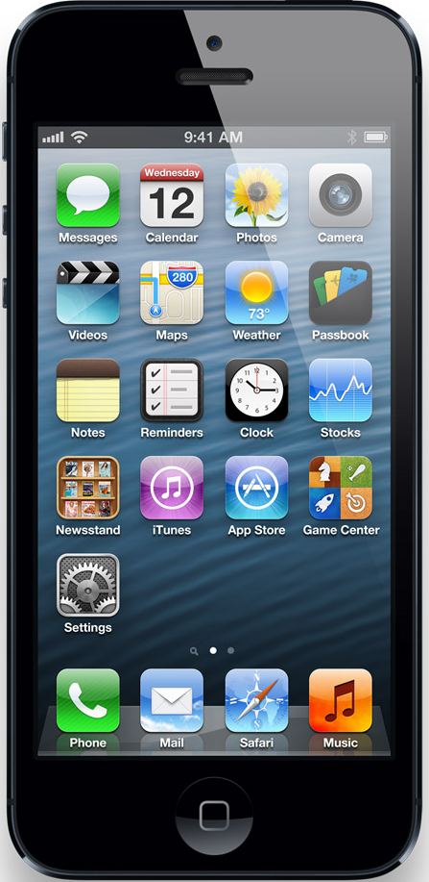
LTE Radio Access Networks
Goal: high capacity wide-area wireless network
  Dense deployment of small cells
Base Station (BS)
Serving Gateway
Packet Data
Network Gateway
User Equipment (UE)
Serving Gateway
Internet
access
core
Notes:
This figure shows the architecture of today’s cellular core networks. User equipment connect to base stations via radio channels.
Base stations connect to the Internet via the cellular core network. There are two main components in the cellular core network, serving gateway and packet data network gateway.

Slide 25
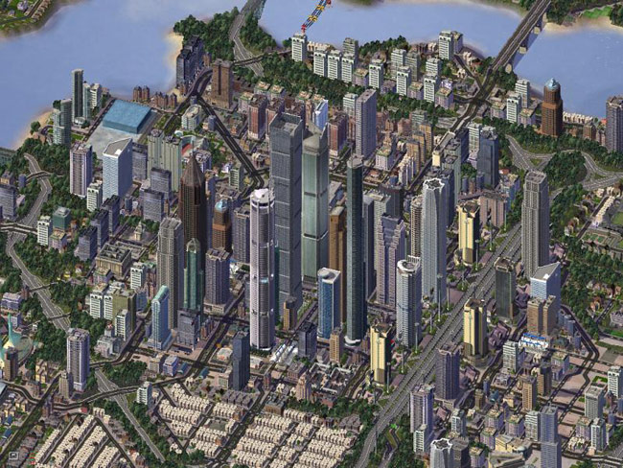

Dense and Chaotic Deployments
Dense: high SNR per user leads to higher capacity
  Small cells, femto cells, repeaters, etc

Slide 26
Problems
Current LTE distributed control plane is ill-suited
  Hard to manage inter-cell interference
  Hard to optimize for variable load of cells
Dense deployment is costly
  Need to share cost among operators
  Maintain direct control of radio resources
    Lacking in current 3gpp RAN sharing standards
26

Slide 27

SoftRAN: Big Base Station Abstraction
Big Base Station
Radio Element 1
time
controller
frequency
Radio Element 2
Radio Element 3
time
time
time
frequency
radio element
frequency
frequency
27

Slide 28
Radio Resource Allocation
Flows
3D Resource Grid
time
radio element
frequency
28

Slide 29

SoftRAN: SDN Approach to RAN
Coordination :
X2 Interface
Control Algo
Control Algo
PHY & MAC
PHY & MAC
Control Algo
PHY & MAC
BS1
BS3
Control Algo
Control Algo
BS5
PHY & MAC
PHY & MAC
BS2
BS4

Slide 30
SoftRAN: SDN Approach to RAN
Control Algo
Operator Inputs
Network OS
RadioVisor
PHY & MAC
PHY & MAC
PHY & MAC
RE3
RE1
RE5
PHY & MAC
PHY & MAC
Radio Element (RE)
RE2
RE4

Slide 31
SoftRAN Architecture Summary
CONTROLLER
RAN Information Base
Periodic Updates
Controller
API
Bytes
Rate
Queue
Size
Network
Operator
Inputs
RADIO ELEMENTS
Interference
Map
Flow
Records
QoS
Constraints
3D Resource Grid
Radio
Element API
Time
Radio Resource
Management
Algorithm
Radio Element
POWER
FLOW
Frequency
31

Slide 32
SoftRAN Architecture: Updates
Radio element -> controller (updates)
  Flow information (downlink and uplink)
  Channel states (observed by clients)
Network operator -> controller (inputs)
  QoS requirements
  Flow preferences
32

Slide 33
SoftRAN Architecture: Controller Design
RAN information base (RIB)
  Update and maintain global network view
    Interference map
    Flow records
Radio resource management
  Given global network view: maximize global utility
  Determine RRM at each radio element
33

Slide 34
SoftRAN Architecture: Radio Element API
Controller -> radio element
  Handovers to be performed
  RF configuration per resource block
    Power allocation and flow allocation
  Relevant information about neighboring radio elements
    Transmit Power being used
34

Slide 35
Refactoring Control Plane
Controller responsibilities:
  Decisions influencing global network state
    Load balancing
    Interference management
Radio element responsibilities:
  Decisions based on frequently varying local network state
    Flow allocation based on channel states
35

Slide 36
SoftRAN Advantages
  Logically centralized control plane:
  Global view on interference and load
    Easier coordination of radio resource management
    Efficient use of wireless resources
  Plug-and-play control algorithms
    Simplified network management
  Smoother handovers
    Better user-experience
36

Slide 37
SoftRAN: Evolving the RAN
Switching off radio elements based on load
  Energy savings
Dynamically splitting the network into Big-BSs
  Handover radio elements between Big-BSs
37

Slide 38
Implementation: Modifications
SoftRAN is incrementally deployable with current infrastructure
  No modification needed on client-side
  API definitions at base station
    Femto API : Standardized interface between scheduler and L1 (http://www.smallcellforum.org/resources-technical-papers)
    Minimal modifications to FemtoAPI required
38

Slide 39
RadioVisor Design
Slice manager
  Slice configuration, creation, modification, deletion and multi-slice operations
Traffic to slice mapping at RadioVisor and radio elements
3D resource grid allocation and isolation
  Considers traffic demand, interference graph and policy
RadioVisor
3D Resource Grid
Allocation & Isolation
Slice
Manager
Traffic to Slice
Mapping

Slide 40
Slice Manager
Slice definition
  Predicates on operator, device, subscriber, app attributes
    A slice can be all M2M traffic of operator 1
Slice configuration at data plane and control plane
  PHY and scheduler: narrow band PHY for M2M slice
  Interference management algorithm
Slice algebra to support flexible slice operations
  Slice merge, split, (un)nest, duplicate

Slide 41
Resource Grid Allocation and Isolation
Slices present resource demands every time window
Max min fair allocation
Example
  Red slice entitles 2/3 and demands 2/3 RE1 only
  Blue slice entitles 1/3 and demand 1/3 RE2 and 1 RE3
Interference Edge
Radio
Element 1
Radio
Element 2
Radio
Element 3
Frequency
Time
Radio Element

Slide 42
Conclusion
Dense deployment calls for central control of radio resources
Deployment costs motivate RAN Sharing
We present the design of RadioVisor
  Enables direct control of per slice radio resources
  Configures per slice PHY and MAC, and interference management algorithm
  Supports flexible slice definitions and operations

Slide 43
A Clean-Slate Design:
Software-Defined Cellular Core Networks

Slide 44
Cellular Core Network Architecture
Base Station (BS)
Serving Gateway
Packet Data
Network Gateway
User Equipment (UE)
Serving Gateway
Internet
access
core
Notes:
This figure shows the architecture of today’s cellular core networks. User equipment connect to base stations via radio channels.
Base stations connect to the Internet via the cellular core network. There are two main components in the cellular core network, serving gateway and packet data network gateway.

Slide 45


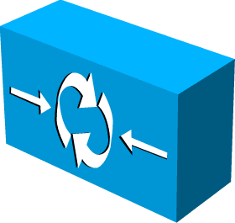
SoftCell Overview
Simple hardware
+ SoftCell software
Controller
Internet
Notes:
To be free from such control bottlenecks, we designed a new cellular network architecture called SoftCell. SoftCell applies the principle of software defined networking. Instead of using specialized data plane equipment, we will just use SDN switches. The SoftCell controller coordinates the data plane functions.
To enable direct control and flexibility, we propose a new architecture. It uses the principle of software defined networking. We will make use of commodity hardware which will be controlled by a controller. We make no changes to user equipment and the Internet.
It makes no change no user equipment, the radio access technology, or the Internet.
It only replaces the core network with commodity switches and middleboxes, controlled by a logically centralized controller.
Data Plane:
Switch: connectivity, traffic steering
Middlebox: various network services
~mix-match, combine functionality from different vendors
~easy to add new functionality
~up-/down-scale
~cheap
Control Plane:
Logically centralized controller, centralized control, rather than distributed protocol (hard to reason, debug, trouble shooting)
~Easy to manage
~Easy to change

Slide 46


SoftCell Design Goal
Fine-grained service policy for diverse app needs
  Video transcoder, content filtering, firewall
  M2M services: fleet tracking, low latency medical device updates
with diverse needs!
Notes:
Due to the diverse needs from subscriber mobile apps and M2M apps, we need to support fine-grained policies such as video transcoder, content filtering, fleet tracking.
We wan three things. First, we want unified control of data plane. Second, we would like to flexibly control routing and Internet exit points. Third,
Given the different needs of subscribers and the many user scenarios of machine type communication (also known as Internet of Things), we would like to design the network for high performance and scalable support of fine-grained policies.

Slide 47
Characteristics of Cellular Core Networks
“North south” traffic pattern
Asymmetric edge
Traffic initiated from low-bandwidth access edge
Gateway Edge
Internet
~1 million Users
~10 million flows
~400 Gbps – 2 Tbps
~1K Users
~10K flows
~1 – 10 Gbps
Access Edge
Notes:
How should we design SoftCell to support fine-grained policies? Can we just apply data center SDN solutions? Before we can answer the question, lets try to understand the characteristics of cellular networks.
First, the dominant traffic in cellular core networks are to or from the Internet, while in data centers, most traffic stays inside the data center. Second, cellular core networks have asymmetric edge. The access edge has lower bandwidth than the gateway edge. At the access, we are talking about 1K users, 10K flows and a few Gbps. At the gateway edge, we are talking about millions of Users, 10s of millions of flows and Tera bits per second. Third, traffic are initiated from low-bandwidth access edge.
First, cellular core networks have fine-grained and sophisticated policies. A cellular core network serves millions of customers with diverse needs.

Slide 48
Challenge: Scalability
Packet classification: decide which service policy to be applied to a flow
  How to classify millions of flows per second?
Traffic steering: generate switch rules to implement policy paths, e.g. traversing a sequence of middleboxes
  How to implement million of paths?
    Limited switch flow tables: ~1K – 4K TCAM, ~16K – 64K L2/Ethernet
Network dynamics: setup policy paths for new users and new flow?
  How to hand million of control plane events per second?
Notes:
SoftCell design faces key scalability challenges. First, we have to do packet classification. Given a flow, we have to decide which service policy to be applied to a flow. The challenge is how to classify millions of flows. Second, we have to generate switch rules to implement policy paths. A policy path needs to go through a sequence of middleboxes. As switches have limited flow table size, how to implement millions of paths in switches is a big challenge. Third, users and M2M devices come and go. They generate millions of control plane events per second. How to scalably handle them is challenging.

Slide 49
SoftCell: Design-in-the-Large
Scalable system design
  Classifying flows at access edge
  Offloading controller tasks to switch local agent
Intelligent algorithms
  Enforcing policy consistency under mobility
  Multi-dimension aggregation to reduce switch rule entries
Controller
LA
LA
Gateway Edge
LA
~1 million Users
~10 million flows
~up to 2 Tbps
LA
Access Edge
~1K Users
~10K flows
~1 – 10 Gbps
Notes:
We will apply the principle of design-in-the-large to address the challenges. We leverage the strength of the numerous access switches. In our system design, we move the packet classification function to the access edge. We offload controller tasks to switch local agent. For example, we can cache service policies. We do not need the controller involvement for flows which matches cached policies.
We use intelligent algorithms to enforce policy consistency under mobility and reduce the number of rules we put in switches.
We would like to move the service functions out of P-GW. To support fine-grained polices, we will need intelligent algorithms to minimizes the number of service routing entries in switch tables.

Slide 50
Multi-Dimensional Aggregation
Use multi-dimensional tags rather than flat tags
Exploit locality in network topology and traffic pattern
Selectively match on one or multiple dimensions
  Supported by the multiple tables in today’s switch chipset
Policy Tag
BS ID
User ID
Aggregate flows that share a common policy (even across Users and BSs)
Aggregate flows going to the same (group of) base stations
Aggregate flows going to the same Users.
Notes:
Let me show you the basic idea of multi-dimensional aggregation. We aggregate in three dimensions, policy tag, BS ID and UE ID. Policy tag aggregate flows that share a common policy, even across devices or base stations. BS ID aggregates flows going to the same base station. UE ID aggregates flows going to the same device. This is especially useful in UE handoff. Multi-dimensional tags allow us to exploit locality in the network. And we can selectively match on one or multiple dimensions in order to further reduce flow table size.

Slide 51
Conclusion and Future Work
SoftCell uses commodity switches and middelboxes to build flexible and cost-effective cellular core networks
SoftCell cleanly separates fine-grained service policies from traffic management policies
SoftCell achieves scalability with
Asymmetric Edge Design
Data Plane
Multi-dimensional Aggregation
Control Plane
Hierarchical Controller Design
Deploy SoftCell in real test bed
Exploit multi-stage tables in modern switches
  Reduce m×n rules to m+n rules
Notes:
In conclusion, CellSDN uses commodity switches and middleboxes to build flexible and cost-effective cellular core networks.
It supports fine-grained service policies and traffic management policies.
It achieves scalability with asymmetric edge design, multi-dimensional aggregation and hierarchical controller.

Slide 52
A Clean-Slate Design:
Software-Defined WAN

Slide 53


Current Mobile WANs
Organized into rigid and very large regions
Minimal interactions among regions
Centralized policy enforcement at PGWs
Two Regions

Slide 54
Mobile WANs Problems
Suboptimal routing in large carriers
  Lack of sufficiently close PGW is a major cause of path inflation
Lack of support for seamless inter-region mobility
  Users crossing regions experience service interruption
Scalability and reliability
  The sheer amount of traffic and centralized policy enforcement
Ill-suited to adapt to the rise of new applications
  E.g., machine-to-machine
  All users’ outgoing traffic traverses a PGW to the Internet, even for reaching a user served by a close base station in a neighbor region

Slide 55
SoftMoW Motivation
Question: How to make the packet core scalable, simple, and flexible for tens of thousands of base stations and millions of mobile users?
Mobile networks should have fully connected core topology, small logical regions, and more egress points
Operators should leverage SDN to manage the whole network with a logically-centralized controller:
  Directs traffic through efficient network paths that might cross region boundaries
  Handles high amount of intra-region signaling load from mobile users
  Supports seamless inter-region mobility and optimizes its performance
  Performs network-wide application-based such as region optimization

Slide 56
SoftMoW Solution
Hierarchically builds up a network-wide control plane
  Lies in the family of recursive SDN designs (e.g. XBAR, ONS’13)
In each level, abstracts both control and data planes and exposes a set of “dynamically-defined” logical components to the control plane of the level above.
  Virtual Base stations (VBS), Gigantic Switches (GS), and Virtual Middleboxes (VMB)
Latency Matrix
Union of Coverage
Sum of capacities
GS
VBS
VMB
Core Net
Radio Net
Policy

Slide 57
SoftMoW Solution
New Dynamic Feature: In each level, the control logic can modify its logical components for optimization purposes
  E.g., merge/spilt and move operations
Merge/Split
Move and Split

Slide 58
First Level-SoftMoW Architecture
Replace inflexible and expensive hardware devices (i.e., PGW, SGW) with SDN switches
Perform distributed policy enforcement using middle-box instances
Partition the network into independent and dynamic logical regions
A child controller manages the data plane of each regions
Bootstrapping phase:
based on location and processing capabilities of child controllers

Slide 59
Second Level-SoftMoW Architecture
A parent runs a global link discovery protocol
  Inter-region links are not detected by BDDP and LLDP
A parent participates in the inter-domain routing protocol
A parent builds virtual middlebox chains and egress-point policies, and dictates to GSs
Notes:
Add inter-domain routing protocol.

Slide 60
Hierarchical Traffic Engineering
A parent pushes a global label into each traffic group
Child controllers perform label swapping
  Ingress point: pop the global label and push some local labels for intra-region paths
  Egress point: pop the local labels and push back the global label
Push W
Pop W2
Push W
Pop W1
Web
Voice
GS Rules
Latency (P1,E2)=300
Latency (P1,E4)=100
Push W
Pop W
Push W1
Pop W
Push W2

Slide 61
Time-of-day Handover Optimization
Q: How can an operator reduce inter-region handovers in peak hours?
Abstraction update
Handover graph
coordination
GS Rule:
Move Border VBS1

Slide 62
Conclusion
SoftMoW:
Brings both simplicity and scalability to the control plane of very large cellular networks
  decouples control and data planes at multiple levels ( focused only on two levels here)
Makes the deployment and design of network-wide applications feasible
  E.g., seamless inter-region mobility, time-of-day handover optimization, region optimization, and traffic engineering

Slide 63
Summary
Mobile computing depends on cellular networks
Cellular network performance still far from meeting demands of mobile computing
Cellular network architecture is evolving to meet demands of mobile computing
  SDN and NFV
    AT&T’s domain 2.0

Slide 64
Questions?

Slide 65
Home Subscriber Server (HSS)
Mobility Management Entity (MME)
Policy Control and Charging Rules Function (PCRF)
User Equipment (UE)
Base
Station (eNodeB)
Serving
Gateway (S-GW)
Packet Data
Network Gateway
(P-GW)

