Slide 1
Cellular Networks and Mobile Computing COMS 6998-7, Spring 2014
Instructor: Li Erran Li (lierranli@cs.columbia.edu)
http://www.cs.columbia.edu/~lierranli/coms6998-7Spring2014/
2/24/2014: Smart phone virtualization and storage

Slide 2
Announcements
March 3: lab session on iOS and HW3 by William
March 7: lecture 6
HW2: due on March 5

Slide 3
Outline
Announcements
Review of Previous Lecture
Virtualization
Android Virtualization on X86 Servers (TODO)
Android Virtualization on Mobile Device
Running iOS apps on Android Device
ARM/KVM Virtualization
Storage

Slide 4
Wakelock
Not mutual-exclusion lock!
Non-reference counted (similar to conditional variable)
acquire() wakes up the component
release() sets component free to sleep irrespective of number of acquire()
Reference counted (similar to semaphore)
acquire() increments internal counter
release() decrements the counter
Component can sleep if internal counter reaches zero

Slide 5
Review of Previous Lecture
What are the categories of ebugs?

Slide 6
Ebug Taxonomy
23%
Hardware
OS
35%
Software
No Sleep Bug
Apps
Ebug
Loop Bug
Immortality Bug
External Service
12%
External
Network Signal Strength
30%
Wireless Handovers
Unknown
Courtesy: Pathak et al

Slide 7
Review of Previous Lecture (Cont’d)
What are the types of no-sleep ebugs?
How to detect no-sleep ebugs?

Slide 8
Types of NoSleep Bugs and Detection
NoSleep Code Paths
Static Data Flow Analysis
Reaching Definitions Data Flow Problem
NoSleep Race Conditions
NoSleep Dilations
Courtesy: Jindal et al

Slide 9
Review of Previous Lecture (Cont’d)
How to build fine-grained power models?

Slide 10
Finite-State-Machine (FSM) as Power Model Representation
Use Finite-State-Machine (FSM)
Nodes: Power states
Base State: No activity on phone
Productive state: Actual utilization
Tail state: No-useful work
Edges: Transition rules
System calls (start/completion)
Workload (Ex: 50 pkts/sec)
Timeout
State 1
Transitions
State 2
State 3
Courtesy: Pathak et al

Slide 11
FSM Power Model Construction
Systematic ‘Brute Force’ Approach
Step 1 : Model Single System Call
Step 2 : Model Multiple System Calls for Same Component
Step 3 : Model Multiple Components (Entire Phone)
Requires domain knowledge
Semantics of system calls
Courtesy: Pathak et al

Slide 12
Review of Previous Lecture (Cont’d)
How to build an energy profiling tool such as Eprof?

Slide 13
Energy Profiling
Tracking power activities
System call based online power model
Tracking app activities
IO: Backtrace system calls
CPU: Just like gprof [PLDI ‘82]
Mapping power activities to app activities
Accounting Policy: Lingering Energy Consumption
Courtesy: Pathak et al

Slide 14
Outline
Announcements
Review of Previous Lecture
Virtualization
Android Virtualization on X86 Servers (TODO)
Android Virtualization on Mobile Device
Running iOS apps on Android Device
ARM/KVM Virtualization
Storage

Slide 15
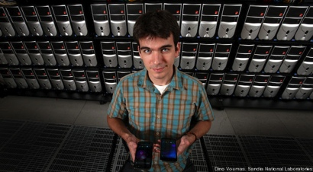
Smart Phone Virtualization: on Servers/PCs
Bluestacks (Demo)
MegaDroid
Off-the-shelf PCs emulates a town of 300,000 Android phones
Emulate cellular and GPS behavior
Usage:
Tracing the wider effects of natural disasters
Hacking attempts
Software bugs
Assist real phone (e.g. offload computation, virus check)
Video: http://www.engadget.com/2012/10/03/sandia-labs-megadroid-project-simulates-300-000-android-phones/

Slide 16
Outline
Announcements
Review of Previous Lecture
Virtualization
Android Virtualization on X86 Servers (TODO)
Android Virtualization on Mobile Device
Running iOS apps on Android Device
ARM/KVM Virtualization
Storage

Slide 17
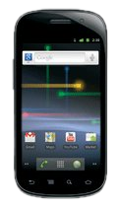
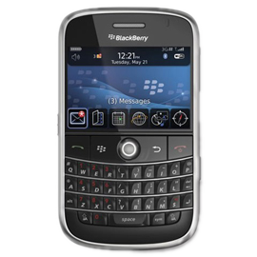
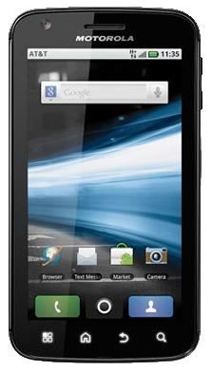
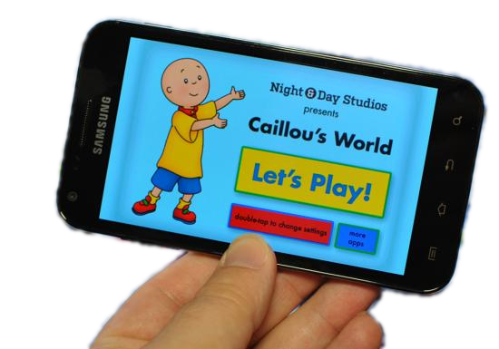
Personal Phone
Business Phone
Developer Phone
Children’s Phone
Courtesy: Jason Nieh et al.

Slide 18
Virtualization
Courtesy: Jason Nieh et al.

Slide 19
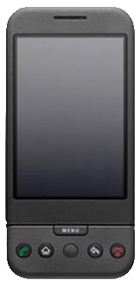
Server Virtualization
Bare-Metal Hypervisor
poor device support / sharing
OS
Kernel
OS
Kernel
OS
Kernel
Hypervisor / VMM
Hardware
Courtesy: Jason Nieh et al.

Slide 20
Desktop Virtualization
Hosted Hypervisor
poor device
performance
host user space
OS
OS
OS
Hypervisor / VMM
kernel
module
emulated
devices
Host OS Kernel
Hardware
Courtesy: Jason Nieh et al.

Slide 21
Non-Virtualization
User Space SDK
no standard apps
less secure
custom user space API for isolated apps
OS Kernel
Hardware
Courtesy: Jason Nieh et al.

Slide 22
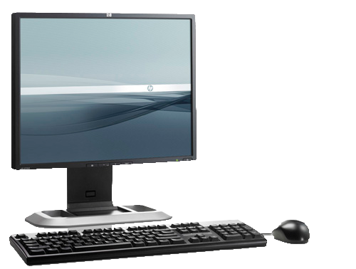
Key Challenges
device diversity
mobile usage model
graphics-accelerated UI
microphone
headset
Power
Touchscreen
Buttons
GPS
Cell Radio
WiFi
GPU
Framebuffer
h.264 accel.
pmem
Binder IPC
Compass
camera(s)
speakers
Accelerometer
RTC / Alarms
Courtesy: Jason Nieh et al.

Slide 23
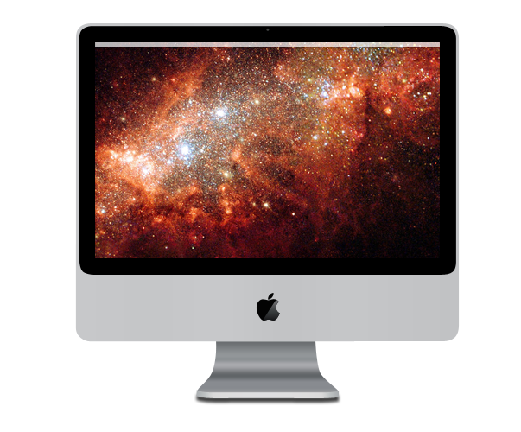
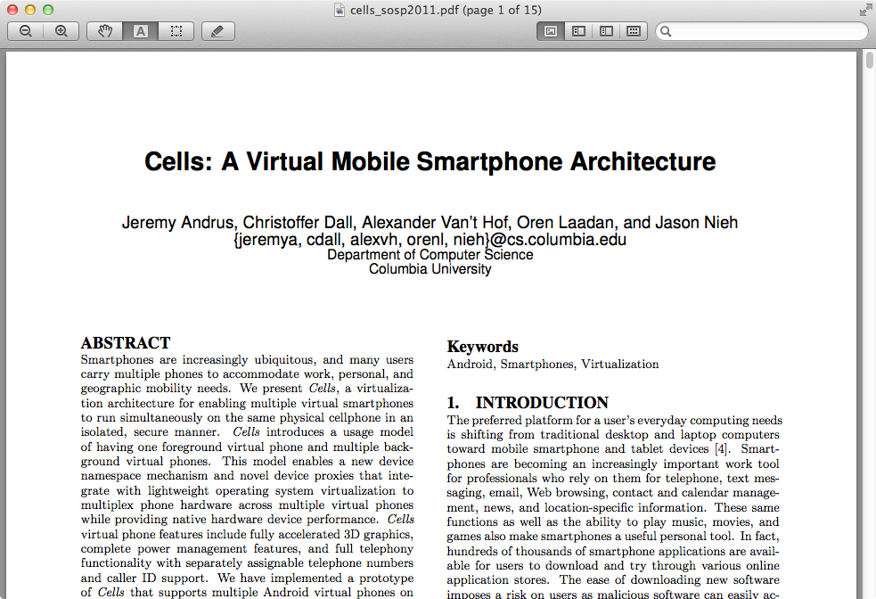
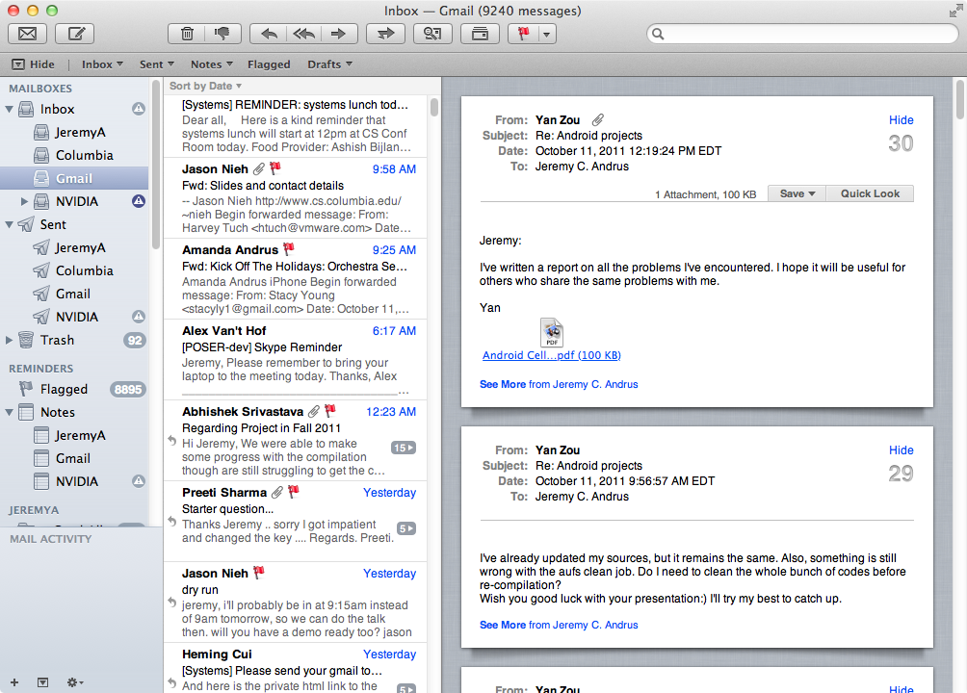
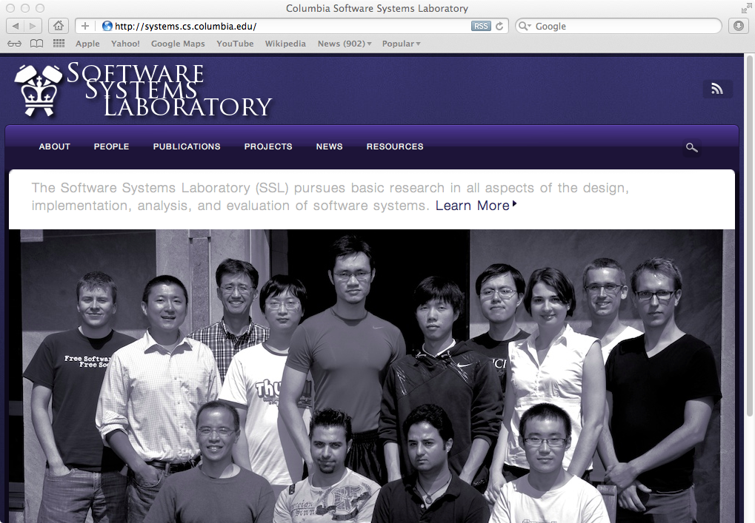
microphone
Cells
Key Observation
small:
one app at a time
large: lots of windows/apps
Courtesy: Jason Nieh et al.

Slide 24
microphone
Cells
Key Observation
screen real-estate is limited, and mobile phone users are accustomed to interacting with one thing at time
Courtesy: Jason Nieh et al.

Slide 25
microphone
Cells
Usage Model
foreground
/ background
Courtesy: Jason Nieh et al.

Slide 26
microphone
Cells
Complete Virtualization
multiple, isolated virtual phones (VPs) on a single mobile device
100% device support in each VP
unique phone numbers - single SIM!
accelerated 3D graphics!
Courtesy: Jason Nieh et al.

Slide 27
microphone
Cells
Efficient Virtualization
less than 2% overhead in runtime tests
imperceptible switch time among VPs
Courtesy: Jason Nieh et al.

Slide 28
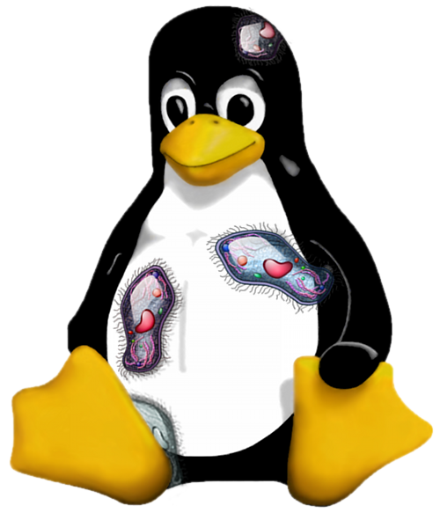
Single Kernel: Multiple VPs
VP 1
VP 2
VP 3
isolated collection
of processes
•••
virtualize at OS interface
Linux
Kernel
Courtesy: Jason Nieh et al.

Slide 29
Single Kernel: Device Support
VP 1
VP 2
VP 3
Power
Touchscreen
microphone
headset
•••
WiFi
Buttons
GPS
Cell Radio
hw codec
pmem
GPU
Framebuffer
camera(s)
speakers
Binder IPC
Compass
Accelerometer
RTC / Alarms
Linux
Kernel
Courtesy: Jason Nieh et al.

Slide 30
Single Kernel: Device Support
VP 1
VP 2
VP 3
all VPs access the same device simultaneously
•••
Linux
Kernel
Input
GPU
Sensors
Android...
Power
Audio/Video
WiFi
Framebuffer
RTC / Alarms
Cell Radio
•••
Courtesy: Jason Nieh et al.

Slide 31
Device Namespaces
VP 1
VP 2
VP 3
safely, correctly multiplex access to devices
•••
Linux
Kernel
device namespaces
GPU
Power
Input
Sensors
Android...
Audio/Video
WiFi
Framebuffer
RTC / Alarms
Cell Radio
•••
Courtesy: Jason Nieh et al.

Slide 32
Cells
device namespaces
+
foreground
/ background
=
Complete, Efficient, Transparent
Mobile Virtualization
Courtesy: Jason Nieh et al.

Slide 33
efficient basic graphics virtualization
hardware accelerated graphics
proprietary/closed interface
Linux
Kernel
device namespaces
GPU
Power
Input
Sensors
Android...
Audio/Video
WiFi
Framebuffer
RTC / Alarms
Cell Radio
Cell Radio
GPU
•••
Framebuffer
Courtesy: Jason Nieh et al.

Slide 34
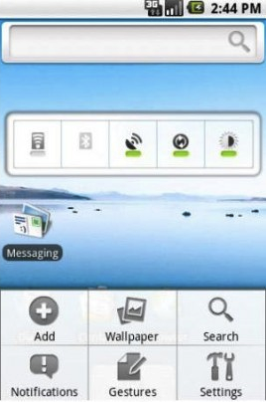
Approach 1: Single Assignment
virtual addresses
physical addresses
screen memory
Framebuffer
Courtesy: Jason Nieh et al.

Slide 35
Approach 2: Emulated Hardware
emulated framebuffer
screen memory
virtual state
Framebuffer
Courtesy: Jason Nieh et al.

Slide 36
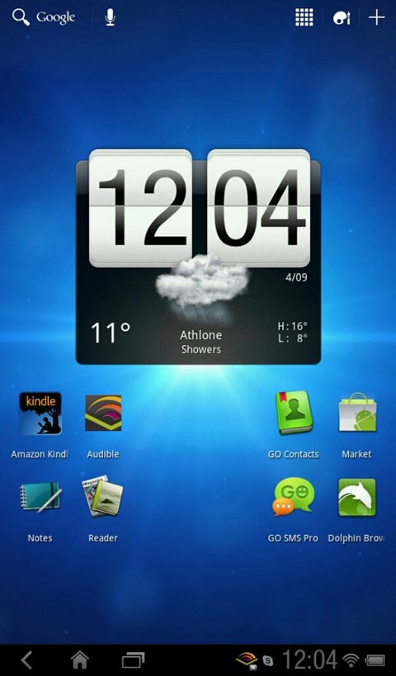
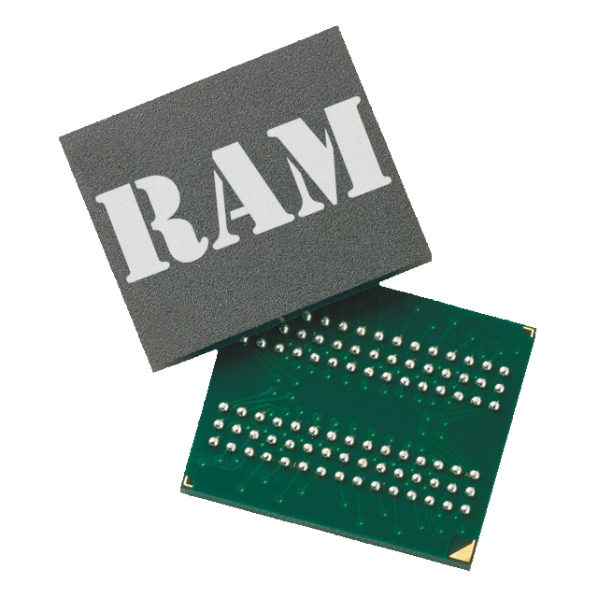
Cells: Device Namespaces
VP 1
VP 2
VP 3
mux_fb presents
identical device
interface to all VPs
using device namespaces
foreground
background
background
swap virt addr mappings:
point to different phys addr
virtual addresses
mux_fb
physical addresses
screen memory
Framebuffer
Courtesy: Jason Nieh et al.

Slide 37
Accelerated Graphics
VP 1
VP 2
VP 3
VP: just a set
of processes!
OpenGL
OpenGL
OpenGL
context
context
context
screen memory
process isolation
Framebuffer
MMU
graphics virtual addresses
physical addresses
GPU
Courtesy: Jason Nieh et al.

Slide 38
Device Namespace + Graphics Context
VP 1
VP 2
VP 3
foreground
background
background
OpenGL
OpenGL
OpenGL
context
context
context
screen memory
graphics virtual addresses
MMU
GPU
physical addresses
Courtesy: Jason Nieh et al.

Slide 39
VoIP?
RilD
Vendor RIL
VoIP
VoIP
Drivers
Linux
Kernel
Baseband: GSM / CDMA
Courtesy: Jason Nieh et al.

Slide 40
Dual-SIM?
RilD
RilD
Vendor RIL
Vendor RIL
Drivers
Drivers
Linux
Kernel
GSM/CDMA
GSM / CDMA
Courtesy: Jason Nieh et al.

Slide 41
Cells: User-Level Namespace Proxy
VP 1
VP 2
VP 3
foreground
background
background
RilD
RilD
RilD
vendor API
proprietary hardware/software requires a well-defined interface.
Vendor RIL
Cells RIL
Cells RIL
Cells RIL
CellD
Drivers
Linux
Kernel
Root Namespace
Baseband: GSM / CDMA
Courtesy: Jason Nieh et al.

Slide 42
Experimental Results
Setup
Nexus S
five virtual phones
overhead vs. stock 〈Android 2.3〉
Courtesy: Jason Nieh et al.

Slide 43
Experimental Results
Setup
CPU 〈Linpack〉
graphics 〈Neocore〉
storage 〈Quadrant〉
web browsing 〈Sun Spider〉
networking 〈Custom WiFi Test〉
Courtesy: Jason Nieh et al.

Slide 44
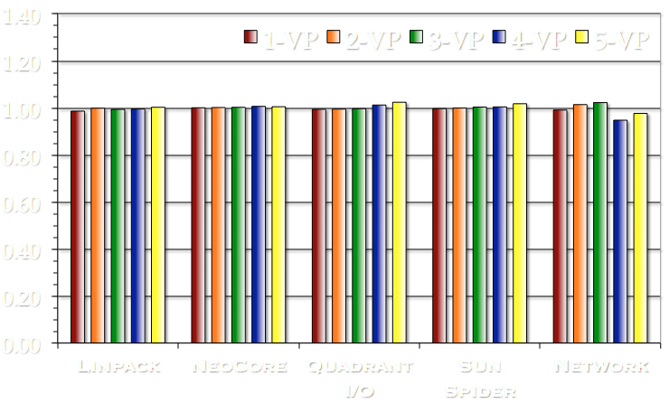
Experimental Results
Runtime Overhead
Negligible Overhead In 3D Measurements!
Courtesy: Jason Nieh et al.

Slide 45
Cells
Complete, Efficient, Transparent
Mobile Virtualization
device namespaces
safely and efficiently share devices
foreground / background
designed specifically for mobile devices
implemented on Android
less than 2% overhead on Nexus S
Courtesy: Jason Nieh et al.

Slide 46
More Info
cells.cs.columbia.edu
cellrox.com
Courtesy: Jason Nieh et al.

Slide 47
Outline
Announcements
Review of Previous Lecture
Virtualization
Android Virtualization on X86 Servers (TODO)
Android Virtualization on Mobile Device
Running iOS apps on Android Device
ARM/KVM Virtualization
Storage

Slide 48
Overview of iOS and Android
Android framework
SystemServer: starts Launcher, home screen app
SurfaceFlinger: the rendering engine using GPU to compose graphics surfaces
iOS framework
launchd: boot system, start/stop services and apps
Configd: sys config daemon
Notifyd: async notification server
Mediaserverd: audio/video server
SpringBoard: displays iOS home screen, handles and routes user input to apps, use GPU to compose app display surfaces to screen
iOS built on XNU kernel:
BSD socket and VFS subsystem
VMM and IPC from Mach

Slide 49
System Integration
iOS app on Cider needs access to iOS libraries and user-level Mach IPC
Copy binaries from iOS and run on Android
launchd, configd, notifyd, core framework libraries
CiderPress proxy is a standard Android app
Launch and execute iOS app with Android’s Launcher and system services

Slide 50
Cider Architecture
Interaction between app and OS is defined by kernel app binary interface (ABI)
ABI includes: binary loader, async signal delivery, and syscall
Mach-O binary loader built into Linux kernel
Kernel tags current thread with iOS persona
Persona is an execution mode (exec foreign or domestic code) assigned to each thread
Translation layer for async signal (illegal instruction, segmentation fault) delivery
Multiple syscall interface
Wrapper mapping arguments from XNU structures to Linux ones

Slide 51
Duct Tape
Mach IPC missing in Linux
Duct tape to the rescue
Direct compilation of unmodified foreign kernel source code into domestic kernel
Direct translates foreign Kernel API such as sync, memory allocation, processing control into domestic kernel API
Duct tape has three steps:
Create three distinct coding zones: foreign, domestic, duct tape
No cross access between foreign and domestic
Cross access between foreign (domestic) and duct tape
Identify foreign symbols conflicting with domestic code
Remap conflicting symbols to unique domestic ones
Duct tape advantages: easy to maintain and reusable

Slide 52
Duct Tape (Cont’d)
Cider uses duct tape to add three subsystems
pthread: differ from Linux, use kernel-level support for mutexes, semaphores and condition variables
Mach IPC: direct compilation; rewrite recursive queuing structures
Apple’s I/O Kit device driver framework
Source code at: http://www.opensource.apple.com/source/xnu/xnu-2050.18.24/iokit/

Slide 53
Diplomatic Functions
Mobile apps often use closed proprietary hardware and software stacks
OpenGL ES libraries directly communicate with GPU through proprietary software and hardware interfaces using device-specific ioctls (Android) or opaque IPC messages (iOS)
How to direct access to proprietary hardware?
Diplomatic function temporarily switches the persona of a calling thread to exec domestic functions from within foreign app

Slide 54
iOS Subsystems on Android: Input
SpringBoard
Communicates with iOS input system
Determines which app receives input
Send input events to app via Mach IPC
Cider creates a new thread (eventpump) in each iOS app
Listens for events from CiderPress app on a BSD socket
Pumps events into iOS app via Mach IPC
SpringBoard
iOS App
Events: touch, button, etc
Input
Mach IPC

Slide 55
iOS Subsystems on Android: Graphics
Open GL ES called into proprietary closed source
Closed source use opaque Mach IPC to closed source kernel driver
Cider:
Interposes diplomatic functions on key IOSurface (zero-copy abstraction for graphics memory) API that called into Android graphics memory allocation libraries
Replaces entire iOS OpenGL ES libraries with diplomats
WebKit, UIKit, Core Anim.
OpenGL ES
IOSurface
Kernel
Mach IPC
Closed Source
Driver
GPU

Slide 56
Cider Screen Shot

Slide 57
Summary
Cider is first system that can run unmodified iOS apps on non-Apple devices
Cider has two novel mechanisms: duct tape and diplomatic functions

Slide 58
Outline
Announcements
Review of Previous Lecture
Virtualization
Android Virtualization on X86 Servers (TODO)
Android Virtualization on Mobile Device
Running iOS apps on Android Device
ARM/KVM Virtualization
Storage

Slide 59
KVM/ARM
Motivation
ARM based on micro-servers and upward push of ARM CPUs into traditional server systems
X86 hypervisor designs not directly amenable to ARM due to different virtualization support

Slide 60
Background on ARM Virtualization Extension
TrustZone (security ext):
Does not support trap-and-emulate
Not useful for virtualization
ARM CPU powers up in secure world
Bootloader transitions to non-secure world early
Secure world only used for special cases such as digital rights management
ARMv7, v8-A have a new Hyp mode
Hyp model has trap-and-emulate
Traps into Hyp mode on various sensitive instructions and hardware interupts
ARM allows many traps to be configured which reduces virtualization overhead
Virtual interrupts trap to kernel mode

Slide 61
ARM vs X86
X86: root and non-root orthogonal to user, kernel modes
Both root and non-root supports user and kernel modes
Trap can happen from non-root to root
Intel has hardware support: a single instruction to save and restore when switching to and from root mode
X86 has not virtual interrupts or timers

Slide 62
Memory Virtualization
Nested page tables
Virtual address first translated into guest physical address
Finally translated into home physical address
VTTBR: virtualization translation table base register
TTBR: translation table base register

Slide 63
KVM/ARM
Running KVM/ARM entirely in Hyp mode is problematic
Low-level architecture dependent code is written for kernel mode; would not run in Hyp mode unmodified
Adversely impact native performance
Hyp mode has no direct access to user address space

Slide 64
KVM/ARM (Cont’d)
Highvisor: leverages existing Linux functionalities such as scheduler
Lowvisor: take advantage of the hardware virtualization support available in Hyp mode
Memory mapped interface is used to share data between highvisor and lowvisor

Slide 65
Summary
First full system virtualization solution
Runs unmodified guest OS on ARM multicore hardware
Split-mode virtualization
Leverages ARM virtualization support
Leverages Linux kernel mechanisms
KVM/ARM has minimal performance impact and virtualization overhead
Integrated KVM/ARM into mainline Linux kernel

Slide 66
Outline
Announcements
Review of Previous Lecture
Virtualization
Android Virtualization on X86 Servers (TODO)
Android Virtualization on Mobile Device
Running iOS apps on Android Device
ARM/KVM Virtualization
Storage

Slide 67
WebBench: Sequential versus Random I/O
I/O Breakdown
Vendor | Seq:Rand perf ratio | Rand IOPS
Transcend | 4 | 302
Sandisk | 8 | 179
RiData | 395 | 5
Kingston | 490 | 2.6
Wintec | 1500 | 2.6
A-Data | 1080 | 2.6
Patriot | 1050 | 2.6
PNY | 1530 | 2.6
Few reads, mostly at the start; significantly more writes
About 2X more sequential writes than random writes
Since rand is worse than seq by >> 2X, random dominates
Apps write enough randomly to cause severe performance drop
Courtesy: Nitin Agrawal et al.

Slide 68
How Apps Use Storage?
Exactly what makes web browsing slow on Android?
Key lies in understanding how apps use SQLite and FS interface
/data/data/com.necla.webview
WebBench Storage Schema
lib (empty)
cache
These files written to FS in write-behind
webviewCache
6aaa3f00, 03051d8d, …
many files (5.5MB)
databases
These files written to SQLite in sync
webview.db (14KB)
webviewCache.db (129KB)
Apps typically store some data in FS (e.g., cache files) and some in a SQLite database (e.g., cache map)
All data through SQLite is written synchronously → slow!
Apps often use SQLite oblivious to performance effects
Courtesy: Nitin Agrawal et al.

Slide 69
What-If Analysis for Solutions
A. Web Cache in RAM
B. DB (SQLite) in RAM
C. All in RAM
D. All on SD w/ no-sync
What is the potential for improvements?
E.g., if all data could be kept in RAM?
Analysis to answer hypothetical questions
Placing Cache on Ramdisk does not improve perf. much
WebBench on RiData
DB on Ramdisk alone improves perf. significantly
Both Cache and DB on SD without sync recoups most perf
Both Cache and DB in RAM → no extra benefit
A
B
C
D
Courtesy: Nitin Agrawal et al.

Slide 70
Implications of Experimental Analysis
Storage stack affects mobile application performance
Depends on random v/s sequential I/O performance
Key bottleneck is ``wimpy’’ storage on mobile devices
Performance can be much worse than laptops, desktops
Storage on mobile being used for desktop-like workloads
Android exacerbates poor storage performance through synchronous SQLite interface
Apps use SQLite for functionality, not always needing reliability
SQLite write traffic is quite random → further slowdown!
Apps use Android interfaces oblivious to performance
Browser writes cache map to SQLite; slows cache writes a lot
Courtesy: Nitin Agrawal et al.

Slide 71
Questions?

