Slide 1
Cellular Networks and Mobile Computing COMS 6998-7, Spring 2014
Instructor: Li Erran Li (lierranli@cs.columbia.edu)
http://www.cs.columbia.edu/~lierranli/coms6998-7Spring2014/
2/10/2014: Introduction to Android

Slide 2
Review from Last Lecture
How does Objective-C manage memory allocation?
What is class categories and extensions?
What is a protocol?
Is the association of an object and its methods done in compile time or runtime?
What is the programming model?

Slide 3
Review from Last Lecture (Cont’d)
How does Objective-C manage memory allocation?
Automatic Reference Counting (ARC)
Compiler adds retain/release/autorelease for you
No GC overhead
No delayed de-allocation
No garbage collector
No heap scans
No whole app pauses
No non-deterministic releases

Slide 4
Review from Last Lecture (Cont’d)
ARC problems: strong reference cycles in object reference graph
@interface LinkedListNode: NSObject {
LinkedListNode *parent;
LinkedListNode *child;
NSString *value;
}
@property (strong) LinkedListNode *parent;
@property (strong) LinkedListNode *child;
@property (strong) NSString *value;
@end
@interface LinkedListNode : NSObject {
LinkedListNode __weak
*parent;
LinkedListNode *child;
NSString *value;
}
@property (weak) LinkedListNode *parent;
@property (strong) LinkedListNode *child;
@property (strong) NSString *value;
@end

Slide 5
Review from Last Lecture (Cont’d)
What is class categories and extensions?
Categories allows new methods to be added to existing class without using subclass
Class extensions are like anonymous categories
What is a protocol?
protocols declare methods that are independent of any specific class
Protocols declare methods that can be implemented by any class.
Protocols are useful in at least three situations:
To declare methods that others are expected to implement
To declare the interface to an object while concealing its class
To capture similarities among classes that are not hierarchically related (pseudo multi-inheritance)

Slide 6
Review from Last Lecture (Cont’d)
Is the association of an object and its methods done in compile time or runtime?
Object and methods are input parameters to dynamic dispatcher: objc_msgSend(id Self, SEL op, …) and the dynamic dispatcher performs a lookup at runtime.
What is the programming model?
Model-View-Controller (MVC)
What are the communication mechanisms between controller and view?
Outlet, Target-Action, Delegate, Data Source
How does the model notify the controller?
Key Value Observing (KVO)

Slide 7
Collection Object Types
NSMutableArray: any objects of type id can be stored in the same array
Similar to NSDictionary, NSSet
A variable of type id can be any class

Slide 8
Objective-C Pointers
Objective-C does not permit a variable to contain the contents of objects, only a pointer to an object

Slide 9
No Class Variable and Mixing with C++
Objective-C does not support class variables
Class variables can be emulated
If mixing with C++, use .mm file extension
@interface myClass: NSObject
+(int) myval;//class method
@end
@implementation myClass
static int myval = 200;
+(int)myval {
return myval;
}
@end
Usage:
if([myClass myval]>100)
…

Slide 10
Creating Singletons
Sole instances of classes
UIApplication and UIDevice classes uses singletons
Let you access information about the currently running application and the device hardware
@interface MyClass: NSObject
+( MyClass *) sharedInstance;
@end
@@implementation MyClass
static MyClass __strong *sharedInstance = nil;
+( MyClass *) sharedInstance {
if(!sharedInstance)
sharedInstance = [[self alloc] init];
return sharedInstance;
}
// Class behavior defined here
@end

Slide 11
Outline
Android OS Overview
Android Development Process
Eclipse and Android SDK Demo
Application Framework
Activity, content provider, broadcast receiver, intent
Android App Framework Demo
Networking
Google Cloud Messaging (GCM)

Slide 12
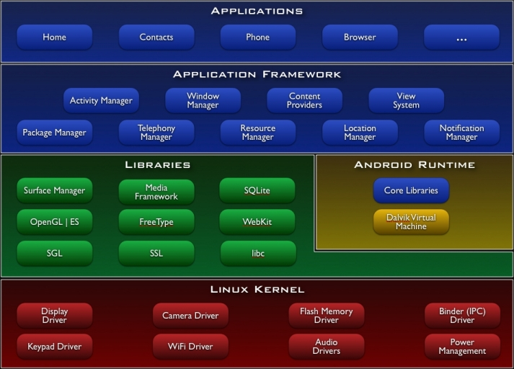
Android Architecture
Cocoa Touch
(storyboard,
UIViewController)
Media
Core Services
(SQLite,
Core Location)
Core OS
Analogy to iOS

Slide 13
Android Development Process
Setup develop environment (SDK, Eclipse)
SDK: compiler, debugger, device emulator
Multiplatform support: Windows, Mac, Linux
Java programming: has its own Java Virtual Machine and special byte code
Create app
Android project containing java files and resource files
Test app
Pack project into debuggable *.apk
Install, run and debug on emulator or device
Publish app in Android market
Get rich!

Slide 14
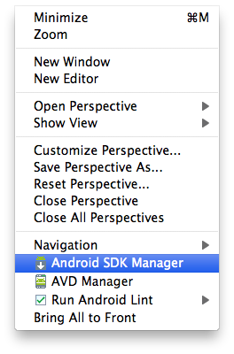
Setup SDK with Eclipse
Download and install
Java Development Kit (JDK)
Eclipse
Install and configure Android SDK plugin in Eclipse
Install Android Development Tools (ADT) plugin
Follow instructions on http://developer.android.com/sdk/installing/installing-adt.html
Eclipse will prompt you to specify Android SDK directory
Use Android SDK manager to install specific versions of Android
Notes:
Class: defines the grouping of data and code, the “type” of an object
Instance: a specific allocation of a class
Method: a “function” that an object knows how to perform
Selector: a message and arguments that will (at some point) trigger the execution of a method
• Design Patterns
Instance Variable (or “ivar”): a specific piece of data belonging to an object
Static typing means that the legality of a member function invocation is checked at the earliest possible moment: by the compiler at compile time. The compiler uses the static type of the pointer to determine whether the member function invocation is legal. If the type of the pointer can handle the member function, certainly the pointed-to object can handle it as well. E.g., if Vehicle has a certain member function, certainly Car also has that member function since Car is a kind-of Vehicle.
Dynamic binding means that the address of the code in a member function invocation is determined at the last possible moment: based on the dynamic type of the object at run time. It is called "dynamic binding" because the binding to the code that actually gets called is accomplished dynamically (at run time). Dynamic binding is a result of virtual functions.

Slide 15
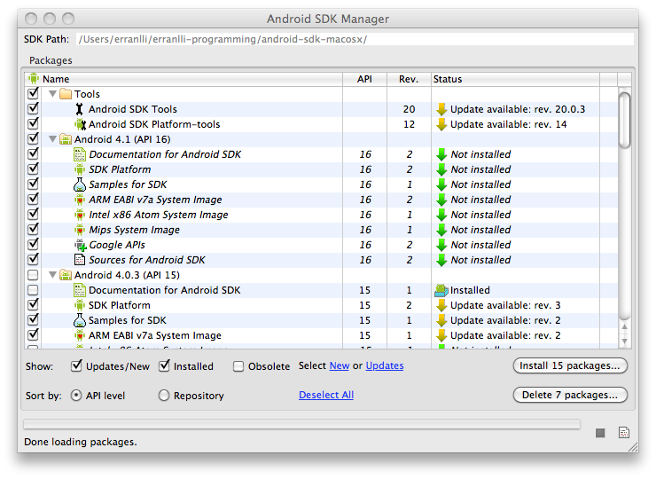
Android SDK Manager

Slide 16
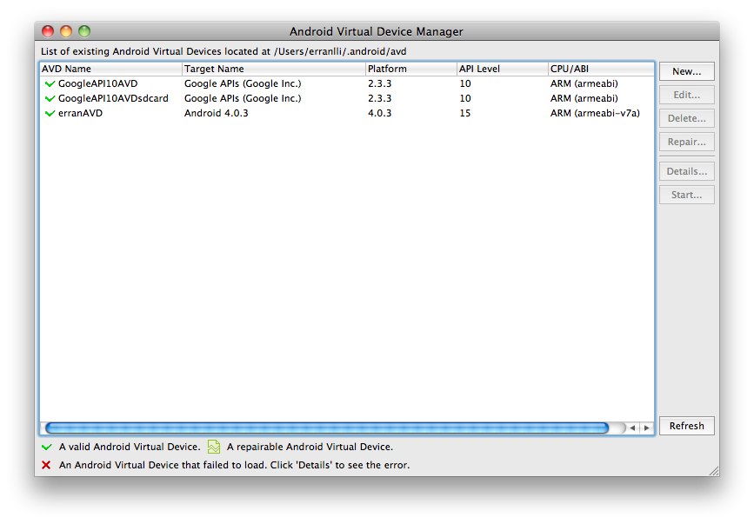
Option 1: Use an Emulator
Create an Android Virtual Device (AVD)
Lets you specify the configuration of a device to be emulated by the Android Emulator
Create AVD in Eclipse by selecting Window>AVD Manager

Slide 17
Option 2: Use a Device
Install drivers for device
Connect device to a computer via USB cable
Make sure turned on USB debugging on device (Settings -> Application -> Development -> USB debugging)
Device will be recognized within Eclipse (DDMS view)

Slide 18
Android Application Framework
Runs in its own virtual machine & process
Isolation among apps
Is composed of basic components
App components can be activated when any of its components needs to be executed
Notes:
Android Asset Packaging Tool (aapt)

Slide 19
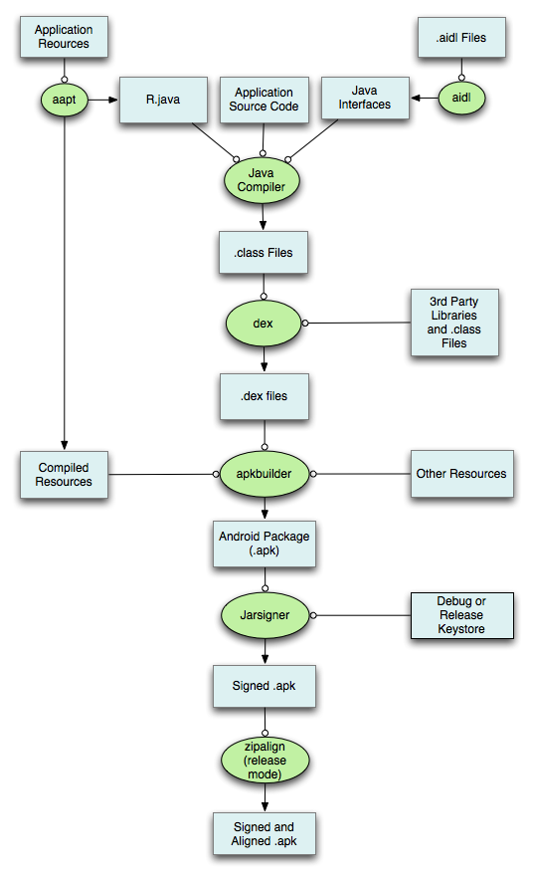
Android Application Framework (Cont’d)

Slide 20
Inter-Process Communications (IPC)
Inter-process communication is designed to promote the development of complex applications, by allowing developers to reuse existing data and services from other applications.
One may also use IPC for intra-app communications (e.g., between Activities of the same app)

Slide 21
IPC Use Cases
One component of Android sends messages to another component of Android
An IPC message in Android is called Intent
Component
Component

Slide 22
Intent Data Structure
Primary pieces of info in an Intent
Action: The general action to be performed
ACTION_VIEW, ACTION_DIAL, ACTION_EDIT, …
Your own definition of strings
Data: a URI
tel:123
content://contacts/people/1
http://www.cs.columbia.edu/~lierranli/coms6998-7Spring2014
Other attributes
Category
Type (MIME type)
Component (class name)
Extras (key-value store)

Slide 23
Android App Components
Basic Components | Description
Activity | Deals with UI aspects. Typically corresponds to a single screen
Service | Background tasks (e.g. play music in background while user is web surfing) that typically have no UI
BroadCastReceiver | Can receive messages (e.g. “low battery”) from system/apps and act upon them
ContentProvider | Provide an interface to app data. Lets apps share data with each other.

Slide 24
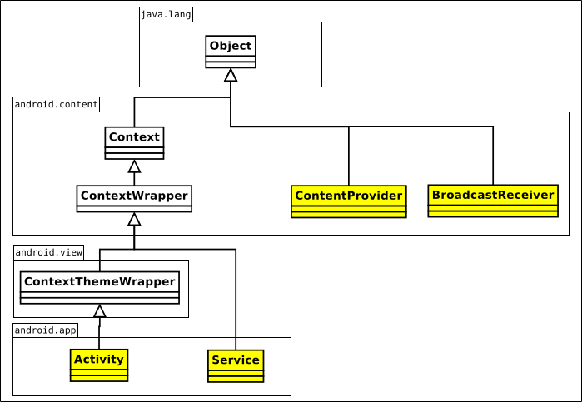
Android Application Component: Class View

Slide 25
Activity
UI portion of an app
One activity typically corresponds to a single screen of an app
Conceptually laid out as a stack
Activity on top of stack visible in foreground
Background activities are stopped but state is retained
Back button resumes previous Activity in stack
HOME button moves app and its activity in background

Slide 26
Activity Example
MainActivity.java
public class MainActivity extends Activity {
@Override
public void onCreate(Bundle savedInstanceState) {
// savedInstanceState holds any data that may have been saved
// for the activity before it got killed by the system (e.g.
// to save memory) the last time
super.onCreate(savedInstanceState);
setContentView(R.layout.main);
}
AndroidManifest.xml
<manifest xmlns:android="http://schemas.android.com/apk/res/android” package="com.example.hellotest” >
<application
android:label="@string/app_name” >
<activity
android:name=".MainActivity” >
<intent-filter>
<action android:name="android.intent.action.MAIN" />
<category android:name="android.intent.category.LAUNCHER" />
</intent-filter>
</activity>
</application>
</manifest>

Slide 27
Intent Filter
Problem: how to know what an Activity/Service can handle?
Solution: Activities/Services/Receivers declare what they can/want to receive in Intent filter
action
category
data

Slide 28
Intent Filter: Example
AndroidManifest.xml file for com.android.browser
<intent-filter> <action android:name="android.intent.action.VIEW" /> <category android:name="android.intent.category.DEFAULT" /> <scheme android:name="http" /> <scheme android:name="https" /> <scheme android:name="file" /> </intent-filter>
String action = "android.intent.action.VIEW";
Uri data = Uri.parse("http://www.google.com");
Intent myIntent = new Intent(action, data);
startActivity(myIntent);

Slide 29
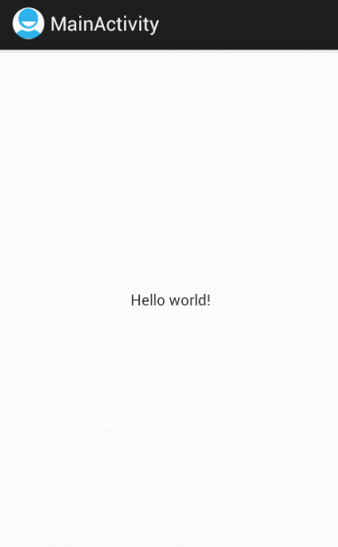
Views
Views are building blocks of UI; Two types of views:
Leaf: TextView, EditText, Button, Form, TimePicker,ListView
Composite (ViewGroup): LinearLayout, Relativelayout, …
Main.xml
<?xml version="1.0" encoding="utf-8"?>
<LinearLayout xmlns:android="http://schemas.android.com/apk/res/android"
android:layout_width="fill_parent"
android:layout_height="fill_parent"
android:orientation="vertical" >
<TextView
android:layout_width="fill_parent"
android:layout_height="wrap_content"
android:text="@string/hello_world" />
</LinearLayout>
MainActivity.java
public class MainActivity extends Activity {
@Override
public void onCreate(Bundle savedInstanceState) {
// savedInstanceState holds any data that may have been saved
// for the activity before it got killed by the system (e.g.
// to save memory) the last time
super.onCreate(savedInstanceState);
setContentView(R.layout.main);
}

Slide 30
Access View Defined by XML
main.xml
<?xml version=”1.0” encoding=”utf-8”?>
<LinearLayout xmlns:android=”http://schemas.android.com/apk/res/android”
android:orientation=”vertical”
android:layout_width=”fill_parent”
android:layout_height=”fill_parent”>
<TextView
android:id=”@+id/myTextView”
android:layout_width=”fill_parent”
android:layout_height=”wrap_content”
android:text=”Hello World, HelloWorld”
/>
</LinearLayout>
@Override
public void onCreate(Bundle icicle) {
super.onCreate(icicle);
setContentView(R.layout.main);
}
…
TextView myTextView = (TextView)findViewById(R.id.myTextView);

Slide 31
Views (Cont’d)
Views can also be created programmatically
MainActivity.java
public class MainActivity extends Activity {
@Override
public void onCreate(Bundle savedInstanceState) {
// savedInstanceState holds any data that may have been saved
// for the activity before it got killed by the system (e.g.
// to save memory) the last time
super.onCreate(savedInstanceState);
//setContentView(R.layout.main);
TextView tv = new TextView(this);
tv.setText("Hello, Android");
setContentView(tv);
}

Slide 32
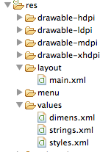
Layouts
Controls how Views are laid out: LinearLayout, TableLayout, RelativeLayout
Main.xml
<?xml version="1.0" encoding="utf-8"?>
<LinearLayout xmlns:android="http://schemas.android.com/apk/res/android"
android:layout_width="fill_parent"
android:layout_height="fill_parent"
android:orientation="vertical" >
<TextView
android:layout_width="fill_parent"
android:layout_height="wrap_content"
android:text="@string/hello_world" />
</LinearLayout>
MainActivity.java
public class MainActivity extends Activity {
@Override
public void onCreate(Bundle savedInstanceState) {
// savedInstanceState holds any data that may have been saved
// for the activity before it got killed by the system (e.g.
// to save memory) the last time
super.onCreate(savedInstanceState);
setContentView(R.layout.main);
}

Slide 33
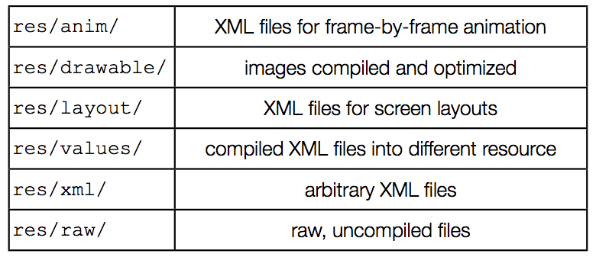
Resources
Reference included content via R.java

Slide 34
Services
Faceless components that typically run in the background
Music player, network download, etc
Services can be started in two ways
A component can start the service by calling startService()
A component can call bindService() to create the service
Service started using startService() remains running until explicitly killed
Service started using bindService() runs as long as the component that created it is still “bound” to it.
The Android system can force-stop a service when memory is low
However “foreground” services are almost never killed
If the system kills a service, it will restart the service as soon as resource is available

Slide 35
Services Example
BackgroundSoundServie.java
public class BackgroundSoundService extends Service {
MediaPlayer player;
public void onCreate() {
super.onCreate();
player = MediaPlayer.create(this, R.raw.waltz);
player.setLooping(false);
player.setVolume(100,100);
}
public int onStartCommand(Intent intent, int flags, int startId) {
player.start();
return 1;
}
}
AndroidManifest.xml
<service
android:enabled="true" android:name=".BackgroundSoundService" />
MainActivity.java
public class MainActivity extends Activity {
@Override
public void onCreate(Bundle savedInstanceState) {
…
Intent svc=new Intent(this, BackgroundSoundService.class);
startService(svc);
}
}

Slide 36
Broadcast Receivers
Components designed to respond to broadcast messages (called Intents)
Can receive broadcast messages from the system. For example when:
A new phone call comes in
There is a change in the battery level or cell ID
Can receive messages broadcast by apps
Apps can also define new broadcast messages

Slide 37
Broadcast Receivers Example
Listen to phone state changes
AndroidManifest.xml
<uses-permission android:name="android.permission.READ_PHONE_STATE" >
<receiver android:name="MyPhoneReceiver" >
<intent-filter>
<action android:name="android.intent.action.PHONE_STATE" >
</action>
</intent-filter>
</receiver>
public class MyPhoneReceiver extends BroadcastReceiver {
public void onReceive(Context context, Intent intent) {
Bundle extras = intent.getExtras();
if (extras != null) {
String state = extras.getString(TelephonyManager.EXTRA_STATE);
if (state.equals(TelephonyManager.EXTRA_STATE_RINGING)) {
String phoneNumber = extras.getString(TelephonyManager.EXTRA_INCOMING_NUMBER);
Toast.makeText(context, "Incoming number: "+phoneNumber,
Toast.LENGTH_LONG).show();
}
}
}
}

Slide 38
Content Providers
Enable sharing of data across apps
Address book, photo gallery, etc.
Provides uniform APIs for
Query, delete, update, and insert rows
Content is represented by URI and MIME type
API: extends ContentProvider implement methods such as insert, delete, query, update, oncreate

Slide 39
Content Provider (Cont’d)
Each content provider exposes a public URI that uniquely identifies its data set:
android.provider.Contacts.Phones.CONTENT_URI android.provider.Contacts.Photos.CONTENT_URI android.provider.CallLog.Calls.CONTENT_URI android.provider.Calendar.CONTENT_URI
A content consumer declares access requirement
<uses-permission android:name="android.permission.READ_CONTACTS"/>

Slide 40
Content Providers Example
AndroidManifest.xml
<uses-permission android:name="android.permission.READ_CONTACTS"/>
MainActivity.java
public class MainActivity extends Activity {
@Override
public void onCreate(Bundle savedInstanceState) {
…
Cursor people = getContentResolver().query(ContactsContract.Contacts.
CONTENT_URI, null, null, null, null);
while(people.moveToNext()) {
int nameFieldColumnIndex = people.getColumnIndex (PhoneLookup.DISPLAY_NAME);
String contact = people.getString(nameFieldColumnIndex);
contactView.append("Name: ");
contactView.append(contact);
contactView.append("\n");
}
people.close();
}
}

Slide 41
Event Handler and Responsiveness
Event handler blocks events in the msg queue from being processed => slow running handler leads to no UI response
UI events
system events
UI (main) thread
message
Looper
message
message
http://developer.android.com/guide/practices/responsiveness.html

Slide 42
Responsiveness: Numbers
Nexus One:
~5-25 ms – uncached flash reading a byte
~5-200+(!) ms – uncached flash writing tiny amount
100-200 ms – human perception of slow action

Slide 43
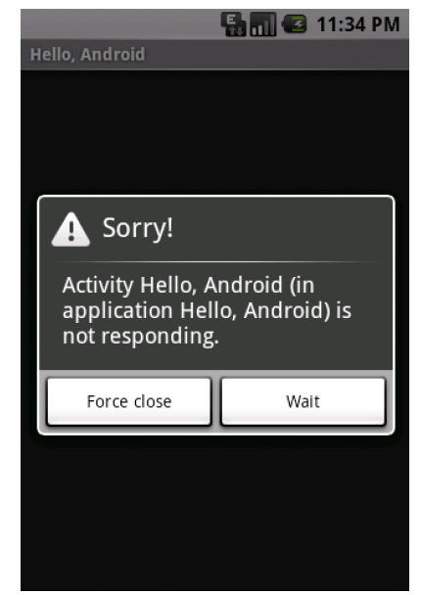
Event Handler and Android Not Responding
Android system detects no response
Main thread (“event”/UI) does not respond to input in 5 sec

Slide 44
Networking
Net APIs
Standard java networking APIs
Two Http clients: HttpURLConnection and Apache Http client

Slide 45
Telephony APIs (android.telephony)
Send and receive SMS
Get mobile network info (network type, operator,…)
Get current value of network parameters (cellID, signal strength, SNR, roaming state …)
Monitor state changes (cellID, call state, connectivity …)
Get current device state (connected, idle, active)
Get device paramesters (IMSI, IMEI, device type)

Slide 46
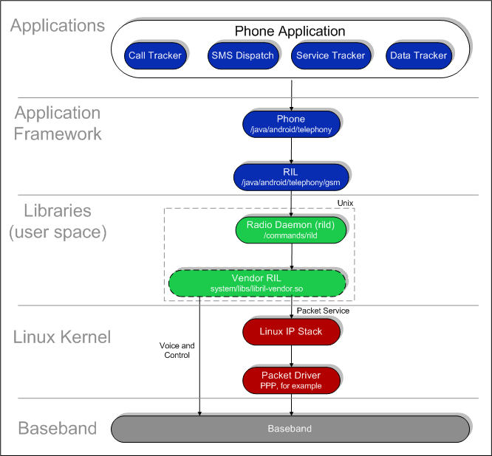
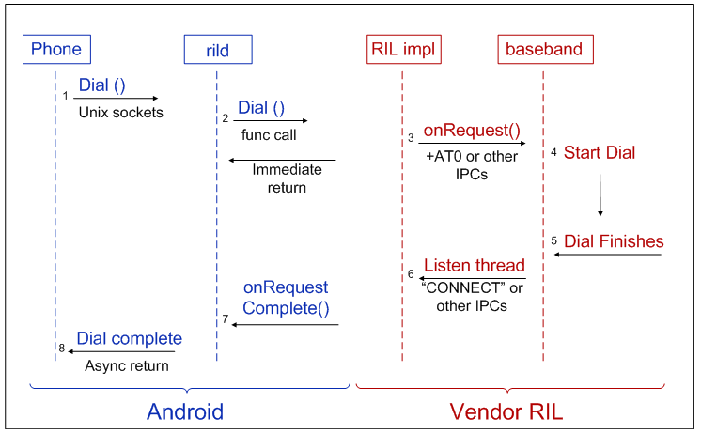
Android Telephony Deep Dive

Slide 47
Google Cloud Messaging (GCM)
Various mechanisms to keep an app in synch with changes in the server (e.g. twitter, facebook)
Polling: app periodically polls the servers for changes
Push: servers push changes to app
Polling can be inefficient if server data changes infrequently
Unnecessary battery drain and network overhead (signaling and data)
Several apps polling independently without coordination can also be inefficient
High battery drain and radio signaling every time the devices moves from IDLE to CONNECTED state

Slide 48
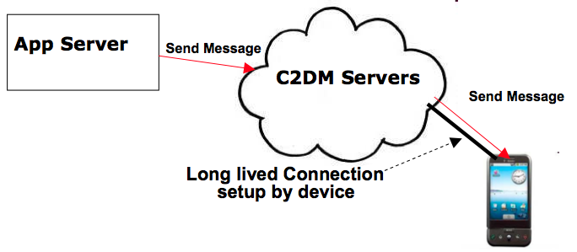
Google Cloud Messaging (Cont’d)
GCM Servers
Push notification problems
Network firewalls prevent servers from directly sending messages to mobile devices
GCM solution
Maintain a connection between device and Google GCM server
Push server updates to apps on the device via this connection
Optimize this connection to minimize bandwidth and battery consumption (e.g. adjusting the frequency of keep alive messages)

Slide 49
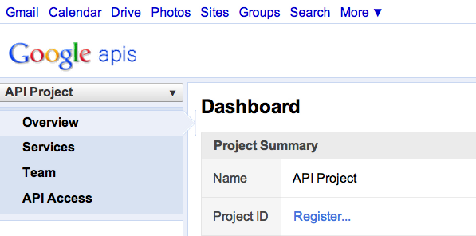
Google Cloud Messaging (Cont’d)
C2DM is deprecated, accepts no new users
Step 1
Create a Google API project from Google APIs console pagehttps://code.google.com/apis/console/#project:908058729336
Enable GCM service
Obtain an API key
Create new server key
Install helper libraries

Slide 50
Google Cloud Messaging (Cont’d)
Step 2
Write the Android app
Copy gcm.jar file into your app classpath
Configure manifest file for SDK version, permission
Add broadcast receiver
Add intent service
Write my_app_package.GCMIntentService class
Write main activity
import com.google.android.gcm.GCMRegistrar;
…
GCMRegistrar.checkDevice(this);
GCMRegistrar.checkManifest(this);
final String regId = GCMRegistrar.getRegistrationId(this);
if (regId.equals("")) {
GCMRegistrar.register(this, SENDER_ID);
} else {
Log.v(TAG, "Already registered");
}

Slide 51
Google Cloud Messaging (Cont’d)
Step 3
Write server-side app
Copy gcm-server.jar file from the SDK’s gcm-server/dist directory to your server class path
Create a servlet that can be used to receive client’s GCM registration ID
Create a servlet to unregister registration ID
Use com.google.android.gcm.server.Sender helper class from GCM library to send a message to client
import com.google.android.gcm.server.*;
Sender sender = new Sender(myApiKey);
Message message = new Message.Builder().build();
MulticastResult result = sender.send(message, devices, 5);

Slide 52
Online Resources
Android API: http://developer.android.com/reference/packages.html
Basics http://developer.android.com/guide/components/index.html
GCM: http://developer.android.com/guide/google/gcm/index.html

Slide 53
Questions?

