Slide 1
Cellular Networks and Mobile Computing
COMS 6998-7, Spring 2014
Instructor: Li Erran Li (lierranli@cs.columbia.edu)
http://www.cs.columbia.edu/~lierranli/coms6998-7Spring2014/
2/3/2014 Introduction to iOS & Objective-C

Slide 2
Review from Last Lecture
What is the relationship between Objective-C and ANSI C?
What are the four layers of iOS?
What is the difference between #include, #import, @import?
Why use property instead of variable?
Does Objective-C use named arguments?
What is the root class?

Slide 3
Review from Last Lecture (Cont’d)
What are the four layers of iOS?
  Core OS, Core Services, Media, Cocoa Touch
What is the relationship between Objective-C and ANSI C?
  Strict superset
What is the difference between #include, #import, @import?
  #import: include once
  @import: compile once

Slide 4
Review from Last Lecture (Cont’d)
Why use property instead of variable?
  Encapsulation, dot notation, memory management
Does Objective-C use named arguments?
  No, argument order matters in Objective-C
Why is the root class?
  NSObject

Slide 5
Collection Object Types
NSMutableArray: any objects of type id can be stored in the same array
  Similar to NSDictionary, NSSet
A variable of type id can be any class

Slide 6
Objective-C Pointers
Objective-C does not permit a variable to contain the contents of objects, only a pointer to an object

Slide 7
No Class Variable and Mixing with C++
Objective-C does not support class variables
Class variables can be emulated
If mixing with C++, use .mm file extension
@interface myClass: NSObject
+(int) myval;//class method
@end
@implementation myClass
static int myval = 200;
+(int)myval {
return myval;
}
@end
Usage:
if([myClass myval]>100)
…

Slide 8
Creating Singletons
Sole instances of classes
  UIApplication and UIDevice classes uses singletons
  Let you access information about the currently running application and the device hardware
@interface MyClass: NSObject
+( MyClass *) sharedInstance;
@end
@@implementation MyClass
static MyClass __strong *sharedInstance = nil;
+( MyClass *) sharedInstance {
if(!sharedInstance)
sharedInstance = [[self alloc] init];
return sharedInstance;
}
// Class behavior defined here
@end

Slide 9
Outline
iOS Overview
Objective-C
Model-View-Controller
Demo
Networking
iCloud

Slide 10
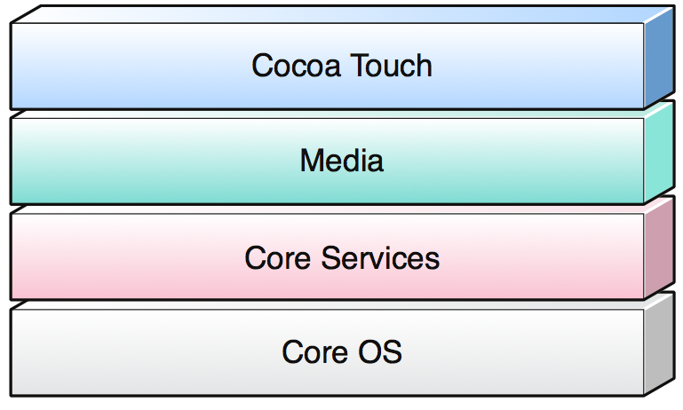
iOS Architecture
Implemented as a number of layers
Lower layers provide fundamental services and technologies
Higher layers provide more sophisticated services
  Builds upon the functionality provided by the lower layers
  Provides object-oriented abstractions for lower layer constructs
Each layer has a number of frameworks (packages of system interfaces)
  Each framework contains dynamically shared libraries and associated resources (header files, images, etc)
  When a framework is used, they need to be linked into the project
    Standard frameworks such as Foundation and UIKit are linked by default, when a template project is started

Slide 11
iOS Overview: CoreOS
System Framework (based on Mach)
  Threading (POSIX)
  Networking (BSD sockets)
  File system
  Service discovery (Bonjour & DNS)
  Memory management
  Math computations
Core Bluetooth Framework and External Accessory Framework
  Support for communicating with hardware accessories
Accelerate Framework
  DSP, linear algebra and image processing optimized for hardware
Security Framework
  Crypto library and keychain Services (secure storage of passwords, keys, for one or more users)

Slide 12
iOS Overview: Core Services
High level features
  iCloud storage (iOS5)
  Automatic reference counting (iOS5)
  SQLite: lightweight SQL database
  Grand Central Dispatch (GCD): manage concurrent execution of tasks
    Thread management code moved to the system level
    Tasks specified are added to an appropriate dispatch queue
  Block objects: a C-level language construct; an anonymous function and the data (a closure or lambda)
  In-App purchase: process financial transactions from iTune account
  XML support
Notes:
Bonjour is Apple’s proposal for zero-configuration networking over IP. Bonjour comes out of the work of the ZEROCONF Working Group, part of the Internet Engineering Task Force (IETF). The ZEROCONF Working Group’s requirements and proposed solutions for zero-configuration networking over IP essentially cover three areas:
addressing (allocating IP addresses to hosts)
naming (using names to refer to hosts instead of IP addresses)
service discovery (finding services on the network automatically)
Bonjour has a zero-configuration solution for all three of these areas, as described in the following four sections.
Bonjour allows service providers, hardware manufacturers, and application programmers to support a single network protocol—IP—while breaking new ground in ease of use.
Network users no longer have to assign IP addresses, assign host names, or even type in names to access services on the network. Users simply ask to see what network services are available, and choose from the list.
In many ways, this kind of browsing is even more powerful for applications than for users. Applications can automatically detect services they need or other applications they can interact with, allowing automatic connection, communication, and data exchange, without requiring user intervention.

Slide 13
iOS Overview: Core Services (Cont’d)
CFNetwork Framework
  Object-oriented abstractions for working with network protocols (DNS, http, Bonjour services)
Core Telephony Framework
System Configuration Framework
  Determine network configuration
Social Framework
  Post status updates and images to social networks
Foundation Framework: objective-C wrapper
Address Book Framework
Core Data Framework
Core Foundation Framework
Core Media Framework: C interface for media
Core Location Framework
Newsstand Kit Framework
Store Kit Framework: in app purchase
Notes:
Bonjour is Apple’s proposal for zero-configuration networking over IP. Bonjour comes out of the work of the ZEROCONF Working Group, part of the Internet Engineering Task Force (IETF). The ZEROCONF Working Group’s requirements and proposed solutions for zero-configuration networking over IP essentially cover three areas:
addressing (allocating IP addresses to hosts)
naming (using names to refer to hosts instead of IP addresses)
service discovery (finding services on the network automatically)
Bonjour has a zero-configuration solution for all three of these areas, as described in the following four sections.
Bonjour allows service providers, hardware manufacturers, and application programmers to support a single network protocol—IP—while breaking new ground in ease of use.
Network users no longer have to assign IP addresses, assign host names, or even type in names to access services on the network. Users simply ask to see what network services are available, and choose from the list.
In many ways, this kind of browsing is even more powerful for applications than for users. Applications can automatically detect services they need or other applications they can interact with, allowing automatic connection, communication, and data exchange, without requiring user intervention.

Slide 14
iOS Overview: Media
Graphics
  Core graphics framework
  Core animation framework
  Core image framework
  OpenGL ES and GLKit framework
  Core text framework
Audio/video
  Meida player framework: access to iTunes
  OpenAL framework: positional audio playback
  Core audio framework: Airplay, recording audio
  Core video framework: buffer support for core media framework
  AV Foundation framework (Objective-C interface): playback, recording, Airplay
  Asset Library Framework: retrieving photos and videos from user’s device
Notes:
Bonjour is Apple’s proposal for zero-configuration networking over IP. Bonjour comes out of the work of the ZEROCONF Working Group, part of the Internet Engineering Task Force (IETF). The ZEROCONF Working Group’s requirements and proposed solutions for zero-configuration networking over IP essentially cover three areas:
addressing (allocating IP addresses to hosts)
naming (using names to refer to hosts instead of IP addresses)
service discovery (finding services on the network automatically)
Bonjour has a zero-configuration solution for all three of these areas, as described in the following four sections.
Bonjour allows service providers, hardware manufacturers, and application programmers to support a single network protocol—IP—while breaking new ground in ease of use.
Network users no longer have to assign IP addresses, assign host names, or even type in names to access services on the network. Users simply ask to see what network services are available, and choose from the list.
In many ways, this kind of browsing is even more powerful for applications than for users. Applications can automatically detect services they need or other applications they can interact with, allowing automatic connection, communication, and data exchange, without requiring user intervention.

Slide 15
iOS Overview: Cocoa Touch
UI Kit Framework
  Apple push notification service
  Storyboards: supplant nib files as the recommended way to design your application’s user interface
  Document Support: UIDocument class for managing the data associated with user documents
  Multitasking
  Printing: support allows applications to send content wirelessly to nearby printers
  Local push notification
  Gesture recognizers
  Accelerometer data, built-in camera, battery state information, proximity sensor information
Notes:
Bonjour is Apple’s proposal for zero-configuration networking over IP. Bonjour comes out of the work of the ZEROCONF Working Group, part of the Internet Engineering Task Force (IETF). The ZEROCONF Working Group’s requirements and proposed solutions for zero-configuration networking over IP essentially cover three areas:
addressing (allocating IP addresses to hosts)
naming (using names to refer to hosts instead of IP addresses)
service discovery (finding services on the network automatically)
Bonjour has a zero-configuration solution for all three of these areas, as described in the following four sections.
Bonjour allows service providers, hardware manufacturers, and application programmers to support a single network protocol—IP—while breaking new ground in ease of use.
Network users no longer have to assign IP addresses, assign host names, or even type in names to access services on the network. Users simply ask to see what network services are available, and choose from the list.
In many ways, this kind of browsing is even more powerful for applications than for users. Applications can automatically detect services they need or other applications they can interact with, allowing automatic connection, communication, and data exchange, without requiring user intervention.

Slide 16
iOS Overview: Cocoa Touch (Cont’d)
Game Kit Framework
  Peer-to-peer services: over Bluetooth, e.g. multi-player games
Address Book UI Framework: contact management
iAd Framework: deliver banner-based advertisements from your application
Map Kit Framework: a scrollable map interface
Message UI Framework: support for composing and queuing email messages in the user’s outbox
Notes:
Bonjour is Apple’s proposal for zero-configuration networking over IP. Bonjour comes out of the work of the ZEROCONF Working Group, part of the Internet Engineering Task Force (IETF). The ZEROCONF Working Group’s requirements and proposed solutions for zero-configuration networking over IP essentially cover three areas:
addressing (allocating IP addresses to hosts)
naming (using names to refer to hosts instead of IP addresses)
service discovery (finding services on the network automatically)
Bonjour has a zero-configuration solution for all three of these areas, as described in the following four sections.
Bonjour allows service providers, hardware manufacturers, and application programmers to support a single network protocol—IP—while breaking new ground in ease of use.
Network users no longer have to assign IP addresses, assign host names, or even type in names to access services on the network. Users simply ask to see what network services are available, and choose from the list.
In many ways, this kind of browsing is even more powerful for applications than for users. Applications can automatically detect services they need or other applications they can interact with, allowing automatic connection, communication, and data exchange, without requiring user intervention.

Slide 17
Outline
iOS Overview
Objective-C
Model-View-Controller
Demo
Networking
iCloud

Slide 18
Objective-C
A strict superset of ANSI C
Originally used within NeXT’s NEXTSTEP OS (precursor of Mac OS X)
Single inheritance
Dynamic runtime: everything is looked up and dispatched at run time
No garbage collection on iPhone, iTouch and iPad
New types
  id type: dynamic type to refer to any object
  Selectors: a message and arguments that will (at some point) trigger the execution of a method
Notes:
How can C++ achieve dynamic binding yet also static typing?
When you have a pointer to an object, the object may actually be of a class that is derived from the class of the pointer (e.g., a Vehicle* that is actually pointing to a Car object; this is called "polymorphism"). Thus there are two types: the (static) type of the pointer (Vehicle, in this case), and the (dynamic) type of the pointed-to object (Car, in this case).
Static typing means that the legality of a member function invocation is checked at the earliest possible moment: by the compiler at compile time. The compiler uses the static type of the pointer to determine whether the member function invocation is legal. If the type of the pointer can handle the member function, certainly the pointed-to object can handle it as well. E.g., if Vehicle has a certain member function, certainly Car also has that member function since Car is a kind-of Vehicle.
Dynamic binding means that the address of the code in a member function invocation is determined at the last possible moment: based on the dynamic type of the object at run time. It is called "dynamic binding" because the binding to the code that actually gets called is accomplished dynamically (at run time). Dynamic binding is a result of virtual functions.

Slide 19
Objective-C
Introspection
  An object (class, instance, etc) can be asked at runtime what type it is
    Can pass anonymous objects to a method, and let it determine what to do based on the object’s actual type
isKindOfClass: returns whether an object is that kind of class (inheritance included)
isMemberOfClass: returns whether an object is that kind of class (no inheritance)
respondsToSelector:returns whether an object responds to a given method
Notes:
Class: defines the grouping of data and code, the “type” of an object
Instance: a specific allocation of a class
Method: a “function” that an object knows how to perform
Selector: a message and arguments that will (at some point) trigger the execution of a method
• Design Patterns
Instance Variable (or “ivar”): a specific piece of data belonging to an object
Static typing means that the legality of a member function invocation is checked at the earliest possible moment: by the compiler at compile time. The compiler uses the static type of the pointer to determine whether the member function invocation is legal. If the type of the pointer can handle the member function, certainly the pointed-to object can handle it as well. E.g., if Vehicle has a certain member function, certainly Car also has that member function since Car is a kind-of Vehicle.
Dynamic binding means that the address of the code in a member function invocation is determined at the last possible moment: based on the dynamic type of the object at run time. It is called "dynamic binding" because the binding to the code that actually gets called is accomplished dynamically (at run time). Dynamic binding is a result of virtual functions.

Slide 20
Objective-C header file and interface
Objective-C stack.h header file
instance variables
are declared as
properties
“-” denotes instance methods
#import <Foundation/Foundation.h>
@interface Stack : NSObject
@property (nonatomic, strong) NSMutableArray *numStack;
-(void) push: (double) num;
-(double) pop;
@end
define STACKSIZE 10
Class Stack {
private:
double num[STACKSIZE+1];
int top;
public:
Stack();
void push(double x);
double pop();
};
C++ header file
Notes:
@private
The instance variable is accessible only within the class that declares it.
@protected
The instance variable is accessible within the class that declares it and within classes that inherit it. All instance variables without an explicit scope directive have @protected scope.
@public
The instance variable is accessible everywhere.
@package
Using the modern runtime, an @package instance variable has @public scope inside the executable image that implements the class, but acts like @private outside.
The @package scope for Objective-C instance variables is analogous to private_extern for C variables and functions. Any code outside the class implementation’s image that tries to use the instance variable gets a link error.
This scope is most useful for instance variables in framework classes, where @private may be too restrictive but @protected or @public too permissive.

Slide 21
Objective-C Properties
Provide access to object attributes
  Shortcut to implementing getter/setter methods
  Instead of declaring “boilerplate” code, have it generated automatically
Also allow you to specify:
  readonly versus readwrite access memory management policy
  Memory management: weak and strong
Specify @property in the header (*.h) file
Create the accessor methods by @synthesize the properties in the implementation (*.m) file

Slide 22
Objective-C Method Declaration
Each method declaration consists of:
  A name
  A return type
  An optional list of arguments (and their data or object types)
  An indicator to determine if the method is a class or instance method
-(void) setHeight:(double)h Width:(double)w;
Method type:
+ class
- instance
Argument 1 type and name
Argument 2 type and name
Method name: setHeight:Width:

Slide 23
Objective-C Implementation
#import "Stack.h"
@implementation Stack
@synthesize numStack = _numStack;
- (NSMutableArray *) numStack {
if (_numStack==nil)
_numStack = [[NSMutableArray alloc] init];
return _numStack;
}
- (void) push:(double)num {
[self.numStack addObject:[NSNumber numberWithDouble:num]];
}
- (double) pop {
NSNumber *numObject = [self.numStack lastObject];
if(numObject) [self.numStack removeLastObject];
NSLog(@"poped %@",numObject);
return [numObject doubleValue];
}
@end
Objective-C stack.m file
@synthesize creates getter and setter methods
alloc: a class method
Method syntax
self: the instance itself
dot notation to access
setter and getter method
Notes:
@private
The instance variable is accessible only within the class that declares it.
@protected
The instance variable is accessible within the class that declares it and within classes that inherit it. All instance variables without an explicit scope directive have @protected scope.
@public
The instance variable is accessible everywhere.
@package
Using the modern runtime, an @package instance variable has @public scope inside the executable image that implements the class, but acts like @private outside.
The @package scope for Objective-C instance variables is analogous to private_extern for C variables and functions. Any code outside the class implementation’s image that tries to use the instance variable gets a link error.
This scope is most useful for instance variables in framework classes, where @private may be too restrictive but @protected or @public too permissive.

Slide 24
Objective-C Message Syntax
A square brace syntax
[receiver message]
[receiver message:argument]
[receiver message:arg1 :anonymousArg2]
[receiver message:arg1 andArg:arg2]
Main argument
Subsequent named argument
Object receiving
the message
Message itself

Slide 25
C++ Implementation
#include "stack.h"
Stack::Stack()
{
index = top;
}
void Stack::push(double x)
{
if(!is_full())
num[top++] = x;
}
double Stack::pop()
{
if(!is_empty())
return num[--top];
else
return -1;
}
Method syntax
Notes:
@private
The instance variable is accessible only within the class that declares it.
@protected
The instance variable is accessible within the class that declares it and within classes that inherit it. All instance variables without an explicit scope directive have @protected scope.
@public
The instance variable is accessible everywhere.
@package
Using the modern runtime, an @package instance variable has @public scope inside the executable image that implements the class, but acts like @private outside.
The @package scope for Objective-C instance variables is analogous to private_extern for C variables and functions. Any code outside the class implementation’s image that tries to use the instance variable gets a link error.
This scope is most useful for instance variables in framework classes, where @private may be too restrictive but @protected or @public too permissive.

Slide 26
Objective-C Categories and Extensions
Categories allows new methods to be added to existing class without using subclass
  category name is listed within parentheses after the class name and the superclass isn’t mentioned
Class extensions are like anonymous categories
  @interface MyClass ()
  Methods must be implemented in the main @implementation block for the corresponding class
#import <Foundation/Foundation.h>
#import "Stack.h"
@interface Stack (emptyFull)
-(BOOL) isEmpty;
-(BOOL) isFull;
@end
#import "StackExt.h"
#define STACK_CAP 100
@implementation Stack(emptyFull)
- (BOOL) isEmpty{
return ([self.numStack count]==0);
}
- (BOOL) isFull{
return ([self.numStack count]==STACK_CAP);
}
@end
StackExt.h
StackExt.m

Slide 27
Objective-C Protocols
Class and category interfaces declare methods that are associated with a particular class
protocols declare methods that are independent of any specific class
Protocols declare methods that can be implemented by any class. Protocols are useful in at least three situations:
  To declare methods that others are expected to implement
  To declare the interface to an object while concealing its class
  To capture similarities among classes that are not hierarchically related (pseudo multi-inheritance)
@protocol FTPHostDelegate <NSObject>
@required
(void) percentDone: (NSString *)percent;
(void) downloadDone: (id) sender;
(void) uploadDone: (id) sender;
@end
@interface MergedTableController:
UIViewController <UITableViewDelegate,
UITableViewDataSource>
id <FTPHostDelegate> *ftpHost;
SEL finishedAction;
@end
@implementation MergedTableController
…
if (![receiver conformsToProtocol:
@protocol(FTPHostDelegate)])
…
@end

Slide 28
Objective-C Protocols (Cont’d)
#import <UIKit/UIKit.h>
@interface CalculatorAppDelegate : UIResponder <UIApplicationDelegate>
@property (strong, nonatomic) UIWindow *window;
@end
CalculatorAppDelegate.h
@interface UIApplication (UINewsstand)
- (void)setNewsstandIconImage:(UIImage *)image;
@end
@protocol UIApplicationDelegate<NSObject>
@optional
- (void)applicationDidFinishLaunching:(UIApplication *)application;
- (BOOL)application:(UIApplication *)application didFinishLaunchingWithOptions:(NSDictionary *)launchOptions __OSX_AVAILABLE_STARTING(__MAC_NA,__IPHONE_3_0);
(void)applicationDidBecomeActive:(UIApplication *)application;
@end
UIApplication.h

Slide 29
Objective-C: Associative References
@implementation CalculatorBrain(ArithmeticExpressionAdditions)
@dynamic arithExp;
-(NSMutableString*)arithExp { if(objc_getAssociatedObject(self,arithExpKey)==nil){
NSMutableString *str= [[NSMutableString alloc]
initWithFormat:@"%@", @"RPN arith expression: "];
objc_setAssociatedObject(self, arithExpKey, str, OBJC_ASSOCIATION_RETAIN);
}
return objc_getAssociatedObject(self, arithExpKey);
}
- (void)setArithExp:(NSString*)newExpression {
objc_setAssociatedObject(self, arithExpKey, newExpression, OBJC_ASSOCIATION_RETAIN);
}
- (void) appendOp:(NSString*)str {
[self.arithExp appendString:str];
@end
Associative references
  Simulate the addition of object instance variables to an existing class
#import "CalculatorBrain.h"
static const char* const arithExpKey = "myexpkey";
@interface CalculatorBrain(ArithmeticExpressionAdditions)
@property (nonatomic, readwrite, strong) NSMutableString* arithExp;
-(void) appendOp:(NSString*)s;
@end

Slide 30
Objective-C: Fast Enumeration
The enumeration is considerably more efficient than, for example, using NSEnumerator directly.
The syntax is concise.
Enumeration is “safe”—the enumerator has a mutation guard so that if you attempt to modify the collection during enumeration, an exception is raised
NSArray *array = [NSArray arrayWithObjects:
@"one", @"two", @"three", @"four", nil];
for (NSString *element in array) {
NSLog(@"element: %@", element);
}
NSEnumerator *enumerator = [array objectEnumerator];
NSString *next;
while ((next=[enumerator nextObject])!=nil) {
//do something
}

Slide 31
Blocks
Blocks create distinct segments of code that can be passed around to methods or functions as if they were values.
void (^simpleBlock)(void) = ^{
NSLog(@"This is a block");
};
simpleBlock();
double (^multiplyTwoValues)(double, double) =
^(double firstValue, double secondValue) {
return firstValue * secondValue;
};
double result = multiplyTwoValues(2,4);
[self beginTaskWithName:@"mytest" completion:^{
NSLog(@"My test task is done!");
}];

Slide 32
Objective-C: Foundation Framework
Root class: allocation, initialization and duplication of objects, introspection, object encoding and decoding (for archiving / serialization), message forwarding and message dispatching
  NSObject
Value objects: encapsulate values of various primitive types
  NSNumber
  NSDate
  NSString
  NSData
Collections: collections are objects that store other objects
  NSArray, NSMutableArray
  NSDictionary, NSMutableDictionary
  NSSet, NSMutableSet

Slide 33
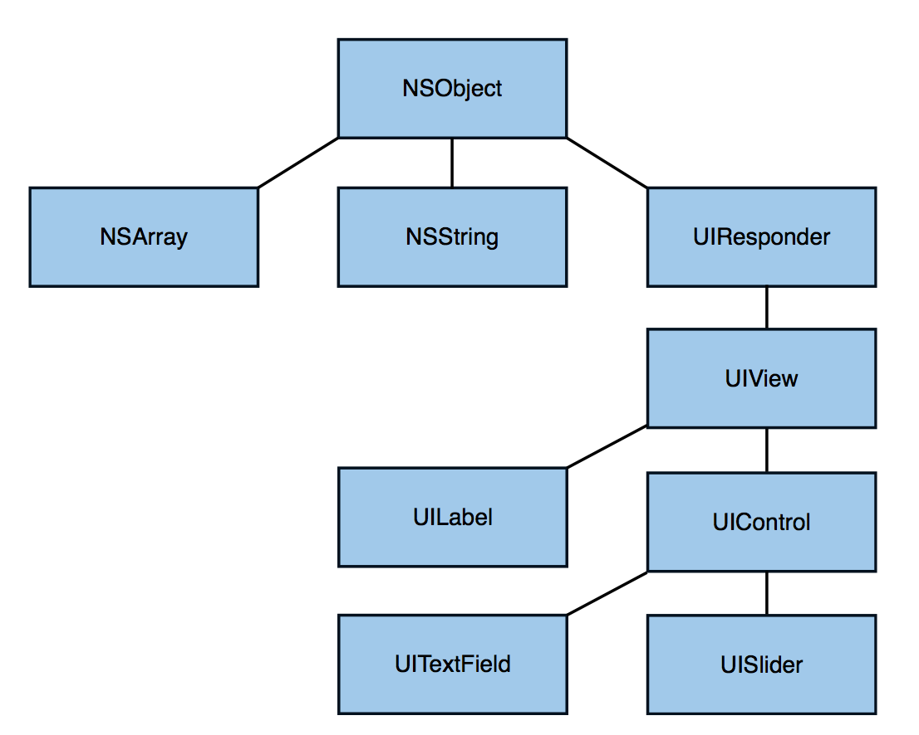
Class Hierarchy

Slide 34
Outline
iOS Overview
Objective-C
Model-View-Controller
  Outlet, Target Action, Delegate, Data Source, Notification, KVO
Demo
Networking
iCloud

Slide 35
Model View Controller (MVC)
Controller
Model
Model
Model
View
View
Divide objects in your program into 3 “camps.”

Slide 36
Model View Controller (MVC)
Controller
Model
Model
Model
View
View
Model = What your application is (but not how it is displayed)

Slide 37
Model View Controller (MVC)
Controller
Model
Model
Model
View
View
Controller = How your Model is presented to the user (UI logic)

Slide 38
Model View Controller (MVC)
Controller
Model
Model
Model
View
View
View = Your Controller’s minions

Slide 39
Model View Controller (MVC)
Controller
Model
Model
Model
View
View
Controller’s can always talk directly to their Model.

Slide 40
Model View Controller (MVC)
Controller
Outlet
Model
Model
Model
View
View
Controller’s can also talk directly to their View
. Through an outlet, an object in your code can obtain a
reference to an object defined in a nib file or storyboard.
Notes:
Through an outlet, an object in your code can obtain a reference to an object defined in a nib file or storyboard

Slide 41
Model View Controller (MVC)
Controller
Outlet
Model
Model
Model
View
View
The Model and View should never speak to each other.

Slide 42
Model View Controller (MVC)
Controller
Outlet
?
Model
Model
Model
View
View
Can the View speak to its Controller?

Slide 43
Model View Controller (MVC)
Controller
Outlet
Model
Model
Model
View
View
Sort of. Communication is “blind” and structured.

Slide 44
Model View Controller (MVC)
Target
Controller
Outlet
Model
Model
Model
View
View
The Controller can drop a target on itself.

Slide 45
Model View Controller (MVC)
Target
Controller
Outlet
Action
Model
Model
Model
View
View
Then hand out an action to the View.
Target-action design pattern: an object holds the information
necessary to send a message to another object when an event occurs.
Notes:
Target-action is a design pattern in which an object holds the information necessary to send a message to another object when an event occurs. The stored information consists of two items of data: an action selector, which identifies the method to be invoked, and a target, which is the object to receive the message. The message sent when the event occurs is called an action message.

Slide 46
Model View Controller (MVC)
Target
Controller
Outlet
Action
Model
Model
Model
View
View
The View sends the action when things happen in the UI.

Slide 47
Model View Controller (MVC)
Target
Controller
Outlet
Action
will
did
Model
Model
Model
View
View
Sometimes the View needs to synchronize with the Controller.

Slide 48
Model View Controller (MVC)
Target
will
did
Controller
Outlet
Action
Model
Model
Model
View
View
The Controller sets itself as the View’s delegate.

Slide 49
Model View Controller (MVC)
Target
will
did
Controller
Outlet
Delegate
Action
Model
Model
Model
View
View
The Controller sets itself as the View’s delegate.
The delegate is set via a protocol (i.e. it’s “blind” to class).
Notes:
Delegates are basically a way of extending the behavior of a class without needing to create subclasses. Applications in iOS often use delegates when one class calls back to another after an important action occurs.

Slide 50
Model View Controller (MVC)
Target
will
did
Controller
Outlet
Delegate
Action
Model
Model
Model
View
View
Views do not own the data they display.

Slide 51
Model View Controller (MVC)
Target
will
did
Controller
Outlet
Delegate
Action
Data
at
count
Model
Model
Model
View
View
So, if needed, they have a protocol to acquire it.

Slide 52
Model View Controller (MVC)
Target
will
did
Controller
Outlet
Data
at
count
Delegate
Action
Data source
Model
Model
Model
View
View
Controller are almost always that data source (not Model!).

Slide 53
Model View Controller (MVC)
Target
will
did
Controller
Outlet
Data
at
count
Delegate
Action
Data source
Model
Model
Model
View
View
Controllers interpret/format Model information for the View.

Slide 54
Model View Controller (MVC)
Target
will
did
Controller
Outlet
?
count
Data
at
Delegate
Action
Data source
Model
Model
Model
View
View
Can the Model talk directly to the Controller?

Slide 55
Model View Controller (MVC)
Target
will
did
Controller
Outlet
Data
at
count
Delegate
Action
Data source
Model
Model
Model
View
View
No. The Model is (should be) UI independent.

Slide 56
Model View Controller (MVC)
Target
will
did
Controller
Outlet
Data
at
count
Delegate
Action
Data source
Model
Model
Model
View
View
So what if the Model has information to update or something?

Slide 57
Model View Controller (MVC)
Target
will
did
Controller
Outlet
Notification and KVO
Data
at
count
Delegate
Action
Data source
Model
Model
Model
View
View
It uses a “radio station”-like broadcast mechanism.

Slide 58
Model View Controller (MVC)
Target
will
did
Controller
Outlet
Notification and KVO
Data
at
count
Delegate
Action
Data source
Model
Model
Model
View
View
Controllers (or other Model) “tune in” to interesting stuff.

Slide 59
Key Value Observing (KVO)
Registering an observer
[self.brain addObserver:self forKeyPath:@"arithExp" options:(NSKeyValueObservingOptionNew) context:@"myContext"];
Receiving notification of a change
(void)observeValueForKeyPath:(NSString *)keyPath
ofObject:(id)object
change:(NSDictionary *)change
context:(void *)context{
NSLog(@"%@ changed: %@", keyPath,
[change objectForKey:NSKeyValueChangeNewKey]);
}

Slide 60
Key Value Observing (KVO) (Cont’d)
Removing an object as an observer
[self.brain removeObserver:self forKeyPath:keyPath];

Slide 61
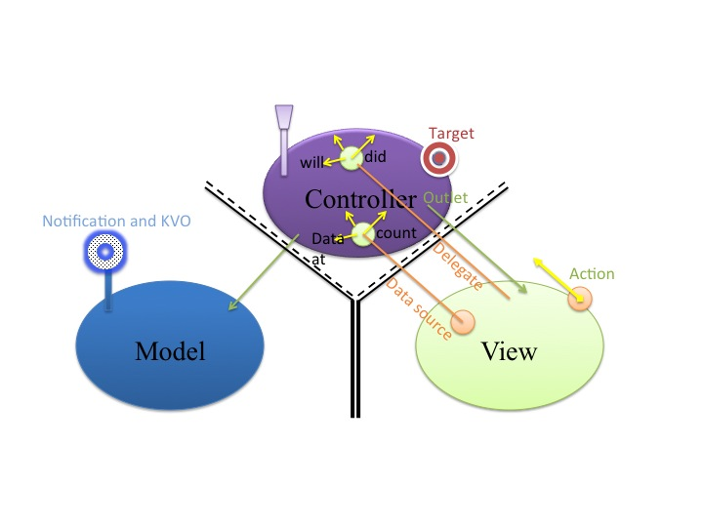
Multiple MVC

Slide 62
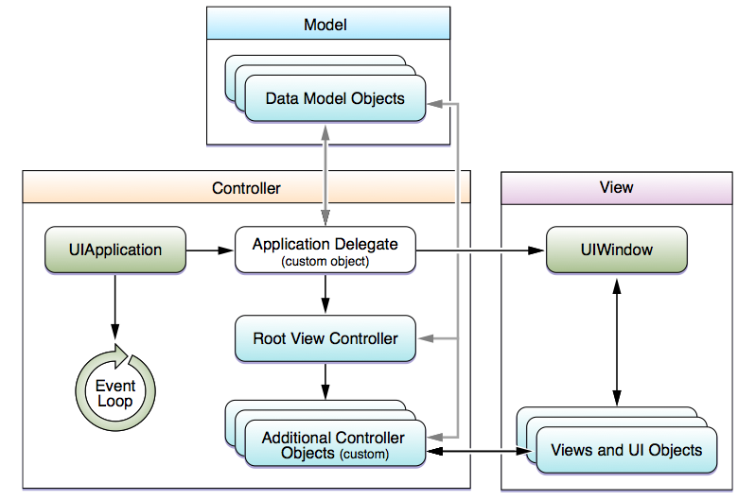
Model View Controller (MVC)
Key objects in iOS apps
UIApplication controller object:
  manages the app event loop
  coordinates other high-level app behaviors
  custom app-level logic resides in your app delegate object
AppDelegate custom object: created at app launch time, usually by the UIApplicationMain function
  handle state transitions within the app

Slide 63
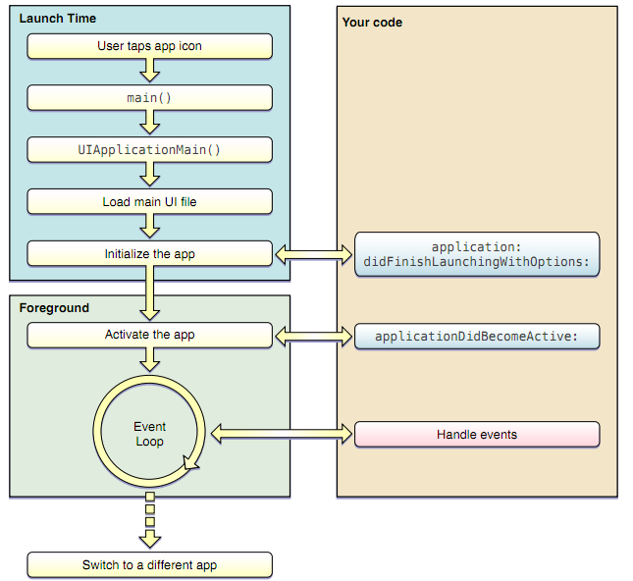
Model View Controller (MVC)
App launch cycle

Slide 64
Model View Controller (MVC)
Controller
Knows both model and view
Acts as a middleman
  When model changes, inform the view
  When data manipulated by view, update the model
Build-in iOS controllers
  UIViewController: managing apps with generic views
  UITabBarController: for tabbed applications (e.g. clock)
  UINavigationController: managing hierarchical data (e.g. email folders)
  UITableController: for lists of data etc (e.g. iTunes tracks)

Slide 65
Automatic Reference Counting
Compiler adds retain/release/autorelease for you
  No GC overhead
  No delayed deallocation
No garbage collector
  No heap scans
  No whole app pauses
  No non-deterministic releases

Slide 66
Automatic Reference Counting (Cont’d)
Problems: strong reference cycles in object reference graph
@interface LinkedListNode: NSObject {
LinkedListNode *parent;
LinkedListNode *child;
NSString *value;
}
@property (strong) LinkedListNode *parent;
@property (strong) LinkedListNode *child;
@property (strong) NSString *value;
@end
@interface LinkedListNode : NSObject {
LinkedListNode __weak
*parent;
LinkedListNode *child;
NSString *value;
}
@property (weak) LinkedListNode *parent;
@property (strong) LinkedListNode *child;
@property (strong) NSString *value;
@end

Slide 67
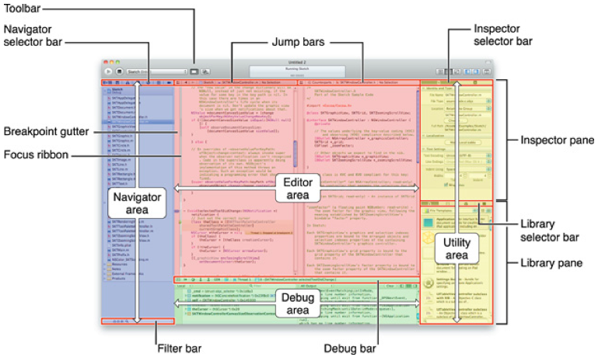
Xcode4
The latest IDE for developing MacOSX and iOS applications
  Single window, supporting multiple workspace
  Integrated Interface Builder
  Assistant Editor (split pane that loads related files, such as header files etc)
  Dynamic syntax checking and alert
  Version editor with Git or Subversion integration
  LLVM 2.0 editor with support for C, C++ and Objective-C
  LLDB debugger

Slide 68
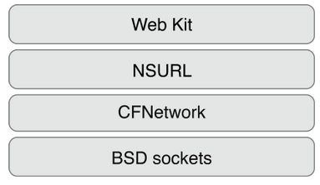
Networking
CFNetwork: Core Services framework that provides a library of abstractions for network protocols.
  Working with BSD sockets
  Creating encrypted connections using SSL or TLS
  Resolving DNS hosts
  Working with HTTP, authenticating HTTP and HTTPS servers
  Working with FTP servers
  Publishing, resolving and browsing Bonjour services: CFNetServices API provides access to Bonjour through three objects
    CFNetService represents a single service on the network
    CFNetServiceBrowser discovers domains and discover network services within domains.
    CFNetServiceMonitor monitors services for changes to their TXT records

Slide 69
Networking (Cont’d)
Core Telephony framework: obtain information about a user’s home cellular service provider
  CTCarrier object provides information about the user’s cellular service provider
  CTCall object provides information about a current call, including a unique identifier and state information—dialing, incoming, connected, or disconnected

Slide 70
iCloud
Fundamentally: nothing more than a URL of a shared directory
Two storage models
  iCloud document storage: store user documents and app data in the user’s iCloud account
  iCloud key-value data storage: share small amounts of noncritical configuration data among instances of your app
iCloud-specific entitlements required
  Select your app target in Xcode
  Select the Summary tab
  In the Entitlements section, enable the Enable Entitlements checkbox

Slide 71
iCloud (Cont’d)
Check availability: URLForUbiquityContainerIdentifier:
All files and directories stored in iCloud must be managed by a file presenter object, and all changes you make to those files and directories must occur through a file coordinator object. A file presenter is an object that adopts the NSFilePresenter protocol
Explicitly move files to iCloud
Be prepared to handle version conflicts for a file
Make use of searches to locate files in iCloud
Be prepared to handle cases where files are in iCloud but not fully downloaded to the local device; this might require providing the user with feedback
Use Core Data for storing live databases in iCloud; do not use SQLite

Slide 72
Online Resources
Client side: iOS
  Install Xcode 4: http://developer.apple.com/xcode
  Learning Objective C and iOS development :http://developer.apple.com/devcenter/ios/index.action
  Stanford iPhone development course(on iTunes):http://www.stanford.edu/class/cs193p/cgi-bin/drupal/

Slide 73
Questions?

