Slide 1
Cellular Networks and Mobile Computing
COMS 6998-10, Spring 2013
Instructor: Li Erran Li (lel2139@columbia.edu)
http://www.cs.columbia.edu/~lierranli/coms6998-7Spring2014/
Lecture 13: Mobile Privacy

Slide 2
Review of Previous Lectures
Malware characterization
  Installation
  Activation
  Malicious payloads
  Evolution
DroidRanger: Non-virtualization-based malware detection
  Behavioral footprint matching for known malware
  Dynamic execution monitoring for unknown malware
DroidScope: Virtualization-based malware detection
  Reconstruct OS, Dalvik VM and native view
Notes:
DroidRanger: Non-virtualization-based malware detection
Behavioral footprint matching for known malware
Dynamic execution monitoring for unknown malware
DroidScope: Virtualization-based malware detection
Reconstruct OS, Dalvik VM and native view

Slide 3
Review of Previous Lectures (Cont’d)
Inter application communication related attacks
  Permission re-delegation (confused deputy attacks)
  Collusion attacks
System vulnerability based attacks
  Control flow attacks (code injection attacks)
  Root exploits (e.g. adbd bug used by DroidKungfu malware)
Application specific attacks

Slide 4
Mobile Privacy
Data privacy
Detecting and preventing privacy leaks
  PiOS for iOS
  TaintDroid for Android
Limiting mobile data exposure with idle eviction [assume device prone to loss]
  CleanOS
Location privacy [after-class reading]
  Quantifying location privacy

Slide 5
PiOS:
Detecting Privacy Leaks
in iOS Applications
Manuel EGELE, Christopher KRUEGEL, Engin KIRDA, Giovanni VIGNA
{maeg,chris,vigna}@cs.ucsb.edu, ek@ccs.neu.edu
Int. Secure Systems Lab, UCSB & TU Vienna & Northeastern University
SAP Security Info Session, Wed. April 20th 2011

Slide 6
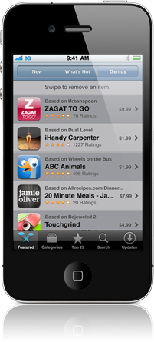
Motivation
App Store: 300k apps available, 10 billion apps downloaded
iOS apps are created by third party developers
“iPhone Developer License Agreement“
States guidelines (e.g., user's privacy)
Submitted binaries are scrutinized by Apple
through a secret vetting process
Apps passing the vetting process → App Store
Cydia: repository for jailbroken devices
Courtesy: Egele et. al

Slide 7
Motivation (cont.)
Vetting process is not flawless
”Bad apps” make it to the App Store
Apple removed several apps after they were available e.g.,
  Flashlight (enables tethering w/o the network operator's consent)
  Storm8 games harvested device phone numbers
  MogoRoad collect phone numbers of free app users
  → Telemarketers called and offered the paid full version
Courtesy: Egele et. al

Slide 8

Motivation (cont.)
How big is the problem?
PiOS
Courtesy: Egele et. al

Slide 9
Overview
Motivation
Goals & Challenges
PiOS Analysis
  Extract CFG
  Reach ability analysis
  Data Flow analysis
Evaluation
Summary
Courtesy: Egele et. al

Slide 10
Goals & Challenges
Goals
  Identify Apps that access privacy sensitive information and transmit this information over the Internet without user intervention or consent
  Perform this analysis on a large body of Apps
  Gain insight in how Apps handle privacy sensitive data
Challenges
  Apps are only available as binary executable
  App Store Apps are encrypted
Courtesy: Egele et. al

Slide 11
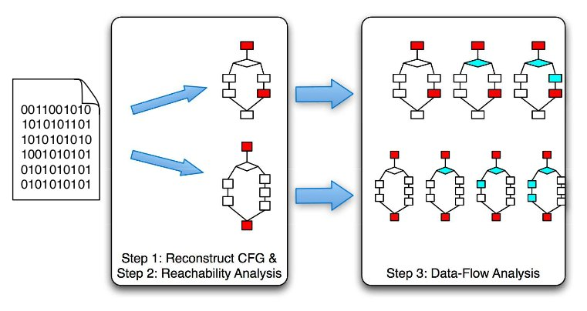
Approach
Extract control flow graph (CFG)
Identify sources of sensitive information and network communication sinks
  Perform reachability analysis between sources and sinks
Data flow analysis on detected paths
Courtesy: Egele et. al

Slide 12
Background (iOS & DRM)
App Store apps are encrypted and digitally signed by Apple
Loader verifies signature and performs decryption in memory
Decrypting App Store apps:
  Attach with debugger while app is running
  Dump decrypted memory regions
  Reassemble binary, toggle encrypted flag
Cydia Apps are not encrypted
Courtesy: Egele et. al

Slide 13
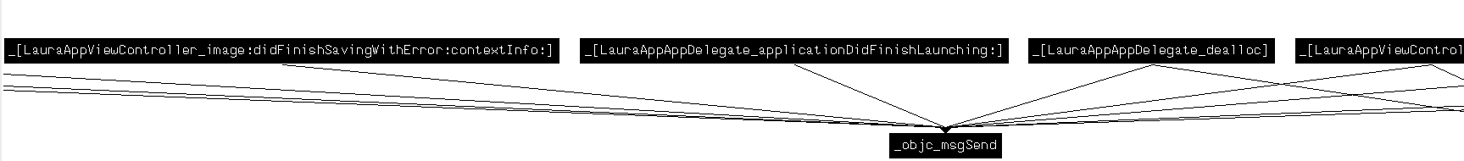
Analysis (CFG)
IDA Pro generated CFG for “Bomberman“
objc_msgSend
Courtesy: Egele et. al

Slide 14
Analysis (CFG)
Most iOS apps are written in Objective-C
Cornerstone: objc_msgSend dispatch function
Task: Resolve type of receiver and value of selector for objc_msgSend calls
  Backwards slicing
  Forward propagation of constants and types
Result: Inter and intra procedural CFG is constructed from successfully resolved objc_msgSend calls
Courtesy: Egele et. al

Slide 15
Background (objc_msgSend)
objc_msgSend dynamic dispatch function
Arguments:
  Receiver (Object)
  Selector (Name of method, string)
  Arguments (vararg)
Method look-up:
  Dynamically traverses class hierarchy
  Calls the method denoted by selector
Non-trivial to do statically
Courtesy: Egele et. al

Slide 16
Analysis (CFG)
Most iOS apps are written in Objective-C
Cornerstone: objc_msgSend dispatch function
Task: Resolve type of receiver and value of selector for objc_msgSend calls
  Backwards slicing
  Forward propagation of constants and types
Result: Inter and intra procedural CFG is constructed from successfully resolved objc_msgSend calls
Courtesy: Egele et. al

Slide 17
Example ObjC to ASM
UIDevice
1 LDR R0, =off_24C58
2 LDR R1, =off_247F4
3 LDR R0, [R0]
4 LDR R1, [R1]
5 BLX _objc_msgSend
6 LDR R1, =off_247F0
7 LDR R1, [R1]
8 BLX _objc_msgSend
…
currentDevice
r0?
r1?
UIDevice
::currentDevice
uniqueIdentifier
UIDevice
r1?
::uniqueIdentifier
9 STR R0, [SP,#0x60+var_34]
10 LDR R3, [SP,#0x60+var_34]
…
11 BLX _objc_msgSend NSString ::initWithFormat:(fmt: "uniqueid=%@&username=%@&country=%@&email=%@")
…
12 BLX _objc_msgSend POSTScore ::startPostingData:toURL: (0x1b478)
Courtesy: Egele et. al
Notes:
First alloc
Then init

Slide 18
Finding Privacy Leaks
Inter and intra procedural Control Flow Graph
Reachability Analysis (find paths)
  From interesting sources
  To network sinks
Implicit interruption of CFG for user-input (e.g., dialog boxes, etc.)
  Touch events are generated by the OS not in the developer's code
Courtesy: Egele et. al

Slide 19
Sources and Sinks
Sources:
  Address book
  GPS coordinates
  Unique device ID
  Photos
  Email account settings
  WiFi connection information
  Phone information (phone #, call lists, etc.)
  YouTube application Settings
  MobileSafari settings and history
  Keyboard Cache (every word typed w/o passwords)
Sinks:
  NSUrlConnection, NSString::initWithContentsOfURL, etc.
Courtesy: Egele et. al

Slide 20
Data Flow Analysis
For each source/sink pair perform reachability analysis
  Is there a path in the CFG that connects the source to the sink?
Along paths that result from reachability analysis
  Taint flow analysis
  Conservatively taint results of methods without implementation if at least one input parameter is tainted
Courtesy: Egele et. al

Slide 21
Evaluation
1,407 Applications (825 from App Store, 582 from Cydia)
  Resolving calls to objc_msgSend
  4,156,612 calls
  3,408,421 identified (82%)
  i.e., class and selector exist and match
Pervasive ad and statistic libraries:
  772 Apps (55%) contain at least one such library
  Leak UDIDs, GPS coordinates, etc.
Courtesy: Egele et. al

Slide 22
Ad and Statistic Libraries
82% use AdMob (Google)
Transmit UDID and AppID on start-up and ad request
Ad company can build detailed usage profiles
  Gets info from all Apps using the ad library
UDIDs cannot be linked to a person directly
Problem: Location based Apps
  Access to GPS is granted per App libraries linked into location based apps have access to GPS too
Courtesy: Egele et. al

Slide 23
Is Leaking UDIDs a Problem?
UDIDs cannot be linked to a person directly
But: Combine UDID with additional information e.g.,
  Google App can link UDID to a Google account
  Social networking app get user's profile (often name)
Linking ICC-ID with UDID is trivial
  114,000 iPad 3G users
Courtesy: Egele et. al

Slide 24
Evaluation Data Flow Analysis
Reachability analysis: 205 apps
Enumerate all paths from source to sink with length < 100 basic blocks
Perform data flow analysis along these paths
PiOS detected flows of sensitive data for 172 apps (TP)
6 true negatives, 27 false negatives
  FN e.g., aliased pointers, format string from config file, JSON library (i.e., invoking JSONRepresentation on each object in a dictionary, PiOS does not track types in aggregates)
Courtesy: Egele et. al

Slide 25
Evaluation: Leaked Data
Source | #App Store 825 | #Cydia 582 | Total 1407
DeviceID | 170 (21%) | 25(4%) | 195(14%)
Location | 35(4%) | 1(0.2%) | 36(3%)
Address book | 4(0.5%) | 1(0.2%) | 5(0.4%)
Phone number | 1(0.1%) | 0(0%) | 1(0.1%)
Safari history | 0(0%) | 1(0.2%) | 1(0.1%)
Photos | 0(0%) | 1(0.2%) | 1(0.1%)
Courtesy: Egele et. al

Slide 26
Evaluation: Case Studies (1)
Address book contents:
  Apps have unrestricted access to the address book
  Facebook and Gowalla transmit the complete AB
  Facebook: detailed warning that data will be sent
  Gowalla (Social networking app):
    User can send Invitations to contacts
    Complete AB is sent on load (i.e., before the user chooses a contact)
    → “We couldn’t find any friends from your Address Book who use Gowalla. Why don’t you invite some below?”
Courtesy: Egele et. al

Slide 27
Evaluation: Case Studies (2)
Phone number
Nov. 2009 Apple removed all Storm8 titles (social games) from App Store
  because apps transmitted phone numbers (SBFormattedPhoneNumber)
  New versions don't have that code anymore
Old version of “Vampires“ PiOS detected the privacy leak
→ Improvement over Apple vetting process
Courtesy: Egele et. al

Slide 28
Summary
PiOS is able to create a CFG from ObjC binaries
82% of the calls to objc_msgSend could be resolved
Data flow analysis is used to identify privacy leaks
PiOS showed how pervasive ad and statistics libraries are used in apps
PiOS identified unknown and known privacy leaks that lead to App Store removal in the past
Courtesy: Egele et. al

Slide 29
Detecting Privacy Leaks in Smartphone Applications at Run Time
Byung-Gon Chun
Yahoo! Research
Joint work with William Enck, Peter Gilbert,
Landon P. Cox, Jaeyeon Jung,
Patrick McDaniel, Anmol N. Sheth
Courtesy: Byung-Gon et. al

Slide 30
Roadmap
Approach
TaintDroid design
Performance study
Application study
Courtesy: Byung-Gon et. al

Slide 31
TaintDroid Goal
Monitor app behavior to determine when privacy sensitive information leaves the phone in real time
Courtesy: Byung-Gon et. al

Slide 32
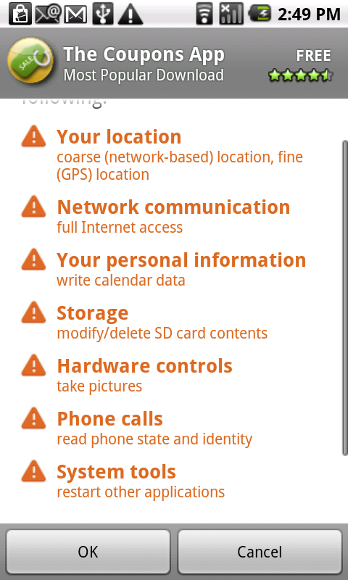
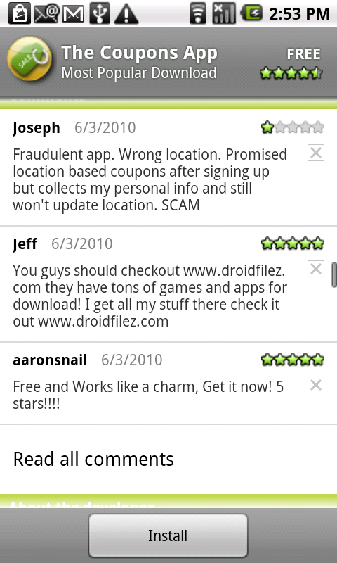
Current “Best” Practice
Trust-or-cancel
Coarse-grained access control
No visibility into the actual behavior
Courtesy: Byung-Gon et. al

Slide 33
TaintDroid Approach
Look inside of applications to watch how they use privacy sensitive data
Trust-or-cancel Trust-but-verify
Courtesy: Byung-Gon et. al

Slide 34
Challenges
Smartphones are resource constrained
Third-party applications are entrusted with several types of privacy sensitive information
Context-based privacy information is dynamic and can be difficult to identify when sent
Applications can share information
Courtesy: Byung-Gon et. al

Slide 35
Dynamic Taint Analysis
A technique that tracks information dependencies from an origin
Taint
  Source
  Propagation
  Sink
C = Taint_source()
…
A = B + C
…
Network_send(A)
Courtesy: Byung-Gon et. al

Slide 36
Dynamic Taint Analysis in Action
register
…
ret
mov al, byte ptr ds[esi]
mov byte ptr ds[edi], al
pop esi
…
…
ret
mov al, byte ptr ds[esi]
mov byte ptr ds[edi], al
pop esi
…
0
0
Expensive! 2-20x slowdown.
Whole-system tracking!
1
0
k
1
0
0
0
0
k
0
1
memory
memory
code snippet from iexplore.exe
taint map
Courtesy: Byung-Gon et. al

Slide 37
TaintDroid
Leverage Android Platform Virtualization
Message-level tracking
Application code
Application code
msg
Virtual machine
Virtual machine
Variable-level
tracking
native system libraries
Method-level
tracking
Network interface
Secondary storage
File-level
tracking
Courtesy: Byung-Gon et. al

Slide 38
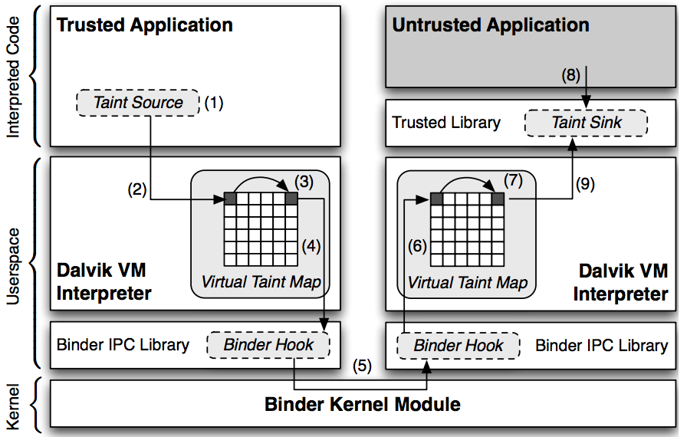
TaintDroid Android Architecture in Detail

Slide 39
VM Variable-level Tracking
Modified the Dalvik VM interpreter to store and propagate taint tags (a taint bitvector) on variables
  Local variables and method args: taint tags stored adjacent to variables on the internal execution stack.
  Class fields: similar to locals, but inside static field heap objects
  Arrays: one taint tag per array to minimize overhead
Courtesy: Byung-Gon et. al

Slide 40
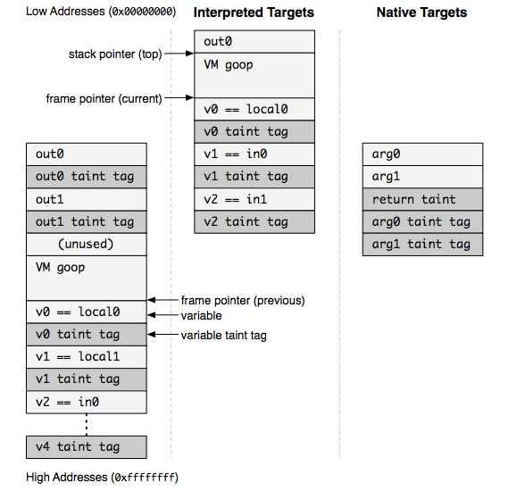
Modified Stack Format Example

Slide 41
DEX Taint Propagation Logic
Op Format | Op Semantics | Taint Propagation | Description
const-op vA C | vA ← C | T(vA) ← 0 | Clear vA taint
move-op vA vB | vA ← vB | T(vA) ← T(vB) | Set vA taint to vB taint
move-op-R vA | vA ← R | T(vA) ← T(R) | Set vA taint to return taint
return-op vA | R ← vA | T(R) ← T(vA) | Set return taint (0 if void)
move-op-E vA | vA ← E | T(vA) ← T(E) | Set vA taint to exception taint
throw-op vA | E ← vA | T(E) ← T(vA) | Set exception taint
unary-op vA vB | vA ← op vB | T(vA) ← T(vB) | Set vA taint to vB taint
binary-op vA vB vC | vA ← vB op vC | T(vA) ← T(vB)UT(vC) | Set vA taint to vB taint U vC taint
binary-op vA vB | vA ← vA op vB | T(vA) ← T(vA)UT(vB) | Set vA taint to vA taint U vB taint
binary-op vA vB C | vA ← vB op C | T(vA) ← T(vB) | Set vA taint to vB taint
aput-op vA vB vC | vB[vC] ← vA | T(vB[]) ← T(vB[]) UT(vA) | Update array vB taint with vA taint
…
binary-op vA vB vC vA ← vB op vC T(vA) ← T(vB) U T(vC)
Courtesy: Byung-Gon et. al

Slide 42
Native Methods
Applications execute native methods through the Java Native Interface (JNI)
TaintDroid uses a combination of heuristics and method profiles to patch VM tracking state
Courtesy: Byung-Gon et. al

Slide 43
IPC and File Taint Propagation
Message-level tracking for IPC
  Marshall data items
  Unmarshall data items
Persistent storage tracked at the file level
  Single taint tag stored in the file system XATTR
Courtesy: Byung-Gon et. al

Slide 44
Roadmap
Approach
TaintDroid design
Performance study
Application study
Courtesy: Byung-Gon et. al

Slide 45
Performance Study: Microbenchmark
CaffeineMark
3.0 benchmark
14% overhead
Courtesy: Byung-Gon et. al

Slide 46
Performance Study
Memory overhead: 4.4%
IPC overhead: 27%
Macro-benchmark
  App load: 3% (2ms)
  Address book: (<20ms) 5.5% create, 18% read
  Phone call: 10% (10ms)
  Take picture: 29% (0.5s)
Courtesy: Byung-Gon et. al

Slide 47
Taint Adaptors
Sources
  Low-bandwidth sensors: location, accelerometer
  High-bandwidth sensors: microphone, camera
  Information databases: address book, SMS storage
  Device identifiers: IMEI, IMSI, ICC-ID, Phone number
Sink: network
Courtesy: Byung-Gon et. al

Slide 48

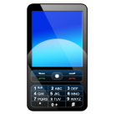

Application Study
Applications (with the Internet permission) | # | Permissions
The Weather Channel, Cetos, Solitarie, Movies, Babble, Manga Browser | 6
Bump, Wertago, Antivirus, ABC --- Animals, Traffic Jam, Hearts, Blackjack, Horoscope, 3001 Wisdom Quotes Lite, Yellow Pages, Datelefonbuch, Astrid, BBC News Live Stream, Ringtones | 14
Layar, Knocking, Coupons, Trapster, Spongebot Slide, ProBasketBall | 6
MySpace, ixMAT, Barcode Scanner | 3
Evernote | 1
Courtesy: Byung-Gon et. al

Slide 49
Findings: Location
15 of the 30 apps shared physical location with at least an ad server (admob.com, ad.qwapi.com,
ads.mobclix.com, data.flurry.com)
e.g., received data with tag 0x411 data=[GET /servernameA1?hello=1&time=1&bumpid=354957030504982&locale=en_US&gpslong=-122.316&gpslat=47.662&gpsaccuracy=32.000&timezone=0…
In no case was sharing obvious to user or in EULA
  In some cases, periodic and occurred without app use
Courtesy: Byung-Gon et. al

Slide 50
Findings: Phone Identifiers
7 apps sent IMEI and 2 apps sent phone #, IMSI, ICC-ID to remote servers without informing the user
Frequency was app-specific, e.g., one app sent phone information every time the phone booted
Courtesy: Byung-Gon et. al

Slide 51
Demo
http://appanalysis.org/demo/index.html

Slide 52
Conclusion
Efficient, system-wide, dynamic taint tracking for mobile platforms.
  14% overhead for computing-intensive work
Private data leak is prevalent
  20 of the 30 studied applications share information in a way that was not expected
www.appanalysis.org
Courtesy: Byung-Gon et. al

Slide 53
CleanOS: Limiting Mobile Data Exposure with Idle Eviction
Yang Tang, Phillip Ames, Sravan Bhamidipati, Ashish Bijlani, Roxana Geambasu, Nikhil Sarda
Columbia University

Slide 54



The Transition to Mobile Devices
Mobiles are replacing desktops as primary computing platform
Desktops
Mobile Devices
Linux, OS X, Windows
Emails, Web browsers, Office
Android, iOS, Windows Phone
Emails, Web browsers, G Docs
New, fun, mobile apps
Increased productivity
Pervasive connectivity

Slide 55


Mobiles Bring New Challenges
Desktops
Mobile Devices
data
Physical security, firewalled networks
Unprotected outdoors, mobiles can be easily stolen, seized, or lost

Slide 56
OSes Not Designed for Challenges
Despite threats, mobile OSes have not evolved to protect sensitive data
Like desktop OSes, mobile OSes accumulate enormous sensitive data
  OS doesn’t securely erase deallocated data
  FS doesn’t securely erase deleted files
  Applications hoard sensitive data for performance or convenience
This data is placed at risk if device is stolen or lost
  Thief can dump RAM, flash memory contents
  Thief can break passwords
  …

Slide 57
Examples of Exposed Data
App | Password | Contents
Email | ✔ | ✔
Gmail |  | ✔
Y! Mail | ✔ | ✔
Google Docs |  | ✔
OI Notepad |  | ✔
Dropbox |  | ✔
KeePass | ✔ | ✔
Keeper | ✔ | ✔
Amazon
Pageonce | ✔ | ✔
Mint |  | ✔
Google+ |  | ✔
Facebook |  | ✔
LinkedIn |  | ✔
TOTAL | 5/14 | 13/14
We dumped memory and SQLite DB for 14 popular Android apps
Email | ✔ | ✔
Default Email App:
Password and email snippets are kept in cleartext RAM at all times
Everything is present in cleartext SQLite DB

Slide 58
Examples of Exposed Data
App | Password | Contents
Email | ✔ | ✔
Gmail |  | ✔
Y! Mail | ✔ | ✔
Google Docs |  | ✔
OI Notepad |  | ✔
Dropbox |  | ✔
KeePass | ✔ | ✔
Keeper | ✔ | ✔
Amazon
Pageonce | ✔ | ✔
Mint |  | ✔
Google+ |  | ✔
Facebook |  | ✔
LinkedIn |  | ✔
TOTAL | 5/14 | 13/14
We dumped memory and SQLite DB for 14 popular Android apps
Overall:
Captured some sensitive data from 13/14 apps
All 13/14 apps hoard some sensitive data in cleartext DB/RAM
9/14 apps hoard sensitive data in cleartext RAM at all times
TOTAL | 5/14 | 13/14

Slide 59
Securing Data Is Darn Hard!
Example protection systems:
  Encrypted file systems
  Encrypted RAM
  Remote wipe-out systems
Challenges / limitations:
  Users don’t lock their devices (57%) or configure poor passwords
  Physical attacks are notoriously difficult to protect against
    E.g., memory dumps, cold boot attacks, breaking trusted-hardware seals can reveal data or decryption keys
In general, these are imperfect stop-gaps on top OSes that were never designed with physical insecurity in mind

Slide 60
Time for New OS Abstractions
Mobile OSes should manage sensitive data rigorously, so as to maintain the device “clean” at any point in time in anticipation of device theft/loss
If device is stolen or lost:
  The minimal amount of sensitive data is exposed
  User retains post-theft control over unexposed data

Slide 61
CleanOS
New Android-based OS that minimizes sensitive data exposure by evicting it to a trusted cloud whenever not under active use
Implements sensitive data objects (SDOs)
  Identifies locations of sensitive data in RAM and stable storage
  Monitors its use by applications
  “Evicts” sensitive data to the cloud whenever it is not under active use
The cloud intermediates all accesses to unused SDOs and can offer a lot of useful post-loss functions:
  Disable SDO access after theft
  Audit SDO exposure and access
  Rate-limit SDO accesses

Slide 62
CleanOS
All layers of current OSes require cleanup
As first step, we focus on cleaning up the application layer
Limit exposure of sensitive data hoarded by apps

Slide 63
Outline
Motivation
Architecture and Prototype
Evaluation
Conclusions

Slide 64
Mobile OS Insights
Although exposed permanently, much sensitive data is only actually used very rarely
    Email password is constantly exposed, but only used upon refresh
    Subjects are constantly exposed, but only used upon inbox listing
    Contents are often exposed, but only used when user reads email
Most mobile apps have a cloud component, which already stores the data
Mobiles are (becoming) mostly connected
  Wi-Fi / cellular coverage is becoming pervasive

Slide 65
CleanOS Basic Functioning
Applications create SDOs and add sensitive data to them
CleanOS implements three functions for SDOs:
  Tracks data in SDOs using taint tracking
  Evicts SDOs to a trusted cloud whenever idle
  Decrypts SDO data when it is accessed again
Email App
Email App
Content SDO
Password
SDO
Content
SDO
Password
SDO
evicted
when user reads an email
when the app goes to the background

Slide 66
CleanOS Increases Post-Loss Control
Device lost/stolen
User notices loss
time
Tamper with device physically or in software:
Attacker
No access to device or cloud keys
dump RAM
cold boot attacks
disable connectivity
break user password
decrypt all SDOs
…
Control data accesses:
Minimize data on the device
CleanOS
audit accesses
disable or rate-limit
suspicious accesses
disable all accesses

Slide 67
The SDO Abstraction
An SDO is a logical collection of Java objects that contain sensitive data and that are related somehow
  Email-password SDO: password string + all objects computed from it
  Email-contents SDO: all emails in a thread
  Bank-account SDO: all transactions in an account
human-readable and used for auditing
class SDO {
SDO(String description, ...); // create SDO
void add(Object o); // adds object to SDO
void remove(Object o); // removes object from SDO
…
private int sdoID; // unique ID for SDO
}
used for identifying SDOs locally and remotely

Slide 68
Example: A Clean Email App
Default Email app hoards passwords and subjects
Hard for apps to manage sensitive on their own
With CleanOS, developers simply create SDOs and place their sensitive data in them
SDO pwSDO = new SDO(“Password of ” + user);
pwSDO.add(password);
...
SDO emailSDO = new SDO(“Email: ” + mSubject);
emailSDO.add(mSubject);
emailSDO.add(mTextContent);
emailSDO.add(mHtmlContent);
emailSDO.add(mTextReply);
emailSDO.add(mHtmlReply);
(code adapted for clarity)

Slide 69
The CleanOS Architecture
Mobile Device
Application (Java)
Dalvik VM
Linux

Slide 70
The CleanOS Architecture
Mobile Device
Trusted Cloud(s)
Application (Java)
SDO Database
registerSDO(
123,
“com.android.email”,
“Password of Yang”,
0x1a2b…)
pwSDO
ID: 123
App: com.android.email
Desc: Password of Yang
Key: 0x1a2b…
CleanOS Dalvik VM
Audit Log
(SDO ID: 123, Key: 0x1a2b…)
Create SDO 123
App: … Desc: …
Tracking
(modified TaintDroid)
Eviction
(evict-idle GC)
Decryption
(modified interpreter)
Linux

Slide 71
The CleanOS Architecture
Mobile Device
Trusted Cloud(s)
Application (Java)
SDO Database
pwSDO: Password of Yang
registerSDO(
123,
“com.android.email”,
“Password of Yang”,
0x1a2b…)
pwSDO
password
ID: 123
App: com.android.email
Desc: Password of Yang
Key: 0x1a2b…
imap://user:password@imap.server.com:143
smtp://user:password@smtp.server.com:25
CleanOS Dalvik VM
Audit Log
(SDO ID: 123, Key: 0x1a2b…)
Create SDO 123
App: … Desc: …
Tracking
(modified TaintDroid)
Eviction
(evict-idle GC)
Decryption
(modified interpreter)
Linux

Slide 72
The CleanOS Architecture
Mobile Device
Trusted Cloud(s)
Application (Java)
SDO Database
pwSDO
ID: 123
App: com.android.email
Desc: Password of Yang
Key: 0x1a2b…
CleanOS Dalvik VM
Audit Log
(SDO ID: 123, Key: 0x1a2b…)
Create SDO 123
App: … Desc: …
Tracking
(modified TaintDroid)
Eviction
(evict-idle GC)
Decryption
(modified interpreter)
Linux

Slide 73
The CleanOS Architecture
Mobile Device
Trusted Cloud(s)
Application (Java)
SDO Database
pwSDO
ID: 123
App: com.android.email
Desc: Password of Yang
Key: 0x1a2b…
sdoEvicted(
“com.android.email”,
123)
CleanOS Dalvik VM
Audit Log
Evicted
(SDO ID: 123, Key: )
Create SDO 123
App: … Desc: …
Tracking
(modified TaintDroid)
Eviction
(evict-idle GC)
Decryption
(modified interpreter)
SDO 123 Evicted
App: … Desc: …
Linux

Slide 74
The CleanOS Architecture
Mobile Device
Trusted Cloud(s)
Application (Java)
SDO Database
pwSDO
ID: 123
App: com.android.email
Desc: Password of Yang
Key: 0x1a2b…
CleanOS Dalvik VM
fetchKey(
“com.android.email”,
123)
Audit Log
(SDO ID: 123, Key: 0x1a2b…)
Create SDO 123
App: … Desc: …
Tracking
(modified TaintDroid)
Eviction
(evict-idle GC)
Decryption
(modified interpreter)
0x1a2b…
SDO 123 Evicted
App: … Desc: …
Fetch Key for SDO 123
App: … Desc: …
Linux

Slide 75
SDO Tracking
CleanOS uses a modified TaintDroid version to track SDOs
TaintDroid uses 32-bit shadow taint tags to mark objects/primitives with one or more taints
CleanOS imposes a specific structure on taint tags
  Includes new tainting scheme to propagate one SDO ID (see paper)
31
taint tag
0
Java object / primitive
0000000000000010000010
31
0
Java object / primitive
E
SDO ID

Slide 76
Evict-Idle Garbage Collection
To evict SDOs, we introduce a new type of Java garbage collector: the evict-idle garbage collector (eiGC)
A traditional GC: deallocates only objects guaranteed to never be used in the future
The eiGC: evicts objects that have not been used for a period of time, even if they might be used again in the future
We run the eiGC periodically to evict idle SDOs
  For any Java object that is tainted with an idle-SDO’s ID, the eiGC “evicts” that object, setting its E bit in the tag

Slide 77
Sensitive Data Encryption
To “evict” a Java object, eiGC traverses it down to the data-bearing fields (primitives & arrays of primitives) and encrypt those with a key generated from the SDO’s key
Primitives:
Metadata struct
Counter
0x1234
pointer
ciphertext
counter
…
SDO key
AES
encryption
Arrays of primitives:
struct ArrayObject {
  contents[];
  ...;
}
struct ArrayObject {
  contents[]; // evict in place
  counter;
  evicted_lock;
  ...;
}
Data field
Ciphertext

Slide 78
CleanOS Defaults
We hope for, but don’t rely upon app modifications
Hence, we provide a set of solid defaults:
  “SSL” SDO
  “User Input” SDO
  “Password” SDO
Although coarse-grained,
default SDOs limit
exposure of sensitive data
in unmodified apps
In SSL library (Java SDK):
SDO sslSDO = new SDO(“ssl”);
sslSDO.add(cleartextDataBuffer);
In InputMethod (Android SDK):
SDO inputSDO = new SDO(“user input”);
SDO pwSDO = new SDO(“password”);
if (type == InputType.TEXT_PASSWORD)
  pwSDO.add(text);
  else
    inputSDO.add(text);
(code adapted for clarity)

Slide 79
Optimizations
CleanOS includes a number of optimizations, which help with both performance and energy consumption
Pausing the eiGC
  After the app becomes idle, we stop running eiGC, until the app is active again
Bulk eviction
  The eiGC evicts all SDOs at once soon after the app becomes idle
Bulk prefetching
  The eiGC remembers which SDO keys were used recently and fetches all those keys at once

Slide 80
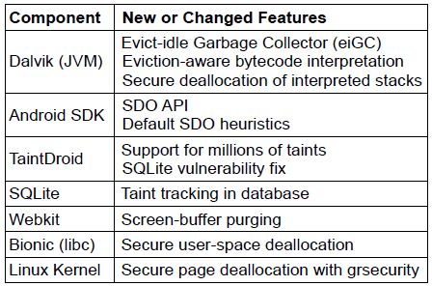
Prototype
Modified Android and TaintDroid in significant ways
Modified two “dirty” apps to use SDOs: Email and KeePass
  Modifications are trivial: 7 LoC for each application

Slide 81
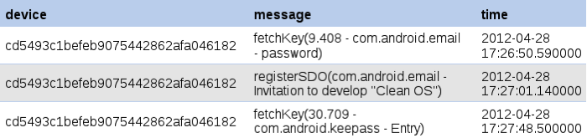
Post-Loss Services
Built a CleanOS service on Google App Engine that supports post-loss auditing
Other services could be supported:
  Disable keys after user notices theft
  Monitor key accesses, detect anomalies, and rate-limit/disable access
  Disable accesses to certain SDOs while outside a trusted network
  …
Screenshot of the CleanOS audit log

Slide 82
Outline
Motivation and Goals
Architecture and Prototype
Evaluation
Conclusion

Slide 83
Questions
Does CleanOS limit data exposure?
Does CleanOS support effective auditing?
Is CleanOS’ performance practical?
Is CleanOS’ energy consumption practical?
Is CleanOS network consumption practical?

Slide 84
Does CleanOS Limit Data Exposure?
Default SDOs reduce exposure by 89.6-93.5%
App SDOs further reduce content exposure to 0.3%
Similar results in Facebook and Mint apps
Thus, default SDOs drastically curb
sensitive-data exposure
Email App Version | Password SDO | Contents SDO
Email without CleanOS | 100% | 95.5%
Email App Version | Password SDO | Contents SDO
Email without CleanOS | 100% | 95.5%
Email with default SDOs | 6.5% | 5.9%
Email App Version | Password SDO | Contents SDO
Email without CleanOS | 100% | 95.5%
Email with default SDOs | 6.5% | 5.9%
Cleaned Email with app SDOs | 6.5% | 0.3%
Fraction of time in which sensitive data was exposed

Slide 85
Is Auditing Effective?
Thus, for best auditing properties,
applications should define their own SDOs
95.1%
95.1% 100%
Audit Precision (%)
0%

Slide 86
Is CleanOS Practical (Wi-Fi)?
88ms
Thus, overheads are largely
unnoticeable over Wi-Fi
289ms
115ms
48ms
30ms
14ms

Slide 87
Is CleanOS Practical (3G)?
1819ms
722ms
953ms
354ms
354ms
92ms

Slide 88
Is CleanOS Practical (3G)?
Optimizations improve 3G performance
significantly, making CleanOS practical
1225ms
392ms
167ms
499ms
10ms
8ms

Slide 89
Conclusions
Mobile OSes and apps accumulate a lot of sensitive data, exposing it to attacks if device is stolen or lost
CleanOS is a new Android-based OS design that minimizes amount of sensitive data exposed on device at any time
  SDO: new OS abstraction for managing sensitive data
  eiGC: garbage-collector that evicts unused SDO data
CleanOS brings new view on data security: minimize and audit exposure of sensitive data to attack
  We believe that this view is applicable more broadly to other domains, such as datacenter and Web data security

