Slide 1
Cellular Networks and Mobile Computing COMS 6998-7, Spring 2014
Instructor: Li Erran Li (lel2139@columbia.edu)
http://www.cs.columbia.edu/~lierranli/coms6998-7Spring2014/
Lecture 12: Mobile Platform Security: Attacks and Defenses

Slide 2
Review of Previous Lecture
How does malware get installed?
How to detect malware?

Slide 3
Malware Installation
Users tend not to install malware intentionally
Attackers trick users into installing malware
Repackaging
Update attack
Drive-by download
Courtesy Yajin Zhou et al.

Slide 4
Footprint-Based Detection Engine
Filter apps with essential permissions
Malware | Essential Permissions | Apps
Geinimi | INTERNET, SEND_SMS | 7, 620 (4.17%)
ADRD | INTERNET, ACCESS_NETWORK_STATE RECEIVE_BOOT_COMPLETED | 10, 379 (5.68%)
Pjapps | INTERNET, RECEIVE_SMS | 4, 637 (2.54%)
Bgserv | INTERNET, RECEIVE_SMS, SEND_SMS | 2, 880 (1.58%)
DroidDream | CHANGE_WIFI_STATE | 4, 096 (2.24%)
zHash | CHANGE_WIFI_STATE | 4, 096 (2.24%)
BaseBridge | NATIVE CODE | 8, 272 (4.52%)
DroidDreamLight | INTERNET, READ_PHONE_STATE | 71, 095 (38.89%)
Zsone | RECEIVE_SMS, SEND_SMS | 3, 204 (1.75%)
jSMSHider | INSTALL_PACKAGES | 1, 210 (0.66%)
Reduced to 0.67% when considering a broadcast receiver
Courtesy Yajin Zhou et al.

Slide 5
Footprint-Based Detection Engine
Distill malware behaviors as behavioral footprint
Information in manifest file
Contain a receiver listening to SMS_RECEIVED
Semantics in the byte-code
Register a receiver listening to SMS_RECEIVED
Call abortBroadcast in the receiver
Send SMS messages to premium numbers
Structural layout of the app
Match apps with malware behavioral footprints
Behavioral
footprint
of Zsone
Courtesy Yajin Zhou et al.
Notes:
Zsone is an SMS trojan. It sends short message to premium numbers and removes billing related notifications messages from service providers.

Slide 6
Heuristics-Based Detection Engine
Filter apps with dynamic Java/native code loading
1055 apps load Java code
508 apps load native code from non-standard locations
Monitor apps’ dynamic execution behaviors
Java code: permission-related framework APIs
Native code: system calls requiring root privileges
Courtesy Yajin Zhou et al.

Slide 7
Outline
Middleware layer: Android framework vulnerabilities based attacks
Permission re-delegation (confused deputy attacks)
Collusion attacks
Kernel layer: system vulnerability based attacks
Root exploits (e.g. adbd bug used by DroidKungfu malware)
Control flow attacks (code injection attacks)

Slide 8
Soundcomber A Stealthy and Context-Aware Sound Trojan for Smartphones
Roman Schlegel
City University of Hong Kong
Kehuan Zhang, Xiaoyong Zhou, Mehool Intwala,
Apu Kapadia, XiaoFeng Wang
Indiana University Bloomington
Courtesy: Roman et. al

Slide 9
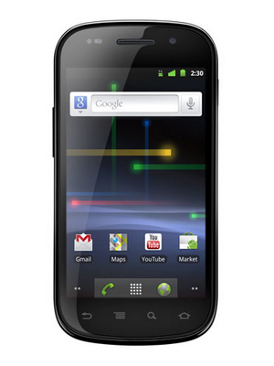
The smartphone in your pocket is really a computer
1 GHz Processor
512MB / 16GB
Android OS (Linux)
Courtesy: Roman et. al
Notes:
- Like a computer, *but*, unlike a computer, with different sensors
- Also other information, not from sensors, such as address book, dialed numbers, etc.
- Sensory Malware

Slide 10
No surprise malware targets smartphones
Android malware steals info from 1’000’000 users¹
Trojan sends premium-rate text messages²
Security experts release Android root-kit³
1. http://nakedsecurity.sophos.com/2010/07/29/android-malware-steals-info-million-phone-owners/
2. http://news.cnet.com/8301-27080_3-20013222-245.html
3. http://www.reuters.com/article/idUSTRE66T52O20100730
Courtesy: Roman et. al
Notes:
- Different sensors

Slide 11
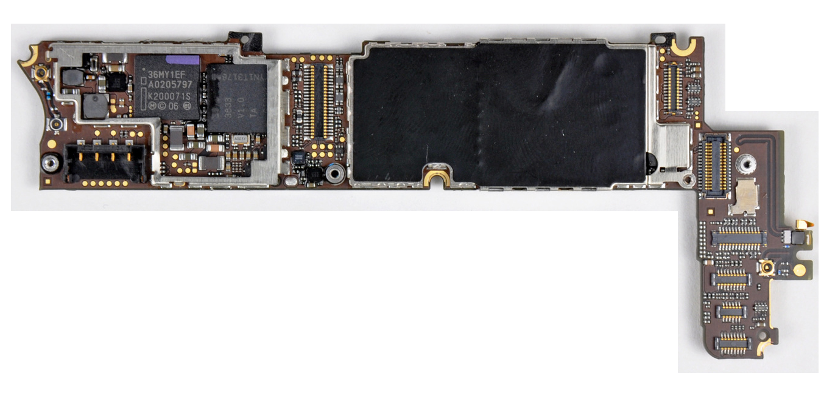
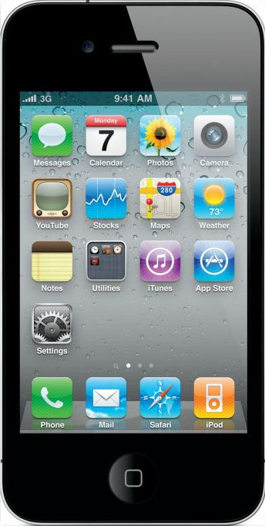
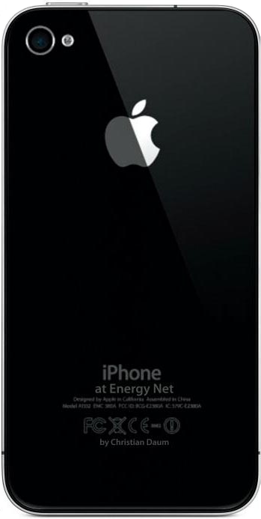
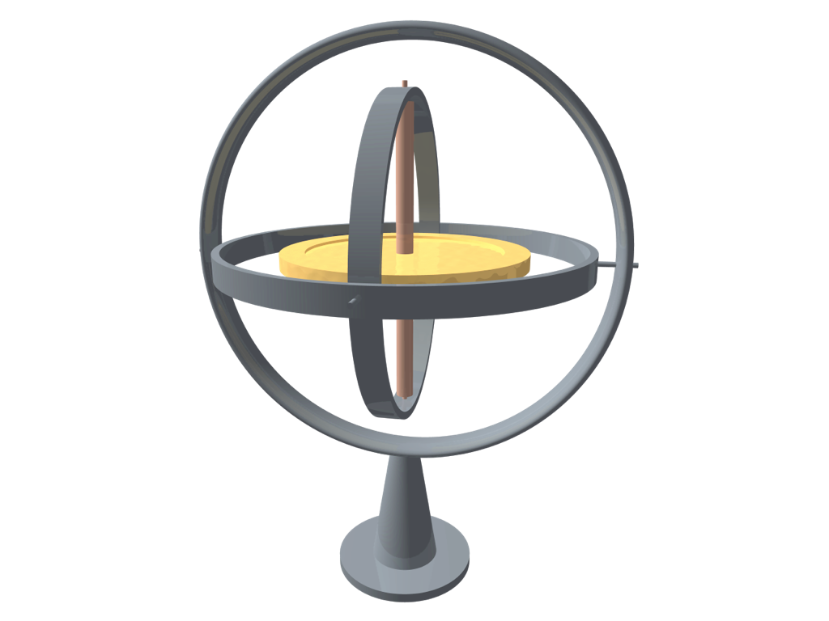
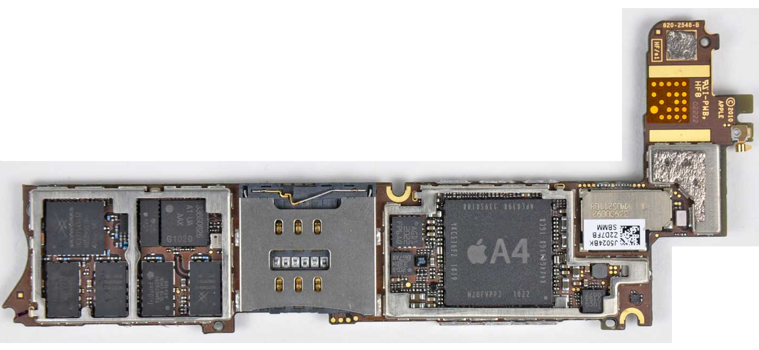
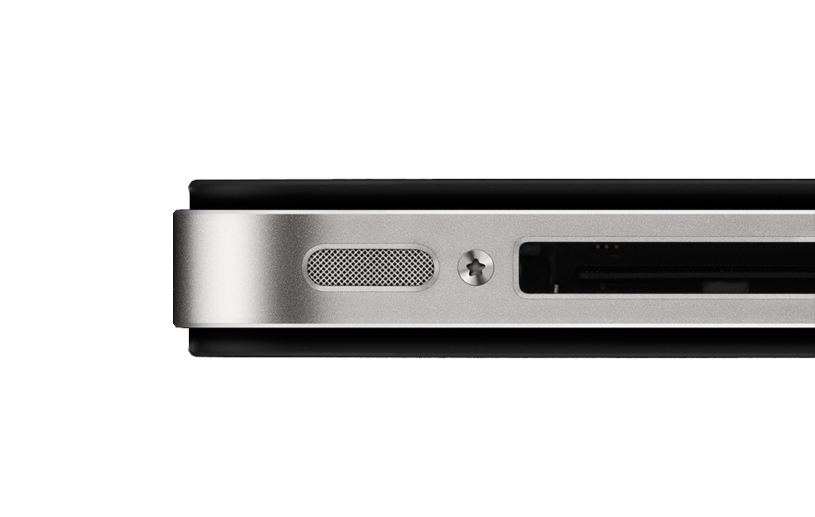
But “sensory malware” can do much more
Camera
Compass
Gyroscope
GPS
Microphone
[15] N. Xu et al.
Courtesy: Roman et. al
Notes:
- Different sensors
- “sensory malware can do much more, other people have shown etc.”

Slide 12
What can malware overhear?
Do you think anybody will ever figure out
that I keep a spare door key in the flower
pot on my front porch?
Nah, how would anybody ever find out?
Courtesy: Roman et. al
Notes:
- What can be picked up through the microphone?
- Confidential information, trade secrets, negotiations?

Slide 13
Some situations are easy to recognize
“Please enter or speak your
credit card number now.”
Bank
Courtesy: Roman et. al
Notes:
- Voice, DTMF tones (side-channel)

Slide 14
Naive approach: record and upload
1’000’000 phones ≈ 1TB/day
≈ 500KB/day
Internet
Malware
Master
Data
Valuable
Information
Courtesy: Roman et. al
Notes:
- not stealthy, lots of network communication, looks anomalous
- too much data for the malware master

Slide 15
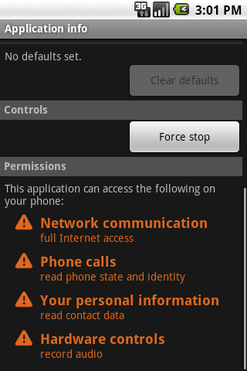
Certain combinations of permissions are suspicious
Can easily be recognized and disallowed
([5] W. Enck et al.)
Courtesy: Roman et. al
Notes:
- refer to paper (Kirin) which prevents the installation of applications with certain combinations of permissions

Slide 16
Our contributions over the naive approach
targeted and local extraction of valuable data
inconspicuous permissions
stealthiness
Courtesy: Roman et. al

Slide 17
Naive approach: record and upload
Internet
Malware
Master
Data
Valuable
Information
Courtesy: Roman et. al
Notes:
- not stealthy, lots of network communication, looks anomalous
- too much data for the malware master

Slide 18
Soundcomber approach: process and upload
Internet
Malware
Master
Valuable
Information
Courtesy: Roman et. al

Slide 19
Two trojans are stealthier than one
Internet
Microphone
(c)overt
channel
Soundcomber
app
Deliverer
app
Courtesy: Roman et. al
Notes:
- separate permissions into two inconspicuous sets of permissions
- Soundcomber: phone state, contacts, record audio
- Deliverer: network

Slide 20
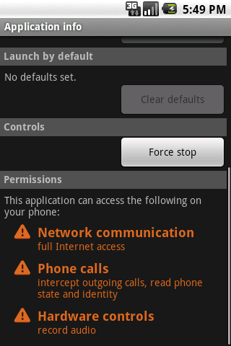
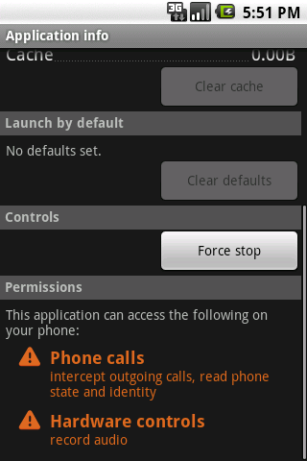
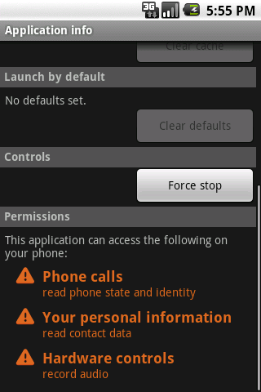
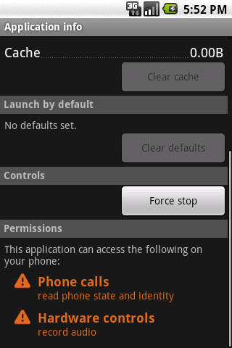
Soundcomber minimizes the necessary permissions
voice-memo app
wake-up alarm app
Courtesy: Roman et. al

Slide 21
Hotline greetings can be fingerprinted easily
“Thank you for calling...”
Bank 1
?
?
“Welcome to ...”
Bank 2
Bank 1
Bank 2
Courtesy: Roman et. al

Slide 22
Tricking the user into installing two apps
pop-up ad
packaged app
Click Here!
Courtesy: Roman et. al

Slide 23
Soundcomber extracts sensitive information locally
Record
Audio
0111010100110101011....
Record
Audio
Microphone
Process
Audio
To
Deliverer
9820305180812615025219029103892...
5180 8126 1502 5219
Profile
Database
Extract
Data
Soundcomber App
Courtesy: Roman et. al

Slide 24
Profiles allow for context aware extraction
Enter
Account #
Enter
PIN
Prompt for Account Number
Acquire PIN
Sensitive Information Acquired
1
Enter
CC #
Initial Menu Options
2
Loan & Credit Card
2
Credit Card Information
1
Prompt for Credit Card #
other
input
other
input
Termination
Courtesy: Roman et. al
Notes:
- state machine

Slide 25
DTMF tones are “dual tones”
8 frequencies
2 simultaneous frequencies for each digit
used to navigate hotline menus
 | 1209 Hz | 1336 Hz | 1477 Hz | 1633 Hz
697 Hz | 1 | 2 | 3 | A
770 Hz | 4 | 5 | 6 | B
852 Hz | 7 | 8 | 9 | C
941 Hz | * | 0 | # | D
Courtesy: Roman et. al

Slide 26
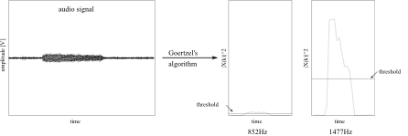
Soundcomber dynamically adjusts thresholds to detect faint tones
Courtesy: Roman et. al
Notes:
- DTMF numbers picked up through side-channel (aural feedback of pressed numbers)

Slide 27
Android introduces new covert channels
vibration settings (87 bps)
volume settings (150 bps)
screen (5.3 bps)
file locks (685 bps)
Courtesy: Roman et. al
Notes:
- file locks are specific to Linux

Slide 28
Vibration settings are broadcast to interested apps
Android
OS
register broadcast
receiver
Deliverer App
set vibration
setting
Audio Manager
vibration setting
changed notification
Soundcomber App
Setting | Bit
VIBRATE_SETTING_ON | 0
VIBRATE_SETTING_ ONLY_SILENT | 1
Courtesy: Roman et. al

Slide 29
Volume settings can be modified and accessed by any app
Volume | Data
0 | 000
1 | 001
... | ...
7 | 111
set volume
setting
Audio Manager
Soundcomber App
small
delay
small
delay
Audio Manager
get volume
setting
Deliverer App
Courtesy: Roman et. al

Slide 30
Soundcomber is fast and accurate
 | No Error | 1 Error | >= 2 Errors | 1 missing | >= 2 missing
Speech | 55 % | 12.5 % | 15 % | 7.5 % | 10 %
Tone | 85 % | 5 % | 0 | 10 % | 0
 | Recording Length | Processing Time
Speech | 20 s | 7 s
Tone | 45 s | 8 s
Courtesy: Roman et. al

Slide 31
Hotlines can be fingerprinted with reasonable accuracy
20 recorded samples of 5 different hotlines (4 each)
20 samples of normal conversation
 | Correct | Missed | Wrong
Hotline | 55 % | 40 % | 5 %
 | Correct
Conversation | 100 %
Courtesy: Roman et. al

Slide 32
Keeping Soundcomber hidden and undetectable
defer/throttle processing
track user presence
performance enhancements
Courtesy: Roman et. al
Notes:
- performance enhancements: DTMF detection

Slide 33
Defense: disable recording when a sensitive number is called
UI
Microphone
Radio Interface Layer
Audio Service
Reference
Service
Controller
Controller
Controller
Baseband
Recorder
Courtesy: Roman et. al
Notes:
- exclusive mode (audio blocked) and non-exclusive mode (audio available)
- audio is blocked before command reaches baseband
- small overhead

Slide 34
Conclusion
stealthy, sensory malware is a real threat
need to explore other such threats
develop generalized defenses to such attacks
Courtesy: Roman et. al

Slide 35
Security Enhanced (SE) Android: Bringing Flexible MAC to Android
Stephen Smalley and Robert Craig Trusted Systems Research National Security Agency

Slide 36
Motivation
●
Android security relies on Linux DAC.
To protect the system from apps. To isolate apps from one another.
To prevent bypass of Android permissions.
●
●
●
●
DAC shortcomings are well established.
Fundamentally inadequate to protect against flawed and malicious applications.
SELinux can address these shortcomings.
●
●

Slide 37
Challenges
●
Kernel
No support for per-file security labeling (yaffs2). Unique kernel subsystems lack SELinux support.
●
●
●
Userspace
●
No existing SELinux support.
All apps forked from the same process (zygote). Sharing through framework services.
●
●
●
Policy
●
Existing policies unsuited to Android.

Slide 38
Kernel Support
●
Implemented per-file security labeling for yaffs2.
Using recent support for extended attributes. Enhanced to label new inodes at creation.
●
●
●
Analyzed and instrumented Binder for SELinux.
●
Permission checks on IPC operations.

Slide 39
Userspace Support
xattr and AT_SECURE support in bionic. Minimal port of SELinux libraries and tools. Labeling support in build and updater tools. Policy loading, device & socket labeling (init). App security labeling (zygote, dalvik, installd). Property service and zygote controls.
Runtime policy management support.
●
●
●
●
●
●
●

Slide 40
Policy Configuration
●
Enforce a small set of platform security goals.
Confine privileged services. Sandbox and isolate apps.
●
●
●
Key properties:
●
Small, fixed policy.
No policy writing for app developers. Invisible to users.
●
●

Slide 41
Policy Size & Complexity
 | SE Android | Fedora
Size | 71K | 4828K
Domains | 39 | 702
Types | 182 | 3197
Allows | 1251 | 96010
Transitions | 65 | 14963
Unconfined | 3 | 61

Slide 42
Middleware MAC (MMAC)
●
Many attacks occur entirely at middleware layer.
●
Cannot be addressed via kernel layer MAC.
●
SELinux userspace object manager model not readily applicable.
Binder IPC, multi-stage call chains. checkPermission API. Implications for SELinux policy.
●
●
●
●
Required a separate middleware MAC layer.

Slide 43
MMAC mechanisms
Enforced by PackageManagerService. Based on app certificate, package name. Can disable even pre-installed apps.
Linkage to SELinux policy via seinfo tag.
●
Install-time MAC
●
●
●
●
●
Permission revocation
Intent MAC, Content Provider MAC
●

Slide 44
Case Studies
Exploid, RageAgainstTheCage, GingerBreak, KillingInTheNameOf, Zimperlich, mempodroid.
Flawed apps
●
Root exploits.
●
Skype, Lookout Mobile, Opera Mobile.
●
All mitigated by SE Android.

Slide 45
Case Study: /proc/pid/mem
●
/proc/pid/mem
Kernel interface for accessing process memory. Write access enabled in Linux 2.6.39+.
●
●
●
CVE-2012-0056
●
Incorrect permission checking.
Induce setuid program into writing own memory.
●
●
Demonstrated by mempodroid exploit.

Slide 46
Mempodroid: Overview
●
Some complexity omitted.
Exploit invokes setuid root run-as program with open fd to /proc/pid/mem as stderr and shellcode as argument.
run-as program overwrites self with shellcode when writing error message.
Shell code sets uid/gid to 0 and execs shell or command.
●
●
●

Slide 47
Mempodroid vs SE Android Part 1
With no specific policy for run-as. Write to /proc/pid/mem will still succeed.
But run-as program runs in caller's security context.
●
●
●
Still restricted by SELinux policy. No privilege escalation.
But also no support for run-as functionality.
●
●
●

Slide 48
Mempodroid vs SE Android Part 2
●
With policy and code changes for run-as.
●
Sufficient to support legitimate functionality.
●
Open file to /proc/pid/mem closed by SELinux due to domain transition.
●
No memory overwrite, exploit fails.
●
run-as confined to least privilege.
●
Minimal capabilities, required transition.

Slide 49
Case Study: Lookout Mobile
Security app for Android. LOOK-11-001
●
●
●
Created files via native calls without setting umask.
Leaving them world-readable and -writable.
●
●
Any other app on the device could:
Disable or reconfigure Lookout. Read private user data.
●
●

Slide 50
SE Android vs Lookout vulnerability
DAC: Permissions are left to the discretion of each application.
MAC: Permissions are defined by the administrator and enforced for all applications.
●
Classic example of DAC vs. MAC.
●
●
●
All third party apps denied access to files created by other apps.
●
Each app and its files have a unique SELinux category set.

Slide 51
Size Comparison (maguro, 4.2)
 | AOSP | SE ANDROID | INCREASE
boot | 4400K | 4552K | +152K
system | 194072K | 194208K | +136K
recovery | 4900K | 5068K | +168K

Slide 52
AnTuTu (maguro, 4.2)
1400
1200
1000
800
AOSP
SE Android
600
400
200
0
memory integer
float
score2d score3d
sdread
sdwrite database

Slide 53
19th Annual Network & Distributed System Security Symposium
Towards Taming Privilege Escalation
Attacks on Android
Alexandra Dmitrienko
Fraunhofer Institute for Secure Information Technology, Darmstadt, Germany
Sven Bugiel, Lucas Davi
TU Darmstadt/CASED,
Germany
Ahmad-Reza Sadeghi, Bhargava Shastry
Fraunhofer SIT/CASED,
Darmstadt, Germany
Thomas Fischer
Ruhr-University
Bochum
@FraunhoferSIT/CASED 2012 Alexandra Dmitrienko, NDSS 2012 DO NOT DISTRIBUTE FURTHER

Slide 54
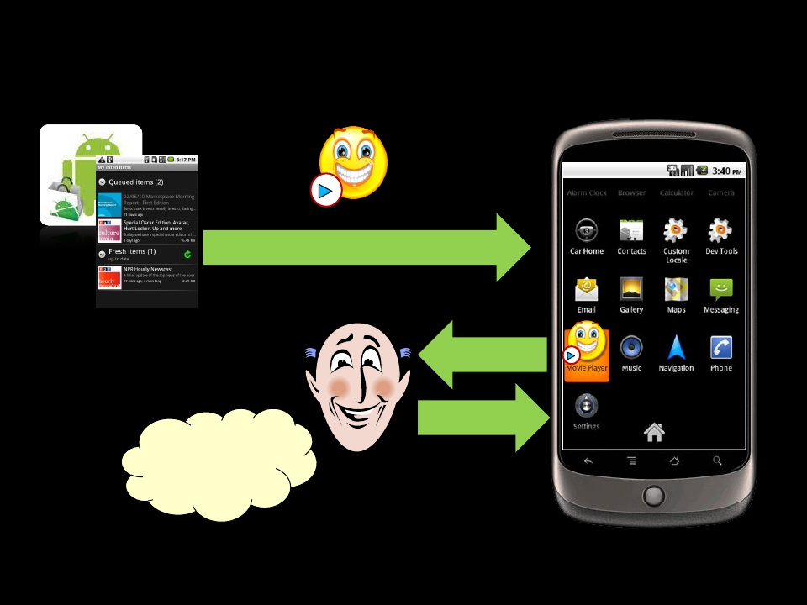
App Installation in Android
Android Market
Movie Player
Download App
Permissions
Install
Requested
permissions are
reasonable
User
@FraunhoferSIT/CASED 2012 Alexandra Dmitrienko, NDSS 2012 DO NOT DISTRIBUTE FURTHER

Slide 55
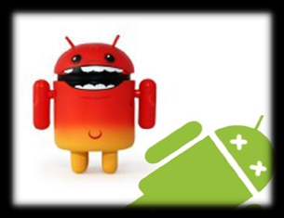
Can apps go beyond their privileges?
YES
Privilege escalation attacks
3
@FraunhoferSIT/CASED 2012 Alexandra Dmitrienko, NDSS 2012 DO NOT DISTRIBUTE FURTHER

Slide 56
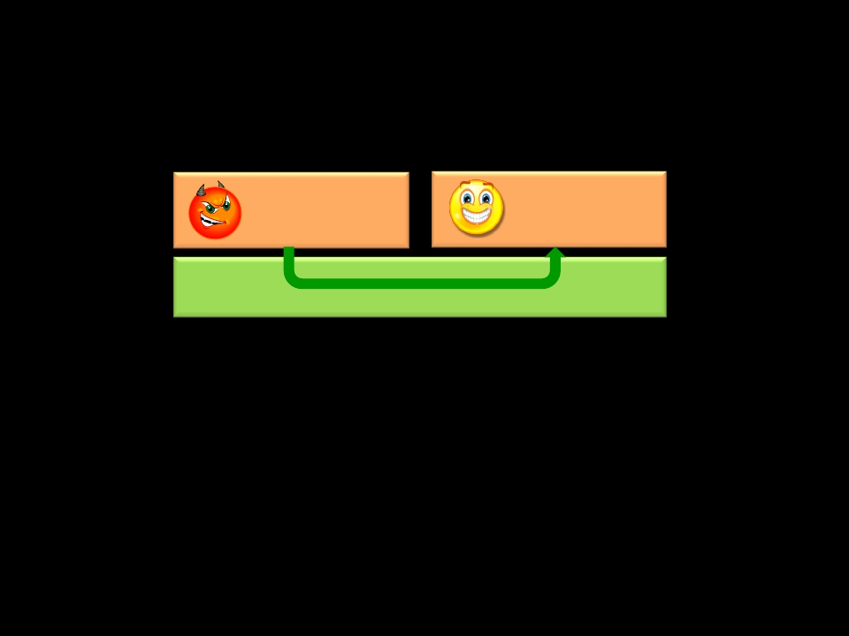
Confused Deputy Attack
Do not have a right permission? Ask your neighbor!
Malware
Privileges: none
Benign app
Privileges: P1
Android OS
Android Middleware
1) Invoke browser to download malicious files (Lineberry et al., BlackHat
2010)
2) Invoke Phone app to perform a phone call (Enck et al., TechReport 2008)
3) Invoke Android Scripting Environment to send SMS messages (Davi et al.,
ISC’2010)
4
@FraunhoferSIT/CASED 2012 Alexandra Dmitrienko, NDSS 2012 DO NOT DISTRIBUTE FURTHER

Slide 57
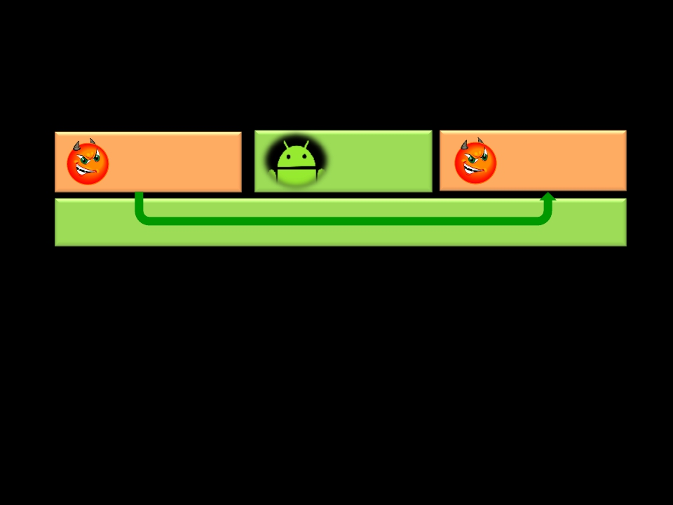
Collusion Attack
Two (or more) apps collude to launch the attack
Malware
Privileges: P1
Android
System App
Benign app
Privileges: P2
Android OS
1) Apps communicate directly
Example: Claudio Marforio et. al, TechReport ETH Zurich
5
@FraunhoferSIT/CASED 2012 Alexandra Dmitrienko, NDSS 2012 DO NOT DISTRIBUTE FURTHER

Slide 58
Collusion Attack
Two (or more) apps collude to launch the attack
Malware
Privileges: P1
Android
System App
Benign app
Privileges: P2
Android OS
2) Apps communicate via covert (e.g., volume settings) or overt (e.g.,
content providers) channels in Android System components
Example: Soundcomber (Schlegel et al., NDSS’2011)
6
@FraunhoferSIT/CASED 2012 Alexandra Dmitrienko, NDSS 2012 DO NOT DISTRIBUTE FURTHER

Slide 59
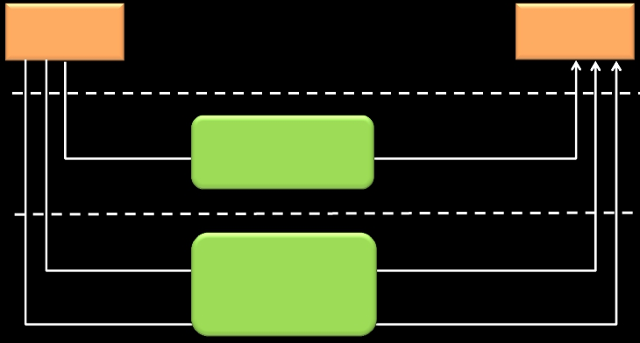
Inter-Application Communication
✴ Inter-process communication (IPC)
✴ Intents and remote procedure calls
✴ File system (files, Unix domain sockets)
✴ Network sockets
AppA
AppB
Application layer
Middleware
Linux kernel
IPC
File System
Network
Sockets
Reference
Monitor
Discretionary
access control
of Linux
@FraunhoferSIT/CASED 2012 Alexandra Dmitrienko, NDSS 2012 DO NOT DISTRIBUTE FURTHER
7

Slide 60
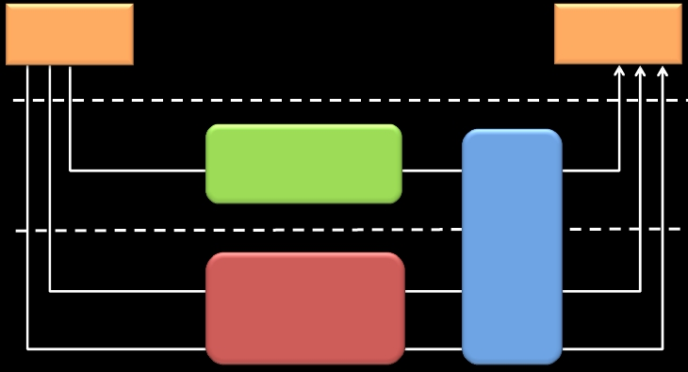
XManDroid:
eXtended Monitoring on Android
✴ Monitors all communication channels between apps
✴ Validates if the requested communication link complies to a system-
centric security policy
AppA
AppB
Application layer
XManDroid
Middleware
Linux kernel
IPC
File System
Network
Sockets
Reference
Monitor
Discretionary
access control
of Linux
@FraunhoferSIT/CASED 2012 Alexandra Dmitrienko, NDSS 2012 DO NOT DISTRIBUTE FURTHER
9

Slide 61
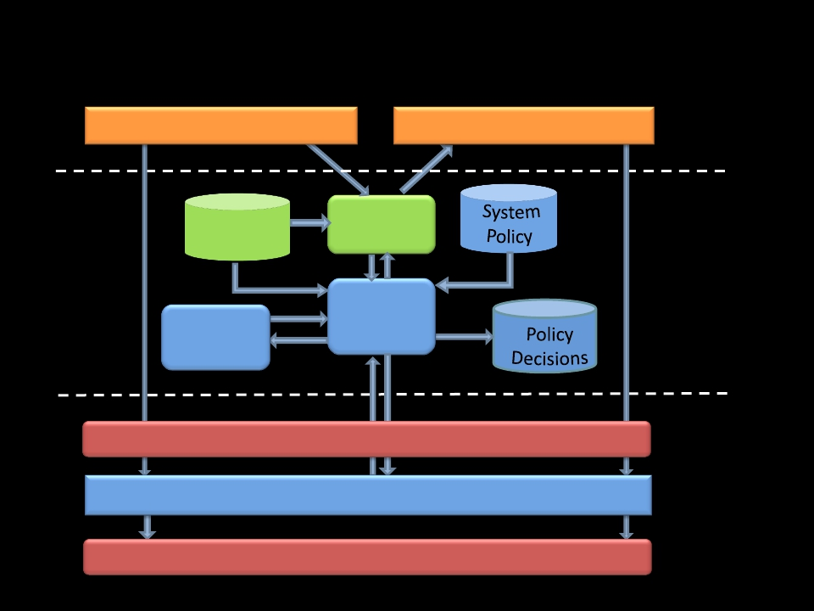
XManDroid Architecture
App A
Android
Permissions
System
View
App B
Application layer
Read/Write File/Socket
Create File/Socket
Reference
Monitor
Decision
Maker
Android Middleware
Middleware layer
Kernel layer
Linux Discretionary Access Control
XManDroid Mandatory Access Control
File System/Internet Sockets
10
@FraunhoferSIT/CASED 2012 Alexandra Dmitrienko, NDSS 2012 DO NOT DISTRIBUTE FURTHER

Slide 62
XManDroid’s SystemView:
Graph-based Representation
Android
Core
System Components
Application sandboxes
Files
IPC calls
Access to files
Socket connections
Internet sockets
11
@FraunhoferSIT/CASED 2012 Alexandra Dmitrienko, NDSS 2012 DO NOT DISTRIBUTE FURTHER

Slide 63
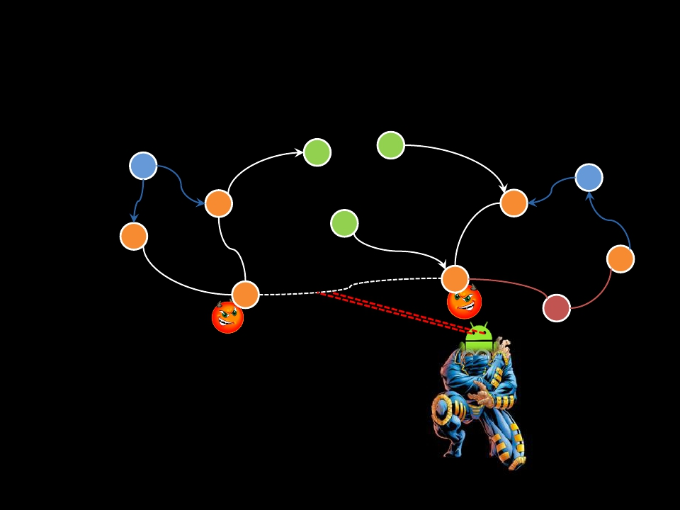
XManDroid: Simplified Example
Android
Core
C
P1
P2
B
A
Policy Rule:
✴ Sandbox A: permission P1, no P2
✴ Sandbox B: permission P2, no P1
✴ Communication type: Direct
✴ Decision: Deny
12

Slide 64
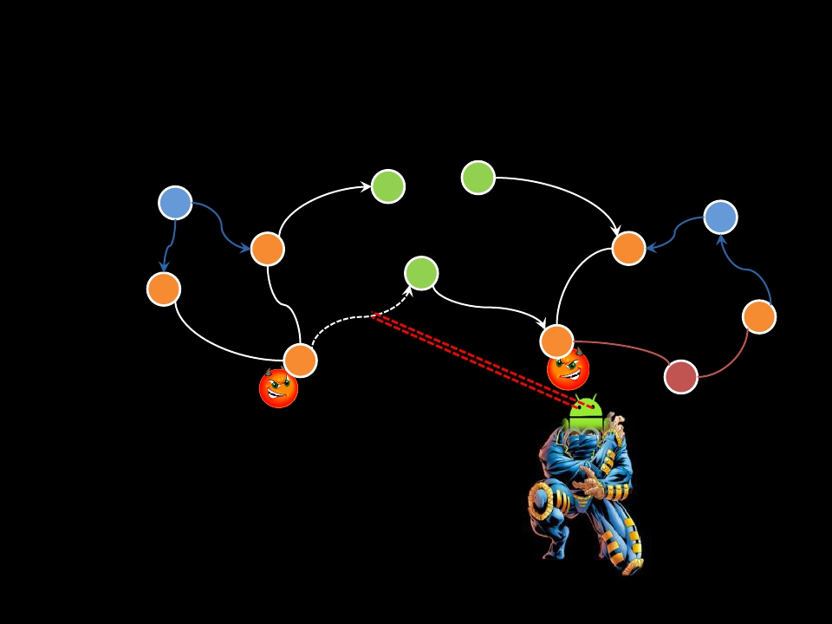
XManDroid: Simplified Example
Android
Core
C
P1
P2
B
A
Policy Rule:
✴ Sandbox A: permission P1, no P2
✴ Sandbox B: permission P2, no P1
✴ Communication type: Indirect
✴ Decision: Deny
13

Slide 65
Contributions
Design
A general
framework
towards taming
privilege
escalation attacks
System-centric
policy
enforcement
Implementation
Kernel-level
mandatory access
control based on
TOMOYO
Callback channel
between kernel-
level and the
middleware
System-centric
IPC call chain
tracking for
Intents (inspired
by QUIRE)
Tests
Evaluation
Study on inter-
application
communication
14
@FraunhoferSIT/CASED 2012 Alexandra Dmitrienko, NDSS 2012 DO NOT DISTRIBUTE FURTHER

Slide 66
Evaluation
1
2
3
Effectiveness (attack prevention)
Performance
Rate of falsely denied communications
15
@FraunhoferSIT/CASED 2012 Alexandra Dmitrienko, NDSS 2012 DO NOT DISTRIBUTE FURTHER

Slide 67
Study on Application Communication
Patterns
16
@FraunhoferSIT/CASED 2012 Alexandra Dmitrienko, NDSS 2012 DO NOT DISTRIBUTE FURTHER

Slide 68
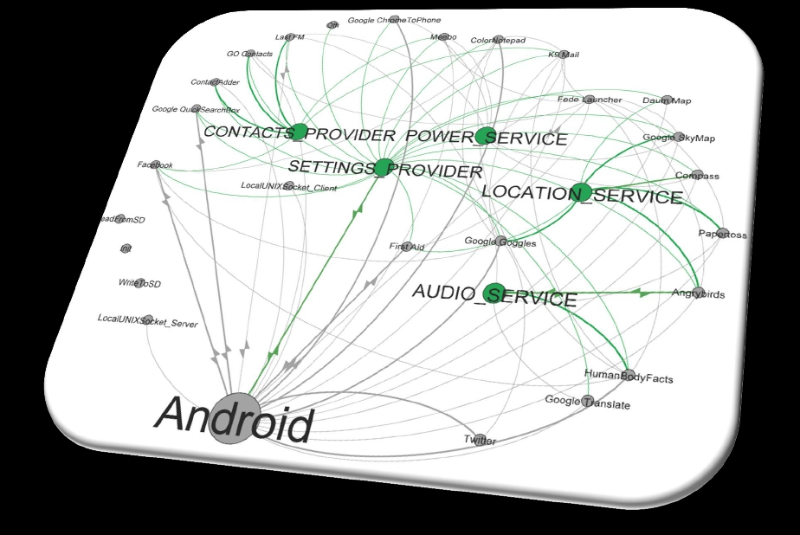
IPC-based Application Communication
17
@FraunhoferSIT/CASED 2012 Alexandra Dmitrienko, NDSS 2012 DO NOT DISTRIBUTE FURTHER

Slide 69
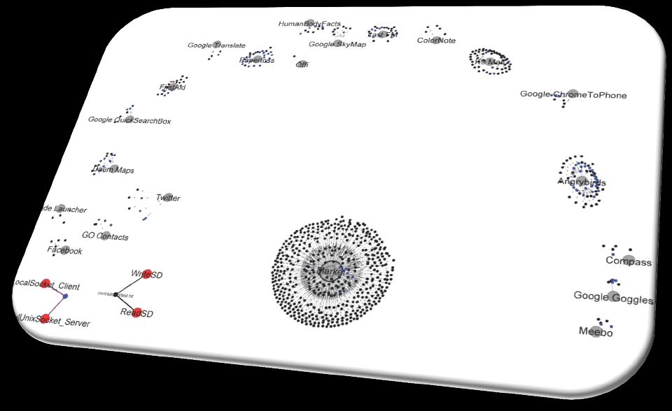
File and Socket-based Application
Communication
18
@FraunhoferSIT/CASED 2012 Alexandra Dmitrienko, NDSS 2012 DO NOT DISTRIBUTE FURTHER

Slide 70
Conclusion and Future Work
✴ First general approach towards tackling privilege escalation
attacks (at application level)
✴ Runtime monitoring, but quite efficient
✴ No false negatives
✴ No false positives, but conceptually they are possible
✴ Current work
✴
✴
✴
✴
Large scale evaluation
Automatic policy engineering
Full IPC call chain tracking
Applying XManDroid framework
for domain isolation on Android
@FraunhoferSIT/CASED 2012 Alexandra Dmitrienko, NDSS 2012 DO NOT DISTRIBUTE FURTHER
BizzTrust
19

Slide 71
Questions?

