Slide 1
Cellular Networks and Mobile Computing
COMS 6998-7, Spring 2014
Instructor: Li Erran Li (lel2139@columbia.edu)
http://www.cs.columbia.edu/~lierranli/coms6998-7Spring2014/
Lecture 11: Mobile Malware

Slide 2
Final Project Grading Guidelines
1. Completeness of a basic prototype (basic functions should work): 20 points
2. Advanced features using class material and novelty (5 points each): 10 points
3. Project report and demo (clarity on motivation, design, etc): 10 points
4. Coding (readability, modular design, etc): 10 points.

Slide 3
Review of Previous Lectures on Mobile Cloud Computing
What are the different programming models for computation offloading?

Slide 4
mCloud Programming Model
MAUI: RPC based offloading architecture
CloneCloud: tight synchronization between cloud and phone
Odessa: data-flow graph to exploit parallelism in perception applications
COMET: distributed shared memory
MAUI, CloneCloud , Odessa all have profiler, solver
 | MAUI | CloneCloud | Odessa | COMET
Remote execution unit | Methods (RMI) | Threads (method entry/exit) | Tasks | Threads (any place)

Slide 5
Syllabus
Mobile App Development (lecture 1,2,3)
  Mobile operating systems: iOS and Android
  Development environments: Xcode, Eclipse with Android SDK
  Programming: Objective-C and android programming
System Support for Mobile App Optimization (lecture 4,5)
  Mobile device power models, energy profiling and ebug debugging
  Core OS topics: virtualization, storage and OS support for power and context management
Interaction with Cellular Networks (lecture 6,7,8)
  Basics of 3G/LTE cellular networks
  Mobile application cellular radio resource usage profiling
  Measurement-based cellular network and traffic characterization
Interaction with the Cloud (lecture 10)
  Mobile cloud computing platform services: push notification, iCloud and Google Cloud Messaging
  Mobile cloud computing architecture and programming models
Mobile Platform Security and Privacy (lecture 11,12,13)
  Mobile platform security: malware detection and characterization, attacks and defenses
  Mobile data and location privacy: attacks, monitoring tools and defenses

Slide 6
Outline
Non-malware
  Misuse of personal/phone identiﬁers, and deep penetration of advertising and analytics networks
Malware characterization
  Installation
  Activation
  Malicious payloads
  Evolution
DroidRanger: Non-virtualization-based malware detection
  Behavioral footprint matching for known malware
  Dynamic execution monitoring for unknown malware
DroidScope Virtualization-based malware detection
  Reconstruct OS, Dalvik VM and native view

Slide 7
Android Malware:
Characterization and Evolution
Malware characterization
  Installation
  Activation
  Malicious payloads
Evolution

Slide 8
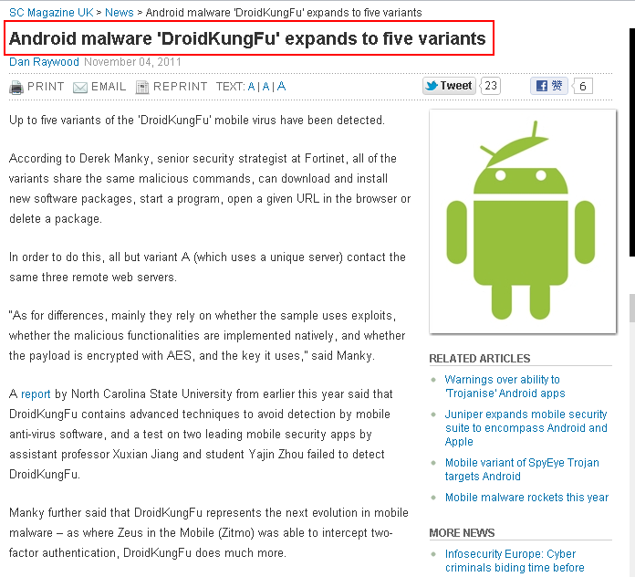
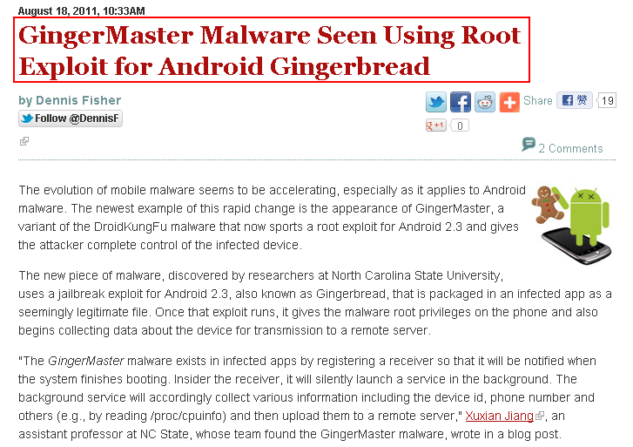
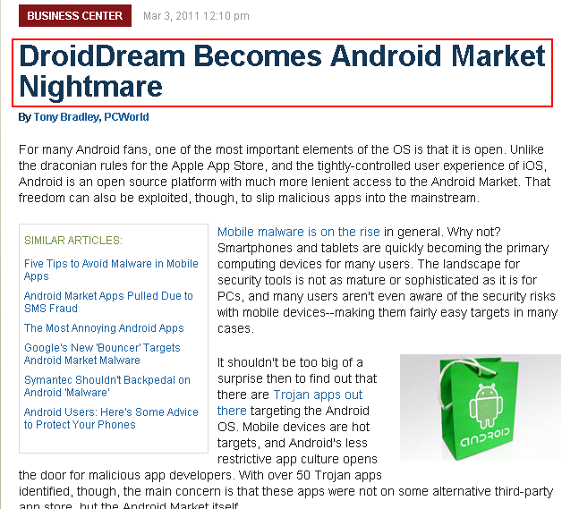
Motivation
Courtesy Yajin Zhou et al.

Slide 9
Motivation
Source: Juniper Networks 2011 Mobile
Threats Report

Slide 10
Motivation
Develop effective defense solutions
Know your enemy
  Insightful understanding of Android malware
  Comprehensive Android malware samples
Courtesy Yajin Zhou et al.

Slide 11
Contributions
Present the first largest public collection of Android malware samples
  There are total 52 families publicly reported between Aug 2010 and Oct 2011
  Dataset has 1260 samples in 49 families
Share the dataset with research community
  Google “Android Malware Genome Project”
Provide initial insights about Android malware
  Characterization
  Evolution
Courtesy Yajin Zhou et al.

Slide 12
Malware Trends
The Cumulative Number of New Malware Samples
2010
2011
AnserverBot
DroidKungFu
(including its variants)
Courtesy Yajin Zhou et al.
Notes:
The Cumulative Growth of New Malware Samples in Our Collection

Slide 13
Malware Characterization
Installation methods
Activation mechanisms
Malicious payloads
Courtesy Yajin Zhou et al.

Slide 14
Malware Installation
Users tend not to install malware intentionally
Attackers trick users into installing malware
  Repackaging
  Update attack
  Drive-by download
Courtesy Yajin Zhou et al.

Slide 15






Installation: Repackaging
+
Attacker
86% of samples in our dataset are repackaged
Courtesy Yajin Zhou et al.

Slide 16
Installation: Repackaging
Victim apps
  Popular games
  Utility apps
  Entertainment apps
“Trustworthy” package names
  com.google.ssearch, com.google.update
Courtesy Yajin Zhou et al.

Slide 17
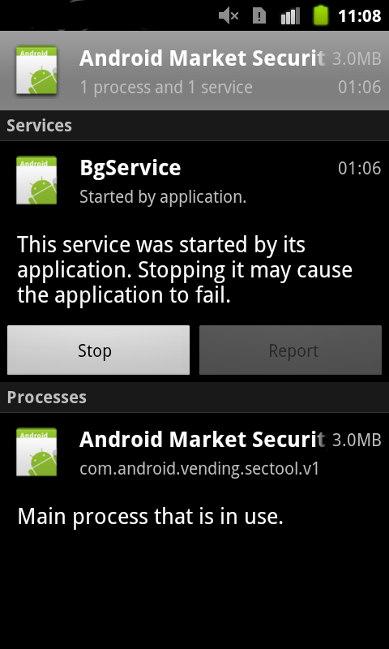
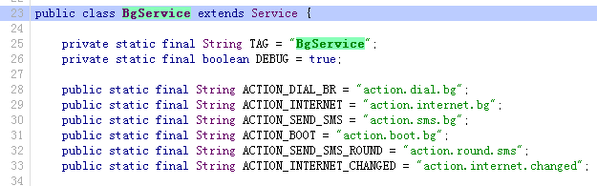
Installation: Repackaging
Malicious payload
Based on public-available code on Google code
Repackaged security tool
Courtesy Yajin Zhou et al.

Slide 18
Installation: Update Attack
Ask user to update to the “latest” version
  Child app: BaseBridge
  Downloaded app: DroidKungFuUpdate
Dynamically load and execute bytecode
  Plankton, AnserverBot
Courtesy Yajin Zhou et al.

Slide 19
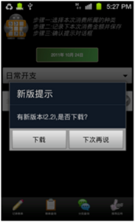
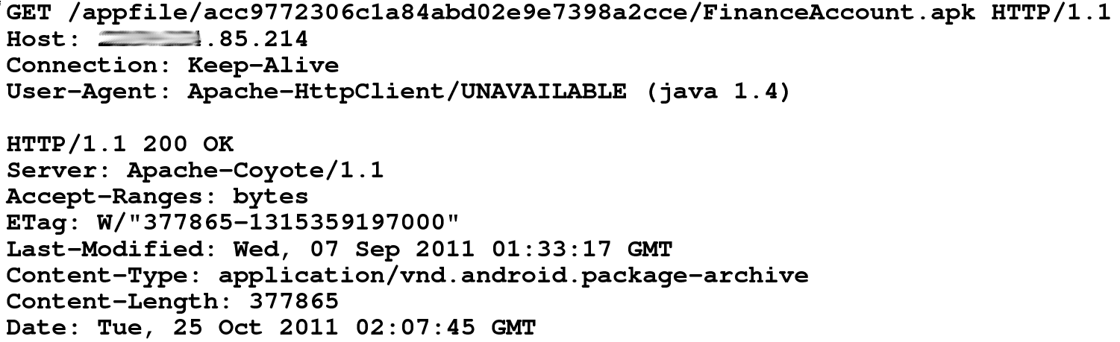
Installation: Update Attack
DroidKungFuUpdate
  Download the “latest” version from remote server
  The downloaded app is DroidKungFu malware
DroidKungFu malware
New version 2.2 found.
Do you want
to download?
Courtesy Yajin Zhou et al.

Slide 20

Installation: Drive-by Download
Trick users into downloading “interesting” apps
  QR code: Jifake
  In-app advertisement: GGTracker
Courtesy Yajin Zhou et al.

Slide 21
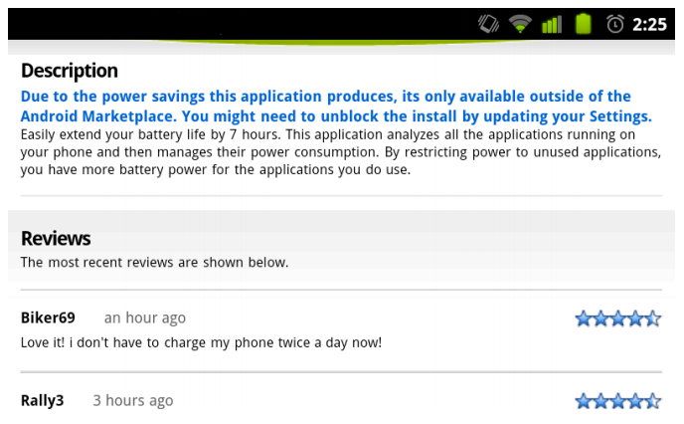
Installation: Drive-by Download
Biker69 seems to like this app.

Slide 22
Malware Activation
By listening to various system events
By hijacking the main activity
The # of malware samples

Slide 23
Malicious Payloads
Privilege escalation
Remote control
Financial charges
Information collection
Courtesy Yajin Zhou et al.

Slide 24
Payloads: Privilege Escalation
Use publicly available root exploits to gain root privilege
  Exploid, RATC, Zimperlich, KillingInTheNameOf, GingerBreak, zergRush
37% of malware samples use root exploits
30% use more than one root exploit
Courtesy Yajin Zhou et al.

Slide 25



Payloads: Privilege Escalation
Malware is getting smarter
  DroidDream: unencrypted root exploits
    Exploit name as its file name
  DroidKungFu: encrypted root exploits
    myicon, secbino
  DroidCoupon: root exploit with obfuscated file name
    ratc.png
Courtesy Yajin Zhou et al.

Slide 26
Payloads: Remote Control
92% of them use HTTP based C&C servers
C&C server URLs can be encrypted
  Pjapps: custom encoding scheme
  DroidKungFu3: AES encryption
  Geinimi: DES encryption
  AnserverBot: Base64
2maodb3ialke8mdeme3gkos9g1icaofm
->
mobilemeego91.com
29BB083B93AE6DD6FB4E2F353586C56218DA99F2421B4B12C6FC74FF3E8E8FF2295907534814906FE15A460C3BA03E78
->
http://search.zi18.com:8511/search/
5ee24082afa27568f4f1e0acc961d767dd7e9ad2131ec4c3
->
117.135.134.185:8080
HoiprJbh9CVp9I0h8Cg1zKVO7CAO7CfaPJSQfvMUH2B574i18CQ_
->
http://b4.cookier.co.cc:8080/jk.action
Courtesy Yajin Zhou et al.

Slide 27
Payloads: Financial Charges
Send SMS
  to hardcoded premium-rate numbers
    FakePlayer, YZHC …
  to other numbers controlled by remote servers
    AnserverBot, BeanBot
Delete/Block SMS
  to remove fee charge information
    Zsone, RogueSPPush …
Reply SMS
  to confirm subscription to premium services
    GGTracker, RogueLemon …
Courtesy Yajin Zhou et al.
Notes:
Zsone 12 GGTracker: 1 RogueLemon:2 SPPush 9 ->auto reply

Slide 28
Payloads: Information Collection
The # of apps
Courtesy Yajin Zhou et al.

Slide 29
Permission Usage
Get started as soon
as possible
Manipulate SMS
Trigger root exploit
# of malware samples and benign apps
Courtesy Yajin Zhou et al.

Slide 30
Evolution: AnserverBot
Basebridge + Plankton
  Malicious payload: BaseBridge
  Dynamic loading: Plankton
Courtesy Yajin Zhou et al.

Slide 31
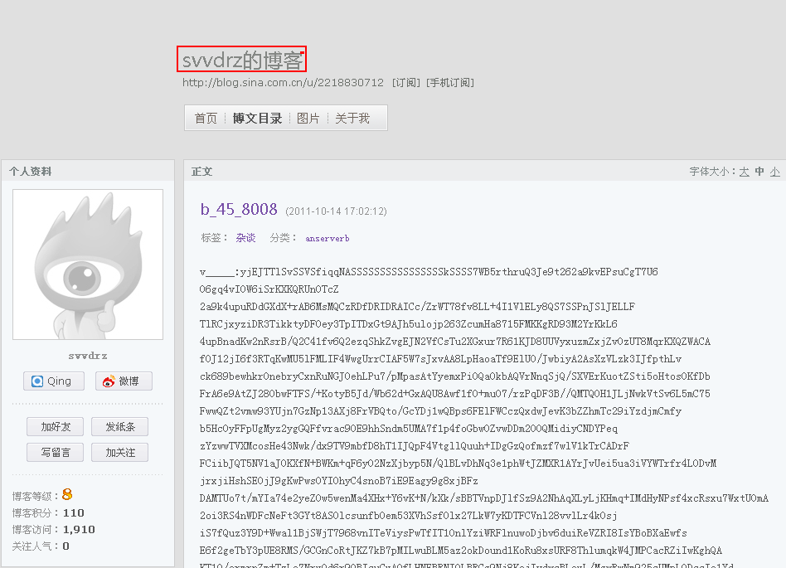
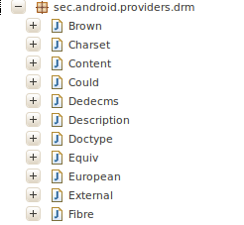
Evolution: AnserverBot
Heavy use of encryption
Heavy use of obfuscation
Anti-analysis
Security software detection
C&C servers
  Address is encrypted
  Public blog
String e=Xmlns.d("8CB9zKRj84uO"); -> onKeyDown
String f=Xmlns.d("8CBozKiTrtgdcxBNutkE8kMCzKFNHxMOKCRD") -> onGetApk_Install_version_id
String g=Xmlns.d("uIkEuxy_"); -> value
Encrypted payload
Svvdrz’s blog
HoiprJbh9CFE8CrOrCRO7cBw8CpO7CQhr2MW8tMeKNnp0JT57wrQfJjYfoFOXxyOHoig8S__
->
http://blog.sina.com.cn/s/blog_8440ab780100rnye.html
Courtesy Yajin Zhou et al.

Slide 32
Discussion
Most samples are repackaged
  Police the Android markets
More than one third samples enclose root exploits
  Apply patches timely
Nearly half of the samples subscribe to premium-rate services with background SMS
  Enhance Android framework
Mobile security apps can be improved
  Develop new defense solutions
Courtesy Yajin Zhou et al.

Slide 33
Conclusion
Present the first largest public Android malware collection
  Share with whole research community
Characterize the malware samples
Study the evolution of Android malware
Call for better anti-mobile-malware solutions
Courtesy Yajin Zhou et al.

Slide 34
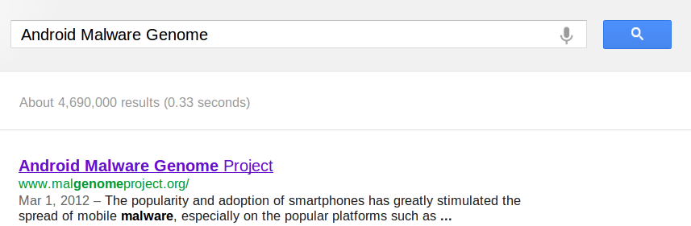
Dataset Release
Android Malware Genome Project
  http://malgenomeproject.org
Courtesy Yajin Zhou et al.

Slide 35
DroidRanger
DroidRanger: Non-virtualization-based malware detection
Known malware
  Permission-based filtering
  Behavioral footprint matching for known malware
Unknown malware
  Heuristic based filtering, e.g. dynamic loading new code
  Dynamic execution monitoring for unknown malware

Slide 36
Design Goal
Scalability
  Permission based filtering
Accuracy
  Behavioral footprint matching
Zero-day malware detection
  Heuristics based detection

Slide 37





System Overview
Malware Samples
Permission-based
Behavioral Footprints
Footprint-Based Detection Engine
Infection from
Known Malware
App
Repository
Representative Android Markets
Heuristics-Based Detection Engine
Infection from
Zero-day Malware
Heuristics
DroidRanger
Courtesy Yajin Zhou et al.

Slide 38
Footprint-Based Detection Engine
Filter apps with essential permissions
Malware | Essential Permissions | Apps
Geinimi | INTERNET, SEND_SMS | 7, 620 (4.17%)
ADRD | INTERNET, ACCESS_NETWORK_STATE RECEIVE_BOOT_COMPLETED | 10, 379 (5.68%)
Pjapps | INTERNET, RECEIVE_SMS | 4, 637 (2.54%)
Bgserv | INTERNET, RECEIVE_SMS, SEND_SMS | 2, 880 (1.58%)
DroidDream | CHANGE_WIFI_STATE | 4, 096 (2.24%)
zHash | CHANGE_WIFI_STATE | 4, 096 (2.24%)
BaseBridge | NATIVE CODE | 8, 272 (4.52%)
DroidDreamLight | INTERNET, READ_PHONE_STATE | 71, 095 (38.89%)
Zsone | RECEIVE_SMS, SEND_SMS | 3, 204 (1.75%)
jSMSHider | INSTALL_PACKAGES | 1, 210 (0.66%)
Reduced to 0.67% when considering a broadcast receiver
Courtesy Yajin Zhou et al.

Slide 39
Footprint-Based Detection Engine
Distill malware behaviors as behavioral footprint
  Information in manifest file
    Contain a receiver listening to SMS_RECEIVED
  Semantics in the byte-code
    Register a receiver listening to SMS_RECEIVED
    Call abortBroadcast in the receiver
    Send SMS messages to premium numbers
  Structural layout of the app
Match apps with malware behavioral footprints
Behavioral
footprint
of Zsone
Courtesy Yajin Zhou et al.
Notes:
Zsone is an SMS trojan. It sends short message to premium numbers and removes billing related notifications messages from service providers.

Slide 40
Heuristics-Based Detection Engine
Filter apps with dynamic Java/native code loading
  1055 apps load Java code
  508 apps load native code from non-standard locations
Monitor apps’ dynamic execution behaviors
  Java code: permission-related framework APIs
  Native code: system calls requiring root privileges
Courtesy Yajin Zhou et al.

Slide 41
Evaluation: Data Set
Crawled the official & four alternative markets
Collected 204,040 free apps during 05/2011-06/2011
Courtesy Yajin Zhou et al.

Slide 42
Evaluation: Overview
Malware | Official Market | eoeMarket | alcatelclub | gfan | mmoovv | Total
Known | 21 | 51 | 48 | 20 | 31 | 171
Zero-day | 11 | 9 | 10 | 1 | 9 | 40
Total | 32 (0.02%) | 60 (0.35%) | 58 (0.39%) | 21 (0.20%) | 40 (0.47%) | 211
Courtesy Yajin Zhou et al.

Slide 43
Evaluation: Known Malware Samples
20 samples from 10 malware families
Malware | First Report | Summary
Geinimi | 10/2010 | Trojan with bot-like capability
ADRD | 02/2011 | Trojan with bot-like capability
Pjapps | 02/2011 | Trojan with bot-like capability
Bgserv | 03/2011 | Trojan with bot-like capability
DroidDream | 03/2011 | Root exploit with Exploid, Rageagainstthecage
zHash | 03/2011 | Root exploit with Exploid
BaseBridge | 05/2011 | Root exploit with Rageagainstthecage
DroidDreamLight | 05/2011 | Trojan with information stealing capability
Zsone | 05/2011 | Trojan that sends premium-rate SMS
jSMSHider | 06/2011 | Trojan that target third-party firmware
Courtesy Yajin Zhou et al.
Notes:
Exploid: udev daemon, CHANGE_WIFI_STATE, Rageagainstthecage: adbd, Zimperlich: zygote

Slide 44
Evaluation: Apps Infected by Known Malware
first report: 10/2010
Courtesy Yajin Zhou et al.

Slide 45
Evaluation: False Positive
Courtesy Yajin Zhou et al.

Slide 46
Evaluation: False Negative
24 samples in 10 known families from contagio
DroidRanger detected 23 sample (96%)
  Missed a payload of DroidDream, not the malware itself
  Found one mis-categorized sample for ADRD
Courtesy Yajin Zhou et al.

Slide 47
Evaluation: Zero-day Malware
Detected two zero-day malware using heuristics
  Plankton: dynamic loading of Java code
  DroidKungFu: dynamic loading of native code
Detected 40 samples using behavioral footprints
  11 samples from the official Android Market
  30 samples from alternative Android Markets
Courtesy Yajin Zhou et al.

Slide 48
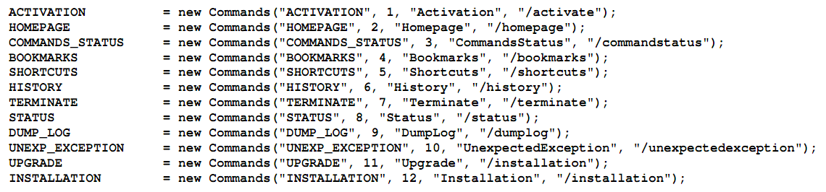
Evaluation: Zero-day Malware
Plankton behaviors
  Upload a list of permissions before downloading a payload
  Contain bot-like command & control channel
DroidKungFu behaviors
  Contain two encrypted root exploits
  Install a payload app mimicking Google Search
Courtesy Yajin Zhou et al.

Slide 49
Discussion
A call for rigorous vetting process
  A large number of user can be infected
  Malware can exist in alternative markets for a long time
  Root exploits are used by many malware
  Zero-day malware exists in Android markets
Need more comprehensive heuristics
  background sending of unauthorized SMS messages
  bot-like behavior controlled by SMS messages
Courtesy Yajin Zhou et al.
Notes:
DroidDream was reported to have infected 260,000 users before Google removed them. Possible limitations: free app only. More heuristics.

Slide 50
Related Work
Smartphone platform security
  TaintDroid (Enck et al., OSDI 10), PiOS (Egele et al., NDSS 11), Stowaway (Felt et al., CCS 11), Cells (Andrus et al., SOSP 11), AppFence (Hornyack et al., CCS 11), Quire (Dietz et al., USENIX Security 11), A Study of Android Application Security (Enck et al., USENIX Security 11), TISSA (Zhou et al., TRUST 11), Woodpecker (Grace et al., NDSS 12) …
Malware detection on mobile devices
  pBMDS (Xie et al., WiSec 10), VirusMeter (Liu et al., RAID 09), Crowdroid (Burguera et al., CCS-SPSM 11) …
Other systematic security study
  HoneyMonkey (Wang et al., NDSS 06), Systematic Web Spyware Study (Moshchuk et al., NDSS 06), All Your iFRAMEs Point to Us (Provo et al., USENIX Security 08) …
Courtesy Yajin Zhou et al.

Slide 51
Conclusion
DroidRanger is a system to systematically study the overall health of existing Android Markets
Malware | Official Market | eoeMarket | alcatelclub | gfan | mmoovv | Total
Known | 21 | 51 | 48 | 20 | 31 | 171
Zero-day | 11 | 9 | 10 | 1 | 9 | 40
Total | 32 (0.02%) | 60 (0.35%) | 58 (0.39%) | 21 (0.20%) | 40 (0.47%) | 211
Courtesy Yajin Zhou et al.

Slide 52
DroidScope Virtualization-based malware detection
Runs as a VM
  Reconstruct OS, Dalvik VM and native view

Slide 53
Android
Java Components
System Services
Native Components
Apps
Courtesy Lok Kwong Yan & Heng Yin

Slide 54
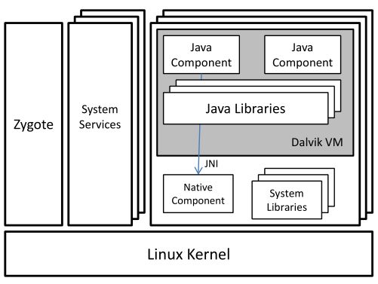
Android
Java Components
System Services
Native Components
Apps
Courtesy Lok Kwong Yan & Heng Yin

Slide 55
Motivation: Static Analysis
Dalvik/Java Static Analysis:
ded, Dexpler, soot,
Woodpecker, DroidMoss
Native Static Analysis:
IDA, binutils, BAP
Courtesy Lok Kwong Yan & Heng Yin

Slide 56
Motivation: Dynamic Analysis
Android Analysis:
TaintDroid, DroidRanger
System Calls
logcat, adb
Courtesy Lok Kwong Yan & Heng Yin

Slide 57
Motivation: Dynamic Analysis
External Analysis: Anubis, Ether, TEMU, …
Courtesy Lok Kwong Yan & Heng Yin

Slide 58
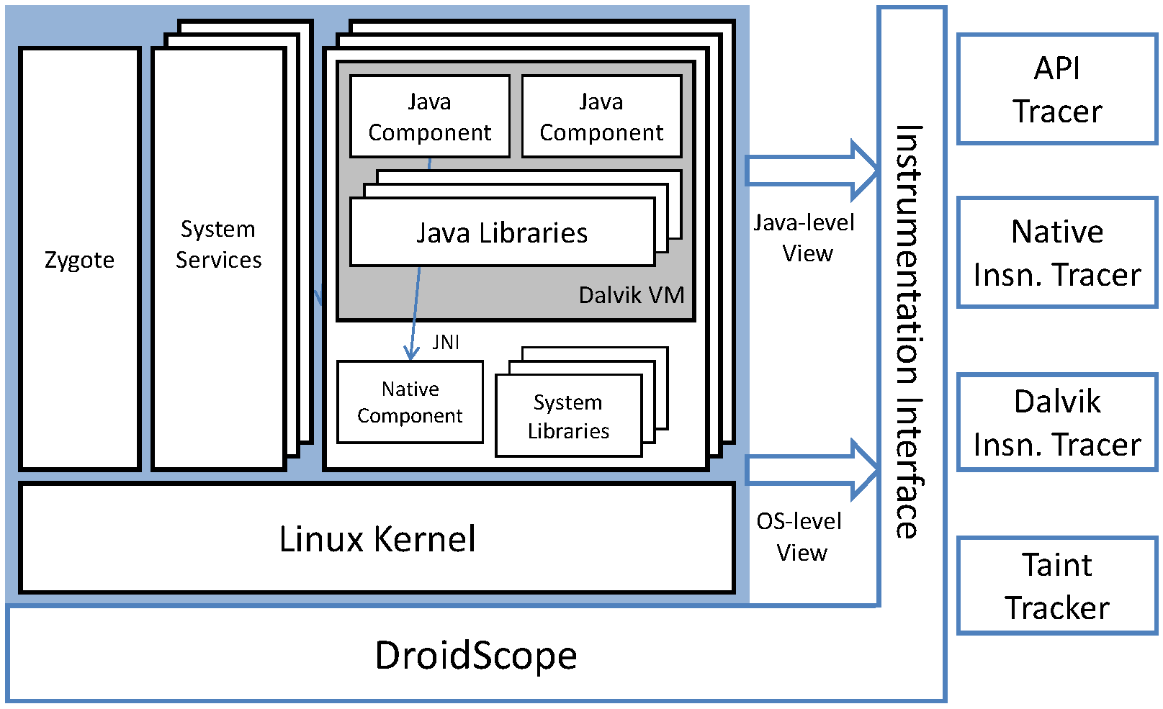
DroidScope Overview
Courtesy Lok Kwong Yan & Heng Yin

Slide 59
Goals
Dynamic binary instrumentation for Android
  Leverage Android Emulator in SDK
  No changes to Android Virtual Devices
  External instrumentation
    Linux context
    Dalvik context
  Extensible: plugin-support / event-based interface
  Performance
    Partial JIT support
    Instrumentation optimization
Courtesy Lok Kwong Yan & Heng Yin

Slide 60
Roadmap
External instrumentation
  Linux context
  Dalvik context
Extensible: plugin-support / event-based interface
Evaluation
  Performance
  Usage
Courtesy Lok Kwong Yan & Heng Yin

Slide 61
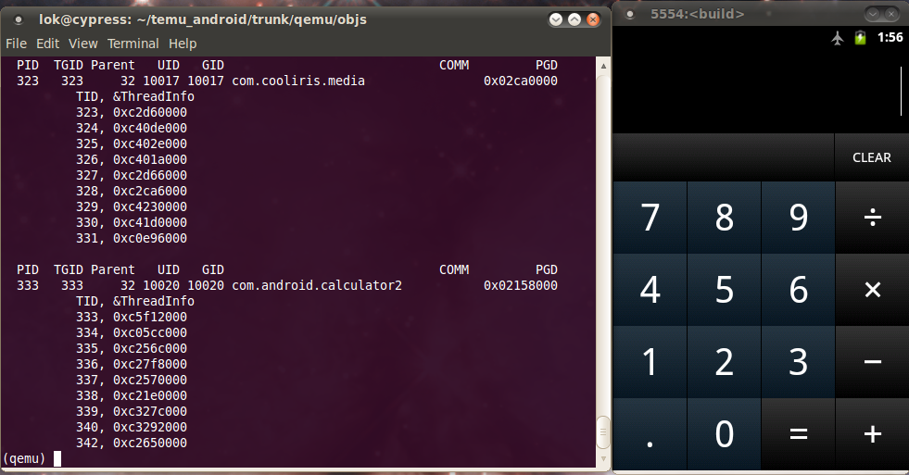
Linux Context: Identify App(s)
Shadow task list
  pid, tid, uid, gid, euid, egid, parent pid, pgd, comm
  argv[0]
Shadow memory map
  Address Space Layout Randomization (Ice Cream Sandwich)
Update on
  fork, execve, clone, prctl and mmap2

Slide 62
Java/Dalvik View
Dalvik virtual machine
  register machine (all on stack)
  256 opcodes
  saved state, glue, pointed to by ARM R6, on stack in x86
mterp
  offset-addressing: fetch opcode then jump to (dvmAsmInstructionStart + opcode * 64)
  dvmAsmSisterStart for emulation overflow
Which Dalvik opcode?
  Locate dvmAsmInstructionStart in shadow memory map
  Calculate opcode = (R15 - dvmAsmInstructionStart) / 64.
Courtesy Lok Kwong Yan & Heng Yin

Slide 63
Just In Time (JIT) Compiler
Designed to boost performance
Triggered by counter - mterp is always the default
Trace based
  Multiple basic blocks
  Multiple exits or chaining cells
  Complicates external introspection
  Complicates instrumentation
Courtesy Lok Kwong Yan & Heng Yin

Slide 64
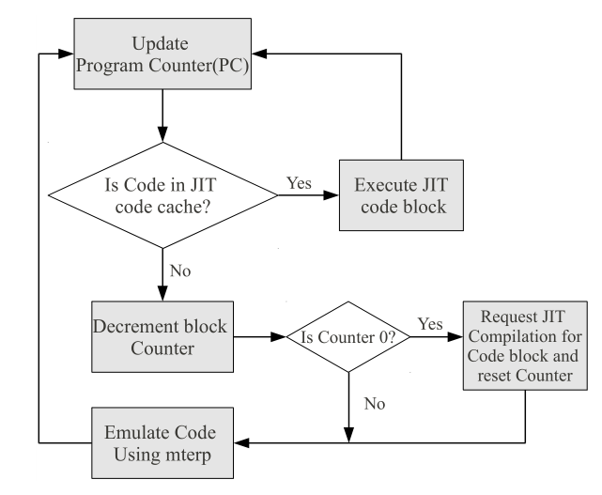
Disabling JIT
dvmGetCodeAddr(PC)
!= NULL
Courtesy Lok Kwong Yan & Heng Yin

Slide 65
Roadmap
External instrumentation
  Linux context
  Dalvik context
Extensible: plugin-support / event-based interface
Evaluation
  Performance
  Usage
Courtesy Lok Kwong Yan & Heng Yin

Slide 66
Instrumentation Design
Event based interface
  Execution: e.g. native and Dalvik instructions
  Status: updated shadow task list
Query and Set, e.g. interpret and change cpu state
Performance
  Example: Native instructions vs. Dalvik instructions
  Instrumentation Optimization
Courtesy Lok Kwong Yan & Heng Yin

Slide 67
Dynamic Instrumentation
Update PC
(un)registerCallback
inCache?
yes
needFlush?
no
yes
Translate
flushType
Execute
invalidateBlock(s)
flushCache
Courtesy Lok Kwong Yan & Heng Yin

Slide 68
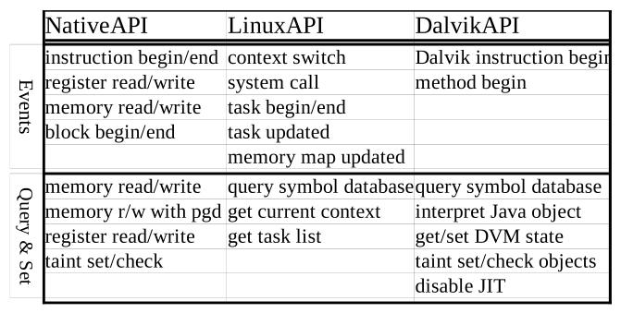
Instrumentation
Courtesy Lok Kwong Yan & Heng Yin

Slide 69
Dalvik Instruction Tracer (Example)
1. void opcode_callback(uint32_t opcode) {
2. printf("[%x] %s\n", GET_RPC, opcodeToStr(opcode));
3. }
4.
5. void module_callback(int pid) {
6. if (bInitialized || (getIBase(pid) == 0))
7. return;
8.
9. gva_t startAddr = 0, endAddr = 0xFFFFFFFF;
10.
11. addDisableJITRange(pid, startAddr, endAddr);
12. disableJITInit(getGetCodeAddrAddress(pid));
13. addMterpOpcodesRange(pid, startAddr, endAddr);
14. dalvikMterpInit(getIBase(pid));
15. registerDalvikInsnBeginCb(&opcode_callback);
16. bInitialized = 1;
17. }
18.
19. void _init() {
20. setTargetByName("com.andhuhu.fengyinchuanshuo");
21. registerTargetModulesUpdatedCb(&module_callback);
22. }
getModAddr(“dfk@classes.dex”, &startAddr, &endAddr);
Courtesy Lok Kwong Yan & Heng Yin

Slide 70
Plugins
API Tracer
  System calls
    open, close, read, write, includes parameters and return values
  Native library calls
  Java API calls
    Java Strings converted to C Strings
Native and Dalvik Instruction Tracers
Taint Tracker
  Taints ARM instructions
  One bit per byte
  Data movement & Arithmetic instructions including barrel shifter
  Does not support control flow tainting
Courtesy Lok Kwong Yan & Heng Yin

Slide 71
Roadmap
External instrumentation
  Linux context
  Dalvik context
Extensible: plugin-support / event-based interface
Evaluation
  Performance
  Usage

Slide 72
Implementation
Configuration
  QEMU 0.10.50 – part of Gingerbread SDK
  Gingerbread
    “user-eng”
    No changes to source
  Linux 2.6.29, QEMU kernel branch
Courtesy Lok Kwong Yan & Heng Yin

Slide 73
Performance Evaluation
Seven free benchmark Apps
  AnTuTu Benchmark
  (ABenchMark) by AnTuTu
  CaffeineMark by Ravi Reddy
  CF-Bench by Chainfire
  Mobile processor benchmark (Multicore) by Andrei Karpushonak
  Benchmark by Softweg
  Linpack by GreeneComputing
Six tests repeated five times each
  Baseline
  NO-JIT Baseline – uses a build with JIT disabled at runtime
  Context Only
  API Tracer
  Dalvik Instruction Trace
  Taint Tracker
Courtesy Lok Kwong Yan & Heng Yin

Slide 74
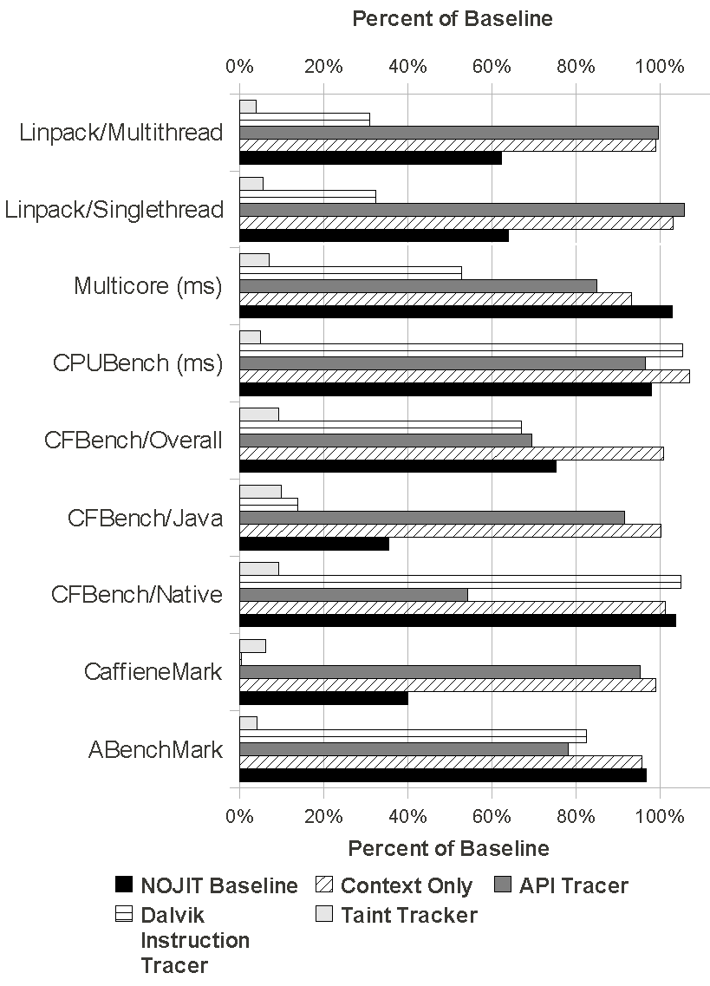
Select Performance Results
APITracer vs. NOJIT
Results are not perfect
Dynamic Symbol Retrieval Overhead
Courtesy Lok Kwong Yan & Heng Yin

Slide 75
Usage Evaluation
Use DroidScope to analyze real world malware
  API Tracer
  Dalvik Instruction Tracer + dexdump
  Taint Tracker – taint IMEI/IMSI @ move_result_object after getIMEI/getIMSI
Analyze included exploits
  Removed patches in Gingerbread
  Intercept system calls
  Native instruction tracer
Courtesy Lok Kwong Yan & Heng Yin

Slide 76
Droid Kung Fu
Three encrypted payloads
  ratc (Rage Against The Cage)
  killall (ratc wrapper)
  gjsvro (udev exploit)
Three execution methods
  piped commands to a shell (default execution path)
  Runtime.exec() Java API (instrumented path)
  JNI to native library terminal emulator (instrumented path)
  Instrumented return values for isVersion221 and getPermission methods
Courtesy Lok Kwong Yan & Heng Yin

Slide 77
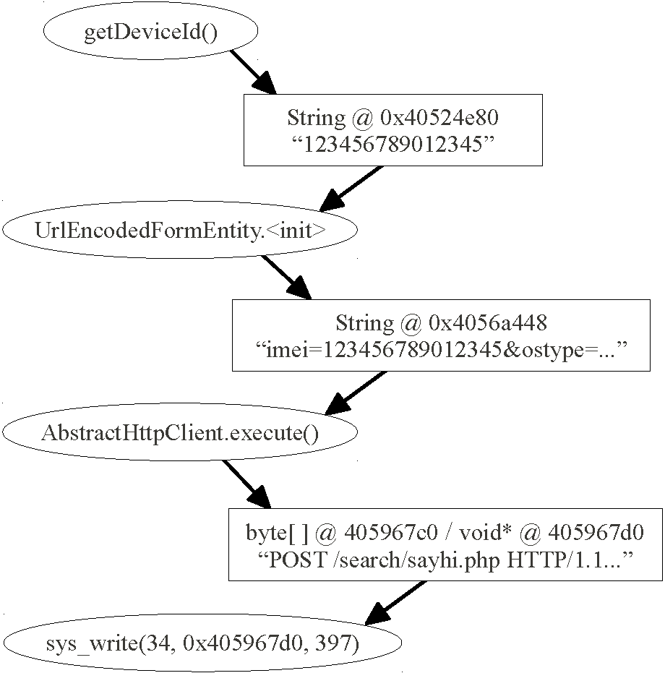
Droid Kung Fu: TaintTracker
Courtesy Lok Kwong Yan & Heng Yin

Slide 78
Challenges
JIT
  Full JIT support
  Flushing JIT cache
Emulation detection
  Real Sensors: GPS, Microphone, etc.
  Bouncer
Timing assumptions, timeouts, events
Closed source systems, e.g. iOS
Courtesy Lok Kwong Yan & Heng Yin

Slide 79
Summary
DroidScope
  Dynamic binary instrumentation for Android
  Built on Android Emulator in SDK
  External Introspection & Instrumentation support
  Four plugins
    API Tracer
    Native Instruction Tracer
    Dalvik Instruction Tracers
    TaintTracker
  Partial JIT support
Courtesy Lok Kwong Yan & Heng Yin

