Slide 1
Cellular Networks and Mobile Computing
COMS 6998-7, Spring 2014
Instructor: Li Erran Li (lel2139@columbia.edu)
http://www.cs.columbia.edu/~lierranli/coms6998-7Spring2014/
4/7/2014: Mobile Cloud Computing

Slide 2
Syllabus
Mobile App Development (lecture 1,2,3)
  Mobile operating systems: iOS and Android
  Development environments: Xcode, Eclipse with Android SDK
  Programming: Objective-C and android programming
System Support for Mobile App Optimization (lecture 4,5)
  Mobile device power models, energy profiling and ebug debugging
  Core OS topics: virtualization, storage and OS support for power and context management
Interaction with Cellular Networks (lecture 6,7,8)
  Basics of 3G/LTE cellular networks
  Mobile application cellular radio resource usage profiling
  Measurement-based cellular network and traffic characterization
Interaction with the Cloud (lecture 10)
  Mobile cloud computing platform services: push notification, iCloud and Google Cloud Messaging
  Mobile cloud computing architecture and programming models
Mobile Platform Security and Privacy (lecture 11,12,13)
  Mobile platform security: malware detection and characterization, attacks and defenses
  Mobile data and location privacy: attacks, monitoring tools and defenses

Slide 3
Outline
Mobile cloud platform services
Existing programming model for code offloading
  MAUI
  Odessa
  CloneCloud
  COMET: code offloading using distributed shared memory
Advancing the state of mobile cloud computing

Slide 4

Mobile Cloud Computing (mCloud) today
Apple iCloud
  Store content in cloud and sync to all registered devices
  Hosted by Windows Azure and Amazon AWS
  iCloud Storage APIs support third-party app document syncing

Slide 5

Mobile Cloud Computing today (Cont’d)
Amazon Silk browser
  Accelerates web access
  Learns user behavior and precache
  Intelligently partition work between local and Amazon cloud

Slide 6
Social Network Services
iOS social framework in core service layer
Facebook, twitter account needs to be configured
Social Framework includes a controller called SLComposeViewController
  An instance must be created: SLComposeViewController *socialController = [SLComposeViewController composeViewControllerForServiceType:socialNetwork];
Calling the API
  if([SLComposeViewController isAvailableForServiceType:socialNetwork]){
  SLComposeViewControllerCompletionHandler __block completionHandler=^(SLComposeViewControllerResult result){
  [socialController dismissViewControllerAnimated:YES completion:nil];
  switch(result){
  case SLComposeViewControllerResultCancelled:
  default:
  NSLog(@"Cancelled.....");
  break;
  case SLComposeViewControllerResultDone:
  NSLog(@"Posted....");
  break;
  }
  };

Slide 7
Social Network Services (Cont’d)
  [socialController addImage:[UIImage
  imageNamed:@"CollatzFractal.png"]];
  [socialController setInitialText:@"Solve the 3x+1 math puzzle."];
  [socialController addURL:[NSURL
  URLWithString:@"http://en.wikipedia.org/wiki/
  Collatz_conjecture"]];
  [socialController
  setCompletionHandler:completionHandler];
  [self presentModalViewController:socialController animated:YES];
  }

Slide 8
Social Network Services (Cont’d)
Also support http request to social networks
NSDictionary *parameters = @{@"message": @"My first iOS 6 Facebook posting "};
NSURL *feedURL = [NSURL URLWithString:@"http://www.facebook.com/erran"];
SLRequest *feedRequest = [SLRequest
requestForServiceType:SLServiceTypeFacebook
requestMethod:SLRequestMethodGET
// requestMethod:SLRequestMethodPOST
URL:feedURL
parameters:parameters];
feedRequest.account = facebookAccount;
[feedRequest performRequestWithHandler:^(NSData *responseData,
NSHTTPURLResponse *urlResponse, NSError *error)
{
// Handle response
NSString *response = [[NSString alloc] initWithData:responseData
encoding:NSUTF8StringEncoding];
NSLog(@"feedRequest response, status code: %d, data:%@", urlResponse.statusCode,
response);
}];

Slide 9
iCloud
Fundamentally: nothing more than a URL of a shared directory
Two storage models
  iCloud document storage: store user documents and app data in the user’s iCloud account
  iCloud key-value data storage: share small amounts of noncritical configuration data among instances of your app
iCloud-specific entitlements required
  Select your app target in Xcode
  Select the Summary tab
  In the Entitlements section, enable the Enable Entitlements checkbox

Slide 10
iCloud (Cont’d)
Check availability: URLForUbiquityContainerIdentifier:
All files and directories stored in iCloud must be managed by a file presenter object, and all changes you make to those files and directories must occur through a file coordinator object. A file presenter is an object that adopts the NSFilePresenter protocol
Explicitly move files to iCloud
Be prepared to handle version conflicts for a file
Make use of searches to locate files in iCloud
Be prepared to handle cases where files are in iCloud but not fully downloaded to the local device; this might require providing the user with feedback
Use Core Data for storing live databases in iCloud; do not use SQLite

Slide 11
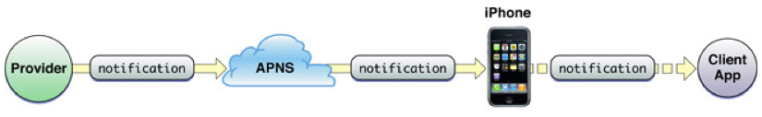
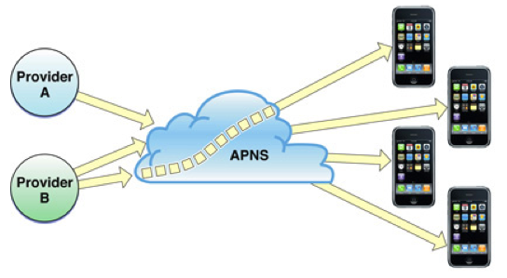
Apple Push Notification Architecture Overview
iOS device maintains a persistent TCP connection to a Apple Push Notification Server(APNS)
A push notification from a provider to a client application
Multi-providers to multiple devices
Notes:
Each push notification carries with it a payload. The payload specifies how users are to be alerted to the data waiting to be downloaded to the client application. The maximum size allowed for a notification payload is 256 bytes; Apple Push Notification Service refuses any notification that exceeds this limit. Remember that delivery of notifications is “best effort” and is not guaranteed.
For each notification, providers must compose a JSON dictionary object that strictly adheres to RFC 4627. This dictionary must contain another dictionary identified by the key aps. The aps dictionary contains one or more properties that specify the following actions:
An alert message to display to the user
A number to badge the application icon with
A sound to play

Slide 12
Apple Push Notification Architecture Overview (Cont’d)
What if devices uninstalled the app?
  Feedback service
    App providers poll to obtain list of device tokens for their applications
    Apple push notification service informs providers in case of repeated failures
What if devices are offline?
  QoS service
    QoS stores the notification
    It retains only the last notification received from a provider
    When the offline device reconnects, QoS service forwards the stored notification to the device
    QoS service retains a notification for a limited period before deleting it
Notes:
Each push notification carries with it a payload. The payload specifies how users are to be alerted to the data waiting to be downloaded to the client application. The maximum size allowed for a notification payload is 256 bytes; Apple Push Notification Service refuses any notification that exceeds this limit. Remember that delivery of notifications is “best effort” and is not guaranteed.
For each notification, providers must compose a JSON dictionary object that strictly adheres to RFC 4627. This dictionary must contain another dictionary identified by the key aps. The aps dictionary contains one or more properties that specify the following actions:
An alert message to display to the user
A number to badge the application icon with
A sound to play

Slide 13
Push Notification
Push notification
  Delivery is best effort and is not guaranteed
  Max size is 256 bytes
  Providers compose a JSON dictionary object
    This dictionary must contain another dictionary identified by the key aps
  Action:
    An alert message to display to the user
    A number to badge the application icon with
    A sound to play
Notes:
Each push notification carries with it a payload. The payload specifies how users are to be alerted to the data waiting to be downloaded to the client application. The maximum size allowed for a notification payload is 256 bytes; Apple Push Notification Service refuses any notification that exceeds this limit. Remember that delivery of notifications is “best effort” and is not guaranteed.
For each notification, providers must compose a JSON dictionary object that strictly adheres to RFC 4627. This dictionary must contain another dictionary identified by the key aps. The aps dictionary contains one or more properties that specify the following actions:
An alert message to display to the user
A number to badge the application icon with
A sound to play

Slide 14
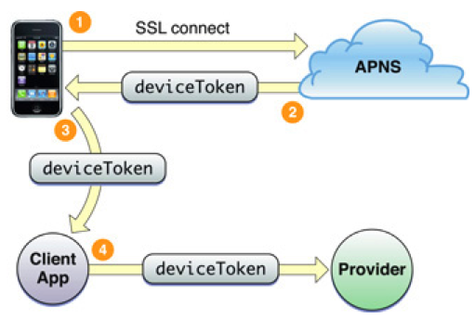
Device Token
Device token is analogous to a phone number
  Contains information that enables APNs to locate the device
  Client app needs to provide the token to its provider
  Device token should be requested and passed to providers every time your application launches
Notes:
By requesting the device token and passing it to the provider every time your application launches, you help to ensure that the provider has the current token for the device. If a user restores a backup to a device or computer other than the one that the backup was created for (for example, the user migrates data to a new device or computer), he or she must launch the application at least once for it to receive notifications again. If the user restores backup data to a new device or computer, or reinstalls the operating system, the device token changes. Moreover, never cache a device token and give that to your provider; always get the token from the system whenever you need it. If your application has previously registered, calling registerForRemoteNotificationTypes: results in the operating system passing the device token to the delegate immediately without incurring additional overhead.

Slide 15
Apple Push Notification Programming Example
Provisioning: https://developer.apple.com/ios/manage/provisioningprofiles/howto.action
  Generate Certification Signing Request (CSR) using Keychain Access
    Save to disk: PushChat.certSigningRequest
    Export the private key as “PushChatKey.p12” and enter a passphrase
  Make an App ID in iOS Provisioning Portal
    Check the Enable for Apple Push Notification service box
    Click on the Configure button for the Development Push SSL Certificate
    Click Download to get the certificate – it is named “aps_development.cer”

Slide 16
Apple Push Notification Programming Example (Cont’d)
Client code
  - (BOOL)application:(UIApplication *)application didFinishLaunchingWithOptions:(NSDictionary *)launchOptions
  {
  // Let the device know we want to receive push notifications
  [[UIApplication sharedApplication] registerForRemoteNotificationTypes:
  (UIRemoteNotificationTypeBadge | UIRemoteNotificationTypeSound | UIRemoteNotificationTypeAlert)];
  return YES;
  }
  - (void)application:(UIApplication*)application didReceiveRemoteNotification:(NSDictionary*)userInfo
  {//userInfo contains the notification
  NSLog(@"Received notification: %@", userInfo);
  }
  - (void)application:(UIApplication*)application didRegisterForRemoteNotificationsWithDeviceToken:(NSData*)deviceToken
  {
  NSLog(@"My token is: %@", deviceToken);
  }
Notes:
A major role of a UIApplication object is to handle the initial routing of incoming user events. It also dispatches action messages forwarded to it by control objects (UIControl) to the appropriate target objects. In addition, the UIApplication object maintains a list of all the windows (UIWindow objects) currently open in the application, so through those it can retrieve any of the application’s UIView objects. The application object is typically assigned a delegate, an object that the application informs of significant runtime events—for example, application launch, low-memory warnings, and application termination—giving it an opportunity to respond appropriately.
Applications can cooperatively handle a resource such as an email or an image file through the openURL: method. For example, an application opening an email URL with this method may cause the mail client to launch and display the message.
The programmatic interfaces of UIApplication and UIApplicationDelegate also allow you to manage behavior that is specific to the device. You can control application response to changes in interface orientation, temporarily suspend incoming touch events, and turn proximity sensing (of the user’s face) off and on again.

Slide 17
Apple Push Notification Programming Example (Cont’d)
Server code
  $devicetoken ='f05571e4be60a4e11524d76e4366862128f430522fb470c46fc6810fffb07af7’;
  // Put your private key's passphrase here:
  $passphrase = 'PushChat';
  // Put your alert message here:
  $message = 'Erran: my first push notification!';
  $ctx = stream_context_create();
  Stream_context_set_option($ctx, 'ssl', 'local_cert', 'ck.pem');
  stream_context_set_option($ctx, 'ssl', 'passphrase', $passphrase);
  // Open a connection to the APNS server
  $fp = stream_socket_client(
  'ssl://gateway.sandbox.push.apple.com:2195', $err,
  $errstr, 60, STREAM_CLIENT_CONNECT|STREAM_CLIENT_PERSISTENT, $ctx);
  if (!$fp)
  exit("Failed to connect: $err $errstr" . PHP_EOL);
  echo 'Connected to APNS' . PHP_EOL;
  // Create the payload body
  $body['aps'] = array(
  'alert' => $message,
  'sound' => 'default'
  );
  // Encode the payload as JSON
  $payload = json_encode($body);
  // Build the binary notification
  $msg = chr(0) . pack('n', 32) . pack('H*', $deviceToken) . pack('n', strlen($payload)) . $payload;
  // Send it to the server
  $result = fwrite($fp, $msg, strlen($msg));
  if (!$result)
  echo 'Message not delivered' . PHP_EOL;
  else
  echo 'Message successfully delivered' . PHP_EOL;
  // Close the connection to the server
  fclose($fp);

Slide 18
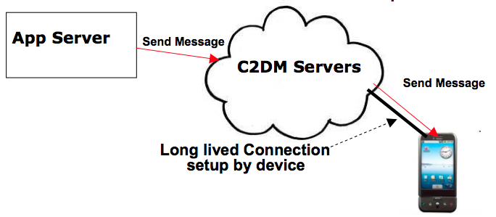
Google Cloud Messaging (Cont’d)
GCM Servers
Push notification problems
  Network firewalls prevent servers from directly sending messages to mobile devices
GCM solution
  Maintain a connection between device and Google GCM server
  Push server updates to apps on the device via this connection
  Optimize this connection to minimize bandwidth and battery consumption (e.g. adjusting the frequency of keep alive messages)
Send-to-sync messages vs. messages with payload
An application can send messages to one or more devices (multicast)

Slide 19
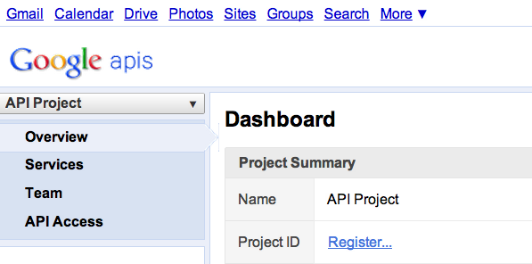
Google Cloud Messaging (Cont’d)
Step 1
Create a Google API project from Google APIs console pagehttps://code.google.com/apis/console/#project:908058729336
  Enable GCM service
  Obtain an API key
  Create new server key
  Install helper libraries

Slide 20
Google Cloud Messaging (Cont’d)
Step 2
Write the Android app
  Copy gcm.jar file into your app classpath
  Configure manifest file for SDK version, permission
  Add broadcast receiver
  Add intent service
  Write my_app_package.GCMIntentService class
  Write main activity
import com.google.android.gcm.GCMRegistrar;
…
GCMRegistrar.checkDevice(this);
GCMRegistrar.checkManifest(this);
final String regId = GCMRegistrar.getRegistrationId(this);
if (regId.equals("")) {
GCMRegistrar.register(this, SENDER_ID);
} else {
Log.v(TAG, "Already registered");
}

Slide 21
Google Cloud Messaging (Cont’d)
Step 3
Write server-side app
  Copy gcm-server.jar file from the SDK’s gcm-server/dist directory to your server class path
  Create a servlet that can be used to receive client’s GCM registration ID
  Create a servlet to unregister registration ID
  Use com.google.android.gcm.server.Sender helper class from GCM library to send a message to client
import com.google.android.gcm.server.*;
Sender sender = new Sender(myApiKey);
Message message = new Message.Builder().build();
MulticastResult result = sender.send(message, devices, 5);

Slide 22
mCloud Fundamental Challenges
What architecture best supports mCloud?
What programming model best enables client to tap mCloud resources?
What are basic services or building blocks for mCloud?
What best supports service interaction?

Slide 23
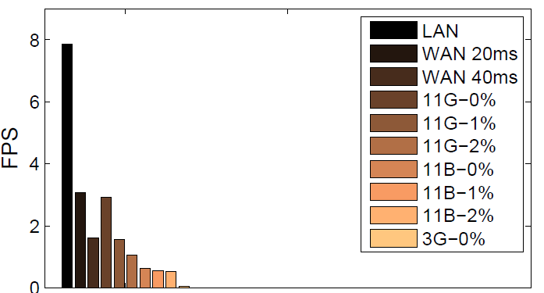
mCloud Architecture
Resource-intensive mobile applications
  Face recognition for social networking app
  Gesture recognition for control media app
  Object and post recognition for augmented reality app
End-to-end latency and througput matters for crisp interaction
  Augmented reality need to display results within 1 sec
  Need high data rate processing capability, low frame rate can miss gesture
Delay, loss on frame rate of video
stream transfer [Odessa, 2011]

Slide 24
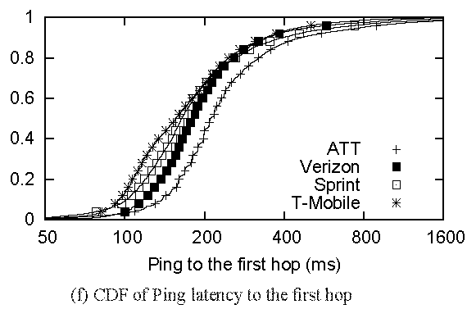
mCloud Architecture (Cont’d)
WAN performance
  First hop latency in 3G is 200ms
  Verizon LTE :128ms, 6.44 Mbps downlink, 5Mbps uplink [Pcworld, March 2011]
There is a need for a middle tier
cloudlet = (compute cluster
+ wireless access point
+ wired Internet access
+ no battery limitations)
→ “data center in a box”
“Anatomizing Application Performance Differences on Smartphones”,
MobiSys 2010 (Huang et al)

Slide 25




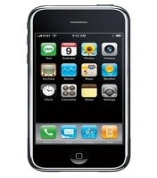
mCloud Architecture (Cont’d)
Cloudlet possible locations
Cellular providers has a unique advantage
Regional Data centers (RDC)
RDC_{A1}
Wireless Core
RDC_{B1}
RNC
Internet
BS
Storage
nodes
Compute
nodes
RDC_{B2}
RDC_{A2}
WiFi AP
Possible locations
of cloudlet

Slide 26
mCloud Programming Model
MAUI: RPC based offloading architecture
CloneCloud: tight synchronization between cloud and phone
Odessa: data-flow graph to exploit parallelism in perception applications
COMET: distributed shared memory
MAUI, CloneCloud , Odessa all have profiler, solver
 | MAUI | CloneCloud | Odessa | COMET
Remote execution unit | Methods (RMI) | Threads (method entry/exit) | Tasks | Threads (any place)

Slide 27
mCloud Programming Model: MAUI
Combine extensive profiling with an ILP solver
  Makes dynamic offload decisions
  Optimize for energy reduction
  Profile: device, network, application
Leverage modern language runtime (.NET CLR)
  Portability:
    Mobile (ARM) vs Server (x86)
    .NET Framework Common Intermediate Language
  Type-Safety and Serialization:
    Automate state extraction
  Reflection:
    Identifies methods with [Remoteable] tag
    Automates generation of RPC stubs

Slide 28
mCloud Programming Model: MAUI (Cont’d)
MAUI architecture
Application
Application
Maui Runtime
Maui Runtime
Handles Errors
Client Proxy
Server Proxy
Provides runtime information
RPC
Intercepts Application Calls
Synchronizes State
Profiler
Profiler
RPC
Solver
Solver
Chooses local or remote
Maui Controller
Smartphone
Maui server
Source: MAUI Mobisys presentation
Notes:
the MAUI coordinator, which handles authentication
and resource allocation for incoming requests to instantiate a partitioned
application.

Slide 29
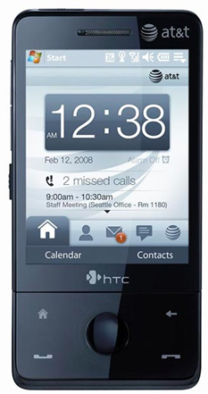
MAUI Profiler
CPU Cycles
State size
Device Profile
Execution Time
Network Latency
Profiler
Callgraph
Network Bandwidth
Computational Power Cost
Computational Delay
Annotated Callgraph
Network Power Cost
Network Delay
Computational Delay
Source: MAUI Mobisys presentation

Slide 30
MAUI Solver
A sample callgraph
C
5000 mJ
3000 ms
10000 mJ
A
1000mJ
B
900 mJ
15ms
Energy and delay for state transfer
Computation energy and delay for execution
25000 mJ
D
15000 mJ
12000 ms
Source: MAUI Mobisys presentation

Slide 31
Is Global Program Analysis Needed?
Yes! – This simple example from Face Recognition app shows why local analysis fails.
InitializeFace
Recognizer
5000 mJ
10000 mJ
User
Interface
1000mJ
FindMatch
900 mJ
Cheaper to do local
25000 mJ
DetectAndExtract Faces
15000 mJ
Source: MAUI Mobisys presentation

Slide 32
Is Global Program Analysis Needed?
Yes! – This simple example from Face Recognition app shows why local analysis fails.
InitializeFace
Recognizer
5000 mJ
10000 mJ
Cheaper to do local
User
Interface
1000mJ
FindMatch
900 mJ
25000 mJ
DetectAndExtract Faces
15000 mJ
Source: MAUI Mobisys presentation
Cheaper to do local

Slide 33
Is Global Program Analysis Needed?
InitializeFace
Recognizer
User
Interface
1000mJ
FindMatch
25900mJ
Cheaper to offload
DetectAndExtract Faces
Source: MAUI Mobisys presentation

Slide 34
Can MAUI Adapt to Changing Conditions?
Adapt to:
  Network Bandwidth/Latency Changes
  Variability on method’s computational requirements
Experiment:
  Modified off the shelf arcade game application
  Physics Modeling (homing missiles)
  Evaluated under different latency settings
Source: MAUI Mobisys presentation

Slide 35
Can MAUI Adapt to Changing Conditions?
HandleEnemies
11KB + missiles
11KB + missiles
DoFrame
DoLevel
HandleBonuses
11KB + missiles
missiles
Required state is smaller
*Missiles take around 60 bytes each
HandleMissiles
Source: MAUI Mobisys presentation
Complexity increases with # of missiles

Slide 36
Case 1
HandleEnemies
Zero Missiles
Low latency (RTT < 10ms)
DoFrame
DoLevel
HandleBonuses
Offload starting at DoLevel
HandleMissiles
Source: MAUI Mobisys presentation
Computation cost is close to zero
*Missiles take around 60 bytes each

Slide 37
Case 2
HandleEnemies
5 Missiles
Some latency (RTT = 50ms)
DoFrame
DoLevel
HandleBonuses
Very expensive to offload everything
Little state to offload
HandleMissiles
Only offload Handle Missiles
Source: MAUI Mobisys presentation
Most of the computation cost
*Missiles take around 60 bytes each

Slide 38
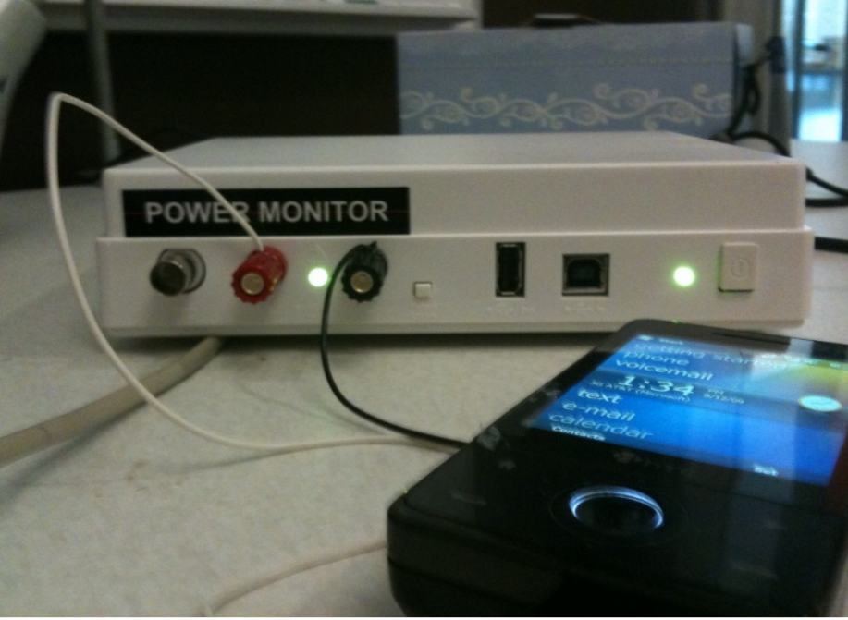
MAUI Implementation
Platform
  Windows Mobile 6.5
  .NET Framework 3.5
  HTC Fuze Smartphone
  Monsoon power monitor
Applications
  Chess
  Face Recognition
  Arcade Game
  Voice-based translator
Source: MAUI Mobisys presentation

Slide 39
Questions
How much can MAUI reduce energy consumption?
How much can MAUI improve performance?
Can MAUI Run Resource-Intensive Applications?
Source: MAUI Mobisys presentation

Slide 40
How much can MAUI reduce energy consumption?
Face Recognizer
An order of magnitude improvement on Wi-Fi
Big savings even on 3G
Source: MAUI Mobisys presentation

Slide 41
How much can MAUI improve performance?
Face Recognizer
Improvement of around an order of magnitude
Source: MAUI presentation

Slide 42
Latency to server impacts the opportunities for fine-grained offload
Arcade Game
Solver would decide not to offload
Up to 40% energy savings on Wi-Fi
Source: MAUI Mobisys presentation

Slide 43
Can MAUI Run Resource-Intensive Applications?
Translator
Can be run on the phone with MAUI
CPU Intensive even on a Core 2 Duo PC
Source: MAUI Mobisys presentation

Slide 44
Conclusions
MAUI enables developers to:
  Bypass the resource limitations of handheld devices
  Low barrier entry: simple program annotations
For a resource-intensive application
  MAUI reduced energy consumed by an order of magnitude
  MAUI improved application performance similarly
MAUI adapts to:
  Changing network conditions
  Changing applications CPU demands
Source: MAUI Mobisys presentation

Slide 45
mCloud Programming Model: CloneCloud
Offloading decision done at beginning of execution

Slide 46
The Before-After Picture
Courtesy: Byung-Gon Chun et. al.

Slide 47
CloneCloud v1 Architecture
Courtesy: Byung-Gon Chun et. al.

Slide 48
AppVM Clones
Virtual machine of entire client device
  Android x86 VM natively executed on VMWare in an x86 machine
Synchronized file systems
Courtesy: Byung-Gon Chun et. al.

Slide 49
Partitioning
Where to partition code,
satisfying any constraints for correctness,
so as to optimize for current conditions
Courtesy: Byung-Gon Chun et. al.

Slide 50
Automatic Partitioning Framework
Optimal
partitioning
points
Partitioning
constraints
Identify valid split points
Application
binary
Static
analysis
location-
constraints
Optimization
solver
Pick best choice for an objective
Profiling
inputs
Dynamic
profiling
cost-annotated
executions
Construct cost models
Partition Analyzer
Courtesy: Byung-Gon Chun et. al.

Slide 51
Partitioning: Static Analysis
Partitioning points
  Restrict to method entry/exit
Identify “pinned” methods
  Identify framework library methods
Identify mutually dependent native state
  Class natives stay together
Collect static control flow
  Who calls whom
Courtesy: Byung-Gon Chun et. al.

Slide 52
Partitioning: Profiling
Pick k invocations
For each invocation
  Run app on mobile device
  Run app on clone
For each method
  Execution time
  Context size entry/exit
  Estimate of energy consumption
Courtesy: Byung-Gon Chun et. al.

Slide 53
Partitioning: Intuition
Partitioning points splice profile trees together
Context size used to estimate network cost
Courtesy: Byung-Gon Chun et. al.

Slide 54
Partitioning: Optimization
List all partitioning choices
Remove partitioning choices that do not meet the constraints
For each choice, compute total time
Find the minimum
Courtesy: Byung-Gon Chun et. al.

Slide 55
Distributed Execution
How to seamlessly execute the partitions of an application locally and remotely
Courtesy: Byung-Gon Chun et. al.

Slide 56
Migration Architecture
Courtesy: Byung-Gon Chun et. al.

Slide 57
Migration: Suspend-Transmit-Resume
Mobile device
Clone
At migration point
  Suspend thread
  Capture context
  Transmit
  Launch process
  Patch migrated context
  Resume thread
  Suspend thread
  Capture context
At reintegration point
Transmit
  Merge migrated
  context
  Resume thread
Courtesy: Byung-Gon Chun et. al.

Slide 58
Migration Challenges
Regular IDs (references) not globally unique
  Address space difference between mobile device and clone
System objects created at boot everywhere
Courtesy: Byung-Gon Chun et. al.

Slide 59
Migration: References in Motion
MID: Object ID at Mobile Device
CID: Object ID at Clone
Courtesy: Byung-Gon Chun et. al.

Slide 60
The CloneCloud v1 Prototype
On Android platform + x86 VM clones
Modified DalvikVM to support thread-level migration and dynamic profiling
Implemented NodeManager to handle registration and communication
Static analysis using JChord
Courtesy: Byung-Gon Chun et. al.

Slide 61
Evaluation Setup
Test applications
  Image search
  Virus scanning
  Privacy-preserving user profiling
Phone: Android Dev Phone 1
Clone VM: a server with a 3.0GHz Xeon CPU running VMWare ESX 4.1 in Intel IT infrastructures
Wireless connection: WiFi, T-mobile 3G
Courtesy: Byung-Gon Chun et. al.

Slide 62
Execution Time Comparison
(Image Search)
Execution time (seconds)
20x
1x
Courtesy: Byung-Gon Chun et. al.

Slide 63
Energy Consumption Comparison
(Image Search)
Energy consumption (J)
20x
1x
Courtesy: Byung-Gon Chun et. al.

Slide 64
Discussion
Applicability is application-specific
  Application characteristics
  Execution mechanism
A design point with focus on automation
  Apps structured to be more amenable to migration
Clone VMs in untrusted environments
Courtesy: Byung-Gon Chun et. al.

Slide 65
Conclusion
CloneCloud: automatic partitioning and migration to enhance mobile applications
  Use of clones
  Flexible app partitioning
  Seamless migration
Courtesy: Byung-Gon Chun et. al.

Slide 66
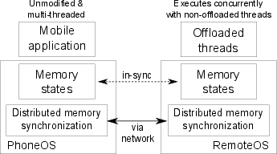
mCloud Programming Model: COMET
Improve mobile computation speed
Require no programmer effort
Generalize well with existing applications
Resist network failures
Courtesy: Mark Gordon et. al.

Slide 67



Distributed Shared Memory
COMET is offloading + DSM
  Offloading bridges computation disparity
  DSM provides logically shared address space
DSM usually applied to cluster environments
  Low latency, high throughput
Mobile relies on wireless communication
Courtesy: Mark Gordon et. al.

Slide 68
DSM (continued)
Conventional DSM (Munin)
X=?
X=555
X=123
X=555
X=555
X=?
X=123
X=123
Waited an RTT for a write
Read could take RTT also
Courtesy: Mark Gordon et. al.

Slide 69
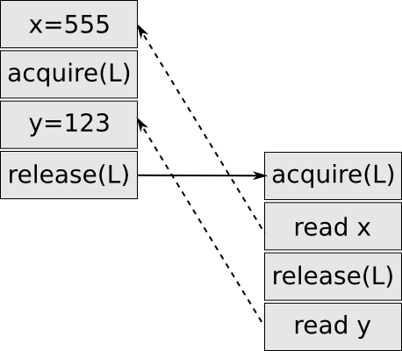
Java Memory Model
Dictates which writes a read can observe
Specifies 'happens-before' partial order
  Access in single thread totally ordered
  Lazy release consistency locking
Fundamental memory unit is the field
  Known alignment, known width
Courtesy: Mark Gordon et. al.
Notes:
More about happens-befoer

Slide 70
Field DSM
Track dirty fields locally
Need 'happens-before' established?
  Transmit dirty fields!
Not clear it scales well past two endpoints
  Not important to our motivation
  Use classic cluster DSM on server
Courtesy: Mark Gordon et. al.

Slide 71
VM-synchronization
Used to establish 'happens-before' relation
Directed operation between pusher and puller
Synchronizes
  Bytecode sources
  Java thread stacks
  Java heap
Courtesy: Mark Gordon et. al.

Slide 72




Lock ownership
Annotate with lock ownership flag
Establish 'happens-before' with VM-sync
Courtesy: Mark Gordon et. al.

Slide 73
Thread Migration
Thread migration trivial
  Push VM-sync
  Transfer lock ownership
Pusher
Puller
Notes:
Need slide about locking

Slide 74
Native Methods
Written in C with bindings for Java
  Math.sin(), OSFileSystem.write(), VMThread.currentThread()
Native methods exist to
  Access device resources (file system, display, etc)
  For performance reasons
  To work with existing libraries
Not generally safe to run on either endpoint
  Manually white list safe native methods
Courtesy: Mark Gordon et. al.

Slide 75
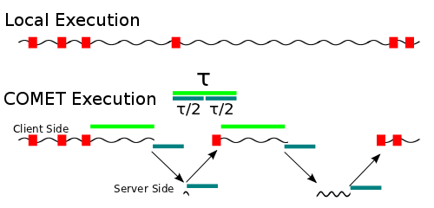
Tau-Scheduler
Τ = 2 * VM-synchronization time
Courtesy: Mark Gordon et. al.
Notes:
TOE=COMET

Slide 76
Implementation
Built from gingerbread CyanogenMod source
~5000 lines of C code
JIT not included
Engine.c:offMigrateThread()
offWriteU1(self, OFF_ACTION_MIGRATE);
deactivate(self);
offThreadWaitForResume(self);
Courtesy: Mark Gordon et. al.

Slide 77
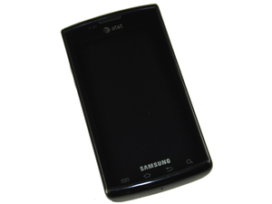
Evaluation Setup
Samsung Captivate (1 GHz Hummingbird)
2 x 3.16GHz quad core Xeon X5460 cores
Courtesy: Mark Gordon et. al.

Slide 78
Benchmarks
8 applications from Google Play
  Average speed-up of 2.88X on WiFi / 1.28X on 3G
  Average energy saving of 1.51X on WiFI / 0.84X on 3G
2 computation benchmark applications
  10.4X speed-up w/ WiFi on Linpack
  200+X speed-up w/ multi-threaded factoring
Courtesy: Mark Gordon et. al.

Slide 79
Conclusion
Offloading+DSM=COMET
  Improve computation speed
  No programmer effort
  Generalize well
  Resist network failures

Slide 80
Contributions
Design/Impl. with four simultaneous goals
  Fine granularity offloading
  Mutli-threading support
Field based DSM coherency

Slide 81
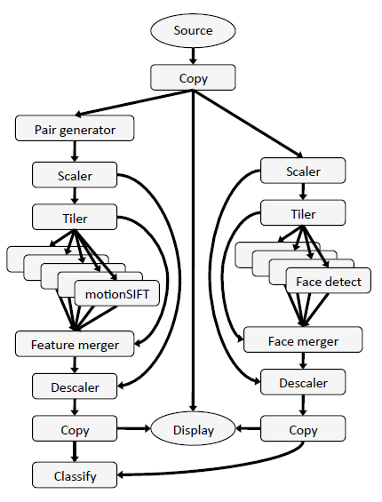
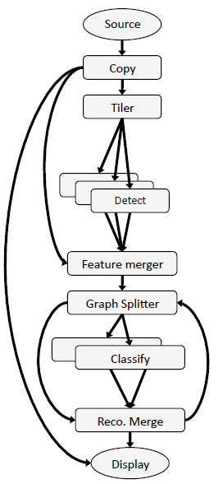
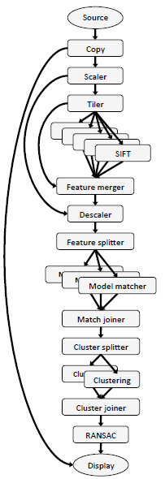
mCloud Programming Model: Odessa
Data flow graph: vertices are stages; edges are connectors; stages share nothing;
Sprout: distributed streaming processing system with data and pipeline parallelism
Source: Odessa Mobisys presentation
Face Recognition
Object Pose Estimation
Gesture Recognition
Notes:
Figure 2(a) shows the application graph for face
recognition. The application consists of two main logical blocks
consisting of face detector and the classifier. Face detection is done
using the default OpenCV [4] Haar Classifier. The face classifier
takes as input the detected faces and runs an online semi-supervised
learning algorithm [17] to recognize the faces from a data set of 10
people.
Object and Pose Recognition Figure 2(b) shows the data-flow
graph for the object instance and pose recognition application [26].
The application consists of four main logical blocks. As shown
in the figure, each image first passes through a proportional downscaler.
SIFT features [20] are then extracted from the image, and
matched against a set of previously constructed 3D models for the
objects of interest. The features for each object are then clustered
by position to separate distinct instances. A random sample consensus
(RANSAC) algorithm with a non-linear optimization is used
to recognize each instance and estimate its 6D pose.
Gesture Recognition. Figure 2(c) shows the application graph for
a gesture recognition application. Each video frame is sent to two
separate tasks, face detection and motion extraction. The latter accumulates
frame pairs, and then extracts SIFT-like features that encode
optical flow in addition to appearance [6]. These features,
filtered by the positions of detected faces, are aggregated over a
window of frames using a previously-generated codebook to create
a histogram of occurrence frequencies. The histogram is treated as
an input vector to a set of support vector machines trained for the
control gestures.
Programming Model. Applications in the Sprout framework are
structured as a data flow graphs; the data flow model is particularly
well suited for media processing applications that perform a series
of operations to an input video or audio stream. The vertices of
the graph are processing steps called stages and the edges are connectors
which represent the data dependencies between the stages.
Stages within an application employ a shared-nothing model: they
share no state, and interact only through connectors. This restriction
keeps the programming complexity of individual stages comparable
to that of sequential programming, and allows concurrency
to be managed by the Sprout runtime. This programming model
allows programmers to express coarse-grained application parallelism
while hiding much of the complexity of parallel and distributed
programming from the application developer.
Automated data transfer. Sprout connectors define data dependencies
and perform data transfer between processing stages. The
underlying implementation of a connector depends on the location
of the stage endpoints. If the connected stages are running in
the same process, the connector is implemented as an in-memory
queue. Otherwise, a TCP connection is used. The Sprout runtime
determines the connector type, and handles serialization and data
transport through connectors transparently. This allows a processing
stage to be written in a way that is agnostic to whether it or
related processing steps have been off-loaded.
Parallelism Support. The Sprout runtime supports coarse-grained
data parallelism and pipeline parallelism. Data parallelism is supported
by having multiple instances of a stage execute in parallel on
separate processor cores. Pipeline parallelism is supported by having
multiple frames be processed simultaneously by the different
processing stages of the application.
The relationship between Sprout and Odessa. Sprout provides
programmers with mechanisms to dynamically adjust running applications,
change the degree of parallelism, and migrate processing
stages between machines. In Odessa, we develop adaptive techniques
for determining when and which stages to offload, and deciding
how much pipelining and data-parallelism is necessary in
order to achieve low makespan and high throughput, and then leverage
the Sprout mechanisms to effect the changes.

Slide 82

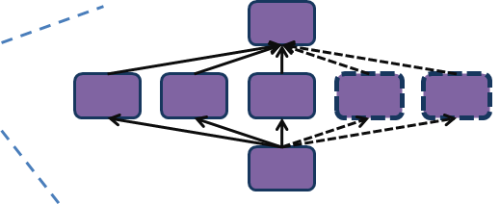
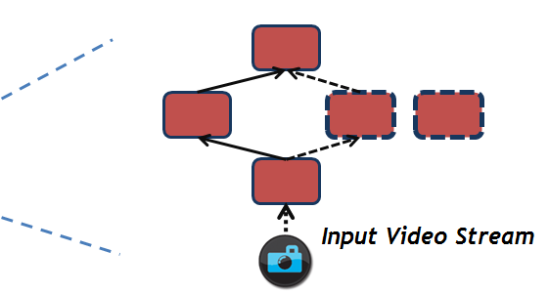

mCloud Programming Model: Odessa (Cont’d)
Offloading DEcision System for Streaming Applications
Application
Odessa Profiler
Sprout
Cloud Infrastructure
Network
Application
Odessa
Runtime
Profiler
Decision
Engine
Odessa
Sprout
Mobile Device
Source: Odessa Mobisys presentation

Slide 83

mCloud Programming Model: Odessa (Cont’d)
Cloud Infrastructure
B2
B1
C
A
Network
B
C
A
Application Data Flow Graph
>
Incremental decisions adapt quickly to input and platform variability.
Screen
Local
Execution
Cost
Remote
Execution
Cost
Smartphone
Source: Odessa Mobisys presentation

Slide 84
Support for Service Interaction
Synergy of mCloud services
  Shared basic services enables more efficient usage of cloud resources(e.g. shared memcache eliminates data duplication of individual services)
  Co-location makes mashed-up applications to achieve native performance (file transfer becomes an object reference)
mCloud offers shared platform services
mCloud optimizes service interaction through active VM migration

Slide 85
Closing Thoughts
Cloud computing needs to advance in architecture, programming model, platform services to revolutionize mobile computing

Slide 86
Useful Tools
Hprof: a heap/CPU profiling tool
Jchord: a static analysis tool on Java bytecode
Dummynet (ipfw): simulates/enforces queue and bandwidth limitations, delays, packet losses
OpenCV: a library of programming functions for real time computer vision

