Slide 1
Cellular Networks and Mobile Computing
COMS 6998-11, Fall 2012
Instructor: Li Erran Li (lierranli@cs.columbia.edu)
http://www.cs.columbia.edu/~lierranli/coms6998-11Fall2012/
10/23/2012: Cellular Network and Traffic Characterization

Slide 2
Announcements
Preliminary project report due this Friday, October 26th
Reminder on next week’s student presentations:
  Odessa - Akhila Athresh (aa3306)
  MAUI: Making smartphones last longer with code offload - Mengtian Fan (mf2782)
  CloneCloud: Elastic execution between mobile device and cloud - Xu Ran (xr2109)

Slide 3
Syllabus
Mobile App Development (lecture 2,3)
  Mobile operating systems: iOS and Android
  Development environments: Xcode, Eclipse with Android SDK
  Programming: Objective-C and android programming
System Support for Mobile App Optimization (lecture 4,7)
  Mobile device power models, energy profiling and ebug debugging
  Core OS topics: virtualization, storage and OS support for power and context management
Interaction with Cellular Networks (lecture 1,5, 8)
  Basics of 3G/LTE cellular networks
  Mobile application cellular radio resource usage profiling
  Measurement-based cellular network and traffic characterization
Interaction with the Cloud (lecture 6,9)
  Mobile cloud computing platform services: push notification, iCloud and Google Cloud Messaging
  Mobile cloud computing architecture and programming models
Mobile Platform Security and Privacy (lecture 10,11,12)
  Mobile platform security: malware detection, attacks and defenses
  Mobile data and location privacy: attacks, monitoring tools and defenses

Slide 4
Outline
Overview of LTE
In-depth study of Middleboxes in Cellular Networks
Cellular Network Architecture Characterization and Implication to CDN
Overview of Software Defined Cellular Networks

Slide 5
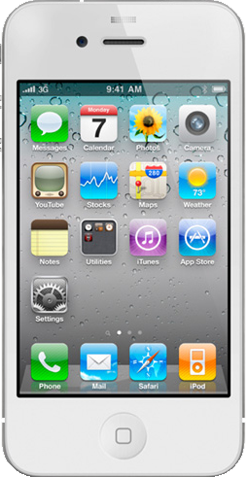
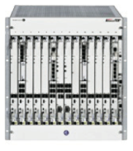
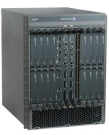
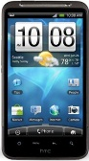
LTE Infrastructure
UE: user equipment
eNodeB: base station
S-GW: serving gateway
P-GW: packet data network gateway
MME: mobility management entity
HSS: home subscriber server
PCRF: policy charging and rule function
eNodeB 1
Cellular Core Network
MME/PCRF/HSS
eNodeB 2
S-GW 1
UE 1
P-GW
Internet and
Other IP Networks
eNodeB 3
S-GW 2
UE 2
GTP Tunnels
Notes:
Verizon claims that, at its current rate of traffic growth, which is roughly doubling each year, it will reach the capacity thresholds on both its 3G EV-DO and LTE networks beginning in some markets by the end of 2013, and across its entire network by the end of 2015. Unless it can get new spectrum — i.e., the cable operators’ 20 MHz of AWS spectrum — its customers’ connection speeds and service quality will start suffering.

Slide 6
Cellular Networks: LTE
Control Plane
Home Subscriber Server (HSS)
Data Plane
Inter-technology handoff leads to long delays and high packet loss rate due to lack of common control protocols
No central control of base stations make radio resource allocation inefficient
Mobility Management Entity (MME)
Policy Control and Charging Rules Function (PCRF)
Packet Data
Station (eNodeB)
Serving
Network Gateway
(P-GW)
User Equipment (UE)
Base
Gateway (S-GW)
Notes:
Verizon claims that, at its current rate of traffic growth, which is roughly doubling each year, it will reach the capacity thresholds on both its 3G EV-DO and LTE networks beginning in some markets by the end of 2013, and across its entire network by the end of 2015. Unless it can get new spectrum — i.e., the cable operators’ 20 MHz of AWS spectrum — its customers’ connection speeds and service quality will start suffering.

Slide 7
An Untold Story of Middleboxes in Cellular Networks
Zhaoguang Wang¹
Zhiyun Qian¹, Qiang Xu¹, Z. Morley Mao¹, Ming Zhang²
¹University of Michigan ²Microsoft Research
Notes:
Hi everyone, I’m xxx, a third year PhD student from university of Michigan.
Thanks for staying here till the very last talk of the conference and
I promise you this is going to be a very interesting one. I am very
excited to present our characterization study of firewall and NAT
policies in cellular networks and their implications. This project is
joint work between Univ of Michigan and Microsoft research.

Slide 8
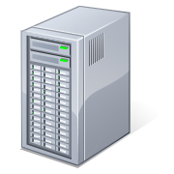


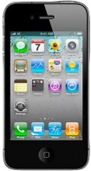

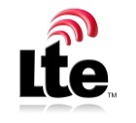
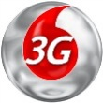
Background on cellular network
Cellular Core Network
Internet
Courtesy: Z. Wang et al.
Notes:
Today cellular data networks are becoming increasingly popular as they
have ubiquitous coverage and faster network speed.
There are new smartphones rolling out every week, people use them to
surf the Internet everywhere.
(Describe basic communication between a smartphone and a server on the internet)
Suppose you want to visit a website on the internet, your request
packets will go into the cellular core network through the base
station your phone is talking to , then they will be routed to the
gateway between the cellular network and the internet, and finally
reach the web server through the internet.
Then the server can send back the webpage.

Slide 9
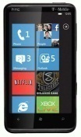


Why carriers deploy middleboxes?
Private IP
Public IP
Cellular Core Network
Internet
IP address
Courtesy: Z. Wang et al.
Notes:
We know there’s a lot malicious traffic on the internet, if there is an attacker on the internet who want to probe the phone inside the cellular network to find out some security vulnerabilities
Carriers never want that happen in their networks so they put a firewall on the gateway to filter incoming traffic, then the attacker cannot probe any devices behind the firewall.
As one carrier has to server millions of smartphones and each one requires an IP address,
Carriers deployed NAT box to help manage IP resources so that one public IP can be shared by multiple devices.
So firewalls and NAT boxes are quite common in the cellular data networks.

Slide 10
Problems with middleboxes
P2P
?
Cellular Core Network
Smartphone energy cost
?
Internet
Policies
?
Application
performance
?
Courtesy: Z. Wang et al.
Notes:
Although they are supposed to bring benefits to the carriers and end users
The policies are mostly unknown to the public and
it is unclear how they are interacting with mobile devices and applications
Are they affecting application performance? Are they costing more energy on smartphone? Any new challenge for P2P applications?
Our study is trying to answer those questions and identify the
implications of NAT and firewall design on network and application
design and management. Note that we focus on NAT and firewall as they
are critical in determining the reachability to mobile devices.

Slide 11



Challenges and solutions
Policies can be complex and proprietary
  Design a suite of end-to-end probes
Cellular carriers are diverse
  Publicly available client Android app
Implications of policies are not obvious
  Conduct controlled experiments
Courtesy: Z. Wang et al.
Notes:
It’s not easy to study the network policies in hundreds of cellular
networks run by different carriers
First of all, Network policies can be quite complex and are generally
proprietary, and it is also not feasible to probe from server alone
since firewall and NATs block probing from the internet
So we design a suite of end-to-end tools using coordinated probing
from both the smartphones inside the cellular network and the server
outside the cellular network.
Secondly, Cellular carriers are diverse, there are hundreds of
carriers out there, we cannot measure each network without user
participation
So we built our measurement tool for android platform have released it
on the Android market. Users benefit from our app by learning about
their cellular network policies. In exchange, we can collect data for
our study.
Third, Implications of network policies are not obvious, we conduct
numerous controlled experiments to verify our findings and understand
the policy impact on smartphone energy and application performance

Slide 12
Related work
Internet middleboxes study
  [Allman, IMC 03], [Medina, IMC 04]
NAT characterization and traversal
  STUN[MacDonald et al.], [Guha and Francis, IMC 05]
Cellular network security
  [Serror et al., WiSe 06], [Traynor et al., Usenix Security 07]
Cellular data network measurement
  WindRider, [Huang et al., MobiSys 10]
Courtesy: Z. Wang et al.
Notes:
People have done related work in the following aspects.
-Studies on internet middleboxes, but we focus on cellular data networks
-People have proposed various techniques to traverse NAT and characterized the NAT behavior on home routers, but we find new behaviors of NAT in cellular network
-While there have been various attacks targeting either cellular network infrastructure or mobile devices,
we are trying to understand if the attacks are feasible given firewalls and NATs are deployed
-Researchers have also measured the performance of cellular data network, we focus on the polices and also look their implications on application performance
To summarize, we build on these existing work, and our work is the
first study on understanding NAT and firewall behavior in cellular
networks and their impact on performance as well as security for
mobile users and carriers.

Slide 13

Goals
Develop a tool that accurately infers the NAT and firewall policies in cellular networks
Understand the impact and implications
  Application performance
  Energy consumption
  Network security
Courtesy: Z. Wang et al.
Notes:
Our goal in this study is to
Develop a measurement tool, so people can use it to infer NAT and firewall policies automatically in their cellular networks
Then we want to understand the impact and implications of those policies in terms of …
Although our findings are focused on the state of the art, we expect
our measurement methodology to provide longer-term monitoring of
evolution of cellular network policies.

Slide 14
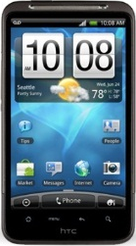


The NetPiculet measurement system
NetPiculet
Client
Cellular Core Network
Internet
NetPiculet
Server
NetPiculet
Client
Policies…
NetPiculet
Client
NetPiculet
Client
Courtesy: Z. Wang et al.
Notes:
We designed our own tool called NetPiculet, piculet is a type of woodpecker, so our tool can poke the network and infer the NAT and firewall policies inside cellular networks
It has a server which is deployed in our university and client application running on smartphones
Because firewall and NAT blocks unsolicited incoming traffic, clients initiate probing and then the server probes back.
By exchanging probing packets between the server and clients, NetPiculet can infer the policies on firewalls and NATs.
As you can see later, NetPiculet consists of many tests to infer different policies. We parallelized those tests so they can run efficiently and finish in 10 seconds

Slide 15
Target policies in NetPiculet
Firewall | IP spoofing
 | TCP connection timeout
 | Out-of-order packet buffering
NAT | NAT mapping type
 | Endpoint filtering
 | TCP state tracking
 | Filtering response
 | Packet mangling
Courtesy: Z. Wang et al.
Notes:
Here is a list of policy inference tests implemented in NetPiculet
We know firewalls are trying to protect users from unsolicited incoming traffic, so we test if they allow IP spoofing, in which case the firewalls potentially lose the functionality to filter unsolicited traffic
Firewalls maintains the states of TCP connections, they can timeout idle connections, they can perform deep packet inspection, so we try to test how they affect TCP performance and try to infer the timeout timer and tests whether they buffer out-of-order packets under packet loss
While the NAT tests are well defined in previous NAT characterization study

Slide 16
Target policies in NetPiculet
Firewall | IP spoofing
 | TCP connection timeout
 | Out-of-order packet buffering
NAT | NAT mapping type
 | Endpoint filtering
 | TCP state tracking
 | Filtering response
 | Packet mangling
Courtesy: Z. Wang et al.
Notes:
I will talk more details about these policies in a few seconds

Slide 17
Key findings
Firewall | Some carriers allow IP spoofing Create network vulnerability
 | Some carriers time out idle connections aggressively Drain batteries of smartphones
 | Some firewalls buffer out-of-order packet Degrade TCP performance
NAT | One NAT mapping linearly increases port # with time Classified as random in previous work
Courtesy: Z. Wang et al.
Notes:
due to the time limit, I am only going to talk about four of them

Slide 18
Diverse carriers studied
NetPiculet released in Jan. 2011
  393 users from 107 cellular carriers in two weeks
Technology
Continent
Courtesy: Z. Wang et al.
Notes:
Before that here is some statistics on the data we collected.
We have data of 107 cellular carriers contributed by about four hundred users.
The figures divide the cellular carriers based on technologies they are using and their geographic locations.
We see most carriers in our data are using UMTS and from Europe
NetPiculet client achieves very good coverage and provides valuable data for us to study the polices in the wild
We will present the resutls from these users

Slide 19
Outline
1
2
3
4
IP spoofing
TCP connection timeout
NAT mapping
TCP out-of-order buffering
Courtesy: Z. Wang et al.
Notes:
I have given you a general idea of what we have done,
now lets look at four interesting policies we studied.
this outline shows the set of key tests as well some of the
interesting unexpected finding we identified.
We start with the basics of IP spoofing test, followed by two
unexpected interaction with TCP protocol, and conclude with another
basic test on NAT type.

Slide 20
Outline
1
2
3
4
IP spoofing
NAT mapping
TCP connection timeout
TCP out-of-order buffering
Courtesy: Z. Wang et al.
Notes:
Lets first start with IP spoofing

Slide 21
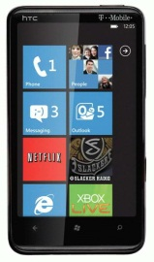




Why allowing IP spoofing is bad?
DST_IP = 10.9.9.101
…
DST_IP = 10.9.9.101
…
DST_IP = 10.9.9.101
…
DST_IP = 10.9.9.101
…
Cellular Core Network
Internet
SRC_IP = 10.9.9.101
…
10.9.9.202
10.9.9.101
Courtesy: Z. Wang et al.
Notes:
we know IP spoofing is bad for
Internet, but it's particularly bad for cellular users (due to battery
draining attacks) and carriers (due to signaling attacks)
So what is IP spoofing and why it’s bad?
firewall is good at isolating internal users from externally generated
unwanted traffic,
so attackers cannot directly send packets into the cellular network,
but what if there is a malicious internal user colludes with outside
attacker?
(describe the animation)
In the network where IP spoofing is allowed,
The malicious user crafts a packet spoofing the target’s IP address
and send this packet to the attacker on the internet. By doing this,
a hole is punched on the firewall which allows communication between
the attacker and the target. Then the attacker can send packets
directly to the targets, for example it can flood the target and drain
its battery stealthily.
Firewalls/NATs are supposed to block unsolicited traffic
IP Spoofing allows attackers to break the rule, then the attacker can
probe the target phone, drain its battery, and waste bandwidth
resources.
[It can also launch signaling attacks on cellular providers by causing
radio resource allocation and deallocation to occur repeatedly].

Slide 22
Test whether IP spoofing is allowed
Cellular Core Network
Internet
NetPiculet
Server
SRC_IP = 10.9.9.202
PAYLOAD = 10.9.9.101
NetPiculet
Client
10.9.9.101
Allow IP spoofing!
Courtesy: Z. Wang et al.
Notes:
To test if a cellular network allows IP spoofing
Our NetPiculet client crafts a packet with a spoofed source IP address
While the original IP of the smartphone is encapsulated as the payload,
Then send this packet to our NetPiculet server,
When the server sees a packet and examines the payload,
It knows that the network allows IP spoofing

Slide 23
4 out of 60 carriers allow IP spoofing
IP spoofing should be disabled
Courtesy: Z. Wang et al.
Notes:
In total we test IP spoofing in 60 cellular networks, among them 56 disallow IP spoofing
But still there are 4 carriers do allow IP spoofing in their networks
IP spoofing should be disabled, it can be done at ggsn, which is much easier than the Internet
existing routers provide such support, so there is no reason
that it should be not disabled, unlike the Internet scenario.

Slide 24
Outline
1
2
3
4
NAT mapping
IP spoofing
TCP out-of-order buffering
TCP connection timeout
Courtesy: Z. Wang et al.
Notes:
Next I will talk about something interesting about TCP connection timeout

Slide 25





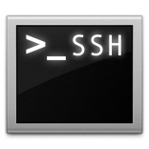

Why short TCP timeout timers are bad?
Cellular Core Network
Internet
KEEP-ALIVE
KEEP-ALIVE
KEEP-ALIVE
Terminate
Idle TCP
Connection
Courtesy: Z. Wang et al.
Notes:
So probably every smartphone users are using push-based service to receive their emails
The way it works is that the phone maintains a long-lived TCP connection with the email application server,
Whenever there is an email for the user, an update is pushed to the phone from the server instantly
There are also other application using push-based service like chatting apps, social network apps
However there is timer associated with each TCP connection on the firewall, once it expires the firewall close that connection and recycle the memory resource
To keep the connection open, send keep-alive before the timer expires
However, in cellular networks, even transmitting one packet would wake up the radio interface and let the phone stay in high power state for a few seconds
And thus waste energy
So the shorter the timer the more frequent the phone has to send keep-alive messages, and thus the more energy is consumed

Slide 26
Measure the TCP timeout timer
Time = 0
Time = 5 min
Time = 10 min
Cellular Core Network
Yes!
Internet
NetPiculet
Server
NetPiculet
Client
Is alive?
Is alive?
5min
< Timer < 10min
5min
< Timer
Courtesy: Z. Wang et al.
Notes:
Summarize (finer grained consume more time)
(just follow the animation)
First the client creates a TCP connection to the server, after 5 minutes it sends a message to the server to check if the connection is still open.
Server replies and indicate that the timer is longer than 5 minutes.
We start this again, but this time the client waits for 10 minutes before checking the connection, however the connection was timed out by the firewall, so this time the message got lost and the client cannot receive the reply from the server
So we know the timer is between 5 and 10 minutes.
In the real implementation, the client actually creates 5 connections to the server simultaneously, each with a different idle time before checking the connection. So we bound the timer into several ranges.

Slide 27
Short timers identified in a few carriers
4 carriers set timers less than 5 minutes
Courtesy: Z. Wang et al.
Notes:
As we can see, most of carriers have timers longer than half an hour,
However, there are 11 carriers set timers smaller than 10 minutes, 4 of them even have timer less than 5 minutes
Next I will show you how much battery would be drained if your phone experiencing a timer like 5 minutes

Slide 28
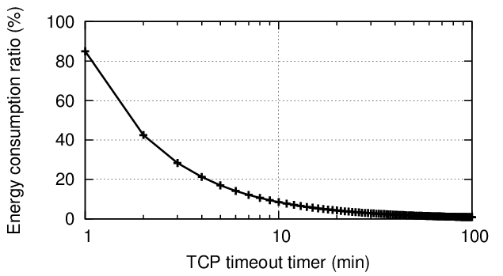
Short timers drain your batteries
Assume a long-lived TCP connection, a battery of 1350mAh
How much battery on keep-alive messages in one day?
20%
5 min
Courtesy: Z. Wang et al.
Notes:
Assume maintain a long-lived connection and a battery of 1350 mAh, which is a typical battery capacity of modern smartphone.
If we only count the radio energy consumed by sending keep-alive messages, how much battery would be drained in one day?
As we can see, 5 minutes -> 20 percent
Of course short timers help firewalls to quickly recycle memory resource, but a single configuration could affect tens of thousands of smartphones,
To save energy on smartphones,
We would suggest carriers to have a timer longer than 30 minutes or longer assuming there are sufficient IP address resources.

Slide 29
Outline
1
2
3
4
IP spoofing
TCP connection timeout
TCP out-of-order buffering
NAT mapping
Courtesy: Z. Wang et al.
Notes:
Now let me talk about another policy related to TCP, out-of-order packet buffering

Slide 30
TCP out-of-order packet buffering
Cellular Core Network
Packet 1
Packet 2
Packet 3
Packet 4
Packet 5
Packet 6
Internet
NetPiculet
Server
NetPiculet
Client
Buffering out-of-order packets
Courtesy: Z. Wang et al.
Notes:
In our study, we surprisingly found some firewalls buffers out-of-order packet
(Describe the behavior following the animation)
Suppose the phone is downloading a file from the server,
Packet 1,2 reach the server, 3 is lost before reaching the firewall, 4,5,6 buffered in the firewall, 4,5,6 will be released when the firewall sees packet 3 which was retransmitted
Why do firewalls buffer out-of-order packet?
We find some documents that describes the capability of doing Deep Packet Inspection on firewall, but that only keeps a copy of out-of-order packets and pass the original packets. But here all the out-of-order packets cannot be delivered to the destination before the firewall sees the missing packet. Misconfiguration on the firewall?

Slide 31
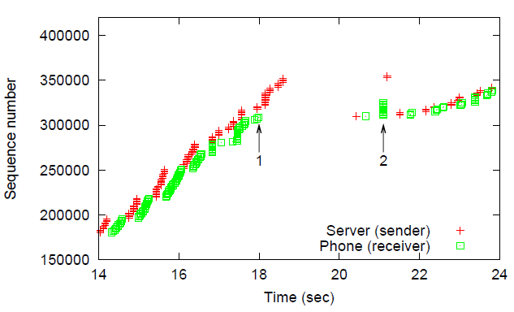
Fast Retransmit cannot be triggered
Degrade TCP performance!
1
2
RTO
Courtesy: Z. Wang et al.
Notes:
Here is a real packet trace in the cellular network, x axis is time in second and y axis is TCP sequence number,
Red dots are sequence number observed on the sender side, green dots are observed on the receiver side
One packet was lost at arrow 1 and following packets are buffered by the firewall
After retransmission timer timed out, at arrow 2, the lost packets was retransmitted and we can see the big gap in the figure, of course this degrades TCP performance

Slide 32
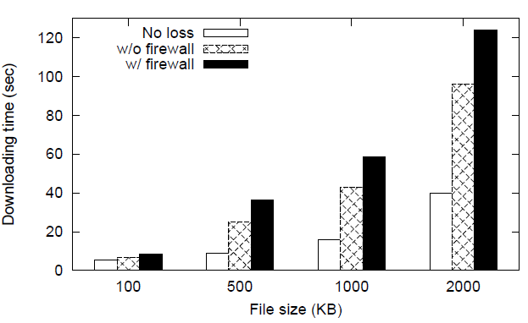
TCP performance degradation
Evaluation methodology
  Emulate 3G environment using WiFi
  400 ms RTT, loss rate 1%
Longer downloading time
More energy consumption
+44%
Courtesy: Z. Wang et al.
Notes:
To quantify the degradation on TCP performance under packet loss,
We emulate 3G environment using WiFi and use a smartphone to download files of different sizes from a server, We control the loss rate to be 1% (based on previous study) and compare the downloading time in two scenarios
One is the normal case, where there is no firewall, And the other is having a firewall buffering out-of-order packets.
In the figure, x axis is the size of file in kilobyte, y axis is the downloading time in second
The buffering behavior increases 21 percent of downloading time if you download a 100 kilobyte file
While 44 percent increase for 500 kilobyte file.
It is not only a matter of time, as the time increases, the phone spends more time in high radio power state and consumes more energy

Slide 33
Outline
1
2
3
4
IP spoofing
TCP connection timeout
TCP out-of-order buffering
NAT mapping
Courtesy: Z. Wang et al.
Notes:
Let’s move to NAT box and see what we found in the cellular network

Slide 34



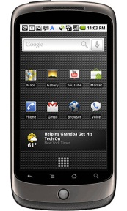
NAT mapping is critical for NAT traversal
P2P
Use NAT mapping type
for port prediction
A
B
NAT 1
NAT 2
Courtesy: Z. Wang et al.
Notes:
Most people are familiar with NAT, it does IP address translation, multiple hosts behind the NAT can share a single public IP, so it can save public IP resource and hide internal network from outside
NAT is prevalent everywhere, but they are hurting direct phone to phone traffic, such as video chatting app like skype, fring, they are using P2P communication
people have developed various NAT traversal techniques, basically they follow the same steps
Same to internet hosts
(animation)
Say A wants to create a connection to B though NAT 2, B has to open a port on its NAT, then A can create a connection through this port.
In order for A to learn which port is opened on B’s NAT, A has to learn the NAT mapping type of B’s NAT and then use it do predict the port.

Slide 35

What is NAT mapping type?
NAT mapping type defines how the NAT assign external port to each connection
12 TCP connections
…
NAT
Courtesy: Z. Wang et al.
Notes:
NAT mapping type defines how the NAT assign external port to each connection, and the methodology for determine the NAT mapping type is presented in IMC 05 paper, here is a review
Where 12 TCP connections are created back-to-back through the NAT box to 4 destinations on two servers,
By observing the source IP and ports on the server side, the NAT mapping type can be then classified
We borrowed the same measurement methodology, but in addition we record the time for each connection so we can look at some time dependent behavior

Slide 36
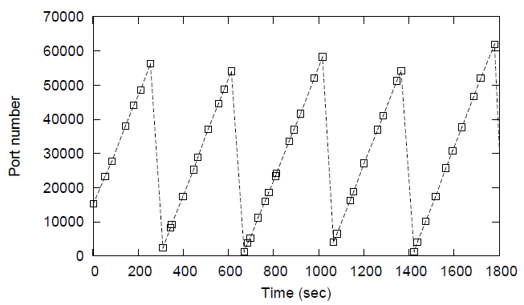
Behavior of a new NAT mapping type
Creates TCP connections to the server with random intervals
Record the observed source port on server
NOT random!
Port prediction is feasible
Treated as random by existing traversal techniques
Thus impossible to predict port
Courtesy: Z. Wang et al.
Notes:
Previous work has defined a series of NAT mapping types, but not this one we found in cellular networks
Which increases port number on the NAT linearly with time
We conduct local experiments to verify this observation, we have a phone connect to our server with random intervals between 0 to 60 seconds, and we record the observed source port number on the server,
In the figure, x axis is time while y axis is the recorded port number, we can see the obvious linear pattern
But traditionally this type would be classified as random mapping and considered hard to traverse
As the port increases with a constant rate, we can actually predict the port number based on time quite well,
We factor in the time and designed a technique to traverse such NAT, please check our paper to see the detail

Slide 37
Lessons learned
Firewall | IP spoofing creates security vulnerability IP spoofing should be disabled
 | Small TCP timeout timers waste user device energy Timer should be longer than 30 minutes
 | Out-of-order packet buffering hurts TCP performance Consider interaction with application carefully
NAT | One NAT mapping linearly increases port # with time Port prediction is feasible
Courtesy: Z. Wang et al.
Notes:
As I have shown you the four interesting policies in cellular data networks, here is what we learned.

Slide 38
Conclusion
NetPiculet is a tool that can accurately infer NAT and firewall policies in the cellular networks
NetPiculet has been wildly deployed in hundreds of carriers around the world
The paper demonstrated the negative impact of the network policies and make improvement suggestions
Courtesy: Z. Wang et al.
Notes:
To conclude…
Unexpected interaction between middleboxes and mobile application
Important for carriers to consider those interaction when designing or configuring middleboxes

Slide 39
Cellular Data Network Infrastructure Characterization &
Implication on Mobile Content Placement
Qiang Xu*, Junxian Huang*, Zhaoguang Wang*
Feng Qian*, Alexandre Gerber⁺⁺, Z. Morley Mao*
*University of Michigan at Ann Arbor
⁺⁺AT&T Labs Research

Slide 40

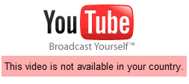
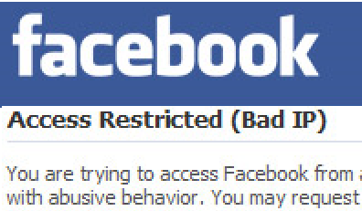
Applications Depending on IP Address
IP-based identification is popular
  Server selection
  Content customization
  Fraud detection
Why? -- IP address has strong correlation with individual user behavior
Cellular Networks and Mobile Computing (COMS 6998-8)
Courtesy: Q. Xu et al.
Notes:
Many web applications are implemented depending on the ip address of the user, including ip-based identification and ip-based localization. For excmple, many popular content delivery sevices such as Akamai and limelight use the Ip address of the user’s local dns to decide which content server has the shortest latency to the user, Video content providers, such as YouTube, use IP address to limit the access to some copyright sensitive content from certain country, and social networks apps, such as facebook, have blacklists of IP addresses that have behaved abnormally.
These examples tell us a truth that so many well-known service providers implement their application relying on IP address, which is because the IP address has strong correlction with the behabior of the indibidual user.

Slide 41
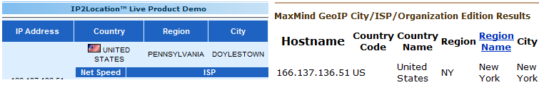
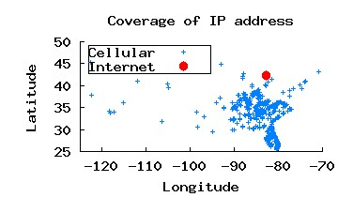
Cellular IP Address is Dynamic
Cellular devices are hard to geo-locate based on IP addresses
  One Michigan’s cellular device’s IP is located to places far away
/24 cellular IP addresses are shared across disjoint regions
Cellular Networks and Mobile Computing (COMS 6998-8)
Courtesy: Q. Xu et al.
Notes:
However, what happened when we refer to cellular networks?
Let me give you some experimental results. The top figure is showing that the IP address of my own smartphone when I was in campus at Michigan was reported to be from somewhere far away. The IP2location website told me I was from PA, while the maxmind website told me I was from NYC.
The bottom figure is borrowed from our later results showing that the GPS location distribution of a /24 address block in cellular network compared with the GPS location of a /24 address block allocated to our university. We can see that the /24 address block spread out in the Southeastern part of the U.S. That means the cellular IP addresses in the same /24 address block can be shared across very disjoint regions. /24, which we believe should be small enough for large cellular ISP to allocate and manage.

Slide 42
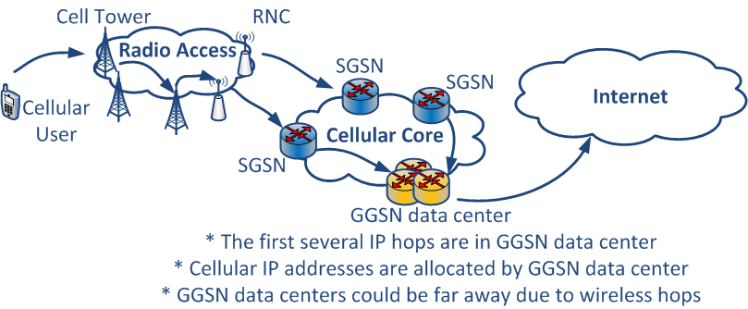
Problem Statement
Discover the cellular infrastructure to explain the diverse geographic distribution of cellular IP addresses and investigate the implications accordingly
  The number of GGSN data centers
  The placement of GGSN data centers
  The prefixes of individual GGSN data centers
Cellular Networks and Mobile Computing (COMS 6998-8)
42
Courtesy: Q. Xu et al.
Notes:
Given this observation that cellular IP addresses have very diverse geographic distribution and popular ip2location services are unable to locate cellular ip addresses. Many uncerntainties immediately pop up. How does the routing happen when we send traffic to two devices with very similar addresses but could be geographically far away to each other? How does IP allocation happen?
Those questions are very critical for people to improve or design services, applications and protocols for cellular users, and it may also help the deployment of the next-generation cellular data networks.
However, answers to these questions are proprietary information to cellular service providers. So, speaking in high level, we want to discover the cellular infrastructure to explain the diverse geographic distribution of cellular IP addresses. Before we go to details, let us have a look at the known facts for cellular infrastructure.
In communication between a cellular device and the internet, the traffic will go thru cell tower, radio network controller, SGSN, and GGSN. Before traffic goes thru GGSN, it is tunnelled by GTP protocol. In other words, GGSN is the first IP hop in path from the cell to the internet. Cellular IP addresses are allocated at GGSN data center. This figure gives us an indication that GGSN data centers could be actually far away from cellular devices, and GGSN data centers are actually the key to discovering the infrastructure.
Coming back to the problem we want to solve in this study, to be concrete, we actually want to find out the number of GGSN data centers, the location of these GGSN data centers, and their geographic coverage accordingly.

Slide 43
Challenges
Cellular networks have limited visibility
  The first IP hop (i.e., GGSN) is far away -- lower aggregation levels of base station/RNC/SGSN are transparent in TRACEROUT
  Outbound TRACEROUTE -- private IPs, no DNS information
  Inbound TRACEROUTE -- silent to ICMP probing
Cellular IP addresses are more dynamic [BALAKRISHNAN et al., IMC 2009]
  One cellular IP address can appear at distant locations
  Cellular devices change IP address rapidly
Courtesy: Q. Xu et al.
Notes:
In order to reverse engineer these GGSNs, we have to face two major challenges. The first challenge is that the cellular infrastructure has limited visibility. As we mentioned, the GGSN is the first IP hop, along the path, the base station, the RNC, the SGSN are all transparent to the IP level. Event at the IP level, active probing doesn’t work either. Traceroute is widely used among internet topology studies. But when we do traceroute from cellular devices to the internet, the first several IP hops, basically the hops within the cellular network, are all private ip address, they have no dns name, hard for us to infer any topology correlation. Also, when we do traceroute from internet to phones, those cellular hops do not responds with ICMP packets.
The second challenge is that cellular ip addresses are more dynamic. On the internet, if we want to discover topology of the interested network, usually, we find some vantage points on the edge and do some active test. But it is not applicable in cellular networks because these addresses are very hard to control. The same observation has been identified in one IMC paper. This observation is elaborated in two folds. One fold (we have mentioned) is that one same ip address can appear at distant locations. The other fold is that one cellular device changes its ip address very fast.

Slide 44
Solutions
Collect data in a new way to get geographic coverage of cellular IP prefixes
  Build Long-term and nation-wide data set to cover major carriers and the majority of cellular prefixes
  Combine the data from both client side and server side
Analyze geographic coverage of cellular IP addresses to infer the placement of GGSN data centers
  Discover the similarity across prefixes in geographic coverage
  Cluster prefixes according to their geographic coverage
Courtesy: Q. Xu et al.
Notes:
In order to cope with these challenges, we have some nation-wide and long-term data sets passively collecting IP address behaviors. These data sets covers the 4 major carriers and the majority of cellular prefixes. Instead of trying to discover those unavailable IP hops, we use geographic coverage of cellular IP address to infer GGSN data centers, which is not straightforward, but does makes sense. Because IP addresses are allocated at GGSN data centers. The IP addresses sharing the same Ip property should have the same allocation policy, which means managed by the same GGSN data center. Here geographic coverage is one type of IP property that we are interested in when the internal cellular network hops are invisivible.

Slide 45
Previous Studies
Cellular IP dynamics
  Measured cellular IP dynamics at two locations [Balakrishnan et al., IMC 2009]
Network infrastructure
  Measured ISP topologies using active probing via TRACEROUTE [Spring et al., SIGCOMM 2002]
Infrastructure’s impact on applications
  Estimated geo-location of Internet hosts using network latency [Padmanabhan et al., SIGMETRICS 2002]
  On the Effectiveness of DNS-based Server Selection [Shaikh et al., INFOCOM 2001]
Courtesy: Q. Xu et al.
Notes:
Then let us have a look at what have been done by others. Our study is motivated by one IMC paper. In their study, they had the observation that cellular ip addresses have the diverse distribution and cellular devices change their Ip address rapidly. However, since they only did the experiments at Mountain view and redmond for one major cellular provider, they did not have a nationwide picture, and didn’t explain their observations either.
One example in the scope of network infrastructure discovery is a SIGCOMM paper measuring IP topologies using active probing via traceroute, however, active probing can’t solve our problem due to limited visibility of cellular networks. But, the limited traceroute results give some side evidence support the correct of our clusters, which is introduced in our paper.
Regarding applications, from the perspective of network latency, one of the related studies is a previous SIGMETRIC paper proposed using network latency to estimate the geo-location of internet host. There also exist studies that investigate the effectiveness of DNS-based content placement and delivery. In our study, we are also interested in the end-to-end latency. we investiage the cellular infracture’s impact on end-to-edn latency and its corresponding implication on mobile content placement.

Slide 46
Outline
Motivation
Problem statement
Previous Studies
Data Sets
Clustering Prefixes
Validating the Clustering Results
Implication on mobile content placement
Courtesy: Q. Xu et al.
Notes:
As we mentioned, we started from analyzing passive data sets. Next we are going to talk in details how to correlated these data sets to derive the mapping table of each prefix’s geographic coverage for major carriers. After that, I will show you how to reverse engineer the placement of GGSNs by clustering the mappings of geographic coverge. We also validate on clusters and will discuss the implication at the end.

Slide 47
Data Sets
DataSource1 (server logs): a location search server
  millions of records
  IP address, GPS, and timestamp
DataSource2 (mobile app logs): an application deployed on iPhone OS, Android OS, and Windows Mobile OS
  140k records
  IP address and carrier
RouteViews: BGP update announcements
  BGP prefixes and AS number
...
timestamp lat. long. address
1251781217 36.75 -119.75 166.205.130.244
1251782220 33.68 -117.17 208.54.4.78
...
device:
<ID:C7F6D4E78020B14FE46897E9908F83B>
<Carrier: AT&T>
address:
<GlobalIP: 166.205.130.51>
...
...|95.140.80.254|31500|166.205.128.0/17|31500 3267 3356 7018 20057|...
...|95.140.80.254|31500|208.54.4.0/24|31500 3267 3356 21928|...
Courtesy: Q. Xu et al.
Notes:
We used three Data Sets in our study, DataSource1, DataSource2, and routeviews data.
DataSource1 is collected from the server side of very popular smartphone app allows user to get the location of the POIs nearby. It collectes the IP address and GPS information. In total, DataSource1 contains millions records with GPS available. The limitation of datasource1 is the lack of carrier name, it does not know the corresponding carrier name of each application request.
DataSource2 is another measurement application running on three different platforms. When the application is running on the phone, it sends back some basic phone-side information to the server, such as network type (wifi or cellular), the carrier name if under cellular access, the ip address. DataSouce2 is limited by its popularity. Compared with DataSource1, it contains only 140 k records, but the advantage is that can tell the carrier name so that it can completement the limitation of datasource1
The third data set is from the RouteViews project. RouteView collects BGP prefix announcements. we can extract the BGP prefix list from this data set.

Slide 48
Map Prefixes to Carriers & Geographic Coverage
Correlate these data sets to resolve each one's limitations to get more visibility
DataSource1
RouteViews
DataSource2
address lat. long.
166.205.130.244 36.75 -119.75
208.54.4.11 33.68 -117.17
prefix
166.205.128.0/17
208.54.4.0/24
address carrier
166.205.130.51 AT&T
208.54.4.11 T-Mobile
prefix lat. long.
166.205.128.0/17 36.75 -119.75
208.54.4.0/24 33.68 -117.17
prefix carrier
166.205.128.0/17 AT&T
208.54.4.0/24 T-Mobile
prefix carrier lat. long.
166.205.128.0/17 AT&T 36.75 -119.75
208.54.4.0/24 T-Mobile 33.68 -117.17
Courtesy: Q. Xu et al.
Notes:
let us have a look how we combine them.
Due to privacy concerns, without comproising the usefulness of our results, we anonymized our the carriers by assiging each of them a letter.
Using DataSource2, we can have a ip to carrier mapping. We can generalize the ip2carrier mapping to prefix2carrier mapping under the help of routeviews. Using DataSource1, we have a ip2gps mapping, and similarly generalize the mapping to prefix2gps mapping through routeviews prefix list. Finally, combine these two mappings together, we can have a prefix2carrier2gps mapping. Therfore, we can know which carrier has which prefixes and the geographic coverage of each prefix.

Slide 49
Outline
Motivation
Problem statement
Previous Studies
Data Sets
Clustering Prefixes
Validating the Clustering Results
Implication on mobile content placement
Courtesy: Q. Xu et al.
Notes:
Once we onbtained the prefix2gps mapping for each carrier, we will use the mapping and start to reverse engineer these GGSNs by cluster prefixes upon their geographic coverage.

Slide 50
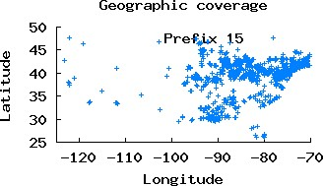
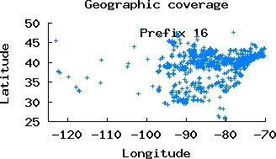
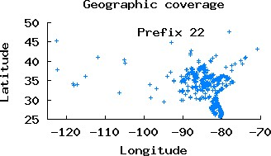
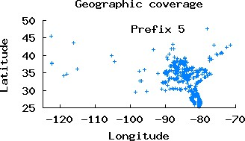
Motivation for Clustering --
Limited Types of Geographic Coverage Patterns
Prefixes with the same geographic coverage should have the same allocation policy (under the same GGSN)
Courtesy: Q. Xu et al.
Notes:
Let us have a close look at some prefixes’s geographic coverage. As we can see, prefix 22 and prefix 5 have the almost the same geographic coverage, also for prefix 15 and prefix 16, they both have similar geographic coverage. From our observation, there are actually only few types of geographic coverage given there are hundreds of prefixes for each carrier. This confirms our expectation that prefixes have the similar geographic coverage are allocated at the same GGSN data center. In other words, we can infer the number of GGSN data centers if we can find out the number of different geographic coverage. Then it is intuitive for us to cluster based on their geographic coverage.

Slide 51
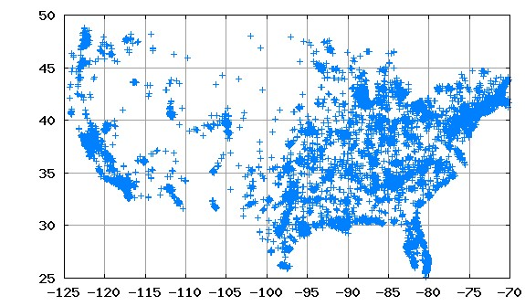
Cluster Cellular Prefixes
1. Pre-filter out those prefixes with very few records (todo)
2. Split the U.S. into N square grids (todo)
3. Assign a feature vector for each prefix to keep # records in each grid
4. Use bisect k-means to cluster prefixes by their feature vectors (todo)
How to avoid aggressive filtering?
  keep at least 99% records
How to choose N?
  # clusters is not affected by N while N > 15 && N < 150
    The geographic coverage of each cluster is coarse-grained
How to control the maximum tolerable SSE?
Cellular Networks and Mobile Computing (COMS 6998-8)
Courtesy: Q. Xu et al.
Notes:
We have qualitively looked at the geographic coverage in the last slide, before we continute, we have to to quantitively define the geographic coverage in advance. We split the US into N square grids. Then we want to find the distribution of the number of records for each prefix across these grids. We assign a feature vector with the same size of the number of grids. Each element in the vector keeps the number of records from each prefix in each particular grid. Then we can use bisect kmeans to cluster those prefix based on their feacture vectors.
In advance, we have to pre-filter out those prefixes with very few records, but at the same time we should prevent from aggressive prefiltering. In our study, we find that the number of records of the prefix are bi-modal distrituted so that it proves the possibility of filtering out these small prefixes without two much information lost.
We vary the number of grids, and find the number of clusters is not affected while N is in the range from 15 to 150.
Since we are using bisect kmeans for clusterring, the only one parameters to control is SSE which is the upper bound of the diversity of prefixes in each cluster. We found that the number of cluster is insenstive to SSE. Out observation is that the similarity of prefixes in the same cluster is very strong and the difference across clusters is very large.
Due to space and time limitation, I am not going to elaborate those three todos. If you are interested, please refer to our paper.

Slide 52
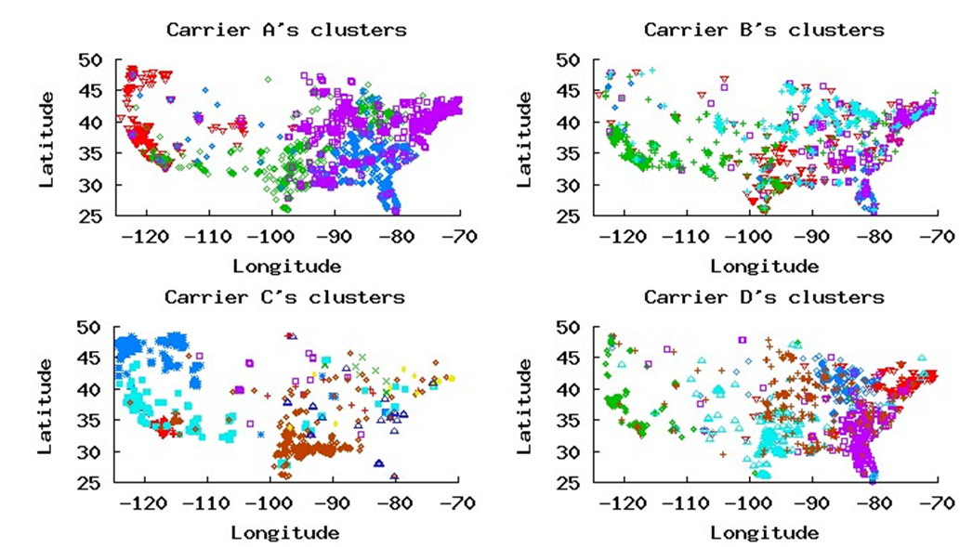
Clusters of the Major Carriers
  All 4 carriers cover the U.S. with only a handful clusters (4-8)
All clusters have a large geographic coverage
Clusters have overlap areas
  Users commute across the boundary of adjacent clusters
  Load balancing
Cellular Networks and Mobile Computing (COMS 6998-8)
Courtesy: Q. Xu et al.
Notes:
Now, we know how the clustering works. These four figures show the cluster results. Each figure reflects one carrier’s clusters. For each carrier, one color represent one cluster. All 4 carriers cover the US with only a handful clusters. The number of clusters ranges from 4 to 8 dependents on the carrier. one cluster covers a large geographic coverage, the coverage is even less fine-grained than state level. We can also observe that there are some overlap across clusters. We can expect two reasons for the overlapping. One is due users mobility. Users may commute across the boundary of adjacent clusters. So that a moving user will keep the IP address of the last cluster when it moves to the current cluster if the current session is not timed out. The second reason is due to load balancing to increase reliability of the system which is a common technique applied in reliable distributed system.

Slide 53
Outline
Motivation
Problem statement
Previous Studies
Data Sets
Clustering Prefixes
Validating the Clustering Results
Implication on mobile content placement
Courtesy: Q. Xu et al.
Notes:
Now we have the clusters. In the paper we validate the correctness of the clusters using three ways.

Slide 54
Validate via local DNS Resolver (DataSource2)
Identify the local DNS resolvers
  Server side: log the incoming DNS requests on the authoritative DNS resolver of eecs.umich.edu and record (id_timestamp, local DNS resolver)
Profile the geographic coverage of local DNS resolvers
  Device side: request id_timestamp.eecs.umich.edu and record the (id_timestamp, GPS)
Courtesy: Q. Xu et al.
Notes:
First, we apply the same clustering on DataSource2’s records. We observe that DataSource2’s clusters are consistent with previous DataSource1’s.
the second way of validation is using the domain name information of the limited number of hops along these partial visiable traceroute paths. In each cluster the traceroute paths are consistent and stable. We find some location correlation between the visible traceroute path and coverage of each cluster.
Due to the space and time limitation, I going to introduce only the third way in details. Which is based on identifying the placement of local DNS resolvers in cellular networks; The intuition for us to identifying the placement of local DNS resolvers is that local DNS resolvers are expected to be placed at the same level of IP gateways, namely GGSNs in our context. We expect to see similar GGSN clusters of local DNS resolvers as well. and
When the datasource2’s application is running on a device, it sends out an unique but nonexisting subdomain of eecs.umich.edu. Since this domain name doesn’t exist, the local DNS server of the deivce eventually will refer the authorative eecs.umich’s DNS resolver. At the same time, we capture the trace on the authoritative DNS resolve of eecs.umich.edu. Therefore, for each experiment, the client side records the GPS, and the server side records the IP address of the local DNS server. Combine them together, we can get tje local DNS server to geographic coverage mapping.

Slide 55
Validate via Cellular DNS Resolver (Cont.)
Clusters of Carrier A’s local DNS resolvers
Clusters of Carrier A’s prefixes
Cellular Networks and Mobile Computing (COMS 6998-8)
Courtesy: Q. Xu et al.
Notes:
Applying the same clustering on the DNS server, we get top 4 figures. Each one of them corresponds to one cluster. Comparing them with the previous cluster of pcrefixes, we can observe the same geogprhaic patterns of clusters. This matching is evidence of the correctness of our previous clusters, also it tells us that for some carriers, local DNS server is placed at the same aggragation level of GGSN.

Slide 56
Clustering Results
Goal -- “…discover the cellular infrastructure to explain the diverse geographic distribution of cellular IP addresses…”
  All 4 major carriers have only a handful (4-8) GGSN data centers
  Individual GGSN data centers all have very large geographic coverage
Goal -- “…investigate the Implications accordingly…”
  Latency sensitive applications may be affected
    CDN servers may not be able close enough to end users
    Applications based on local DNS may not achieve higher resolution than GGSN data centers
Courtesy: Q. Xu et al.
Notes:
So after we have completed the clustering, let us come back to our problem statement. Our goal is to discover the cellular infrastructure to explain the diverse geographic coverage in terms of the number GGSNs, the placement of GGSN, and the corresponding coverage.
We already know that for all these 4 major carriers have only a handful (4-8) data centers to cover the entire US. Each data center has a very large geographic coverage, and they are placed somewhere within their coverage.
The other part of our goal is investigate the implications accordingly. Due to the limited number of GGSNs, we can expect the routing restriction. It’s very likely that the latency sensitive application maybe affected by the routing restriction. For example, CDN servers may not be able to be located close enough to end users, and application based on local DNS server resolution may not be as fine-grained as GGSN level.

Slide 57
Outline
Motivation
Problem statement
Previous Studies
Data Sets
Clustering Prefixes
Validating the Clustering Results
Implication on mobile content placement
Courtesy: Q. Xu et al.
Notes:
In the following slides, I am going to briefly introduce our evaluations of mobile content placement under the impact of cellular infrascture

Slide 58
Routing Restriction:
How to Adapt Existing CDN service to Cellular?
Where to place content?
  Along the wireless hops: require infrastructure support
  Inside the cellular backhaul: require support from cellular providers
  On the Internet: limited benefit, but how much is the benefit?
Which content server to select?
  Based on geo-location: finer-grained location may not available
  Based on GGSN: location of GGSN
Courtesy: Q. Xu et al.
Notes:
We are thinking about how to adapt existing content delivery service to currently cellular network given the routing restriction, we may breakdown the problem into two issues.
One is where to place the content server and the other one is which content server to select for each individual content request.

Slide 59
Server Selection (DataSource2)
Approximately locate the server with the shortest latency
  Based on IP address
  Based on application level information, e.g., GPS, ZIP code, etc.
Compare the latency to the Landmark server (1) closest to device with the latency to the Landmark server (2) closest to the GGSN
  Estimate the location of GGSN
  based on TRACEROUT
Select the content server based on GGSN!
Cellular Networks and Mobile Computing (COMS 6998-8)
Courtesy: Q. Xu et al.
Notes:
Due to time and space limitation, I am only going to introduce how to select the content server. Generally speaking, content delivery service first uses some device side information to locate the incoming request approximatly based on IP address or application level information such as GPS/ZIP code, and so forth. Because these application level information are easily availbel for mobile users. Due to the routing restriction, it’s not necessary that the server physically closest is the best because the traffic anyway has to go throught GGSN.
So we are interested to look at the difference of between latency to the somewhere close to GGSn and latency to somewhere close to the device. In order to compare the latency to the server closest to the deivce nand the latency to the server closest to the GGSN, we choose 20 popular landmark servers physically distributed across the US. Then we compare the lteancy to the landmark server physically closest to the device vs. the latency to the landmark serve closest to the GGSN.
The median difference is around 10ms. This value is not tiny but actually considerable if we take the performance upgrade in cellular networks into consideration.

Slide 60
Contributions
Methodology
  Combine routing, client-side, server-side data to improve cellular geo-location inference
  Infer the placement of GGSN by clustering prefixes with similar geographic coverage
  Validate the results via TRACEROUTE and cellular DNS server.
Observation
  All 4 major carriers cover the U.S. with only 4-8 clusters
  Cellular DNS resolvers are placed at the same level as GGSN data centers
Implication
  Mobile content providers should place their content close to GGSNs
  Mobile content providers should select the content server closest to the GGSN
Courtesy: Q. Xu et al.
Notes:
In this study, from the perspective of methodology, we combine three large data set together and infer the placement of GGSNs from the geographic coverage when the visibility of cellular networks is limited. We also validate our clustering results using three manners.
Given these effort, we observed a surprising result that all 4 major carriers have only a handful GGSNs and each of them has a very big geographic coverage. The nature is that the gateway of the cellular network is very far away and centralized.
In terms of implication, we investigate the impact of the restricted routing on latency sensitive content delivery services. Our suggestion t o mobile content providers is that place the content srever close to GGSN and choose the server claose to the according to the originating GGSN of mobile devices.

Slide 61
Software Defined Cellular Networks
Radio Resource Manager
Mobility Manager
Subscriber Information Base
Policy and Charging Rule Function
Infra-structure Routing
Translates policies on subscriber attributes to rules on packet header
Network Operating System: CellOS
SCTP instead of TCP to avoid head of line blocking
Cell Agent
Cell Agent
Cell Agent
Offloading controller actions, e.g. change priority if counter exceed threshold
Radio Hardware
Packet Forwarding Hardware
Packet Forwarding Hardware
DPI to packet classification based on application
Central control of radio resource allocation
Header compression

Slide 62
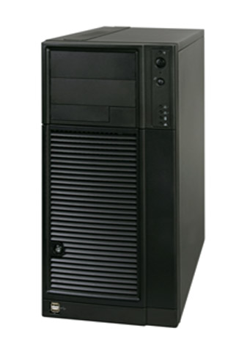
Software Defined Cellular Networks (Cont’d)
Example
Radio Resource Manager
Mobility Manager
Subscriber Information Base
Policy and Charging Rule Function
Infra-structure Routing
CellOS
Control Messages
Add/remove rules
Network Events
Forwarding table miss
Switches

Slide 63
Questions?

