Slide 1
Cellular Networks and Mobile Computing
COMS 6998-11, Fall 2012
Instructor: Li Erran Li (lel2139@columbia.edu)
http://www.cs.columbia.edu/~lierranli/coms6998-11Fall2012/
Lecture 13: Mobile Privacy

Slide 2
Mobile Privacy
Data privacy
Detecting and preventing privacy leaks
  PiOS for iOS
  TaintDroid for Android
Limiting mobile data exposure with idle eviction [assume device prone to loss]
  CleanOS
Stealthy information leaks through covert channels and prevention
  Soundcomber
Location privacy [after-class reading]
  Quantifying location privacy

Slide 3
CleanOS: Limiting Mobile Data Exposure with Idle Eviction
Yang Tang, Phillip Ames, Sravan Bhamidipati, Ashish Bijlani, Roxana Geambasu, Nikhil Sarda
Columbia University

Slide 4



The Transition to Mobile Devices
Mobiles are replacing desktops as primary computing platform
Desktops
Mobile Devices
Linux, OS X, Windows
Emails, Web browsers, Office
Android, iOS, Windows Phone
Emails, Web browsers, G Docs
New, fun, mobile apps
Increased productivity
Pervasive connectivity

Slide 5


Mobiles Bring New Challenges
Desktops
Mobile Devices
data
Physical security, firewalled networks
Unprotected outdoors, mobiles can be easily stolen, seized, or lost

Slide 6
OSes Not Designed for Challenges
Despite threats, mobile OSes have not evolved to protect sensitive data
Like desktop OSes, mobile OSes accumulate enormous sensitive data
  OS doesn’t securely erase deallocated data
  FS doesn’t securely erase deleted files
  Applications hoard sensitive data for performance or convenience
This data is placed at risk if device is stolen or lost
  Thief can dump RAM, flash memory contents
  Thief can break passwords
  …

Slide 7
Examples of Exposed Data
App | Password | Contents
Email | ✔ | ✔
Gmail |  | ✔
Y! Mail | ✔ | ✔
Google Docs |  | ✔
OI Notepad |  | ✔
Dropbox |  | ✔
KeePass | ✔ | ✔
Keeper | ✔ | ✔
Amazon
Pageonce | ✔ | ✔
Mint |  | ✔
Google+ |  | ✔
Facebook |  | ✔
LinkedIn |  | ✔
TOTAL | 5/14 | 13/14
We dumped memory and SQLite DB for 14 popular Android apps
Email | ✔ | ✔
Default Email App:
Password and email snippets are kept in cleartext RAM at all times
Everything is present in cleartext SQLite DB

Slide 8
Examples of Exposed Data
App | Password | Contents
Email | ✔ | ✔
Gmail |  | ✔
Y! Mail | ✔ | ✔
Google Docs |  | ✔
OI Notepad |  | ✔
Dropbox |  | ✔
KeePass | ✔ | ✔
Keeper | ✔ | ✔
Amazon
Pageonce | ✔ | ✔
Mint |  | ✔
Google+ |  | ✔
Facebook |  | ✔
LinkedIn |  | ✔
TOTAL | 5/14 | 13/14
We dumped memory and SQLite DB for 14 popular Android apps
Overall:
Captured some sensitive data from 13/14 apps
All 13/14 apps hoard some sensitive data in cleartext DB/RAM
9/14 apps hoard sensitive data in cleartext RAM at all times
TOTAL | 5/14 | 13/14

Slide 9
Securing Data Is Darn Hard!
Example protection systems:
  Encrypted file systems
  Encrypted RAM
  Remote wipe-out systems
Challenges / limitations:
  Users don’t lock their devices (57%) or configure poor passwords
  Physical attacks are notoriously difficult to protect against
    E.g., memory dumps, cold boot attacks, breaking trusted-hardware seals can reveal data or decryption keys
In general, these are imperfect stop-gaps on top OSes that were never designed with physical insecurity in mind

Slide 10
Time for New OS Abstractions
Mobile OSes should manage sensitive data rigorously, so as to maintain the device “clean” at any point in time in anticipation of device theft/loss
If device is stolen or lost:
  The minimal amount of sensitive data is exposed
  User retains post-theft control over unexposed data

Slide 11
CleanOS
New Android-based OS that minimizes sensitive data exposure by evicting it to a trusted cloud whenever not under active use
Implements sensitive data objects (SDOs)
  Identifies locations of sensitive data in RAM and stable storage
  Monitors its use by applications
  “Evicts” sensitive data to the cloud whenever it is not under active use
The cloud intermediates all accesses to unused SDOs and can offer a lot of useful post-loss functions:
  Disable SDO access after theft
  Audit SDO exposure and access
  Rate-limit SDO accesses

Slide 12
This Talk
All layers of current OSes require cleanup
As first step, we focus on cleaning up the application layer
This talk: limit exposure of sensitive data hoarded by apps

Slide 13
Outline
Motivation
Architecture and Prototype
Evaluation
Conclusions

Slide 14
Mobile OS Insights
Although exposed permanently, much sensitive data is only actually used very rarely
    Email password is constantly exposed, but only used upon refresh
    Subjects are constantly exposed, but only used upon inbox listing
    Contents are often exposed, but only used when user reads email
Most mobile apps have a cloud component, which already stores the data
Mobiles are (becoming) mostly connected
  Wi-Fi / cellular coverage is becoming pervasive

Slide 15
CleanOS Basic Functioning
Applications create SDOs and add sensitive data to them
CleanOS implements three functions for SDOs:
  Tracks data in SDOs using taint tracking
  Evicts SDOs to a trusted cloud whenever idle
  Decrypts SDO data when it is accessed again
Email App
Email App
Content SDO
Password
SDO
Content
SDO
Password
SDO
evicted
when user reads an email
when the app goes to the background

Slide 16
CleanOS Increases Post-Loss Control
Device lost/stolen
User notices loss
time
Tamper with device physically or in software:
Attacker
No access to device or cloud keys
dump RAM
cold boot attacks
disable connectivity
break user password
decrypt all SDOs
…
Control data accesses:
Minimize data on the device
CleanOS
audit accesses
disable or rate-limit
suspicious accesses
disable all accesses

Slide 17
The SDO Abstraction
An SDO is a logical collection of Java objects that contain sensitive data and that are related somehow
  Email-password SDO: password string + all objects computed from it
  Email-contents SDO: all emails in a thread
  Bank-account SDO: all transactions in an account
human-readable and used for auditing
class SDO {
SDO(String description, ...); // create SDO
void add(Object o); // adds object to SDO
void remove(Object o); // removes object from SDO
…
private int sdoID; // unique ID for SDO
}
used for identifying SDOs locally and remotely

Slide 18
Example: A Clean Email App
Default Email app hoards passwords and subjects
Hard for apps to manage sensitive on their own
With CleanOS, developers simply create SDOs and place their sensitive data in them
SDO pwSDO = new SDO(“Password of ” + user);
pwSDO.add(password);
...
SDO emailSDO = new SDO(“Email: ” + mSubject);
emailSDO.add(mSubject);
emailSDO.add(mTextContent);
emailSDO.add(mHtmlContent);
emailSDO.add(mTextReply);
emailSDO.add(mHtmlReply);
(code adapted for clarity)

Slide 19
The CleanOS Architecture
Mobile Device
Application (Java)
Dalvik VM
Linux

Slide 20
The CleanOS Architecture
Mobile Device
Trusted Cloud(s)
Application (Java)
SDO Database
registerSDO(
123,
“com.android.email”,
“Password of Yang”,
0x1a2b…)
pwSDO
ID: 123
App: com.android.email
Desc: Password of Yang
Key: 0x1a2b…
CleanOS Dalvik VM
Audit Log
(SDO ID: 123, Key: 0x1a2b…)
Create SDO 123
App: … Desc: …
Tracking
(modified TaintDroid)
Eviction
(evict-idle GC)
Decryption
(modified interpreter)
Linux

Slide 21
The CleanOS Architecture
Mobile Device
Trusted Cloud(s)
Application (Java)
SDO Database
pwSDO: Password of Yang
registerSDO(
123,
“com.android.email”,
“Password of Yang”,
0x1a2b…)
pwSDO
password
ID: 123
App: com.android.email
Desc: Password of Yang
Key: 0x1a2b…
imap://user:password@imap.server.com:143
smtp://user:password@smtp.server.com:25
CleanOS Dalvik VM
Audit Log
(SDO ID: 123, Key: 0x1a2b…)
Create SDO 123
App: … Desc: …
Tracking
(modified TaintDroid)
Eviction
(evict-idle GC)
Decryption
(modified interpreter)
Linux

Slide 22
The CleanOS Architecture
Mobile Device
Trusted Cloud(s)
Application (Java)
SDO Database
pwSDO
ID: 123
App: com.android.email
Desc: Password of Yang
Key: 0x1a2b…
CleanOS Dalvik VM
Audit Log
(SDO ID: 123, Key: 0x1a2b…)
Create SDO 123
App: … Desc: …
Tracking
(modified TaintDroid)
Eviction
(evict-idle GC)
Decryption
(modified interpreter)
Linux

Slide 23
The CleanOS Architecture
Mobile Device
Trusted Cloud(s)
Application (Java)
SDO Database
pwSDO
ID: 123
App: com.android.email
Desc: Password of Yang
Key: 0x1a2b…
sdoEvicted(
“com.android.email”,
123)
CleanOS Dalvik VM
Audit Log
Evicted
(SDO ID: 123, Key: )
Create SDO 123
App: … Desc: …
Tracking
(modified TaintDroid)
Eviction
(evict-idle GC)
Decryption
(modified interpreter)
SDO 123 Evicted
App: … Desc: …
Linux

Slide 24
The CleanOS Architecture
Mobile Device
Trusted Cloud(s)
Application (Java)
SDO Database
pwSDO
ID: 123
App: com.android.email
Desc: Password of Yang
Key: 0x1a2b…
CleanOS Dalvik VM
fetchKey(
“com.android.email”,
123)
Audit Log
(SDO ID: 123, Key: 0x1a2b…)
Create SDO 123
App: … Desc: …
Tracking
(modified TaintDroid)
Eviction
(evict-idle GC)
Decryption
(modified interpreter)
0x1a2b…
SDO 123 Evicted
App: … Desc: …
Fetch Key for SDO 123
App: … Desc: …
Linux

Slide 25
SDO Tracking
CleanOS uses a modified TaintDroid version to track SDOs
TaintDroid uses 32-bit shadow taint tags to mark objects/primitives with one or more taints
CleanOS imposes a specific structure on taint tags
  Includes new tainting scheme to propagate one SDO ID (see paper)
31
taint tag
0
Java object / primitive
0000000000000010000010
31
0
Java object / primitive
E
SDO ID

Slide 26
Evict-Idle Garbage Collection
To evict SDOs, we introduce a new type of Java garbage collector: the evict-idle garbage collector (eiGC)
A traditional GC: deallocates only objects guaranteed to never be used in the future
The eiGC: evicts objects that have not been used for a period of time, even if they might be used again in the future
We run the eiGC periodically to evict idle SDOs
  For any Java object that is tainted with an idle-SDO’s ID, the eiGC “evicts” that object, setting its E bit in the tag

Slide 27
Sensitive Data Encryption
To “evict” a Java object, eiGC traverses it down to the data-bearing fields (primitives & arrays of primitives) and encrypt those with a key generated from the SDO’s key
Primitives:
Metadata struct
Counter
0x1234
pointer
ciphertext
counter
…
SDO key
AES
encryption
Arrays of primitives:
struct ArrayObject {
  contents[];
  ...;
}
struct ArrayObject {
  contents[]; // evict in place
  counter;
  evicted_lock;
  ...;
}
Data field
Ciphertext

Slide 28
CleanOS Defaults
We hope for, but don’t rely upon app modifications
Hence, we provide a set of solid defaults:
  “SSL” SDO
  “User Input” SDO
  “Password” SDO
Although coarse-grained,
default SDOs limit
exposure of sensitive data
in unmodified apps
In SSL library (Java SDK):
SDO sslSDO = new SDO(“ssl”);
sslSDO.add(cleartextDataBuffer);
In InputMethod (Android SDK):
SDO inputSDO = new SDO(“user input”);
SDO pwSDO = new SDO(“password”);
if (type == InputType.TEXT_PASSWORD)
  pwSDO.add(text);
  else
    inputSDO.add(text);
(code adapted for clarity)

Slide 29
Optimizations
CleanOS includes a number of optimizations, which help with both performance and energy consumption
Pausing the eiGC
  After the app becomes idle, we stop running eiGC, until the app is active again
Bulk eviction
  The eiGC evicts all SDOs at once soon after the app becomes idle
Bulk prefetching
  The eiGC remembers which SDO keys were used recently and fetches all those keys at once

Slide 30
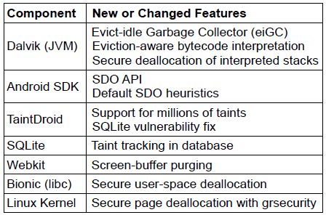
Prototype
Modified Android and TaintDroid in significant ways
Modified two “dirty” apps to use SDOs: Email and KeePass
  Modifications are trivial: 7 LoC for each application

Slide 31
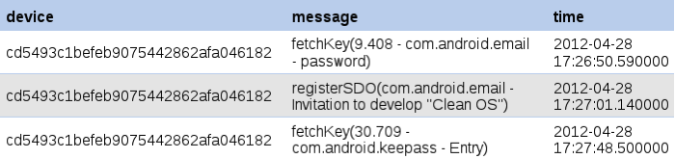
Post-Loss Services
Built a CleanOS service on Google App Engine that supports post-loss auditing
Other services could be supported:
  Disable keys after user notices theft
  Monitor key accesses, detect anomalies, and rate-limit/disable access
  Disable accesses to certain SDOs while outside a trusted network
  …
Screenshot of the CleanOS audit log

Slide 32
Outline
Motivation and Goals
Architecture and Prototype
Evaluation
Conclusion

Slide 33
Questions
Does CleanOS limit data exposure?
Does CleanOS support effective auditing?
Is CleanOS’ performance practical?
Is CleanOS’ energy consumption practical?
Is CleanOS network consumption practical?

Slide 34
Does CleanOS Limit Data Exposure?
Default SDOs reduce exposure by 89.6-93.5%
App SDOs further reduce content exposure to 0.3%
Similar results in Facebook and Mint apps
Thus, default SDOs drastically curb
sensitive-data exposure
Email App Version | Password SDO | Contents SDO
Email without CleanOS | 100% | 95.5%
Email App Version | Password SDO | Contents SDO
Email without CleanOS | 100% | 95.5%
Email with default SDOs | 6.5% | 5.9%
Email App Version | Password SDO | Contents SDO
Email without CleanOS | 100% | 95.5%
Email with default SDOs | 6.5% | 5.9%
Cleaned Email with app SDOs | 6.5% | 0.3%
Fraction of time in which sensitive data was exposed

Slide 35
Is Auditing Effective?
Thus, for best auditing properties,
applications should define their own SDOs
95.1%
95.1% 100%
Audit Precision (%)
0%

Slide 36
Is CleanOS Practical (Wi-Fi)?
88ms
Thus, overheads are largely
unnoticeable over Wi-Fi
289ms
115ms
48ms
30ms
14ms

Slide 37
Is CleanOS Practical (3G)?
1819ms
722ms
953ms
354ms
354ms
92ms

Slide 38
Is CleanOS Practical (3G)?
Optimizations improve 3G performance
significantly, making CleanOS practical
1225ms
392ms
167ms
499ms
10ms
8ms

Slide 39
Conclusions
Mobile OSes and apps accumulate a lot of sensitive data, exposing it to attacks if device is stolen or lost
CleanOS is a new Android-based OS design that minimizes amount of sensitive data exposed on device at any time
  SDO: new OS abstraction for managing sensitive data
  eiGC: garbage-collector that evicts unused SDO data
CleanOS brings new view on data security: minimize and audit exposure of sensitive data to attack
  We believe that this view is applicable more broadly to other domains, such as datacenter and Web data security

Slide 40
PiOS:
Detecting Privacy Leaks
in iOS Applications
Manuel EGELE, Christopher KRUEGEL, Engin KIRDA, Giovanni VIGNA
{maeg,chris,vigna}@cs.ucsb.edu, ek@ccs.neu.edu
Int. Secure Systems Lab, UCSB & TU Vienna & Northeastern University
SAP Security Info Session, Wed. April 20th 2011

Slide 41
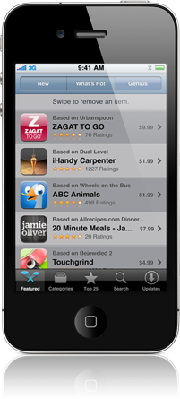
Motivation
App Store: 300k apps available, 10 billion apps downloaded
iOS apps are created by third party developers
“iPhone Developer License Agreement“
States guidelines (e.g., user's privacy)
Submitted binaries are scrutinized by Apple
through a secret vetting process
Apps passing the vetting process → App Store
Cydia: repository for jailbroken devices
Courtesy: Egele et. al

Slide 42
Motivation (cont.)
Vetting process is not flawless
”Bad apps” make it to the App Store
Apple removed several apps after they were available e.g.,
  Flashlight (enables tethering w/o the network operator's consent)
  Storm8 games harvested device phone numbers
  MogoRoad collect phone numbers of free app users
  → Telemarketers called and offered the paid full version
Courtesy: Egele et. al

Slide 43

Motivation (cont.)
How big is the problem?
PiOS
Courtesy: Egele et. al

Slide 44
Overview
Motivation
Goals & Challenges
PiOS Analysis
  Extract CFG
  Reach ability analysis
  Data Flow analysis
Evaluation
Summary
Courtesy: Egele et. al

Slide 45
Goals & Challenges
Goals
  Identify Apps that access privacy sensitive information and transmit this information over the Internet without user intervention or consent
  Perform this analysis on a large body of Apps
  Gain insight in how Apps handle privacy sensitive data
Challenges
  Apps are only available as binary executable
  App Store Apps are encrypted
Courtesy: Egele et. al

Slide 46
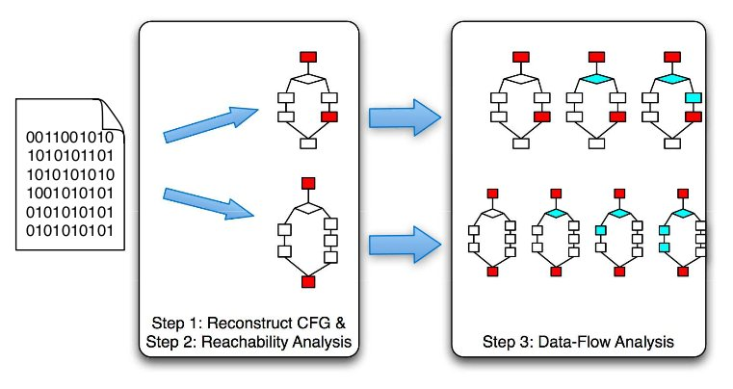
Approach
Extract control flow graph (CFG)
Identify sources of sensitive information and network communication sinks
  Perform reachability analysis between sources and sinks
Data flow analysis on detected paths
Courtesy: Egele et. al

Slide 47
Background (iOS & DRM)
App Store apps are encrypted and digitally signed by Apple
Loader verifies signature and performs decryption in memory
Decrypting App Store apps:
  Attach with debugger while app is running
  Dump decrypted memory regions
  Reassemble binary, toggle encrypted flag
Cydia Apps are not encrypted
Courtesy: Egele et. al

Slide 48
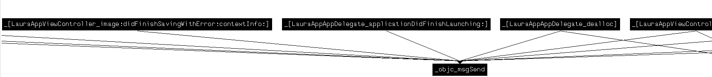
Analysis (CFG)
IDA Pro generated CFG for “Bomberman“
objc_msgSend
Courtesy: Egele et. al

Slide 49
Analysis (CFG)
Most iOS apps are written in Objective-C
Cornerstone: objc_msgSend dispatch function
Task: Resolve type of receiver and value of selector for objc_msgSend calls
  Backwards slicing
  Forward propagation of constants and types
Result: Inter and intra procedural CFG is constructed from successfully resolved objc_msgSend calls
Courtesy: Egele et. al

Slide 50
Background (objc_msgSend)
objc_msgSend dynamic dispatch function
Arguments:
  Receiver (Object)
  Selector (Name of method, string)
  Arguments (vararg)
Method look-up:
  Dynamically traverses class hierarchy
  Calls the method denoted by selector
Non-trivial to do statically
Courtesy: Egele et. al

Slide 51
Analysis (CFG)
Most iOS apps are written in Objective-C
Cornerstone: objc_msgSend dispatch function
Task: Resolve type of receiver and value of selector for objc_msgSend calls
  Backwards slicing
  Forward propagation of constants and types
Result: Inter and intra procedural CFG is constructed from successfully resolved objc_msgSend calls
Courtesy: Egele et. al

Slide 52
Example ObjC to ASM
UIDevice
1 LDR R0, =off_24C58
2 LDR R1, =off_247F4
3 LDR R0, [R0]
4 LDR R1, [R1]
5 BLX _objc_msgSend
6 LDR R1, =off_247F0
7 LDR R1, [R1]
8 BLX _objc_msgSend
…
currentDevice
r0?
r1?
UIDevice
::currentDevice
uniqueIdentifier
UIDevice
r1?
::uniqueIdentifier
9 STR R0, [SP,#0x60+var_34]
10 LDR R3, [SP,#0x60+var_34]
…
11 BLX _objc_msgSend NSString ::initWithFormat:(fmt: "uniqueid=%@&username=%@&country=%@&email=%@")
…
12 BLX _objc_msgSend POSTScore ::startPostingData:toURL: (0x1b478)
Courtesy: Egele et. al
Notes:
First alloc
Then init

Slide 53
Finding Privacy Leaks
Inter and intra procedural Control Flow Graph
Reachability Analysis (find paths)
  From interesting sources
  To network sinks
Implicit interruption of CFG for user-input (e.g., dialog boxes, etc.)
  Touch events are generated by the OS not in the developer's code
Courtesy: Egele et. al

Slide 54
Sources and Sinks
Sources:
  Address book
  GPS coordinates
  Unique device ID
  Photos
  Email account settings
  WiFi connection information
  Phone information (phone #, call lists, etc.)
  YouTube application Settings
  MobileSafari settings and history
  Keyboard Cache (every word typed w/o passwords)
Sinks:
  NSUrlConnection, NSString::initWithContentsOfURL, etc.
Courtesy: Egele et. al

Slide 55
Data Flow Analysis
For each source/sink pair perform reachability analysis
  Is there a path in the CFG that connects the source to the sink?
Along paths that result from reachability analysis
  Taint flow analysis
  Conservatively taint results of methods without implementation if at least one input parameter is tainted
Courtesy: Egele et. al

Slide 56
Evaluation
1,407 Applications (825 from App Store, 582 from Cydia)
  Resolving calls to objc_msgSend
  4,156,612 calls
  3,408,421 identified (82%)
  i.e., class and selector exist and match
Pervasive ad and statistic libraries:
  772 Apps (55%) contain at least one such library
  Leak UDIDs, GPS coordinates, etc.
Courtesy: Egele et. al

Slide 57
Ad and Statistic Libraries
82% use AdMob (Google)
Transmit UDID and AppID on start-up and ad request
Ad company can build detailed usage profiles
  Gets info from all Apps using the ad library
UDIDs cannot be linked to a person directly
Problem: Location based Apps
  Access to GPS is granted per App libraries linked into location based apps have access to GPS too
Courtesy: Egele et. al

Slide 58
Is Leaking UDIDs a Problem?
UDIDs cannot be linked to a person directly
But: Combine UDID with additional information e.g.,
  Google App can link UDID to a Google account
  Social networking app get user's profile (often name)
Linking ICC-ID with UDID is trivial
  114,000 iPad 3G users
Courtesy: Egele et. al

Slide 59
Evaluation Data Flow Analysis
Reachability analysis: 205 apps
Enumerate all paths from source to sink with length < 100 basic blocks
Perform data flow analysis along these paths
PiOS detected flows of sensitive data for 172 apps (TP)
6 true negatives, 27 false negatives
  FN e.g., aliased pointers, format string from config file, JSON library (i.e., invoking JSONRepresentation on each object in a dictionary, PiOS does not track types in aggregates)
Courtesy: Egele et. al

Slide 60
Evaluation: Leaked Data
Source | #App Store 825 | #Cydia 582 | Total 1407
DeviceID | 170 (21%) | 25(4%) | 195(14%)
Location | 35(4%) | 1(0.2%) | 36(3%)
Address book | 4(0.5%) | 1(0.2%) | 5(0.4%)
Phone number | 1(0.1%) | 0(0%) | 1(0.1%)
Safari history | 0(0%) | 1(0.2%) | 1(0.1%)
Photos | 0(0%) | 1(0.2%) | 1(0.1%)
Courtesy: Egele et. al

Slide 61
Evaluation: Case Studies (1)
Address book contents:
  Apps have unrestricted access to the address book
  Facebook and Gowalla transmit the complete AB
  Facebook: detailed warning that data will be sent
  Gowalla (Social networking app):
    User can send Invitations to contacts
    Complete AB is sent on load (i.e., before the user chooses a contact)
    → “We couldn’t find any friends from your Address Book who use Gowalla. Why don’t you invite some below?”
Courtesy: Egele et. al

Slide 62
Evaluation: Case Studies (2)
Phone number
Nov. 2009 Apple removed all Storm8 titles (social games) from App Store
  because apps transmitted phone numbers (SBFormattedPhoneNumber)
  New versions don't have that code anymore
Old version of “Vampires“ PiOS detected the privacy leak
→ Improvement over Apple vetting process
Courtesy: Egele et. al

Slide 63
Summary
PiOS is able to create a CFG from ObjC binaries
82% of the calls to objc_msgSend could be resolved
Data flow analysis is used to identify privacy leaks
PiOS showed how pervasive ad and statistics libraries are used in apps
PiOS identified unknown and known privacy leaks that lead to App Store removal in the past
Courtesy: Egele et. al

Slide 64
Detecting Privacy Leaks in Smartphone Applications at Run Time
Byung-Gon Chun
Yahoo! Research
Joint work with William Enck, Peter Gilbert,
Landon P. Cox, Jaeyeon Jung,
Patrick McDaniel, Anmol N. Sheth
Courtesy: Byung-Gon et. al

Slide 65
Roadmap
Approach
TaintDroid design
Performance study
Application study
Courtesy: Byung-Gon et. al

Slide 66
TaintDroid Goal
Monitor app behavior to determine when privacy sensitive information leaves the phone in real time
Courtesy: Byung-Gon et. al

Slide 67
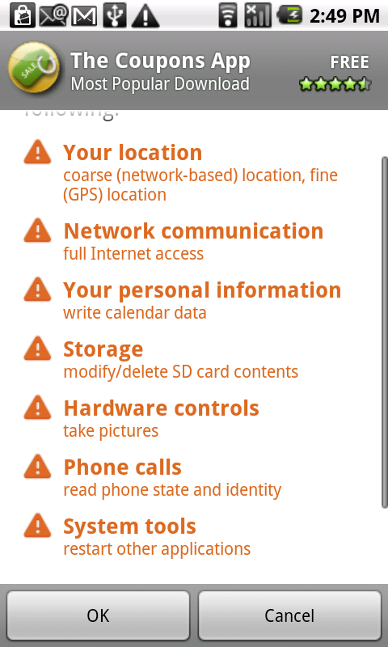
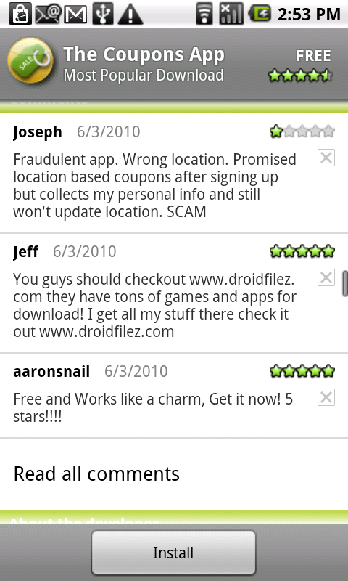
Current “Best” Practice
Trust-or-cancel
Coarse-grained access control
No visibility into the actual behavior
Courtesy: Byung-Gon et. al

Slide 68
TaintDroid Approach
Look inside of applications to watch how they use privacy sensitive data
Trust-or-cancel Trust-but-verify
Courtesy: Byung-Gon et. al

Slide 69
Challenges
Smartphones are resource constrained
Third-party applications are entrusted with several types of privacy sensitive information
Context-based privacy information is dynamic and can be difficult to identify when sent
Applications can share information
Courtesy: Byung-Gon et. al

Slide 70
Dynamic Taint Analysis
A technique that tracks information dependencies from an origin
Taint
  Source
  Propagation
  Sink
C = Taint_source()
…
A = B + C
…
Network_send(A)
Courtesy: Byung-Gon et. al

Slide 71
Dynamic Taint Analysis in Action
register
…
ret
mov al, byte ptr ds[esi]
mov byte ptr ds[edi], al
pop esi
…
…
ret
mov al, byte ptr ds[esi]
mov byte ptr ds[edi], al
pop esi
…
0
0
Expensive! 2-20x slowdown.
Whole-system tracking!
1
0
k
1
0
0
0
0
k
0
1
memory
memory
code snippet from iexplore.exe
taint map
Courtesy: Byung-Gon et. al

Slide 72
TaintDroid
Leverage Android Platform Virtualization
Message-level tracking
Application code
Application code
msg
Virtual machine
Virtual machine
Variable-level
tracking
native system libraries
Method-level
tracking
Network interface
Secondary storage
File-level
tracking
Courtesy: Byung-Gon et. al

Slide 73
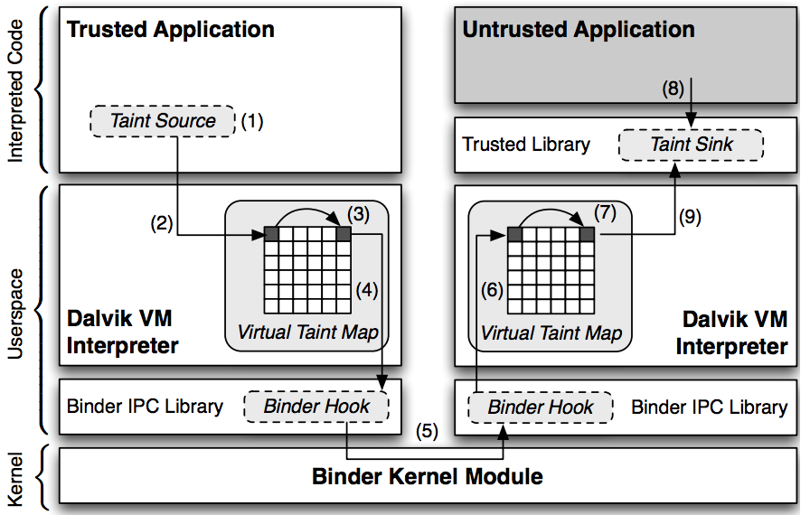
TaintDroid Android Architecture in Detail

Slide 74
VM Variable-level Tracking
Modified the Dalvik VM interpreter to store and propagate taint tags (a taint bitvector) on variables
  Local variables and method args: taint tags stored adjacent to variables on the internal execution stack.
  Class fields: similar to locals, but inside static field heap objects
  Arrays: one taint tag per array to minimize overhead
Courtesy: Byung-Gon et. al

Slide 75
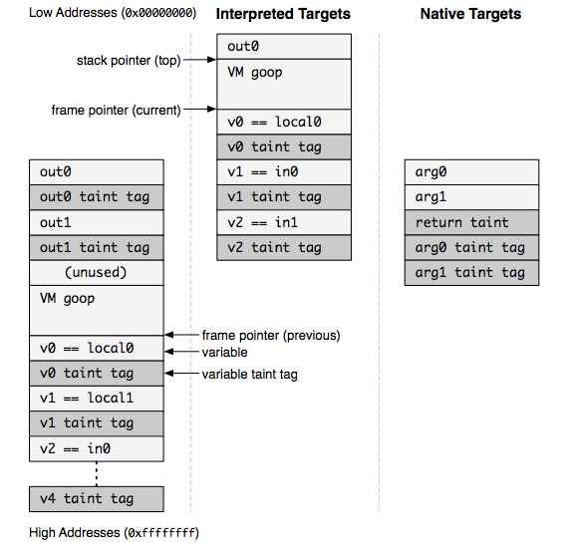
Modified Stack Format Example

Slide 76
DEX Taint Propagation Logic
Op Format | Op Semantics | Taint Propagation | Description
const-op vA C | vA ← C | T(vA) ← 0 | Clear vA taint
move-op vA vB | vA ← vB | T(vA) ← T(vB) | Set vA taint to vB taint
move-op-R vA | vA ← R | T(vA) ← T(R) | Set vA taint to return taint
return-op vA | R ← vA | T(R) ← T(vA) | Set return taint (0 if void)
move-op-E vA | vA ← E | T(vA) ← T(E) | Set vA taint to exception taint
throw-op vA | E ← vA | T(E) ← T(vA) | Set exception taint
unary-op vA vB | vA ← op vB | T(vA) ← T(vB) | Set vA taint to vB taint
binary-op vA vB vC | vA ← vB op vC | T(vA) ← T(vB)UT(vC) | Set vA taint to vB taint U vC taint
binary-op vA vB | vA ← vA op vB | T(vA) ← T(vA)UT(vB) | Set vA taint to vA taint U vB taint
binary-op vA vB C | vA ← vB op C | T(vA) ← T(vB) | Set vA taint to vB taint
aput-op vA vB vC | vB[vC] ← vA | T(vB[]) ← T(vB[]) UT(vA) | Update array vB taint with vA taint
…
binary-op vA vB vC vA ← vB op vC T(vA) ← T(vB) U T(vC)
Courtesy: Byung-Gon et. al

Slide 77
Native Methods
Applications execute native methods through the Java Native Interface (JNI)
TaintDroid uses a combination of heuristics and method profiles to patch VM tracking state
Courtesy: Byung-Gon et. al

Slide 78
IPC and File Taint Propagation
Message-level tracking for IPC
  Marshall data items
  Unmarshall data items
Persistent storage tracked at the file level
  Single taint tag stored in the file system XATTR
Courtesy: Byung-Gon et. al

Slide 79
Roadmap
Approach
TaintDroid design
Performance study
Application study
Courtesy: Byung-Gon et. al

Slide 80
Performance Study: Microbenchmark
CaffeineMark
3.0 benchmark
14% overhead
Courtesy: Byung-Gon et. al

Slide 81
Performance Study
Memory overhead: 4.4%
IPC overhead: 27%
Macro-benchmark
  App load: 3% (2ms)
  Address book: (<20ms) 5.5% create, 18% read
  Phone call: 10% (10ms)
  Take picture: 29% (0.5s)
Courtesy: Byung-Gon et. al

Slide 82
Taint Adaptors
Sources
  Low-bandwidth sensors: location, accelerometer
  High-bandwidth sensors: microphone, camera
  Information databases: address book, SMS storage
  Device identifiers: IMEI, IMSI, ICC-ID, Phone number
Sink: network
Courtesy: Byung-Gon et. al

Slide 83

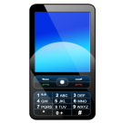

Application Study
Applications (with the Internet permission) | # | Permissions
The Weather Channel, Cetos, Solitarie, Movies, Babble, Manga Browser | 6
Bump, Wertago, Antivirus, ABC --- Animals, Traffic Jam, Hearts, Blackjack, Horoscope, 3001 Wisdom Quotes Lite, Yellow Pages, Datelefonbuch, Astrid, BBC News Live Stream, Ringtones | 14
Layar, Knocking, Coupons, Trapster, Spongebot Slide, ProBasketBall | 6
MySpace, ixMAT, Barcode Scanner | 3
Evernote | 1
Courtesy: Byung-Gon et. al

Slide 84
Findings: Location
15 of the 30 apps shared physical location with at least an ad server (admob.com, ad.qwapi.com,
ads.mobclix.com, data.flurry.com)
e.g., received data with tag 0x411 data=[GET /servernameA1?hello=1&time=1&bumpid=354957030504982&locale=en_US&gpslong=-122.316&gpslat=47.662&gpsaccuracy=32.000&timezone=0…
In no case was sharing obvious to user or in EULA
  In some cases, periodic and occurred without app use
Courtesy: Byung-Gon et. al

Slide 85
Findings: Phone Identifiers
7 apps sent IMEI and 2 apps sent phone #, IMSI, ICC-ID to remote servers without informing the user
Frequency was app-specific, e.g., one app sent phone information every time the phone booted
Courtesy: Byung-Gon et. al

Slide 86
Demo
http://appanalysis.org/demo/index.html

Slide 87
Conclusion
Efficient, system-wide, dynamic taint tracking for mobile platforms.
  14% overhead for computing-intensive work
Private data leak is prevalent
  20 of the 30 studied applications share information in a way that was not expected
www.appanalysis.org
Courtesy: Byung-Gon et. al

Slide 88
Soundcomber
A Stealthy and Context-Aware
Sound Trojan for Smartphones
Roman Schlegel
City University of Hong Kong
Kehuan Zhang, Xiaoyong Zhou, Mehool Intwala,
Apu Kapadia, XiaoFeng Wang
Indiana University Bloomington
Courtesy: Roman et. al

Slide 89
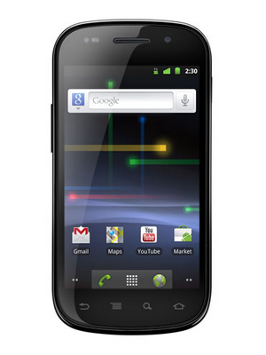
The smartphone in your pocket is really a computer
1 GHz Processor
512MB / 16GB
Android OS (Linux)
Courtesy: Roman et. al
Notes:
- Like a computer, *but*, unlike a computer, with different sensors
- Also other information, not from sensors, such as address book, dialed numbers, etc.
- Sensory Malware

Slide 90
No surprise malware targets smartphones
Android malware steals info from 1’000’000 users¹
Trojan sends premium-rate text messages²
Security experts release Android root-kit³
1. http://nakedsecurity.sophos.com/2010/07/29/android-malware-steals-info-million-phone-owners/
2. http://news.cnet.com/8301-27080_3-20013222-245.html
3. http://www.reuters.com/article/idUSTRE66T52O20100730
Courtesy: Roman et. al
Notes:
- Different sensors

Slide 91
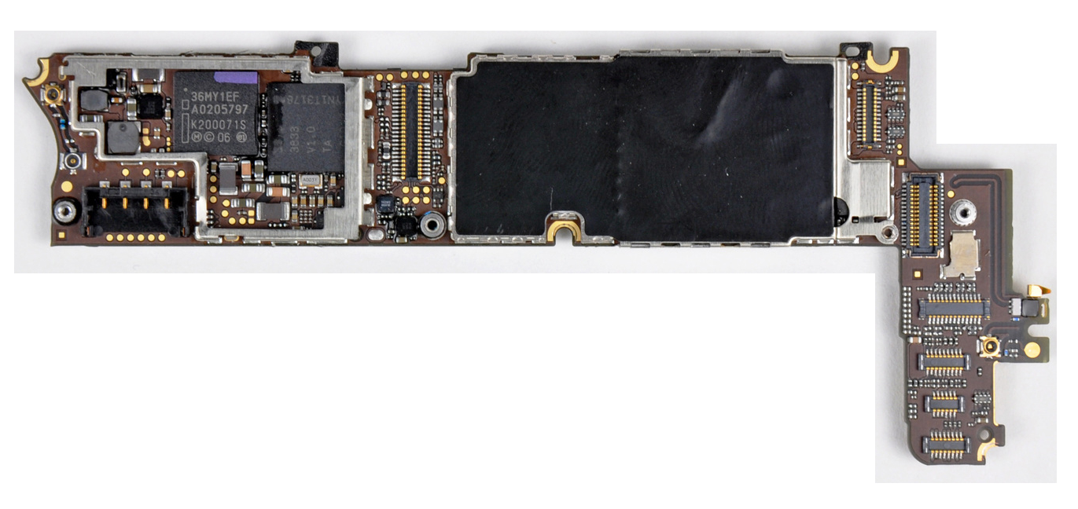
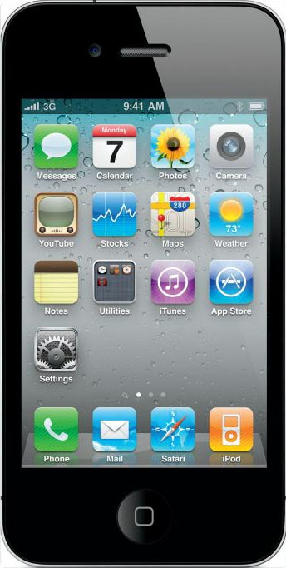
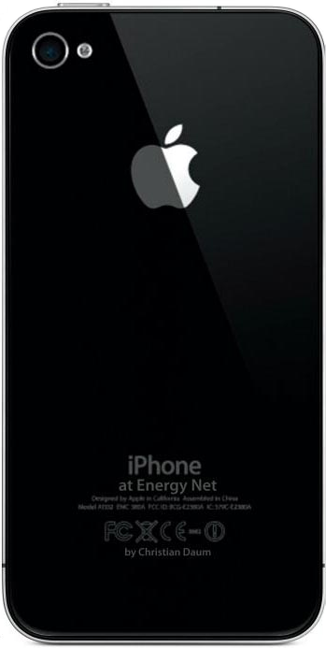

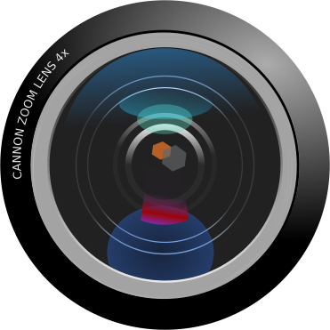



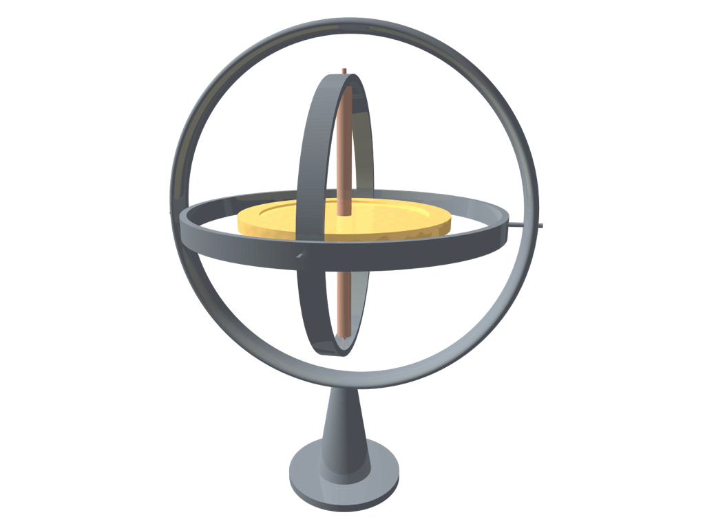

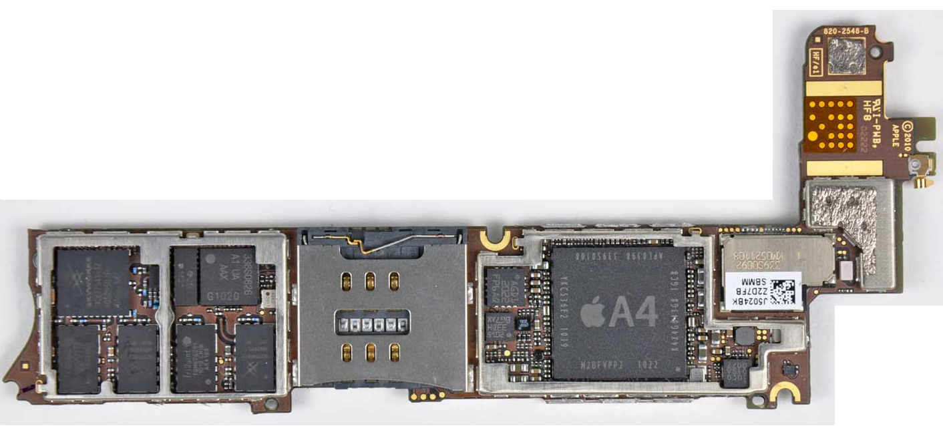


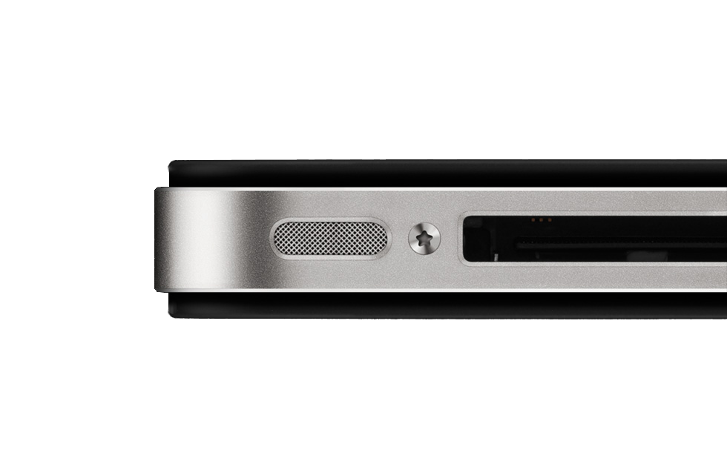
But “sensory malware” can do much more
Camera
Compass
Gyroscope
GPS
Microphone
[15] N. Xu et al.
Courtesy: Roman et. al
Notes:
- Different sensors
- “sensory malware can do much more, other people have shown etc.”

Slide 92



What can malware overhear?
Do you think anybody will ever figure out
that I keep a spare door key in the flower
pot on my front porch?
Nah, how would anybody ever find out?
Courtesy: Roman et. al
Notes:
- What can be picked up through the microphone?
- Confidential information, trade secrets, negotiations?

Slide 93



Some situations are easy to recognize
“Please enter or speak your
credit card number now.”
Bank
Courtesy: Roman et. al
Notes:
- Voice, DTMF tones (side-channel)

Slide 94









Naive approach: record and upload
1’000’000 phones ≈ 1TB/day
≈ 500KB/day
Internet
Malware
Master
Data
Valuable
Information
Courtesy: Roman et. al
Notes:
- not stealthy, lots of network communication, looks anomalous
- too much data for the malware master

Slide 95
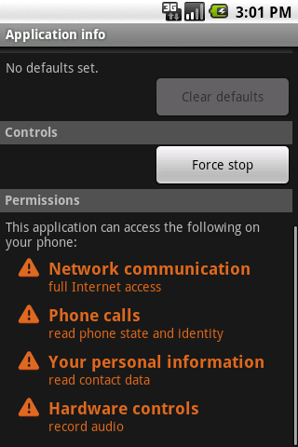



Certain combinations of permissions are suspicious
Can easily be recognized and disallowed
([5] W. Enck et al.)
Courtesy: Roman et. al
Notes:
- refer to paper (Kirin) which prevents the installation of applications with certain combinations of permissions

Slide 96
Our contributions over the naive approach
  targeted and local extraction of valuable data
inconspicuous permissions
stealthiness
Courtesy: Roman et. al

Slide 97
Naive approach: record and upload
Internet
Malware
Master
Data
Valuable
Information
Courtesy: Roman et. al
Notes:
- not stealthy, lots of network communication, looks anomalous
- too much data for the malware master

Slide 98


Soundcomber approach: process and upload
Internet
Malware
Master
Valuable
Information
Courtesy: Roman et. al

Slide 99





Two trojans are stealthier than one
Internet
Microphone
(c)overt
channel
Soundcomber
app
Deliverer
app
Courtesy: Roman et. al
Notes:
- separate permissions into two inconspicuous sets of permissions
- Soundcomber: phone state, contacts, record audio
- Deliverer: network

Slide 100
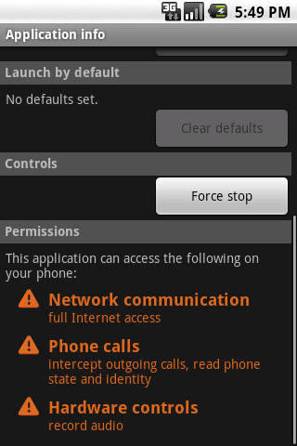
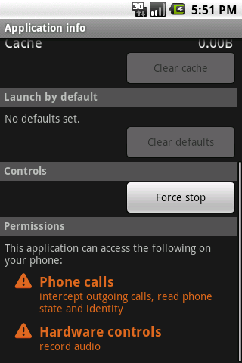
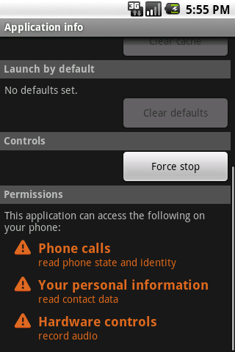
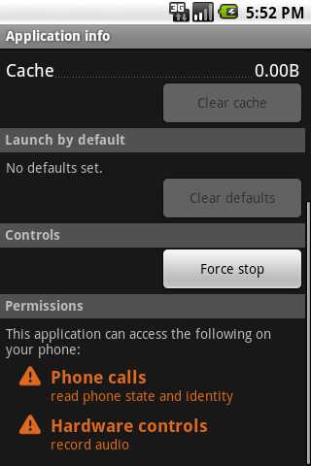
Soundcomber minimizes the necessary permissions
voice-memo app
wake-up alarm app
Courtesy: Roman et. al

Slide 101

Hotline greetings can be fingerprinted easily
“Thank you for calling...”
Bank 1
?
?
“Welcome to ...”
Bank 2
Bank 1
Bank 2
Courtesy: Roman et. al

Slide 102



Tricking the user into installing two apps
pop-up ad
packaged app
Click Here!
Courtesy: Roman et. al

Slide 103

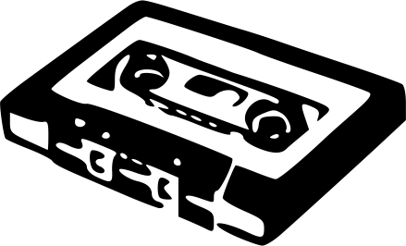




Soundcomber extracts sensitive information locally
Record
Audio
0111010100110101011....
Record
Audio
Microphone
Process
Audio
To
Deliverer
9820305180812615025219029103892...
5180 8126 1502 5219
Profile
Database
Extract
Data
Soundcomber App
Courtesy: Roman et. al

Slide 104
Profiles allow for context aware extraction
Enter
Account #
Enter
PIN
Prompt for Account Number
Acquire PIN
Sensitive Information Acquired
1
Enter
CC #
Initial Menu Options
2
Loan & Credit Card
2
Credit Card Information
1
Prompt for Credit Card #
other
input
other
input
Termination
Courtesy: Roman et. al
Notes:
- state machine

Slide 105

DTMF tones are
“dual tones”
8 frequencies
2 simultaneous frequencies for each digit
used to navigate hotline menus
 | 1209 Hz | 1336 Hz | 1477 Hz | 1633 Hz
697 Hz | 1 | 2 | 3 | A
770 Hz | 4 | 5 | 6 | B
852 Hz | 7 | 8 | 9 | C
941 Hz | * | 0 | # | D
Courtesy: Roman et. al

Slide 106
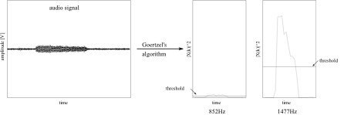
Soundcomber dynamically adjusts thresholds to detect faint tones
Courtesy: Roman et. al
Notes:
- DTMF numbers picked up through side-channel (aural feedback of pressed numbers)

Slide 107


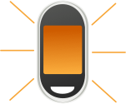


Android introduces new covert channels
vibration settings (87 bps)
volume settings (150 bps)
screen (5.3 bps)
file locks (685 bps)
Courtesy: Roman et. al
Notes:
- file locks are specific to Linux

Slide 108
Vibration settings are broadcast to interested apps
Android
OS
register broadcast
receiver
Deliverer App
set vibration
setting
Audio Manager
vibration setting
changed notification
Soundcomber App
Setting | Bit
VIBRATE_SETTING_ON | 0
VIBRATE_SETTING_ ONLY_SILENT | 1
Courtesy: Roman et. al

Slide 109
Volume settings can be modified and accessed by any app
Volume | Data
0 | 000
1 | 001
... | ...
7 | 111
set volume
setting
Audio Manager
Soundcomber App
small
delay
small
delay
Audio Manager
get volume
setting
Deliverer App
Courtesy: Roman et. al

Slide 110


Soundcomber is fast and accurate
 | No Error | 1 Error | >= 2 Errors | 1 missing | >= 2 missing
Speech | 55 % | 12.5 % | 15 % | 7.5 % | 10 %
Tone | 85 % | 5 % | 0 | 10 % | 0
 | Recording Length | Processing Time
Speech | 20 s | 7 s
Tone | 45 s | 8 s
Courtesy: Roman et. al

Slide 111
Hotlines can be fingerprinted with reasonable accuracy
20 recorded samples of 5 different hotlines (4 each)
20 samples of normal conversation
 | Correct | Missed | Wrong
Hotline | 55 % | 40 % | 5 %
 | Correct
Conversation | 100 %
Courtesy: Roman et. al

Slide 112
Keeping Soundcomber hidden and undetectable
defer/throttle processing
track user presence
performance enhancements
Courtesy: Roman et. al
Notes:
- performance enhancements: DTMF detection

Slide 113



Defense: disable recording when a sensitive number is called
UI
Microphone
Radio Interface Layer
Audio Service
Reference
Service
Controller
Controller
Controller
Baseband
Recorder
Courtesy: Roman et. al
Notes:
- exclusive mode (audio blocked) and non-exclusive mode (audio available)
- audio is blocked before command reaches baseband
- small overhead

Slide 114
Demo
Demo video
  http://www.youtube.com/watch?v=Z8ASb-tQVpU

Slide 115
Conclusion
stealthy, sensory malware is a real threat
need to explore other such threats
develop generalized defenses to such attacks
Courtesy: Roman et. al

Slide 116
Systematic Detection of Capability Leaks in Stock Android Smartphones
NDSS 2012, February 7th 2012, San Diego
Michael Grace Yajin Zhou Zhi Wang Xuxian Jiang
North Carolina State University

Slide 117
Phones and Computers
“I have always wished that my computer would be as easy to use as my telephone. My wish has come true. I no longer know how to use my telephone.”
  – Bjarne Stroustrup (designer of C++)

Slide 118
Phones: the PCs of the Future?
Smartphone shipments increased 42% between 3Q 2010 and 3Q 2011 (Gartner, 11/15/2011)
More smartphones shipping than personal computers (IDC, 2/7/2011)
  New markets: first computer = smartphone

Slide 119
Smartphone ≠ Handheld PC
Unique abilities specific to the form factor
  Many sensors: “context-aware”
  Dialup ➔ always on ➔ always with you
Resource constrained
Different vendor relationships and primacy
Notes:
Somewhere along the line, people stopped saying they had an “IBM PC” in favor of a “Windows PC”. (And what of Commodore and Acorn and Atari?)

Slide 120
Related Work
Problems with Permissions
  e.g., Kirin [Enck et al., CCS ‘09], Soundcomber [Schlegel et al., NDSS ‘11], Stowaway [Felt et al., CCS ‘11], Guess Who’s Texting You [Schrittwieser et al., NDSS ‘12]…
Information Leak Detection
  e.g., PiOS [Egele et al., NDSS ‘11], TaintDroid [Enck et al., OSDI ‘10]…
Phone Defenses
  e.g., MockDroid [Beresford et al., HotMobile ‘11], TISSA [Zhou et al., TRUST ‘11], AppFence [Hornyack et al., CCS ‘11], Permission Re-Delegation [Felt et al., USENIX Security ‘11], QUIRE [Dietz et al., USENIX Security ‘11], XManDroid [Bugiel et al., NDSS ‘12], MoCFI [Davi et al., NDSS ’12]…
Market Issues
  e.g., DroidMOSS [Zhou et al., CODASPY ‘12], DroidRanger [Zhou et al., NDSS ‘12]…

Slide 121
Firmware and Fragmentation
A conspicuous gap in the body of work!
Not like on desktops, or other smartphone platforms
Research Goal: Determine the impact firmware customizations have on security and privacy
Notes:
Dell does not compile their own version of Windows

Slide 122
Android Capabilities
Platform defines some APIs
  APIs may require capabilities (called permissions)
Applications can define APIs the same way
What happens when an application defines a new API based on a restricted old one?
  That’s up to the author!

Slide 123
Capability Leaks
Capability Leak: A situation where an app can gain access to a restricted API without requesting proper permission
Explicit Capability Leak: Broadening access to a restricted API by exposing it via another API
Implicit Capability Leak: Inheriting permissions from other applications

Slide 124
Explicit Capability Leaks
Outside Caller
(no permissions)
Leaking API
(needs no permissions,
has permission P)
Restricted API
(needs permission P)

Slide 125
Detecting Capability Leaks
Android SDK gives us no tools!
Function composition
  Capability leak: g(x) = f(x) + some other stuff
Intuitive algorithm:
  Find interesting (dangerous) APIs (f(x))
  Find new API definitions (g(x))
  Link them!
Notes:
How can we identify capability leaks?

Slide 126
System Overview
Preloaded Apps
Woodpecker
Possible Path Identification
Infeasible Path Pruning
Leak Report
Phone Image
Framework Classes
Android Framework Knowledge

Slide 127
Possible Path Identification
Construct a control-flow graph
Find all paths from an IPC entry point to an API of interest

Slide 128
Possible Path Identification: Challenges
Object references
  Class hierarchy used to conservatively resolve references
Extensive use of callbacks
  Use framework knowledge to stitch together callbacks
UIThread.start()
UIThread.run()
Thread.start()
SMSThread.start()
SMSThread.run()

Slide 129
Infeasible Path Pruning
Many potential paths exist
  Most are either impossible or uninteresting
Must prune these uninteresting paths
  Branch conditions need an understanding of program data-flow
  Explicit permission checks are “infeasible paths”
Our approach: Symbolic Path Simulation

Slide 130
Symbolic Path Simulation
X = 0
X = 0
If X = 0
X = 0
X ≠ 0
Then
Else
Notes:
Follows program execution symbolically
Program state is modeled as a tuple of (instruction counter, data constraints)

Slide 131
Implementation
Based on the baksmali decompiler (1.2.6)
Covers 13 permissions, controlling:
  Phone information
  Location API
  Phone dialing
  Sending text messages
  Camera/microphone
  Rebooting/shutting down the device
  Installing/removing apps
  Factory reset

Slide 132




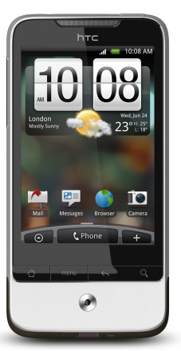
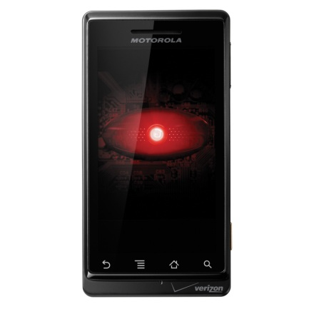
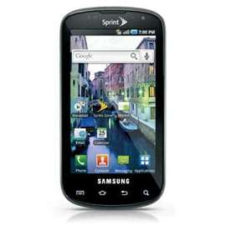
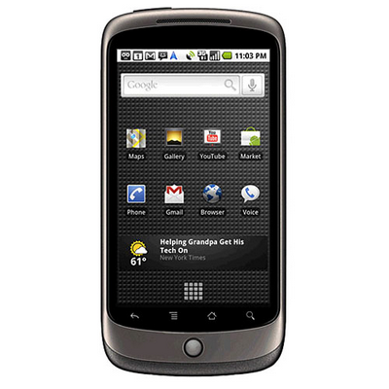
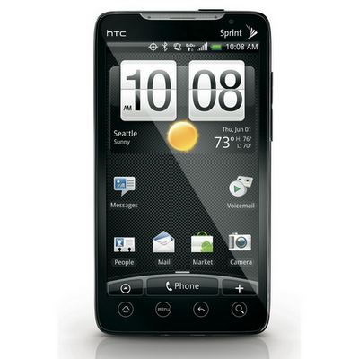
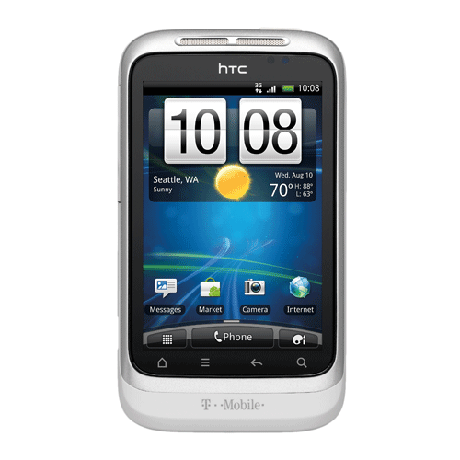
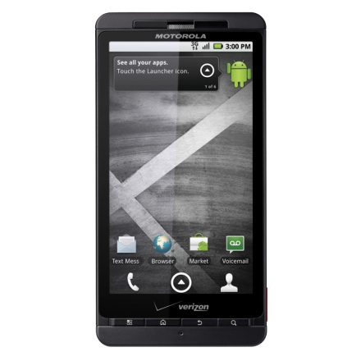
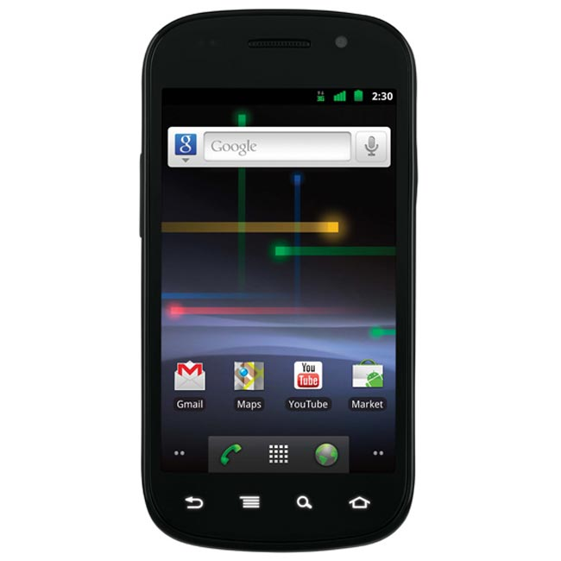
Evaluation

Slide 133
Explicit Capability Leaks Found
Permission | HTC |  |  | Motorola |  | Samsung | Google
 | Legend | EVO 4G | Wildfire S | DROID | DROID X | Epic 4G | Nexus One | Nexus S
Coarse Location | P | P |  |  | P
Fine Location | P | P |  |  | P
Call Phone |  |  |  |  |  | P
Call Privileged
Camera | P | P | P
Delete Packages | P | P | P | P | P | P | P | P
Install Packages
Master Clear |  |  |  |  | P
Read Phone State |  |  |  | P
Reboot |  | P
Record Audio | P | P | P
Send SMS | P | P | P
Shutdown |  | P

Slide 134
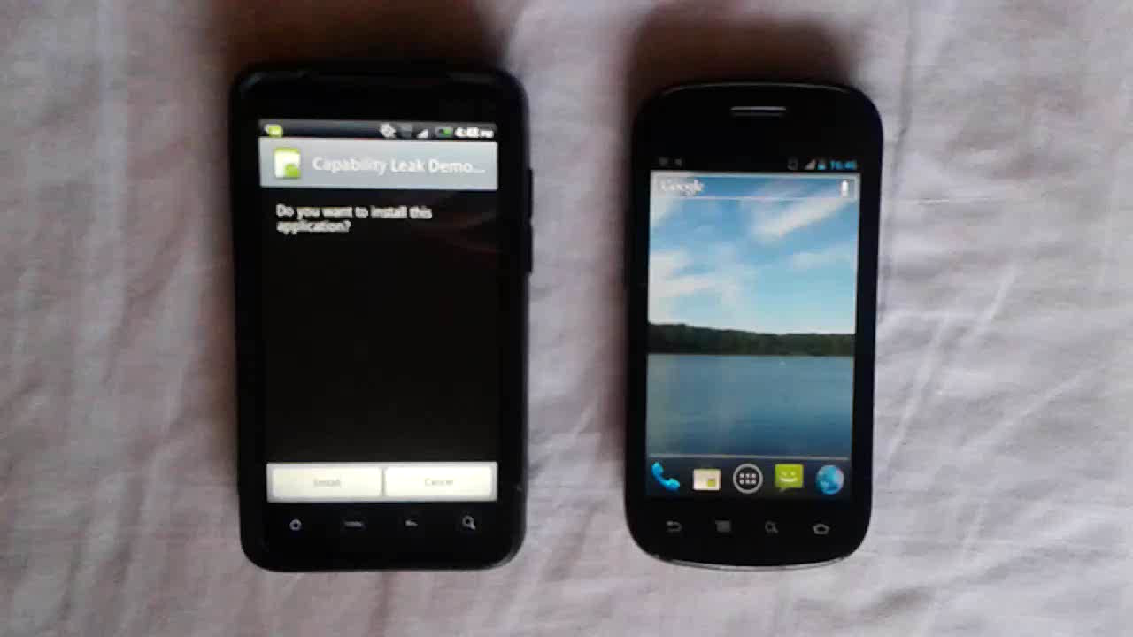
Demo

Slide 135
Implicit Capability Leaks Found
Permission | HTC |  |  | Motorola |  | Samsung | Google
 | Legend | EVO 4G | Wildfire S | DROID | DROID X | Epic 4G | Nexus One | Nexus S
Coarse Location | P | P | P
Fine Location |  |  | P
Call Phone |  |  |  |  |  | P
Call Privileged |  |  | P
Camera
Delete Packages
Install Packages
Master Clear
Read Phone State | P | P | P |  |  | P
Reboot
Record Audio
Send SMS
Shutdown

Slide 136
Performance Measurement
Vendor | Model | Time | # Apps
HTC | Legend | 3366.63s | 125
 | EVO 4G | 4175.03s | 160
 | Wildfire S | 3894.37s | 144
Motorola | DROID | 2138.38s | 76
 | DROID X | 3311.94s | 161
Samsung | Epic 4G | 3732.56s | 138
Google | Nexus One | 2059.47s | 76
 | Nexus S | 1815.71s | 72

Slide 137
Discussion
Accuracy
  False negatives: native code, undocumented extensions
  False positives: conservative analysis
Threads and Time
  Instruction interleaving, shared state
  Example: callback handling
Notes:
Some API calls can be defined by parameters, not clear-cut method invocations

Slide 138
Conclusions
Capability leaks present a tangible threat to security and privacy on existing Android smartphones
We present a system, Woodpecker, to detect these capability leaks

