Slide 1
Cellular Networks and Mobile Computing COMS 6998-1, Fall 2012
Instructor: Li Erran Li (lel2139@columbia.edu)
http://www.cs.columbia.edu/~lierranli/coms6998-11Fall2012/
Lecture 12: Mobile Platform Security: Attacks and Defenses

Slide 2
Mobile Security Attacks and Defenses
Inter application communication related attacks
Permission re-delegation (confused deputy attacks)
Collusion attacks
System vulnerability based attacks
Control flow attacks (code injection attacks)
Root exploits (e.g. adbd bug used by DroidKungfu malware)
Application specific attacks (e.g. texting apps)

Slide 3
Permission Re-delegation: Attacks and Defenses
Adrienne Porter Felt¹, Helen J Wang², Alexander Moshchuk², Steve Hanna¹, Erika Chin¹
¹University of California, Berkeley
²Microsoft Research

Slide 4
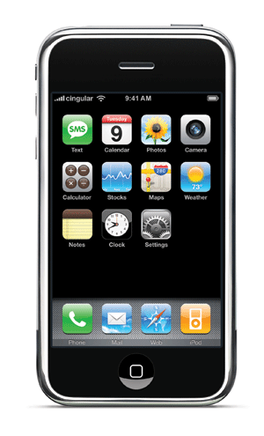
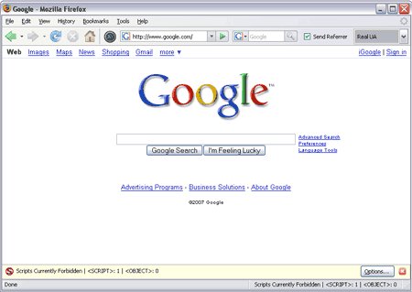
modern client platforms
Applications are untrusted, or partially trusted
Isolated from each other, except for IPC
By default, denied access to private devices and data
Users explicitly grant permissions for devices, data
Each application may have its own set of permissions
Courtesy: Felt et. al

Slide 5
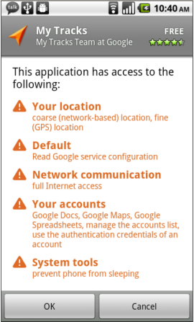
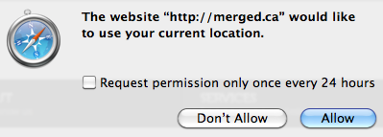
permissions
Android, iOS, HTML5, browser extensions…
Courtesy: Felt et. al

Slide 6
permission re-delegation
Permission re-delegation occurs when an application without a permission gains additional privileges through another application
A special case of the confused deputy problem
Privilege obtained through user permissions
Courtesy: Felt et. al
Notes:
We have client platforms with both per-application permissions and application communication. A privileged application that accidentally or carelessly provides a public interface can provide a path for another application to access a protected resource without the appropriate permission. We call such an attack a permission re-delegation attack.

Slide 7
Demo malware
pressButton(0)
Settings
toggleWifi()
Permission System
API
Courtesy: Felt et. al

Slide 8
Outline
Threat model
Permission re-delegation is a real problem, and systems should not permit permission re-delegation
We propose IPC Inspection as a defense mechanism
Courtesy: Felt et. al

Slide 9
The permission system
Permission system enforces user’s permission policy
Malware
Deputy
toggleWifi()
toggleWifi()
Permission System
API
Courtesy: Felt et. al
Notes:
The purpose of this slide is to help assert that a system-enforced mechanism is better than a developer-enforced mechanism

Slide 10
The deputy
Has user authorization
Not malicious, but not a security watchdog
Exposes public services Confused? Careless?
Malware
Malware
Deputy
toggleWifi()
Permission System
API
Courtesy: Felt et. al

Slide 11
The attacker
User installs/runs it, but doesn’t trust it
Exploits a deputy to access a resource
Malware
Malware
pressButton(0)
Deputy
toggleWifi()
Permission System
API
Courtesy: Felt et. al

Slide 12
Real world permission re-delegation attacks
Android case study,
precautionary for the future of the web
Courtesy: Felt et. al

Slide 13
Identifying candidates
Two necessary preconditions for an attack:
Has a dangerous permission
Has a public interface
Analyzed manifests of 872 Android applications
16 system apps, 756 most popular, 100 recently uploaded
320 apps (37%) are candidates for attacks
Courtesy: Felt et. al

Slide 14
Finding exploits
Built tool for finding attacks
Call graph analysis: find paths from public entry points to protected API calls
Manually verified all exploits
Public
entry points
API calls
Courtesy: Felt et. al
Notes:
Disassembled applications
Built the call graph
Looked for paths from public entry points to dangerous API calls
Mention that it’s for “proof of concept” – this is why we do not provide either a false positive or false negative analysis

Slide 15
attacks
Built attacks using 5 of the 16 system apps
Found 15 attacks in the 5 applications
Several confirmed and fixed
This is a lower bound; likely more exist
Courtesy: Felt et. al

Slide 16
Attack on the settings app
Demo malware
Message: 0://0#0
User pressed button[0]
Settings
com.android.settings.widget. SettingsAppWidgetProvider
wifiManager.setWifiEnabled(true)
Permission System
API
Courtesy: Felt et. al

Slide 17
More example attacks
DeskClock:
Start an internal service
Tell it to infinitely vibrate with a WAKE_LOCK on
Phone:
Trigger the “phone call answered” message receiver
Phone call will be silenced, vibrate cancelled
Courtesy: Felt et. al
Notes:
Also attacks in the Music player and Launcher applications

Slide 18
Preventing permission re-delegation
Courtesy: Felt et. al

Slide 19
Our goals
We don’t want to rely on application developers for prevention
Enable the system to prevent permission re-delegation
We don’t want to break applications
Courtesy: Felt et. al
Notes:
Developers can’t be trusted to prevent these types of attacks. They make mistakes! As we just showed, a third of the built-in Android system applications have these attacks – and those apps were written by Google Android engineers, who are probably among the best developers out there.
If you don’t want to place the responsibility on a system, you’ll get a very different looking defense mechanism. The next talk from Rice presents such a system.

Slide 20
IPC Inspection
When a deputy receives a message, system reduces deputy’s permissions (for the session) to: {requester’s permissions} {deputy’s permissions}
A deputy’s current set of permissions captures its communication history
Deputy can specify who can(not) send it messages
Generalizes stack inspection to IPC calls
Courtesy: Felt et. al
Notes:
Say that we are focused on preventing access to API calls, not tracking the resulting data

Slide 21
Handling a potential attack
Time-of-use system
Add a new runtime prompt for permission re-delegation
Install-time system
Requester must statically ask for necessary permissions
Permission re-delegation is simply blocked at runtime
Courtesy: Felt et. al
Notes:
When I say “prevent permission re-delegation”, I don’t mean that I want to stop applications from communicating with each other. Instead, our goal is to keep the decision of what applications have what permissions in the user’s hands.

Slide 22
Application instances
Deputy might need to service user and multiple app requesters simultaneously
Solution: create one instance per request
User interacts with primary instance
When new interaction starts, create a new “application instance”
Each instance has its own set of current permissions
However, instances share app storage, etc.
Courtesy: Felt et. al

Slide 23
implementation
Android implementation: modify PackageManager, ActivityManager
PackageManager installs applications, stores permissions, enforces permission requirements
ActivityManager notifies PackageManager when relevant events happen, e.g. starting Activity, receiving Broadcast Intent
A few hundred lines of code
Courtesy: Felt et. al

Slide 24
evaluation
Do we break applications?
Do we stop attacks?
Courtesy: Felt et. al

Slide 25
Broken applications
20 Android applications
Developers might need to make changes to these applications:
Intentional Deputy | 5 applications (25%)
Requester | 6 applications (30%)
One application is both an intentional deputy and a requester
Of those requesters: 2 of 6 requesters (10% of apps) need to add permissions
Courtesy: Felt et. al
Notes:
20 randomly selected applications

Slide 26
Effectiveness at Attack prevention
20 Android applications
IPC Inspection prevents these from being exploited:
Unintentional Deputy | 4 applications (20%)
Also stops all the attacks on the built-in system applications
Courtesy: Felt et. al
Notes:
20 randomly selected applications

Slide 27
Conclusion
Real world permission re-delegation vulnerabilities exist
A third of Android system applications contain permission re-delegation attacks
Future systems should be designed to prevent permission re-delegation
IPC Inspection: an OS mechanism that prevents permission re-delegation
Install-time: some requesters will need to add permissions
Courtesy: Felt et. al

Slide 28
Guess Who’s Texting You?
Evaluating the Security of Smartphone Messaging Applications
Sebastian Schrittwieser

Slide 29
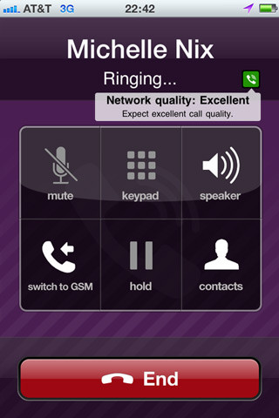
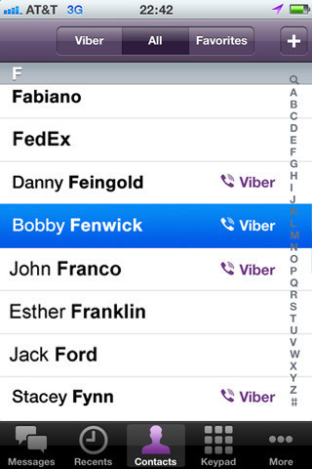
Smartphone Messaging
Aim at replacing traditional text messaging (SMS) and GSM/CDMA/3G calls
Free phone calls and text messages over the Internet
Novel authentication concept
Phone number used as single authenticating identifier

Slide 30
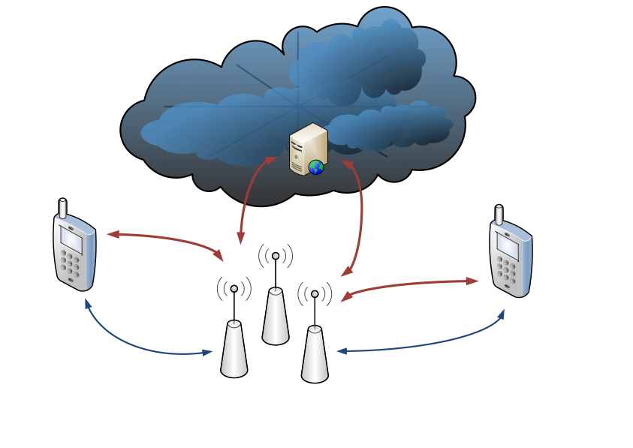
Internet
Telecom infrastructure

Slide 31
Motivation
 | Traditional SMS/talk | Messenger/VoIP Apps
Protocol | proprietary | HTTP(S), XMPP
Security | cryptographically sound authentication (SIM card) | application depended, much weaker authentication (phone number, IMEI, UDID)
Users’ perception | SMS/talk

Slide 32
Evaluation
Authentication Mechanism and Account Hijacking
Sender ID Spoofing / Message Manipulation
Unrequested SMS / phone calls
User Enumeration
Modifying Status Messages

Slide 33
Experimental Setup
Samsung Nexus S running Android 2.3.3 and Apple iPhone 4 running iOS 4.3.3
SSL proxy to read encrypted HTTPS traffic
Used to understand the protocol, not for the actual attack (i.e., MITM between victim and server)!

Slide 34
Certificates?

Slide 35
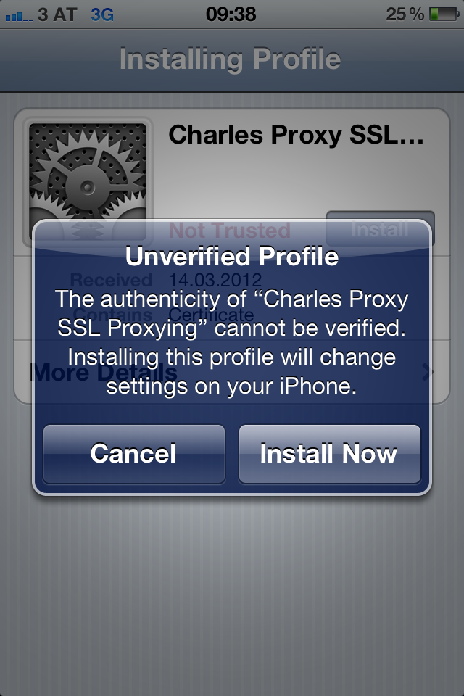

Slide 36
WhatsApp
eBuddy XMS
WowTalk
Viber
HeyTell
Forfone
Voypi
Tango
EasyTalk

Slide 37
WhatsApp
Paper:
Guess who’s texting you? Evaluating the Security of Smartphone Messaging Applications
Schrittwieser, S., Frühwirt, P., Kieseberg, P., Leithner, M., Mulazzani, M., Huber, M., Weippl, E., NDSS 2012

Slide 38
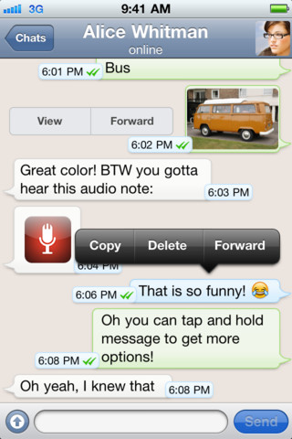
WhatsApp
Instant Messaging
Status messages
23+ million users worldwide (estimation)
> 10 billion messages per day
Clients available for Android, iOS, Symbian and Blackberry

Slide 39
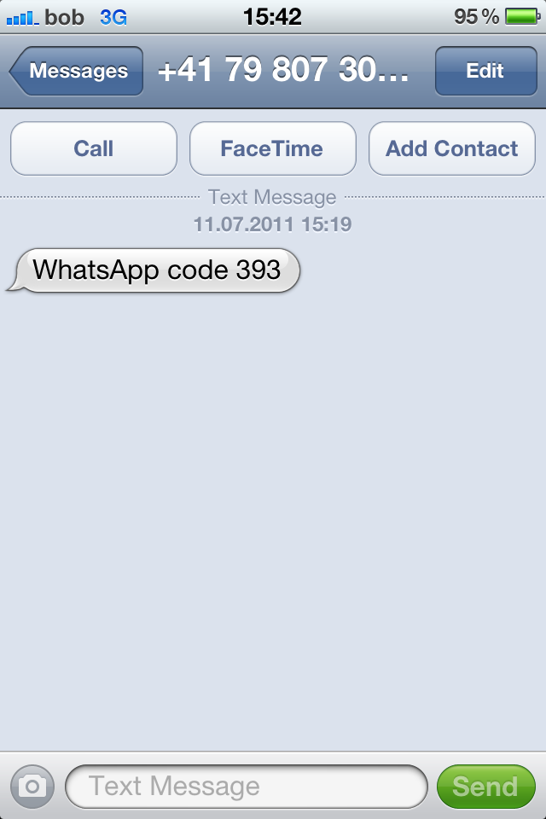
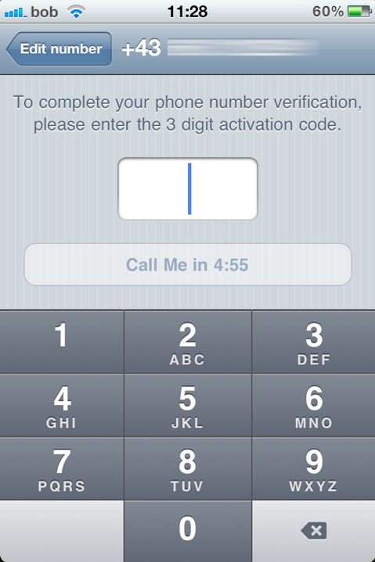
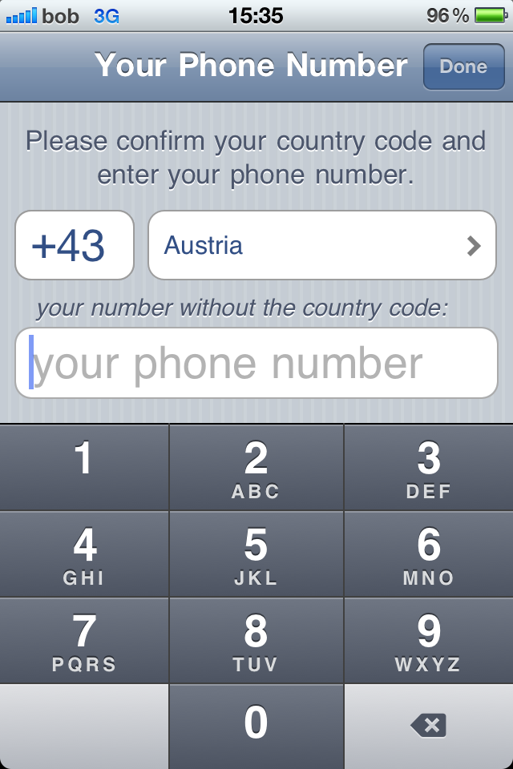

Slide 40
Authentication in WhatsApp

Slide 41
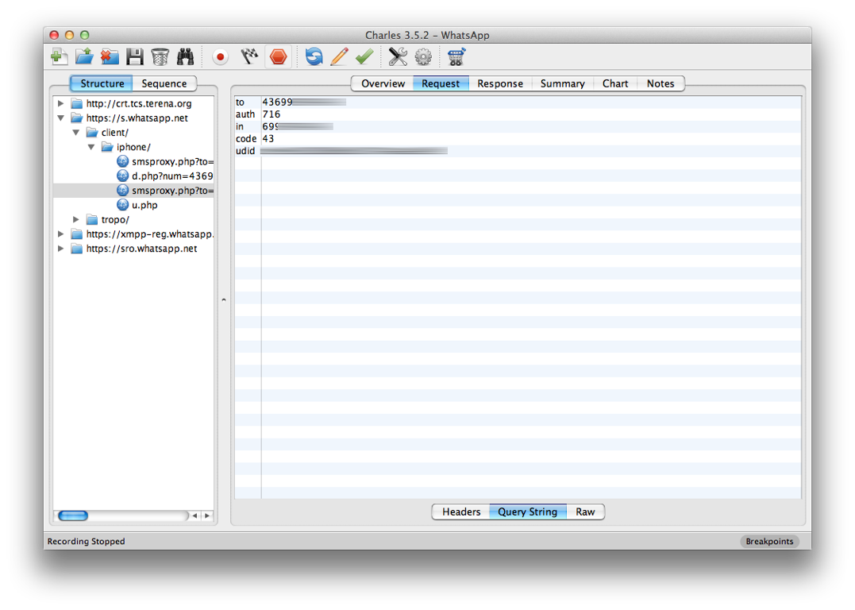

Slide 42
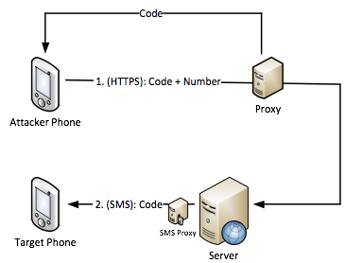
Attack against authentication

Slide 43
Attack against authentication
Intercepting the connection between the server and the attacker’s phone
The victim’s phone isn’t involved in the attack at all
Similar attacks successful in 6 out of 9 tested applications

Slide 44
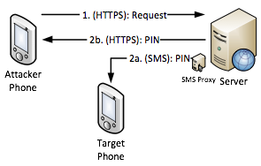
WowTalk

Slide 45
Free SMS (WhatsApp)
Authentication code in HTTPS request can be replaced with arbitrary text
No server-side validation (command injection?)
Forwarded to SMS proxy and sent via SMS
Can be misused for sending free SMS

Slide 46
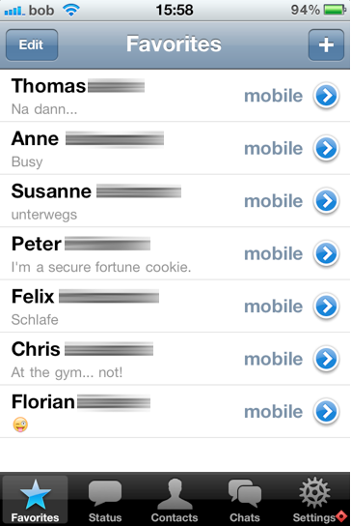
Status Messages

Slide 47
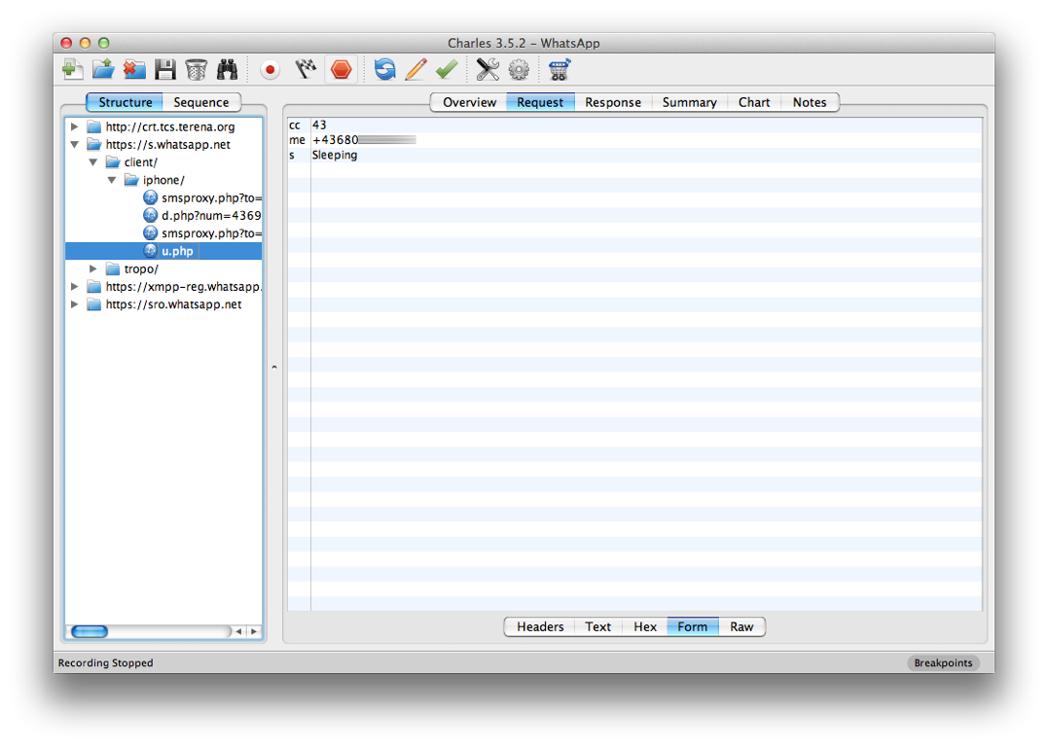

Slide 48
https://s.whatsapp.net/client/iphone/u.php?cc=countrycode&me=phonenumber&s=statusmessage

Slide 49
Sender ID spoofing
Example: Forfone
Messages are authenticated by IMEI (Android) or UDID (iOS)
Both numbers can be accessed by 3rd party applications
Voypi: no authentication at all

Slide 50
User Enumeration
Applications upload the user’s address book to the server
Server compares the contained phone numbers to already registered phone numbers
Server returns a subset list containing only phone numbers that are registered
Entire user base enumeration?

Slide 51
User Enumeration
US area code 619 (Southern San Diego)
Number range: +1 (619) XXXXXXX
10 million possible phone numbers
Uploaded entire number range in chunks of 5000 numbers each
WhatsApp returned a subset containing 21.095 (active) phone numbers

Slide 52
On vacation
At work ... Bleh.
Sleeping
Missing my love!
Heartbroken
Nicaragua in
4 days!!
On my way to Ireland!
at work but not doing shit
I’m never drinking again

Slide 53
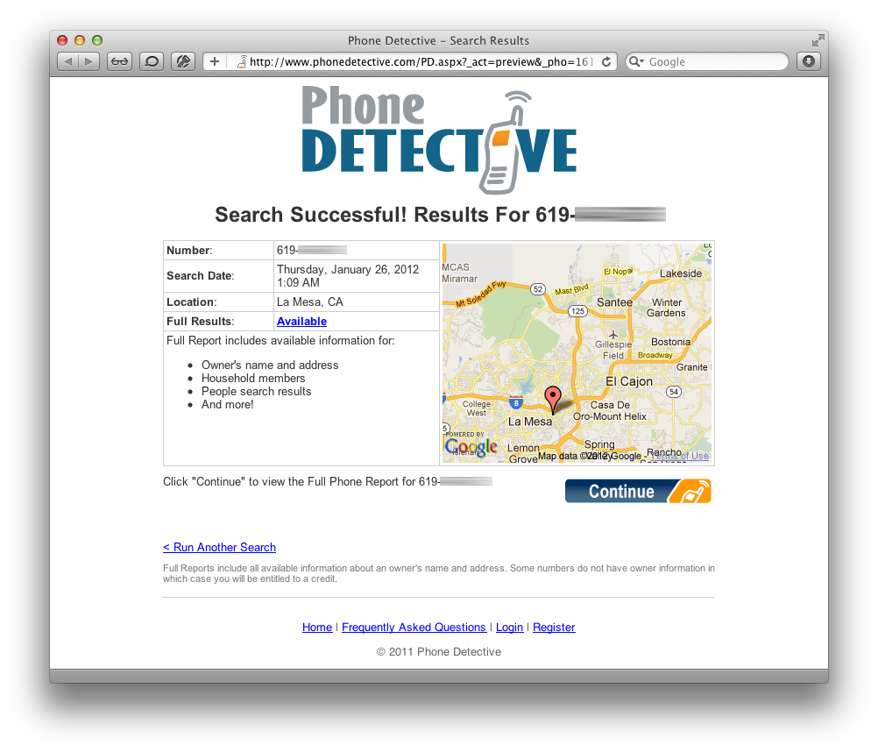

Slide 54
User Enumeration
Entire Austria (population: 8.3 million)
4 carriers, 12.3 million SIM cards
Uploaded entire number range in chunks of 5000 numbers each
Server returned 182.793 WhatsApp users (phone number + status message) in less than 5 hours

Slide 55
Results
 | Account Hijacking | Spoofing/Manipulation | Unrequested SMS | Enumeration | Other Vulnerabilities
WhatsApp | yes | no | yes | yes | yes
Viber | no | no | yes | yes | no
eBuddy XMS | no | no | yes | yes | no
Tango | yes | no | yes | yes | no
Voypi | yes | yes | yes | yes | yes
Forfone | no | yes | yes | yes | no
HeyTell | yes | no | no | limited | no
EasyTalk | yes | no | yes | yes | no
Wowtalk | yes | no | yes | yes | yes

Slide 56
Responsible Disclosure
Research between spring and fall 2011
Vendors notified in November 2011
Vulnerabilities weren’t made public until NDSS
WhatsApp fixed some vulnerabilities:
Account hijacking & free SMS
(Modifying status messages)

Slide 57
Independent Results (WhatsApp)
Andreas Kurtz (June 2011)
account hijacking
SEC Consult Vulnerability Lab (September 2011)
updating arbitrary users' status
account hijacking (brute force)
usage of plain text protocols
Several blog posts on WhatsApp security in 2011

Slide 58
Conclusions
6 out of 9 tested applications have broken authentication mechanisms
Many other vulnerabilities
All identified flaws stem from well-known software design and implementation errors
Trusting the client
No input validation
No/weak authentication mechanisms

