Slide 1
Cellular Networks and Mobile Computing
COMS 6998-8, Spring 2012
Instructor: Li Erran Li (lel2139@columbia.edu)
http://www.cs.columbia.edu/~coms6998-8/
4/2/2012: Mobile Cloud Computing

Slide 2

Mobile Cloud Computing (mCloud) today
Apple iCloud
  Store content in cloud and sync to all registered devices
  Hosted by Windows Azure and Amazon AWS
  iCloud Storage APIs support third-party app document syncing

Slide 3

Mobile Cloud Computing today (Cont’d)
Amazon Silk browser
  Accelerates web access
  Learns user behavior and precache
  Intelligently partition work between local and Amazon cloud

Slide 4
mCloud Fundamental Challenges
What architecture best supports mCloud?
What programming model best enables client to tap mCloud resources?
What are basic services or building blocks for mCloud?
What best supports service interaction?

Slide 5
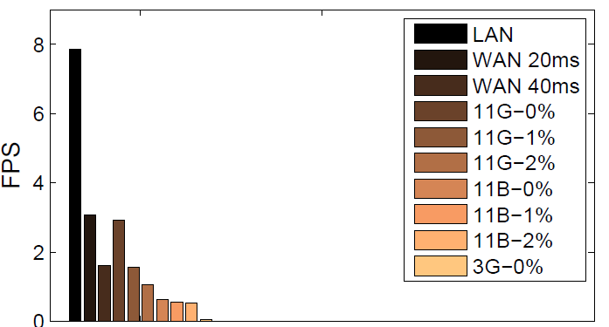
mCloud Architecture
Resource-intensive mobile applications
  Face recognition for social networking app
  Gesture recognition for control media app
  Object and post recognition for augmented reality app
End-to-end latency and througput matters for crisp interaction
  Augmented reality need to display results within 1 sec
  Need high data rate processing capability, low frame rate can miss gesture
Delay, loss on frame rate of video
stream transfer [Odessa, 2011]

Slide 6
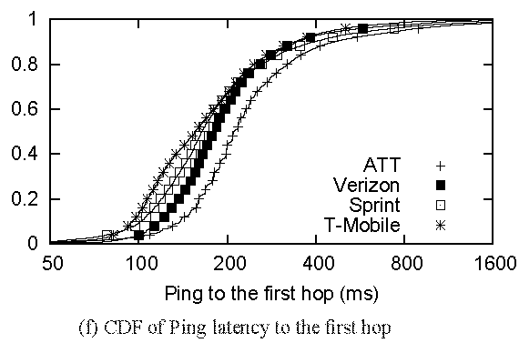
mCloud Architecture (Cont’d)
WAN performance
  First hop latency in 3G is 200ms
  Verizon LTE :128ms, 6.44 Mbps downlink, 5Mbps uplink [Pcworld, March 2011]
There is a need for a middle tier
cloudlet = (compute cluster
+ wireless access point
+ wired Internet access
+ no battery limitations)
→ “data center in a box”
“Anatomizing Application Performance Differences on Smartphones”,
MobiSys 2010 (Huang et al)

Slide 7




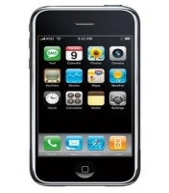
mCloud Architecture (Cont’d)
Cloudlet possible locations
Cellular providers has a unique advantage
Regional Data centers (RDC)
RDC_{A1}
Wireless Core
RDC_{B1}
RNC
Internet
BS
Storage
nodes
Compute
nodes
RDC_{B2}
RDC_{A2}
WiFi AP
Possible locations
of cloudlet

Slide 8
mCloud Programming Model
MAUI: RPC based offloading architecture
CloneCloud: tight synchronization between cloud and phone
Odessa: data-flow graph to exploit parallelism in perception applications
Orelans: a new programming model based on grains
MAUI, CloneCloud , Odessa all have profiler, solver
 | MAUI | CloneCloud | Odessa | Orleans
Remote execution unit | Methods (RMI) | Threads | Tasks | Grains

Slide 9
mCloud Programming Model: MAUI
Combine extensive profiling with an ILP solver
  Makes dynamic offload decisions
  Optimize for energy reduction
  Profile: device, network, application
Leverage modern language runtime (.NET CLR)
  Portability:
    Mobile (ARM) vs Server (x86)
    .NET Framework Common Intermediate Language
  Type-Safety and Serialization:
    Automate state extraction
  Reflection:
    Identifies methods with [Remoteable] tag
    Automates generation of RPC stubs

Slide 10
mCloud Programming Model: MAUI (Cont’d)
MAUI architecture
Application
Application
Maui Runtime
Maui Runtime
Handles Errors
Client Proxy
Server Proxy
Provides runtime information
RPC
Intercepts Application Calls
Synchronizes State
Profiler
Profiler
RPC
Solver
Solver
Chooses local or remote
Maui Controller
Smartphone
Maui server
Source: MAUI Mobisys presentation
Notes:
the MAUI coordinator, which handles authentication
and resource allocation for incoming requests to instantiate a partitioned
application.

Slide 11
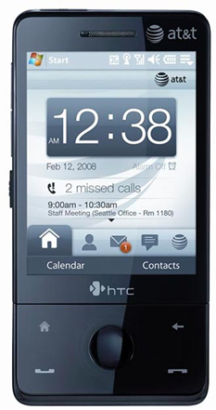
MAUI Profiler
CPU Cycles
State size
Device Profile
Execution Time
Network Latency
Profiler
Callgraph
Network Bandwidth
Computational Power Cost
Computational Delay
Annotated Callgraph
Network Power Cost
Network Delay
Computational Delay
Source: MAUI Mobisys presentation

Slide 12
MAUI Solver
A sample callgraph
C
5000 mJ
3000 ms
10000 mJ
A
1000mJ
B
900 mJ
15ms
Energy and delay for state transfer
Computation energy and delay for execution
25000 mJ
D
15000 mJ
12000 ms
Source: MAUI Mobisys presentation

Slide 13
Is Global Program Analysis Needed?
Yes! – This simple example from Face Recognition app shows why local analysis fails.
InitializeFace
Recognizer
5000 mJ
10000 mJ
User
Interface
1000mJ
FindMatch
900 mJ
Cheaper to do local
25000 mJ
DetectAndExtract Faces
15000 mJ
Source: MAUI Mobisys presentation

Slide 14
Is Global Program Analysis Needed?
Yes! – This simple example from Face Recognition app shows why local analysis fails.
InitializeFace
Recognizer
5000 mJ
10000 mJ
Cheaper to do local
User
Interface
1000mJ
FindMatch
900 mJ
25000 mJ
DetectAndExtract Faces
15000 mJ
Source: MAUI Mobisys presentation
Cheaper to do local

Slide 15
Is Global Program Analysis Needed?
InitializeFace
Recognizer
User
Interface
1000mJ
FindMatch
25900mJ
Cheaper to offload
DetectAndExtract Faces
Source: MAUI Mobisys presentation

Slide 16
Can MAUI Adapt to Changing Conditions?
Adapt to:
  Network Bandwidth/Latency Changes
  Variability on method’s computational requirements
Experiment:
  Modified off the shelf arcade game application
  Physics Modeling (homing missiles)
  Evaluated under different latency settings
Source: MAUI Mobisys presentation

Slide 17
Can MAUI Adapt to Changing Conditions?
HandleEnemies
11KB + missiles
11KB + missiles
DoFrame
DoLevel
HandleBonuses
11KB + missiles
missiles
Required state is smaller
*Missiles take around 60 bytes each
HandleMissiles
Source: MAUI Mobisys presentation
Complexity increases with # of missiles

Slide 18
Case 1
HandleEnemies
Zero Missiles
Low latency (RTT < 10ms)
DoFrame
DoLevel
HandleBonuses
Offload starting at DoLevel
HandleMissiles
Source: MAUI Mobisys presentation
Computation cost is close to zero
*Missiles take around 60 bytes each

Slide 19
Case 2
HandleEnemies
5 Missiles
Some latency (RTT = 50ms)
DoFrame
DoLevel
HandleBonuses
Very expensive to offload everything
Little state to offload
HandleMissiles
Only offload Handle Missiles
Source: MAUI Mobisys presentation
Most of the computation cost
*Missiles take around 60 bytes each

Slide 20
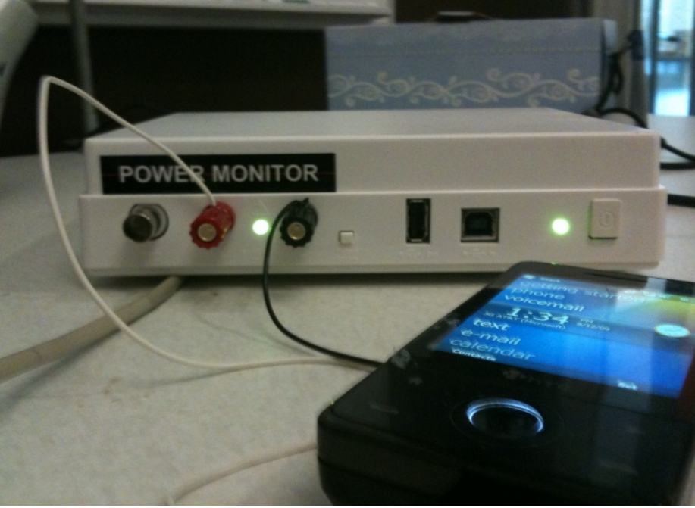
MAUI Implementation
Platform
  Windows Mobile 6.5
  .NET Framework 3.5
  HTC Fuze Smartphone
  Monsoon power monitor
Applications
  Chess
  Face Recognition
  Arcade Game
  Voice-based translator
Source: MAUI Mobisys presentation

Slide 21
Questions
How much can MAUI reduce energy consumption?
How much can MAUI improve performance?
Can MAUI Run Resource-Intensive Applications?
Source: MAUI Mobisys presentation

Slide 22
How much can MAUI reduce energy consumption?
Face Recognizer
An order of magnitude improvement on Wi-Fi
Big savings even on 3G
Source: MAUI Mobisys presentation

Slide 23
How much can MAUI improve performance?
Face Recognizer
Improvement of around an order of magnitude
Source: MAUI presentation

Slide 24
Latency to server impacts the opportunities for fine-grained offload
Arcade Game
Solver would decide not to offload
Up to 40% energy savings on Wi-Fi
Source: MAUI Mobisys presentation

Slide 25
Can MAUI Run Resource-Intensive Applications?
Translator
Can be run on the phone with MAUI
CPU Intensive even on a Core 2 Duo PC
Source: MAUI Mobisys presentation

Slide 26
Conclusions
MAUI enables developers to:
  Bypass the resource limitations of handheld devices
  Low barrier entry: simple program annotations
For a resource-intensive application
  MAUI reduced energy consumed by an order of magnitude
  MAUI improved application performance similarly
MAUI adapts to:
  Changing network conditions
  Changing applications CPU demands
Source: MAUI Mobisys presentation

Slide 27
mCloud Programming Model: CloneCloud
Offloading decision done at beginning of execution

Slide 28
The Before-After Picture
Courtesy: Byung-Gon Chun et. al.

Slide 29
CloneCloud v1 Architecture
Courtesy: Byung-Gon Chun et. al.

Slide 30
AppVM Clones
Virtual machine of entire client device
  Android x86 VM natively executed on VMWare in an x86 machine
Synchronized file systems
Courtesy: Byung-Gon Chun et. al.

Slide 31
Partitioning
Where to partition code,
satisfying any constraints for correctness,
so as to optimize for current conditions
Courtesy: Byung-Gon Chun et. al.

Slide 32
Automatic Partitioning Framework
Optimal
partitioning
points
Partitioning
constraints
Identify valid split points
Application
binary
Static
analysis
location-
constraints
Optimization
solver
Pick best choice for an objective
Profiling
inputs
Dynamic
profiling
cost-annotated
executions
Construct cost models
Partition Analyzer
Courtesy: Byung-Gon Chun et. al.

Slide 33
Partitioning: Static Analysis
Partitioning points
  Restrict to method entry/exit
Identify “pinned” methods
  Identify framework library methods
Identify mutually dependent native state
  Class natives stay together
Collect static control flow
  Who calls whom
Courtesy: Byung-Gon Chun et. al.

Slide 34
Partitioning: Profiling
Pick k invocations
For each invocation
  Run app on mobile device
  Run app on clone
For each method
  Execution time
  Context size entry/exit
  Estimate of energy consumption
Courtesy: Byung-Gon Chun et. al.

Slide 35
Partitioning: Intuition
Partitioning points splice profile trees together
Context size used to estimate network cost
Courtesy: Byung-Gon Chun et. al.

Slide 36
Partitioning: Optimization
List all partitioning choices
Remove partitioning choices that do not meet the constraints
For each choice, compute total time
Find the minimum
Courtesy: Byung-Gon Chun et. al.

Slide 37
Distributed Execution
How to seamlessly execute the partitions of an application locally and remotely
Courtesy: Byung-Gon Chun et. al.

Slide 38
Migration Architecture
Courtesy: Byung-Gon Chun et. al.

Slide 39
Migration: Suspend-Transmit-Resume
Mobile device
Clone
At migration point
  Suspend thread
  Capture context
  Transmit
  Launch process
  Patch migrated context
  Resume thread
  Suspend thread
  Capture context
At reintegration point
Transmit
  Merge migrated
  context
  Resume thread
Courtesy: Byung-Gon Chun et. al.

Slide 40
Migration Challenges
Regular IDs (references) not globally unique
  Address space difference between mobile device and clone
System objects created at boot everywhere
Courtesy: Byung-Gon Chun et. al.

Slide 41
Migration: References in Motion
Courtesy: Byung-Gon Chun et. al.

Slide 42
The CloneCloud v1 Prototype
On Android platform + x86 VM clones
Modified DalvikVM to support thread-level migration and dynamic profiling
Implemented NodeManager to handle registration and communication
Static analysis using JChord
Courtesy: Byung-Gon Chun et. al.

Slide 43
Evaluation Setup
Test applications
  Image search
  Virus scanning
  Privacy-preserving user profiling
Phone: Android Dev Phone 1
Clone VM: a server with a 3.0GHz Xeon CPU running VMWare ESX 4.1 in Intel IT infrastructures
Wireless connection: WiFi, T-mobile 3G
Courtesy: Byung-Gon Chun et. al.

Slide 44
Execution Time Comparison
(Image Search)
Execution time (seconds)
20x
1x
Courtesy: Byung-Gon Chun et. al.

Slide 45
Energy Consumption Comparison
(Image Search)
Energy consumption (J)
20x
1x
Courtesy: Byung-Gon Chun et. al.

Slide 46
Discussion
Applicability is application-specific
  Application characteristics
  Execution mechanism
A design point with focus on automation
  Apps structured to be more amenable to migration
Clone VMs in untrusted environments
Courtesy: Byung-Gon Chun et. al.

Slide 47
Conclusion
CloneCloud: automatic partitioning and migration to enhance mobile applications
  Use of clones
  Flexible app partitioning
  Seamless migration
Lots of excitements in mobile cloud computing
Courtesy: Byung-Gon Chun et. al.

Slide 48
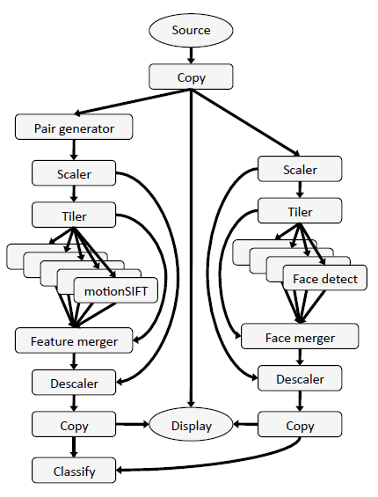
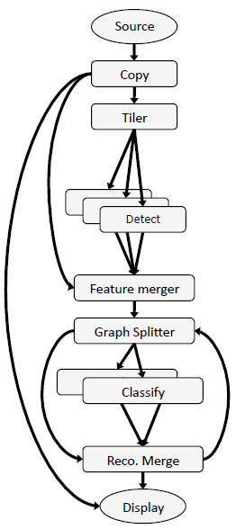
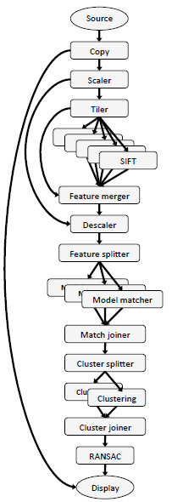
mCloud Programming Model: Odessa
Data flow graph: vertices are stages; edges are connectors; stages share nothing
Source: Odessa Mobisys presentation
Face Recognition
Object Pose Estimation
Gesture Recognition
Notes:
Figure 2(a) shows the application graph for face
recognition. The application consists of two main logical blocks
consisting of face detector and the classifier. Face detection is done
using the default OpenCV [4] Haar Classifier. The face classifier
takes as input the detected faces and runs an online semi-supervised
learning algorithm [17] to recognize the faces from a data set of 10
people.
Object and Pose Recognition Figure 2(b) shows the data-flow
graph for the object instance and pose recognition application [26].
The application consists of four main logical blocks. As shown
in the figure, each image first passes through a proportional downscaler.
SIFT features [20] are then extracted from the image, and
matched against a set of previously constructed 3D models for the
objects of interest. The features for each object are then clustered
by position to separate distinct instances. A random sample consensus
(RANSAC) algorithm with a non-linear optimization is used
to recognize each instance and estimate its 6D pose.
Gesture Recognition. Figure 2(c) shows the application graph for
a gesture recognition application. Each video frame is sent to two
separate tasks, face detection and motion extraction. The latter accumulates
frame pairs, and then extracts SIFT-like features that encode
optical flow in addition to appearance [6]. These features,
filtered by the positions of detected faces, are aggregated over a
window of frames using a previously-generated codebook to create
a histogram of occurrence frequencies. The histogram is treated as
an input vector to a set of support vector machines trained for the
control gestures.
Programming Model. Applications in the Sprout framework are
structured as a data flow graphs; the data flow model is particularly
well suited for media processing applications that perform a series
of operations to an input video or audio stream. The vertices of
the graph are processing steps called stages and the edges are connectors
which represent the data dependencies between the stages.
Stages within an application employ a shared-nothing model: they
share no state, and interact only through connectors. This restriction
keeps the programming complexity of individual stages comparable
to that of sequential programming, and allows concurrency
to be managed by the Sprout runtime. This programming model
allows programmers to express coarse-grained application parallelism
while hiding much of the complexity of parallel and distributed
programming from the application developer.
Automated data transfer. Sprout connectors define data dependencies
and perform data transfer between processing stages. The
underlying implementation of a connector depends on the location
of the stage endpoints. If the connected stages are running in
the same process, the connector is implemented as an in-memory
queue. Otherwise, a TCP connection is used. The Sprout runtime
determines the connector type, and handles serialization and data
transport through connectors transparently. This allows a processing
stage to be written in a way that is agnostic to whether it or
related processing steps have been off-loaded.
Parallelism Support. The Sprout runtime supports coarse-grained
data parallelism and pipeline parallelism. Data parallelism is supported
by having multiple instances of a stage execute in parallel on
separate processor cores. Pipeline parallelism is supported by having
multiple frames be processed simultaneously by the different
processing stages of the application.
The relationship between Sprout and Odessa. Sprout provides
programmers with mechanisms to dynamically adjust running applications,
change the degree of parallelism, and migrate processing
stages between machines. In Odessa, we develop adaptive techniques
for determining when and which stages to offload, and deciding
how much pipelining and data-parallelism is necessary in
order to achieve low makespan and high throughput, and then leverage
the Sprout mechanisms to effect the changes.

Slide 49

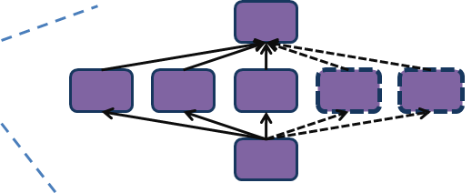
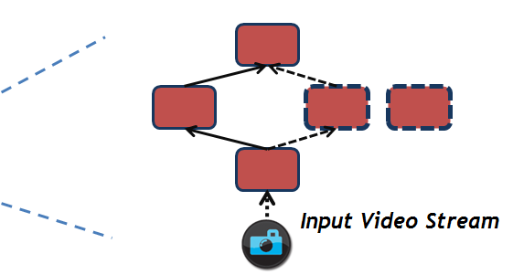

mCloud Programming Model: Odessa (Cont’d)
Offloading DEcision System for Streaming Applications
Application
Odessa Profiler
Sprout
Cloud Infrastructure
Network
Application
Odessa
Runtime
Profiler
Decision
Engine
Odessa
Sprout
Mobile Device
Source: Odessa Mobisys presentation

Slide 50

mCloud Programming Model: Odessa (Cont’d)
Cloud Infrastructure
B2
B1
C
A
Network
B
C
A
Application Data Flow Graph
>
Incremental decisions adapt quickly to input and platform variability.
Screen
Local
Execution
Cost
Remote
Execution
Cost
Smartphone
Source: Odessa Mobisys presentation

Slide 51
mCloud Programming Model: Orleans
Software framework and runtime to make cloud programming easier and more productive
Shift burden of correctness and performance from developer to Orleans system
Experimental system from Microsoft Research
Radically simplified, prescriptive programming model
  Actors
  Asynchronous messaging
  Lightweight transactions
  Persistence
  Adaptive performance management
Application
Servers
Orleans
.NET
Azure

Slide 52
mCloud Programming Model: Orleans (Cont’d)
Actor based: fine-grain distributed objects are natural abstraction
Grains partition data
Secure and isolated computation with clear points of communications
  Enable computation replication
Natural integration with persistent storage
  Grain resides on disk until activated

Slide 53

mCloud Programming Model: Orleans (Cont’d)
Grain (actor)
Field | Value
Name | “John Doe”
Email | “john.doe@hotmail.com”
Address | “123 Main St., Anywhere UR 01234”
Products
Customer Grain
Messages
Checkout
AddProduct
RemoveProduct
State
Grain ID₁
Message Queue
Grain ID₂
Methods
Courtesy Jim Larus

Slide 54
Support for Service Interaction
Synergy of mCloud services
  Shared basic services enables more efficient usage of cloud resources(e.g. shared memcache eliminates data duplication of individual services)
  Co-location makes mashed-up applications to achieve native performance (file transfer becomes an object reference)
mCloud offers shared platform services
mCloud optimizes service interaction through active VM migration

Slide 55
Closing Thoughts
Cloud computing needs to advance in architecture, programming model, platform services to revolutionize mobile computing

Slide 56
Useful Tools
Hprof: a heap/CPU profiling tool
Jchord: a static analysis tool on Java bytecode
Dummynet (ipfw): simulates/enforces queue and bandwidth limitations, delays, packet losses
OpenCV: a library of programming functions for real time computer vision

