Slide 1
Cellular Networks and Mobile Computing COMS 6998-11, Fall 2012
Instructor: Li Erran Li (lel2139@columbia.edu)
http://www.cs.columbia.edu/~lierranli/coms6998-11Fall2012/
Lecture 10: Mobile Malware

Slide 2
Syllabus
Mobile App Development (lecture 2,3)
Mobile operating systems: iOS and Android
Development environments: Xcode, Eclipse with Android SDK
Programming: Objective-C and android programming
System Support for Mobile App Optimization (lecture 4,7)
Mobile device power models, energy profiling and ebug debugging
Core OS topics: virtualization, storage and OS support for power and context management
Interaction with Cellular Networks (lecture 1,5, 8)
Basics of 3G/LTE cellular networks
Mobile application cellular radio resource usage profiling
Measurement-based cellular network and traffic characterization
Interaction with the Cloud (lecture 6,9)
Mobile cloud computing platform services: push notification, iCloud and Google Cloud Messaging
Mobile cloud computing architecture and programming models
Mobile Platform Security and Privacy (lecture 10,11,12)
Mobile platform security: malware detection and characterization, attacks and defenses
Mobile data and location privacy: attacks, monitoring tools and defenses

Slide 3
Outline
DroidRanger: Non-virtualization-based malware detection
Behavioral footprint matching for known malware
Dynamic execution monitoring for unknown malware
DroidScope Virtualization-based malware detection
Reconstruct OS, Dalvik VM and native view
Malware characterization
Installation
Activation
Malicious payloads
Evolution

Slide 4
DroidRanger
DroidRanger: Non-virtualization-based malware detection
Known malware
Permission-based filtering
Behavioral footprint matching for known malware
Unknown malware
Heuristic based filtering, e.g. dynamic loading new code
Dynamic execution monitoring for unknown malware

Slide 5
Design Goal
Scalability
Permission based filtering
Accuracy
Behavioral footprint matching
Zero-day malware detection
Heuristics based detection

Slide 6
System Overview
Malware Samples
Permission-based
Behavioral Footprints
Footprint-Based Detection Engine
Infection from
Known Malware
App
Repository
Representative Android Markets
Heuristics-Based Detection Engine
Infection from
Zero-day Malware
Heuristics
DroidRanger
Courtesy Yajin Zhou et al.

Slide 7
Footprint-Based Detection Engine
Filter apps with essential permissions
Malware | Essential Permissions | Apps
Geinimi | INTERNET, SEND_SMS | 7, 620 (4.17%)
ADRD | INTERNET, ACCESS_NETWORK_STATE RECEIVE_BOOT_COMPLETED | 10, 379 (5.68%)
Pjapps | INTERNET, RECEIVE_SMS | 4, 637 (2.54%)
Bgserv | INTERNET, RECEIVE_SMS, SEND_SMS | 2, 880 (1.58%)
DroidDream | CHANGE_WIFI_STATE | 4, 096 (2.24%)
zHash | CHANGE_WIFI_STATE | 4, 096 (2.24%)
BaseBridge | NATIVE CODE | 8, 272 (4.52%)
DroidDreamLight | INTERNET, READ_PHONE_STATE | 71, 095 (38.89%)
Zsone | RECEIVE_SMS, SEND_SMS | 3, 204 (1.75%)
jSMSHider | INSTALL_PACKAGES | 1, 210 (0.66%)
Reduced to 0.67% when considering a broadcast receiver
Courtesy Yajin Zhou et al.

Slide 8
Footprint-Based Detection Engine
Distill malware behaviors as behavioral footprint
Information in manifest file
Contain a receiver listening to SMS_RECEIVED
Semantics in the byte-code
Register a receiver listening to SMS_RECEIVED
Call abortBroadcast in the receiver
Send SMS messages to premium numbers
Structural layout of the app
Match apps with malware behavioral footprints
Behavioral
footprint
of Zsone
Courtesy Yajin Zhou et al.
Notes:
Zsone is an SMS trojan. It sends short message to premium numbers and removes billing related notifications messages from service providers.

Slide 9
Heuristics-Based Detection Engine
Filter apps with dynamic Java/native code loading
1055 apps load Java code
508 apps load native code from non-standard locations
Monitor apps’ dynamic execution behaviors
Java code: permission-related framework APIs
Native code: system calls requiring root privileges
Courtesy Yajin Zhou et al.

Slide 10
Evaluation: Data Set
Crawled the official & four alternative markets
Collected 204,040 free apps during 05/2011-06/2011
Courtesy Yajin Zhou et al.

Slide 11
Evaluation: Overview
Malware | Official Market | eoeMarket | alcatelclub | gfan | mmoovv | Total
Known | 21 | 51 | 48 | 20 | 31 | 171
Zero-day | 11 | 9 | 10 | 1 | 9 | 40
Total | 32 (0.02%) | 60 (0.35%) | 58 (0.39%) | 21 (0.20%) | 40 (0.47%) | 211
Courtesy Yajin Zhou et al.

Slide 12
Evaluation: Known Malware Samples
20 samples from 10 malware families
Malware | First Report | Summary
Geinimi | 10/2010 | Trojan with bot-like capability
ADRD | 02/2011 | Trojan with bot-like capability
Pjapps | 02/2011 | Trojan with bot-like capability
Bgserv | 03/2011 | Trojan with bot-like capability
DroidDream | 03/2011 | Root exploit with Exploid, Rageagainstthecage
zHash | 03/2011 | Root exploit with Exploid
BaseBridge | 05/2011 | Root exploit with Rageagainstthecage
DroidDreamLight | 05/2011 | Trojan with information stealing capability
Zsone | 05/2011 | Trojan that sends premium-rate SMS
jSMSHider | 06/2011 | Trojan that target third-party firmware
Courtesy Yajin Zhou et al.
Notes:
Exploid: udev daemon, CHANGE_WIFI_STATE, Rageagainstthecage: adbd, Zimperlich: zygote

Slide 13
Evaluation: Apps Infected by Known Malware
first report: 10/2010
Courtesy Yajin Zhou et al.

Slide 14
Evaluation: False Positive
Courtesy Yajin Zhou et al.

Slide 15
Evaluation: False Negative
24 samples in 10 known families from contagio
DroidRanger detected 23 sample (96%)
Missed a payload of DroidDream, not the malware itself
Found one mis-categorized sample for ADRD
Courtesy Yajin Zhou et al.

Slide 16
Evaluation: Zero-day Malware
Detected two zero-day malware using heuristics
Plankton: dynamic loading of Java code
DroidKungFu: dynamic loading of native code
Detected 40 samples using behavioral footprints
11 samples from the official Android Market
30 samples from alternative Android Markets
Courtesy Yajin Zhou et al.

Slide 17
Evaluation: Zero-day Malware
Plankton behaviors
Upload a list of permissions before downloading a payload
Contain bot-like command & control channel
DroidKungFu behaviors
Contain two encrypted root exploits
Install a payload app mimicking Google Search
Courtesy Yajin Zhou et al.

Slide 18
Discussion
A call for rigorous vetting process
A large number of user can be infected
Malware can exist in alternative markets for a long time
Root exploits are used by many malware
Zero-day malware exists in Android markets
Need more comprehensive heuristics
background sending of unauthorized SMS messages
bot-like behavior controlled by SMS messages
Courtesy Yajin Zhou et al.
Notes:
DroidDream was reported to have infected 260,000 users before Google removed them. Possible limitations: free app only. More heuristics.

Slide 19
Related Work
Smartphone platform security
TaintDroid (Enck et al., OSDI 10), PiOS (Egele et al., NDSS 11), Stowaway (Felt et al., CCS 11), Cells (Andrus et al., SOSP 11), AppFence (Hornyack et al., CCS 11), Quire (Dietz et al., USENIX Security 11), A Study of Android Application Security (Enck et al., USENIX Security 11), TISSA (Zhou et al., TRUST 11), Woodpecker (Grace et al., NDSS 12) …
Malware detection on mobile devices
pBMDS (Xie et al., WiSec 10), VirusMeter (Liu et al., RAID 09), Crowdroid (Burguera et al., CCS-SPSM 11) …
Other systematic security study
HoneyMonkey (Wang et al., NDSS 06), Systematic Web Spyware Study (Moshchuk et al., NDSS 06), All Your iFRAMEs Point to Us (Provo et al., USENIX Security 08) …
Courtesy Yajin Zhou et al.

Slide 20
Conclusion
DroidRanger is a system to systematically study the overall health of existing Android Markets
Malware | Official Market | eoeMarket | alcatelclub | gfan | mmoovv | Total
Known | 21 | 51 | 48 | 20 | 31 | 171
Zero-day | 11 | 9 | 10 | 1 | 9 | 40
Total | 32 (0.02%) | 60 (0.35%) | 58 (0.39%) | 21 (0.20%) | 40 (0.47%) | 211
Courtesy Yajin Zhou et al.

Slide 21
DroidScope Virtualization-based malware detection
Runs as a VM
Reconstruct OS, Dalvik VM and native view

Slide 22
Android
Java Components
System Services
Native Components
Apps
Courtesy Lok Kwong Yan & Heng Yin

Slide 23
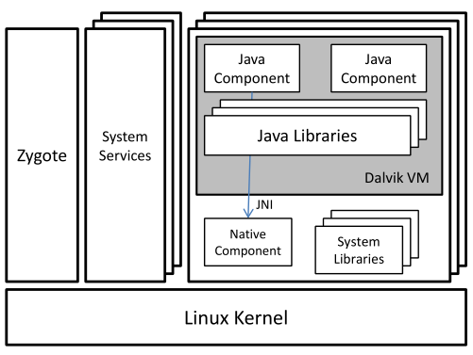
Android
Java Components
System Services
Native Components
Apps
Courtesy Lok Kwong Yan & Heng Yin

Slide 24
Motivation: Static Analysis
Dalvik/Java Static Analysis:
ded, Dexpler, soot,
Woodpecker, DroidMoss
Native Static Analysis:
IDA, binutils, BAP
Courtesy Lok Kwong Yan & Heng Yin

Slide 25
Motivation: Dynamic Analysis
Android Analysis:
TaintDroid, DroidRanger
System Calls
logcat, adb
Courtesy Lok Kwong Yan & Heng Yin

Slide 26
Motivation: Dynamic Analysis
External Analysis: Anubis, Ether, TEMU, …
Courtesy Lok Kwong Yan & Heng Yin

Slide 27
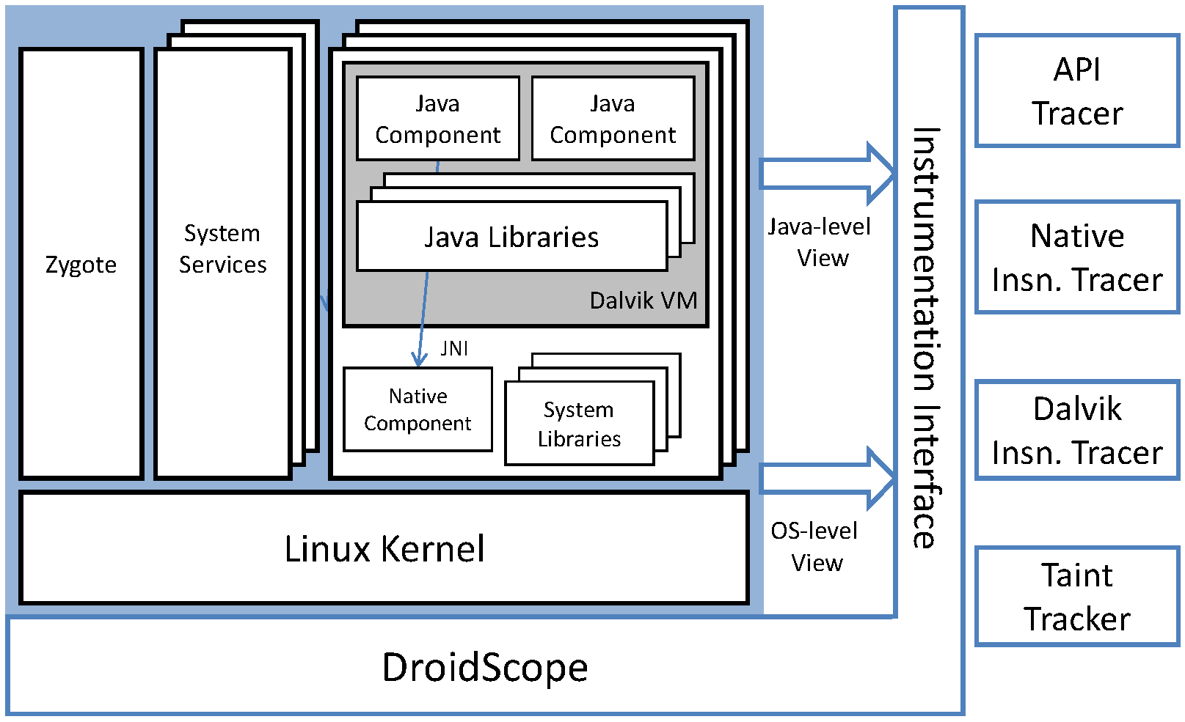
DroidScope Overview
Courtesy Lok Kwong Yan & Heng Yin

Slide 28
Goals
Dynamic binary instrumentation for Android
Leverage Android Emulator in SDK
No changes to Android Virtual Devices
External instrumentation
Linux context
Dalvik context
Extensible: plugin-support / event-based interface
Performance
Partial JIT support
Instrumentation optimization
Courtesy Lok Kwong Yan & Heng Yin

Slide 29
Roadmap
External instrumentation
Linux context
Dalvik context
Extensible: plugin-support / event-based interface
Evaluation
Performance
Usage
Courtesy Lok Kwong Yan & Heng Yin

Slide 30
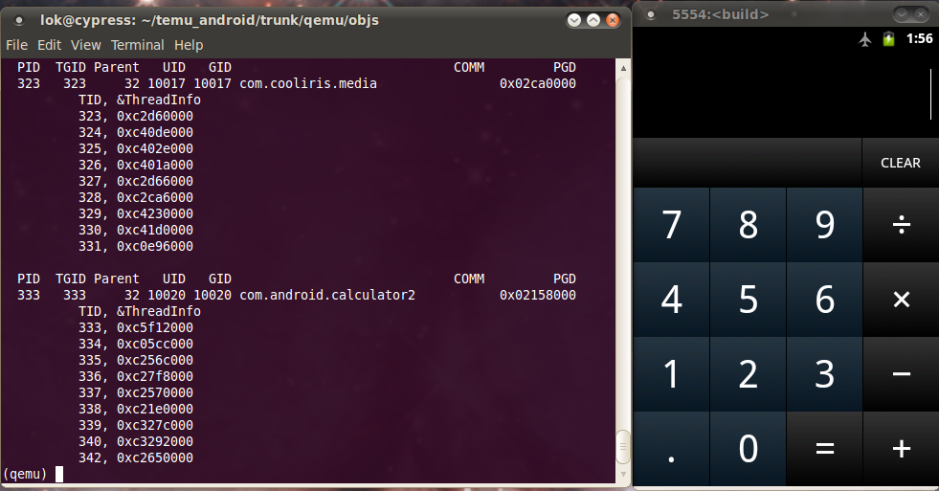
Linux Context: Identify App(s)
Shadow task list
pid, tid, uid, gid, euid, egid, parent pid, pgd, comm
argv[0]
Shadow memory map
Address Space Layout Randomization (Ice Cream Sandwich)
Update on
fork, execve, clone, prctl and mmap2

Slide 31
Java/Dalvik View
Dalvik virtual machine
register machine (all on stack)
256 opcodes
saved state, glue, pointed to by ARM R6, on stack in x86
mterp
offset-addressing: fetch opcode then jump to (dvmAsmInstructionStart + opcode * 64)
dvmAsmSisterStart for emulation overflow
Which Dalvik opcode?
Locate dvmAsmInstructionStart in shadow memory map
Calculate opcode = (R15 - dvmAsmInstructionStart) / 64.
Courtesy Lok Kwong Yan & Heng Yin

Slide 32
Just In Time (JIT) Compiler
Designed to boost performance
Triggered by counter - mterp is always the default
Trace based
Multiple basic blocks
Multiple exits or chaining cells
Complicates external introspection
Complicates instrumentation
Courtesy Lok Kwong Yan & Heng Yin

Slide 33
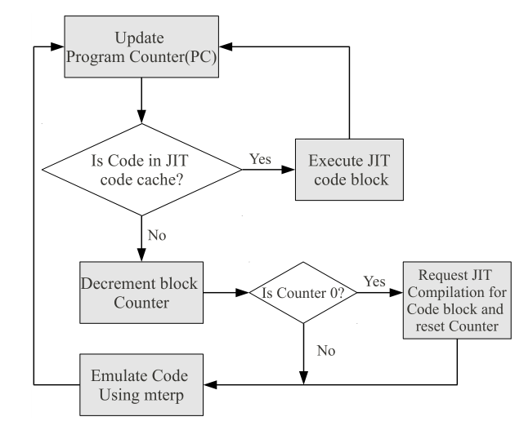
Disabling JIT
dvmGetCodeAddr(PC) != NULL
Courtesy Lok Kwong Yan & Heng Yin

Slide 34
Roadmap
External instrumentation
Linux context
Dalvik context
Extensible: plugin-support / event-based interface
Evaluation
Performance
Usage
Courtesy Lok Kwong Yan & Heng Yin

Slide 35
Instrumentation Design
Event based interface
Execution: e.g. native and Dalvik instructions
Status: updated shadow task list
Query and Set, e.g. interpret and change cpu state
Performance
Example: Native instructions vs. Dalvik instructions
Instrumentation Optimization
Courtesy Lok Kwong Yan & Heng Yin

Slide 36
Dynamic Instrumentation
Update PC
(un)registerCallback
inCache?
yes
needFlush?
no
yes
Translate
flushType
Execute
invalidateBlock(s)
flushCache
Courtesy Lok Kwong Yan & Heng Yin

Slide 37
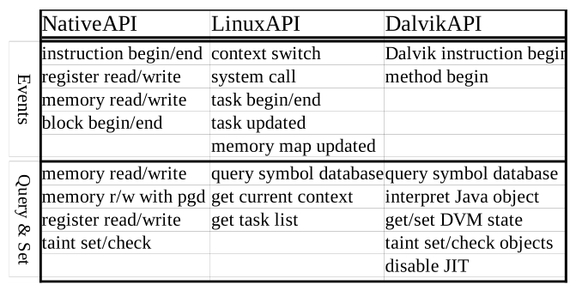
Instrumentation
Courtesy Lok Kwong Yan & Heng Yin

Slide 38
Dalvik Instruction Tracer (Example)
1. void opcode_callback(uint32_t opcode) {
2. printf("[%x] %s\n", GET_RPC, opcodeToStr(opcode));
3. }
4.
5. void module_callback(int pid) {
6. if (bInitialized || (getIBase(pid) == 0))
7. return;
8.
9. gva_t startAddr = 0, endAddr = 0xFFFFFFFF;
10.
11. addDisableJITRange(pid, startAddr, endAddr);
12. disableJITInit(getGetCodeAddrAddress(pid));
13. addMterpOpcodesRange(pid, startAddr, endAddr);
14. dalvikMterpInit(getIBase(pid));
15. registerDalvikInsnBeginCb(&opcode_callback);
16. bInitialized = 1;
17. }
18.
19. void _init() {
20. setTargetByName("com.andhuhu.fengyinchuanshuo");
21. registerTargetModulesUpdatedCb(&module_callback);
22. }
getModAddr(“dfk@classes.dex”, &startAddr, &endAddr);
Courtesy Lok Kwong Yan & Heng Yin

Slide 39
Plugins
API Tracer
System calls
open, close, read, write, includes parameters and return values
Native library calls
Java API calls
Java Strings converted to C Strings
Native and Dalvik Instruction Tracers
Taint Tracker
Taints ARM instructions
One bit per byte
Data movement & Arithmetic instructions including barrel shifter
Does not support control flow tainting
Courtesy Lok Kwong Yan & Heng Yin

Slide 40
Roadmap
External instrumentation
Linux context
Dalvik context
Extensible: plugin-support / event-based interface
Evaluation
Performance
Usage

Slide 41
Implementation
Configuration
QEMU 0.10.50 – part of Gingerbread SDK
Gingerbread
“user-eng”
No changes to source
Linux 2.6.29, QEMU kernel branch
Courtesy Lok Kwong Yan & Heng Yin

Slide 42
Performance Evaluation
Seven free benchmark Apps
AnTuTu Benchmark
(ABenchMark) by AnTuTu
CaffeineMark by Ravi Reddy
CF-Bench by Chainfire
Mobile processor benchmark (Multicore) by Andrei Karpushonak
Benchmark by Softweg
Linpack by GreeneComputing
Six tests repeated five times each
Baseline
NO-JIT Baseline – uses a build with JIT disabled at runtime
Context Only
API Tracer
Dalvik Instruction Trace
Taint Tracker
Courtesy Lok Kwong Yan & Heng Yin

Slide 43
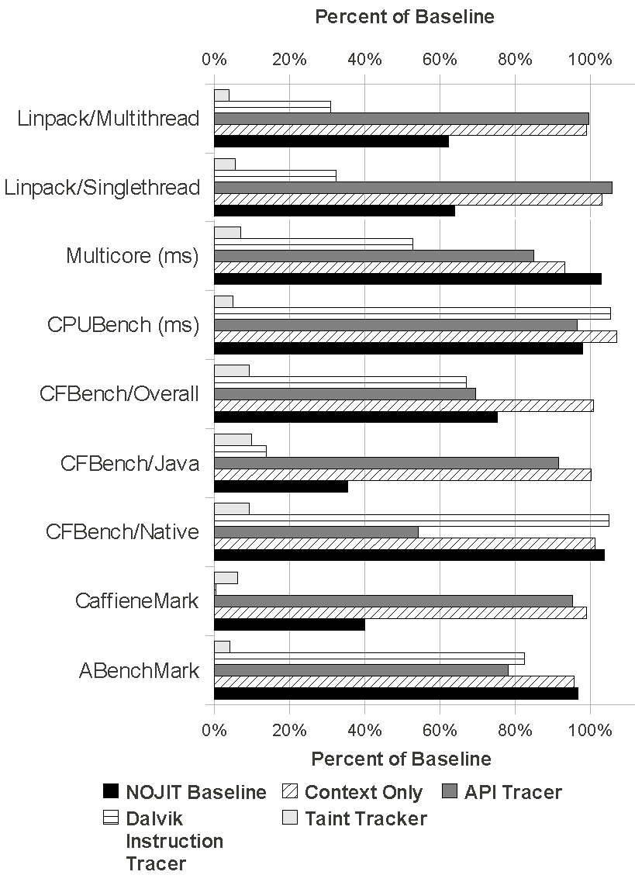
Select Performance Results
APITracer vs. NOJIT
Results are not perfect
Dynamic Symbol Retrieval Overhead
Courtesy Lok Kwong Yan & Heng Yin

Slide 44
Usage Evaluation
Use DroidScope to analyze real world malware
API Tracer
Dalvik Instruction Tracer + dexdump
Taint Tracker – taint IMEI/IMSI @ move_result_object after getIMEI/getIMSI
Analyze included exploits
Removed patches in Gingerbread
Intercept system calls
Native instruction tracer
Courtesy Lok Kwong Yan & Heng Yin

Slide 45
Droid Kung Fu
Three encrypted payloads
ratc (Rage Against The Cage)
killall (ratc wrapper)
gjsvro (udev exploit)
Three execution methods
piped commands to a shell (default execution path)
Runtime.exec() Java API (instrumented path)
JNI to native library terminal emulator (instrumented path)
Instrumented return values for isVersion221 and getPermission methods
Courtesy Lok Kwong Yan & Heng Yin

Slide 46
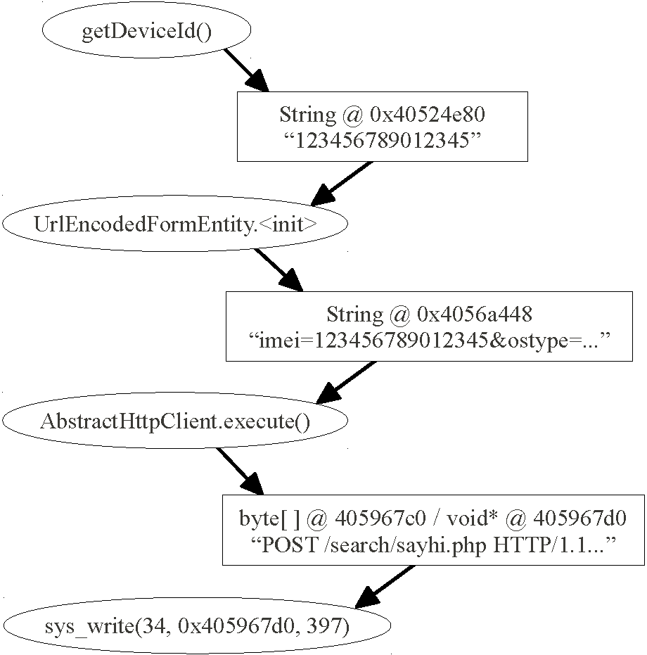
Droid Kung Fu: TaintTracker
Courtesy Lok Kwong Yan & Heng Yin

Slide 47
DroidDream
Same payloads as DroidKungFu
Two processes
Normal droiddream process clears logcat
droiddream:remote is malicious
xor-encrypts private information before leaking
Instrumented sys_connect and sys_write
Courtesy Lok Kwong Yan & Heng Yin

Slide 48
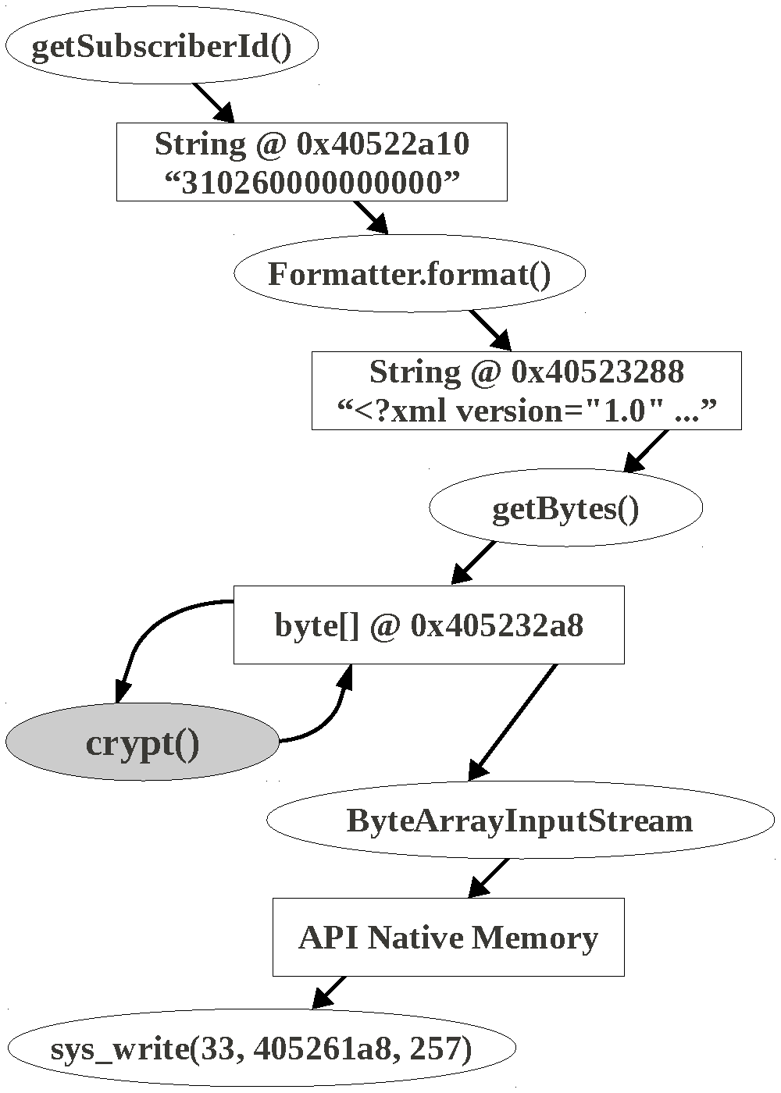
Droid Dream: TaintTracker
Courtesy Lok Kwong Yan & Heng Yin

Slide 49
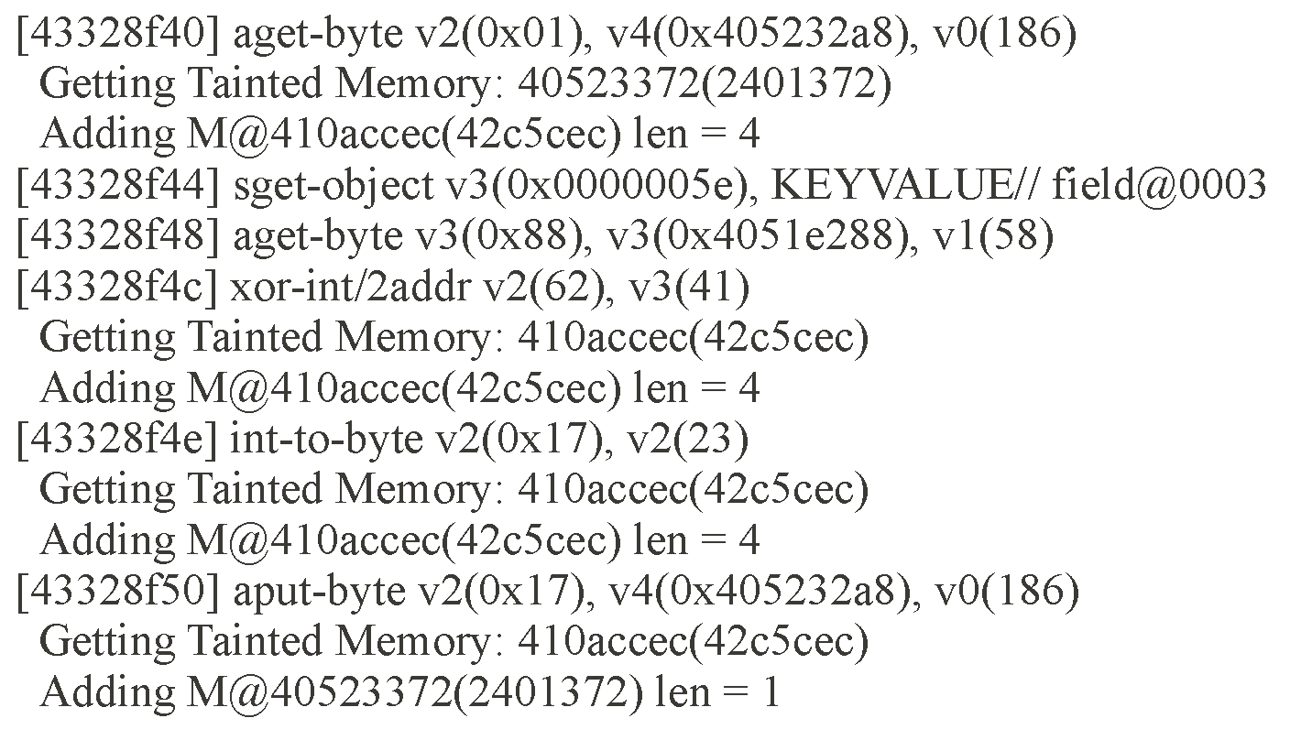
DroidDream: crypt trace
Courtesy Lok Kwong Yan & Heng Yin

Slide 50
Summary
DroidScope
Dynamic binary instrumentation for Android
Built on Android Emulator in SDK
External Introspection & Instrumentation support
Four plugins
API Tracer
Native Instruction Tracer
Dalvik Instruction Tracers
TaintTracker
Partial JIT support
Courtesy Lok Kwong Yan & Heng Yin

Slide 51
Related Works
Static Analysis
ded, Dexpler, soot
Woodpecker, DroidMoss
Dynamic Analysis
TaintDroid
DroidRanger
PIN, Valgrind, DynamoRIO
Anubis, TEMU, Ether, PinOS
Introspection
Virtuoso
VMWatcher
Courtesy Lok Kwong Yan & Heng Yin

Slide 52
Challenges
JIT
Full JIT support
Flushing JIT cache
Emulation detection
Real Sensors: GPS, Microphone, etc.
Bouncer
Timing assumptions, timeouts, events
Closed source systems, e.g. iOS
Courtesy Lok Kwong Yan & Heng Yin

Slide 53
Android Malware: Characterization and Evolution
Malware characterization
Installation
Activation
Malicious payloads
Evolution

Slide 54
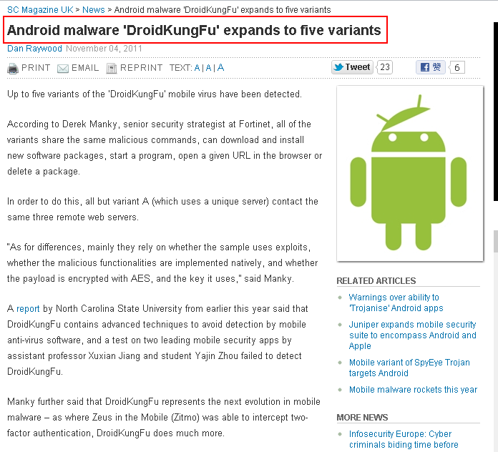
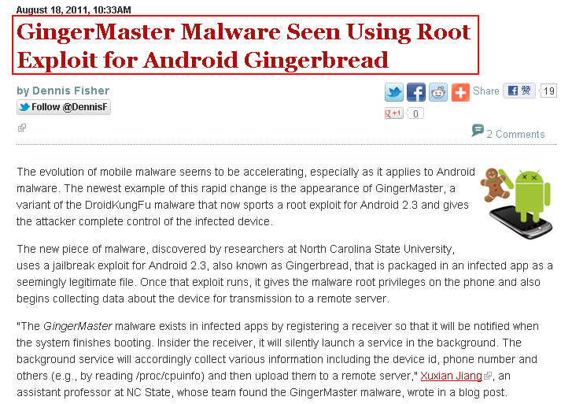
Motivation
Courtesy Yajin Zhou et al.

Slide 55
Motivation
Source: Juniper Networks 2011 Mobile Threats Report

Slide 56
Motivation
Develop effective defense solutions
Know your enemy
Insightful understanding of Android malware
Comprehensive Android malware samples
Courtesy Yajin Zhou et al.

Slide 57
Contributions
Present the first largest public collection of Android malware samples
There are total 52 families publicly reported between Aug 2010 and Oct 2011
Our dataset has 1260 samples in 49 families
Share the dataset with research community
Google “Android Malware Genome Project”
Provide initial insights about Android malware
Characterization
Evolution
Courtesy Yajin Zhou et al.

Slide 58
Malware Trends
The Cumulative Number of New Malware Samples
2010
2011
AnserverBot
DroidKungFu
(including its variants)
Courtesy Yajin Zhou et al.
Notes:
The Cumulative Growth of New Malware Samples in Our Collection

Slide 59
Malware Characterization
Installation methods
Activation mechanisms
Malicious payloads
Courtesy Yajin Zhou et al.

Slide 60
Malware Installation
Users tend not to install malware intentionally
Attackers trick users into installing malware
Repackaging
Update attack
Drive-by download
Courtesy Yajin Zhou et al.

Slide 61
Installation: Repackaging
+
Attacker
86% of samples in our dataset are repackaged
Courtesy Yajin Zhou et al.

Slide 62
Installation: Repackaging
Victim apps
Popular games
Utility apps
Entertainment apps
“Trustworthy” package names
com.google.ssearch, com.google.update
Courtesy Yajin Zhou et al.

Slide 63
Installation: Repackaging
Malicious payload
Based on public-available code on Google code
Repackaged security tool
Courtesy Yajin Zhou et al.

Slide 64
Installation: Update Attack
Ask user to update to the “latest” version
Child app: BaseBridge
Downloaded app: DroidKungFuUpdate
Dynamically load and execute bytecode
Plankton, AnserverBot
Courtesy Yajin Zhou et al.

Slide 65
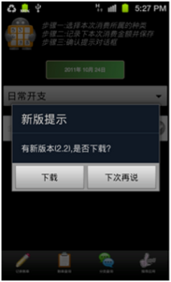
Installation: Update Attack
DroidKungFuUpdate
Download the “latest” version from remote server
The downloaded app is DroidKungFu malware
DroidKungFu malware
New version 2.2 found.
Do you want
to download?
Courtesy Yajin Zhou et al.

Slide 66
Installation: Drive-by Download
Trick users into downloading “interesting” apps
QR code: Jifake
In-app advertisement: GGTracker
Courtesy Yajin Zhou et al.

Slide 67
Installation: Drive-by Download
Biker69 seems to like this app.

Slide 68
Malware Activation
By listening to various system events
By hijacking the main activity
The # of malware samples

Slide 69
Malicious Payloads
Privilege escalation
Remote control
Financial charges
Information collection
Courtesy Yajin Zhou et al.

Slide 70
Payloads: Privilege Escalation
Use publicly available root exploits to gain root privilege
Exploid, RATC, Zimperlich, KillingInTheNameOf, GingerBreak, zergRush
37% of malware samples use root exploits
30% use more than one root exploit
Courtesy Yajin Zhou et al.

Slide 71
Payloads: Privilege Escalation
Malware is getting smarter
DroidDream: unencrypted root exploits
Exploit name as its file name
DroidKungFu: encrypted root exploits
myicon, secbino
DroidCoupon: root exploit with obfuscated file name
ratc.png
Courtesy Yajin Zhou et al.

Slide 72
Payloads: Remote Control
92% of them use HTTP based C&C servers
C&C server URLs can be encrypted
Pjapps: custom encoding scheme
DroidKungFu3: AES encryption
Geinimi: DES encryption
AnserverBot: Base64
2maodb3ialke8mdeme3gkos9g1icaofm
->
mobilemeego91.com
29BB083B93AE6DD6FB4E2F353586C56218DA99F2421B4B12C6FC74FF3E8E8FF2295907534814906FE15A460C3BA03E78
->
http://search.zi18.com:8511/search/
5ee24082afa27568f4f1e0acc961d767dd7e9ad2131ec4c3
->
117.135.134.185:8080
HoiprJbh9CVp9I0h8Cg1zKVO7CAO7CfaPJSQfvMUH2B574i18CQ_
->
http://b4.cookier.co.cc:8080/jk.action
Courtesy Yajin Zhou et al.

Slide 73
Payloads: Financial Charges
Send SMS
to hardcoded premium-rate numbers
FakePlayer, YZHC …
to other numbers controlled by remote servers
AnserverBot, BeanBot
Delete/Block SMS
to remove fee charge information
Zsone, RogueSPPush …
Reply SMS
to confirm subscription to premium services
GGTracker, RogueLemon …
Courtesy Yajin Zhou et al.
Notes:
Zsone 12 GGTracker: 1 RogueLemon:2 SPPush 9 ->auto reply

Slide 74
Payloads: Information Collection
The # of apps
Courtesy Yajin Zhou et al.

Slide 75
Permission Usage
Get started as soon
as possible
Manipulate SMS
Trigger root exploit
# of malware samples and benign apps
Courtesy Yajin Zhou et al.

Slide 76
Evolution: AnserverBot
Basebridge + Plankton
Malicious payload: BaseBridge
Dynamic loading: Plankton
Courtesy Yajin Zhou et al.

Slide 77
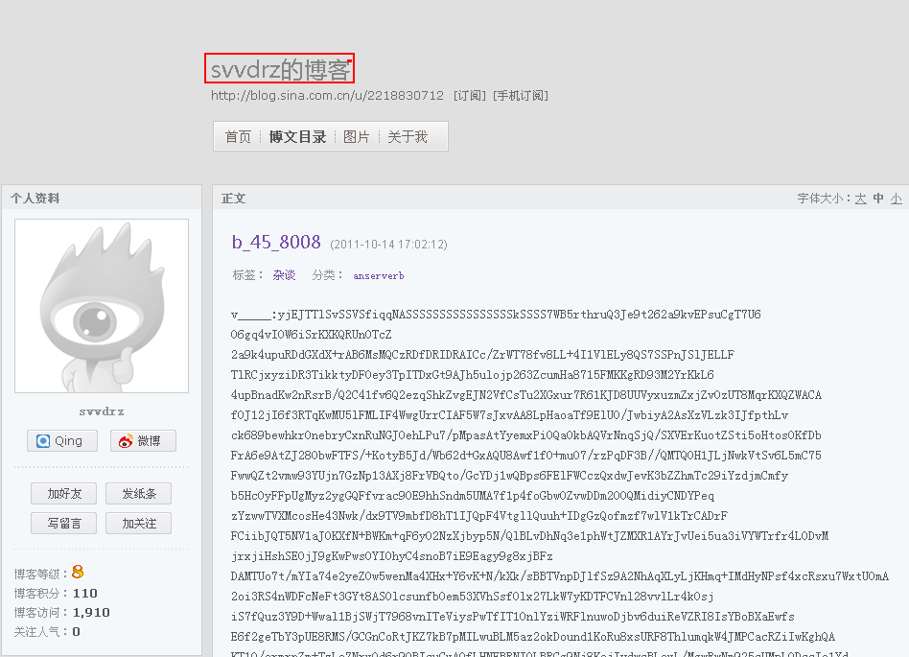
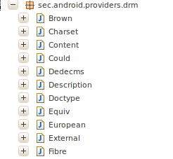
Evolution: AnserverBot
Heavy use of encryption
Heavy use of obfuscation
Anti-analysis
Security software detection
C&C servers
Address is encrypted
Public blog
String e=Xmlns.d("8CB9zKRj84uO"); -> onKeyDown
String f=Xmlns.d("8CBozKiTrtgdcxBNutkE8kMCzKFNHxMOKCRD") -> onGetApk_Install_version_id
String g=Xmlns.d("uIkEuxy_"); -> value
Encrypted payload
Svvdrz’s blog
HoiprJbh9CFE8CrOrCRO7cBw8CpO7CQhr2MW8tMeKNnp0JT57wrQfJjYfoFOXxyOHoig8S__
->
http://blog.sina.com.cn/s/blog_8440ab780100rnye.html
Courtesy Yajin Zhou et al.

Slide 78
Discussion
Most samples are repackaged
Police the Android markets
More than one third samples enclose root exploits
Apply patches timely
Nearly half of the samples subscribe to premium-rate services with background SMS
Enhance Android framework
Mobile security apps can be improved
Develop new defense solutions
Courtesy Yajin Zhou et al.

Slide 79
Related Work
Identify privacy leakage problems
TaintDroid [Enck et al., OSDI 10], Comdroid [Chin et al., MobiSys 11], Stowaway [Felt et al., CCS 11], AdRisk [Grace et al., WiSec 12], Woodpecker [Grace et al., NDSS 12], DroidMOSS [Zhou et al., CODASPY 12], …
Enhance Android framework
Kirin [Enck et al, CCS 09], TISSA [Zhou et al., TRUST 11], QUIRE [Dietz et al., USENIX Security 11], Cells [Andrus et al., SOSP 11] …
Assess/survey mobile apps
App Security [Enck et al., USENIX Security 11], Malware Survery [Felt et al., CCS-SPSM 11], DroidRanger [Zhou et al., NDSS 11], RiskRanker [Grace et al., MobiSys 12] …
Courtesy Yajin Zhou et al.

Slide 80
Conclusion
Present the first largest public Android malware collection
Share with whole research community
Characterize the malware samples
Study the evolution of Android malware
Call for better anti-mobile-malware solutions
Courtesy Yajin Zhou et al.

Slide 81
Dataset Release
Android Malware Genome Project
http://malgenomeproject.org
Courtesy Yajin Zhou et al.

