Slide 1
Cellular Networks and Mobile Computing
COMS 6998-10, Spring 2013
Instructor: Li Erran Li (lierranli@cs.columbia.edu)
http://www.cs.columbia.edu/~lierranli/coms6998-10Spring2013/
3/26/2013: Mobile Cloud Platform Services

Slide 2
Announcements
Project proposal due
Windows Phones available for project use
  On loan from Microsoft, please take good care of them ☺

Slide 3
Review of Previous Lecture
Can I use IP addresses of mobile devices to select closest servers in content distribution networks (e.g. Akamai)?

Slide 4
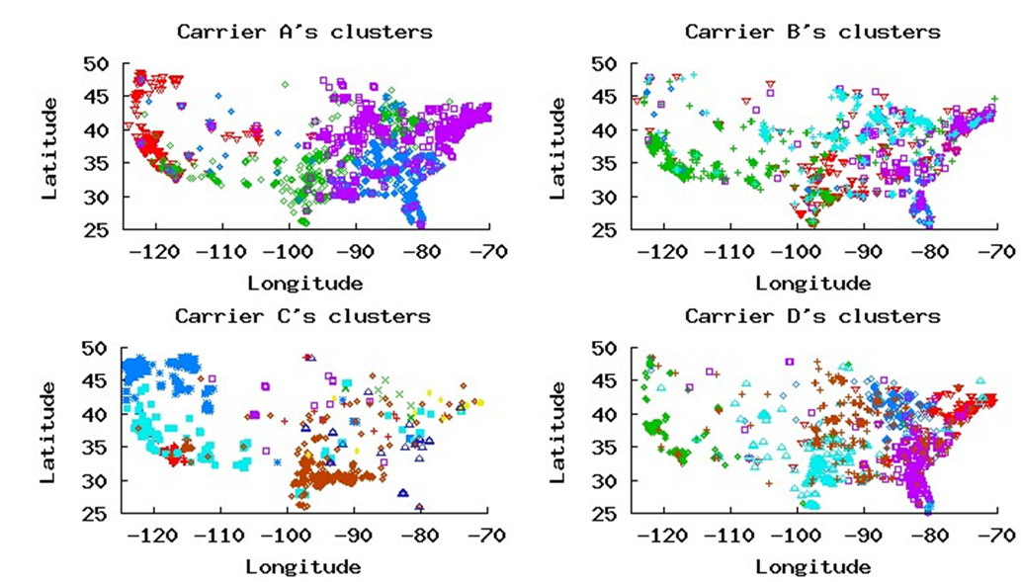
Clusters of the Major Carriers
  All 4 carriers cover the U.S. with only a handful clusters (4-8)
All clusters have a large geographic coverage
Clusters have overlap areas
  Users commute across the boundary of adjacent clusters
  Load balancing
3/26/13
Cellular Networks and Mobile Computing (COMS 6998-10)
Courtesy: Q. Xu et al.
Notes:
Now, we know how the clustering works. These four figures show the cluster results. Each figure reflects one carrier’s clusters. For each carrier, one color represent one cluster. All 4 carriers cover the US with only a handful clusters. The number of clusters ranges from 4 to 8 dependents on the carrier. one cluster covers a large geographic coverage, the coverage is even less fine-grained than state level. We can also observe that there are some overlap across clusters. We can expect two reasons for the overlapping. One is due users mobility. Users may commute across the boundary of adjacent clusters. So that a moving user will keep the IP address of the last cluster when it moves to the current cluster if the current session is not timed out. The second reason is due to load balancing to increase reliability of the system which is a common technique applied in reliable distributed system.

Slide 5
Review of Previous Lecture (Cont’d)
How does firewall affect application performance?

Slide 6
Review of Previous Lecture (Cont’d)
How does firewall affect application performance?
  TCP timeout
  TCP out-of-order buffering
  Security reduced!

Slide 7
Short timers identified in a few carriers
4 carriers set timers less than 5 minutes
Courtesy: Z. Wang et al.
Notes:
As we can see, most of carriers have timers longer than half an hour,
However, there are 11 carriers set timers smaller than 10 minutes, 4 of them even have timer less than 5 minutes
Next I will show you how much battery would be drained if your phone experiencing a timer like 5 minutes

Slide 8
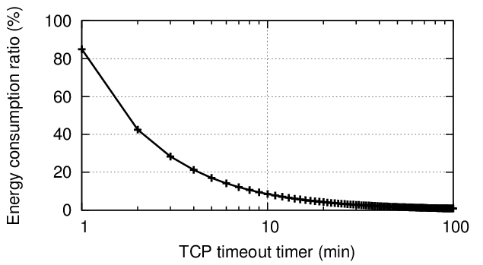
Short timers drain your batteries
Assume a long-lived TCP connection, a battery of 1350mAh
How much battery on keep-alive messages in one day?
20%
5 min
Courtesy: Z. Wang et al.
Notes:
Assume maintain a long-lived connection and a battery of 1350 mAh, which is a typical battery capacity of modern smartphone.
If we only count the radio energy consumed by sending keep-alive messages, how much battery would be drained in one day?
As we can see, 5 minutes -> 20 percent
Of course short timers help firewalls to quickly recycle memory resource, but a single configuration could affect tens of thousands of smartphones,
To save energy on smartphones,
We would suggest carriers to have a timer longer than 30 minutes or longer assuming there are sufficient IP address resources.

Slide 9
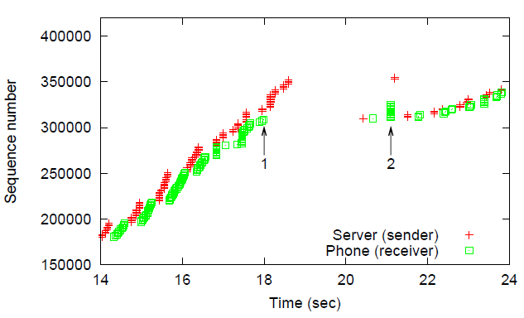
Fast Retransmit cannot be triggered
Degrade TCP performance!
1
2
RTO
Courtesy: Z. Wang et al.
Notes:
Here is a real packet trace in the cellular network, x axis is time in second and y axis is TCP sequence number,
Red dots are sequence number observed on the sender side, green dots are observed on the receiver side
One packet was lost at arrow 1 and following packets are buffered by the firewall
After retransmission timer timed out, at arrow 2, the lost packets was retransmitted and we can see the big gap in the figure, of course this degrades TCP performance

Slide 10
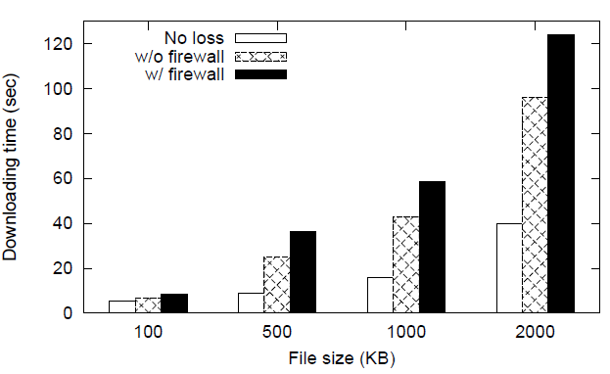
TCP performance degradation
Evaluation methodology
  Emulate 3G environment using WiFi
  400 ms RTT, loss rate 1%
Longer downloading time
More energy consumption
+44%
Courtesy: Z. Wang et al.
Notes:
To quantify the degradation on TCP performance under packet loss,
We emulate 3G environment using WiFi and use a smartphone to download files of different sizes from a server, We control the loss rate to be 1% (based on previous study) and compare the downloading time in two scenarios
One is the normal case, where there is no firewall, And the other is having a firewall buffering out-of-order packets.
In the figure, x axis is the size of file in kilobyte, y axis is the downloading time in second
The buffering behavior increases 21 percent of downloading time if you download a 100 kilobyte file
While 44 percent increase for 500 kilobyte file.
It is not only a matter of time, as the time increases, the phone spends more time in high radio power state and consumes more energy

Slide 11
Off-Path TCP Sequence Number Inference Attack
(How Firewall Middleboxes Reduce Security)
Zhiyun Qian, Z. Morley Mao
University of Michigan
Notes:
TCP sequence number is for reliable in-order delivery of a stream of bytes
TCP is popular, HTTP

Slide 12
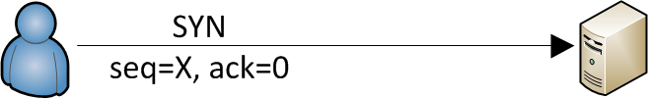

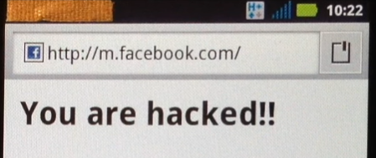
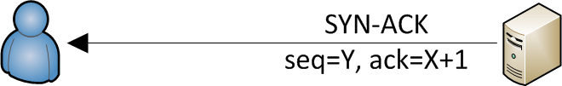
Known Attacks against TCP
Man-in-the-middle based attacks
  Read, modify, insert TCP content
Off-path attacks
  Write to existing TCP connection by guessing sequence numbers
  Defense: initial sequence number nowadays are randomized (2^32)
X = ? Y = ?
Courtesy: Z. Qian and M. Mao

Slide 13
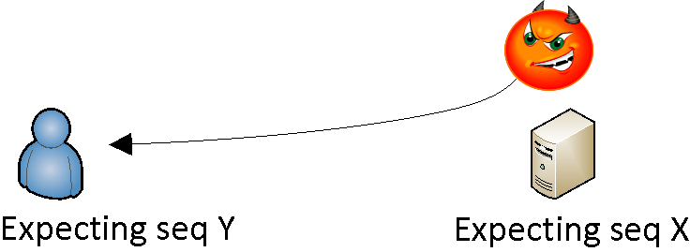
TCP sequence number inference attack
Seq = ?
Required information
  Target four tuples (source/dest IP, source/dest port)
  Feedback on whether guessed sequence numbers are correct
Courtesy: Z. Qian and M. Mao

Slide 14
Req 1 – obtaining target four tuples
On-site unprivileged malware
  netstat (no root required)
netstat -nn
Active Internet connections
Proto Recv-Q Send-Q Local Address Foreign Address (state)
tcp4 37 0 192.168.1.102.50469 199.47.219.159.443 CLOSE_WAIT
tcp4 37 0 192.168.1.102.50468 174.129.195.86.443 CLOSE_WAIT
tcp4 37 0 192.168.1.102.50467 199.47.219.159.443 CLOSE_WAIT
tcp4 0 0 192.168.1.102.50460 199.47.219.159.443 LAST_ACK
tcp4 0 0 192.168.1.102.50457 199.47.219.159.443 LAST_ACK
tcp4 0 0 192.168.1.102.50445 199.47.219.159.443 LAST_ACK
tcp4 0 0 192.168.1.102.50441 199.47.219.159.443 LAST_ACK
tcp4 0 0 127.0.0.1.26164 127.0.0.1.50422 ESTABLISHED
Courtesy: Z. Qian and M. Mao
Notes:
Emphasize that there are other attack models that do not require on-device malware

Slide 15
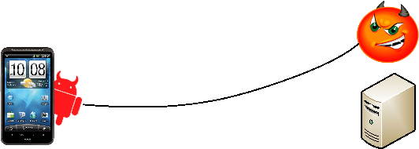
Req 2 – obtaining feedback through side channels ?
Seq = X
Seq = Y
Not correct!
Correct!
Expecting seq Y
Courtesy: Z. Qian and M. Mao

Slide 16
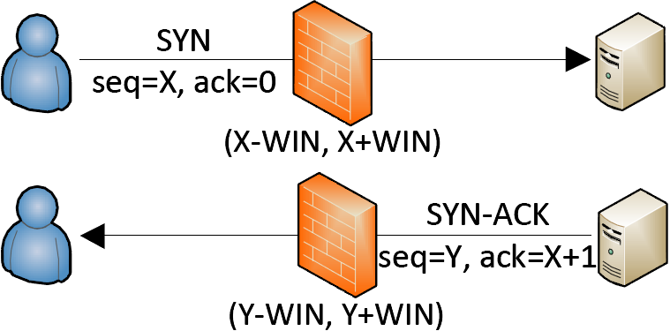



TCP sequence-number-checking firewall Enables the Attack
Purpose: drop blindly injected packets
  Cut down resource waste
  Prevent feedback on sequence number guessing
33% of the 179 tested carriers deploy such firewalls
  Vendors: Cisco, Juniper, Checkpoint…
  Could be used in other networks as well
Courtesy: Z. Qian and M. Mao
Notes:
The window is needed for the cases such as some earlier packets are lost, but the later packets need to be allowed.

Slide 17
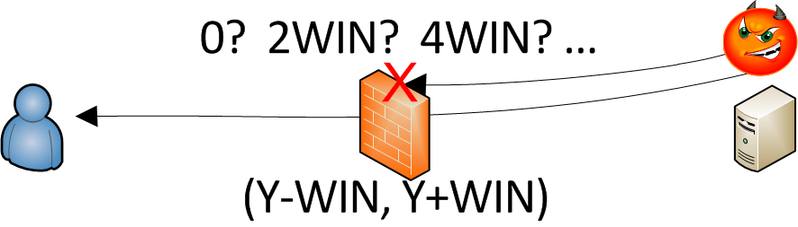
Attack model
Required information
  Target four tuples (source/dest IP, source/dest port)
  Feedback (if packets went through the firewall)
Courtesy: Z. Qian and M. Mao

Slide 18
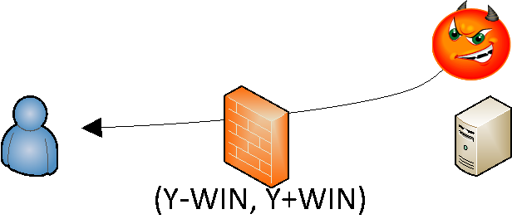

Side-channels: Packet counter and IPID
Host packet counter (e.g., # of incoming packets)
  “netstat –s” or procfs
  Error counters particularly useful
netstat –s
Tcp:
3466 active connections openings
242344 passive connection openings
19300 connection resets received
157921111 segments received
125446192 segments send out
39673 segments retransmited
489 bad segments received
679561 resets sent
TcpExt:
25508 ICMP packets dropped because they were out-of-window
9491 TCP sockets finished time wait in fast timer
1646 packets rejects in established connections because of timestamp
Error counter++
Error Header
WrongSeq
Error Header
CorrectSeq
Courtesy: Z. Qian and M. Mao

Slide 19
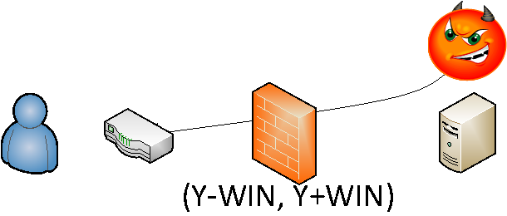
Side-channels: Packet counter and IPID
Host packet counter (e.g., # of incoming packets)
  “netstat –s” or procfs
  Error counters particularly useful
IPID from intermediate hops
Wrong Seq
Correct Seq
IPID++
TTL expired
Courtesy: Z. Qian and M. Mao
Notes:
Change the IPID feedback to animation

Slide 20
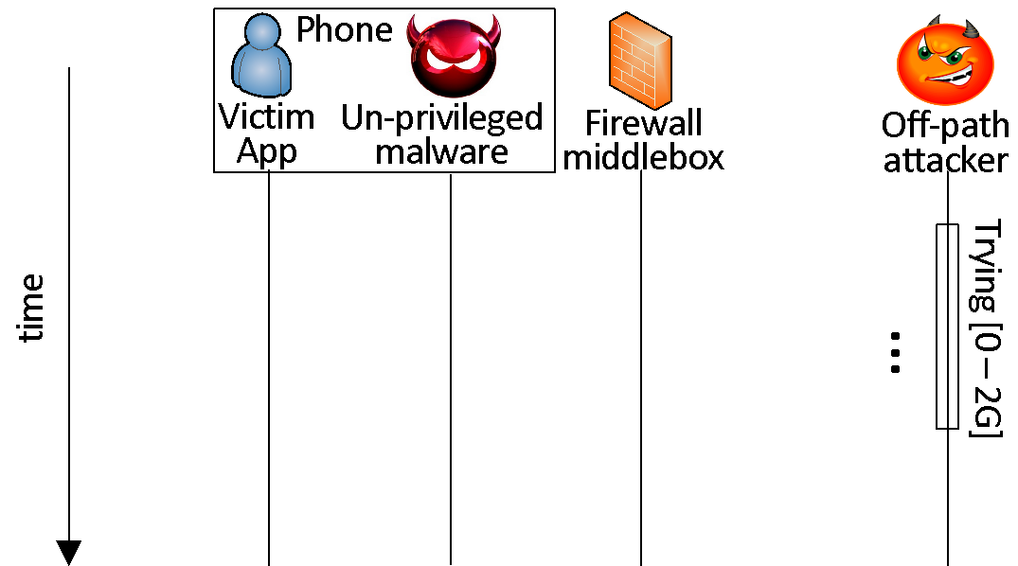
Sequence number inference – an example
X
Seq = 0
X
Seq = 2WIN
Seq = 4WIN
Error counter++
X
Seq = 2G
Counter++
Courtesy: Z. Qian and M. Mao

Slide 21
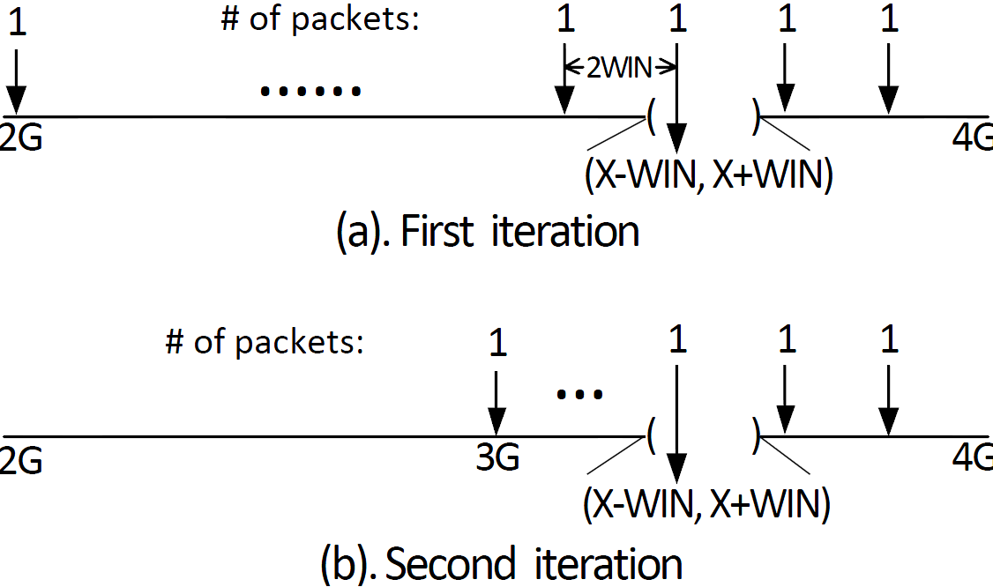
Binary search on sequence number
Total # of packets required: 4G/2WIN
Typically, WIN = 256K, 512K, 1M
# of packets = 4096 – 16384
Time: 4 – 9 seconds
Courtesy: Z. Qian and M. Mao

Slide 22
Attacks built on top of it
TCP connection hijacking
TCP active connection inference
  No malware requirement
  Target long-lived connections
Spoofed TCP connections to a target server
  Denial of service
  Spamming
Courtesy: Z. Qian and M. Mao

Slide 23
Attacks built on top of it
TCP connection hijacking
TCP active connection inference
  No malware requirement
  Target long-lived connections
Spoofed TCP connections
  Denial of service
  Spamming
Courtesy: Z. Qian and M. Mao

Slide 24
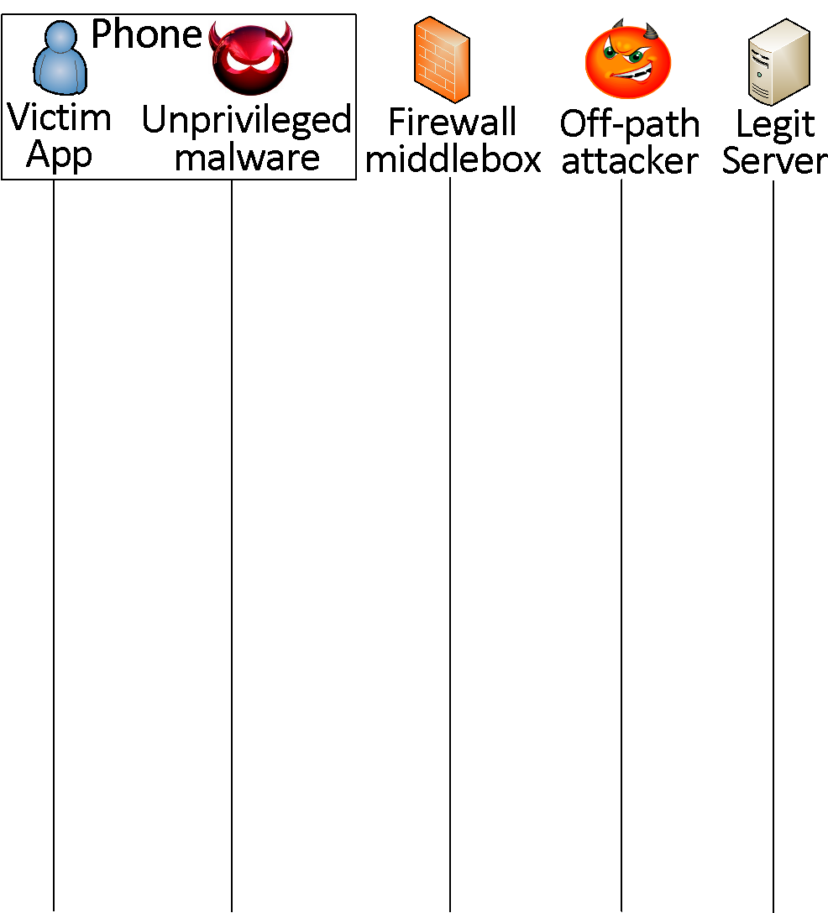
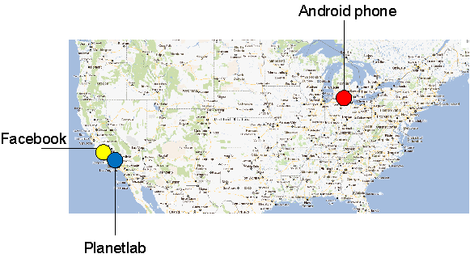
A step further – TCP connection hijack: Reset-the-server
SYN
Notification
SYN-ACK
Spoofed RSTs
ACK/Request
Seq inference
-- start
Success rate: 65%
…
Connection reset
Seq inference
-- end
Malicious payload
Courtesy: Z. Qian and M. Mao
Notes:
The bandwidth requirement causes the failures

Slide 25
TCP connection hijacks
Reset-the-server | Preemptive SYN | Hit-and-run
Bandwidth requirement | Additional attack phone | Low bandwidth requirement
Succ rate: 65% | Succ rate: 65% | Succ rate: 85%
Courtesy: Z. Qian and M. Mao

Slide 26
Lessons learned
Failed to secure sensitive state against side-channels
  Firewall middlebox stores sensitive state (sequence number)
  IPID and packet counter side-channels allows sequence number inference
  Future network middlebox design needs to better secure sensitive state (e.g., cryptographic keys)
Mitigations
  Improve firewall middleboxes?
  Remove the redundant state
  Everything in SSL
HTTP
TCP
Courtesy: Z. Qian and M. Mao
Notes:
Why it happened?
Defense?
Security property
Two options of the solution (lessons for better design):
Eliminate access or provide access control to the channels (isolation of the side channel).
Protect the state
Remove redundant state (smaller footprint).
Keep the state confidential (encrypt).
Build systems that are resistant to the side channels.
Related work on side channels to summarize the defenses.

Slide 27
Syllabus
Mobile App Development (lecture 1,2,3)
  Mobile operating systems: iOS and Android
  Development environments: Xcode, Eclipse with Android SDK
  Programming: Objective-C and android programming
System Support for Mobile App Optimization (lecture 4,5)
  Mobile device power models, energy profiling and ebug debugging
  Core OS topics: virtualization, storage and OS support for power and context management
Interaction with Cellular Networks (lecture 6,7,8)
  Basics of 3G/LTE cellular networks
  Mobile application cellular radio resource usage profiling
  Measurement-based cellular network and traffic characterization
Interaction with the Cloud (lecture 9,10)
  Mobile cloud computing platform services: push notification, iCloud and Google Cloud Messaging
  Mobile cloud computing architecture and programming models
Mobile Platform Security and Privacy (lecture 11,12,13)
  Mobile platform security: malware detection and characterization, attacks and defenses
  Mobile data and location privacy: attacks, monitoring tools and defenses

Slide 28
Mobile Cloud Platform Services
Social network services
Compute and storage
  Syncing and storage service (iCloud)
  Amazon EC2 infrastructure and platform services
Proxy service (Kindle Split Browser)
Push notification service
Location based service
  Track service (supporting location based services)
Recognition services
  Speech to text/text to speech service
  Natural language processing service (open Siri API for 3rd party applications in the future)

Slide 29
Outline
RadioJockey: optimizing radio resource usage leveraging fast dormancy and machine learning (Xin Ye and Nan Yan)
iCloud service
Push notification service
  Apple push notification service
  Google GCM
  Thialfi (Xiaoting Ye and Chang Liu): reliable push notification system
Track service (Binyan Chen and Matthew Duane)
COMET: code offloading using distributed shared memory (Jiatian Li and Chong Zhang)

Slide 30
Social Network Services
iOS social framework in core service layer
Facebook, twitter account needs to be configured
Social Framework includes a controller called SLComposeViewController
  An instance must be created: SLComposeViewController *socialController = [SLComposeViewController composeViewControllerForServiceType:socialNetwork];
Calling the API
  if([SLComposeViewController isAvailableForServiceType:socialNetwork]){
  SLComposeViewControllerCompletionHandler __block completionHandler=^(SLComposeViewControllerResult result){
  [socialController dismissViewControllerAnimated:YES completion:nil];
  switch(result){
  case SLComposeViewControllerResultCancelled:
  default:
  NSLog(@"Cancelled.....");
  break;
  case SLComposeViewControllerResultDone:
  NSLog(@"Posted....");
  break;
  }
  };

Slide 31
Social Network Services (Cont’d)
  [socialController addImage:[UIImage
  imageNamed:@"CollatzFractal.png"]];
  [socialController setInitialText:@"Solve the 3x+1 math puzzle."];
  [socialController addURL:[NSURL
  URLWithString:@"http://en.wikipedia.org/wiki/
  Collatz_conjecture"]];
  [socialController
  setCompletionHandler:completionHandler];
  [self presentModalViewController:socialController animated:YES];
  }

Slide 32
Social Network Services (Cont’d)
Also support http request to social networks
NSDictionary *parameters = @{@"message": @"My first iOS 6 Facebook posting "};
NSURL *feedURL = [NSURL URLWithString:@"http://www.facebook.com/erran"];
SLRequest *feedRequest = [SLRequest
requestForServiceType:SLServiceTypeFacebook
requestMethod:SLRequestMethodGET
// requestMethod:SLRequestMethodPOST
URL:feedURL
parameters:parameters];
feedRequest.account = facebookAccount;
[feedRequest performRequestWithHandler:^(NSData *responseData,
NSHTTPURLResponse *urlResponse, NSError *error)
{
// Handle response
NSString *response = [[NSString alloc] initWithData:responseData
encoding:NSUTF8StringEncoding];
NSLog(@"feedRequest response, status code: %d, data:%@", urlResponse.statusCode,
response);
}];

Slide 33
iCloud
Fundamentally: nothing more than a URL of a shared directory
Two storage models
  iCloud document storage: store user documents and app data in the user’s iCloud account
  iCloud key-value data storage: share small amounts of noncritical configuration data among instances of your app
iCloud-specific entitlements required
  Select your app target in Xcode
  Select the Summary tab
  In the Entitlements section, enable the Enable Entitlements checkbox

Slide 34
iCloud (Cont’d)
Check availability: URLForUbiquityContainerIdentifier:
All files and directories stored in iCloud must be managed by a file presenter object, and all changes you make to those files and directories must occur through a file coordinator object. A file presenter is an object that adopts the NSFilePresenter protocol
Explicitly move files to iCloud
Be prepared to handle version conflicts for a file
Make use of searches to locate files in iCloud
Be prepared to handle cases where files are in iCloud but not fully downloaded to the local device; this might require providing the user with feedback
Use Core Data for storing live databases in iCloud; do not use SQLite

Slide 35
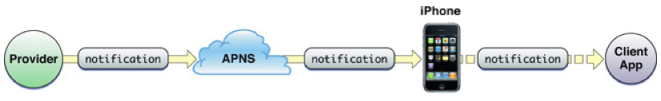
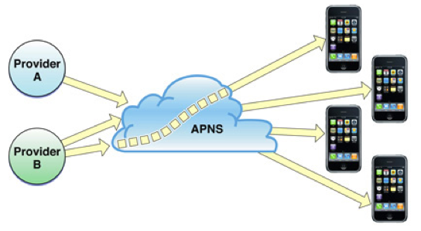
Apple Push Notification Architecture Overview
iOS device maintains a persistent TCP connection to a Apple Push Notification Server(APNS)
A push notification from a provider to a client application
Multi-providers to multiple devices
Notes:
Each push notification carries with it a payload. The payload specifies how users are to be alerted to the data waiting to be downloaded to the client application. The maximum size allowed for a notification payload is 256 bytes; Apple Push Notification Service refuses any notification that exceeds this limit. Remember that delivery of notifications is “best effort” and is not guaranteed.
For each notification, providers must compose a JSON dictionary object that strictly adheres to RFC 4627. This dictionary must contain another dictionary identified by the key aps. The aps dictionary contains one or more properties that specify the following actions:
An alert message to display to the user
A number to badge the application icon with
A sound to play

Slide 36
Apple Push Notification Architecture Overview (Cont’d)
What if devices uninstalled the app?
  Feedback service
    App providers poll to obtain list of device tokens for their applications
    Apple push notification service informs providers in case of repeated failures
What if devices are offline?
  QoS service
    QoS stores the notification
    It retains only the last notification received from a provider
    When the offline device reconnects, QoS service forwards the stored notification to the device
    QoS service retains a notification for a limited period before deleting it
Notes:
Each push notification carries with it a payload. The payload specifies how users are to be alerted to the data waiting to be downloaded to the client application. The maximum size allowed for a notification payload is 256 bytes; Apple Push Notification Service refuses any notification that exceeds this limit. Remember that delivery of notifications is “best effort” and is not guaranteed.
For each notification, providers must compose a JSON dictionary object that strictly adheres to RFC 4627. This dictionary must contain another dictionary identified by the key aps. The aps dictionary contains one or more properties that specify the following actions:
An alert message to display to the user
A number to badge the application icon with
A sound to play

Slide 37
Push Notification
Push notification
  Delivery is best effort and is not guaranteed
  Max size is 256 bytes
  Providers compose a JSON dictionary object
    This dictionary must contain another dictionary identified by the key aps
  Action:
    An alert message to display to the user
    A number to badge the application icon with
    A sound to play
Notes:
Each push notification carries with it a payload. The payload specifies how users are to be alerted to the data waiting to be downloaded to the client application. The maximum size allowed for a notification payload is 256 bytes; Apple Push Notification Service refuses any notification that exceeds this limit. Remember that delivery of notifications is “best effort” and is not guaranteed.
For each notification, providers must compose a JSON dictionary object that strictly adheres to RFC 4627. This dictionary must contain another dictionary identified by the key aps. The aps dictionary contains one or more properties that specify the following actions:
An alert message to display to the user
A number to badge the application icon with
A sound to play

Slide 38
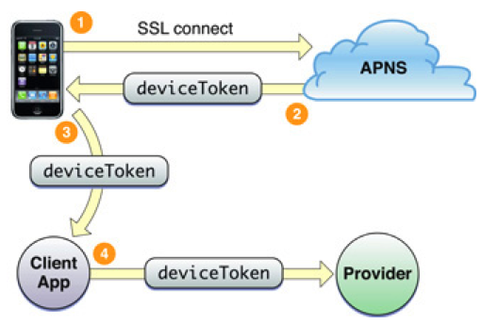
Device Token
Device token is analogous to a phone number
  Contains information that enables APNs to locate the device
  Client app needs to provide the token to its provider
  Device token should be requested and passed to providers every time your application launches
Notes:
By requesting the device token and passing it to the provider every time your application launches, you help to ensure that the provider has the current token for the device. If a user restores a backup to a device or computer other than the one that the backup was created for (for example, the user migrates data to a new device or computer), he or she must launch the application at least once for it to receive notifications again. If the user restores backup data to a new device or computer, or reinstalls the operating system, the device token changes. Moreover, never cache a device token and give that to your provider; always get the token from the system whenever you need it. If your application has previously registered, calling registerForRemoteNotificationTypes: results in the operating system passing the device token to the delegate immediately without incurring additional overhead.

Slide 39
Apple Push Notification Programming Example
Provisioning: https://developer.apple.com/ios/manage/provisioningprofiles/howto.action
  Generate Certification Signing Request (CSR) using Keychain Access
    Save to disk: PushChat.certSigningRequest
    Export the private key as “PushChatKey.p12” and enter a passphrase
  Make an App ID in iOS Provisioning Portal
    Check the Enable for Apple Push Notification service box
    Click on the Configure button for the Development Push SSL Certificate
    Click Download to get the certificate – it is named “aps_development.cer”

Slide 40
Apple Push Notification Programming Example (Cont’d)
Client code
  - (BOOL)application:(UIApplication *)application didFinishLaunchingWithOptions:(NSDictionary *)launchOptions
  {
  // Let the device know we want to receive push notifications
  [[UIApplication sharedApplication] registerForRemoteNotificationTypes:
  (UIRemoteNotificationTypeBadge | UIRemoteNotificationTypeSound | UIRemoteNotificationTypeAlert)];
  return YES;
  }
  - (void)application:(UIApplication*)application didReceiveRemoteNotification:(NSDictionary*)userInfo
  {//userInfo contains the notification
  NSLog(@"Received notification: %@", userInfo);
  }
  - (void)application:(UIApplication*)application didRegisterForRemoteNotificationsWithDeviceToken:(NSData*)deviceToken
  {
  NSLog(@"My token is: %@", deviceToken);
  }
Notes:
A major role of a UIApplication object is to handle the initial routing of incoming user events. It also dispatches action messages forwarded to it by control objects (UIControl) to the appropriate target objects. In addition, the UIApplication object maintains a list of all the windows (UIWindow objects) currently open in the application, so through those it can retrieve any of the application’s UIView objects. The application object is typically assigned a delegate, an object that the application informs of significant runtime events—for example, application launch, low-memory warnings, and application termination—giving it an opportunity to respond appropriately.
Applications can cooperatively handle a resource such as an email or an image file through the openURL: method. For example, an application opening an email URL with this method may cause the mail client to launch and display the message.
The programmatic interfaces of UIApplication and UIApplicationDelegate also allow you to manage behavior that is specific to the device. You can control application response to changes in interface orientation, temporarily suspend incoming touch events, and turn proximity sensing (of the user’s face) off and on again.

Slide 41
Apple Push Notification Programming Example (Cont’d)
Server code
  $devicetoken ='f05571e4be60a4e11524d76e4366862128f430522fb470c46fc6810fffb07af7’;
  // Put your private key's passphrase here:
  $passphrase = 'PushChat';
  // Put your alert message here:
  $message = 'Erran: my first push notification!';
  $ctx = stream_context_create();
  Stream_context_set_option($ctx, 'ssl', 'local_cert', 'ck.pem');
  stream_context_set_option($ctx, 'ssl', 'passphrase', $passphrase);
  // Open a connection to the APNS server
  $fp = stream_socket_client(
  'ssl://gateway.sandbox.push.apple.com:2195', $err,
  $errstr, 60, STREAM_CLIENT_CONNECT|STREAM_CLIENT_PERSISTENT, $ctx);
  if (!$fp)
  exit("Failed to connect: $err $errstr" . PHP_EOL);
  echo 'Connected to APNS' . PHP_EOL;
  // Create the payload body
  $body['aps'] = array(
  'alert' => $message,
  'sound' => 'default'
  );
  // Encode the payload as JSON
  $payload = json_encode($body);
  // Build the binary notification
  $msg = chr(0) . pack('n', 32) . pack('H*', $deviceToken) . pack('n', strlen($payload)) . $payload;
  // Send it to the server
  $result = fwrite($fp, $msg, strlen($msg));
  if (!$result)
  echo 'Message not delivered' . PHP_EOL;
  else
  echo 'Message successfully delivered' . PHP_EOL;
  // Close the connection to the server
  fclose($fp);

Slide 42
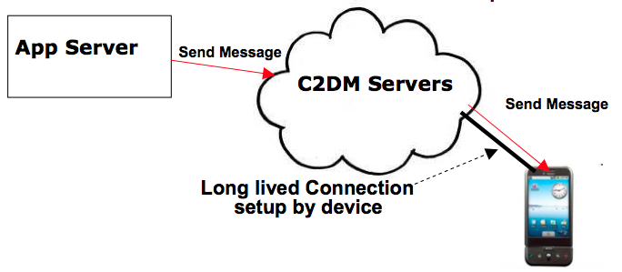
Google Cloud Messaging (Cont’d)
GCM Servers
Push notification problems
  Network firewalls prevent servers from directly sending messages to mobile devices
GCM solution
  Maintain a connection between device and Google GCM server
  Push server updates to apps on the device via this connection
  Optimize this connection to minimize bandwidth and battery consumption (e.g. adjusting the frequency of keep alive messages)
Send-to-sync messages vs. messages with payload
An application can send messages to one or more devices (multicast)

Slide 43
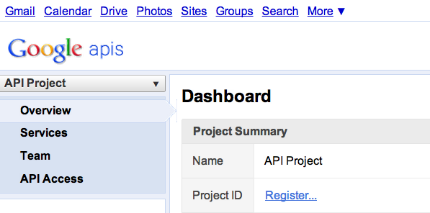
Google Cloud Messaging (Cont’d)
C2DM is deprecated, accepts no new users
Step 1
Create a Google API project from Google APIs console pagehttps://code.google.com/apis/console/#project:908058729336
  Enable GCM service
  Obtain an API key
  Create new server key
  Install helper libraries

Slide 44
Google Cloud Messaging (Cont’d)
Step 2
Write the Android app
  Copy gcm.jar file into your app classpath
  Configure manifest file for SDK version, permission
  Add broadcast receiver
  Add intent service
  Write my_app_package.GCMIntentService class
  Write main activity
import com.google.android.gcm.GCMRegistrar;
…
GCMRegistrar.checkDevice(this);
GCMRegistrar.checkManifest(this);
final String regId = GCMRegistrar.getRegistrationId(this);
if (regId.equals("")) {
GCMRegistrar.register(this, SENDER_ID);
} else {
Log.v(TAG, "Already registered");
}

Slide 45
Google Cloud Messaging (Cont’d)
Step 3
Write server-side app
  Copy gcm-server.jar file from the SDK’s gcm-server/dist directory to your server class path
  Create a servlet that can be used to receive client’s GCM registration ID
  Create a servlet to unregister registration ID
  Use com.google.android.gcm.server.Sender helper class from GCM library to send a message to client
import com.google.android.gcm.server.*;
Sender sender = new Sender(myApiKey);
Message message = new Message.Builder().build();
MulticastResult result = sender.send(message, devices, 5);

Slide 46
Thialﬁ: A Client Notiﬁcation Service for Internet-Scale Applications
Atul Adya, Gregory Cooper,
Daniel Myers, Michael Piatek
Google Seattle

Slide 47


A Case for Notifications
Problem: Ensuring cached data is fresh across users and devices
Courtesy: Adya et al.

Slide 48
Common Application Patterns
Clients poll to detect changes
  Simple and reliable, but slow and inefficient
Push updates to the client
  Fast but complex
  Add backup polling to get reliability
  Tail latencies can be high: masks bugs
  Application-specific protocol
⇒ sacrifice reliability
Courtesy: Adya et al.

Slide 49
Solution: Thialfi
Scalable: tracks millions of clients and objects
Fast: notifies clients in less than a second
Reliable: even when entire data centers fail
Easy to use: deployed in Chrome Sync, Contacts, Google Plus
Courtesy: Adya et al.

Slide 50
Thialfi Outline
Thialfi’s abstraction: reliable signaling
Delivering notifications in the common case
Detecting and recovering from failures
Evaluation and experience
Courtesy: Adya et al.

Slide 51
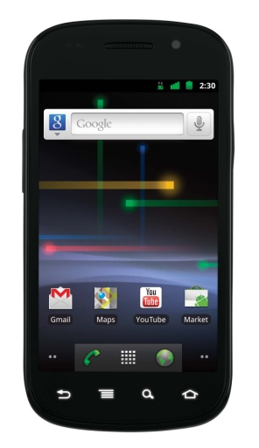
Thialfi Overview
Client C1
Client C2
Register X
Notify X
Thialfi client library
Register
Update X
Register
Client
Data center
Thialfi Service
Application backend
Notify X
Notify X
Update X
X: C1, C2
Courtesy: Adya et al.

Slide 52
Thialfi Abstraction
Objects have unique IDs and version numbers, monotonically increasing on every update
Delivery guarantee
  Registered clients learn latest version number
  Reliable signal only: cached object ID X at version Y
Courtesy: Adya et al.

Slide 53
Why Signal, Not Data?
Developers want reliable, in-order data delivery
Adds complexity to Thialfi and application, e.g.,
  Hard state, arbitrary buffering
  Offline applications flooded with data on wakeup
For most applications, reliable signal is enough
  Invoke polling path on signal: simplifies integration
Courtesy: Adya et al.

Slide 54
API Without Failure Recovery
Client
Library
Register(objectId)
Unregister(objectId)
Notify(objectId, version)
Thialfi Service
Publish(objectId, version)
Courtesy: Adya et al.

Slide 55
Thialfi Outline
Thialfi’s abstraction: reliable signaling
Delivering notifications in the common case
Detecting and recovering from failures
Evaluation and experience
Courtesy: Adya et al.

Slide 56
Architecture
Client library
Registrations, notifications,
acknowledgments
Client
Data center
Client
Bigtable
Registrar
Each server handles a contiguous
range of keys,
Each server maintains an in-memory
version
Bigtable: log structured, fast write
Object
Bigtable
Notifications
Application Backend
Matcher
Matcher: Object ID → registered clients, version
Registrar: Client ID → registered objects, notifications
Courtesy: Adya et al.
Notes:
Use an internal Google infrastructure publish/subscribe service to disseminate messages to data centers.

Slide 57
Life of a Notification
Client C2
x
Ack: x, v7
C1: x, v7
Data center
Client
Bigtable
Notify: x, v7
Registrar
C2: x, v7
C1: x, v5
C2: x,
C1: x, v7
C2: x, v7
x, v7
Publish(x, v7)
Object
Bigtable
Matcher
x: v5; C1, C2
x: v7; C1, C2
x: v7; C1, C2
Courtesy: Adya et al.

Slide 58
Thialfi Outline
Thialfi’s abstraction: reliable signaling
Delivering notifications in the common case
Detecting and recovering from failures
Evaluation and experience
Courtesy: Adya et al.

Slide 59
Possible Failures
Client
Store
Server state loss/
schema migration
Client
Library
Client restart
Data center loss
Partial storage unavailability
Client state loss
Network failures
Client
Bigtable
Client
Bigtable
Registrar
Registrar
. . .
Object
Bigtable
Matcher
Object
Bigtable
Matcher
Data center 1
Thialfi Service
Data center n
Publish Feed
Courtesy: Adya et al.

Slide 60
Failures Addressed by Thialfi
Client restart
Client state loss
Network failures
Partial storage unavailability
Server state loss / schema migration
Publish feed loss
Data center outage
Courtesy: Adya et al.

Slide 61
Main Principle: No Hard State
Thialfi remains correct even if all state is lost
  All registrations
  All object versions
Detect and reconstruct after failures using:
  ReissueRegistrations() client event
  Registration Sync Protocol
  NotifyUnknown() client event
Courtesy: Adya et al.

Slide 62
Recovering Client Registrations
ReissueRegistrations()
Registrar
x
x
y
y
Object
Bigtable
Matcher
Register(x); Register(y)
ReissueRegistrations: Not a burden for applications
  Application stores objects in its cache, or
  Object list is implicit, e.g., bookmarks for user X
Courtesy: Adya et al.

Slide 63
Syncing Client Registrations
Register: x, y
Hash(x, y)
Registrar
x
y
x
Hash(x, y)
Reg sync
y
Object
Bigtable
Matcher
Merkle tree for syncing large number of objects
Goal: Keep client-registrar registration state in sync
Every message contains hash of registered objects
Registrar initiates protocol when detects out-of-sync
Allows simpler reasoning of registration state
Courtesy: Adya et al.

Slide 64
Recovering From Lost Versions
Versions may be lost, e.g. schema migration
Refreshing from backend requires tight coupling
Inform client with NotifyUnknown(objectId)
  Client must refresh, regardless of its current state
Courtesy: Adya et al.

Slide 65
Thialfi Outline
Thialfi’s abstraction: reliable signaling
Delivering notifications in the common case
Detecting and recovering from failures
Evaluation and experience
Courtesy: Adya et al.

Slide 66
Notification Latency Breakdown
Batching accounts for significant fraction of latency
Courtesy: Adya et al.

Slide 67
Thialfi Usage by Applications
Application | Language | Network Channel | Client Lines of Code (Semi-colons)
Chrome Sync | C++ | XMPP | 535
Contacts | JavaScript | Hanging GET | 40
Google+ | JavaScript | Hanging GET | 80
Android Application | Java | C2DM + Standard GET | 300
Google BlackBerry | Java | RPC | 340
Courtesy: Adya et al.

Slide 68
Some Lessons Learned
Add complexity at the server, not the client
  Deploy at server: minutes. Upgrade clients: years+
Asynchronous events, not callbacks
  Spontaneous events occur: need to handle them
Initial applications have few objects per client
  Earlier use of polling forces such a model
Courtesy: Adya et al.

Slide 69
Thialfi Summary
Fast, scalable notification service
Reliable even when data centers fail
Two key ideas simplify failure handling
  Deliver a reliable signal, not data
  No hard state: reconstruct after failure
Deployed in Chrome Sync, Contacts, Google+
Courtesy: Adya et al.

Slide 70
Outline
Speech to text service demo
Push notification service
  Apple push notification service
  Google C2DM(not covered in this lecture)
  Thialfi: reliable push notification system
Track service

Slide 71
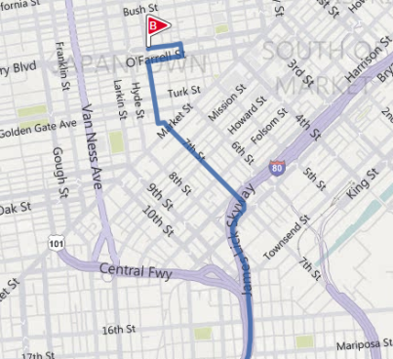


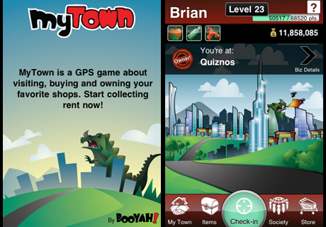



Location-Based Applications
Many phones already have the ability to determine their own location
  GPS, cell tower triangulation, or proximity to WiFi hotspots
Many mobile applications use location information
Courtesy: Maya et al.
Notes:
As you may know, many mobile devices these days, especially cell phones, have the ability to determine their own location. Cell phones equipped with GPS chips are becoming common place and even phones without GPS can use techniques like cell tower triangulation or proximity to WiFi hotspots to estimate their locations.
This location awareness has led to a flood of location-based applications. These applications provide driving directions based on where you currently are; allow you to locate friends; or build interesting games out of people’s locations.

Slide 72
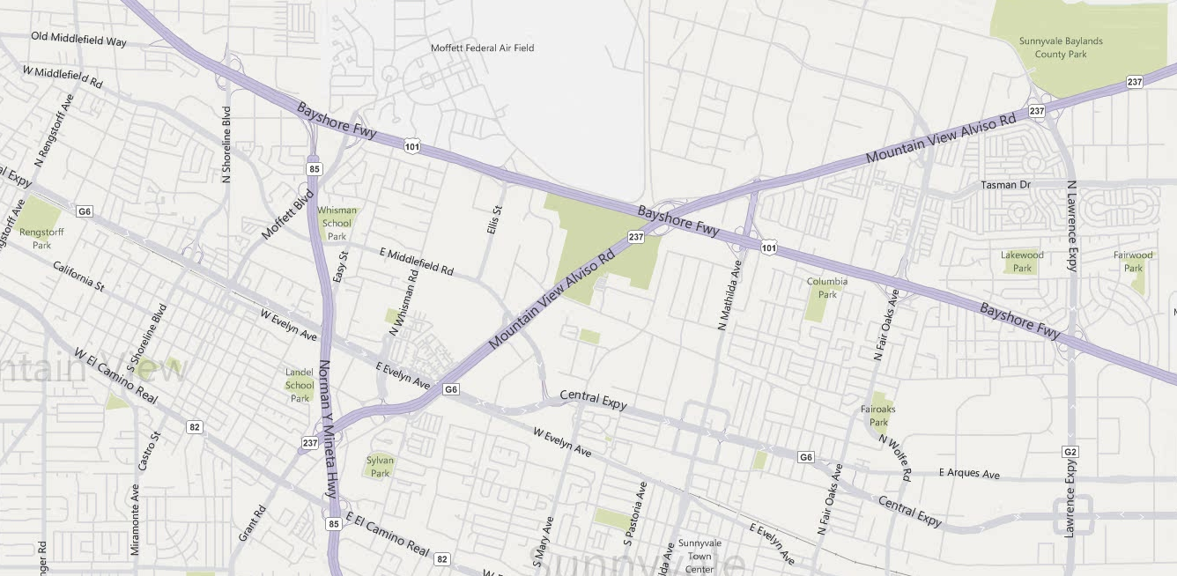

Track
  Time-ordered sequence of location readings
Latitude: 37.4013
Longitude: -122.0730
Time: 07/08/10 08:46:45.125
Courtesy: Maya et al.
Notes:
In this work we’ve focused on extending the information that’s available to applications to also include how people move BETWEEN places. If a device periodically records its current location, by connecting these samples we get what we call a track.
More precisely, a track is a time-ordered sequence of samples, where each sample is composed of a latitude and longitude, and a time.
Tracks enable a new class of applications, that can benefit from having access to users’ historic location information. One example is a driving directions service that personalizes directions based on a user’s track history.

Slide 73
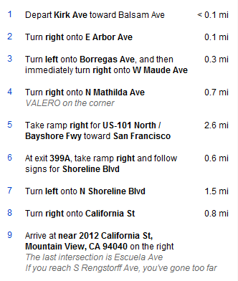


Application: Personalized Driving Directions
  Goal: Find directions to new gym
$≈$Take US-101 North
Courtesy: Maya et al.
Notes:
Consider for example, that this is my typical commute from home to work – I’m fairly familiar with this set of directions. When I use a service to search for directions from my home to a new gym, I’m presented with a set of detailed directions starting from my home. By mining my history of tracks, the application could identify that the initial portion of the directions to the gym are exactly the same as the ones I take on a regular basis. In this example, the first five directions, for example, could be collapsed into a single direction that tells me to get onto US-101 N.
This is one example of a track-based application. To put track-based apps into context, we can classify..

Slide 74
A Taxonomy of Applications
 | Personal | Social
Current location | Driving directions, Nearby restaurants | Friend finder, Crowd scenes
Past locations | Personal travel journal, Geocoded photos | Post-it notes, Recommendations
Tracks | Personalized Driving Directions, Track-Based Search | Ride sharing, Discovery, Urban sensing
Class of applications enabled by StarTrack
Courtesy: Maya et al.
Notes:
We can classify these applications based on the amount of data that they access.
And finally, we can also classify applications based on whether they access data for a single user at a time, or if they access data across a group of users.
Some applications only use the current location of users to provide some service. Others use not only the current location, but also location instances in the past.
In the last row, we show examples of potential track-based applications, that access historical track information. Personalized Driving Directions, that I described in the last slide, is an example. An application that automatically identifies ride-sharing partners based on user’s track histories is another example.
StarTrack was designed to facilitate the construction of this last row of applications.
Currently, location-based applications have to collect and maintain their own set of location data. StarTrack provides a centralized infrastructure to collect location data in the form of tracks, and enables sharing of this data across applications.

Slide 75


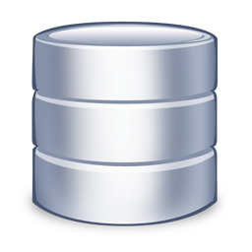

StarTrack System
Insertion Application
Insertion
ST Server
Location Manager
ST Client
ST Server
Application
ST Server
ST Client
Retrieval
Manipulation
Comparison
…
Courtesy: Maya et al.
Notes:
Here is a high level overview of the StarTrack System. StarTrack servers handle requests from clients and store tracks in a set of database servers. Modern database systems provide some form of geospatial support – meaning that they provide special data types for storing geometries and specialized indices for accessing such objects.
The StarTrack API exposes a number of track-based operations. An insertion application, for example may pass samples to an insertion operation. StarTrack will break the samples into tracks, do some pre-processing, and insert them into the database. Once tracks are in the database, different applications may use and combine a number of operations to fetch the information that they’re interested in. They may retrieve tracks based on different criteria, they may compare two tracks for similarity, or they may pass a track as an argument and fetch the most similar tracks.

Slide 76
System Challenges
Handling error-prone tracks
Flexible programming interface
Efficient implementation of operations on tracks
Scalability and fault tolerance
Courtesy: Maya et al.
Notes:
Despite the simplicity of the architecture, handling tracks and providing a track-based infrastructure proved to be harder than we originally antecipated.
The first very basic problem with tracks has to do we how we represent them. Coordinates in a track are a sample of a path, and sampling is inherently error prone. That makes it difficult to compare two tracks for equality, which is one of the most important operations involving tracks.
Another issue was related to the API. When we studied the needs of track-based applications, we realized that apps have a need to combine a number of operations in order to get the information they are interested in.
Efficiently implementing the set of complex track-based operations was also a major challenge we faces. Even though spatial databases have come a long way, tracks are complex geographic objects, often containing hundreds of coordinates. When handling large numbers of tracks, relying solely on the database proved to be insufficient.
Finally, StarTrack should be scalable and fault tolerant, and we employed well known techniques to ensure so. These techniques are not particular to tracks, so for the rest of the talk, I’ll focus on the first three challenges and how we address them in StarTrack.

Slide 77
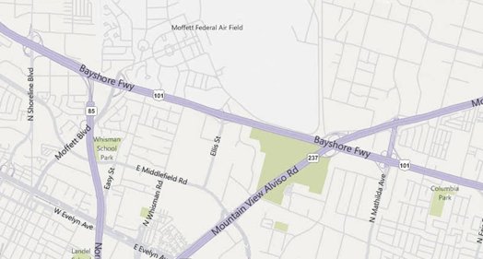
Challenges of Using Raw Tracks
Advantages of Canonicalization:
  More efficient retrieval and comparison operations
  Enables StarTrack to maintain a list of non-duplicate tracks
Courtesy: Maya et al.
Notes:
One of the most basic difficulties with handling tracks arises from the fact that tracks are sets of discrete locations, sampled over time.
Consider the track, that I presented earlier in the talk. Here is a second track, taken while following the same path on a different day. A path taken multiple times leads to completely different samples, and comparing tracks for equality, at this raw form, although possible, becomes easily expensive.
In the new system, StarTrack canonicalizes tracks based on road networks. Canonicalization here means that the raw track is converted to another one that only passes through a set of standard points on roads or highways in the underlying network. Here in this example, the two tracks, after canonicalization, share the exact same coordinates.
Canonicalization presents several advantages: By drawing samples from a standard set of coordinates, we can employ additional techniques to make retrieval more efficient, and comparing tracks becomes simpler and less error-prone.
More effective comparison making it easier to identify highly similar tracks, and thanks to that now also maintains a separate list of non-duplicate tracks per user, or tracks that only differ in time. It is a well known fact users have repetitive travel patterns. Most people, for example, take the same path between home and work. This leads to a large number of duplicate tracks. By keeping this smaller list of non-duplicate tracks, StarTrack can often accelerate operations by not having to work on the entire larger collection.

Slide 78
StarTrack API
Track Collections (TC): Abstract grouping of tracks
  Programming Convenience
  Implementation Efficiency
    Prevent unnecessary client-server message exchanges
    Enable delayed evaluation
    Enable caching and use of in-memory data structures
Pre-filter tracks
Manipulate tracks
Fetch tracks
Courtesy: Maya et al.
Notes:
A second major challenge we faced involved designing a flexible programming interface.
As we identified and studied the need of track-based applications, we realized that they typically operate in three steps: they first narrow down a set of tracks based on some simple criteria; Next they manipulate these sets, for example sorting them based on length or frequency, and narrowing them further by applying some similarity criteria. And In the end, they end up fetching only a small number of these tracks.
So we introduced the concept of a track collection, which is an abstract grouping of tracks. TCs have two main advantages:
First, it better matches the application needs – and this set of three steps. Applications can now create an aggregation of tracks, can manipulate and further narrow down this collection, and then only fetch the tracks that it’s actually interested in.
Another important benefit is that it leads to performance enhancements. Allowing the application to combine a number of operations before retrieving tracks prevents unnecessary message exchanges between the client and the server, and enables StarTrack to delay the evaluation of these operations until tracks are actually fetched. A third advantage is that they allow the server to treat the set of tracks that are repeatedly accessed together as a single entity for the purposes of caching. It also allows the server to construct specialized data structures that operate exclusively on these tracks.
Next, I’ll tell you more about the API and how it matches this set of three phases.

Slide 79
StarTrack API: Track Collections
Creation
  TC MakeCollection(GroupCriteria criteria, bool removeDuplicates)
Manipulation
  TC JoinTrackCollections (TC tCs[], bool removeDuplicates)
  TC SortTracks (TC tC, SortAttribute attr)
  TC TakeTracks(TC tC, int count)
  TC GetSimilarTracks (TC tC, Track refTrack, float simThreshold)
  TC GetPassByTracks (TC tC, Area[] areas)
  TC GetCommonSegments(TC tC, float freqThreshold)
Retrieval
  Track[] GetTracks (TC tC, int start, int count)
Courtesy: Maya et al.
Notes:
A client starts its interaction with StarTrack through a call to MakeCollection. MakeCollection takes as input a set of criteria, which can involve properties on users, time or geography, and creates a track collection that matches the given criteria. It also takes a second argument, which allows applications to specify if they want duplicates to be ommitted from the returned collection.
Once an application has created a track collection, it can pass the track collection as argument to a set of StarTrack operations that further manipulate them – here are common examples. Each of these operations, in turn, returns a new track collection.
As an example, consider the GetSimilarTracks operation. It takes a collection, a reference track, and a threshold, and returns all tracks in the collection that are at least as similar to the reference track as the given threshold.
And finally, we have an operation to fetch tracks from a given track collection.

Slide 80
API Usage: Ride-Sharing Application
// get user’s most popular track in the morning
  TC myTC = MakeCollection(“name = Maya”, [0800 1000], true);
  TC myPopTC = SortTracks(myTC, FREQ);
  Track track = GetTracks(myPopTC, 0, 1);
// find tracks of all fellow employees
  TC msTC = MakeCollection(“name.Employer = MS”, [0800 1000], true);
// pick tracks from the community most similar to user’s popular track
  TC similarTC = GetSimilarTracks(msTC, track, 0.8);
  Track[] similarTracks = GetTracks(similarTC, 0, 20);
// Verify if each track is frequently traveled by its respective owner
  User[] result = FindOwnersOfFrequentTracks(similarTracks);
Courtesy: Maya et al.
Notes:
As an example of how this API is used, let’s consider how a ride sharing application could be implemented. The application tries to find the best share partners for a given user. There are three main parts in this application.
First, the application tries to fetch the user’s typical commute track in the morning. To do that, it first calls MakeCollection, giving the user’s name and times as criteria, and requesting duplicates to be ommitted. Then it sorts the resulting track collection based on the frequency of each of the tracks. Finally, it fetches the first track in the collection. The returned track should be typical of the person’s morning commute.
The application then creates a second TrackCollection to fetch all tracks for employees of the company where the user works, again between 8 and 10, and again omitting duplicates. This track collection, together with the user’s morning commute track are then passed to a call to GetSimilarTracks, which will return a new track collection containing only tracks similar to the user’s morning commute. Again it finishes with a call to GetTracks, to fetch the first 20 tracks, which should be the most similar tracks.
There is a final step, that I’ve ommitted in the interest of time – the application needs to iterate over the 20 matches, and each of them is in fact a regular commute track for another person for its owner.
Let’s focus for a bit on this second part of the application. Evaluation of the MakeCollection and GetSimilarTracks is delayed until GetTracks is called. All calls up until GetTracks can occur at the client side. When GetTracks is called, it will trigger the evaluation of the chain of operations, starting with the MakeCollection operation. MakeCollection gets mapped to a query to the database. Once the tracks are in memory, GetSimilarTracks is executed. In order to accelerate calls to GetSimilarTracks, StarTrack builds a specialized in-memory data-structure called a Track Tree on all tracks in the msTC collection, that are now in memory.
This data structure can be cached in memory and reused in further calls from the same application, when searching for ride-sharing partners for other users.
The key message here is that the new API and the introduction of track collections makes it easier for applications to interact with StarTrack, in order to narrow down the set of tracks that it is really interested in.

Slide 81
Efficient Implementation of Operations
StarTrack exploits redundancy in tracks for efficient retrieval from database
  Set of non-duplicate tracks per user
  Separate table of unique coordinates
StarTrack builds specialized in-memory data-structures to accelerate the evaluation of some operations
  Quad-Trees for geographic range searches
  Track Trees for similarity searches
Courtesy: Maya et al.
Notes:
The third challenge we faced involved efficiently evaluating operations in our API.
To evaluate more complex operations, we build & cache specialized data structures at the ST servers, making decisions about which structure to use on the fly. For example, we build quad-trees for accelerating geographic range queries, and we build a novel ds called track tree to accelerate queries involving track similarity. I’ll next describe the track-tree structure in more detail, since fetching similar tracks is one of the most important operations in StarTrack.

Slide 82


Track Similarity
Track C
s6
s7
S5
S6-7
s5
$$\text{SIM}\left(\text{A}\text{,}\text{B}\right)=\frac{|\text{S}\text{1−}5|}{\left|\text{S}\text{1−}5\right|}$$
Tracks A, B
s4
s8
$$\text{SIM}\left(\text{A}\text{,}\text{C}\right)=\frac{|\text{S}\text{1−4}|}{\left|\text{S}\text{1−4}\right|+\left|\text{S}\text{5}\right|+|\text{S}\text{6−7}|}$$
s3
s9
Track D
s2
s1
S1-4
Limited database support for computing track similarity
Courtesy: Maya et al.
Notes:
For the purposes of this explanation, consider the following, very small, track collection with only 4 tracks. Tracks A and B are identical. Tracks C and D share some road segments with other tracks but are not the same.
We compute the similarity between two tracks as follows. It is the length of the segments in common between the two tracks divided by the sum of the lengths of all segments included in either track. This results in a similarity metric between zero and one. For tracks A and B, the similarity is 1.0 as expected. For tracks A and C, the similarity is the length of segments 1 through 4, which they share, divided by this common length plus segment 5 which is unique to track A and segments 6 and 7 which are unique to track C. Computing this similarity efficiently is the real challenge.
In order to efficiently satisfy calls to GetSimilarTracks, we prebuild a data structure called track tree over the entire track collection. Tipically, when two tracks overlap, they usually do so on one or very few contiguous segments.

Slide 83
Track Tree
Track C
s6
s7
1) Create leaf nodes for all segments
2) Merge nodes based on # of tracks that go through adjacent segments
s5
Tracks A, B
S1-5
s4
s8
s3
Track D
s9
S1-4
s2
s1
S1-3
S1-2
S6-7
S8-9
s1
s2
s3
s4
s5
s6
s7
s8
s9
Courtesy: Maya et al.
Notes:
A track tree is a hierarchical, binary data structure.
In this data structure, each node represents a segment in the road network. The leaves of the tree are individual segments for any track in the collection and internal nodes of the tree represent contiguous sequences of such segments. Associated with each node is the set of tracks that share that segment or segments.
The tree is constructed to maximize the number of tracks that share internal nodes. After all segments in a track collection are stored as leaf nodes, pairs of nodes that refer to geographically adjacent segments are considered for merging to form interior nodes. If there is a choice of nodes to merge, the pair that has the highest number of tracks in common is picked. This will lead to more commonly traveled segments being mapped to interior nodes in the tree. So in this example, we start by computing the number of tracks that go through each pair of contiguous segments.
Once a track tree has been constructed, it is used by StarTrack to accelerate different operations, like GetSimilarTracks, that fetches tracks similar to a reference track, and getCommonSegments, which identifies sequences of segments most commonly traveled within a collection.
As I mentioned earlier, Track Tree is one example of a data structure used by StarTrack. We also use Quad-Trees to accelerate operations involving geographic range queries, and may use aditional data structures as new operations are added to the API.

Slide 84
Evaluation
Performance of our Track Tree approach
Performance of 2 sample applications
  Ride-sharing
  Personalized Driving Directions
Configuration
  Synthetically generated tracks
  Up to 9 StarTrack Servers + 3 Database Servers
  Server Configuration:
    2.6 GHz AMD Opteron Quad-Core Processors
    16 GB RAM
Courtesy: Maya et al.
Notes:
We’ve evaluated the performance of StarTrack and many of its different components, but given the time restrictions, I’ll only present two sets of experiment results. First I’ll show how track trees perform compared against a few alternative approaches.
I’ll also present some results from macro experiments involving requests from two sample applications that we’ve built and I’ve earlier mentioned – ride-sharing and personalized driving directions.
The set of tracks we used were synthetically generated based on salient features observed in a real dataset of tracks.
We used similar configurations for both startrack and database servers.

Slide 85
Evaluation: Track Tree
Evaluation of GetSimilarTracks
Alternative approaches:
  Database filtering
    Pre-filter tracks that intersect ref track at database
  In-memory filtering
    Pre-filter tracks that intersect ref track in memory
  In-memory brute force
    Compute similarity between each track and ref track in memory
Courtesy: Maya et al.
Notes:
We evaluated the track tree approach against three alternative approaches for fetching similar tracks, given a reference track.
In all these approaches, we assume that a track collection has already been created and either stored as a materialized view in the database, or brought into memory.
In the Database filtering approach, we use the spatial features of the database to fetch all tracks that intersect our reference track, followed by a sequential scan through all tracks to compute the similarity against our reference track.
In the In-Memory Filtering approach, we pre-build a dictionary to lookup tracks that go through a given point. Given the reference track, we quickly identify tracks that touch any of the points, and then sequential scan the filtering candidates.
In the In-Memory Brute Force, we sequentially compare the reference track against all the tracks.

Slide 86
Get Similar Tracks – Query Time
Database Filtering
In-Memory Brute Force
In-Memory Filtering
Track Tree
Courtesy: Maya et al.
Notes:
In this graph we show how query time varies as we increase the size of the track collection up to 100 thousand tracks. Notice that the query time axe is in logarithmic scale.
As you can see there’s a significant difference in times among the different approaches, and StarTrack performs at least two orders of magnitude better than all the alternatives.

Slide 87
Track Tree Construction Costs
Memory (MB)
Time (s)
Number of Tracks (thousands)
Courtesy: Maya et al.
Notes:
There are costs associated with building in-memory data structures. It takes time and memory to build and maintain them. In this graph, you can see the Memory consumption and computational costs for building a track tree as we increase the number of tracks. The cost is linear on the number of tracks, but as you can see, it takes in the order of 120 seconds to build a track tree for 100 thousand tracks.
So there is a clear tradeoff for using a track tree (and the same holds for other complex data structures) – it takes time to construct it, but once constructed, it leads to significantly optimized queries. These costs are justified when there are repetitive calls against a track collection. For example, in the case of the ride-sharing application, it makes sense to build a track tree for a community or geographic region, and keep it around to satisfy queries coming from different users.

Slide 88
Performance of Applications
Personalized Driving Directions
- Track Collection for single user at a time
- Calls to GetCommonSegments
- 30 requests/s at about 100 ms (uncached)
- 250 requests/s at about 55 ms (cached)
Ride Sharing
- Track Collection on multiple users
- Calls to GetSimilarTracks
- 30 requests/s at about 170 ms
Courtesy: Maya et al.
Notes:
We’ve tested the performance and scalability of the StarTrack system when hitting it with requests from 2 sample applications: ride sharing – for which we saw the pseudocode earlier in this talk, and personalized driving directions, which involves mining tracks belonging to a given user in order to find the most familiar segments for that user.
We evaluated the maximum request rates and latencies when handling requests from each of these apps.
In the case of ride-sharing, we pre-built a track tree in the server containing around 50K unique tracks. In the ride-sharing application, which involves a few operations, a single server was able to satisfy requests of 30 instances of ride-sharing per second, with an approximate latency of around 150 ms.
In the case of the Personalized Driving Directions application, we evaluated the maximum load when track collections for each user were uncached and when they were pre-cached in memory. In the case where they were cached, a track tree was also pre-built in memory – This application issues calls to GetCommonSegments operation, which is also accelerated by track trees.

Slide 89
Related Work
Management of tracks has been studied by the database community
  Storage of tracks as 3-dimensional objects
  Specialized indexing schemes (Quad-Trees, R-Trees, etc.)
CarTel Project (MIT) – Provides an infrastructure for collecting traces, relying on a relational database using spatial queries
Access and sharing of data in StarTrack is similar to that provided by social networks, where users’ data is shared by applications; Similar access control policies could be employed to ensure privacy in StarTrack.
Courtesy: Maya et al.

Slide 90
Summary
StarTrack is a scalable service designed to manage tracks and facilitate the construction of track-based applications
Important Design Features
  Canonicalization of Tracks
  API based on Track Collections
  Use of Novel Data Structures
Courtesy: Maya et al.
Notes:
The takeaway from this talk is that StarTrack is a scalable service designed to manage tracks and facilitate the construction of track-based applications.
It provides a centralized infrastructure to collect location data and enables sharing of this data across applications.
Some of the most interesting challenges we faced when building StarTrack involved dealing with raw tracks, coming up with the right API and efficiently implementing operations in the API. We employed a number of techniques to address these issues: we introduced track canonicalization, track collections, and specialized in-memory data structures, among other things. I’ve ommitted other aspects of the system – please look at the paper if you’re interested in learning more about the system.

Slide 91
Questions?

