Slide 1
Cellular Networks and Mobile Computing
COMS 6998-10, Spring 2013
Instructor: Li Erran Li (lierranli@cs.columbia.edu)
http://www.cs.columbia.edu/~lierranli/coms6998-10Spring2013/
3/5/2013: Radio Resource Usage Profiling and Optimization

Slide 2
Announcements
Course evaluation due!
Project description due on March 25

Slide 3
Review of Previous Lecture
What are the physical layer technologies in 3G and LTE?

Slide 4
UMTS Physical Layer
Code Division Multiple Access (CDMA)
Use of orthogonal codes to separate different transmissions
Each symbol or bit is transmitted as a larger number of bits using the user specific code – Spreading
Spread spectrum technology
  The bandwidth occupied by the signal is much larger than the information transmission rate
  Example: 9.6 Kbps voice is transmitted over 1.25 MHz of bandwidth, a bandwidth expansion of ~100
Courtesy: Harish Vishwanath

Slide 5
LTE Physical Layer
The key improvement in LTE radio is the use of OFDM
Orthogonal Frequency Division Multiplexing
  2D frame: frequency and time
  Narrowband channels: equal fading in a channel
    Allows simpler signal processing implementations
  Sub-carriers remain orthogonal under multipath propagation
One resource block
12 subcarriers during one slot
(180 kHz × 0.5 ms)
One resource element
frequency
12 subcarriers
Time domain structure
Frame (10 ms)
One OFDM symbol
One slot
time
Slot (0.5 ms)
Subframe (1 ms)

Slide 6
Review of Previous Lecture (Cont’d)
What are the mobility protocols used in cellular networks?

Slide 7
Mobility Protocol: GTP
SGi
PDN GW
HSS
S5
GTP
Gn
GTP
SGW
S11
MME
SGSN
MSC
IuPS
IuCS
RNC
S1-U
S1-CP
GTP
Iub
eNodeB
NodeB
UE
Courtesy: Zoltán Turányi

Slide 8
Mobility Protocol: Proxy Mobile IP (PMIP)
SGi
PDN GW
HSS
S5
PMIP
S2
SGW
MME
PMIP
S11
Non-3GPP Access
(cdma2000, WiMax, WiFi)
S1-U
S1-CP
GTP
eNodeB
UE
EPC – Evolved Packet Core
Courtesy: Zoltán Turányi

Slide 9
Review of Previous Lecture (Cont’d)
Is carrier sensing multiple access (CSMA) used in cellular networks?

Slide 10
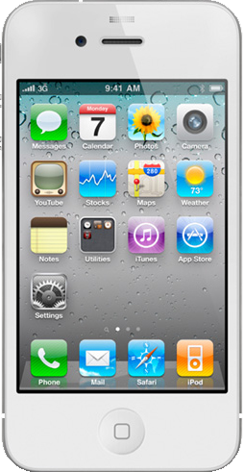
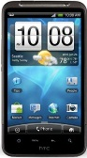
Random Access
Why not carrier sensing like WiFi?
Base station coverage is much larger than WiFi AP
  UEs most likely cannot hear each other
How come base station can hear UEs’ transmissions?
  Base station receivers are much more sensitive and expensive
Base station
UE 2
UE 1
Notes:
Time-frequency resource on which random-access preamble is transmitted on the PRACH channel

Slide 11
Review of Previous Lecture (Cont’d)
What are the problems of current LTE network architecture?

Slide 12
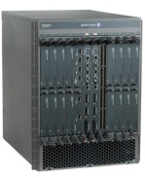
LTE Data Plane is too Centralized
Data plane is too centralized
UE: user equipment
eNodeB: base station
S-GW: serving gateway
P-GW: packet data network gateway
eNodeB 1
Cellular Core Network
Scalability challenges at P-GW on charging and policy enforcement!
eNodeB 2
S-GW 1
UE 1
P-GW
Internet and
Other IP Networks
eNodeB 3
S-GW 2
UE 2
GTP Tunnels
Notes:
Verizon claims that, at its current rate of traffic growth, which is roughly doubling each year, it will reach the capacity thresholds on both its 3G EV-DO and LTE networks beginning in some markets by the end of 2013, and across its entire network by the end of 2015. Unless it can get new spectrum — i.e., the cable operators’ 20 MHz of AWS spectrum — its customers’ connection speeds and service quality will start suffering.

Slide 13
LTE Control Plane is too Distributed
No clear separation of control plane and data plane
Control Plane
Home Subscriber Server (HSS)
Problem with Inter-technology (e.g. 3G to LTE) handoff
Problem of inefficient radio resource allocation
Data Plane
Mobility Management Entity (MME)
Policy Control and Charging Rules Function (PCRF)
Packet Data
Station (eNodeB)
Serving
Network Gateway
(P-GW)
User Equipment (UE)
Base
Gateway (S-GW)

Slide 14
Review of Previous Lecture (Cont’d)
What can we do to design a better cellular network for the future?

Slide 15
CellSDN Architecture
Central control of radio resource allocation
Radio Resource Manager
Mobility Manager
Subscriber Information Base
Policy and Charging Rule Function
Infra-structure Routing
Translates policies on subscriber attributes to rules on packet header
Network Operating System: CellOS
SCTP instead of TCP to
avoid head of line blocking
Cell Agent
Cell Agent
Cell Agent
Offloading controller actions, e.g. change priority if counter exceed threshold
Radio Hardware
Packet Forwarding Hardware
Packet Forwarding Hardware
DPI to packet classification based on application

Slide 16
CellSDN Virtualization
Network OS
(Slice 1)
Network OS
(Slice 2)
Network OS
(Slice N)
Slice semantic space, e.g. all roaming subscribers, all iPhone users
Slicing Layer: CellVisor
Cell Agent
Cell Agent
Cell Agent
Radio Hardware
Packet Forwarding Hardware
Packet Forwarding Hardware

Slide 17
Outline
Introduction
Network Characteristics
RRC State Inference
Radio Resource Usage Profiling & Optimization
  Biayo Su and Ashwin Ramachandran on radio resource profiling (15min)
Network RRC Parameters Optimization
  Xin Ye and Nan Yan on RadioJockey (15min)
Conclusion

Slide 18








Introduction
Typical testing and optimization in cellular data network
Little focus has been put on their cross-layer interactions
Many mobile applications are not cellular-friendly.
The key coupling factor: the RRC State Machine
  Application traffic patterns trigger state transitions
  State transitions control radio resource utilization, end-user experience and device energy consumption (battery life)
?
RRC
State
Machine
Courtesy: Feng Qian et al.

Slide 19
Network characteristics
4GTest on Android
  http://mobiperf.com/4g.html
  Measures network performance with the help of 46 M-Lab nodes across the world
  3,300 users and 14,000 runs in 2 months 10/15/2011 ~ 12/15/2011
4GTest user coverage in the U.S.
Courtesy: Junxian Huang et al.
Notes:
To make such large-scale measurement, we developed and published an app called 4GTest in Android market.
In order to make sure that the Internet path does not become the bottleneck, 4GTest chooses the closest M-Lab nodes to connect to, which are distributed across the world.
Within 2 months of deployment, we collect data from more than 3000 users
Based on this figure, we can see that our data set has a reasonably good coverage in the United States.

Slide 20
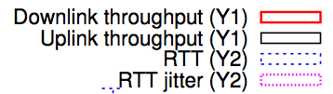
Downlink throughput
LTE median is 13Mbps, up to 30Mbps
  The LTE network is relatively unloaded
WiFi, WiMAX < 5Mbps median
Notes:
Comparing downlink throughput, LTE’s median throughout is 13Mbps, and for some users, it can be up to 30Mbps.
We need to notice that LTE network is currently relatively unloaded due to its new coming.
For WiFi and WiMAX, their median downlink throughput is smaller than 5Mbps. And 3G networks are lower.

Slide 21
Uplink throughput
LTE median is 5.6Mbps, up to 20Mbps
WiFi, WiMAX < 2Mbps median
Notes:
For uplink throughput, LTE’s median throughput is 5.6Mbps, which is also much higher than that of WiFi or WiMAX.

Slide 22
RTT
LTE median 70ms
WiFi similar to LTE
WiMAX higher
Notes:
For RTT, LTE and WiFi have similar median value of 70ms,
WiMAX and 3G networks have higher RTTs, and the median value is between 100ms and 200ms.

Slide 23
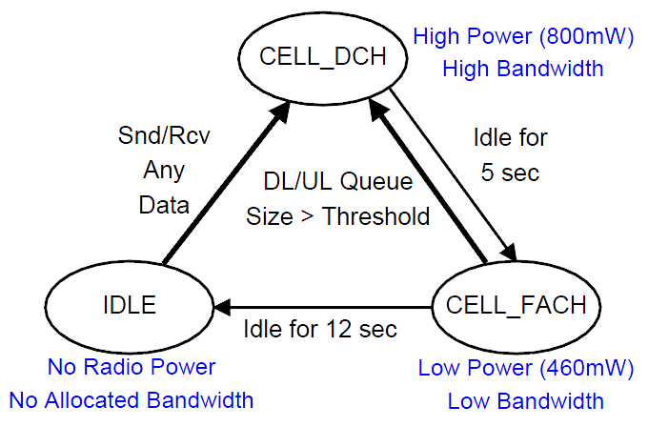
The RRC State Machine for UMTS Network
State promotions have promotion delay
State demotions incur tail times
Tail Time
Delay: 2s
 | Channel | Radio Power
IDLE | Not allocated | Almost zero
CELL_FACH | Shared, Low Speed | Low
CELL_DCH | Dedicated, High Speed | High
Delay: 1.5s
Tail Time
Courtesy: Feng Qian et al.
Notes:
State machine – the standard for all UMTS carriers – transitions & paras can change

Slide 24
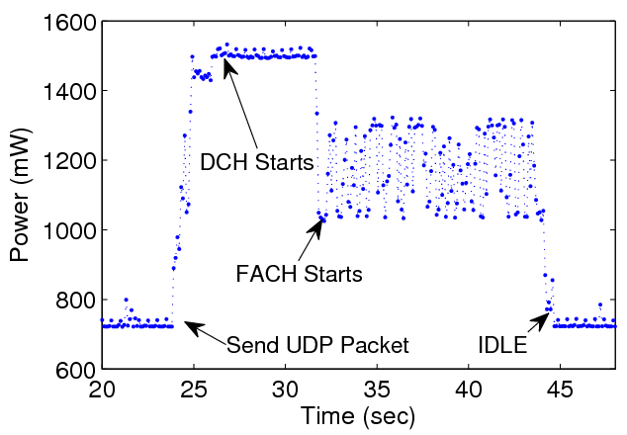
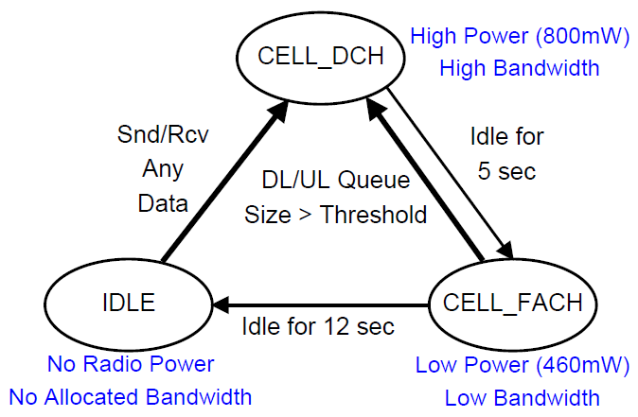
Example: RRC State Machine for a Large Commercial 3G Network
DCH Tail: 5 sec
FACH Tail: 12 sec
Promo Delay: 2 Sec
Tail Time: waiting
inactivity timers to expire
DCH: High Power State (high throughput and power consumption)
FACH: Low Power State (low throughput and power consumption)
IDLE: No radio resource allocated
Courtesy: Feng Qian et al.

Slide 25
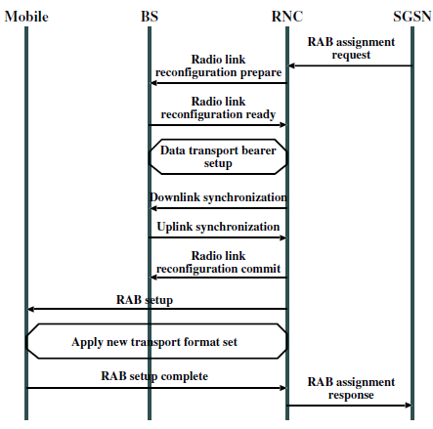
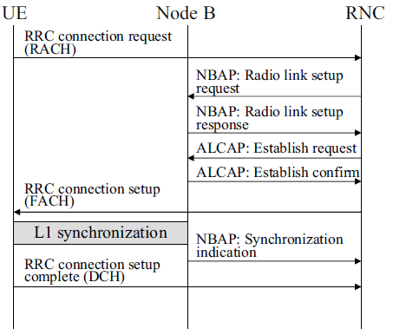
Why State Promotion Slow?
Tens of control messages are exchanged during a state promotion.
RRC connection setup: ~ 1sec
+
Radio Bearer Setup: ~ 1 sec
Figure source: HSDPA/HSUPA for UMTS: High Speed Radio Access for Mobile Communications. John Wiley and Sons, Inc., 2006.

Slide 26
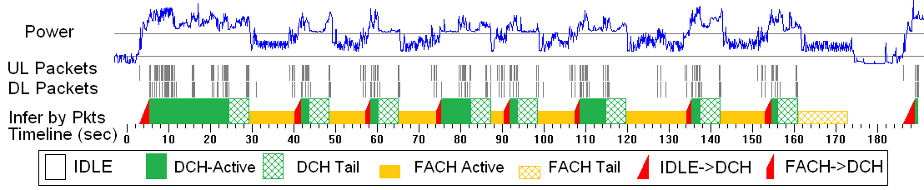
Example of the State Machine Impact:
Inefficient Resource Utilization
State transitions impact end user experience and generate signaling load.
A significant amount of channel occupation time and battery life is wasted by scattered bursts.
Analysis powered by the ARO tool
 | FACH and DCH
Wasted Radio Energy | 34%
Wasted Channel Occupation Time | 33%
Courtesy: Feng Qian et al.
Notes:
A huge problem

Slide 27
RRC state transitions in LTE
Courtesy: Junxian Huang et al.

Slide 28
RRC state transitions in LTE
RRC_IDLE
No radio resource allocated
Low power state: 11.36mW average power
Promotion delay from RRC_IDLE to RRC_CONNECTED: 260ms
Courtesy: Junxian Huang et al.

Slide 29
RRC state transitions in LTE
RRC_CONNECTED
Radio resource allocated
Power state is a function of data rate:
  1060mW is the base power consumption
  Up to 3300mW transmitting at full speed
Courtesy: Junxian Huang et al.

Slide 30
RRC state transitions in LTE
Continuous Reception
Send/receive a packet
Promote to RRC_CONNECTED
Reset Ttail
Courtesy: Junxian Huang et al.

Slide 31
RRC state transitions in LTE
DRX
Ttail expires
Ttail stops
Demote to RRC_IDLE
Courtesy: Junxian Huang et al.

Slide 32
Tradeoffs of Ttail settings
Ttail setting | Energy Consumption | # of state transitions | Responsiveness
Long | High | Small | Fast
Short | Low | Large | Slow
Courtesy: Junxian Huang et al.
Notes:
Ttail is a very important parameter for both 3G and 4G networks.
It incurs tradeoffs between UE energy consumption, signaling overhead in the network quantified by the # of state transitions here
, and responsiveness
When Ttail is set to be a long value, UE consumes more energy, with smaller # of state transitions and fast responsiveness since UE spends more time in the RRC_CONNECTED state and there is less promotion delays.
When Ttail is set to be a short value, UE consumes less energy, incurring larger number of state transitions and more promotions delays
Later in this talk, we will explore in more details the impact of setting Ttail for LTE network.

Slide 33
RRC state transitions in LTE
DRX: Discontinuous Reception
Listens to downlink channel periodically for a short duration and sleeps for the rest time to save energy at the cost of responsiveness
Courtesy: Junxian Huang et al.
Notes:
Discontinuous reception, or DRX, is an important feature in LTE for energy saving purpose.
Instead of continuous monitoring downlink channel, in DRX, UE only listens to downlink channel periodically for a short duration, and sleeps for the rest time to save energy at the cost of responsiveness.

Slide 34
Discontinuous Reception (DRX): micro-sleeps for energy saving
In LTE 4G, DRX makes UE micro-sleep periodically in the RRC_CONNECTED state
  Short DRX
  Long DRX
DRX incurs tradeoffs between energy usage and latency
  Short DRX – sleep less and respond faster
  Long DRX – sleep more and respond slower
In contrast, in UMTS 3G, UE is always listening to the downlink control channel in the data transmission states
Courtesy: Junxian Huang et al.
Notes:
We explain DRX in more details here.
In LTE 4G networks, DRX makes UE micro-sleep periodically in RRC_CONNECTED state.
There are two types of DRX in RRC_CONNECTED, Short DRX and Long DRX.
Different types of DRX incurs tradeoffs between battery saving and latency.
Short DRX sleeps slightly less with smaller energy saving and respond faster
Long DRX, sleeps more with more energy saving and respond slower.
The DRX in the data transmission state is one major difference between 3G and LTE.
In UMTS 3G networks, during the data transmission states, UE is continuously listening to the downlink control channel

Slide 35
DRX in LTE
A DRX cycle consists of
  ‘On Duration’ - UE monitors the downlink control channel (PDCCH)
  ‘Off Duration’ - skip reception of downlink channel
T_{i}: Continuous reception inactivity timer
  When to start Short DRX
T_{is}: Short DRX inactivity timer
  When to start Long DRX
Courtesy: Junxian Huang et al.
Notes:
Now let’s look at DRX with a microscope.
DRX is periodic and each DRX cycle consists of
‘On Duration’ during which UE monitors the downlink control channel
‘Off Duration’ during which UE can sleep and skip the reception of downlink channel for battery saving purpose.
The On Duration is typically much smaller than the Off Duration so as to make effective energy saving
First, let’s start from the red dots where the UE starts transferring data.
Every time a packet is sent or received, the continuous reception inactivity timer Ti is started.
And when Ti expires, UE starts short DRX.
Then the short DRX inactivity timer Tis starts and when Tis expires without seeing any data, long DRX starts.

Slide 36
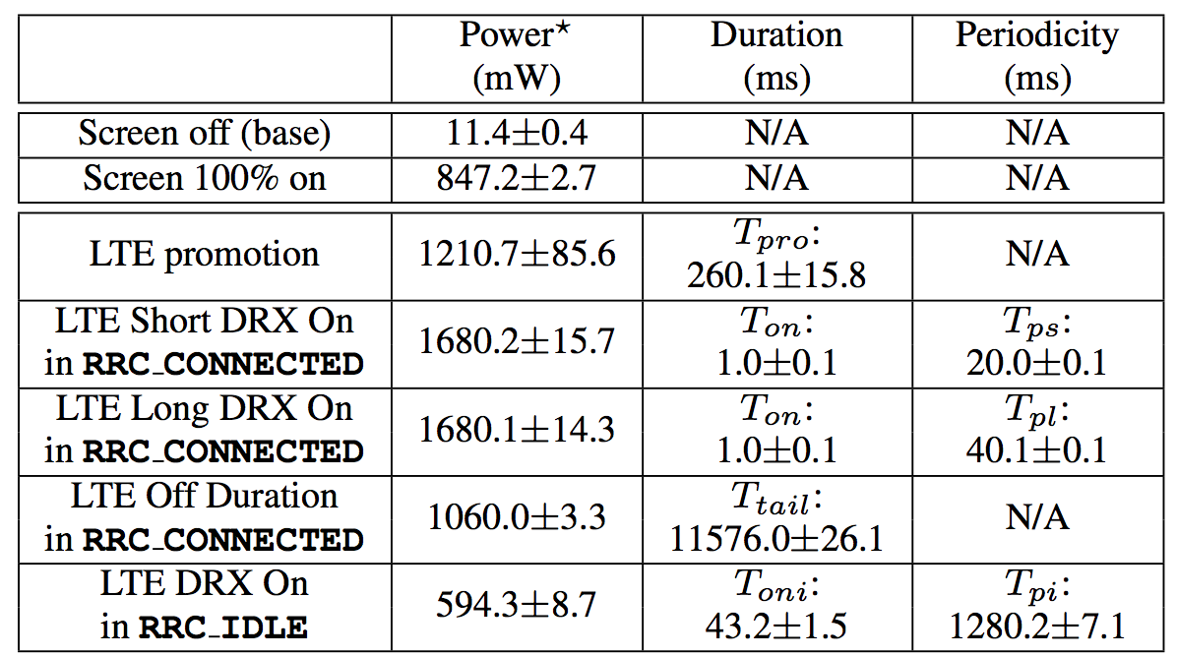
LTE power model
Measured with a LTE phone and Monsoon power meter, averaged with repeated samples
Notes:
We measure the LTE power model with our test device and Monsoon power meter.
And we take the average with repeated samples.
All the energy are measured with screen turned off.

Slide 37
LTE power model
Measured with a LTE phone and Monsoon power meter, averaged with repeated samples
Notes:
As a reference for comparison, we measure the power level when the device is doing nothing but with the screen 100% on.
The power level is around 850 mW.

Slide 38
LTE power model
Measured with a LTE phone and Monsoon power meter, averaged with repeated samples
Notes:
We notice that in the RRC_CONNECTED tail, for any DRX cycle, the power level of the off duration is 1060mW.
And the tail timer is measured to be 11.6seconds

Slide 39
LTE power model
Measured with a LTE phone and Monsoon power meter, averaged with repeated samples
Notes:
For DRX on duration, the power level is even higher, up to 1680mW.

Slide 40
LTE power model
Measured with a LTE phone and Monsoon power meter, averaged with repeated samples
P(on) – P(off) = 620mW, DRX saves 36% energy in RRC_CONNECTED
High power levels in both On and Off durations in the DRX cycle of RRC_CONNECTED
Notes:
We make two interesting observations out of this table.
First, we notice that the DRX on duration has a higher power level than that of the off duration and
The gap between on and off is 620mW. This large gap allows the DRX to save 36% energy in RRC_CONNECTED state.
So DRX is effective.
Second, both on and off durations in the DRX cycle of RRC_CONNECTED, have high power levels.
So even though DRX helps save significant amount of energy, LTE still has high energy consumption in RRC_CONNECTED state.
This observation suggests that the high-power tail might still be a key source of energy inefficiency of LTE network as it is in 3G network.

Slide 41
LTE consumes more instant power than 3G/WiFi in the high-power tail
Average power for WiFi tail
  120 mW
Average power for 3G tail
  800 mW
Average power for LTE tail
  1080 mW
Courtesy: Junxian Huang et al.
Notes:
We compare the instant tail power level of the three network types, since tail energy is the main source of wasted energy.
WiFi appears to be the least power consuming, only 120 mW.
3G tail has a high power level of 800 mW.
LTE has the even higher power level in RRC_CONNECTED mode, 1080 mW.
Considering that LTE tail timer is even longer than that for 3G in our measured network, more energy is wasted in the tail for LTE than 3G in that network.

Slide 42
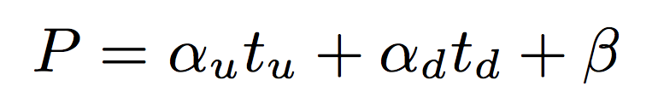

Power model for data transfer
A linear model is used to quantify instant power level:
  Downlink throughput t_{d} Mbps
  Uplink throughput t_{u} Mbps
< 6% error rate in evaluations with real applications
Courtesy: Junxian Huang et al.
Notes:
In addition to the power states, we also use a simple linear model to quantify the
instant power level based on the data rates in uplink and downlink.
The higher the throughput, the higher the power.
It’s simple yet validated to be effective and accurate, with the error rate for the predicted energy usage of real applications to be < 6%.

Slide 43
Energy per bit comparison
LTE’s high throughput compensates for the promotion energy and tail energy
Transfer Size | LTE μ J / bit | WiFi μ J / bit | 3G μ J / bit
10KB | 170 | 6 | 100
10MB | 0.3 | 0.1 | 4
Total energy per bit for downlink bulk data transfer
Courtesy: Junxian Huang et al.
Notes:
In this table, we compare the energy per bit for the three networks in the downloading bulk data with different sizes.
For a small download of 10KB, LTE and 3G is clearly much more power consuming than WiFi, with LTE as 170 μJ/bit
However, when we download a large file of 10MB LTE’s high throughput compensates for the promotion energy and tail energy.
The energy per bit for LTE in this scenario is 0.3 μJ/bit, which is comparable to WiFi’s μJ/bit. While for 3G, it is much worse, with 4 μJ/bit.

Slide 44
Energy per bit comparison
LTE’s high throughput compensates for the promotion energy and tail energy
Small data transfer, LTE wastes energy
Large data transfer, LTE is energy efficient
Transfer Size | LTE μ J / bit | WiFi μ J / bit | 3G μ J / bit
10KB | 170 | 6 | 100
10MB | 0.3 | 0.1 | 4
Total energy per bit for downlink bulk data transfer
Courtesy: Junxian Huang et al.
Notes:
So the high level observation for LTE network is that
It wastes energy for small data transfers,
But could become energy efficient for large data transfer.
For large data transfers, LTE has comparable energy efficiency compared with WiFi.

Slide 45
Example of the State Machine Impact:
DNS timeout in UMTS networks
Start from CELL_DCH STATE (1 request / response) – Keep in DCH
Start from CELL_FACH STATE (1 request / response) – Keep in FACH
Start from IDLE STATE (2~3 requests / responses) – IDLE → DCH
Starting from IDLE triggers at least one DNS timeout (default is 1 sec in WinXP)
2 second promotion delay because of the wireless state machine (see previous slide), but DNS timeout is 1 second!
=> Triple the volume of DNS requests…
Courtesy: Feng Qian et al.

Slide 46
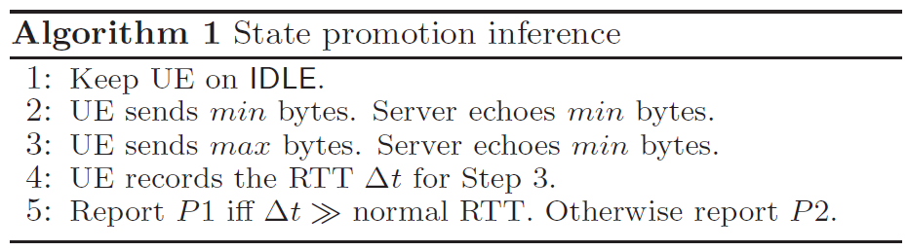
State Machine Inference
State Promotion Inference
  Determine one of the two promotion procedures
  P1: IDLE→FACH→DCH; P2:IDLE→DCH
State demotion and inactivity timer inference
  See paper for details
P1: IDLE→FACH, P2:IDLE→DCH
P1: FACH→DCH, P2:Keep on DCH
Normal RTT < 300ms
RTT w/ Promo > 1500ms
A packet of min bytes never triggers FACH→DCH promotion (we use 28B)
A packet of max bytes always triggers FACH→DCH promotion (we use 1KB)
Courtesy: Feng Qian et al.

Slide 47
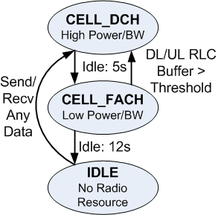
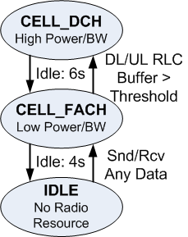
RRC State Machines of Two Commercial UMTS Carriers
Promotion
Inference
Reports P2
IDLE→DCH
Promotion
Inference
Reports P1
IDLE→FACH→DCH
Carrier 1
Carrier 2
Timer | Carrier 1 | Carrier 2
DCH→FACH (α timer) | 5 sec | 6 sec
FACH→IDLE (β timer) | 12 sec | 4 sec
What are the optimal inactivity timer values?
Courtesy: Feng Qian et al.

Slide 48
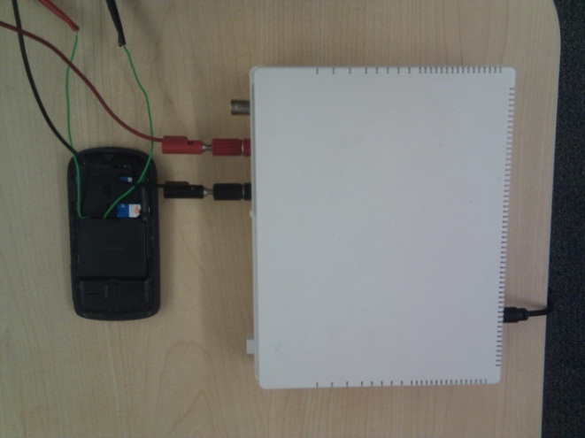
State Machine Inference
Validation using a power meter
DCH Tail: 5 sec
FACH Tail: 12 sec
RRC State | Avg Radio Power
IDLE | 0
FACH | 460 mW
DCH | 800 mW
FACH→DCH | 700 mW
IDLE→DCH | 550 mW
Carrier 1
Promo Delay: 2 Sec

Slide 49
Outline
Introduction
RRC State Inference
Radio Resource Usage Profiling & Optimization
Network RRC Parameters Optimization
Conclusion

Slide 50
ARO: Mobile Application Resource Optimizer
Motivations:
  Are developers aware of the RRC state machine and its implications on radio resource / energy? NO.
  Do they need a tool for automatically profiling their prototype applications? YES.
  If we provide that visibility, would developers optimize their applications and reduce the network impact? Hopefully YES.
ARO: Mobile Application Resource Optimizer
  Provide visibility of radio resource and energy utilization.
  Benchmark efficiencies of cellular radio resource and battery life for a specific application
Courtesy: Feng Qian et al.

Slide 51
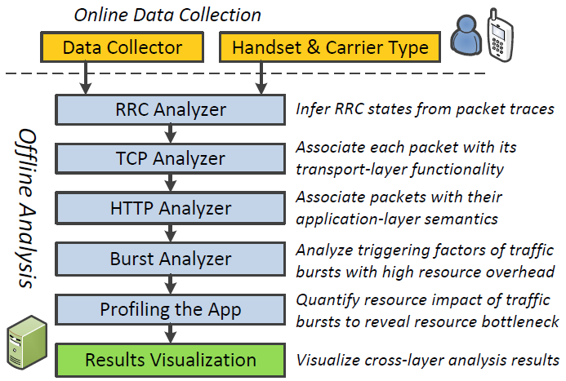
ARO System Architecture
Courtesy: Feng Qian et al.

Slide 52
ARO System Architecture
Courtesy: Feng Qian et al.

Slide 53
The Data Collector
Collects three pieces of information
  The packet trace
  User input (e.g., touching the screen)
  Packet-process correspondence
    The RRC state transition is triggered by the aggregated traffic of all concurrent applications
    But we are only interested in our target application.
Less than 15% runtime overhead when the throughput is as high as 600kbps
Courtesy: Feng Qian et al.

Slide 54
ARO System Architecture
Courtesy: Feng Qian et al.

Slide 55
RRC Analyzer: State Inference
RRC state inference
  Taking the packet trace as input, simulate the RRC state machine to infer the RRC states
    Iterative packet driven simulation: given RRC state known for pkt_{i}, infer state for pkt_{i+1} based on inter-arrival time, packet size and UL/DL
  Evaluated by measuring the device power
Example: Web Browsing Traffic on HTC TyTn II Smartphone
Courtesy: Feng Qian et al.
Notes:
We have done earlier work that infers the state machine paras
Can plug in any state machine transition model
Evaluation: …

Slide 56
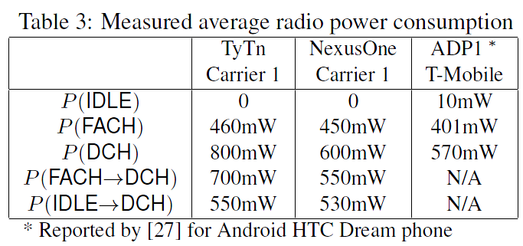

RRC Analyzer: Applying the Energy Model
Apply the energy model
  Associate each state with a constant power value
  Based on our measurement using a power-meter
Courtesy: Feng Qian et al.
Notes:
High power state consumes almost double as low power state

Slide 57
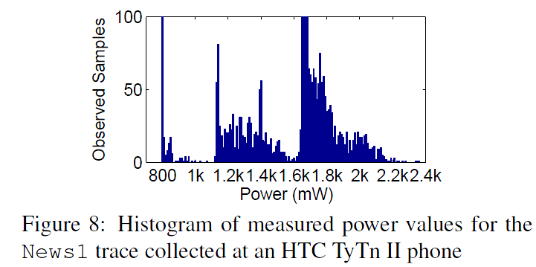
RRC Analyzer: Applying the Energy Model (Cont’d)
3G radio interface power consumption
  at DCH, the radio power (800 mW) contributes 1/3 to 1/2 of total device power (1600 mW to 2400 mW)
IDLE
FACH
DCH
Courtesy: Feng Qian et al.

Slide 58
ARO System Architecture
Courtesy: Feng Qian et al.
Notes:
HTTP: > 95% traffic
TCP Retransmission - Occurs when the sender retransmits a packet after the expiration of the acknowledgement.
TCP Fast Retransmission - Occurs when the sender retransmits a packet before the expiration of the acknowledgement timer. Senders receive some packets which sequence number are bigger than the acknowledged packets. Senders should Fast Retransmit upon receipt of 3 duplicate ACKs.
TCP_Out-of-order - Occurs when a packet is seen with a sequence number lower than the previously received packet on that connection.
TCP Previous segment lost - Occurs when a packet arrives with a sequence number greater than the "next expected sequence number" on that connection, indicating that one or more packets prior to the flagged packet did not arrive. This event is a good indicator of packet loss and will likely be accompanied by "TCP Retransmission" events.
TCP_ACKed_lost_segment -
TCP Keep-Alive - Occurs when the sequence number is equal to the last byte of data in the previous packet. Used to elicit an ACK from the receiver.
TCP Keep-Alive ACK - Self-explanatory. ACK packet sent in response to a "keep-alive" packet.
TCP DupACK - Occurs when the same ACK number is seen AND it is lower than the last byte of data sent by the sender. If the receiver detects a gap in the sequence numbers, it will generate a duplicate ACK for each subsequent packet it receives on that connection, until the missing packet is successfully received (retransmitted). A clear indication of dropped/missing packets.
TCP ZeroWindow - Occurs when a receiver advertises a receive window size of zero. This effectively tells the sender to stop sending because the receiver's buffer is full. Indicates a resource issue on the receiver, as the application is not retrieving data from the TCP buffer in a timely manner.
TCP ZerowindowProbe - The sender is testing to see if the receiver's zero window condition still exists by sending the next byte of data to elicit an ACK from the receiver. If the window is still zero, the sender will double his persist timer before probing again.
TCP ZeroWindowViolation - The sender has ignored the zero window condition of the receiver and sent additional bytes of data.
TCP WindowUpdate - This indicates that the segment was a pure WindowUpdate segment. A WindowUpdate occurs when the application on the receiving side has consumed already received data from the RX buffer causing the TCP layer to send a WindowUpdate to the other side to indicate that there is now more space available in the buffer. Typically seen after a TCP ZeroWindow condition has occurred. Once the application on the receiver retrieves data from the TCP buffer, thereby freeing up space, the receiver should notify the sender that the TCP ZeroWindow condition no longer exists by sending a TCP WindowUpdate that advertises the current window size.
TCP WindowFull - This flag is set on segments where the payload data in the segment will completely fill the RX buffer on the host on the other side of the TCP session. The sender, knowing that it has sent enough data to fill the last known RX window size, must now stop sending until at least some of the data is acknowledged (or until the acknowledgement timer for the oldest unacknowledged packet expires). This causes delays in the flow of data between sender and receiver and lowers throughput. When this event occurs, a ZeroWindow condition might occur on the other host and we might see TCP ZeroWindow segments coming back. Do note that this can occur even if no ZeroWindow condition is ever triggered. For example, if the TCP WindowSize is too small to accommodate a high end-to-end latency this will be indicated by TCP WindowFull and in that case there will not be any TCP ZeroWindow indications at all. --- This should be broken out to its own page with a more detailed explanation.

Slide 59
TCP / HTTP Analysis
TCP Analysis
  Infer transport-layer properties for each TCP packet
    SYN, FIN, or RESET?
    Related to loss? (e.g., duplicated ACK / recovery ACK)
    …
HTTP Analysis:
  HTTP is the dominant app-layer protocol for mobile apps.
  Model HTTP behaviors
Courtesy: Feng Qian et al.
Notes:
Certain TCP behaviors make perfect sense in WiFi, but…
TCP ZeroWindow - Occurs when a receiver advertises a receive window size of zero. This effectively tells the sender to stop sending because the receiver's buffer is full. Indicates a resource issue on the receiver, as the application is not retrieving data from the TCP buffer in a timely manner.

Slide 60
ARO System Architecture
Courtesy: Feng Qian et al.

Slide 61
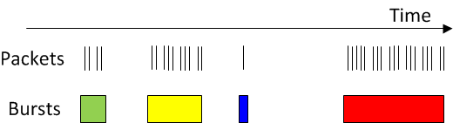
Burst Analysis
A burst consists of consecutive packets transferred
in a batch (i.e., their IAT is less than a threshold)
We are interested in short bursts that incur energy / radio resource inefficiencies
ARO finds the triggering factor of each short burst
    Triggered by user interaction?
    By server / network delay?
    By application delay?
    By TCP protocol?
Courtesy: Feng Qian et al.
Notes:
Add a picture to illustrate
(1) Separating the bursts
(2) burst analysis (begin/end)
(3) Why do we care

Slide 62
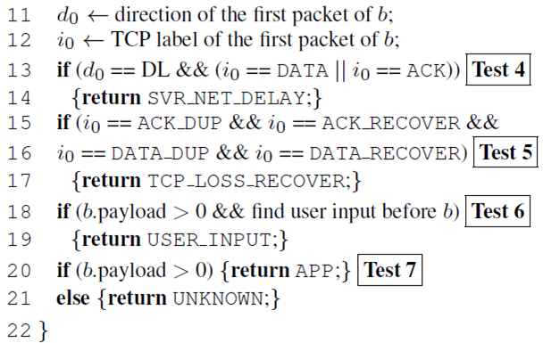
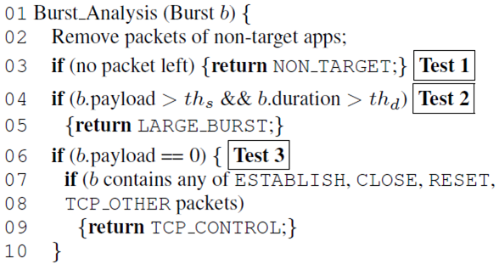
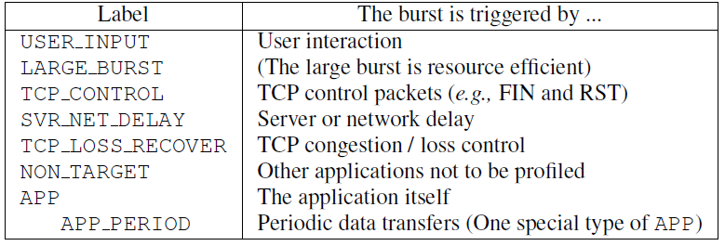
Burst Analysis Algorithm
Courtesy: Feng Qian et al.

Slide 63
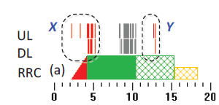
Compute Resource
Consumption of a Burst
Upperbound of resource utilization
  The resource impact of a burst B_{i} is from the beginning of B_{i} to the beginning of the next burst B_{i+1}
  May overestimate resource consumption, as one burst may already be covered by the tail of the previous burst
Resource Impact of Burst X
Resource Impact of Burst Y
Courtesy: Feng Qian et al.

Slide 64
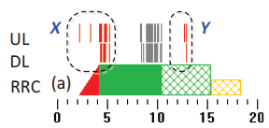
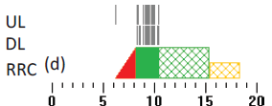
Compute Resource
Consumption of a Burst
Lowerbound of resource utilization
  Compute the total resource utilization of the original trace
  Remove the interested burst, then compute the resource utilization again
  Take the delta
The original trace
Resource Utilization is E₁
Remove X and Y
Resource utilization is E₂
The resource impact of X and Y is E₁-E₂
Courtesy: Feng Qian et al.

Slide 65
ARO System Architecture
Courtesy: Feng Qian et al.

Slide 66
Profiling Applications
From RRC Analysis
  We know the radio resource state and
  the radio power at any given time
From Burst analysis
  We know the triggering factor of each burst
  We know the transport-layer
  and application-layer behavior of each burst
By “profiling applications”, we mean
  Compute resource consumption of each burst
  Therefore identify the root cause of resource inefficiency.
Courtesy: Feng Qian et al.

Slide 67
Metrics for Quantifying Resource Utilization Efficiency
Handset radio energy consumption
DCH occupation time
  Quantifies radio resource utilization
Total state promotion time (IDLE→DCH, FACH→DCH)
  Quantifies signaling overhead
Details of computing the three metrics (upperbound and lowerbound) in the paper
Courtesy: Feng Qian et al.

Slide 68
Implementation
Data collector built on Android: modified tcpdump with two new features (1K lines of code)
  logging user inputs: reads /dev/input/event*
    captures all user input events such as touching the screen, pressing buttons
  ﬁnding packet-to-application association
    /proc/PID/fd containing mappings from process ID (PID) to inode of each TCP/UDP socket
    /proc/net/tcp(udp) maintaining socket to inode mappings,
    /proc/PID/cmdline that has the process name of each PID
The analyzers were implemented in C++ on Windows 7 (7.5K lines of code)

Slide 69
Case Studies
Fully implemented for Android platform (7K LoC)
Study 17 popular Android applications
  All in the “TOP Free” Section of Android Market
  Each has 250,000+ downloads as of Dec 2010
ARO pinpoints resource inefficiency for many popular applications. For example,
  Pandora Streaming
  High radio energy overhead (50%) of periodic measurements
  Fox News
  High radio energy overhead (15%) due to users’ scrolling
  Google Search
  High radio energy overhead (78%) due to real-time query suggestions
Courtesy: Feng Qian et al.
Notes:
Before case studies, put best practices slides – simple, but just follow them

Slide 70
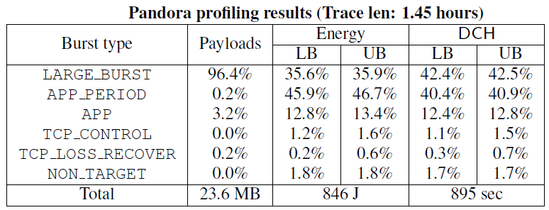
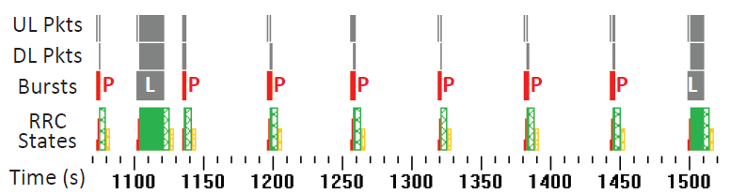
Case Study: Pandora Music
Problem: High resource overhead of periodic audience measurements (every 1 min)
Recommendation: Delay transfers and batch them with delay-sensitive transfers
Courtesy: Feng Qian et al.
Notes:
First explain the app
Problem – recommendation: make annimation

Slide 71
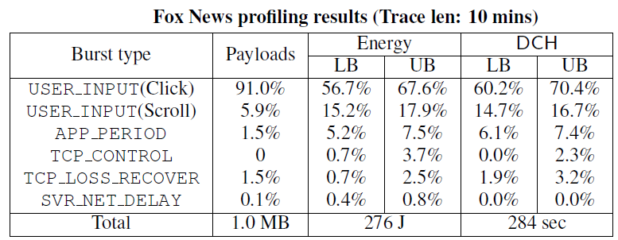
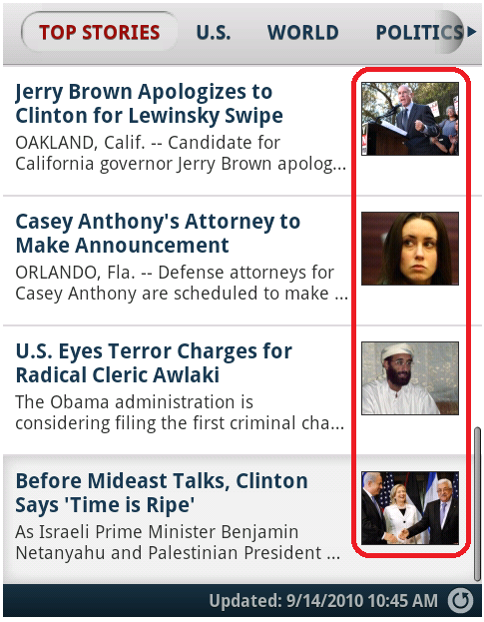
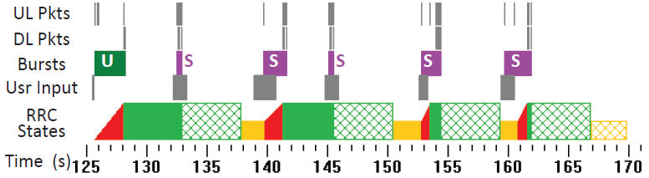
Case Study: Fox News
Problem: Scattered bursts due to scrolling
Recommendation: Group transfers of small thumbnail images in one burst
Courtesy: Feng Qian et al.
Notes:
UI appears at the beginning
Recommendation: group images…

Slide 72
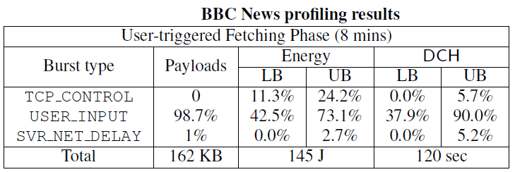
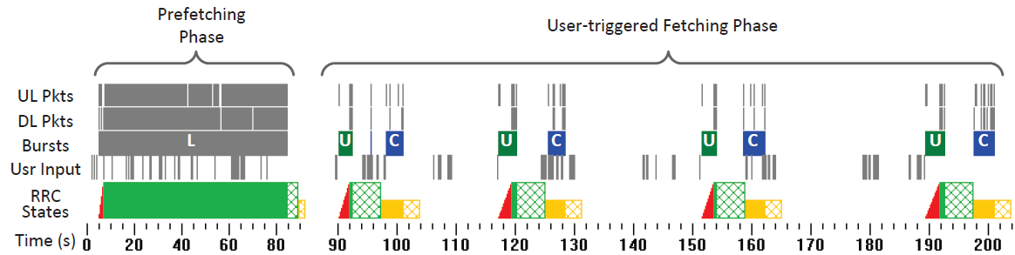
Case Study: BBC News
Problem: Scattered bursts of delayed FIN/RST packets
Recommendation: Close a connection immediately if possible, or within tail time
Scattered bursts of delayed
FIN/RST Packets
Courtesy: Feng Qian et al.

Slide 73
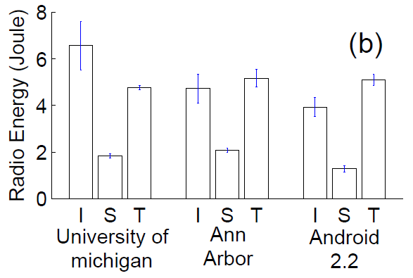
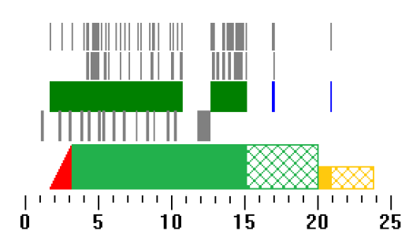
Case Study: Google Search
UL Packets
DL Packets
Bursts
Usr Input
RRC States
Search three key words.
ARO computes energy consumption for three phases
I: Input phase S: Search phase T: Tail Phase
Problem: High resource overhead of query suggestions and instant search
Recommendation: Balance between functionality and resource when battery is low
Courtesy: Feng Qian et al.

Slide 74
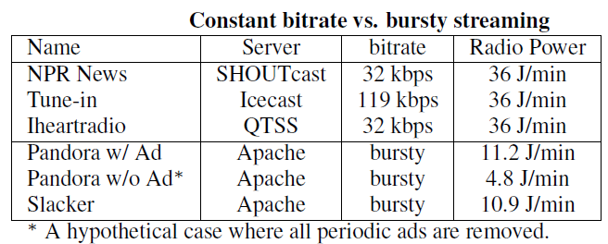
Case Study: Audio Streaming
Problem: Low DCH utilization due to constant-bitrate streaming
Recommendation: Buffer data and periodically stream data in one burst
Courtesy: Feng Qian et al.

Slide 75
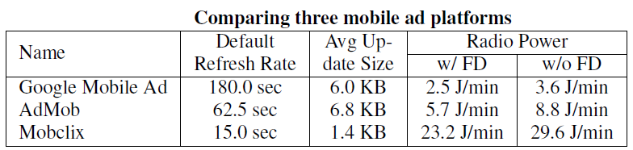
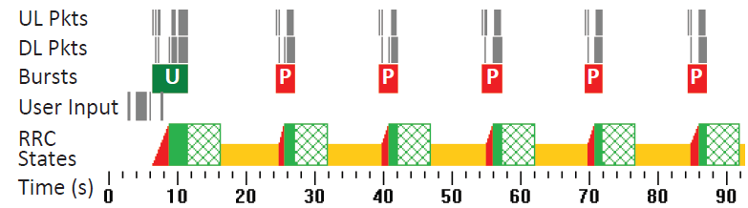
Case Study: Mobile Advertisements
Problem: Aggressive ad refresh rate making the handset persistently occupy FACH or DCH
Recommendation: Decrease the refresh rate, piggyback or batch ad updates
Courtesy: Feng Qian et al.

Slide 76
Outline
Introduction
RRC State Inference
Radio Resource Usage Profiling & Optimization
Network RRC Parameters Optimization
Conclusion

Slide 77
What-if Analysis for Inactivity Timers
Inactivity timers are the most crucial parameters affecting
  UE energy consumption
  State promotion overhead
  Radio resource utilization (i.e., DCH occupation time)
What is the impact of changing inactivity timers
  Perform what-if analysis by replaying traces to the simulator with different inactivity timer values.
Courtesy: Feng Qian et al.

Slide 78
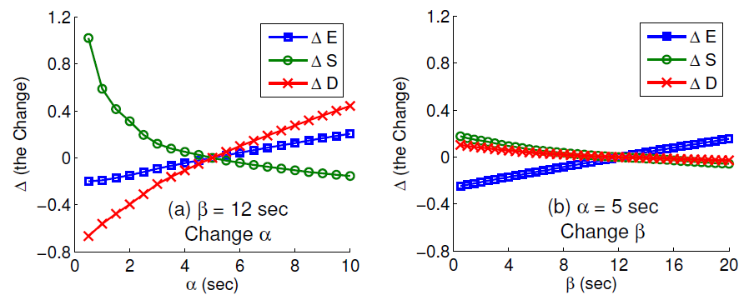
What-if Analysis for Inactivity Timers (Cont’d)
 | Relative Change of…
ΔE | Radio Energy
Δ S | Promotion Delay
Δ D | DCH Occupation Time
Fix the α (DCH→FACH) timer
Change the β(FACH→IDLE) timer
Fix the β(FACH→IDLE) timer
Change the α (DCH→FACH) timer
The α (DCH→FACH) timer imposes much higher impact on the
three metrics than the β(FACH→IDLE) timer does.
Very small α timer values (< 2 sec) cause significant increase of state
promotion overhead.
It is difficult to well balance the tradeoff. The fundamental reason
is that timers are globally and statically set to constant values.
Courtesy: Feng Qian et al.

Slide 79
Fast Dormancy
A new feature added in 3GPP Release 7
When finishing transferring the data, a handset sends a special RRC message to RAN
The RAN immediately releases the RRC connection and lets the handset go to IDLE
Fast Dormancy dramatically
reduces the tail time, saving
radio resources and battery life
Fast Dormancy has been supported
in some devices (e.g., Google Nexus
One) in application-agnostic manner
----- Without FD
----- With FD (Illustration)
Courtesy: Feng Qian et al.

Slide 80
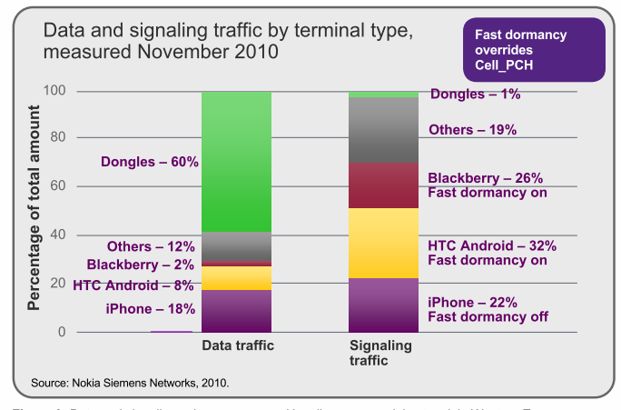
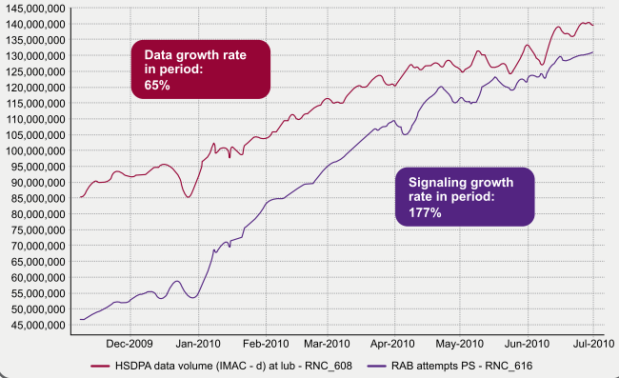
Fast Dormancy Woes
Disproportionate increase in signaling traffic caused due to increase in use of fast-dormancy
“Apple upset several operators last year when it implemented firmware 3.0 on the iPhone with a fast dormancy feature that prematurely requested a network release only to follow on with a request to connect back to the network or by a request to re-establish a connection with the network …”
What's really causing the capacity crunch? - FierceWireless
Courtesy: Vishnu Navda et al.

Slide 81
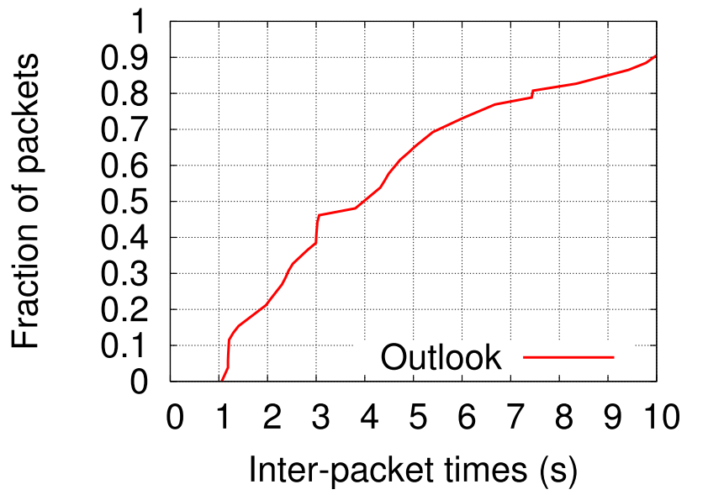
Problem #1: Chatty Background Apps
No distinctive knee
High mispredictions for fixed inactivity timer
Courtesy: Vishnu Navda et al.

Slide 82
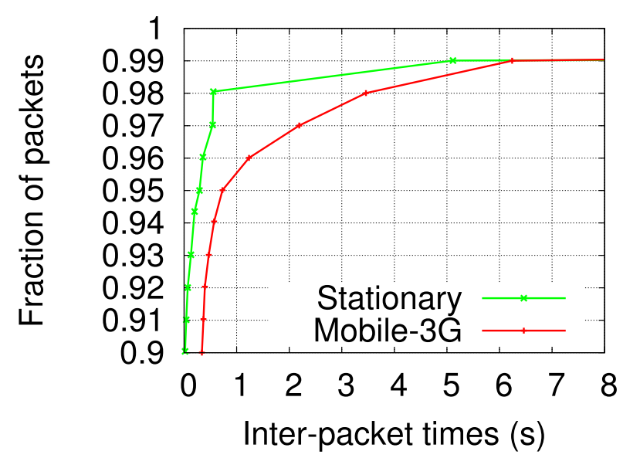
Problem #2: Varying Network Conditions
Signal quality variations and handoffs cause sudden latency spikes
Aggressive timers frequently misfire
Courtesy: Vishnu Navda et al.

Slide 83
Objectives
Design a fast-dormancy policy for long-standing background apps which
  Achieves energy savings
  Without increasing signaling overhead
  Without requiring app modifications
Courtesy: Vishnu Navda et al.
Notes:
Drawbacks of existing approaches:
Require app modification
Requires app writers to be aware of network behavior
Aggressive Inactivity timers cause increased signaling
Context:
No foreground apps (latency issue)

Slide 84
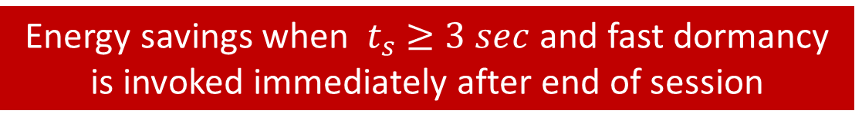

When to Invoke Fast Dormancy?
fast dormancy
Packets within session
End of session - EOS
$${ ≥t}_{s}$$
App
traffic
time
Energy
Profile
DCH
DCH
DCH
IDLE
Example 1
Example 2
Energy savings when ${ t}_{s} ≥3 sec$ and fast dormancy is invoked immediately after end of session
Courtesy: Vishnu Navda et al.

Slide 85

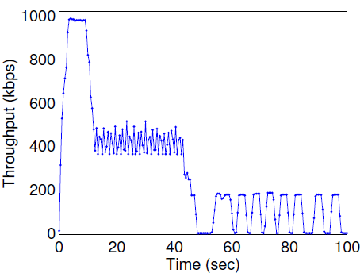
Use Fast Dormancy to Enhance Chunk Mode
Examle: YouTube
YouTube video streaming
  Collect a 10-min YouTube trace using Android G2 of Carrier 2.
  Traffic pattern
  First 10 sec: maximal bw is utilized
  Next 30 sec: constant bitrate of 400kbps
  Remaining: transmit intermittently with
  the inter-burst time between 3~5 s.
  Under-utilization of
  network bandwidth causes its
  long DCH occupation time.
    Energy/radio resource efficiency is
    much worse than Pandora
Courtesy: Feng Qian et al.

Slide 86
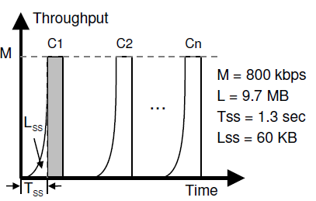
Use Fast Dormancy to Enhance Chunk Mode (Cont’d)
Proposed traffic pattern: Chunk Mode
  The video content is split into n chunks C₁, …, C_{n}
  Each transmitted at the highest bit rate.
  n should not be too small as users often do not watch the entire video
Para | Meaning
M | Maximal BW
L | Content size
T_{SS} | Slow start duration
L_{SS} | Bytes transferred in slow start
How to eliminate the Tail for each chunk?
Using Fast Dormancy
Courtesy: Feng Qian et al.

Slide 87
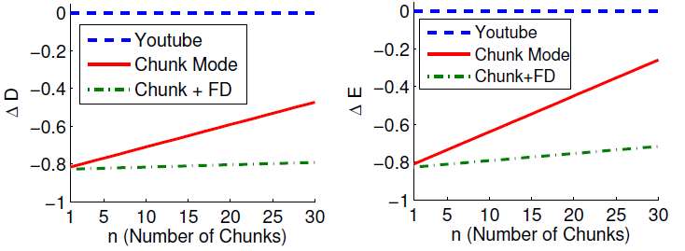
Use Fast Dormancy to Enhance Chunk Mode (Cont’d)
Invoke fast dormancy at the end of each chunk
  To immediately release radio resources (assuming no concurrent network activity exists)
  In general, however, aggressively invoking fast dormancy may increase the state promotion overhead
 | Relative Change of…
ΔE | Radio Energy
Δ D | DCH Occupation Time
Chunk Mode: Save 80% of DCH occupation time and radio energy for YouTube
Fast Dormancy: Keep ΔD and ΔE almost constant regardless of # of chunks.
Courtesy: Feng Qian et al.

Slide 88


Problem: predict end of session (or onset of network inactivity)
Idea: exploit unique application characteristics
(if any) at end of sessions
Typical operations performed:
  UI element update
  Memory allocation or cleanup
  Processing received data
System calls invoked by an app can provide insights into the operations being performed

Slide 89
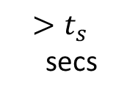



Predicting onset of network inactivity
Technique: Supervised learning using C5.0 decision trees
Data item: system calls observed immediately after a packet
(encoded as bit-vector)
Label: ACTIVE or EOS
ACTIVE
data-item
EOS
data-item
EOS
data-item
$${ t}_{w}$$
WaitForSingleObjectEx( )
DispatchMessageW( )
ReleaseMutex( )
CloseHandle( )
FreeLibrary( )
…( )
…( )
…( )
CloseHandle( )
FreeLibrary( )
…( )
…( )
…( )
System call
trace
Network traffic
secs
Time
P1
P2
P3
Packets in
Session 1
packet in session 2
Courtesy: Vishnu Navda et al.
Notes:
Input to the learning algorithm – a set of labeled data items
Function Call Attributes – Name, return value, action and depth
Packet Attributes – TCP flags, protocol, direction, hash(TCP payload)

Slide 90
Decision tree example
Application: gnotify
DispatchMessage
0
1
ACTIVE
send
0
1
EOS
ACTIVE
Rules:
(DispatchMessage & ! send) => EOS
! DispathcMessage => ACTIVE
(DispatchMessage & send) => ACTIVE
Courtesy: Vishnu Navda et al.

Slide 91
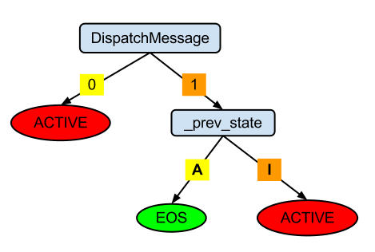

RadioJockey System
Offline learning
App 1 Rules
App k Rules
System Calls
+
Network Traffic
Training
using C5.0
traces
Runtime Engine
App System Calls
+
Packet timestamps
Tree-matching
(run-time)
Fast Dormancy
Cellular Radio Interface
Courtesy: Vishnu Navda et al.
Notes:
Function Call Attributes – Name, return value, action and depth
Packet Attributes – TCP flags, protocol, direction, hash(TCP payload)

Slide 92
Evaluation
Trace driven simulations on traces from 14 applications (Windows and Android platform) on 3G network
  Feature set evaluation for training
  variable workloads and network characteristics
  20-40% energy savings and 1-4% increase in signaling over 3 sec idle timer
Runtime evaluation on 3 concurrent background applications on Windows

Slide 93
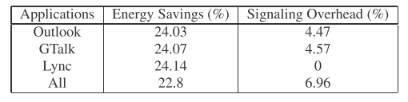
Runtime Evaluation with Concurrent Background Applications
22-24% energy savings at a cost of 4-7 % signaling overhead
Marginal increase in signaling due to variance in packet timestamps
Notes:
Vishnu Navda

Slide 94
Conclusion
ARO helps developers design cellular-friendly smartphone applications by providing visibility of radio resource and energy utilization.
Cellular friendly techniques (http://developer.att.com/home/develop/referencesandtutorials/networkapibestpractices/Top_Radio_Resource_Issues_in_Mobile_Application_Development.pdf)
  Group multiple simultaneous connections from the same server
  Batching and piggybacking
  Close unnecessary TCP connections early
  Offloading to WiFi when possible (ms setup rather than 2sec)
  Caching and avoid duplicate content
  Prefetching intelligently
  Access peripherals judicially
Try out the ARO tool at:
  http://developer.att.com/developer/forward.jsp?passedItemId=9700312
ARO is now open source!
  https://github.com/attdevsupport/ARO

Slide 95
Questions?

