Slide 1
Cellular Networks and Mobile Computing
COMS 6998-10, Spring 2013
Instructor: Li Erran Li (lierranli@cs.columbia.edu)
http://www.cs.columbia.edu/~lierranli/coms6998-10Spring2013/
2/19/2013: Smart phone virtualization and storage

Slide 2
Clarification on wakelock
Not mutual-exclusion lock!
Non-reference counted (similar to conditional variable)
  acquire() wakes up the component
  release() sets component free to sleep irrespective of number of acquire()
Reference counted (similar to semaphore)
  acquire() increments internal counter
  release() decrements the counter
  Component can sleep if internal counter reaches zer0

Slide 3
Review of Previous Lecture
What are the categories of ebugs?

Slide 4
Ebug Taxonomy
23%
Hardware
OS
35%
Software
No Sleep Bug
Apps
Ebug
Loop Bug
Immortality Bug
External Service
12%
External
Network Signal Strength
30%
Wireless Handovers
Unknown
Courtesy: Pathak et al

Slide 5
Review of Previous Lecture (Cont’d)
What are the types of no-sleep ebugs?
How to detect no-sleep ebugs?

Slide 6
Types of NoSleep Bugs and Detection
NoSleep Code Paths
Static Data Flow Analysis
Reaching Definitions Data Flow Problem
NoSleep Race Conditions
NoSleep Dilations
Courtesy: Jindal et al

Slide 7
Review of Previous Lecture (Cont’d)
How to build fine-grained power models?

Slide 8
Finite-State-Machine (FSM) as Power Model Representation
Use Finite-State-Machine (FSM)
Nodes: Power states
  Base State: No activity on phone
  Productive state: Actual utilization
  Tail state: No-useful work
Edges: Transition rules
  System calls (start/completion)
  Workload (Ex: 50 pkts/sec)
  Timeout
State 1
Transitions
State 2
State 3
Courtesy: Pathak et al

Slide 9
FSM Power Model Construction
Systematic ‘Brute Force’ Approach
  Step 1 : Model Single System Call
  Step 2 : Model Multiple System Calls for Same Component
  Step 3 : Model Multiple Components (Entire Phone)
Requires domain knowledge
  Semantics of system calls
Courtesy: Pathak et al

Slide 10
Review of Previous Lecture (Cont’d)
How to build an energy profiling tool such as Eprof?

Slide 11

Energy Profiling
Tracking power activities
  System call based online power model
Tracking app activities
  IO: Backtrace system calls
  CPU: Just like gprof [PLDI ‘82]
Mapping power activities to app activities
  Accounting Policy: Lingering Energy Consumption
Courtesy: Pathak et al

Slide 12
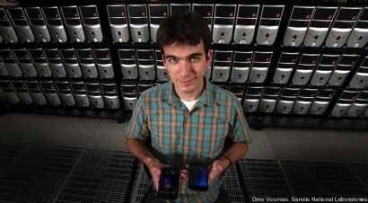
Smart Phone Virtualization: on Servers/PCs
Bluestacks (Demo)
MegaDroid
Off-the-shelf PCs emulates a town of 300,000 Android phones
  Emulate cellular and GPS behavior
Usage:
  Tracing the wider effects of natural disasters
  Hacking attempts
  Software bugs
  Assist real phone (e.g. offload computation, virus check)
Video: http://www.engadget.com/2012/10/03/sandia-labs-megadroid-project-simulates-300-000-android-phones/

Slide 13
Smart Phone Virtualization: on Devices
Cells video: http://www.youtube.com/watch?v=i_F92AS9a6s

Slide 14
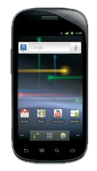
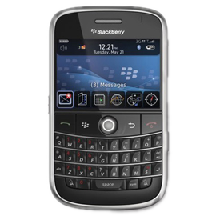
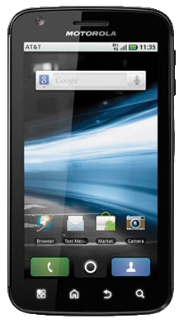
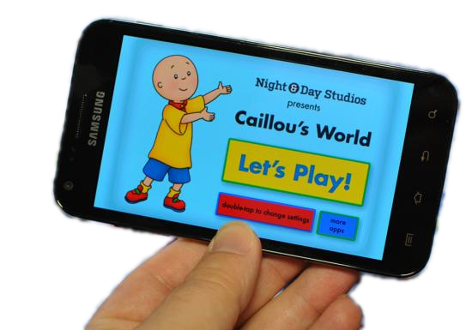
Personal Phone
Business Phone
Developer Phone
Children’s Phone
Courtesy: Jason Nieh et al.

Slide 15
Virtualization
Courtesy: Jason Nieh et al.

Slide 16
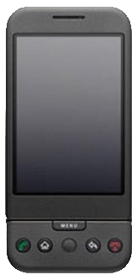
Server Virtualization
Bare-Metal Hypervisor
poor device support / sharing
OS
Kernel
OS
Kernel
OS
Kernel
Hypervisor / VMM
Hardware
Courtesy: Jason Nieh et al.

Slide 17
Desktop Virtualization
Hosted Hypervisor
poor device
performance
host user space
OS
OS
OS
Hypervisor / VMM
kernel
module
emulated
devices
Host OS Kernel
Hardware
Courtesy: Jason Nieh et al.

Slide 18


Non-Virtualization
User Space SDK
no standard apps
less secure
custom user space API for isolated apps
OS Kernel
Hardware
Courtesy: Jason Nieh et al.

Slide 19
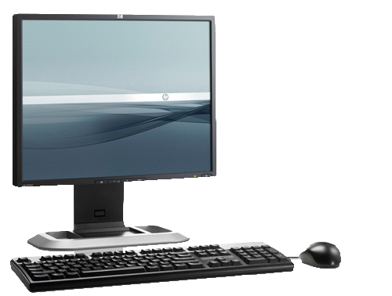
Key Challenges
device diversity
mobile usage model
graphics-accelerated UI
microphone
headset
Power
Touchscreen
Buttons
GPS
Cell Radio
WiFi
GPU
Framebuffer
h.264 accel.
pmem
Binder IPC
Compass
camera(s)
speakers
Accelerometer
RTC / Alarms
Courtesy: Jason Nieh et al.

Slide 20
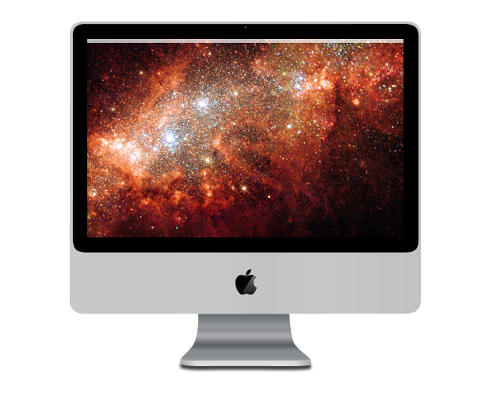
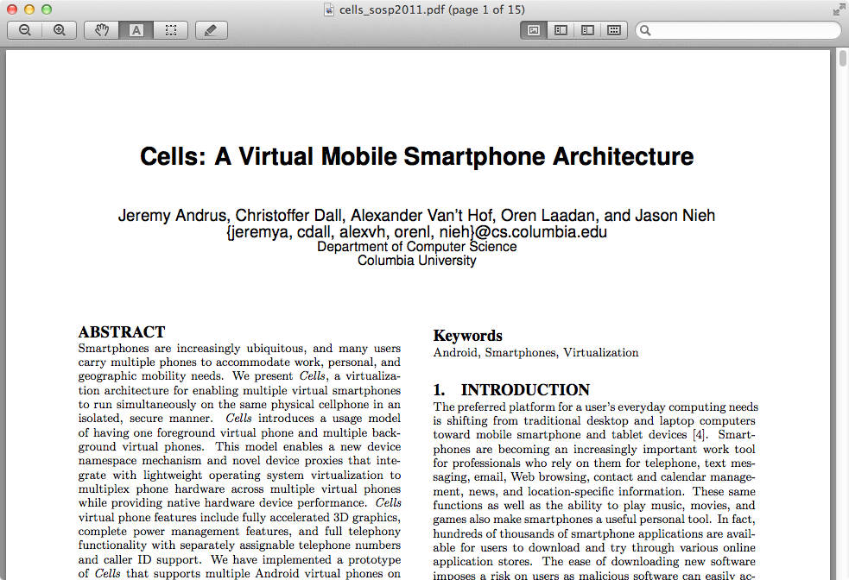
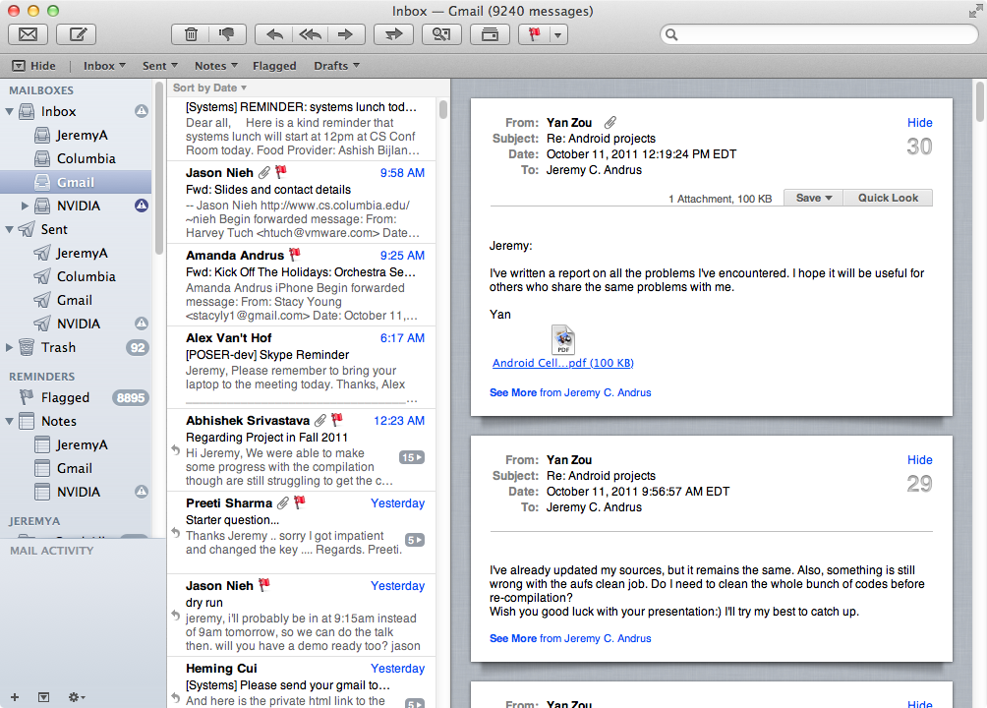
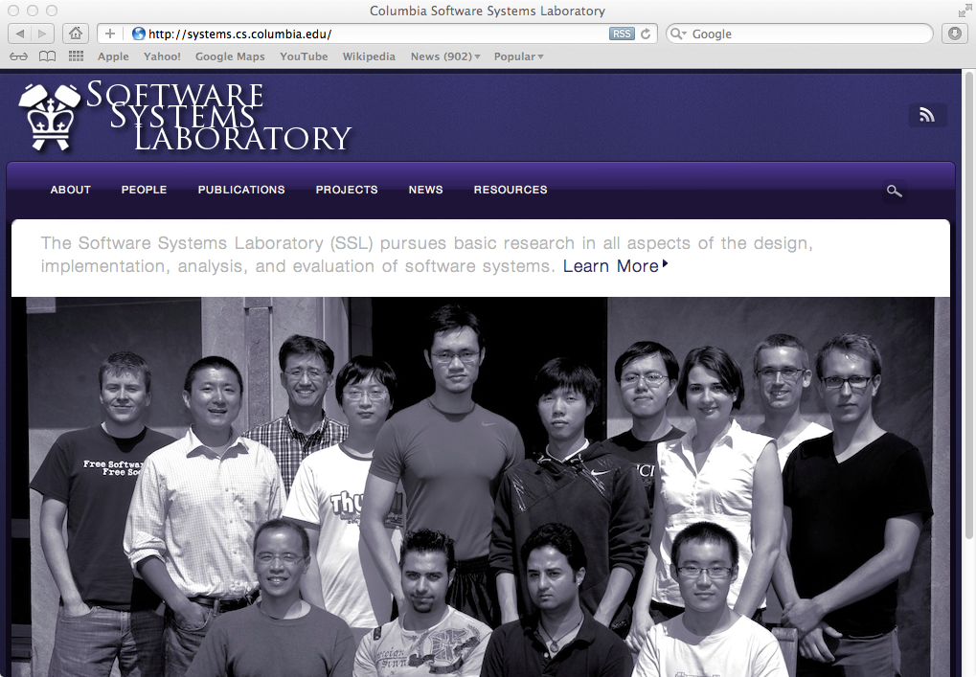

microphone
Cells
Key Observation
small:
one app at a time
large: lots of windows/apps
Courtesy: Jason Nieh et al.

Slide 21
microphone
Cells
Key Observation
screen real-estate is limited, and mobile phone users are accustomed to interacting with one thing at time
Courtesy: Jason Nieh et al.

Slide 22
microphone
Cells
Usage Model
foreground
/ background
Courtesy: Jason Nieh et al.

Slide 23
microphone
Cells
Complete Virtualization
multiple, isolated virtual phones (VPs)
on a single mobile device
100% device support in each VP
unique phone numbers - single SIM!
accelerated 3D graphics!
Courtesy: Jason Nieh et al.

Slide 24
microphone
Cells
Efficient Virtualization
less than 2% overhead in runtime tests
imperceptible switch time among VPs
Courtesy: Jason Nieh et al.

Slide 25

Single Kernel: Multiple VPs
VP 1
VP 2
VP 3
isolated collection
of processes
•••
virtualize at OS interface
Linux
Kernel
Courtesy: Jason Nieh et al.

Slide 26
Single Kernel: Device Support
VP 1
VP 2
VP 3
Power
Touchscreen
microphone
headset
•••
WiFi
Buttons
GPS
Cell Radio
hw codec
pmem
GPU
Framebuffer
camera(s)
speakers
Binder IPC
Compass
Accelerometer
RTC / Alarms
Linux
Kernel
Courtesy: Jason Nieh et al.

Slide 27
Single Kernel: Device Support
VP 1
VP 2
VP 3
all VPs access the same device simultaneously
•••
Linux
Kernel
Input
GPU
Sensors
Android...
Power
Audio/Video
WiFi
Framebuffer
RTC / Alarms
Cell Radio
•••
Courtesy: Jason Nieh et al.

Slide 28
Device Namespaces
VP 1
VP 2
VP 3
safely, correctly multiplex access to devices
•••
Linux
Kernel
device namespaces
GPU
Power
Input
Sensors
Android...
Audio/Video
WiFi
Framebuffer
RTC / Alarms
Cell Radio
•••
Courtesy: Jason Nieh et al.

Slide 29
Cells
device namespaces
+
foreground
/ background
=
Complete, Efficient, Transparent
Mobile Virtualization
Courtesy: Jason Nieh et al.

Slide 30
efficient basic graphics virtualization
hardware accelerated graphics
proprietary/closed interface
Linux
Kernel
device namespaces
GPU
Power
Input
Sensors
Android...
Audio/Video
WiFi
Framebuffer
RTC / Alarms
Cell Radio
Cell Radio
GPU
•••
Framebuffer
Courtesy: Jason Nieh et al.

Slide 31
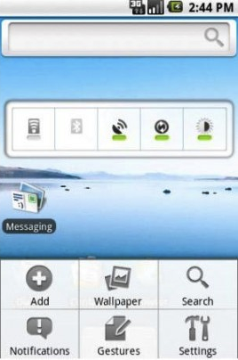
Approach 1: Single Assignment
virtual addresses
physical addresses
screen memory
Framebuffer
Courtesy: Jason Nieh et al.

Slide 32


Approach 2: Emulated Hardware
emulated framebuffer
screen memory
virtual state
Framebuffer
Courtesy: Jason Nieh et al.

Slide 33
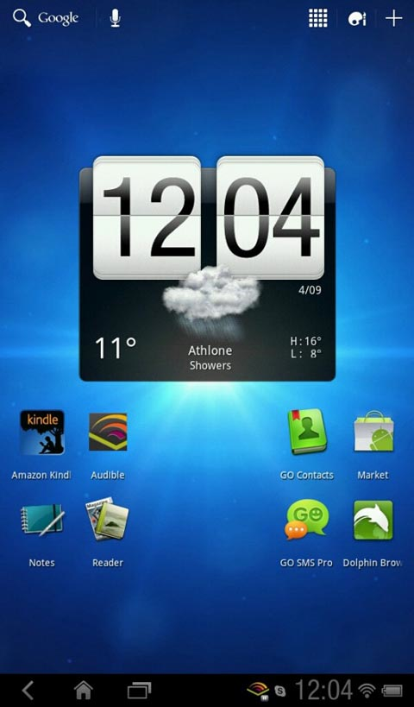
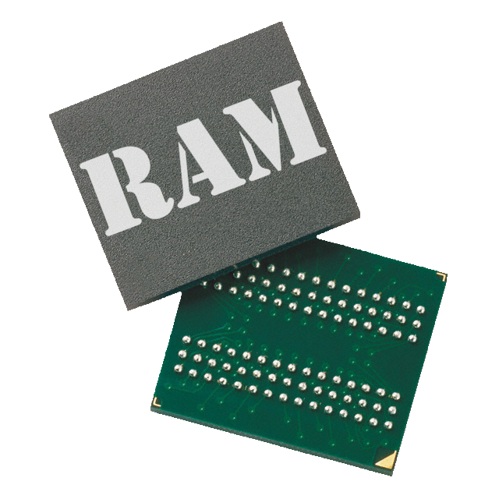

Cells: Device Namespaces
VP 1
VP 2
VP 3
mux_fb presents
identical device
interface to all VPs
using device namespaces
foreground
background
background
swap virt addr mappings:
point to different phys addr
virtual addresses
mux_fb
physical addresses
screen memory
Framebuffer
Courtesy: Jason Nieh et al.

Slide 34
Accelerated Graphics
VP 1
VP 2
VP 3
VP: just a set
of processes!
OpenGL
OpenGL
OpenGL
context
context
context
screen memory
process isolation
Framebuffer
MMU
graphics virtual addresses
physical addresses
GPU
Courtesy: Jason Nieh et al.

Slide 35
Device Namespace + Graphics Context
VP 1
VP 2
VP 3
foreground
background
background
OpenGL
OpenGL
OpenGL
context
context
context
screen memory
graphics virtual addresses
MMU
GPU
physical addresses
Courtesy: Jason Nieh et al.

Slide 36
VoIP?
RilD
Vendor RIL
VoIP
VoIP
Drivers
Linux
Kernel
Baseband: GSM / CDMA
Courtesy: Jason Nieh et al.

Slide 37
Dual-SIM?
RilD
RilD
Vendor RIL
Vendor RIL
Drivers
Drivers
Linux
Kernel
GSM/CDMA
GSM / CDMA
Courtesy: Jason Nieh et al.

Slide 38
Cells: User-Level Namespace Proxy
VP 1
VP 2
VP 3
foreground
background
background
RilD
RilD
RilD
vendor API
proprietary hardware/software requires a well-defined interface.
Vendor RIL
Cells RIL
Cells RIL
Cells RIL
CellD
Drivers
Linux
Kernel
Root Namespace
Baseband: GSM / CDMA
Courtesy: Jason Nieh et al.

Slide 39
Experimental Results
Setup
Nexus S
five virtual phones
overhead vs. stock 〈Android 2.3〉
Courtesy: Jason Nieh et al.

Slide 40
Experimental Results
Setup
CPU 〈Linpack〉
graphics 〈Neocore〉
storage 〈Quadrant〉
web browsing 〈Sun Spider〉
networking 〈Custom WiFi Test〉
Courtesy: Jason Nieh et al.

Slide 41
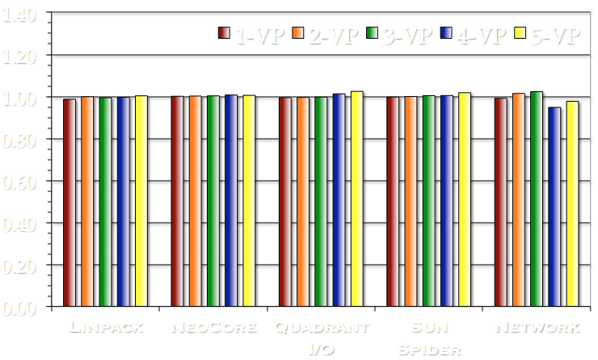
Experimental Results
Runtime Overhead
Negligible Overhead In 3D Measurements!
Courtesy: Jason Nieh et al.

Slide 42
Cells
Complete, Efficient, Transparent
Mobile Virtualization
device namespaces
safely and efficiently share devices
foreground / background
designed specifically for mobile devices
implemented on Android
less than 2% overhead on Nexus S
Courtesy: Jason Nieh et al.

Slide 43



More Info
cells.cs.columbia.edu
cellrox.com
Courtesy: Jason Nieh et al.

Slide 44


Revisiting Storage for Smartphones
Hyojun Kim
Nitin Agrawal
Cristian Ungureanu

Slide 45
Background
blktrace: collect block level traces for device I/O
monkeyrunner
  installed at android-sdk-macosx/tools/monkeyrunner
  functional testing framework for Interactive Android applications

Slide 46
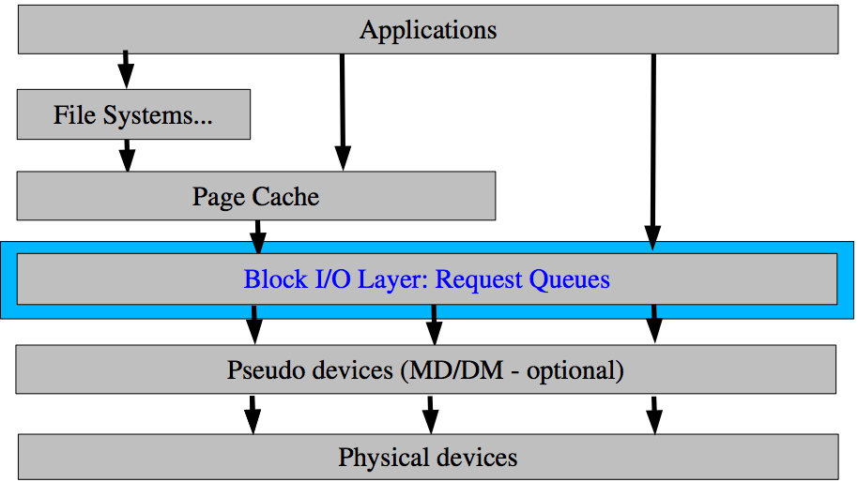
blktrace
Block IO layer

Slide 47
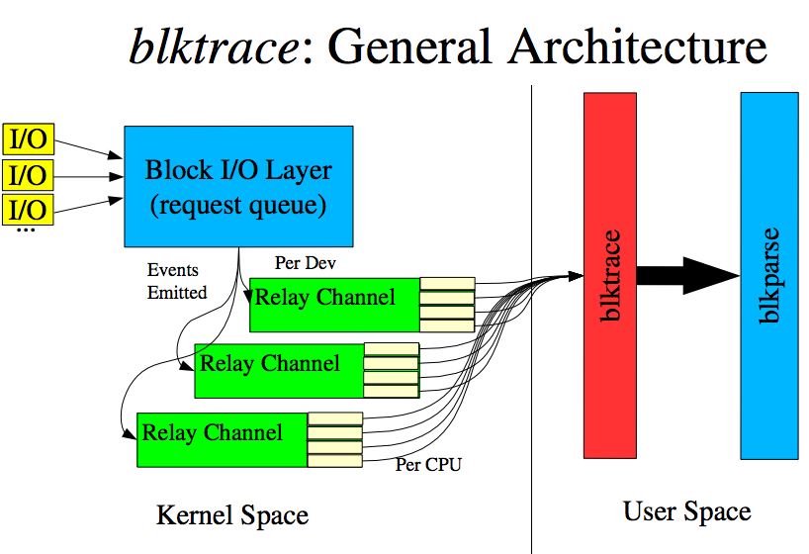
blktrace (Cont’d)
Source: Alan D. Brunell
http://www.gelato.org/pdf/apr2006/gelato_ICE06apr_blktrace_brunelle_hp.pdf

Slide 48
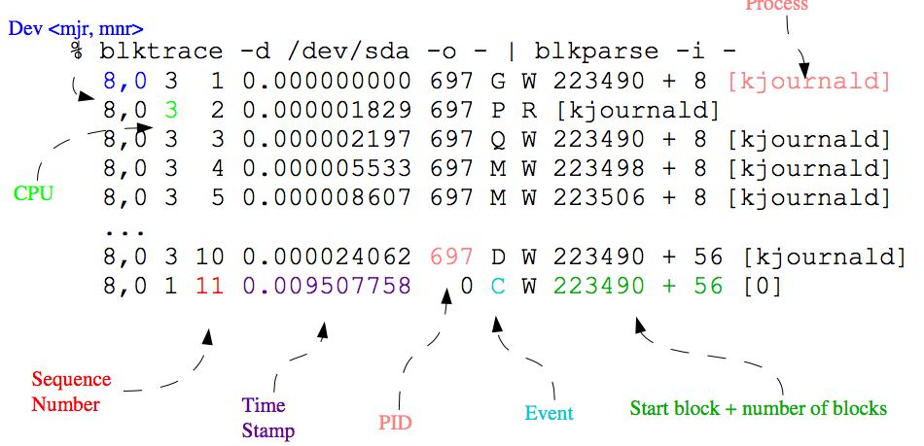
blktrace (Cont’d)
blktrace sample traces
Source: Alan D. Brunell
http://www.gelato.org/pdf/apr2006/gelato_ICE06apr_blktrace_brunelle_hp.pdf

Slide 49
monkeyrunner
Example code
# Imports the monkeyrunner modules used by this program
from com.android.monkeyrunner import MonkeyRunner, MonkeyDevice
def main():
# Connects to the current device, returning a MonkeyDevice object
device = MonkeyRunner.waitForConnection()
print 'waiting for connection...\n’
package = 'coms6998.cs.columbia.edu’
activity = 'coms6998.cs.columbia.edu.VoiceRegonitionDemoActivity'
# sets the name of the component to start
runComponent = package + '/' + activity
# Runs the component
device.startActivity(component=runComponent)
# Presses the speaker button
device.press(’DPAD_DOWN', MonkeyDevice.DOWN_AND_UP)
  device.press(’DPAD_CENTER', MonkeyDevice.DOWN_AND_UP)
# Takes a screenshot
screenshot = device.takeSnapshot()
# Writes the screenshot to a file
screenshot.writeToFile('./device1.png','png')
reference = MonkeyRunner.loadImageFromFile(./device.png')
if not screenshot.sameAs('./device.png', 0.9):
print "comparison failed!\n"
if __name__ == '__main__':
main()

Slide 50
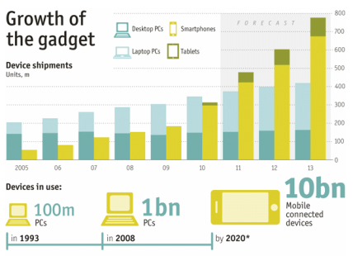
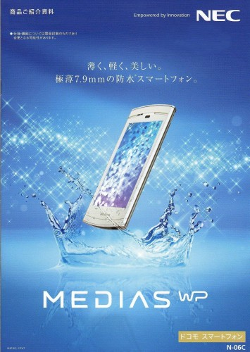
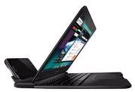
Life in the “Post-PC” Mobile Era
Mobile
Smartphone and tablet markets are huge & growing
  100 Million smartphones shipped in Q4 2010, 92 M PCs [IDC]
  Out of 750 Million Facebook users, 250 Million (& growing) access through mobile; mobile users twice as active [FB]
Innovation in mobile hardware: packing everything you need in your pocket
  Blurring the phone/tablet divide: Samsung Galaxy Note
  Hardware add-ons: NEC Medias (6.7mm thick, waterproof shell, TV tuner, NFC, HD camera, ..)
Manufacturers making it easier to replace PCs
  Motorola Atrix dock converts a phone into laptop
PC
Courtesy: Nitin Agrawal et al.

Slide 51






















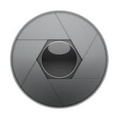






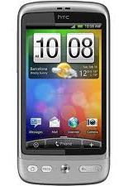
























Courtesy: Nitin Agrawal et al.

Slide 52

Courtesy: Nitin Agrawal et al.

Slide 53
Waiting is undesirable!
Annoying for the user
More so for interactive
mobile users
More time, more battery
Easy to lose customers
Aren’t network and CPU the real problem?
Why are we talking about storage?
Courtesy: Nitin Agrawal et al.

Slide 54
Understanding Mobile Performance
Well understood!
Network performance can impact user experience
  3G often considered the bottleneck for apps like browsing
  Service providers heavily investing in 4G and beyond
CPU and graphics performance crucial as well
  Plenty of gaming, video, flash-player apps hungry for compute
  Quad-core CPUs, GPUs to appear on mobile devices
Does storage performance impact mobile experience?
  For storage, vendors & consumers mostly refer to capacity
Not well understood!
Courtesy: Nitin Agrawal et al.

Slide 55
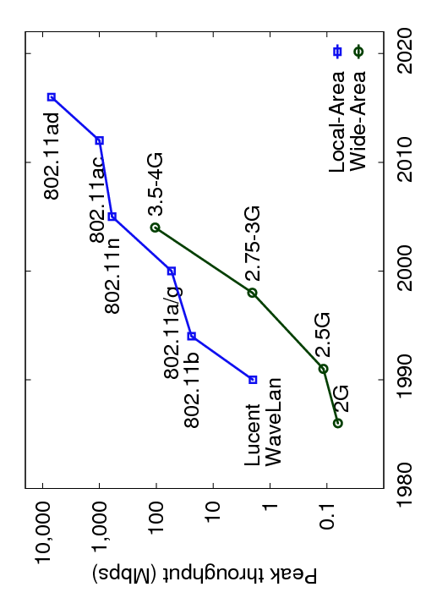

Wireless Network Throughput Progression
Standard (theoretical)
Measured in Lab
Mobile Flash
802.11 a/g
3G
Flash storage on mobile performs better than wireless networks
Most apps are interactive; as long as performance exceeds that of the network, difficult for storage to be bottleneck
Courtesy: Nitin Agrawal et al.

Slide 56
Outline
Introduction
Why storage is a problem
Android storage background and setup
Experimental results
Solutions
Courtesy: Nitin Agrawal et al.

Slide 57
Why Storage is a Problem
Random versus Sequential Disparity
Vendor (16GB) | Speed Class | Cost US $ | Seq Write | Rand Write
Transcend | 2 | 26 | 4.2 | 1.18
RiData | 2 | 27 | 7.9 | 0.02
Sandisk | 4 | 23 | 5.5 | 0.70
Kingston | 4 | 25 | 4.9 | 0.01
Wintec | 6 | 25 | 15.0 | 0.01
A-Data | 6 | 30 | 10.8 | 0.01
Patriot | 10 | 29 | 10.5 | 0.01
PNY | 10 | 29 | 15.3 | 0.01
Performance for random I/O significantly worse than seq; inherent with flash storage
Mobile flash storage classified into speed classes based on sequential throughput
  Random write performance is orders of magnitude worse
Performance MB/s
Consumer-grade SD performance
However, we find that for several popular apps, substantial
fraction of I/O is random writes (including web browsing!)
Courtesy: Nitin Agrawal et al.

Slide 58
Why Storage is a Problem
Shifting Performance Bottlenecks
Standard (theoretical)
Measured in Lab
Mobile Flash Seq
802.11 A/G
3G
Mobile Flash Rand
Storage coming under increasingly more scrutiny in mobile usage
  Random I/O performance has not kept pace with network improvements
  802.11n (600 Mbps peak) and 802.11ad (7 Gbps peak) offer potential for significantly faster network connectivity to mobile devices in the future
Courtesy: Nitin Agrawal et al.

Slide 59
Deconstructing Mobile App Performance
Focus: understanding contribution of storage
  How does storage subsystem impact performance of popular and common applications on mobile devices?
  Performed analysis on Android for several popular apps
Several interesting observations through measurements
  Storage adversely affects performance of even interactive apps, including ones not thought of as storage I/O intensive
  SD Speed Class not necessarily indicative of app performance
  Higher total CPU consumption for same activity when using slower storage; points to potential problems with OS or apps
Improving storage stack to improve mobile experience
Courtesy: Nitin Agrawal et al.

Slide 60
Outline
Introduction
Why storage is a problem
Android storage background and setup
Experimental results
Solutions
Courtesy: Nitin Agrawal et al.

Slide 61
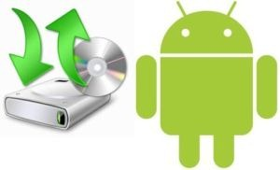










Storage Partitions on Android
/misc
/recovery
/boot
/system
/cache
/data
/sdcard
896KB
settings
rootfs
4MB
alternate boot
rootfs
3.5MB
kernel
yaffs2
145MB
read-only
yaffs2
95MB
read write
yaffs2
196.3MB
read write
FAT32
16GB
read write
Internal NAND Flash Memory (512MB)
External SD
Partition | Function
Misc | H/W settings, persistent shared space between OS & bootloader
Recovery | Alternative boot-into-recovery partition for advanced recovery
Boot | Enables the phone to boot, includes the bootloader and kernel
System | Contains the remaining OS, pre-installed system apps ; read-only
Cache | Used to stage and apply “over the air” updates; holds system images
Data | Stores user data (e.g., contacts, messages, settings) and installed apps; SQLite DB containing app data also stored here. Wiped on factory reset
Sdcard | External SD card partition to store media, documents, backup files etc
Sd-ext | Non-standard partition on SD card that can act as data partition
Courtesy: Nitin Agrawal et al.

Slide 62
Phone and Generic Experimental Setup
Rooted and set up a Google Nexus One phone for development
  GSM phone with a 1 GHz Qualcomm QSD8250 Snapdragon processor
  512 MB RAM, and 512 MB internal flash storage
Setup dedicated wireless access point
  802.11 b/g on a laptop for WiFi experiments
Installed AOSP (Android Open Source Project)
  Linux kernel 2.6.35.7 modified to provide resource usage information
Courtesy: Nitin Agrawal et al.

Slide 63
Custom Experimental Setup
Requirements beyond stock Android
Ability to compare app performance on different storage devices
  Several apps heavily use the internal non-removable storage
  To observe and measure all I/O activity, we modified Android’s init process to mount all internal partitions on SD card
  Measurement study over the internal flash memory and 8 external SD cards, chosen 2 each from the different SD speed classes
Observe effects of shifting bottlenecks w/ faster wireless networks
  But, faster wireless networks not available on the phones of today
  Reverse Tethering to emulate faster networks: lets the smartphone access the host computer’s internet connection through a wired link (miniUSB cable)
Instrumentation to measure CPU, storage, memory, n/w utilization
Setup not typical but allows running what-if scenarios with storage devices and networks of different performance characteristics
Courtesy: Nitin Agrawal et al.

Slide 64






Apps and Experiments Performed
WebBench Browser
Visits 50 websites
Based on WebKit
Using HTTP proxy server
App Install
Top 10 apps on Market
App Launch
Games, Weather, YouTube
GasBuddy, Gmail, Twitter,
Books, Gallery, IMDB
RLBench SQLite
Synthetic SQL benchmark
Facebook
Android Email
Google Maps
Pulse News Reader
Background
Apps: Twitter, Books, Gmail
Contacts, Picasa, Calendar
Widgets: Pulse, YouTube,
News, Weather, Calendar,
Facebook, Market, Twitter
Courtesy: Nitin Agrawal et al.

Slide 65
Outline
Introduction
Why storage is a problem
Android storage background and setup
Experimental results (talk focuses on runtime of apps)
  Paper has results on I/O activity, CPU, App Launch behavior, etc
Solutions
Courtesy: Nitin Agrawal et al.

Slide 66
WebBench Results: Runtime
WiFi
Time (s)
USB
Time taken for iPerf to download 100MB
Runtime on WiFi varies by 2000% between internal and Kingston
Even with repeated experiments, with new cards across speed classes
Even without considering Kingston, significant performance variation (~200%)
Storage significantly affects app performance and consequently user experience
With a faster network (USB in RT), variance was 222% (without Kingston)
With 10X increase in N/W speed, hardly any difference in runtime
Courtesy: Nitin Agrawal et al.

Slide 67
WebBench Results: Runtime
WiFi
Time (s)
USB
Time taken for iPerf to download 100MB
Runtime on WiFi varies by 2000% between internal and Kingston
Even with repeated experiments, with new cards across speed classes
Even without considering Kingston, significant performance variation (~200%)
Storage significantly affects app performance and consequently user experience
With a faster network (USB in RT), variance was 222% (without Kingston)
With 10X increase in N/W speed, hardly any difference in runtime
Courtesy: Nitin Agrawal et al.

Slide 68
Runtimes for Popular Apps (without Kingston)
We find a similar trend for several popular apps
Storage device performance important, better card → faster apps
Apart from the benefits provided by selecting a good flash device, are there additional opportunities for improvement in storage?
Courtesy: Nitin Agrawal et al.

Slide 69
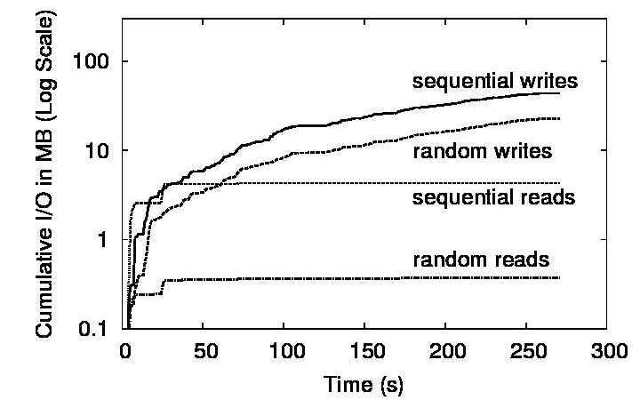
WebBench: Sequential versus Random I/O
I/O Breakdown
Vendor | Seq:Rand perf ratio | Rand IOPS
Transcend | 4 | 302
Sandisk | 8 | 179
RiData | 395 | 5
Kingston | 490 | 2.6
Wintec | 1500 | 2.6
A-Data | 1080 | 2.6
Patriot | 1050 | 2.6
PNY | 1530 | 2.6
Few reads, mostly at the start; significantly more writes
About 2X more sequential writes than random writes
Since rand is worse than seq by >> 2X, random dominates
Apps write enough randomly to cause severe performance drop
Paper has a table on I/O activity for other apps
Courtesy: Nitin Agrawal et al.

Slide 70
How Apps Use Storage?
Exactly what makes web browsing slow on Android?
  Key lies in understanding how apps use SQLite and FS interface
/data/data/com.necla.webview
WebBench Storage Schema
lib (empty)
cache
These files written to FS in write-behind
webviewCache
6aaa3f00, 03051d8d, …
many files (5.5MB)
databases
These files written to SQLite in sync
webview.db (14KB)
webviewCache.db (129KB)
Apps typically store some data in FS (e.g., cache files) and some in a SQLite database (e.g., cache map)
  All data through SQLite is written synchronously → slow!
  Apps often use SQLite oblivious to performance effects
Courtesy: Nitin Agrawal et al.

Slide 71
What-If Analysis for Solutions
A. Web Cache in RAM
B. DB (SQLite) in RAM
C. All in RAM
D. All on SD w/ no-sync
What is the potential for improvements?
  E.g., if all data could be kept in RAM?
  Analysis to answer hypothetical questions
Placing Cache on Ramdisk does not improve perf. much
WebBench on RiData
DB on Ramdisk alone improves perf. significantly
Both Cache and DB on SD without sync recoups most perf
Both Cache and DB in RAM → no extra benefit
A
B
C
D
Courtesy: Nitin Agrawal et al.

Slide 72
Implications of Experimental Analysis
Storage stack affects mobile application performance
  Depends on random v/s sequential I/O performance
Key bottleneck is ``wimpy’’ storage on mobile devices
  Performance can be much worse than laptops, desktops
  Storage on mobile being used for desktop-like workloads
Android exacerbates poor storage performance through synchronous SQLite interface
  Apps use SQLite for functionality, not always needing reliability
  SQLite write traffic is quite random → further slowdown!
Apps use Android interfaces oblivious to performance
  Browser writes cache map to SQLite; slows cache writes a lot
Courtesy: Nitin Agrawal et al.

Slide 73
Outline
Introduction
Why storage is a problem
Android storage background and setup
Experimental results
Solutions
Courtesy: Nitin Agrawal et al.

Slide 74
Pilot Solutions
Base
RAID-0 over SD card and internal flash
  Leverage I/O parallelism already existent
  Simple software RAID driver with striped I/O
  As expected speedup, along with super linear speedup due to flash idiosyncrasies (in paper)
Back to log-structured file systems
  Using NilFS2 to store SQLite databases
  Moderate benefit; suboptimal implementation
Application-specific selective sync
  Turn off sync for files that are deemed async per our analysis (e.g., WebCache Map DB)
  Benefits depend on app semantics & structure
PCM write buffer for flash cards
  Store performance sensitive I/O (SQLite DB)
  Small amount of PCM goes a long way
RAID
PCM
RAM
LogFS
SelSync
Base
RAID
PCM
RAM
LogFS
SelSync
Courtesy: Nitin Agrawal et al.
WebBench on RiData

Slide 75
Conclusion
Contrary to conventional wisdom, storage does affect mobile application performance
  Effects are pronounced for a variety of interactive apps!
Pilot solutions hint at performance improvements
  Small degree of application awareness leads to efficient solutions
  Pave the way for robust, deployable solutions in the future
Storage subsystem on mobile devices needs a fresh look
  Have taken the first steps, plenty of exciting research ahead!
  E.g., poor storage can consume excessive CPU; potential to improve energy consumption through better storage
Courtesy: Nitin Agrawal et al.

Slide 76
Questions?

