Slide 1
Cellular Networks and Mobile Computing
COMS 6998-10, Spring 2013
Instructor: Li Erran Li (lierranli@cs.columbia.edu)
http://www.cs.columbia.edu/~lierranli/coms6998-10Spring2013/
2/12/2013: Ebug debugging, Power Models, and Profiling

Slide 2
Announcements
Programming assignment 1 will be due on Friday
Programming assignment 2 will be out today, due in 10 days. Please start early!

Slide 3
Review of Previous Lecture
What are the four major app components?
Which file to declare these components?
What is the mechanism for inter-component communication?
Which file declares your view hierarchy?
How to access your resources in your program?

Slide 4
Review of Previous Lecture (Cont’d)
Four major app components: Activity, Service, Broadcast receiver, Content Provider.
Declare app components in AndroidManifest.xml
Components communicate using Intent
View hierarchy are declared in layout.xml
Access your resources by R.* (e.g. R.id.button1)

Slide 5
Outline
The Rise of Ebugs
Debugging no-sleep Ebugs
Methods of Measuring Power Usage
Power Models
  Usage based
  System call trace based
Profiling
Conclusion

Slide 6
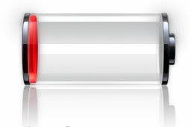
The Rise of Energy Bugs
Single Symptom:
Severe, Unexpected Battery Drain
Apps Need Not Crash
No Blue Screen Of Death
Common Perception:
Kill some apps to fix
Courtesy: Pathak et al

Slide 7
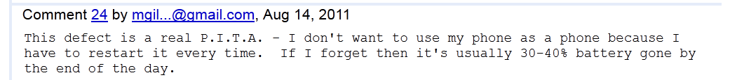
User Frustration
(Dialer App EBug)
Courtesy: Pathak et al

Slide 8
Crawling Internet Forums
4 Online
Mobile Forums
1.2M Posts
(~400 mobile devices;
Several mobile OSes)
1.
39K Posts
1000 Clusters
grep “power drain”,
“battery drain”, etc.
K-means
EBug Taxonomy
Human
2.
2 Mobile Bugs/Issues Repository
Indepth Analysis
Courtesy: Pathak et al

Slide 9
Ebug Taxonomy
23%
Hardware
OS
35%
Software
No Sleep Bug
Apps
Ebug
Loop Bug
Immortality Bug
External Service
12%
External
Network Signal Strength
30%
Wireless Handovers
Unknown
Courtesy: Pathak et al

Slide 10
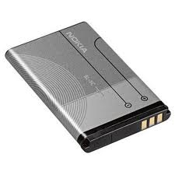
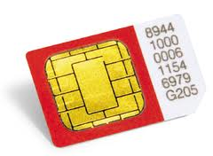
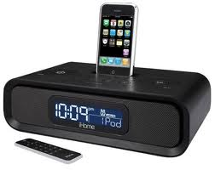
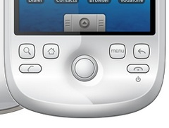
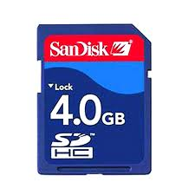
Hardware EBug
Hardware
23%
Software
35%
Ebug
External
12%
Unknown
30%
Sim Card
Battery
External Hardware
Exterior Hardware Damage
SDCard
Courtesy: Pathak et al

Slide 11








Ebug Taxonomy
23%
Hardware
OS
35%
Software
No Sleep Bug
Apps
Ebug
Loop Bug
Immortality Bug
External Service
12%
External
Network Signal Strength
30%
Wireless Handovers
Unknown
Courtesy: Pathak et al

Slide 12
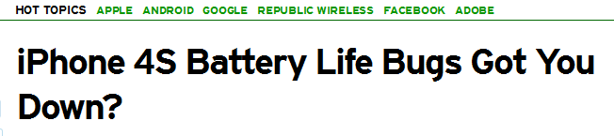
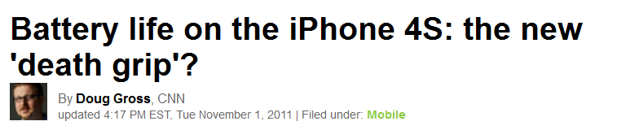
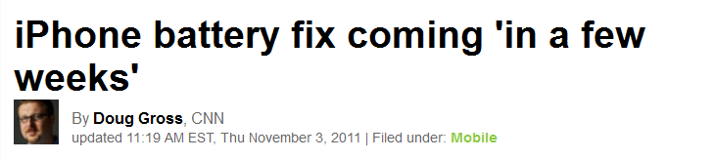
OS Ebugs
Why does OS Leak Energy?
  Hard to infer
  OS Processes
  System Configuration
IOS Version: 4.0 – 4.3.3 (5% posts)
2.5% posts
Courtesy: Pathak et al

Slide 13
Apps EBug: No Sleep Bug
Aggressive Sleeping Policies: Smartphone OSes freeze system after brief inactivity
Power encumbered Programming: Programmer has to manage sleep/wake cycle of components
No Sleep Bug: At least one component is kept awake due to mismanagement
Courtesy: Pathak et al

Slide 14
External Conditions
Hardware
23%
Software
35%
Ebug
External
12%
Unknown
30%
External Services (<1%)
Network Signal Strength (11%)
Wireless Handovers (<1%)
Courtesy: Pathak et al

Slide 15
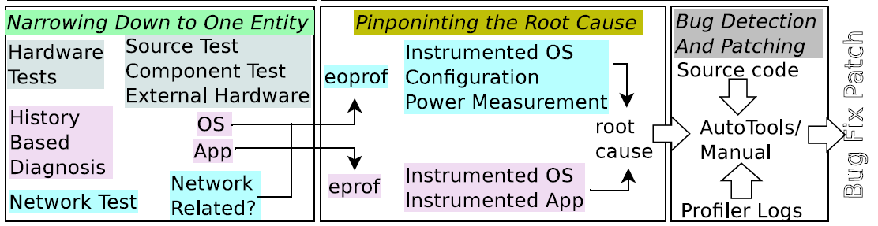
EDB: Energy Debugging Framework
Courtesy: Pathak et al

Slide 16


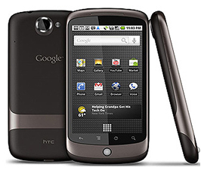

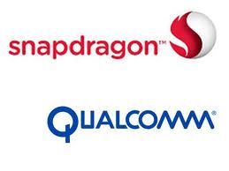




Mobile Programming EcoSystem:
The EBug Blame Game
Network Operators
App Developers
Hardware Manufacturers
Framework Developers
Firmware/OEM Developers
Kernel Developers
Courtesy: Pathak et al

Slide 17
Outline
The Rise of Ebugs
Debugging no-sleep Bugs
Methods of Measuring Power Usage
Power Models
  Usage based
  System call trace based
Profiling
Conclusion

Slide 18

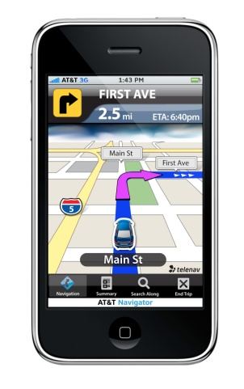
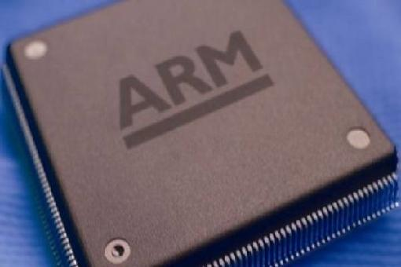
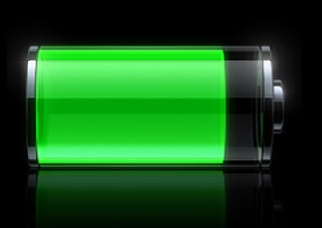
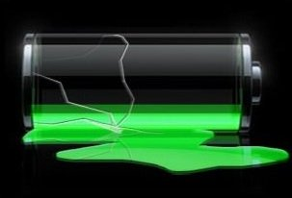
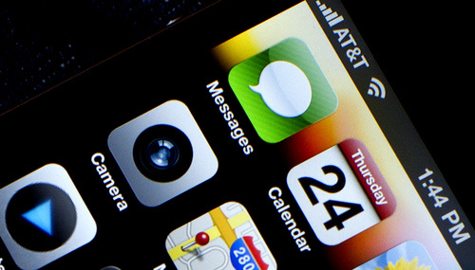

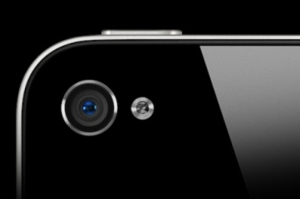
Smartphones are Energy Constrained
Battery energy density only doubled in last 15 years
3G/4G
GPS
CPU
Screen
Camera
WiFi
Courtesy: Jindal et al

Slide 19
Paradigm Shift in Power Management
Desktop/Server/Laptop: Default ON
  CPU turned off when idle for long time
Smartphones: Default OFF
  Smartphone OSes aggressively turn off Screen/CPU after brief user inactivity
  Helps increasing standby time period
Courtesy: Jindal et al

Slide 20
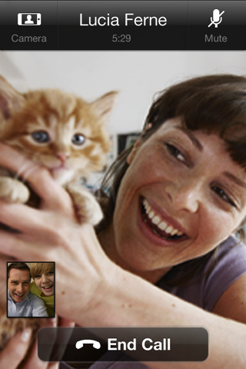

Consequences of Aggressive
Sleeping Policy
public void DoNetwork ( )
{
}
Sync_Over_Network ( ); //Sync state with remote server
//Can take up to a minute
Background jobs
User is not always touching phone
Need a mechanism to explicitly keep components awake.
Keep the screen on !
Courtesy: Jindal et al

Slide 21
Android API to Explicitly Keep Components Awake
PowerManager pm = (PowerManager) getSystemService(Context.POWER_SERVICE);
PowerManager.WakeLock wakelock= pm.newWakeLock(PowerManager.PARTIAL_WAKE_LOCK, null);
API | Component (s)
PARTIAL_WAKE_LOCK | CPU
SCREEN_DIM_WAKE_LOCK | CPU and Screen (DIM)
SCREEN_BRIGHT_WAKE_LOCK | CPU and Screen (Bright)
Camera.startPreview() Camera.release() | Camera
Courtesy: Jindal et al

Slide 22
Android API to Explicitly Keep Components Awake (Cont’d)
public void DoNetwork ( ) {
}
wakelock.acquire ( ); //Don’t let CPU sleep till I say so
wakelock.release ( ); //CPU is now free to sleep
Sync_Over_Network ( ); //Sync state with remote server
//Can take up to a minute
Courtesy: Jindal et al

Slide 23
iOS API to Explicitly Keep Components Awake
Screen: idleTimerDisabled property in UIApplication
  If NO, the idle timer turns off the device’s screen after a specified period of inactivity
GPS: enable/disable location updates, and set the distance filter and accuracy levels
  Core Location uses the available GPS, cell, and Wi-Fi networks to determine the user’s location
  Core Location minimizes the use of these radios
  Setting the accuracy and filter values gives Core Location the option to turn off hardware altogether in situations where it is not needed.
WiFi: UIRequiresPersistentWiFi key in the app’s Info.plist file
  System will not shut down the Wi-Fi hardware while your app is running.

Slide 24
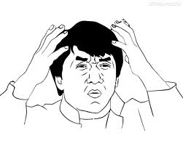
Power Encumbered Programming
App programmer has to manage sleep/wake cycle of components
Courtesy: Jindal et al

Slide 25
NoSleep Energy Bugs
An error in smartphone app, where a component is woken up, but not put to sleep
Component | Impact (Google Nexus)
CPU | 50-60% battery in 12 hrs
Screen | 100% battery in 4-6 hrs
GPS | 100% battery in 3-5 hrs
Courtesy: Jindal et al

Slide 26



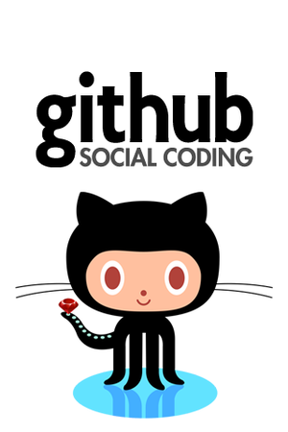
Collecting and Characterizing Bugs
Online mobile forums
Bug lists
Open source code repositories
Running the detection tool
Courtesy: Jindal et al

Slide 27
Types of NoSleep Bugs
NoSleep Code Paths
NoSleep Race Conditions
NoSleep Dilations
Courtesy: Jindal et al

Slide 28




(a) NoSleep CodePaths
At least one path in program wakes up a component and does not put it to sleep
public void DoNetwork ( )
{
}
try
{
} catch (SomeException e){
Print.Error ( e ); //Print Error for Debugging purposes
}
wakelock.acquire ( ); //Don’t let CPU sleep till I say so
wakelock.release ( ); //CPU is now free to sleep
Sync_Over_Network ( ); //Sync state with remote server
//Can take upto a minute
;throws
;exception
Courtesy: Jindal et al

Slide 29
(b) NoSleep Race Condition (1)
Process
Process
acquire
release
acquire
Time
Thread 1
release
Time
Thread 2
Thread 1
Thread 2
Courtesy: Jindal et al

Slide 30

(b) NoSleep Race Conditions (2)
public class MainThread
{
}
public class WorkerThread
{
}
boolean KillFlag = false; //Kill Flag
while(true){ //Infinite Loop
}
wakelock.acquire ( ); //CPU Cant Sleep
if(KillFlag) break; //Exit
WorkerThread.start ();//start worker
NetSync(); //Critical Section
…….
…….
......
wakelock.release ( ); //CPU can sleep
KillFlag = true; //Kill the worker thread
Thread.Sleep (3 Mins);//Sleep for 3 mins
WorkerThread.interrupt();//stop worker
wakelock.acquire ( ); //CPU Cant Sleep
wakelock.release ( ); //CPU can sleep now
…….
…….
Correct Execution
Buggy Execution
Courtesy: Jindal et al

Slide 31

(c) NoSleep Dilations
Components are eventually turned off but are kept on for unusually long duration of time
public void onCreate( )
{
}
public long startNewTrack( )
{
..
}
wakelock.acquire ( ) ;
+ wakelock.acquire ( ) ;
Courtesy: Jindal et al

Slide 32
Detecting NoSleep Bugs
NoSleep Code Paths
NoSleep Race Conditions
Static Data Flow Analysis
  Reaching Definitions Data Flow Problem
Courtesy: Jindal et al

Slide 33
Reaching Definitions Data Flow Problem
entry
y = 3;
x = 10;
y = 11;
if( y > 5 ) {
x = 1;
y = 2;
} else {
z = x;
x = 4;
}
OUT[entry] = {}
IN[B0]
: {}
B0
d0: y = 3
d1: x = 10
d2: y = 11
if (y>5)
OUT[B0]
: {d1, d2}
IN[B1]
: {d1, d2}
IN[B2]
: {d1, d2}
B1
d3: x = 1
d4: y = 2
B2
d5: z = x
d6: x = 4
OUT[B1]
: {d3, d4}
OUT[B2]
: {d2, d5, d6}
IN[exit]
: {d2, d3, d4, d5, d6}
Problem Statement: For each point in the program, determine which definition of variable are reachable
exit
Courtesy: Jindal et al

Slide 34
NoSleep Code Path DataFlow Analysis
try
{
} catch (SomeException e){
Print.Error ( e ); //Print Error for Debugging purposes
}
Entry
Entry
wakelock.acquire ( ); //Don’t let CPU sleep till I say so
wakelock.release ( ); //CPU is now free to sleep
B0
B0
d0: wakelock = 1;
Sync_over_network()
d0: wakelock.acquire();
Sync_over_network()
Sync_Over_Network ( ); //Sync state with remote server
//Can take upto a minute
;throws
;exception
B2
B1
B2
B1
d1: wakelock = 0;
Print.error(e);
d1: wakelock.
realease();
Print.Error(e)
: {d0}
: {d1}
IN[exit]
: {d0, d1}
exit
exit
Apply reaching definitions to NoSleep CodePaths
Courtesy: Jindal et al

Slide 35
Implementation
Soot Implementation
  Open source framework for analyzing java bytecode from Sable research group at McGill University
  Added ~2 KLOC
Runs on Java byte code
  No need for source code
Courtesy: Jindal et al

Slide 36
Evaluation: NoSleep Code Paths
500 Apps
187
86
55
Apps Manipulating
components
Apps which could
be decompiled
Find NoSleep Bugs
Total Apps 86 | BUG in reality | No BUG in reality
Tool reports BUG (55) | True Positive 42 | False Positive 13
Tool reports no BUG (31) | False Negative 0 | True Negative 31
Courtesy: Jindal et al

Slide 37
Causes of Detected NoSleep Bugs
Category | Number of Apps | Examples
Incorrect Wakelock Handling in Events | 26 | MyTracks
If, else + exception Paths | 12 | Facebook
Forgot Release | 4 | K9Mail
Courtesy: Jindal et al

Slide 38

Common Cause of False Positives
ENTER
If(caller != BLACKLISTED)
Wl.acquire();
.
.
If(caller != BLACKLISTED)
Wl.release();
EXIT
Courtesy: Jindal et al

Slide 39
Summary
Paradigm shift in power management
  Power encumbered programming
NoSleep energy bugs
  Code paths, race, dilation
Reaching definition data flow analysis
  Found 30 new previously unreported bugs
Courtesy: Jindal et al

Slide 40
Future Work
Comprehensive approaches to No-Sleep bug
  Detection: e.g. Symbolic execution
  Prevention: e.g. Better abstraction for power management API
  Mitigation: e.g. Runtime detection, Limiting damage of the bug
Courtesy: Jindal et al

Slide 41
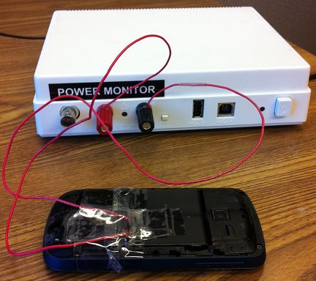
Measuring Power Usage
Approach 1: Use power meter (offline)
  Buy an expensive equipment ($770)
  Problems:
    Only reports entire device energy
    consumption
Approach 2 : Use built-in battery sensor (online)

Slide 42
iOS Battery API
Use UIDevice class to obtain information and notifications about
  charging state (property batteryState)
  charging level (property batteryLevel)
[[UIDevice currentDevice] setBatteryMonitoringEnabled:YES];
NSArray *batteryStatus = [NSArray arrayWithObjects:
@"Battery status is unknown.",
@"Battery is in use (discharging).",
@"Battery is charging.",
@"Battery is fully charged.", nil];
if ([[UIDevice currentDevice] batteryState] == UIDeviceBatteryStateUnknown)
NSLog(@"%@", [batteryStatus objectAtIndex:0]);
else
{
NSString *msg = [NSString stringWithFormat:
@"Battery charge level: %0.2f%%\n%@", [[UIDevice currentDevice] batteryLevel] * 100,
[batteryStatus objectAtIndex:[[UIDevice currentDevice] batteryState]] ];
NSLog(@"%@", msg);
}

Slide 43
Android Battery API
Sample updates stored in files:
  Current: /sys/class/power_supply/battery/batt_chg_current
  Voltage: /sys/class/power_supply/battery/batt_vol
  Capacity: /sys/class/power_supply/battery/capacity
  File fcur = new File("/sys/class/power_supply/battery/batt_chg_current");
  if (fcur.exists())
  …
File names are vendor dependent
Access using Android Debug Bridge (adb)
  <sdk>platform-tools
  Command: adb shell

Slide 44
Outline
The Rise of Ebugs
Debugging no-sleep Bugs
Methods of Measuring Power Usage
Power Models
  Usage based
  System call trace based
Profiling
Conclusion

Slide 45
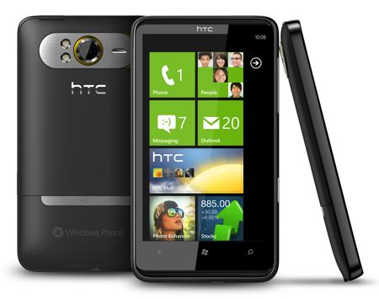
Smartphone is Energy Constrained
Energy: One of the most critical issues in smartphones
  Limited battery lifetime
Battery energy density only
doubled in last 15 yrs
Smartphone capability has increased drastically
  Multiple Components: GPS, 3G, retina display, ….
Courtesy: Pathak et al

Slide 46
Towards Understanding Energy Drain
Key Question: Where is energy being spent?
  Which component/process/thread/function(?)
Courtesy: Pathak et al

Slide 47

Generic Power Modeling
Triggers
Triggers
Actual
Power
Consumption
Power meter
Predicted
Power
Consumption
Training
Phase
Prediction
Phase
Model
Courtesy: Pathak et al
Notes:
Make fonts large
Blue color not visible
Put down LR somewhere

Slide 48
Smartphone Power Modeling: Utilization Based (1/3)
Triggers
Utilization
Triggers
Utilization
Actual
Power
Consumption
Power meter
Predicted
Power
Consumption
Training
Phase
Prediction
Phase
Model
Linear Regression (LR) and Superimposition
Model = (Util_{Net})* E_{Net} + (Util_{CPU})* E_{CPU} + (Util_{Disk})* E_{Disk}
Courtesy: Pathak et al

Slide 49
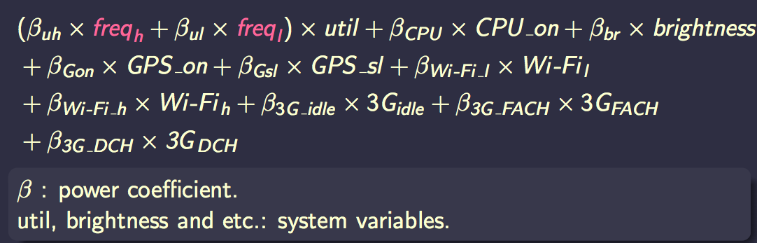
Smartphone Power Modeling: Utilization Based (2/3)
PowerTutor model
Sesame paper has two optimizations: model molding, principle component analysis (PCA)

Slide 50

Smartphone Power Modeling: Utilization Based (3/3)
Model = (Util_{Net})* E_{Net} + (Util_{CPU})* E_{CPU} + (Util_{Disk})* E_{Disk}
Fundamental (yet intuitive) assumption
(Only active) Utilization => power consumption
Second assumption
Energy scales linearly with amount of work
Third assumption
Components power consumption add linearly
Desired Feature
Which process/thread/function? Hard to correlate
Courtesy: Pathak et al

Slide 51
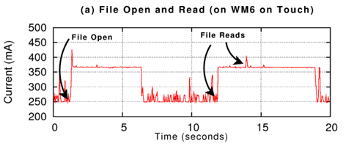
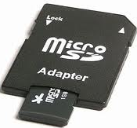
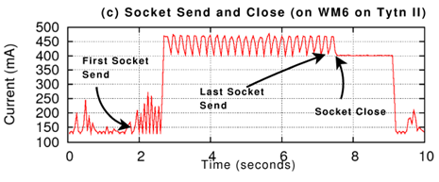
(Only active) Utilization => Power Consumption
File open/delete/
close/create
change power state
Several components
have tail states
(3G, disk, wifi, gps)
Courtesy: Pathak et al
Notes:
Write down what have to say

Slide 52
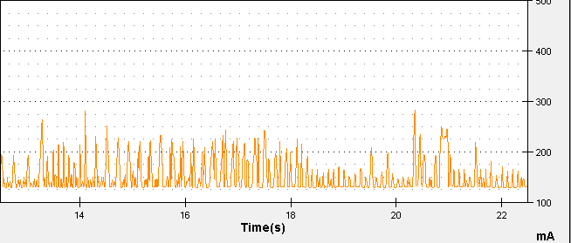
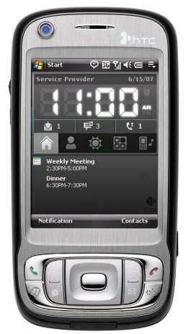
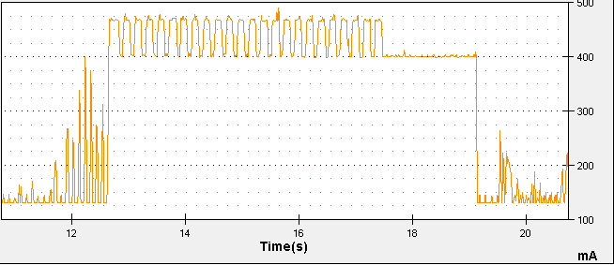
Energy scales linearly with amount of work
(1) Send packets
@ < 50pkts/s
+100-125mA
(2) Send packets
@ > 50pkts/s
+325mA
WM6.5 on Tytn II
Courtesy: Pathak et al

Slide 53
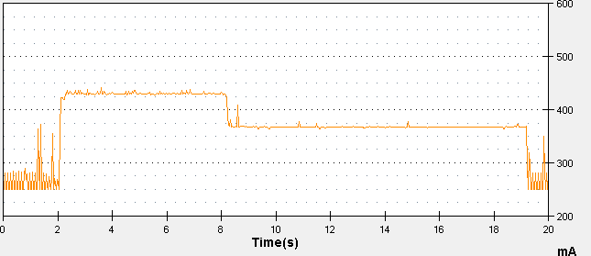
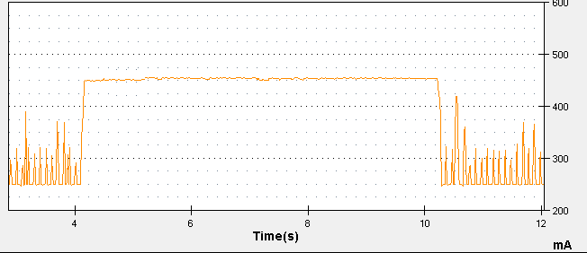
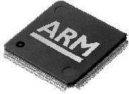
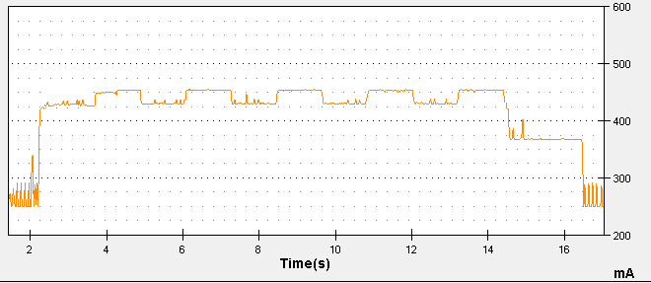
Components power consumption add linearly
WM6.5 on HTC Touch
Send
start
Send done
Spin_CPU
Spin_CPU Stop
Socket close
+200mA
+180mA
+110mA
Send(10mb);
sleep();
Socket.close();
Spin_CPU(2M)
(i = 1)
(2) Spin_CPU(10M);
Send(2mb)
(i = 5)
Spin_cpu(2M)
(i = 5)
(3)
for (i in 1 to 5){
Send(2mb);
Spin_CPU(2M);
}
Sleep();
Socket.close();
Send(2mb)
(i = 1)
+200mA
+110mA
+180mA
Socket close
Network tail
Courtesy: Pathak et al

Slide 54
What have we learnt so far?
Simple (state-of-art) energy modeling assumptions are wrong
There exits a notion of power states
What have we hinted so far?
Device drivers have intelligent power control rules
System calls play a role in power consumption
Challenges in fine-grained power modeling?
Device drivers are closed source (no code/no information)
Courtesy: Pathak et al

Slide 55
System Calls As Power Triggers
Key observation: System call is the interface through which an application communicates with the underlying system (hardware) and outside world (Internet, GPS, etc.)
Key Idea: Use System Calls as triggers in power modeling
Advantages:
  Encapsulates utilization based triggers
    Parameters of system calls
  Captures power behavior of ones that do not
  necessarily imply utilization
  Can be traced back to process, thread, function
    Eases energy accounting
Courtesy: Pathak et al

Slide 56
Finite-State-Machine (FSM) as Power Model Representation
We Use Finite-State-Machine (FSM)
Nodes: Power states
  Base State: No activity on phone
  Productive state: Actual utilization
  Tail state: No-useful work
Edges: Transition rules
  System calls (start/completion)
  Workload (Ex: 50 pkts/sec)
  Timeout
State 1
Transitions
State 2
State 3
Courtesy: Pathak et al

Slide 57
FSM Power Model Construction
Systematic ‘Brute Force’ Approach
  Step 1 : Model Single System Call
  Step 2 : Model Multiple System Calls for Same Component
  Step 3 : Model Multiple Components (Entire Phone)
Requires domain knowledge
  Semantics of system calls
Courtesy: Pathak et al

Slide 58
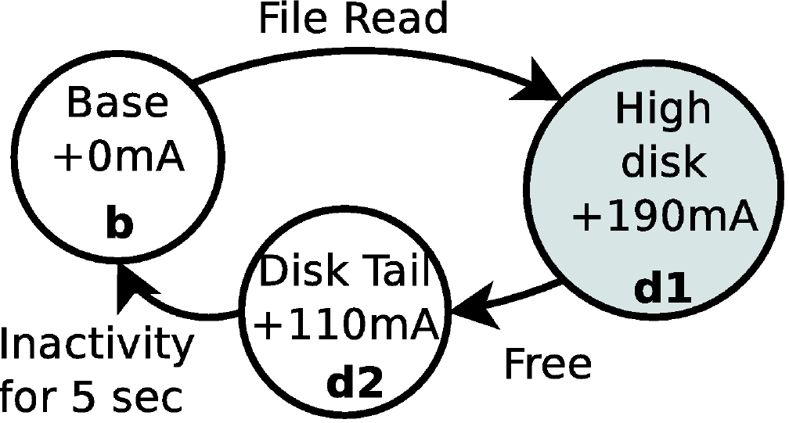
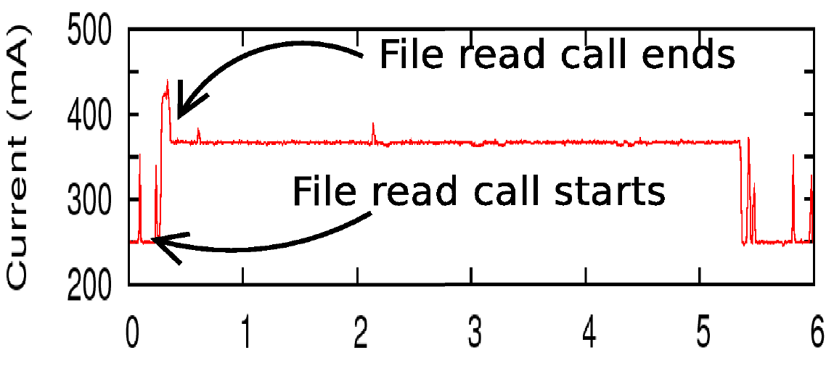

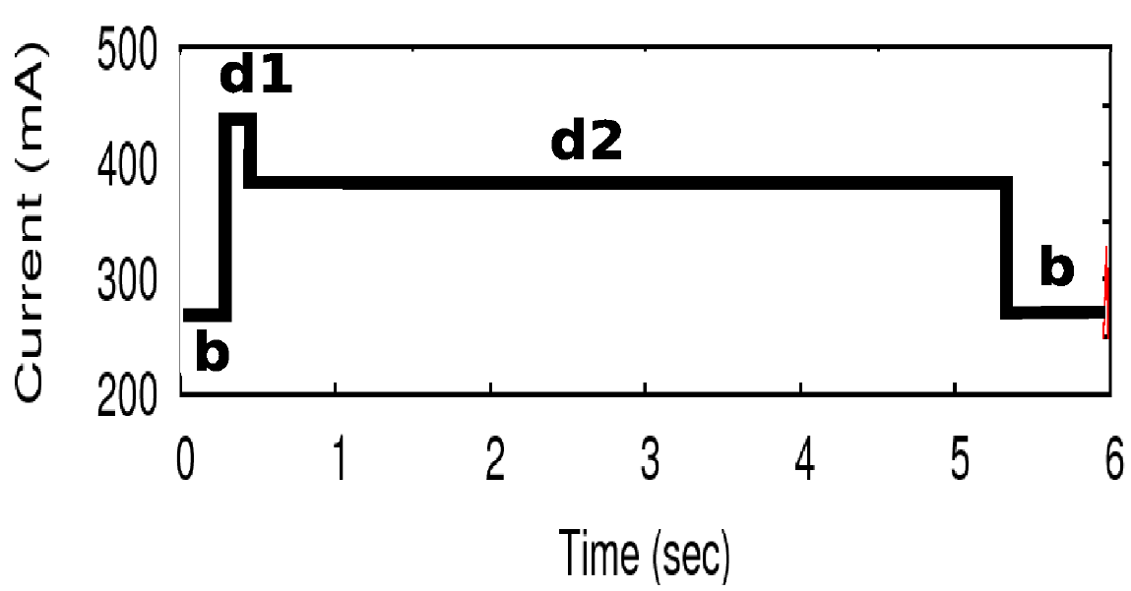
Step 1: Single System Call FSM
WM6.5 on HTC Touch
System call: read (fd, buf, size);
Measured power consumption +
system calls (trigger)
Modeled power consumption
FSM
Courtesy: Pathak et al

Slide 59
Step 2: Modeling Multiple System Calls of Same Component
Observation: A component can only
have a small finite number of power states
Methodology
  Identify and merge similar power states
  Obey programming order
  Model concurrent system calls
Courtesy: Pathak et al

Slide 60
Step 2: WiFi NIC
WM6.5 on HTC Tytn II
Send < 50
Pkts/sec
SEND
Base State +0mA
Low Net
+125 mA
Base State +0mA
Socket close
CLOSE
Send done
Send > 50
Pkts/sec
Socket close
Net Tail
+280 mA
High Net
+325 mA
Net Tail
+280 mA
Send
Send < 50
Pkts/sec
Send done
Base State +0mA
Low Net
+125 mA
Send done
Socket close
Send > 50
Pkts/sec
Socket close
High Net
+325 mA
Net Tail
+280 mA
Send
Send done
Courtesy: Pathak et al

Slide 61
Step 3: Modeling Multiple Components
Observation: Different components may interact with each other’s power consumption
Methodology
  Try to reach different combination of states
  Construct new states and transitions in FSM
Courtesy: Pathak et al

Slide 62


Implementation
Windows Mobile 6.5
  Extended CeLog
Android
  System Tap: Logs kernel events
  Android debugging framework: Custom logging in Dalvik VM
Courtesy: Pathak et al

Slide 63
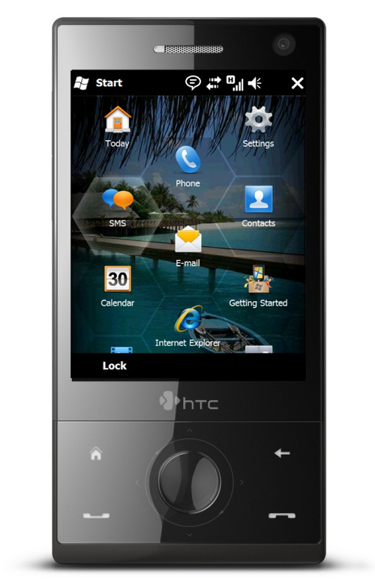
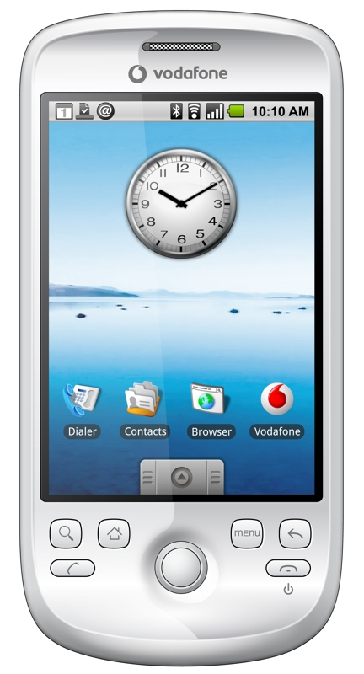
Evaluation: Handsets Used
HTC Tytn II | HTC Touch | HTC Magic
Win 6.5 (CE 5.2) | Win 6.5 (CE 5.2) | Android (Linux 2.6.34)
Courtesy: Pathak et al

Slide 64
Snapshot of FSM for Entire Phone
Net Tail + CPU
+300 mA
High CPU
+130
mA
CPU
CPU (ctx_in) ctx_out
WM6.5 on HTC Tytn II
Send < 50
Pkts/sec
Base State +0mA
Low Net
+125 mA
Net Tail
+270 mA
High Net
+325 mA
Send
Send done
Send > 50
Pkts/sec
Send done
Disk: Read
/write/open/close/create/delete
Timeout 1.7s
Timeout 3s
Disk
Tail
+75
mA
DTail+
CPU
+130
mA
High Disk
+125
mA
Disk
Call completed
CPU
Courtesy: Pathak et al

Slide 65
End-To-End Energy Estimation Error
FSM: under 4%
LR: 1% – 20%
Courtesy: Pathak et al
Notes:
Say what are applications

Slide 66
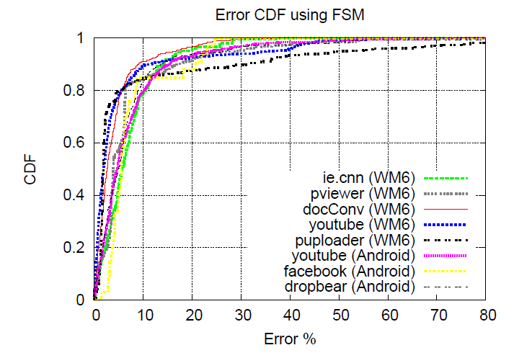
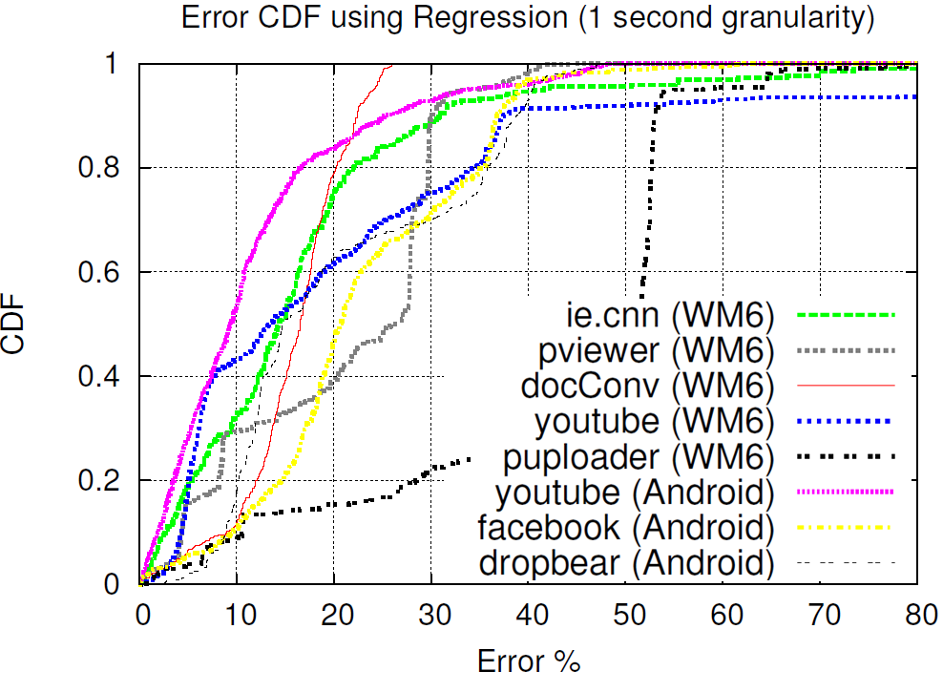
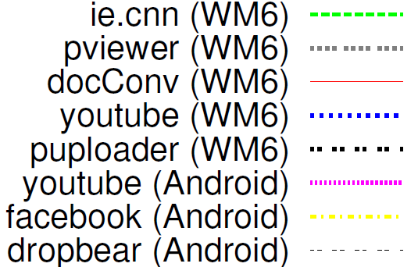
Fine-Grained Energy Estimation
CDF of energy estimation error per 50ms time interval
FSM based on System calls | Linear Regression (State-of-art)
FSM: 80th percentile error less than 10% for all apps
LR: 10th percentile error less than 10% for all apps
Courtesy: Pathak et al
Notes:
What to say here
Make fig fonts larger

Slide 67
Outline
The Rise of Ebugs
Methods of Measuring Power Usage
Power Models
  Usage based
  System call trace based
Profiling
Conclusion

Slide 68
Energy Profiling
eprof published in Eurosys 2012
QCOM Trepn Profiler
  Trepn leverages hardware sensors built into the Snapdragon MDP
  Analyze power consumption of hardware blocks in the Snapdragon MDP, including:
    CPU (system and auxiliary)
    GPS
    Bluetooth
    Camera
    Audio
    Memory
    Network data (optimizes data transfer frequency)
Courtesy: Pathak et al

Slide 69

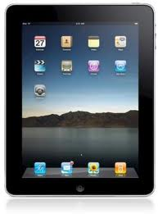

Towards Energy Profiling
Performance
Energy: One of the most critical issues in smartphones
Battery energy density only
doubled in last 15 yrs
1970’s-80’s
2010
Gnu Profiler
(gprof PLDI’82)
Energy Profiler…?
Courtesy: Pathak et al

Slide 70


Approach (a) : Power Meters
Power Consumed by mobile
Time (seconds)
Courtesy: Pathak et al

Slide 71
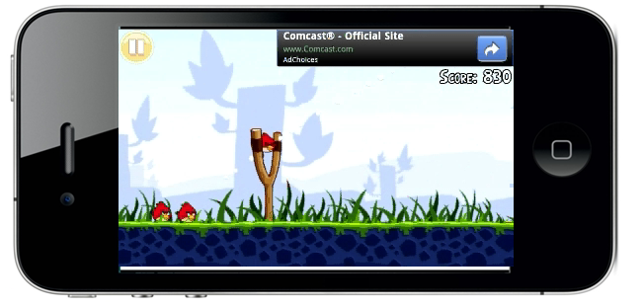
Approach (a) : Power Meters
Power Consumed by mobile
Time (seconds)
Courtesy: Pathak et al

Slide 72
Approach (b) : Software Energy Profiling
Tracking power activities
Tracking app activities
Mapping power activities to app activities
Courtesy: Pathak et al

Slide 73
Tracking Power Activities
Power Modeling
State-of-art ‘utilization based’ power models are inaccurate on smartphones
  Only active utilization => power consumption
  Energy is consumed linearly w.r.t utilization
  Hard to map power triggers to fine grained app activities
System call triggered FSM based
fine-grained power model [Eurosys ‘11]
  Use system calls as power triggers
  System calls drive Finite-State-Machine
Base
State
Prod.State
Tail
State
Courtesy: Pathak et al

Slide 74






Tracking App Activities
Granularity of Energy Accounting
Third Party Ad Module
Multi Threading:
Multiple Routines:
Multi Processing:
Collect information
Upload information
Download ads
Courtesy: Pathak et al

Slide 75
Tracking App Activities
Granularity of Energy Accounting
  eprof supports per Process/Thread/Routine granularity
I/O Devices
  Track system call to program entity
    Process – getpid()
    Thread – gettid()
    Routine – backtrace()
CPU
  Just like gprof [PLDI ‘82]
  Periodic sampling of routine call stack
Courtesy: Pathak et al

Slide 76

Where is Energy Spent Inside My App?
Tracking power activities
  System call based online power model
Tracking app activities
  IO: Backtrace system calls
  CPU: Just like gprof [PLDI ‘82]
Mapping power activities to app activities
  Accounting Policy: Lingering Energy Consumption
Courtesy: Pathak et al

Slide 77
Lingering Energy Consumption
(a) Tail Energy
Effect on power/energy consumed by a component
because of an activity lasts beyond the end of the activity
send 10 KB
send completed
Power Consumed (mW)
Tail (upto 7 seconds)
Components with tail: Sdcard
3G
WiFi
GPS
Time
foo()
Courtesy: Pathak et al

Slide 78
Lingering Energy Consumption
(b) Persistent State Wakelock
Aggressive Sleeping Policies: Smartphone OSes freeze system after brief inactivity
Power encumbered Programming: Programmer has to manage sleep/wake cycle of components
Acquire
wakelock
Release
wakelock
Power Consumed (mW)
Keep the screen on !
Time
foo()
Courtesy: Pathak et al

Slide 79
Lingering Energy Consumption
Case 1: Single Call Single Tail
send 10 KB
Energy represented in terms of
an energy tuple (U, T)
(U, T) is attributed to entity (s)
containing send system call
send completed
Power Consumed (mW)
Tail (upto 7 seconds)
T
Time
U
Courtesy: Pathak et al

Slide 80
Lingering Energy Consumption
Case 2: Multiple Calls Multiple Tails
How to split tail T₂ among?
send₁
send₂
Power Consumed (mW)
Average Policy: Split tail energy T₂ in weighted ratio
T₁
T₂
Time
U₁
U₂
Not easy to define weights
Policy gets complicated in presence of multiple system calls
Courtesy: Pathak et al

Slide 81
Lingering Energy Consumption
Case 2: Multiple Calls Multiple Tails
Last-Trigger-Policy: Assign asynchronous (tail) energy to the last active system call
send₁
send₂
send₁ : (U₁, T₁ )
send₂ : (U₂, T₂ )
Power Consumed (mW)
T₁
T₂
Time
U₁
U₂
Not easy to define weights
Policy gets complicated in presence of multiple system calls
Courtesy: Pathak et al

Slide 82
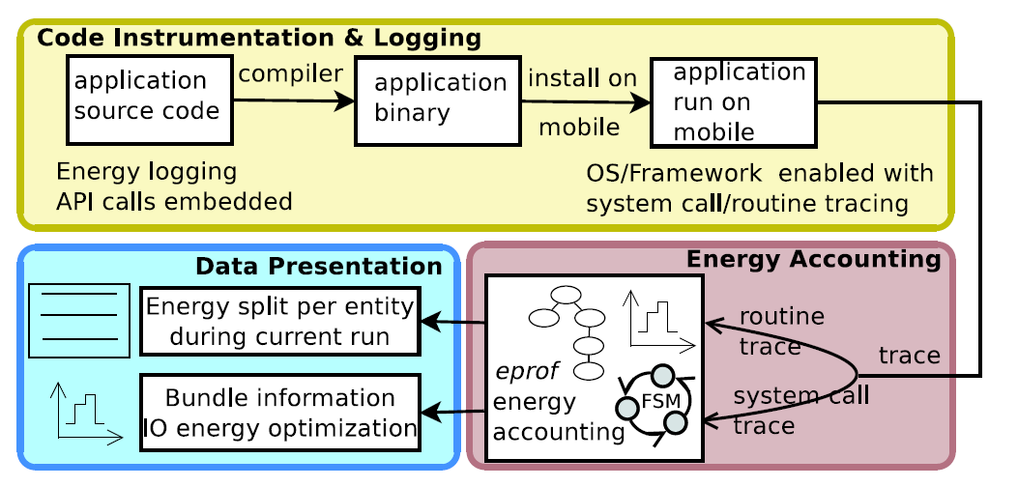
eprof System
(Android and Windows Mobile)
Logging Overhead:
2-15% Run Time,
1-13% Run Energy
Courtesy: Pathak et al

Slide 83
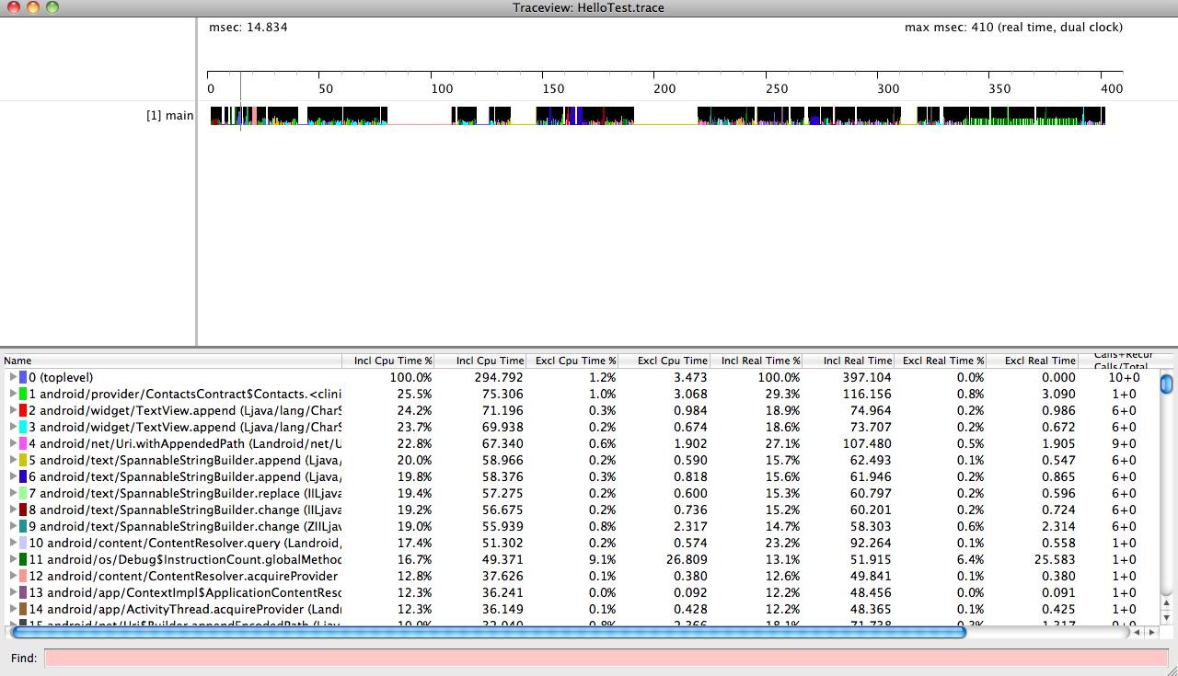
eprof Implementation
AndroidManifest.xml
<uses-permission android:name="android.permission.WRITE_EXTERNAL_STORAGE" />
MainActivity.java
import android.os.Debug;
---
public void onCreate(Bundle savedInstanceState) {
…
Debug.startMethodTracing("HelloTest");
…
Debug.stopMethodTracing();
}
adb pull /mnt/sdcard/HelloTest.trace .
traceview HelloTest.trace
SDK routine tracing: extend Android routine profiling framework
  http://developer.android.com/reference/android/os/Debug.html
NDK routine tracing: use gprof port of NDK
  http://code.google.com/p/android-ndk-profiler/
System call tracing: insert ADB logging APIs in framework code and log CPU (sched.switch) scheduling event in kernel using systemtap
  http://www.cyanogenmod.com/

Slide 84
eprof Implementation (Cont’d)
Augmented TraceView in Dalvik
  gprof-like tracing + syscall tracing
eprof API: StartEnergyTracing() StopEnergyTracing()
  Needs app recompile
Modified Android framework to trace each app by default
(no need for app source)
Courtesy: Pathak et al

Slide 85
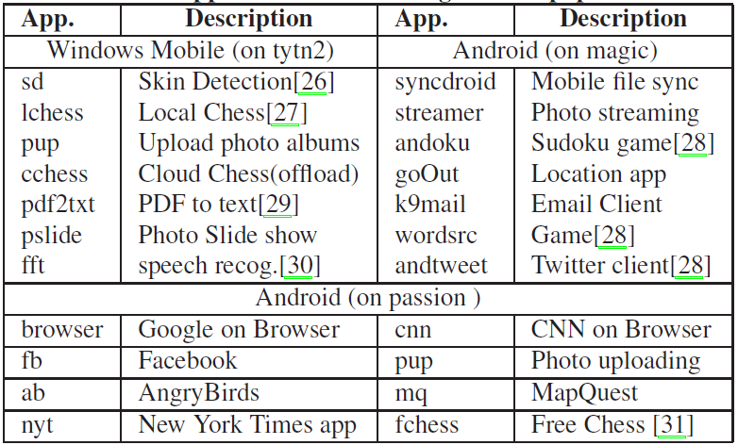
Using eprof
App | Num Routine calls | Num Threads | 3rd Party Modules
Browser | 1M | 34 | --
AngryBirds | 200K | 47
FChess | 742K | 37
NYTimes | 7.4M | 29
MapQuest | 6M | 43
Profiled popular mobile apps using EProf
Courtesy: Pathak et al

Slide 86
Case Studies: (a) Android Browser
Google Search
Activity | Energy %
HTTP | 38%
TCP Conditioning | 25%
User Tracking | 16%
GUI Rendering | 5%
Courtesy: Pathak et al

Slide 87
Case Studies: (b) Map Quest
Courtesy: Pathak et al

Slide 88
Case Studies: (c) – Angry Birds
Google Nexus (3G)
Activity | Energy %
User Tracking & Uploading Information | 45%
Fetching Ads | 28%
Game Play | 20%
Courtesy: Pathak et al

Slide 89
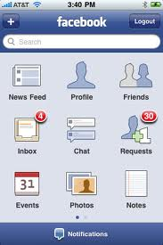
Case Studies (d):
Facebook Wakelock Bug
Google Nexus (WiFi)
FaceBookService: 25%
AppSession.acquireWakelock()
Power Consumed (mW)
Time
Courtesy: Pathak et al

Slide 90
App Energy Drain Characteristics
IO consumes the most energy
  Most apps spent 50% - 90% of their energy in IO
  A linear energy presentation does not help with debugging
IO energy is spent in bursts, called bundles
  A bundle is defined as a continuous period where IO component actively consumes energy
  Very few IO bundles per app
Power Consumed (mW)
Time
IO Energy Bundles
Courtesy: Pathak et al

Slide 91
IO Bundle Representation
Very Few Routines
One Network Bundle
SendPacket()
send₁
send₂
send₃
Base State +0mA
Net send
Net Send
+265 mA
Power Consumed (mW)
Net send
5 seconds inactivity
Net Tail
+150 mA
T₁
T₂
T₃
?????
TimeLine
U₁
U₂
U₃
What is the app doing here?
Courtesy: Pathak et al

Slide 92
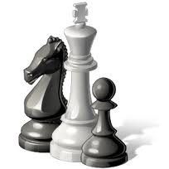

Optimizing IO Energy using Bundles
Why is a bundle so long?
Why are there so many bundles?
DownloadMgr.
Read()
AdWhirl.FetchAd()
Base State +0mA
Net send
Net Send
+265 mA
Base State +0mA
Net send
Net Send
+265 mA
Net send
18
5 seconds inactivity
Net send
Net Tail
+150 mA
5 seconds inactivity
GZipStream.read()
JsonNode.Deserialize()
SQLiteDB.insert()
Net Tail
+150 mA
PID 0 (null loop)
Reduced energy consumption of 4 apps by 20-65% by minimizing number of bundles and reducing bundle lengths
Courtesy: Pathak et al

Slide 93
Summary
eprof: fine-grained energy profiler
  Enables opportunities for in-depth study of app energy consumption
Case studies of popular apps energy consumption
  65-75% of app energy spent in tracking user and fetching ads (for example angrybirds)
Bundles: IO energy representation
  Helps debugging smartphone app energy

Slide 94
Conclusion and Future work
Ebugs need to be dealt with
  No-sleep ebug debugging studied
Fine-grained energy modeling and profiling very important to pinpoint energy bottleneck and ebugs
  Accounting is tricky
  I/O energy consumption is a major part
Display energy modeling and profiling is still lacking

Slide 95
Online Resources
Soot: open source framework for analyzing java bytecode
  http://www.sable.mcgill.ca/soot/
ded: decompiling android application tool
  http://siis.cse.psu.edu/ded/
SDK routine tracinghttp://developer.android.com/reference/android/os/Debug.html
gprof: NDK routine tracing
  http://code.google.com/p/android-ndk-profiler/
systemtap: system call tracing

Slide 96
Questions?

