Slide 1
Cellular Networks and Mobile Computing
COMS 6998-10, Spring 2013
Instructor: Li Erran Li (lierranli@cs.columbia.edu)
http://www.cs.columbia.edu/~lierranli/coms6998-10Spring2013/
2/5/2013: Introduction to Android

Slide 2
Announcement
Contact Delband Khodadad(dk2624) to access lab Mac computers
Make a note of the lab schedule on the door
iOS lab session by Mason Silber(mds2161) on Wed 6:15-7:30pm
Topics covered:
  TableView
  Network calls
  Multiple MVC and segues

Slide 3
Brief Review of Last Lecture
Objective-C
  Properties, associative references, blocks (lambda in ML), fast enumeration
  Categories (Ruby “monkey patching”), protocols (similar to Java interface)
  Automatic reference counting, dynamic binding, grand central dispatch (GCD)
  Foundation classes: NSNumber,NSArray,NSString
MVC
  Outlet, target-action, delegate, data source, KVO

Slide 4
Outline
Android OS Overview
Android Development Process
Eclipse and Android SDK Demo
Application Framework
  Activity, content provider, broadcast receiver, intent
Android App Framework Demo
Networking
Google Cloud Messaging (GCM)

Slide 5
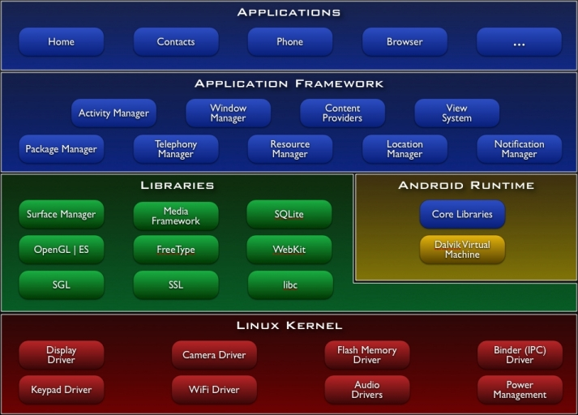
Android Architecture
Cocoa Touch
(storyboard,
UIViewController)
Media
Core Services
(SQLite,
Core Location)
Core OS
Analogy to iOS

Slide 6
Android Development Process
Setup develop environment (SDK, Eclipse)
  SDK: compiler, debugger, device emulator
    Multiplatform support: Windows, Mac, Linux
  Java programming: has its own Java Virtual Machine and special byte code
Create app
  Android project containing java files and resource files
Test app
  Pack project into debuggable *.apk
  Install, run and debug on emulator or device
Publish app in Android market
Get rich!

Slide 7
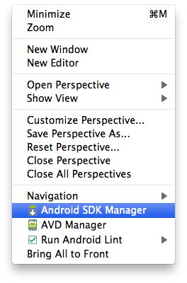
Setup SDK with Eclipse
Download and install
  Java Development Kit (JDK)
  Eclipse
Install and configure Android SDK plugin in Eclipse
  Install Android Development Tools (ADT) plugin
    Follow instructions on http://developer.android.com/sdk/installing/installing-adt.html
  Eclipse will prompt you to specify Android SDK directory
  Use Android SDK manager to install specific versions of Android
Notes:
Class: defines the grouping of data and code, the “type” of an object
Instance: a specific allocation of a class
Method: a “function” that an object knows how to perform
Selector: a message and arguments that will (at some point) trigger the execution of a method
• Design Patterns
Instance Variable (or “ivar”): a specific piece of data belonging to an object
Static typing means that the legality of a member function invocation is checked at the earliest possible moment: by the compiler at compile time. The compiler uses the static type of the pointer to determine whether the member function invocation is legal. If the type of the pointer can handle the member function, certainly the pointed-to object can handle it as well. E.g., if Vehicle has a certain member function, certainly Car also has that member function since Car is a kind-of Vehicle.
Dynamic binding means that the address of the code in a member function invocation is determined at the last possible moment: based on the dynamic type of the object at run time. It is called "dynamic binding" because the binding to the code that actually gets called is accomplished dynamically (at run time). Dynamic binding is a result of virtual functions.

Slide 8
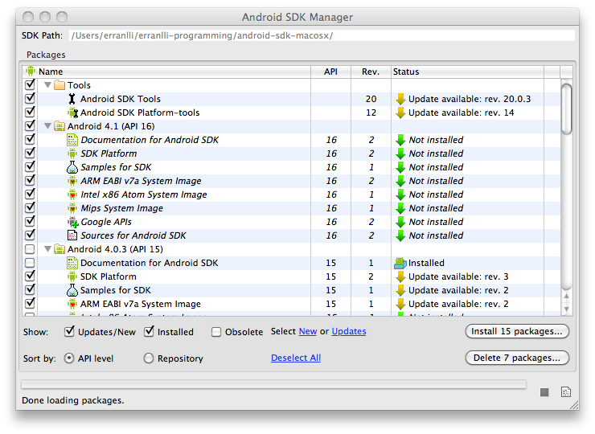
Android SDK Manager

Slide 9
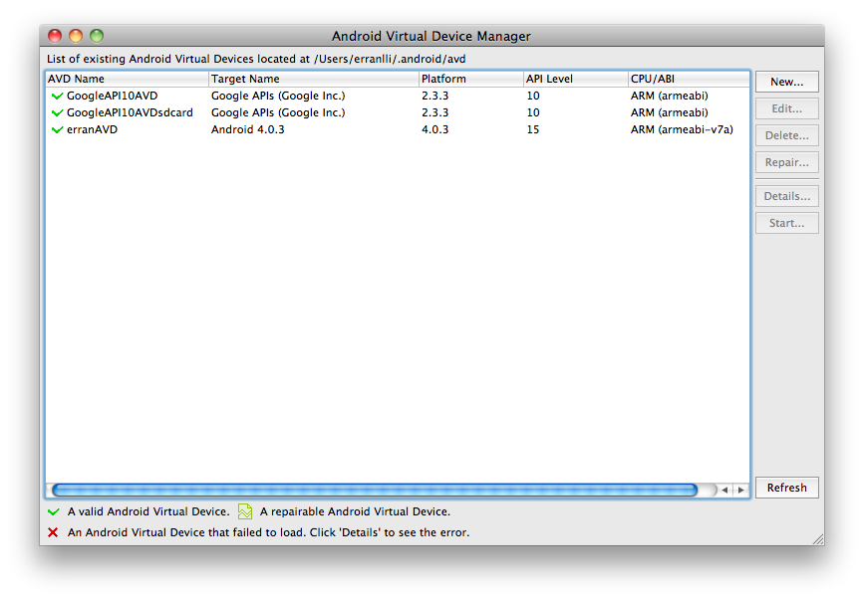
Option 1: Use an Emulator
Create an Android Virtual Device (AVD)
  Lets you specify the configuration of a device to be emulated by the Android Emulator
  Create AVD in Eclipse by selecting Window>AVD Manager

Slide 10
Option 2: Use a Device
Install drivers for device
Connect device to a computer via USB cable
  Make sure turned on USB debugging on device (Settings -> Application -> Development -> USB debugging)
Device will be recognized within Eclipse (DDMS view)

Slide 11
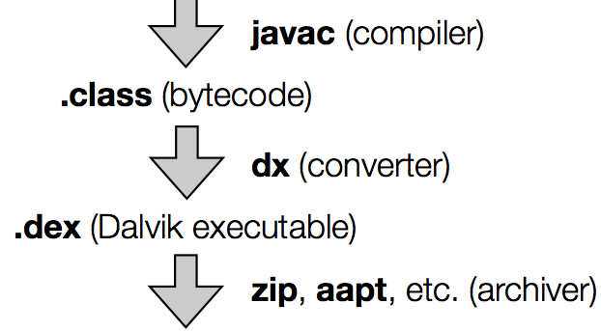

Android Application Framework
Runs in its own virtual machine & process
  Isolation among apps
Is composed of basic components
App components can be activated when any of its components needs to be executed

Slide 12
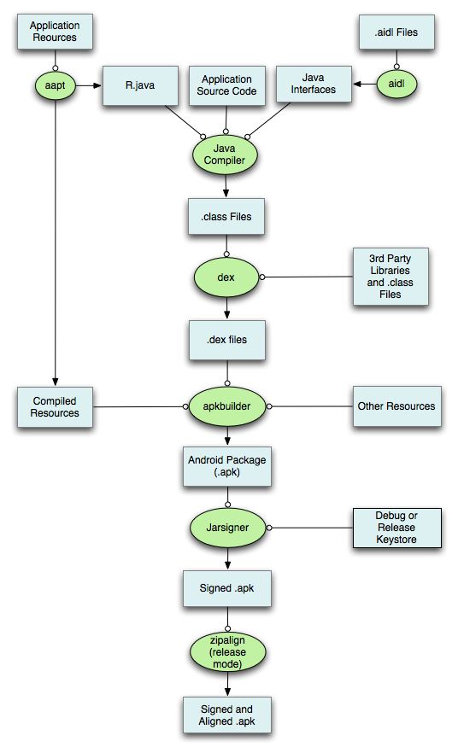
Android Application Framework (Cont’d)

Slide 13
Inter-Process Communications (IPC)
Inter-process communication is designed to promote the development of complex applications, by allowing developers to reuse existing data and services from other applications.
One may also use IPC for intra-app communications (e.g., between Activities of the same app)

Slide 14

IPC Use Cases
One component of Android sends messages to another component of Android
An IPC message in Android is called Intent
Component
Component

Slide 15
Intent Data Structure
Primary pieces of info in an Intent
  Action: The general action to be performed
    ACTION_VIEW, ACTION_DIAL, ACTION_EDIT, …
    Your own definition of strings
  Data: a URI
    tel:123
    content://contacts/people/1
    http://www.cs.columbia.edu/~lierranli/coms6998-10Spring2013
Other attributes
  Category
  Type (MIME type)
  Component (class name)
  Extras (key-value store)

Slide 16
Android App Components
Basic Components | Description
Activity | Deals with UI aspects. Typically corresponds to a single screen
Service | Background tasks (e.g. play music in background while user is web surfing) that typically have no UI
BroadCastReceiver | Can receive messages (e.g. “low battery”) from system/apps and act upon them
ContentProvider | Provide an interface to app data. Lets apps share data with each other.

Slide 17
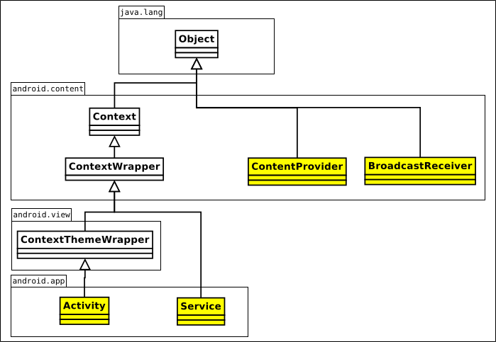
Android Application Component:
Class View

Slide 18
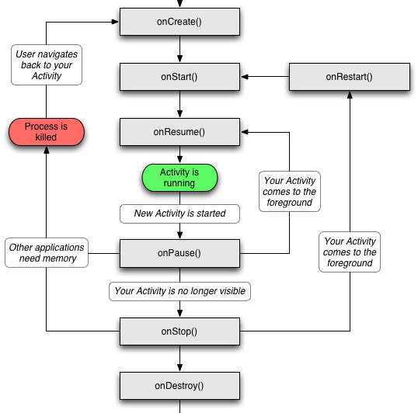
Activity
UI portion of an app
One activity typically corresponds to a single screen of an app
Conceptually laid out as a stack
  Activity on top of stack visible in foreground
  Background activities are stopped but state is retained
  Back button resumes previous Activity in stack
  HOME button moves app and its activity in background

Slide 19
Activity Example
MainActivity.java
public class MainActivity extends Activity {
@Override
public void onCreate(Bundle savedInstanceState) {
// savedInstanceState holds any data that may have been saved
// for the activity before it got killed by the system (e.g.
// to save memory) the last time
super.onCreate(savedInstanceState);
setContentView(R.layout.main);
}
AndroidManifest.xml
<manifest xmlns:android="http://schemas.android.com/apk/res/android” package="com.example.hellotest” >
<application
android:label="@string/app_name” >
<activity
android:name=".MainActivity” >
<intent-filter>
<action android:name="android.intent.action.MAIN" />
<category android:name="android.intent.category.LAUNCHER" />
</intent-filter>
</activity>
</application>
</manifest>

Slide 20
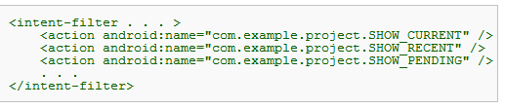
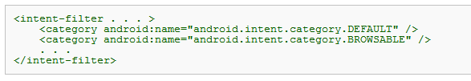
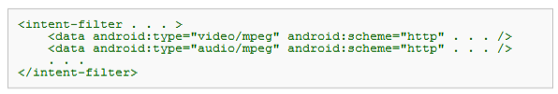
Intent Filter
Problem: how to know what an Activity/Service can handle?
Solution: Activities/Services/Receivers declare what they can/want to receive in Intent filter
action
category
data

Slide 21
Intent Filter: Example
AndroidManifest.xml file for com.android.browser
<intent-filter>
<action android:name="android.intent.action.VIEW" />
<category android:name="android.intent.category.DEFAULT" />
<scheme android:name="http" />
<scheme android:name="https" />
<scheme android:name="file" />
</intent-filter>
String action = "android.intent.action.VIEW";
Uri data = Uri.parse("http://www.google.com");
Intent myIntent = new Intent(action, data);
startActivity(myIntent);

Slide 22
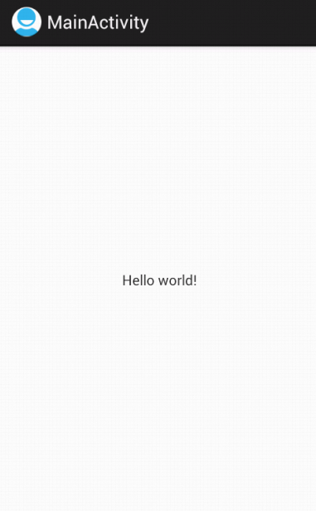
Views
Views are building blocks of UI; Two types of views:
  Leaf: TextView, EditText, Button, Form, TimePicker,ListView
  Composite (ViewGroup): LinearLayout, Relativelayout, …
Main.xml
<?xml version="1.0" encoding="utf-8"?>
<LinearLayout xmlns:android="http://schemas.android.com/apk/res/android"
android:layout_width="fill_parent"
android:layout_height="fill_parent"
android:orientation="vertical" >
<TextView
android:layout_width="fill_parent"
android:layout_height="wrap_content"
android:text="@string/hello_world" />
</LinearLayout>
MainActivity.java
public class MainActivity extends Activity {
@Override
public void onCreate(Bundle savedInstanceState) {
// savedInstanceState holds any data that may have been saved
// for the activity before it got killed by the system (e.g.
// to save memory) the last time
super.onCreate(savedInstanceState);
setContentView(R.layout.main);
}

Slide 23
Access View Defined by XML
main.xml
<?xml version=”1.0” encoding=”utf-8”?>
<LinearLayout xmlns:android=”http://schemas.android.com/apk/res/android”
android:orientation=”vertical”
android:layout_width=”fill_parent”
android:layout_height=”fill_parent”>
<TextView
android:id=”@+id/myTextView”
android:layout_width=”fill_parent”
android:layout_height=”wrap_content”
android:text=”Hello World, HelloWorld”
/>
</LinearLayout>
@Override
public void onCreate(Bundle icicle) {
super.onCreate(icicle);
setContentView(R.layout.main);
}
…
TextView myTextView =
(TextView)findViewById(R.id.myTextView);

Slide 24
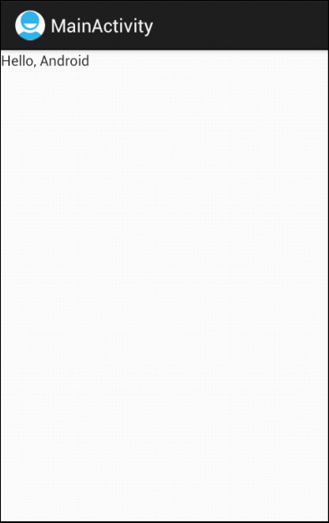
Views (Cont’d)
Views can also be created programmatically
MainActivity.java
public class MainActivity extends Activity {
@Override
public void onCreate(Bundle savedInstanceState) {
// savedInstanceState holds any data that may have been saved
// for the activity before it got killed by the system (e.g.
// to save memory) the last time
super.onCreate(savedInstanceState);
//setContentView(R.layout.main);
TextView tv = new TextView(this);
tv.setText("Hello, Android");
setContentView(tv);
}

Slide 25
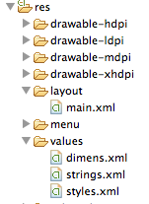
Layouts
Controls how Views are laid out: LinearLayout, TableLayout, RelativeLayout
Main.xml
<?xml version="1.0" encoding="utf-8"?>
<LinearLayout xmlns:android="http://schemas.android.com/apk/res/android"
android:layout_width="fill_parent"
android:layout_height="fill_parent"
android:orientation="vertical" >
<TextView
android:layout_width="fill_parent"
android:layout_height="wrap_content"
android:text="@string/hello_world" />
</LinearLayout>
MainActivity.java
public class MainActivity extends Activity {
@Override
public void onCreate(Bundle savedInstanceState) {
// savedInstanceState holds any data that may have been saved
// for the activity before it got killed by the system (e.g.
// to save memory) the last time
super.onCreate(savedInstanceState);
setContentView(R.layout.main);
}

Slide 26
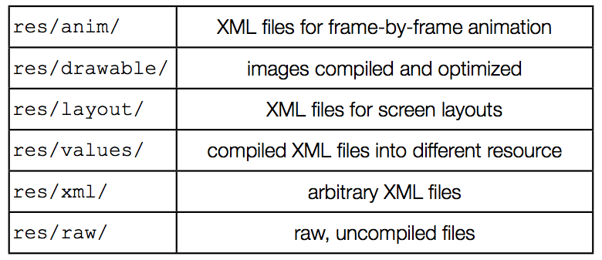
Resources
Reference included content via R.java

Slide 27
Services
Faceless components that typically run in the background
  Music player, network download, etc
Services can be started in two ways
  A component can start the service by calling startService()
  A component can call bindService() to create the service
Service started using startService() remains running until explicitly killed
Service started using bindService() runs as long as the component that created it is still “bound” to it.
The Android system can force-stop a service when memory is low
  However “foreground” services are almost never killed
  If the system kills a service, it will restart the service as soon as resource is available

Slide 28
Services Example
BackgroundSoundServie.java
public class BackgroundSoundService extends Service {
MediaPlayer player;
public void onCreate() {
super.onCreate();
player = MediaPlayer.create(this, R.raw.waltz);
player.setLooping(false);
player.setVolume(100,100);
}
public int onStartCommand(Intent intent, int flags, int startId) {
player.start();
return 1;
}
}
AndroidManifest.xml
<service
android:enabled="true" android:name=".BackgroundSoundService" />
MainActivity.java
public class MainActivity extends Activity {
@Override
public void onCreate(Bundle savedInstanceState) {
…
Intent svc=new Intent(this, BackgroundSoundService.class);
startService(svc);
}
}

Slide 29
Broadcast Receivers
Components designed to respond to broadcast messages (called Intents)
Can receive broadcast messages from the system. For example when:
  A new phone call comes in
  There is a change in the battery level or cell ID
Can receive messages broadcast by apps
  Apps can also define new broadcast messages

Slide 30
Broadcast Receivers Example
Listen to phone state changes
AndroidManifest.xml
<uses-permission android:name="android.permission.READ_PHONE_STATE" >
<receiver android:name="MyPhoneReceiver" >
<intent-filter>
<action android:name="android.intent.action.PHONE_STATE" >
</action>
</intent-filter>
</receiver>
public class MyPhoneReceiver extends BroadcastReceiver {
public void onReceive(Context context, Intent intent) {
Bundle extras = intent.getExtras();
if (extras != null) {
String state = extras.getString(TelephonyManager.EXTRA_STATE);
if (state.equals(TelephonyManager.EXTRA_STATE_RINGING)) {
String phoneNumber = extras.getString(TelephonyManager.EXTRA_INCOMING_NUMBER);
Toast.makeText(context, "Incoming number: "+phoneNumber,
Toast.LENGTH_LONG).show();
}
}
}
}

Slide 31
Content Providers
Enable sharing of data across apps
  Address book, photo gallery, etc.
Provides uniform APIs for
  Query, delete, update, and insert rows
  Content is represented by URI and MIME type
API: extends ContentProvider implement methods such as insert, delete, query, update, oncreate

Slide 32
Content Provider (Cont’d)
Each content provider exposes a public URI that uniquely identifies its data set:
  android.provider.Contacts.Phones.CONTENT_URI
  android.provider.Contacts.Photos.CONTENT_URI
  android.provider.CallLog.Calls.CONTENT_URI
  android.provider.Calendar.CONTENT_URI
A content consumer declares access requirement
  <uses-permission android:name="android.permission.READ_CONTACTS"/>

Slide 33
Content Providers Example
AndroidManifest.xml
<uses-permission android:name="android.permission.READ_CONTACTS"/>
MainActivity.java
public class MainActivity extends Activity {
@Override
public void onCreate(Bundle savedInstanceState) {
…
Cursor people = getContentResolver().query(ContactsContract.Contacts.
CONTENT_URI, null, null, null, null);
while(people.moveToNext()) {
int nameFieldColumnIndex = people.getColumnIndex (PhoneLookup.DISPLAY_NAME);
String contact = people.getString(nameFieldColumnIndex);
contactView.append("Name: ");
contactView.append(contact);
contactView.append("\n");
}
people.close();
}
}

Slide 34
Event Handler and Responsiveness
Event handler blocks events in the msg queue from being processed
=>
slow running handler leads to no UI response
UI events
system
events
UI (main) thread
message
Looper
message
message
http://developer.android.com/guide/practices/responsiveness.html

Slide 35
Responsiveness: Numbers
Nexus One:
~5-25 ms – uncached flash reading a byte
~5-200+(!) ms – uncached flash writing tiny amount
100-200 ms – human perception of slow action
108/350/500/800 ms – ping over 3G. varies!
~1-6+ seconds – TCP setup + HTTP fetch of 6k over 3G

Slide 36
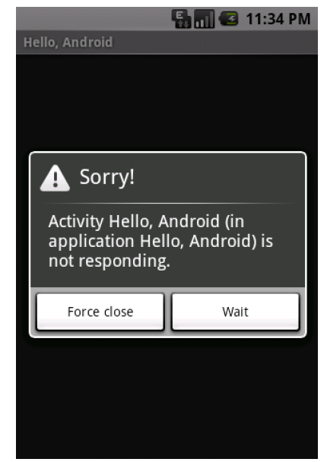
Event Handler and Android Not Responding
Android system detects no response
  Main thread (“event”/UI) does not respond to input in 5 sec

Slide 37
Networking
Net APIs
  Standard java networking APIs
  Two Http clients: HttpURLConnection and Apache Http client

Slide 38
Telephony APIs (android.telephony)
Send and receive SMS
Get mobile network info (network type, operator,…)
Get current value of network parameters (cellID, signal strength, SNR, roaming state …)
Monitor state changes (cellID, call state, connectivity …)
Get current device state (connected, idle, active)
Get device paramesters (IMSI, IMEI, device type)

Slide 39
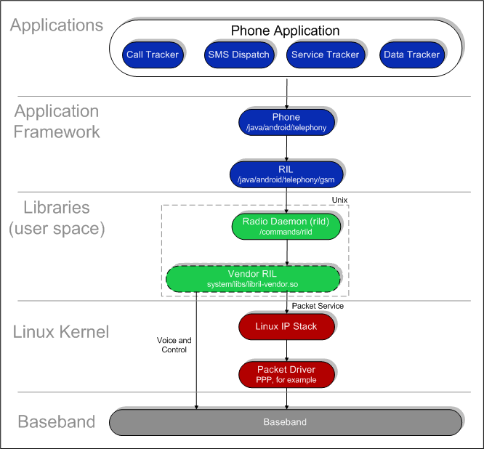
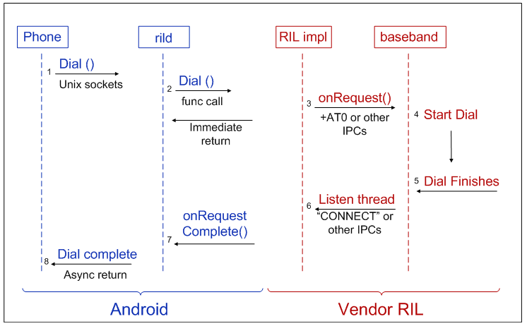
Android Telephony Deep Dive

Slide 40
Google Cloud Messaging (GCM)
Various mechanisms to keep an app in synch with changes in the server (e.g. twitter, facebook)
  Polling: app periodically polls the servers for changes
  Push: servers push changes to app
Polling can be inefficient if server data changes infrequently
  Unnecessary battery drain and network overhead (signaling and data)
Several apps polling independently without coordination can also be inefficient
  High battery drain and radio signaling every time the devices moves from IDLE to CONNECTED state

Slide 41
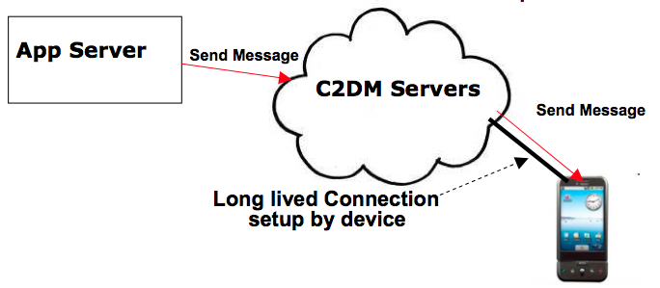
Google Cloud Messaging (Cont’d)
GCM Servers
Push notification problems
  Network firewalls prevent servers from directly sending messages to mobile devices
GCM solution
  Maintain a connection between device and Google GCM server
  Push server updates to apps on the device via this connection
  Optimize this connection to minimize bandwidth and battery consumption (e.g. adjusting the frequency of keep alive messages)

Slide 42
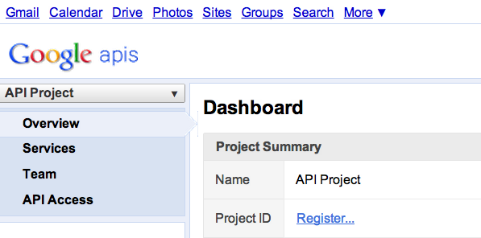
Google Cloud Messaging (Cont’d)
C2DM is deprecated, accepts no new users
Step 1
Create a Google API project from Google APIs console pagehttps://code.google.com/apis/console/#project:908058729336
  Enable GCM service
  Obtain an API key
  Create new server key
  Install helper libraries

Slide 43
Google Cloud Messaging (Cont’d)
Step 2
Write the Android app
  Copy gcm.jar file into your app classpath
  Configure manifest file for SDK version, permission
  Add broadcast receiver
  Add intent service
  Write my_app_package.GCMIntentService class
  Write main activity
import com.google.android.gcm.GCMRegistrar;
…
GCMRegistrar.checkDevice(this);
GCMRegistrar.checkManifest(this);
final String regId = GCMRegistrar.getRegistrationId(this);
if (regId.equals("")) {
GCMRegistrar.register(this, SENDER_ID);
} else {
Log.v(TAG, "Already registered");
}

Slide 44
Google Cloud Messaging (Cont’d)
Step 3
Write server-side app
  Copy gcm-server.jar file from the SDK’s gcm-server/dist directory to your server class path
  Create a servlet that can be used to receive client’s GCM registration ID
  Create a servlet to unregister registration ID
  Use com.google.android.gcm.server.Sender helper class from GCM library to send a message to client
import com.google.android.gcm.server.*;
Sender sender = new Sender(myApiKey);
Message message = new Message.Builder().build();
MulticastResult result = sender.send(message, devices, 5);

Slide 45
Online Resources
Android API: http://developer.android.com/reference/packages.html
Basics http://developer.android.com/guide/components/index.html
GCM: http://developer.android.com/guide/google/gcm/index.html

Slide 46
Questions?

