Slide 1
Cellular Networks and Mobile Computing COMS 6998-10, Spring 2013
Instructor: Li Erran Li (lel2139@columbia.edu)
http://www.cs.columbia.edu/~lierranli/coms6998-10Spring2013/
Lecture 12: Mobile Platform Security: Attacks and Defenses

Slide 2
Mobile Security Attacks and Defenses
Inter application communication related attacks (Lianhao Qu and Joseph Orilogbon on QUIRE and Akhila on XManDroid)
Permission re-delegation (confused deputy attacks)
Collusion attacks
System vulnerability based attacks (Ying-Chi Meng and Sichang Li on MoCFI)
Control flow attacks (code injection attacks)
Root exploits (e.g. adbd bug used by DroidKungfu malware)
Application specific attacks (Jill Jermyn and Snigdha Challa on texting apps)

Slide 3
19th Annual Network & Distributed System Security Symposium
Towards Taming Privilege Escalation
Attacks on Android
Alexandra Dmitrienko
Fraunhofer Institute for Secure Information Technology, Darmstadt, Germany
Sven Bugiel, Lucas Davi
TU Darmstadt/CASED,
Germany
Ahmad-Reza Sadeghi, Bhargava Shastry
Fraunhofer SIT/CASED,
Darmstadt, Germany
Thomas Fischer
Ruhr-University
Bochum
@FraunhoferSIT/CASED 2012 Alexandra Dmitrienko, NDSS 2012 DO NOT DISTRIBUTE FURTHER

Slide 4
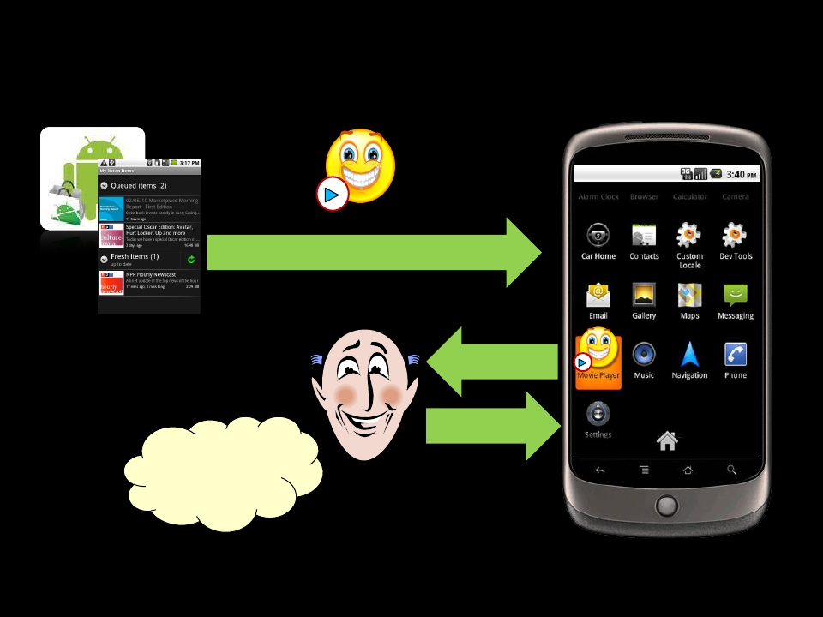
App Installation in Android
Android Market
Movie Player
Download App
Permissions
Install
Requested
permissions are
reasonable
User
@FraunhoferSIT/CASED 2012 Alexandra Dmitrienko, NDSS 2012 DO NOT DISTRIBUTE FURTHER

Slide 5
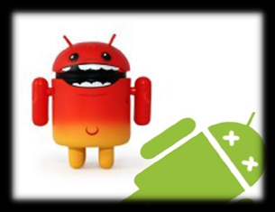
Can apps go beyond their privileges?
YES
Privilege escalation attacks
3
@FraunhoferSIT/CASED 2012 Alexandra Dmitrienko, NDSS 2012 DO NOT DISTRIBUTE FURTHER

Slide 6
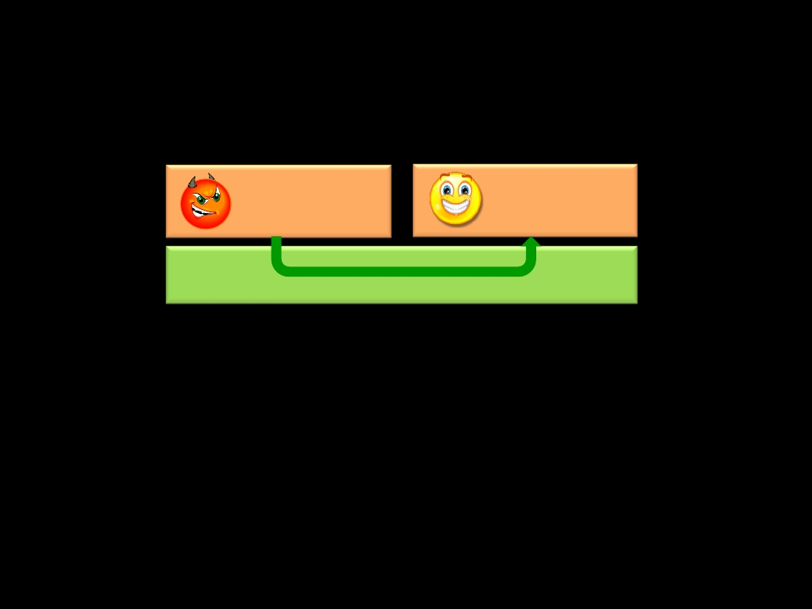
Confused Deputy Attack
Do not have a right permission? Ask your neighbor!
Malware
Privileges: none
Benign app
Privileges: P1
Android OS
Android Middleware
1) Invoke browser to download malicious files (Lineberry et al., BlackHat
2010)
2) Invoke Phone app to perform a phone call (Enck et al., TechReport 2008)
3) Invoke Android Scripting Environment to send SMS messages (Davi et al.,
ISC’2010)
4
@FraunhoferSIT/CASED 2012 Alexandra Dmitrienko, NDSS 2012 DO NOT DISTRIBUTE FURTHER

Slide 7
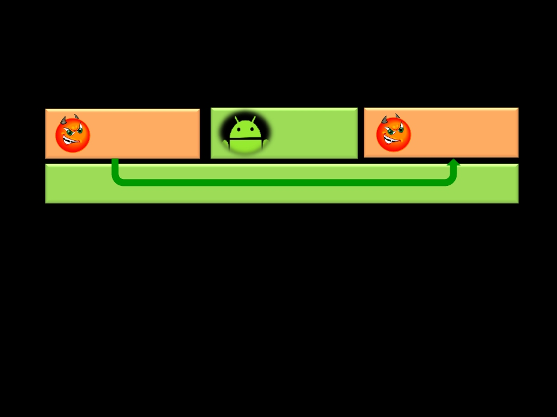
Collusion Attack
Two (or more) apps collude to launch the attack
Malware
Privileges: P1
Android
System App
Benign app
Privileges: P2
Android OS
1) Apps communicate directly
Example: Claudio Marforio et. al, TechReport ETH Zurich
5
@FraunhoferSIT/CASED 2012 Alexandra Dmitrienko, NDSS 2012 DO NOT DISTRIBUTE FURTHER

Slide 8
Collusion Attack
Two (or more) apps collude to launch the attack
Malware
Privileges: P1
Android
System App
Benign app
Privileges: P2
Android OS
2) Apps communicate via covert (e.g., volume settings) or overt (e.g.,
content providers) channels in Android System components
Example: Soundcomber (Schlegel et al., NDSS’2011)
6
@FraunhoferSIT/CASED 2012 Alexandra Dmitrienko, NDSS 2012 DO NOT DISTRIBUTE FURTHER

Slide 9
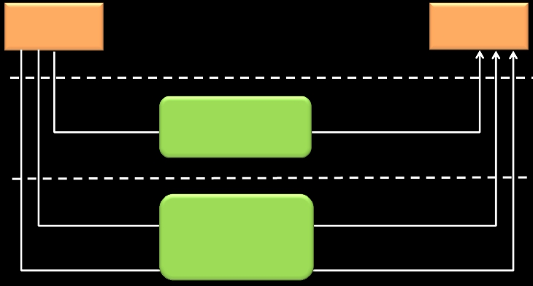
Inter-Application Communication
✴ Inter-process communication (IPC)
✴ Intents and remote procedure calls
✴ File system (files, Unix domain sockets)
✴ Network sockets
AppA
AppB
Application layer
Middleware
Linux kernel
IPC
File System
Network
Sockets
Reference
Monitor
Discretionary
access control
of Linux
@FraunhoferSIT/CASED 2012 Alexandra Dmitrienko, NDSS 2012 DO NOT DISTRIBUTE FURTHER
7

Slide 10
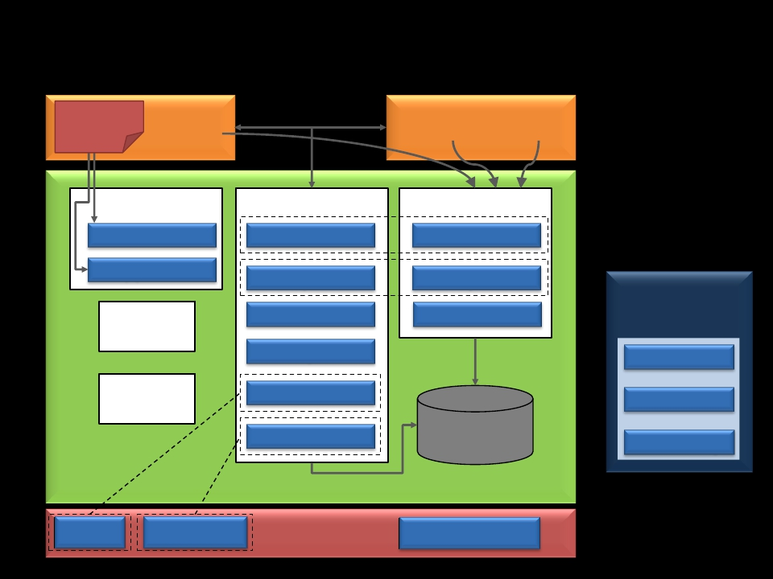
Related Work
Sensitive
Data
App A
Perm. P1
App B
Perm. P2 Perm. P3
Dalvik VM
TaintDroid
Reference Monitor
Saint
Installer
Saint
AppFence
Porscha
Mediator
Paranoid
Android
Apex
CRePE
IPC Inspection
QUIRE
TrustDroid
Apex
Kirin
Permission
Database
Static and Offline
Analysis Tools
ded
ComDroid
Stowaway
Android Middleware
QUIRE
TrustDroid
Linux Kernel
SELinux
@FraunhoferSIT/CASED 2012 Alexandra Dmitrienko, NDSS 2012 DO NOT DISTRIBUTE FURTHER
8

Slide 11
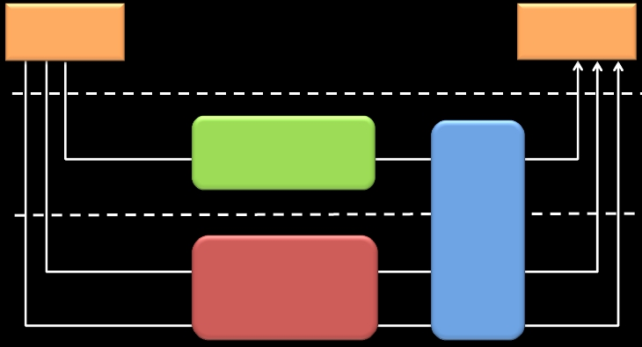
XManDroid:
eXtended Monitoring on Android
✴ Monitors all communication channels between apps
✴ Validates if the requested communication link complies to a system-
centric security policy
AppA
AppB
Application layer
Middleware
Linux kernel
IPC
File System
Network
Sockets
Reference
Monitor
Discretionary
access control
of Linux
XManDroid
@FraunhoferSIT/CASED 2012 Alexandra Dmitrienko, NDSS 2012 DO NOT DISTRIBUTE FURTHER
9

Slide 12
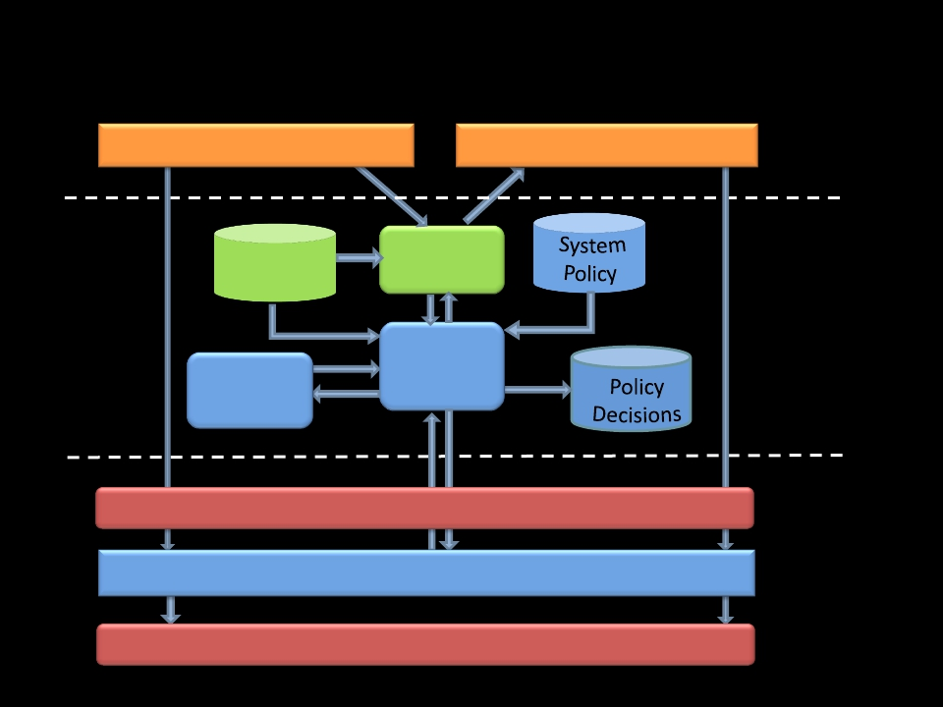
XManDroid Architecture
App A
Android
Permissions
System
View
App B
Application layer
Read/Write File/Socket
Create File/Socket
Reference
Monitor
Decision
Maker
Android Middleware
Middleware layer
Kernel layer
Linux Discretionary Access Control
XManDroid Mandatory Access Control
File System/Internet Sockets
10
@FraunhoferSIT/CASED 2012 Alexandra Dmitrienko, NDSS 2012 DO NOT DISTRIBUTE FURTHER

Slide 13
XManDroid’s SystemView:
Graph-based Representation
Android
Core
System Components
Application sandboxes
Files
IPC calls
Access to files
Socket connections
Internet sockets
11
@FraunhoferSIT/CASED 2012 Alexandra Dmitrienko, NDSS 2012 DO NOT DISTRIBUTE FURTHER

Slide 14
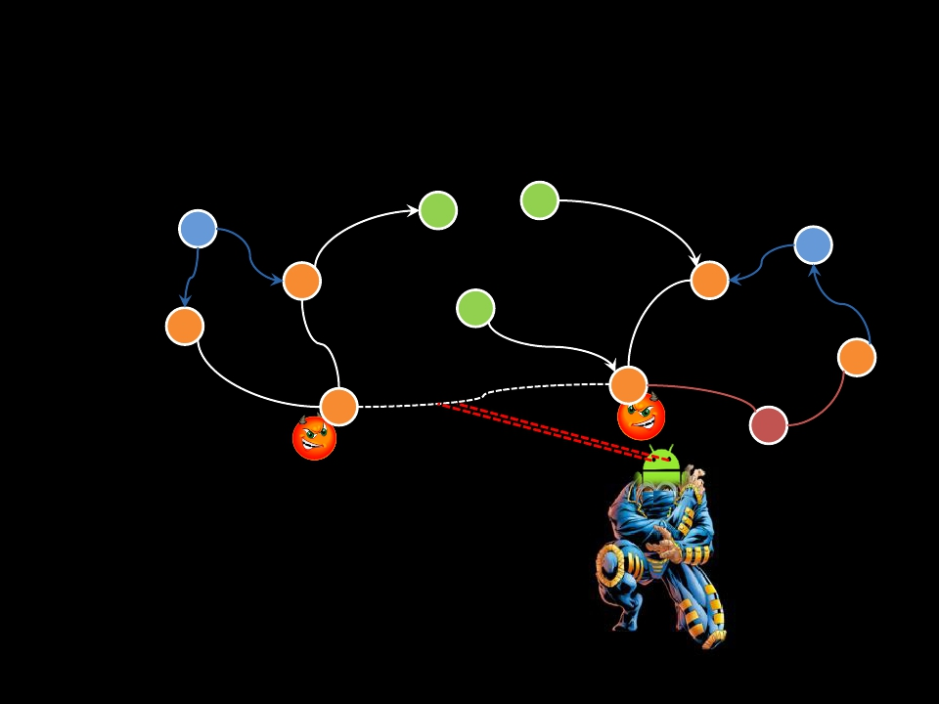
XManDroid: Simplified Example
Android
Core
C
P1
P2
B
A
Policy Rule:
✴ Sandbox A: permission P1, no P2
✴ Sandbox B: permission P2, no P1
✴ Communication type: Direct
✴ Decision: Deny
12
@FraunhoferSIT/CASED 2012 Alexandra Dmitrienko, NDSS 2012 DO NOT DISTRIBUTE FURTHER

Slide 15
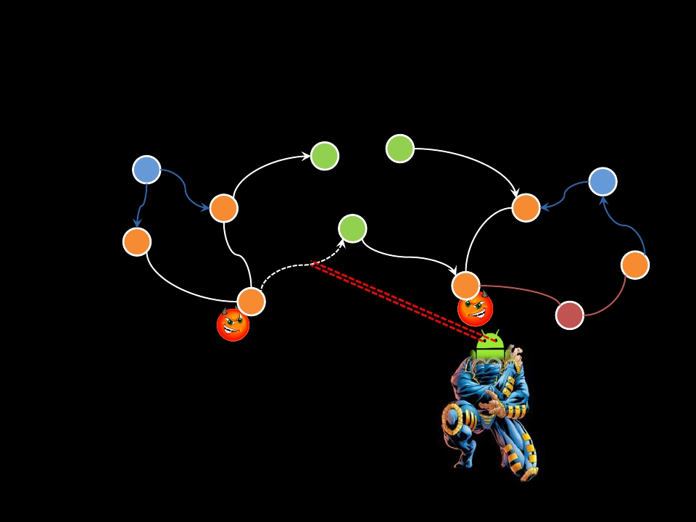
XManDroid: Simplified Example
Android
Core
C
P1
P2
B
A
Policy Rule:
✴ Sandbox A: permission P1, no P2
✴ Sandbox B: permission P2, no P1
✴ Communication type: Indirect
✴ Decision: Deny
13
@FraunhoferSIT/CASED 2012 Alexandra Dmitrienko, NDSS 2012 DO NOT DISTRIBUTE FURTHER

Slide 16
Contributions
Design
A general
framework
towards taming
privilege
escalation attacks
System-centric
policy
enforcement
Implementation
Kernel-level
mandatory access
control based on
TOMOYO
Callback channel
between kernel-
level and the
middleware
System-centric
IPC call chain
tracking for
Intents (inspired
by QUIRE)
Tests
Evaluation
Study on inter-
application
communication
14
@FraunhoferSIT/CASED 2012 Alexandra Dmitrienko, NDSS 2012 DO NOT DISTRIBUTE FURTHER

Slide 17
Evaluation
1
2
3
Effectiveness (attack prevention)
Performance
Rate of falsely denied communications
15
@FraunhoferSIT/CASED 2012 Alexandra Dmitrienko, NDSS 2012 DO NOT DISTRIBUTE FURTHER

Slide 18
Study on Application Communication
Patterns
16
@FraunhoferSIT/CASED 2012 Alexandra Dmitrienko, NDSS 2012 DO NOT DISTRIBUTE FURTHER

Slide 19
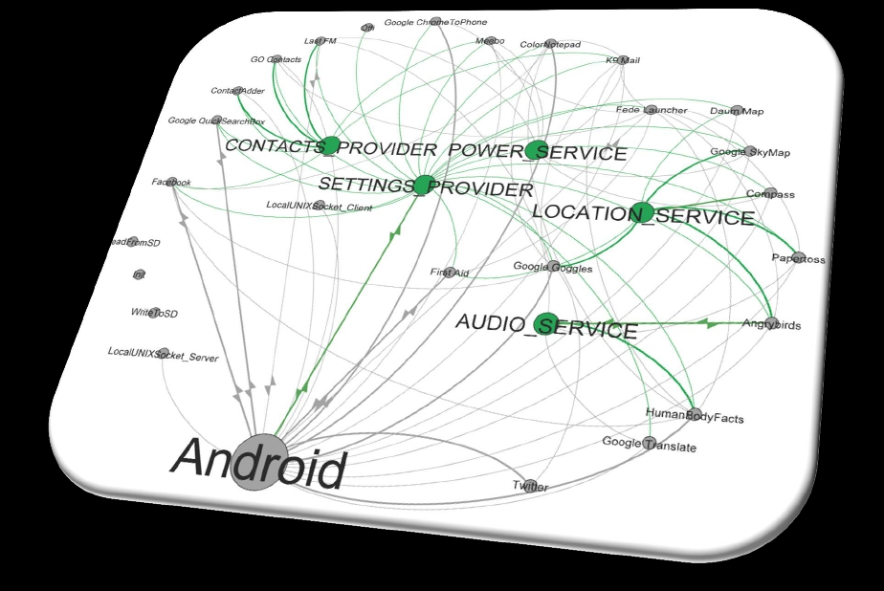
IPC-based Application Communication
17
@FraunhoferSIT/CASED 2012 Alexandra Dmitrienko, NDSS 2012 DO NOT DISTRIBUTE FURTHER

Slide 20
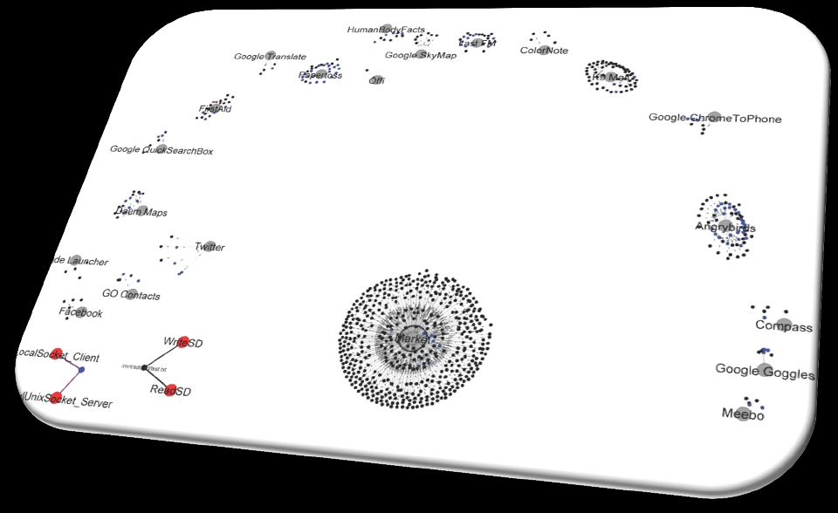
File and Socket-based Application
Communication
18
@FraunhoferSIT/CASED 2012 Alexandra Dmitrienko, NDSS 2012 DO NOT DISTRIBUTE FURTHER

Slide 21
Conclusion and Future Work
✴ First general approach towards tackling privilege escalation
attacks (at application level)
✴ Runtime monitoring, but quite efficient
✴ No false negatives
✴ No false positives, but conceptually they are possible
✴ Current work
✴
✴
✴
✴
Large scale evaluation
Automatic policy engineering
Full IPC call chain tracking
Applying XManDroid framework
for domain isolation on Android
@FraunhoferSIT/CASED 2012 Alexandra Dmitrienko, NDSS 2012 DO NOT DISTRIBUTE FURTHER
BizzTrust
19

Slide 22
1
@TU Darmstadt/CASED 2012
LucasDavi, NDSS 2012
DO NOT DISTRIBUTEFURTHER

Slide 23
2
@TU Darmstadt/CASED 2012
LucasDavi, NDSS 2012
DO NOT DISTRIBUTEFURTHER

Slide 24
3
@TU Darmstadt/CASED 2012
LucasDavi, NDSS 2012
DO NOT DISTRIBUTEFURTHER

Slide 25
4
@TU Darmstadt/CASED 2012
LucasDavi, NDSS 2012
DO NOT DISTRIBUTEFURTHER

Slide 26
5
@TU Darmstadt/CASED 2012
LucasDavi, NDSS 2012
DO NOT DISTRIBUTEFURTHER

Slide 27
BBL 1
entry
ins, ins, ins, …
exit
BBL 2
entry
ins, ins, ins, …
exit
BBL 4
entry
ins, ins, ins, …
exit
BBL 3
entry
ins, ins, ins, …
exit
BBL 5
entry
ins, ins, ins, …
exit
Entry: Any instruction that is target of a branch (e.g., first instruction of a function)
Exit:
Any branch (e.g., indirect or direct jump and call, return)
6
@TU Darmstadt/CASED 2012
LucasDavi, NDSS 2012
DO NOT DISTRIBUTEFURTHER

Slide 28
BBL 1
BBL 3
entry
ins, ins, ins, …
exit
entry
ins, ins, ins, …
exit
Malicious Code
Shellcode
BBL 2
entry
ins, ins, ins, …
exit
1
Code Injection
2 ROP; ret2libc
LibraryCode
InstructionSequences
LibraryFunctions
BBL 4
entry
ins, ins, ins, …
exit
BBL 5
entry
ins, ins, ins, …
exit
Entry: Any instruction that is target of a branch (e.g., first instruction of a function)
Exit:
Any branch (e.g., indirect or direct jump and call, return)
7
@TU Darmstadt/CASED 2012
LucasDavi, NDSS 2012
DO NOT DISTRIBUTEFURTHER

Slide 29
8
@TU Darmstadt/CASED 2012
LucasDavi, NDSS 2012
DO NOT DISTRIBUTEFURTHER

Slide 30
BBL 1
label_1
entry
ins, ins, ins, …
exit
BBL 3
label_3
entry
ins, ins, ins, …
exit
BBL 2
label_2
entry
ins, ins, ins, …
exit
1.
Insert LABEL instructions (that
serve as nop instructions) at the
beginning of each BBL
BBL 4
label_4
entry
ins, ins, ins, …
exit
BBL 5
label_5
entry
ins, ins, ins, …
exit
9
@TU Darmstadt/CASED 2012
LucasDavi, NDSS 2012
DO NOT DISTRIBUTEFURTHER

Slide 31
BBL 1
label_1
entry
ins, ins, ins, …
exit
BBL 3
label_3
entry
ins, ins, ins, …
exit
BBL 2
label_2
entry
ins, ins, ins, …
exit
2.
Rewrite all exit instructions with
a control-flowcheck
BBL 4
label_4
entry
ins, ins, ins, …
exit
BBL 5
label_5
entry
ins, ins, ins, …
exit
CFI Check:
*BBL3[exit] == label_5
10
@TU Darmstadt/CASED 2012
LucasDavi, NDSS 2012
DO NOT DISTRIBUTEFURTHER

Slide 32
BBL 1
BBL 3
label_1
entry
ins, ins, ins, …
exit
BBL 2
label_2
entry
ins, ins, ins, …
exit
BBL 4
label_4
entry
ins, ins, ins, …
exit
label_3
entry
ins, ins, ins, …
exit
1
2
BBL 5
label_5
entry
ins, ins, ins, …
exit
Malicious Code
Shellcode
LibraryCode
InstructionSequences
LibraryFunctions
CFI Check:
*BBL3[exit] == label_5
11
@TU Darmstadt/CASED 2012
LucasDavi, NDSS 2012
DO NOT DISTRIBUTEFURTHER

Slide 33
12
@TU Darmstadt/CASED 2012
LucasDavi, NDSS 2012
DO NOT DISTRIBUTEFURTHER

Slide 34
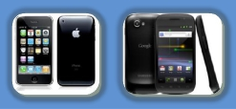
Intel x86 Approach
[Abadi et al., CCS 2005]
ARM
•Not compatible to application
signing
•Requires sophisticated binary
instrumentation framework (Vulcan)
and debugging information
•Program counter directly accessible
•No dedicated return instructions
•Side-Effects of control-flow
instructions, e.g., POP {r4-r7,pc}
•ARM supports two instruction sets
(ARM/THUMB)
Smartphones
•Application Signing
•Application Encryption
•Typically, no access to source code
13
@TU Darmstadt/CASED 2012
LucasDavi, NDSS 2012
DO NOT DISTRIBUTEFURTHER

Slide 35
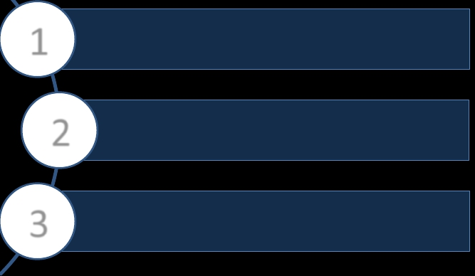
Contributions
1
3
First control-flow integrity framework for
smartphone platforms
We present rewriting techniques that tackle
unique challenges of smartphones
Our prototype for iOS requires no source code
and efficiently performs CFI at runtime
2
14
@TU Darmstadt/CASED 2012
LucasDavi, NDSS 2012
DO NOT DISTRIBUTEFURTHER

Slide 36
10011…
Unprotectedand
01100…
encryptediOSBinary
1
Preprocessor
Decryption
Disassembling
2
Unprotectedplain
iOSBinary
3
Generate Rewriting
Information
Static Analysis
Patchfile
Runtime Enforcement
Instructions…
call Func_A
4
Control-Flow Graph
Generator
Control-Flow
Graph
15
@TU Darmstadt/CASED 2012
LucasDavi, NDSS 2012
DO NOT DISTRIBUTEFURTHER

Slide 37
10011…
Unprotectedand
01100…
encryptediOSBinary
1
Preprocessor
Decryption
Disassembling
Static Analysis
Runtime Enforcement
MoCFI Library
Load-TimeModule RuntimeModule
Binary Rewriting CFI Enforcement
6
CFIProtected
iOSBinary
2
Unprotectedplain
iOSBinary
3
Generate Rewriting
Information
5
Instructions…
call Func_A
Patchfile
4
Control-Flow Graph
Generator
Control-Flow
Graph
16
@TU Darmstadt/CASED 2012
LucasDavi, NDSS 2012
DO NOT DISTRIBUTEFURTHER

Slide 38
10011…
Unprotectedand
01100…
encryptediOSBinary
1
Preprocessor
Decryption
Disassembling
Static Analysis
Runtime Enforcement
MoCFI Library
Load-TimeModule RuntimeModule
Binary Rewriting CFI Enforcement
6
2
Unprotectedplain
iOSBinary
3
5
Instructions…
call Func_A
Generate Rewriting
Information
Instructions…
call CFI_Library
Patchfile
CFIProtected
iOSBinary
7
4
Control-Flow Graph
Generator
Control-Flow
Graph
17
@TU Darmstadt/CASED 2012
LucasDavi, NDSS 2012
DO NOT DISTRIBUTEFURTHER

Slide 39
18
@TU Darmstadt/CASED 2012
LucasDavi, NDSS 2012
DO NOT DISTRIBUTEFURTHER

Slide 40
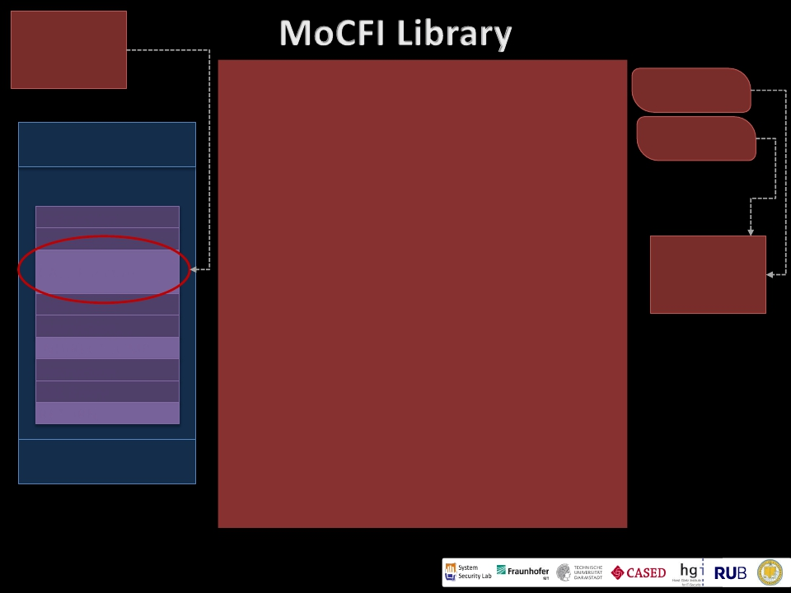
4 Byte
THUMB
Instruction!
Original iOS Binary
Header
Code
Instruction
Instruction, …
CALL Function
Instruction
Load-Time Module – Binary Rewriting
Control-Flow
Graph
Shadow
Stacks
MoCFI
Runtime
Module
Instruction, …
INDIRECT JUMP
Instruction
BBL Entry
RETURN
Data
“BBL Entry” refers to an instruction that is target of other branch
instructions in the program
19
@TU Darmstadt/CASED 2012
LucasDavi, NDSS 2012
DO NOT DISTRIBUTEFURTHER

Slide 41
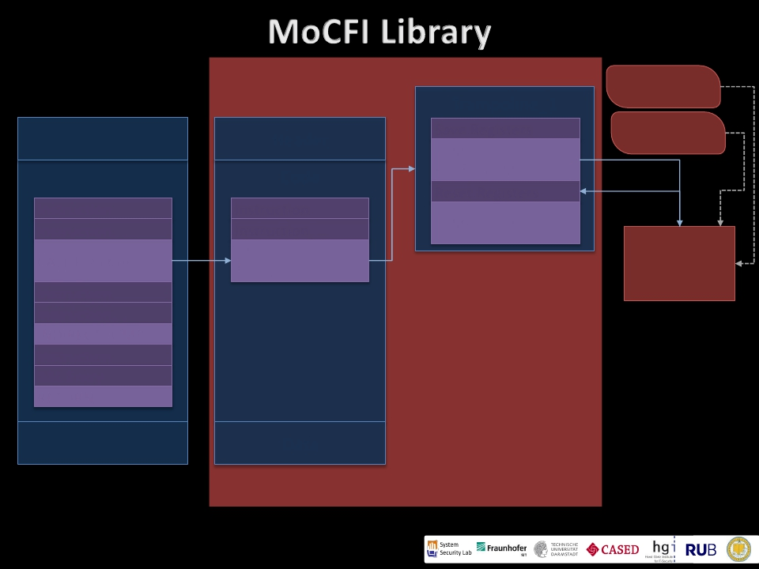
Load-Time Module – Binary Rewriting
Control-Flow
Original iOS Binary
Header
Code
Instruction
Instruction, …
CALL Function
Instruction
Rewritten iOS Binary
Header
Code
Instruction
Instruction, …
CALL
Trampoline_1
Trampoline_1
Save Registers
JUMP
Runtime_Module
Reset Registers
JUMP Function
Graph
Shadow
Stacks
MoCFI
Runtime
Module
Instruction, …
INDIRECT JUMP
Instruction
BBL Entry
RETURN
Data
Data
“BBL Entry” refers to an instruction that is target of other branch
instructions in the program
20
@TU Darmstadt/CASED 2012
LucasDavi, NDSS 2012
DO NOT DISTRIBUTEFURTHER

Slide 42
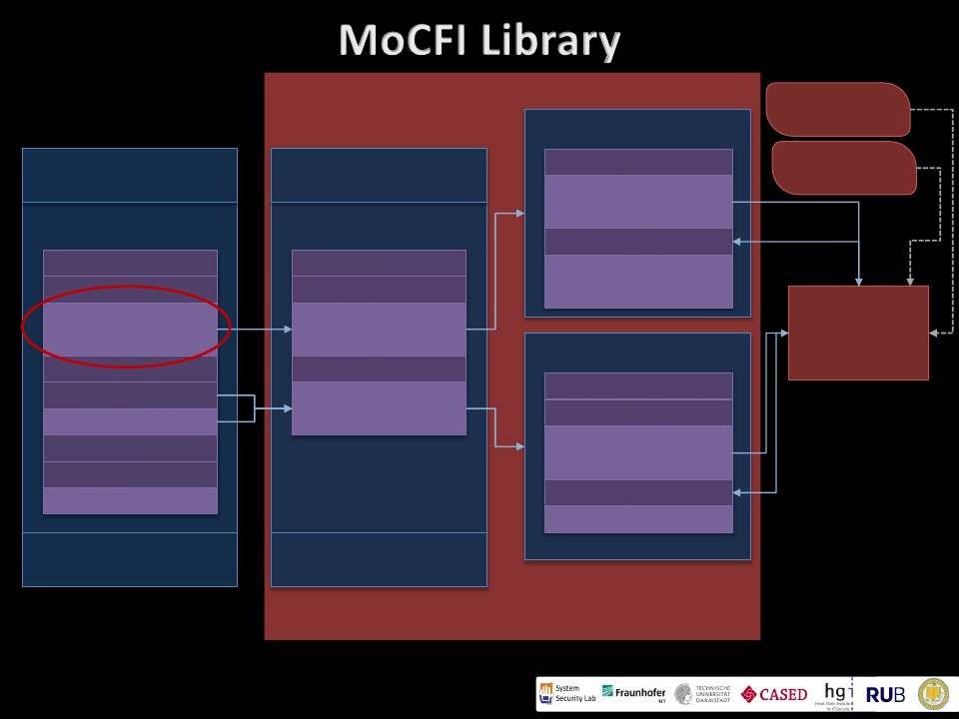
Load-Time Module – Binary Rewriting
Control-Flow
Original iOS Binary
Header
Code
Instruction
Instruction, …
CALL Function
Instruction
Instruction, …
INDIRECT JUMP
Instruction
BBL Entry
RETURN
Data
Rewritten iOS Binary
Header
Code
Instruction
Instruction, …
CALL
Trampoline_1
Instruction
JUMP
Trampoline_2
Data
Trampoline_1
Save Registers
JUMP
Runtime_Module
Reset Registers
JUMP Function
Trampoline_2
Previous Instruction
Save Registers
JUMP
Runtime_Module
Reset Registers
INDIRECT JUMP
Graph
Shadow
Stacks
MoCFI
Runtime
Module
“BBL Entry” refers to an instruction that is target of other branch
instructions in the program
21
@TU Darmstadt/CASED 2012
LucasDavi, NDSS 2012
DO NOT DISTRIBUTEFURTHER

Slide 43
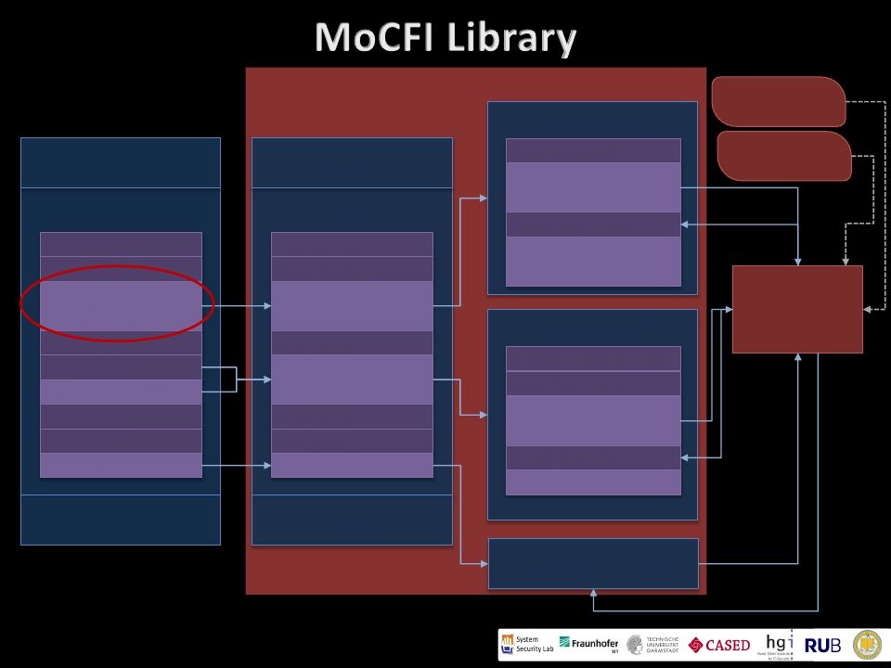
Load-Time Module – Binary Rewriting
Control-Flow
Original iOS Binary
Header
Code
Instruction
Instruction, …
CALL Function
Instruction
Instruction, …
INDIRECT JUMP
Instruction
BBL Entry
RETURN
Data
Rewritten iOS Binary
Header
Code
Instruction
Instruction, …
CALL
Trampoline_1
Instruction
JUMP
Trampoline_2
Instruction
BBL Entry
#ILLEGAL INS
Data
Trampoline_1
Save Registers
JUMP
Runtime_Module
Reset Registers
JUMP Function
Trampoline_2
Previous Instruction
Save Registers
JUMP
Runtime_Module
Reset Registers
INDIRECT JUMP
Graph
Shadow
Stacks
MoCFI
Runtime
Module
Exception Handler
“BBL Entry” refers to an instruction that is target of other branch
instructions in the program
22
@TU Darmstadt/CASED 2012
LucasDavi, NDSS 2012
DO NOT DISTRIBUTEFURTHER

Slide 44
⬥ Library Injection
⬥ Our MoCFI library is injected into the process of the
application by setting DYLD_INSERT_LIBRARIES
⬥ Jailbreak?
⬥ We require a jailbreak for setting one environment
variable and installing our library
⬥ In order to perform binary rewriting, we require the
dynamic code-signing entitlement
23
@TU Darmstadt/CASED 2012
LucasDavi, NDSS 2012
DO NOT DISTRIBUTEFURTHER

Slide 45
⬥ Performance Measurements
⬥ Worst-Case Scenario: quicksort
application that frequently demands a
CFI check
Performance Measurements for quicksort
Factor Without MoCFI With MoCFI
n=100 0.047 ms 0.432 ms
⬥ Average overhead measurement with
gensystek
n=1,000
n=10,000
0.473 ms
6.725 ms
6.186 ms
81.163 ms
100
80
60
40
20
0
with MoCFI
without MoCFI
Time in Seconds
FPU/ALU
4,87
PI Calc
3,85
MD5 Calc
1,19
ScrShot
1,02
RAM
5,00
Disk
1,21
Quartz2D
1,03
ResizeIMG
1,01
Trans3D
1,09
Benchmarks and Slowdown Factor for gensystek
⬥ Applied MoCFI to popular iOS apps (e.g., Facebook, Texas
Holdem, Minesweeper)
24
@TU Darmstadt/CASED 2012
LucasDavi, NDSS 2012
DO NOT DISTRIBUTEFURTHER

Slide 46
⬥ First CFI framework for smartphone platforms
⬥ It performs CFI enforcement on-the-fly at runtime
⬥ Compatible to application signing/encryption and
memory randomization (e.g., ASLR)
⬥ Requires no access to source code
⬥ Ongoing Work
⬥ CFI for native iOS libraries
⬥ Formal Analysis
⬥ CFI for Android
25
@TU Darmstadt/CASED 2012
LucasDavi, NDSS 2012
DO NOT DISTRIBUTEFURTHER

Slide 47
Guess Who’s Texting You?
Evaluating the Security of Smartphone Messaging Applications
Sebastian Schrittwieser

Slide 48
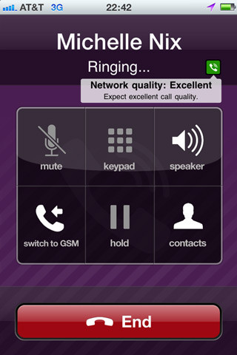
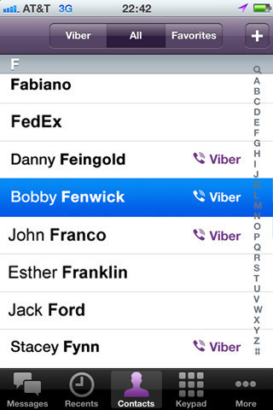
Smartphone Messaging
Aim at replacing traditional text messaging (SMS) and GSM/CDMA/3G calls
Free phone calls and text messages over the Internet
Novel authentication concept
Phone number used as single authenticating identifier

Slide 49
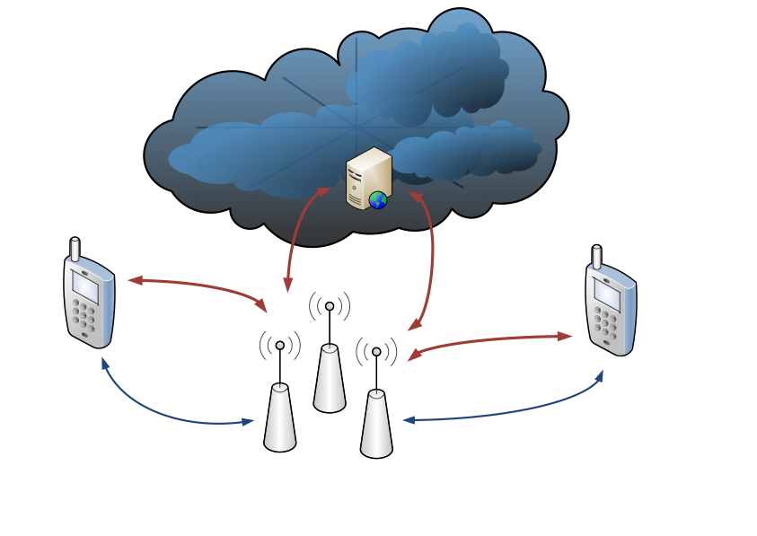
Internet
Telecom infrastructure

Slide 50
Motivation
 | Traditional SMS/talk | Messenger/VoIP Apps
Protocol | proprietary | HTTP(S), XMPP
Security | cryptographically sound authentication (SIM card) | application depended, much weaker authentication (phone number, IMEI, UDID)
Users’ perception | SMS/talk

Slide 51
Evaluation
Authentication Mechanism and Account Hijacking
Sender ID Spoofing / Message Manipulation
Unrequested SMS / phone calls
User Enumeration
Modifying Status Messages

Slide 52
Experimental Setup
Samsung Nexus S running Android 2.3.3 and Apple iPhone 4 running iOS 4.3.3
SSL proxy to read encrypted HTTPS traffic
Used to understand the protocol, not for the actual attack (i.e., MITM between victim and server)!

Slide 53
Certificates?

Slide 54
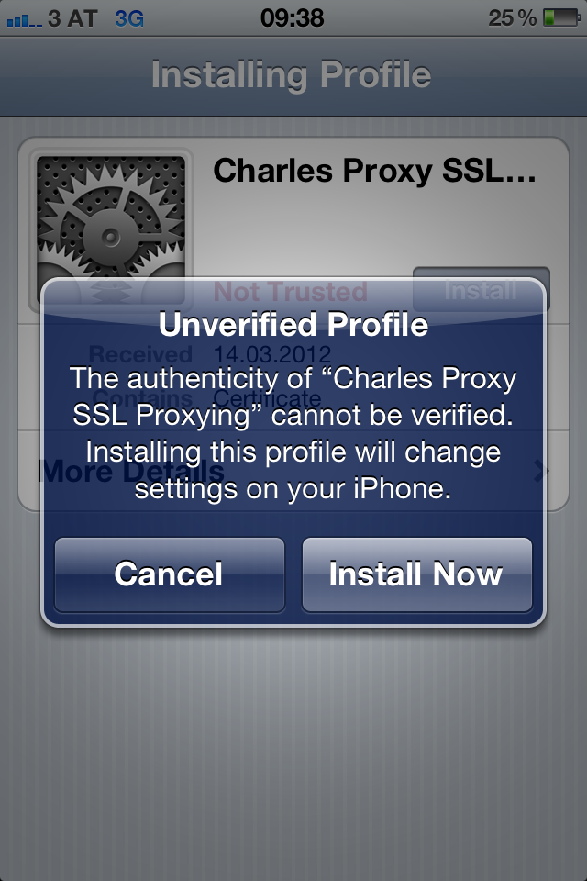

Slide 55
WhatsApp
eBuddy XMS
WowTalk
Viber
HeyTell
Forfone
Voypi
Tango
EasyTalk

Slide 56
WhatsApp
Paper:
Guess who’s texting you? Evaluating the Security of Smartphone Messaging Applications
Schrittwieser, S., Frühwirt, P., Kieseberg, P., Leithner, M., Mulazzani, M., Huber, M., Weippl, E., NDSS 2012

Slide 57
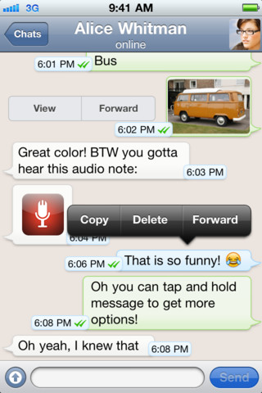
WhatsApp
Instant Messaging
Status messages
23+ million users worldwide (estimation)
> 10 billion messages per day
Clients available for Android, iOS, Symbian and Blackberry

Slide 58
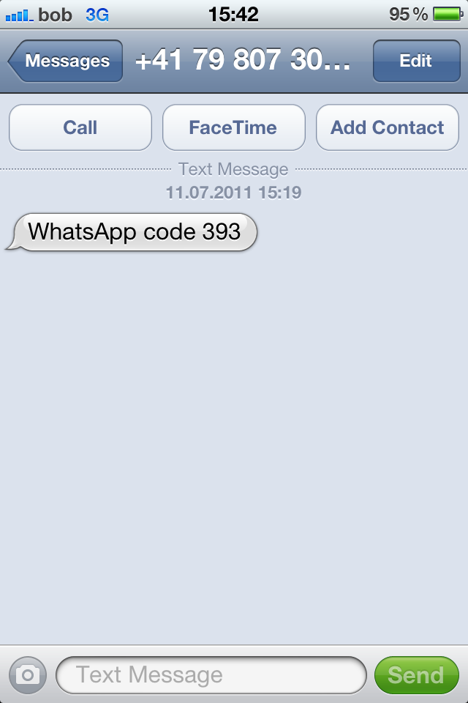
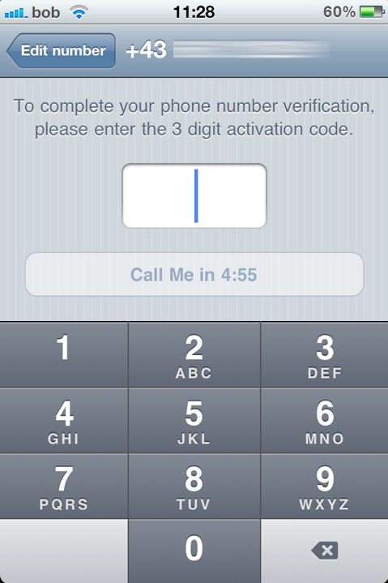
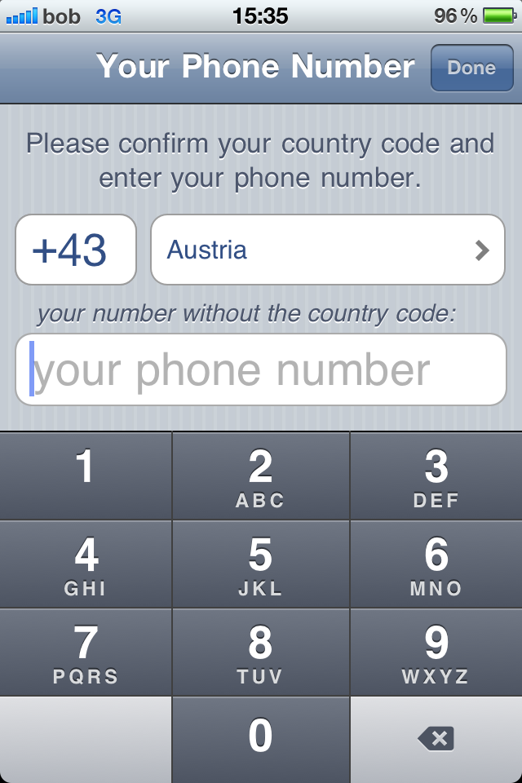

Slide 59
Authentication in WhatsApp

Slide 60
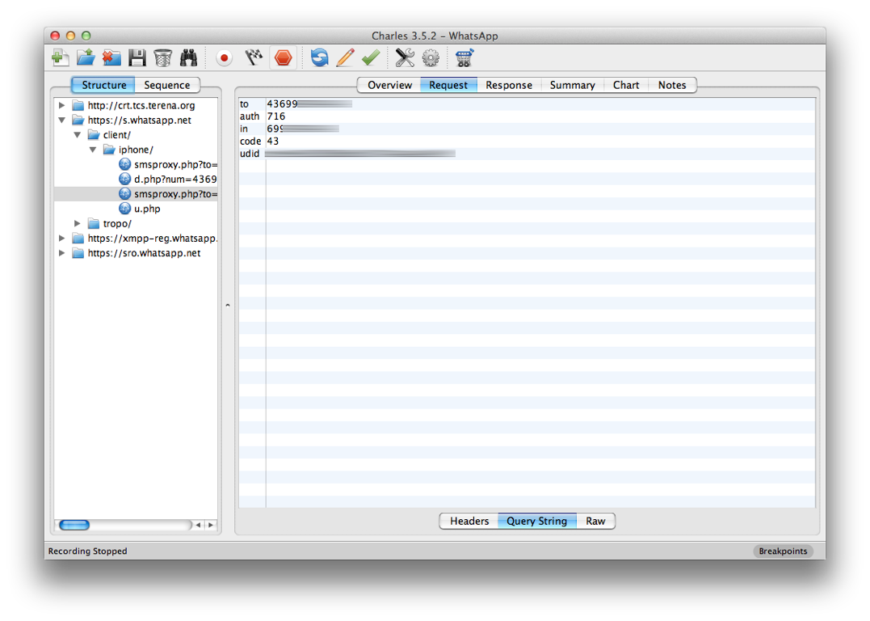

Slide 61
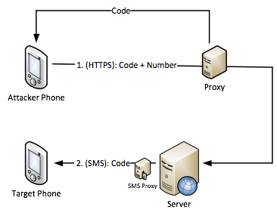
Attack against authentication

Slide 62
Attack against authentication
Intercepting the connection between the server and the attacker’s phone
The victim’s phone isn’t involved in the attack at all
Similar attacks successful in 6 out of 9 tested applications

Slide 63
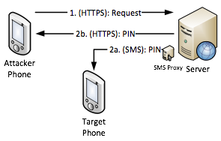
WowTalk

Slide 64
Free SMS (WhatsApp)
Authentication code in HTTPS request can be replaced with arbitrary text
No server-side validation (command injection?)
Forwarded to SMS proxy and sent via SMS
Can be misused for sending free SMS

Slide 65
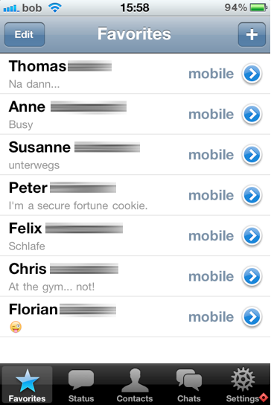
Status Messages

Slide 66
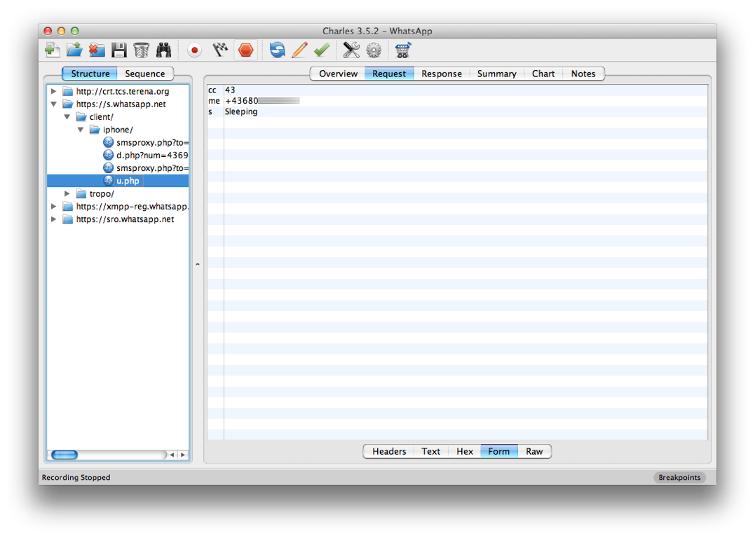

Slide 67
https://s.whatsapp.net/client/iphone/u.php?cc=countrycode&me=phonenumber&s=statusmessage

Slide 68
Sender ID spoofing
Example: Forfone
Messages are authenticated by IMEI (Android) or UDID (iOS)
Both numbers can be accessed by 3rd party applications
Voypi: no authentication at all

Slide 69
User Enumeration
Applications upload the user’s address book to the server
Server compares the contained phone numbers to already registered phone numbers
Server returns a subset list containing only phone numbers that are registered
Entire user base enumeration?

Slide 70
User Enumeration
US area code 619 (Southern San Diego)
Number range: +1 (619) XXXXXXX
10 million possible phone numbers
Uploaded entire number range in chunks of 5000 numbers each
WhatsApp returned a subset containing 21.095 (active) phone numbers

Slide 71
On vacation
At work ... Bleh.
Sleeping
Missing my love!
Heartbroken
Nicaragua in
4 days!!
On my way to Ireland!
at work but not doing shit
I’m never drinking again

Slide 72
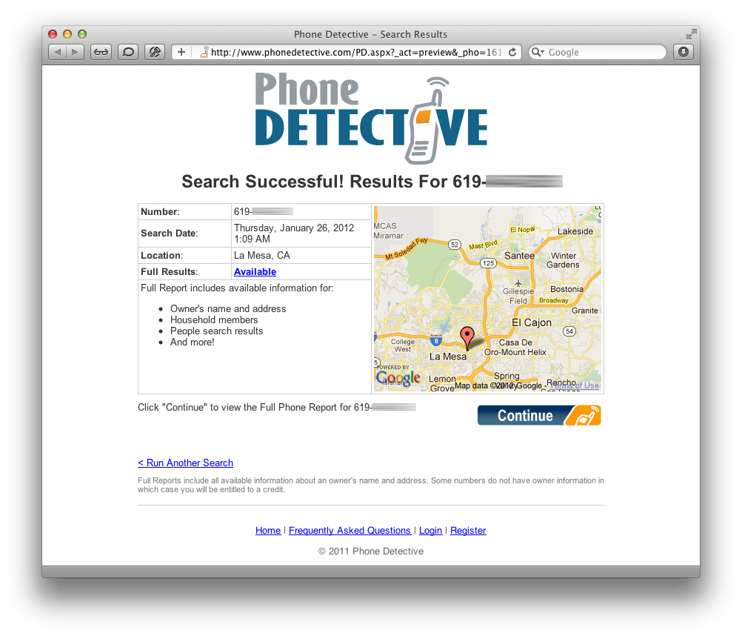

Slide 73
User Enumeration
Entire Austria (population: 8.3 million)
4 carriers, 12.3 million SIM cards
Uploaded entire number range in chunks of 5000 numbers each
Server returned 182.793 WhatsApp users (phone number + status message) in less than 5 hours

Slide 74
Results
 | Account Hijacking | Spoofing/Manipulation | Unrequested SMS | Enumeration | Other Vulnerabilities
WhatsApp | yes | no | yes | yes | yes
Viber | no | no | yes | yes | no
eBuddy XMS | no | no | yes | yes | no
Tango | yes | no | yes | yes | no
Voypi | yes | yes | yes | yes | yes
Forfone | no | yes | yes | yes | no
HeyTell | yes | no | no | limited | no
EasyTalk | yes | no | yes | yes | no
Wowtalk | yes | no | yes | yes | yes

Slide 75
Responsible Disclosure
Research between spring and fall 2011
Vendors notified in November 2011
Vulnerabilities weren’t made public until NDSS
WhatsApp fixed some vulnerabilities:
Account hijacking & free SMS
(Modifying status messages)

Slide 76
Independent Results (WhatsApp)
Andreas Kurtz (June 2011)
account hijacking
SEC Consult Vulnerability Lab (September 2011)
updating arbitrary users' status
account hijacking (brute force)
usage of plain text protocols
Several blog posts on WhatsApp security in 2011

Slide 77
Conclusions
6 out of 9 tested applications have broken authentication mechanisms
Many other vulnerabilities
All identified flaws stem from well-known software design and implementation errors
Trusting the client
No input validation
No/weak authentication mechanisms

Slide 78
Additional Slides
Permission Re-delegation: Attacks and Defenses

Slide 79
Permission Re-delegation: Attacks and Defenses
Adrienne Porter Felt¹, Helen J Wang², Alexander Moshchuk², Steve Hanna¹, Erika Chin¹
¹University of California, Berkeley
²Microsoft Research

Slide 80
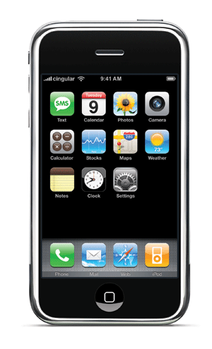
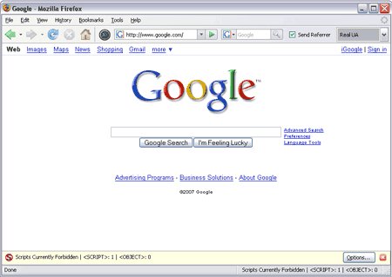
modern client platforms
Applications are untrusted, or partially trusted
Isolated from each other, except for IPC
By default, denied access to private devices and data
Users explicitly grant permissions for devices, data
Each application may have its own set of permissions
Courtesy: Felt et. al

Slide 81
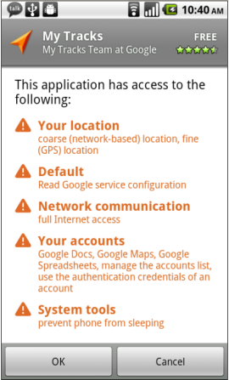
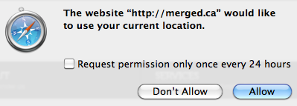
permissions
Android, iOS, HTML5, browser extensions…
Courtesy: Felt et. al

Slide 82
permission re-delegation
Permission re-delegation occurs when an application without a permission gains additional privileges through another application
A special case of the confused deputy problem
Privilege obtained through user permissions
Courtesy: Felt et. al
Notes:
We have client platforms with both per-application permissions and application communication. A privileged application that accidentally or carelessly provides a public interface can provide a path for another application to access a protected resource without the appropriate permission. We call such an attack a permission re-delegation attack.

Slide 83
Demo malware
pressButton(0)
Settings
toggleWifi()
Permission System
API
Courtesy: Felt et. al

Slide 84
Outline
Threat model
Permission re-delegation is a real problem, and systems should not permit permission re-delegation
We propose IPC Inspection as a defense mechanism
Courtesy: Felt et. al

Slide 85
The permission system
Permission system enforces user’s permission policy
Malware
Deputy
toggleWifi()
toggleWifi()
Permission System
API
Courtesy: Felt et. al
Notes:
The purpose of this slide is to help assert that a system-enforced mechanism is better than a developer-enforced mechanism

Slide 86
The deputy
Has user authorization
Not malicious, but not a security watchdog
Exposes public services Confused? Careless?
Malware
Malware
Deputy
toggleWifi()
Permission System
API
Courtesy: Felt et. al

Slide 87
The attacker
User installs/runs it, but doesn’t trust it
Exploits a deputy to access a resource
Malware
Malware
pressButton(0)
Deputy
toggleWifi()
Permission System
API
Courtesy: Felt et. al

Slide 88
Real world permission re-delegation attacks
Android case study,
precautionary for the future of the web
Courtesy: Felt et. al

Slide 89
Identifying candidates
Two necessary preconditions for an attack:
Has a dangerous permission
Has a public interface
Analyzed manifests of 872 Android applications
16 system apps, 756 most popular, 100 recently uploaded
320 apps (37%) are candidates for attacks
Courtesy: Felt et. al

Slide 90
Finding exploits
Built tool for finding attacks
Call graph analysis: find paths from public entry points to protected API calls
Manually verified all exploits
Public
entry points
API calls
Courtesy: Felt et. al
Notes:
Disassembled applications
Built the call graph
Looked for paths from public entry points to dangerous API calls
Mention that it’s for “proof of concept” – this is why we do not provide either a false positive or false negative analysis

Slide 91
attacks
Built attacks using 5 of the 16 system apps
Found 15 attacks in the 5 applications
Several confirmed and fixed
This is a lower bound; likely more exist
Courtesy: Felt et. al

Slide 92
Attack on the settings app
Demo malware
Message: 0://0#0
User pressed button[0]
Settings
com.android.settings.widget. SettingsAppWidgetProvider
wifiManager.setWifiEnabled(true)
Permission System
API
Courtesy: Felt et. al

Slide 93
More example attacks
DeskClock:
Start an internal service
Tell it to infinitely vibrate with a WAKE_LOCK on
Phone:
Trigger the “phone call answered” message receiver
Phone call will be silenced, vibrate cancelled
Courtesy: Felt et. al
Notes:
Also attacks in the Music player and Launcher applications

Slide 94
Preventing permission re-delegation
Courtesy: Felt et. al

Slide 95
Our goals
We don’t want to rely on application developers for prevention
Enable the system to prevent permission re-delegation
We don’t want to break applications
Courtesy: Felt et. al
Notes:
Developers can’t be trusted to prevent these types of attacks. They make mistakes! As we just showed, a third of the built-in Android system applications have these attacks – and those apps were written by Google Android engineers, who are probably among the best developers out there.
If you don’t want to place the responsibility on a system, you’ll get a very different looking defense mechanism. The next talk from Rice presents such a system.

Slide 96
IPC Inspection
When a deputy receives a message, system reduces deputy’s permissions (for the session) to: {requester’s permissions} {deputy’s permissions}
A deputy’s current set of permissions captures its communication history
Deputy can specify who can(not) send it messages
Generalizes stack inspection to IPC calls
Courtesy: Felt et. al
Notes:
Say that we are focused on preventing access to API calls, not tracking the resulting data

Slide 97
Handling a potential attack
Time-of-use system
Add a new runtime prompt for permission re-delegation
Install-time system
Requester must statically ask for necessary permissions
Permission re-delegation is simply blocked at runtime
Courtesy: Felt et. al
Notes:
When I say “prevent permission re-delegation”, I don’t mean that I want to stop applications from communicating with each other. Instead, our goal is to keep the decision of what applications have what permissions in the user’s hands.

Slide 98
Application instances
Deputy might need to service user and multiple app requesters simultaneously
Solution: create one instance per request
User interacts with primary instance
When new interaction starts, create a new “application instance”
Each instance has its own set of current permissions
However, instances share app storage, etc.
Courtesy: Felt et. al

Slide 99
implementation
Android implementation: modify PackageManager, ActivityManager
PackageManager installs applications, stores permissions, enforces permission requirements
ActivityManager notifies PackageManager when relevant events happen, e.g. starting Activity, receiving Broadcast Intent
A few hundred lines of code
Courtesy: Felt et. al

Slide 100
evaluation
Do we break applications?
Do we stop attacks?
Courtesy: Felt et. al

Slide 101
Broken applications
20 Android applications
Developers might need to make changes to these applications:
Intentional Deputy | 5 applications (25%)
Requester | 6 applications (30%)
One application is both an intentional deputy and a requester
Of those requesters: 2 of 6 requesters (10% of apps) need to add permissions
Courtesy: Felt et. al
Notes:
20 randomly selected applications

Slide 102
Effectiveness at Attack prevention
20 Android applications
IPC Inspection prevents these from being exploited:
Unintentional Deputy | 4 applications (20%)
Also stops all the attacks on the built-in system applications
Courtesy: Felt et. al
Notes:
20 randomly selected applications

Slide 103
Conclusion
Real world permission re-delegation vulnerabilities exist
A third of Android system applications contain permission re-delegation attacks
Future systems should be designed to prevent permission re-delegation
IPC Inspection: an OS mechanism that prevents permission re-delegation
Install-time: some requesters will need to add permissions
Courtesy: Felt et. al

