Slide 1
Cellular Networks and Mobile Computing
COMS 6998-10, Spring 2013
Instructor: Li Erran Li (lel2139@columbia.edu)
http://www.cs.columbia.edu/~lierranli/coms6998-10Spring2013/
Lecture 10: Mobile Malware

Slide 2
Announcement
Lab sessions on iOS and Android
  Send in your suggested topics
Next lecture by Akhila
  instructor out of town

Slide 3
Review of Previous Lectures on Mobile Cloud Computing
What is the difference between APNS, GCM and Thialfi?

Slide 4
Review of Previous Lectures on Mobile Cloud Computing (Cont’d)
Push notification service
  Unreliable: APNS, GCM
  Reliable: Thialfi (has a notion of objects)
Notes:
(1) C2DM and APNS are essentially messaging channels - they don't have a concept of allowing applications to register for multiple objects with each object being shared by multiple users. They simply allow a cloud service to send a message to mobile phone. That's it.
(2) We did start out with a one table design but quickly realized that we need the second table to be partitioned on client ids so that we can store a client's registrations, pending notifications, etc. Otherwise, a client that comes back online has to (potentially) read 1000s of rows in the Matcher table to determine if there is a new notification for it.

Slide 5
Thialfi Architecture
Client library
Registrations, notifications,
acknowledgments
Client
Data center
Client
Bigtable
Registrar
Each server handles a contiguous
range of keys,
Each server maintains an in-memory
version
Bigtable: log structured, fast write
Object
Bigtable
Notifications
Application Backend
Matcher
Matcher: Object ID → registered clients, version
Registrar: Client ID → registered objects, notifications
Courtesy: Adya et al.
Notes:
Use an internal Google infrastructure publish/subscribe service to disseminate messages to data centers.

Slide 6
Thialfi: Life of a Notification
Client C2
x
Ack: x, v7
C1: x, v7
Data center
Client
Bigtable
Notify: x, v7
Registrar
C2: x, v7
C1: x, v5
C2: x,
C1: x, v7
C2: x, v7
x, v7
Publish(x, v7)
Object
Bigtable
Matcher
x: v5; C1, C2
x: v7; C1, C2
x: v7; C1, C2
Courtesy: Adya et al.

Slide 7
Review of Previous Lecture (Cont’d)
How to classify location based services?

Slide 8
A Taxonomy of Applications
 | Personal | Social
Current location | Driving directions, Nearby restaurants | Friend finder, Crowd scenes
Past locations | Personal travel journal, Geocoded photos | Post-it notes, Recommendations
Tracks | Personalized Driving Directions, Track-Based Search | Ride sharing, Discovery, Urban sensing
Class of applications enabled by StarTrack
Courtesy: Maya et al.
Notes:
We can classify these applications based on the amount of data that they access.
And finally, we can also classify applications based on whether they access data for a single user at a time, or if they access data across a group of users.
Some applications only use the current location of users to provide some service. Others use not only the current location, but also location instances in the past.
In the last row, we show examples of potential track-based applications, that access historical track information. Personalized Driving Directions, that I described in the last slide, is an example. An application that automatically identifies ride-sharing partners based on user’s track histories is another example.
StarTrack was designed to facilitate the construction of this last row of applications.
Currently, location-based applications have to collect and maintain their own set of location data. StarTrack provides a centralized infrastructure to collect location data in the form of tracks, and enables sharing of this data across applications.

Slide 9
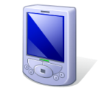



StarTrack System
Insertion Application
Insertion
ST Server
Location Manager
ST Client
ST Server
Application
ST Server
ST Client
Retrieval
Manipulation
Comparison
…
Courtesy: Maya et al.
Notes:
Here is a high level overview of the StarTrack System. StarTrack servers handle requests from clients and store tracks in a set of database servers. Modern database systems provide some form of geospatial support – meaning that they provide special data types for storing geometries and specialized indices for accessing such objects.
The StarTrack API exposes a number of track-based operations. An insertion application, for example may pass samples to an insertion operation. StarTrack will break the samples into tracks, do some pre-processing, and insert them into the database. Once tracks are in the database, different applications may use and combine a number of operations to fetch the information that they’re interested in. They may retrieve tracks based on different criteria, they may compare two tracks for similarity, or they may pass a track as an argument and fetch the most similar tracks.

Slide 10
What are System Challenges of Track Service?
Handling error-prone tracks
Flexible programming interface
Efficient implementation of operations on tracks
Scalability and fault tolerance
Courtesy: Maya et al.
Notes:
Despite the simplicity of the architecture, handling tracks and providing a track-based infrastructure proved to be harder than we originally antecipated.
The first very basic problem with tracks has to do we how we represent them. Coordinates in a track are a sample of a path, and sampling is inherently error prone. That makes it difficult to compare two tracks for equality, which is one of the most important operations involving tracks.
Another issue was related to the API. When we studied the needs of track-based applications, we realized that apps have a need to combine a number of operations in order to get the information they are interested in.
Efficiently implementing the set of complex track-based operations was also a major challenge we faces. Even though spatial databases have come a long way, tracks are complex geographic objects, often containing hundreds of coordinates. When handling large numbers of tracks, relying solely on the database proved to be insufficient.
Finally, StarTrack should be scalable and fault tolerant, and we employed well known techniques to ensure so. These techniques are not particular to tracks, so for the rest of the talk, I’ll focus on the first three challenges and how we address them in StarTrack.

Slide 11
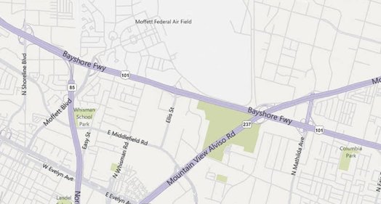
Challenges of Using Raw Tracks
Advantages of Canonicalization:
  More efficient retrieval and comparison operations
  Enables StarTrack to maintain a list of non-duplicate tracks
Courtesy: Maya et al.
Notes:
One of the most basic difficulties with handling tracks arises from the fact that tracks are sets of discrete locations, sampled over time.
Consider the track, that I presented earlier in the talk. Here is a second track, taken while following the same path on a different day. A path taken multiple times leads to completely different samples, and comparing tracks for equality, at this raw form, although possible, becomes easily expensive.
In the new system, StarTrack canonicalizes tracks based on road networks. Canonicalization here means that the raw track is converted to another one that only passes through a set of standard points on roads or highways in the underlying network. Here in this example, the two tracks, after canonicalization, share the exact same coordinates.
Canonicalization presents several advantages: By drawing samples from a standard set of coordinates, we can employ additional techniques to make retrieval more efficient, and comparing tracks becomes simpler and less error-prone.
More effective comparison making it easier to identify highly similar tracks, and thanks to that now also maintains a separate list of non-duplicate tracks per user, or tracks that only differ in time. It is a well known fact users have repetitive travel patterns. Most people, for example, take the same path between home and work. This leads to a large number of duplicate tracks. By keeping this smaller list of non-duplicate tracks, StarTrack can often accelerate operations by not having to work on the entire larger collection.

Slide 12
StarTrack API
Track Collections (TC): Abstract grouping of tracks
  Programming Convenience
  Implementation Efficiency
    Prevent unnecessary client-server message exchanges
    Enable delayed evaluation
    Enable caching and use of in-memory data structures
Pre-filter tracks
Manipulate tracks
Fetch tracks
Courtesy: Maya et al.
Notes:
A second major challenge we faced involved designing a flexible programming interface.
As we identified and studied the need of track-based applications, we realized that they typically operate in three steps: they first narrow down a set of tracks based on some simple criteria; Next they manipulate these sets, for example sorting them based on length or frequency, and narrowing them further by applying some similarity criteria. And In the end, they end up fetching only a small number of these tracks.
So we introduced the concept of a track collection, which is an abstract grouping of tracks. TCs have two main advantages:
First, it better matches the application needs – and this set of three steps. Applications can now create an aggregation of tracks, can manipulate and further narrow down this collection, and then only fetch the tracks that it’s actually interested in.
Another important benefit is that it leads to performance enhancements. Allowing the application to combine a number of operations before retrieving tracks prevents unnecessary message exchanges between the client and the server, and enables StarTrack to delay the evaluation of these operations until tracks are actually fetched. A third advantage is that they allow the server to treat the set of tracks that are repeatedly accessed together as a single entity for the purposes of caching. It also allows the server to construct specialized data structures that operate exclusively on these tracks.
Next, I’ll tell you more about the API and how it matches this set of three phases.

Slide 13
StarTrack API: Track Collections
Creation
  TC MakeCollection(GroupCriteria criteria, bool removeDuplicates)
Manipulation
  TC JoinTrackCollections (TC tCs[], bool removeDuplicates)
  TC SortTracks (TC tC, SortAttribute attr)
  TC TakeTracks(TC tC, int count)
  TC GetSimilarTracks (TC tC, Track refTrack, float simThreshold)
  TC GetPassByTracks (TC tC, Area[] areas)
  TC GetCommonSegments(TC tC, float freqThreshold)
Retrieval
  Track[] GetTracks (TC tC, int start, int count)
Courtesy: Maya et al.
Notes:
A client starts its interaction with StarTrack through a call to MakeCollection. MakeCollection takes as input a set of criteria, which can involve properties on users, time or geography, and creates a track collection that matches the given criteria. It also takes a second argument, which allows applications to specify if they want duplicates to be ommitted from the returned collection.
Once an application has created a track collection, it can pass the track collection as argument to a set of StarTrack operations that further manipulate them – here are common examples. Each of these operations, in turn, returns a new track collection.
As an example, consider the GetSimilarTracks operation. It takes a collection, a reference track, and a threshold, and returns all tracks in the collection that are at least as similar to the reference track as the given threshold.
And finally, we have an operation to fetch tracks from a given track collection.

Slide 14
API Usage: Ride-Sharing Application
// get user’s most popular track in the morning
  TC myTC = MakeCollection(“name = Maya”, [0800 1000], true);
  TC myPopTC = SortTracks(myTC, FREQ);
  Track track = GetTracks(myPopTC, 0, 1);
// find tracks of all fellow employees
  TC msTC = MakeCollection(“name.Employer = MS”, [0800 1000], true);
// pick tracks from the community most similar to user’s popular track
  TC similarTC = GetSimilarTracks(msTC, track, 0.8);
  Track[] similarTracks = GetTracks(similarTC, 0, 20);
// Verify if each track is frequently traveled by its respective owner
  User[] result = FindOwnersOfFrequentTracks(similarTracks);
Courtesy: Maya et al.
Notes:
As an example of how this API is used, let’s consider how a ride sharing application could be implemented. The application tries to find the best share partners for a given user. There are three main parts in this application.
First, the application tries to fetch the user’s typical commute track in the morning. To do that, it first calls MakeCollection, giving the user’s name and times as criteria, and requesting duplicates to be ommitted. Then it sorts the resulting track collection based on the frequency of each of the tracks. Finally, it fetches the first track in the collection. The returned track should be typical of the person’s morning commute.
The application then creates a second TrackCollection to fetch all tracks for employees of the company where the user works, again between 8 and 10, and again omitting duplicates. This track collection, together with the user’s morning commute track are then passed to a call to GetSimilarTracks, which will return a new track collection containing only tracks similar to the user’s morning commute. Again it finishes with a call to GetTracks, to fetch the first 20 tracks, which should be the most similar tracks.
There is a final step, that I’ve ommitted in the interest of time – the application needs to iterate over the 20 matches, and each of them is in fact a regular commute track for another person for its owner.
Let’s focus for a bit on this second part of the application. Evaluation of the MakeCollection and GetSimilarTracks is delayed until GetTracks is called. All calls up until GetTracks can occur at the client side. When GetTracks is called, it will trigger the evaluation of the chain of operations, starting with the MakeCollection operation. MakeCollection gets mapped to a query to the database. Once the tracks are in memory, GetSimilarTracks is executed. In order to accelerate calls to GetSimilarTracks, StarTrack builds a specialized in-memory data-structure called a Track Tree on all tracks in the msTC collection, that are now in memory.
This data structure can be cached in memory and reused in further calls from the same application, when searching for ride-sharing partners for other users.
The key message here is that the new API and the introduction of track collections makes it easier for applications to interact with StarTrack, in order to narrow down the set of tracks that it is really interested in.

Slide 15
Review of Previous Lectures on Mobile Cloud Computing (Cont’d)
What are the different programming models for computation offloading?

Slide 16
mCloud Programming Model
MAUI: RPC based offloading architecture
CloneCloud: tight synchronization between cloud and phone
Odessa: data-flow graph to exploit parallelism in perception applications
COMET: distributed shared memory
MAUI, CloneCloud , Odessa all have profiler, solver
 | MAUI | CloneCloud | Odessa | COMET
Remote execution unit | Methods (RMI) | Threads (method entry/exit) | Tasks | Threads (any place)

Slide 17
Syllabus
Mobile App Development (lecture 1,2,3)
  Mobile operating systems: iOS and Android
  Development environments: Xcode, Eclipse with Android SDK
  Programming: Objective-C and android programming
System Support for Mobile App Optimization (lecture 4,5)
  Mobile device power models, energy profiling and ebug debugging
  Core OS topics: virtualization, storage and OS support for power and context management
Interaction with Cellular Networks (lecture 6,7,8)
  Basics of 3G/LTE cellular networks
  Mobile application cellular radio resource usage profiling
  Measurement-based cellular network and traffic characterization
Interaction with the Cloud (lecture 9,10)
  Mobile cloud computing platform services: push notification, iCloud and Google Cloud Messaging
  Mobile cloud computing architecture and programming models
Mobile Platform Security and Privacy (lecture 11,12,13)
  Mobile platform security: malware detection and characterization, attacks and defenses
  Mobile data and location privacy: attacks, monitoring tools and defenses

Slide 18
Outline
Non-malware (Yunjia Dai and David Engelhardt)
  Misuse of personal/phone identiﬁers, and deep penetration of advertising and analytics networks
Malware characterization (Hao Hu and Chaoteng Cheng)
  Installation
  Activation
  Malicious payloads
  Evolution
DroidRanger: Non-virtualization-based malware detection (Yibo Zhu and Li Yan)
  Behavioral footprint matching for known malware
  Dynamic execution monitoring for unknown malware
DroidScope Virtualization-based malware detection
  Reconstruct OS, Dalvik VM and native view

Slide 19
Android Malware:
Characterization and Evolution
Malware characterization
  Installation
  Activation
  Malicious payloads
Evolution

Slide 20
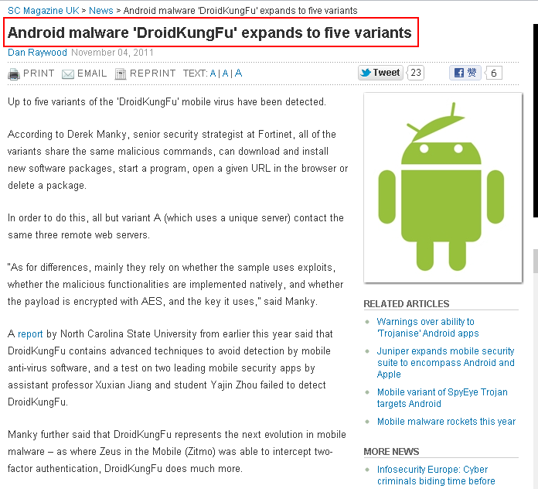
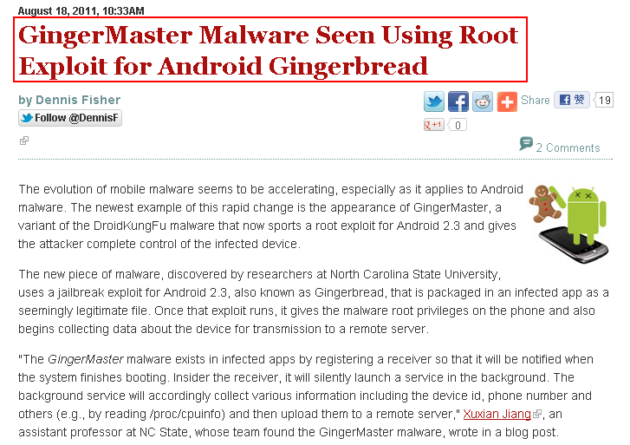
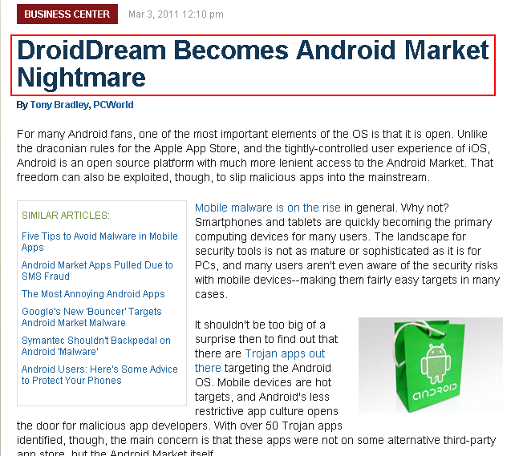
Motivation
Courtesy Yajin Zhou et al.

Slide 21
Motivation
Source: Juniper Networks 2011 Mobile Threats Report

Slide 22
Motivation
Develop effective defense solutions
Know your enemy
  Insightful understanding of Android malware
  Comprehensive Android malware samples
Courtesy Yajin Zhou et al.

Slide 23
Contributions
Present the first largest public collection of Android malware samples
  There are total 52 families publicly reported between Aug 2010 and Oct 2011
  Our dataset has 1260 samples in 49 families
Share the dataset with research community
  Google “Android Malware Genome Project”
Provide initial insights about Android malware
  Characterization
  Evolution
Courtesy Yajin Zhou et al.

Slide 24
Malware Trends
The Cumulative Number of New Malware Samples
2010
2011
AnserverBot
DroidKungFu
(including its variants)
Courtesy Yajin Zhou et al.
Notes:
The Cumulative Growth of New Malware Samples in Our Collection

Slide 25
Malware Characterization
Installation methods
Activation mechanisms
Malicious payloads
Courtesy Yajin Zhou et al.

Slide 26
Malware Installation
Users tend not to install malware intentionally
Attackers trick users into installing malware
  Repackaging
  Update attack
  Drive-by download
Courtesy Yajin Zhou et al.

Slide 27






Installation: Repackaging
+
Attacker
86% of samples in our dataset are repackaged
Courtesy Yajin Zhou et al.

Slide 28
Installation: Repackaging
Victim apps
  Popular games
  Utility apps
  Entertainment apps
“Trustworthy” package names
  com.google.ssearch, com.google.update
Courtesy Yajin Zhou et al.

Slide 29
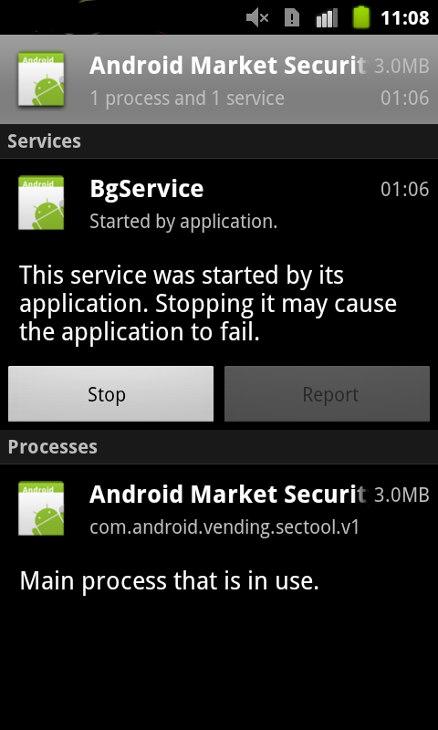
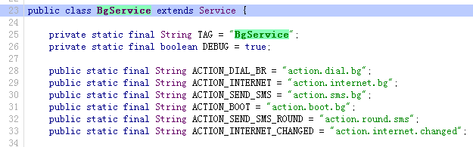
Installation: Repackaging
Malicious payload
Based on public-available code on Google code
Repackaged security tool
Courtesy Yajin Zhou et al.

Slide 30
Installation: Update Attack
Ask user to update to the “latest” version
  Child app: BaseBridge
  Downloaded app: DroidKungFuUpdate
Dynamically load and execute bytecode
  Plankton, AnserverBot
Courtesy Yajin Zhou et al.

Slide 31
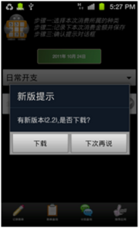
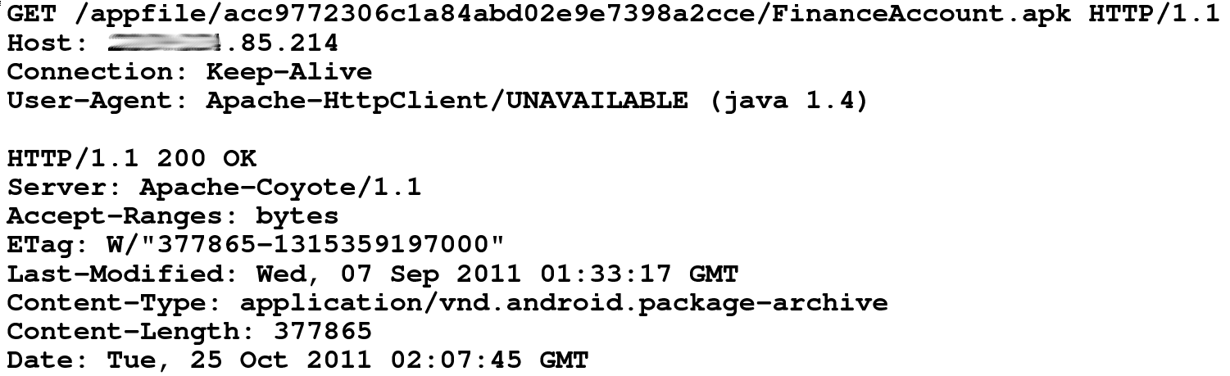
Installation: Update Attack
DroidKungFuUpdate
  Download the “latest” version from remote server
  The downloaded app is DroidKungFu malware
DroidKungFu malware
New version 2.2 found.
Do you want
to download?
Courtesy Yajin Zhou et al.

Slide 32

Installation: Drive-by Download
Trick users into downloading “interesting” apps
  QR code: Jifake
  In-app advertisement: GGTracker
Courtesy Yajin Zhou et al.

Slide 33
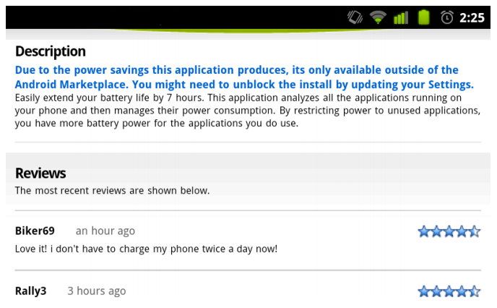
Installation: Drive-by Download
Biker69 seems to like this app.

Slide 34
Malware Activation
By listening to various system events
By hijacking the main activity
The # of malware samples

Slide 35
Malicious Payloads
Privilege escalation
Remote control
Financial charges
Information collection
Courtesy Yajin Zhou et al.

Slide 36
Payloads: Privilege Escalation
Use publicly available root exploits to gain root privilege
  Exploid, RATC, Zimperlich, KillingInTheNameOf, GingerBreak, zergRush
37% of malware samples use root exploits
30% use more than one root exploit
Courtesy Yajin Zhou et al.

Slide 37



Payloads: Privilege Escalation
Malware is getting smarter
  DroidDream: unencrypted root exploits
    Exploit name as its file name
  DroidKungFu: encrypted root exploits
    myicon, secbino
  DroidCoupon: root exploit with obfuscated file name
    ratc.png
Courtesy Yajin Zhou et al.

Slide 38
Payloads: Remote Control
92% of them use HTTP based C&C servers
C&C server URLs can be encrypted
  Pjapps: custom encoding scheme
  DroidKungFu3: AES encryption
  Geinimi: DES encryption
  AnserverBot: Base64
2maodb3ialke8mdeme3gkos9g1icaofm
->
mobilemeego91.com
29BB083B93AE6DD6FB4E2F353586C56218DA99F2421B4B12C6FC74FF3E8E8FF2295907534814906FE15A460C3BA03E78
->
http://search.zi18.com:8511/search/
5ee24082afa27568f4f1e0acc961d767dd7e9ad2131ec4c3
->
117.135.134.185:8080
HoiprJbh9CVp9I0h8Cg1zKVO7CAO7CfaPJSQfvMUH2B574i18CQ_
->
http://b4.cookier.co.cc:8080/jk.action
Courtesy Yajin Zhou et al.

Slide 39
Payloads: Financial Charges
Send SMS
  to hardcoded premium-rate numbers
    FakePlayer, YZHC …
  to other numbers controlled by remote servers
    AnserverBot, BeanBot
Delete/Block SMS
  to remove fee charge information
    Zsone, RogueSPPush …
Reply SMS
  to confirm subscription to premium services
    GGTracker, RogueLemon …
Courtesy Yajin Zhou et al.
Notes:
Zsone 12 GGTracker: 1 RogueLemon:2 SPPush 9 ->auto reply

Slide 40
Payloads: Information Collection
The # of apps
Courtesy Yajin Zhou et al.

Slide 41
Permission Usage
Get started as soon
as possible
Manipulate SMS
Trigger root exploit
# of malware samples and benign apps
Courtesy Yajin Zhou et al.

Slide 42
Evolution: AnserverBot
Basebridge + Plankton
  Malicious payload: BaseBridge
  Dynamic loading: Plankton
Courtesy Yajin Zhou et al.

Slide 43
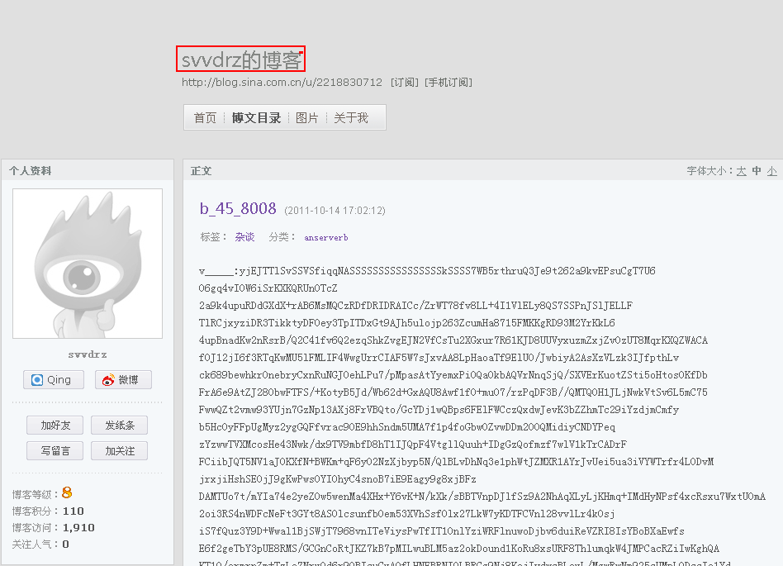
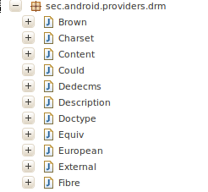
Evolution: AnserverBot
Heavy use of encryption
Heavy use of obfuscation
Anti-analysis
Security software detection
C&C servers
  Address is encrypted
  Public blog
String e=Xmlns.d("8CB9zKRj84uO"); -> onKeyDown
String f=Xmlns.d("8CBozKiTrtgdcxBNutkE8kMCzKFNHxMOKCRD") -> onGetApk_Install_version_id
String g=Xmlns.d("uIkEuxy_"); -> value
Encrypted payload
Svvdrz’s blog
HoiprJbh9CFE8CrOrCRO7cBw8CpO7CQhr2MW8tMeKNnp0JT57wrQfJjYfoFOXxyOHoig8S__
->
http://blog.sina.com.cn/s/blog_8440ab780100rnye.html
Courtesy Yajin Zhou et al.

Slide 44
Discussion
Most samples are repackaged
  Police the Android markets
More than one third samples enclose root exploits
  Apply patches timely
Nearly half of the samples subscribe to premium-rate services with background SMS
  Enhance Android framework
Mobile security apps can be improved
  Develop new defense solutions
Courtesy Yajin Zhou et al.

Slide 45
Related Work
Identify privacy leakage problems
  TaintDroid [Enck et al., OSDI 10], Comdroid [Chin et al., MobiSys 11], Stowaway [Felt et al., CCS 11], AdRisk [Grace et al., WiSec 12], Woodpecker [Grace et al., NDSS 12], DroidMOSS [Zhou et al., CODASPY 12], …
Enhance Android framework
  Kirin [Enck et al, CCS 09], TISSA [Zhou et al., TRUST 11], QUIRE [Dietz et al., USENIX Security 11], Cells [Andrus et al., SOSP 11] …
Assess/survey mobile apps
  App Security [Enck et al., USENIX Security 11], Malware Survery [Felt et al., CCS-SPSM 11], DroidRanger [Zhou et al., NDSS 11], RiskRanker [Grace et al., MobiSys 12] …
Courtesy Yajin Zhou et al.

Slide 46
Conclusion
Present the first largest public Android malware collection
  Share with whole research community
Characterize the malware samples
Study the evolution of Android malware
Call for better anti-mobile-malware solutions
Courtesy Yajin Zhou et al.

Slide 47
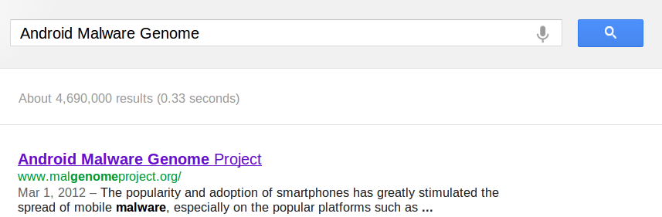
Dataset Release
Android Malware Genome Project
  http://malgenomeproject.org
Courtesy Yajin Zhou et al.

Slide 48
DroidRanger
DroidRanger: Non-virtualization-based malware detection
Known malware
  Permission-based filtering
  Behavioral footprint matching for known malware
Unknown malware
  Heuristic based filtering, e.g. dynamic loading new code
  Dynamic execution monitoring for unknown malware

Slide 49
Design Goal
Scalability
  Permission based filtering
Accuracy
  Behavioral footprint matching
Zero-day malware detection
  Heuristics based detection

Slide 50





System Overview
Malware Samples
Permission-based
Behavioral Footprints
Footprint-Based Detection Engine
Infection from
Known Malware
App
Repository
Representative Android Markets
Heuristics-Based Detection Engine
Infection from
Zero-day Malware
Heuristics
DroidRanger
Courtesy Yajin Zhou et al.

Slide 51
Footprint-Based Detection Engine
Filter apps with essential permissions
Malware | Essential Permissions | Apps
Geinimi | INTERNET, SEND_SMS | 7, 620 (4.17%)
ADRD | INTERNET, ACCESS_NETWORK_STATE RECEIVE_BOOT_COMPLETED | 10, 379 (5.68%)
Pjapps | INTERNET, RECEIVE_SMS | 4, 637 (2.54%)
Bgserv | INTERNET, RECEIVE_SMS, SEND_SMS | 2, 880 (1.58%)
DroidDream | CHANGE_WIFI_STATE | 4, 096 (2.24%)
zHash | CHANGE_WIFI_STATE | 4, 096 (2.24%)
BaseBridge | NATIVE CODE | 8, 272 (4.52%)
DroidDreamLight | INTERNET, READ_PHONE_STATE | 71, 095 (38.89%)
Zsone | RECEIVE_SMS, SEND_SMS | 3, 204 (1.75%)
jSMSHider | INSTALL_PACKAGES | 1, 210 (0.66%)
Reduced to 0.67% when considering a broadcast receiver
Courtesy Yajin Zhou et al.

Slide 52
Footprint-Based Detection Engine
Distill malware behaviors as behavioral footprint
  Information in manifest file
    Contain a receiver listening to SMS_RECEIVED
  Semantics in the byte-code
    Register a receiver listening to SMS_RECEIVED
    Call abortBroadcast in the receiver
    Send SMS messages to premium numbers
  Structural layout of the app
Match apps with malware behavioral footprints
Behavioral
footprint
of Zsone
Courtesy Yajin Zhou et al.
Notes:
Zsone is an SMS trojan. It sends short message to premium numbers and removes billing related notifications messages from service providers.

Slide 53
Heuristics-Based Detection Engine
Filter apps with dynamic Java/native code loading
  1055 apps load Java code
  508 apps load native code from non-standard locations
Monitor apps’ dynamic execution behaviors
  Java code: permission-related framework APIs
  Native code: system calls requiring root privileges
Courtesy Yajin Zhou et al.

Slide 54
Evaluation: Data Set
Crawled the official & four alternative markets
Collected 204,040 free apps during 05/2011-06/2011
Courtesy Yajin Zhou et al.

Slide 55
Evaluation: Overview
Malware | Official Market | eoeMarket | alcatelclub | gfan | mmoovv | Total
Known | 21 | 51 | 48 | 20 | 31 | 171
Zero-day | 11 | 9 | 10 | 1 | 9 | 40
Total | 32 (0.02%) | 60 (0.35%) | 58 (0.39%) | 21 (0.20%) | 40 (0.47%) | 211
Courtesy Yajin Zhou et al.

Slide 56
Evaluation: Known Malware Samples
20 samples from 10 malware families
Malware | First Report | Summary
Geinimi | 10/2010 | Trojan with bot-like capability
ADRD | 02/2011 | Trojan with bot-like capability
Pjapps | 02/2011 | Trojan with bot-like capability
Bgserv | 03/2011 | Trojan with bot-like capability
DroidDream | 03/2011 | Root exploit with Exploid, Rageagainstthecage
zHash | 03/2011 | Root exploit with Exploid
BaseBridge | 05/2011 | Root exploit with Rageagainstthecage
DroidDreamLight | 05/2011 | Trojan with information stealing capability
Zsone | 05/2011 | Trojan that sends premium-rate SMS
jSMSHider | 06/2011 | Trojan that target third-party firmware
Courtesy Yajin Zhou et al.
Notes:
Exploid: udev daemon, CHANGE_WIFI_STATE, Rageagainstthecage: adbd, Zimperlich: zygote

Slide 57
Evaluation: Apps Infected by Known Malware
first report: 10/2010
Courtesy Yajin Zhou et al.

Slide 58
Evaluation: False Positive
Courtesy Yajin Zhou et al.

Slide 59
Evaluation: False Negative
24 samples in 10 known families from contagio
DroidRanger detected 23 sample (96%)
  Missed a payload of DroidDream, not the malware itself
  Found one mis-categorized sample for ADRD
Courtesy Yajin Zhou et al.

Slide 60
Evaluation: Zero-day Malware
Detected two zero-day malware using heuristics
  Plankton: dynamic loading of Java code
  DroidKungFu: dynamic loading of native code
Detected 40 samples using behavioral footprints
  11 samples from the official Android Market
  30 samples from alternative Android Markets
Courtesy Yajin Zhou et al.

Slide 61
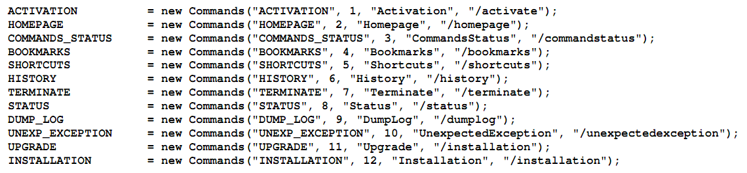
Evaluation: Zero-day Malware
Plankton behaviors
  Upload a list of permissions before downloading a payload
  Contain bot-like command & control channel
DroidKungFu behaviors
  Contain two encrypted root exploits
  Install a payload app mimicking Google Search
Courtesy Yajin Zhou et al.

Slide 62
Discussion
A call for rigorous vetting process
  A large number of user can be infected
  Malware can exist in alternative markets for a long time
  Root exploits are used by many malware
  Zero-day malware exists in Android markets
Need more comprehensive heuristics
  background sending of unauthorized SMS messages
  bot-like behavior controlled by SMS messages
Courtesy Yajin Zhou et al.
Notes:
DroidDream was reported to have infected 260,000 users before Google removed them. Possible limitations: free app only. More heuristics.

Slide 63
Related Work
Smartphone platform security
  TaintDroid (Enck et al., OSDI 10), PiOS (Egele et al., NDSS 11), Stowaway (Felt et al., CCS 11), Cells (Andrus et al., SOSP 11), AppFence (Hornyack et al., CCS 11), Quire (Dietz et al., USENIX Security 11), A Study of Android Application Security (Enck et al., USENIX Security 11), TISSA (Zhou et al., TRUST 11), Woodpecker (Grace et al., NDSS 12) …
Malware detection on mobile devices
  pBMDS (Xie et al., WiSec 10), VirusMeter (Liu et al., RAID 09), Crowdroid (Burguera et al., CCS-SPSM 11) …
Other systematic security study
  HoneyMonkey (Wang et al., NDSS 06), Systematic Web Spyware Study (Moshchuk et al., NDSS 06), All Your iFRAMEs Point to Us (Provo et al., USENIX Security 08) …
Courtesy Yajin Zhou et al.

Slide 64
Conclusion
DroidRanger is a system to systematically study the overall health of existing Android Markets
Malware | Official Market | eoeMarket | alcatelclub | gfan | mmoovv | Total
Known | 21 | 51 | 48 | 20 | 31 | 171
Zero-day | 11 | 9 | 10 | 1 | 9 | 40
Total | 32 (0.02%) | 60 (0.35%) | 58 (0.39%) | 21 (0.20%) | 40 (0.47%) | 211
Courtesy Yajin Zhou et al.

Slide 65
DroidScope Virtualization-based malware detection
Runs as a VM
  Reconstruct OS, Dalvik VM and native view

Slide 66
Android
Java Components
System Services
Native Components
Apps
Courtesy Lok Kwong Yan & Heng Yin

Slide 67
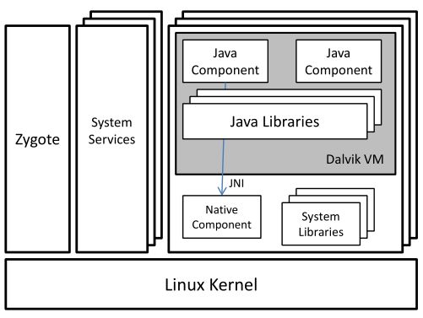
Android
Java Components
System Services
Native Components
Apps
Courtesy Lok Kwong Yan & Heng Yin

Slide 68
Motivation: Static Analysis
Dalvik/Java Static Analysis:
ded, Dexpler, soot,
Woodpecker, DroidMoss
Native Static Analysis:
IDA, binutils, BAP
Courtesy Lok Kwong Yan & Heng Yin

Slide 69
Motivation: Dynamic Analysis
Android Analysis:
TaintDroid, DroidRanger
System Calls
logcat, adb
Courtesy Lok Kwong Yan & Heng Yin

Slide 70
Motivation: Dynamic Analysis
External Analysis: Anubis, Ether, TEMU, …
Courtesy Lok Kwong Yan & Heng Yin

Slide 71
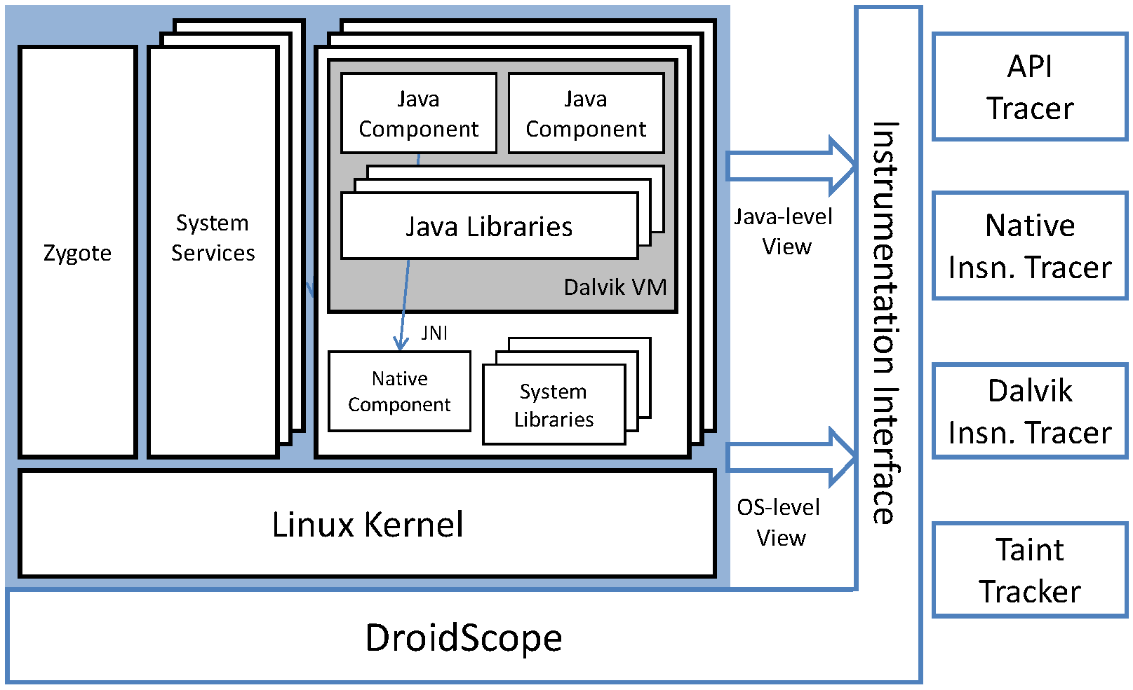
DroidScope Overview
Courtesy Lok Kwong Yan & Heng Yin

Slide 72
Goals
Dynamic binary instrumentation for Android
  Leverage Android Emulator in SDK
  No changes to Android Virtual Devices
  External instrumentation
    Linux context
    Dalvik context
  Extensible: plugin-support / event-based interface
  Performance
    Partial JIT support
    Instrumentation optimization
Courtesy Lok Kwong Yan & Heng Yin

Slide 73
Roadmap
External instrumentation
  Linux context
  Dalvik context
Extensible: plugin-support / event-based interface
Evaluation
  Performance
  Usage
Courtesy Lok Kwong Yan & Heng Yin

Slide 74
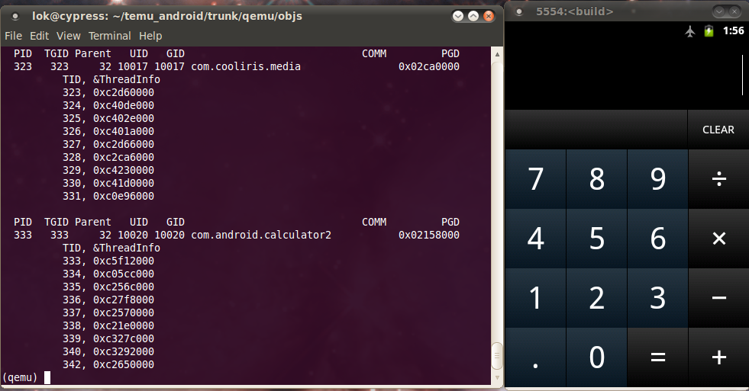
Linux Context: Identify App(s)
Shadow task list
  pid, tid, uid, gid, euid, egid, parent pid, pgd, comm
  argv[0]
Shadow memory map
  Address Space Layout Randomization (Ice Cream Sandwich)
Update on
  fork, execve, clone, prctl and mmap2

Slide 75
Java/Dalvik View
Dalvik virtual machine
  register machine (all on stack)
  256 opcodes
  saved state, glue, pointed to by ARM R6, on stack in x86
mterp
  offset-addressing: fetch opcode then jump to (dvmAsmInstructionStart + opcode * 64)
  dvmAsmSisterStart for emulation overflow
Which Dalvik opcode?
  Locate dvmAsmInstructionStart in shadow memory map
  Calculate opcode = (R15 - dvmAsmInstructionStart) / 64.
Courtesy Lok Kwong Yan & Heng Yin

Slide 76
Just In Time (JIT) Compiler
Designed to boost performance
Triggered by counter - mterp is always the default
Trace based
  Multiple basic blocks
  Multiple exits or chaining cells
  Complicates external introspection
  Complicates instrumentation
Courtesy Lok Kwong Yan & Heng Yin

Slide 77
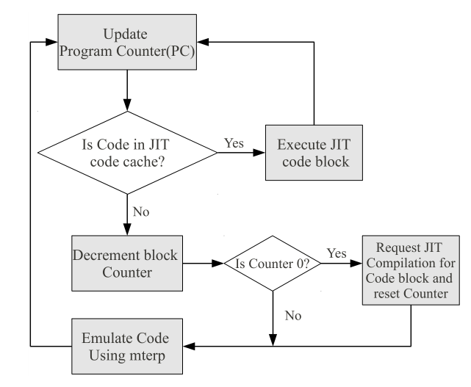
Disabling JIT
dvmGetCodeAddr(PC)
!= NULL
Courtesy Lok Kwong Yan & Heng Yin

Slide 78
Roadmap
External instrumentation
  Linux context
  Dalvik context
Extensible: plugin-support / event-based interface
Evaluation
  Performance
  Usage
Courtesy Lok Kwong Yan & Heng Yin

Slide 79
Instrumentation Design
Event based interface
  Execution: e.g. native and Dalvik instructions
  Status: updated shadow task list
Query and Set, e.g. interpret and change cpu state
Performance
  Example: Native instructions vs. Dalvik instructions
  Instrumentation Optimization
Courtesy Lok Kwong Yan & Heng Yin

Slide 80
Dynamic Instrumentation
Update PC
(un)registerCallback
inCache?
yes
needFlush?
no
yes
Translate
flushType
Execute
invalidateBlock(s)
flushCache
Courtesy Lok Kwong Yan & Heng Yin

Slide 81
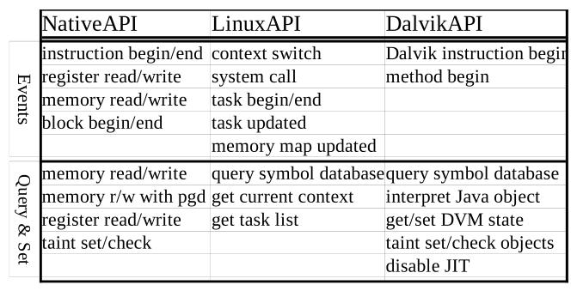
Instrumentation
Courtesy Lok Kwong Yan & Heng Yin

Slide 82
Dalvik Instruction Tracer (Example)
1. void opcode_callback(uint32_t opcode) {
2. printf("[%x] %s\n", GET_RPC, opcodeToStr(opcode));
3. }
4.
5. void module_callback(int pid) {
6. if (bInitialized || (getIBase(pid) == 0))
7. return;
8.
9. gva_t startAddr = 0, endAddr = 0xFFFFFFFF;
10.
11. addDisableJITRange(pid, startAddr, endAddr);
12. disableJITInit(getGetCodeAddrAddress(pid));
13. addMterpOpcodesRange(pid, startAddr, endAddr);
14. dalvikMterpInit(getIBase(pid));
15. registerDalvikInsnBeginCb(&opcode_callback);
16. bInitialized = 1;
17. }
18.
19. void _init() {
20. setTargetByName("com.andhuhu.fengyinchuanshuo");
21. registerTargetModulesUpdatedCb(&module_callback);
22. }
getModAddr(“dfk@classes.dex”, &startAddr, &endAddr);
Courtesy Lok Kwong Yan & Heng Yin

Slide 83
Plugins
API Tracer
  System calls
    open, close, read, write, includes parameters and return values
  Native library calls
  Java API calls
    Java Strings converted to C Strings
Native and Dalvik Instruction Tracers
Taint Tracker
  Taints ARM instructions
  One bit per byte
  Data movement & Arithmetic instructions including barrel shifter
  Does not support control flow tainting
Courtesy Lok Kwong Yan & Heng Yin

Slide 84
Roadmap
External instrumentation
  Linux context
  Dalvik context
Extensible: plugin-support / event-based interface
Evaluation
  Performance
  Usage

Slide 85
Implementation
Configuration
  QEMU 0.10.50 – part of Gingerbread SDK
  Gingerbread
    “user-eng”
    No changes to source
  Linux 2.6.29, QEMU kernel branch
Courtesy Lok Kwong Yan & Heng Yin

Slide 86
Performance Evaluation
Seven free benchmark Apps
  AnTuTu Benchmark
  (ABenchMark) by AnTuTu
  CaffeineMark by Ravi Reddy
  CF-Bench by Chainfire
  Mobile processor benchmark (Multicore) by Andrei Karpushonak
  Benchmark by Softweg
  Linpack by GreeneComputing
Six tests repeated five times each
  Baseline
  NO-JIT Baseline – uses a build with JIT disabled at runtime
  Context Only
  API Tracer
  Dalvik Instruction Trace
  Taint Tracker
Courtesy Lok Kwong Yan & Heng Yin

Slide 87
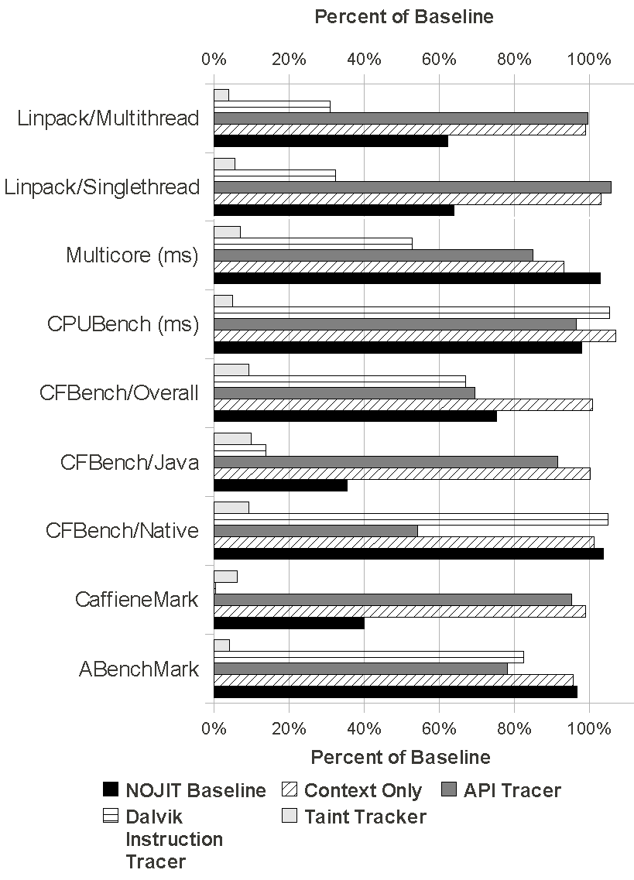
Select Performance Results
APITracer vs. NOJIT
Results are not perfect
Dynamic Symbol Retrieval Overhead
Courtesy Lok Kwong Yan & Heng Yin

Slide 88
Usage Evaluation
Use DroidScope to analyze real world malware
  API Tracer
  Dalvik Instruction Tracer + dexdump
  Taint Tracker – taint IMEI/IMSI @ move_result_object after getIMEI/getIMSI
Analyze included exploits
  Removed patches in Gingerbread
  Intercept system calls
  Native instruction tracer
Courtesy Lok Kwong Yan & Heng Yin

Slide 89
Droid Kung Fu
Three encrypted payloads
  ratc (Rage Against The Cage)
  killall (ratc wrapper)
  gjsvro (udev exploit)
Three execution methods
  piped commands to a shell (default execution path)
  Runtime.exec() Java API (instrumented path)
  JNI to native library terminal emulator (instrumented path)
  Instrumented return values for isVersion221 and getPermission methods
Courtesy Lok Kwong Yan & Heng Yin

Slide 90
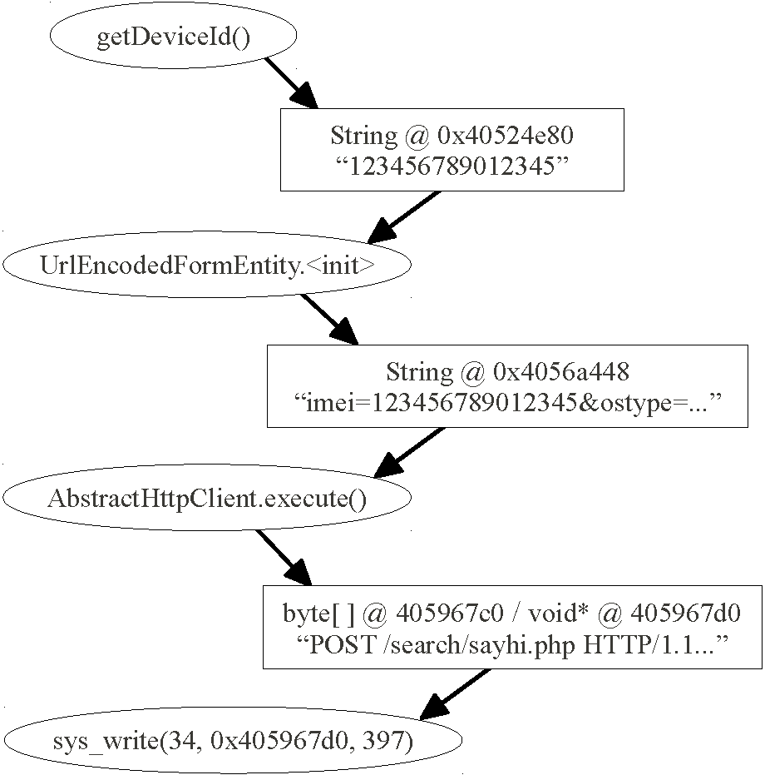
Droid Kung Fu: TaintTracker
Courtesy Lok Kwong Yan & Heng Yin

Slide 91
DroidDream
Same payloads as DroidKungFu
Two processes
  Normal droiddream process clears logcat
  droiddream:remote is malicious
xor-encrypts private information before leaking
Instrumented sys_connect and sys_write
Courtesy Lok Kwong Yan & Heng Yin

Slide 92
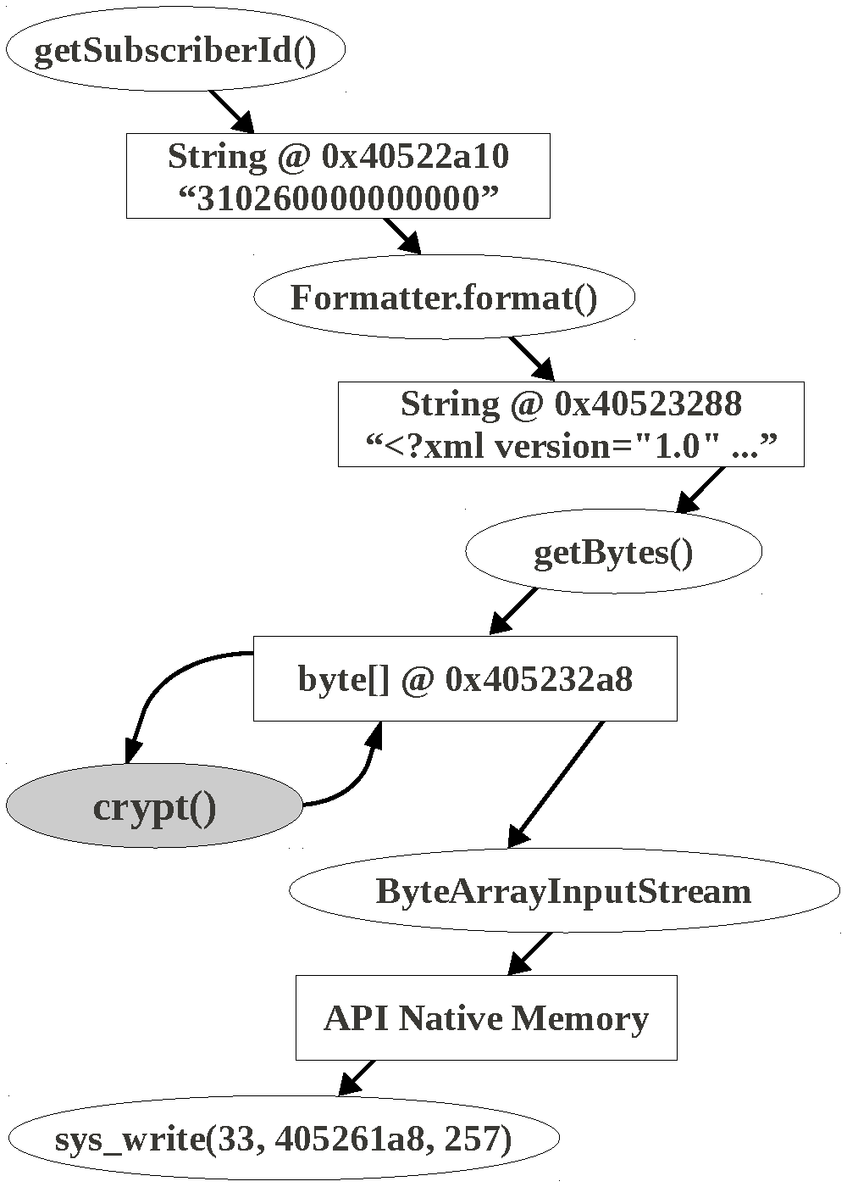
Droid Dream: TaintTracker
Courtesy Lok Kwong Yan & Heng Yin

Slide 93
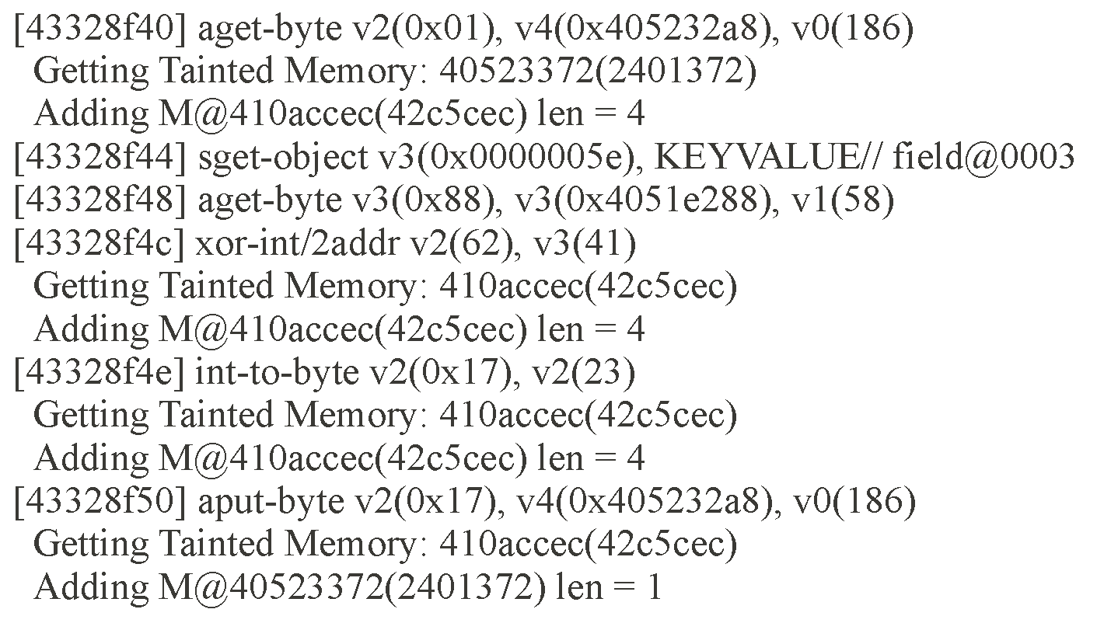
DroidDream: crypt trace
Courtesy Lok Kwong Yan & Heng Yin

Slide 94
Related Work
Static Analysis
  ded, Dexpler, soot
  Woodpecker, DroidMoss
Dynamic Analysis
  TaintDroid
  DroidRanger
  PIN, Valgrind, DynamoRIO
  Anubis, TEMU, Ether, PinOS
Introspection
  Virtuoso
  VMWatcher
Courtesy Lok Kwong Yan & Heng Yin

Slide 95
Challenges
JIT
  Full JIT support
  Flushing JIT cache
Emulation detection
  Real Sensors: GPS, Microphone, etc.
  Bouncer
Timing assumptions, timeouts, events
Closed source systems, e.g. iOS
Courtesy Lok Kwong Yan & Heng Yin

Slide 96
Summary
DroidScope
  Dynamic binary instrumentation for Android
  Built on Android Emulator in SDK
  External Introspection & Instrumentation support
  Four plugins
    API Tracer
    Native Instruction Tracer
    Dalvik Instruction Tracers
    TaintTracker
  Partial JIT support
Courtesy Lok Kwong Yan & Heng Yin

