Slide 1
Cellular Networks and Mobile Computing
COMS 6998-10, Spring 2013
Instructor: Li Erran Li (lel2139@columbia.edu)
http://www.cs.columbia.edu/~lierranli/coms6998-10Spring2013/
4/2/2013: Mobile Cloud Computing

Slide 2
Review of Previous Lecture
Push notification service
Track service

Slide 3
Review of Previous Lecture (Cont’d)
What is the difference between APNS, GCM and Thialfi?

Slide 4
Review of Previous Lecture (Cont’d)
Push notification service
  Unreliable: APNS, GCM
  Reliable: Thialfi (has a notion of objects)
Notes:
(1) C2DM and APNS are essentially messaging channels - they don't have a concept of allowing applications to register for multiple objects with each object being shared by multiple users. They simply allow a cloud service to send a message to mobile phone. That's it.
(2) We did start out with a one table design but quickly realized that we need the second table to be partitioned on client ids so that we can store a client's registrations, pending notifications, etc. Otherwise, a client that comes back online has to (potentially) read 1000s of rows in the Matcher table to determine if there is a new notification for it.

Slide 5
Thialfi Architecture
Client library
Registrations, notifications,
acknowledgments
Client
Data center
Client
Bigtable
Registrar
Each server handles a contiguous
range of keys,
Each server maintains an in-memory
version
Bigtable: log structured, fast write
Object
Bigtable
Notifications
Application Backend
Matcher
Matcher: Object ID → registered clients, version
Registrar: Client ID → registered objects, notifications
Courtesy: Adya et al.
Notes:
Use an internal Google infrastructure publish/subscribe service to disseminate messages to data centers.

Slide 6
Thialfi: Life of a Notification
Client C2
x
Ack: x, v7
C1: x, v7
Data center
Client
Bigtable
Notify: x, v7
Registrar
C2: x, v7
C1: x, v5
C2: x,
C1: x, v7
C2: x, v7
x, v7
Publish(x, v7)
Object
Bigtable
Matcher
x: v5; C1, C2
x: v7; C1, C2
x: v7; C1, C2
Courtesy: Adya et al.

Slide 7
Review of Previous Lecture (Cont’d)
How to classify location based services?

Slide 8
A Taxonomy of Applications
 | Personal | Social
Current location | Driving directions, Nearby restaurants | Friend finder, Crowd scenes
Past locations | Personal travel journal, Geocoded photos | Post-it notes, Recommendations
Tracks | Personalized Driving Directions, Track-Based Search | Ride sharing, Discovery, Urban sensing
Class of applications enabled by StarTrack
Courtesy: Maya et al.
Notes:
We can classify these applications based on the amount of data that they access.
And finally, we can also classify applications based on whether they access data for a single user at a time, or if they access data across a group of users.
Some applications only use the current location of users to provide some service. Others use not only the current location, but also location instances in the past.
In the last row, we show examples of potential track-based applications, that access historical track information. Personalized Driving Directions, that I described in the last slide, is an example. An application that automatically identifies ride-sharing partners based on user’s track histories is another example.
StarTrack was designed to facilitate the construction of this last row of applications.
Currently, location-based applications have to collect and maintain their own set of location data. StarTrack provides a centralized infrastructure to collect location data in the form of tracks, and enables sharing of this data across applications.

Slide 9


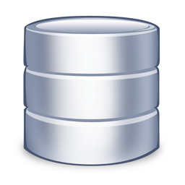

StarTrack System
Insertion Application
Insertion
ST Server
Location Manager
ST Client
ST Server
Application
ST Server
ST Client
Retrieval
Manipulation
Comparison
…
Courtesy: Maya et al.
Notes:
Here is a high level overview of the StarTrack System. StarTrack servers handle requests from clients and store tracks in a set of database servers. Modern database systems provide some form of geospatial support – meaning that they provide special data types for storing geometries and specialized indices for accessing such objects.
The StarTrack API exposes a number of track-based operations. An insertion application, for example may pass samples to an insertion operation. StarTrack will break the samples into tracks, do some pre-processing, and insert them into the database. Once tracks are in the database, different applications may use and combine a number of operations to fetch the information that they’re interested in. They may retrieve tracks based on different criteria, they may compare two tracks for similarity, or they may pass a track as an argument and fetch the most similar tracks.

Slide 10
What are System Challenges of Track Service?
Handling error-prone tracks
Flexible programming interface
Efficient implementation of operations on tracks
Scalability and fault tolerance
Courtesy: Maya et al.
Notes:
Despite the simplicity of the architecture, handling tracks and providing a track-based infrastructure proved to be harder than we originally antecipated.
The first very basic problem with tracks has to do we how we represent them. Coordinates in a track are a sample of a path, and sampling is inherently error prone. That makes it difficult to compare two tracks for equality, which is one of the most important operations involving tracks.
Another issue was related to the API. When we studied the needs of track-based applications, we realized that apps have a need to combine a number of operations in order to get the information they are interested in.
Efficiently implementing the set of complex track-based operations was also a major challenge we faces. Even though spatial databases have come a long way, tracks are complex geographic objects, often containing hundreds of coordinates. When handling large numbers of tracks, relying solely on the database proved to be insufficient.
Finally, StarTrack should be scalable and fault tolerant, and we employed well known techniques to ensure so. These techniques are not particular to tracks, so for the rest of the talk, I’ll focus on the first three challenges and how we address them in StarTrack.

Slide 11
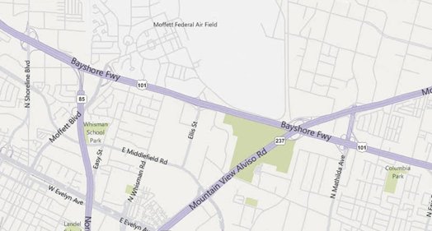
Challenges of Using Raw Tracks
Advantages of Canonicalization:
  More efficient retrieval and comparison operations
  Enables StarTrack to maintain a list of non-duplicate tracks
Courtesy: Maya et al.
Notes:
One of the most basic difficulties with handling tracks arises from the fact that tracks are sets of discrete locations, sampled over time.
Consider the track, that I presented earlier in the talk. Here is a second track, taken while following the same path on a different day. A path taken multiple times leads to completely different samples, and comparing tracks for equality, at this raw form, although possible, becomes easily expensive.
In the new system, StarTrack canonicalizes tracks based on road networks. Canonicalization here means that the raw track is converted to another one that only passes through a set of standard points on roads or highways in the underlying network. Here in this example, the two tracks, after canonicalization, share the exact same coordinates.
Canonicalization presents several advantages: By drawing samples from a standard set of coordinates, we can employ additional techniques to make retrieval more efficient, and comparing tracks becomes simpler and less error-prone.
More effective comparison making it easier to identify highly similar tracks, and thanks to that now also maintains a separate list of non-duplicate tracks per user, or tracks that only differ in time. It is a well known fact users have repetitive travel patterns. Most people, for example, take the same path between home and work. This leads to a large number of duplicate tracks. By keeping this smaller list of non-duplicate tracks, StarTrack can often accelerate operations by not having to work on the entire larger collection.

Slide 12
StarTrack API
Track Collections (TC): Abstract grouping of tracks
  Programming Convenience
  Implementation Efficiency
    Prevent unnecessary client-server message exchanges
    Enable delayed evaluation
    Enable caching and use of in-memory data structures
Pre-filter tracks
Manipulate tracks
Fetch tracks
Courtesy: Maya et al.
Notes:
A second major challenge we faced involved designing a flexible programming interface.
As we identified and studied the need of track-based applications, we realized that they typically operate in three steps: they first narrow down a set of tracks based on some simple criteria; Next they manipulate these sets, for example sorting them based on length or frequency, and narrowing them further by applying some similarity criteria. And In the end, they end up fetching only a small number of these tracks.
So we introduced the concept of a track collection, which is an abstract grouping of tracks. TCs have two main advantages:
First, it better matches the application needs – and this set of three steps. Applications can now create an aggregation of tracks, can manipulate and further narrow down this collection, and then only fetch the tracks that it’s actually interested in.
Another important benefit is that it leads to performance enhancements. Allowing the application to combine a number of operations before retrieving tracks prevents unnecessary message exchanges between the client and the server, and enables StarTrack to delay the evaluation of these operations until tracks are actually fetched. A third advantage is that they allow the server to treat the set of tracks that are repeatedly accessed together as a single entity for the purposes of caching. It also allows the server to construct specialized data structures that operate exclusively on these tracks.
Next, I’ll tell you more about the API and how it matches this set of three phases.

Slide 13
StarTrack API: Track Collections
Creation
  TC MakeCollection(GroupCriteria criteria, bool removeDuplicates)
Manipulation
  TC JoinTrackCollections (TC tCs[], bool removeDuplicates)
  TC SortTracks (TC tC, SortAttribute attr)
  TC TakeTracks(TC tC, int count)
  TC GetSimilarTracks (TC tC, Track refTrack, float simThreshold)
  TC GetPassByTracks (TC tC, Area[] areas)
  TC GetCommonSegments(TC tC, float freqThreshold)
Retrieval
  Track[] GetTracks (TC tC, int start, int count)
Courtesy: Maya et al.
Notes:
A client starts its interaction with StarTrack through a call to MakeCollection. MakeCollection takes as input a set of criteria, which can involve properties on users, time or geography, and creates a track collection that matches the given criteria. It also takes a second argument, which allows applications to specify if they want duplicates to be ommitted from the returned collection.
Once an application has created a track collection, it can pass the track collection as argument to a set of StarTrack operations that further manipulate them – here are common examples. Each of these operations, in turn, returns a new track collection.
As an example, consider the GetSimilarTracks operation. It takes a collection, a reference track, and a threshold, and returns all tracks in the collection that are at least as similar to the reference track as the given threshold.
And finally, we have an operation to fetch tracks from a given track collection.

Slide 14
API Usage: Ride-Sharing Application
// get user’s most popular track in the morning
  TC myTC = MakeCollection(“name = Maya”, [0800 1000], true);
  TC myPopTC = SortTracks(myTC, FREQ);
  Track track = GetTracks(myPopTC, 0, 1);
// find tracks of all fellow employees
  TC msTC = MakeCollection(“name.Employer = MS”, [0800 1000], true);
// pick tracks from the community most similar to user’s popular track
  TC similarTC = GetSimilarTracks(msTC, track, 0.8);
  Track[] similarTracks = GetTracks(similarTC, 0, 20);
// Verify if each track is frequently traveled by its respective owner
  User[] result = FindOwnersOfFrequentTracks(similarTracks);
Courtesy: Maya et al.
Notes:
As an example of how this API is used, let’s consider how a ride sharing application could be implemented. The application tries to find the best share partners for a given user. There are three main parts in this application.
First, the application tries to fetch the user’s typical commute track in the morning. To do that, it first calls MakeCollection, giving the user’s name and times as criteria, and requesting duplicates to be ommitted. Then it sorts the resulting track collection based on the frequency of each of the tracks. Finally, it fetches the first track in the collection. The returned track should be typical of the person’s morning commute.
The application then creates a second TrackCollection to fetch all tracks for employees of the company where the user works, again between 8 and 10, and again omitting duplicates. This track collection, together with the user’s morning commute track are then passed to a call to GetSimilarTracks, which will return a new track collection containing only tracks similar to the user’s morning commute. Again it finishes with a call to GetTracks, to fetch the first 20 tracks, which should be the most similar tracks.
There is a final step, that I’ve ommitted in the interest of time – the application needs to iterate over the 20 matches, and each of them is in fact a regular commute track for another person for its owner.
Let’s focus for a bit on this second part of the application. Evaluation of the MakeCollection and GetSimilarTracks is delayed until GetTracks is called. All calls up until GetTracks can occur at the client side. When GetTracks is called, it will trigger the evaluation of the chain of operations, starting with the MakeCollection operation. MakeCollection gets mapped to a query to the database. Once the tracks are in memory, GetSimilarTracks is executed. In order to accelerate calls to GetSimilarTracks, StarTrack builds a specialized in-memory data-structure called a Track Tree on all tracks in the msTC collection, that are now in memory.
This data structure can be cached in memory and reused in further calls from the same application, when searching for ride-sharing partners for other users.
The key message here is that the new API and the introduction of track collections makes it easier for applications to interact with StarTrack, in order to narrow down the set of tracks that it is really interested in.

Slide 15
Outline
Mobile cloud platform services (previous lecture)
Existing programming model for code offloading
  MAUI (Nishtha Agarwal and Shuo Qiu)
  Odessa (Junyang Lu and Xiaoji Li)
  CloneCloud
  COMET: code offloading using distributed shared memory
Advancing the state of mobile cloud computing (Deepika Tunikoju and Rashmi Prithyani)

Slide 16

Mobile Cloud Computing (mCloud) today
Apple iCloud
  Store content in cloud and sync to all registered devices
  Hosted by Windows Azure and Amazon AWS
  iCloud Storage APIs support third-party app document syncing

Slide 17

Mobile Cloud Computing today (Cont’d)
Amazon Silk browser
  Accelerates web access
  Learns user behavior and precache
  Intelligently partition work between local and Amazon cloud

Slide 18
mCloud Fundamental Challenges
What architecture best supports mCloud?
What programming model best enables client to tap mCloud resources?
What are basic services or building blocks for mCloud?
What best supports service interaction?

Slide 19
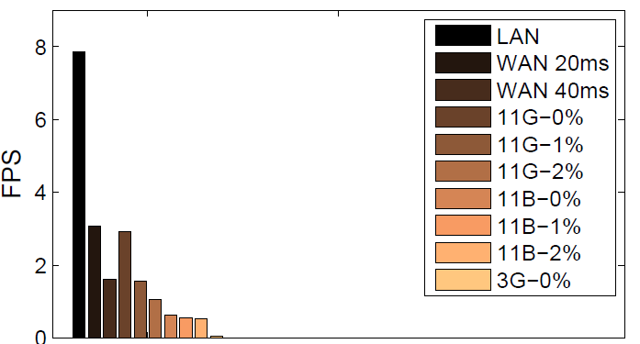
mCloud Architecture
Resource-intensive mobile applications
  Face recognition for social networking app
  Gesture recognition for control media app
  Object and post recognition for augmented reality app
End-to-end latency and througput matters for crisp interaction
  Augmented reality need to display results within 1 sec
  Need high data rate processing capability, low frame rate can miss gesture
Delay, loss on frame rate of video
stream transfer [Odessa, 2011]

Slide 20
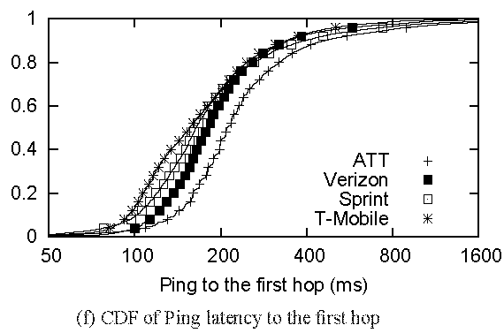
mCloud Architecture (Cont’d)
WAN performance
  First hop latency in 3G is 200ms
  Verizon LTE :128ms, 6.44 Mbps downlink, 5Mbps uplink [Pcworld, March 2011]
There is a need for a middle tier
cloudlet = (compute cluster
+ wireless access point
+ wired Internet access
+ no battery limitations)
→ “data center in a box”
“Anatomizing Application Performance Differences on Smartphones”,
MobiSys 2010 (Huang et al)

Slide 21




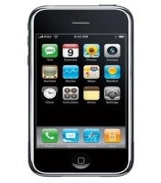
mCloud Architecture (Cont’d)
Cloudlet possible locations
Cellular providers has a unique advantage
Regional Data centers (RDC)
RDC_{A1}
Wireless Core
RDC_{B1}
RNC
Internet
BS
Storage
nodes
Compute
nodes
RDC_{B2}
RDC_{A2}
WiFi AP
Possible locations
of cloudlet

Slide 22
mCloud Programming Model
MAUI: RPC based offloading architecture
CloneCloud: tight synchronization between cloud and phone
Odessa: data-flow graph to exploit parallelism in perception applications
COMET: distributed shared memory
MAUI, CloneCloud , Odessa all have profiler, solver
 | MAUI | CloneCloud | Odessa | COMET
Remote execution unit | Methods (RMI) | Threads (method entry/exit) | Tasks | Threads (any place)

Slide 23
mCloud Programming Model: MAUI
Combine extensive profiling with an ILP solver
  Makes dynamic offload decisions
  Optimize for energy reduction
  Profile: device, network, application
Leverage modern language runtime (.NET CLR)
  Portability:
    Mobile (ARM) vs Server (x86)
    .NET Framework Common Intermediate Language
  Type-Safety and Serialization:
    Automate state extraction
  Reflection:
    Identifies methods with [Remoteable] tag
    Automates generation of RPC stubs

Slide 24
mCloud Programming Model: MAUI (Cont’d)
MAUI architecture
Application
Application
Maui Runtime
Maui Runtime
Handles Errors
Client Proxy
Server Proxy
Provides runtime information
RPC
Intercepts Application Calls
Synchronizes State
Profiler
Profiler
RPC
Solver
Solver
Chooses local or remote
Maui Controller
Smartphone
Maui server
Source: MAUI Mobisys presentation
Notes:
the MAUI coordinator, which handles authentication
and resource allocation for incoming requests to instantiate a partitioned
application.

Slide 25
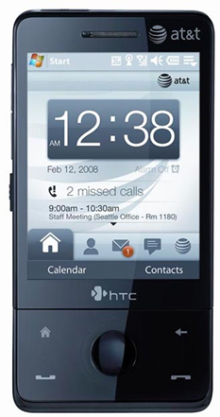
MAUI Profiler
CPU Cycles
State size
Device Profile
Execution Time
Network Latency
Profiler
Callgraph
Network Bandwidth
Computational Power Cost
Computational Delay
Annotated Callgraph
Network Power Cost
Network Delay
Computational Delay
Source: MAUI Mobisys presentation

Slide 26
MAUI Solver
A sample callgraph
C
5000 mJ
3000 ms
10000 mJ
A
1000mJ
B
900 mJ
15ms
Energy and delay for state transfer
Computation energy and delay for execution
25000 mJ
D
15000 mJ
12000 ms
Source: MAUI Mobisys presentation

Slide 27
Is Global Program Analysis Needed?
Yes! – This simple example from Face Recognition app shows why local analysis fails.
InitializeFace
Recognizer
5000 mJ
10000 mJ
User
Interface
1000mJ
FindMatch
900 mJ
Cheaper to do local
25000 mJ
DetectAndExtract Faces
15000 mJ
Source: MAUI Mobisys presentation

Slide 28
Is Global Program Analysis Needed?
Yes! – This simple example from Face Recognition app shows why local analysis fails.
InitializeFace
Recognizer
5000 mJ
10000 mJ
Cheaper to do local
User
Interface
1000mJ
FindMatch
900 mJ
25000 mJ
DetectAndExtract Faces
15000 mJ
Source: MAUI Mobisys presentation
Cheaper to do local

Slide 29
Is Global Program Analysis Needed?
InitializeFace
Recognizer
User
Interface
1000mJ
FindMatch
25900mJ
Cheaper to offload
DetectAndExtract Faces
Source: MAUI Mobisys presentation

Slide 30
Can MAUI Adapt to Changing Conditions?
Adapt to:
  Network Bandwidth/Latency Changes
  Variability on method’s computational requirements
Experiment:
  Modified off the shelf arcade game application
  Physics Modeling (homing missiles)
  Evaluated under different latency settings
Source: MAUI Mobisys presentation

Slide 31
Can MAUI Adapt to Changing Conditions?
HandleEnemies
11KB + missiles
11KB + missiles
DoFrame
DoLevel
HandleBonuses
11KB + missiles
missiles
Required state is smaller
*Missiles take around 60 bytes each
HandleMissiles
Source: MAUI Mobisys presentation
Complexity increases with # of missiles

Slide 32
Case 1
HandleEnemies
Zero Missiles
Low latency (RTT < 10ms)
DoFrame
DoLevel
HandleBonuses
Offload starting at DoLevel
HandleMissiles
Source: MAUI Mobisys presentation
Computation cost is close to zero
*Missiles take around 60 bytes each

Slide 33
Case 2
HandleEnemies
5 Missiles
Some latency (RTT = 50ms)
DoFrame
DoLevel
HandleBonuses
Very expensive to offload everything
Little state to offload
HandleMissiles
Only offload Handle Missiles
Source: MAUI Mobisys presentation
Most of the computation cost
*Missiles take around 60 bytes each

Slide 34
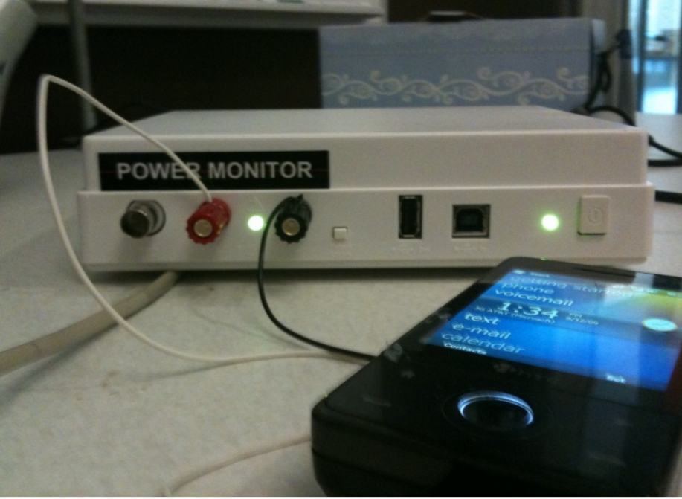
MAUI Implementation
Platform
  Windows Mobile 6.5
  .NET Framework 3.5
  HTC Fuze Smartphone
  Monsoon power monitor
Applications
  Chess
  Face Recognition
  Arcade Game
  Voice-based translator
Source: MAUI Mobisys presentation

Slide 35
Questions
How much can MAUI reduce energy consumption?
How much can MAUI improve performance?
Can MAUI Run Resource-Intensive Applications?
Source: MAUI Mobisys presentation

Slide 36
How much can MAUI reduce energy consumption?
Face Recognizer
An order of magnitude improvement on Wi-Fi
Big savings even on 3G
Source: MAUI Mobisys presentation

Slide 37
How much can MAUI improve performance?
Face Recognizer
Improvement of around an order of magnitude
Source: MAUI presentation

Slide 38
Latency to server impacts the opportunities for fine-grained offload
Arcade Game
Solver would decide not to offload
Up to 40% energy savings on Wi-Fi
Source: MAUI Mobisys presentation

Slide 39
Can MAUI Run Resource-Intensive Applications?
Translator
Can be run on the phone with MAUI
CPU Intensive even on a Core 2 Duo PC
Source: MAUI Mobisys presentation

Slide 40
Conclusions
MAUI enables developers to:
  Bypass the resource limitations of handheld devices
  Low barrier entry: simple program annotations
For a resource-intensive application
  MAUI reduced energy consumed by an order of magnitude
  MAUI improved application performance similarly
MAUI adapts to:
  Changing network conditions
  Changing applications CPU demands
Source: MAUI Mobisys presentation

Slide 41
mCloud Programming Model: CloneCloud
Offloading decision done at beginning of execution

Slide 42
The Before-After Picture
Courtesy: Byung-Gon Chun et. al.

Slide 43
CloneCloud v1 Architecture
Courtesy: Byung-Gon Chun et. al.

Slide 44
AppVM Clones
Virtual machine of entire client device
  Android x86 VM natively executed on VMWare in an x86 machine
Synchronized file systems
Courtesy: Byung-Gon Chun et. al.

Slide 45
Partitioning
Where to partition code,
satisfying any constraints for correctness,
so as to optimize for current conditions
Courtesy: Byung-Gon Chun et. al.

Slide 46
Automatic Partitioning Framework
Optimal
partitioning
points
Partitioning
constraints
Identify valid split points
Application
binary
Static
analysis
location-
constraints
Optimization
solver
Pick best choice for an objective
Profiling
inputs
Dynamic
profiling
cost-annotated
executions
Construct cost models
Partition Analyzer
Courtesy: Byung-Gon Chun et. al.

Slide 47
Partitioning: Static Analysis
Partitioning points
  Restrict to method entry/exit
Identify “pinned” methods
  Identify framework library methods
Identify mutually dependent native state
  Class natives stay together
Collect static control flow
  Who calls whom
Courtesy: Byung-Gon Chun et. al.

Slide 48
Partitioning: Profiling
Pick k invocations
For each invocation
  Run app on mobile device
  Run app on clone
For each method
  Execution time
  Context size entry/exit
  Estimate of energy consumption
Courtesy: Byung-Gon Chun et. al.

Slide 49
Partitioning: Intuition
Partitioning points splice profile trees together
Context size used to estimate network cost
Courtesy: Byung-Gon Chun et. al.

Slide 50
Partitioning: Optimization
List all partitioning choices
Remove partitioning choices that do not meet the constraints
For each choice, compute total time
Find the minimum
Courtesy: Byung-Gon Chun et. al.

Slide 51
Distributed Execution
How to seamlessly execute the partitions of an application locally and remotely
Courtesy: Byung-Gon Chun et. al.

Slide 52
Migration Architecture
Courtesy: Byung-Gon Chun et. al.

Slide 53
Migration: Suspend-Transmit-Resume
Mobile device
Clone
At migration point
  Suspend thread
  Capture context
  Transmit
  Launch process
  Patch migrated context
  Resume thread
  Suspend thread
  Capture context
At reintegration point
Transmit
  Merge migrated
  context
  Resume thread
Courtesy: Byung-Gon Chun et. al.

Slide 54
Migration Challenges
Regular IDs (references) not globally unique
  Address space difference between mobile device and clone
System objects created at boot everywhere
Courtesy: Byung-Gon Chun et. al.

Slide 55
Migration: References in Motion
Courtesy: Byung-Gon Chun et. al.

Slide 56
The CloneCloud v1 Prototype
On Android platform + x86 VM clones
Modified DalvikVM to support thread-level migration and dynamic profiling
Implemented NodeManager to handle registration and communication
Static analysis using JChord
Courtesy: Byung-Gon Chun et. al.

Slide 57
Evaluation Setup
Test applications
  Image search
  Virus scanning
  Privacy-preserving user profiling
Phone: Android Dev Phone 1
Clone VM: a server with a 3.0GHz Xeon CPU running VMWare ESX 4.1 in Intel IT infrastructures
Wireless connection: WiFi, T-mobile 3G
Courtesy: Byung-Gon Chun et. al.

Slide 58
Execution Time Comparison
(Image Search)
Execution time (seconds)
20x
1x
Courtesy: Byung-Gon Chun et. al.

Slide 59
Energy Consumption Comparison
(Image Search)
Energy consumption (J)
20x
1x
Courtesy: Byung-Gon Chun et. al.

Slide 60
Discussion
Applicability is application-specific
  Application characteristics
  Execution mechanism
A design point with focus on automation
  Apps structured to be more amenable to migration
Clone VMs in untrusted environments
Courtesy: Byung-Gon Chun et. al.

Slide 61
Conclusion
CloneCloud: automatic partitioning and migration to enhance mobile applications
  Use of clones
  Flexible app partitioning
  Seamless migration
Courtesy: Byung-Gon Chun et. al.

Slide 62
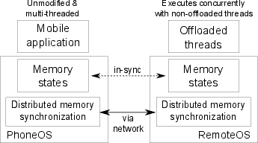
mCloud Programming Model: COMET
Improve mobile computation speed
Require no programmer effort
Generalize well with existing applications
Resist network failures
Courtesy: Mark Gordon et. al.

Slide 63



Distributed Shared Memory
COMET is offloading + DSM
  Offloading bridges computation disparity
  DSM provides logically shared address space
DSM usually applied to cluster environments
  Low latency, high throughput
Mobile relies on wireless communication
Courtesy: Mark Gordon et. al.

Slide 64
DSM (continued)
Conventional DSM (Munin)
X=?
X=555
X=123
X=555
X=555
X=?
X=123
X=123
Waited an RTT for a write
Read could take RTT also
Courtesy: Mark Gordon et. al.

Slide 65
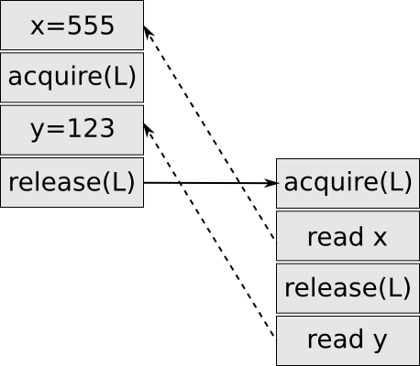
Java Memory Model
Dictates which writes a read can observe
Specifies 'happens-before' partial order
  Access in single thread totally ordered
  Lazy Release Consistency locking
Fundamental memory unit is the field
  Known alignment, known width
Courtesy: Mark Gordon et. al.
Notes:
More about happens-befoer

Slide 66
Field DSM
Track dirty fields locally
Need 'happens-before' established?
  Transmit dirty fields! (mark fields clean)
Not clear it scales well past two endpoints
  Not important to our motivation
  Use classic cluster DSM on server
Courtesy: Mark Gordon et. al.

Slide 67
VM-synchronization
Used to establish 'happens-before' relation
Directed operation between pusher and puller
Synchronizes
  Bytecode sources
  Java thread stacks
  Java heap
Courtesy: Mark Gordon et. al.

Slide 68
Bytecode Update (Step 1 of 3)
Operation begins by sending any new code
I loaded file xyz.dex
I have xyz.dex cached
Pusher
Courtesy: Mark Gordon et. al.
Puller

Slide 69
Stack Update (Step 2 of 3)
Next we send over thread stacks
nom
Thread id: 2
job2::run
pc:5
registers[42, 555, 0]
workLoop
pc:6
registers[0, [obj:9]]
start
pc:3
Registers[101, [obj:9]]
Pusher
Puller

Slide 70
Heap Update (Step 3 of 3)
Finally send over heap update
  We send updates to any changed (or new) field
  Only send updates of 'shared' heap
[obj:2].y = 1
[obj:4].z = [obj:3]
...
Pusher
Puller

Slide 71




Lock ownership
Annotate with lock ownership flag
Establish 'happens-before' with VM-sync
Courtesy: Mark Gordon et. al.

Slide 72
Thread Migration
Thread migration trivial
  Push VM-sync
  Transfer lock ownership
Pusher
Puller
Notes:
Need slide about locking

Slide 73
Native Methods
Written in C with bindings for Java
  Math.sin(), OSFileSystem.write(), VMThread.currentThread()
Native methods exist to
  Access device resources (file system, display, etc)
  For performance reasons
  To work with existing libraries
Not generally safe to run on either endpoint
  Manually white list safe native methods
Courtesy: Mark Gordon et. al.

Slide 74
Failure Recovery
VM-synchronization is recovery safe
Always leave enough information on client
If server is lost resume threads running locally!
X=557
X=556
X=555
X=556
X=555
Thread 1
foo()
r0=[X]
r0=r0+1
[X]=r0
> bar()
Thread 1
foo()
r0=[X]
r0=r0+1
[X]=r0
> bar()
Thread 1
> foo()
r0=[X]
r0=r0+1
[X]=r0
bar()
Thread 1
> foo()
r0=[X]
r0=r0+1
[X]=r0
bar()
Courtesy: Mark Gordon et. al.

Slide 75
Failure Recovery
VM-synchronization is recovery safe
Always leave enough information on client
If server is lost resume threads running locally!
X=556
X=555
X=556
X=555
Thread 1
foo()
r0=[X]
r0=r0+1
[X]=r0
> bar()
Thread 1
foo()
r0=[X]
r0=r0+1
[X]=r0
> bar()
Thread 1
> foo()
r0=[X]
r0=r0+1
[X]=r0
bar()
Thread 1
> foo()
r0=[X]
r0=r0+1
[X]=r0
bar()
Courtesy: Mark Gordon et. al.

Slide 76
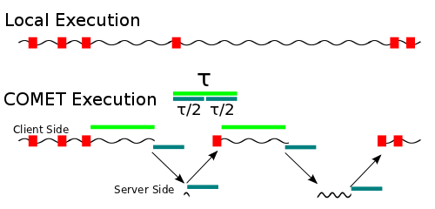
Tau-Scheduler
Τ = 2 * VM-synchronization time
Courtesy: Mark Gordon et. al.
Notes:
TOE=COMET

Slide 77
Implementation
Built from gingerbread CyanogenMod source
~5000 lines of C code
JIT not included
Engine.c:offMigrateThread()
offWriteU1(self, OFF_ACTION_MIGRATE);
deactivate(self);
offThreadWaitForResume(self);
Courtesy: Mark Gordon et. al.

Slide 78
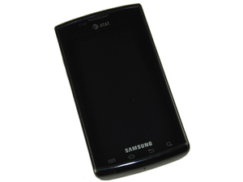
Evaluation Setup
Samsung Captivate (1 GHz Hummingbird)
2 x 3.16GHz quad core Xeon X5460 cores
Courtesy: Mark Gordon et. al.

Slide 79
Benchmarks
8 applications from Google Play
  Average speed-up of 2.88X on WiFi / 1.28X on 3G
  Average energy saving of 1.51X on WiFI / 0.84X on 3G
2 computation benchmark applications
  10.4X speed-up w/ WiFi on Linpack
  200+X speed-up w/ multi-threaded factoring
Courtesy: Mark Gordon et. al.

Slide 80
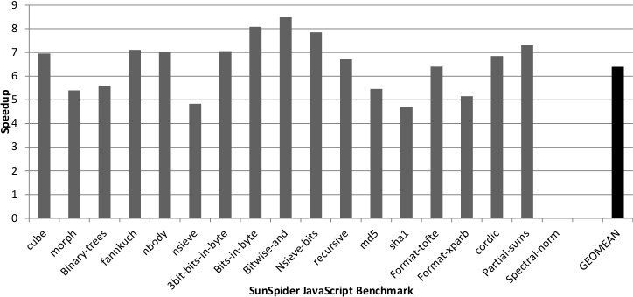
Rhino
Java JavaScript Interpreter
  Ran with SunSpider JavaScript benchmark

Slide 81
Conclusion
Offloading+DSM=COMET
  Improve computation speed
  No programmer effort
  Generalize well
  Resist network failures

Slide 82
Contributions
Design/Impl. with four simultaneous goals
  Fine granularity offloading
  Mutli-threading support
Field based DSM coherency

Slide 83
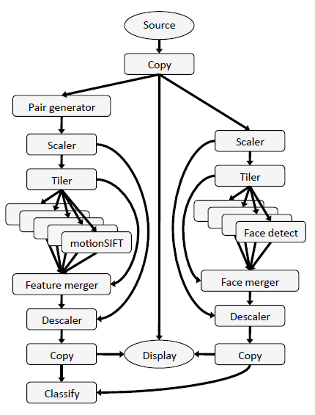
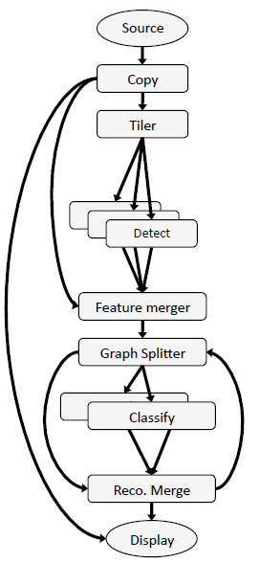
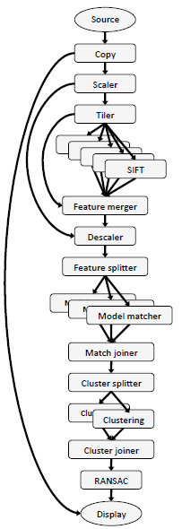
mCloud Programming Model: Odessa
Data flow graph: vertices are stages; edges are connectors; stages share nothing
Source: Odessa Mobisys presentation
Face Recognition
Object Pose Estimation
Gesture Recognition
Notes:
Figure 2(a) shows the application graph for face
recognition. The application consists of two main logical blocks
consisting of face detector and the classifier. Face detection is done
using the default OpenCV [4] Haar Classifier. The face classifier
takes as input the detected faces and runs an online semi-supervised
learning algorithm [17] to recognize the faces from a data set of 10
people.
Object and Pose Recognition Figure 2(b) shows the data-flow
graph for the object instance and pose recognition application [26].
The application consists of four main logical blocks. As shown
in the figure, each image first passes through a proportional downscaler.
SIFT features [20] are then extracted from the image, and
matched against a set of previously constructed 3D models for the
objects of interest. The features for each object are then clustered
by position to separate distinct instances. A random sample consensus
(RANSAC) algorithm with a non-linear optimization is used
to recognize each instance and estimate its 6D pose.
Gesture Recognition. Figure 2(c) shows the application graph for
a gesture recognition application. Each video frame is sent to two
separate tasks, face detection and motion extraction. The latter accumulates
frame pairs, and then extracts SIFT-like features that encode
optical flow in addition to appearance [6]. These features,
filtered by the positions of detected faces, are aggregated over a
window of frames using a previously-generated codebook to create
a histogram of occurrence frequencies. The histogram is treated as
an input vector to a set of support vector machines trained for the
control gestures.
Programming Model. Applications in the Sprout framework are
structured as a data flow graphs; the data flow model is particularly
well suited for media processing applications that perform a series
of operations to an input video or audio stream. The vertices of
the graph are processing steps called stages and the edges are connectors
which represent the data dependencies between the stages.
Stages within an application employ a shared-nothing model: they
share no state, and interact only through connectors. This restriction
keeps the programming complexity of individual stages comparable
to that of sequential programming, and allows concurrency
to be managed by the Sprout runtime. This programming model
allows programmers to express coarse-grained application parallelism
while hiding much of the complexity of parallel and distributed
programming from the application developer.
Automated data transfer. Sprout connectors define data dependencies
and perform data transfer between processing stages. The
underlying implementation of a connector depends on the location
of the stage endpoints. If the connected stages are running in
the same process, the connector is implemented as an in-memory
queue. Otherwise, a TCP connection is used. The Sprout runtime
determines the connector type, and handles serialization and data
transport through connectors transparently. This allows a processing
stage to be written in a way that is agnostic to whether it or
related processing steps have been off-loaded.
Parallelism Support. The Sprout runtime supports coarse-grained
data parallelism and pipeline parallelism. Data parallelism is supported
by having multiple instances of a stage execute in parallel on
separate processor cores. Pipeline parallelism is supported by having
multiple frames be processed simultaneously by the different
processing stages of the application.
The relationship between Sprout and Odessa. Sprout provides
programmers with mechanisms to dynamically adjust running applications,
change the degree of parallelism, and migrate processing
stages between machines. In Odessa, we develop adaptive techniques
for determining when and which stages to offload, and deciding
how much pipelining and data-parallelism is necessary in
order to achieve low makespan and high throughput, and then leverage
the Sprout mechanisms to effect the changes.

Slide 84

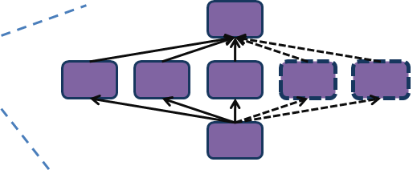
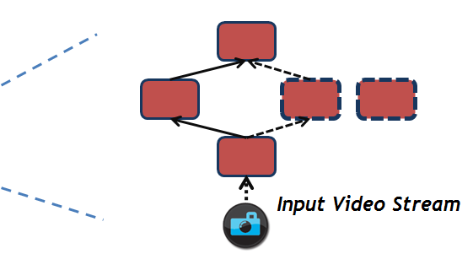

mCloud Programming Model: Odessa (Cont’d)
Offloading DEcision System for Streaming Applications
Application
Odessa Profiler
Sprout
Cloud Infrastructure
Network
Application
Odessa
Runtime
Profiler
Decision
Engine
Odessa
Sprout
Mobile Device
Source: Odessa Mobisys presentation

Slide 85

mCloud Programming Model: Odessa (Cont’d)
Cloud Infrastructure
B2
B1
C
A
Network
B
C
A
Application Data Flow Graph
>
Incremental decisions adapt quickly to input and platform variability.
Screen
Local
Execution
Cost
Remote
Execution
Cost
Smartphone
Source: Odessa Mobisys presentation

Slide 86
Support for Service Interaction
Synergy of mCloud services
  Shared basic services enables more efficient usage of cloud resources(e.g. shared memcache eliminates data duplication of individual services)
  Co-location makes mashed-up applications to achieve native performance (file transfer becomes an object reference)
mCloud offers shared platform services
mCloud optimizes service interaction through active VM migration

Slide 87
Closing Thoughts
Cloud computing needs to advance in architecture, programming model, platform services to revolutionize mobile computing

Slide 88
Useful Tools
Hprof: a heap/CPU profiling tool
Jchord: a static analysis tool on Java bytecode
Dummynet (ipfw): simulates/enforces queue and bandwidth limitations, delays, packet losses
OpenCV: a library of programming functions for real time computer vision

