Slide 1
Cellular Networks and Mobile Computing COMS 6998-10, Spring 2013
Instructor: Li Erran Li (lierranli@cs.columbia.edu)
http://www.cs.columbia.edu/~lierranli/coms6998-10Spring2013/
1/22/2013: Class Introduction

Slide 2
Outline
Introduction
Course content
Course goals and structure
Example projects
Programming environment setup

Slide 3
Introduction
Researcher at Bell Labs, Alcatel-Lucent
Ph.D. from Dept. of CS, Cornell, 2001
Research interest: cellular networks, mobile computing, cloud computing, and security
Research Goal: improve our mobile user experience through innovation in cellular network architecture, mobile cloud computing systems and security

Slide 4
Experiences
Relevant working experiences
Cellular networks: monitoring and trouble shooting, software defined cellular networks
Mobile computing: mobile cloud computing
Cloud computing: scaling out enterprise applications, cloud-based video proxy, policy-aware enterprise application cloud extension
Professional Activities
ACM SIGCOMM Workshop on Cellular Networks: Operations, Challenges, and Future Design (CellNet), August 2012
DIMACS Workshop on Software Defined Networking, Dec, 2012
ACM MobiSys Workshop on Mobile Cloud Computing & Services: Social Networks and Beyond (MCS), June 2010
DIMACS Workshop on Systems and Networking Advances in Cloud Computing, Dec, 2011

Slide 5
Introduction (Cont’d)
Current research projects:
Eikon: smartphone virtualization on x86
mCloud: mobile cloud computing (ACM Mobisys MCS workshop’12)
Software-defined cellular networks (Euro SDN workshop’12)
Argos: scaling up cellular networks using a large number of antennas (ACM MobiCom’12)

Slide 6
Course Content
Apps
Systems
Mobile
Computing
Cellular Networks
Cloud Computing
Security and Privacy
Notes:
Pandora, due to the poor interaction between the radio resource control policy and the application’s data transfer scheduling mechanism,46% of its radio energy is spent on periodic audience measurements that account for only 0.2% of received user data

Slide 7
Course Syllabus
Mobile App Development (lecture 2,3)
Mobile operating systems: iOS and Android
Development environments: Xcode, Eclipse with Android SDK
Programming: Objective-C and android programming
System Support for Mobile App Optimization (lecture 4,5)
Mobile device power models, energy profiling and ebug debugging
Core OS topics: virtualization, storage and OS support for power and context management
Interaction with Cellular Networks (lecture 6, 7, 8)
Basics of 3G/LTE cellular networks
Mobile application cellular radio resource usage profiling
Measurement-based cellular network and traffic characterization
Interaction with the Cloud (lecture 9, 10)
Mobile cloud computing platform services: push notification, iCloud and Google Cloud Messaging
Mobile cloud computing architecture and programming models
Mobile Platform Security and Privacy (lecture 11, 12, 13)
Mobile platform security: malware detection and characterization, attacks and defenses
Mobile data and location privacy: attacks, monitoring tools and defenses

Slide 8
Course Content (Cont’d)
Why study cellular networks and mobile computing together?
Mobile apps with no knowledge of cellular networks can perform poorly
Pandora consumes 46% radio energy on periodic transfers of 0.2% received user data
Cellular networks with no knowledge of mobile apps can perform poorly, e.g. poor traffic planning, high latency for delay sensitive traffic
Notes:
Pandora, due to the poor interaction between the radio resource control policy and the application’s data transfer scheduling mechanism,46% of its radio energy is spent on periodic audience measurements that account for only 0.2% of received user data

Slide 9
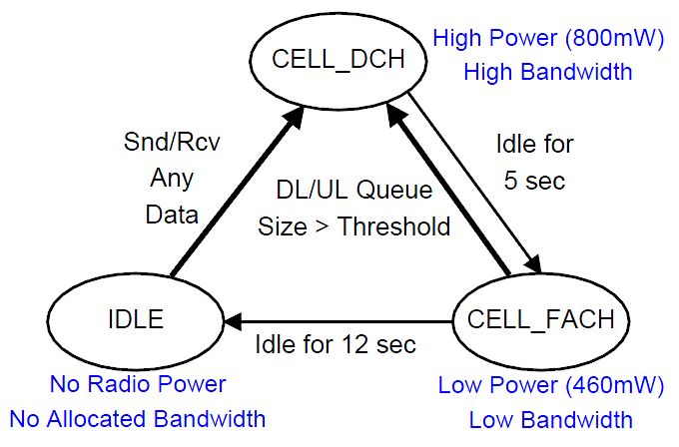
Example in Detail: The RRC State Machine for UMTS Network
State promotions have promotion delay
State demotions incur tail times
Delay: 2s
Tail Time
Delay: 1.5s
 | Channel | Radio Power
IDLE | Not allocated | Almost zero
CELL_FACH | Shared, Low Speed | Low
CELL_DCH | Dedicated, High Speed | High
Tail Time
Courtesy: Feng Qian
Notes:
State machine – the standard for all UMTS carriers – transitions & paras can change

Slide 10
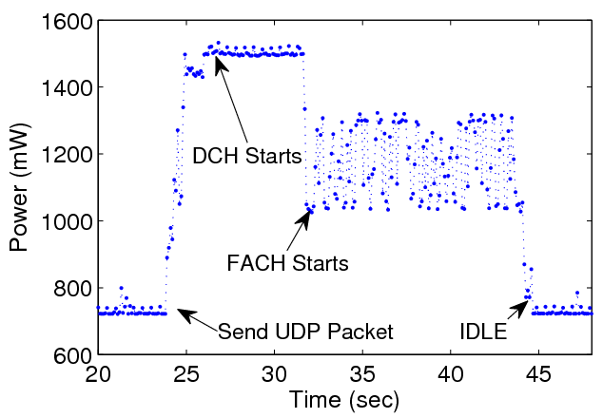
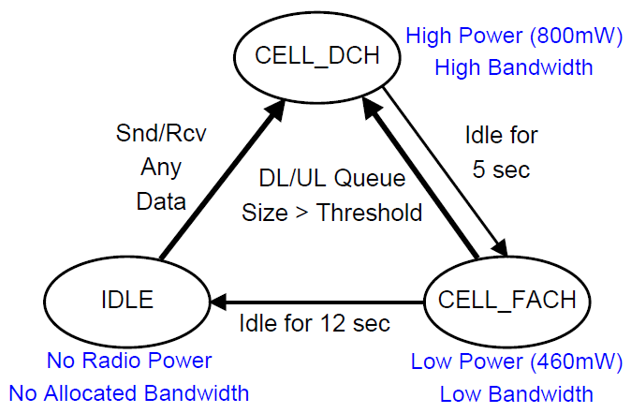
Example in Detail: RRC State Machine for a Large Commercial 3G Network
Promo Delay: 2 Sec
DCH Tail: 5 sec
FACH Tail: 12 sec
Tail Time
Waiting inactivity timers to expire
DCH: High Power State (high throughput and power consumption)
FACH: Low Power State (low throughput and power consumption)
IDLE: No radio resource allocated
Courtesy: Feng Qian

Slide 11
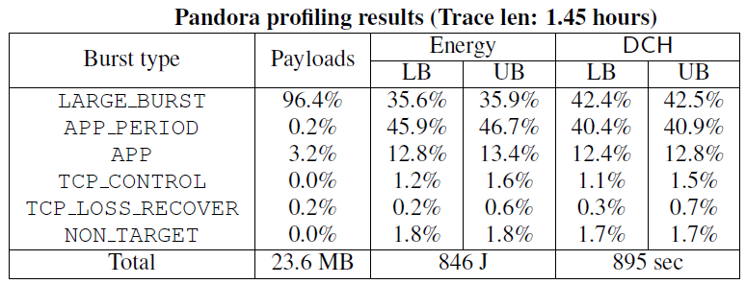
Example in Detail: Pandora Music
Problem: High resource overhead of periodic audience measurements (every 1 min)
Recommendation: Delay transfers and batch them with delay-sensitive transfers
Courtesy: Feng Qian
Notes:
First explain the app
Problem – recommendation: make annimation

Slide 12
Example in Detail: Feedback from Pandora
AT&T's analysis of the Pandora application gave us a much better view of how Pandora interacts with low-level cellular network resources. Now that we better understand these interactions, we can optimize our application to make more efficient use of these resources. In fact, we'd like to incorporate AT&T's profiling tool as part of our normal ongoing testing.
Tom Conrad, CTO of PANDORA®
Courtesy: Feng Qian

Slide 13
Course Goals and Structure
The course equips you to address the following questions:
How to develop mobile apps?
How to profile app energy usage?
How to fix energy bugs (ebugs)?
How to profile for radio resource usage?
What impacts mobile browser performance?
What is the most efficient mechanism for app servers to contact smart phones?
How to offload computation to the cloud?
How to keep my smart phone secure and data private?
Notes:
Understanding the interplay of cellular networks and mobile computing through measurements
Cellular aware mobile application design

Slide 14
Course Goals and Structure (Cont’d)
Basics: brief overview of cellular networks and mobile OS and development platforms
Recent literature: review recent research on cellular network measurements, and mobile computing
Paper presentation, summary, and discussion
Learn by doing: work on a research project

Slide 15
Basics
Overview of cellular networks
UMTS(3G) and LTE: air interface, architecture, mobility management
Mobile OS and development platform
iOS development platform: Xcode, model-view-controller programming model, Objective-C features, iCloud
Android programming: Eclipse Android SDK, Activity, Service, Intent, ContentProvider
Cloud computing (NOT COVERED, lab sessions?)
Google AppEngine
Amazon EC2

Slide 16
Recent Literature
Your duties:
Read all assigned papers before class
Participate in class discussions
Present and summarize 1 papers

Slide 17
Research Project
Topic
Choose from a list of topics
Come up with your own topic
Must be related to mobile computing
Should contain some research elements
Teams of 1 to 4 students
Final deliverables
Project report (research paper format, 10 to 12 pages)
Project presentation and demo

Slide 18
Research Project (Cont’d)
Precisely define the project
Understand related work
Propose novel techniques or systems
Creativity will be evaluated
System implementation
Client side: iOS or Android
Server side: Google AppEngine or Amazon EC2
Networking component: measurement, modeling

Slide 19
Research Project (Cont’d)
Evaluate your solution, e.g. performance, scalability
Thoroughness will be evaluated
Write up and present your projects
Evaluated using professional paper review criterions
Project timelines
Feb. 5: Form final project team
March 12: project description (2-4 pages)
April 30: final presentation and demo
May 10: final project report (10-12 pages)
I will meet with you regularly

Slide 20
Grading
Project reports: 50%
Three programming assignments: 30%
Paper presentation and summary: 10%
Class discussion participation: 10%

Slide 21
Class Resources
Web page: schedule, project timelines, list of potential projects, etc
For any questions or concerns: email me at lierranli@cs.columbia.edu
TA: Akhila Athresh, aa3306@columbia.edu

Slide 22
Example projects
Ideal project criterions
Solves a real problem in cellular networks and mobile computing
Has a research component, e.g. scalable system design, novel inference algorithm of cellular network properties
Real implementation at client side running iOS or Android, and at server side using public cloud platforms such as Google AppEngine or Amazon EC2

Slide 23
Example project 1 from Spring’12 class: iConnect
Goal: build an app that makes file sharing easy among iOS devices
Research: multi-hop issue and low power usage
Implementation: Bonjour, file system API and the network API
Bonjour service discovers devices in the same wireless network
The file system API is used to select or store files
The network API sets up network connection

Slide 24
Example project 2 from Fall’12 class: CloudShrink
Goal: store high resolution photos in dropbox
Research: scalable server and client system design
Implementation: dropbox API, background upload, dynamic download, compression
Background upload: optimize network and battery
Dynamic download: pinch-to-zoom
Compression

Slide 25
Other Example Projects
iChess: peer to peer chess playing in a classroom setting
iPong: peer to peer Ping Pong game
CloudTransfer: transfer files between “clouds”

Slide 26
Programming environment setup
Client side: iOS
Install Xcode 4: http://developer.apple.com/xcode
Learning Objective C and iOS development :http://developer.apple.com/devcenter/ios/index.action
Stanford iPhone development course(on iTunes):http://www.stanford.edu/class/cs193p/cgi-bin/drupal/
Email TA to provision your iOS devices

Slide 27
Programming environment setup (Cont’d)
Client side: Android
Install Eclipse: http://www.eclipse.org/downloads/
Install Android SDK:http://developer.android.com/sdk/index.html
Android programming resources:http://developer.android.com/index.html
Stanford course: http://www.stanford.edu/class/cs193a/

Slide 28
Programming environment setup (Cont’d)
Server side: Google AppEngine
Install: http://code.google.com/appengine/
Install plugin for Eclipse: http://code.google.com/appengine/downloads.html#Download_the_Google_Plugin_for_Eclipse
Amazon EC2: http://aws.amazon.com/ec2/
Free usage tier: http://aws.amazon.com/free/
Notes:
web.mit.edu/6.897/www/
Install Eclipse: http://www.eclipse.org/downloads/
Install Android SDK:http://developer.android.com/sdk/index.html
Install: http://code.google.com/appengine/
Install plugin for Eclipse: http://code.google.com/appengine/downloads.html#Download_the_Google_Plugin_for_Eclipse

Slide 29
Questions?

