Slide 1
Software Defined Networking COMS 6998-10, Fall 2014
Instructor: Li Erran Li (lierranli@cs.columbia.edu)
http://www.cs.columbia.edu/~lierranli/coms6998-10SDNFall2014/
11/10/2014: SDN Traffic Engineering

Slide 2
Outline
Announcement
December 1 lecture reschedule to November 21 (Friday) at 545 Mudd
SDN Traffic Management (20 min)
Motivation
Why SDN
Challenges
Architecture and Algorithms
Implementation and Evaluation
Conclusions and Future Work
Midterm (90 min)

Slide 3
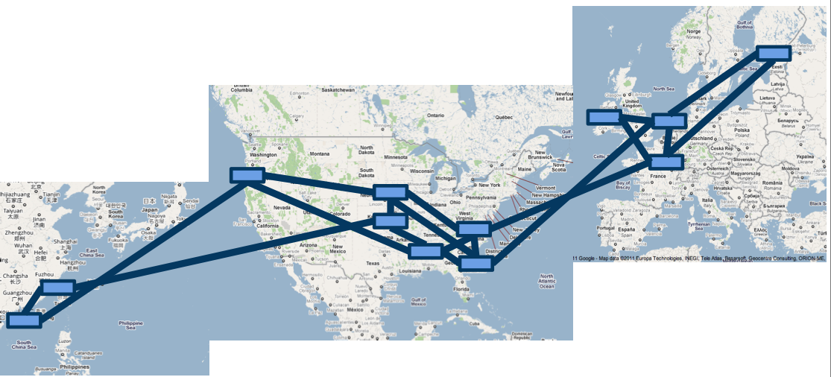
Motivation
Inter-DC WANs bandwidth demand is high
Content distribution both between servers and to end clients
Site replication for geographic locality and bandwidth efficiency
Availability zones: cross-zone replication

Slide 4
Motivation (Cont’d)
Inter-DC WANs are highly expensive

Slide 5
Two key problems
Poor efficiency
Poor sharing
average utilization over time of busy links is only 30-50%
little support for flexible resource sharing
Why?
Source: Ming Zhang, MSR

Slide 6
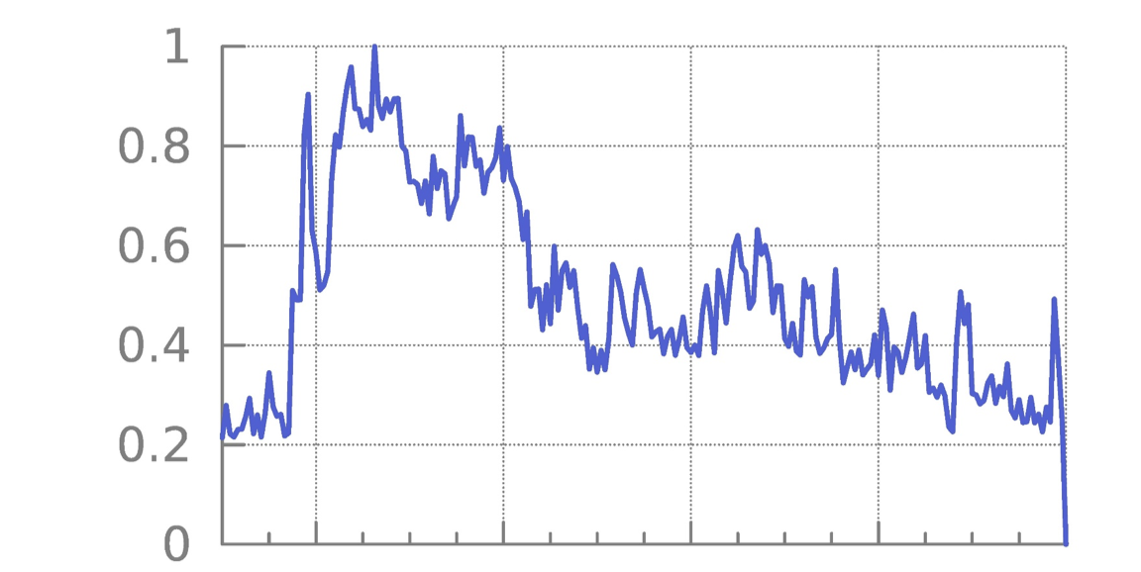
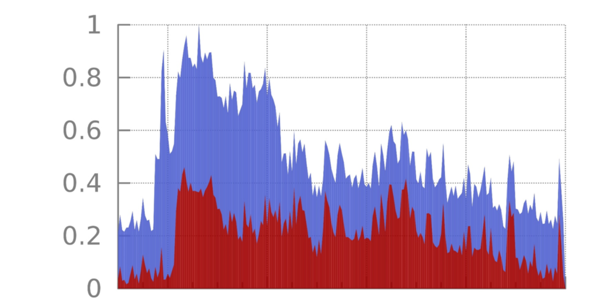
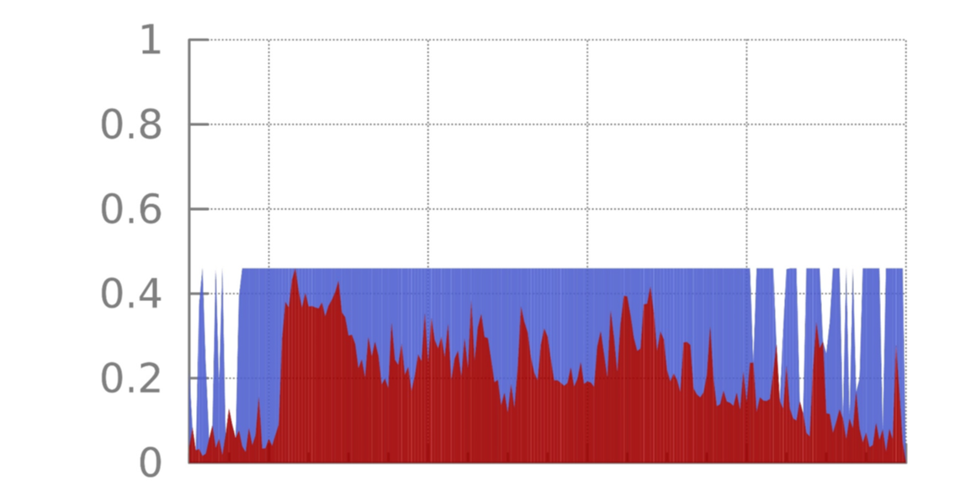
One cause of inefficiency: lack of coordination
peak before rate adaptation
Background traffic
> 50% peak reduction
Norm. traffic rate
peak after rate adaptation
mean
Non-background traffic
Time (~ one day)
Source: Ming Zhang, MSR

Slide 7
Poor sharing
When services compete today, they can get higher throughput by sending faster
Mapping services onto different queues at switches helps, but # services ≫ # queues
(hundreds)
(4 - 8 typically)
Borrowing the idea of edge rate limiting, we can have better sharing without many queues

Slide 8
Outline
SDN Traffic Management
Motivation
Why SDN
Challenges
Architecture and Algorithms
Implementation and Evaluation
Conclusions and Future Work
Midterm

Slide 9
Why SDN
Status Quo
SDN Approach
Forwarding and control
Separate forwarding hardware
intermixed on a single box
from control software
Manage network as 1000s of
Manage network as a single
individual boxes
fabric
Decentralized, non-
Logically centralized control
deterministic protocols
with traffic engineering
All bits are created equal
Allocate resources based on
application priority
Apps regulated by per-flow
Demand measurement and
TCP “fair” share
resource shaping at the edge

Slide 10
Challenges
High performance distributed control systems
Inter-operation with legacy networks (other non-SDN sites or the Internet)
Scalable computation of max-min fair allocation among flows with different priority
Congestion-free data plane update
Working with limited switch memory

Slide 11
Outline
SDN Traffic Management
Motivation
Why SDN
Challenges
Architecture and Algorithms
Implementation and Evaluation
Conclusions and Future Work
Midterm

Slide 12
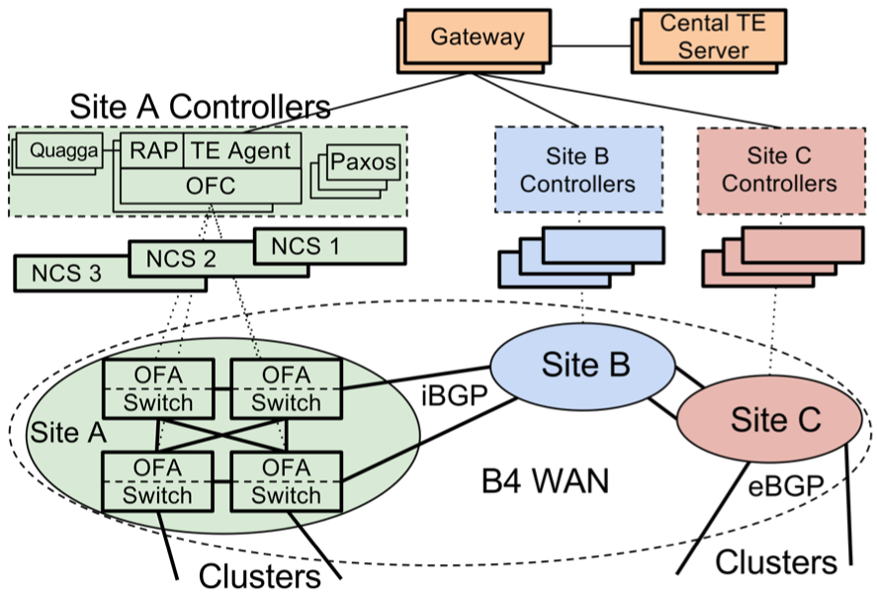
B4 Architecture
NCS: Network Control Servers
RAP: Routing Application Proxy
OFC: OpenFlow Controller
OFA: OpenFlow Agent
NCS and switches share
Out of band
control network

Slide 13
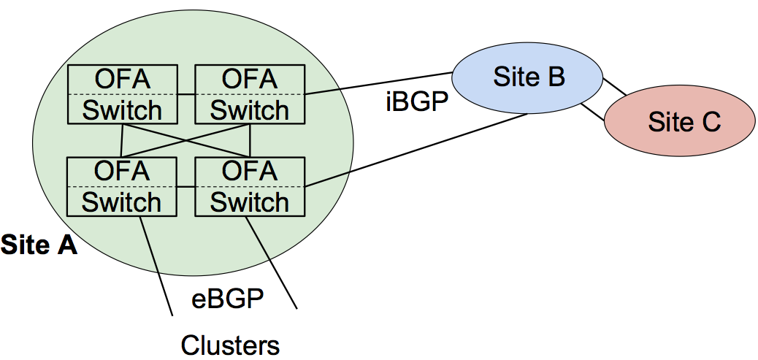
B4 Architecture: Data Plane
OFA
OFA
Site B
Switch
iBGP
Switch
Site C
OFA
OFA
Switch
Switch
Site A
OpenFlow Agent (OFA): is a user-level process running on switch hardware
implement extended OpenFlow to manage the hardware pipeline
Forward BGP routing packets to OFC, in turn to BGP stack.
eBGP
Clusters
Google Confidential and Proprietary

Slide 14
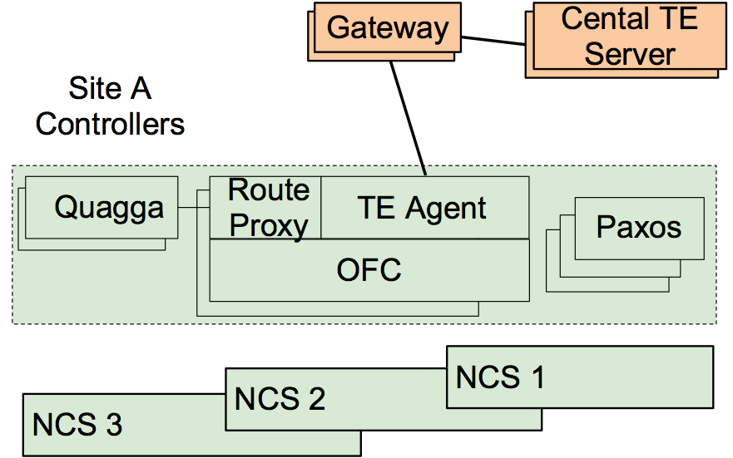
B4 Architecture: Control Plane
Gateway
Cental TE
Server
Site A Controllers
Route Proxy: controller app to connect Quagga and OF switches
BGP/ISIS route updates
Routing protocol packets
Interface updates from switches to Quagga
Rout
Quagga
TE Agent
Prox
Paxos
OFC
NCS 1
NCS 2
NCS 3
Google Confidential and Proprietary

Slide 15
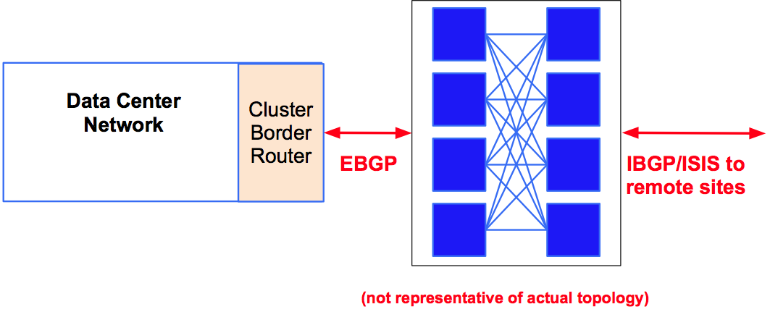
Hybrid SDN Deployment
Data Center Network
Cluster
Border
Router
EBGP IBGP/ISIS to
remote sites
(not representative of actual topology)

Slide 16
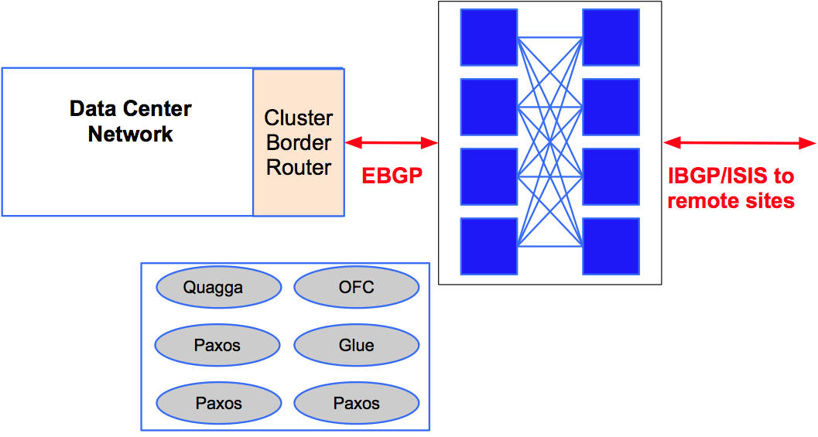
Hybrid SDN Deployment
Data Center Network
Cluster
Border
Router
EBGP IBGP/ISIS to
remote sites
Quagga
OFC
Paxos
Glue
Paxos
Paxos

Slide 17
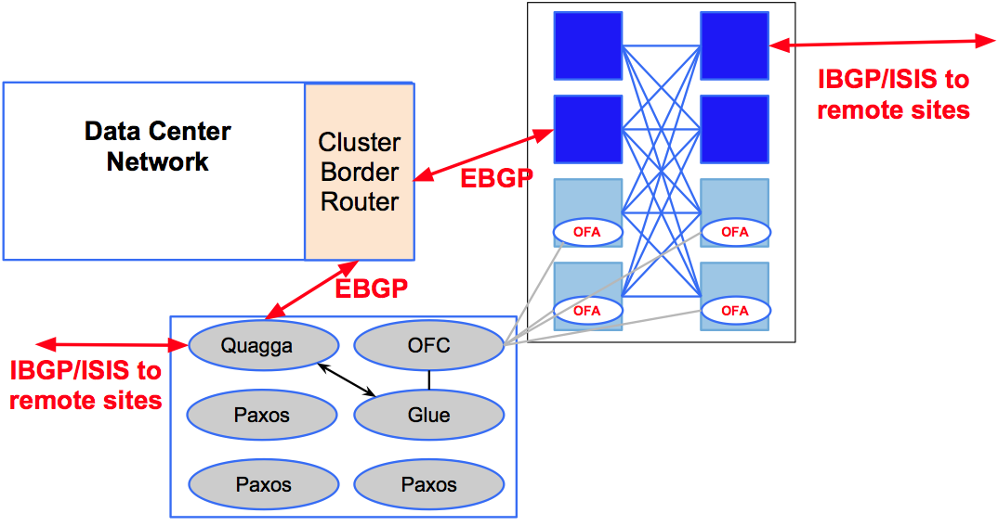
Hybrid SDN Deployment
IBGP/ISIS to
remote sites
Data Center Network
Cluster
Border
EBGP
Router
OFA OFA
EBGP
OFA OFA
Quagga OFC
IBGP/ISIS to remote sites
Paxos Glue
Paxos Paxos

Slide 18
Hybrid SDN Deployment
OFA OFA
Data Center Network
Cluster OFA OFA
Border
Router
OFA OFA
EBGP
OFA OFA
Quagga OFC
IBGP/ISIS to remote sites
Paxos Glue
Paxos Paxos
● SDN site delivers full interoperability with legacy sites

Slide 19
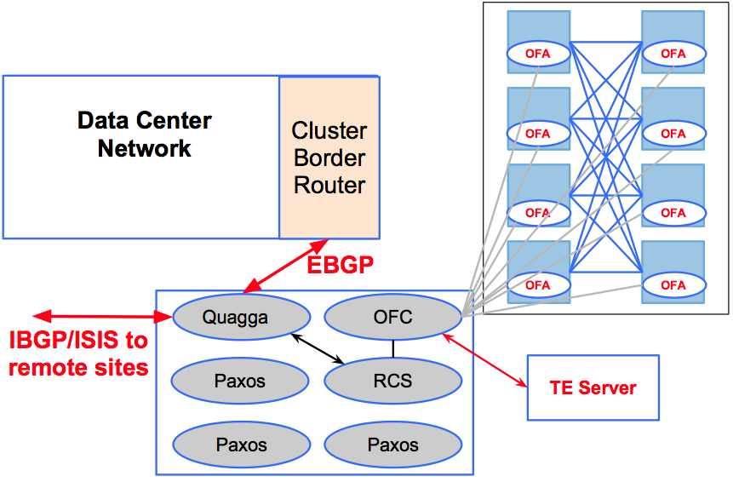
Hybrid SDN Deployment
OFA OFA
Data Center Network
Cluster OFA OFA
Border
Router
OFA OFA
EBGP
OFA OFA
Quagga OFC
IBGP/ISIS to remote sites
Paxos RCS
TE Server
Paxos Paxos
● Ready to introduce new functionality, e.g., TE

Slide 20
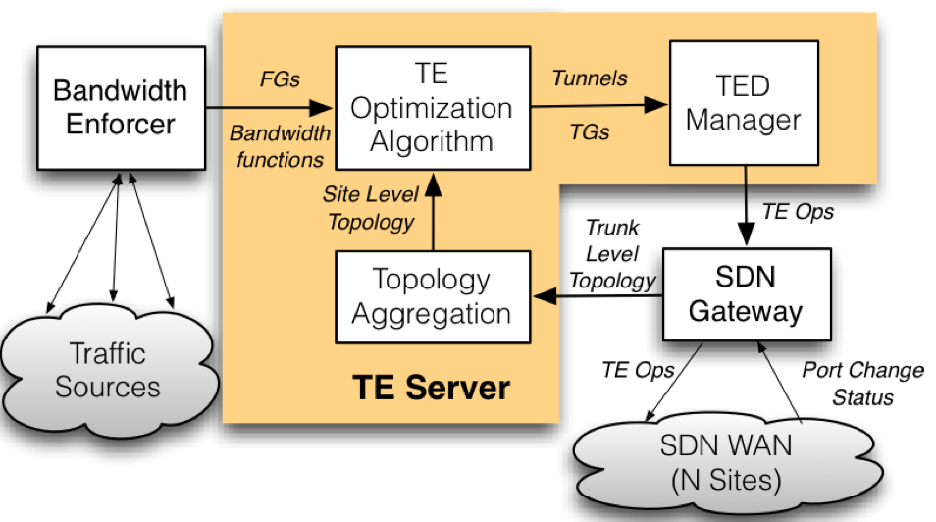
Traffic Engineering Architecture

Slide 21
TE Optimization Problem
● Max-min fair bandwidth allocation to FlowGroups
○ FlowGroups: {DC Pairs, priority class}
● FlowGroup’s priority represented by bandwidth function ● HW capabilities constrains solution:
○ Maximum number of paths ○ Splits quantization

Slide 22
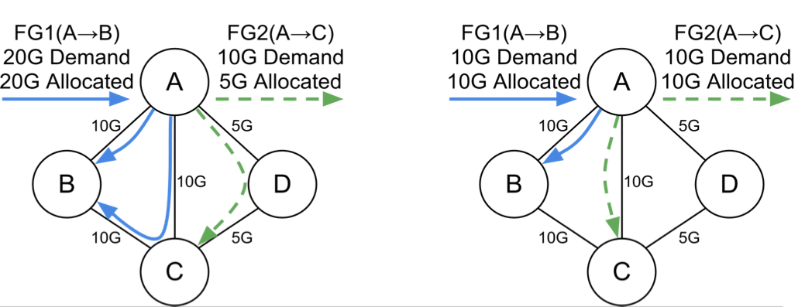
TE Optimization Algorithm
● Max-min fair bandwidth allocation to FlowGroups
● Fill higher priority along shortest paths and then move to longer paths if needed
● Example: FG1 HIPRI, FG2 LOPRI

Slide 23
Congestion-free update Problem
How to update forwarding plane without causing transient congestion?
See lecture 6 on congestion free updates

Slide 24
Outline
SDN Traffic Management
Motivation
Why SDN
Challenges
Architecture and Algorithms
Implementation and Evaluation
Conclusions and Future Work
Midterm

Slide 25
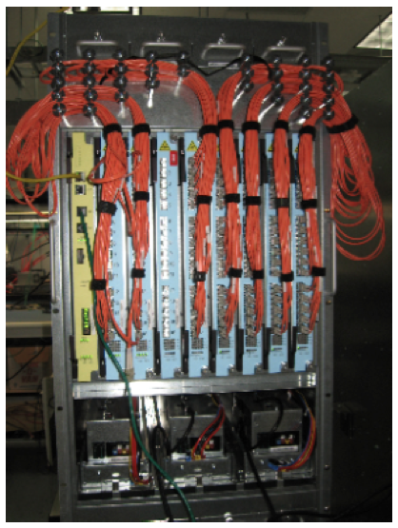
SDN Switch with legacy Routing Protocols
● Built from merchant silicon ○ 100s of ports of
nonblocking 10GE ● OpenFlow support
● Open source routing stacks for BGP, ISIS
● Does not have all features ● Multiple chassis per site ○ Fault tolerance
○ Scale to multiple Tbps

Slide 26
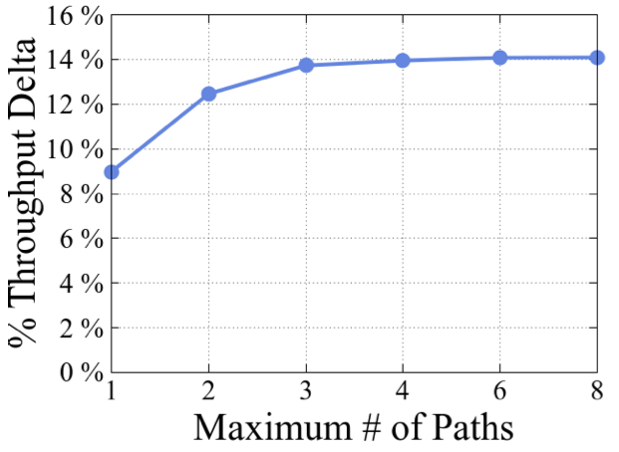
Benefits of Centralized TE
Relative to Shortest Path
Main benefit comes from reduced provisioning for fault tolerance on high priority traffic

Slide 27
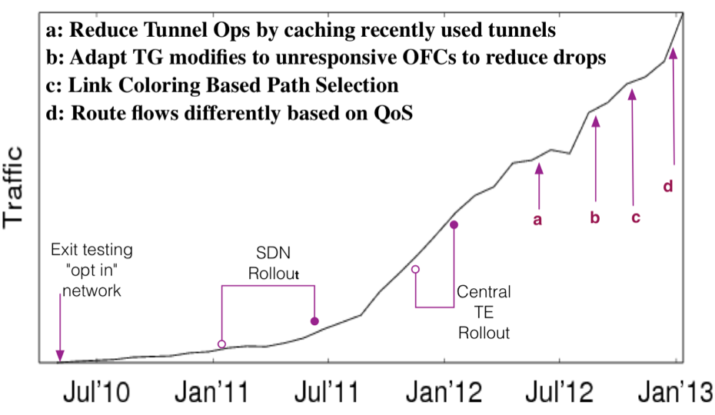
B4 WAN History

Slide 28
Conclusions and Future Work
● Dramatic growth in WAN bandwidth requirements
○ Existing software/hardware architectures make it impractical to deliver necessary bandwidth globally ● Software Defined Networking: it works and at scale
○ Separation of hardware from software
○ Efficient logically centralized control/management ○ Incremental migration path
● Convergence to public facing WAN

Slide 29
Questions?

