Slide 1
Software Defined Networking
COMS 6998-10, Fall 2014
Instructor: Li Erran Li (lierranli@cs.columbia.edu)
http://www.cs.columbia.edu/~lierranli/coms6998-10SDNFall2014/
10/27/2014: SDN Virtualization

Slide 2
Outline
Announcements
  Next Monday is a holiday
  Reminder: midterm November 10
  OpenDaylight lab session on Wednesday
Review of Previous Lecture: Forwarding Abstraction
SDN Virtualization
  OpenvSwitch
  Network Hypervisor for VM Overlay Networks: NVP/NSX
  Network Hypervisor for Physical networks: FlowVisor, OpenVirteX, Compositional Hypervisor

Slide 3
Review of Previous Lecture
What are the different platforms for forwarding?
  Dedicated hardware
  Network processors
  NetFPGA
  General purpose software on commodity servers

Slide 4
Review of Previous Lecture (Cont’d)
What are performance and programmability tradeoffs?
  Software:
    Flexible and easy to program
    Slow forwarding speed
  Programmable hardware:
    Flexible and fast
    Hard to program, costly and power hungry
  Custom hardware:
    Fast, cheap and power efficient
    Long development cycle and not flexible

Slide 5
Review of Previous Lecture (Cont’d)
What are the forwarding abstractions?
  Fixed match action table (today’s switch chipset)
  Reconfigurable match table (OpenFlow++)
    Flexible header fields, flexible actions, flexible memory allocation in multi-stages of match and actions
  Programmable pipeline with modular hardware building blocks on NetFPGA (SwitchBlade)
  Modular router (Click)

Slide 6
Fixed function switch
Review of Previous Lecture (Cont’d)
L2: 128k x 48
Exact match
L3: 16k x 32
Longest prefix
match
ACL: 4k
Ternary match
X
X
X
X
X
PBB Stage
?????????
L2 Stage
L3 Stage
ACL Stage
Queues
In
L2 Table
L3 Table
ACL Table
Out
Action: set L2D
Action: set L2D, dec TTL
Action: permit/deny
Parser
Deparser
Stage 1
Stage 2
Stage 3
Data
Source: P. Bosshart, TI

Slide 7
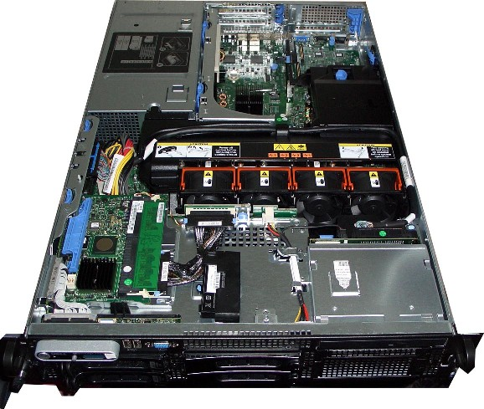
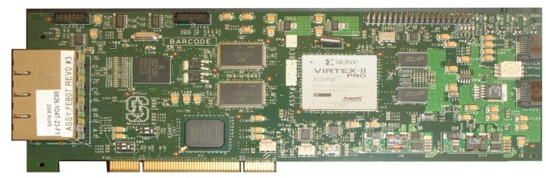
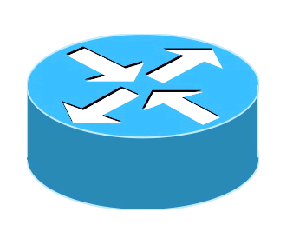
Review of Previous Lecture (Cont’d)
NetFPGA
Software
VE2
VE3
VE3
VE1
VE2
VE3
VE4
VE1
Click
Click
Click
Click
CPU
Memory
Hard Disk
PCI
NetFPGA
VDP1
VDP2
VDP3
VDP4
SwitchBlade
Software
VDP = Virtual Data Plane
Click = Click Software Router
VE = Virtual Environment
Hardware
Virtual Env.
Source: B. Anwer, Gatech
Notes:
Switchblade is simply a server with an FPGA card installed in it, in this case its NetFPGA.
[Click] As you can see this is a simple server with software running on CPU utilizing memory and harddsik. There is a NetFPGA card that is connected through the PCI slot.
[Click]
So what SwitchBlade does is that it extends the software virtual environments to hardware and each virtual environment has a corresponding virtualized data plane in hardware.
So what happens in switchblade is that the pipeline changes according the virtualized data plane. So for each incoming packet the pipeline changes according to individual dataplane user selection. For an OpenFlow VDP pipeline is different than IPv4 VDP etc.
Switchblade is a forwarding device that can be used as a switch or router or at any layer which user wants.

Slide 8
Review of Previous Lecture (Cont’d)
SwitchBlade
Virtual Data
Plane Selection
Shaping
Preprocessing
Forwarding
Postprocessing
Parallel custom data planes
  Ability to demultiplex into existing data planes and maintain isolation on common hardware platform
Rapid development and deployment
  Pluggable preprocessor (e.g. packet parser) modules enable a range of customizable functions at hardware rates
Customizability and programmability
  Dynamic selection of modules, and ability to operate in several different forwarding modes (IPv4, IPv6, OpenFlow).
Source: B. Anwer, Gatech

Slide 9
Review of Previous Lecture (Cont’d)
Click modular router
  Elements
    Small building blocks, performing simple operations
    Instances of C++ classes
  Packets traverse a directed graph of elements
FromDevice(eth0)->CheckIPHeader(14)
->IPPrint->Discard;
Control plane
User-level
routing daemons
Linux kernel
Click
Forwarding plane

Slide 10
Review of Previous Lecture (Cont’d)
Push connection
  Source pushes packets downstream
  Triggered by event, such as packet arrival
  Denoted by filled square or triangle
Pull connection
  Destination pulls packets from upstream
  Packet transmission or scheduling
  Denoted by empty square or triangle
Agnostic connection
  Becomes push or pull depending on peer
  Denoted by double outline
10/26/14
PATS Research Group
10
Notes:
10

Slide 11
Review of Previous Lecture (Cont’d)
RMT
Ethernet
ETHERTYPE
VLAN
VLAN
IPV4
IPV6
L2S
IPV4-DA
IPV6-DA
RCP
L2D
RCP
TCP
UDP
ACL
Done
MY-TABLE
Parse Graph
Table Graph
Source: P. Bosshart, TI

Slide 12
Review of Previous Lecture (Cont’d)
RMT logical to physical mapping
Physical
Stage 1
Physical
Stage 2
Physical
Stage n
3
IPV4
9 ACL
ETH
VLAN
TCAM
2
VLAN
5
IPV6
Match Table
Match Table
Match Table
L2S
IPV4
IPV6
640b
Action
Action
Action
4
L2S
7 TCP
L2D
TCP
UDP
SRAM
HASH
8 UDP
ACL
Logical Table 6
L2D
Logical Table 1
Ethertype
640b
Table Graph
Notes:
To make it possible to efficiently use multiple stages of match tables, it is assumed that the RMT Model can be configured to map Logical Tables to the Physical Tables.
To create bigger tables, one table may traverse multiple stages.
To create many smaller tables, several tables can be packed into one stage.
To make the allocation even more flexible, the Action instructions and the Statistic could share the same table space.
This slide gives a crude representation of how the the Logical Tables could be mapped to the Physical Tables.
In practice, the control plane would need to create a Table Flow Graph (to accompany the Parse Graph) to decide how the Logical Tables are mapped.
The control plane is assumed to know the number and size of the physical stages available.
There could be as few as 1 stage. A given switch might only allow Logical Tables to directly correspond to Physical Tables.

Slide 13
Review of Previous Lecture (Cont’d)
P4 Compiler
Parser
  Programmable parser: translate to state machine
  Fixed parser: verify the description is consistent
Control program
  Target-independent: table graph of dependencies
  Target-dependent: mapping to switch resources
Rule translation
  Verify that rules agree with the (logical) table types
  Translate the rules to the physical tables
Notes:
Parser:
Programmable parser: translate parser description into a state machine
Fixed parser: verify that the parser description is consistent with the target processor
Control program
Table graph: dependencies on processing order, opportunities for parallelism
Mapping to switch resources: physical tables, types of memory, sizes, combining tables
Rule translation
Verify rules agree with the types
Translate rules into the physical tables

Slide 14
Review of Previous Lecture (Cont’d)
Compiling to Target Switches
Software switches
  Directly map the table graph to switch tables
  Use data structure for exact/prefix/ternary match
Hardware switches with RAM and TCAM
  RAM: hash table for tables with exact match
  TCAM: for tables with wildcards in the match
Switches with parallel tables
  Analyze table graph for possible concurrency

Slide 15
Review of Previous Lecture (Cont’d)
Compiling to Target Switches
Applying actions at the end of pipeline
  Instantiate tables that generate meta-data
  Use meta-data to perform actions at the end
Switches with a few physical tables
  Map multiple logical tables to one physical table
  “Compose” rules from the multiple logical tables
  … into “cross product” of rules in physical table

Slide 16
Outline
Announcements
  Next Monday is a holiday
  Reminder: midterm November 10
  OpenDaylight lab session on Wednesday
Review of Previous Lecture: Forwarding Abstraction
SDN Virtualization
  OpenvSwitch
  Network Hypervisor for VM Overlay Networks: NVP/NSX
  Network Hypervisor for Physical networks: FlowVisor, OpenVirteX, Compositional Hypervisor

Slide 17
Networking in Virtual Environments
is Important
One cloud is planning to run 128 VMs per host.
That's 2+ full racks in one machine.

Slide 18

Networking in Virtual Environments
is Different
Challenges
● Scalability (105 VMs)
● Isolation
● Mobility
● ...
Conveniences
● Hypervisor info
● Introspection
● Leaf nodes
● ...
Source: B. Pfaff, Nicira

Slide 19
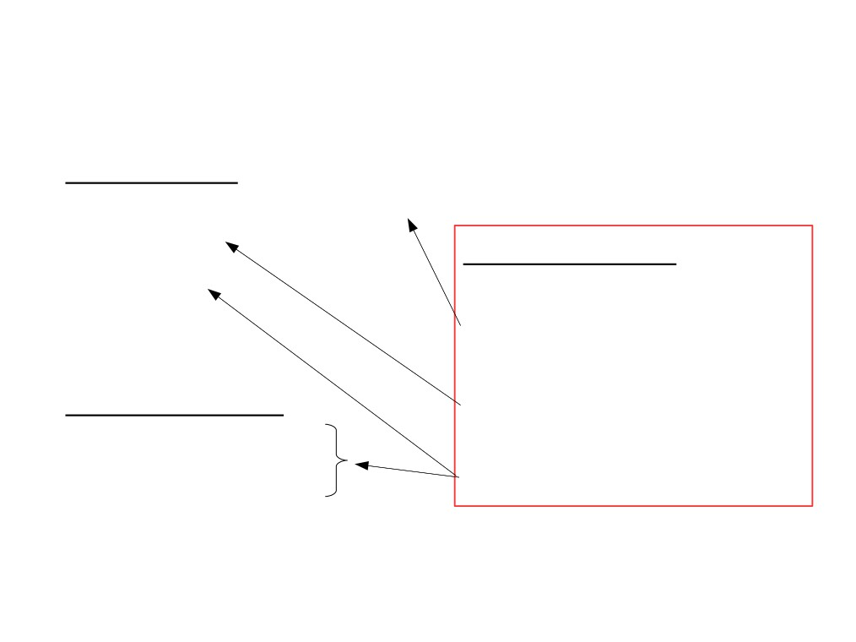
Networking in Virtual Environments
is Different
Challenges
● Scalability (105 VMs)
● Isolation
● Mobility
Open vSwitch
Distribute the Switch
Centralized Control
Take Advantage
● ...
Conveniences
● Hypervisor info
● Introspection
● Leaf nodes
● ...
Source: B. Pfaff, Nicira

Slide 20
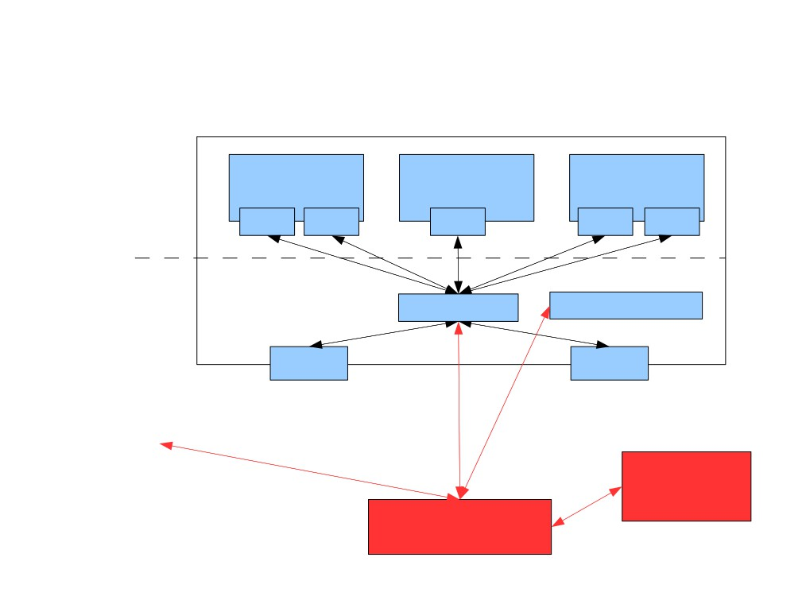
Basic Design (Xen)
Xen host (physical machine)
Virtual machines
(DomUs)
VM 1 VM 2
VM 3
VNIC VNIC VNIC
VNIC VNIC
Control domain
(Dom0)
ovs-vswitchd
XAPI
NIC
NIC
...other Xen hosts...
Adminstrative
CLI/GUI
Controller
Source: B. Pfaff, Nicira

Slide 21
Open vSwitch
Controller
  Configuration: read/write config. states, setup triggers for asynchronous events
  OpenFlow
Features
  VLAN
  Port mirroring
  ACLs
  NetFlow logging for VMs
  QoS
Source: B. Pfaff, Nicira

Slide 22
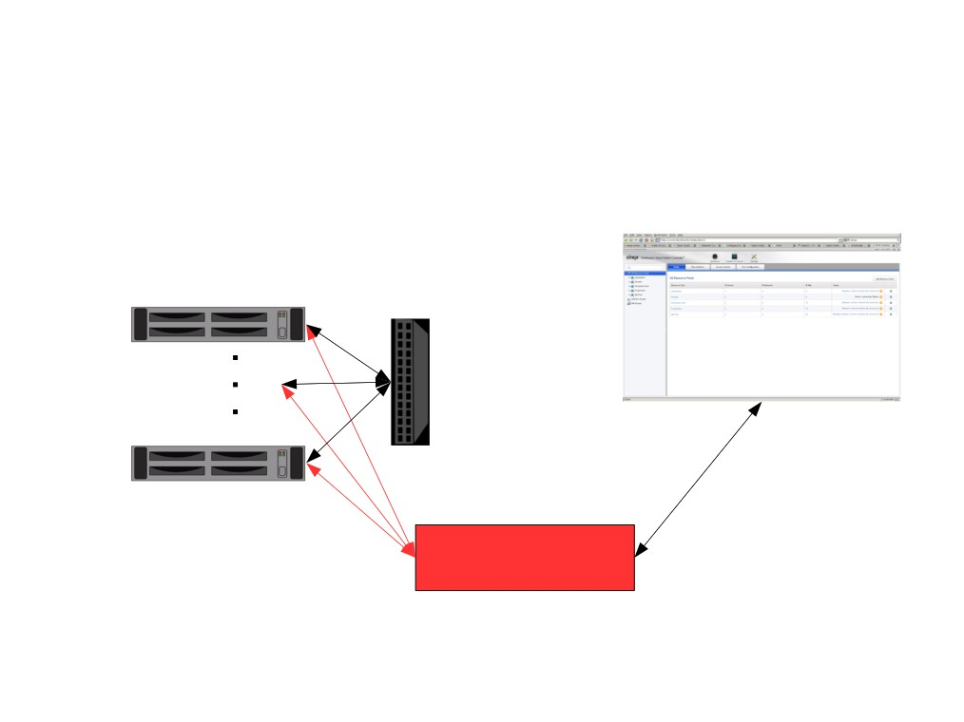
Open vSwitch Application:
Single Distributed Switch
VM host 1
VM host n
Web UI
Controller
Source: B. Pfaff, Nicira

Slide 23
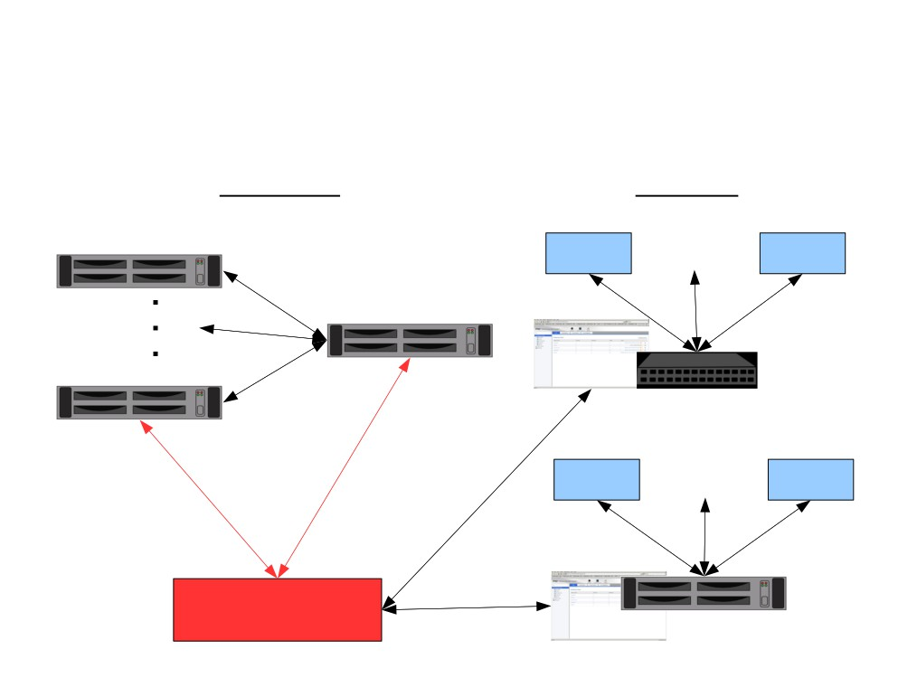
Open vSwitch Application:
Multiple Distributed Switches
Physical
Logical
VM host 1
VM 1 VM n
GRE
Physical vSwitch
VM host n
Tenant #1 (switched)
VM 1
VM n
Web UI
Controller
Web UI
Tenant #2 (routed)
Source: B. Pfaff, Nicira

Slide 24
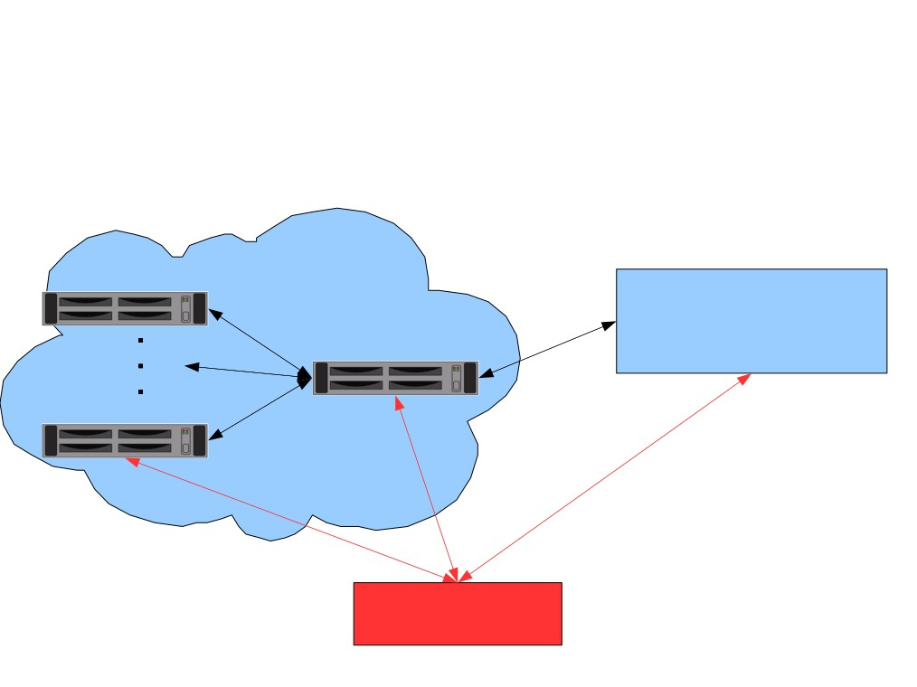
Open vSwitch Application:
Extending Data Center into Cloud
Managed Cloud
VM host 1
GRE/
IPSEC/
SSL
Customer Data Center
GRE
“Cloud access server”
VM host n
Controller
Source: B. Pfaff, Nicira

Slide 25
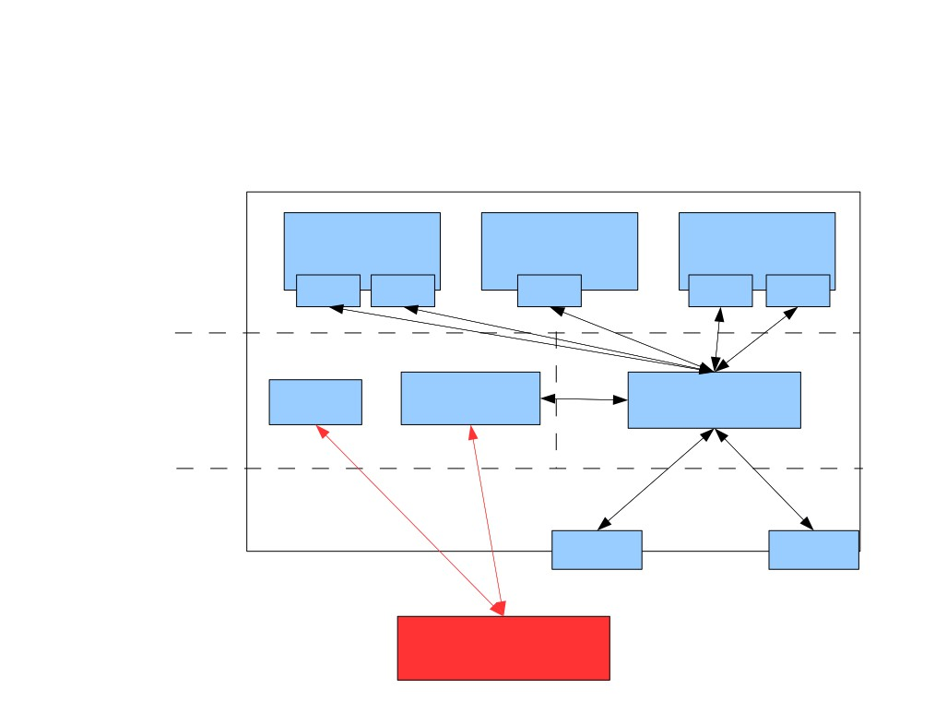
Implementation (Xen)
Physical machine
Virtual machines
(DomUs)
VM 1 VM 2
VM 3
VNIC VNIC VNIC
VNIC VNIC
Control domain
(Dom0)
Fast Path
XAPI ovs-vswitchd
user
kernel
Xen hypervisor
NIC
NIC
Controller
Source: B. Pfaff, Nicira

Slide 26
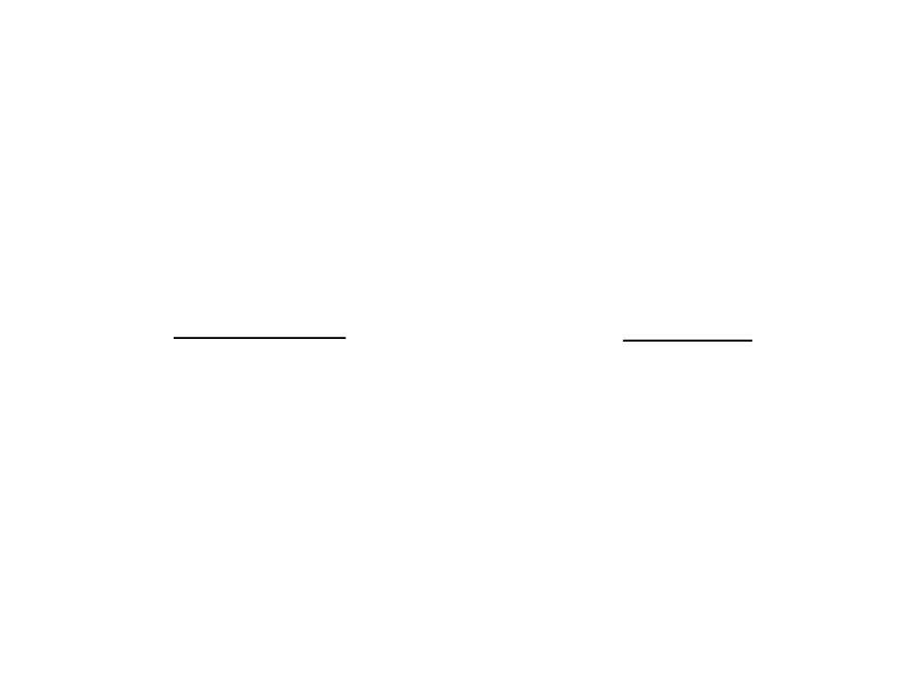
Open vSwitch is Fast
As fast as Linux bridge
with same CPU usage
Bandwidth
Latency
Fast Path: > 1 Gbps
Fast Path: < 1 µs
ovs-vswitchd: 100 Mbps
ovs-vswitchd: < 1 ms
Controller: 10 Mbps
Controller: ms
Source: B. Pfaff, Nicira

Slide 27
Open vSwitch Source Code and Commands
Install in OpenFlow VirtualBox VM
  git clone git://git.openvswitch.org/openvswitch
  make install
Run
  /etc/init.d/openvswitch-switch start
ovs-vsctl: Configures ovs-vswitchd, a high-level interface for database
  Create a bridge:
    ovs-vsctl -- --may-exist add-br br0
  Add port to a bridge:
    ovs-vsctl -- --may-exist add-port br0 eth0

Slide 28
Open vSwitch Source Code and Commands (Cont’d)
  List all bridges:
    ovs-vsctl list-br
  List all ports:
    ovs-vsctl list-ports br0
  Find uuid of port s1-eth1:
    Ovs-vsctl list port s1-eth1
ovsdb-tool: Command-line tool for managing database file
  ovsdb-tool show-log [-mmm] <file>

Slide 29
Open vSwitch Source Code and Commands (Cont’d)
ovs-ofctl speaks to OpenFlow module
  ovs-ofctl dump-flows <bridge>
  ovs-ofctl snoop <bridge>
ovs-dpctl speaks to kernel module
  See datapaths and their ahached interfaces:
    ovs-dpctl show <bridge>
  Exact match flows cached in datapath:
    ovs-dpctl dump-flows <bridge>

Slide 30
Outline
Announcements
  Next Monday is a holiday
  Reminder: midterm November 10
  OpenDaylight lab session on Wednesday
Review of Previous Lecture: Forwarding Abstraction
SDN Virtualization
  OpenvSwitch
  Network Hypervisor for VM Overlay Networks: NVP/NSX
  Network Hypervisor for Physical networks: FlowVisor, OpenVirteX, Compositional Hypervisor

Slide 47
Outline
Announcements
  Next Monday is a holiday
  Reminder: midterm November 10
  OpenDaylight lab session on Wednesday
Review of Previous Lecture: Forwarding Abstraction
SDN Virtualization
  OpenvSwitch
  Network Hypervisor for VM Overlay Networks: NVP/NSX
  Network Hypervisor for Physical networks: FlowVisor, OpenVirteX, Compositional Hypervisor

Slide 48
Flowvisor Overview
App
App
App
App
App
App
Controller 1
Controller
2
Windows
(OS)
Linux
Mac
OS
Controller 1
Controller
2
Windows
(OS)
Linux
Mac
OS
Controller 1
Controller
2
Windows
(OS)
Linux
Mac
OS
Virtualization
Virtualization (FlowVisor)
x86
(Computer)
OpenFlow
Simple, common, stable, hardware substrate below
+ Programmability
+ Strong isolation model
+ Competition above
→ Faster innovation

Slide 49

Flowvisor Overview (Cont’d)
• Divide the production network into logical slices
o each slice/service controls its own packet forwarding
o users pick which slice controls their traffic: opt-in
o existing production services run in their own slice
▪e.g., Spanning tree, OSPF/BGP
• Enforce strong isolation between slices
o actions in one slice do not affect another
• Allows the (logical) slice to mirror the production network
o real hardware, performance, topologies, scale, users
Source: R. Sherwood

Slide 50
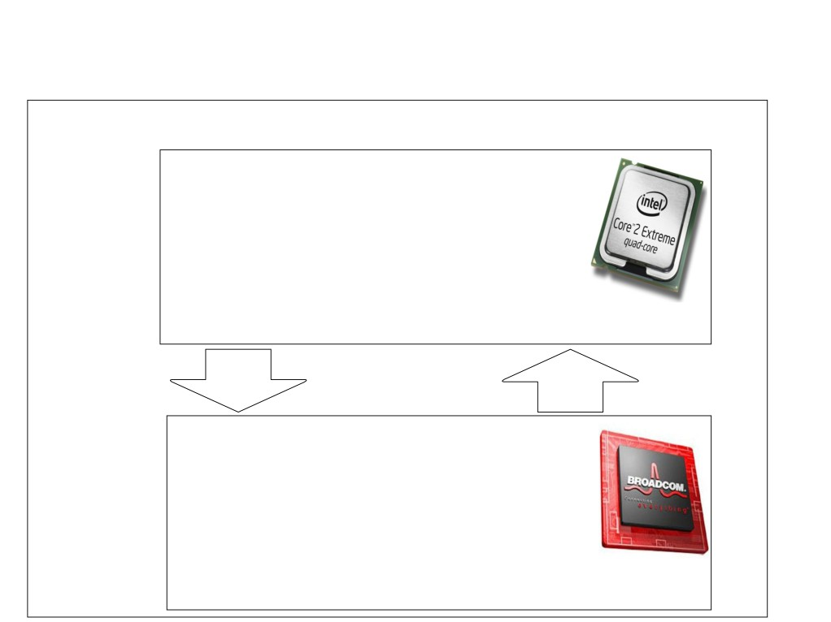
Current Network Devices
Switch/Router
• Computes forwarding rules
Control
• “128.8.128/16 --> port 6”
Plane
• Pushes rules down to data
plane
General-purpose
CPU
Rules
Control/Data
Protocol
Excepts
• Enforces forwarding rules
Data
• Exceptions pushed back to
control plane
Plane
• e.g., unmatched packets
Custom
ASIC

Slide 51
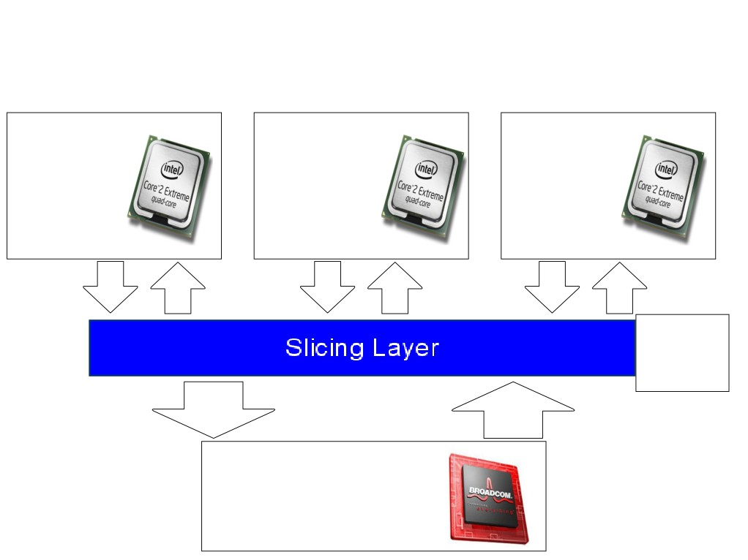
Add a Slicing Layer Between Planes
Slice 2
Slice 1
Slice 3
Control
Control
Control
Plane
Plane
Plane
Slice
Policies
Control/Data
Protocol
Rules
Excepts
Data
Plane
Source: R. Sherwood

Slide 52
Network Slicing Architecture
A network slice is a collection of sliced switches/routers
• Data plane is unmodified
- Packets forwarded with no performance penalty
- Slicing with existing ASIC
• Transparent slicing layer
- each slice believes it owns the data path
- enforces isolation between slices
• i.e., rewrites, drops rules to adhere to slice police
- forwards exceptions to correct slice(s)
Source: R. Sherwood

Slide 53
Slicing Policies
The policy specifies resource limits for each slice:
- Link bandwidth
- Maximum number of forwarding rules
- Topology
- Fraction of switch/router CPU
- FlowSpace: which packets does the slice
control?
Source: R. Sherwood

Slide 54
Substrate: “Flowspace”
Ethernet
DA, SA, etc
IP
DA, SA, etc
TCP
DP, SP, etc
Payload
Collection of bits to plumb flows
(of different granularities)
between end points
Header
User-defined flowspace
Payload
“OpenFlow++”
Source: N. Mckeown

Slide 55
Flowspace: Simple example
Single flow
All flows from A
All flows between two subnets
IP DA
A
IP SA
Source: N. Mckeown

Slide 56
Flowspace: Generalization
Single flow
Set of flows
Field 1
Field 2
Field n
Source: N. Mckeown

Slide 57
Properties of Flowspace
Backwards compatible
  Current layers are a special case
  No end points need to change
Easily implemented in hardware
  e.g. TCAM flow-table in each switch
Strong isolation of flows
  Simple geometric construction
  Can prove which flows can/cannot communicate
Source: N. Mckeown

Slide 58
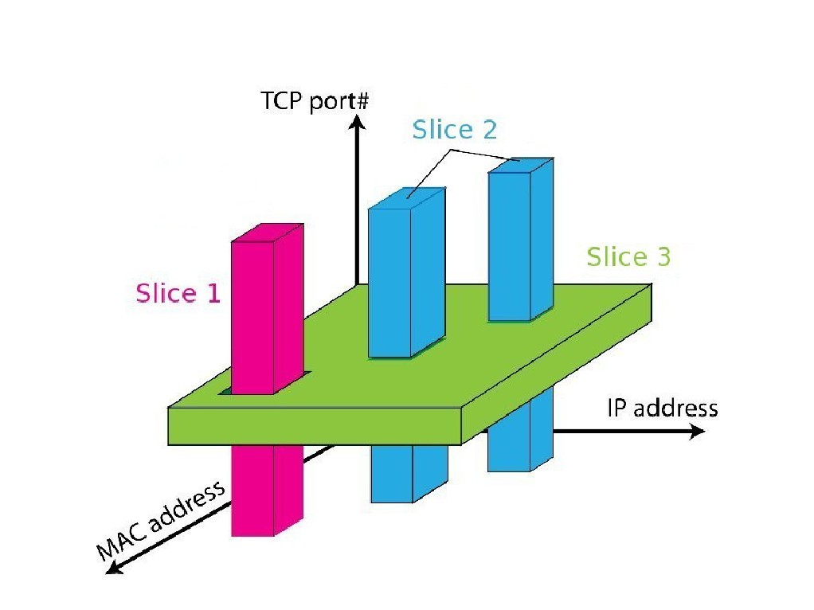
FlowSpace: Maps Packets to Slices
Source: R. Sherwood

Slide 59
Real User Traffic: Opt-In
• Allow users to Opt-In to services in real-time
o Users can delegate control of individual flows to
Slices
o Add new FlowSpace to each slice's policy
• Example:
o "Slice 1 will handle my HTTP traffic"
o "Slice 2 will handle my VoIP traffic"
o "Slice 3 will handle everything else"
• Creates incentives for building high-quality services
Source: R. Sherwood

Slide 60



FlowVisor Slicing Example
Bob’s
Controller
Alice’s
Controller
OpenFlow
Protocol
OpenFlow
Switch
FlowVisor
OpenFlow
Protocol
OpenFlow
Switch
OpenFlow
Switch
Source: N. Mckeown

Slide 61



FlowVisor Slicing Example (Cont’d)
http
Load-balancer
Broadcast
Multicast
OpenFlow
Protocol
OpenFlow
Switch
FlowVisor
OpenFlow
Protocol
OpenFlow
Switch
OpenFlow
Switch
Source: N. Mckeown

Slide 62
FlowVisor Slicing Example (Cont’d)
LTE-WiFi
Handover
Tricast Lossless
Handover
Learning
switch
Mobile VMs
New BGP
Bob’s
FlowVisor
Alices’s
FlowVisor
GENI’s
FlowVisor
Production
Network
Controller
OpenFlow Protocol
Network Administrator’s
FlowVisor
OpenFlow Protocol
OpenFlow
Switch
OpenFlow
Switch
OpenFlow
Switch
Source: N. Mckeown

Slide 63
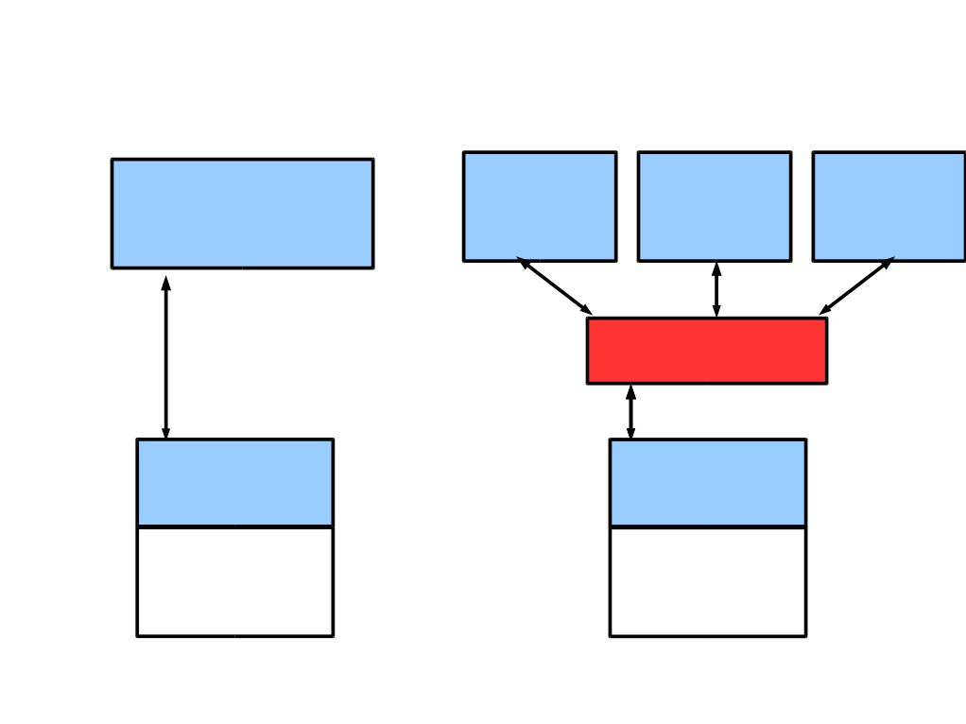
FlowVisor Implemented on OpenFlow
Server
Servers
Custom
OpenFlow
Controller
OpenFlow OpenFlow OpenFlow
Control
Controller Controller Controller
Plane
OpenFlow
Network
OpenFlow
FlowVisor
Protocol
OpenFlow
Stub
Control
OpenFlow
OpenFlow
Plane
Firmware
Firmware
Data
Plane
Data Path
Data Path
Switch/
Switch/
Router
Router

Slide 64
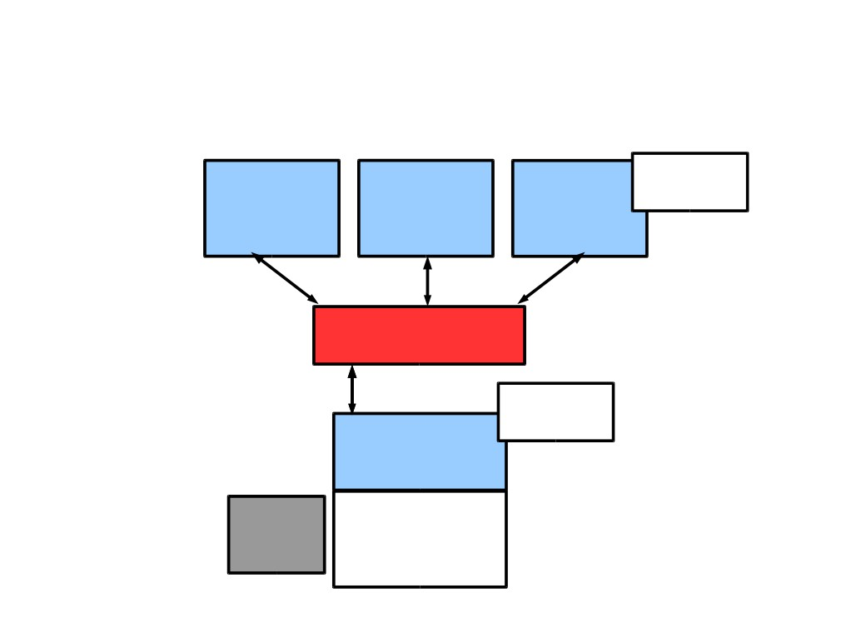
FlowVisor Message Handling
Alice Bob
Rule
Cathy
Controller Controller
Controller
OpenFlow
Policy Check:
Policy Check:
Is this rule
allowed?
FlowVisor
Who controls
this packet?
OpenFlow
Full Line Rate
Forwarding
Exception
OpenFlow
Firmware
Packet
Data Path
Source: R. Sherwood

Slide 65
FlowVisor Implementation
●Custom handlers for each of OpenFlow's 20
message types
● Transparent OpenFlow proxy
● 8261 LOC in C
● New version with extra API for GENI
●Code: git clone git://openflow.org/flowvisor.git`
Source: R. Sherwood

Slide 66
Isolation Techniques
Isolation is critical for slicing
Link bandwidth: per-slice queue on each port of a switch
Forwarding rules: pre-set limit of number of flow entries of a given slice
Topology: limit to per-slice view
Flow space: rewrite flow definition and actions to prevent violation of slice definition
Device CPU

Slide 67
Device CPU Isolation
• Ensure that no slice monopolizes device CPU
• CPU exhaustion
• prevent rule updates
• drop LLDPs ---> Causes link flapping
• Techniques
• Limiting rule insertion rate from controller
• Use periodic drop-rules to throttle exceptions
Source: R. Sherwood

Slide 68
Flowvisor Commands
fvconfig generate config.xml
Run: flowvisor config.xml
fvctl is the cli used to control a running instance of flowvisor (over XMLRPC)
fvctl --passwd-file=/etc/flowvisor/fvpasswd command [args…]
fvctl command [args…]

Slide 69
Conclusion and Future Work
• Network slicing can help perform more realistic
evaluations and support multiple tenants
• FlowVisor allows experiments to run concurrently
but safely on the production network
• Currently limited to subsets of actual topology
  - Add virtual links, nodes support

Slide 70
Outline
Announcements
  Next Monday is a holiday
  Reminder: midterm November 10
  OpenDaylight lab session on Wednesday
Review of Previous Lecture: Forwarding Abstraction
SDN Virtualization
  OpenvSwitch
  Network Hypervisor for VM Overlay Networks: NVP/NSX
  Network Hypervisor for Physical networks: FlowVisor, OpenVirteX, Compositional Hypervisor

Slide 71

Problems with FlowVisor
Flowspace slicing approaches
Header space shared amongst tenants
Conﬁguration complexity increases exponentially with number of tenants
OpenVirteX overcomes these limitations.

Slide 72

























What is OpenVirteX?
OpenVirteX enables the virtualization of OpenFlow networks
NOS
NOS
NOS
Address Space Virtualization
Topology Virtualization
Programmability through OpenFlow
OpenVirteX
Provides an OpenStack neutron plugin
Open Source software
OpenFlow Network

Slide 73



























Address Virtualization
Multiple vnets can use the same address space
Tenant Network OS
The rewriting inserts a tag to enable OVX to identify the packets owner
Virtual IP
OpenVirteX
Rewriting process is completely transparent to NOS and end hosts
Physical IP
Tenant VM
Edge
Tenant VM
Switch
Physical IP
Physical IP
A tenant cannot use the whole address space.
Virtual IP
Virtual IP
Physical Network

Slide 74
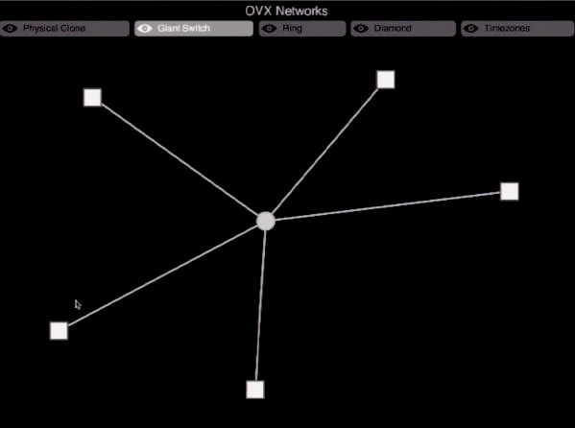
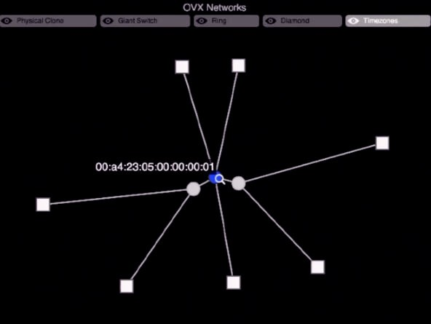
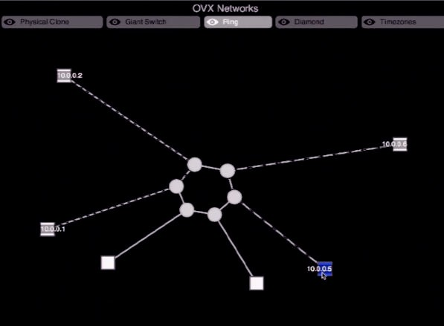






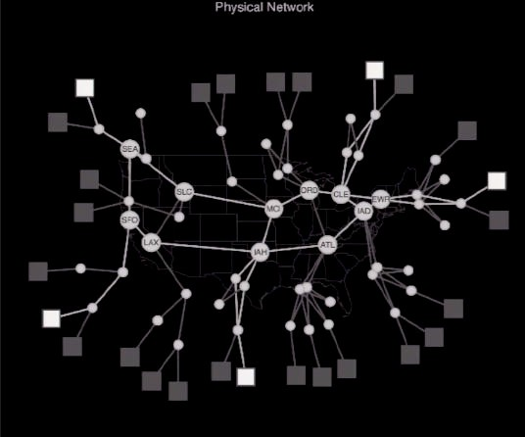
Topology Virtualization
Each virtual network is controlled by its own Network Operating System

Slide 75




Current Status
OpenVirteX‐0.0.1‐prealpha released:
Full header space virtualization
Arbitrary topology support
Virtual Networks programmable by OpenFlow
Supports any OpenFlow controller
Start/Stop/Delete/Create/Modify Virtual Networks
Excellent documentation
Tutorial available at www.openvirtex.org
Try it out!
Future possible features:
Join the community
Virtual network snapshotting and migration
Virtual Network pausing
Physical switch exploding

Slide 76
Outline
Announcements
  Next Monday is a holiday
  Reminder: midterm November 10
  OpenDaylight lab session on Wednesday
Review of Previous Lecture: Forwarding Abstraction
SDN Virtualization
  OpenvSwitch
  Network Hypervisor for VM Overlay Networks: NVP/NSX
  Network Hypervisor for Physical networks: FlowVisor, OpenVirteX, Compositional Hypervisor

Slide 77

Incremental Update for a Compositional SDN Hypervisor
Xin Jin
Jennifer Rexford, David Walker

Slide 78
Software-Defined Networking
Centralized control with open APIs
Application
Controller
OpenFlow
Network

Slide 79
Multiple Management Tasks
Hard to develop and maintain a monolithic application
Load Balancing + Routing + Monitoring
Controller
OpenFlow
Network

Slide 80
Modular SDN Applications
Frenetic: composition operators to combine multiple applications
Limitation: need to adopt Frenetic language and runtime system
Load Balancing
Routing
Monitoring
Frenetic Controller
OpenFlow
Network

Slide 81


Frenetic is Not Enough
“Best of breed” applications are developed by different parties
  Use different programming languages
  Run on different controllers
Load Balancing
Routing
Monitoring
POX
Ryu
Floodlight
Administrator
Network

Slide 82
Slicing is Not Enough
Controllers work on disjoint parts of traffic
  Useful for multi-tenancy
But we want them to collaboratively work on the same traffic
Load Balancing
Routing
Monitoring
POX
Ryu
Floodlight
Administrator
Network

Slide 83
Our Solution: Compositional Hypervisor
A transparent layer between switches and controllers
Combine controllers with Frenetic-like composition operators
  Parallel operator (+)
  Sequential operator (>>)
Load Balancing
Routing
Monitoring
POX
Ryu
Floodlight
OpenFlow
OpenFlow
OpenFlow
Compositional Hypervisor
OpenFlow
Network

Slide 84
Policy Compilation
Policy: a list of rules
Each controller outputs a policy
Hypervisor compiles them to a single policy
Monitoring
Routing
9. srcip=1.0.0.0/24 ➔ count
0. * ➔ drop
7. dstip=2.0.0.0/30 ➔ fwd(1)
0. * ➔ drop
Priority
Match
Action

Slide 85
Policy Compilation
Policy: a list of rules
Each controller outputs a policy
Hypervisor compiles them to a single policy
Monitoring
Routing
9. srcip=1.0.0.0/24 ➔ count
0. * ➔ drop
7. dstip=2.0.0.0/30 ➔ fwd(1)
0. * ➔ drop
?. srcip=1.0.0.0/24, dstip=2.0.0.0/30 ➔ count, fwd(1)

Slide 86
Policy Compilation
Policy: a list of rules
Each controller outputs a policy
Hypervisor compiles them to a single policy
Monitoring
Routing
9. srcip=1.0.0.0/24 ➔ count
0. * ➔ drop
7. dstip=2.0.0.0/30 ➔ fwd(1)
0. * ➔ drop
?. srcip=1.0.0.0/24, dstip=2.0.0.0/30 ➔ count, fwd(1)
?. srcip=1.0.0.0/24 ➔ count
?. dstip=2.0.0.0/30 ➔ fwd(1)
?. * ➔ drop

Slide 87
Key challenge: Efficient data plane update
Controllers continuously update their policies
Hypervisor recompiles them and update switches
Monitoring
Routing
9. srcip=1.0.0.0/24 ➔ count
0. * ➔ drop
7. dstip=2.0.0.0/30 ➔ fwd(1)
3. dstip=2.0.0.0/26 ➔ fwd(2)
0. * ➔ drop
?. srcip=1.0.0.0/24, dstip=2.0.0.0/30 ➔ count, fwd(1)
?. srcip=1.0.0.0/24 ➔ count
?. dstip=2.0.0.0/30 ➔ fwd(1)
?. * ➔ drop

Slide 88
Key challenge: Efficient data plane update
Computation overhead
  The computation to recompile the new policy
Rule-update overhead
  The rule-updates to update switches to the new policy
Monitoring
Routing
9. srcip=1.0.0.0/24 ➔ count
0. * ➔ drop
7. dstip=2.0.0.0/30 ➔ fwd(1)
3. dstip=2.0.0.0/26 ➔ fwd(2)
0. * ➔ drop
?. srcip=1.0.0.0/24, dstip=2.0.0.0/30 ➔ count, fwd(1)
?. srcip=1.0.0.0/24 ➔ count
?. dstip=2.0.0.0/30 ➔ fwd(1)
?. * ➔ drop

Slide 89
Naïve Solution
Assign priorities from top to bottom by decrement of 1
Monitoring
Routing
9. srcip=1.0.0.0/24 ➔ count
0. * ➔ drop
7. dstip=2.0.0.0/30 ➔ fwd(1)
0. * ➔ drop
3. srcip=1.0.0.0/24, dstip=2.0.0.0/30 ➔ count, fwd(1)
2. srcip=1.0.0.0/24 ➔ count
1. dstip=2.0.0.0/30 ➔ fwd(1)
0. * ➔ drop

Slide 90
Naïve Solution
Assign priorities from top to bottom by decrement of 1
Monitoring
Routing
9. srcip=1.0.0.0/24 ➔ count
0. * ➔ drop
7. dstip=2.0.0.0/30 ➔ fwd(1)
3. dstip=2.0.0.0/26 ➔ fwd(2)
0. * ➔ drop
5. srcip=1.0.0.0/24, dstip=2.0.0.0/30 ➔ count, fwd(1)
4. srcip=1.0.0.0/24, dstip=2.0.0.0/26 ➔ count, fwd(2)
3. srcip=1.0.0.0/24 ➔ count
2. dstip=2.0.0.0/30 ➔ fwd(1)
1. dstip=2.0.0.0/26 ➔ fwd(2)
0. * ➔ drop

Slide 91
Naïve Solution
Assign priorities from top to bottom by decrement of 1
3. srcip=1.0.0.0/24, dstip=2.0.0.0/30 ➔ count, fwd(1)
2. srcip=1.0.0.0/24 ➔ count
1. dstip=2.0.0.0/30 ➔ fwd(1)
0. * ➔ drop
Computation overhead
Recompute the whole switch table and assign priorities
Rule-update overhead
Only 2 new rules, but 3 more rules change priority
Update
5. srcip=1.0.0.0/24, dstip=2.0.0.0/30 ➔ count, fwd(1)
4. srcip=1.0.0.0/24, dstip=2.0.0.0/26 ➔ count, fwd(2)
3. srcip=1.0.0.0/24 ➔ count
2. dstip=2.0.0.0/30 ➔ fwd(1)
1. dstip=2.0.0.0/26 ➔ fwd(2)
0. * ➔ drop

Slide 92
Incremental Update
Add priorities for parallel composition
Monitoring
Routing
9. srcip=1.0.0.0/24 ➔ count
0. * ➔ drop
7. dstip=2.0.0.0/30 ➔ fwd(1)
0. * ➔ drop
9+7 = 16. srcip=1.0.0.0/24, dstip=2.0.0.0/30 ➔ count, fwd(1)

Slide 93
Incremental Update
Add priorities for parallel composition
Monitoring
Routing
9. srcip=1.0.0.0/24 ➔ count
0. * ➔ drop
7. dstip=2.0.0.0/30 ➔ fwd(1)
0. * ➔ drop
9+7=16. srcip=1.0.0.0/24, dstip=2.0.0.0/30 ➔ count, fwd(1)
9+0=9. srcip=1.0.0.0/24 ➔ count
0+7=7. dstip=2.0.0.0/30 ➔ fwd(1)
0+0=0. * ➔ drop

Slide 94
Incremental Update
Add priorities for parallel composition
Monitoring
Routing
9. srcip=1.0.0.0/24 ➔ count
0. * ➔ drop
7. dstip=2.0.0.0/30 ➔ fwd(1)
3. dstip=2.0.0.0/26 ➔ fwd(2)
0. * ➔ drop
9+7=16. srcip=1.0.0.0/24, dstip=2.0.0.0/30 ➔ count, fwd(1)
9+3=12. srcip=1.0.0.0/24, dstip=2.0.0.0/26 ➔ count, fwd(1)
9+0=9. srcip=1.0.0.0/24 ➔ count
0+7=7. dstip=2.0.0.0/30 ➔ fwd(1)
0+3=3. dstip=2.0.0.0/26 ➔ fwd(1)
0+0=0. * ➔ drop

Slide 95
Incremental Update
Add priorities for parallel composition
16. srcip=1.0.0.0/24, dstip=2.0.0.0/30 ➔ count, fwd(1)
9. srcip=1.0.0.0/24 ➔ count
7. dstip=2.0.0.0/30 ➔ fwd(1)
0. * ➔ drop
Computation overhead
Only compose the new rule with rules in monitoring
Rule-update overhead
Add 2 new rules
Update
16. srcip=1.0.0.0/24, dstip=2.0.0.0/30 ➔ count, fwd(1)
12. srcip=1.0.0.0/24, dstip=2.0.0.0/26 ➔ count, fwd(2)
9. srcip=1.0.0.0/24 ➔ count
7. dstip=2.0.0.0/30 ➔ fwd(1)
3. dstip=2.0.0.0/26 ➔ fwd(2)
0. * ➔ drop

Slide 96
Incremental Update
Add priorities for parallel composition
Concatenate priorities for sequential composition
Load Balancing
Routing
3. srcip=0.0.0.0/2, dstip=3.0.0.0 ➔ dstip=2.0.0.1
1. dstip=3.0.0.0 ➔ dstip=2.0.0.2
0. * ➔ drop
1. dstip=2.0.0.1 ➔ fwd(1)
1. dstip=2.0.0.2 ➔ fwd(2)
0. * ➔ drop
.
srcip=0.0.0.0/2, dstip=3.0.0.0 ➔ dstip=2.0.0.1, fwd(1)
.
.
3 >> 1 = 25,
011
001
High
Bits
Low
Bits

Slide 97
Incremental Update
Add priorities for parallel composition
Concatenate priorities for sequential composition
Load Balancing
Routing
3. srcip=0.0.0.0/2, dstip=3.0.0.0 ➔ dstip=2.0.0.1
1. dstip=3.0.0.0 ➔ dstip=2.0.0.2
0. * ➔ drop
1. dstip=2.0.0.1 ➔ fwd(1)
1. dstip=2.0.0.2 ➔ fwd(2)
0. * ➔ drop
25. srcip=0.0.0.0/2, dstip=3.0.0.0 ➔ dstip=2.0.0.1, fwd(1)
9. dstip=3.0.0.0 ➔ dstip=2.0.0.2, fwd(2)
0. * ➔ drop

Slide 98
Evaluation
Naive
Incremental
Naive
Incremental
Monitoring + Routing
Load balancing >> Routing

Slide 99
Evaluation
Naive
Incremental
Naive
Incremental
Monitoring + Routing
Load balancing >> Routing
Reduce computation overhead by 4x, rule updates by 5x

Slide 100
Conclusion
Compositional network hypervisor
Novel algorithm to efficiently update the data plane
Ongoing work: prototype in OpenVirteX

Slide 101
Questions?

