Slide 1
Software Defined Networking
COMS 6998-10, Fall 2014
Instructor: Li Erran Li (lierranli@cs.columbia.edu)
http://www.cs.columbia.edu/~lierranli/coms6998-10SDNFall2014/
10/6/2014: SDN Verification

Slide 2
Outline
Review of previous lecture on SDN programming language
  Maple: generic programming language syntax such as Java, Python
  Frenetic NetCore/NetKAT: domain specific programming language
SDN Verification
  Verification of network properties
  Verification of controller correctness
  Verification of software data plane

Slide 3
Review of Previous Lecture
What is algorithmic policies
Function in a general purpose language that describes how a packet should be routed, not how flow tables are configured.
Conceptually invoked on every packet entering the network; may also access network environment state; hence it has the form:
Written in a familiar language such as Java, Python, or Haskell
Source: Andreas Voellmy, Yale

Slide 4
Example Algorithmic Policy in Java
Review of Previous Lecture (Cont’d)
Does not specify flow table configutation
if (p.tcpDstIs(22))
return null();
else {
Location sloc = e.location(p.ethSrc());
Location dloc = e.location(p.ethDst());
Path path =shortestPath(e.links(),sloc,dloc);
if (p.ethDstIs(2))
return null();
else
return unicast(sloc,dloc,path);
}
}
Source: Andreas Voellmy, Yale
Notes:
The programming model makes the programmer’s life easy: just take a packet and say what to do with it.

Slide 5
Policy
EthDest:1,
TcpDst:80
Route f(Packet p, Env e) {
if (p.tcpDstIs(22))
return null();
else {
Location dloc =
e.location(p.ethDst());
Location sloc =
e.location(p.ethSrc());
Path path =
shortestPath(
e.links(),sloc,dloc);
if (p.ethDstIs(2))
return null();
else
return unicast(sloc,dloc,path);
}
}
Assert(TcpDst,22)
false
Read(EthDst)
4
Read(EthSrc)
6
path1
Source: Andreas Voellmy, Yale
Notes:
Here is how the tracing method works for the example Java algorithmic policy.
Suppose Maple executes the algorithmic policy on a packet with Ethernet source 1, Ethernet dest 2 and tcp destination 80. As the packet moves through the policy, Maple collects a trace of the execution.
When this packet arrives at the check on tcp destination, Maple records the assertion, and its outcome. In this case, the outcome is false. The program proceeds to the else branch, where it reads the source and destination addresses, both of which Maple logs. Finally, the program returns the computed path.

Slide 6
Policy
Trace Tree
EthDst:1,
TcpDst:22
Assert(TcpDst,22)
Route f(Packet p, Env e) {
if (p.tcpDstIs(22))
return null();
else {
Location dloc =
e.location(p.ethDst());
Location sloc =
e.location(p.ethSrc());
Path path =
shortestPath(
e.links(),sloc,dloc);
if (p.ethDstIs(2))
return null();
else
return unicast(sloc,dloc,path);
}
}
Assert(TcpDst,22)
true
null
true
false
Read(EthDst)
?
4
Read(EthSrc)
6
path1
Source: Andreas Voellmy, Yale
Notes:
Maple then uses this trace to begin generating the Trace Tree. In this case, Maple still doesn’t know what will happen if the assertion is true, and it therefore adds a placeholder under the true branch.
Now, if we execute f on a packet to tcp destination 22, the assertion is true, and the packet is dropped. Maple logs this new trace and uses it to refine its Trace Tree, filling in the true branch of the assertion.

Slide 7
Compile recorded executions into flow table
Review of Previous Lecture (Cont’d)
tcpDst==22
3
1
True
False
2
ethDst
drop
2
4
drop
ethSrc
6
port 30
barrier rule:
match:{ethDst:4,ethSrc:6}
action:[port 30]
match:{tcpDst==22}
action:ToController
Priority
Source: Andreas Voellmy, Yale
Notes:
The basic compilation algorithm is actually very simple, and we explain it here in the context of an example trace tree. For simplicity the leaves are labelled with switch-specific actions, such as forward on some ports or drop.
The basic algorithm generates one rule for each execution of f, and each execution of f is stored as a path from the root of the trace tree to a leaf. For example, the right-most path in this tree resulted from an execution that observed that tcpDst!=22 and ethDst==4 and ethSrc==6.
The leaf stores the action and the match condition can be obtained from the path from the root to the leaf. In this case, we would want to match on tcpDst!=22, ethDst==4 and ethSrc==6. Of course, as we described earlier, we cannot match on tcpDst!=22, and so instead we will generate a rule at a higher priority that matches on the condition which we wish to negate. This rule, which we call a “barrier rule” ensures that the rule for the execution which we are considering only fires when the condition is false.
We observe that all the rules that require tcpDst!=22 are under the False branch of the assertion node and all the rules that require tcpDst==22 are under the True branch of the assertion node. Therefore, we can determine the priority level of the barrier rule by first generating rules and assigning priorities to the False branch of the node, and then assigning the priority of the barrier rule to have the next higher priority. Then we can assign priorities to the True branch. Hence, by generating rules with a classical in-order traversal from False to True branches, we can correctly assign priorities to rules.
Finally, since the subtree under the True branch may not completely describe how to handle all tcpDst==22 packets, some packets with tcpDst==22 may fall through to the reach the barrier rule. Therefore, the action for the barrier rule must be ToController, so that we can continue to trace f correctly.

Slide 8
Basic compilation: in-order traversal & barrier rules
Negative branch first!
Review of Previous Lecture (Cont’d)
tcpDst==22
Priority := 0
Priority := 2
Priority := 3
accumulated
match: {}
Priority := 1
True
False
ethDst
{tcpDst:22}
null
{}
2
4
{ethDst:2}
null
ethSrc
(prio:3,{tcpDst:22},action:drop)
{ethDst:4}
6
{ethDst:4,
ethSrc:6}
barrier rule:
(prio:2,{tcpDst:22},action:ToController)
port 30
(prio:1,{ethDst:2},action:drop)
(prio:0,{ethDst:4, ethSrc:6},action:[port 30])
Source: Andreas Voellmy, Yale
Notes:
We step through the execution of the algorithm on the example tree. We initialize a priority variable to 0. We then recursively process the tree in-order processing False branches before True branches.
As we descend in the tree, we keep track of the positively occurring match conditions along the path to the root.
At the root, the set of accumulated match conditions is empty. We then process the ethDst node in the False subtree, which also has an empty set of accumulated match conditions. We then proceed down to the leaf labelled port 30, which has accumulated positive matches on ethDst and ethSrc. We output the rule at the current value of the priority variable and increment the priority variable.
We then backtrack to the ethDst node and process its other child, outputting a rule at priority 1 and increment the priority variable.
We backtrack to the root, where we output the barrier at the current priority 2, increment the priority and finally process the True branch of the assertion.

Slide 9
Review of Previous Lecture (Cont’d)
Modular programming abstraction
Monitor
Route
Load Balance
Firewall
Compiler + Run-Time System
Controller Platform
Design languages based on modular programming abstractions, and engineer efficient implementations using a compiler and run-time system
Source: Nate Foster, Cornell

Slide 10
Review of Previous Lecture (Cont’d)
Parallel Composition
Pattern | Actions
dstip=3.4.5.6 | Fwd 1
dstip=6.7.8.9 | Fwd 2
Pattern | Actions
srcip=1.2.3.4 | Count
Monitor
+
Route
Controller Platform
Pattern | Actions
srcip=1.2.3.4, dstip=3.4.5.6 | Fwd 1, Count
srcip=1.2.3.4, dstip=6.7.8.9 | Fwd 2, Count
srcip=1.2.3.4 | Count
dstip=3.4.5.6 | Fwd 1
dstip=6.7.8.9 | Fwd 2
Source: Nate Foster, Cornell

Slide 11
Review of Previous Lecture (Cont’d)
Sequential Composition
Pattern | Actions
srcip=*0 | dstip:=10.0.0.1
srcip=*1 | dstip:=10.0.0.2
Pattern | Actions
dstip=10.0.0.1 | Fwd 1
dstip=10.0.0.2 | Fwd 2
Load Balance
;
Route
Controller Platform
Pattern | Actions
srcip=*0 | dstip:=10.0.0.1, Fwd 1
srcip=*1 | dstip:=10.0.0.2, Fwd 2
Source: Nate Foster, Cornell

Slide 12
Outline
Review of previous lecture on SDN programming language
  Maple: generic programming language syntax such as Java, Python
  Frenetic NetCore/NetKAT: domain specific programming language
SDN Verification
  Verification of network properties
  Verification of controller correctness
  Verification of software data plane

Slide 13
Verification of Network Properties
Motivations
NetPlumber: Real time policy checking tool
  How it works
  How to check policy
  How to parallelize
Evaluation on Google WAN
Conclusions
Source: P. Kazemian, Stanford

Slide 14

Network debugging is hard!
Forwarding state is hard to analyze!
.
.
.
.
.
.
Rule
Rule
Rule
Rule
.
.
.
Rule
Rule
Rule
Rule
Rule
Source: P. Kazemian, Stanford
Notes:
Network debugging and verification is famous to be hard.
It is hard because the forwarding state of the network is hard to analyze.
Tforwarding state of network is the set of forwarding rules in the forwarding tables of switches, routers or other boxes that define how an incoming packet is processed and forwarded to the next hop. And the set of forwarding state of network determines how the network behaves overall.

Slide 15
Network debugging is hard!
Forwarding state is hard to analyze!
  Distributed across multiple tables and boxes
  Written to network by multiple independent writers (different protocols, network admins)
  Presented in different formats by vendors
  Not directly observable or controllable
Not constructed in a way that lend itself well to checking and verification
Source: P. Kazemian, Stanford
Notes:
The forwarding state of network is hard to analyze because first of all it is generated by different boxes from multiple vendors with different presentation formats which makes understanding them harder.. Distributed across multiple tables and boxes which makes predicating the overall behavior harder. Is written to network by multiple independent writes such as local and remote instances of multiple different protocols or manually by different network admins which makes their interactions unpredictable.

Slide 16


Header Space Analysis: Snapshot-based Checking
a
T_{A}
T_{D}
T_{C}
T_{B}
Can host a talk to host b?
b
Is there any forwarding loop in the network?
Source: P. Kazemian, Stanford
Notes:
Last year I talked about a snapshot based tool for verifying networks, which was based on a modeling framework called Header Space Analysis. The tool gets a snapshot of the forwarding state of network, and generates a model of the network where each box is modeled by a transfer function. And then we could use this model to verify properties of network, such as “can host a talk to host b?” or “is there any forwarding loop in the network?”

Slide 17
Real-Time Incremental Checking
+
-
-
+
Time
Source: P. Kazemian, Stanford
Notes:
However networks change all the time. Individual Rules may get added or deleted or even rules may get added and deleted in batches.

Slide 18

Real-Time Incremental Checking
Time
Set of Policies/Invariants
?
-
+
-
+
Yes/No
  Prevent errors before they hit network
  Report a violation as soon as it happens
Source: P. Kazemian, Stanford
Notes:
Today I want to talk about the design and implementation of a new tool that can verify the compliance of a stream of network state changes in real time. It is a re-implementation of Hassel checks that runs incrementally on each state change. The tool creates a model of network to which we apply the stream of network changes in real time, and also give it a set of policies and invariants to check and the system always give us a yes/no answer for each of the specified policies and invariants as the changes happen in the network. By doing these policy checks in real time, we can …

Slide 19
Verification of Network Properties
Motivations
NetPlumber: Real time policy checking tool
  How it works
  How to check policy
  How to parallelize
Evaluation on Google WAN
Conclusions
Source: P. Kazemian, Stanford
Notes:
The outline of this talk is as follows. I start by reviewing the header space analysis framework, then introduce our real time policy checking tool, called netplumber.

Slide 20
NetPlumber
The System for real time policy checking is called NetPlumber
App
App
App
App
Controller
Logically centralized location
to observe the state changes
State updates
NetPlumber
SNMP Trap
Source: P. Kazemian, Stanford
Notes:
The system that we build for this purpose is called NetPlumber. It runs on a single or clusters of machines on the side and checks the stream of state updates against network policy. NetPlumber is more suitable for Software Defined networks, because IN SDNs, the interface between the controller and switches is a logically centralized location to observe all the state changes such as installation or removal of rules or link up/down events. So NetPlumber can tap into this communication and get a stream of network update. However NP can be used in conventional networks

Slide 21
NetPlumber
The System we build for real time policy checking is called NetPlumber
  Creates a dependency graph of all forwarding rules in the network and uses it to verify policy
  Nodes: forwarding rules in the network
  Directed Edges: next hop dependency of rules
Switch 1
Switch 2
R1
R2
Source: P. Kazemian, Stanford
Notes:
Internally, NetPlumber creates a dependency graph of al rules in the network and uses it to verify network policy. The nodes of this graph are forwarding rules of networks and directed edges show the next hop relationship between edges, meaning that there is an edge from Rule R1 to R2, if there is a physical link from switch 1 to switch 2 in the network and also the input header space of R1, has some intersection with the input header space of R2. In another word, all this next hop dependency is saying is that there is at least one packet header processed by R1, can be processed next by R2.

Slide 22
NetPlumber – Nodes and Edges
0
1
X
X
1 0 0 1
1 0 X X
S
S
Source: P. Kazemian, Stanford
Notes:
To understand how NetPlumber works, Let’s look at one simple example, consisting of these 4 switches. NP look at the forwarding rules of each of these switch and for each rule, create one rule node in the net plumber graph. We use a completely visual representation of the rules in this example. We assume that headers are only 4 bits long. The match pattern of each rule that specify which packets should be processed by the rule is represented by these 8 squares. The upper square corresponds to value 0, and the lower squares corresponds to value 0. For example this rule matches on 1001 headers and forward them to the green box. This one matches on 01xx headers, rewrite them to 001x and forward to the green box. NP puts one node for every rule in the switches. Then it creates directed edges between the rules. For example we have this directed edge because the output headers of this rule has some intersection with input headers of this rule

Slide 23
NetPlumber – Intra table dependency
S
S
Source: P. Kazemian, Stanford
Notes:
Also each rule keeps a pointer to the higher priority rules with the same table whose match patterns has some intersection, because those rules have priority processing packets that would otherwise match on the lower priority rule. We will see how this comes handy later.

Slide 24
NetPlumber – Computing Reachability
A
B
Source
Node
S
S
?
Probe
Node
Source: P. Kazemian, Stanford
Notes:
Now that we have this dependency graph, we can use it to check network properties. For example let’s say we want to find reachability between A and B. All we need to do is to connect a source node in the location of the source and a probe node in the location of the destination. The source node pushed an all-wildcard flow through the dependency graph and NetPlumber propagate the flow through the dependency graph until it reached the destination. The reason that we push an all-wildcard flow is that it represents the entire set of packet headers that A can possibly generate. I should emphasize that NetPlumber is an online checking tool running on the side and it doesn’t send any traffic in the network. What I am showing here is just computation process.

Slide 25
NetPlumber – Computing Reachability with Updates
Create directed edges
New rules installed
A
B
Source
Node
S
S
?
Source: P. Kazemian, Stanford
Notes:
The real power on this dependency graph is at updating check results. Let’s assume we have a new rule installed in the green box. All we need to do to update reachability results is to connect this rule using the directed edges to the rest of the graph

Slide 26
NetPlumber – Computing Reachability with Updates
Create directed edges
Route flows
Update intra-table dependency
A
B
-
Source
Node
S
S
?
Source: P. Kazemian, Stanford
Notes:
Then we can get the flow from previous hop nodes and process it by the new rule. Then continue propagating the flow throughout the graph.
Here we also need to take care of the new intra-table dependency. Because now some the flows that were previously going through this bottom path, will go through this top path. Therefore we need to subtract those flows from the bottom path. Once we do that, the whole flow on the bottom path will reduce to empty and should be removed.

Slide 27
NetPlumber – Checking Policy
Back-tracing to check if 0010 packets go through RED box
A
B
Source
Node
S
S
?
Policy: packets go through RED box.
Notes:
The probe nodes that we used for receiving flows at the destination can actually check constraints of the flows and that’s how we can check policy. For example we may have a policy that 0010 packets go through the red box. Probe node is in perfect position to check this policy, because it sees all flows from the source and has the complete history of every flow. Therefore by tracing through the history of 0010 packets, it sees that they actually go through the red box, and hence policy is satisfied.

Slide 28
NetPlumber – Checking Policy
Back-tracing to check if 0010 packets go through RED box
Update policy checking with rule deletion
A
B
Source
Node
S
S
?
Policy: packets go through RED box.
Notes:
To understand how NetPlumber works, Let’s look at one simple example, consisting of these 4 switches. We look at the forwarding rules of each of these switch and for each rule, create one rule node in the net plumber graph. We then connect these nodes according to the next hop dependency.

Slide 29

Checking Policy with NetPlumber
Policy: Guests can not access Server S.
G₁
S
G₂
.
.
.
.
.
.
.
.
.
.
.
.
?
.
.
.
.
.
.
.
.
.
.
.
.

Slide 30
Checking Policy with NetPlumber
Policy: http traffic from client C to server S doesn’t go through more than 4 hops.
C
S
.
.
.
.
.
.
.
.
.
HTTP
.
.
.
?
.
.
.
.
.
.
.
.
.
.
.
.
Source: P. Kazemian, Stanford

Slide 31
Checking Policy with NetPlumber
Policy: traffic from client C to server S should go through middle box M.
C
M
S
.
.
.
.
.
.
.
.
.
.
.
.
?
.
.
.
.
.
.
.
.
.
.
.
.
Source: P. Kazemian, Stanford

Slide 32
Why the dependency graph helps
Incremental update
  Only have to trace through dependency sub-graph affected by an update
Flexible policy expression
  Probe and source nodes are flexible to place and configure
Parallelization
  Can partition dependency graph into clusters to minimize inter-cluster dependences
Notes:
…
The naïve way for doing it by partitioning based on physical node will be worst

Slide 33
Distributed NetPlumber
S
?
Source: P. Kazemian, Stanford

Slide 34
Dependency Graph Clustering
S
?
Source: P. Kazemian, Stanford

Slide 35
?
?
Source: P. Kazemian, Stanford

Slide 36
Verification of Network Properties
Motivations
NetPlumber: Real time policy checking tool
  How it works
  How to check policy
  How to parallelize
Evaluation on Google WAN
Conclusions
Source: P. Kazemian, Stanford

Slide 37
Experiment On Google WAN
Google Inter-datacenter WAN.
  Largest deployed SDN, running OpenFlow
  ~143,000 OF rules
Source: P. Kazemian, Stanford

Slide 38
Experiment On Google WAN
Policy check: all 52 edge switches can talk to each other
More than 2500 pairwise reachability check
Used two snapshots taken 6 weeks apart
Used the first snapshot to create initial NetPlumber state and used the diff as a sequential update
Source: P. Kazemian, Stanford

Slide 39
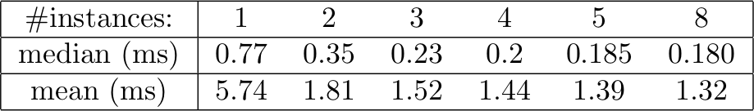
Experiment On Google WAN
Default/Aggregate Rules
Run time with Hassel > 100s
Not much more benefit!
Source: P. Kazemian, Stanford

Slide 40
Conclusions
Designed a protocol-independent system for real time network policy checking
Key component: dependency graph of forwarding rule, capturing all flow paths
  Incremental update
  Flexible policy expressions
  Parallelization by clustering

Slide 41
Outline
Review of previous lecture on SDN programming language
  Maple: generic programming language syntax such as Java, Python
  Frenetic NetCore/NetKAT: domain specific programming language
SDN Verification
  Verification of network properties
  Verification of controller correctness
  Verification of software data plane

Slide 42
Machine-Verified Controllers
Source: Nate Foster, Cornell

Slide 43

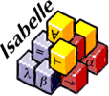



Certified Software Systems
Recent successes
seL4 [SOSP ’09]
CompCert [CACM ’09]
F* [ICFP ’11, POPL ’12, ’13]
Inductive pred : Type :=
| OnSwitch : Switch -> pred
| InPort : Port -> pred
| DlSrc : EthernetAddress -> pred
| DlDst : EthernetAddress -> pred
| DlVlan : option VLAN -> pred
| ...
| And : pred -> pred -> pred
| Or : pred -> pred -> pred
| Not : pred -> pred
| All : pred
| None : pred
Inductive act : Type :=
| ForwardMod : Mod -> PseudoPort -> act
| ...
Inductive pol : Type :=
| Policy : pred -> list act -> pol
| Union : pol -> pol -> pol
| Restrict : pol -> pred -> pol
| ...
Write code
Lemma inter_wildcard_other : forall x,
Wildcard_inter WildcardAll x = x.
Proof.
intros; destruct x; auto.
Qed.
Lemma inter_wildcard_other1 : forall x,
Wildcard_inter x WildcardAll = x.
Proof.
intros; destruct x; auto.
Qed.
Lemma inter_exact_same : forall x,
Wildcard_inter (WildcardExact x) (WildcardExact x) = WildcardExact x.
Proof.
intros.
unfold Wildcard_inter.
destruct (eqdec x x); intuition.
Qed.
(** val handle_event :
event -> unit Monad.m **)
let handle_event = function | SwitchConnected swId ->
handle_switch_connected swId | SwitchDisconnected swId ->
handle_switch_disconnected swId | SwitchMessage (swId, xid0, msg) -> (match msg with | PacketInMsg pktIn ->
handle_packet_in swId pktIn | _ ->
Monad.ret ()) (** val main : unit Monad.m **) let main = Monad.forever
(Monad.bind Monad.recv (fun evt ->
handle_event evt))
Prove correct
Extract code
Tools
Textbooks
Certified Programming with Dependent Types
Certified
binary
Source: Nate Foster, Cornell
Notes:
what does correctness mean--discuss offline

Slide 44
Certified NetKAT Controller
Each level of abstraction formalized in Coq
Machine-checked proofs that the transformations between levels preserve semantics
Code extracted to OCaml and deployed with real switch hardware
NetKAT
Compiler
Flow tables
Optimizer
Run-time system
OpenFlow messages
Source: Nate Foster, Cornell

Slide 45
NetKAT Compiler
Overview
Compiler: maps NetKAT programs to flow tables
Optimizer: eliminates “empty” and “shadowed” rules
Correctness Theorem
Theorem compile_correct :
forall opt pol sw pt pk bufId, SemanticsPreserving opt ->
netcore_eval pol sw pt pk bufId = flowtable_eval (compile pol sw) sw pt pk bufId.
Formalization Highlights
Library of algebraic properties of flow tables
New tactic for proving equalities on bags
Key invariant: all packet patterns “natural”
Source: Nate Foster, Cornell

Slide 46






OpenFlow 1.0 Specification
42 pages...
...of informal prose
...diagrams and flow charts
...and C struct definitions
Source: Nate Foster, Cornell

Slide 47
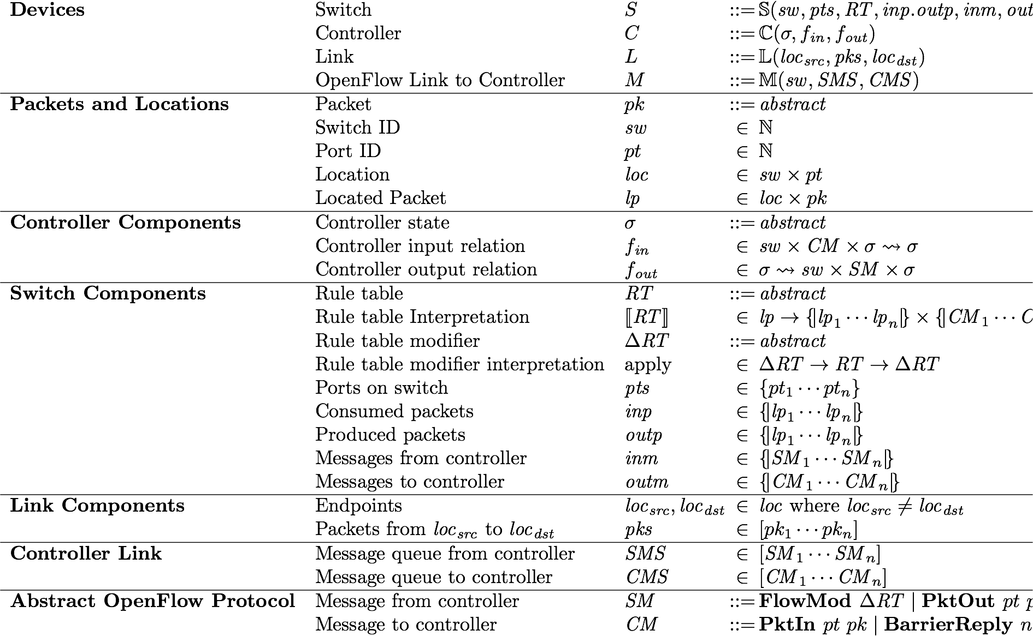
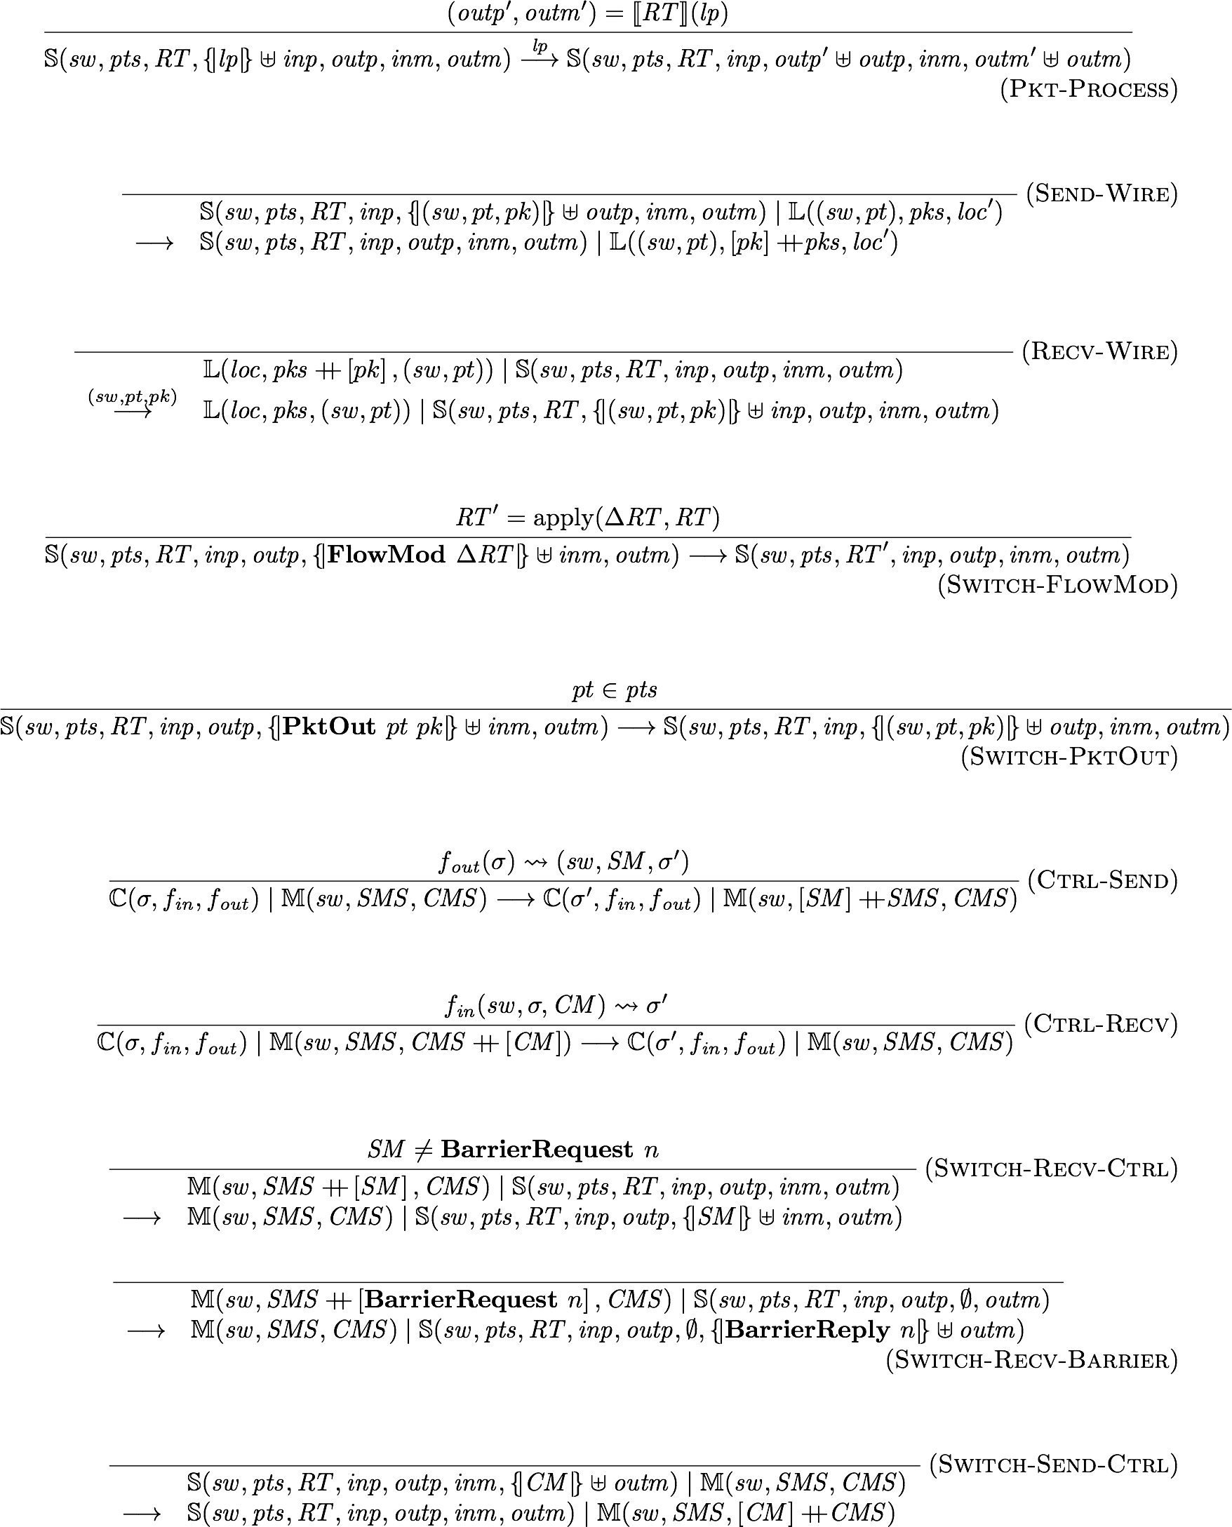
Featherweight OpenFlow
Syntax
Semantics
Key Features:
Models all features related to packet forwarding and all essential asynchrony
Supports arbitrary controllers
Source: Nate Foster, Cornell

Slide 48
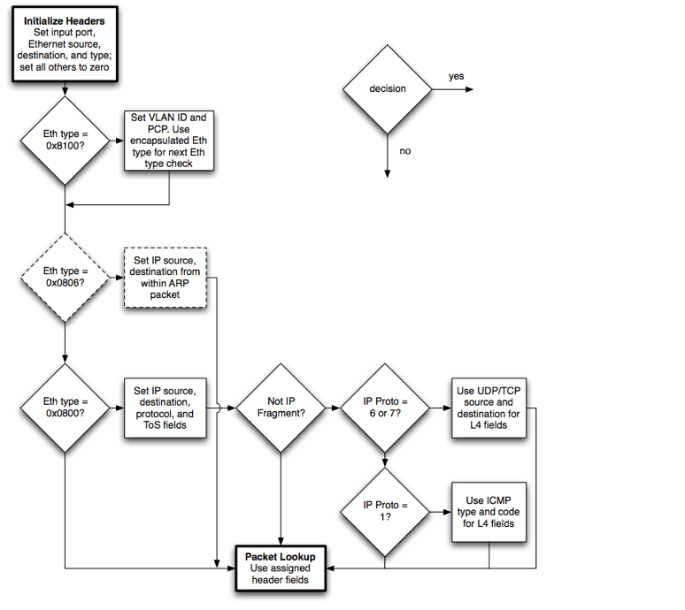
Forwarding
/* Fields to match against flows */
struct ofp_match {
uint32_t wildcards; /* Wildcard fields. */
uint16_t in_port; /* Input switch port. */
uint8_t dl_src[OFP_ETH_ALEN]; /* Ethernet source address. */
uint8_t dl_dst[OFP_ETH_ALEN]; /* Ethernet destination address. */
uint16_t dl_vlan; /* Input VLAN. */
uint8_t dl_vlan_pcp; /* Input VLAN priority. */
uint8_t pad1[1]; /* Align to 64-bits. */
uint16_5 dl_type; /* Ethernet frame type. */
uint8_t nw_tos; /* IP ToS (DSCP field, 6 bits). */
uint8_t nw_proto; /* IP protocol or lower 8 bits of
ARP opcode. */
uint8_t pad2[2]; /* Align to 64-bits. */
uint32_t nw_src; /* IP source address. */
uint32_t nw_dst; /* IP destination address. */
uint16_t tp_src; /* TCP/UDP source port. */
uint16_t tp_dst; /* TCP/UDP destination port. */
};
OFP_ASSERT(sizeof(struct ofp_match) == 40);
Record Pattern : Type := MkPattern {
dlSrc : Wildcard EthernetAddress;
dlDst : Wildcard EthernetAddress;
dlType : Wildcard EthernetType;
dlVlan : Wildcard VLAN;
dlVlanPcp : Wildcard VLANPriority;
nwSrc : Wildcard IPAddress;
nwDst : Wildcard IPAddress;
nwProto : Wildcard IPProtocol;
nwTos : Wildcard IPTypeOfService;
tpSrc : Wildcard TransportPort;
tpDst : Wildcard TransportPort;
inPort : Wildcard Port
}.
Detailed model of matching, forwarding, and flow table update
Definition Pattern_inter (p p':Pattern) :=
let dlSrc := Wildcard_inter EthernetAddress.eqdec (ptrnDlSrc p) (ptrnDlSrc p') in
let dlDst := Wildcard_inter EthernetAddress.eqdec (ptrnDlDst p) (ptrnDlDst p') in
let dlType := Wildcard_inter Word16.eqdec (ptrnDlType p) (ptrnDlType p') in
let dlVlan := Wildcard_inter Word16.eqdec (ptrnDlVlan p) (ptrnDlVlan p') in
let dlVlanPcp := Wildcard_inter Word8.eqdec (ptrnDlVlanPcp p) (ptrnDlVlanPcp p') in
let nwSrc := Wildcard_inter Word32.eqdec (ptrnNwSrc p) (ptrnNwSrc p') in
let nwDst := Wildcard_inter Word32.eqdec (ptrnNwDst p) (ptrnNwDst p') in
let nwProto := Wildcard_inter Word8.eqdec (ptrnNwProto p) (ptrnNwProto p') in
let nwTos := Wildcard_inter Word8.eqdec (ptrnNwTos p) (ptrnNwTos p') in
let tpSrc := Wildcard_inter Word16.eqdec (ptrnTpSrc p) (ptrnTpSrc p') in
let tpDst := Wildcard_inter Word16.eqdec (ptrnTpDst p) (ptrnTpDst p') in
let inPort := Wildcard_inter Word16.eqdec (ptrnInPort p) (ptrnInPort p') in
MkPattern dlSrc dlDst dlType dlVlan dlVlanPcp
nwSrc nwDst nwProto nwTos
tpSrc tpDst
inPort.
Definition exact_pattern (pk : Packet) (pt : Word16.T) : Pattern :=
MkPattern
(WildcardExact (pktDlSrc pk)) (WildcardExact (pktDlDst pk))
(WildcardExact (pktDlTyp pk))
(WildcardExact (pktDlVlan pk)) (WildcardExact (pktDlVlanPcp pk))
(WildcardExact (pktNwSrc pk)) (WildcardExact (pktNwDst pk))
(WildcardExact (pktNwProto pk)) (WildcardExact (pktNwTos pk))
(Wildcard_of_option (pktTpSrc pk)) (Wildcard_of_option (pktTpDst pk))
(WildcardExact pt).
Definition match_packet (pt : Word16.T) (pk : Packet) (pat : Pattern) : bool :=
negb (Pattern_is_empty (Pattern_inter (exact_pattern pk pt) pat)).
Source: Nate Foster, Cornell

Slide 49
Asynchrony
“In the absence of barrier messages, switches may arbitrarily reorder messages to maximize performance.”
“There is no packet output ordering guaranteed within a port.”
Essential asynchrony: packet buffers, message reordering, and barriers
Definition InBuf := Bag Packet.
Definition OutBuf := Bag Packet.
Definition OFInBuf := Bag SwitchMsg.
Definition OFOutBuf := Bag CtrlMsg.
Source: Nate Foster, Cornell

Slide 50






Asynchrony (Cont’d)
Distributed Programming:
non-atomic table updates
Priority | Predicate | Action
Priority | Predicate | Action
10 | SSH | Drop
⊆
⊆
Priority | Predicate | Action
5 | dst_ip = H1 | Fwd 1
Priority | Predicate | Action
10 | SSH | Drop
5 | dst_ip = H1 | Fwd 1
update re-ordering
⊆
Priority | Predicate | Action
5 | dst_ip = H1 | Fwd 1
5 | dst_ip = H2 | Fwd 2
Priority | Predicate | Action
10 | SSH | Drop
5 | dst_ip = H1 | Fwd 1
5 | dst_ip = H2 | Fwd 2
Source: Nate Foster, Cornell

Slide 51

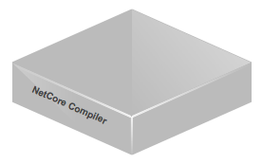

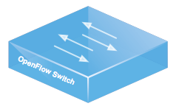


Controllers
Ultimately we want to prove theorems about controllers that implement the NetKAT run-time system...
...but we didn’t want to bake specific controllers into Featherweight OpenFlow!
Controller model: fully abstract
Controller Parameters
: abstract type of controller state
fin :
fout :
Source: Nate Foster, Cornell

Slide 52








Weak Bisimulation
(H1,
)
(S1,pt1,
)
(S2,pt1,
)
(H2,
)
≈
≈
≈
≈
≈
≈
≈
≈
add rules
add rules
Theorem fwof_abst_weak_bisim :
weak_bisimulation concreteStep abstractStep
bisim_relation.
Source: Nate Foster, Cornell

Slide 53

The System
predicates
policies
queries
stream of snapshots over time
predicates
policies
queries
predicates
policies
queries
Frenetic
Frenetic
OCaml embedding
predicates and policies
queries
implemented using
OX
Ox
OCaml OpenFlow Platform
similar to Nox, Pox, Floodlight, etc.
Source: Nate Foster, Cornell

Slide 54
The System
Domain-specific language
predicates and policies
monitoring
mac learning
network address translation
Frenetic DSL
implemented using
Frenetic
Frenetic
OCaml embedding
predicates and policies
queries
implemented using
OX
Ox
OCaml OpenFlow Platform
similar to Nox, Pox, Floodlight, etc.
Source: Nate Foster, Cornell

Slide 55
Outline
Review of previous lecture on SDN programming language
  Maple: generic programming language syntax such as Java, Python
  Frenetic NetCore/NetKAT: domain specific programming language
SDN Verification
  Verification of network properties
  Verification of controller correctness
  Verification of software data plane

Slide 56
Software Dataplane Verification
Mihai Dobrescu
Katerina Argyraki
EPFL

Slide 57
Software dataplanes
intrusion detection
application acceleration
IP forwarding

Slide 58
Software dataplanes
Flexibility
  new intrusion detection, traffic filtering, sampling, application acceleration, ...
Unpredictability
  special packet causes router to crash
  or doubles per-packet latency

Slide 59
Dataplane verification
intrusion detection
application acceleration
IP forwarding
dataplane executable D
target property P
verification tool
D does (not) satisfy property P

Slide 60
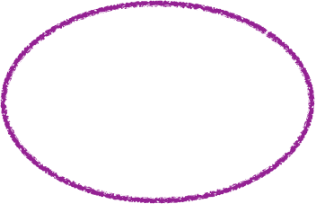
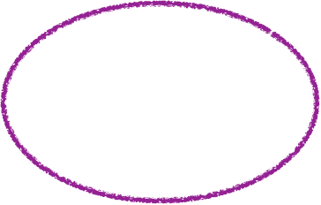
if (in.x < 0)
  out = ...;
else
  out = in;
if (in.y < 10)
  out = ...;
else
  out = in;
Compositional Test Generation, POPL 2007
in.y < 10
in.x < 0
in.y ≥ 10
in.y < 10
in.x ≥ 0
DART, PLDI 2005
in.y ≥ 10
Klee, OSDI 2008

Slide 61
Dataplane-specific verification
Define the domain
  propose rules on how to write dataplanes
  make it easy to apply composition
Leverage the domain specificity
  use it to sidestep path explosion
  open the door to dataplane verification

Slide 62
Outline
Pipeline
Loops
Data structures
Results

Slide 63
Outline
Pipeline
Loops
Data structures
Results

Slide 64
intrusion detection
application acceleration
IP forwarding
m elements
do not share mutable state
n branches
per element
verification time ∼ 2 ^{n m}

Slide 65
intrusion detection
application acceleration
...
assert(src != dst);
...
IP forwarding
do not share mutable state
verification time ∼ m 2 ^{n}

Slide 66
Pipeline decomposition
Rule: pipeline structure
  distinct packet-processing elements
  do not share mutable state
Effect: compose at the element level
  can reduce #paths from ∼ 2 ^{n m}
  to ∼ m 2 ^{n}

Slide 67
Outline
Pipeline
Loops
Data structures
Results

Slide 68
IP options

Slide 69
option #1
option #2
...
option #m
m options
n option
types
verification time ∼ n ^{m}

Slide 70
option #1
option #2
...
option #m
m options
little state sharing across iterations
n option
types
...
verification time ∼ m n

Slide 71
Loop decomposition
Rule: “mini-pipeline” structure
  little state shared across iterations
  made explicit by the programmer
Effect: compose at the iteration level
  can reduce #paths from ∼ n ^{m}
  to ∼ m n

Slide 72
Outline
Pipeline
Loops
Data structures
Results

Slide 73
IP lookup

Slide 74
...
output_port = table[ dst_prefix ]
...
...

Slide 75
table impl
...
output_port = table.read( dst prefix )
...
...

Slide 76
Data-access decomposition
Rule: data-structure interface
  made explicit by the programmer
Effect: abstract data-structure implementation
  prevents data-structure size from contributing to path explosion

Slide 77
Verified data structures
Use pre-allocated arrays
  no dynamic memory (de)allocation
  hash table, longest prefix match
Trade-off memory for “verifiability”
  at least as fast (array lookups)
  but larger memory footprint (pre-allocation)

Slide 78
Outline
Pipeline
Loops
Data structures
Results

Slide 79
Results
Verified stateless & simple stateful pipelines
  IP router, NAT box, traffic monitor
Proved bounded execution
  no more than X instructions per packet
  disparity between worst-case and common path
Proved crash-freedom
  no packet will cause the pipeline to abort

Slide 80
/* IPFragmenter:: optcopy */
      for ( int i = 0; i < opts_len; ) {
          int opt = oin[i], optlen;
          if (opt == IPOPT_NOP)
              optlen = 1;
          else if (opt == IPOPT_EOL || i == opts_len - 1 || i + (optlen = oin[i+1]) > opts_len)
              break;
          if (opt & 0x80) {
              //copy the option
              memcpy(...);
          }
          i += optlen;
      }

Slide 81
/* IPFragmenter:: optcopy */
      for ( int i = 0; i < opts_len; ) {
          int opt = oin[i], optlen;
          if (opt == IPOPT_NOP)
              optlen = 1;
          else if (opt == IPOPT_EOL || i == opts_len - 1 || i + (optlen = oin[i+1]) > opts_len)
              break;
          if (opt & 0x80) {
              //copy the option
              memcpy(...);
          }
          i += optlen;
      }

Slide 82
/* IPFragmenter:: optcopy */
      for ( int i = 0; i < opts_len; ) {
          int opt = oin[i], optlen;
          if (opt == IPOPT_NOP)
              optlen = 1;
          else if (opt == IPOPT_EOL || i == opts_len - 1 || i + (optlen = oin[i+1]) > opts_len)
              break;
          if (opt & 0x80) {
              //copy the option
              memcpy(...);
          }
          i += optlen;
      }

Slide 83
/* IPFragmenter:: optcopy */
      for ( int i = 0; i < opts_len; ) {
          int opt = oin[i], optlen;
          if (opt == IPOPT_NOP)
              optlen = 1;
          else if (opt == IPOPT_EOL || i == opts_len - 1 || i + (optlen = oin[i+1]) > opts_len)
              break;
          if (opt & 0x80) {
              //copy the option
              memcpy(...);
          }
          i += optlen;
      }

Slide 84
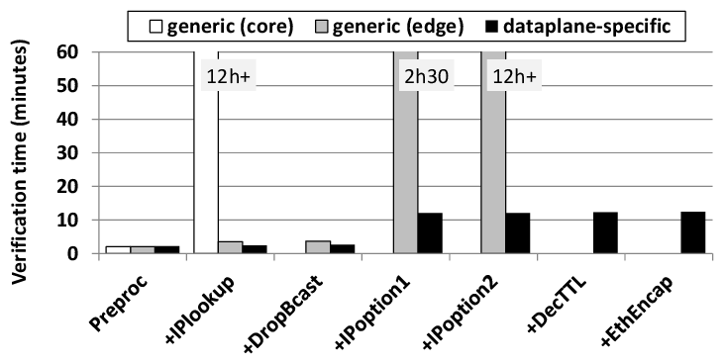
Verification time for Click pipelines

Slide 85
Homage
Active networks
  Tennenhouse & Wetherall, CCR 1996
S2E software analyzer
  Chipounov et al., ASPLOS 2011
Compositional analysis
  Godefroid, POPL 2007
Click programming framework
  Kohler, PhD thesis, 2000

Slide 86
Conclusion
Dataplane-specific verification
  symbolic execution + composition
  pipeline structure, limited loops, pre-allocated key/value stores
Enables dataplane verification in useful time
  complete and sound analysis
  of stateless and 2 simple stateful pipelines

