Slide 1
Software Defined Networking COMS 6998-10, Fall 2014
Instructor: Li Erran Li (lierranli@cs.columbia.edu)
http://www.cs.columbia.edu/~lierranli/coms6998-10SDNFall2014/
9/22/2014: SDN Scalability

Slide 2
Outline
Homework 1 due Oct 1
Review of previous lecture
SDN scalability
Scale controller
Flat structure multiple controllers [ONIX, OSDI’10; ONOS, HotSDN’14]
Recursive controller design [Xbar, ONS,13]
Hierarchical controller design [Kandoo, HotSDN’12]
Offload to switch
Offload to switch control plane [Diffane, SIGCOMM’10]
Offload of switch data plane [DevoFlow, SIGCOMM’11]

Slide 3
Home Work 1
External Application
There is a learning switch module and a firewall module in Floodlight
Implement IFloodlightModule, IOFMessageListener
Need to process OpenFlow messages
PacketIn: switch generates PacketIn message for first packet of a flow
PacketOut: used by controller to send a packet through data plane
FlowMod: used by controller to modify flow table entries (add/delete/modify)
FlowRemoved: used by switch to notify controller about flow entry time out
IFloodlight-Module
REST
Floodlight Controller
Switch
Switch
vSwitch

Slide 4
Review of Previous Lecture
Flow Table Entries
Rule
Action
Stats
Packet + byte counters
Forward packet to zero or more ports
Encapsulate and forward to controller
Send to normal processing pipeline
Modify Fields
Any extensions you add!
Switch
Port
VLAN
ID
VLAN
pcp
MAC
src
MAC
dst
Eth
type
IP
Src
IP
Dst
IP
ToS
IP
Prot
L4
sport
L4
dport
+ mask what fields to match
Notes:
Now I’ll describe the API that tries to meet these goals.

Slide 5
Review of Previous Lecture (Cont’d)
Switching
Examples
Switch
Port
MAC
src
MAC
dst
Eth
type
VLAN
ID
IP
Src
IP
Dst
IP
Prot
TCP
sport
TCP
dport
Action
*
*
00:1f:..
*
*
*
*
*
*
*
port6
Flow Switching
Switch
Port
MAC
src
MAC
dst
Eth
type
VLAN
ID
IP
Src
IP
Dst
IP
Prot
TCP
sport
TCP
dport
Action
port3
00:20..
00:1f..
0800
vlan1
1.2.3.4
5.6.7.8
4
17264
80
port6
Firewall
Switch
Port
MAC
src
MAC
dst
Eth
type
VLAN
ID
IP
Src
IP
Dst
IP
Prot
TCP
sport
TCP
dport
Action
*
*
*
*
*
*
*
*
*
22
drop

Slide 6
Review of Previous Lecture (Cont’d)
Routing
Examples
Switch
Port
MAC
src
MAC
dst
Eth
type
VLAN
ID
IP
Src
IP
Dst
IP
Prot
TCP
sport
TCP
dport
Action
*
*
*
*
*
*
5.6.7.8
*
*
*
port6
VLAN Switching
Switch
Port
MAC
src
MAC
dst
Eth
type
VLAN
ID
IP
Src
IP
Dst
IP
Prot
TCP
sport
TCP
dport
Action
port6,
port7,
port9
*
*
00:1f..
*
vlan1
*
*
*
*
*

Slide 7
Review of Previous Lecture (Cont’d)
Which is the configuration and management protocol?
OF-CONFIG
What does OF-CONFIG do?
Bootstrap OpenFlow network, e.g. configure switches to connect to controllers
Allocate resources within switches, e.g. ports, queues

Slide 8
Outline
SDN scalability
Distributed system building blocks
Scale controller
Flat structure multiple controllers [ONIX, OSDI’10]
Recursive controller design [Xbar, ONS,13]
Hierarchical controller design [Kandoo, HotSDN’12]
Offload to switch
Offload to switch control plane [Diffane, SIGCOMM’10]
Offload of switch data plane [DevoFlow, SIGCOMM’11]

Slide 9
Distributed System Building Blocks
Distributed storage system
Cassandra
RAMCloud (in-memory storage)
Distributed graph database (Titan)
Optimized for storing and querying graphs containing billions of vertices and edges
Distributed event notification (HazelCast)
Distributed coordination service (Zookeeper)
Distributed system data structures and algorithms
Distributed hash table (DHT)
Paxos consensus algorithm
Failure detector
Checkpointing
Transaction (ACID property)

Slide 10
Scalability issues
Frequent events stress the control plane.
Stress controller’s resources.
Control Plane
Data Plane
Stress the control channels.
Source: Soheil Hassas Yeganeh
Notes:
Highly frequent events consume a lot from the control channel and computing resources.
For example, if we collect network-wide state with high frequency
LOAD ON THE NETWORK

Slide 11
Solution Space
Distributed Controllers:
Data Plane Extensions:
Control Plane
Control Plane
Control Plane
Control Plane
Data Plane
Data Plane
Consider this as an intrinsic limitation.
Onix, Devolved Controllers, ...
Delegate more responsibilities to the data plane.
DIFANE, DevoFlow, ...
Source: Soheil Hassas Yeganeh
Notes:
There are two categories of solutions for this problem: 1. ... and 2....

Slide 12
Solution Space (Cont’d)
Comes at the cost of visibility.
Still, high control channel consumption.
Control Plane
Control Plane
Control Plane
Control Plane
Data Plane
Data Plane
Need to modify the data plane.
Source: Soheil Hassas Yeganeh
Notes:
The problem with ... is that ...
On the other hand, dataplane extensions result into less visibility
More importantly you need to modify OpenFlow, more optional features, fragmentation, ...

Slide 13
Overheads: Flow Setup
Switch with finite bandwidth between data & control plane, i.e. overheads between ASIC and CPU
Setup capability: 275~300 flows/sec
In data center: mean flow inter-arrival per server 30 ms
Rack with 40 servers ⇒ 1300 flows/sec

Slide 14
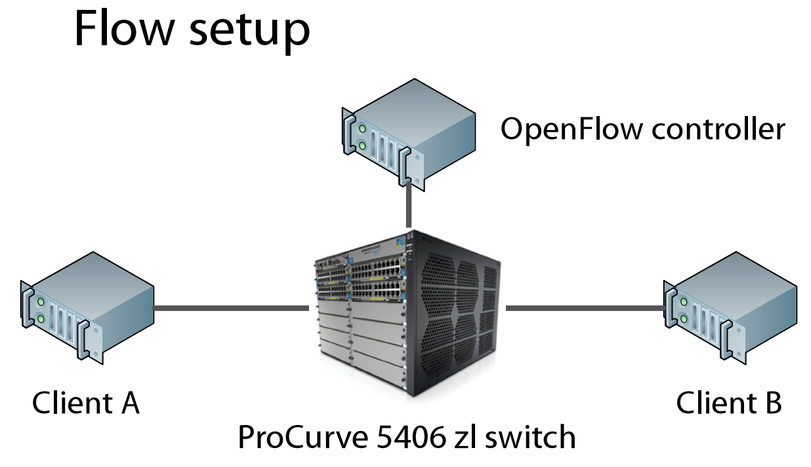
Overheads: Flow Setup
Experiment: a single switch

Slide 15
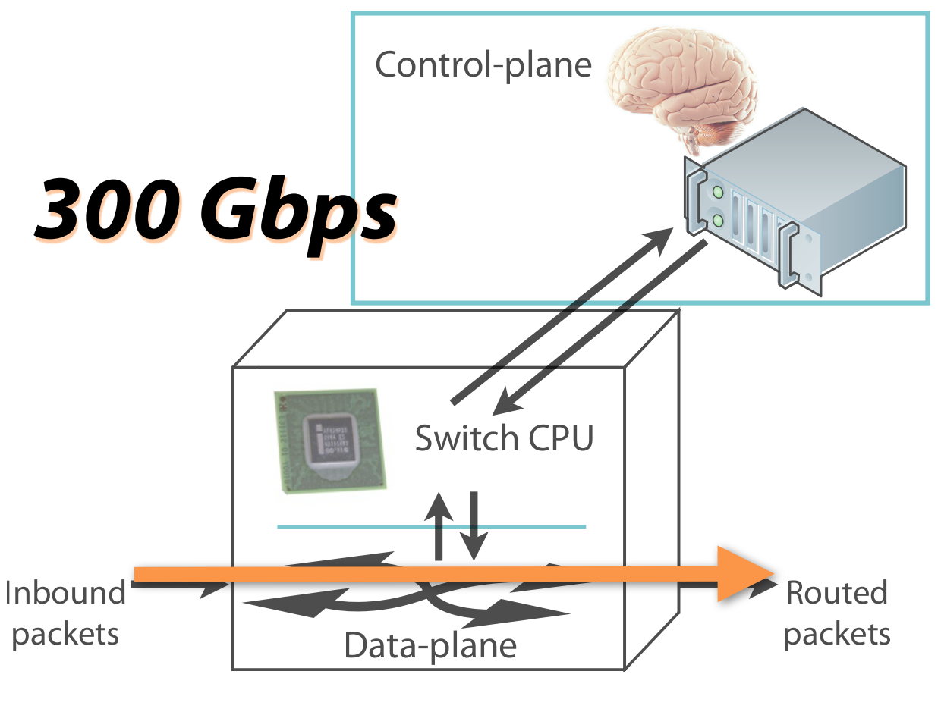
Overheads: Flow Setup
ASIC switching rate
Latency: 5 μs

Slide 16
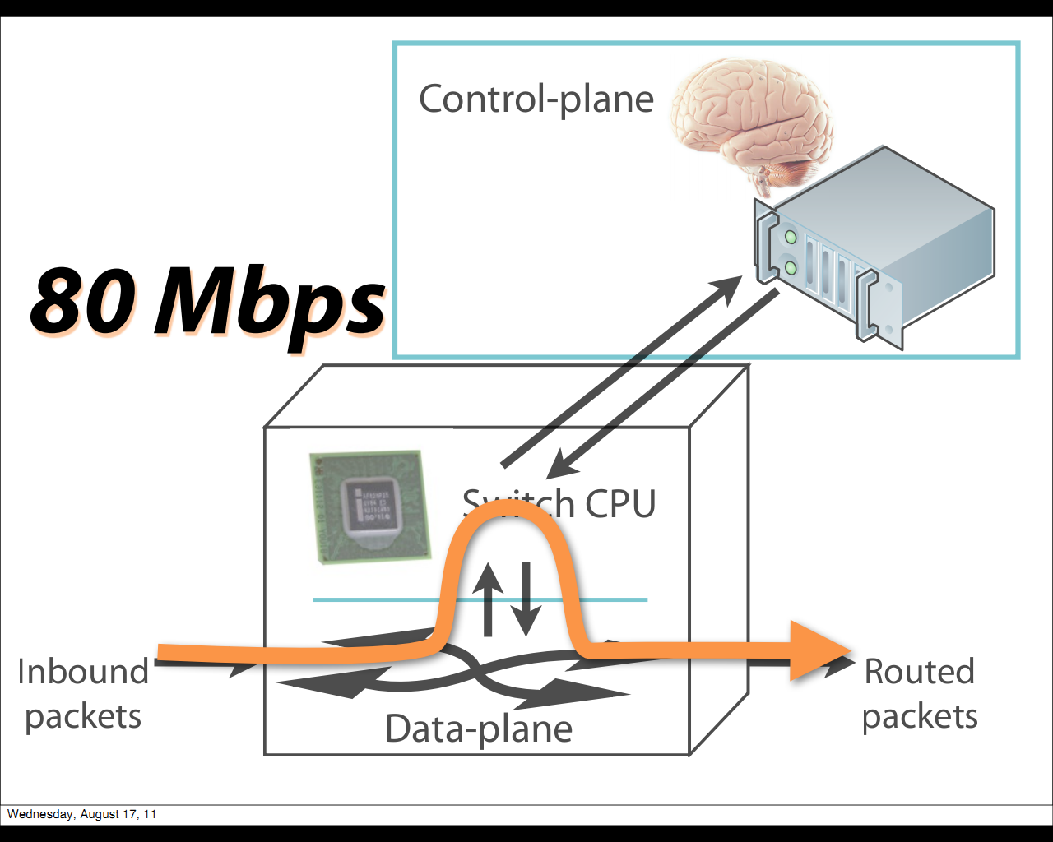
Overheads: Flow Setup
ASIC ⇒ CPU
Latency: 0.5 ms

Slide 17
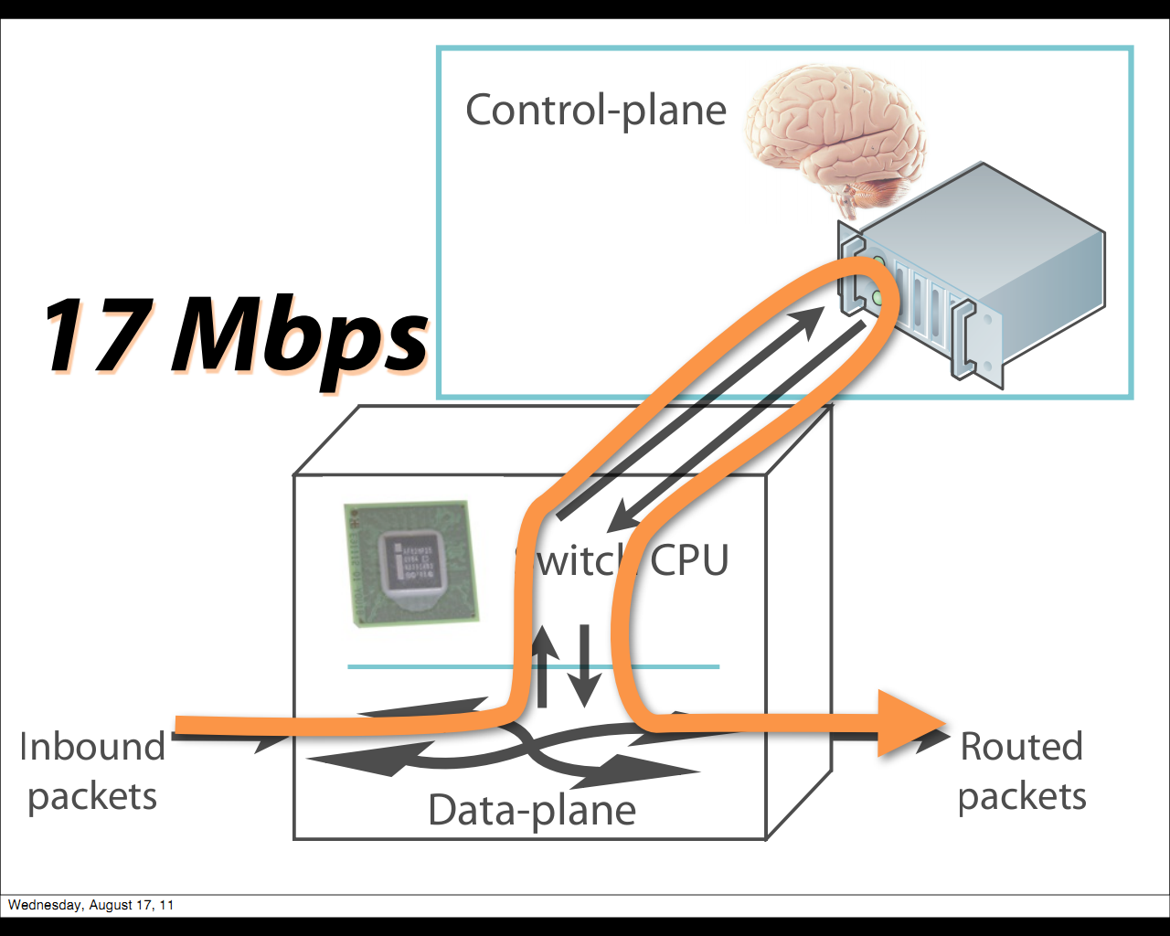
Overheads: Flow Setup
CPU ⇒ Controller
Latency: 2 ms
A huge waste
of resources!

Slide 18
Overheads: Gathering Statistics
[30] most longest-lived flows last only a few sec
Counters: (pkts, bytes, duration)
Push-based: to controller when flow ends
Pull-based: fetch actively by controller
In OpenFlow, each flow table entry provides 88 bytes of statistics
In HP Procurve 5406zl switch: Entries:1.5K wildcard match, 13K exact match ⇒ total 1.3 MB, 2 fetches/sec, >17 Mbps ⇒ Not fast enough! Consumes a lot of bandwidth!
[30] S. Kandula, S. Sengupta, A. Greenberg, and P. Patel. The
Nature of Datacenter Traffic: Measurements & Analysis. In
Proc. IMC , 2009.

Slide 19
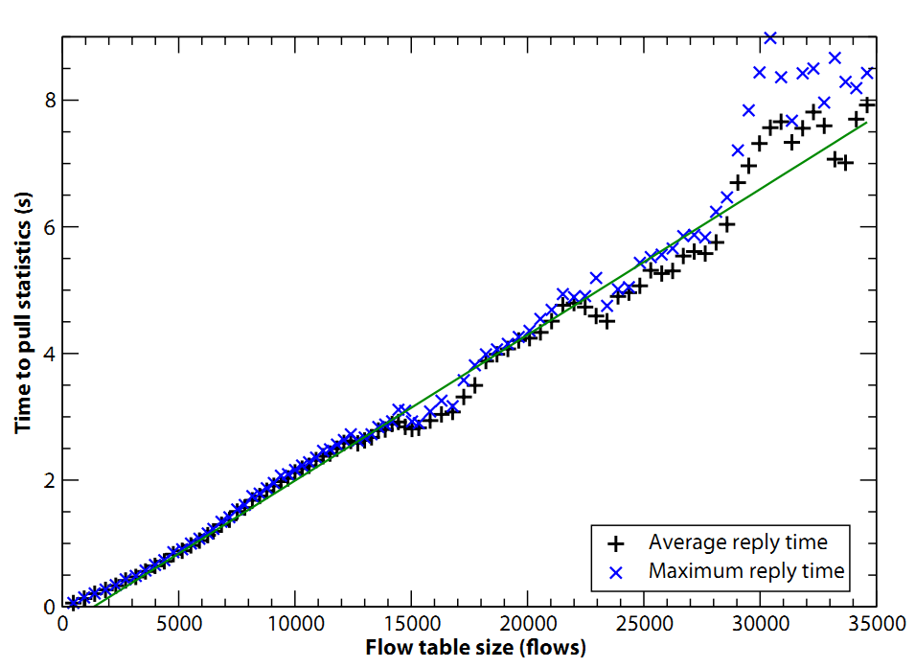
Overheads: Gathering Statistics
2.5 sec to pull 13K entries
1 sec to pull 5,600 entries
0.5 sec to pull 3,200 entries

Slide 20
Overheads: Gathering Statistics
Per-flow setup generates too many entries
More the controller fetch ⇒ longer
Longer to fetch ⇒ longer the control loop
In Hedera (centralized flow scheduler): control loop 5 secs BUT workload too ideal, Pareto distribution
Workload in VL2 (scalable data center network architecture), 5 sec only improves 1~5% over ECMP
[41], must be less than 0.5 sec to be better
[41] C. Raiciu, C. Pluntke, S. Barre, A. Greenhalgh, D. Wischik,
and M. Handley. Data center networking with multipath TCP.
In HotNets , 2010.

Slide 21
ONIX: Distributed Controller
Abstractions: It provides general API for management applications.
Basic functionalities:
State distribution primitives between controllers and network elements

Slide 22
Design Requirements
Generality: Support a wide range of network management applications
Scalability: No inherent limitations due to the platform
Reliability: Graceful failure handling
Simplicity: Network management applications should become simpler
Performance: Sufficient performance

Slide 23
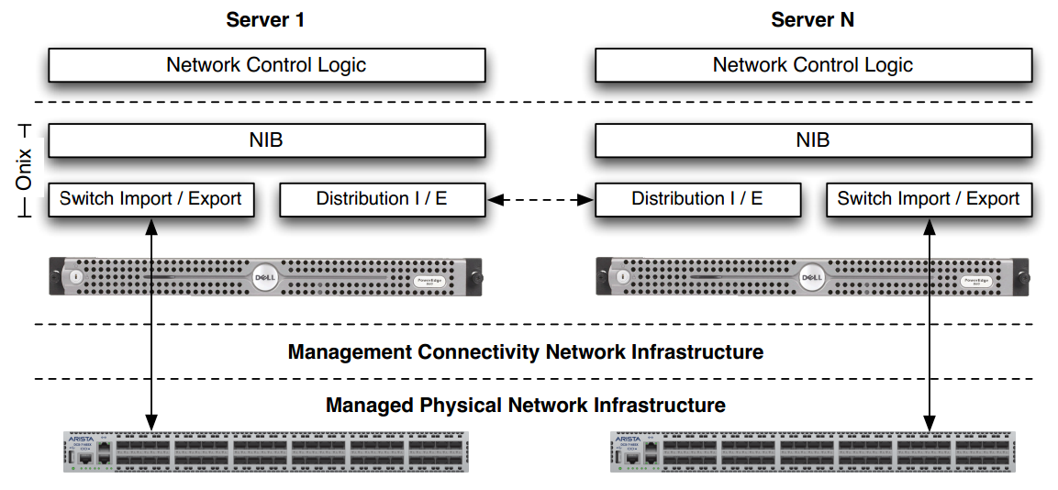
Onix Architecture

Slide 24
Four components of Onix
Physical infrastructure: switches, routers, and other things.
Connectivity infrastructure: Channels for control messages.
Onix: A distributed system running the controller.
Control logic: Network management applications on top of Onix.

Slide 25
Onix Abstractions
Global View: Observe and control a centralized network view which contains all physical network elements.
Flows: The first packet and subsequent packets with the same header are treated in the same way.
Switch: <header: counters, actions>
Event-based operation: The controller operations are triggered by routers or applications.
Do you like these abstractions for networking management? Why?

Slide 26
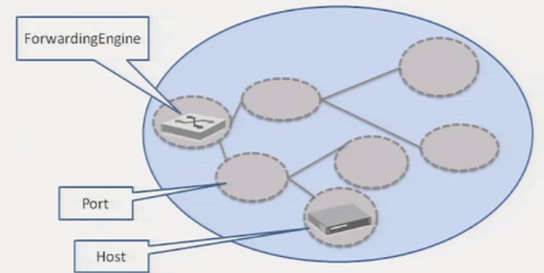
Onix API
Developers program against a network graph
Nodes represent physical network entities
Write flow entry
List ports
Register for updates
……

Slide 27
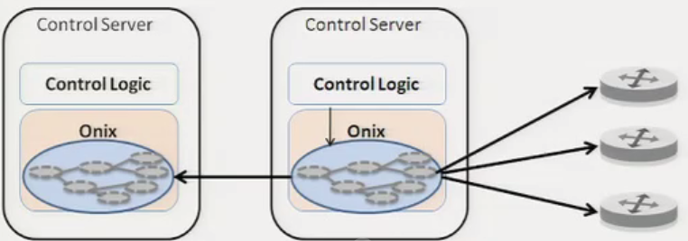
Network Information Base
The NIB is the focal point of the system
State for applications to access
External state changes imported into it
Local state changes exported from it

Slide 28
Scalability and Reliability
A single physical controller will become the bottlenecks:
Memory: to keep NIB
CPU and bandwidth: to process events
Solutions: Partitioning and aggregation
Now, either performance or consistency will suffer.

Slide 29
Scalability/Reliability Requirements
Let the applications decide the preference for durability and consistency.
Onix provides two built-in storage options
Replicated transactions (SQL) storage
One-hop memory-based DHT
What if there are conflicts? The applications should detect and resolve conflicts.

Slide 30
Discussion: Consistency
Do we need strong consistency for NIB stored in controllers?
Can Onix do better than asking applications for consistency preference and resolving conflicts?

Slide 31
Scaling: Partitioning
Multiple dimensions available to applications:
Onix instances with different computations tasks
Onix instances have only subsets of the NIB
Switches connect to a subset of Onix instances

Slide 32
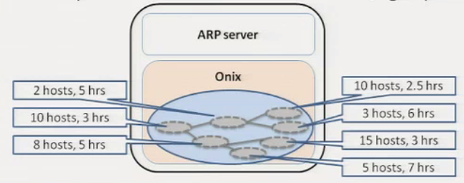
Scaling: aggregation
Reduce fidelity of information before disseminating within the cluster

Slide 33
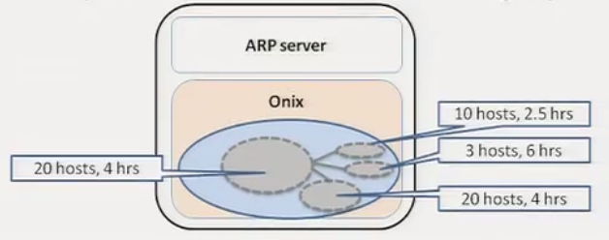
Scaling: aggregation
Reduce fidelity of information before disseminating within the cluster

Slide 34
Reliability
Network Element & Link Failures: Applications' responsibility
Management Connectivity Infrastructure Failures: Assumed reliable
Onix Failures: Onix provides distributed coordination facilities provided for app failover

Slide 35
Summary
Onix solves state distribution for developers
The designers of management applications still have to understand the scalability implications of their design

Slide 36
Outline
SDN scalability
Scale controller
Flat structure multiple controllers [ONIX, OSDI’10; ONOS, HotSDN’14]
Recursive controller design [Xbar, ONS,13]
Hierarchical controller design [Kandoo, HotSDN’12]
Offload to switch
Offload to switch control plane [Diffane, SIGCOMM’10]
Offload of switch data plane [DevoFlow, SIGCOMM’11]

Slide 37
ONOS
Towards an Open, Distributed
SDN OS
Pankaj Berde, Matteo Gerola, Jonathan Hart,
Yuta Higuchi,
Masayoshi Kobayashi, Toshio Koide, Bob Lantz,
Brian O’Connor, Pavlin Radoslavov, William Snow, Guru Parulkar
Open Networking Laboratory, NEC Corporation of America, Create-Net, Stanford
9/22/14
Software Defined Networking (COMS 6998-10)
37

Slide 38
WAN
Networks
Today!
Core
~250 routers
5K - 10K ports
High Availability:
Metro
10K - 50K routers
3M+ ports
99.99%
Application
Application
Global Network View/State
ONOS
(200GB
–
1TB+)
Access
~50K devices
1M+ ports
High Throughput:
500K – 1M
ops/sec
Low Latency:
10 – 100ms
Co
re Net
work
9/22/14
Software Defined Networking (COMS 6998-10)
38

Slide 39
Distributed,!SDN OS!
Scale-out
High
Availability
High
Performance
ONOS
Programming
Abstractions
Applications
Network OS for WAN and Service Provider networks
Clean separation of Control Plane from Data Plane
9/22/14
Software Defined Networking (COMS 6998-10)
39

Slide 40
Distributed Architecture
Application
Application
Application
Network View API
Distributed Data Store
(RAMCloud)
Global
Context
Modules
Global
Context
Modules
Global
Context
Modules
Distributed Registry
(Zookeeper)
Event Notifications
(Hazelcast)
OpenFlow
Manager
(Floodlight)
OpenFlow
Manager
(Floodlight)
OpenFlow
Manager
(Floodlight)
9/22/14
40
Software Defined Networking (COMS 6998-10)

Slide 41
Global Network View
Applications
observe
Applications
Applications
Applications
program
Network State
•
Topology
(Switch, Port, Link, …)
Network Events
(Link down, Packet-­‐In, …)
Flow state
(Flow-­‐tables, connectivity paths, ...)
Switch
Port
•
Link
Host
•
Intent
FlowPath
9/22/14
FlowEntry
Software Defined Networking (COMS 6998-10)

Slide 42
Topology State
•
Sometimes remote
reads/writes are too slow
Topology Replicas
•
Exploit read-heavy
access pattern by storing
a copy on each instance
Build indices in-memory to improve lookup time
Apply updates atomically to maintain integrity
•
•
9/22/14
42
Software Defined Networking (COMS 6998-10)

Slide 43
Looking Ahead
•
Open Source by
the end 2014
•
•
•
•
•
•
Improvements to high availability and performance
Better and more general abstractions
Isolation and Security
Resource Scheduling
Hierarchical or Peer-to-Peer coordination
More use cases and deployments
9/22/14
Software Defined Networking (COMS 6998-10)
43

Slide 44
Outline
SDN scalability
Scale controller
Flat structure multiple controllers [ONIX, OSDI’10; ONOS, HotSDN’14]
Recursive controller design [Xbar, ONS,13]
Hierarchical controller design [Kandoo, HotSDN’12]
Offload to switch
Offload to switch control plane [Diffane, SIGCOMM’10]
Offload of switch data plane [DevoFlow, SIGCOMM’11]

Slide 45
Incorporate Recursion into SDN
Aggregation/hierarchy/recursion are the proven method for scaling networks
Recursive hierarchy is the midway point between centralized and distributed
Looks centralized at any particular level
But introduces points for aggregation, failure domains, etc.
Source: Murphy Mccauley

Slide 46
Example: Logical xBars (LXBs)
Specific RSDN control logic that supports a recursive programmable switch abstraction
Each controller looks like switch to its parent
Transforms table entries from parent to children (more abstract → more specific)
Uses label versioning to support transactional changes at each level
Source: Murphy Mccauley

Slide 47
LXBs: Handling Failures
Source: Murphy Mccauley

Slide 48
LXBs: Handling Failures
Source: Murphy Mccauley
Notes:
Link handled by…

Slide 49
LXBs: Handling Failures
Source: Murphy Mccauley
Notes:
Link handled by…

Slide 50
LXBs: Handling Failures
Config
State
Source: Murphy Mccauley
Notes:
Link handled by…
State up, config down

Slide 51
LXBs: Some Questions
How good is LXB-based failure localization?
How optimal are LXB-based paths?
How do you optimally divide network into hierarchical subgraphs (e.g., LXBs)?
We don’t!
Not even for evaluation (we use naïve clustering)
Source: Murphy Mccauley
Notes:
Assumption is that in general, clustering is dictated by technology, organization, geography

Slide 52
Summary
Single mechanism for entire control plane:
Hopefully true even across technologies (we have mostly been thinking about copper)
Standard benefits of hierarchy:
Failures localized, churn is contained
Maps to organizational boundaries
Stacks arbitrarily high to meet needs
Source: Murphy Mccauley

Slide 53
Next Steps
Mapping to provider network topologies
Addressing regulatory boundaries
Multitechnology issues (e.g., copper, fiber, wireless)
… ?
Source: Murphy Mccauley

Slide 54
Outline
SDN scalability
Scale controller
Flat structure multiple controllers [ONIX, OSDI’10]
Recursive controller design [Xbar, ONS,13]
Hierarchical controller design [Kandoo, HotSDN’12]
Offload to switch
Offload to switch control plane [Diffane, SIGCOMM’10]
Offload of switch data plane [DevoFlow, SIGCOMM’11]

Slide 55
Kandoo: The IDEA
OFFLOADING
LOCAL CONTROL APPS
TO
LOCAL RESOURCES.
Applications that do not need the network-wide state.
Resources close to switches.
Source: Soheil Hassas Yeganeh
Notes:
Our answer to this question is based on offloading control applications that ... to resources close to switches.
In the next couple of slides I will explain ...

Slide 56
Local Apps
An assumption in distributed controllers:
All control apps require the network-wide state.
But, there are many apps that are local in scope:
Applications that require only local switch state.
App
Controller
App
Controller
Controller
Local App
Local App
App
Switch
Switch
Switch
Switch
Switches
Source: Soheil Hassas Yeganeh

Slide 57
Local apps.
Local applications:
Learning Switch
Local Policy Enforcer
Link Discovery
Local components in control applications:
Elephant Flow Detection in an Elephant Flow Rerouting application.
Local apps have implicit parallelism.
Local App
Local App
Local App
Local App
Switch
Switch
Switch
Switch
Source: Soheil Hassas Yeganeh
Notes:
are either local in nature such as ....
are local components in a larger non-local app! for example

Slide 58
Local Resources
We can offload local apps to computing resources next to switches.
Inside programmable switches.
On the same hosts running software switches.
Hosts close to switches.
End-Host
End-Host
Switch
Local App
Local App
Local App
Soft. Switch
Programmable
Switch
Switch
Source: Soheil Hassas Yeganeh

Slide 59
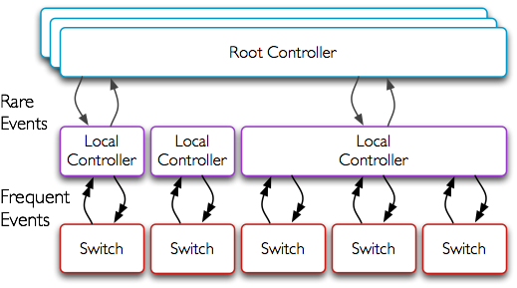
Kandoo
Two layers of controllers:
A logically centralized Root Controller.
Local Controllers.
The root controller runs non-local apps.
Local controllers run local apps.
Lightweight and easy to implement.
Local controllers shield the root controller.
Source: Soheil Hassas Yeganeh

Slide 60
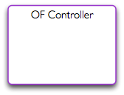
An Example: Elephant flow rerouteing.
Source: Soheil Hassas Yeganeh

Slide 61
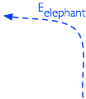
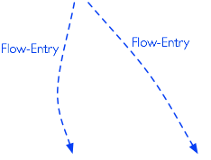
An Example: Elephant flow rerouteing.
Kandoo’s event channels.
Application-specific events.
Scales linearly with the number of switches.
Source: Soheil Hassas Yeganeh

Slide 62
Future directions
A Generalized Hierarchy
Filling the gap between local and non-local apps
Finding the right scope is quite challenging
Finding the right scope is quite challenging
Source: Soheil Hassas Yeganeh

Slide 63
Outline
SDN scalability
Scale controller
Flat structure multiple controllers [ONIX, OSDI’10]
Recursive controller design [Xbar, ONS,13]
Hierarchical controller design [Kandoo, HotSDN’12]
Offload to switch
Offload to switch control plane [Diffane, SIGCOMM’10]
Offload of switch data plane [DevoFlow, SIGCOMM’11]

Slide 64
What’s DIFANE?
Traditional enterprise
Hard to manage
Limited policies
Distributed
Flow-based networking
Easy to manage
Support fine-grained policy
Scalability remains a challenge
DIFANE:
A scalable way to apply fine-grained policies in enterprises
Source: Minlan Yu

Slide 65
Flexible Policies in Enterprises
Access control
Drop packets from
malicious hosts
Customized routing
Direct Skype calls on
a low-latency path
Measurement
Collect detailed HTTP traffic statistics
HTTP
HTTP
Source: Minlan Yu

Slide 66
Flow-based Switches
Install rules in flow-based switches
Store rules in high speed memory (TCAM)
Perform simple actions based on rules
Rules: Match on bits in the packet header
Actions: Drop, forward, count
Flow space
src.
forward via link 1
dst.
drop
Source: Minlan Yu

Slide 67
Challenges of Policy-Based Management
Policy-based network management
Specify high-level policies in a management system
Enforce low-level rules in the switches
Challenges
Large number of hosts, switches and policies
Limited TCAM space in switches
Support host mobility
No hardware changes to commodity switches
Source: Minlan Yu

Slide 68
Pre-install Rules in Switches
Pre-install
rules
Controller
Packets hit
the rules
Forward
Problems:
No host mobility support
Switches do not have enough memory
Source: Minlan Yu

Slide 69
Install Rules on Demand (Ethane, NOX)
Buffer and send
packet header
to the controller
Controller
Install
rules
First packet
misses the rules
Forward
Problems:
Delay of going through the controller
Switch complexity
Misbehaving hosts
Source: Minlan Yu

Slide 70
DIFANE Architecture (two stages)
DIstributed Flow Architecture
for Networked Enterprises

Slide 71
Stage 1
The controller proactively generates the rules and distributes them to authority switches.
Source: Minlan Yu

Slide 72
Partition and Distribute the Flow Rules
Flow space
accept
Controller
Distribute partition information
AuthoritySwitch B
Authority Switch A
Authority Switch C
reject
Authority
Switch B
Egress Switch
Authority
Switch A
Ingress Switch
Authority
Switch C
Source: Minlan Yu

Slide 73
Stage 2
The authority switches keep packets always in the data plane and reactively cache rules.
Source: Minlan Yu

Slide 74
Packet Redirection and Rule Caching
Authority Switch
Feedback:
Cache rules
Ingress Switch
Forward
Egress Switch
Redirect
First packet
Following packets
Hit cached rules and forward
A slightly longer path in the data plane is faster than going through the control plane
Source: Minlan Yu

Slide 75
Locate Authority Switches
Partition information in ingress switches
Using a small set of coarse-grained wildcard rules
… to locate the authority switch for each packet
Distributed directory service but not DHT
Hashing does not work for wildcards
Keys can have wildcards in arbitrary bit positions
X
AuthoritySwitch B
X:0-1 Y:0-3 ➔ A
X:2-5 Y: 0-1➔B
X:2-5 Y:2-3 ➔ C
Authority Switch A
Authority Switch C
Y
Source: Minlan Yu

Slide 76
Packet Redirection and Rule Caching
Authority Switch
Feedback:
Cache rules
Ingress Switch
Redirect
Auth. Rules
Forward
Egress Switch
First packet
Cache Rules
Partition Rules
Following packets
Hit cached rules and forward
Source: Minlan Yu

Slide 77
Three Sets of Rules in TCAM
Type | Priority | Field 1 | Field 2 | Action | Timeout
Cache Rules | 210 | 00** | 111* | Forward to Switch B | 10 sec
 | 209 | 1110 | 11** | Drop | 10 sec
 | … | … | … | … | …
Authority Rules | 110 | 00** | 001* | Forward Trigger cache manager | Infinity
 | 109 | 0001 | 0*** | Drop, Trigger cache manager
 | … | … | … | … | …
Partition Rules | 15 | 0*** | 000* | Redirect to auth. switch
 | 14 |  |  | …
 | … | … | … | … | …
In ingress switches
reactively installed by authority switches
In authority switches
proactively installed by controller
In every switch
proactively installed by controller
Source: Minlan Yu

Slide 78
DIFANE Switch Prototype _{Built with OpenFlow switch}
Cache rules
Recv Cache
Updates
Send Cache
Updates
Only in Auth. Switches
Control Plane
Cache
Manager
Notification
Just software modification for authority switches
Cache Rules
Data
Plane
Authority Rules
Partition Rules
Source: Minlan Yu

Slide 79
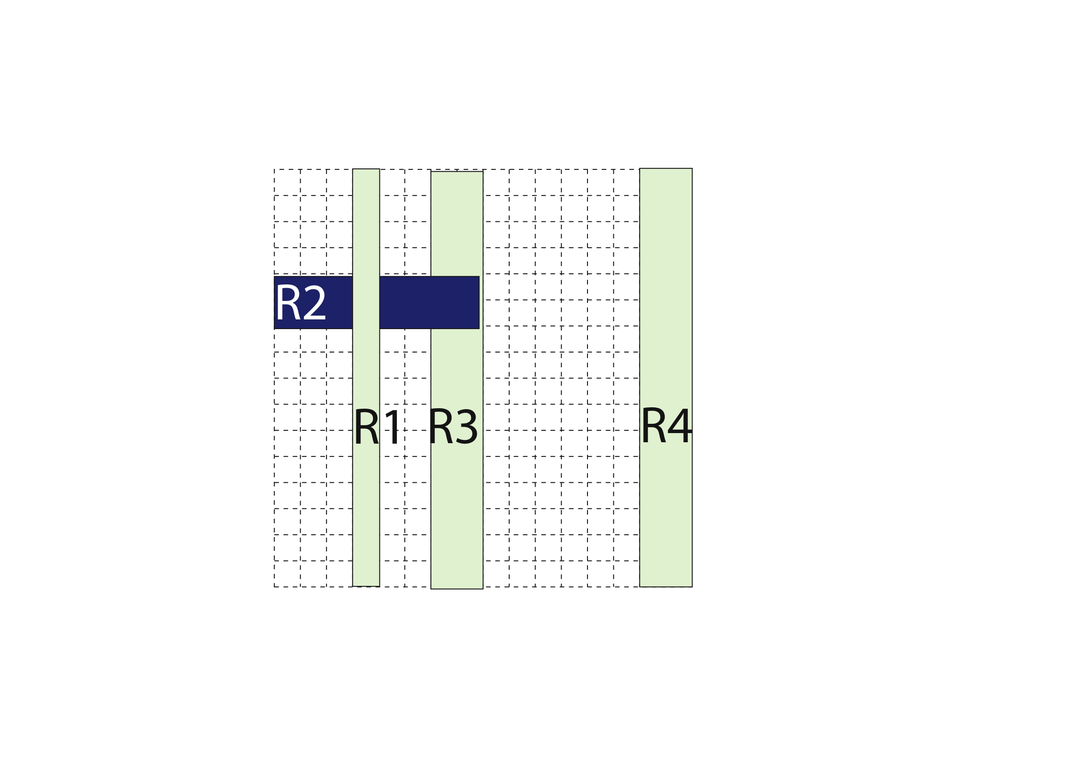
Caching Wildcard Rules
Overlapping wildcard rules
Cannot simply cache matching rules
Source: Minlan Yu

Slide 80
Caching Wildcard Rules
Multiple authority switches
Contain independent sets of rules
Avoid cache conflicts in ingress switch
Authorityswitch 1
Authorityswitch 2
Source: Minlan Yu

Slide 81
Partition Wildcard Rules
Partition rules
Minimize the TCAM entries in switches
Decision-tree based rule partition algorithm
Cut B is better than Cut A
Cut B
Cut A
Source: Minlan Yu

Slide 82
Handling Network Dynamics
Network dynamics | Cache rules | Authority Rules | Partition Rules
Policy changes at controller | Timeout | Change | Mostly no change
Topology changes at switches | No change | No change | Change
Host mobility | Timeout | No change | No change
Source: Minlan Yu

Slide 83
Summary
Controller proactively generates the rules and distributes them to authority switches
Authority switches keep packets always in the data plane and ingress switches reactively cache rules
Can the switch control plane handle all the events?
What if high level policy changes often?
What about monitoring overhead?

Slide 84
Outline
SDN scalability
Scale controller
Flat structure multiple controllers [ONIX, OSDI’10]
Recursive controller design [Xbar, ONS,13]
Hierarchical controller design [Kandoo, HotSDN’12]
Offload to switch
Offload to switch control plane [Diffane, SIGCOMM’10]
Offload of switch data plane [DevoFlow, SIGCOMM’11]

Slide 85
Dilemma
Control dilemma:
Role of controller: visibility and mgmt capability however, per-flow setup too costly
Flow-match wildcard, hash-based: much less load, but no effective control
Statistics-gathering dilemma:
Pull-based mechanism: counters of all flows full visibility but demand high BW
Wildcard counter aggregation: much less entries but lose trace of elephant flows
Aim to strike in between

Slide 86
Main Concept of DevoFlow
Devolving most flow controls to switches
Maintain partial visibility
Keep trace of significant flows
Default v.s. special actions:
Security-sensitive flows: categorically inspect
Normal flows: may evolve or cover other flows become security-sensitive or significant
Significant flows: special attention
Collect statistics by sampling, triggering, and approximating

Slide 87
Design Principles of DevoFlow
Try to stay in data-plane, by default
Provide enough visibility:
Esp. for significant flows & sec-sensitive flows
Otherwise, aggregate or approximate statistics
Maintain simplicity of switches

Slide 88
Mechanisms
Control
Rule cloning
Local actions
Statistics-gathering
Sampling
Triggers and reports
Approximate counters

Slide 89
Rule Cloning
ASIC clones a wildcard rule as an exact match rule for new microflows
Timeout or output port by probability

Slide 90
Rule Cloning
ASIC clones a wildcard rule as an exact match rule for new microflows
Timeout or output port by probability

Slide 91
Rule Cloning
ASIC clones a wildcard rule as an exact match rule for new microflows
Timeout or output port by probability

Slide 92
Local Actions
Rapid re-routing: fallback paths predefined ⇒Recover almost immediately
Multipath support: based on probability dist. Adjusted by link capacity or loads

Slide 93
Statistics-Gathering
Sampling
Pkts headers send to controller with1/1000 prob.
Triggers and reports
Set a threshold per rule
When exceeds, enable flow setup at controller
Approximate counters
Maintain list of top-k largest flows

Slide 94
DevoFlow Summary
Per-flow control imposes too many overheads
Balance between
Overheads and network visibility
Effective traffic engineering, network management
Switches with limited resources
Flow entries, control-plane BW
Hardware capability, power consumption

Slide 95
Questions?

