Slide 1
Software Defined Networking COMS 6998-10, Fall 2014
Instructor: Li Erran Li (lierranli@cs.columbia.edu)
http://www.cs.columbia.edu/~lierranli/coms6998-10SDNFall2014/
9/15/2014: SDN Basics

Slide 2
Outline
Review of previous lecture
SDN Basics
Concepts
OpenFlow
Controller: Floodlight
OF-Config
Mininet

Slide 3
Review of Previous Lecture
What is the control plane of a network?
The functions in the network that control the behavior of the network, e.g., network paths, forwarding behavior
What is the data plane of a network?
The functions in the network that are responsible for forwarding or not forwarding traffic. Typically, the data plane is instantiated as forwarding tables in routers, switches, firewalls, and middleboxes

Slide 4
Review of Previous Lecture (Cont’d)
Which network first had the separation of control plane and data plane?
The telephone network, specifically AT&T introduced then Network Control Point in 1981 to support a wide range of network applications such as 800 Service and Calling Card Service.
Why separate control?
More rapid innovation: control logic is not tied to hardware
Network wide view: easier to infer and reason about network behavior
More flexibility: can introduce services more rapidly

Slide 5
Review of Previous Lecture
What is the definition of SDN?
The separation of control plane from data plane
A specific SDN: configuration, distribution and forwarding abstraction
What is one API between control plane and data plane?
OpenFlow protocol

Slide 6
Outline
Review of previous lecture
SDN Basics
Concepts
OpenFlow
Controller: Floodlight
OF-Config
Mininet

Slide 7
SDN in a Nutshell
Source: Scott Shenker, UC Berkeley
SDN is defined precisely by these three abstractions
Distribution, forwarding, configuration
SDN not just a random good idea…
Fundamental validity and general applicability
SDN may help us finally create a discipline
Abstractions enable reasoning about system behavior
Provides environment where formalism can take hold….
OK, but what are these abstractions?
9/8/14
Software Defined Networking (COMS 6998-10)

Slide 8
1. Distributed State Abstraction
Source: Scott Shenker, UC Berkeley
Shield control mechanisms from state distribution
While allowing access to this state
Natural abstraction: global network view
Annotated network graph provided through an API
Implemented with “Network Operating System”
Control mechanism is now program using API
No longer a distributed protocol, now just a graph algorithm
E.g. Use Dijkstra rather than Bellman-Ford
9/15/14
Software Defined Networking (COMS 6998-10)

Slide 9
Software Defined Network (SDN)
Traditional Control Mechanisms
Network of Switches and/or Routers
Source: Scott Shenker, UC Berkeley
e.g. routing, access control
Control Program
Global Network View
Distributed algorithm running between neighbors
Network OS
9/15/14
Notes:
Project 2 would have been trivial: Dijkstra on a graph.

Slide 10
Major Change in Paradigm
Source: Scott Shenker, UC Berkeley
No longer designing distributed control protocols
Design one distributed system (NOS)
Use for all control functions
Now just defining a centralized control function
Configuration = Function(view)
9/15/14
Software Defined Networking (COMS 6998-10)
Notes:
Stop. Does everyone get this. Unless I see everyone’s hands up, I am not going further.

Slide 11
2. Specification Abstraction
Source: Scott Shenker, UC Berkeley
Control program should express desired behavior
It should not be responsible for implementing that behavior on physical network infrastructure
Natural abstraction: simplified model of network
Simple model with only enough detail to specify goals
Requires a new shared control layer:
Map abstract configuration to physical configuration
This is “network virtualization”
9/8/14
Software Defined Networking (COMS 6998-10)
Notes:
Just like VMs. Virtualizing network with abstractions, rather than physical topology.

Slide 12
Simple Example: Access Control
Source: Scott Shenker, UC Berkeley
What
Abstract Network
Model
Global
Network View
How
9/15/14
Notes:
What is access control?

Slide 13
Software Defined Networks
Source: Scott Shenker, UC Berkeley
Abstract Network Model
Network Virtualization
Control Program
Global Network View
Network OS
9/15/14

Slide 14
What Does This Picture Mean?
Source: Scott Shenker, UC Berkeley
Write a simple program to configure a simple model
Configuration merely a way to specify what you want
Examples
ACLs: who can talk to who
Isolation: who can hear my broadcasts
Routing: only specify routing to the degree you care
Some flows over satellite, others over landline
TE: specify in terms of quality of service, not routes
Virtualization layer “compiles” these requirements
Produces suitable configuration of actual network devices
NOS then transmits these settings to physical boxes
9/15/14
Software Defined Networking (COMS 6998-10)

Slide 15
Software Defined Networks
Source: Scott Shenker, UC Berkeley
Specifies behavior
Control Program
Abstract Network Model
Compiles to topology
Network Virtualization
Global Network View
Transmits to switches
Network OS
9/15/14

Slide 16
Outline
Review of previous lecture
SDN Basics
Concepts
OpenFlow
Switches and Controllers
OF-Config
Mininet

Slide 17
OpenFlow
Why OpenFlow?
How does OpenFlow work?

Slide 18
Why OpenFlow?

Slide 19
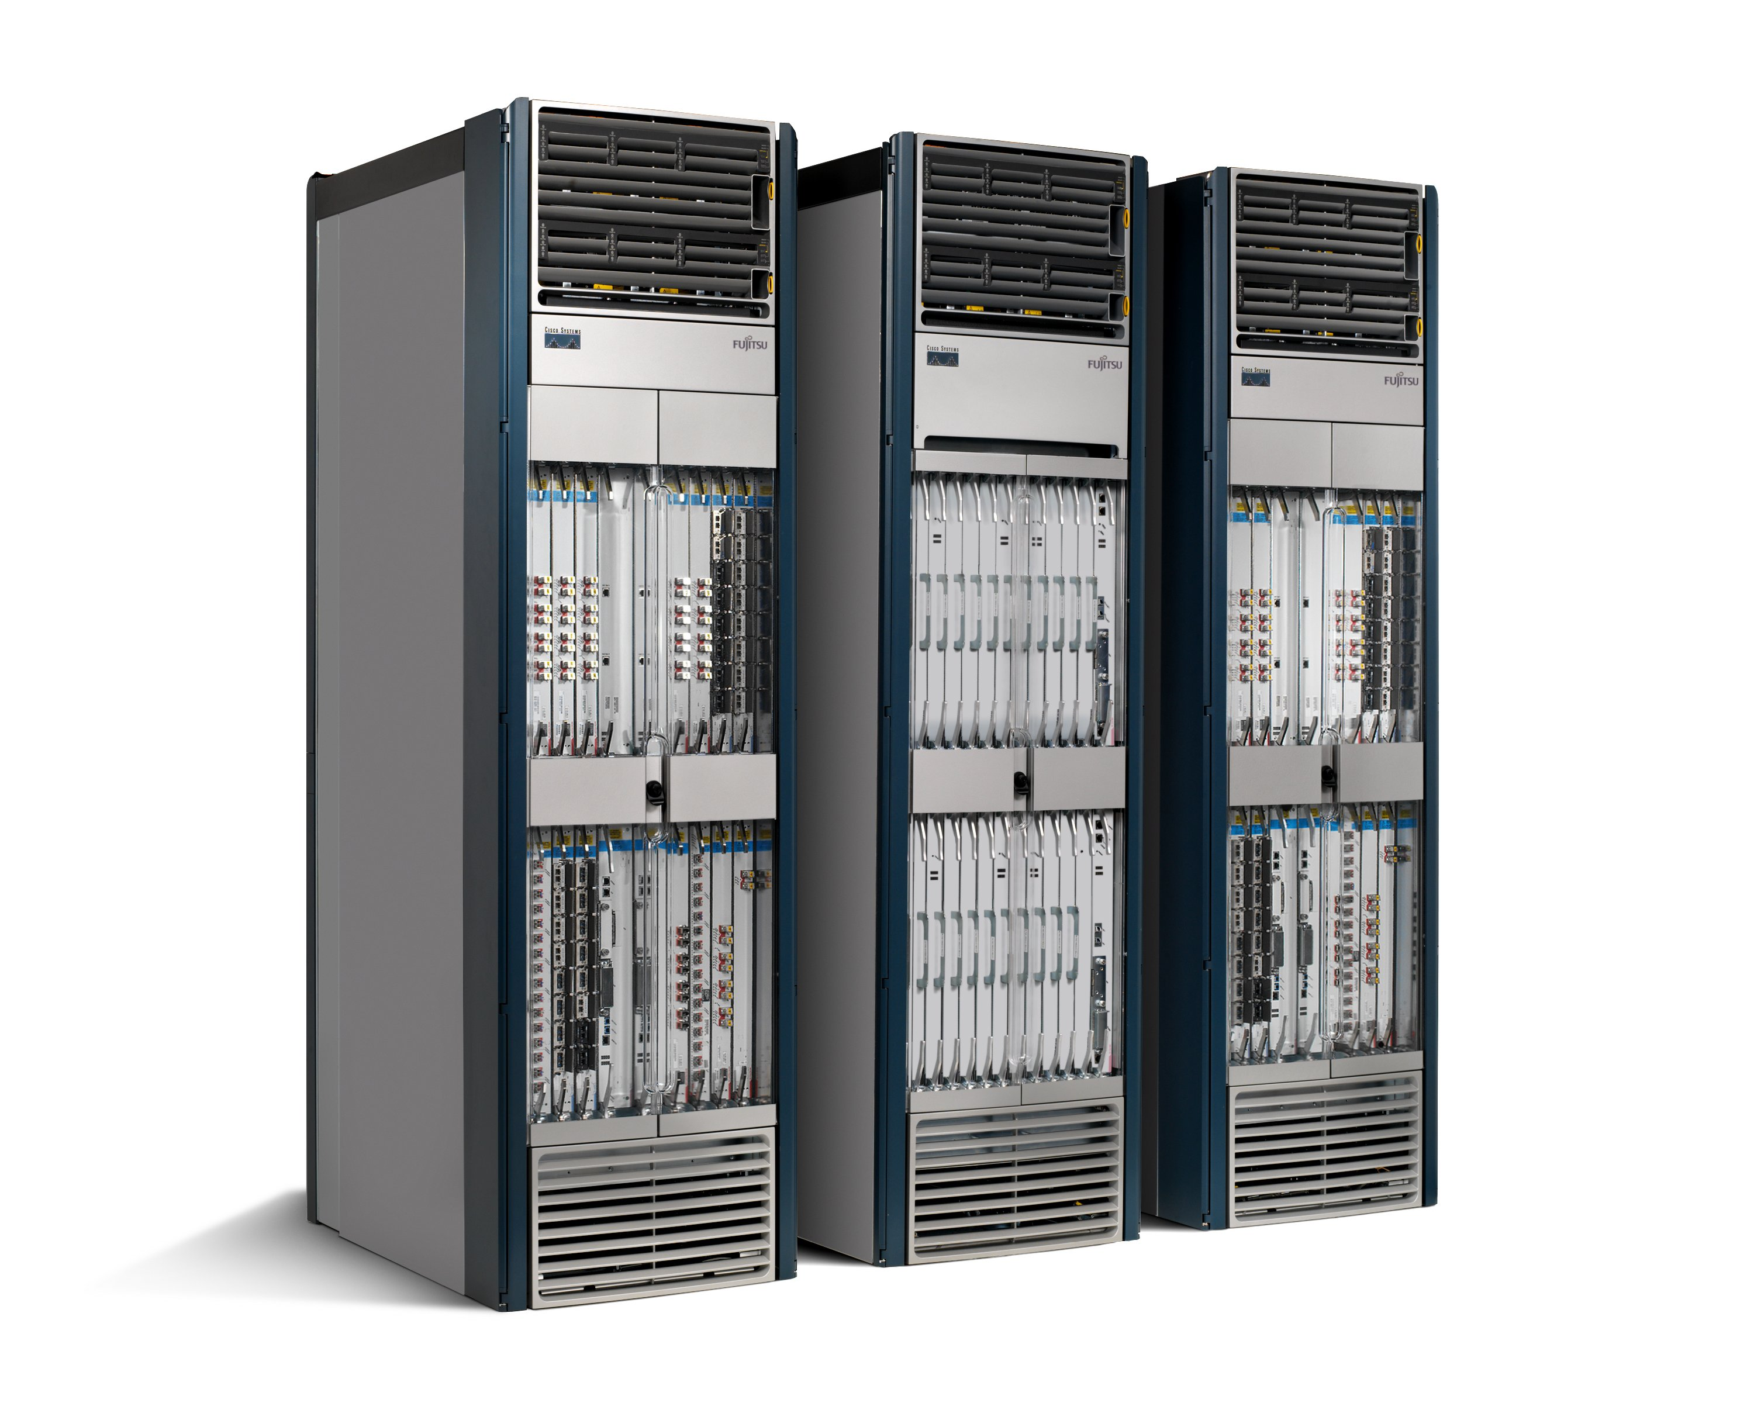
The Ossified Network
Routing, management, mobility management, access control, VPNs, …
Feature
Feature
Million of lines of source code
5400 RFCs
Barrier to entry
Operating
System
Specialized Packet Forwarding Hardware
Billions of gates
Bloated
Power Hungry
Many complex functions baked into the infrastructure
OSPF, BGP, multicast, differentiated services, Traffic Engineering, NAT, firewalls, MPLS, redundant layers, …
An industry with a “mainframe-mentality”, reluctant to change
19
Notes:
19

Slide 20
Research Stagnation
Lots of deployed innovation in other areas
OS: filesystems, schedulers, virtualization
DS: DHTs, CDNs, MapReduce
Compilers: JITs, vectorization
Networks are largely the same as years ago
Ethernet, IP, WiFi
Rate of change of the network seems slower in comparison
Need better tools and abstractions to demonstrate and deploy
Notes:
In these other areas, you can real systems on top of high-quality, open platforms, and you don’t need to reinvent the wheel

Slide 21
Closed Systems (Vendor Hardware)
Stuck with interfaces (CLI, SNMP, etc)
Hard to meaningfully collaborate
Need a fully open system – a Linux equivalent

Slide 22
OpenFlow: a pragmatic compromise
+ Speed, scale, fidelity of vendor hardware
+ Flexibility and control of software and simulation
Vendors don’t need to expose implementation
Leverages hardware inside most switches today (ACL tables)

Slide 23
How does OpenFlow work?
23

Slide 24
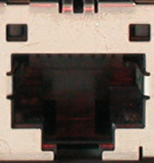
Ethernet Switch

Slide 25
Ethernet Switch
Control Path
Control Path (Software)
Data Path (Hardware)

Slide 26
OpenFlow Controller
OpenFlow Protocol (SSL/TCP)
Control Path
OpenFlow
Data Path (Hardware)

Slide 27
OpenFlow Example
Controller
OpenFlow Client
PC
Software
Layer
Flow Table
MAC
src
MAC
dst
IP
Src
IP
Dst
TCP
sport
TCP
dport
Action
Hardware
Layer
*
*
*
5.6.7.8
*
*
port 1
port 1
port 2
port 3
port 4
5.6.7.8
1.2.3.4

Slide 28
OpenFlow Basics Flow Table Entries
Rule
Action
Stats
Packet + byte counters
Forward packet to zero or more ports
Encapsulate and forward to controller
Send to normal processing pipeline
Modify Fields
Any extensions you add!
Switch
Port
VLAN
ID
VLAN
pcp
MAC
src
MAC
dst
Eth
type
IP
Src
IP
Dst
IP
ToS
IP
Prot
L4
sport
L4
dport
+ mask what fields to match
Notes:
Now I’ll describe the API that tries to meet these goals.

Slide 29
Examples
Switching
Switch
Port
MAC
src
MAC
dst
Eth
type
VLAN
ID
IP
Src
IP
Dst
IP
Prot
TCP
sport
TCP
dport
Action
*
*
00:1f:..
*
*
*
*
*
*
*
port6
Flow Switching
Switch
Port
MAC
src
MAC
dst
Eth
type
VLAN
ID
IP
Src
IP
Dst
IP
Prot
TCP
sport
TCP
dport
Action
port3
00:20..
00:1f..
0800
vlan1
1.2.3.4
5.6.7.8
4
17264
80
port6
Firewall
Switch
Port
MAC
src
MAC
dst
Eth
type
VLAN
ID
IP
Src
IP
Dst
IP
Prot
TCP
sport
TCP
dport
Action
*
*
*
*
*
*
*
*
*
22
drop

Slide 30
Examples
Routing
Switch
Port
MAC
src
MAC
dst
Eth
type
VLAN
ID
IP
Src
IP
Dst
IP
Prot
TCP
sport
TCP
dport
Action
*
*
*
*
*
*
5.6.7.8
*
*
*
port6
VLAN Switching
Switch
Port
MAC
src
MAC
dst
Eth
type
VLAN
ID
IP
Src
IP
Dst
IP
Prot
TCP
sport
TCP
dport
Action
port6,
port7,
port9
*
*
00:1f..
*
vlan1
*
*
*
*
*

Slide 31
Centralized vs Distributed Control Both models are possible with OpenFlow
Centralized Control
Distributed Control
Controller
Controller
OpenFlow
Switch
OpenFlow
Switch
Controller
OpenFlow
Switch
OpenFlow
Switch
Controller
OpenFlow
Switch
OpenFlow
Switch

Slide 32
Flow Routing vs. Aggregation Both models are possible with OpenFlow
Flow-Based
Every flow is individually set up by controller
Exact-match flow entries
Flow table contains one entry per flow
Good for fine grain control, e.g. campus networks
Aggregated
One flow entry covers large groups of flows
Wildcard flow entries
Flow table contains one entry per category of flows
Good for large number of flows, e.g. backbone

Slide 33
Reactive vs. Proactive (pre-populated) Both models are possible with OpenFlow
Reactive
First packet of flow triggers controller to insert flow entries
Efficient use of flow table
Every flow incurs small additional flow setup time
If control connection lost, switch has limited utility
Proactive
Controller pre-populates flow table in switch
Zero additional flow setup time
Loss of control connection does not disrupt traffic
Essentially requires aggregated (wildcard) rules

Slide 34
What can you not do with OpenFlow ver1.0
Non-flow-based (per-packet) networking
ex. Per-packet next-hop selection (in wireless mesh)
yes, this is a fundamental limitation
BUT OpenFlow can provide the plumbing to connect these systems
Use all tables on switch chips
yes, a major limitation (cross-product issue)
BUT OpenFlow 1.3 version will expose these

Slide 35
What can you not do with OpenFlow ver1.0
New forwarding primitives
BUT provides a nice way to integrate them through extensions
New packet formats/field definitions
BUT a generalized OpenFlow (2.0) is on the horizon
Optical Circuits
BUT efforts underway to apply OpenFlow model to circuits
Low-setup-time of individual flows
BUT can push down flows proactively to avoid delays

Slide 36
Where it’s going
OF v1.3
multiple tables: leverage additional tables
tags and tunnels
multipath forwarding
per flow meters
OF v2+
generalized matching and actions: protocol independent forwarding

Slide 37
Outline
Review of previous lecture
SDN Basics
Concepts
OpenFlow
Switches and Controllers
OF-Config
Mininet

Slide 38
Switches and Controllers
OpenFlow switches and vendors
Controllers
Floodlight

Slide 39
OpenFlow building blocks
oflops
ndb
Monitoring/ debugging tools
Firewall
Traffic Engineering
Load Balancing
Mobility
Applications
Frenetic
Floodlight
OpenDayLight
ONOS
Ryu
POX
Controller
Slicing
Software
FlowVisor
Console
FlowVisor
Commercial Switches
Software switches and experimental platforms
HP, NEC, Pronto, Juniper.. and many more
NetFPGA
Broadcom
Ref. Switch
OpenFlow
Switches
OpenWRT
OpenVSwitch
39
Notes:
There are components at different levels that work together in making it work
The commercial switch details will follow in next slide
There are a plethora of applications possible. I only list those available at Stanford

Slide 40
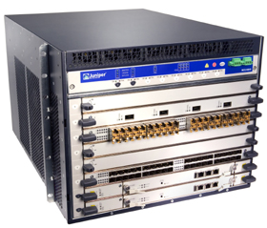
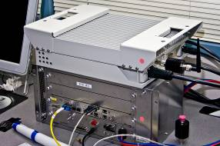
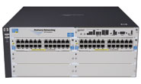
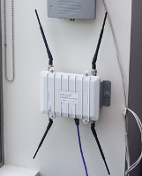
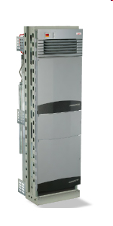
Current SDN hardware
Juniper MX-series
NEC IP8800
WiMax (NEC)
HP Procurve 5400
Netgear 7324
PC Engines
Pronto 3240/3290
Ciena Coredirector
More coming soon...
40

Slide 41
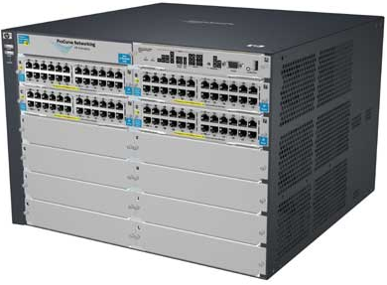
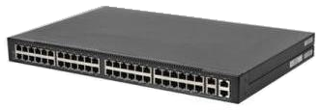
Commercial Switch Vendors
Model | Virtualize | Notes
HP Procurve 5400zl or 6600 | 1 OF instance per VLAN | LACP, VLAN and STP processing before OpenFlow Wildcard rules or non-IP pkts processed in s/w Header rewriting in s/w CPU protects mgmt during loop
NEC IP8800 | 1 OF instance per VLAN | OpenFlow takes precedence Most actions processed in hardware MAC header rewriting in h/w
Pronto 3240 or 3290 with Pica8 or Indigo firmware | 1 OF instance per switch | No legacy protocols (like VLAN and STP) Most actions processed in hardware MAC header rewriting in h/w
41
Notes:
All support ver 1.0
All have approx 1500 flow table entry limit

Slide 42
Controller Vendors
Vendor | Notes
Nicira’s NOX | Open-source GPL C++ and Python Researcher friendly
Nicira’s ONIX | Closed-source Datacenter networks
Ryu | Open-source GPL Python
Vendor | Notes
Stanford’s Beacon | Open-source Researcher friendly Java-based
BigSwitch controller | Ha open source version Based on Beacon Enterprise network
OpenDayLight | Open-source Based on Java
Frenetic | Open-source Written in functional programming languages
42

Slide 43
Floodlight Architecture
Source: Big Switch Networks
Overview
FloodlightProvider
(IFloodlightProviderService)
Floodlight is a collection of modules
Some modules (not all) export services
All modules in Java
Rich, extensible REST API
TopologyManager
(ITopologyManagerService)
LinkDiscovery
(ILinkDiscoveryService)
Forwarding
DeviceManager
(IDeviceService)
StorageSource
(IStorageSourceService)
RestServer
(IRestApiService)
StaticFlowPusher
(IStaticFlowPusherService)
VirtualNetworkFilter
(IVirtualNetworkFilterService)
Notes:
Our topology, device manager know about host attachment points and make it possible to deal with integrating openflow and non openflow networks.

Slide 44
Floodlight Architecture
Source: Big Switch Networks
Module descriptions
FloodlightProvider
(IFloodlightProviderService)
Translates OF messages to Floodlight events
Managing connections to switches via Netty
TopologyManager
(ITopologyManagerService)
Computes shortest path using Dijsktra
Keeps switch to cluster mappings
LinkDiscovery
(ILinkDiscoveryService)
Maintains state of links in network
Sends out LLDPs
Forwarding
Installs flow mods for end-to-end routing
Handles island routing
DeviceManager
(IDeviceService)
Tracks hosts on the network
MAC -> switch,port, MAC->IP, IP->MAC
StorageSource
(IStorageSourceService)
DB style storage (queries, etc)
Modules can access all data and subscribe to changes
RestServer
(IRestApiService)
Implements via Restlets (restlet.org)
Modules export RestletRoutable
StaticFlowPusher
(IStaticFlowPusherService)
Supports the insertion and removal of static flows
REST-based API
VirtualNetworkFilter
(IVirtualNetworkFilterService)
Create layer 2 domain defined by MAC address
Used for OpenStack / Quantum
44
Notes:
Our topology, device manager know about host attachment points and make it possible to deal with integrating openflow and non openflow networks.

Slide 45
Floodlight Programming Model
Northbound APIs
IFloodlightModule
Java module that runs as part of Floodlight
Consumes services and events exported by other modules
OpenFlow (ie. Packet-in)
Switch add / remove
Device add /remove / move
Link discovery
External Application
IFloodlight-Module
REST
Floodlight Controller
External Application
Communicates with Floodlight via REST
Quantum / Virtual networks
Normalized network state
Static flows
Switch
Switch
vSwitch
Switch

Slide 46
REST API Reference
Source: Big Switch Networks
A moving target…but…
Network State
List Hosts
List Links
List Switches
GetStats (DPID)
GetCounters (OFType…)
Static Flows
Add Flow
Delete Flow
List Flows
RemoveAll Flows
Virtual Network
Create Network
Delete Network
Add Host
Remove Host
User Extensions
…
Floodlight Controller
Switch
Switch
Switch
vSwitch

Slide 47
Floodlight Installation and Tutorial
Download
http://www.projectfloodlight.org/getting-started/
Tutorial:
http://docs.projectfloodlight.org/display/floodlightcontroller/Tutorials

Slide 48
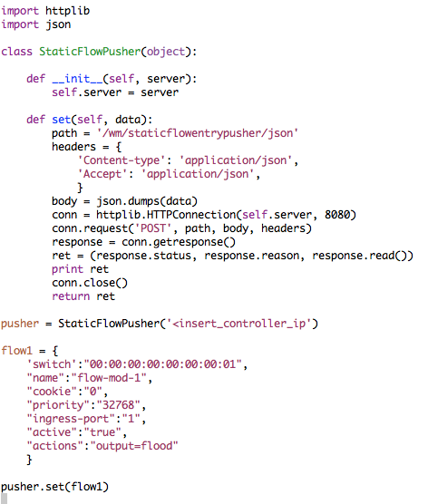
Programming Floodlight
Using the REST API
Fine-grained ability to push flows over REST
Access to normalized topology and device state
Extensible access to add new APIs

Slide 49
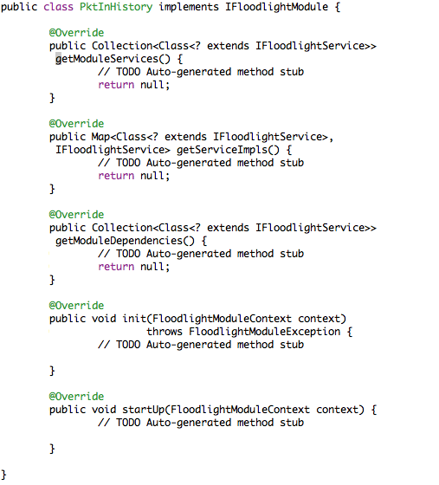
Programming Floodlight
Source: Big Switch Networks
Creating a module
Handle OpenFlow messages directly (ie. PacketIn)
Expose services to other modules
Add new REST APIs

Slide 50
Outline
Review of previous lecture
SDN Basics
Concepts
OpenFlow
Switches and Controllers
OF-Config
Mininet

Slide 51
OpenFlow configuration and Management Protocol
Bootstrap OpenFlow network
Switch connects to controller
Controller(s) to connect to must be configured at switches
Allocate resources within switches
Ports
Queues
. . .
controller
controller
switch
switch
switch
switch

Slide 52
OpenFlow configuration and Management Protocol: Reference Model
Configuration Point
Source of switch configuration
OpenFlow Capable Switch
Hosts one or more logical switches
OpenFlow Controller
OpenFlow Logical Switch
instance of an OpenFlow Switch
Configuration Point
Configuration Point
Configuration Point
Configuration Point
OpenFlow
Controller
OpenFlow
Controller
OF-CONFIG
using IETF Netconf & XML data models
OpenFlow
OpenFlow
OpenFlow
Capable Switch
resources (ports, queues)
OF Logical Switch
OF Logical Switch

Slide 53
OF-CONFIG Scope and Releases
WG established
in Sep 2011
OF-CONFIG 1.0 (Jan 2012) based on OpenFlow 1.2
assigning controllers to logical switches
retrieving assignment of resources to logical switches
configuring some properties of ports and queues
OF-CONFIG 1.1 (Apr 2012) based on OpenFlow 1.3
added controller certificates and resource type "table"
retrieving logical switch capabilities signaled to controller
configuring of tunnel endpoints
OF-CONFIG 1.1.1 (Aug 2012) based on OpenFlow 1.3.1
consolidation of version 1.1, fixing small inconsistencies
OF-CONFIG 1.2 (early 2013) based on OpenFlow 1.3.1
features still under discussion, candidates include
retrieving capable switch capabilities, configuring logical switch capab.
assigning resources to logical switches
simple topology detection
event notification

Slide 54
Use of Netconf and Yang
Netconf was chosen as management protocol
not necessarily accepted as ideal solution
still discussing alternatives
XML schema was chosen as modeling language
Yang is also used, but XML is normative
normative XML schema generated from Yang code
So far, the focus has been on configuration
bootstrap of an OpenFlow network is the obvious first thing to do

Slide 55
Outline
Review of previous lecture
SDN Basics
Concepts
OpenFlow
Switches and Controllers
OF-Config
Mininet

Slide 56
Mininet
Machine-local virtual network
great dev/testing tool
Uses linux virtual network features
Cheaper than VMs
Arbitrary topologies, nodes

Slide 57
Mininet (Cont’d)
Rapidly prototype, develop and test
Interestingly-sized networks (16-100 nodes) start up in seconds
No lengthy lab reconfiguration or rebooting required
Always-accessible network resources, in any topology, at essentially no cost
Designs that work on Mininet transfer seamlessly to hardware for full speed operation

Slide 58
Mininet (Cont’d)
Repeatably test, analyze, and predict network behavior
Easy replication of experimental and test results
Examine effects of code or network changes before testing/deploying on hardware
Allows automated system-level tests and experiments
Recreate real-world network and test cases for a variety of topologies and configurations

Slide 59
Mininet (Cont’d)
Quickly get up and running
Free and permissively licensed (BSD)
Minimal hardware requirements
Accessible to novices thanks to simple CLI
Smooth learning curve thanks to walkthrough, tutorial, examples and API documentation
Strong users and support community

Slide 60
Mininet (Cont’d)
Download: http://mininet.org/download/
Tutorial: http://mininet.org/walkthrough/
Python API: https://github.com/mininet/mininet/wiki/Introduction-to-Mininet
Remote (host computer) access of mininet VM
ssh –Y mininet@[minnet VM IP]
Use ifconfig –a to find mininet VM IP

Slide 61
Mininet (Cont’d)
Basic commands:
Display an xterm for switch s1
mininet> xterm s1
Inspect flow tables at switch xterm
dpctl dump-flows tcp:127.0.0.1:6634
To view OpenFlow protocol messages, at mininet-VM xterm:
sudo wireshark &
Capture the interface to controller
In wireshark filter box, enter filter to filter OpenFlow messages: of

Slide 62
Mininet (Cont’d)
Basic commands:
Create a network consists of one OpenvSwitch, three hosts and is controlled by a remote controller with IP address 192.168.56.1
sudo mn --topo single,3 --controller remote,ip=192.168.56.1 --switch ovsk
mininet> help
mininet> dump nodes
mininet> h1 ping h2

Slide 63
Questions?

