Slide 1
Software Defined Networking
COMS 6998-10, Fall 2014
Instructor: Li Erran Li (lierranli@cs.columbia.edu)
http://www.cs.columbia.edu/~lierranli/coms6998-10SDNFall2014/
12/8/2014 SDN Storage

Slide 2
Outline
Reminder: Course Evaluation Due today!
SDN Storage

Slide 3
Background: Enterprise data centers
General purpose applications
Application runs on several VMs
Separate network for VM-to-VM
traffic and VM-to-Storage traffic
Storage is virtualized
Resources are shared
VM
VM
VM
VM
VM
VM
Virtual
Machine
Virtual
Machine
Hypervisor
vDisk
vDisk
S-NIC
NIC
S-NIC
NIC
Switch
Switch
Switch
S-NIC
S-NIC
Storage server
Storage server
Source: Thereska, et al, MSR
12/8/14
Software Defined Networking (COMS 6998-8)
2
Notes:
-Such DCs comprise compute and storage servers. We can think of each app as a tenant -The storage servers act as front ends for back end storage. Storage is virtualized and VMs are presented with virtual hard disks that are simply large files on storage servers.

Slide 4
Motivation
Want: predictable application behaviour and performance
Need system to provide end-to-end SLAs, e.g.,
Guaranteed storage bandwidth B
Guaranteed high IOPS and priority
Per-application control over decisions along IOs’ path
It is hard to provide such SLAs today
12/8/14
Source: Thereska, et al, MSR
Notes:
-Tenant want predictable behaviour and performance in these shared resource environments, as if they had their own dedicated resources. They want performance guarantees and control over the services processing their data along the IO stack.
- The problem is that data centers today cannot provide those guarantees and control. Let’s understand why through an example.

Slide 5
Example: guarantee aggregate bandwidth B for Red tenant
App
App
OS
OS
VM
VM
Virtual
Machine
Virtual
Machine
Malware scan
Compression
Hypervisor
vDisk
…
…
vDisk
File system
File system
Storage server
S-NIC
NIC
S-NIC
NIC
Caching
Caching
Scheduling
Scheduling
File system
Switch
Switch
Switch
Hypervisor
Deduplication
IO Manager
S-NIC
S-NIC
…
Storage server
Storage server
Drivers
Caching
Deep IO path with 18+ different layers that are configured and operate independently and do not understand SLAs
Scheduling
Drivers
Notes:
No understanding of application performance requirements. Applications today do not have any way of expressing their SLAs, e.g., you do not open a file specifying how fast you want to read from it. It’s all best effort.
Sharing resources today means living with interference from neighbouring tenants, e.g., blue application can be aggressive and consume most of the storage bandwidth. This interference causes unpredictable performance.
Now, you might be thinking: there are other resources, e.g., network resources are also part of the end-to-end SLA, and we have ways to handle this complexity like software-defined networking. Why is storage different?

Slide 6
Challenges in enforcing end-to-end SLAs
No storage control plane
No enforcing mechanism along storage data plane
Aggregate performance SLAs
  - Across VMs, files and storage operations
Want non-performance SLAs: control over IOs’ path
Want to support unmodified applications and VMs
12/8/14
Source: Thereska, et al, MSR
Notes:
-No storage control plane that can coordinate the layers configuration to enforce an SLA
-Each layer has own configuration and makes own decisions.
- We have set a high bar for the SLAS: Want detailed SLAs. Aggregate is challenging because it adds a further distributed dimension to the config problem: configuration of layers across machines

Slide 7
IOFlow architecture
Decouples the data plane (enforcement) from the
control plane (policy logic)
App
App
High-level SLA
Storage server
OS
OS
File system
Malware scan
Compression
File system
File system
Controller
Deduplication
Scheduling
Scheduling
Hypervisor
…
Caching
IO Manager
Scheduling
Drivers
Drivers
Client-side IO stack
IOFlow API
Server-side IO stack
12/8/14
Source: Thereska, et al, MSR
Notes:
Controller is logically centralized and has global visibility

Slide 8
Contributions
Defined and built storage control plane
Controllable queues in data plane
Interface between control and data plane (IOFlow API)
Built centralized control applications that demonstrate power of architecture
12/8/14
Source: Thereska, et al, MSR

Slide 9
Storage flows
Storage “Flow” refers to all IO requests to which an SLA applies
  <{VMs}, {File Operations}, {Files}, {Shares}> ---> SLA
Aggregate, per-operation and per-file SLAs, e.g.,
<{VM 1-100}, write, *, \\share\db-log}>---> high priority
<{VM 1-100}, *, *, \\share\db-data}> ---> min 100,000 IOPS
Non-performance SLAs, e.g., path routing
<VM 1, *, *, \\share\dataset>---> bypass malware scanner
source set
destination sets
12/8/14
Source: Thereska, et al, MSR
Notes:
- IOFlow supports a flow abstraction described using four parameters
- Min: system can do more if underutilized
-We make the observation that this high level flow description maps in a straightforward way to low level queues and their functions that we’ve built as we’ll see next.

Slide 10
IOFlow API: programming data plane queues
  1. Classification [IO Header -> Queue]
  2. Queue servicing [Queue -> <token rate, priority, queue size>]
  3. Routing [Queue -> Next-hop]
IO
Header
Malware
scanner
…
…
…
12/8/14
Source: Thereska, et al, MSR
Notes:
3 key functions that IOFlow provides. -If a queue reaches the queue size threshold, the queue notifies the controller and blocks any further inserts to that queue. There is no support in the IO stack for dropping IO requests like in networking, but there is support for blocking requests and applying
- There are two storage-specific technical challenges: there is no end-to-end classification of storage traffic in the storage stack. Also, rate limiting storage requests is challenging.

Slide 11
Lack of common IO Header for storage traffic
SLA: <VM 4, *, *, \\share\dataset> --> Bandwidth B
Block device
Z: (/device/scsi1)
Stage configuration: “All IOs from VM4_sid to //serverX/AB79.vhd should be rate limited to B”
Volume and file
H:\AB79.vhd
Server and VHD
\\serverX\AB79.vhd
Block device
/device/ssd5
12/8/14
Source: Thereska, et al, MSR
Notes:
-For concreteness, we move to a concrete storage stack inside Windows.
- Mismatch: SLAs specified using high-level names, but layers observe different low-level identifiers/IO Headers
-VM name is also lost. By the time a request arrives at the storage server its source VM is lost.
-This is not just a problem in Windows. Other OSes have similar stacks.
- Root cause: layers with diverse functionalities. Virtualization made problem worse. Networks do not have this problem <ip, port, protocol>

Slide 12
Flow name resolution through controller
SLA: {VM 4, *, *, //share/dataset} --> Bandwidth B
Controller
SMBc exposes IO Header it understands:
<VM_SID, //server/file.vhd>
Queuing rule (per-file handle):
<VM4_SID, //serverX/AB79.vhd> --> Q1
Q1.token rate --> B
12/8/14
Source: Thereska, et al, MSR
Notes:
-Layers expose IO headers to controller. Controller maps the SLA to layer-specific IO headers
-SMB is file server protocol inside hypervisor. It understands VM Security descriptors, remote servers and file names. – When do you install this rule? When the file is opened. Queuing rule is maintained as part of the file handle and any subsequent IOs on that handle obey the rule. The controller is not on the IO data path
-Main takeaway is that controller is exposed to previously-private metadata that each layer had.
Controller is not on critical path

Slide 13
Rate limiting for congestion control
  Queue servicing [Queue -> <token rate, priority, queue size>]
Important for performance SLAs
Today: no storage congestion control
Challenging for storage: e.g., how to rate limit two VMs, one reading, one writing to get equal storage bandwidth?
tokens
IOs
12/8/14
Source: Thereska, et al, MSR
Notes:
- If an aggressive tenant sends too many IO requests to the storage node it might prevent it from meeting another tenant’s SLA
-Token buckets are a standard algorithm for rate limiting network packets. The token bucket algorithm outputs incoming packets as long as enough tokens are available. By providing a queue with more or less tokens, one can control the rate at which its requests drain.

Slide 14
Rate limiting on payload bytes does not work
VM
VM
8KB Reads
8KB Writes
Storage server
12/8/14
Source: Thereska, et al, MSR
Notes:
- Note that requests cannot be dropped on the storage stack, unlike in networks. So a key congestion signal is unavailable for storage. Once they enter the storage server, the server is committed to completing them.

Slide 15
Rate limiting on bytes does not work
VM
VM
8KB Reads
8KB Writes
Storage server
12/8/14
Source: Thereska, et al, MSR
Notes:
- Step in the right direction since the hypervisor knows the read io size from the IO header
- For SSDs, writes could be more expensive than reads, by an order of magnitude
- So let’s rate limit on number of requests or IOPS

Slide 16
Rate limiting on IOPS does not work
VM
VM
64KB Reads
8KB Writes
Storage server
Need to rate limit based on cost
12/8/14
Source: Thereska, et al, MSR
Notes:
Read limiting based on IOPS cannot handle bandwidth changes. Reads would get more bandwidth. Furthermore, storage requests can have arbitrary long sizes (e.g., 1GB)
Clear that need to rate limit based on cost.

Slide 17
Rate limiting based on cost
Controller constructs empirical cost models based on device type and workload characteristics
    RAM, SSDs, disks: read/write ratio, request size
Cost models assigned to each queue
    ConfigureTokenBucket [Queue -> cost model]
Large request sizes split for pre-emption
12/8/14
Source: Thereska, et al, MSR
Notes:
Controller knows when new devices are added and through the discovery component it constructs models for them.
Cost models: E.g., consume 2 tokens for 64KB requests and 1 token for 4K requests.

Slide 18
Recap: Programmable queues on data plane
  Classification [IO Header -> Queue]
    Per-layer metadata exposed to controller
    Controller out of critical path
  Queue servicing [Queue -> <token rate, priority, queue size>]
    Congestion control based on operation cost
  Routing [Queue -> Next-hop]
How does controller enforce SLA?
12/8/14
Source: Thereska, et al, MSR
Notes:
Changes on data plane: Not all layers are expected to implement all 3 calls, they can implement 0 or a subset

Slide 19
Distributed, dynamic enforcement
<{Red VMs 1-4}, *, * //share/dataset> --> Bandwidth 40 Gbps
VM
VM
SLA needs per-VM enforcement
Need to control the aggregate rate of VMs 1-4 that reside on different physical machines
Static partitioning of bandwidth is sub-optimal
VM
VM
VM
VM
VM
VM
Hypervisor
Hypervisor
40Gbps
Storage server
12/8/14
Source: Thereska, et al, MSR
Notes:
In practice they read from multiple servers, but for simplicity here we focus on VM aggregation

Slide 20
Work-conserving solution
VMs with traffic demand should be able to send it as long as the aggregate rate does not exceed 40 Gbps
Solution: Max-min fair sharing
VM
VM
VM
VM
VM
VM
VM
VM
Hypervisor
Hypervisor
Storage server
12/8/14
Source: Thereska, et al, MSR

Slide 21
Max-min fair sharing
Well studied problem in networks
  Existing solutions are distributed
    Each VM varies its rate based on congestion
    Converge to max-min sharing
  Drawbacks: complex and requires congestion signal
But we have a centralized controller
  Converts to simple algorithm at controller
12/8/14
Source: Thereska, et al, MSR

Slide 22
Controller-based max-min fair sharing
t = control interval
s = stats sampling interval
What does controller do?
Infers VM demands
Uses centralized max-min within a tenant and across tenants
Sets VM token rates
Chooses best place to enforce
INPUT:
per-VM demands
Controller
s
t
OUTPUT:
per-VM allocated token rate
12/8/14
Source: Thereska, et al, MSR

Slide 23
Controller decides where to enforce
Minimize # times IO is queued and distribute rate limiting load
VM
VM
SLA constraints
  Queues where resources shared
  Bandwidth enforced close to source
  Priority enforced end-to-end
Efficiency considerations
  Overhead in data plane ~ # queues
  Important at 40+ Gbps
VM
VM
VM
VM
VM
VM
Hypervisor
Hypervisor
Storage server
12/8/14
Source: Thereska, et al, MSR
Notes:
-Based on SLA constraints and efficiency considerations. Can be thought of as an optimization problem. -The enforcement bottleneck tends to be queue locks. In this case this means enforcing at the hypervisors, but there are cases for high IOPS rates (>400000) when both hypervisors and storage servers do enforcement.
- Controller sets up queues and their service rates

Slide 24
Centralized vs. decentralized control
Centralized controller in SDS allows for simple algorithms that focus on SLA enforcement and not on distributed system challenges
Analogous to benefits of centralized control in software-defined networking (SDN)
12/8/14
Source: Thereska, et al, MSR

Slide 25
IOFlow implementation
2 key layers for
VM-to-Storage
performance SLAs
Controller
4 other layers
. Scanner driver (routing)
. User-level (routing)
. Network driver
. Guest OS file system
Implemented as filter drivers on top of layers
12/8/14
Source: Thereska, et al, MSR
Notes:
- Adding the IOFlow API to all layers I mentioned in the design is ongoing work. So far we have added it to:
- 2 key layers. File server protocol in hypervisor and entrance to the storage server.
- Key strength: no need to change apps
We have also added it to several other layers. For routing we have scanner and the ability to route to a user-space layer.
Controller is a separate service

Slide 26
Evaluation map
IOFlow’s ability to enforce end-to-end SLAs
Aggregate bandwidth SLAs
Priority SLAs and routing application in paper
Performance of data and control planes
12/8/14
Source: Thereska, et al, MSR

Slide 27
Evaluation setup
Clients:10 hypervisor servers, 12 VMs each
4 tenants (Red, Green, Yellow, Blue)
30 VMs/tenant, 3 VMs/tenant/server
VM
VM
VM
VM
VM
VM
VM
VM
Hypervisor
Hypervisor
…
Storage network:
Mellanox 40Gbps RDMA RoCE full-duplex
Switch
1 storage server:
16 CPUs, 2.4GHz (Dell R720)
SMB 3.0 file server protocol
3 types of backend: RAM, SSDs, Disks
Storage server
Controller: 1 separate server
1 sec control interval (configurable)
12/8/14
Source: Thereska, et al, MSR
Notes:
RoCE: RDMA over Converged Ethernet.
In this evaluation we show RAM for two reasons: it shows IOFlow can enforce high-perf SLAs and it shows worst-case data plane overheads in doing so.

Slide 28
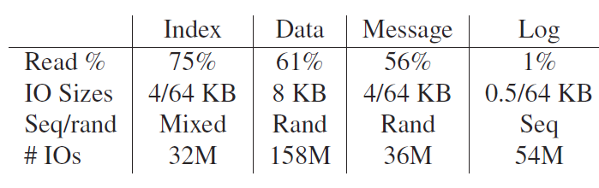
Workloads
4 Hotmail tenants {Index, Data, Message, Log}
Used for trace replay on SSDs (see paper)
IoMeter is parametrized with Hotmail tenant characteristics (read/write ratio, request size)
12/8/14
Source: Thereska, et al, MSR
Notes:
-The “Message” workload stores email content in files; ‘Index” is a background maintenance activity scheduled at night time in the data center; the “Data” and “Log” workloads are database data and transaction logs respectively. Metadata on emails is stored on these databases. So we have a diverse combination of file system, database and log workloads, typical of enterprise data centers.

Slide 29
Enforcing bandwidth SLAs
  4 tenants with different storage bandwidth SLAs
  Tenants have different workloads
    Red tenant is aggressive: generates more requests/second
Tenant | SLA
Red | {VM1 – 30} -> Min 800 MB/s
Green | {VM31 – 60} -> Min 800 MB/s
Yellow | {VM61 – 90} -> Min 2500 MB/s
Blue | {VM91 – 120} -> Min 1500 MB/s
12/8/14
Notes:
Access same storage server

Slide 30
Things to look for
Distributed enforcement across 4 competing tenants
  Aggressive tenant(s) under control
Dynamic inter-tenant work conservation
  Bandwidth released by idle tenant given to active tenants
Dynamic intra-tenant work conservation
  Bandwidth of tenant’s idle VMs given to its active VMs
12/8/14
Source: Thereska, et al, MSR

Slide 31
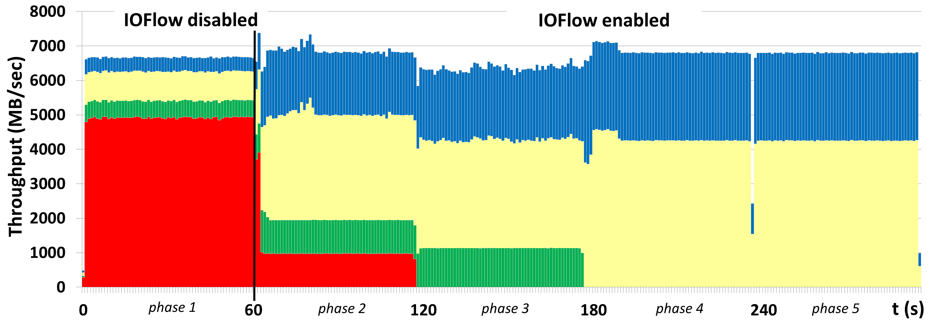
Results
Controller notices red tenant’s performance
Intra-tenant work conservation
Inter-tenant work conservation
Tenants’ SLAs enforced. 120 queues cfg.
12/8/14
Source: Thereska, et al, MSR

Slide 32
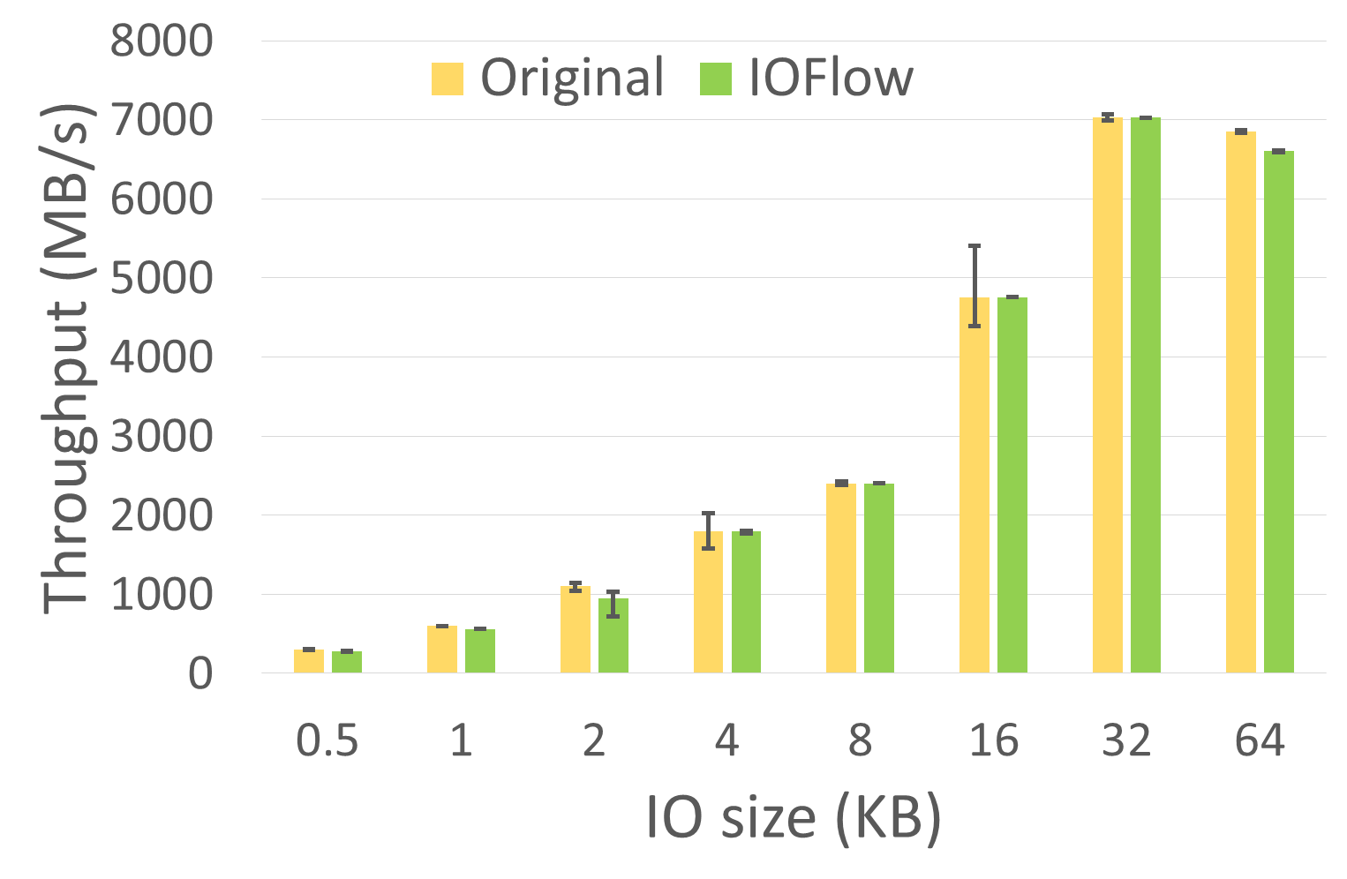
Data plane overheads at 40Gbps RDMA
Negligible in previous experiment. To bring out worst case varied IO sizes from 512Bytes to 64KB
Reasonable overheads for enforcing SLAs
Notes:
Metric: total throughput overhead across 120 tenants
Per-op overheads in general dominate per-byte overheads as expected, but overall the overheads are reasonable. The results for SSDs and disks are qualitatively similar.
At 512B: ~500K IOPS
Details: IoMeter with random-access requests, read:write 1:1
120 tenants with an SLA of 1/120th of storage capacity
Enforcement at hypervisors SMBc layer

Slide 33
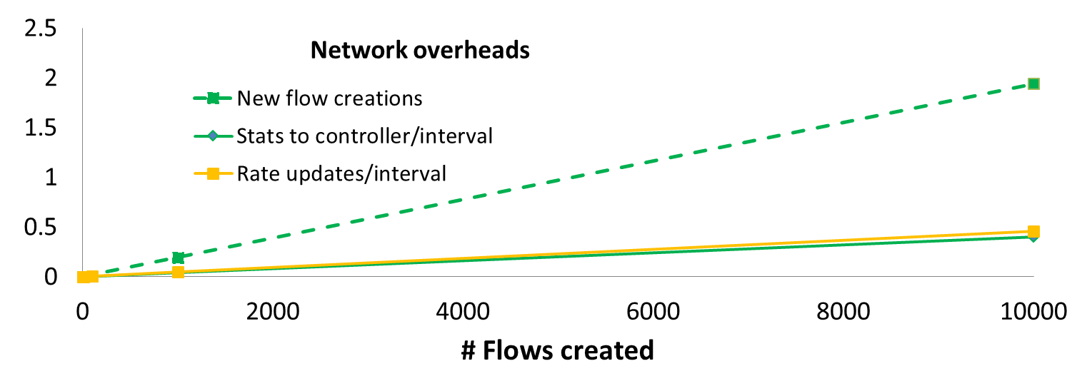
Control plane overheads: network and CPU
Controller configures queue rules, receives statistics and updates token rates every interval
<0.3% CPU overhead at controller
Overheads (MB)
12/8/14
Source: Thereska, et al, MSR

Slide 34
Summary of contributions
Defined and built storage control plane
Controllable queues in data plane
Interface between control and data plane (IOFlow API)
Built centralized control applications that demonstrate power of architecture
Ongoing work: applying to public cloud scenarios
12/8/14
Source: Thereska, et al, MSR

Slide 35










VMWare’s SDS Framework
What is Policy-based Management?
Key Features
  Simple policies to specify app SLA requirements
  Automation of storage provisioning and VM placement across clusters
  Works for any protocol : block, file
  and object
  SLA Compliance monitoring & automatic remediation
SLA Definitions
Availability = 99.99%
DR RTO = 1 hour
Back up = daily
Storage capacity = 1 TB
Performance = High I/O
Security = High
SLA Definitions
Availability = 99%
DR RTO = 4 hour
Back up = weekly
Storage capacity = 10 TB
Performance = High I/O
Security = High
Availability = 99.99%
DR RTO = 1 hour
Max Laten
Availability = 99.99%
DR RTO = 1 hour
Max Laten
Software Defined Storage
Customer Benefits
  Drastically simplify storage provisioning
  Management of different storage tiers
  as one
  Reduce storage cost by optimizing consumption
Virtual SAN
BLOB Storage
Enterprise SAN/ NAS
Notes:
Finally….
We will create an orchestration layer which will control different storage tiers in order to deliver application specific SLAs. This will help with VMware’s vision of cloud scale provisioning by drastically simplifying storage provisioning. This will help customer create, manage and consolidate different storage tiers in order to reduce the storage cost by using right storage for right application. No more over provisioning of resources… increase utilization overall…
Application requirements are captured in simple policies.. Customer can create different services levels using these policies though self service portals.. The automated placement of VM’s storage to match the requirements would simplify how storage provisioning done for applications. Should reduce the app deployment time from days to minutes. The compliance monitoring and automatic remediation will enforce SLA automatically.

Slide 36
Questions?

