Slide 1
Software Defined Networking
COMS 6998-10, Fall 2014
Instructor: Li Erran Li (lierranli@cs.columbia.edu)
http://www.cs.columbia.edu/~lierranli/coms6998-10SDNFall2014/
11/24/2014: SDN Middleboxes and NFV

Slide 2
Outline
Review of SDN Wireless Networks
SDN Middleboxes and NFV
  Middlebox
  NFV (Middlebox Virtualization)
  NFV Use Cases
  NFV Architecture, Proof-of-Concept Implementation, Monitoring and DPDK
  Virtualization Optimization: ClickOS
  Enforcing Network-Wide Policy: FlowTags

Slide 3
Mobile WANs Problems
Suboptimal routing in large carriers
  Lack of sufficiently close PGW is a major cause of path inflation (Path Inflation, PAM’14)
Lack of support for seamless inter-region mobility
  No inter-PGW mobility support (DMM, Zuniga et.al., 2013)
Scalability and reliability
  Centralized policy enforcement
Ill-suited to adapt to new trends of mobile traffic
  Signaling storm problem

Slide 4
What is SoftMoW?
Clean-slate architecture of cellular WANs
Scalable control plane and data plane
  Millions of UEs and hundreds of thousands of BSs
Performs new global applications
  Runs Region optimization
  Supports Seamless mobility
  Enables optimal end to end paths

Slide 5
SoftMoW Overview
SoftMOW?
Controller: enforce service policies and run new apps
Core networks: Inter-connected SDN switches nationwide
  Sufficient egress points per region to avoid path inflation
Radio networks: organized into base stations groups
  Fine-grained classifier access switch attached to each BS
Service policies: middle-boxes placed in edge networks
  Any sophisticated network functions, e.g., billing and noise cancelation

Slide 6
SoftMoW Challenges
Distributed control plane
    Recursively build up a hierarchical and reconfigurable control plane
Path setup
  Keep per packet overhead minimal on recursive abstractions
Topology discovery
  Cross-region links are visible to only a non-leaf controller
Global applications
  Optimization without a global network state at each controller.

Slide 7
Recursive and Reconfigurable Control Plane
Recursively partition the data plane network into logical regions and assign to control node
Recursively expose:
  Gigantic Switch (G-switch), Gigantic Middlebox (G-middlebox), Gigantic Base station (G-BS)
Reconfiguration: Each non-leaf controller can reconfigure logical entities
  Optimize hierarchy and data plane operations without a global state

Slide 8
SoftMoW Controller Architecture
Network operating system
  Agnostic of cell apps
Operator apps
  E.g., region optimization, HSS, PCRF
Recursive abstraction app
  Eastbound API for operator apps
  Agent communicates with a parent
  Expose G-switch, G-Bses, G-Middleboxes
Management Plane
  Bootstraps the recursive control plane.
  E.g., IP assignment, tree configuration

Slide 9


Core Service: Topology Discovery
  Scalable and fast link and switch detection
  Two challenges:
    Inter-region links visible to only a non-leaf controller
    Leaf controllers with direct control
  Parallel- sequential periodical protocol:
    G-switch discovery
    Inter-Gswitch link disocvery
    Abstract Gswitch computation
GS1
GS2
C0
C1
C2
SW1
SW2
SW3
SW4

Slide 10
Core Service: Topology Discovery
Discovery message:
  Meta data field: properties of the traversed physical
  Stack field: stores the traversed path
    Format: (Controller ID, G-switch ID, G-switch port)
(1)
GS1
(C0, GS1, p1)
(4)
GS2
(C0, GS1, p1)
(GS2, p4)
C0
(C1, SW2, p2)
C1
C2
(C0, GS1, p1)
(3)
(2)
(SW3, p3)
(C1, SW2, p2)
(C0, GS1, p1)
SW1
SW2
SW3
SW4
Payload
Stack

Slide 11
Core Service: Path Setup
Access switches perform fine-grained packet classification
Goal 1: each controller should be able to make local decisions
Goal 2: decisions made by an ancestor controller should be visible across links it discovers.
Simple solution: label stacking has high per-packet overhead
L1, L2, L3, L4
Per packet stack

Slide 12
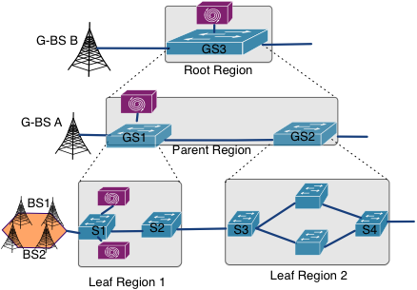
Recursive Label Swapping
Root has a single-path service policy for rate-limiting
Any controller has its own local policy or label
Ingress switch: Pop parent label, Push local labels
Egress switch: Pop local labels, Push parent label

Slide 13
App: Region Optimization and Reconfiguration
Inter region handovers increase “east-west” control plane load
Require the intervention of three controllers:
  the source and target leaf controllers, and the ancestor controller.
Regions should be refined to reduce the load
Handover patterns vary across time-of-day.
  Difficult to find static borders
Design a greedy-iterative approach
  Priority top to bottom

Slide 14
App: Region Optimization and Reconfiguration
Reconfiguration mechanism for an initiator controller:
Find the highest gain gigantic base station
Contact the management plane
Management plane finds the leaf controllers
Seamless control transfer at the leaf using EQUAL ROLE
Reconfigure logical data planes from bottom up to the initiator controller
Two leaf regions
Root graph before optimization
Root graph after optimization

Slide 15
Outline
Review of SDN Wireless Networks
SDN Middleboxes and NFV
  Middlebox
  NFV (Middlebox Virtualization)
  NFV Use Cases
  NFV Architecture, Proof-of-Concept Implementation, Monitoring and DPDK
  Virtualization Optimization: ClickOS
  Enforcing Network-Wide Policy: FlowTags

Slide 16
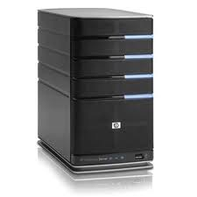
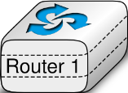
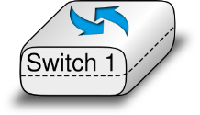
The Idealized Network
Application
Application
Transport
Transport
Network
Network
Network
Datalink
Datalink
Datalink
Datalink
Physical
Physical
Physical
Physical
Page 16
Notes:
The view of the network as taught in schools look ssomething like this: end systems with a network in between containing switches and routers. Pretty simple.

Slide 17
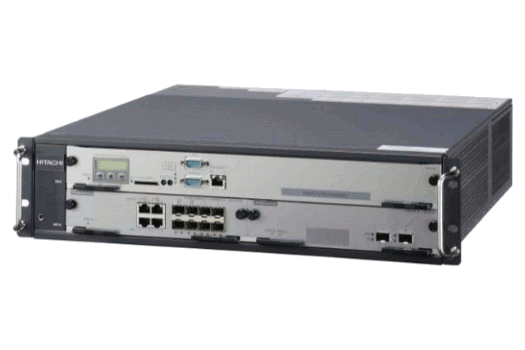
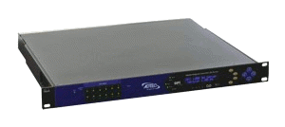
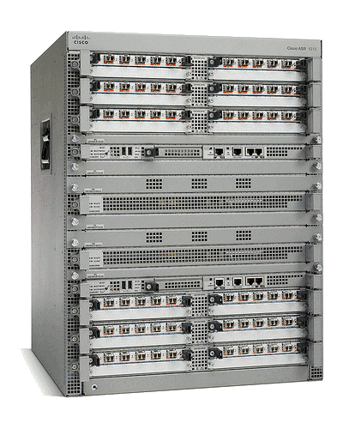
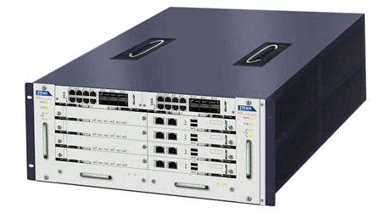
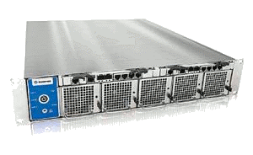
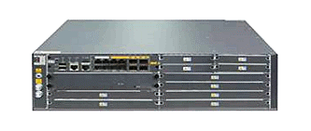
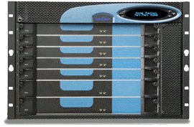
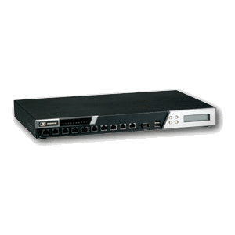
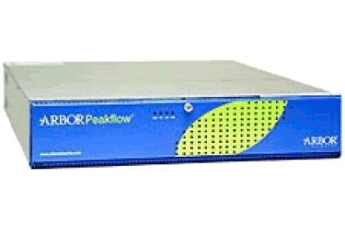
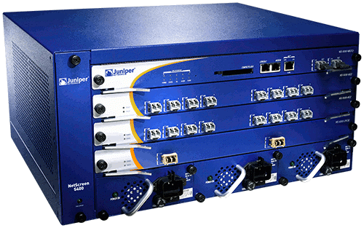
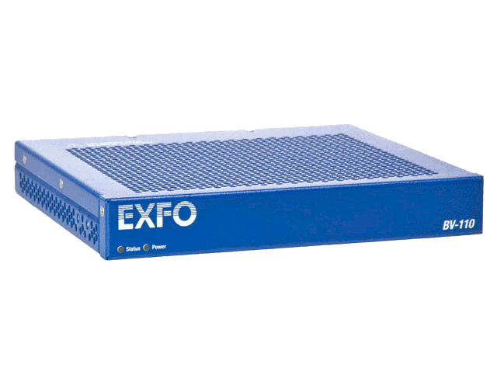
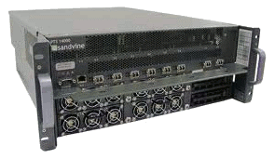
A Middlebox World
ad insertion
WAN accelerator
BRAS
transcoder
session border
controller
IDS
carrier-grade NAT
load balancer
DDoS protection
firewall
DPI
QoE monitor
Page 17
Notes:
But as we all know the reality is quite different. Middleboxes are commonplace in today’s networks, as many middleboxes as routers/switches. They are useful for many reasons: security (firewalls, Intrusion detection systems), monitoring (DPI, QoE monitors), traffic shaping (load balancers, rate limiters), address exhaustion (NATs), performance optimization (WAN accelerators, transcoders, caches, proxies) and others of a more dubious nature like this ad insertion box.

Slide 18





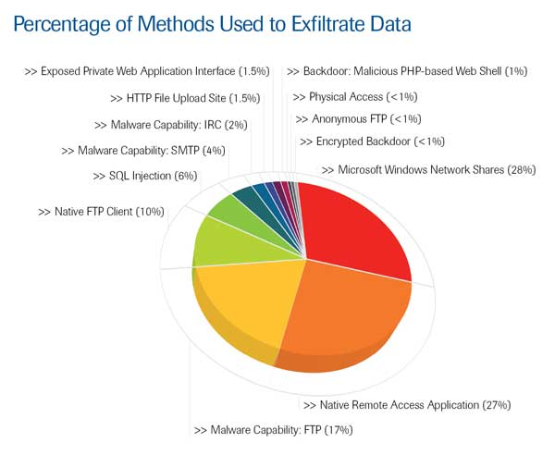




Need for Network Evolution
New applications
Evolving
threats
Policy
constraints
Performance, Security
New devices

Slide 19
Network Evolution today: Middleboxes!
Type of appliance | Number
Firewalls | 166
NIDS | 127
Media gateways | 110
Load balancers | 67
Proxies | 66
VPN gateways | 45
WAN Optimizers | 44
Voice gateways | 11
Total Middleboxes | 636
Total routers | ~900
Data from a large enterprise:
>80K users across tens of sites
Just network security
$10 billion
(Sherry et al, SIGCOMM’ 12)

Slide 20
There are many middleboxes!
Survey across 57 enterprise networks
(Sherry et al, SIGCOMM’ 12)

Slide 21
Things to keep in mind about middleboxes
A middlebox is any traffic processing device except for routers and switches.
Why do we need them?
  Security
  Performance
Deployments of middlebox functionalities:
  Embedded in switches and routers (e.g., packet filtering)
  Specialized devices with hardware support of SSL acceleration, DPI, etc.
  Virtual vs. Physical Appliances
  Local (i.e., in-site) vs. Remote (i.e., in-the-cloud) deployments
They can break end-to-end semantics (e.g., load balancing)

Slide 22
SDN Stack
Where do middleboxes logically fit in?
App
Applications
Controller
Runtime
Control Flow, Data Structures, etc.
Controller Platform
Switch API
Switches

Slide 23
Hardware Middleboxes - Drawbacks
Expensive equipment/power costs
Difficult to add new features (vendor lock-in)
Difficult to manage
Cannot be scaled on demand (peak planning)
Page 23
Notes:
Obviously middleboxes are very useful, but they come with a number of problems: the most dedicated st clear one is price but it certainly not the only one; another issue is that is difficult to add new features; once you buy a cisco box for example you are stuck with them; they are difficult to manage, often requiring specialized personnel for each type of middlebox. Hardware middleboxes cannot be scaled on demand nor can they be shared among different tenants, and it is hard for new players to enter the market.
(pause)

Slide 24
Outline
Review of SDN Wireless Networks
SDN Middleboxes and NFV
  Middlebox
  NFV (Middlebox Virtualization)
  NFV Use Cases
  NFV Architecture, Proof-of-Concept Implementation, Monitoring and DPDK
  Virtualization Optimization: ClickOS
  Enforcing Network-Wide Policy: FlowTags

Slide 25
Middlebox Virtualization
Virtual network function (VNF):
  software implementation of a network function capable of running over NFV infrastructure
Advantage of NFV
  use standard COTS hardware (e.g., high volume servers, storage)
    reduces CAPEX and OPEX
  fully implement functionality in software
    reducing development and deployment cycle times, opening up the R&D market
  consolidate equipment types
    reducing power consumption
  optionally concentrate network functions in datacenters
    obtaining further economies of scale and enabling rapid scale-up and scale-down

Slide 26
Potential VNFs
Potential Virtual Network Functions (from NFV ISG whitepaper)
Switching elements:
  Ethernet switch, Broadband Network Gateway, CG-NAT, router
Mobile network nodes:
  HLR/HSS, MME, SGSN, GGSN/PDN-GW, RNC, NodeB, eNodeB
Residential nodes: home router and set-top box functions
Tunnelling gateway elements: IPSec/SSL VPN gateways
Traffic analysis: DPI, QoE measurement
QoS: service assurance, SLA monitoring, test and diagnostics
NGN signaling: SBCs, IMS
Converged and network-wide functions:
  AAA servers, policy control, charging platforms
Application-level optimization:
  CDN, cache server, load balancer, application accelerator
Security functions: firewall, virus scanner, IDS/IPS, spam protection

Slide 27
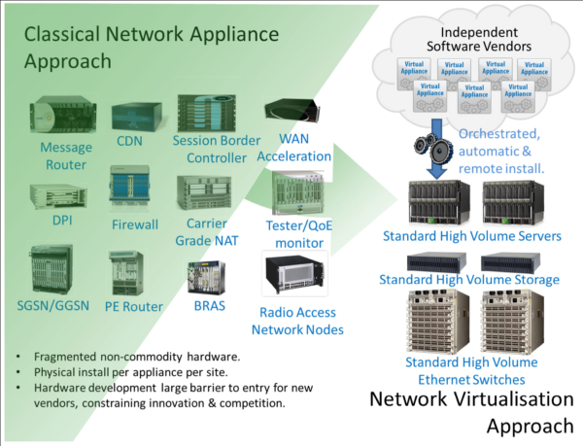
Potential VNFs (Cont’d)

Slide 28
Outline
Review of SDN Wireless Networks
SDN Middleboxes and NFV
  Middlebox
  NFV (Middlebox Virtualization)
  NFV Use Cases
  NFV Architecture, Proof-of-Concept Implementation, Monitoring and DPDK
  Virtualization Optimization: ClickOS
  Enforcing Network-Wide Policy: FlowTags

Slide 29
NFV Use Cases
NFV Infrastructure as a service
VNF as a service
Virtual network platform as a service
Virtualization of mobile core networks and IMS
Virtualization of mobile base station
Virtualization of home environment
Virtualization of CDN
Fixed access network function virtualization

Slide 30
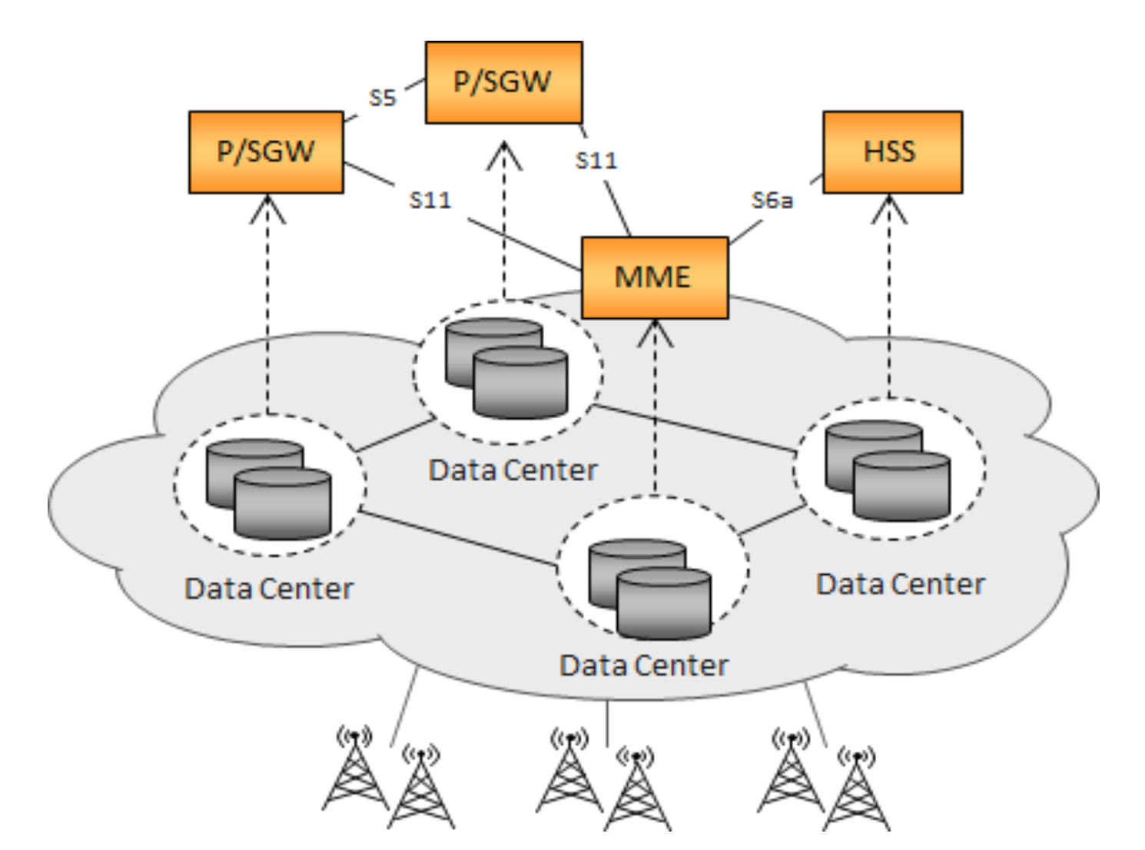
NFV Use Case Example
Virtualization of Evolved Packet Core (cellular core networks)

Slide 31
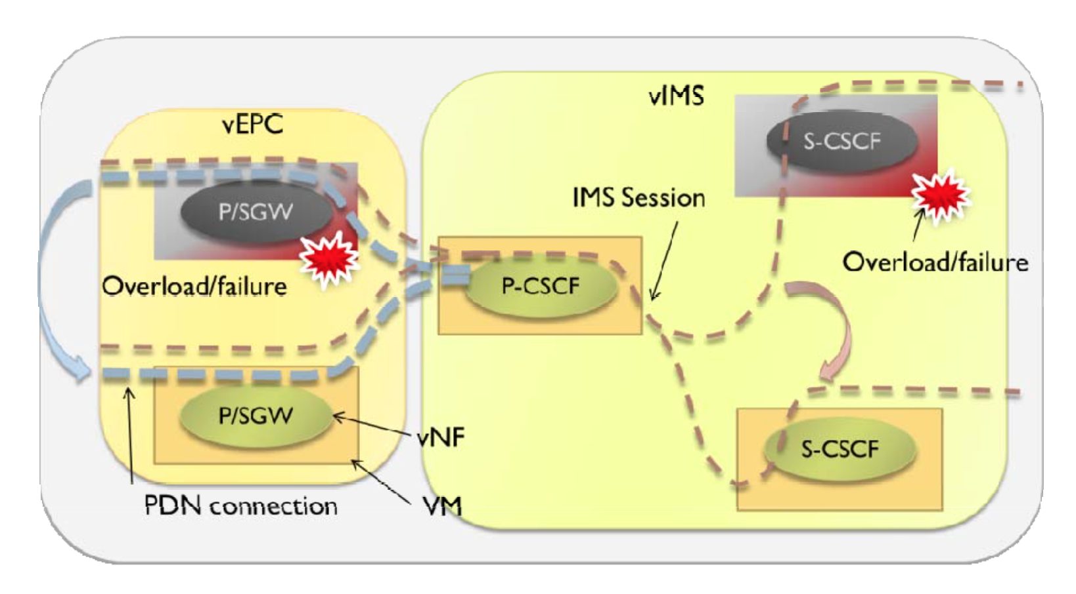
NFV Use Case Example (Cont’d)
VNF relocation

Slide 32
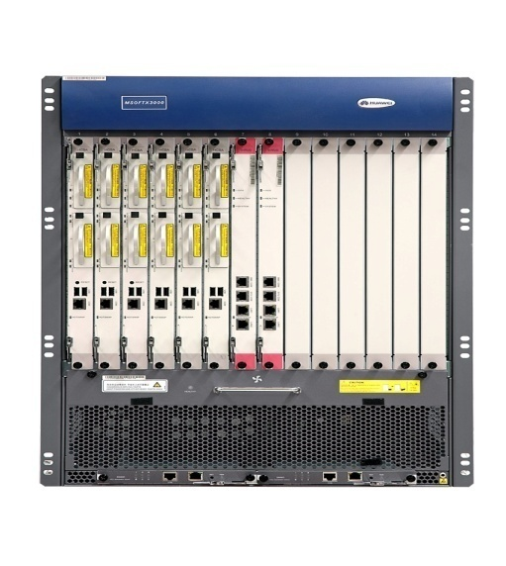
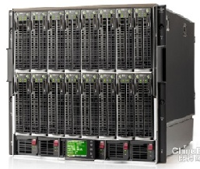

NFV High Level Architecture
OSS / BSS: (operation/Business Support)
NFV Scope
Virtualized Network Functions (VNFs)
NFV Management and
Orchestration (MANO)
Service
End-Points
(End-users,
Other Services)
VNF
VNF
VNF
VNF
NFV Infrastructure (NFVI)
Virtual Infrastructure
Virtual Computing
Virtual Storage
Virtual Networking
Physical Infrastructure
Other Networks
Compute
Storage
Network

Slide 33
ETSI NFV Reference Architecture
NFV Management and Orchestration
Main NFV reference points
Os-Ma
Orchestrator
OSS/BSS
Se-Or
Other reference points
Service and Infrastructure Requirements
Or-Vnfm
Execution reference points
EMS 1
EMS 2
EMS 3
Ve-Vnfm
VNF
Manager(s)
VNF 1
VNF 2
VNF 3
Or-Vi
Vn-Nf
Vnfm-Vi
NFVI
Virtual Computing
Virtual Storage
Virtual Network
Virtualised
Infrastructure
Manager(s)
Nf-Vi
Virtualisation Layer
Vi-Ha
Hardware resources
Computing
Hardware
Storage
Hardware
Network
Hardware
Notes:
End to end architecture view starting to form.
Recent Outcome on Bonn meeting (Last NFV meeting)
A lot of ground still needs to be covered on interface definitions and functional layout

Slide 34
Implementation of Reference Architecture
Os-Ma
Service Orchestrator
OSS/BSS
Se-Ma
Service, VNF and Infrastructure Description
Or-Vnfm
EMS 1
EMS 2
EMS 3
Ve-Vnfm
VNF
Manager(s)
VNF 1
VNF 2
VNF 3
vPE
Or-Vi
DPDK
Vn-Nf
Vi-Vnfm
NFVI
Modular L2/3
OVS
Virtual Computing
Virtual Storage
Virtual Network
Openstack
Virtualised
Infrastructure
Manager(s)
Nf-Vi
KVM, ESXi
Virtualisation Layer
Vl-Ha
Hardware resources
Redhat Linux
Computing
Hardware
Storage
Hardware
Network
Hardware
OpenDayLight
Intel
NetApps
Mellanox
Execution reference points
Other reference points
Main NFV reference points
Notes:
Instantiate, modify, move, remove vPE

Slide 35
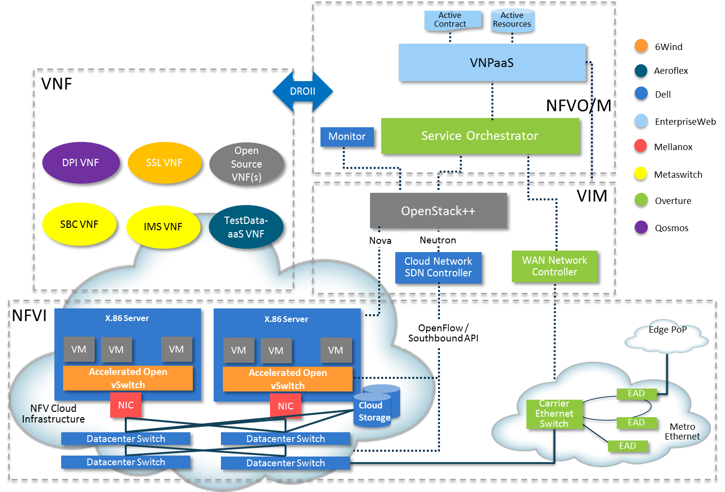
Dell ETSI NFV POC#1 experiences

Slide 36
KPI Monitoring and Enforcement
By: Mike Lynch, John Browne (Intel)
Interface exposure of MAC/PHY Level Counters
Interface for Time stamp on RX
Interface for Time stamp on TX
Traffic Monitoring reports: Packet Delay Variation, Drops, Uni-directional Delays
Per subscriber SLA measurement/enforcement provided by the specific VNF (e.g. HQOS)
Performance Monitoring Detects and report violations
Reporting/
Querying Interfaces
Virtual Network Function
Traffic Monitoring
Performance
Monitoring
Mgt
Agent
(eg SNMP)
Note: These
are common utilities that can be used by all VNFs, they are not VNF specific
Rx
VNF Specific Processing
Tx
2
3
1
Host OS Enabled with Virtualization: Linux
Real-Time Patch PREMEPT_RT
QEMU/KVM
DPDK
CPU Pinning Ctrls
Software
Hardware
Intel® Architecture CPU
Intel 10Gbe NIC
36
Notes:
Focused on Traffic Quality KPI’s in the Data-plane
Local Measurable QOS factors affecting QOE
Examples from MEF
Packet Delay Variation
Packet loss
Uni-directional frame delay
Others: Call drops, Call Setup Success Rate, Call Setup time etc.
Measured in-service
Supports Reporting by standard Telco mechanisms (e.g. SNMP)
VM SLA Monitoring and Enforcement
Impacts QOS but treated separately

Slide 37
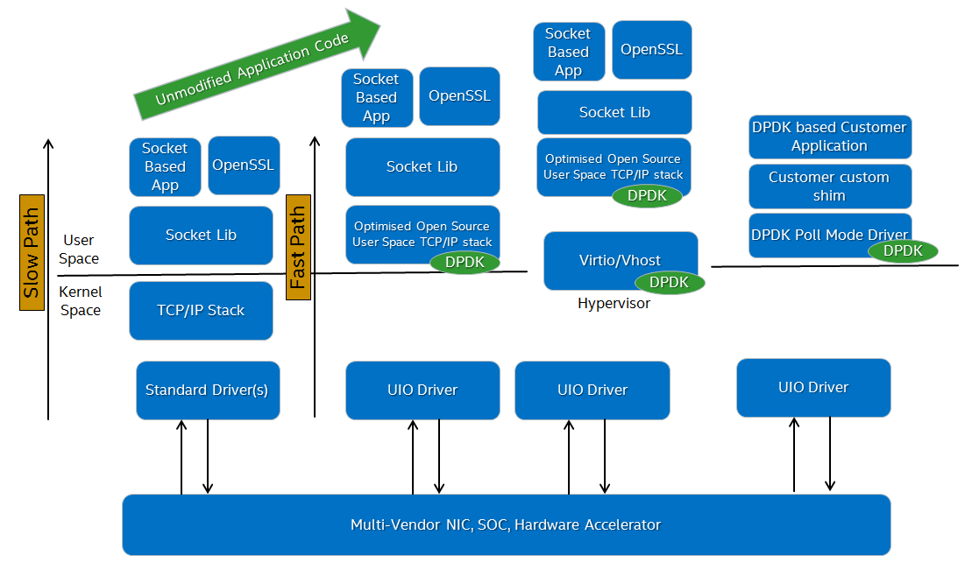
DPDK and Acceleration of Standard Interfaces
By: Venky Venkatesan, Pranav Mehta (Intel)
Goal: Define & implement a common API for data path configuration, control/status and I/O functionality
Terms of Reference:
Existing Enterprise platform software interfaces (OS/VMM) insufficient for evolving application (VNF) performance needs
Create a performant open source reference implementation by using DPDK to accelerate these existing standard interfaces/APIs (Sockets, RDMA, OpenSSL, zLib, VirtIO, …)
Support multiple accelerated APIs - Let VNFs choose which accelerated interface is needed based on VNF requirements.
Over time, this work would evolve to become a new “normalized” OS/VMM Data Plane API
Multi-vendor support
  Support different/multi-vendor NIC and SOC hardware
  Configuration API for supporting varied/enhanced offload capabilities for data path in a standardized fashion
Multiple standardized control/status API choices depending on level of functionality
  HW Offload – various depending on functionality supported on NIC
  Forwarding engines (L3) - OpenFlow, OVSDB …
  Netlink, netfilter
  Need to recommend a subset that can form a baseline
37

Slide 38
Outline
Review of SDN Wireless Networks
SDN Middleboxes and NFV
  Middlebox
  NFV (Middlebox Virtualization)
  NFV Use Cases
  NFV Architecture, Proof-of-Concept Implementation, Monitoring and DPDK
  Virtualization Optimization: ClickOS
  Enforcing Network-Wide Policy: FlowTags

Slide 39
Shifting Middlebox Processing to Software
Can share the same hardware across multiple users/tenants
Reduced equipment/power costs through consolidation
Safe to try new features on a operational network/platform
But can it be built using commodity hardware while still achieving high performance?
ClickOS: tiny Xen-based virtual machine that runs Click
39
Notes:
So clearly moving these middleboxes in software and in “the cloud” would certainly solve most of these issues. Problem is whether this software middleboxes can be built in commodity hardware while still achieving high performance as seen by the hardware middleboxes.
(pause)
We believe so, and thats what we propose with ClickOS. In one sentence, ClickOS is a MiniOS based virtual machine that runs Click modular router software.

Slide 40

From Thought to Reality - Requirements
Fast Instantiation
Small footprint
Isolation
Performance
Flexibility
ClickOS
30 msec boot times
5MB when running
provided by Xen
10Gb/s line rate*
45 μsec delay
provided by Click
* for most packet sizes
40
Notes:
Our goal is to build a versatile, high performance software middlebox platform on commodity hardware. Such a platform must satisfy a set of requirements: Fast instantiation, should be able to instantiate middlebox processing quickly, and allow quick adaptation to network conditions; Small footprint, in order to potentially run hundreds of middleboxes; Isolation of both CPU, memory and ability to accommodate a wide range of OSes/software packages, to by hosted by the operator or untrusted third parties; Performance, should be able to cope with HW offerings and scale on demand; Flexibility, should cover a wide range of middlebox processing;
ClickOS fullfills all of those: it boots on 30 millseconds; only requires 5 MB of RAM to run; Isolation: we base our work on Xen since its support for paravirtualization; has line-rate for almost all packet sizes; adds 45 microseconds of delay, and covers a wide range of packet processing with Click;

Slide 41
What's ClickOS ?
domU
ClickOS
apps
Click
guest
OS
mini
OS
paravirt
paravirt
Work consisted of:
  Build system to create ClickOS images (5 MB in size)
  Emulating a Click control plane over MiniOS/Xen
  Reducing boot times (roughly 30 milliseconds)
  Optimizations to the data plane (10 Gb/s for almost all pkt sizes)
  Implementation of a wide range of middleboxes
41
Notes:
In Xen, a virtual machine consists of: a paravirtualization layer, a guest OS and applications on top. In the case of ClickOS, we use MiniOS as the guest OS. . MiniOS runs on a single core, it has a single memory space, no processes, and a cooperative scheduler. On top of MiniOS, we run Click and we call the whole thing ClickOS. We want to eliminate all the clutter from a generic operating system, and decrease to the bare minimum necessary to packet processing.
Our work/contributions include:
- A generic build system in order to generate ClickOS XEN virtual machines. We also used it to build other applications on top of MiniOS.
- Emulating a Click control plane for MiniOS (there is not a command line in MiniOS that can be used to control Click).
- Doing optimizations to reduce ClickOS boot times down to 30 miliseconds
- Finally optimizations to the data plane to achieve line-rate for almost all packet sizes. Applying these optimizations to other guest OSes such as Linux;
- And implementation of a wide range of middleboxes;
I will focus on the last two items which we think it has higher contribution.

Slide 42
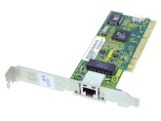
Performance analysis
packet size (bytes) | 10 Gbit/s rate
64 | 14.88 Mp/s
128 | 8.4 Mp/s
256 | 4.5 Mp/s
512 | 2.3 Mp/s
1024 | 1.2 Mp/s
1500 | 810 Kp/s
Driver Domain (or Dom 0)
ClickOS Domain
netback
Xen bus/store
netfront
Click
NW driver
OVS
vif
Event channel
FromDevice
ToDevice
Xen ring API
(data)
300* Kp/s
350 Kp/s
225 Kp/s
* - maximum-sized packets
42
Notes:
So let me talk to you in a little bit more detail about how Xen’s I/O subsystem works. First, we have a NIC, in our case a 10Gb intel NIC. Then the Domain-0 has a network driver for it, for instance the ixgbe driver. This network driver is attached to a software switch, say the Linux bridge or openvswitch. To the switch we attach a virtual interface called VIF, which is managed by the netback driver. The netback driver connects to the netfront driver over a XEN ring API. Event channels are used for notifications and the xenbus used for control/initialization.
Finally, we created two new elements called FromDevicet and ToDevice that Click can interact with the netfront driver.
So the goal is to reach 10Gb/s, meaning 813,000 packets per second for maximum sized packets all the way up to 14.8 Mp/s for min-sized ones, as the table shows.
The problem is that when we first put all of this together there were several important performance bottlenecks. For instance, openvswitch could only 300 Kpps; the netback driver and VIF 350 Kpps and 225 Kpps for the MiniOS netfront driver, when we put everything together.

Slide 43
Performance analysis
Driver Domain (or Dom 0)
ClickOS Domain
netback
Xen bus/store
netfront
Click
NW driver
OVS
vif
Event channel
FromDevice
ToDevice
Xen ring API
~3.4 us (3)
772 ns (1)
~600 ns (2)
Copying packets between guests greatly affects packet I/O (1)
Packet metadata allocations (2)
Backend switch is slow (3)
MiniOS netfront not as good as Linux
43
Notes:
To get a better ideia of where the problems we've made a trace of all operations in the backend driver. Based on the measurements you can see on the right, we came to realize the following:
- The backend switch. The linux bridge/openvswitch is not prepared to handle high packet rates, although still able to achive 10Gbs relying on NIC feature. While for end systems this is good enough, for middleboxes this is far from ideal, whereas the switch needs to handle millions of packets per second.
- Regarding the backend and frontend communication, packets always need to be copied from the guest to the backend domain. This copy between domains are normally done in batches of packets, and is one of the main causes for low packet rates.
- In addition to the copy, netback works with packet metadata data structures (skb or mbufs in FreeBSD) in which allocation and its manipulation also slow things down.
- Last but not least, the MiniOS netfront is entirely functional, and thus not as fast and featurefull as Linux Netfront. Before optimizations we started with a rate of 8 Kpps.

Slide 44
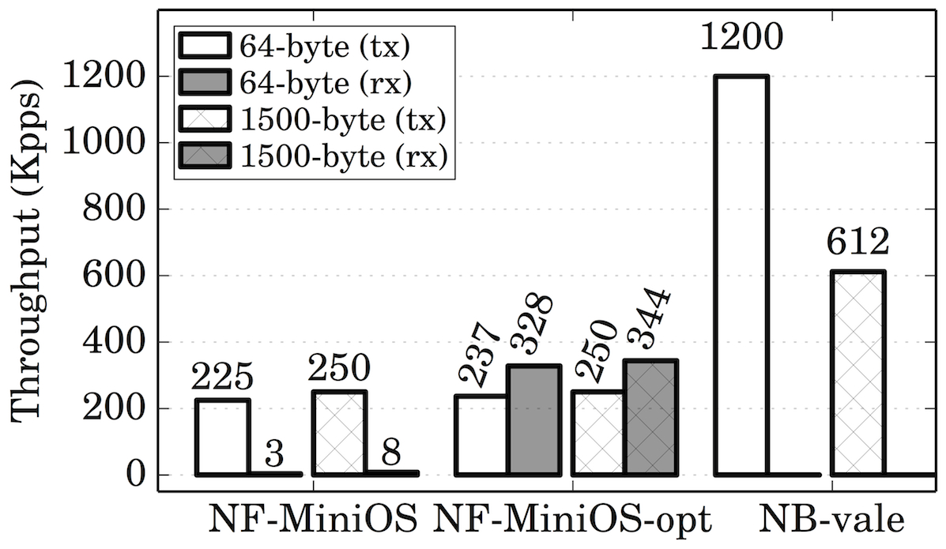
Optimizing Network I/O – Backend Switch
Driver Domain (or Dom 0)
ClickOS Domain
NW driver
(netmap mode)
netback
netfront
Click
OVS
Xen bus/store
VALE
Event channel
FromDevice
port
ToDevice
Xen ring API
(data)
Reuse Xen page permissions (frontend)
Introduce VALE[1] as the backend switch
Increase I/O requests batch size
[1] VALE, a switched ethernet for virtual machines, ACM CoNEXT'2012
Luigi Rizzo, Giuseppe Lettieri
Universita di Pisa
44
Notes:
Moving forward after careful analysis we start optimizing. We first started by reusing grants in the frontend. Grants consists off a table with the page and the permissions of a target domain. These are now done at initialization time instead of a per packet basis. This optimization led us to increase the rate by 40x. Afterwards we changed the backend switch, to introduce VALE software switch.
Furthermore we added support for bigger I/O rings, which let us batch more packets in the XEN ring.
Applying all of these changes, results were actually good, getting 2.7x improvement for maximum-sized packets and 4.2x for minimum sized packets.

Slide 45
Optimizing Network I/O
Driver Domain (or Dom 0)
ClickOS Domain
netback
netback
Xen bus/store
netfront
Click
NW driver
VALE
Event channel
FromDevice
port
ToDevice
Xen ring API
(data)
Netmap API
(data)
Minimal memory requirements
  For max. throughput a guest only needs 4 MB of memory
Breaks other (non-MiniOS) guests
  But we have implemented Linux netfront driver
slots | KB (per ring) | # grants (per ring)
64 | 135 | 33
128 | 266 | 65
256 | 528 | 130
512 | 1056 | 259
1024 | 2117 | 516
2048 | 4231 | 1033
45
Notes:
The next optimization was replacing the XEN I/O rings with the netmap ring. We map all the memory regarding a VALE port all the way to the guest. The netmap buffers are also mapped to the guest, so that we don't need the expensive copy between domain.
We also applied another technique in which we call it asynchronous operation, whereas TX and RX operation happens by maintaining a private copy of the control datastructures when backend is processing packets.
The backend has a bit higher memory requirements, altough still very small. Overall to reach the high rate we only require to map a total of 4 MB to the guest. Although we gain major improvements with this new network backend, we also break other guests support. To show that our optimizations do apply to other guests we also implemented a Linux netfront driver compatible with this new backend.

Slide 46
ClickOS Prototype Overview
Click changes are minimal ~600 LoC
New toolstack for fast boot times
Cross compile toolchain for MiniOS-based apps
netback changes comprise ~500 LoC
netfront (Linux/MiniOS) around ~600 LoC
VALE switch extended to:
  Connect NIC ports and modular switching
46
Notes:
Overall to ClickOS prototype consists of very little changes to the core click around 50 lines of code, plus the MiniOS glue and additional elements;
We built a new toolstack to enable fast boot times
Overall and after several iterations, netback changes are only ~500 lines of code. The frontends are about the same size, being most of it spent on the memory sharing mechanism.
Finally VALE switch was extended to add support for NIC ports, before only virtual ports were supported. And to modularize packet swtiching, which means you can create your own kernel module that implements its own lookup functions.

Slide 47
Experiments
ClickOS Instantiation
State reading/insertion performance
Delay compared with other systems
Memory footprint
Switch performance for 1+ NICs
ClickOS/MiniOS performance
Chaining experiments
Scalability over multiple guests
Scalability over multiple NICs
Implementation and evaluation of middleboxes
Linux Performance
47
Notes:
Overall to ClickOS prototype consists of very little changes to the core click around 50 lines of code, plus the MiniOS glue and additional elements;
We built a new toolstack to enable fast boot times
Overall and after several iterations, netback changes are only ~500 lines of code. The frontends are about the same size, being most of it spent on the memory sharing mechanism.
Finally VALE switch was extended to add support for NIC ports, before only virtual ports were supported. And to modularize packet swtiching, which means you can create your own kernel module that implements its own lookup functions.

Slide 48
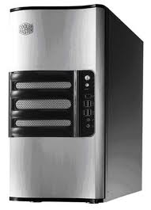
ClickOS Base Performance
ClickOS
Measurement Box
10Gb/s direct cable
Intel Xeon E1220 4-core 3.2GHz (Sandy bridge)
16GB RAM, 1x Intel x520 10Gb/s NIC.
One CPU core assigned to VMs, the rest to the Domain-0
Linux 3.6.10
48
Notes:
ClickOS VM (i.e., Click configurations) are used to generate packets (Tx) and to receive and count rates (Rx). Again, this is a single VM using a single CPU core.

Slide 49
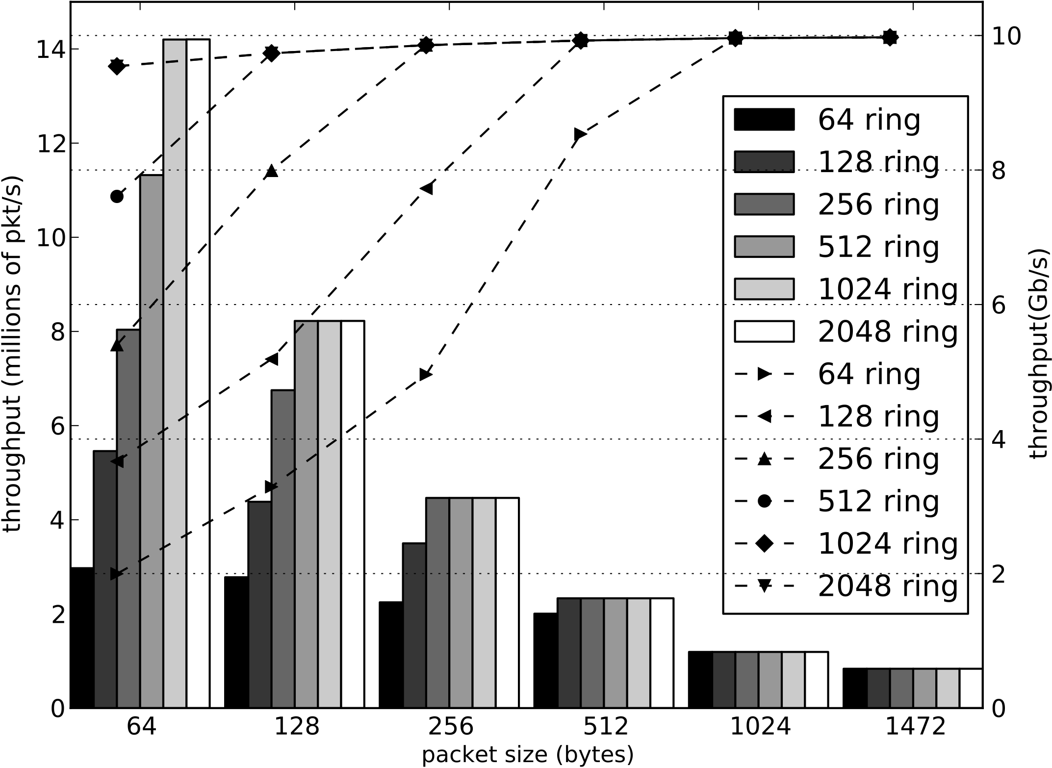
ClickOS Base TX Performance
49
Notes:
ClickOS VM (i.e., Click configurations) are used to generate packets (Tx) and to receive and count rates (Rx). Again, this is a single VM using a single CPU core.

Slide 50
ClickOS (virtualized) Middlebox Performance
10Gb/s direct cable
10Gb/s direct cable
Host 1
ClickOS
Host 2
Intel Xeon E1220 4-core 3.2GHz (Sandy bridge)
16GB RAM, 2x Intel x520 10Gb/s NIC.
One CPU core assigned to Vms, 3 CPU cores Domain-0
Linux 3.6.10
50
Notes:
Single ClickOS VM/CPU core performance for different mboxes. Wire=FromNetfront->ToNetfront (baseline); ethermirror: simply flips src/dst mac addresses; ip router: standards-compliant ipv4 router; firewall: loaded with 10 rules; cg-nat: almost standards-compliant, each packet is assigned random src/dst ports to stress it; BRAS: checks for existing session, strips PPPoE headers, performs IP lookup, re-writes MACs. LB: load balancer, based on 5-tuples, and in a round-robin fashion, markes packets by using the src MAC address (so that something else, e.g., the back-end switch, can then split packets based on that field); flow mon: keep per-flow packet counts and rates; IDS: based on regular expression matching, contains a single rule to match the string “abc” at the beginning of packets’ payloads.

Slide 51
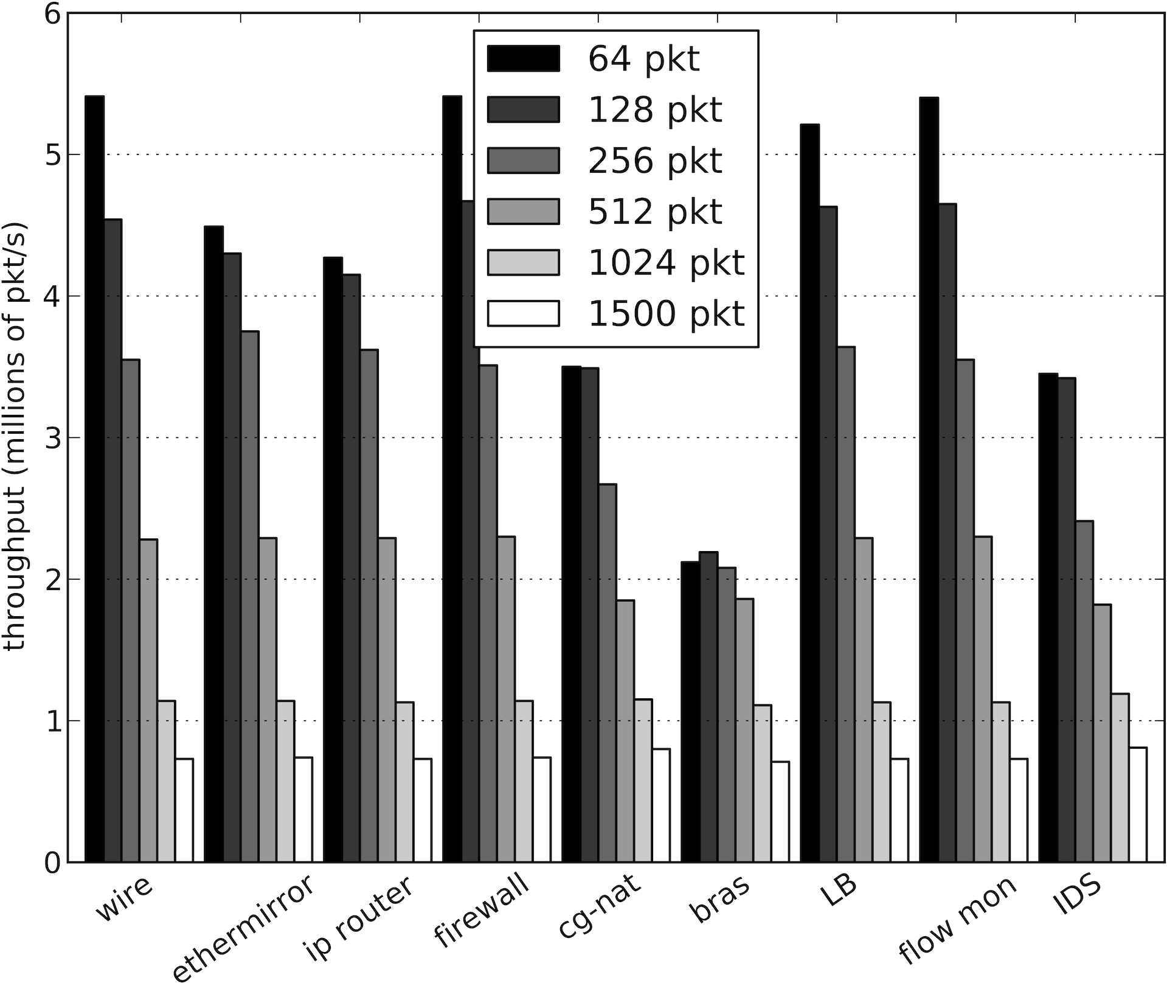
ClickOS (virtualized) Middlebox Performance
51
Notes:
Single ClickOS VM/CPU core performance for different mboxes. Wire=FromNetfront->ToNetfront (baseline); ethermirror: simply flips src/dst mac addresses; ip router: standards-compliant ipv4 router; firewall: loaded with 10 rules; cg-nat: almost standards-compliant, each packet is assigned random src/dst ports to stress it; BRAS: checks for existing session, strips PPPoE headers, performs IP lookup, re-writes MACs. LB: load balancer, based on 5-tuples, and in a round-robin fashion, markes packets by using the src MAC address (so that something else, e.g., the back-end switch, can then split packets based on that field); flow mon: keep per-flow packet counts and rates; IDS: based on regular expression matching, contains a single rule to match the string “abc” at the beginning of packets’ payloads.

Slide 52
Linux Guest Performance
Note that our Linux optimizations apply only to netmap-based applications
52
Notes:
This graph shows the performance for a Linux guest. The bars are respectively, KVM rates measured with in-kernel pkt-gen with VirtIO backend and VHOST enabled cpus pinned, XEN measured with in-kernel pkt-gen, and our optimized XEN version with userspace netmap pkt-gen. This experiment is a bit unfair as we are not using the host stack in the optimized version, thus bypassing all of its bottlenecks. But still shows fast you could go by using our backend and frontend with netmap.

Slide 53
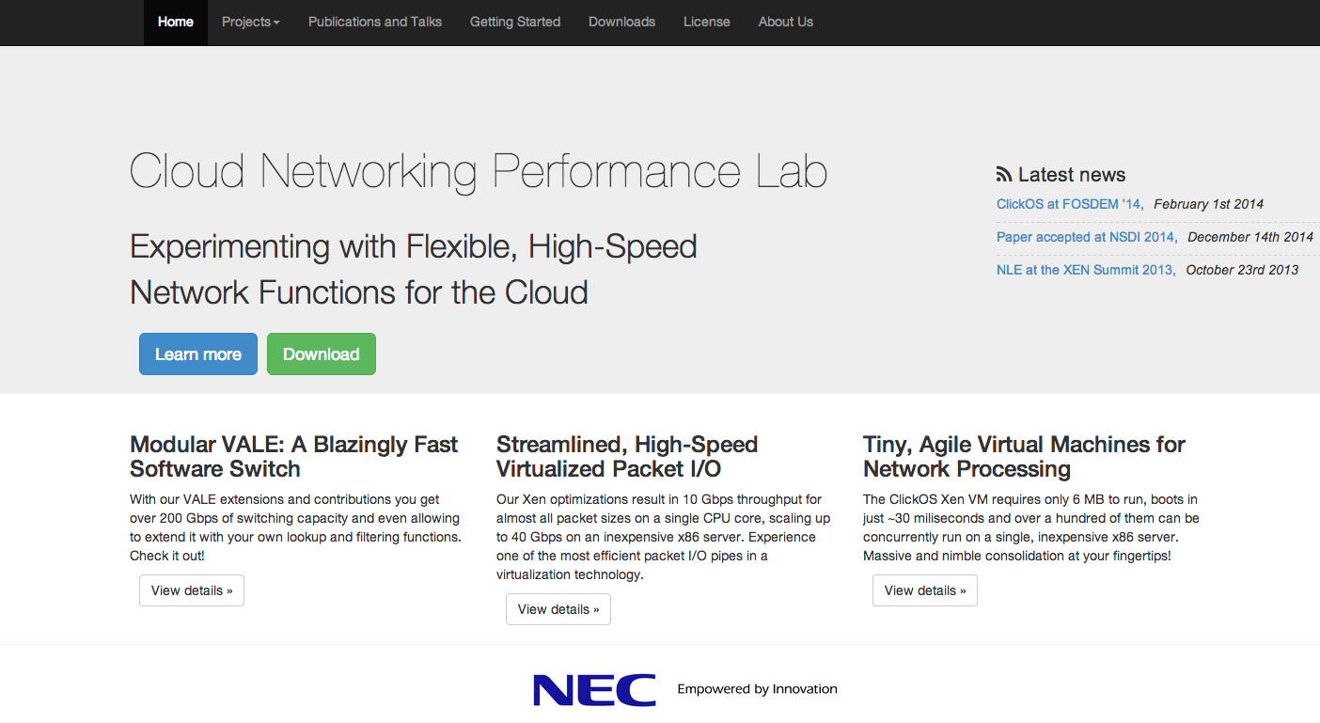
It's Open Source!
Checkout
  ClickOS, Backend Switch, Xen optimizations and more!
  Github ( )
  Tutorials
  Better performance!
53
Notes:
Introducing Netmap API for virtual machines, breaks the XEN guests such as the Linux one. We are modifying the Linux netfront so that it benefits from our performance improvements.
We are also investigating ways of chaining middleboxes together on the same server in an efficient manner.

Slide 54
Conclusions
Virtual machines can do flexible high speed networking
ClickOS: Tailor-made operating system for network processing
  Small is better: Low footprint is the key to heavy consolidation
  Memory footprint: 5MB
  Boot time: 30ms
Future work:
  Massive consolidation of VMs (thousands)
  Improved Inter-VM communication for service chaining
  Reactive VMs (e.g., per-flow)
54

Slide 55
Outline
Review of SDN Wireless Networks
SDN Middleboxes and NFV
  Middlebox
  NFV (Middlebox Virtualization)
  NFV Use Cases
  NFV Architecture, Proof-of-Concept Implementation, Monitoring and DPDK
  Virtualization Optimization: ClickOS
  Enforcing Network-Wide Policy: FlowTags
    Motivation and High Level Ideas
    Design and Evaluation

Slide 56

Middleboxes complicate policy enforcement in SDN
Policy:
E.g., service chaining,
access control
Control Apps
Network OS
Dynamic and
traffic-dependent
modifications!
e.g., NATs, proxies
Data Plane

Slide 57

Modifications → Attribution is hard
Block the access of H₂ to certain websites.
NAT
Firewall
H₁
Internet
H₂
S₁
S₂

Slide 58
Dynamic actions → Policy violations
Web ACL
Block H₂ → xyz.com
Proxy
H₁
1. Get xyz.com
2. Response
Cached
response
Internet
S₁
S₂
3. Get xyz.com
H₂
4. Cached response

Slide 59
FlowTags
Some candidate (non-)solutions:
Placement, tunneling, consolidation, correlation
Address some symptoms but not root cause
→ OriginBinding and PathsFollowPolicy violations
FlowTags provides an architectural solution:
→ Enables policy enforcement and diagnosis
despite dynamic middlebox actions.

Slide 60
High-level idea
Middleboxes need to restore SDN tenets
  Possibly only option for correctness
  Minimal changes to middleboxes
Add missing contextual information as Tags
  NAT gives IP mappings,
  Proxy provides cache hit/miss info
FlowTags controller configures tagging logic

Slide 61

FlowTags architecture
Control Apps
e.g., steering, verification
Admin
Control Apps
New control apps
e.g., policy steering, verification
Policy
Network OS
Control plane
Existing APIs
e.g., OpenFlow
FlowTags
APIs
Data plane
FlowTags
Enhanced
Middleboxes
FlowTags
Tables
Mbox
Config
SDN
Switches
FlowTable

Slide 62
FlowTags in action
Config w.r.t original principals
Block: 10.1.1.2 → xyz.com
H₁ 10.1.1.1
<SrcIP,Cache Hit> | Tag
10.1.1.2, Hit | 2
Tag | OrigSrcIP
2 | 10.1.1.2
Proxy
Web ACL
DROP
xyz.com
2
S₁
S₂
Internet
Tag | Fwd
2 | S₂
Tag | Fwd
2 | ACL
xyz.com
H₂
10.1.1.2

Slide 63
Outline
Review of SDN Wireless Networks
SDN Middleboxes and NFV
  Middlebox
  NFV (Middlebox Virtualization)
  NFV Use Cases
  NFV Architecture, Proof-of-Concept Implementation, Monitoring and DPDK
  Virtualization Optimization: ClickOS
  Enforcing Network-Wide Policy: FlowTags
    Motivation and High Level Ideas
    Design and Evaluation

Slide 64
Challenge 1: Tag Semantics
FlowTags-enhanced
SDN Controller
Control plane
Data plane
Add Tag
Decode Tag
H₁
10.1.1.1
Proxy
Web ACL
Internet
H₂
10.1.1.2
S₁
S₂
Tag | Forward
Tag | Forward

Slide 65
Challenge 2: New APIs, control apps
FlowTags-enhanced
SDN Controller
Control plane
Data plane
Add Tag
Decode Tag
H₁
10.1.1.1
Proxy
Web ACL
Internet
H₂
10.1.1.2
S₁
S₂
Tag | Forward
Tag | Forward

Slide 66
Challenge 3: Middlebox Extensions
FlowTags-enhanced
SDN Controller
Control plane
Data plane
Add Tag
Decode Tag
H₁
10.1.1.1
Proxy
Web ACL
Internet
H₂
10.1.1.2
S₁
S₂
Tag | Forward
Tag | Forward

Slide 67
FlowTags Design
Tag semantics
Controller and APIs
Middlebox modification

Slide 68
Semantics: Dynamic Policy Graph (DPG)
Proxy
Web ACL: Block H₂ → xyz.com
H₁
Internet
H₂
S₁
S₂
{H₁}; Miss
{H₁}; Hit
{H₂}; <Allowed,Miss>
Internet
H₁
{H₁}; -
{H₂}; Hit
{H₂}; Miss
ACL
Proxy
{H₂}; -
H₂
{H₂}; Blocked
{H₂}; <Allowed,Hit>
Drop

Slide 69
Semantics: Dynamic Policy Graph (DPG)
Proxy
Web ACL: Block H₂ → xyz.com
H₁
Internet
H₂
S₁
S₂
{H₁}; Miss
{H₁}; Hit
{H₂}; <Allowed,Miss>
Internet
H₁
{H₁}; -
{H₂}; Hit
{H₂}; Miss
ACL
Proxy
{H₂}; -
H₂
{H₂}; Blocked
{H₂}; <Allowed,Hit>
Drop
Intuitively, need a Tag <per flow, per-edge> in DPG

Slide 70
FlowTags APIs
OpenFlow
FlowTags
FlowTags-enhanced
SDN Controller
Generate Tag
Consume Tag
H₁ 10.1.1.1
Tag | OrigSrcIP
<SrcIP,Cache Hit> | Tag
Tag | OrigSrcIP
2 | 10.1.1.2
<SrcIP,Cache Hit> | Tag
10.1.1.2, Hit | 2
Proxy
Web ACL
S₁
S₂
Internet
Tag | Fwd
Tag | Fwd
2 | S2
Tag | Fwd
Tag | Fwd
2 | ACL
H₂
10.1.1.2

Slide 71
FlowTags-enhanced controller
Policy DPG
Reactive
Physical
realization
Middlebox Event Handlers
Switch Event Handlers
Tag generate and consume
Flow expiry
Flow rules
S₁
S₂
S₃
S₄

Slide 72
Middlebox extension strategies to add FlowTags support
Strategy 1: Packet Rewriting
Middlebox
module
module
input traffic
output
traffic
module
module
module
module
Light-weight packet
rewriting shims
Pro: One shot
Con: Hard to get internal context

Slide 73
Middlebox extension strategies to add FlowTags support
Strategy 2: Module Modification
Middlebox
module
module
input traffic
output
traffic
module
module
module
module
Pro: More change is needed
Con: Suited for getting internal context

Slide 74
Middlebox extension strategies to add FlowTags support
Middlebox
Shim
module
module
input traffic
output
traffic
module
module
module
module
Tag generation
Tag consumption
Our Strategy:
Packet rewriting for Tag consumption
Module modification for Tag generation

Slide 75
Key evaluation questions
Feasibility of middlebox modification
FlowTags overhead
Number of Tag bits
New capabilities

Slide 76
FlowTags needs minimal middlebox modifications
Middlebox | Total LOC | Modified LOC
Squid | 216,000 | 75
Snort | 336,000 | 45
Balance | 2,000 | 60
iptables | 42,000 | 55
PRADS | 15,000 | 25

Slide 77
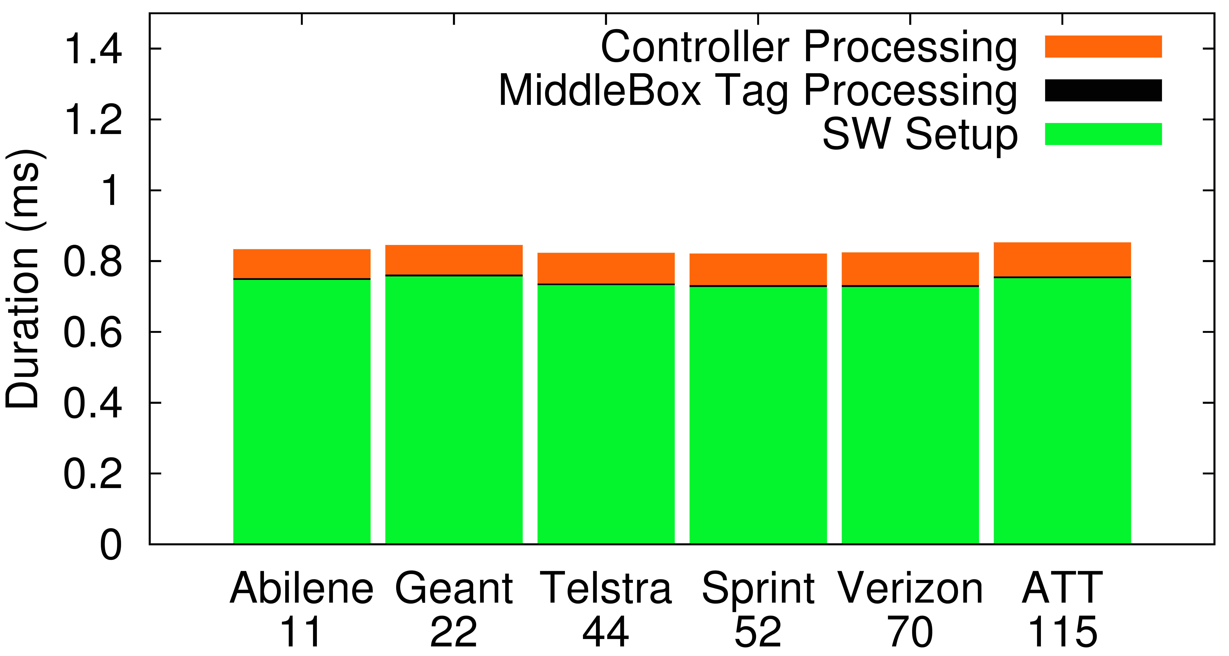
FlowTags adds low overhead
1.4
1.2
1
0.8
0.6
0.4
0.2
0
Controller Processing
Middlebox Tag Processing
Switch Setup
Breakdown of flow processing time (ms)
Abilene Geant Telstra Sprint Verizon AT&T
# PoPs:
11 22 44 52 70 115

Slide 78
Summary of other results
Adds < 1% overhead to middlebox processing
Tags can be encoded in ~ 15 bits
  E.g., IP-ID, IPv6 FlowLabel, EncapHeaders (NVP)
Can enable new capabilities
  Extended header space analysis
  Diagnosing network bottlenecks

Slide 79
Conclusions
Middleboxes complicate enforcement
  E.g., NAT/LB rewrite headers, proxy sends cached response
Root cause: Violation of the SDN tenets
  Origin Binding and Paths-Follow-Policy
FlowTags extends SDN with new middlebox APIs
  Restores tenets using new DPG abstraction
  No changes to switches and switch APIs
FlowTags is practical
  Minimal middlebox changes, low overhead
  An enabler for verification, testing, and diagnosis

